Slide 1
Drawing on KS2 grammar knowledge for KS3 foreign languages
Rowena Kasprowicz
NCELP Hub Day
3rd July 2020
Date updated: 13/7/20
Notes:
Hello. My name is Rowena Kasprowicz and I am a Research Specialist with NCELP.
This presentation will consider the language knowledge that children bring with them from Key Stage 2, in particular the grammatical knowledge they have developed in English, as well as in any foreign language they may have been learning in primary school.

Slide 2
Aims of the session
Explore KS2 grammar teaching in terms of:
a) the foreign language curriculum
b) the English curriculum
Consider the role of metalanguage and terminology we can build on from KS2
Discuss the benefits of developing learners’ knowledge about language
Explore the role of language analysis and cross-linguistic analysis in L2 learning
Introduce some examples of activities to promote cross-linguistic comparisons
Rowena Kasprowicz
Notes:
In this presentation, we will:
Explore what grammar teaching at Key stage 2 looks like, in terms of both the foreign language curriculum and the English curriculum
Consider the role of metalanguage, i.e. how we talk about language, and discuss the terminology we can build on from Key Stage 2.
We will also discuss the benefits of developing learners’ knowledge about language and
Explore the role of language analysis and cross-linguistic analysis in second language learning → how we can exploit these to support their foreign language learning.

Slide 3
MFL Pedagogy Review
When new starters arrive in Year 7, to what extent are you aware of:
What the children have learnt so far about grammar in English?
What the children have learnt so far about other languages?
Rowena Kasprowicz
Notes:
On the slide here, you can see the references within the MFL Pedagogy Review to the knowledge students are bringing from primary school.
I’ll give you a moment to read these.
So the review emphasises the importance of secondary schools being familiar with the content of both the national curriculum for English and the modern foreign languages taught at their feeder primary schools, so that they are able to build on this in Year 7.
There are two questions on the board – please take a moment to reflect on these for your own context. So when new starters arrive in Year 7, what information do you have in terms of:
What the children have learnt so far about grammar in English?
What the children have learnt so far about other languages?
Take a moment to think about these questions for your own context.

Slide 4
Grammar teaching in KS2
In the foreign language curriculum…
Also the (archived, but still widely used) KS2 framework for languages…
Focus on developing learners’ knowledge about language
“When learning a new language, children reinforce and reinterpret knowledge and
understanding gained in learning their first language(s). […] They compare the new language with English or another language […] They become aware of rules or patterns in language and begin to apply their knowledge when creating new language.”
“understand basic grammar relevant to the language being studied, including (where relevant): feminine, masculine and neuter forms and the conjugation of high-frequency verbs; key features and patterns of the language; how to apply these, for instance to build sentences; and how these differ from or are similar to English”
(DfE, 2013a)
Rowena Kasprowicz
Notes:
Developing learners’ awareness about language is a key part of the KS2 languages curriculum, which is emphasised both in the current Programme of Study as well as the (now archived) framework for languages, which is still widely used at KS2. On the screen you can see snippets from these two documents, which not only emphasise the importance of developing learners’ understanding of the grammatical structures within the language but also the need to develop learners’ knowledge about language, for example their awareness of their similarities and differences between languages, and how they can build and apply their existing knowledge of English when learning a new language.
The KS2 Framework for languages contains three core strands – oracy, literacy, and intercultural understanding, alongside two cross-cutting strands, language learning strategies and knowledge about language. And it is these cross-cutting strands which emphasise the development of learners’ knowledge about language.
I’m not going to focus too much on the specifics of primary foreign language curriculum today, since provision can vary so drastically between different schools and contexts. However, it is important to acknowledge the intention set out in the curriculum for primary foreign languages. As we’ve discussed before, often children’s motivation is tied to their sense of progression, so it is important to keep in mind what children (may) have covered prior to arriving in Year 7.
In addition, even if children begin learning a new foreign language in Year 7 (which is different to the language learnt in primary school), we can still draw on that prior learning and the knowledge about language, the language awareness, that they have gained through language learning at primary school, to support their future language learning – this point will be discussed further later in the session.

Slide 5
Grammar teaching in KS2
In the English curriculum…
Driven by the Grammar, Punctuation and Spelling component of the SATs tests
Developing pupils’ explicit knowledge about English to enable “more conscious control and choice” in their language use (DfE, 2013a)
In tandem with developing literacy skills: exploring how new grammatical concepts are used by others (e.g. in their reading) and how to apply these concepts (e.g. in their writing)
Rowena Kasprowicz
Notes:
In terms of the language and in particular grammar teaching within the primary English curriculum, the focus on language analysis and grammar teaching is very much driven by the Grammar, Punctuation and Spelling component of the SATs tests, which was previously referred to as SPaG. There has been a strong washback effect of the test on teaching, in terms of determining what is covered when and how, as you might expect.
The primary English national curriculum explicitly focusses on developing learners’ explicit knowledge about English. This explicit focus on the grammar of the English language happens alongside the development of students’ literacy skills. Often the language students are able to use in speech is far more complex than the language they are able to use when writing. And so the Grammar, Punctuation and Spelling component of primary English teaching aims to help pupils become more sophisticated writers. And there will be a lot of focus on encouraging students to explore how new grammatical concepts are used by others (for example in their reading) and learning how to apply these concepts in their writing.

Slide 6
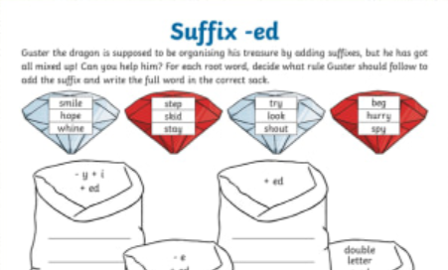
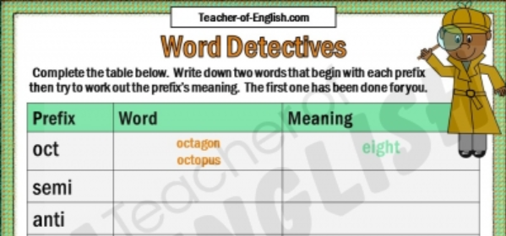
Grammar teaching in KS2
What does (English) grammar teaching look like in KS2?
Explicit, decontextualized practice (e.g. prefix bingo)
Definitions of grammatical terms; functions of word classes
Repeated exposure to and reinforcement of metalanguage (in line with curriculum)
Frequent repetition and revisiting (e.g. “grammar starter” to every literacy lesson)
Highlighting and discussing structures when they arise in guided reading, shared and guided writing, and in other subject work (e.g. history)
Proof-reading own work, identifying errors, making improvements
(Safford, 2016, pg. 10)
Rowena Kasprowicz
Notes:
So, what does grammar teaching look like in Key Stage 2?
Much of the grammar teaching at this level will be very explicit, focused and systematic. Often, this takes the form of decontextualized explicit practice of particular grammatical structures (such as the worksheet excerpts you can see at the top of the screen) and small units of syntactic analysis (so breaking sentences down to explore how suffixes or prefixes are used for example), introducing definitions of grammatical terms, and discussing the functions of individual word classes.
There is lots of repetition and revisiting – grammar practice is likely to be part of primary school students’ daily ‘diet’.
In a study by Safford in 2016, which gathered teachers’ views on grammar punctuation and spelling teaching – many teachers reported that grammar teaching is also very much embedded throughout the school curriculum. Any opportunity to draw attention to grammatical rules / particular structures or metalanguage is utilised. So for example, highlighting and discussing structures when they arise in guided reading, shared and guided writing, and in other subject work (e.g. history)
So there is a tendency to also make use of more contextualised practice too, emphasising how grammar is used to convey meaning. (Although this more contextualised practice is in contrast with how grammar is tested in the SATs tests – follow this point up on next slide).
In addition, it is not just about providing input to pupils about what key grammatical terms and structures mean, but also encouraging students to notice, discuss, and correct grammar in their own writing.

Slide 7
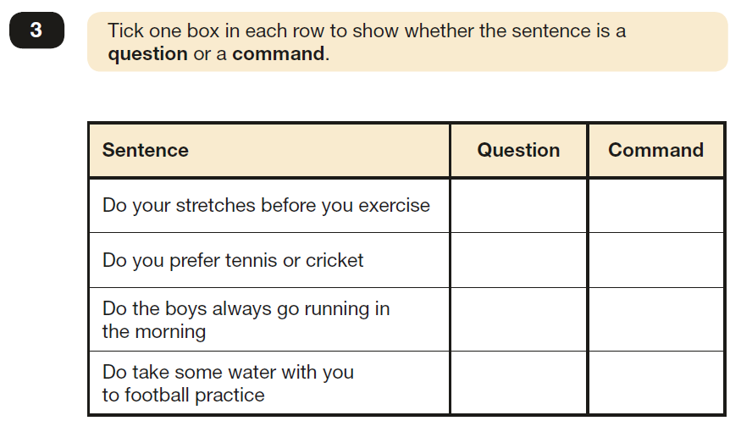
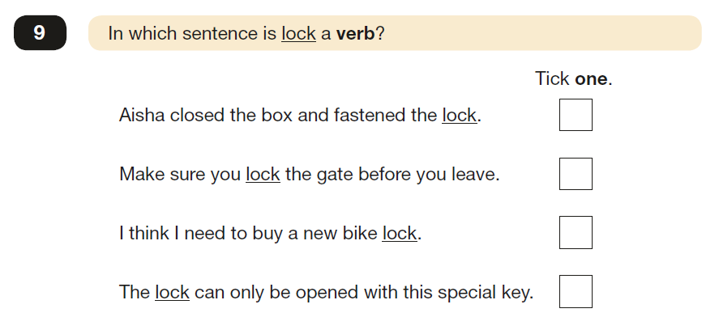
Grammar teaching in KS2
(Examples taken from 2019 test paper)
What does (English) grammar assessment look like in KS2?
Rowena Kasprowicz
Notes:
The examples on the screen here are excerpts from the Grammar punctuation and spelling SATs tests – these are all taken from the 2019 test paper.
As you can see, this test is very much providing a discrete decontextualized measure of grammatical knowledge. The focus is on testing, for example, whether students can label parts of speech correctly, whether they can identify different types of sentences (E.g. questions versus commands in number 3) or whether they can transform words from one tense to another.
In many ways the focus is on pupils’ understanding of the terminology itself – for example those words that are in bold within the question text (although it is also interesting to note that some questions could well be completed just by intuition rather than really understanding and applying the target terminology).
And there is a question about whether this test really requires students to demonstrate awareness at the level of understanding for the grammatical structures tested. For example in question 3, students may well be able to correctly indicate which sentences are questions and which are commands, and could well do this based on intuition, or what ‘sounds right’, but there is a question there about whether, in order to complete this successfully, they really need to understand why this is the case? And what it is about the structure of each sentence which indicates whether a sentence is a question or a statement?
As we can see then, there are issues with the Grammar Punctuation and Spelling test (for example this emphasis on identification of grammar features rather than testing understanding of their meaning). But we’re not going to focus any further on the issues. I wanted to just include these examples as a demonstration of the way in which children are interacting with and talking about language in KS2 and what they are expected to be able to do.

Slide 8
Using metalanguage
MFL Pedagogy Review recommends making use of standard grammatical terminology
The KS1 and KS2 (English) curriculums also require children to recognise and use grammatical terminology.
This knowledge is tested in the Grammar Punctuation and Spelling test at the end of KS2.
Why is this useful?
Equips children with language they can use to talk about their knowledge and learning
Provides clarity through shared understanding of a clearly defined set of terms and definitions
Boosts children’s confidence, including lower ability learners
To some extent, facilitates application of these concepts to different contexts and languages (Safford, 2016; TSC, 2016)
Rowena Kasprowicz
Notes:
The MFL Pedagogy Review also emphasises the importance of making use of standard grammatical terminology when talking abut language with students. And as we have seen, a key focus of the KS1 and KS2 English curriculums is on developing children’s ability to recognise and use grammatical terminology.
In a large part, it is this recognition of terminology that is tested in the Grammar Punctuation and Spelling test at the end of KS2. As noted on an earlier slide, whether or not the GPS test does a good job of testing pupils’ grammatical knowledge is open for debate, but in theory this is the purpose of the test.
Why is it useful to focus on using standard grammatical terminology?
Firstly, it equips pupils with a clearly defined set of language which they can use to talk about their own knowledge and learning.
Secondly, it provides clarity through a shared understanding, amongst both teachers and pupils, through a clearly defined set of terms and definitions.
Thirdly, grammar teaching equips students with the tools to analyse their own learning and own language use. Students find this empowering & this builds confidence, in particular for weaker readers and writers. it can boost children’s confidence, including for lower ability learners. The Safford study found that in the context of their grammar learning, students do seem to find it easier to reflect on their own learning and understand what they do and don’t know, for example either they know what preposition is or not etc.
Finally, to some extent, the use of a standard set of terminology in principle facilitates the application of these concepts to different contexts and languages. If a pupil has a clear understanding of what we mean by ‘subject’ or ‘object’ or ‘pronoun’ in English, then they can draw on this understanding when they encounter those terms in relation to a new language.
It’s important to acknowledge, of course, as we’ve said before, that although at KS2, students are developing knowledge of terminology and different grammatical concepts, the GPS test in itself really just seems to focus on labelling grammar features / matching terminology to grammatical features. Therefore, it is not exactly clear how transferable this knowledge is, and the test in and of itself doesn’t necessarily tell us whether pupils are really understanding how and why particular grammatical structures are used. Nevertheless, at KS2, pupils have at least begun to establish knowledge of this core terminology, which we can build upon at KS3 and beyond.

Slide 9
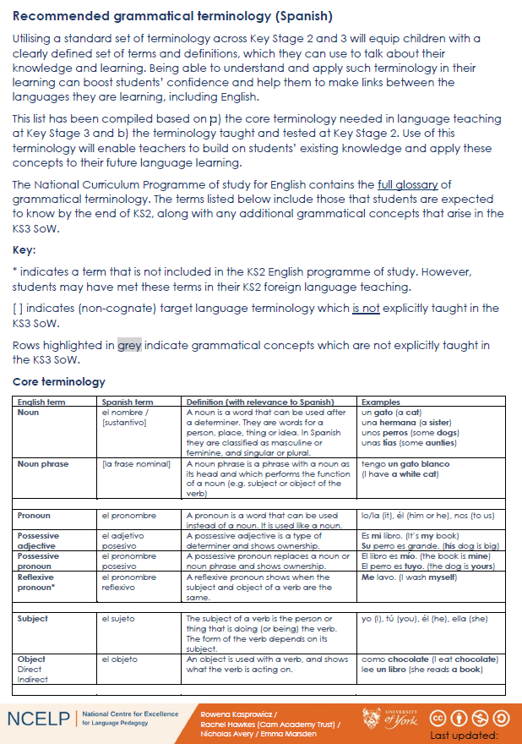
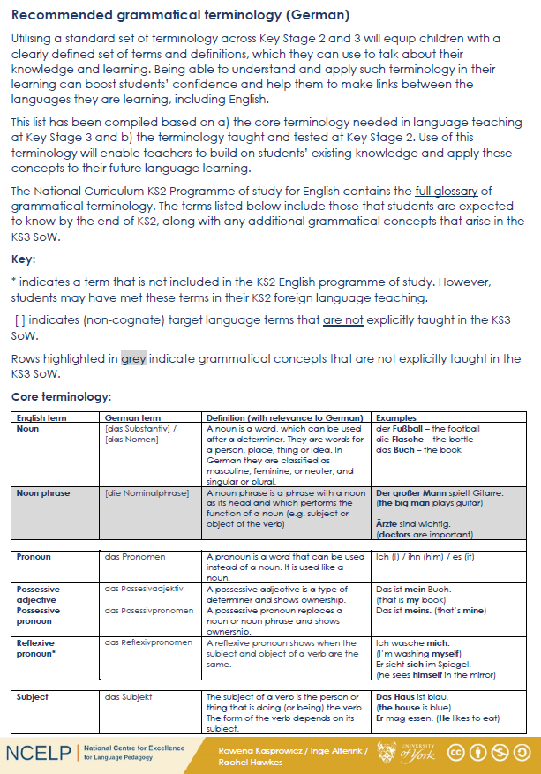
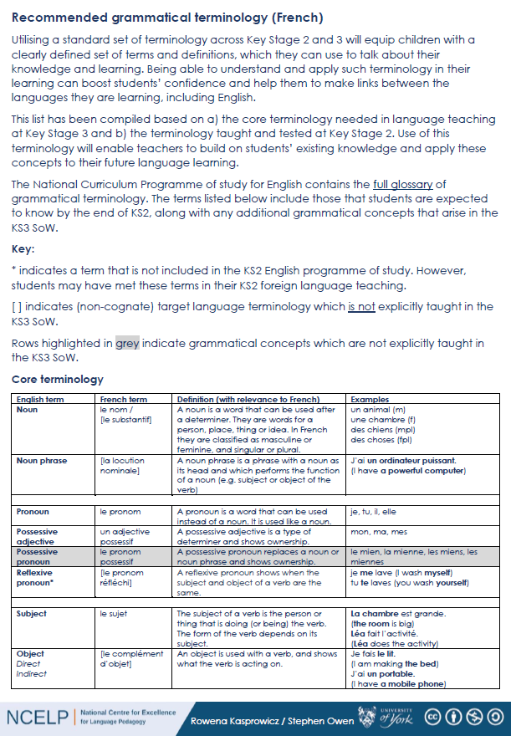
Access the handouts: NCELP Resource portal → KS2 Grammar
Rowena Kasprowicz
Notes:
In line with the recommendation from the pedagogy review, NCELP have been developing a list of recommended grammatical terminology.
There are three handouts, which accompany this presentation, contain the list of terminology for French, German, and Spanish respectively. The lists can be found on the Resource Portal → search for KS2 Grammar and you will find all of the resources for this session.
The lists have been developed based on a) what structures students will be encountering in the KS3 SoW, and b) based on the terminology and concepts that children have covered in primary school, taking into consideration primarily the English but also the foreign language curriculums.
There is a bespoke version of the terminology list for each language, with definitions and examples tailored to that specific language.
You will see from the handouts, that we have included the equivalent target language terminology within the list. The target language terms which are given in square brackets are non-cognate terms, which are not expected to be explicitly taught, but are just provided for reference. Terms that have an * next to them, are terms which are not included in the KS2 English programme of study, however, students may have met some of the terms through their KS2 foreign language learning – for example terms such as “gender”. Finally, rows highlighted in grey are grammatical concepts that will not be introduced in the KS3 SoW in that language (but they might come up in one of the other languages). Those guidelines are included in the Key which you can find on page 1 of the handout.
I would recommend having a look at these handouts after the session. Do let us know if there are any terms that you feel are missing and coule helpfully be included here.

Slide 10
Using metalanguage – English first
Introduce new grammatical concepts using terminology in English first.
Why?
Building on learning from KS2
Ensuring understanding is firmly established in English
Avoiding cognitive overload
Once understanding is firmly established, introduce equivalent TL terms in subsequent practice
In NCELP SOW, TL terms in year 7 if they are COGNATES (e.g., adjectif)
Other terms (non-cognates) might be introduced in year 8 or 9 (or beyond)
Ensure that meaning of term is clear in English
Ensure that examples are clear in both English and TL
Rowena Kasprowicz
Notes:
Before we move on, I wanted to just say a few words about NCELP’s approach to introducing the terminology in the target language.
In general, NCELP recommends introducing new grammatical concepts using terminology in English first. This is because, it is important to ensure understanding is established using the L1 (English) terms first, before introducing new terminology in the L2. This will build on pupils’ learning from KS2, reinforce their understanding of these concepts and how they can then apply them to the L2.
It is also important to avoid overloading pupils – so that they are not having to deal with multiple levels of new learning / knowledge all at the same time (for example, understanding the meaning of the new L2 terminology, whilst also getting to grips with the new TL structure and it’s meaning and use). Using grammatical terminology in English, which pupils are already familiar with, removes one layer of complexity when introducing these new concepts.
Once understanding of a new grammatical concept in the target language is firmly established, equivalent target language terminology could then be introduced in subsequent practice.
In the context of the NCELP SoW, Target language terms introduced in Year 7 are all cognates. Other terms (which are non-cognates) may then be introduced in later years.
The guiding principles that are followed within the NCELP resources, when using grammatical terminology to introduce a new grammatical concept, is to ensure that the meaning of the term is clearly established in English, and to ensure that clear examples are included in both English and the target language. This is to avoid any misunderstandings or ambiguity.

Slide 11
Developing learners’ knowledge about language
A substantial body of research explores the benefits of developing learners’ awareness of and knowledge about language (in their first language and in other languages) and the impact this can have on language learning.
metalinguistic ability / awareness
ability to look at language as an object
ability to describe linguistic phenomena and (where known) using technical language
(Han & Ellis, 1998; White & Ranta, 2002)
metalinguistic knowledge
→ knowledge of the rules governing a language
knowledge of the technical language used to describe
patterns and linguistic phenomena
language analytical ability
ability to spot patterns in language
ability to make generalizations and extrapolate rules
(Roehr-Brackin & Tellier, 2019)
Such knowledge, skills, and abilities are developing during middle childhood (around 7 to 11 years old).
This coincides with biological maturation, the onset of literacy, and (where present) exposure to other languages.
Rowena Kasprowicz
Notes:
This next section of the presentation focusses on the development of learners’ knowledge about language, and we will look at some research studies which have investigated the role of knowledge about language in the learning process.
There are a number of different terms that are used within the literature to refer to learners’ knowledge about language or language awareness.
Firstly, the term metalinguistic is applied to / used to define tasks that require learners to look at language as an object
So, we can talk about a learners’ metalinguistic ability / awareness, and this is generally used to refer to learners’ ability to look at language as an object and their ability to describe linguistic phenomena and (where known) their ability to use technical language to do this.
The term metalinguistic knowledge refers to learners’ knowledge of the rules governing a language and knowledge of the technical language used to describe patterns and linguistic phenomena
We can also talk about a learners’ language analytic ability – this is learners’ ability to analyse language, spot patterns, and to make generalisations / extrapolate rules based on those patterns.
These analytical skills / abilities are developing rapidly during middle childhood, which is generally defined as around 7 to 11 years old. This coincides with / is triggered by the biological changes happening in children at this age, as well as the development of their literacy skills once they start school, and any exposure they might have to other languages. By the time pupils reach KS3 / secondary school, have a much greater propensity to be able to look at language in an abstract way.
As I mentioned just now, different terms tend to be used across different research studies; however, they are all essentially talking about learners’ ability to look at language as an object, pick out patterns, apply rules, and talk about the language. In the following slides, when talking about specific studies, I will use the terminology that was used within that particular study.

Slide 12
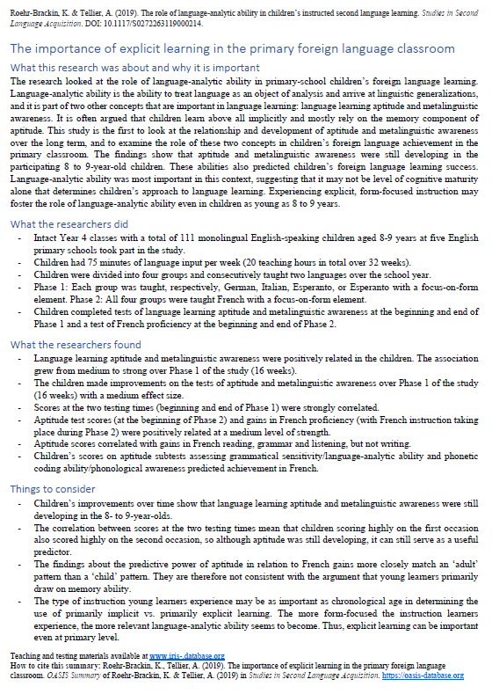
Developing learners’ knowledge about language
Developing learners’ knowledge about language and their ability to analyse language can be beneficial for language learning.
Language analytic ability (LAA) has been found to predict foreign language proficiency in young learners
OASIS Summary of Roehr-Brackin & Tellier (2019)
N = 111 8-9 year olds from 5 primary schools
Observed a strong relationship between LAA and the learners’ L2 French proficiency after 16 weeks of French learning
LAA seems to be particularly important in instructed settings where learners are more likely to be relying on explicit learning (e.g. through focus-on-form activities to practise grammar)
Similarly, Kasprowicz, Marsden & Sephton (2019) found LAA was related to performance on Gaming Grammar (N = 113 learners aged 8-11)
Resource portal →
KS2 Grammar
Rowena Kasprowicz
Notes:
The relationship between language learning and analytic ability is already fairly accepted for older learners / adults. Studies have demonstrated that for older learners there is a strong relationship between analytical skills and success in language learning. However, this relationship is less clear for younger learners, because analytical skills are still developing. Earlier research suggested that younger learners rely primarily on memory abilities in learning. However, more recent research conducted in an instructed context, where learners are more likely to be encountering more explicit learning approaches and focussing on form, indicates that language analytic ability is also important for younger learners.
Studies have shown that developing learners’ knowledge about language and their ability to analyse language can be beneficial for language learning.
Further, although LAA is still developing throughout childhood, a number of studies have shown that language analytic ability seems to be predictive of learners’ foreign language proficiency for younger learners, as well as for older learners.
There is an OASIS summary of a study by Karen Roehr-Brackin & Angela Tellier (2019), which accompanies this session – again this can be found on the resource portal. Their study was conducted with 111 8-9 year olds from 5 primary schools who were learning French. They found that LAA (rather than memory abilities) was the strongest predictor of proficiency (i.e. those learners with higher LAA were more likely to be doing well in their French learning).
Similarly, in our recent research with GG, we found a similar pattern, where learners’ LAA predicted how well they would do on the game, and how quickly they would pick up the grammatical patterns being introduced. The Kasprowicz et al summary is also available
These findings suggest that language analytic ability is particularly important in instructed settings where learners are more likely to be relying on explicit learning. In other words, the more form-focused the instruction learners experience, the more relevant language-analytic ability becomes, and the greater its role in children’s language learning success.

Slide 13
Developing learners’ knowledge about language
Studies have also observed a relationship between learners’ metalinguistic knowledge and their ability to use the foreign language
Summary of White & Ranta (2002)
Two classes of French children (N = 59) in intensive English programme (Quebec)
Both classes engaged in communicative language lessons.
One class also received metalinguistic instruction about use of his/her in English vs. French
Picture description task
Both classes improved their use of possessive adjectives
BUT
Higher proportion of learners who received metalinguistic instruction demonstrated mastery of agreement rule for his/her than in other group.
Without metalinguistic instruction, learners had to rely more on own ability: those learners with higher LAA were more likely to improve use of his/her, compared to learners with lower LAA.
his? her?
Rowena Kasprowicz
Notes:
Another benefit to providing some instruction that develops learners’ metalinguistic knowledge, is that there is evidence of the relationship between learners’ metalinguistic knowledge and their ability to use the foreign language
A study by White and Ranta in 2002 compared two groups of children who were learning English through an intensive programme.
Both classes engaged in communicative language lessons, however, one class also received metalinguistic instruction about use of his/her in English vs. French. This instruction included explanations about the different uses of his/her in English versus French and activities to practice comparing and contrasting their use in the two languages.
The researchers found that although, overall, both classes improved in their use of the possessive adjectives, a higher proportion of learners in the metalinguistic instruction group had mastered the use of the agreement rule for his/her than in the other group.
For the comparison group, it seems that without the metalinguistic instruction, learners had to rely more on their own ability. i.e. those learners with higher language analytic ability were more likely to improve their use of his/her because they were able to independently work out how these structures are used in English compared with French. However, learners with lower LAA were not able to work out the rules unaided. Whereas in the class who did receive the metalinguistic instruction, it seems that the instruction helped to ‘level out’ these differences, meaning a higher proportion of learners demonstrated mastery of this feature.
The important take-away here is that: if we don't teach it and provide some metalinguistic instruction, then it is, arguably, less equitable - learners who are naturally good at analysing language could perhaps do it anyway, but those who can't are less likely to 'get it‘ and pick up the rules unaided. So when we provide some metalinguistic support, learning success becomes less reliant on individual variation between learners.

Slide 14
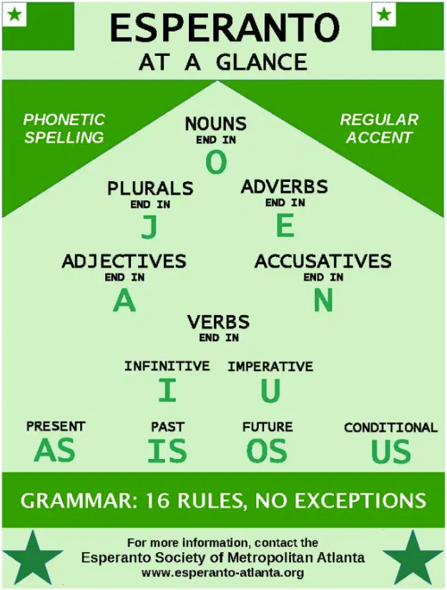
Developing learners’ knowledge about language
Training pupils in language analysis seems to lead to more consistent outcomes amongst pupils
White & Ranta (2002) observed less variation in outcomes for their metalinguistic instruction group
Resource portal →
KS2 Grammar
OASIS Summary of Roehr-Brackin & Tellier (2018)
Three studies investigated whether metalinguistic ability can be improved by learning Esperanto before going on to learn French
Across all three studies there was less variation in L2 performance among children who learnt Esperanto
Fewer learners did poorly
Artificial language governed by transparent, systematic, unambiguous rules
Rowena Kasprowicz
Notes:
It, therefore, seems that training pupils in language analysis seems to lead to more consistent outcomes.
This was demonstrated in the previous study (White & Ranta) where there was less variation in performance within the group who had received metalinguistic instruction – overall a higher proportion of learners had mastered the target grammar feature, compared to the comparison group.
Similarly, Handout 5 gives an overview of a second study by R-B & T that observed a similar finding.
This summary gives an overview of series of studies looking at the benefits of teaching Esperanto (an artificial language, which has transparent, systematic, unambiguous grammatical rules) → the researchers were interested to see whether providing some teaching in Esperanto could improve learners’ metalinguistic ability?
Essentially, the idea is that Esperanto is a good ‘test bed’ for developing learners’ metalinguistic and language analytic ability, because it is very systematic and unambiguous, with no exceptions to the rules.
The researchers conducted three studies, where they compared pupils who spent half a year learning either Esperanto / German / Italian. All pupils then went onto learn French for the second half of the year..
They were interested to look at whether the different languages led to an improvement in a) learners’ metalinguistic ability & b) the subsequent benefits for learning French.
The researchers found that:
Engaging learners with grammar teaching (form-focused activities) seemed to have a beneficial impact on learners’ metalinguistic ability (regardless of whether they were learning Esperanto or French)
Esperanto itself didn’t seem to have any greater benefits than other languages, in terms of learners’ overall metalinguistic ability and language proficiency.
Importantly, however, there was less variation in L2 performance among the children who had learnt Esperanto. So having that period of form-focussed instruction which focussed on developing learners’ metalinguistic ability did seem to be beneficial.
The important take-home from this study is that: these findings suggest that metalinguistic ability is trainable. This can help to ‘level the playing field’ by helping learners who are less naturally analytical in languages. Success in language learning is therefore less reliant on individual differences and learners’ natural propensity for analysis etc.

Slide 15
Engaging in language analysis
… can facilitate a deeper understanding of language by encouraging learners to
“spot patterns in language and to identify variables”
… can include any and all languages,
i.e. first language, home language(s), foreign language(s)
… can develop learners’ understanding of both language and culture
(how languages are used in similar and different ways to convey meaning)
… is in line with the move towards more explicit and direct teaching of language
… can lead to greater interest and enjoyment in language study
… can prepare learners for further language learning later in life
(Eric Hawkins’ “language apprenticeship”)
(CLiE Manifesto https://clie.org.uk/laser/#manifesto)
Rowena Kasprowicz
Notes:
Bringing together the findings from those studies, we can conclude that engaging in language analysis can be beneficial for language learning for the following reasons:
It can facilitate a deeper understanding of language by encouraging learners to “spot patterns in language”
It can include any and all languages and it is useful to note that this can also be useful as a way to incorporate learners’ home languages in the classroom discourse.
Engaging in language analysis can help to develop learners’ understanding of language and culture, by encouraging learners’ to draw comparisons between their first language (i.e. whether that’s English or another language) and the foreign language. It gives pupils a chance to explore how language is used to covey meaning in different ways between different languages.
It is also in line with moves towards more explicit and direct teaching of language, and will help learners to engage in more explicit learning activities.
Point 5 on the screen, highlights another important benefit of LA in FL teaching, which is to present the target language as a source of interest, in order to encourage students’ enjoyment of and engagement in language learning.
Further, as L1 English speakers, there is not one obvious language that we will need later in life. Therefore, developing learners’ ability to analyse and talk about language will help to equip learners to tackle any language they may choose / need to learn in the future. This of course is reflected in the 2014 National Curriculum for languages which notes that ‘language teaching should provide the foundation for learning further languages, equipping pupils to study and work in other countries.’ → developing language analytic abilities is one part of this.

Slide 16
Yodaspeak
Activity
Exploring word order
Notes:
We’re now going to look at an example of an activity designed to encourage learners to break down and analyse language.
This activity was kindly shared by Rachel Hawkes, originally adapted from UK Linguistics Olympiad set of activities, and is an activity based around analysing Yodaspeak.

Slide 17
Practising language analysis
Adapted from UKLO activity
(see Slide 24)
Example:
Yodaspeak activity
Practise identifying subject / verb / object in English sentences to consolidate understanding of these terms
Practise identifying and describing word order patterns
Practise manipulating word order in English sentences
Precursor to introduction of word order changes in German
Rachel Hawkes / UKLO
Notes:
The aim of this activity is to give learners practice identifying the subject, verb, and object in English sentences to consolidate their understanding of these terms. To practise identifying and describing word order patterns and practise manipulating word order in English sentences.
Rachel used this activity as a precursor to introducing word order changes in German.

Slide 18
Practising language analysis: Example
Yodaspeak
In the Star Wars movies, the character Yoda was heard to speak English with a distinctive word order, apparently a deliberate device to make him seem different and special.
We are going to look at some examples of Yoda’s English, all genuine examples from the Star Wars movies.
In the examples:
Circle the verbs, box the subjects, and underline the objects.
Rachel Hawkes / UKLO
Notes:
On the screen here you can see the introduction for this activity.
The first part of the activity asks students to identify the verbs, subjects and objects within a series of sentences which are produced by Yoda in the Star Wars films.
Importantly, this activities uses sentences that are made up of English words, but use an unfamiliar word order. This means, that learners aren’t preoccupied with understanding the meaning of the individual words or lexical items, but can really focus in on the grammatical function of the words in each sentence.

Slide 19
Examples of questions
Look at the examples. Circle the verbs, box the subjects, and underline the objects.
1. Take you to him I will.
2. A domain of evil it is.
3. Help them you could.
4. Chewbacca and Tarfful, miss you I will.
5. Truly wonderful the mind of a child is.
6. Much to learn you still have.
7. When nine hundred years old you reach, look as good you will not.
8. Lost a planet Master Obi-Wan has.
9. Begun the Clone Wars have.
10. Your father he is.
Rachel Hawkes / UKLO
Notes:
On the screen here you can see the sentences that pupils would be working with. I’ll give you a moment to have a look through them.

Slide 20
Practising in language analysis
Look at the examples. Circle the verbs, box the subjects, and underline the objects.
1. Take you to him I will.
2. A domain of evil it is.
3. Help them you could.
4. Chewbacca and Tarfful, miss you I will .
5. Truly wonderful the mind of a child is.
6. Much to learn you still have .
7. When nine hundred years old you reach , look as good you will not.
8. Lost a planet Master Obi-Wan has .
9. Begun the Clone Wars have .
10. Your father he is .
Rachel Hawkes / UKLO
Notes:
On this screen we have highlighted the answers. This activity is introducing the idea of word order moving away from strict SVO order that we follow in English. It is introducing the idea of verbs appearing at the end of the sentence and also sometimes at the start (for example when the sentence includes a modal or auxiliary verb).

Slide 21
Yoda’s sentences
Q. What does the position of the subject and verb tell us about how Yoda forms his sentences?
The subject moves to the end of the sentence just before the verb.
VERBS move!
If there is just one main verb, it moves to the end of the sentence.
If there are two verbs (e.g. modal verb + main verb), the modal verb moves to the end of the sentence and the main verb moves to the start of the sentence.
If there is an object, it moves to the start of the sentence. If there are two verbs, the object comes just after the main verb at the start of the sentence.
Q. How are Yoda’s sentences different from regular English sentences?
Rachel Hawkes / UKLO
Notes:
The next step would be to ask students to examine the sentences they have been working with, to spot the patterns in these sentences. There is a question to prompt students to do this.
For example, they might spot that the subject moves to the end of the sentence just before the verb. And crucially that verbs move in Yoda’s sentences. Similarly, in Yoda’s sentences the object appears at or near the start of the sentence.
Students are then encouraged to compare Yoda’s sentence to regular English sentences and explain the differences.

Slide 22
Practising in language analysis
Now, take the following genuine but ‘incorrect’ examples (a-j) and rewrite them in ‘pure’ Yoda-speak.
Incorrect sentences | Correct ‘Yodaspeak’
The boy has no patience. | No patience the boy has.
I cannot teach him. | Teach him I cannot.
A Jedi’s strength flows from the Force. | From the force a Jedi’s strength flows.
The fear of loss is a path to the dark side. | A path to the dark side the fear of loss is.
Great care we must take. | Take great care we must.
Disturbing is this move by Chancellor Palpatine. | Disturbing this move by Chancellor Palpatine is.
The capture of General Grievous will end this war. | End this war the capture of General Grievous will.
A little more knowledge might light our way. | Light our way a little more knowledge might.
Sick have I become. | Become sick I have.
Rachel Hawkes / UKLO
Notes:
The final part of this activity asks pupils to create sentences in correct ‘Yodaspeak’ using the patterns and rules they identified in the first part of the activity. So here, pupils are having to actively manipulate word order and apply the rules that they have identified. → examples
This is one example of an activity that could be used to provide some practice and training in language analysis, in preparation for introducing new grammatical concepts and structures in the foreign language. And importantly this is building on and consolidating students understanding of key terminology such as ‘subject’ ‘object’ ‘verb’, before they then have to apply them to the foreign language.

Slide 23
Practising language analysis
UK Linguistics Olympiad
Aim to develop learners’ understanding of language
Lots of example problem sets available via the website
Wide range of languages (including Fr / Ge / Sp)
Wide range of language features / structures / patterns explored
Rowena Kasprowicz
Notes:
As I mentioned, the Yodaspeak activity was adapted from a UK linguistics Olympiad practice activity. I just wanted to flag this as a potentially useful resource for these sorts of activities.
The UK Linguistics Olympiad is a yearly competition, which aims to develop learners’ understanding of language.
UK Linguistics Olympiad website has a huge range of example problem sets, drawing on a wide range of languages – useful database to explore, for inspiration for these sorts of activities.

Slide 24
Comparing different languages
Although there is often a concern about using the L1 in the foreign language classroom, strategic, systematic use and discussion of the L1 (and other languages) and comparison with the L2 can have distinct benefits for both L1 and L2 learning.
(Cook, 2001; Horst, White, Bell, 2010; Macaro, 2002; Turnbull, 2001)
Making L1/L2 comparisons can have a positive effect on L2 learning. Some evidence…
Earlier study by White & Ranta (2002)
Study by Ammar, Lightbown, Spada (2010): positive relationship between learners’ awareness of L1-L2 differences and ability to accurately form questions
Series of studies by McManus & Marsden demonstrating the benefit of L1 grammar explanation and practice on L2 learning (see summaries from Grammar & Meaningful Practice)
Cross-linguistic awareness (awareness of the similarities and differences between languages) is part of a learners’ metalinguistic awareness
Rowena Kasprowicz
Notes:
As noted earlier – another very effective method for developing learners’ analytical abilities and metalinguistic awareness is through activities that encourage comparisons between different languages.
Strategically and systematically using the L1 (and other languages) in comparison with the L2, can be beneficial for both L1 and L2 learning.
This cross-linguistic awareness is an important part of learners’ wider metalinguistic awareness.
In previous sessions (grammar, meaningful practice, use of TL), and Earlier in this session, we’ve seen a range of evidence that explicitly drawing comparisons between the L1 (i.e. English) and L2 can be beneficial for learners’ developing knowledge of the L2.
We saw this in the earlier study by W&R where we saw that metalinguistic instruction about possessive adjectives in French versus English had a positive impact of learners’ mastery of possessive adjectives in the L2 (English).
In addition, a study by Ammar, Lightbown, and Spada in (2010) looked at the benefits of instruction which focussed on drawing learners’ attention to the differences in question formation in English vs. French. The study found that this instruction had a positive impact on learners’ ability to accurately form questions.
In addition, we’ve encountered the studies by McManus and Marsden in previous sessions, which demonstrated that providing the grammar explanation and practice in the L1 English (about how habitual vs. ongoing meaning is conveyed in the past tense) as well as the L2 French, was beneficial for learning how to form these structures in French, and led to better learning than providing Explanation and practice for French alone. Importantly, they found that it was the combination of L1 explanation + L1 practice was important (the L1 practice without L1 explanation did not lead to the same benefits).
Another study by McManus 2019 in Language Awareness also demonstrated that awareness of form-meaning mappings in the L1 can benefit L2 learning of crosslinguistically complex features (i.e. those that exist but behave differently in the two languages)
Important take away here from these studies is that: teaching, comparing, switching between languages can be helpful for L2 learning for certain features (see next slide).

Slide 25
Comparing different languages
“regardless of the extent to which the language teacher avoids using the L1 in class,
it is still always there in the minds of the learner”
(Horst et al., 2010, p. 333)
We know that the L1 can positively and negatively influence L2 learning
Learners try to apply patterns from their L1 when interpreting and using the L2
Learners view the L2 through the “lens” of their L1, especially in earlier stages of learning (and across all areas of language learning, including phonics, vocabulary & grammar)
(N. Ellis, 2006)
Cross-linguistic comparisons can help to reinforce correct L2 form-meaning connections
particularly for features which behave differently in the L1 versus the L2
Rowena Kasprowicz
Notes:
We know, of course, that learners’ knowledge about the L1 is always there – even if the L1 is not explicitly mentioned in the classroom.
In addition, learners are making use of this knowledge, in the process of trying to breakdown, understand, and use the L2 – with potentially positive and negative consequences.
For instance, (particularly in the early stages of language learning), learners try to apply patterns from their L1 in the L2 – for example, transferring the canonical S-V-O word order from English. This can lead to difficulties when learning languages such as German where word order behaves quite differently to English.
We know that, particularly in the earlier stages of learning, pupils are likely to be viewing the new language through the lens of their L1.
Given that learner’s knowledge about L1 is always there and that learners do make use of this (regardless of whether its explicitly mentioned or not), the important question becomes “how can we harness what pupils have been learning about English, to help them develop their knowledge and understanding of the L2”? As mentioned on the previous slide, this is where drawing cross-linguistic comparisons (i.e. comparing L2 and L1) can be useful.
Note: this is not necessarily a blanket approach for all aspects of the L2. This sort of comparison is particularly useful for features that have a complex relationship between the L1 and L2, i.e. those features that exist in both languages but behave differently.

Slide 26
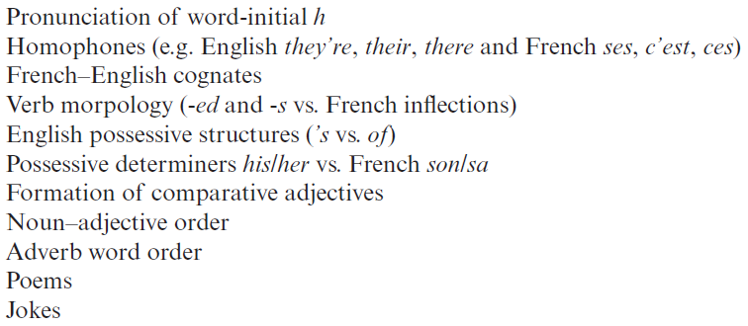
Comparing different languages
Resource portal →
KS2 Grammar
Features Horst et al (2010) identified for the (L1 French) learners of English in their study
OASIS Summary of Horst, White & Bell (2010)
In both the L1 and L2 classroom, observed minimal, sporadic comparisons with the other language.
Developed cross-linguistic awareness activities for L1 French learners of English.
Learners able to clearly compare the languages and note useful points of similarity and difference.
In your own teaching, where do you think it might be useful to draw comparisons between English and the target language?
Are there particular language structures that it would be useful to explore with your pupils?
Rowena Kasprowicz
Notes:
Handout 6: 10 minutes to read through + 10 minutes for discussion of questions (ideas on post-it notes, see below)
One final research summary I wanted to mention is of a pilot study by Horst, White, and Bell, that was looking at the feasibility of using cross-linguistic comparison activities in the classroom. This summary can be found on the Resource Portal.
Within the study, the researchers observed both the first language (French) classes and second language (English classes that a group of secondary school pupils received. They then developed a series of cross linguistic awareness activities to trial in the English lessons and gathered feedback from both the teachers and the pupils about these activities. The box in the top-right hand corner lists the features that they explored in these activities.
It is important to note, that this was a pilot study and therefore, does not provide evidence about the impact of these activities.
Nevertheless, their main findings were, that:
Unprompted use of L1/L2 comparisons was rare in both of the classrooms observed → this suggests that when/where/how to draw on these comparisons and utilise these sorts of activities needs to be considered and planned systematically and explicitly.
They found that the use of cross-linguistic activities did not lead to overuse of the L1 (the students knew when it was time to talk about/use the L1), contrary to some initial concerns expressed by the teachers.
Both the teachers and students expressed positive responses to the language comparison activities.
Students’ learning diaries suggested that they were able to draw thoughtful, detailed comparisons between the two languages and reflect on similarities and differences.
Based on these studies then, and the evidence we’ve explored about the usefulness of cross-linguistic comparisons, there are two questions on the screen that it might be useful to reflect on after the session for your own contexts.
In your own teaching, where do you think it might be useful to draw comparisons between English and the target language? Any particular structures and exist but behave quite differently in the target language, and therefore would be useful to explore with your students, to investigate the similarities and differences with English?
Are there particular language structures that it would be useful to explore with your pupils?
We don’t have time to discuss these now, but they may be useful questions for you to follow up on, and consider after the session.

Slide 27
Asking questions
Explanation and activity
Notes:
We’re now going to turn to look at an example of how cross-linguistic comparisons have been embedded in the NCELP resources
The example we’re going to look at here is taken from a set of resources for introducing question formation in German.
Syntax, and changes in word order, is one particular area where cross-linguistic comparisons can be particularly useful, to draw pupils’ attention to the differences in how structures, such as questions, are formed in different languages.

Slide 28
Asking questions
grammar explanation
Word order
To ask a ‘yes/no’ question in English, ‘do you..’ is followed by a verb.
Note that when you hear questions, you get an extra clue from the intonation, and when you read, you see the question mark.
Statement
You | have | a football.
Question
Do you | have | a football?
In German, just swap the verb and subject (e.g. ‘du’ (you), like this:
Statement
Du | hast | einen Fußball.
Question
Hast | du | einen Fußball?
→
Do you | have | a bottle?
Hast | du | eine Flasche?
Notes:
Many of the grammar explanations within the NCELP resources, begin with an explanation of how the structure is formed in English. This is important, because, as we discussed earlier, students are bringing their expectations from English with them, when they being learning the new language. So it can be helpful to remind students of how we form structures, such as questions, in English, and then explicitly contrast this with how the other language forms this structure.
This slide is included in week 1.1.7 to introduce students to question formation in German. On the screen here you can see we start with the explanation about English.
This is then followed by the explanation about German. You’ll notice that in both the English and the German examples, the verb has been highlighted to draw learners’ attention to the fact that in English the verb doesn’t move when we create a question, whereas in German the verb moves in front of the subject.
It is also useful to explain to students why they might find it tricky to remember this because a) the English construction is different, and b) additional clues are provided by intonation in spoken form, and punctuation in written form.
Of course with German, there is also the added complication of the homophony between the English ‘do’ at the start of the question and the German ‘du’ pronoun – so it is useful to ensure pupils understand that this German ‘du’ is not the English ‘do’!

Slide 29
Ist das eine Frage?
lesen
Frau Organisiert is texting Herr Organisiert to plan the shopping. He is confused as there is no punctuation!
Help Herr Organisiert. Write "?" after questions and "." after statements.
1. Hast du eine Flasche Cola __
4. Hast du ein Heft __
7. Du hast ein Lied __
2. Du hast einen Fußball __
5. Du hast eine Wasserflasche __
8. Hast du einen Film __
3. Hast du ein Buch __
6. Du hast einen Tisch __
9. Hast du eine Frage __
Notes:
We then move into a reading task where pupils are deciding whether each sentence is a question or a statement, based on the position of the verb.
TASK SLIDE
Students can do the task by writing numbers 1-9 and noting ? or . next to each. Alternatively, if needed for particular students, this slide could be printed.

Slide 30
Frage oder Satz?
Grammatik
Closed (yes/no) questions
As you know, closed questions are formed by swapping the verb and subject:
Note that when you hear questions, you get an extra clue from the intonation, and when you read, you see the question mark.
Statement
Du | spielst | oft Tennis.
You often play Tennis.
Question
Spielst | du | oft Tennis?
Do you often play Tennis?
Statement
Du | schreibst | ein Buch.
You are writing a book.
Question
Schreibst | du | ein Buch?
Are you writing a book?
This is how you ask ‘do’ or ‘are’ questions in German.
Notes:
This slide is taken from week 1.2.3, and is used to revisit the knowledge that students were taught in week 1.1.7 about question formation.
Here you can see that the focus is now primarily on the change in word order which is used to form questions in German. Again the verbs are highlighted to remind students that to form a question in German we have to move the verb in front of the subject. But importantly we still have the English translation on the screen, and it is useful to remind students here that German does not have a word for do/does or the continuous equivalent are/is.

Slide 31
Frage oder Satz?
hören
Zorg is making observations about Wolfgang. He can produce a lot of words, but lacks intonation (and manners!)
Is Zorg asking a question or making a statement? Write ? or .
?
.
C
A
B
D
E
F
G
H
I
Notes:
We then have a listening activity to revisit the VSO syntax of questions vs SVO order of statements. It is important to revisit essential grammar with different lexis for students to deepen their understanding of the grammar feature. Here vocabulary is recycled from previous weeks (1.2.1 and 1.2.2) and integrated with the frequency adverbs from this week.
Example slide
This slide is an example to do first with students and correct. It has audio inserted for A and B and the corresponding answers.
Then go to the next slide for the full exercise. The next slide has the audio and the answers.
NB: If it seems strange to students that we have so many appearances from Zorg, the robot, explain that it is important that we remove the audible clues (i.e. raised intonation) that come with questions, so that they only focus on the syntax.
Transcript
a) Hörst du jeden Tag das Leid
b) Du arbeitest kaum im Garten
c) Putzt du manchmal das Auto
d) Du tanzt nicht so gut
e) Du sitzt oft zu Hause am Computer
f) Gehst du nie in den Garten
g) Du redest sehr oft im Unterricht
h) Lernst du manchmal in der Schule
i) Spielst du nie mit Freunden Fußball

Slide 32
Open (wh-) questions
Grammatik
Open (wh-) questions
To ask an open question, place a question word directly in front of the verb:
Closed
Schreibst | du | ein Buch?
Are you writing a book?
Open
Wer
Who is writing a book?
Wo
schreibst | du | ein Buch?
Where are you writing a book?
schreibt |  | ein Buch?
Beispiel:
Was hast du am Montag?
What do you have on Monday?
Wo spielst du Tennis?
Where do you play tennis?
Wie oft putzt du dein Zimmer?
How often do you clean your room?
Wer ist dein Lieblingslehrer?
Who is your favourite (male) teacher?
Notes:
This next slide shows the explanation that takes the students onto the next stage of question formation in German, using question words.
Again here as you can see the word order change has been highlighted, and the target language sentences are contrasted with the English sentences, to draw learners’ attention to the differences in how questions are formed in the two languages.
Explanation of open (wh-) questions
Teacher to draw attention to word order: VSO for closed questions, Question word + VSO or VO for open questions.
Several examples using previously taught question words are given in German. Teacher elicits the meaning in English.
This primes for the question generation task later this lesson.

Slide 33
Order of words in a question
Grammatik
Sentences are turned into questions by swapping the verb and subject.
Du spielst zu Hause Gitarre.
Spielst du zu Hause Gitarre?
You play/are playing guitar at home.
Do you play / Are you playing guitar at home?
To ask an open question, place a question word in front of the verb.
Only the verb and subject swap places. The adverb and noun stay in the same position.
Wann spielst du zu Hause Gitarre?
When do you play / are you playing guitar at home?
Wer spielt zu Hause Gitarre?
Who plays / is playing guitar at home?
Notes:
SOW Week 1.2.4
Here we have a further explanation slide used to revisit the question formation rules that students have learnt – this slide comes from a later week, week 1.2.4.
This slide is animated within the resources, so that each point and each example sentence appears sequentially. This provides the opportunity for the teacher to elicit the du and er/sie forms of the sentences, as well as the English translations.
Here we can pay special attention to the word order with adverbs, highlighting that a word-for-word translation from English will result in incorrect word order.

Slide 34
Saying what people do [1]
Present simple and continuous
Resource portal →
KS2 Grammar
Year 7 French
Term 1.2 - Week 3 - Lesson 19
Natalie Finlayson / Emma Marsden /
Stephen Owen
Notes:
Ok we have looked through one example together to demonstrate how explanations and examples are including for both English and the target language structures, within the NCELP grammar resources. There is a separate Powerpoint which accompanies this presentation, and contains some further examples of crosslinguistic comparisons within the NCELP resources. Again, these materials are available on the resource portal under KS2 grammar. You might like to have a look through these examples after this presentation.
The examples include the “Present simple and continuous” tenses in French…

Slide 35
Possessive adjectives
Resource portal →
KS2 Grammar
Notes:
The use of possessive adjectives in French

Slide 36
3rd person singular
Explanation and activity
Resource portal →
KS2 Grammar
Notes:
And the third person singular verb form in German. You will also see lots of other instances of comparisons between English and the target language embedded throughout the NCELP resources for all three languages.

Slide 37
KS2 – KS3 Transition
NCELP Resource Portal → Transition
https://tinyurl.com/NCELPTransition
Evidence from research about the effectiveness of teaching primary foreign languages
The current state of play and key challenges identified
Methods for improving primary-secondary transition from the grassroots
‘Quick wins’: ideas from practice about how this might happen
One ‘quick win’: identifying and building on the language knowledge children have already developed at KS2
Rowena Kasprowicz
Notes:
Direct attention to a really useful set of NCELP resources on KS2-KS3 transition. Don’t have time to explore this today, but encourage to go away and look at this.
Scan QR code or go to tinyurl link.
About activities that can be employed fairly quickly and easily to help to ease students’ transition from KS2 to KS3.

Slide 38
Summary
Students have encountered quite a wide range of grammatical metalanguage and concepts during KS2, through the English curriculum.
Use of metalanguage can provide clarity, boost students’ confidence, and enable students’ to talk about the language.
Developing learners’ language analytic ability can have a ‘levelling’ effect.
Activities which promote crosslinguistic comparison are useful, particularly for grammatical concepts which work differently in the L2 (compared to English).
Rowena Kasprowicz
Notes:
This slide just provides a summary of the content of the presentation.
We looked first of all at grammar teaching at KS2 in both the English and foreign language curriculums. We saw that students have encountered quite a wide range of grammatical metalanguage and concepts during KS2, in particular through the English curriculum.
We also considered the role of metalanguage and discussed the study by Safford from 2016 which highlighted that adopting standard terminology for talking about language can provide clarity and boost students’ confidence, and equip students with the language they need to talk about the language itself as well as their learning.
We looked at a number of key research findings, which have demonstrated the benefits of developing learners’ language analytic ability – and this indeed seems to have a levelling effect, helping a wider range of learners to access and benefit from more explicit teaching.
And in the final part of this session we have looked at ways in which we can draw cross-linguistic comparisons, which can be particularly helpful for grammatical features which exist, but work differently in the target language compared to English.

Slide 39
Questions?

Slide 40
References
Ammar, A., Lightbown, P., & Spada, N. (2010). Awareness of L1/L2 differences: Does it matter? Language Awareness 19(2), 129-146.
DfE (2013a). English programmes of study: Key Stages 1 and 2. London: Crown Copyright.
DfE (2013b). Languages programme of study: Key Stage 2. London: Crown Copyright.
DfE (2019). National curriculum assessments at Key Stage 2 in England, 2019: Revised. London: Crown Copyright.
Ellis, N. (2006). Selective attention, and transfer phenomena in L2 acquisition: Contingency, cue competition, salience, interference, overshadowing, blocking, and perceptual learning. Applied Linguistics, 27(2), 164-194.
Han, Y. & Ellis, R. (1998). Implicit knowledge, explicit knowledge and general language proficiency. Language Teaching Research, 2, 1-23.
Horst, M., White, J., & Bell, P. (2010). First and second language knowledge in the language classroom. International Journal of Bilingualism, 14(3), 331-349.
McManus, K. & Marsden, E. (2017). L1 explicit instruction can improve L2 online and offline comprehension. Studies in Second Language Acquisition, 39, 459-492.
McManus, K. & Marsden, E. (2018). Online and offline effects of L1 practice in L2 grammar learning: A partial replication. Studies in Second Language Acquisition, 40, 459-475.
Roehr-Brackin, K. & Tellier, A. (2019). The role of language analytic ability in children’s instructed second language learning. Studies in Second Language Acquisition, 45(5), 1111-1131.
Roehr-Brackin. K. & Tellier, A. (2018). Esperanto as a tool in classroom foreign language learning in England. Language Problems and Language Planning, 42(1), 89 –111.
Safford, K. (2016). Teaching grammar and testing grammar in the English primary school: The impact on teachers and their teaching of the grammar element of the statutory test in spelling punctuation and grammar (SPaG). Changing English, 23(1), 3-21.
White, J. & Ranta, L. (2002). Examining the interface between metalinguistic task performance and oral production in a second language. Language Awareness, 11(4), 259-290.
Rowena Kasprowicz
Notes:
Here we have the references for literature that informed this presentation. The references in bold refer to the OASIS summaries that accompany this presentation.

Slide 41
Other resources
Englicious: a free online library of original English language teaching resources
Rowena Kasprowicz
Notes:
Finally, I just wanted to mention the Englicious website, which is a free online library of original English language teaching resources. These might prove a useful resource for revisiting and practising some of the key grammatical concepts in English, before introducing them in the target language.

Slide 42
Grammar teaching in KS2
Pupils’ perceptions of grammar teaching at KS2:
Often contrary to teachers’ view of grammar teaching…
Viewed positively and enjoyed by pupils
Appreciate having a clearly defined set of rules (at least within context of SPaG)
Boosts confidence of weaker readers and writers
Embedding grammar practice in wider literacy work helps to deepen pupils’ understanding of the concepts (although this isn’t reflected in the content of the test)
Notably, SPaG is one area in which EAL learners perform at a similar level (or indeed outperform) L1 English learners (DfE, 2019)
(Safford, 2016)
Rowena Kasprowicz
Notes:
The points on this slide are drawn from the Safford study I mentioned earlier, and these reflect the teachers’ observations of how pupils respond to their grammar teaching at Key Stage 2.
What is particularly notable is that, in this study at least, students’ perceptions of grammar teaching often seemed to be contrary to the views expressed by teachers.
The teachers in this study expressed fairly negative views of the amount of grammar teaching that is happening and required at KS2. But interestingly they also observed that students actually seem to express quite positive views about their grammar learning.
One particular aspect which pupils seemed to respond quite positively to, is the fact that, at least within the context of the SPaG (or grammar) part of the SATs tests, there is a clearly defined set of rules and terminology which pupils have to learn. So it tends to be a bit less subjective than some areas of the learning, such as creative writing for example. In the context of their grammar learning, students found it easier to reflect on their own learning and understand what they do and don’t know, for example either they know what preposition is or not etc.
Grammar teachers felt that the grammar teaching was equipping learners with the tools to analyse their own learning and own language use. Students find this empowering & this builds confidence, in particular for weaker readers and writers. It is also interesting to note that SPaG is one area in which EAL learners in particular perform at a similar or indeed higher level that pupils with English as their first language.
Similarly, there is potential for pupils’ grammar learning in English to support their learning of a new language. In particular is can be useful to draw connections with the language and structures that pupils already know and have encountered in English.

Slide 43
Using metalanguage
Handouts 1 to 3: List of recommended terminology
Based on terminology taught in KS1 & KS2 English curriculum and core grammatical concepts introduced in SoW
How closely do the terms match with those you currently use in your teaching?
Are there any terms that are surprising or potentially problematic?
Is there anything missing?
Rowena Kasprowicz
Notes:
In line with the recommendation from the pedagogy review, NCELP have been developing a list of recommended grammatical terminology. Handouts 1 to 3, which accompany this presentation, contain the list of terminology for French, German, and Spanish respectively. The lists have been developed based on a) what structures students will be encountering in the KS3 SoW, and b) based on the terminology and concepts that children have covered in primary school, taking into consideration primarily the English but also the foreign language curriculums.
There is a bespoke version of the terminology list for each language, with definitions and examples tailored to that specific language.
You will see from the handouts, that we have included the equivalent target language terminology within the list. The target language terms which are given in square brackets are non-cognate terms, which are not expected to be explicitly taught, but are just provided for reference. Terms that have an * next to them, are terms which are not included in the KS2 English programme of study, however, students may have met some of the terms through their KS2 foreign language learning – for example terms such as “gender”. Finally, rows highlighted in grey are grammatical concepts that will not be introduced in the KS3 SoW in that language (but they might come up in one of the other languages). Those guidelines are included in the Key which you can find on page 1 of the handout.
I would suggest that you pause this presentation for 5 to 10 minutes and have a look at the handouts. Whilst looking through the handouts, you might like to consider the questions on the screen.
When you are ready, continue with this presentation.

Slide 44
Developing learners’ knowledge about language
Training pupils in language analysis seems to lead to more consistent outcomes amongst pupils
White & Ranta (2002) observed less variation in outcomes for their metalinguistic instruction group
Resource portal →
KS2 Grammar
OASIS Summary of Roehr-Brackin & Tellier (2018)
Three studies investigated whether metalinguistic ability can be improved by learning Esperanto
Form-focused activities improved metalinguistic ability, regardless of language (real language or Esperanto)
Learning Esperanto did not confer special benefits for metalinguistic ability or language proficiency
BUT
Across all three studies there was less variation in L2 performance among children who learnt Esperanto
Fewer learners did poorly
Artificial language governed by transparent, systematic, unambiguous rules
Rowena Kasprowicz
Notes:
It, therefore, seems that training pupils in language analysis seems to lead to more consistent outcomes.
This was demonstrated in the previous study (White & Ranta) where there was less variation in performance within the group who had received metalinguistic instruction – overall a higher proportion of learners had mastered the target grammar feature, compared to the comparison group.
Similarly, Handout 5 gives an overview of a second study by R-B & T that observed a similar finding.
This summary gives an overview of series of studies looking at the benefits of teaching Esperanto (an artificial language, which has transparent, systematic, unambiguous grammatical rules) → the researchers were interested to see whether providing some teaching in Esperanto could improve learners’ metalinguistic ability?
Essentially, the idea is that Esperanto is a good ‘test bed’ for developing learners’ metalinguistic and language analytic ability, because it is very systematic and unambiguous, with no exceptions to the rules.
Across the three studies, the researchers compared pupils who spent half a year learning either Esperanto / German / Italian. All pupils then went onto learn French for the second half of the year..
They were interested to look at whether the different languages led to an improvement in a) learners’ metalinguistic ability & b) the subsequent benefits for learning French.
The researchers found that:
Engaging learners with grammar teaching (form-focused activities) seemed to have a beneficial impact on learners’ metalinguistic ability (regardless of whether they were learning Esperanto or French)
Esperanto itself didn’t seem to have any greater benefits than other languages, in terms of learners’ overall metalinguistic ability and language proficiency.
Importantly, however, there was less variation in L2 performance among the children who had learnt Esperanto. So having that period of form-focussed instruction which focussed on developing learners’ metalinguistic ability did seem to be beneficial.
The important take-home from this study is that: these findings suggest that metalinguistic ability is trainable. This can help to ‘level the playing field’ by helping learners who are less naturally analytical in languages. Success in language learning is therefore less reliant on individual differences and learners’ natural propensity for analysis etc.

Slide 45
Ist das eine Frage?
ANTWORTEN
Frau Organisiert is texting Herr Organisiert to plan the shopping. He is confused as there is no punctuation!
Help Herr Organisiert. Write "?" after questions and "." after statements.
1. Hast du eine Flasche Cola __
4. Hast du ein Heft __
7. Du hast ein Lied __
?
?
.
2. Du hast einen Fußball __
5. Du hast eine Wasserflasche __
8. Hast du einen Film __
.
.
?
3. Hast du ein Buch __
6. Du hast einen Tisch __
9. Hast du eine Frage __
?
.
?
Notes:
The answers are then displayed – in the resources the answers would be revealed one by one, so that the teacher can elicit responses from the class item-by-item.
Answer slide
Teacher elicits responses by asking ‘Ist das eine Frage?’ (Ja/nein) and pointing to the item. Students already know ‘Frage’, and the grammatical focus of this week is yes/no questions so the use of those here in input serves to reinforce the pattern. The word for sentence ‘Satz’ [582] is also a high-frequency word, and some teachers might find themselves naturally introducing it here.
Note: Students have not yet been taught numbers in the SOW so at this point there is not direction to use them. Depending on the class, some teachers may feel that they can begin to use them in tasks receptively, priming for subsequent teaching.

Slide 46
Frage oder Satz?
hören
Zorg is making observations about Wolfgang. He can produce a lot of words, but lacks intonation (and manners!)
Is Zorg asking a question or making a statement? Write ? or .
?
.
C
?
A
B
.
.
?
D
E
F
.
?
I
?
G
H
Notes:
Task slide
Students can do the task by writing letters A-I and noting ? or . next to each.
Audio is activated by clicking the individual letters.
Answers revealed on individual clicks. Teacher elicits responses by asking ‘Ist A eine Frage oder ein Satz?’ (‘A ist eine Frage … B ist ein Satz …’)
Transcript
a) Hörst du jeden Tag das Leid
b) Du arbeitest kaum im Garten
c) Putzt du manchmal das Auto
d) Du tanzt nicht so gut
e) Du sitzt oft zu Hause am Computer
f) Gehst du nie in den Garten
g) Du redest sehr oft im Unterricht
h) Lernst du manchmal in der Schule
i) Spielst du nie mit Freunden Fußball

Slide 47
Saying what people do [1]
Present simple and continuous
Resource portal →
KS2 Grammar
Year 7 French
Term 1.2 - Week 3 - Lesson 19
Natalie Finlayson / Emma Marsden /
Stephen Owen
Notes:
Ok we have looked through one example together to demonstrate how explanations and examples are including for both English and the target language structures, within the NCELP grammar resources. There is a separate Powerpoint which accompanies this presentation, and contains some further examples of crosslinguistic comparisons within the NCELP resources. You might like to have a look through these examples after this presentation.
The examples include the “Present simple and continuous” tenses in French…

Slide 48
Le verbe
grammaire
Verbs tell you how two nouns relate to each other.
Verbs are not just action words! They can mean things that we can’t see or hear:
In English, you can add ‘-ed’ or ‘-ing’ to the end of verbs and put ‘to’ in front of them.
Verbs can have other verbs in front of them, like ‘do’, ‘was’, ‘is’, or ‘has’.
studies
hates
The girl ??? French.
loves
speaks
be
have
want
get
become
happen
Notes:
Robust knowledge of verb vocabulary is absolutely critical for learning a language. That is, the meaning of verbs – ‘go’, ‘eat’, ‘be’, ‘play’, ‘love’ – not the grammar of verbs in their different tenses and forms. It would be useful to explain this to students. It is something that we take for granted in our own language.
Students in year 7 should all know what a verb is, from their primary school lessons. It might, however, be worth checking this in the initial stages.
Before showing this slide, ask students to define a verb and give some examples.
Note (2nd to last point): important to emphasise here that we’re trying to move away from the reliance of ‘verb is an action word’. What is demonstrated here is the importance of the DISTRIBUTION in the language - this is how we know whether something is a verb - not by its meaning, but by what words come around it. It is not taught like this generally. Generally people focus on the semantics (e.g. adj is a describing word - but to be an adjective it needs to be describing a noun). Another example is that nouns often have 'the' or 'a' in front of them → you can't define a noun by 'it's a thing or a person' as it can be an activity, and then children are stumped.

Slide 49
Le verbe
grammaire
Circle the verb/verbs in the following sentences.
1. George plays computer games for three hours every day. 2. Helen loves detective stories. 3. Everyone thinks that it is great. 4. He never really liked fizzy drinks. 5. The climate is getting warmer.
6. If the match had been more exciting, the players would have been happier. 7. Are you becoming a bore? 8. What kind of taste do you detect? 9. The fish was eaten by the shark. 10. Making myself do sport is my ambition this year!
1. George plays computer games for three hours every day. [to play]
2. Helen loves detective stories. [to love]
3. Everyone thinks that it is great. [to think, to be]
4. He never really liked fizzy drinks. [to like]
5. The climate is getting warmer. [to get]
6. If the match had been more exciting, the players would have been happier. [to be, to be]
7. Are you becoming a bore? [to become]
8. What kind of taste do you detect? [to do, to detect]
9. The fish was eaten by the shark. [to eat]
10. Making myself do sport is my ambition this year! [to make, to do, to be]
Notes:
Awareness-raising exercise in English to teach students to recognise different forms of verbs. This is in preparation for a lot of work with verbs and, in particular, the two forms of the present in English with the one equivalent form in French.
Answers revealed on clicks.
To go further you could ask students to:
tell you what the ‘infinitive’, the dictionary form, of each verb is in English (shown in square brackets above)
- change the ‘dictionary’ form into as many different versions of the same VERB as they can, without turning it into a different word class (part of speech)! e.g. think, thinks, thinking, thought are all forms of the same verb; BUT…. thoughtful, thoughtless, thinker are NOT verbs, but they come from the same word family.
- give you some words that can be both a noun and a verb (e.g., head; captain; chair; cook).

Slide 50
Present simple or continuous?
grammaire
English has two present tense forms.
I make the bed every week. I am making the bed at the moment.
French has one present tense only. The BE + -ing form does not exist.
Je fais le lit chaque semaine. Je fais le lit en ce moment.
Present simple - normally; routine
Je fais = I make AND
I’m making
Present continuous (BE + -ing) - ongoing; current
Adverbs of time tell us which English tense to choose.
In French, the present simple is used with all adverbs.
Notes:
Here, the metalanguage (present simple, present continuous and adverbs) used to talk about verbs in this and subsequent sequences is described and explained.
Teacher to highlight the distinction between present simple for routine actions and present continuous for current/ongoing actions.
Teacher to stress the fact that the BE + -ing form is an English construction only. Être cannot be used with a verb this way.

Slide 51
Adverbs of time
chaque semaine
[every week]
[at the moment]
en ce moment
Notes:
The majority of this week’s vocabulary items will be formally introduced in lesson 2, but these phrases are used in the activities that follow.
Teacher to elicit pronunciation and English meaning from students.
To prepare for the listening exercise that follows, the teacher writes ‘chaque semaine and ‘en ce moment’ on the board, and asks students which form of the English present tense is indicated by each.

Slide 52
Present simple or continuous?
lire (1/2)
Nick is babysitting for the Petit family. He makes notes about the children, Jaques and Géraldine.
1.1 Choose the correct adverb.
A
Jaques is playing tennis at the moment/every week.
B
Géraldine wears a uniform at the moment/every week.
C
Géraldine is having lunch at the moment/every week.
D
Jaques is doing his homework at the moment/every week.
E
Jaques goes for a walk at the moment/every week.
Notes:
Awareness-raising exercise in English to teach students to connect temporal adverbs with tense. Note choice of French names incorporates this week’s SSCs: Jaques and Géraldine.

Slide 53
Present simple or continuous?
lire (2/2)
Nick is babysitting for the Petit family. She makes notes about the children, Jaques and Géraldine.
1.2 Choose present simple (normally; routine) or continuous (ongoing; current).
F
Jaques washes/is washing up at the moment.
G
Géraldine learns/is learning English every week.
H
Géraldine plays/is playing with her friends at the moment.
I
Jaques reads/is reading a book at the moment.
J
Géraldine sings/is singing every week.
Notes:
Awareness-raising exercise in English to teach pupils to connect temporal adverbs with tense.

Slide 54
Possessive adjectives
Resource portal →
KS2 Grammar
Notes:
The use of possessive adjectives in French

Slide 55
Possessive adjectives
Compare these French and English sentences.
What do you notice about the possessive adjectives?
Elle adore son livre.
She loves her book.
Il adore son livre.
He loves his book.
Elle adore sa voiture.
She loves her car.
Il adore sa voiture.
He loves his car.
Rowena Kasprowicz
Notes:
This slide encourages pupils to consider the differences between possessive adjectives in English and French.
Invite ideas from pupils.
Click reveal arrows to draw attention to these differences.

Slide 56
Possessive adjectives
“agree” means it needs to match the noun’s gender (masculine or feminine) and number (singular or plural)
In English, the possessive adjective (his / her) has to agree with the subject of the sentence
She loves her book.
He loves his car.
In French, the possessive adjective (his / her) has to agree with the noun it belongs to.
Elle adore son livre.
Il adore sa voiture.
Rowena Kasprowicz
Notes:
Explanation of the differences between possessive adjectives in English and French.

Slide 57
Possessive adjectives
Choose which possessive adjective is needed to complete the French sentences. Don’t be tricked by the English sentences!
English | French
She loves her brother. | Elle adore son / sa frère.
He likes his sister. | Il aime son / sa sœur.
He reads his book. | Il lit son / sa livre.
She finds her mobile phone. | Elle trouve son / sa portable.
She writes her letter. | Elle écrit son / sa lettre.
He wears his shirt. | Il porte son / sa chemise.
Rowena Kasprowicz
Notes:
Receptive activity – choosing the correct possessive adjective to complete the French sentences.
Note: this could of course also be practised using referential style / prediction style activities: son..... which word follows frère v sœur etc. so that pupils are provided with the grammar that is hard, and have to use it to choose what this then means for the language and meaning.

Slide 58
3rd person singular
Explanation and activity
Resource portal →
KS2 Grammar
Notes:
And the third person singular verb form in German. You will also see lots of other instances of comparisons between English and the target language embedded throughout the NCELP resources.

