Slide 1
Saying what you want and have to do
modal verbs with dependent infinitives
devoir, vouloir (je, il/elle)
SSC [-tion] [revisited]
Y7 French
Term 3.2 - Week 5 – Lesson 67
Adeline Charlton / Natalie Finlayson
Artwork by: Chloé Motard
Date updated: 16/08/21
Notes:
Learning outcomes (lesson 1):
Introducing modal verbs devoir and vouloir (je vs il/elle)
Consolidation of SSC [-tion]
Word frequency (1 is the most frequent word in French):
3.2.5 (introduce) devoir [39], dois [39], doit [39], veut [57], veux [57], vouloir [57], visiter [1378], billet [1916]
3.1.6 (revisit) belle [393], bonne [94], haut [264], nouveau [52], nouvelle [52], vieille [671], vieux [671], bâtiment [1952], église [1782], jardin [2284], pont
3.1.1 (revisit) apprendre [327], comprendre [95], dire [37], dis [37], dit [37], prend [43], prendre [43], prends [43], erreur [612], vérité [907], facile [822]
Source: Londsale, D., & Le Bras, Y. (2009). A Frequency Dictionary of French: Core vocabulary for learners London: Routledge.

Slide 2
-tion
Attention!
Notes:
Timing: 1 minute
Aim: To consolidate SSC [-tion]
Procedure: 1. Present the letter(s) and say the [-tion] sound first, on its own. Students repeat it with you. 2. Bring up the word ”attention” on its own, say it, students repeat it, so that they have the opportunity to focus all of their attention on the connection between the written word and its sound.
3. A possible gesture for this would be to wave one’s hand in front of oneself to indicate not to proceed. 4. Roll back the animations and work through 1-3 again, but this time, dropping your voice completely to listen carefully to the students saying the [-tion] sound, pronouncing ”attention” and, if using, doing the gesture.
Word frequency (1 is the most frequent word in French):
attention [482].
Source: Londsale, D., & Le Bras, Y. (2009). A Frequency Dictionary of French: Core vocabulary for learners London: Routledge.

Slide 3
-tion
Attention!
Notes:
With sound and no pictures to focus all attention on the sound-symbol correspondence.

Slide 4
-tion
Attention!
Notes:
Without sound to elicit pronunciation (without first hearing the teacher).
Teacher to elicit pronunciation by asking “Comment dit-on …"

Slide 5
-tion
population
situation
attention!
action
solution
international
Notes:
Timing: 2 minutes
Aim: To consolidate SSC [-tion]
Procedure:
1. Introduce and elicit the pronunciation of the individual SSC [-tion] and then the source word again ‘attention’ (with gesture, if using). 2. Then present and elicit the pronunciation of the five cluster words.
The cluster words have been chosen for their high-frequency, from a range of word classes, with the SSC (where possible) positioned within a variety of syllables within the words (e.g. initial, 2nd, final etc.). Additionally, we have tried to use words that build cumulatively on previously taught SSCs (see the Phonics Teaching Sequence document) and do not include new SSCs. Where new SSCs are used, they are often consonants which have a similar symbol-sound correspondence in English.
Word frequency (1 is the most frequent word in French): population [509]; action [355] situation [223]; international [282]; solution [608]; attention [482]. Source: Londsale, D., & Le Bras, Y. (2009). A Frequency Dictionary of French: Core vocabulary for learners London: Routledge.

Slide 6
-tion
population
situation
attention!
action
solution
international
Notes:
With sound and no pictures to focus all attention on the sound-symbol correspondence.

Slide 7
-tion
population
situation
attention!
action
solution
international
Notes:
Without sound to elicit pronunciation (without first hearing the teacher).
Teacher to elicit pronunciation by asking “Comment dit-on …"

Slide 8
Karaoké SSC
parler
Dis le mot français pour chaque numéro. Attention: ce n’est pas le mot anglais !
6
imagination
3
invitation
Words ending with [-tion] have similar written forms in English and French. This is because English has borrowed these words from French.
However, the spoken form is different.
2
option
1
station
10
transformation
4
satisfaction
5
promotion
9
description
8
destination
7
ambition
Notes:
Timing: 5 minutes
Aim: Aural consolidation of SSC [-tion] with unfamiliar vocabulary, recognising that the French sound/spelling correspondence differs from the English one.
Procedure:
Click to highlight a word.
Say the word out loud, focusing on the SSC.
Click on the number button next to the word to check pronunciation.
Repeat as needed.
Transcript and word frequency (1 is the most frequent word in French):
station [1399]
option [2056]
invitation [2237]
satisfaction [2108]
promotion [2139]
imagination [2705]
ambition [2280]
destination [2301]
description [2779]
transformation [2330]
Source: Londsale, D., & Le Bras, Y. (2009). A Frequency Dictionary of French: Core vocabulary for learners London: Routledge.

Slide 9
devoir
[must / to have to| having to]
doit
[must / has to | is having to]
Notes:
Timing: 3 minutes for sequence of six verb forms
Aim: to introduce the verb devoir more explicitly. Devoir is one of the 25 most frequently used verbs in French. All 25 most frequent verbs will be introduced early on using the same format. Both long form (infinitive) and short form (3rd person singular) are introduced in order to familiarise students with various forms of the same verb.
Procedure
Bring up the word devoir on its own, say it, students repeat it, and remind them of the phonics. Draw attention to SSCs [e] and [oi].
Try to elicit the meaning from the students. Students have had explicit teaching that the present tense in French communicates two different present tense meanings in English. This reinforces that learning. Emphasise the two meanings for the short form, reminding students that French only has one form and does not have a direct equivalent of the grammar for ‘is + ing’, the continuous form (as covered in previous weeks).
Bring up the picture, and, if using gestures, a possible gesture would be to point your index finger in the air and waggle it as though emphasising an important instruction.
Then bring up the English translations. Emphasise the two meanings for the infinitive.
Bring up the short form doit. Say it, students repeat it. Draw attention to SSC [oi] and SFC.
Try to elicit the meaning from the students. Emphasise the two meanings for the short form.

Slide 10
devoir
[must / to have to| having to]
doit
[must / has to | is having to]
Notes:
Cycle through the long and short form again.

Slide 11
doit
[must / has to |is having to]
Elle doit parler.
[She must / has to speak | is having to speak.]
Notes:
Introduce the short form in a sentence.

Slide 12
devoir
[must / to have to|having to]
Elle aime devoir parler français.
[She likes having to speak French.]
Notes:
Introduce the long form in a sentence.

Slide 13
doit
[must / has to |is having to]
doit
Elle parler français.
[She must / has to speak | is having to speak French.]
Notes:
Cycle through the short form in context again.

Slide 14
devoir
[must / to have to| having to]
devoir
Elle aime parler français.
[She likes having to speak French.]
Notes:
Cycle through the long form in context again.

Slide 15
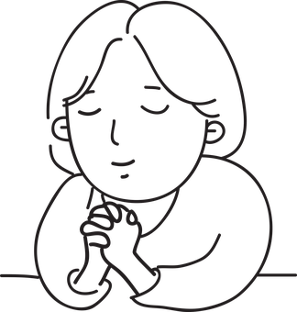
vouloir
[to want (to) |wanting (to)]
veut
[wants (to) | is wanting (to)]
Notes:
Timing: 3 minutes for sequence of six verbs
Aim: to introduce the verb vouloir more explicitly. Vouloir is one of the 25 most frequently used verbs in French. All 25 most frequent verbs will be introduced early on using the same format. Both long form (infinitive) and short form (3rd person singular) are introduced in order to familiarise students with various forms of the same verb.
Procedure
Bring up the word vouloir on its own, say it, students repeat it, and remind them of the phonics. Draw attention to SSCs [ou] and [oi].
Try to elicit the meaning from the students. Students have had explicit teaching that the present tense in French communicates two different present tense meanings in English. This reinforces that learning. Emphasise the two meanings for the short form, reminding students that French only has one form and does not have a direct equivalent of the grammar for ‘is + ing’, the continuous form (as covered in previous weeks).
Bring up the picture, and, if using gestures, a possible gesture would be to close your eyes and cross your fingers as though making a wish.
Then bring up the English translations. Emphasise the two meanings for the infinitive.
Bring up the short form veut, say it, students repeat it. Draw attention to SSCs [eu] and SFC.
Try to elicit the meaning from the students. Emphasise the two meanings for the short form.

Slide 16
vouloir
to want (to) | wanting (to)
veut
[wants (to) | is wanting (to]
Notes:
Cycle through the long and short form again.

Slide 17
veut
[wants (to) | is wanting (to)]
Elle veut parler.
[She wants to speak.]
Notes:
Introduce the short form in a sentence.

Slide 18
vouloir
[to want (to) | wanting (to)]
Elle va vouloir parler français.
[She will want to speak French.]
Notes:
Introduce the long form in a sentence.

Slide 19
veut
[wants | is wanting]
veut
Elle parler français.
[She wants | is wanting to speak French.]
Notes:
Cycle through the short form in context again.

Slide 20
vouloir
[to want | wanting]
vouloir
Elle va parler français.
[She will want to speak French.]
Notes:
Cycle through the long form in context again.

Slide 21
Mur de mots
lire
Trouve les mots anglais !
le billet
le pont
l’église (f)
le bâtiment
visiter
dire
church
to visit, visiting
to say, saying
ticket
bridge
building
prendre
devoir
vouloir
to want (to),
wanting (to)
to take, taking
must, to have to
je prends
tu prends
je dois
tu dois
je veux
tu veux
I take, am taking
you take, are taking
I must, have to
you must, have to
I want (to)
you want (to)
il prend
elle prend
il doit
elle doit
il veut
elle veut
he takes, is taking
she takes, is taking
he must, has to
she must, has to
he wants (to)
she wants (to)
Notes:
Timing: 2 minutes
Aim: This slide practises the meaning of the new vocabulary introduced this week, as well as some revisited vocabulary. Timed spoken speed recall.
Procedure:
The activity is designed like a scratch card. On clicks, the English translations appear in a random order.
Click to select a word (the word will change colour). Ask en anglais, c’est quoi?
Click again to trigger a 5-second ‘scratch’ animation, which slowly reveals the English equivalent. Students must race against the timer and try to say the word before it is fully revealed.

Slide 22
Mur de mots
parler
Trouve les mots français !
ticket
bridge
church
building
to visit, visiting
to say, saying
le billet
le pont
l’église (f)
le bâtiment
visiter
dire
to take,
taking
must,
to have to
to want (to),
wanting (to)
prendre
devoir
vouloir
I take,
I am taking
you take, you are taking
I must,
I have to
you must, you have to
I want (to)
you want (to)
je prends
tu prends
je dois
tu dois
je veux
tu veux
he takes,
he is taking
she takes,
she is taking
he must,
he has to
she must,
she has to
he wants (to)
she wants (to)
il prend
elle prend
il doit
elle doit
il veut
elle veut
Notes:
Timing: 2 minutes
Aim: This slide practises the spoken form and meaning of the new vocabulary introduced this week, as well as some revisited vocabulary. Timed spoken speed recall. NB: this activity can be done at the beginning of lesson two, if students need a little more time to consolidate meaning.
Procedure:
The activity is designed like a scratch card. On clicks, the French translations appear in a random order.
Click to select a word (the word will change colour). Ask en français, c’est quoi?
Click again to trigger a 5-second ‘scratch’ animation, which slowly reveals the French equivalent. Students must race against the timer and try to say the word before it is fully revealed.

Slide 23
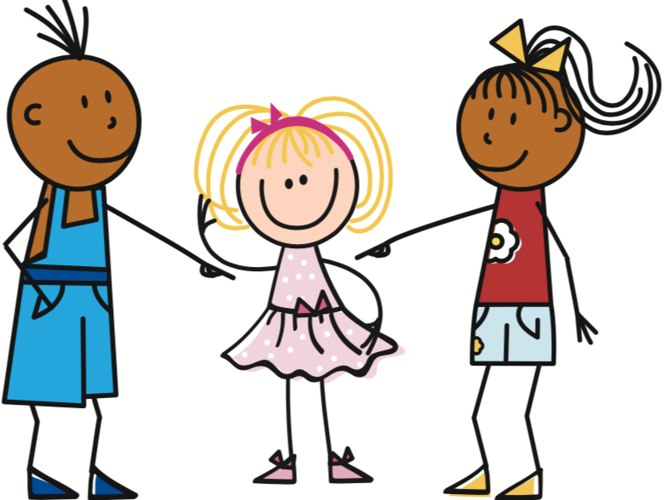
‘Devoir’ et ‘vouloir’ (je, il/elle)
grammaire
Devoir and vouloir are irregular verbs. The short forms have different endings from regular verbs.
1st person singular
3rd person singular
he
she
I
il
elle
je
Expressing something about yourself
Expressing something about
someone else
je
dois
I
must, have to
il/elle
doit
he/she
must, has to
je
veux
I
want (to)
Il/elle
veut
he/she
wants (to)
Notes:
Timing: 1 minute
Aim: to present the first and third persons singular of the verbs pouvoir and devoir, and make students aware of the fact that the singular forms sound the same in French.

Slide 24
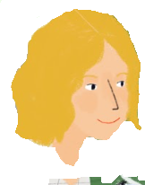
Un voyage à Nice!
Note: each sentence contains two verbs side by side, pouvoir/vouloir in short form, and the main verb in long form.
lire
La mère de Léa prépare le voyage. Elle parle avec Amir. De qui parlent-ils ?
2. Salut Amir, je / Léa veut venir à Nice!
1. Très bien! Elle / je veut rester combien de jours?
3. Je / Elle doit passer une semaine.
4. D’accord! Je / Elle veux venir à l’aéroport.
5. C’est sympa, mais,
elle / je doit venir en train.
6. D’accord, je / elle dois venir au train! Elle / Je doit voyager quelle semaine?
7. Je / elle dois demander à la professeure.
8. Je comprends. Je / Elle dois attendre, à bientôt!
Notes:
Timing: 6 minutes
Aim: Practice in connecting the short form of modal verbs with the person (I or he/she) to whom they refer.
Suggested procedure:
Students write numbers 1-8 in their books.
Students decide who is the subject of the sentence by looking at the form of the modal verb.
Whole-class correction. Ask: ‘numéro 1, quelle personne?’
Oral translation of the dialogue. Students read the full French sentence aloud, then provide an English gloss.

Slide 25
Modal verbs (devoir, vouloir)
grammaire
Pouvoir and vouloir are modal verbs. Modal verbs give more information about a second verb in a sentence.
Vouloir gives information about whether someone is willing to do something:
Il veut dormir. He wants to sleep.
Devoir gives information about whether someone has to do something:
Il doit dormir. He must / has to sleep.
In two-verb sentences like these, the modal verb appears first, in short form.
The second verb is in long form (infinitive), and comes after the modal verb.
Remember!
You have met some similar structures before:
J’aime dormir.
Je vais dormir.
Notes:
Timing: 3 minutes
Aim: To raise awareness of word order in two-verb structures with modal verbs. Picture animation visually reinforces the structure (modal first, main idea second).
The bubble acts as reminder of double verb structures which follow a similar pattern. Before revealing these with a final click, students should think about where they have met two-verb structures before (with aimer and aller + future intention).

Slide 26
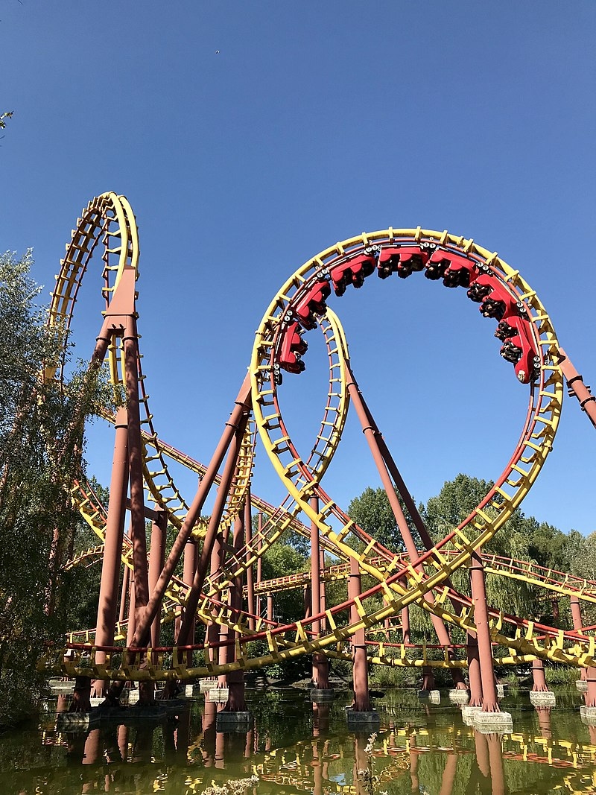
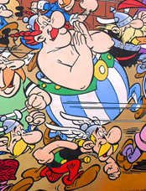
Rêve ou réalité ?
Le Parc Astérix est un parc d'attraction basé sur l'univers d'Astérix ! Il est situé à 50km de Paris.
lire
Amir rêve très souvent ! C’est la réalité ou un rêve ? Coche.
 |  | un rêve (veux) | la réalité (-)
1. | Je veux visiter Parc Astérix.
2. | Je regarde le Grand Prix de Monaco.
3. | Je veux apprendre une nouvelle langue.
4. | Je veux avoir un chien.
5. | Je suis dans le jardin.
6. | Je veux être dans ma chambre.
7. | Je comprends l’anglais.
8. | Je dis la verité!
____
____
____
____
____
____
____
____
Notes:
Timing: 8 minutes
Aim: Practice in connecting the long form of the main verb in a sentence with modality, in this case ‘wanting’ to do something.
Suggested procedure:
Check understanding of the scenario. Students have learned the noun rêve, so should be able to recognise the verb form used here.
Students write numbers 1-8 in their books.
Students decide whether Amir is talking about reality or a dream by looking at the form of the main verb.
Whole-class correction. Ask: ‘numéro 1, rêve ou réalité ?’
Oral translation of the sentences. Students read the full French sentence aloud, then provide an English gloss.
Word frequency of unknown words used in the task instructions and info bubble (1 is the most frequent word in French): attraction [>5000], basé [baser – 1712], rêver [1871], réalité [532], situé [situer - 815], univers [2112]
Source: Londsale, D., & Le Bras, Y. (2009). A Frequency Dictionary of French: Core vocabulary for learners London: Routledge.

Slide 27
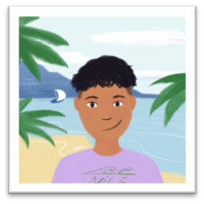
Bonjour, c’est Amir! (1/2)
parler 1/8
lire / écouter / écrire
Tu as un message ! Que dit Amir ? Écoute et prends des notes !
Partenaire A: Écris le message d’Amir en français
Partenaire B: Dis le message d’Amir en anglais
Hello, I’m Amir from Nice.
My English friend wants to learn French.
That must be easy!
I want to speak English with my friend.
I have to do some exercises in English!
Bonjour, c’est Amir de Nice !
Mon ami anglais, il veut apprendre le français.
Ça doit être facile !
Je veux parler anglais avec mon ami.
Je dois faire des exercices en anglais !
Notes:
IN-CLASS ACTIVITY (a home-learning version can be found on slides 26-27).
Timing: 12 minutes for two slides
Aim: Sight translation activity in oral (French to English) and written (English to French) modality, testing ability to comprehend and produce this week’s grammar point and new and revisited vocabulary
Suggested procedure:
Partner B faces the board, partner A faces away from the board.
The first French sentence in Amir’s message appears on a click.
Partner B reads the French sentence and translates it orally into English for Partner A.
Partner A writes a translation of the sentence they hear in French.
Repeat for the remaining four sentences.
Partner A turns around and checks their answers against the full message now displayed on the board.
A suggested English translation is revealed on a click.
Students swap roles and repeat the task with the message on the next slide.

Slide 28
Bonjour, c’est Amir! (2/2)
parler 1/8
lire / écouter / écrire
Tu as un message ! Que dit Amir ? Écoute et prends des notes !
Partenaire B: Écris le message d’Amir en français (1/1)
Partenaire A: Dis le message d’Amir en anglais (1/1)
1. Why does Léa want to visit Nice?
2. She has to go to the beach!
3. Does Sophie want to come as well?
4. I want to travel too!
5. I have to take the train.
1. Pourquoi Léa veut visiter Nice?
2. Elle doit aller à la plage!
3. Sophie, elle veut venir aussi?
4. Je veux voyager aussi!
5. Je dois prendre le train.
Notes:
As previous

Slide 29
Bonjour, c’est Amir! (1/2)
parler 1/8
parler / écrire
Tu as un message ! Que dit Amir ? Écoute et prends des notes !
Dis les phrases en français.
Clique pour vérifier.
Hello, I’m Amir from Nice.
My English friend wants to learn French.
That must be easy!
I want to speak English with my friend.
I have to do some exercises in English!
Bonjour, c’est Amir de Nice !
Mon ami anglais, il veut apprendre le français.
Ça doit être facile !
Je veux parler anglais avec mon ami.
Je dois faire des exercices en anglais !
Notes:
HOME-LEARNING ACTIVITY (an in-class version can be found on slides 24-25).
Timing: 12 minutes for two slides
Aim: Sight translation activity in oral and written (English to French) modality, testing ability to comprehend and produce this week’s grammar point and new and revisited vocabulary
Suggested procedure:
Say the five sentences in French.
Written transcriptions of each sentence appear on clicks.
Click the ‘play’ button to hear a recording of the full text and check your pronunciation.

Slide 30
Bonjour, c’est Amir! (2/2)
parler 1/8
parler / écrire
Tu as un message ! Que dit Amir ? Écoute et prends des notes !
Dis les phrases en français.
Clique pour vérifier.
1. Why does Léa want to visit Nice?
2. She has to go to the beach!
3. Does Sophie want to come as well?
4. I want to travel too!
5. I have to take the train.
1. Pourquoi Léa veut visiter Nice?
2. Elle doit aller à la plage!
3. Sophie, elle veut venir aussi?
4. Je veux voyager aussi!
5. Je dois prendre le train.
Notes:
As previous

Slide 31
Saying what you want and have to do
modal verbs with dependent infinitives in questions
devoir, vouloir (tu, il/elle)
prépositions en, dans, pour, à [revisited]
SSC [-tion] [revisited]
Y7 French
Term 3.2 - Week 5 – Lesson 68
Adeline Charlton / Natalie Finlayson
Artwork by: Chloé Motard
Date updated: 09/07/21
Notes:
Learning outcomes (lesson 1):
Introducing modal verbs devoir and vouloir (tu vs il/elle)
Consolidation of SSC [-tion]
Word frequency (1 is the most frequent word in French):
3.2.5 (introduce) devoir [39], dois [39], doit [39], veut [57], veux [57], vouloir [57], visiter [1378], billet [1916]
3.1.6 (revisit) belle [393], bonne [94], haut [264], nouveau [52], nouvelle [52], vieille [671], vieux [671], bâtiment [1952], église [1782], jardin [2284], pont
3.1.1 (revisit) apprendre [327], comprendre [95], dire [37], dis [37], dit [37], prend [43], prendre [43], prends [43], erreur [612], vérité [907], facile [822]
Source: Londsale, D., & Le Bras, Y. (2009). A Frequency Dictionary of French: Core vocabulary for learners London: Routledge.

Slide 32
Tennis phonétique !
parler 1/8
parler
Dis le mot en anglais, après dis le mot en français.
9
éducation
5
fiction
1
réaction
8
introduction
6
portion
3
solution
2
nation
10
intention
4
correction
7
expédition
Notes:
Timing: 5 minutes
Aim: To raise awareness of the difference in pronunciation between English and French cognate words ending in SSC [-tion] (English: [sh] + schwa + > oral vowel + [n] / nasal vowel + [n] vs. French: [s-y]+ [o] + [nasal vowel])
Procedure:
1. Students work in pairs and take turns to pronounce pairs of works.
2. Click to reveal a French word which lands on the English side of the tennis court. Student 1 says the English translation.
3. On a click, the word is ‘passed’ to the French side of the court. Student 1 says the French translation.
4. Check pronunciation by clicking on the loudspeaker icon beside the tennis ball.
5. Click to release a new word for Student 2.
Transcript and word frequency (1 is the most frequent word in French):
réaction [947]
nation [576]
solution [608]
correction [3005]
fiction [2612]
portion [3806]
expédition [3762]
introduction [2917]
éducation [995]
intention [782]
Source: Londsale, D., & Le Bras, Y. (2009). A Frequency Dictionary of French: Core vocabulary for learners London: Routledge.

Slide 33
Mur de mots
écrire
Trouve les mots français !
ticket
bridge
church
building
to visit, visiting
to say, saying
le billet
le pont
l’église (f)
le bâtiment
visiter
dire
to take,
taking
must,
to have to
to want (to),
wanting (to)
prendre
devoir
vouloir
I take,
I am taking
you take, you are taking
I must,
I have to
you must, you have to
I want (to)
you want (to)
je prends
tu prends
je dois
tu dois
je veux
tu veux
he takes,
he is taking
she takes,
she is taking
he must,
he has to
she must,
she has to
he wants (to)
she wants (to)
il prend
elle prend
il doit
elle doit
il veut
elle veut
Notes:
Timing: 4 minutes
Aim: This slide practises the written form and meaning of the new vocabulary introduced this week, as well as some revisited vocabulary. Timed written recall.
Procedure:
The activity is designed like a scratch card. On clicks, the French translation appears following the horizontal (left to right) order of the display. The words are sorted by word category, i.e. nouns, infinitive verbs, prendre (long form, short forms), devoir (long form, short forms), vouloir (long form, short forms).
Students guess the meaning of mur [1335], used in the activity title.
Click to select a word (the word will change colour). Ask en français, c’est quoi?
Click again to trigger a 10-second ‘scratch’ animation, which slowly reveals the French equivalent. Students must race against the timer, and try to write the word before it is fully revealed.

Slide 34
Directions pour aller chez Amir
parler 1/8
écrire
Derrière une enveloppe, la mère de Léa écrit les directions pour arriver chez Amir. Le message rapide est incomplet. Écris les mots. Attention aux adjectifs irréguliers au féminin !
Elle doit apprendre à voyager dans Nice. (have to, learn)
C’est facile . (easy)
Elle veut aller chez Amir? (want to, go) C’est une bonne (good) idée!
Après le train, elle arrive devant un haut bâtiment . (tall building)
C’est le vieux cinéma. (old)
Elle prend (take)la rue entre la vieille église (old church) et le beau pont . (beautiful bridge)
Amir habite derrière la nouvelle (new) poste, dans une belle (beautiful) maison avec un jardin (garden).
Léa fait une erreur (mistake)?
Elle doit demander (have to, ask) au nouveau (new) collège…
… ou elle doit parler avec Amir au téléphone. (must, speak)
____
__________
_____
____
____
_____
___
________
_____
______
_____
______
____
____
________
____
_____
_____
___
__________
________
___
____
Notes:
Timing: 8 minutes
Aim: A combined writing task consolidating this week’s grammar (modal verb in short form + infinitive) with recall of this weeks’s revisited vocabulary.
Procedure:
Recap the short form of modal verbs devoir and vouloir, and the placement of these before an infinitive.
Where the missing word is an adjective, remind students to check the gender of the noun before deciding which form to use.
Students write numbers 1-10 in their books and write the missing words.
Answers revealed on clicks.
Oral translation of completed sentences to check overall comprehension.
Word frequency or near-cognates used in the text (1 is the most frequent word in French):
enveloppe [3125], direction [582], incomplet [complet - 965], téléphone [1366]

Slide 35
‘Devoir’ et ‘vouloir’ (tu, il/elle)
grammaire
Devoir and vouloir are irregular verbs. The short forms have different endings from regular verbs.
2nd person singular
3rd person singular
you
he
she
tu
il
elle
Expressing something about someone else present/involved
Expressing something about
someone else not present/not involved
tu
dois
you
must, have to
il/elle
doit
he/she
must, has to
tu
veux
you
want (to)
Il/elle
veut
he/she
wants (to)
Notes:
Timing: 1 minute
Aim: to present the second and third persons singular of the verbs pouvoir and devoir, and make students aware of the fact that the singular forms sound the same in French.

Slide 36
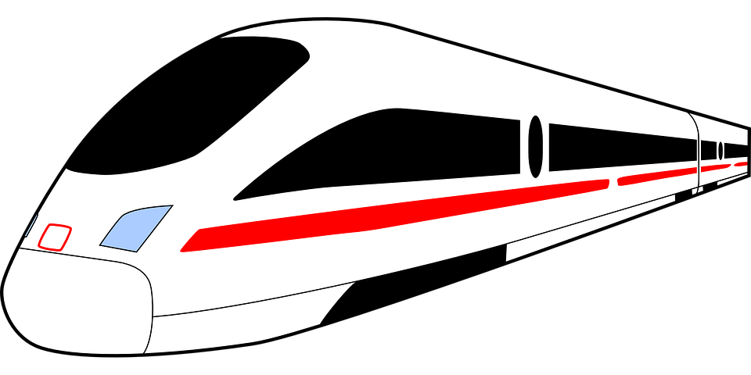
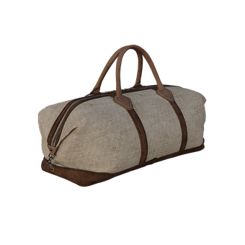
Règles et informations
Attention!
Which word do you need to add to the English questions?
parler 1/8
lire
Tu, ou il / elle?
Écris en anglais.
Tu veux prendre un train rapide ?
Tu dois arriver tôt.
Tu veux prendre un animal ?
Il doit être calme.
Il veut manger ?
Tu dois faire attention.
Il doit demander ton billet.
Tu dois montrer ton billet.
Elle veut regarder un film ?
Tu dois demander le code WIFI.
Do you want to take a fast train?
You have to arrive early.
Do you want to take an animal?
It must be quiet.
Does it want to eat?
You have to be careful.
He has to ask for your ticket.
You have to show your ticket.
Does she want to watch a film?
You have to ask for the wifi code.
Notes:
Timing: 8 minutes
Aim: Practice in connecting the short form of modal verbs with the person (you or he/she) to whom they refer.
Suggested procedure:
Check students understand the scenario. They have not met règle with its second meaning ‘rule’ but should be able to work out the meaning from context, and from knowledge of the first meaning ‘ruler’.
Students write numbers 1-10 in their books.
Students decide who is the subject of the sentence by looking at the form of the modal verb.
Ask ‘C’est il/elle ou tu’?
Answers revealed on clicks.
On a click, the task instruction Écris en anglaise appears.
Students translate the sentences into English, paying close attention to the translation of intonation questions (with do/does in English).
Possible extension: students write a set of class rules.
Word frequency of cognates used in the text (1 is the most frequent word in French):
code [1228], information [317]
Source: Londsale, D., & Le Bras, Y. (2009). A Frequency Dictionary of French: Core vocabulary for learners London: Routledge.

Slide 37
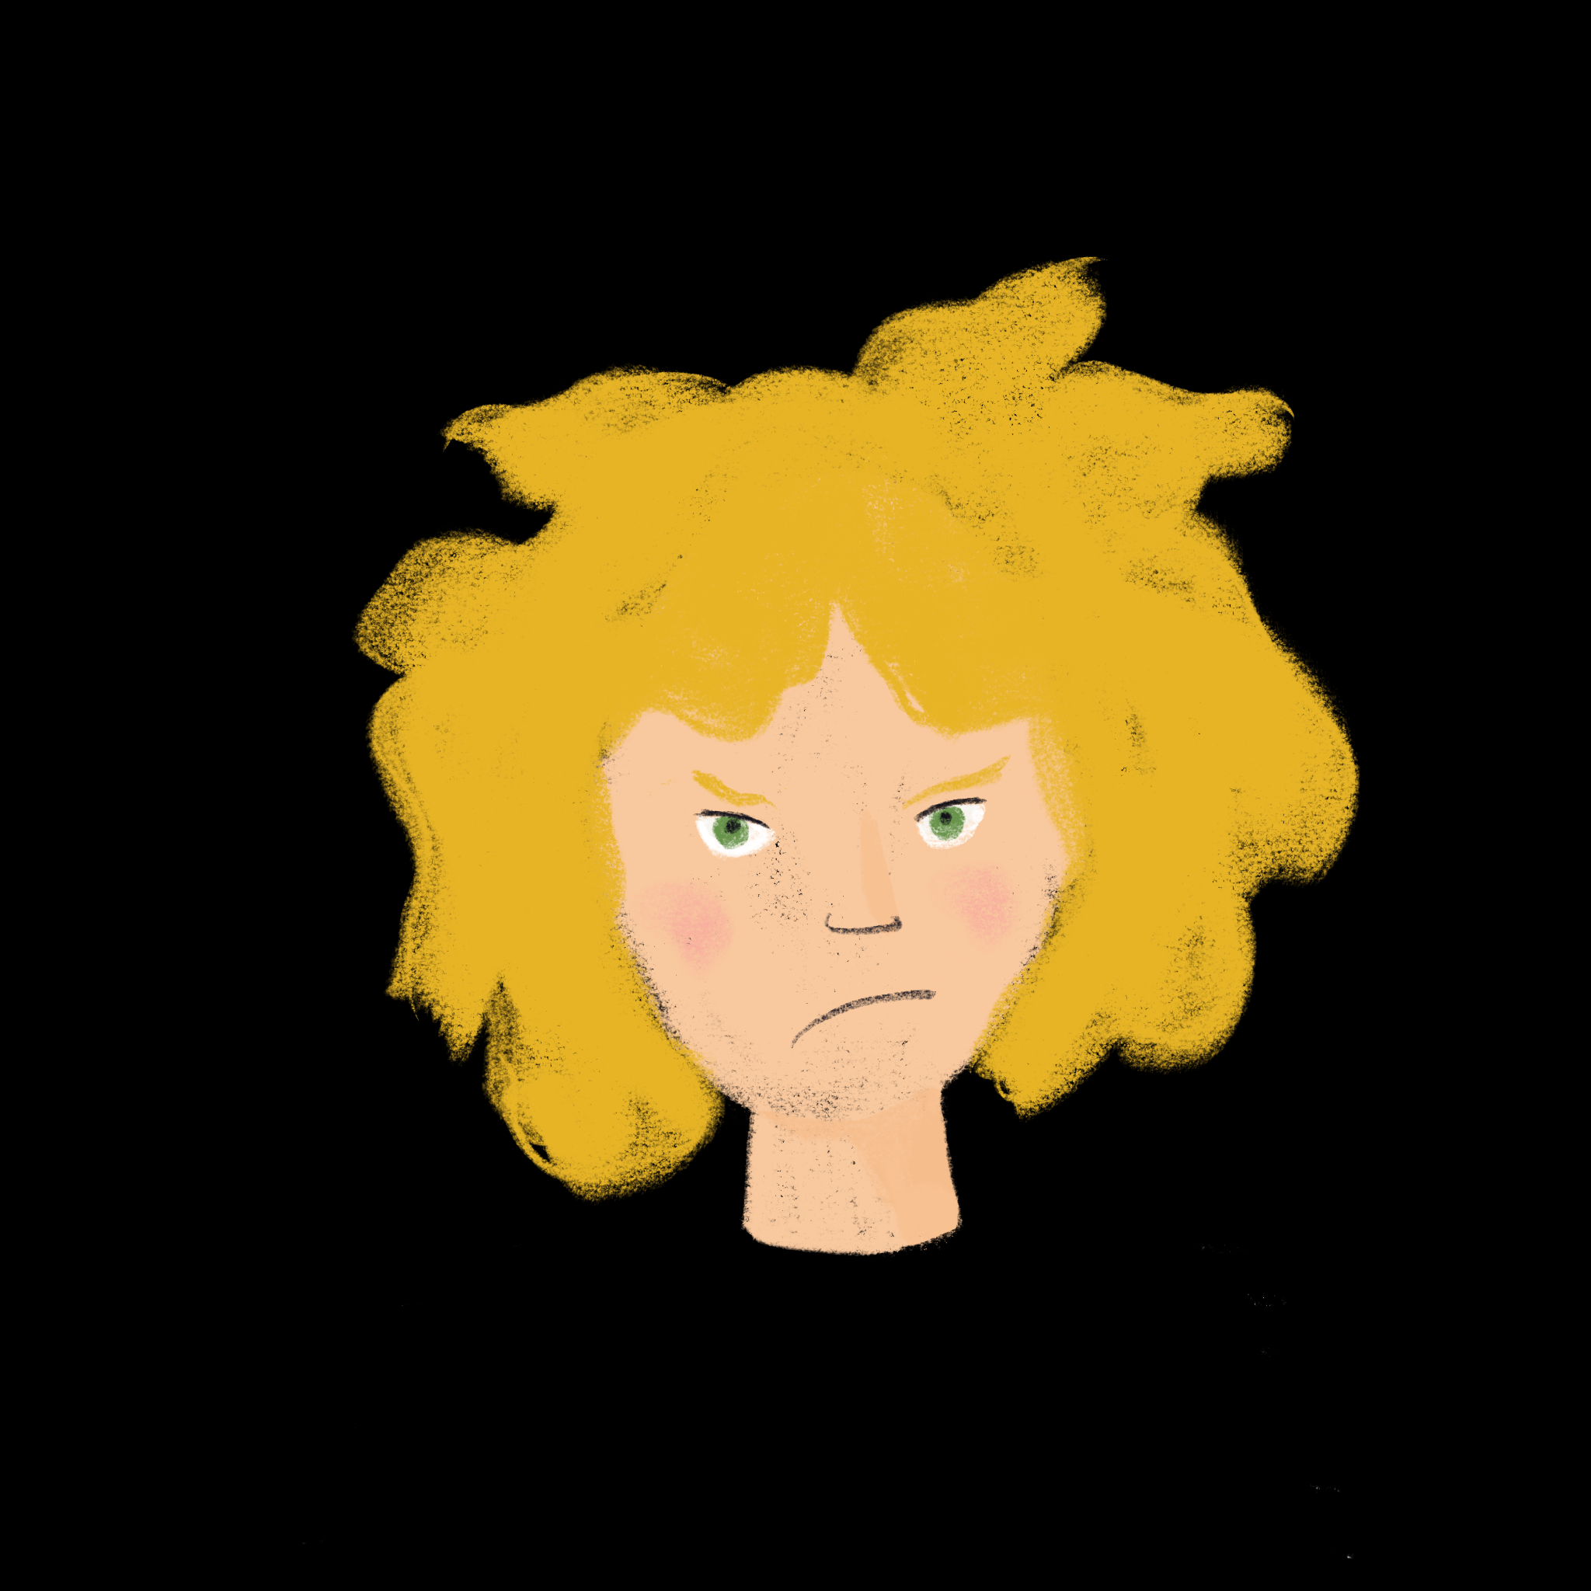
La semaine de vacances
parler 1/8
écouter
Léa et Abdel parlent de la semaine de vacances.
Elle veut faire quoi ? Il doit faire quoi ? Écoute, coche, et écris les activités.
 | activity | wants to (vouloir) | has to (devoir)
 | go to the beach
 | do homework
 | take a plane
 | go food shopping
 | go to the shops
 | do a Segway tour
 | prepare the rooms
 | watch a film on the train
1
2
3
4
5
6
7
8
Notes:
Timing: 8 minutes
Aim: Listening comprehension to distinguish between wanting to and having to do things.
Suggested procedure:
Students sketch the grid in their books.
Students listen to the audio and decide whether the individuals want or have to do certain things. Remind students that it is the modal verb directly before the main verb that gives them this information.
Student note down the key words relating to the activity.
Answers revealed on clicks.
Transcript:
1. Je veux aller à la plage.
2. Je veux faire les devoirs.
3. Tu veux prendre l’avion.
4. Je dois faire des courses.
5. Je veux faire les magasins.
6. Je dois faire un tour en Segway.
7. Je dois préparer les chambres.
8. Tu veux regarder un film dans le train.
Word frequency of cognates used (1 is the most frequent word in French):
segway [>5000]
Source: Londsale, D., & Le Bras, Y. (2009). A Frequency Dictionary of French: Core vocabulary for learners London: Routledge.

Slide 38
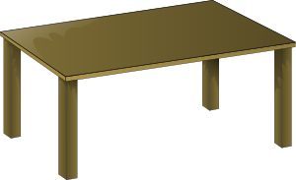
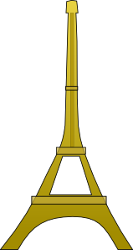
Les prépositions
grammaire
Prepositions connect nouns and pronouns with other words in a sentence:
Le chien (noun 1) est sur (preposition) la table (noun 2).
Prepositions can be tricky! They don’t always have the same meanings in English.
Examples of French prepositions which can be confusing are:
en
1. with transport (how) en avion
(by plane)
2. with countries (f) en France
(in/to France)
pour
1. with meaning ‘for’
un cadeau pour Léa
(a present for Léa)
2. transport (where) le bus pour Nantes
(the bus to Nantes)
à
1. with meaning ‘at’
à la maison
(at home)
2. with cities/places à Paris
(in/to Paris)
dans
1. with meaning ’in’ or ‘inside’ dans le bus
(in the bus)
This is an unsual use of pour. Think of it as ‘the bus for Nantes’
Notes:
Timing: 4 minutes
Aim: to revise uses of prepositions en, pour, dans and à encountered so far, in preparation for the production activities that follow.
Procedure:
Click to bring up the definition of a ‘preposition’.
Students give examples of prepositions they met so far.
Click to reveal the target prepositions for today’s lesson.
Students give examples of contexts in which they have encountered these prepositions before.
Click for examples.
Note: The anomalous use of pour (with destinations of transport) has not been encountered before, and is flagged in a bubble which appears on the final click.

Slide 39
Léa fait un voyage
lire / parler
Quelle est la préposition correcte: en, dans, pour ou à ?
Léa va à Nice.
Elle voyage en train.
Elle prend le train pour Nice.
Elle dort dans le train.
Amir arrive en ville.
Il a une surprise pour Léa !
Ils vont à la plage en Segway.
Le train part en Allemagne.
Notes:
Timing: 5 minutes
Aim of task: to practise use of prepositions en, pour, dans and à in restricted contexts in advance of the free production activity on the next slide.
Procedure:
Students write numbers 1-8 in their books and write the correct preposition.
Point at number 1 and ask: ‘C’est quoi, la phrase complète?’
Students read the first sentence out loud to get a feel for saying the prepositions in context (at more advanced levels, step one may be skipped).
Answer revealed on a click. Ask students to explain why this preposition is needed, with reference to the previous slide.
Students read the correct sentence out loud several more times, at increasing speeds.
Repeat steps 2-5 for the remaining examples.

Slide 40
Les idées de vacances
parler / écrire
Tu veux faire quoi ? Que dois-tu faire ? Écris cinq phrases avec vouloir et devoir.
Example (je)
Paris
1. Je dois voyager en avion à Paris.
2. Je veux visiter les vieilles églises.
devoir
Mes phrases
1. Je … 2. 3.
4. 5.
vouloir
Parle avec un(e) partenaire. Que veut-il/elle fait ? Il/elle doit faire quoi ? Écris cinq phrases.
Example (il/elle)
1. Il veut aller à la plage.
2. Elle doit faire les devoirs dans le train.
vouloir
Mon/ma partenaire
1. Elle … 2. 3.
4. 5.
devoir
Notes:
NB an alternative spoken activity for home-learning can be found on slide 36.
Timing: 10 minutes
Aim: Semi-structured writing exercise to practise independent production of structures with modal verbs vouloir and devoir and prepositions.
Procedure:
1. Students use the pictures on the storyboard to practise writing example sentences with modal verbs in the first person.
2. Students then write five additional sentences of their own using devoir and vouloir to say what they want and have to do during the holidays.
3. Click to bring up the second task instruction.
4. Students use the pictures on the storyboard to practise writing example sentences with modal verbs in the third person.
5. Students exchange their je sentences orally with a partner, taking notes on what their partner has said.
6. Students then write five sentences in the third person to convey what their partner wants and has to do.

Slide 41
Billet de train
écouter / parler
Dans le train, un homme parle avec le contrôleur. Le contrôleur ne comprend pas.
Dis les phrases en français et en anglais.
2- I don’t understand.
3- I don’t have my ticket.
2- Je ne comprends pas.
5- Yes, that’s true.
9- I want to take the plane!
7- It’s difficult …
3- Je n’ai pas mon billet.
5- Oui, c’est vrai.
1- Tu dois montrer ton billet.
9- Je veux prendre l’avion!
7- C’est difficile ….
10- Tu dois!
6- Tu veux un nouveau billet?
6- Do you want a new ticket?
4- Tu dois faire attention !
8- Tu dois sortir!
4- You must be careful.
1- You must show your ticket.
8- You must get out!
10- You must!
Notes:
NB this is an alternative spoken activity for home-learning, or an optional extension.
Timing: 8 minutes
Aim: Simple interpreting task to practise the vocabulary and grammar points introduced this week in a real-life scenario.
Procedure:
1. Click to bring up the conductor’s first line.
2. Translate it orally into English.
3. Click to check your answer.
4. Click to bring up the traveler's first line.
5. Translate it orally into French.
6. Click to check your answer.
7. Repeat steps 1-6 for the remainder of the dialogue.
Word frequency of cognates used (1 is the most frequent word in French):
contrôleur [4423]

Slide 42
Gaming Grammar
Gaming Grammar
Relevant mini game(s):
Verbs (present): 1st person singular/plural (Verb agreement (present))
Verbs (present): 2nd person singular/plural (Verb agreement (present))
Verbs (present): 3rd person singular/plural (Verb agreement (present))
Preposition (to the): Gender (Prepositions)
Notes:
This slide links to Gaming Grammar login screen. The appropriate mission can then be selected from the menu page.
Students will progress through the game at their own rate; teachers should use the teacher interface to check progress. This will help to inform future lesson planning.

Slide 43
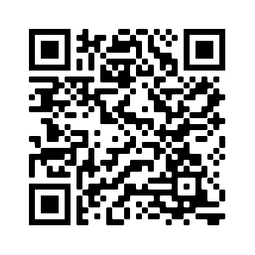
Devoirs
Vocabulary Learning Homework (Term 3.2, Week 6)
Audio file
Audio file QR code:
Student worksheet
Quizlet link
In addition, revisit: Term 3.2 Week 3
Term 3.1 Week 2

