Slide 1
Spanish SSC (symbol-sound correspondences)
Source Words
Date updated: 21/11/19
Notes:
All pictures selected are available under a Creative Common license, no attribution required. This is the full set of SSC (Symbol-sound correspondence) SOURCE words. This PPT is to be used in combination with the cluster words presentation. There is a suggested teaching order document, and there are many supporting resources for the teaching and consolidation of each individual SSC, also on the portal.
NB: Each SFC is presented twice, on two slides. The first is accompanied by a visual image, the second without the image. Teachers can elicit meanings or gestures to reinforce the word-meaning connection. Seeing just the SFC and source word on the slide also focuses attention closely on the symbol-sound relationship.

Slide 2
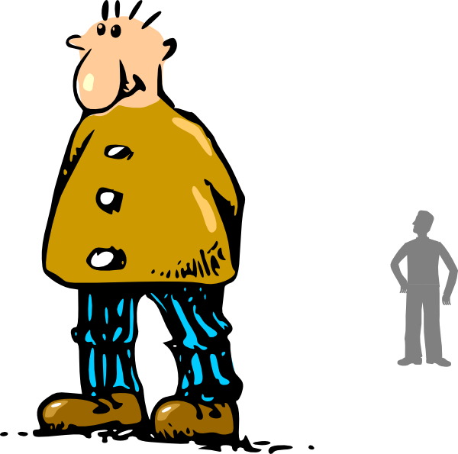
a
alto
Nick Avery
Notes:
Introduce and elicit the pronunciation of the individual SSC ‘a’ and then present and practise the pronunciation of the source word ‘alto’.
A possible gesture for this source word would be to stretch up one hand high above your head, fingers bent at right angle to show act of ‘measuring’
Say and repeat the word. Ensure pupils know the meaning (use usual routine for this – e.g. ¿Qué significa’? ‘tall’, sí, es correcto.

Slide 3
a
alto
Nick Avery
Notes:
Repeat the ‘a’ sound and elicit the source word.

Slide 4
e
elefante
Nick Avery
Notes:
Introduce and elicit the pronunciation of the individual SSC ‘e’ and then present and practise the pronunciation of the source word ‘elefante’.
A possible gesture for this source word would be to extend your arm and swing back your hand, as if it were the end of an elephant trunk
Say and repeat the word. Ensure pupils know the meaning (use usual routine for this – e.g. ¿Qué significa’? ‘tall’, sí, es correcto. However, with cognates and/or such concrete nouns that there will be no question as to meaning, there is no need to ask, for the sake of asking.

Slide 5
e
elefante
Nick Avery
Notes:
Repeat the ‘e’ sound and elicit the source word.

Slide 6
i
idea
Nick Avery
Notes:
Introduce and elicit the pronunciation of the individual SSC ‘i’ and then present and practise the pronunciation of the source word ‘idea’.
A possible gesture for this source word would be to
Bring a single finger to the temple of your head
Quickly move the finger horizontally away from the head
Use facial expressions to convey the positive surprise of a ‘lightbulb’ moment

Slide 7
i
idea
Nick Avery
Notes:
Repeat the sound and elicit the source word.

Slide 8
o
yo
Nick Avery
Notes:
Introduce and elicit the pronunciation of the individual SSC ‘O’ and then present and practise the pronunciation of the source word ‘yo’.
A possible gesture for this source word would be to use the index fingers on both hands to point towards yourself

Slide 9
o
yo
Nick Avery
Notes:
Repeat the sound and elicit the source word.

Slide 10
u
universo
Nick Avery
Notes:
Introduce and elicit the pronunciation of the individual SSC ‘U’ and then present and practise the pronunciation of the source word ‘universo’.
A possible gesture for this source word would be to extend your arms over your head and then out to the sides in a single motion

Slide 11
u
universo
Nick Avery
Notes:
Repeat the sound and elicit the source word.

Slide 12
ll
llamar
Nick Avery
Notes:
Introduce and elicit the pronunciation of the individual SSC ‘LL’ and then present and practise the pronunciation of the source word ‘llamar’.
A possible gesture for this source word would be to bring an imaginary phone to your ear

Slide 13
ll
llamar
Nick Avery
Notes:
Repeat the sound and elicit the source word.

Slide 14
l
libro
Nick Avery
Notes:
Introduce and elicit the pronunciation of the individual SSC ‘L’ and then present and practise the pronunciation of the source word ‘libro’.
A possible gesture for this source word would be to open an imaginary book

Slide 15
l
libro
Nick Avery
Notes:
Repeat the sound and elicit the source word.

Slide 16
ca
casa
Nick Avery
Notes:
Introduce and elicit the pronunciation of the individual SSC ‘ca’ and then present and practise the pronunciation of the source word ‘casa’.
A possible gesture for this source word would be to bring both your hands together in the shape of a roof

Slide 17
ca
casa
Nick Avery
Notes:
Repeat the sound and elicit the source word.

Slide 18
co
comer
Nick Avery
Notes:
Introduce and elicit the pronunciation of the individual SSC ‘co’ and then present and practise the pronunciation of the source word ‘comer’.
A possible gesture for this source word would be to pretend to chew

Slide 19
co
comer
Nick Avery
Notes:
Repeat the sound and elicit the source word.

Slide 20
cu
cuerpo
Nick Avery
Notes:
Introduce and elicit the pronunciation of the individual SSC ‘cu’ and then present and practise the pronunciation of the source word ‘cuerpo’.
A possible gesture for this source word would be to point at both sides of your body, starting with the upper chest and moving downwards to the legs

Slide 21
cu
cuerpo
Nick Avery
Notes:
Repeat the sound and elicit the source word.

Slide 22
cue
cue
escuela
Notes:
Introduce and elicit the pronunciation of the individual SSC ‘z’ and then the source word again (with gesture, if using). Then present and elicit the pronunciation of the five cluster words.
The cluster words have been chosen for their high-frequency, from a range of word classes, with the SSC (where possible) positioned within a variety of syllables within the words (e.g. initial, 2nd, final etc.). Additionally, we have tried to use words that build cumulatively on previously taught SSCs (see the Phonics Teaching Sequence document) and do not include new SSCs. Where new SSCs are used, they are often consonants which have a similar symbol-sound correspondence in English.

Slide 23
cue
cue
escuela
Notes:
Introduce and elicit the pronunciation of the individual SSC ‘z’ and then the source word again (with gesture, if using). Then present and elicit the pronunciation of the five cluster words.
The cluster words have been chosen for their high-frequency, from a range of word classes, with the SSC (where possible) positioned within a variety of syllables within the words (e.g. initial, 2nd, final etc.). Additionally, we have tried to use words that build cumulatively on previously taught SSCs (see the Phonics Teaching Sequence document) and do not include new SSCs. Where new SSCs are used, they are often consonants which have a similar symbol-sound correspondence in English.

Slide 24
cue
cua
cuatro
Notes:
Introduce and elicit the pronunciation of the individual SSC ‘z’ and then the source word again (with gesture, if using). Then present and elicit the pronunciation of the five cluster words.
The cluster words have been chosen for their high-frequency, from a range of word classes, with the SSC (where possible) positioned within a variety of syllables within the words (e.g. initial, 2nd, final etc.). Additionally, we have tried to use words that build cumulatively on previously taught SSCs (see the Phonics Teaching Sequence document) and do not include new SSCs. Where new SSCs are used, they are often consonants which have a similar symbol-sound correspondence in English.

Slide 25
cue
cua
cuatro
Notes:
Introduce and elicit the pronunciation of the individual SSC ‘z’ and then the source word again (with gesture, if using). Then present and elicit the pronunciation of the five cluster words.
The cluster words have been chosen for their high-frequency, from a range of word classes, with the SSC (where possible) positioned within a variety of syllables within the words (e.g. initial, 2nd, final etc.). Additionally, we have tried to use words that build cumulatively on previously taught SSCs (see the Phonics Teaching Sequence document) and do not include new SSCs. Where new SSCs are used, they are often consonants which have a similar symbol-sound correspondence in English.

Slide 26
cue
cui
to look after;
take care of
cuidar
Notes:
Introduce and elicit the pronunciation of the individual SSC ‘z’ and then the source word again (with gesture, if using). Then present and elicit the pronunciation of the five cluster words.
The cluster words have been chosen for their high-frequency, from a range of word classes, with the SSC (where possible) positioned within a variety of syllables within the words (e.g. initial, 2nd, final etc.). Additionally, we have tried to use words that build cumulatively on previously taught SSCs (see the Phonics Teaching Sequence document) and do not include new SSCs. Where new SSCs are used, they are often consonants which have a similar symbol-sound correspondence in English.

Slide 27
cue
cui
cuidar
Notes:
Introduce and elicit the pronunciation of the individual SSC ‘z’ and then the source word again (with gesture, if using). Then present and elicit the pronunciation of the five cluster words.
The cluster words have been chosen for their high-frequency, from a range of word classes, with the SSC (where possible) positioned within a variety of syllables within the words (e.g. initial, 2nd, final etc.). Additionally, we have tried to use words that build cumulatively on previously taught SSCs (see the Phonics Teaching Sequence document) and do not include new SSCs. Where new SSCs are used, they are often consonants which have a similar symbol-sound correspondence in English.

Slide 28
ce
MADRID 1KM
cerca
Nick Avery
Notes:
Introduce and elicit the pronunciation of the individual SSC ‘ce’ and then present and practise the pronunciation of the source word ‘cerca’.
A possible gesture for this source word would be to bring two open palms close together (but not touching)

Slide 29
ce
cerca
Nick Avery
Notes:
Repeat the sound and elicit the source word.

Slide 30
ci
cierto
Nick Avery
Notes:
Introduce and elicit the pronunciation of the individual SSC ‘ci’ and then present and practise the pronunciation of the source word ‘cierto’.
A possible gesture for this source word would be to give a ‘thumbs up’

Slide 31
ci
cierto
Nick Avery
Notes:
Repeat the sound and elicit the source word.

Slide 32
z
zona
Nick Avery
Notes:
Introduce and elicit the pronunciation of the individual SSC ‘Z’ and then present and practise the pronunciation of the source word ‘zona’.
A possible gesture for this source word would be use your hands to draw an imaginary space around you

Slide 33
z
zona
Nick Avery
Notes:
Repeat the sound and elicit the source word.

Slide 34
que
porque
Nick Avery
Notes:
Introduce and elicit the pronunciation of the individual SSC ‘que’ and then present and practise the pronunciation of the source word ‘porque’.
A possible gesture for this source word would be to rotate your index fingers in a clockwise direction, akin to miming a wheel in forward motion.
Whilst abstract, this is a gesture often used in the classroom to encourage learners to justify their opinions with reasons. NB: The English meaning ‘because’ should be clearly given to ensure secure word-meaning mapping.

Slide 35
que
porque
Nick Avery
Notes:
Repeat the sound and elicit the source word.

Slide 36
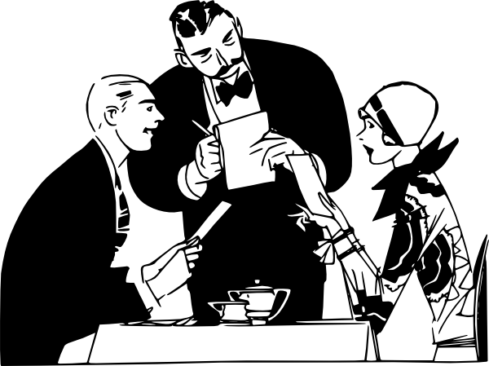
qui
quiero
Nick Avery
Notes:
Introduce and elicit the pronunciation of the individual SSC ‘qui’ and then present and practise the pronunciation of the source word ‘quiero’.
A possible gesture for this source word would be to fold hands over your heart, and then move the right hand away from the body.

Slide 37
qui
quiero
Nick Avery
Notes:
Repeat the sound and elicit the source word.

Slide 38
ga
ganar
Nick Avery
Notes:
Introduce and elicit the pronunciation of the individual SSC ‘ga’ and then present and practise the pronunciation of the source word ‘ganar’.
A possible gesture for this source word would be to clench your first, as above, raise it and give two fist pumps coinciding with the two syllables of the word, ga-nar.

Slide 39
ga
ganar
Nick Avery
Notes:
Repeat the sound and elicit the source word.

Slide 40
go
gol
Nick Avery
Notes:
Introduce and elicit the pronunciation of the individual SSC ‘go’ and then present and practise the pronunciation of the source word ‘gol’.
A possible gesture for this source word would be to pretend to kick a ball and celebrate! Alternatively, raise the right hand and form an ‘o’ shape with the fingers and thumb, when saying ‘¡gol! in a celebratory tone of voice!

Slide 41
go
gol
Nick Avery
Notes:
Repeat the sound and elicit the source word.

Slide 42
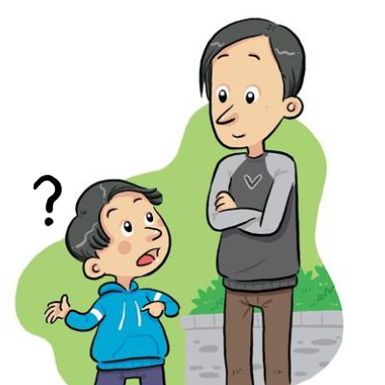
gu
preguntar
Nick Avery
Notes:
Introduce and elicit the pronunciation of the individual SSC ‘gu’ and then present and practise the pronunciation of the source word ‘preguntar’.
A possible gesture for this source word would be to raise your hand above your head (as students do to ask a question)

Slide 43
gu
preguntar
Nick Avery
Notes:
Repeat the sound and elicit the source word.

Slide 44
j
ojo
Nick Avery
Notes:
Introduce and elicit the pronunciation of the individual SSC ‘j’ and then present and practise the pronunciation of the source word ‘ojo’.
A possible gesture for this source word would be to point towards your eye

Slide 45
j
ojo
Nick Avery
Notes:
Repeat the sound and elicit the source word.

Slide 46
ge
gente
Nick Avery
Notes:
Introduce and elicit the pronunciation of the individual SSC ‘ge’ and then present and practise the pronunciation of the source word ‘gente’.
A possible gesture for this source word would be to point to all the people surrounding you in a single, semi-circular motion, palm upwards.

Slide 47
ge
gente
Nick Avery
Notes:
Repeat the sound and elicit the source word.

Slide 48
gi
imaginar
Nick Avery
Notes:
Introduce and elicit the pronunciation of the individual SSC ‘gi’ and then present and practise the pronunciation of the source word ‘imaginar’.
A possible gesture for this source word would be to start with your palm closed and touching your head. Then, gradually remove the palm away from your head and open it (as if the thought were about to disappear into the air)

Slide 49
gi
imaginar
Nick Avery
Notes:
Repeat the sound and elicit the source word.

Slide 50
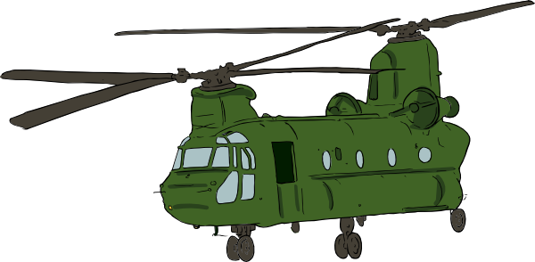
gue
guerra
Nick Avery
Notes:
Introduce and elicit the pronunciation of the individual SSC ‘gue’ and then present and practise the pronunciation of the source word ‘guerra’.
A possible gesture for this source word would be to simulate an explosion with your hand

Slide 51
gue
guerra
Nick Avery
Notes:
Repeat the sound and elicit the source word.

Slide 52
gui
guitarra
Nick Avery
Notes:
Introduce and elicit the pronunciation of the individual SSC ‘gui’ and then present and practise the pronunciation of the source word ‘guitarra’.
A possible gesture for this source word would be to pretend to play the guitar

Slide 53
gui
guitarra
Nick Avery
Notes:
Repeat the sound and elicit the source word.

Slide 54
ñ
español
Nick Avery
Notes:
Introduce and elicit the pronunciation of the individual SSC ‘ñ’ and then present and practise the pronunciation of the source word ‘español’.
A possible gesture for this source word would be to raise the right hand high above the head, and lower the left, putting middle finger and thumb together to simulate a ‘flamenco’ dance posture. Reverse the position of the hands (left hand up / right hand down) on the <ñ> syllable.

Slide 55
ñ
español
Nick Avery
Notes:
Repeat the sound and elicit the source word.

Slide 56
n
mano
Nick Avery
Notes:
Introduce and elicit the pronunciation of the individual SSC ‘n’ and then present and practise the pronunciation of the source word ‘mano’.
A possible gesture for this source word would be to open the palm of both your hands, one after the other on each syllable, ma-no.

Slide 57
n
mano
Nick Avery
Notes:
Repeat the sound and elicit the source word.

Slide 58
v
ver
Nick Avery
Notes:
Introduce and elicit the pronunciation of the individual SSC ‘V’ and then present and practise the pronunciation of the source word ‘ver’.
A possible gesture for this source word would be to pretend to look through binoculars, as in the picture above

Slide 59
v
ver
Nick Avery
Notes:
Repeat the sound and elicit the source word.

Slide 60
b
celebrar
Nick Avery
Notes:
Introduce and elicit the pronunciation of the individual SSC ‘b’ and then present and practise the pronunciation of the source word ‘celebrar’.
A possible gesture for this source word would be to put your hands above your ahead and dance/jump

Slide 61
b
celebrar
Nick Avery
Notes:
Repeat the sound and elicit the source word.

Slide 62
rr
perro
Nick Avery
Notes:
Introduce and elicit the pronunciation of the individual SSC ‘rr’ and then present and practise the pronunciation of the source word ‘perro’.
A possible gesture for this source word would be pretend to sniff around or to bark, or to hold up two hands as ‘paws’ with fingers bent over and make two, quick dipping motions on each of the two syllables pe-rro.

Slide 63
rr
perro
Nick Avery
Notes:
Repeat the sound and elicit the source word.

Slide 64
r
pero
Nick Avery
Notes:
Introduce and elicit the pronunciation of the individual SSC ‘r’ and then present and practise the pronunciation of the source word ‘pero’.
A possible gesture for this source word would be hold up your right hand, palm facing away, as if raising an objection or rejecting something. NB: Picture and gesture are abstract and pupils need to be told that ‘pero’ means ‘but’.

Slide 65
r
pero
Nick Avery
Notes:
Repeat the sound and elicit the source word.

Slide 66
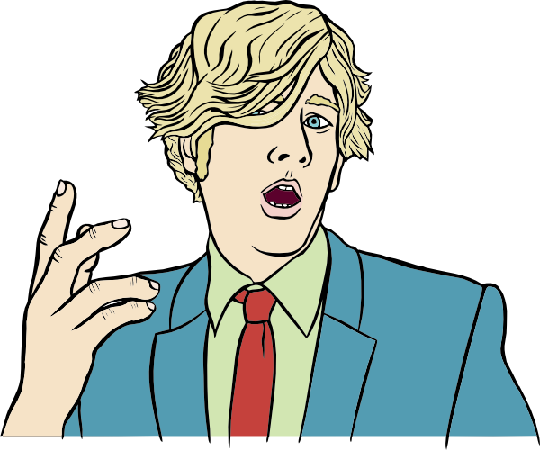
h
hablar
Nick Avery
Notes:
Introduce and elicit the pronunciation of the individual SSC ‘h’ and then present and practise the pronunciation of the source word ‘hablar’.
A possible gesture for this source word would be to open your mouth and your hand

Slide 67
h
hablar
Nick Avery
Notes:
Repeat the sound and elicit the source word.

