Slide 1
Talking about movement into, and location in, places
Prepositions in and auf + R2 (acc) + movement + R3(dat) + location
Y7 German
Term 3.1 - Week 3 - Lesson 53
Mel Yates / Stephen Owen / Rachel Hawkes
Date updated: 04/05/20
Notes:
Learning outcomes (lesson 1)
Introduction of SSC [st]
Introduction of prepositions in and auf + R2 (acc) + movement, R3(dat) + location
Frequency rankings of vocabulary introduced this week (1 is the most common word in German):
3.1.3 - in [4], auf [17] springen [1468] fallen [278] das Kino [1825] die Stadt [186] das Konzert [1721] das Geschäft [663] das Museum [1360] angenehm [1748]
die Party [3634] die Straße [355] der Markt [508]
Frequency rankings of vocabulary revisited this week (1 is the most common word in German):
2.2.4 - Rad fahren [2156/169] am Nachmittag [1426] am Abend [313] am Wochenende [764] mit wem? [13/173] heute [121] Fleisch [1624] Gemüse [3450] Eis [2818] die Tasche [1638]
2.1.3 - mag [151] mögen [151] ihn (him/it) [93] sie (her/it) [10] die Fremdsprache [1791] die Kunst [468] die Naturwissenschaft [3772] das Schulfach [208/698] die Mathematik [1827] Deutsch [105]
Additional known vocabulary or cognates to recycle:
der Boden [445] der Park [>4034] die Stadt [188] die Schule [208] das Klassenzimmer [609/619] das Café [2345] die Bibliothek [927] das Theater [725] kommen [61] stehen [87] sitzen [261] still [1405]

Slide 2
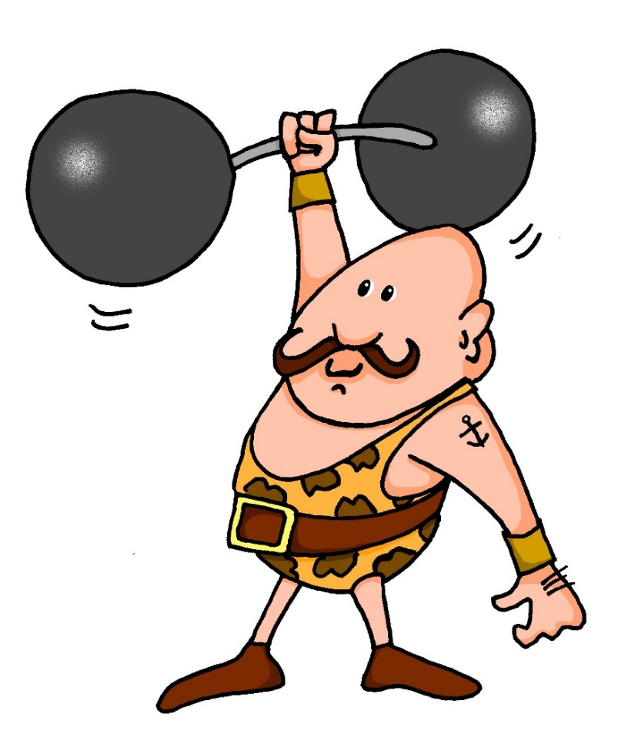
st-
stark
Notes:
Introduce and elicit the pronunciation of the individual SSC ‘st-’ and then present and practise the pronunciation of the source word ‘stark’.
A possible gesture for this would be to mime lifting dumbells by clenching your fists and raising them above your head.

Slide 3
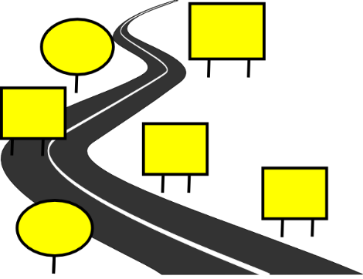
st
Straße
stehen
stark
Stadt
verstehen
bestimmt
[to understand]
[certain/special/specific]
Notes:
Introduce and elicit the pronunciation of the individual SSC ‘st’ and then the source word again (with gesture, if using). Then present and elicit the pronunciation of the five cluster words. The cluster words have been chosen for their high-frequency, from a range of word classes, with the SSC (where possible) positioned within a variety of syllables within the words (e.g. initial, 2nd, etc.) and additionally, we have tried to use words that build cumulatively on previously taught SSCs (see the Phonics Teaching Sequence document) and do not include new SSCs. Where new SSCs are used, they are often consonants which have a similar symbol-sound correspondence in English.
Word frequency rankings (1 is the most common word in German): stark [207]; Straße [355] stehen [87]; verstehen [222]; bestimmt [226]; Stadt [186]. Source: Jones, R.L. & Tschirner, E. (2006). A frequency dictionary of German: core vocabulary for learners. Routledge

Slide 4
st
Straße
stehen
stark
Stadt
verstehen
bestimmt
Notes:
Without pictures to focus on the SSC alone.

Slide 5
st
Straße
stehen
stark
Stadt
verstehen
bestimmt
Notes:
Without sound to elicit the pronunciation.

Slide 6
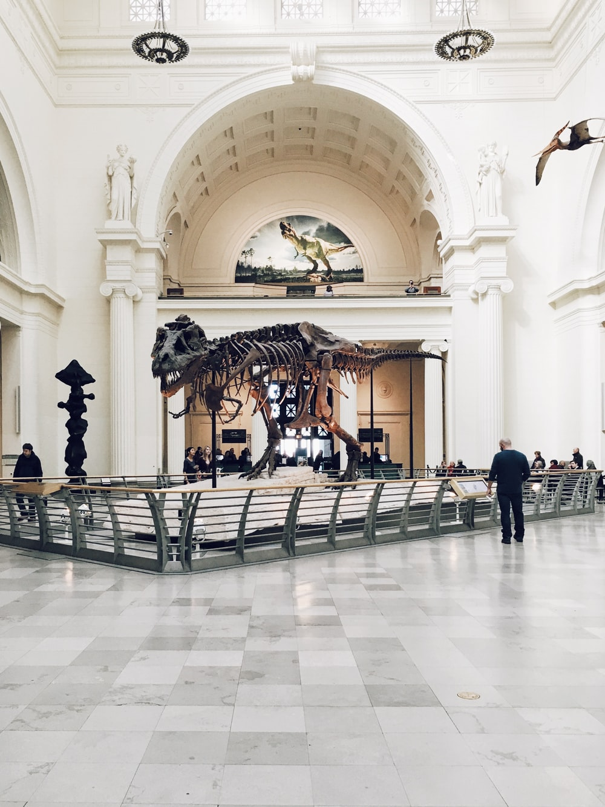
Vokabeln
lesen
d_ _ M _ _ _ _ _ !
das Museum!
Ich mag Kunst.
Notes:
Vocabulary
This vocabulary starter activity revisits the following vocabulary from this, and previous weeks. The words in bold type are revisited in this task.
Frequency rankings of vocabulary introduced this week (1 is the most common word in German):
3.1.3 - in [4], auf [17] springen [1468] fallen [278] das Kino [1825] die Stadt [186] das Konzert [1721] das Geschäft [663] das Museum [1360] angenehm [1748]
Frequency rankings of vocabulary revisited this week (1 is the most common word in German):
2.2.4 - Rad fahren [2156/169] am Nachmittag [1426] am Abend [313] am Wochenende [764] mit wem? [13/173] heute [121] Fleisch [1624] Gemüse [3450] Eis [2818] die Tasche [1638]
2.1.3 - mag [151] mögen [151] ihn (him/it) [93] sie (her/it) [10] die Fremdsprache [1791] die Kunst [468] die Naturwissenschaft [3772] das Schulfach [208/698] die Mathematik [1827] Deutsch [105]
Additional known vocabulary or cognates to recycle:
der Boden [445] der Park [>4034] die Stadt [188] die Schule [208] das Klassenzimmer [609/619] das Café [2345] die Bibliothek [927] das Theater [725] der Markt [508] kommen [61] stehen [87] sitzen [261] still [1405]

Slide 7
Vokabeln
lesen
d _ _ K _ _ _!
das Kino!
Ich mag Naturwissenschaften.
Wir essen dort Eis.

Slide 8
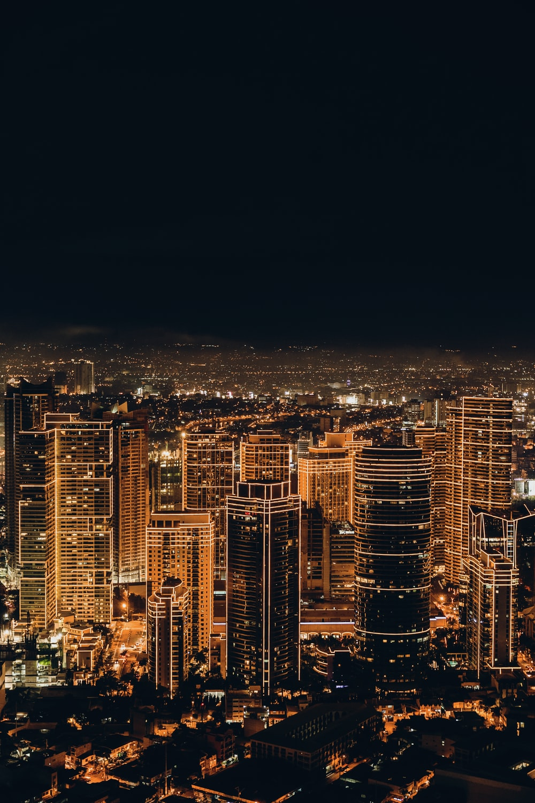
Vokabeln
lesen
d_ _ S _ _ _ _ !
die Stadt!
Wir fahren am
Wochenende dort Rad.

Slide 9
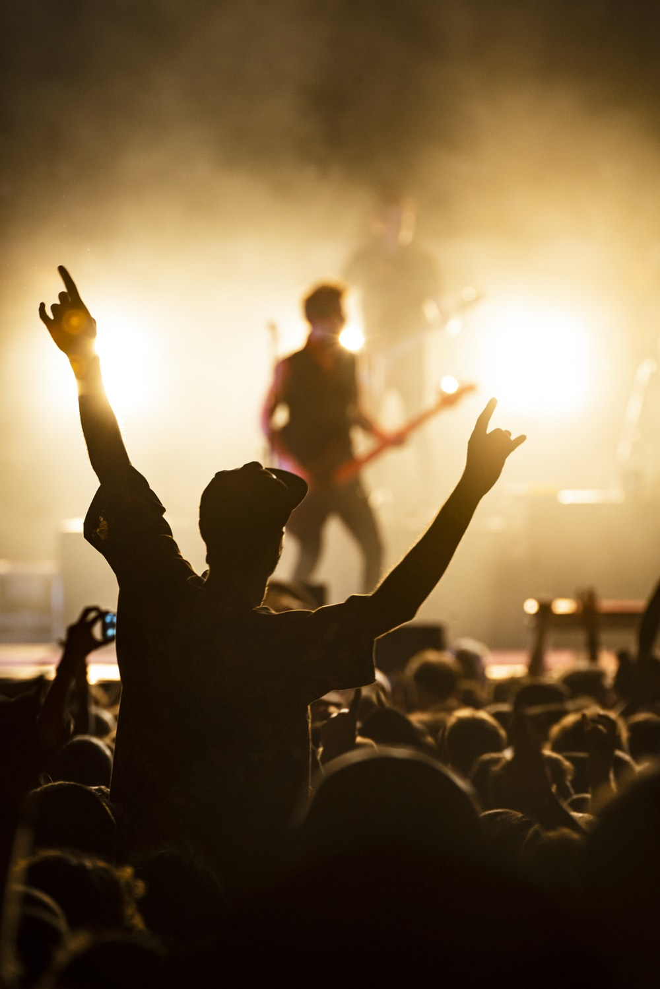
Vokabeln
lesen
das Konzert!
d _ _ K _ _ _ _ _ _ _ !
Ich mag Naturwissenschaften.
Ich spiele am Abend Klarinette.

Slide 10
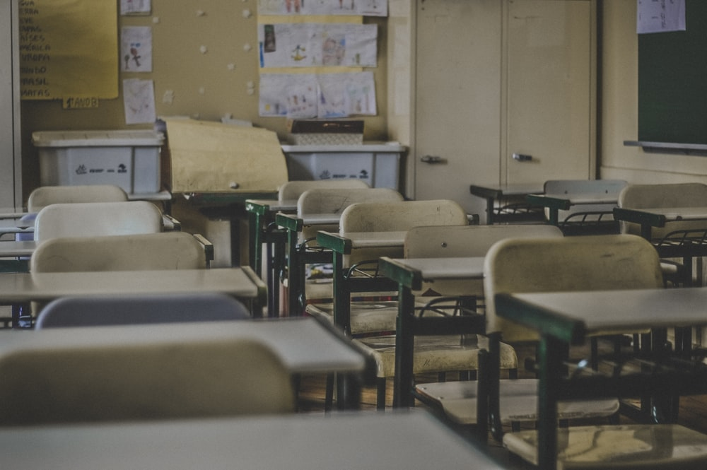
Vokabeln
lesen
d_ _ S_ _ _ _ _ !
die Schule!
Wir mögen Naturwissenschaften.

Slide 11
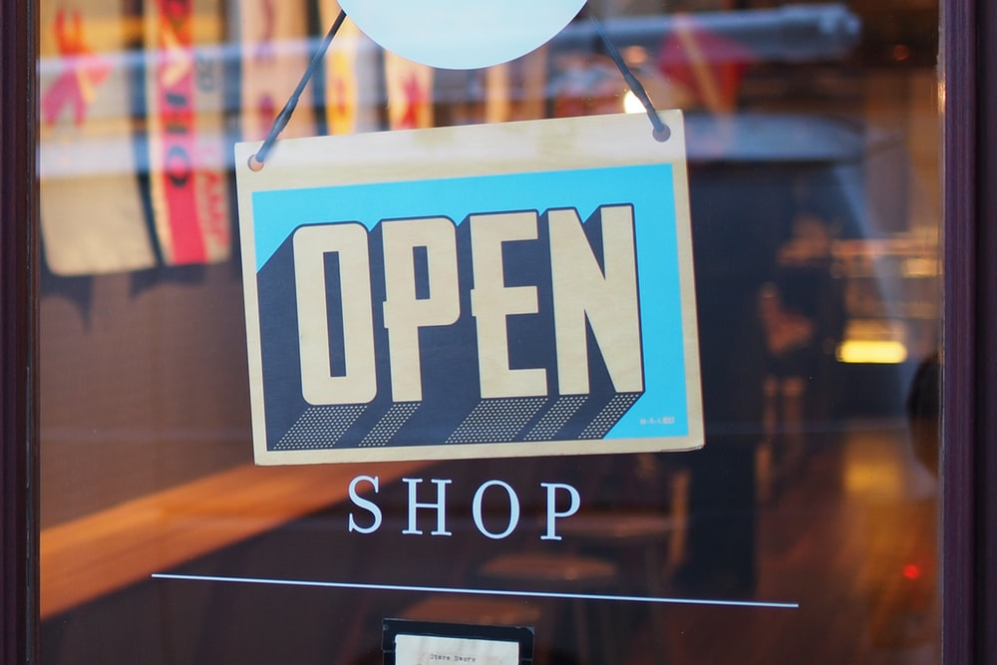
Vokabeln
lesen
d _ _ G _ _ _ _ _ _ _ !
das Geschäft!
Ich brauche eine Tasche.

Slide 12
Vokabeln
lesen
Eine Person oder zwei?
1. Ich mag Naturwissenschaften. 2. Ich brauche eine Tasche.
3. Wir essen Eis. 4. Ich spiele am Abend Klarinette. 5. Wir fahren am Wochenende Rad. 6. Wir mögen Mathematik.
1. Ich mag Naturwissenschaften. 2. Ich brauche eine Tasche.
3. Wir essen Eis. 4. Ich spiele am Abend Klarinette. 5. Wir fahren am Wochenende Rad. 6. Wir mögen Mathematik.
3, 5 und 6 sind ‘we’.
Remember! The ‘wir’ form of the verb is always the same as the infinitive.
Notes:
Draw students’ attention to the ‘we’ forms in sentences 3,5 and 6; it is useful to take every opportunity to compel learners to notice different verb inflections (endings) and connect them to their meanings.

Slide 13
Vokabeln
der
das
der
die
__________
Geschäft
Notes:
Photo by Mike Petrucci on Unsplash
Set of revision slides for all new vocabulary from this week’s sequence. Focus as above for gender to make it as salient as possible.
Frequency rankings of vocabulary introduced this week (1 is the most common word in German):
3.1.3 - in [4], auf [17] springen [1468] fallen [278] das Kino [1825] die Stadt [186] das Konzert [1721] das Geschäft [663] das Museum [1360] angenehm [1748]
die Party [3634] die Straße [355] der Markt [508]

Slide 14
Vokabeln
der
die
das
__________
Kino
Notes:
Photo by Mansoor on Unsplash
Frequency rankings of vocabulary introduced this week (1 is the most common word in German):
3.1.3 - in [4], auf [17] springen [1468] fallen [278] das Kino [1825] die Stadt [186] das Konzert [1721] das Geschäft [663] das Museum [1360] angenehm [1748]
die Party [3634] die Straße [355] der Markt [508]

Slide 15
Vokabeln
der
die
das
__________
Stadt
Notes:
Photo by JC Gellidon on Unsplash
Frequency rankings of vocabulary introduced this week (1 is the most common word in German):
3.1.3 - in [4], auf [17] springen [1468] fallen [278] das Kino [1825] die Stadt [186] das Konzert [1721] das Geschäft [663] das Museum [1360] angenehm [1748]
die Party [3634] die Straße [355] der Markt [508]

Slide 16
Vokabeln
der
die
das
__________
Konzert
Notes:
Photo by Tijs van Leur on Unsplash
Frequency rankings of vocabulary introduced this week (1 is the most common word in German):
3.1.3 - in [4], auf [17] springen [1468] fallen [278] das Kino [1825] die Stadt [186] das Konzert [1721] das Geschäft [663] das Museum [1360] angenehm [1748]
die Party [3634] die Straße [355] der Markt [508]

Slide 17
Vokabeln
der
die
das
__________
Museum
Notes:
Photo by Chris Nguyen on Unsplash
Frequency rankings of vocabulary introduced this week (1 is the most common word in German):
3.1.3 - in [4], auf [17] springen [1468] fallen [278] das Kino [1825] die Stadt [186] das Konzert [1721] das Geschäft [663] das Museum [1360] angenehm [1748]
die Party [3634] die Straße [355] der Markt [508]

Slide 18
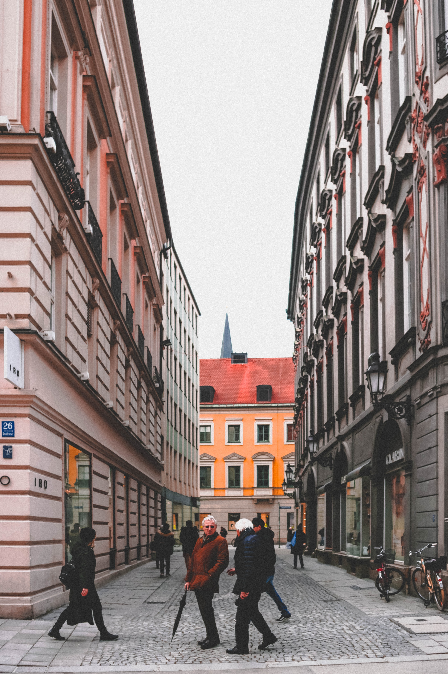
Vokabeln
der
die
das
__________
Straße
Notes:
Photo by Samantha Gades on Unsplash
Frequency rankings of vocabulary introduced this week (1 is the most common word in German):
3.1.3 - in [4], auf [17] springen [1468] fallen [278] das Kino [1825] die Stadt [186] das Konzert [1721] das Geschäft [663] das Museum [1360] angenehm [1748]
die Party [3634] die Straße [355] der Markt [508]

Slide 19
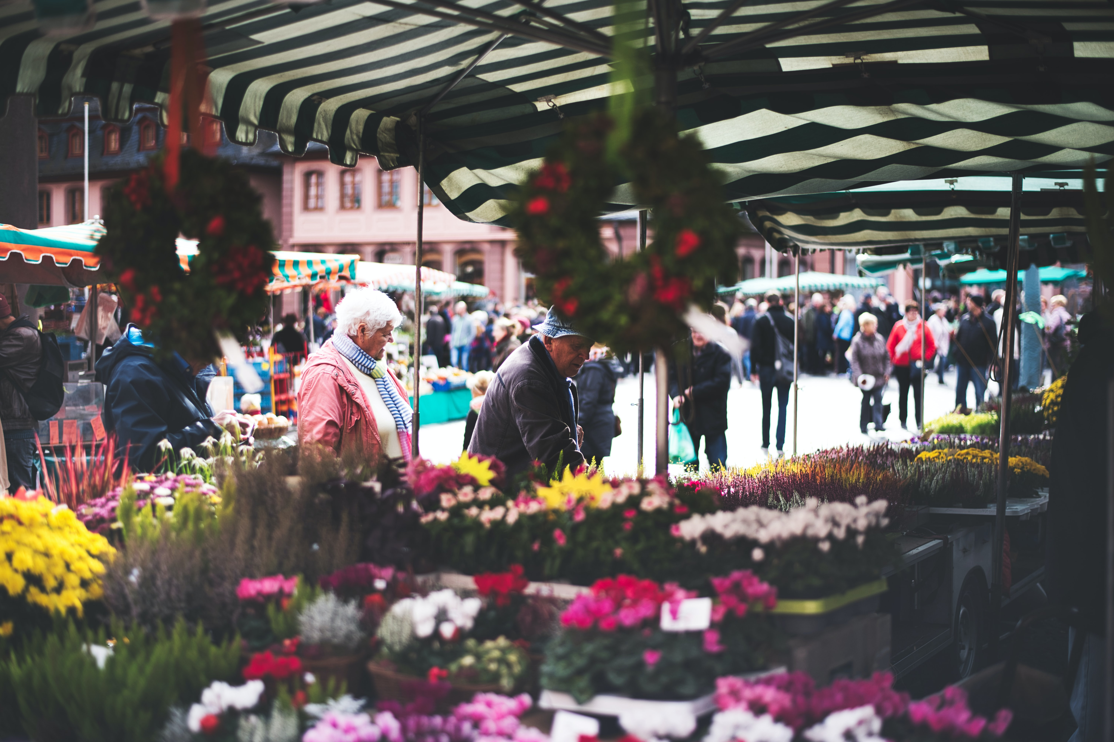
Vokabeln
der
die
das
__________
Markt
Notes:
Photo by Anastasia Dulgier on Unsplash
Frequency rankings of vocabulary introduced this week (1 is the most common word in German):
3.1.3 - in [4], auf [17] springen [1468] fallen [278] das Kino [1825] die Stadt [186] das Konzert [1721] das Geschäft [663] das Museum [1360] angenehm [1748]
die Party [3634] die Straße [355] der Markt [508]

Slide 20
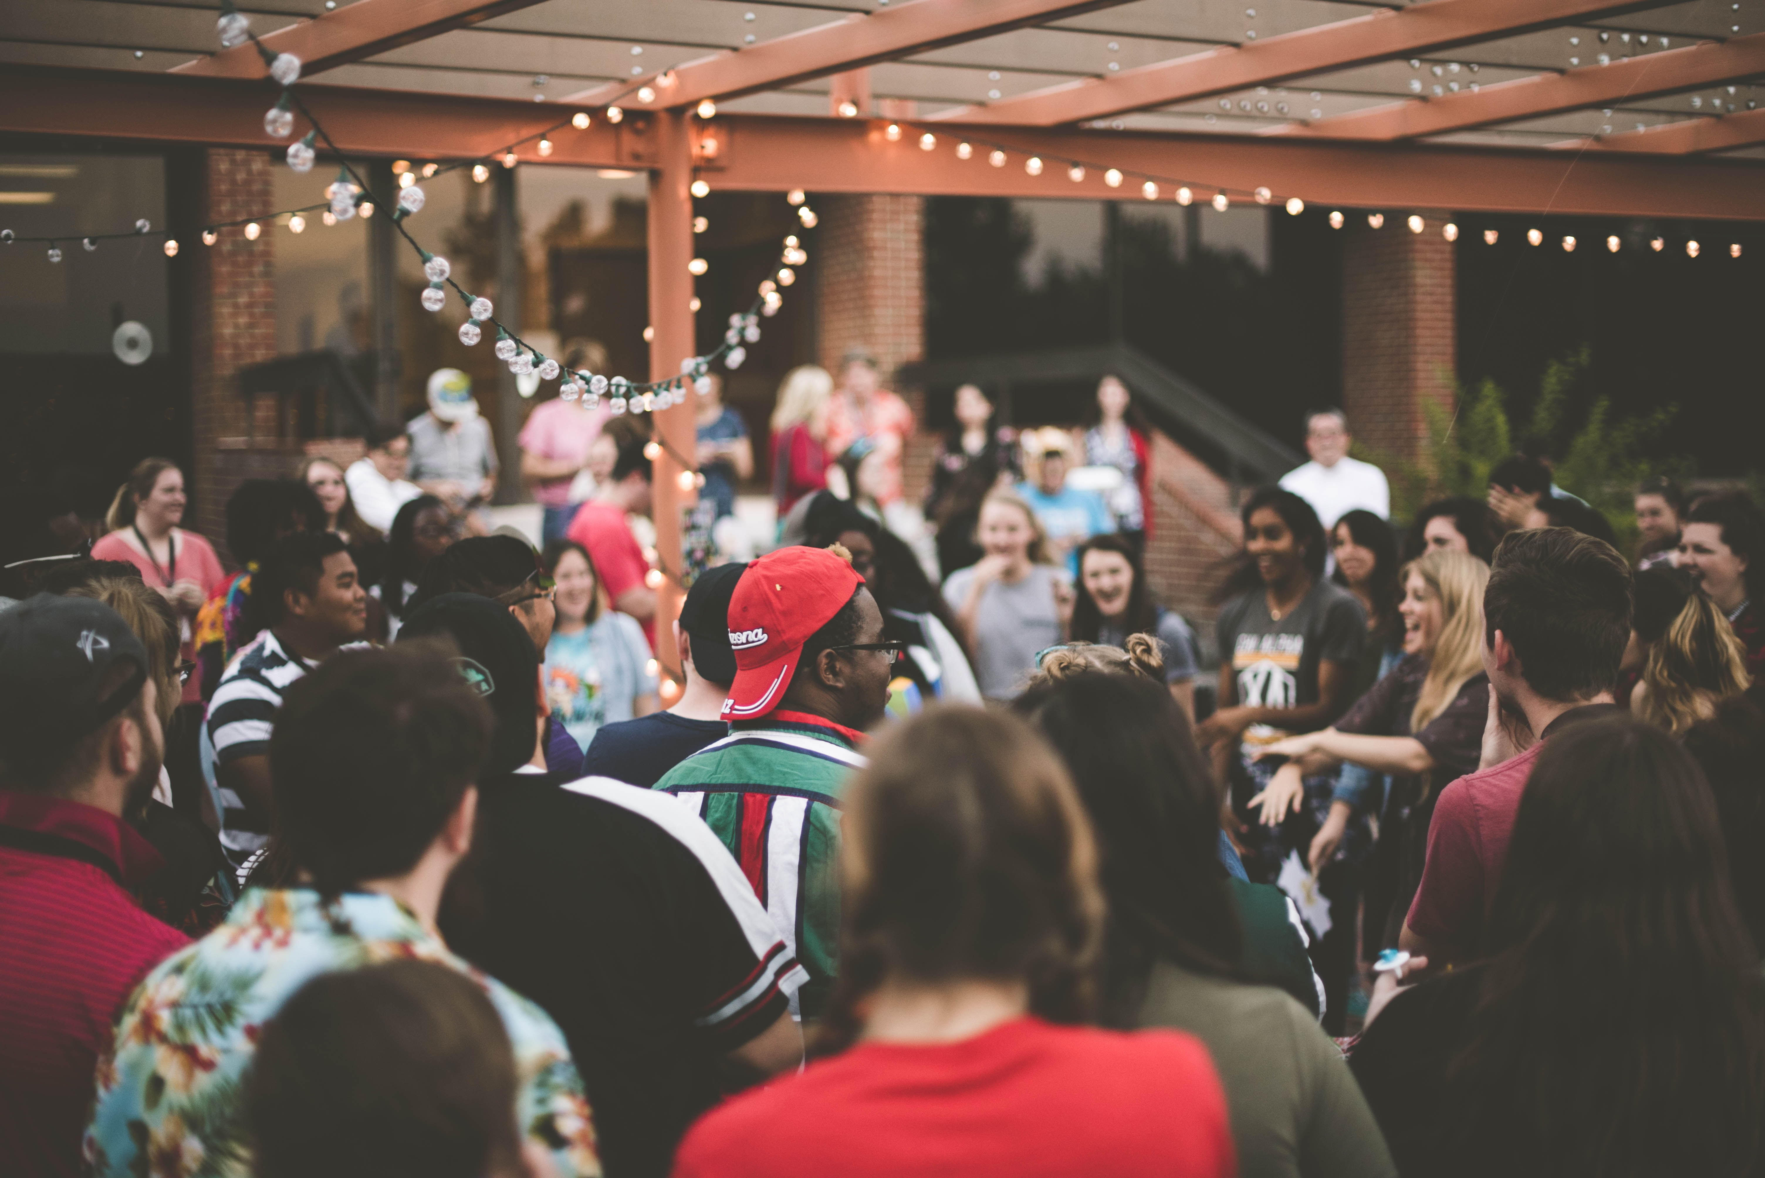
Vokabeln
der
die
das
__________
Party
Notes:
Photo by Samantha Gades on Unsplash
Frequency rankings of vocabulary introduced this week (1 is the most common word in German):
3.1.3 - in [4], auf [17] springen [1468] fallen [278] das Kino [1825] die Stadt [186] das Konzert [1721] das Geschäft [663] das Museum [1360] angenehm [1748]
die Party [3634] die Straße [355] der Markt [508]

Slide 21
Vokabeln
__________
angenehm
[pleasant]
Notes:
Photo by Paige Cody on Unsplash
Frequency rankings of vocabulary introduced this week (1 is the most common word in German):
3.1.3 - in [4], auf [17] springen [1468] fallen [278] das Kino [1825] die Stadt [186] das Konzert [1721] das Geschäft [663] das Museum [1360] angenehm [1748]
die Party [3634] die Straße [355] der Markt [508]

Slide 22
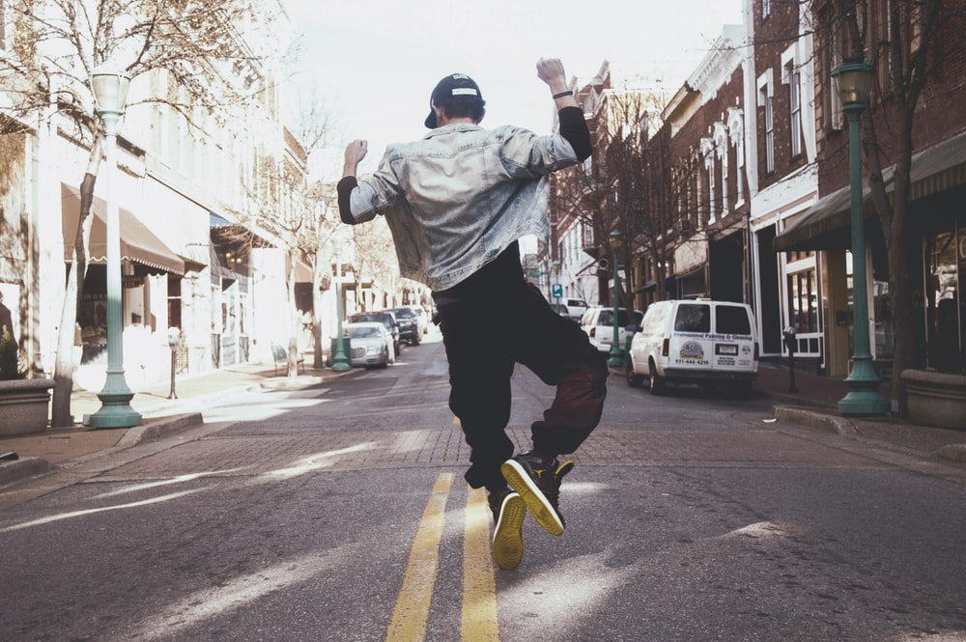
Vokabeln
__________
springen
Notes:
Photo by Mike Petrucci on Unsplash
Frequency rankings of vocabulary introduced this week (1 is the most common word in German):
3.1.3 - in [4], auf [17] springen [1468] fallen [278] das Kino [1825] die Stadt [186] das Konzert [1721] das Geschäft [663] das Museum [1360] angenehm [1748]
die Party [3634] die Straße [355] der Markt [508]

Slide 23
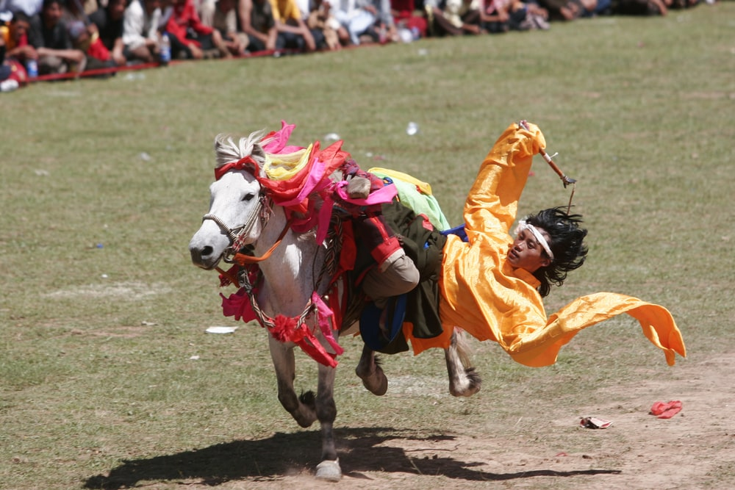
Vokabeln
__________
fallen
Notes:
Photo by @zhushuibuxing on Unsplash
Frequency rankings of vocabulary introduced this week (1 is the most common word in German):
3.1.3 - in [4], auf [17] springen [1468] fallen [278] das Kino [1825] die Stadt [186] das Konzert [1721] das Geschäft [663] das Museum [1360] angenehm [1748]
die Party [3634] die Straße [355] der Markt [508]

Slide 24
Vokabeln
__________
in
[in / into]
Notes:
Frequency rankings of vocabulary introduced this week (1 is the most common word in German):
3.1.3 - in [4], auf [17] springen [1468] fallen [278] das Kino [1825] die Stadt [186] das Konzert [1721] das Geschäft [663] das Museum [1360] angenehm [1748]
die Party [3634] die Straße [355] der Markt [508]

Slide 25
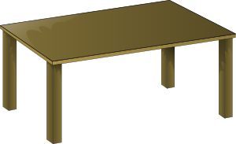
Vokabeln
__________
auf
[on / onto]
Notes:
Frequency rankings of vocabulary introduced this week (1 is the most common word in German):
3.1.3 - in [4], auf [17] springen [1468] fallen [278] das Kino [1825] die Stadt [186] das Konzert [1721] das Geschäft [663] das Museum [1360] angenehm [1748]
die Party [3634] die Straße [355] der Markt [508]

Slide 26
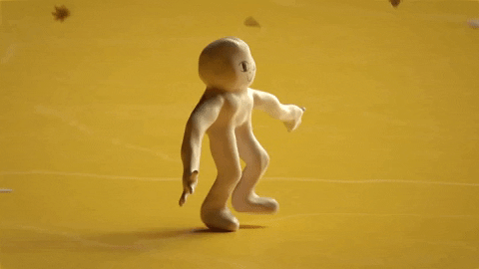
Talking about where something or someone is moving to
‘in das ‘ is often shortened to ‘ins’:
→ ich gehe ins Kino.
Note: the masculine word for the (definite article) changes:
Grammatik
To say where something or someone is moving to, use the prepositions ‘in’ (into) and ‘auf’ (onto):
der Park
die Stadt
das Kino
Ich gehe…
in den Park
in die Stadt
in das Kino
der Tisch
die Zeitung
das Heft
Die Katze springt...
auf den Tisch
auf die Zeitung
auf das Heft
These are the Row 2 (or accusative case) forms of the definite article.
Notes:
Note: Students have been taught definite (and indefinite) article in Row 2 (accusative) in Term 1.1 Weeks 5 & 6.
This explanation expands the students’ knowledge of the Row 2 (accusative) definite article to their use following these two high-frequency prepositions.
Teachers should elicit the English meanings of each sentence from students, stressing the directional movement involved: ‘I go / I’m going’ and ‘The cat jumps / is jumping’.
A listening and reading activity to practise this will follow.

Slide 27
Talking about where something is
Grammatik
To say where something or someone is located, use the same prepositions ‘in’ (in) and ‘auf’ (on), but change the word for the (definite article):
der Park
die Stadt
das Kino
Ich bin…
in dem Park
in der Stadt
in dem Kino
‘in dem ‘ is often shortened to ‘im’:
→ ich bin im Park. → ich bin im Kino.
der Tisch
die Zeitung
das Heft
Das Buch ist…
auf dem Tisch
auf der Zeitung
auf dem Heft
These are the Row 3 (dative case) forms of the definite article.
Notes:
Note: This explanation expands the students knowledge of the definite article to the dative (Row 3).
Teachers should elicit the English meanings of each sentence from students, stressing the static position implicated by ‘I am’ and ‘The book is’, as well as the difference in prepositional meaning between ‘into’ and ‘in’, ‘onto’ and ‘on’.
A listening and reading activity to practise this will follow.

Slide 28
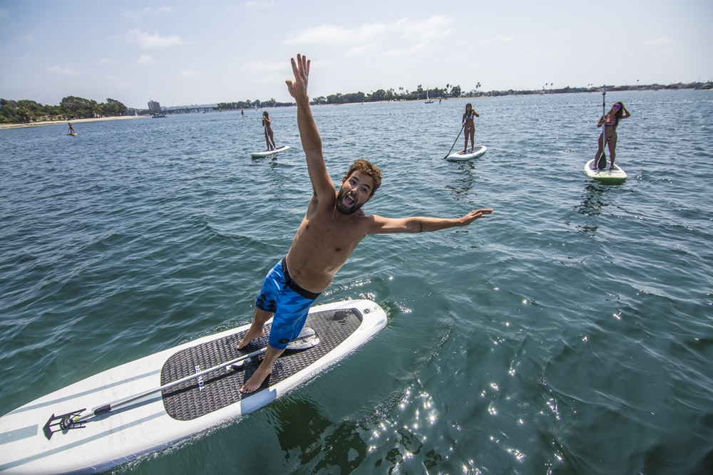
R2 and R3: summary
Grammatik
Row 2 is used when describing motion into/onto something
Changes to the definite article:
Row 1:
der Park
die Stadt
das Kino
ins Kino
Row 2:
Ich gehe…
in den Park
in die Stadt
in das Kino
im Park
in dem Park
in der Stadt
im Kino
Row 3:
Ich bin…
in dem Kino
Row 3 is used when describing location in or on something
fallen is a strong verb
Which row is this? Why?
Er fällt ins Wasser!
What gender is ‘Wasser’?
Notes:
This slide summarises the changes to the article for Row 2 and Row 3, reiterating when to use each.

Slide 29
Mia sendet Katja eine SMS*
lesen
*die SMS - text message (stands for ‘Short Message Service’)
...aber keine Fotos! ☹ Es gibt ein Problem mit dem Handy.
Welches Verb ist richtig?
Mia: Hier sind einige Fotos. Mieze sitzt / springt auf den Boden!
Hier ist Wolfgang im Urlaub! Er fällt / steht ins Wasser!
Hier geht / ist Mehmet in den Garten…
Hier ist / geht Wolfgang auf dem Markt…
1
3
5
7
…und Einstein sitzt / springt auf dem Tisch!
und Mehmt steht / fällt im Wasser.
Auf diesem Foto bist / gehst du in der Schule.
…und ich gehe / bin in die Stadt.
2
4
6
8
Notes:
This reading activity requires students to pay attention to the case used for the definite article, in order to choose the correct verb – location or motion.
The answers are animated and appear upon successive clicks of the mouse.

Slide 30
Ich gehe oder ich bin?
hören
ich gehe
ich bin
ich gehe
ich bin
1
7
2
8
3
9
4
10
5
11
6
12
Notes:
This listening activity requires students to pay attention to the case used for the definite article, in order to choose the correct verb – location or motion. Students need only write 1-8 and either gehe or bin.
The answers are animated and appear upon successive clicks of the mouse.
Transcript
1. Ich [gehe] ins Kino.
2. Ich [bin] im Konzert.
3. Ich [bin] in der Bibliothek.
4. Ich [gehe] in den Park.
5. Ich [bin] im Museum.
6. Ich [gehe] in die Stadt.
7. Ich [gehe] in den Garten.
8. Ich [bin] im Theater.
9. Ich [gehe] ins Café.
10. Ich [gehe] in die Schule.
11. Ich [bin] im Klassenzimmer.
12. Ich [gehe] ins Geschäft.

Slide 31
Talking about movement into, and location in, places
Prepositions in and auf + R2 (acc) + movement + R3(dat) + location
Y7 German
Term 3.1 - Week 3 - Lesson 54
Mel Yates / Stephen Owen / Rachel Hawkes
Date updated: 04/05/20
Notes:
Learning outcomes (lesson 2)
Further practice with SSC [st]
Further work with prepositions in and auf + R2 (acc) + movement, R3(dat) + location
Frequency rankings of vocabulary introduced this week (1 is the most common word in German):
3.1.3 - in [4], auf [17] springen [1468] fallen [278] das Kino [1825] die Stadt [186] das Konzert [1721] das Geschäft [663] das Museum [1360] angenehm [1748]
die Party [3634] die Straße [355] der Markt [508]
Frequency rankings of vocabulary revisited this week (1 is the most common word in German):
2.2.4 - Rad fahren [2156/169] am Nachmittag [1426] am Abend [313] am Wochenende [764] mit wem? [13/173] heute [121] Fleisch [1624] Gemüse [3450] Eis [2818] die Tasche [1638]
2.1.3 - mag [151] mögen [151] ihn (him/it) [93] sie (her/it) [10] die Fremdsprache [1791] die Kunst [468] die Naturwissenschaft [3772] das Schulfach [208/698] die Mathematik [1827] Deutsch [105]
Additional known vocabulary or cognates to recycle:
der Boden [445] der Park [>4034] die Stadt [188] die Schule [208] das Klassenzimmer [609/619] das Café [2345] die Bibliothek [927] das Theater [725] kommen [61] stehen [87] sitzen [261] still [1405]

Slide 32
SCH oder ST?
hören und schreiben
Sch
___ulfach
st
__reng
1
6
__ehen
st
sch
Ge ___enk
2
7
St
__ück
sch
3
8
Deut___
sch
____reiben
Gut ___ein
sch
4
9
st
Flei ___
Kun__
sch
5
10
Notes:
To challenge students further, ask them to turn away from the board to complete the task and write the whole word independently. This allows for differentiation through more/less support. If the whole class is high attaining, then the prompts can be removed from the slide, of course. Teachers should elicit meanings to confirm vocabulary knowledge. They should also point out that the –st in Kunst is pronounced as in English, to reinforce the fact that it is only a ‘sht’ sound at the beginning of word.
Frequency rankings of vocabulary featured (1 is the most common word in German):
das Schulfach [208/698] 2.1.3
stehen [87] 1.2.5
das Stück [417] 1.2.6
schreiben [245] 1.2.1
das Fleisch [1624] 2.2.4
streng [1224] 2.1.4
das Geschenk [2610] 2.1.1
das Deutsch [105] 2.1.3
der Gutschein [78/3025] 2.1.1
die Kunst [468] 2.1.3

Slide 33
SCH oder ST?
hören und schreiben
Schulfach
streng
1
6
stehen
Geschenk
2
7
Stück
Deutsch
3
8
schreiben
Gutschein
4
9
Fleisch
Kunst
5
10
Notes:
Same task, but answers appear as a whole word, rather than just the target graphemes. Teachers should elicit meanings to confirm vocabulary knowledge. They should also point out that the –st in Kunst is pronounced as in English, to reinforce the fact that it is only a ‘sht’ sound at the beginning of word.
Frequency rankings of vocabulary featured (1 is the most common word in German):
das Schulfach [208/698] 2.1.3
stehen [87] 1.2.5
das Stück [417] 1.2.6
schreiben [245] 1.2.1
das Fleisch [1624] 2.2.4
streng [1224] 2.1.4
das Geschenk [2610] 2.1.1
das Deutsch [105] 2.1.3
der Gutschein [78/3025] 2.1.1
die Kunst [468] 2.1.3

Slide 34
Vokabeln
am Nachmittag
mögen
die Kunst
mit wem?
ihn
das Deutsch
sie
heute
sie
kommen
das Fleisch
die Fremdsprache
still
das Gemüse
1. Ich sehe [her].
Ich sehe sie.
Notes:
This task (Slides 31 - 38) revises all of the vocabulary items not yet incorporated into the sequence from the sets to be revisited (see title slide).
Students choose a word/words from those displayed to write the full sentence, replacing the English word(s) of the same meaning.
The answers appear upon clicking the mouse, and the correct option is highlighted from the list.

Slide 35
Vokabeln
am Nachmittag
mögen
die Kunst
mit wem?
ihn
das Deutsch
ihn
heute
sie
kommen
das Fleisch
die Fremdsprache
still
das Gemüse
2. Ich mag [him].
Ich mag ihn.

Slide 36
Vokabeln
am Nachmittag
die Kunst
mögen
mögen
mit wem?
ihn
das Deutsch
Deutsch
heute
sie
kommen
das Fleisch
die Fremdsprache
still
das Gemüse
3. Wir [like German].
Wir mögen Deutsch.
Notes:
This items offers the opportunity to reinforce that in German, as in English, the definite article is not needed with school subjects.

Slide 37
Vokabeln
am Nachmittag
mögen
die Kunst
mit wem?
ihn
das Deutsch
heute
sie
kommen
das Fleisch
die Fremdsprache
still
Fremdsprache
das Gemüse
4. Wir lernen eine
[foreign language].
Wir lernen eine
Fremdsprache.
Notes:
And here, hopefully students will realise that they wouldn’t put eine + die together in a sentence, but if they do do this, it’s an opportunity to elicit why this doesn’t work, and reinforce the use of definite / indefinite articles.

Slide 38
Vokabeln
am Nachmittag
mögen
die Kunst
mit wem?
ihn
das Deutsch
heute
kommen
heute
sie
das Fleisch
die Fremdsprache
still
still
das Gemüse
5. Es ist [quiet today].
Es ist heute still.
Notes:
Here students may naturally put the adjective before the adverb of time, as we do in English. Teachers can remind students that adverbs go directly after the verb in German (this is a rule they were previously taught).

Slide 39
Vokabeln
am Nachmittag
mögen
die Kunst
mit wem?
ihn
das Deutsch
heute
sie
kommen
Fleisch
das Fleisch
die Fremdsprache
still
Gemüse
das Gemüse
6. Wir essen
[meat] und [vegetables].
Wir essen
Fleisch und Gemüse.
Notes:
The absence of articles in this sentence also mirrors the English.

Slide 40
Vokabeln
am Nachmittag
mögen
die Kunst
am Nachmittag
Mit wem?
das Deutsch
mit wem?
ihn
heute
sie
kommen
das Fleisch
die Fremdsprache
still
das Gemüse
7. [With whom?] gehst du
[in the afternoon]?
Mit wem gehst du
am Nachmittag?

Slide 41
Vokabeln
am Nachmittag
mögen
die Kunst
Kunst
mit wem?
ihn
das Deutsch
heute
kommen
sie
kommen
das Fleisch
die Fremdsprache
still
das Gemüse
Wir haben Kunst.
- Wir kommen!
8. Wir haben [art].
- Wir [are coming]!
Notes:
The second phrase here reinforces the knowledge that German only has one present tense and it expresses both ‘we are coming’ and ‘we come’.
It would be worth teachers asking students how they would say in German ‘we come’ to reinforce this learning.

Slide 42
Using auf to mean ‘at’ or ‘to’
Grammatik
We use the preposition ‘auf’ to mean ‘on’ or ‘onto’, e.g.:
Der Hund sitzt auf dem Tisch.
Die Katze springt auf den Boden.
(location)
(motion)
But ‘auf’ can also sometimes mean ‘at’ or ‘to’:
Ich bin…
auf dem Markt
Often, as in these examples, the use of auf is for open spaces or events. For example, also use auf for an open air or pop concert.
(location)
auf der Party
auf dem Festival
Ich gehe…
auf den Markt
auf die Party
(motion)
auf das Festival
Notes:
This slide explains the use of auf to mean ‘at’ or ‘to’ (we have previously seen it meaning ‘on’ or ‘onto’).
New vocabulary
die Party [3634] die Straße [355] der Markt [508]

Slide 43
Saying ‘to’ and ‘in’ in French
lesen
The different meanings of auf
Remember! The translation of auf is ‘onto’ or ‘to’ with verbs of movement Row 2 article) and ‘on’ or ‘at’ with verbs of location (Row 3 article).
What is the correct translation in each case below?
 |  | ‘on’ | ‘onto’ | ‘at’ | ‘to’
1. | Ich gehe auf die Party.
2. | Ich bin auf dem Festival.
3. | Das Buch is auf dem Tisch.
4. | Die Katze springt auf den Tisch.
Notes:
This reading activity practises the different translation of the preposition auf with verbs of movement and location.
Attention should be drawn to the fact that the same preposition can be translated differently depending on the context.

Slide 44
Saying ‘to’ and ‘in’ in French
lesen
The different meanings of auf [2]
Remember! The translation of auf is ‘onto’ or ‘to’ with verbs of movement Row 2 article) and ‘on’ or ‘at’ with verbs of location (Row 3 article).
What is the correct translation in each case below?
 |  | ‘on’ | ‘onto’ | ‘at’ | ‘to’
5. | Ich bin auf der Party.
6. | Ich gehe auf den Markt.
7. | Ich springe auf den Boden.
8. | Der Hund sitzt auf dem Boden.
Notes:
This is a continuation of the previous slide.

Slide 45
Wolfgang und Mia gehen shoppen
normal
langsam
multimodal
Am Samstagnachmittag gehen Wolfgang und Mia in die Stadt. Sie brauchen Gemüse. Wolfgang isst Fleisch aber Heidi ist Vegetarierin. Am Sonntagabend kocht Wolfgang für sie zu Hause. Mia braucht auch eine Tasche.
Zuerst gehen sie ins Geschäft. Dort gibt es sehr viel Gemüse! Dann gehen sie auf den Markt. Mia sieht eine Tasche. Sie mag sie sehr!
Sie gehen danach ins Café, und dann in den Park. Heidi ist im Park! Wolfgang findet das toll! Sie reden über die Schule. Mias Lieblinsfach ist Deutsch, aber Wolfgang und Heidi mögen Naturwissenschaften und Kunst. Sie finden Mathematik beide schwierig.
Sie gehen gemeinsam ins Kino. Mehmet sitzt auch im Kino! Er isst ein Eis – mmm, lecker! Die vier Freunde finden den Film sehr lustig. Mehmets Lieblingsschauspieler spielt im Film mit! Danach springt Mehmet auf sein Rad und fährt nach Hause.
Mia, Wolfgang und Heidi gehen auch nach Hause. Am Abend gibt Mia in der Schule ein Konzert.
_____
_______
___
__________
__________
_______
________________________
_______
___
___
___________
_______
die Vegetarierin – vegetarian (f); für – for; sein – his; der Schauspieler - actor
Notes:
This segmentation exercise, which consists of known words and cognates, with a small number of (glossed) exceptions, can be treated as a reading exercise, a listening exercise, or a multimodal exercise, as described below. N.B. The word Schauspieler features in next week’s vocabulary list. Teachers should flag the compounds for times of day – e.g. Samstagnachmittag, Sonntagabend, reminding students to try to break down longer words into more familiar single words.
1/ Teacher presses play. Students listen to the audio and read along. Alternatively the teacher can read the text him/herself.
2/ Teacher pauses the audio before the gaps.
3/ Students and teacher summarise the meaning of what has come before as a class.
4/ Students are then given 10 seconds to propose a sensible word (or phrase) which could come next, and to write it down.
5/ Teacher elicits suggestions from the class. Multiple suggestions are possible. Students should be encouraged to be creative, and recap vocabulary from previous learning.
6/ Teacher reveals the written solution by clicking on the gap, and presses play to continue.
If time permits, students can write a summary from audio only, or work with the written text to produce a summary or full translation.

Slide 46
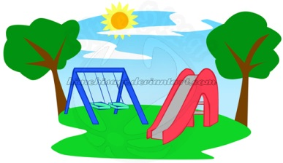
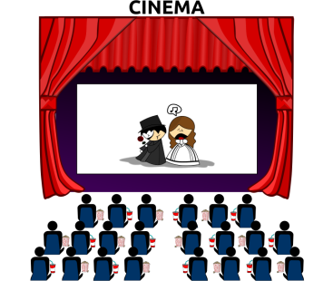
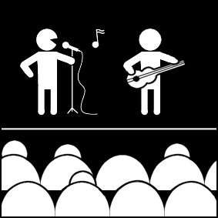
Wo ist er/sie? Wohin geht er/sie?
sprechen
Partner A/B
going to
already at
going to
already at
1
e.g. Festival
4
e.g. Schule
2
5
3
6
Wohin? - Where…to?
Notes:
This activity requires partners to listen to the information from each other about where Wolfgang and Mia (a) are going, and (b) are already situated. Partners have complementary information, making this a genuine information-gap exercise.
Partners note the answers in English on the printed version of the exercise (which shows the different information for each partner) – this is available to download as a Word file from the NCELP Resource Portal.
N.B. The table is blank, apart from the examples, in the version on this slide. This is to avoid giving away the answers, which are shown on slide 48.
E.g., ‘1. Er ist auf dem Festival’; ‘4. Sie geht in die Schule’.
The student speaking is thus compelled to select the correct preposition, case and use the correct article, whilst the listener is processing the vocabulary meaning.

Slide 47
Self-study version
sprechen
Partner A
going to
already at
going to
already at
1
4
2
5
3
6
Wohin? - Where…to?
Notes:
This is a self-study version of the task. The information that Partner B has is recorded and activated by clicking on each number. Students listen and record the answers in the correct part of the table, depending on whether Wolfgang and meaning are already somewhere or going somewhereuse the prompts to give their information in German for each question, and then click to hear Partner B’s information, which they then write down. After that, they can use the details on the Partner A pairwork sheet to give their information in German.

Slide 48
Wo ist er/sie? Wohin geht er/sie?
sprechen
Partner A/B
going to
already at
going to
already at
1
shop
concert
4
town
theatre
2
café
library
5
park
museum
3
market
cinema
6
school
classroom
Wohin? - Where…to?
Notes:
These are the answers to the acitivity on the previous slide.

Slide 49
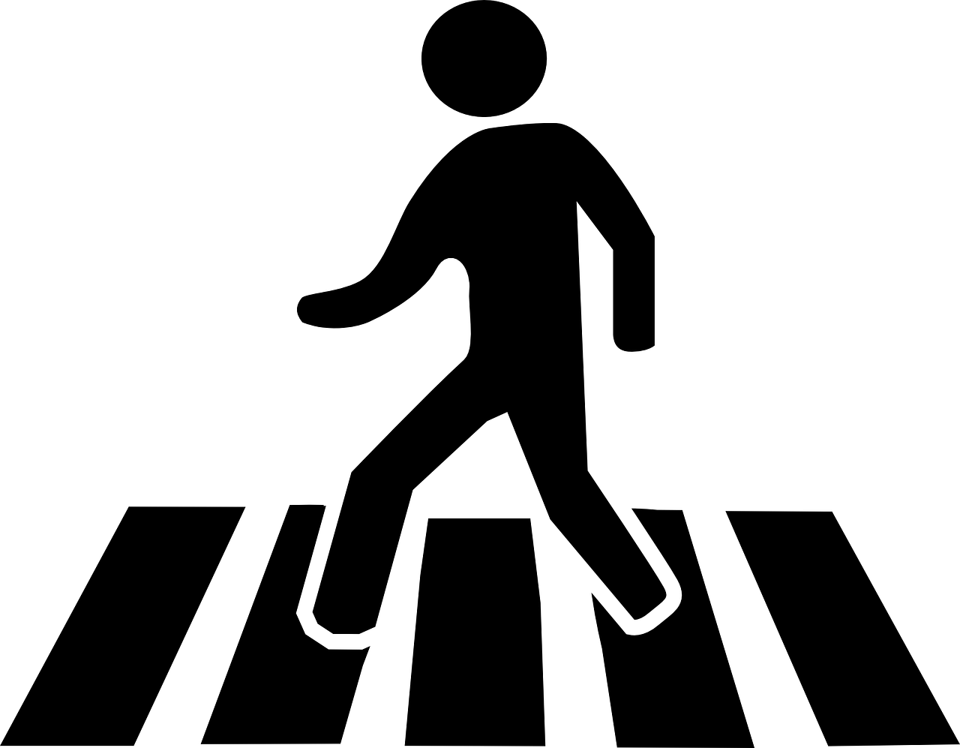
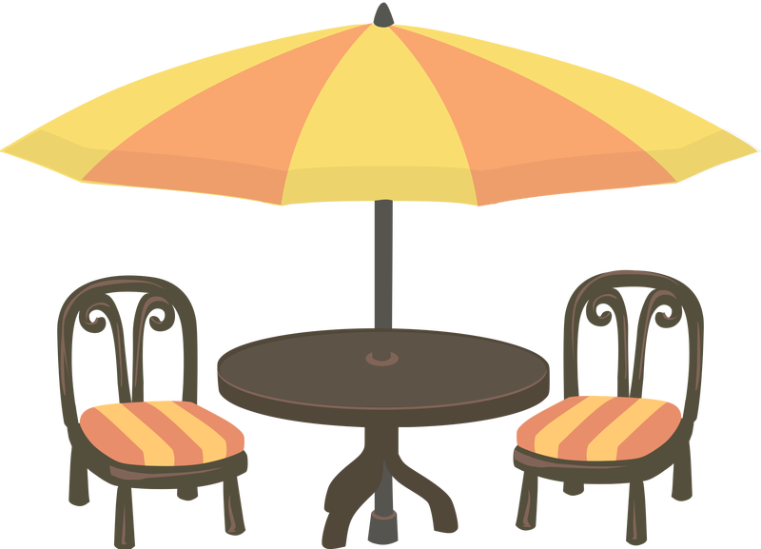
Wo bist du? Wohin gehst du?
schreiben
Wolfgang and Heidi are trying to meet up, but they are so busy! Sie schreiben SMS: “Ich bin... aber ich gehe jetzt…”Schreib drei SMS für Wolfgang oder Heidi.
“Ich bin... aber ich gehe jetzt…”
Wohin? – Where (to)?
Notes:
Students write the sentences implied by the pictures in each thought bubble, taking care to use the Row 2 and Row 3 articles correctly.
Each student writes three extended sentences, choosing to be either Wolfgang OR Heidi.
Note: they won’t all be the same sentences as students can choose which combination of places to talk about in each sentence.
Students can be encouraged to share their texts with each other. They can orally translate these into English, and peer check answers for meaning.
Clearly, teachers will want to circulate as students are writing to check accuracy of Row 2/Row 3 articles.

Slide 50
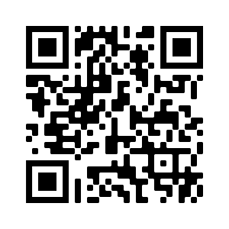
Hausaufgaben
Vocabulary Learning Homework (Term 3.1, Week 4)
Audio file: www.ncelp.org/audio/GY7T3-1W4
Audio file QR code:
Student worksheet
Quizlet link
In addition, revisit: Term 2.2 Week 4
Term 2.1 Week 3
Notes:
Note to resource creators: links needs to be properly formatted as hyperlinks (copy url, select target text, right click, and add hyperlink), do not paste the website url directly on the slide. The Student worksheet link to the resource portal needs to be formatted like the other links on the slide, if this is done correctly there is no need to shorten the url.

