Slide 1
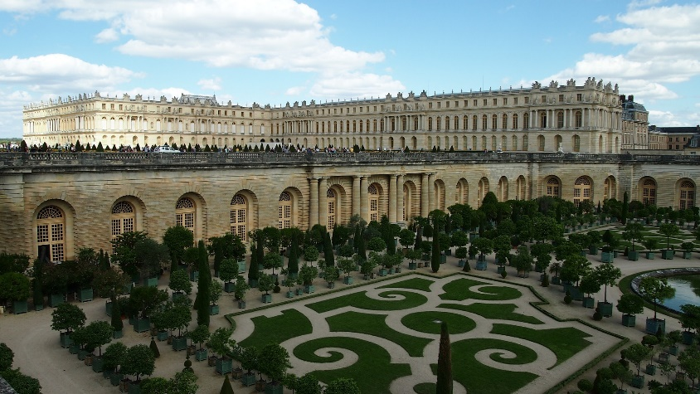
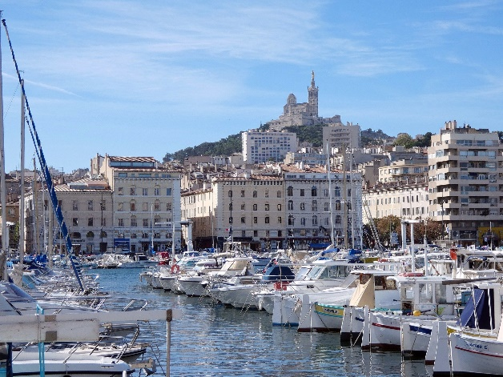
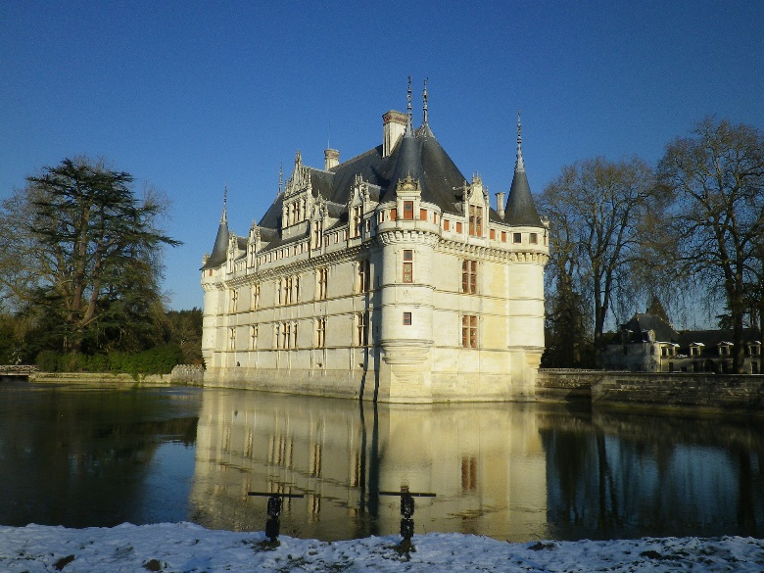
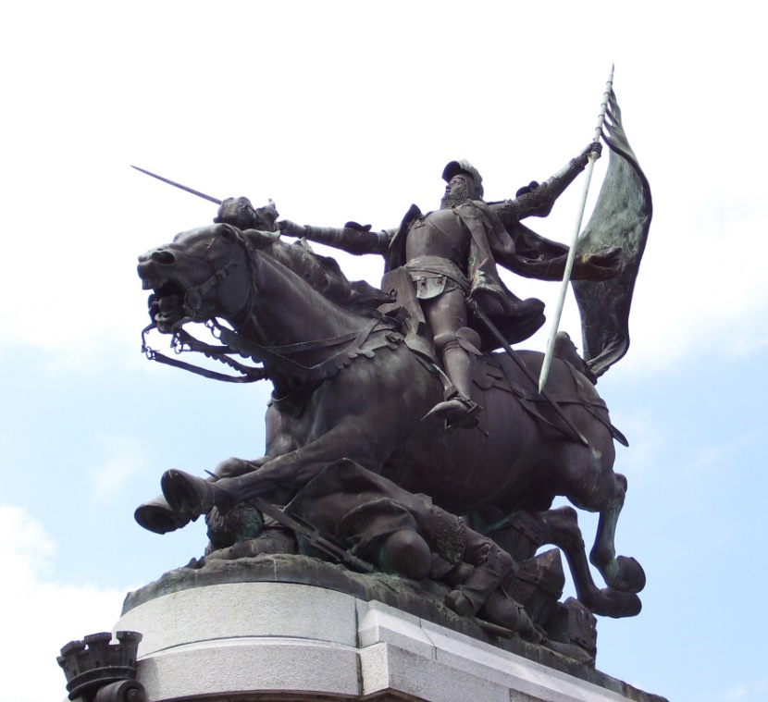

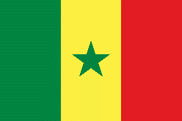

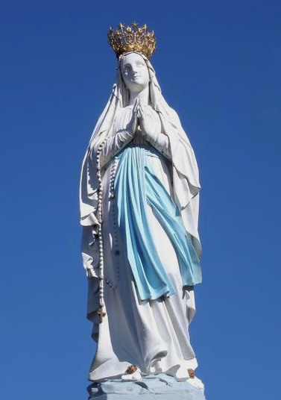
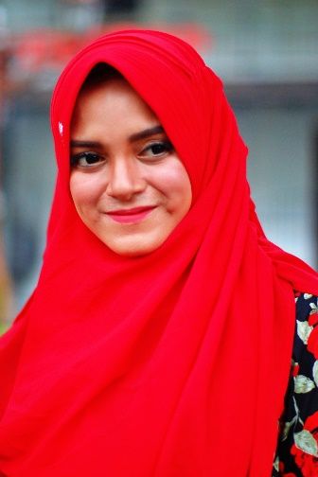
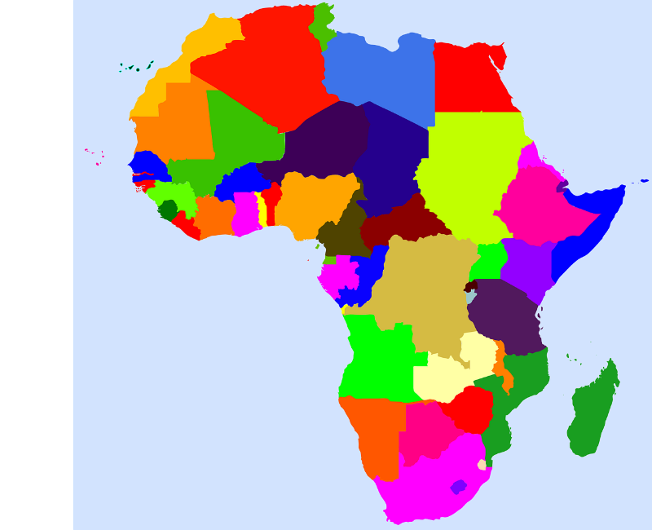
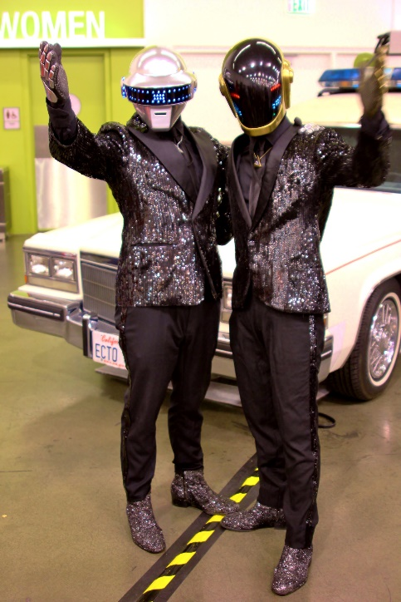
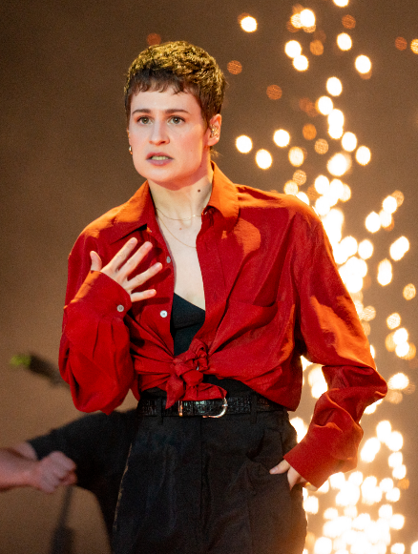
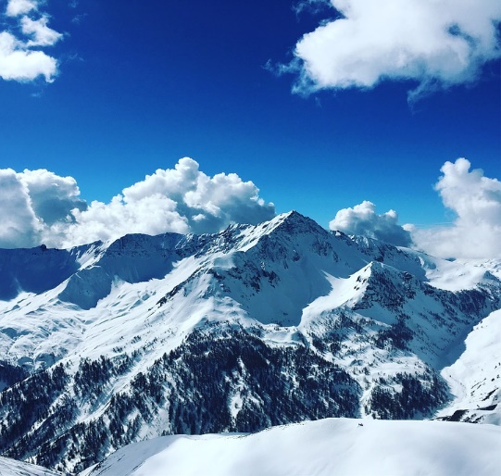
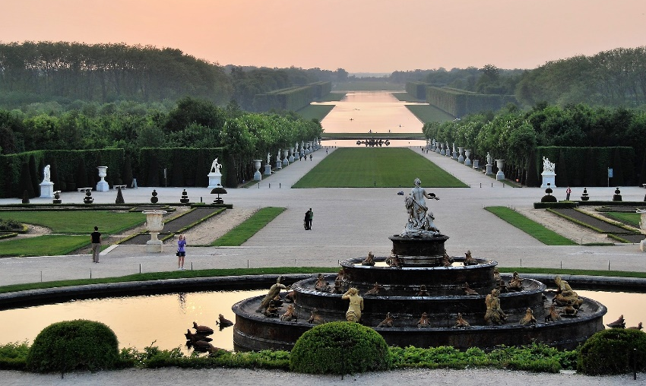
Français
Year 9 Language Guide
Nom: …………………………………………..
Professeur/Professeure: ……………………
Last updated: 03/07/2022
Notes:
Primavera19_-48 by Raph_PH is licensed under CC BY 2.0
daft punk! by RyC - Behind The Lens is licensed under CC-BY 2.0
Statue de Notre Dame de Lourdes by Octave 444 is licensed under CC BY-SA 4.0

Slide 2
Contents
Themes overview | 3 | Perfect tense: -ER verbs taking être, past participle agreement (feminine) Where you went/what you did | 44
Sounds of the language | 4-12
Word patterns and word families | 13-14 | Perfect tense: -ER verbs taking être, past participle agreement (plural) Accidents and emergencies | 45-46
être, negation, adjective agreement Identity: describing self and others | 15-16
 |  | Text exploitation: J’ai cherché | 47
-ER verbs, pour/sans, adverbs, pronoun on, intonation/est-ce que questions, Cultural events : Le festival de Dieppe | 17-18 | Relative pronoun ‘qui’, à/de before a noun, verbs like entendre and écrire Free time | 47-48
Two-verb structures with aller (future) Motivations and goals | 19 | moi and toi after prepositions Crime | 49
Modal verbs (nous, vous, ils/elles) Talking about what you can(not), must (not) and (don’t) want to do at work | 20-22 | Imperfect tense (habitual: ‘used to’): -ER verbs (je, il/elle/on), ordinal numbers French school system | 50-52
il (ne) faut (pas), adjective agreement Talking about what needs to happen | 23 | Imperfect tense (habitual: ‘used to’): all regular verb groups (je tu, il/elle/on) Childhood | 53-55
connaître (je, tu, il/elle), à/en + countries Saying what, where and who you know | 24-25 | Using ‘il y a’ and imperfect tense Describing | 56-58
ne…pas, ne…jamais, verbs like entendre What always/sometimes/never happens | 26-27 | Perfect tense with être, empathetic pronouns Identity and expression | 59-61
Infinitives used as nouns, uses of infinitives Travel activities in France | 28-29 | Conjugation guide, revisiting tenses | 62-65
croire (je, tu, il/elle), noun agreement, être + nationality/religion, verbs like venir Identity : nationality/religion | 30-31 | Pronoun, direct objects and word patterns School | 65-68
Possessive adjectives, register: tu vs vous Staying in a hotel | 32-33 | Using ‘it’ and contracting articles Shoppping | 69-70
Grammar revision for assessment Senegal | 34-35 | à and de, quell and ce | 71-72
avoir/être + feelings, il est + time, inversion questions, numbers 32-69 Talking about your day | 38-39 | ‘il est’, word patterns and imperson expressions Universal experiences | 73-75
Comparatives, adjective positioning, partitive article, expressions of quantity + de, boire (sing.), Text: Vive le vent Noël | 40-41 | Prepositions of place and word patterns | 76-77
Perfect tense: forms, adverb placement, negation (ne…pas, ne…jamais) La Révolution française | 42-43 | Perfect tense with choisir and sortir Occupied France | 78-79

Slide 3
Contents
Direct and reflexive object pronouns | 80-81
Saying ‘it, him and her’ Time periods: quantity vs. duration Refugees in France | 82-84
Imperfect tense Describing historical figures Il y a vs. il y avait Inversion Questions | 85
Imperfect vs perfect Talking about things that happened at the same time Est-ce que questions
Text exploitation: excerpts from Kiffe kiffe demain and two poems Indefinite adjectives

Slide 4
Overview
Overview | Theme / Topic
Autumn Term 1 | Talking about identity (1): Describing self and others Cultural events [1]: Le festival de Dieppe Motivations and goals Work Experience Talking about what needs to happen Talking about what, where, and who you know Things that always, sometimes and never happen
Autumn Term 2 | Talking about travel activities in France Talking about identity (2) : Nationality and religion Staying in a hotel Senegal Talking about your day Noël
Spring Term 1 | La Révolution française Talking about where you went and what you did Talking about what has happened (1): Accidents and emergencies Text exploitation: J’ai cherché Talking about what you do in your free time Talking about what has happened (2): Crime
Spring Term 2 | Describing how things are and how they used to be (1): French school system Describing how things are and how they used to be (2): Childhood memories Gender identity and expression: Drag montréalaise Talking about what happened once vs all the time Talking about what people did and what they used to do
Summer Term 1 | Talking about what you read Helping each other at school Shopping Making decisions about the future Talking about universal experiences: La pandémie de Covid-19 Avion supersonique: L’histoire de Concorde
Summer Term 2 | Introduction à la France occupée et le Régime de Vichy Introduction à l’Empire colonial français Talking about what you do to yourself Talking about what someone else does to themselves: Refugees in France Describing historical figures Talking about things that happened at the same time Text exploitation: excerpts from Kiffe kiffe demain and two poems

Slide 5
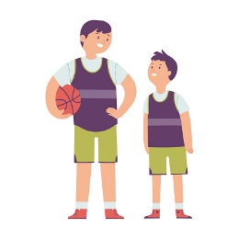
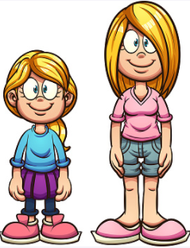




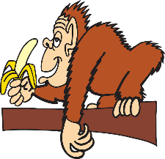






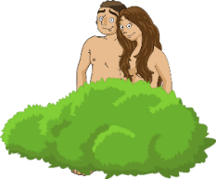
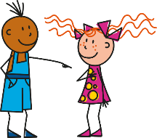







Y9 Sounds of the language
In Y9, SSC knowledge is further developed by activities focused on two or more SSC. This could be a contrast between two French SSC, or an English and a French SSC with notable similarities or differences. In some weeks, more than two SSC are revisited. These are the pairs we focus on:
SFC
SFE
[shy]
grand
[tall, m.]
grande
[tall, f.]
dans
timide
X
X
[é/-er/-ez]
SFE
[shy]
manger
[to eat, eating]
il mange
[he eats, is eating]
écrire
X
timide
[en/an]
[on]
il ment
[he’s lying]
mon
[my]
enfant
non
[ou]
[u]
nous
[we]
nu
[naked]
nous
tu
[i]
liste
list
midi
[ai]
[é]
je fais
[I do, make]
fée
[fairy]
vrai
écrire
4

Slide 6

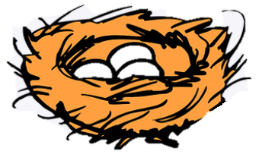








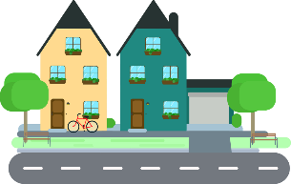





Y9 Sounds of the language
In Y9, SSC knowledge is further developed by activities focused on two or more SSC. This could be a contrast between two French SSC, or an English and a French SSC with notable similarities or differences. In some weeks, more than two SSC are revisited. These are the pairs we focus on:
[i]
[e]
nid
[nest]
ne
[not]
midi
je
[qu]
?
musique
music
question
[ien]
[ê/è]
italien
[Italian (m.)]
italienne
[Italian (f.)]
bien
tête
open [eu/œu]
[r]
acteur
actor
cœur
rue
[en/an]
[in/ain]
enfant
[child]
enfin
[finally]
enfant
train
[tion]
attention
révolution
5

Slide 7

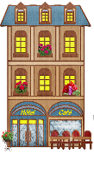


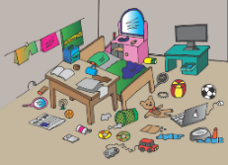







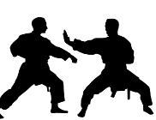
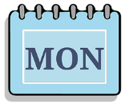
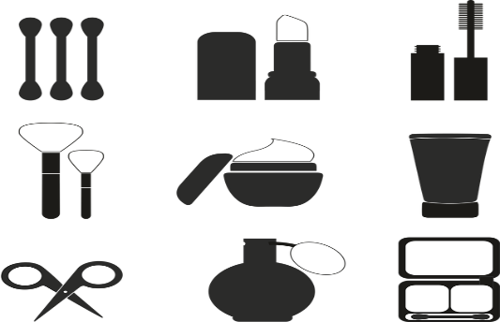
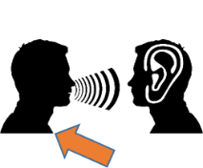


Sounds of the Language
In Year 9, we also revisit the ‘Sounds of the Language’ cycle introduced in Year 8. This revisits knowledge of SSC (Sound-spelling correspondences) and liaison patterns taught in Year 7, adding to this stress syllabification exercises to draw attention to cross-linguistic differences in stress patterns, and fifteen new SSC.
h
[history,
story]
8
heure
hôtel
hôpital
histoire
hiver
huit
em/am
[together]
[to look like]
[spring]
[time]
camp
ensemble
ressembler (à)
printemps
chambre
temps
aim/im
[simple]
[important]
[impossible]
faim
grimper
simple
important
impossible
imprimer
om
[to
understand]
[account]
[to fall]
Nathalie
Lefèvre
ombre
compte
tomber
combat
nom
comprendre
um/un
1
[none]
[each]
[common]
un
lundi
aucun
chacun
commun
parfum
r
[brother]
[modern]
[to be]
frère
moderne
être
parler
triste
rue
6
Notes:
The cluster words have been chosen for their high-frequency, from a range of word classes, with the SSC (where possible) positioned within a variety of syllables within the words(e.g. initial, 2nd, final etc.., although not, of course with SFC!). Additionally, we have tried to use words that build cumulatively on previously taught SSCs (see the Phonics Teaching Sequence document) and do not include new SSCs. Where new SSCs are used, they are often consonants which have a similar symbol-sound correspondence in English.
Source: Londsale, D., & Le Bras, Y. (2009). A Frequency Dictionary of French: Core vocabulary for learners London: Routledge.
Word frequency rankings (1 is the most common word in French):
histoire [263]; huit [877]; hôpital [1308]; hôtel [1774]; hiver [1586]; heure [99].
camp [1084]; chambre [633] ensemble [124]; printemps [1288]; temps [65]; ressembler [1398].
faim [1986]; simple [212]; important [215]; grimper [2646]; imprimer [3092]; impossible [3092].
nom [171]; comprendre [95]; compte [254]; tomber [547]; combat [1062]; ombre [2001].
un [3]; aucun [63] chacun [323]; commun [780]; lundi [1091]; parfum [4477].
rue [598]; frère [1043], triste [1843], moderne [1239], être [5], parler [106]

Slide 8




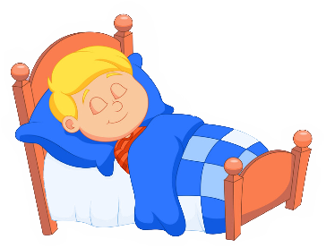





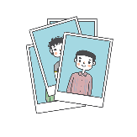
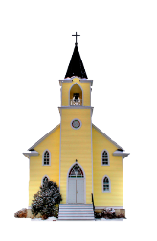


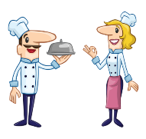









Sounds of the language 2
These words have been especially chosen for their high-frequency. This means words that are used a lot when you speak French, and therefore they are very useful words for you to know!
9
open eu/œu
[young]
[mistake]
[sister]
cœur
acteur
jeune
erreur
sœur
neuf
open o
[person]
porte
école
d’accord
personne
dormir
poste
closed o/ô
[thing]
[word]
photo
contrôle
drôle
chose
mot
hôpital
-s-
[sorry]
[thing]
maison
magasin
désolé
chose
cuisine
église
-gn-
[to not
know]
ligne
gagner
espagnol
ignorer
Allemagne
montagne
th
[nice]
[method]
thé
théatre
sympathique
méthode
maths
bibliothèque
7
Notes:
acteur [1552]; cœur [568]; jeune [152]; erreur [612]; neuf [787]; sœur [1558].
porte [696]; d’accord [736]; personne [84]; dormir [39]; école [477]; poste [489].
photo [1412], mot [220], hôpital [1310], chose [125], contrôle [662], drôle [2166]
maison [325]; chose [125]; magasin [1736]; église [1782]; désolé [2081]; cuisine [2618].
ligne [342]; gagner [258]; ignorer [639]; espagnol [1666]; montagne [1734]; Allemagne [N/A].
thé [3517]; méthode [1149]; théâtre [1701]; bibliothèque [2511]; maths [3438]; sympathique [4164].

Slide 9



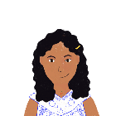










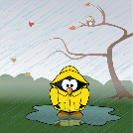











Sounds of the language 3
You will sometimes learn these SSC in pairs.
This helps you to distinguish between two very similar sounds.
-ill-/-ille
[to dress]
[family]
fille
brillant
habiller
famille
pavillon
juillet
-aill-/-ail
[to work]
[elsewhere]
[detail]
taille
ail
travailler
ailleurs
détail
medaille
-eill-/-eil
[marvellous]
[device]
[best]
oreille
soleil
merveilleux
appareil
bouteille
meilleur
-euill-/-euil
[to collect]
[welcome]
feuille
fauteuil
accueil
œil
écureuil
recueillir
-ouill-/-ouil
[to rummage]
[to scramble]
[to disentangle]
[wet]
brouillard
fouiller
mouillé
brouiller
débrouiller
grenouille
y
[to analyse]
y
système
style
physique
analyser
rythme
oy
[employee]
[average]
[journey]
envoyer
nettoyer
royal
employé
moyen
voyage
8
Notes:
brillant [2569]; juillet [1326]; habiller [3576]; famille [172]; pavillon [3412].
taille [1500]; ail [>5000]; détail[318]; médaille [3361] travailler [290]; ailleurs [360].
oreille [1844], meilleur [194], soleil [1713], bouteille [2979], merveilleux [2209], appareil [1420]
fauteuil [2743]; feuille [2440] recueillir [1230]; accueil [2541], écureuil [>5000], oeil [474]
fouiller [3431]; brouiller [4682] débrouiller [3618]; grenouille [>5000], mouillé [>5000]
système [289]; style [1999] physique [1146]; analyser [1209]; rythme [1662]
envoyer [526]; royal [2290]; nettoyer [3887]; employé [1485]; voyage [904]; moyen [186]

Slide 10

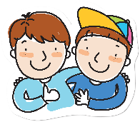


Liaison
If a word normally ends with a Silent Final Consonant, the final consonant is pronounced before a word beginning with [h] or a vowel. This is called liaison.
Here are some examples:
C’est amusant It’s funny.
Because the -t is followed by a vowel, it is pronounced.
Je parle avec mon ami. I speak with my friend.
Because the -n is followed by a vowel, it is pronounced.
Voici trois hôtels. Here are three ideas.
Because the -s is followed by an h-, it is pronounced.
Il y a deux équipes. There are two teams.
Because the -x is followed by a vowel, it is pronounced like a -z.
Syllables and Stress
French does not have the same system of stressed and unstressed syllables as English.
All syllables are sounded fairly equally, with a bit of extra emphasis on the last spoken syllable of each word.
Vowels are not ‘reduced’ – they are sounded in full.
9

Slide 11

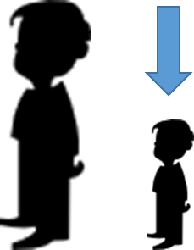
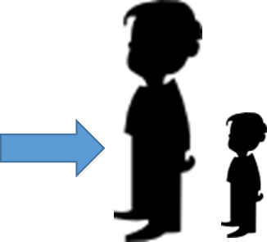


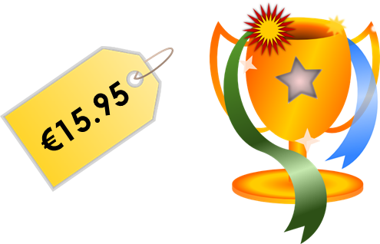


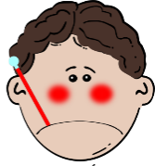





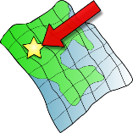
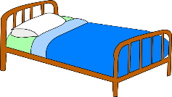
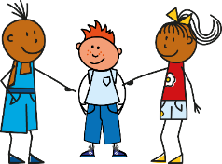




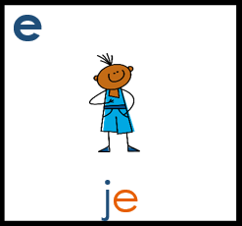
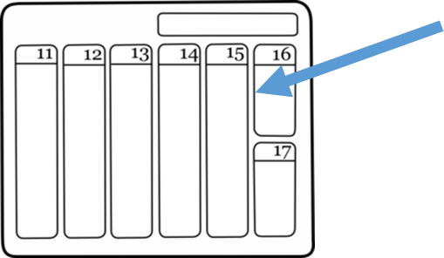
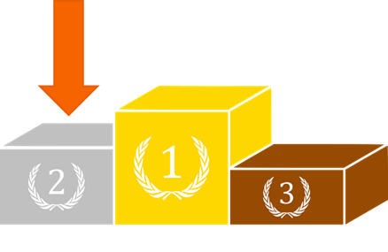






Year 7 phonics
In Year 9, we also revisit the following SSC (Sound-spelling correspondences) taught in Year 7. Learning these will help you to pronounce written French more confidently and to recognise and spell words you hear.
Silent final consonant [SFC)
Something that makes French sound different from English is that some consonants at the ends of words are silent. This means you don’t pronounce them at all!
petit
grand
mot
mais
prix
table
malade
mal
sac
ça va ?
petit
ici
lit
il
qui?
[a little]
[place]
feu
jeu
jeudi
un peu
lieu
[that]
[to have to]
samedi
second
cela
cheval
devoir
[also]
faux
beau
aussi
bateau
10
eau
Notes:
The cluster words have been chosen for their high-frequency, from a range of word classes, with the SSC (where possible) positioned within a variety of syllables within the words(e.g. initial, 2nd, final etc.., although not, of course with SFC!). Additionally, we have tried to use words that build cumulatively on previously taught SSCs (see the Phonics Teaching Sequence document) and do not include new SSCs. Where new SSCs are used, they are often consonants which have a similar symbol-sound correspondence in English.
Source: Londsale, D., & Le Bras, Y. (2009). A Frequency Dictionary of French: Core vocabulary for learners London: Routledge.
Word frequency rankings (1 is the most common word in French):
dans [11]; petit [138] prix [310]; mot [220]; mais [30]; grand [59]
ça va?[54 (cela), 53 (aller)]; malade [1066] mal [277]; table [1019]; sac [2343]; animal [1002]
petit [138]; lit [1837] ici [167]; il[13]; qui [14]; midi [2483]
jeudi[1112]; lieu [117] feu [786]; un peu [138/91]; jeu [291]; deux [41]
samedi [1355]; cela [54] second [379]; devoir [39]; cheval [2220]; je [22]
gauche [607]; aussi [44]; faux[555] photo [1412]; beau [393]; eau [475]

Slide 12





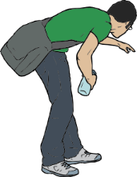










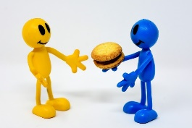



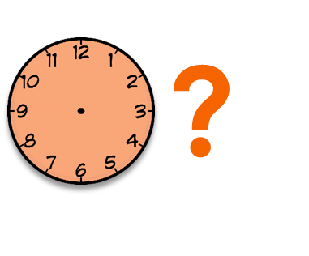


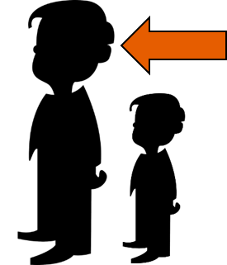


SSC pairs
You will sometimes practise the SSC in pairs.
This helps you to distinguish between two very similar sounds.
[on]
[to use]
Salut!
vue
amusant
sur
utiliser
[always;
still]
trouver
jouer
Bonjour!
toujours
douze
[life]
monde
moderne
centre
vie
douze
bébé
aller
donner
nez
parler
[to take]
grand
quand
penser
prendre
encore
[to show]
[at the
back]
[to continue]
onze
continuer
monde
montrer
au fond
11
Notes:
tu [112]; salut ! [2205] vue [191]; sur [16]; amusant [4695]; utiliser [345]
nous [31]; trouver [83] jouer [219]; bonjour [1972]; toujours [103]; douze [1664]
timide [3835]; monde [77]; moderne [1239] centre [491]; vie [132]; douze [1664]
écrire [382]; bébé [>5000]; aller [55] donner [46]; et [6]; parler [106]
enfant [126]; grand [59]; quand [119] penser [116]; prendre[43]; encore [51];
non [72]; onze [2447]; continuer [113] monde [77]; montrer [108]; au fond [553];

Slide 13




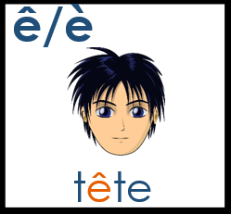

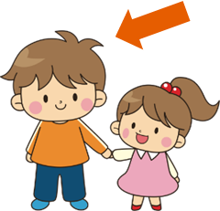


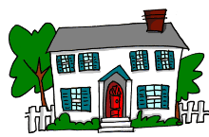







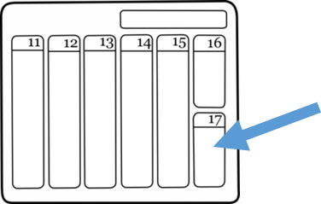






Year 7 phonics 3
These words have been especially chosen for their high-frequency. This means words that are used a lot when you speak French, and therefore they are very useful words for you to know!
[end]
[now]
fin
matin
vingt
maintenant
main
[problem]
[to be]
fête
frère
collège
problème
être
[reason]
[bad]
[to do]
[week]
maison
raison
mauvais
faire
semaine
[to have]
[why?]
droite
avoir
au revoir
pourquoi ?
trois
[field]
dimanche
chanter
bouche
champ
chat
[to decide]
français
garçon
cinéma
décider
cinq
12
Notes:
train [232]; fin [111]; matin [442] vingt[1273]; maintenant [192]; main [418]
tête [343]; fête [1490]; frère [1043] collège [2116]; problème [188]; être[5]
vrai [292]; maison [325]; raison [72] mauvais [274]; faire [25]; semaine [245]
voir [69]; droite [1293]; avoir [8] au revoir [n/a]; pourquoi[193]; trois[115]
chercher [336]; dimanche [1235]; chanter [1820] bouche [1838]; champ [847]; chat [3138]
ici [167]; français [251]; garçon [1599]; cinéma [1623]; décider [165]; cinq [288]

Slide 14














Year 7 phonics 4
[to explain]
[to miss;
be missing]
[unique;
only]
quatre
musique
expliquer
manquer
unique
[I have]
[subject]
[already]
[never]
j’ai
génial
sujet
déja
jamais
population
action
situation
international
solution
[nothing]
[soon]
chien
rien
bientôt
ancien
combien ?
Des virelangues pour pratiquer. (Some tongue twisters to practise).
1 Trois gros rats gris dans trois gros trous très creux.
1 Three big grey rats in three big, very deep holes.
2 Ce ver vert va vers le verre vert.
2 This green worm goes towards the green glass.
3 Fruits frais, fruits frits, fruits cuits, fruits crus.
3 Fresh fruits, fried fruits, cooked fruits, raw fruits.
13
Notes:
question[144]; quatre[283]; musique [1139] expliquer [252]; manquer [583]; unique [402]
jour [78]; j’ai [8 - avoir]; génial [3872] sujet [353]; déjà [58]; jamais [179];
attention [482]; population [509]; action [355] situation [223]; international [282]; solution [608];
bien [47]; chien [1744]; rien [168] bientôt [1208]; ancien [392]; combien? [800];
un [3]; quelqu’un [772]; lundi [1091]
Fruit image: Wolfgang Eckert en Pixabay

Slide 15






Word Patterns and Word Families
To develop vocabulary knowledge, we focus explicitly on some high frequency word patterns. To teach these patterns, a range of types of lexical item (e.g. frequent/infrequent; known/unknown) are used as examples. We also develop learners’ knowledge of word families (any parts of speech connected by a common, semantically-related stem).
Cognates: French word adds –e
bomb ➜ bombe
Watch out! If the word ends in –e, the last consonant is pronounced (no SFC).
Suffixes: English '-ly' ➜ French '-ment’
première ➜ premièrement
Watch out! The French adjective is in feminine form. The –ment part is SSC [en/an] + SFC.
Suffixes: English ‘-ive' ➜ French ‘-if’
active ➜ actif
Watch out! The [i] is pronounced differently in French and English.
Prefixes: 're-’ + verb (to do again)
‘re-’ + faire (to do, doing) ➜ refaire (to do again, redo)
Watch out! ‘re-’ is pronounced differently in French and English.
14

Slide 16






Word Patterns and Word Families
To develop vocabulary knowledge, we focus explicitly on some high frequency word patterns. To teach these patterns, a range of types of lexical item (e.g. frequent/infrequent; known/unknown) are used as examples. We also develop learners’ knowledge of word families (any parts of speech connected by a common, semantically-related stem).
Cognates: English ‘-c’, ‘-ck’ and ‘-k’ → French ‘-que’
fantastic ➜ fantastique
magic OR magical ➜ magique
Watch out! The –ique part has the SSC [i] and [qu].
Noun and adjective pairs: adjective + article ➜ noun
nouveau ➜ le nouveau (new ➜ the new one)
anglaise ➜ l'Anglaise (English (f.) ➜ the English person (f.))
Watch out! Add a capital letter to nouns describing nationalities.
Cognates: English ‘-or’ or ’our’ ➜ ‘eur’
actor ➜ acteur
honour ➜ honneur
Watch out! The SSC [eu] is always open before -r in French.
Cognates: English ‘-al’ ➜ ‘el’
cultural ➜ culturel
annual ➜ annuel
15

Slide 17


T1.1 Semaine 1
Grammaire
La féminisation des adjectifs
Adjectives change when they describe a feminine noun.
The most common change is to add ‘e’ to the end of the adjective.
un oiseau vert une voiture verte
When we add ‘e’, the SFC is no longer silent, and the ending is SFe instead.
The other rules for making adjectives agree with feminine nouns:
Adjectives ending in SFe stay the same.
Adjectives ending in –eux change to –euse.
Adjectives ending in –l change to –lle.
Adjectives ending in –n change to –nne.
Les pronoms et être
The singular subject pronouns are:
je
I
tu
you _{[sing.]}
il/elle/on
he/she/we
The singular forms of être are:
je suis
I am
tu es
you_{[sing.]} are
il/elle/on est
he/she is, we are
16
Notes:
Revisit Y7 vocabulary (1/7)
écrire [382], lire [278], affaires [170], anglais2 [784], cadeau [2298], chemise [3892], chien [1744], courses [1289], devoirs [39], femme [154], français2 [251], fruit [896], homme [136], livre [358], mot [220], ordinateur [2201], parents [546], phrase [2074], portable [4002], porte [696], règle [488], télé [2746], vacances [1726], vélo [4594], vêtements [2383], voiture [881], et [6], ou [33], un2 [3], une2 [3], des [3], le [1], la [1], les [1], ce [12], ça [54 (cela)], il2 [13], elle2 [38], voici [1103], cinq [288], deux [41], dix [372], douze [1664], huit [877], neuf [787], onze (2447), quatre [253], sept [905], six [450], trois [115], au revoir [4/1/1274], bonjour [1972], quoi [297], comment ça s’écrit ? [234/54/17/382], il y a [13/36/8]

Slide 18





Le pluriel des adjectifs
We often add –s to make adjectives agree with plural nouns.
des chats noirs des guitares noires
The other ways to make adjectives agree with plural nouns are:
Adjectives ending in –s or –x stay the same.
Les pronoms et être
The plural subject pronouns are:
nous
we
vous
you _{[plural, formal]}
ils/elles
they
The plural forms of être are:
nous sommes
we are
vous êtes
you_{[pl., formal]} are
ils/elles sont
they are
Some people who identify as non-binary use ‘iel’ or ‘ol’ as a gender-neutral pronoun, in the same way we use ‘they’ for one person in English. It is always best to ask a person how they would like to be addressed.
Talking about identity [1]
Vocabulaire
Revisit
1/13
Y7 & Y8 vocab
17
Notes:
Revisit Y7 vocabulary (1/7)
écrire [382], lire [278], affaires [170], anglais2 [784], cadeau [2298], chemise [3892], chien [1744], courses [1289], devoirs [39], femme [154], français2 [251], fruit [896], homme [136], livre [358], mot [220], ordinateur [2201], parents [546], phrase [2074], portable [4002], porte [696], règle [488], télé [2746], vacances [1726], vélo [4594], vêtements [2383], voiture [881], et [6], ou [33], un2 [3], une2 [3], des [3], le [1], la [1], les [1], ce [12], ça [54 (cela)], il2 [13], elle2 [38], voici [1103], cinq [288], deux [41], dix [372], douze [1664], huit [877], neuf [787], onze (2447), quatre [253], sept [905], six [450], trois [115], au revoir [4/1/1274], bonjour [1972], quoi [297], comment ça s’écrit ? [234/54/17/382], il y a [13/36/8]

Slide 19
T1.1 Semaine 2
Grammaire
-ER verbs in the present tense
To form the singular forms of -ER verbs in the present tense, we take the long form of the verb, remove –er, and then:
Long form:
regarder
Long form: infinitive / dictionary form
Short form: form that goes with the pronoun
Singular short forms:
je regarde
add -e
tu regardes
add -es
il/elle regarde
add -e
Pour and sans + infinitive
Pour means ‘(in order) to’ and sans means ‘without’.
To say ‘(in order) to do something’ or ‘without doing something’, we use pour/sans before a verb in the infinitive (long form).
Elle travaille dur pour réussir.
She works hard (in order) to succeed.
Elle travaille dur sans réussir.
She works hard without succeeding.
In French, sans is followed by the infinitive (long form). In English, without is followed by the -ing form.
Questions
You can ask questions in French by raising the pitch of your voice.
Statement:
Tu chantes.
You sing.
Question:
Tu chantes ?
Do you sing?
You can add a question word to the end of the sentence for more information.
Statement:
Tu chantes.
You sing.
Question:
Tu chantes quand ?
When do you sing?
qui: who
comment: how
quand: when
quoi: what
où: where
18
pourquoi: why

Slide 20

Cultural events [1]: Le festival de Dieppe
-ER verbs in the present tense
Grammaire
To form the plural forms of -ER verbs in the present tense, we take the long form of the verb, remove –er, and then:
Long form:
regarder
Long form: infinitive / dictionary form
Short form: form that goes with the pronoun
Plural short forms:
nous regardons
add -ons
vous regardez
add -ez
ils/elles regardent
add -ent
Saying ‘we’
The pronouns on and nous both mean ‘we’.
On means ‘we’ when talking about people in general. We can also translate it as ‘people’, you’, or ‘one’. It uses the il/elle verb endings.
On parle français ici.
We speak French here.
People speak French here.
The pronoun nous always means ‘we’ when talking about yourself and another person or people. We can also translate it as ‘you and I’. The verb ending is -ons.
Nous parlons français.
We speak French.
You and I speak French.
Questions
As you know, you can ask a question by putting est-ce que in front of a statement and raising your voice:
Est-ce qu’elle habite ici ?
Does she live here?
You can request more information by adding a question word at the start:
Pourquoi est-ce qu’elle habite ici ?
Why does she live here?
Revisit
(2/13)
Y7 & Y8 Vocab
19

Slide 21


T1.1 Semaine 3
Grammaire
aller + infinitive
je vais
tu vas
il/elle/on va
nous allons
vous allez
ils/ells vont
We can use aller in the short form followed by a second verb in the long form (infinitive to talk about the future:
Je vais dormir tôt.
I am going to sleep early.
Tu vas aller en Espagne.
You (sing.) are going to go to Spain.
Elle va faire le repas.
She is going to make the meal.
Nous allons boire de l’eau.
We are going to drink water.
Vous allez emprunter le livre.
You (pl.) are going to borrow the book.
Ils vont traduire en français.
They are going to translate into French.
Ne…pas with two-verb structures
We add ne…pas around the verb to make a sentence negative.
Je vais à l’université.
Je ne vais pas à l’université.
In sentences with two verbs, ne…pas surrounds the first verb in the short form. The second verb in the long (infinitive) form comes after pas.
Je vais aller à l’université.
Je ne vais pas aller à l’université.
Motivations and Goals
Revisit
(3/13)
Y7 & Y8 Vocab
20

Slide 22
Modal verbs and adverbs
Modal verbs
Grammaire
devoir must/ have to | vouloir to want (to) | pouvoir can/ be able to | savoir can/know how to
je dois | je veux | je peux | je sais
tu dois | tu veux | tu peux | tu sais
il/elle/on doit | il/elle/on veut | il/elle/on peut | il/elle/on sait
Use pouvoir for ability or permission. Use savoir for things/skills you have learned to do.
Remember to use the modal verb in the short form. If there is a second verb, it must be in the long form (infinitive).
Je veux du chocolat.
I want some chocolate.
Je veux manger du chocolat.
I want eat some chocolate.
Adverbs
An adverb or adverbial phrase gives more information about when, where, how often, or how something happens. They are used to describe verbs.
Adverbs that tell us how and how often normally come after the verb they describe.
Il parle souvent à Sophie.
He often speaks to Sophie.
Je mange bien au restaurant.
I eat well at the restaurant.
Exception! Parfois (sometimes) and normalement (normally) can also come at the beginning of a sentence.
Adverbs that tell us when and where normally come at the beginning or the end.
Demain, je vais au parc.
I am going to the park tomorrow.
Je vais au parc demain.
Exception! Aussi (also) can sometimes come at the end of the sentence. This is different from English.
21

Slide 23

T1.1 Semaine 4
Grammaire
Modal verbs
You already know the je, tu, and il/elle forms of these modal verbs:
devoir must/to have to | vouloir to want (to) | pouvoir can/be able to | savoir can/know how to
je dois | je veux | je peux | je sais
tu dois | tu veux | tu peux | tu sais
il/elle/on doit | il/elle/on veut | il/elle/on peut | il/elle/on sait
The plural nous and vous forms of all modal verbs are formed in the same way:
Remove –oir from the infinitive: devoir → dev
Add –ons for nous. Add –ez for vous.
nous devons | nous voulons | nous pouvons | nous savons
vous devez | vous voulez | vous pouvez | vous savez
The ils/elles form adds –ent. Devoir, pouvoir, and vouloir change their stems.
devoir ils/elles doivent
The stem goes back to doi- like the singular forms and adds v.
pouvoir ils/elles peuvent
The stem goes back to peu- like the singular forms and adds v.
vouloir ils/elles veulent
The stem goes back to veu- like the singular forms and adds l.
savoir ils/elles savent
The stem stays the same as the other plural forms.
Remember the sentence structure with modal verbs:
modal verb in short form + main verb in long form (infinitive)
22
Nous voulons jouer le jeu. We want to play the game.

Slide 24

Talking about what you can(not), must (not) and (don’t) want to do at work
Modal verbs in the negative
Grammaire
Remember: to make a sentence with two or more verbs negative, we add ne…pas around the first verb in short form.
nous voulons chanter.
We want to sing.
nous ne voulons pas chanter.
We don’t want to sing.
vb | nous devons | we must, we have to
vb | vous devez | you (formal/pl) must, have to
vb | ils/elles doivent | they must,they have to
vb | ils/elles peuvent | they can, they are able to
vb | ils/elles savent | they know how to, knowing how to
vb | ils/elles veulent | they want (to)
n | l'entreprise (f) | company
n | l'attitude (f) | attitude
n | le collègue | colleague (m)
n | la collègue | colleague (f)
n | le directeur | headteacher, manager (m.)
n | la directrice | headteacher, manager (f)
n | la piscine | swimming pool
n | le stage | work experience
adj | actif | energetic (m)
adj | active | energetic (f)
adj | négatif | negative (m)
adj | négative | negative (f)
adj | positif | positive (m)
adj | positive | positive (f)
adj | sportif | sporty (m)
adj | sportive | sporty (f)
Revisit
8.3.1.2
and 8.3.2.4
23

Slide 25
T1.1 Semaine 5
Grammaire
Il faut + infinitive
We already know one way to talk about necessity:
Nous devons regarder les messages.
Here is another way:
Il faut regarder les messages.
It is necessary to look the messages.
Il faut is a special verb form that is only used in the third person singular.
Il faut never changes form. It does not give information about who must do something. It is the same for one person or multiple people. It simple states that it is necessary to do something.
Il ne faut pas
You already know how to make negative sentences with modal verbs:
il ne sait pas he doesn’t know how to
We can also add ne…pas to il faut to say what must not be done:
il ne faut pas arriver en retard You must not arrive late.
La féminisation des adjectifs
You already know various ways to make a masculine adjective feminine.
Here is another rule:
change –if to –ive
masculine
actif
négatif
feminine
active
négative
24

Slide 26





T1.1 Semaine 6
Grammaire
Saying ‘to’ and ‘in’
We use the preposition à to talk about going to or being in a town or city:
Je vais …
à Paris
to Paris
Tu es …
à Paris
in Paris
We use the preposition en to talk about going to or being in a feminine country:
Elle va …
en France
to France
Ils sont …
en France
in France
Country names ending in -e are normally feminine.
Country names ending in letters other than -e are masculine (e.g., le Canada).
We use au (à + le) to talk about going to or being in a masculine country:
Nous allons …
au Canada
to Canada
Je suis …
au Canada
in Canada
We also use au (à le) to talk about going to or being in a masculine region:
Vous allez …
au Québec
to Quebec
Il est …
au Québec
in Quebec
Le verbe ‘connaître’
Here is the pattern of endings for the first, second and third person singular forms of connaître:
je connais
I am familiar with, know
tu connais
you are familiar with, know
il connaît
he is familiar with, knows
elle connaît
she is familiar with, knows
25

Slide 27

Talking about what, where and who you know
Two words for ‘know’
Grammaire
'Connaître’ and ‘savoir’ both mean ‘to know’.
‘Connaître’ means knowing (being familiar with) a person, place or thing:
Je connais la chanson !
I know the song!
‘Savoir’ means ‘can/know how to’ when used as a modal before another verb:
Elle sait faire l’exercice.
She can/knows how to do the exercise.
‘Savoir’ means ‘know’ when used alone, with a question word or with que (that):
Je ne sais pas !
I don’t know.
Il sait que c’est important.
He knows that it’s important.
Tu sais où on peut manger ?
Do you know where we can eat?
vb | connaître | to be familiar with, to know
vb | je connais | I am familiar with, I know
 | tu connais | you are familiar with, you know
vb | savoir | to know how to, know
vb | la chanson | song
n | le chemin | way, path
n | l'endroit (m) | place, spot
n | les gens (mpl) | people
n | le groupe | group
adj | québécois | from Quebec (m)
adj | québécoise | from Quebec (f)
adj | canadien | Canadian (m)
adj | canadienne | Canadian (f)
n | le Canada | Canada
n | le Québec | Quebec
Revisit
8.3.1.4 & 8.3.2.6
26
Notes:
connaître, connais [133], chanson [2142], chemin [859], endroit [650], gens [236], groupe [187], québécois [1970], canadien [611], Canada [n/a], Québec [n/a]

Slide 28



T1.1 Semaine 7
Grammaire
Verbs like ‘entendre’: ‘mettre’
‘Mettre’ and ‘remettre’ follow the same pattern of endings as ‘entendre’:
In the je, tu and il/elle forms, these verbs lose a ‘t’.
The remaining ‘t’ is a silent final consonant (SFC).
je mets
I put, am putting
nous mettons
we put, are putting
tu mets
you put, are putting
vous mettez
you put, are putting
il met
he puts, is putting
ils mettent
they put, are putting
elle met
she puts, is putting
elles mettent
they put, are putting
Saying ‘never’: ne … jamais
We know that ne…pas around a verb in short form makes a sentence negative:
Tu ne manges pas de fromage.
You are not eating cheese.
Elle ne lit pas de journaux.
She does not read newspapers.
Ne…jamais means ‘never’. It surrounds a verb in short form in the same way:
Tu ne manges jamais de fromage.
You never eat cheese.
Elle ne lit jamais de journaux.
She never read newspapers.
27

Slide 29


Talking in the Negative
Vocabulaire
vb | mettre | to put, putting
vb | je mets | I put, I am putting
vb | tu mets | you put, you are putting
vb | il/elle met | he/she puts, he/she is putting
vb | remettre | to put back, putting back
vb | je remets | I put back, I am putting back
vb | tu remets | you put back, you are putting back
vb | il/elle remet | he/she puts back, he/she is putting back
n | la campagne | countryside
n | le dollar | dollar
n | la population | population
n | la province | province
n | le lac | lake
n | l'habitant (m) | resident (m)
n | l'habitante (f) | resident (f)
n | le fleuve | river
n | le sac | bag
adv | jamais | never
Revisit
8.3.1.5 & 8.3.2.7
28
Notes:
mettre, met, mets [27], remettre, remet, remets [156], perdre [250], campagne [666], dollar [432], habitant [1333], fleuve [2893], lac [3121], population [509], province [861], jamais [179]

Slide 30

T1.2 Semaine 1
T1.2 Semaine 1
Grammaire
L’infinitif
The infinitive is the long form of the verb. You know these types of infinitives: -er, like regarder; -re, like prendre, lire, entendre; -ir, like venir, sortir, chosir ; irregular (aller, avoir, boire, être, faire).
To form it, remove the short form ending and add the infinitive ending.
An infinitive (long form) can be used as the subject of a sentence to express an activity. It works like a noun and is often the first word in the sentence:
Conduire dans la neige, c’est difficile.
When the sentence starts with an infinitive, the activity is often followed by a comma + ‘c’est’. This is different from English.
We normally translate this using the English verb in the –ing form:
Driving in the snow is difficult.
A verb in short form at the start of a sentence normally indicates a question about what someone or something is doing:
Conduit-il dans la neige ? Is he driving in the snow ?
Uses of infinitives: modal verbs
We can use the infinitive after a modal verb. The English translation of the infinitive changes depending on whether it is being used as a noun or after a modal:
At the beginning of a sentence to express a noun (-ing form in English)
Conduire dans la neige, c'est difficile.
Driving in the snow is difficult.
Il doit conduire dans la neige.
After a modal verb
(short form in English)
He must/has to drive in the snow.
29

Slide 31

Talking about travel activities in France
Uses of infinitives: aimer and aller
Grammaire
We also use the infinitive after ‘aimer’ and ‘aller’. The English translation of the infinitive depends on the context.
Il va conduire dans la neige.
After the present tense of aller to describe a future action
(‘to’ form in English)
He is going to drive in the snow.
Il aime conduire dans la neige.
After ‘aimer’
(-ing form or ‘to’ form in English)
He likes driving/to drive in the snow.
Pour/sans + infinitif
Use the infinitive after pour to say why someone is doing something.
Je vais à la piscine pour faire de l’exercice.
Use the infinitive after sans to mean “without doing something”.
Il regarde un film sans écouter.
Talking about travel activities in France
vb
vb
vb
vb
nf
nm
adj
adj
adj
adj
adj
empêcher | to prevent, preventing
pratiquer | to practise, practising
risquer | to risk, risking
respecter | to respect, respecting
la région | region
le château | castle, palace
historique | historic
utile | useful
essentiel | essential (m)
essentielle | essential (f)
fantastique | fantastic
Vocabulaire
Revisit
9.1.1.4 & 8.3.2.4
30

Slide 32


T1.2 Semaine 2
T1.2 Semaine 2
Grammaire
La féminisation des adjectifs
To make adjectives that end in ‘-ien’ agree with feminine nouns, we add ‘-ne’.
un livre italien une glace italienne
an Italian book an Italian ice cream
Lots of adjectives ending in ‘-ien’ in French end in ‘-ian’ in English.
Verbs like ‘venir’
The verbs appartenir and soutenir follow the same pattern as venir.
j’appartiens
I belong
tu soutiens
you_{[sing]} support
il/elle appartient
he/she belongs
Using the verb ‘croire’
The singular forms of croire follow the same pattern as boire:
je crois
I believe
tu crois
you_{[sing]} believe
il/elle croit
he/she believes
Noun-adjective pairs
Nationality adjectives become nouns if we add a definite article:
français → le Français French → French person (m.)
Religion adjectives follow the same pattern:
musulman → le musulman Muslim → Muslim (person)
Many other adjectives also follow this pattern:
nouveau → le nouveau new → the new one
We don’t use a word for ‘a’ after ‘être’ with nouns for nationalities or jobs. The same applies to nouns for religious identities, or any other nouns to describe identities.
31

Slide 33


La féminisation des noms
La féminisation des noms
Grammaire
The ways to make nouns feminine are:
1. add –e: un avocat une avocate
2. change the article only: un médecin une médecin
3. change –eur to –rice: un acteur une actrice
4. change –n to –nne: un italien une italienne
Lots of nouns ending in ‘-ien’ in French end in ‘-ian’ in English.
Le pluriel des noms
We usually make nouns plural by adding –s:
le chien → les chiens dog → dogs
Nouns ending in –eu, –(e)au, –al, or –ail make their plurals with –x:
le feu → les feux fire → fires
Nouns ending in –s or –x don’t change in the plural:
le pays → les pays country → countries
Talking about identity (2): nationality and religion
appartenir à | to belong to, belonging to
croire | to believe, believing
je crois | I believe, am believing
tu crois | you _{[sing.]} believe,are believing
il/elle croit | he/she believes, is believing
soutenir | to support, supporting
le dieu | god
la foi | faith
la laïcité | being non-religious
la liberté | freedom
chrétien | Christian (m)
chrétienne | Christian (f)
européen | European (m)
européenne | European (f)
juif | Jewish (m)
juive | Jewish (f)
musulman | Muslim (m)
musulmane | Muslim (f)
religieux | religious (m)
religieuse | religious (f)
Revisit
9.1.1.6 & 8.3.1.6
32

Slide 34
T1.2 Semaine 3
Grammaire
Possessive adjectives (1)
We have already learnt how to say ‘my’ and your’ in French:
(m) noun:
(f) noun:
(m/f) before a vowel/h:
(m/f pl) noun:
mon frère
ma sœur
mon ami(e)
mes ami(e)s
ton chien
ta famille
ton animal
tes parents
The words for ‘my’ and ‘your’ agree with the gender and number of the possession.
We use this form of ‘your’ in informal situations, such as when we are talking about friends, family, and children.
When we are talking about more than one person, or one person in a formal situation, we use votre or vos to say ‘your’.
votre choix
votre rue
votre chambre
vos idées
The words for ‘your’ (formal/plural) agree with the number of the possession only.
Possessive adjectives (2)
We have already learnt how to say ‘his/her’ and our’ in French:
(m) noun:
(f) noun:
(m/f) before a vowel/h:
(m/f pl) noun:
son père
sa mère
son enfant
ses enfants
The words for ‘his/her’ agree with the gender and number of the possession.
notre fils
notre maison
notre équipe
nos vies
In French, we use leur or leurs to say ‘their’:
leur choix
leur rue
leur chambre
leurs idées
The words for ‘their’ agree with the number of the possession only.
33

Slide 35


Staying in a hotel
Vocabulaire
vb | commander | to order, ordering
vb | réserver | to reserve, reserving
n | l'addition (f) | bill
n | le choix | choice
n | le restaurant | restaurant
n | la table | table
n | la carte | menu
n | la nuit | night
n | la réception | reception
n | le service | service
adj | leur | their (m/f)
adj | leurs | their (pl)
adj | votre | your (m/f)
adj | vos | your (pl)
Revisit
9.1.1.7 & 8.3.2.4
34

Slide 36

T1.2 Semaine 4
T1.2 Semaine 4
Grammaire
The perfect tense
The French perfect tense has two equivalent tenses in English:
When we know the specific year, month, day or time, we use the simple past.
J’ai visité le Sénégal l’année dernière.
I visited Senegal last year.
When we don’t, we can use either the present perfect or the simple past.
J’ai visité le Sénégal. I have visited Senegal. I visited Senegal.
Le placement des adjectifs
Adverbs that tell us exactly when or where something happens normally come at the beginning or end of sentences:
Hier, j’ai mangé du fromage. I ate some cheese yesterday.
Il lit en ce moment. He’s reading at the moment.
Adverbs that tell us how or how frequently something happens normally come in the middle of a sentence, after the verb in short form:
Il va souvent au Sénégal. He often goes to Senegal.
In the perfect tense, adverbs that tell us how or how frequently something happens normally come between the form of avoir and the past participle:
Il a déjà acheté le pain. He already bought the bread.
Irregular past participles
je bois (I drink/I am drinking) j’ai bu (I drank/have drunk)
elle a (she has) elle a eu (she has had/had)
35

Slide 37

The perfect tense
The perfect tense
Grammaire
The singular forms of the perfect tense of –ER verbs are:
j’ai gagné I won/have won
tu as gagné you _{(sing.)} won/have won
il/elle a gagné he/she won/has won
And the plural forms are:
nous avons gagné we won/have won
vous avez gagné you _{(pl.)} won/have won
ils/elles ont gagné they won/have won
present tense of avoir + past participle
The perfect tense of verbs like prendre
The past participle of ‘prendre’ is ‘pris’:
je prends (I take/am taking) j’ai pris (I took/have taken)
With other verbs like prendre, the past participle ends in -pris:
tu as appris (you learnt/have learnt)
il a compris (he understood/has understood)
Possessive adjectives
Possessive adjectives say who things belong to. They change to agree with the gender and number of the noun.
 | (m.) noun | (f.) noun | (f.) noun before a vowel/h | (m.f. pl.) noun
my | mon père | ma mère | mon amie | mes livres
your _{(sing.)} | ton père | ta mère | ton amie | tes livres
his/her | son père | ta mère | son amie | ses livres
our | notre père | notre mère |  | nos livres
your _{(pl.)} | votre père | votre mère |  | vos livres
their | leur père | leur mère |  | vos livres
36

Slide 38



Inversion questions
Inversion questions
Grammaire
We can turn sentences with two verbs into questions by swapping the position of the subject pronoun and the verb in short form:
Statement: Ils vont réussir l’examen.
Question: Vont-ils réussir l’examen ?
We can use the same rule to turn statements into questions in the perfect tense. Remember, avoir is the verb in short form.
Statement: Vous avez compris le texte.
Question: Avez-vous compris le texte ?
Remember to add a hyphen between subject and verb!
Inversion questions
To say what doesn’t happen, we use ne … pas before and after the verb.
Il ne conduit pas. He doesn’t drive.
To say what never happens, we use ne … jamais before and after the verb.
Nous ne regardons jamais la téle. We never watch TV.
When there are two verbs, ne … pas and ne … jamais go around the first verb, which is the verb in the short form.
Ils n’aiment pas aller à la piscine.
They don’t like to go to the swimming pool.
Je n’ai jamais écouté cette chanson.
I have never listened to that song.
Remember ne becomes n’ before a vowel!
Le Sénégal
La féminisation des adjectifs
Remember, adjectives ending in –if change to –ive when they describe a feminine noun.
Il est sportif. He is sporty.
Elle est sportive. She is sporty.
Vocabulaire
Revisit
4/13
Y7 & Y8 vocab
37

Slide 39



Modal verbs
Modal verbs
Grammaire
Modal verbs give us more information about the second verb.
The modal verb is in the short form and the second verb is in the long form.
We use devoir to say what someone must do:
Je dois aller au marché. I must go to the market.
We use vouloir to say what someone wants to do:
Il veut manger au café. He wants to eat at the café.
We use pouvoir to say what someone is able to do:
Vous pouvez venir demain ?
Can/Are you [pl.] able to come tomorrow?
We use savoir to say what someone knows how to do:
Elles savent jouer du piano.
They [f.] know how to play the piano.
Another way to say what must happen is to use il faut. It is followed by a verb in the long form.
Il faut lire les règles. It is necessary to read the rules.
The verb croire
The present tense singular forms of the verb croire are:
je crois I believe
tu crois you _{(sing.)} believe
il/elle croit he/she believes
The verb connaître
The present tense singular forms of the verb connaître are:
je connais I am familiar with/know
tu connais you _{(sing.)} are familiar with/know
il/elle connait he/she is familar with/knows
38

Slide 40



T1.2 Semaine 6
Grammaire
Les numéros 32-69
The numbers 32-69 follow the same pattern as 17-31:
thirty-three
quarante et un
forty-one
trente-trois
Add a hyphen between the numbers.
Add et before un.
Telling the time
To ask what time it is in French, we say:
Quelle heure est-il ? What time is it?
To ask what time something happens, we say:
À quelle heure… [+ verb] ? (At) What time… [+ verb]?
Tu manges à quelle heure ? (At) What time do you eat?
À quelle heure manges-tu ?
In informal, spoken French you will sometimes hear À quelle heure tu manges ? without inversion.
To say what time it is in French, we use:
Il est + [number] + heure(s) + [minutes]
Il est dix-sept heures trente-cinq. / Il est 17h35.
It’s seventeen thirty-five. / It’s 17:35.
To say what time something happens, we use à.
Je mange à dix-huit heures quinze / 18h15.
I eat at eighteen fifteen / 18:15.
39

Slide 41












Talking about your day
Expressions with avoir
Grammaire
Usually, avoir + article + noun means ‘to have something.’ However, certain expressions with avoir + no article + noun translate differently:
J’ai faim I am hungry
Tu as peur You are scared
Elle a mal She is in pain
Il a tort He is wrong
Nous avons soif We are thirsty
Vous avez froid You [pl.fml] are cold
Ils ont raison They (m.) are right
Elles ont chaud They (f) are warm/hot
Vocabulaire
nf
nf
nf
nm
nm
nm
num
num
num
other
nf
nf
la faim | hunger
la soif | thirst
la peur | fear
le tort | wrong
le midi | midday
le minuit | midnight
quarante | forty
cinquante | fifty
soixante | sixty
donc | so, therefore
l’heure (f.) | time of day
la raison | reason, right
Revisit
9.1.2.1 & 8.3.2.6
40

Slide 42







T1.2 Semaine 7
T1.2 Semaine 7
Grammaire
Le placement des adjectifs
In French, adjectives usually come after the noun they describe, except adjectives that refer to:
N O S B A G S
number
same
age
size
other
beauty
goodness
When there is more than one adjective after the noun, we put “et ” in between. This is just like English.
Le garçon intelligent et amusant
The boy (who is) intelligent and funny
When there is more than one adjective before the noun, we don’t need “et”.
La belle nouvelle guitare The beautiful new guitar
If the adjectives go in different positions, they surround the noun.
Le petit oiseau bleu The small blue bird
41

Slide 43








Le placement des adjectifs
The partitive article
Grammaire
We use un/une (the indefinite article) to talk about ‘whole’ things, and du/de la/de l’ (the partitive article) to talk about ‘parts’ of things in French:
un gâteau
a cake
du gâteau
some cake
The partitive article changes to de after an expression of quantity:
un kilo de viande
a kilo of meat
une bouteille d’huile
a bottle of oil
The partitive article also changes to de in negative sentences:
Il n’y a pas de cadeaux.
There are no gifts.
Noël
Vocabulaire
vb
nm
nm
nm
nm
nm
adj
adj
other
nf
nf
nf
contenir | to contain, containing
l’air (m.) | atmosphere, feeling
le bonheur | happiness
le symbole | symbol
le souvenir | memory
le vent | wind
fort | strong
long, longue | long
vers | towards
l’Afrique (f.) | Africa
l’Asie (f.) | Asia
l’Europe (f.) | Europe
Revisit
9.1.1.2 & 8.3.2.7
42

Slide 44

T1.2 Semaine 1
T2.1 Semaine 1
Grammaire
Perfect tense forms
Verbs in the perfect tense tell us what happened in the past.
To form the perfect tense, you need present tense of avoir + past participle.
avoir: j’ai tu as il/elle/on a
nous avons vous avez ils/elles ont
past participles:
-ER verbs: stem +é
e.g. visiter
→ visité
verbs like prendre: end in -pris
e.g. apprendre
→ appris
Some verbs have irregular participles. You just have to learn these!
faire
→ fait
boire
→ bu
dire
→ dit
avoir
→ eu
Yes and no questions in the perfect tense
To ask a question, you can either use intonation or est-ce que. In the present tense, it looks like this:
Tu joues au foot ? /
Est-ce que tu joues au foot ?
Oui, je joue au foot /
Non, je ne joue pas au foot
ne … pas fits around the verb
In the perfect tense, it looks like this:
Tu as joué au foot ? /
Est-ce que tu as joué au foot ?
Oui, j’ai joué au foot /
Non, je n’ai pas joué au foot
ne … pas fits around avoir
43

Slide 45

T1.2 Semaine 1
T2.1 Semaine 1
Grammaire
La position des adverbes
Verbs in the perfect tense tell us what happened in the past.
Adverbs tell us when, where, how or how often something (has) happened.
When
Where
How / how often
Position: beginning or end
Hier, j’ai fait des courses / J’ai fait des courses hier.
Translation:
past simple
Yesterday I did the
food shopping /
I did the food shopping yesterday.
Position:
beginning or end
J’ai fait du sport dehors.
Translation: past simple if we know when it happened
I did sport outside.
Translation: present perfect if we don’t know when it happened
I have done sport outside.
Position:
after short form verb
Il a vite bu du thé.
Translation:
past simple if we know when it happened
He drank tea quickly.
Translation: present perfect if we don’t know when it happened
He has drunk tea quickly.
Revisit Y7 and Y8 vocabulary 5/13
Vocabulaire
44

Slide 46

T2.1 Semaine 2
Grammaire
The perfect tense – saying what you did and where you went
We usually use the present tense of avoir to make the first part of the perfect tense, but some verbs take être instead.
Compare these examples:
Verbs that take ‘avoir’ in the perfect tense don’t involve moving from one place to another.
J’ai mangé I ate
Tu as regardé you _{[sing. informal]} watched
Il a joué he played
Je suis allé(e) I went
All the verbs that take être express movement or a change of state, except for rester, which expresses a lack of movement.
Tu es resté(e) you _{[sing. informal]} stayed
Il/elle est arrivé(e) He/she arrived
We add ‘e’ to the past participle if the subject is feminine.
Vocabulaire
Revisit Y7 and Y8 vocabulary 6/13
45

Slide 47



T1.2 Semaine 7
T2.1 Semaine 3
Grammaire
-er verbs that take être in the perfect tense
You know the singular forms of verbs that take être in the perfect tense :
je suis entré(e)
I entered, have entered
Add ‘e’ to the past participle if the subject is feminine.
tu es monté(e)
you _{[sing.]} went up, have gone up
il est retourné
he returned, has returned
elle est tombé(e)
No –s when on means ‘one’ or ‘people in general’.
she fell, has fallen
on est entré
one entered, has entered
Plural forms
The plural forms follow the same pattern, and we add –s to the past participle:
Add –s when on means ‘we’.
on est entrés
we entered, have entered
we went up, have gone up
nous sommes montés
vous êtes retourné(s)
No –s when vous means ‘you [sing fml]’.
you _{[pl./fml]} returned, have returned
ils sont tombés
they fell, have fallen
46

Slide 48

T1.2 Semaine 7
Talking about what has happened: Accidents and emergencies
Vocabulaire
Revisit
9.1.2.3 & 8.3.2.4
vb | entrer | to enter, entering
vb | monter | to go up, going up
vb | retourner | to return, returning
vb | tomber | to fall, falling
nm | l'après-midi (m) | afternoon
nf | l'attente (f) | wait
nm | le corps | body
nm | le doigt | finger
nm | le dos | back
nm | le médicament | medicine
nm | le pied | foot
nf | la santé | health
nf | la situation | situation
nm | le soir | evening
nf | l'urgence (f) | emergency
adj | faible | weak
adv | seulement | only
adv | trop | too
47

Slide 49



T1.2 Semaine 7
T2.1 Semaine 4
Vocabulaire
vb | blesser | to hurt, hurting
vb | jeter | to throw, throwing
vb | laisser | to leave behind, leaving behind
nm | l'amour (m) | love
nf | l'envie (f) | desire
nf | la mer | sea
nm | le prix | price
nm | le sens | sense, meaning
adv | tellement | so much, so many
Revisit
9.1.2.3 & 9.1.1.4
T2.1 Semaine 5
Grammaire
Verbs + à/de + noun
Using a verb + de + noun:
(including talking about playing a musical instrument)
Je joue de la guitare
guitare (f)
Using a verb + à + noun
(including talking about playing sports and games)
Je joue au tennis
tennis (m)
The form of de changes when it is used with le or les:
Je joue…
du piano
des instruments
I play…
the piano
the instruments
48

Slide 50


Grammaire
The form of à changes when it is used with le or les:
Je pense…
au printemps
aux îles
I think about…
the spring
the islands
Relative pronoun ‘qui’
You already know that qui means ‘who?’ in a question, but it also means ‘who’, ‘which’, ‘or ‘that’ in the middle of a sentence. It introduces a relative clause to give more information about a noun.
le papa qui a treize instruments
In English, we use who/that for people and which/that for animals and things.
the dad who has thirteen instruments
le bus qui descend la rue
the bus that goes down the street
Verbs like écrire
Grammaire
j’écris
tu écris
il/elle/on écrit
I write
you [sing.] write
he/she/one writes, we write
nous écrivons
vous écrivez
ils/elles écrivent
we write
you [pl./fml.] write
they write
Talking about what you do in your free time
Revisit
Y7 & Y8 vocab 7/13
Vocabulaire
49

Slide 51

T2.1 Semaine 6
Emphatic pronouns
Grammaire
Moi and toi are emphatic pronouns. We use them after prepositions.
Le chien mange après moi.
The dog eats after me.
Nous arrivons avant toi.
We are arriving before you.
Prepositions
Prepositions tell us where something is or when something happens in relation to something else.
Emphatic pronouns can be used after prepositions such as pour, avec, contre, chez, à, sous, sur, derrière, devant, entre, près de, sans, après, avant, selon.
Talking about what has happened (2): Crime
vb | approcher | to approach, approaching
vb | avoir besoin de | to need, needing
vb | téléphoner (à) | to telephone, telephoning
vb | voler (à) | to steal (from), stealing (from)
pron | moi | me
pron | toi | you
nf | la fréquence | rate
nf | la sécurité | safety
nf | la responsabilité | responsibility
nm | le criminel | criminal
nm | le crime | serious crime
adj | proche | close, nearby
prep | après | after
prep | avant | before
prep | selon | according to
Vocabulaire
Revisit
9.1.2.7 & 9.1.1.7
50

Slide 52
T2.2 Semaine 1
Grammaire
L’imparfait – the imperfect tense
We use the imperfect tense to talk about events and actions that used to happen regularly in the past.
Je jouais au foot tous les jours. I used to play football every day.
imparfait
You can translate the imperfect to English using the phrases ‘used to’ and ‘kept (on) …ing’
We use the present tense to talk about something that happens regularly now.
Maintenant, je joue au foot les samedis. Now, I play football on Saturdays.
présent
You already know one past tense; the perfect tense is made up of two verbs, an auxiliary verb and a past participle.
The imperfect is made up of one word.
To form the imperfect tense for je:
je + stem of present tense ‘nous’ form + -ais
e.g. regarder → nous → je
regardons
regardais
e.g. aller → nous → j’
allons
allais
empêchons
empêchais
e.g. empêcher → nous → j’
To form the imperfect tense for il/elle/on, you need:
il/elle/on + stem of present tense ‘nous’ form + -ait
You have seen this before in the phrase
il y avait = there was, there were
travaillons
e.g. travailler → nous → il/elle/on
travaillait
voyageons
e.g. voyager → nous → il/elle/on
voyageait
cochons
e.g. cocher → nous → il/elle/on
cochait
Il mangeait dans le jardin.
51
He used to eat in the garden.

Slide 53







Les nombres ordinaux
Grammaire
Ordinal numbers are used to describe the order in which things happen.
For example, the fourth year, the sixth lesson, the tenth test!
In English, we normally add -th to numbers to make them ordinal. In French, we add –ième:
Translating the English ordinal number first into French is different:
First becomes premier or première (depending on whether the subject is masculine or feminine).
However, twenty-first follows the normal pattern, becoming le vingt-et-unième.
number
Ordinal number
Exception: for cardinal numbers ending with ‘e’ such as quatre, remove the ‘e’ before adding the suffix –ième
For cinq, add ‘u’ before the suffix –ième
second
deux
le deuxième
third
trois
le troisième
fourth
quatre
le quatrième
fifth
cinq
le cinquième
sixth
six
le sixième
[s-]/[x-] before a vowel
As you have already learned, an -x or -s at the end of a word is a silent final consonant (SFC), e.g. deux, trois.
However, when these numbers become ordinal numbers the [x] and [s] are no longer the last letter.
Instead, they are between two vowels, which changes SFC to [-s-].
deux >
deuxième
trois >
troisième
SFC >
[-s-]
SFC >
[-s-]
52

Slide 54


Describing things past and present
Vocabulaire
vb
vb vb
nf
nf
nm
nm
adj
adj
adj
adj
adj
adj adv
corriger | to correct, correcting
durer | to last, lasting
poser | to ask (a question)
la compétence | skill
la connaissance | knowledge
le contrôle | test
le système | system
cinquième | fifth
deuxième | second
quatrième | fourth
primaire | primary
sixième | sixth
troisième | third
longtemps | a long time
Revisit
9.2.1.3 & 9.1.2.1
53

Slide 55



T2.2 Semaine 2
Grammaire
Un an vs. une année
Un an or une année both mean ‘a year’.
Un an is used with a number (including tous) to count years or the number of times something happens in a year.
L’enfance dure 18 ans.
Je suis arrivée en France il y a 5 ans.
UN AN
= QUANTITY
Une année is used to describe what happened in a particular year, or to say how many years something took.
Il a écrit beaucoup l’année dernière.
C’est la deuxième année du festival.
UNE ANNÉE
= DESCRIPTION OR DURATION
‘ans’ for age
We also use ans to talk about age in French.
In English, we say ‘to be X years old’.
In French, we say ‘avoir X ans’ (to have, having X years).
To ask someone’s age in French, ask:
Tu as quel âge?
‘Which age’ do you have?’
Quel âge as-tu ?
To respond, say,
J’ai __ ans.
Numbers:
(12) douze, (13) treize, (14) quatorze
54

Slide 56

L’imparfait (je, il/elle/on)
Grammaire
Remember: the imperfect describes states and actions that were ongoing or repeated in the past – things that used to happen.
To form the imperfect:
i) take the nous form of the present tense
ii) remove the –ons ending
iii)add the imperfect ending (je –ais)(il/elle/on –ait
e.g. visiter → nous visitons → visit- → je visitais / il visitait
This rule applies to all verb groups!
e.g. construire → nous contruisons → contruis- → je contruisais, il/elle/on contruisait
Let’s recap nous forms:
écrire →
nous écrivons
prendre →
nous prenons
choisir →
nous choississons
entendre →
nous entendons
sortir →
nous sortons
lire →
nous lisons
Présent vs imparfait
Both the present and imperfect are one-word tenses (no auxiliary).
The word order is the same in both tenses.
So, the only way to tell them apart is the verb ending.
je mange
il/elle/on mange
je mangeais
il/elle/on mangeait
They can both describe an ongoing action, but remember the imperfect means it happened for a period of time in the past.
Je réfléchis chaque jour.
I think every day.
Je réfléchissais chaque jour.
I used to think every day.
55

Slide 57


Using ‘il y a’
Grammaire
Il y a + noun = there is/there are
This does not change for number or gender.
Il y a une grande piscine. There is a big swimming pool.
Il y a beaucoup de gens. There are a lot of people.
Il y a + time = ago
Il y a followed by a time (number of minutes, hours, days, years …) tells us how long ago something happened)
Vocabulaire
Il y a deux ans. Two years ago.
J’ai mangé il y a trois heures. I ate three hours ago.
Remember!
‘Year’ is translated as an after a number. So, il y a will be followed by ans when you are talking about how many years ago something happened.
56

Slide 58



Describing how things are and how they used to be (2): Childhood memories
Vocabulaire
vb | construire | to build, building
vb | réagir (à) | to react (to), reacting (to)
vb | réfléchir (à) | to think (about), thinking (about)
nm | l’an (m) | year
nf | la clé | key
nm | le club | club
nm | le comportement | behaviour
nf | l’enfance (f) | childhood
nf | l’habitude | habit
adj | ancien | former
adj | familial | family-related
adj | libre | free
adj | quotidien | daily
adj | responsable | responsible
other | il y a | ago, there is, there are
Revisit
9.2.1.4 & 9.1.2.2
57

Slide 59

T2.2 Semaine 3
Grammaire
L’imparfait (tu)
The tu form of the imperfect is the same as the je form.
Je chantais à l’école. I used to sing at school.
Tu chantais à l’école. You used to sing at school.
To make it a question, raise your voice (as in the perfect tense).
Tu chantais à la reception ? Did you use to sing at school?
L’imparfait (pronoms neutres)
Verbs with gender neutral pronouns take the il/elle/on endings:
Iel commandait un café chaque matin.
They used to order coffee every morning.
The pronouns iel, ielle, iels and ielles are starting to become more widely-used in French.
Just once or all the time?
We know that the imperfect tense tells us what used to happen over a period of time.
Le lundi, je jouais dans l'orchestre.
I used to play in the orchestra on Mondays.
We use the past perfect to talk about things that happened once.
Une fois, j’ai joué dans un orchestre.
I played in an orchestra once..
This can be challenging because we always use time expressions or context to show the difference in English. In French, we can express the same idea using the verb only.
The imperfect is sometimes found with time expressions which describe how often something happened.
The perfect is sometimes found with time expressions which describe when something happened.
58

Slide 60


Gender identity and expression: Drag montréalaise
Talking about what happened once vs all the time
Vocabulaire
vb | participer à | to participate in, participating in
nmf | l’artiste (m/f) | artist
nm | le concours | competition
nf | la diversité | diversity
nm | le défi | challenge
nf | l’émission (f) | TV programme
nm | le sexe | sex. gender
nm | le personnage | character
nf | la scène | stage
nm | le spectacle | show
adj | annuel | annual
adj | culturel | cultural
adj | transgenre | transgender, trans
adj | sexuel | sexual
adj | non-binaire | non-binary
Revisit
9.2.1.4 & 9.1.2.2
59

Slide 61
T2.2 Semaine 4
Grammaire
Perfect tense with être
I went, have gone
je suis allé(e)
you _{[sing.]} stay, have stayed
tu es resté(e)
Remember, we add –e to the past participle when the subject of the verb is feminine.
he arrived, has arrived
il est arrivé
she went up, has gone up
elle est montée
No –s when on means ‘one’ or ‘people in general’.
one entered, has entered
on est entré
we arrived, have arrived
on est arrivé(e)s
Add –s when on means ‘we’.
we fell, have fallen
ils sont allés
you _{[pl./fml]} returned, have returned
vous êtes retourné(e)(s)
No –s when vous means ‘you [sing fml]’.
they (m.) went, have gone
nous sommes tombé(e)s
they (f.) stayed, have stayed
elles sont restées
60

Slide 62


Grammaire
Emphatic pronouns: moi and toi
Remember, we use the emphatic pronouns moi and toi after a preposition.
Veux-tu chanter avec moi ?
Do you want to sing with me?
Le chien est derrière toi.
The dog is behind you.
Relative pronoun “qui”
Remember, qui can be used to introduce more information about a noun. It translates into English as who, which, or that.
Le garçon qui habite ici.
The boy who/that lives here.
Le magasin qui est près de l’école.
The shop which/that is near the school.
In English, we use who or that for people and animals, and we use which or that for things.
Imperfect tense
We use the imperfect tense to talk about events and actions that used to happen regularly in the past.
To form the imperfect tense for je:
je + stem of present tense ‘nous’ form + -ais
allons
e.g. aller → nous → j’
I used to go
allais
To form the imperfect tense for il/elle/on, you need:
il/elle/on + stem of present tense ‘nous’ form + -ait
voyageons
voyageait
e.g. voyager → nous →. il/elle/on
he/she used to travel
61

Slide 63





Conjugation guide
Grammaire
Verbs like prendre (apprendre, comprendre):
Verbs like venir (devenir, revenir, appartenir, soutenir, contenir):
Verbs like sortir (partir, dormir):
Verbs like entendre (attendre, répondre, perdre, dépendre, descendre, mettre, remettre):
62

Slide 64




Conjugation guide
Grammaire
Verbs like lire (dire, conduire, interdire, construire, traduire):
Verbs like écrire (inscrire, décrire):
Verbs like choisir (réussir, finir, remplir, définir, réagir, réfléchir, nourrir):
63

Slide 65

Perfect and imperfect tenses
Grammaire
Remember, you need present tense of avoir + past participle to form the perfect tense:
avoir j’ai tu as il/elle/on a
nous avons vous avez ils/elles ont
I visited
e.g. visiter
→ J’ai visité
past participles:
-ER verbs: stem + é
We use the perfect tense to talk about specific or one-off events and actions that happened in the past.
You also know how to form the imperfect tense:
Stem of present tense ‘nous’ form + -ais (je form) or + -ait (il/elle/on)
e.g. regarder → nous
regardons →
je regardais
I used to watch
We use the imperfect tense to talk about events and actions that used to happen regularly in the past.
tu regardais
You _{[sing.]} used to watch
elle regardait
She used to watch
Revisit
Y7 & T8 Vocabulary mashup 8/12
64

Slide 66




T1.2 Semaine 7
T3.1 Semaine 1
Grammaire
This week recaps the present tense of some commonly used French verbs.
The verb: faire
I do, make
je fais
we do, make
nous faisons
you (sing) do, make
tu fais
you (fml, pl) do, make
vous faites
he/she/one does, makes
Il, elle, on fait
they (m, f) do, make
ils/elles font
The verb: prendre (comprendre, apprendre)
I take
je prends
we take
nous prenons
you (sing) understand
tu comprends
you (fml, pl) understand
vous comprenez
he/she/one learn
Il, elle, on apprend
they (m, f) learn
ils/elles apprennent
The verb: lire (dire, conduire, interdire, construire, traduire)
I read
je lis
we build
nous construisons
you (sing) drive
tu conduis
you (fml, pl) translate
vous traduisez
he/she/one bans
il, elle, on interdit
  they (m, f) say
ils/elles disent
65

Slide 67





T3.1 Semaine 1
Grammaire
Saying ‘it’ and ‘they’
Remember we can use il/elle to mean it (referring to a thing).
We use il for masculine nouns and elle for feminine nouns.
Le collège est grand.
Il est grand.
It is big.
La fenêtre est nouvelle.
Elle est nouvelle.
It is new.
We use ils/elles to mean they (referring to people and things).
Ils sont intelligents.
Amir et Océane sont intelligents.
They are intelligent.
Amir and Océane are intelligent.
Les glaces sont bonnes.
Elles sont bonnes.
The ice creams are good.
They are good.
Verbs with direct objects
Some verbs need a direct object to follow them.
Je prends un livre.
I take a book.
Some verbs can take a direct object, but also make sense on their own.
Il lit un journal.
Il lit.
He reads a newspaper.
He reads.
Some verbs can’t take a direct object.
We sleep.
Nous dormons.
Word pattern: -ate/-er
Lots of English verbs end in –ate. Many of these verbs come from French verbs ending in –er. This knowledge can help us to work out the English for new French verbs.
éliminer
→ eliminate
→ liberate
libérer
intégrer
→ integrate
→ evaluate
évaluer
Revisit
Y7 & T8 Vocabulary mashup 9/12
66

Slide 68



T3.1 Semaine 2
Grammaire
Direct object pronouns
Remember, some verbs take direct objects.
Je regarde le chat.
I look at the cat.
When the direct object is ‘me’, we use the direct object pronoun me.
Il me cherche.
He looks for me.
When the direct object is ‘you’, we use the direct object pronoun te.
Direct object pronouns go before the verb.
Je te respecte.
I respect you.
Me → m’ and te → t’
When me is before a verb beginning with a vowel, it becomes m’.
Tu m’encourages dans les cours de sport.
[You encourage me in sport lessons.]
When te is before a verb beginning with a vowel, it becomes t’.
Elle t’envoie au directeur.
[She sends you to the headteacher.]
67

Slide 69


Helping each other at school
Vocabulaire
vb | encourager | to encourage, encouraging
vb | obliger | to force, forcing
pron | me/m' | me (obj)
pron | te/t' | you (obj)
nf | la difficulté | difficulty
nm | l'objectif (m) | objective
nf | la recherche | research
nm | le résultat | result
adj | clair | clear
adv | presque | almost
adj | supplémentaire | extra
Revisit 9.2.2.1 & 9.1.2.6
68

Slide 70




T3.1 Semaine 3
Grammaire
Saying ‘it’
The word for ‘it’ in French changes according to whether the noun it is replacing is masculine or feminine.
To replace a masculine noun, we use le.
To replace a feminine noun, we use la.
The word for ‘it’ goes before the verb.
Je construis le modèle.
Je le construis.
I build the model.
I build it.
Je trouve la clé.
Je la trouve.
I find the key.
I find it.
Contraction of le and la
When the direct object pronouns le and la come before a verb beginning with a vowel or h, they are shortened to l’.
J’aime la guitare.
Tu l’achètes ?
I like the guitar.
Are you buying it ?
Je regarde le chapeau.
Tu l’essaies ?
I’m looking at the hat.
Are you trying it on?
69

Slide 71


Shopping
Vocabulaire
vb | livrer | to deliver, delivering
vb | oublier | to forget, forgetting
vb | payer | to pay, paying
pron | le²/l'² | it (m), the (m)
pron | la²/l'² | it (f), the (f)
nm | le coût | cost
nm | le client | customer
nf | la marque | brand
nf | la mode | fashion
num | cent | hundred
num | mille | thousand
num | quatre-vingt | eighty
num | quatre-vingt-dix | ninety
num | soixante-dix | seventy
Revisit 9.2.2.2 &
9.1.2.7
70

Slide 72

T3.1 Semaine 4
Grammaire
Verbs with à before an infinitive
Some verbs in French can be followed by à and an infinitive. Usually, à is translated as ‘to’.
J’apprends à faire le ménage. I am learning to do the housework.
Sometimes you can add a person’s name or a noun relating to a person before à and an infinitive.
J’aide ma mère à cuisiner. I am helping my mum to cook.
Some verbs you know that take à and an infinitive include: apprendre, aider, commencer
Verbs with de before an infinitive
Some verbs in French can be followed by de and an infinitive. Usually, de is translated as ‘to’.
Je choisis de travailler dur. I choose to work hard
Sometimes you can add à and a person’s name or a noun relating to a person before de and an infinitive.
Je demande à mon père I ask my dad to close the door.
de fermer la porte.
Sometimes you can add a person before de and an infinitive.
J’empêche les enfants de I prevent the children from
tomber. falling.
de is not always translated as ‘to’
Some verbs you know that take de and an infinitive include: choisir, demander, dire, empêcher, finir, parler, proposer
71

Slide 73

T3.1 Semaine 5
‘quel’ and ‘ce’
Grammaire
Interrogative adjectives quel, quelle, quels, quelles are used to ask ‘which’.
Demonstrative adjectives ce, cet, cette, ces are used to mean ‘this/that/those’ – often in response to a ‘which’ question.
In English, we differentiate between ‘this/that’ but in French, we use ‘ce’ for both meanings!
Remember: adjectives must agree with the relevant noun in number and gender!
Interrogative: Démonstrative:
Quel produit ? Ce produit !
Quel événement ? Cet événement !
Quelle ville ? Cette ville !
Quels vêtements ? Ces vêtements !
Quelles affaires ? Ces affaires !
Vocabulaire
Revisit Y7 & Y8 vocabulary 10/12
Grammaire
il est + adjective + de
In grammar, the word ‘impersonal’ does not mean ‘unfriendly!’ It means that a statement applies to everyone, rather than a specific person or group.
You already know how to use an impersonal pronoun, ‘on’, to talk about what people in general do. It is followed by a verb in short form:
On porte des masques ici. People wear masks here.
72

Slide 74

T3.1 Semaine 5
Grammaire
Another way to talk about how things are for people in general is to use an impersonal expression with il est + adjective + de:
In impersonal phrases with il est + adjective + de, ‘il’ normally means ‘it’ (and never means ‘he’).
Il est nécessaire de porter des masques ici. It is necessary to wear masks here.
Adjectives in impersonal phrases are always in the masculine form.
Like verbs with de, impersonal expressions with de are followed by verbs in long form.
Word patterns
Sometimes, changing a noun to an adjective this way is as simple as adding -al to the end of the noun
e.g. la nation → national.
Sometimes, -al replaces the final letter or letters
e.g. le centre → central
la musique → musical.
The green part of these words is known as the root.
73

Slide 75

Impersonal expressions
Grammaire
As we have seen, il est can be used with an adjective and a verb in long form (infinitive) to talk about how things are for people in general.
You know some other impersonal expressions with il:
il y a there is, there are
il n’y a pas there isn’t, there aren’t
il y avait there was, there were
il n’y avait pas there wasn’t, there weren’t
il faut + verb (long form)
you need to, it is necessary to
il ne faut pas + verb (long form)
you must not
il fait beau the weather is good
il fait mauvais the weather is bad
il fait froid/chaud it is hot/cold
il est 1/2/3 heures it is 1/2/3 o’clock
74

Slide 76


Talking about universal experiences: La pandémie de Covid-19
Vocabulaire
vb | annuler | to cancel, cancelling
vb | arriver² à | to manage to, managing to
vb | continuer | to continue, continuing
vb | continuer de | to continue to, continuing to
vb | décider | to decide, deciding
vb | décider de | to decide, deciding
vb | essayer | to try, trying
vb | essayer de | to try to, trying to
vb | voler² | to steal, to fly
nf | la bise | kiss on the cheek
vb | faire la bise | to kiss on the cheek, kissing on the cheek
nm | l'isolement (m) | isolation
nm | le masque | face mask
nf | la pandémie | pandemic
nm | le vol² | theft, flight
adj | impossible | impossible
adj | interdit | not allowed
adj | mondial | global
adj | nécessaire | necessary
Revisit
9.2.2.3 & 9.2.1.3
75

Slide 77










T3.1 Semaine 6
T3.1 Semaine 6
Grammaire
Prepositions of place
Prepositions of place tell use where things are in relation to other things.
dans | in | à droite | to the right
entre | between | à gauche | to the left
sous | under | à côte | next to
sur | on | près | near
derrière | behind | loin | far
devant | in front of
The prepositions o the right need ‘de’ before a noun.
L’addition est à droite de la carte et à gauche du verre. L’addition est sur la table.
Remember!
de + le -> du
de + les -> des
Prepositions of movement
Prepositions of movement are used to translate ‘to’ and ‘from’ (a place).
Remember!
a + le -> au
a + les -> aux
Cet avion va au Brésil.
Je vais aux États-Unis
à | at, to, in | vers | towards
en | in, by, to | de | from
chez | (to) (the place of), at (the place of)
Different prepositions are used to talk about going to …
1) a feminine country Je vole en Italie.
2) a city Ils vont à Edimbourg.
3) a masculine country/region L’avion va au Japon.
Les années
Years in French are said in the same way as normal numbers, unlike English. For example: the year 1982
In English, we split the four-digit number in half:
nineteen
eighty-two
But in French, we say the whole number:
quatre-vingt-deux
mille
neuf cent
76

Slide 78


T3.1 Semaine 6
Grammaire
Word pattern: -ion/-ation
In French, many nouns end in -ation and -ion.
Many of these nouns have a verb in the same family.
These nouns are formed by removing the ending of verbs, leaving the stem, then adding -ation or -ion to the stem.
e.g.
progresser
Je dois préparer l’avion.
La préparation est très importante pour les avions
→ progression
préparer
→ préparation
Verbs like sortir, choisir and venir
sortir
to go out, to take out
choisir
to choose
venir
to come
I go out, take out
je sors
I choose
je choisis
I come
je viens
you (sing) go out, take out
tu sors
you (sing) choose
tu choisis
you (sing) come
tu viens
he/she/one goes out, takes out
Il, elle, on sort
he/she/one chooses
Il, elle, on choisit
he/she/one comes
il, elle, on vient
we go out, take out
nous sortons
we choose
nous choisissons
we come
nous venons
you (fml, pl) go out, take out
vous sortez
you (fml, pl) choose
vous choisissez
you (fml, pl) come
vous venez
they (m, f) go out, take out
ils/elles sortent
they (m, f) choose
ils/elles choisissent
they (m, f) come
ils/elles viennent
Vocabulaire
Revisit Y7 and Y8 vocabulary 11/12
77

Slide 79


T3.2 Semaine 1
T3.2 Semaine 1
Grammaire
Perfect tense: sortir and choisir
As you know, we use the perfect tense to talk about specific or one-off events and actions that happened in the past.
The perfect tense is made up of an auxiliary verb (present form of avoir or être) and a past participle (a form of the main verb that is the same for all persons).
The past participles of verbs like sortir and choisir both end in -i.
J’ai grandi dans le Nord.
I grew up/have grown up in the north.
→
→
Nous sommes parti(e)s pour le Sud.
We left/have left for the south.
To form them, just remove –r from the infinitive form of the verb.
choisir → j’ai choisi sortir → je suis sorti(e)
Verbs with être as an auxiliary, such as partir and sortir, normally express movement. Their past participles add an ending to agree with the subject.
L’Allemagne a occupé le Nord et l'Ouest, et l’Italie a occupé une petite zone dans le Sud-Est. Le reste du pays est resté un ‘zone libre’ sous le gouvernement de l'État français. Le leader, Maréchal Philippe Pétain, a établi son gouvernement à Vichy, une ville au centre de la France.
Pétain a établi un régime autoritaire et une collaboration avec Hitler. Il a fourni à l’Allemagne des soldats et des ressources jusqu'à* la fin du Régime de Vichy en 1944.
78

Slide 80

La France occupée et le Régime de Vichy
Present vs perfect: sortir vs choisir
Grammaire
Verbs like sortir look and sound very different in the present and perfect tenses.
 | present | perfect | present | perfect
je/j’ | sors | suis sorti(e) | choisis | ai choisi
tu | sors | es sorti(e) | choisis | as choisi
il/elle/on | sort | est sorti(e) | choisit | a choisi
nous | sortons | sommes sorti(e)(s) | choisissons | avons choisi
vous | sortez | êtes | choisissez | avez choisi
ils/elles | sortent | sont sorti(e)(s) | choisissent | ont choisi
The past participle and present tense forms of verbs like choisir sound identical. Listen out for an auxiliary verb to know whether the verb is in past or present.
Vocabulaire
v
v
v
v
v
v
nf
nm
nm
nm
étabilir | to establish, establishing
fournir | to provide, providing
grandir | to enlarge, enlarging
réussir | to succeed, succeeding
sentir | to feel, feeling
servir | to serve, serving
nm
nm
nm
nm
nm
nf
l’ouest | west
le sud | south
l’est | east
le nord | north
le soldat | soldier
la fin | end
l’armée | army
le début | beginning
l'État (m)/l'état (m) | state
le gouvernement | government
Revisit
9.2.1.6 & 9.2.1.4
79

Slide 81
T3.2 Semaine 3
Grammaire
T3.2 Semaine 3
Direct object pronouns ‘me’ and ‘te’
Remember, when ‘me’ or ‘you’ is the direct object of a verb, we use the direct object pronouns me and te.
Le professeur me corrige.
The teacher corrects me.
Je te respecte.
I respect you.
The direct object pronoun goes before the verb.
Reflexive pronouns ‘me’ and ‘te’
Sometimes, the ‘doer’ (subject) and the ‘receiver’ (object) of a verb is the same person.
Words like ‘myself’ and ‘yourself’ are called reflexive pronouns.
In French, we can use me and te as reflexive pronouns.
Je m’organise.
Tu te demandes.
Remember, me and te are shortened to m’ and t’ before verbs that begin with a vowel or h muet.
Using reflexive pronouns
Reflexive pronouns usually go before the verb. This is different from English.
Je me demande.
I ask myself.
Tu te prépares.
You prepare yourself.
80

Slide 82


Talking about what you do
Vocabulaire
vb | laver | to wash, washing
vb | se laver | to wash oneself, washing oneself
vb | appeler | to call
vb | s'appeler | to be called, being called
vb | présenter | to present
vb | se présenter | introduce oneself
vb | réveiller | to wake, wake
vb | se réveiller | to wake (oneself) up, waking (oneself) up
nm | l'accord | agreement
nf | la journée | day (duration)
nm | le membre | member
nf | la paix | peace
adj | efficace | effective
adj | fier | proud
adj | officiel | official (adjective)
Revisit
9.3.1.5 & 9.2.2.1
81

Slide 83
T3.2 Semaine 4
Grammaire
T3.2 Semaine 4
Saying ‘it, him, and her’
Remember, we use le and la to mean it. We use le to refer to a masculine noun, and la to refer to a feminine noun. Direct object pronouns like le and la usually go before the verb.
Le nord du pays ? Je le connais bien.
The north of the country? I know it well.
La clé ? Je la donne au professeur.
The key? I’m giving it to the teacher.
We can also use le to mean him and la to mean her.
Le garçon qui a tort ? Je le corrige.
Je l’aide.
The boy who is wrong ? I’m correcting him.
I’m helping him.
Remember, le and la are shortened to l’ before a verb that begins with a vowel or h muet.
La femme du club ? Je la connais.
The woman from the club? I know her.
Saying what somebody does to himself/herself
As you know, we can use me and te as reflexive pronouns to mean myself and yourself.
Je me regarde dans la photo.
I look at myself in the photo.
Tu te demandes.
You ask yourself./You wonder.
The reflexive pronoun for himself and herself is se.
Il se lave.
He washes himself.
Elle se réveille.
She wakes (herself) up.
Il s’appelle Max.
Like me and te, se is shortened to s’ before a verb that begins with a vowel or h muet.
He calls himself Max./
He is called Max.
82

Slide 84
Grammaire
Time periods: quantity vs. duration
As you already know, un an and une année both mean ‘a year’.
Un an is used to indicate a specific unit of time or quantity.
Je suis arrivée en France il y a 5 ans.
Une année is used for a description or duration.
Je vais passer l’année prochaine en France.
We can apply the same rules to other periods of time…
I arrived one day ago.
The journey lasted one day.
- Je suis arrivé il y a un jour.
- Le voyage a duré une journée.
- Je suis allé au théâtre hier soir.
I went to the theatre yesterday evening.
I spent an evening at
the theatre.
- J’ai passé une soirée au théâtre.
I am going to arrive on Wednesday morning.
I am going to spend a morning at the park.
- Je vais arriver mercredi matin.
- Je vais passer une matinée au parc.
Reflexive pronouns vs direct object pronouns
As you know, we use the reflexive pronoun se when somebody is doing the action of the verb to himself or herself.
Nina se réveille.
Nina wakes (herself) up.
If somebody is doing the action to somebody else, we use the direct object pronouns le and la for the receiver of the action.
Stéphanie réveille Nina.
Stéphanie wakes Nina up.
Elle la réveille.
She wakes her up.
83

Slide 85


Refugees in France
Vocabulaire
vb | se sentir | to feel, feeling
vb | se lever | to get up, to stand up
vb | s’organiser | to get organised, to organise oneself
vb | se trouver | to be located, to find oneself
vb | se demander | to ask oneself, to wonder
vb | se loger | to stay, staying
nm | l'Afghanistan | Afghanistan
nm | conflit | conflict (m)
nf | crise | crisis (f)
nf | association | association (f)
adj | afghan/afghane | Afghan (m/f)
adj | grave | serious
adj | actuel | current
Revisit 9.2.2.2 & 9.3.2.1
84

Slide 86
T3.2 Semaine 5
Grammaire
T3.2 Semaine 5
Imperfect Tense
The imperfect tense is used to talk about things that used to happen regularly in the past.
To form the imperfect tense, follow these steps:
1. Take the nous form of the present tense.
e.g. nous cochons (cocher)
2. Remove the –ons ending to find the stem.
e.g. coch-
There are some exceptions to the rule.
For example, the stem of être is ét-.
3. Add the imperfect ending.
je -ais e.g. je cochais
tu -ais tu cochais
il/elle/on –ait il/elle/on cochait
Il y a vs il y avait
Remember, we use il y a to say ‘there is’ or ‘there are’. The imperfect tense of il y a is il y avait, which means ‘there used to be’.
Describing historical figures
The verb être can be used in the imperfect tense with an adjective to mean ‘was’. The verb avoir can be used in the imperfect tense to mean ‘had’ or ‘was’.
Il était méchant.
He was mean
Tu avais raison.
You were right.
Inversion Questions
You can ask a question in French by swapping the subject and the first verb in a sentence. If the verb ends with a vowel and the subject begins with a vowel, you need to add -t- between the verb and the subject.
Il était français.
Était-il français ?
Mangeait-elle du chocolat ?
Elle mangeait du chocolat.
85

Slide 87




T3.2 Semaine 6
Grammaire
Imperfect vs perfect
The perfect tense is used to describe one-off actions or events that happened in the past.
Hier, j’ai dansé.
Yesterday, I danced.
The imperfect tense is used to describe things that used to happen regularly in the past.
Quand j’étais jeune, je dansais.
When I was young, I used to dance.
The imperfect tense in French is also used to express the English PAST CONTINUOUS. The English PAST CONTINUOUS is made from the past tense of the verb TO BE and the -ing form of a verb:
Je dansais.
I was dancing.
Simultaneous events
To talk about an event which occurs when something else is already happening, we use the perfect and imperfect tenses together:
This involves using the conjunctions quand [when] or pendant que [while]:
While I was doing my homework…
Pendant que je faisais mes devoirs…
…ma mère a appelé son amie.
…my mother called her friend.

Slide 88


Simultaneous events
I was dancing on the stage…
Je dansais sur scène…
…when my friend arrived.
…quand mon amie est arrivée.
We can ask about two things happening at the same time using est-ce que:
Qu’est-ce qu’elle faisait…
What was she doing…
…quand il a acheté le livre?
…when he bought the book?
Est-ce que tu as bu ton café…
Did you drink your coffee…
…pendant que tu écoutais de la musique ?
…while you were listening to music?

Slide 89


Talking about things that happened at the same time
vb | dîner | to have dinner, having dinner
vb | voir | to see, seeing
vb | je vois | I see, I am seeing
vb | tu vois | you see, you are seeing
vb | il voit | he sees, he is seeing
vb | elle voit | she sees, she is seeing
nf | la pièce | room
nm | le téléphone | telephone
nm | l’escalier | stairs
nm | le salon | lounge
nf | la salle à manger | dining room
nf | la cave | cellar
conj | quand | when
conj | pendant que | while
Vocabulaire
Revisit 9.2.2.3 & 9.3.2.2

Slide 90



T3.2 Semaine 7
Vocabulaire
vb | couler | to flow, flowing
vb | raconteur | to tell (a story), telling (a story)
vb | surprendre | to surprise, surprising
nf | la banlieue | suburbs
nm | le cou | neck
nm | l’écrivain (m.) | writer
nm | l’immeuble (m.) | apartment block
nf | la tour | tower
adj | doux | soft (m.)
adj | douce | soft (f.)
adj | pauvre | poor
adj | quelques | some
Revisit 9.2.2.4 & 9.3.2.3

