Slide 1
Vocabulary and Memory
Without grammar very little can be conveyed,
without vocabulary nothing can be conveyed.
David Wilkins
Rachel Hawkes / Robert Woore
Notes:
Vocabulary and memory: 1.5 hrs Every languages teacher knows that vocabulary teaching and learning is vital. Learners can’t understand, say or write anything without knowing some words. So what is there to know? This session sets out to address all the Ws and the Hs of vocabulary learning – Why is vocabulary so important? What does it mean to know a word? Which words do learners need to know? How many words do they need to know? How can they best learn those words? Answers come from research and practice, and include (freely available) resources for the classroom.
Why is vocabulary so important? What does it mean to know a word? Which words do learners need to know? How many words do they need to know? How can they best learn and retain those words?
Quotation: Wilkins, David A. (1972). Linguistics in language teaching. Edward Arnold, London. p.111-112 British Professor (Linguistics) Emeritus Reading University

Slide 2
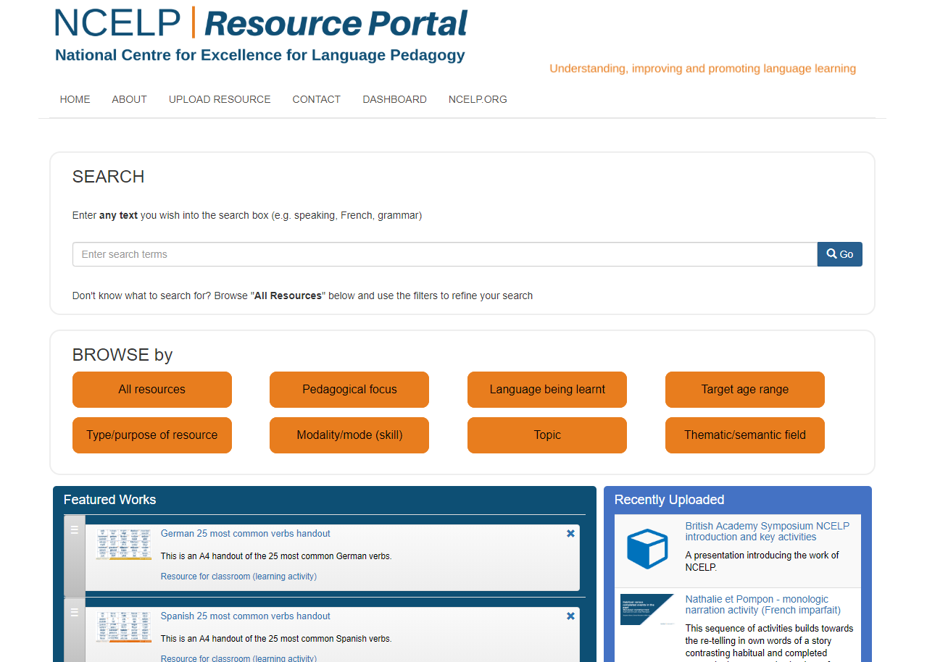
https://resources.ncelp.org/
Notes:
Slide 2 will be a brief introduction to NCELP – fusing research and practice more closely than has previously been possible. Stress the importance of both practitioner knowledge and research – one is no substitute for the other, both are necessary and complementary.
In November 2016, the Teaching Schools Council published the Report of the MFL Pedagogy Review .
The report noted that only a third of pupils achieves a languages GCSE at grade 4 or above and that less than a half of pupils even takes a language GCSE.
Research has shown that poor motivation in studying a language is partly due to pupils feeling that they do not know the language and feeling that they are not making progress.
The National Centre for Excellence for Language Pedagogy (NCELP)’ s approach to FL pedagogy is both research- and practice-informed, taking into account the time-poor context of curriculum FL learning in English classrooms.
The pedagogy helps pupils establish, early in their course, a robust knowledge of basic vocabulary, grammar, and the sound and spelling systems (phonics). The pedagogy then reinforces this knowledge via planned practice in using the knowledge during meaningful activities Anon. 2016. Modern Foreign Languages Pedagogy Review. A review of modern foreign languages teaching practice in key stage 3 and key stage 4. (Chair: Ian Bauckham). Teaching Schools Council

Slide 3
NCELP team
Research and CPD specialists
Prof Suzanne Graham (University of Reading) KS2-3 transition, literature, meaningful practice Dr Rowena Kasprowicz (University of Reading) KS2 knowledge about language, grammar Prof René Koglbauer (University of Newcastle) School FL policy, leadership training, CALL David Shanks (Harris Federation) School FL policy, CALL, differentiation Dr Robert Woore (University of Oxford) Teaching and learning phonics, reading, vocabulary
Director: Prof Emma Marsden (University of York)
Co-Director: Dr Rachel Hawkes (Cam Academy Trust)
Resource developers
Dr Inge Alferink Nick Avery
Natalie Finlayson
CPD providers
Victoria Hobson Stephen Owen
Management and administration
Ann Mannion, Heather Bradley, Wendy Burns
Tech team for Gaming Grammar
Andy Wood Dr Nick Sephton
Tech team, Resource Portal
Dr Frank Feng Dr Sebastian Pelucha
Notes:
An even quicker introduction to the NCELP team, both in York and around the country.

Slide 4
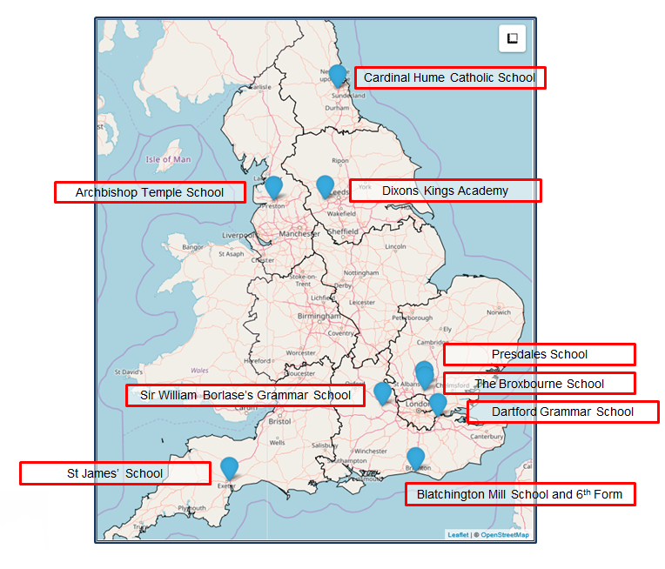
The Nine Lead Schools
Working with 9 Hubs:
9 Lead Schools each with 4 hub schools
Dartford Grammar School, Dartford
Dixons Kings Academy, Bradford
Presdales School, Ware, Hertfordshire
Sir William Borlase’s Grammar School, Marlow
St James’ School, Exeter
The Broxbourne School, Broxbourne, Hertfordshire
Archbishop Temple School, Preston
Blatchington Mill School and Sixth Form, Hove
Cardinal Hume Catholic School, Gateshead

Slide 5
Why is vocabulary learning important?

Slide 6
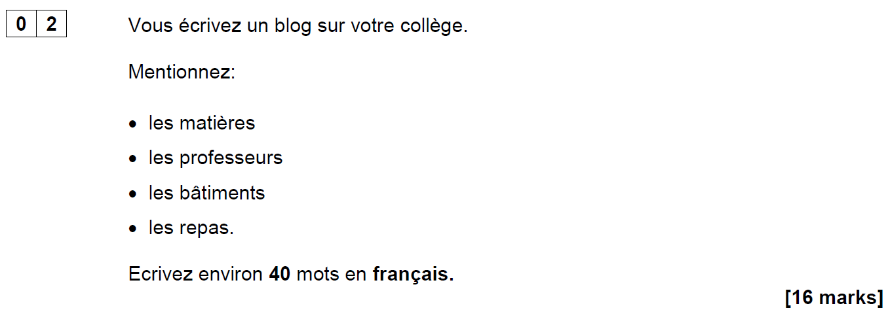
AQA French Foundation Writing Paper Q2 (June 2018)
Notes:
Opening sequence: Slides 1-6. 10 minutes Let’s start with something that confronts us with some of the issues…! This question (the 2nd easiest on the Foundation Writing paper – aimed at Grade 2/3 (old Grade E, bottom of D) required learners to know these four words (as well as the word ‘college’ of course). It’s easy to spot the words which caused problems for many foundation candidates in June 2018!

Slide 7
Are all these words…
562
1150
1952
2948
les matières
les professeurs
les bâtiments
les repas
on a list of 2000 most frequently-occurring French words?
on the AQA Foundation French Core Vocabulary list?
in the most popular French Foundation GCSE textbook?
Notes:
What do we think? Do all these words…
come into the top 2000 most frequent words in French? If you don’t think so, which one(s) don’t? Can you rank them in order of frequency?
appear on the AQA Foundation French Core Vocabulary list?
appear in the most popular GCSE textbook?
Answer a) b) c) consecutively. After a) reveal the 4 word frequencies. Ask colleagues to match them to the words.
ANSWERS a) matière (562), professeur (1150), bâtiment (1952), repas (2948) b) Yes c) Yes
OK – given that we’ve said ‘yes’ to b) and c), why do we think many students just didn’t know or recognise them?

Slide 8
Possible reasons…
an over-reliance on cognates for comprehension?
vocabulary knowledge is too context-dependent?
absence of additional contextual clues?
(Macaro & Erler, 2008)
“Vocabulary listed under a particular theme should be considered transferable, as appropriate, to the other themes.” AQA-8658-Specification 2016 French, p.22.
The words appear as individual items in a list, without the support of other words in a sentence to aid understanding.
Notes:
OK – given that we’ve said ‘yes’ to b) and c), why do we think many students just didn’t know or recognise them? Possible reasons to consider: 1) Some learners’ comprehension is limited by an over-reliance on cognates. If the word is not similar to English, it is more effort to acquire it (even receptively) and some learners, after five years, acquire relatively few non-cognate words. (Reference for this: Raising the Achievement of Young-beginner Readers of French through Strategy Instruction. (Macaro,E. & Erler, L., 2008). Applied Linguistics 29/1: 90–119. So, when we set out to improve the breadth of learners’ vocabulary, we need perhaps to consider focusing on the ‘harder to acquire’ non-cognates? 2) Two of these words (batiments and repas) are not listed in the topic of school/education on the AQA vocabulary list (they are in Home town, neighbourhood etc.. and Free time activities, respectively). The AQA vocabulary guidance states very clearly that words learnt in one topic context may be expected to be tested in another! “Vocabulary listed under a particular theme should be considered transferable, as appropriate, to the
other themes.” p.22 AQA-8658-Specification 2016 French
GO TO NEXT SLIDE: In the text book, they are also learnt in contexts other than school If learners encounter the words in one context only they may find it much harder to recognise the word in a different context. Their knowledge of certain words is too context-dependent. The other important point is that, in two cases here, the key words are the ‘category’ words, rather than the specific content words – it can be the case that these words are sometimes overlooked (or at least ‘under-worked’) in our teaching – if they are both non-cognates and category words, they are often not known by less-proficient learners.
GO BACK TO PREVIOUS SLIDE: 3) These words appear as individual words in a list, without the support of a sentence to give additional contextual clues.
The suggests that we need also to work on the depth of vocabulary knowledge – at least with respect to developing learners’ ability to know the meaning of words (readily) when they appear in a variety of different thematic contexts, but also when there are limited contextual clues – i.e. when words are presented in isolation, as individual words in a list, without the support of a sentence.

Slide 9
Studio AQA GCSE French Foundation (Pearson)
Module 6 p.132
Module 4 p.90
Module 3 p.70
Notes:
Slide

Slide 10
Possible responses…
J’adore les repas!
Je déteste les bâtiments!
Our aim should be ‘to give students the language they need in order to read texts, not to teach them to manage as well as they can without that language'. (Swan, 2008:267)
Talking sense about learning strategies, Swan (2008), RELC, Vol. 39(2), 262-273.
Notes:
Final important point to make… As teachers, when faced with a scenario like this, we search around for solutions to help our students succeed, as indeed we should. However… this particular exam question led to suggestions within the teaching community that students should be taught simply to put an opinion phrase in front of any nouns they don’t understand, in a question like this: So we might have seen: J’adore les repas or Je déteste les bâtiments
And there’s no denying that this would enable students to gain a significantly better mark than if they omit these two (unknown) words from their answer. As a examination strategy it therefore has some validity. As a communication strategy for real life, we can be less convinced…! If learners go into conversations prepared to say they like / dislike things without knowing what they’re referring to, they could get into all sorts of interesting situations…! At the end of Y11, as a last-ditch attempt to support our students’ GCSE outcomes, and compensate for a lack of knowledge, this might be justifiable (!?!). However, in the earlier stages of language learning, we have time to do more than teach compensatory approaches.
Swan (2008) in an article which critiques the over-reliance on teaching reading strategies says that the aim should be 'to give students the language they need in order to read texts, not to teach them to manage as well as they can without that language'. p.267 Talking Sense about Learning Strategies, Swan (2008). RELC, Vol 39(2) 262-273 So, just by this preliminary look at one Foundation GCSE writing task, we can conclude that there’s quite a lot to know about vocabulary!

Slide 11
There’s quite a lot to know!
Why is vocabulary important?
How many words do learners need to know?
Which words do learners need to know?
How can they best learn the words?
What does it mean to know a word?
Notes:
[3 mins max]
Having warmed up by thinking about some of the issues, can we suggest a list of questions? The first one was explicitly demonstrated in our opening discussion… Some of the others might not be as deducible but let’s see how we do…

Slide 12
How many words to learners need to know?

Slide 13
What’s in a number? If this is the answer, …?
Answers
What is…
5-10
98%
1772
8
2000
3
4222
…the lexical frequency ranking of the verb SER in Spanish?
…the expected size of vocabulary needed to function adequately at CEFR Threshold B1 level?
…the number of new words learners might be expected to learn on average each lesson?
…the lexical coverage needed for comfortable comprehension of a text?
…the lexical frequency ranking of the verb SEIN in German?
…the number of words on the AQA Spanish Higher Minimal Core Vocabulary list?
…the lexical frequency ranking of the noun POULET in French?
Notes:
What’s in a word (in numbers!)?
If this is the answer…
5-10
98%
1772
8
2000
3
4222
what is the question?
…the lexical frequency rating of the verb SER in Spanish? [8]
…the expected size of vocabulary needed to function adequately at CEFR Threshold B1 level? [2000]
…the number of new words learners might be expected to learn each lesson? [5-10] NB: with 38 teaching weeks per year, 2 x lessons per week, if you take 7.5 new words per lesson, this suggests 570 words per year, which would give 2,850 words after 5 years. But the Milton (2006) study suggests learners learn on average 170 words per year up to GCSE (a little over 2 new words per lesson), and 530 words in two years to A level.
…the lexical coverage needed for comfortable comprehension of a text? [98%]
…the lexical frequency rating of the verb SEIN in German? [3]
…the number of words on the AQA Spanish Higher Minimal Core Vocabulary list? [1772]
…the lexical frequency rating of the noun POULET in French? [4222]
The point of this slide is to introduce (again) the different elements into the discussion: 1) What are the expectations for vocabulary size set by UK examination system? 2) How does this expectation match up to other measures of vocabulary size requirement for functioning at a similar level? 3) What is the expectation for rate of vocabulary learning, as laid out in the Pedagogy Review? 3) What is the relationship between coverage and comprehension? 4) What role does the word frequency play in our decision-making?
Some of these numbers are more secure than others… which? i.e. 98% (Schmitt, Jiang & Grabe, 2011) The Percentage of Words Known in a Text and Reading Comprehension The Modern Language Journal, 95, i,

Slide 14
'According to standard frequency lists, the first 1000 words make up approximately 75% word tokens of a text, and the first 2000 approximately 85% (Meara 1995, 33). The Common European Framework of References for Language Learning and Teaching (CEFR) suggests a vocabulary of 500 words for its first level, A1 (‘Breakthrough’), 1200 words for its second level, A2 (‘Waystage’), and 2000 words for its third level, B1 (‘Threshold’) (Council of Europe 2001).’
(Häcker, 2008:215)
Notes:
Eleven pets and 20 ways to express one's opinion: the vocabulary learners of German acquire at English secondary schools. (Häcker, M. (2008). Language Learning Journal,
36:2, 215-226

Slide 15
Actually, I have _____ my mind and heart for what I _____ to say to you today. I have asked myself what I _____ I had known at my own _____, and what important _____ I have learned in the number of years that have _____ between that day and this.
I have come up with two answers on this _____ day, when we are _____ together to _____ your _____ success. I have decided to talk to you about the benefits of _____; and, as you stand on the _____ of what is sometimes called real life, I want to _____ the _____ _____ of _____.
Words ≥ 1K removed (85.0% coverage)

Slide 16
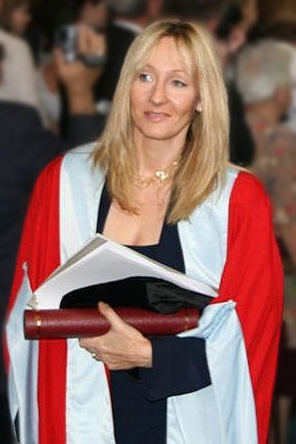
Full text: J. K. Rowling – Harvard Commencement Address, 2011: The Fringe Benefits of Failure and the Importance of Imagination.
Actually, I have wracked my mind and heart for what I ought to say to you today. I have asked myself what I wish I had known at my own graduation, and what important lessons I have learned in the number of years that have expired between that day and this.
I have come up with two answers on this wonderful day, when we are gathered together to celebrate your academic success. I have decided to talk to you about the benefits of failure; and, as you stand on the threshold of what is sometimes called real life, I want to extol the crucial importance of imagination.
Word frequencies based on the Corpus of Contemporary American English.
Notes:
I think I may omit slide 23 and summarise this activity, by saying that even a relatively small number of unknown words can interfere with comprehension. So, on the one hand, our goal must be for learners to learn as many words as possible in their 5-year (9-year with KS2) learning to GCSE, whilst on the other hand we must be mindful that, the GCSE reading sets out to include some unknown words (or at least, some words which are not on the Minimum Core Vocabulary list!).
We will return to this aspect later….

Slide 17
Which words do learners need to know? And why?
Notes:
Slides 33 – 42 With brainstorming task 12 mins, without 7 mins.

Slide 18
VOCABULARY
the frequency principle
the verb lexicon
mixed word class vocabulary sets
developing depth (e.g. through information gaps and rich texts)
planned four-stage revisiting
Davies, M, & Davies, K.H. (2018). A Frequency Dictionary of Spanish: Core Vocabulary for Learners. Routledge. Häcker, M. (2008). Eleven pets and 20 ways to express one's opinion: the vocabulary learners of German acquire at English secondary schools, The Language Learning Journal, 36:2, 215-226. Jones, R.L. & Tschirner, E. (2006). A frequency dictionary of German: core vocabulary for learners. Routledge. Lonsdale, D. & Le Bras, Y. (2009) A Frequency dictionary for French. Routledge. Milton, J. (2006). Language Lite? Learning French Vocabulary in School. Journal of French Language Studies, 16,187-205. Milton, J. (2009). Measuring second language vocabulary acquisition. Multilingual Matters Milton, J. (2013). Measuring the contribution of vocabulary knowledge to proficiency in the four skills. Eurosla Monographs Series 2, 57-78. http://www.eurosla.org/monographs/EM02/Milton.pdf
Schmitt, N. (2008). Review Article. Instructed second language vocabulary learning. Language Teaching Research, 12(3), 329–363. https://doi.org/10.1177/1362168808089921 Swan, M. (2008). Talking Sense about Learning Strategies, RELC, Vol 39(2), 262-273.

Slide 19
Which words?
Vocabulary to be taught should be informed by frequency of occurrence in the language, and special attention should be paid to common verbs in the early stages... A consequence of not attending to frequency of occurrence in vocabulary choice is pupils realising that they cannot say or understand basic things in the language.
Anon. 2016. Modern Foreign Languages Pedagogy Review. A review of modern foreign languages teaching practice in key stage 3 and key stage 4. (Chair: Ian Bauckham). Teaching Schools Council.
Vocabulary lists, rationale and uses
https://resources.ncelp.org/concern/resources/t722h880z?locale=en
Rachel Hawkes / Emma Marsden
Notes:
Vocabulary We start from the Pedagogy Review recommendation about ‘frequency’ and ‘common verbs’.
Ask ‘So how do we do this?’ Do we know the frequency of the words we are teaching? Do we have any way of knowing? What determines our vocabulary choice currently? The text book at KS3/4, the GCSE specification vocabulary list?
Do we know what informs the vocabulary choices in these resources?
Handout 1: Vocabulary lists, rationale and uses People will need to read this later!

Slide 20
En la ciudad [in town]
¿Qué hay en tu ciudad? |  | What is there in your town?
Hay… | There is… | En… | In…
un castillo | a castle | mi barrio | my neighbourhood
un centro comercial | a shopping centre | mi ciudad | my town/city
un estadio | a stadium | mi pueblo | my village/town
un mercado | a market | No hay museo. | There isn’t a museum.
un museo | a museum | No hay nada. | There’s nothing.
un parque | a park | unos museos | some museums
una piscina | a swimming pool | unas tiendas | some shops
una plaza | a square | muchos museos | a lot of museums
un polideportivo | a sports centre | muchas tiendas | a lot of shops
un restaurante | a restaurant
una tienda | a shop
una universidad | a university
 | Word | Frequency ranking | Part of speech
1 | la plaza | 806 | noun
2 | la iglesia | 437 | noun
3 | el teatro | 605 | noun
4 | ser | 7 | verb
5 | grande | 66 | adjective
6 | pequeño/a | 202 | adjective
7 | estar | 21 | verb
8 | cerca (de) | 1042 | adverb
9 | lejos (de) | 833 | adverb
10 | el museo | 1114 | noun
Notes:
So, it’s the notion that the first introductory lesson to a new theme, topic would not be one ‘verb starter’ and 12 nouns but instead a set of mixed word class vocabulary.
Later, as appropriate, more nouns would be added from the same semantic field (more places in the town for example) but the core words would be these, as ultimately pupils can express more and varied meanings with these, than they can with ‘Hay’ and a set of places in the town.
This is the slide of 10 words pupils are going to learn.
Note the mixed word class selection, and the frequency (all well within the top 2000 more frequently occurring words in Spanish).

Slide 21
Which words?
In the early stages of a language course, particular attention should be paid to the planned building of pupils’ verb lexicon, focussing on the meaning of the stem or infinitive form of common verbs. A strong basic verb lexicon has been found to relate positively to pupils’ ability to effectively manipulate those verbs at later stages.
Anon. 2016. Modern Foreign Languages Pedagogy Review. A review of modern foreign languages teaching practice in key stage 3 and key stage 4. (Chair: Ian Bauckham). Teaching Schools Council.
Rachel Hawkes / Emma Marsden
Notes:
Which words? The verb lexicon
Handout 2: Focusing on the verb lexicon: Why and how to teach a verb vocabulary.
Again, people will have to read this later!
https://resources.ncelp.org/concern/resources/cj82k728n?locale=en

Slide 22
Which verbs do Y7 learners learn?

Slide 23
sein | sehen
haben | lassen
werden | stehen
können | finden
müssen | bleiben
sagen | liegen
machen | heißen
geben | denken
kommen | nehmen
sollen | tun
wollen | dürfen
gehen | glauben
wissen
25 most common verbs in German.
Which verbs from our Y7 SOW are not in the 25
most common?
Source:
A frequency dictionary of German: core vocabulary for learners. Randall L.Jones and Erwin Tschirner. Routledge.
Notes:
Source:
A frequency dictionary of German: core vocabulary for learners. Randall L.Jones and Erwin Tschirner. Routledge. https://www.amazon.co.uk/Frequency-Dictionary-German-Routledge-Dictionaries/dp/0415316332/ref=tmm_pap_swatch_0?_encoding=UTF8&qid=1547270191&sr=8-1 Online: https://www.memrise.com/course/198332/4000-german-words-by-frequency-with-audio/

Slide 24
First encounters with high-frequency verbs
25 highest frequency verbs
15 high frequency prototype verbs
Long form (infinitive) and short form (3rd person singular)
Sentences (revisiting high-frequency (phonics) vocabulary)
NB: these are for first encounters with these important verbs. Further practice and gradual extension to working with further pairs of forms/meanings would follow (e.g. next step - 1st and 2nd person singular)
Notes:
Which words? The verb lexicon
This slide describes the essential features of the sets of verb resources, a sample of which will follow this slide. Refer to the handouts which list all of the verbs and the sentences that are included in the PowerPoint resources. Handouts 3,4,5: French 25 and 15 verbs and sentences https://resources.ncelp.org/concern/resources/7w62f8209?locale=en German 25 and 15 verbs and sentences https://resources.ncelp.org/concern/resources/qf85nb285?locale=en Spanish 25 and 15 verbs and sentences https://resources.ncelp.org/concern/resources/0p0966881?locale=en

Slide 25
être
avoir
faire
aller
trouver
5
8
25
53
83
to be| being
to have | having
to do, to make | doing, making
to go| going
to find| finding
est
a
fait
va
trouve
is
has
does, makes | is doing, is making
goes | is going
finds | is finding
venir
passer
donner
dire
prendre
88
90
45
37
43
to come| coming
to spend (time) | spending (time)
to give | giving
to tell, say| telling, saying
to take | taking
vient
passe
donne
dit
prend
comes | is coming
spends (time) | is spending (time)
gives | is giving
tells, says | is telling, is saying
takes | is taking
mettre
porter
80
rester
penser
27
105
demander
100
116
to put | putting
to wear, carry | wearing, carrying
to ask | asking
to stay | staying
to think | thinking
met
porte
demande
reste
pense
puts | is putting
wears, carries | is wearing, is carrying
asks | is asking
stays | is staying
thinks | is thinking
pouvoir
vouloir
devoir
voir
savoir
20
57
39
69
67
to be able | being able
to want | wanting
to have to | having to
to see | seeing
to know | knowing
peut
veut
doit
voit
sait
is able, can
wants
has to, must
sees | is seeing
knows | is knowing
tenir
108
parler
falloir
104
montrer
106
68
95
comprendre
to hold | holding
to show | showing
to speak | speaking
to be necessary
to understand | understanding
tient
montre
parle
faut
comprend
holds | is holding
shows | is showing
speaks | is speaking
is necessary
understands | is understanding
25 most common French verbs
Source: A Frequency Dictionary of French (Londsale & Le Bras, 2009), published by Routledge.]
Notes:
Posters of the 25 most common and 15 other high-frequency ‘prototype’ verbs

Slide 26
219
1338
429
1820
960
jouer
manger
écouter
chanter
étudier
to play | playing
to eat | eating
to listen | listening
to sing | singing
to study | studying
joue
mange
écoute
chante
étudie
plays | is playing
eats | is eating
listens | is listening
sings | is singing
studies | is studying
425
382
327
1836
290
regarder
écrire
apprendre
dormir
travailler
to watch, look | watching, looking
to write | writing
to learn | learning
to sleep | sleeping
to work | working
regarde
écrit
apprend
dort
travaille
watches | is watching
writes | is writing
learns | is learning
sleeps | is sleeping
works | is working
201
413
309
1447
1532
préparer
aider
sortir
courir
marcher
to prepare | preparing
to help | helping
to go out | going out
to run | running
to walk | walking
prépare
aide
sort
court
marche
prepares | is preparing
helps | is helping
goes out | is going out
runs | is running
walks | is walking
15 high-frequency prototype French verbs
Source: A Frequency Dictionary of French (Londsale & Le Bras, 2009), published by Routledge.]

Slide 27
How can they best learn the words?

Slide 28
How?
‘Most vocabulary tasks focus their attention almost solely on introducing the meaning of new words.’ (Schmitt, 2008:343)
Learning new words (breadth)
Consolidating and extending word knowledge (depth)
Using words more quickly (automaticity/fluency)
Different tasks are needed to develop these different aspects. (Schmitt, 2008)

Slide 29
How?
L1 translation can be efficient for establishing form-meaning link initially.
Seeing and hearing words in context then becomes important to develop depth of knowledge (collocation, shades of meaning, etc.).
Multiple exposures and use are important to consolidate knowledge and develop fluency, anywhere between 5 – 20 encounters. (Nation, 2001:81)
This could be done at home, even in advance of a lesson (‘flipped learning’) and mediated by technology (e.g. Memrise, Quizlet)
For high-frequency words, spontaneous target language interaction and ‘reading for interest’ may help with this.
Notes:
As regards the initial establishment of the initial form-meaning link, there is substantial evidence supporting the provision of L2-L1 pairs, rather than L2-picture pairs (Lotto & de Groot, 1998) or L2-based context or meanings (Prince, 1996; Ramachandran & Rahim, 2004).
Once the link is established, attention can be given to learning more contextualised types of word knowledge, and it becomes important to encounter the new lexical items in L2 contexts. An important finding is that reading-while-listening is generally superior to reading-only in promoting vocabulary learning (Amer, 1997; Brown, Waring & Donkaewbua, 2008) Where a word is often used across different topics, care should be taken to build these links explicitly, building depth – ensuring that learners recognise them readily in more than one topic area. A useful approach here is to use a range of texts of different styles (literary extracts, poems, songs) which provide additional exposures in less familiar contexts, allowing the form-meaning link to strengthen.
5-20 is quite some range - It is not straightforward to say how many repeated encounters with a given word are necessary to learn it. Nation's (2001, p.81) review of several studies gives a range of 5 - 20 encounters. Most important, however, is that recycling of language is crucial, if it is not to be forgotten. Most forgetting occurs soon after the learning session, so the first recyclings are particularly important and need to occur quickly (Baddeley, 1990). Schmitt suggests we think in terms of 8-10 exposures. Planning for and monitoring this is important.

Slide 30
 | Word | English meaning
1 | la plaza | town square
2 | la iglesia | church
3 | el teatro | theatre
4 | ser | to be [permanent]
5 | grande | big
6 | pequeño/a | small
7 | estar | to be [location]
8 | cerca (de) | near (to)
9 | lejos (de) | far (from)
10 | el museo | museum

Slide 31
1
to be [location]
museum
near (to)
A
B
C
to be [permanent]
big
theatre
D
E
F
far (from)
small
church
town square
G
H
I
J
Notes:
Listening task 1 [Note: the three rounds of this activity look the same when in presentation mode, so the slides have been numbered for clarity.]
Explain to students that they are going to hear ten Spanish words, and that they should arrange their cards in a 3x3 grid as shown (working from A-I, with J as the spare), English-side up, in the order they hear the words.
NB: Students don’t add letters to their flashcards, these are just to show the order that they need to place the cards in, according to the order in which the teacher says the words. It’s easier to model this task than explain too much about it. The first time students do it, a few might be unsure, but after the first time, they will immediately know from this slide exactly what they have to do. It’s worth reassuring them of this, the first time you do it!
Teacher reads the transcript.
Teacher then asks the students ‘Qué es A? to elicit the response ‘A es ‘estar’, Note: The answers appear in English on the screen under each letter, so all can see/read/check their answers and know if they heard correctly, BUT this task additionally elicits the Spanish from students that can already produce it, so it offers ideal differentiation. On the other hand, if the whole class is already able to produce the language, then the teacher can elicit the answers chorally from the whole class.
Answers revealed by clicking the letter.
Transcript
estar, el museo, cerca de, ser, grande, el teatro, lejos de, pequeño/pequeña, la iglesia (la plaza)

Slide 32
2
far (from)
town square
to be [permanent]
A
B
C
small
church
near (to)
D
E
F
museum
to be [location]
theatre
big
G
H
I
J
Notes:
Transcript: lejos de, la plaza, ser, pequeño/pequeña, la iglesia, cerca de, el museo, estar, el teatro (grande)

Slide 33
3
small
to be [permanent]
A
B
C
big
to be [location]
town square
D
E
F
near (to)
far (from)
church
museum
theatre
G
H
I
J
Notes:
Transcript: pequeño/pequeña, ser, grande, cerca de, estar, la plaza, lejos de, la iglesia, el museo, (el teatro)

Slide 34
Escucha.
1
4
town square – to be [location] - near
church – to be [permanent] - small
La iglesia es pequeña.
La plaza está cerca.
5
chuch – to be [location] in the square
2
museum – to be [location] - far
El museo está lejos.
La iglesia está en la plaza.
3
theatre – to be [permanent] - big
6
museum – to be [permanent] - small
El teatro es grande.
El museo es pequeño.
Notes:
2 Sentences recorded [I suggest 3 x sets of 6 sentences for each bunch of 10 words] SET 1a Third, with Spanish side up, pupils hear sentences with 2-3-4 of the items in them and they place them down in order – this might sound easy, but remember they will be seeing the infinitive, but hearing the short form, so there is still some significant processing to do (plus the fact that you will have several items together in an order, so not as easy as it might seem). Fourth, a bingo game. Pupils place 6 of their cards English side up in a 3 x 2 formation and they turn them to Spanish when they hear the word called. Winner is i) a complete row then ii) a full house. Fifth, with English side up, pupils listen to a set of sentences containing 2-4 of the items and have to put them in order. E.g. El teatro es grande (they would need to place ‘theatre’, then ‘to be(description)’ then ‘big’. This is challenging (sentences will be slow and careful), but it will be useful to have them recorded at 3 different speeds! I normally do this just with my voice).
TRANSCRIPT
1 La iglesia es pequeña.
2 El museo está lejos.
3 El teatro es grande.
4 La plaza está cerca.
5 La iglesia está en la plaza.
6 El museo es pequeño.

Slide 35
¿SER o ESTAR?
1
1. El teatro ________ cerca de la iglesia.
2
2. La plaza ________ muy pequeña.
3
3. ¿Dónde _________ la plaza?
4
4. El museo no __________ aburrido.
5
5. La iglesia, que ________ grande, _________ en la plaza mayor.
6
6. La plaza, que _____ en el centro, ______ pequeña.
Notes:
This focuses pupils’ attention on the two verbs to be. A sound effect obscures the verb – pupils have to fill in their choice of ‘es’ or ‘está’
TRANSCRIPT
1 El teatro ________ cerca de la iglesia.
2 La plaza ________ muy pequeña.
3 ¿Dónde _________ la plaza?
4 El museo no __________ aburrido.
5 La iglesia, que ________ grande, _________ en la plaza mayor.
6 La plaza, que _____ en el centro, ______ pequeña

Slide 36
RESPUESTAS
¿SER o ESTAR?
1
está
1. El teatro ________ cerca de la iglesia.
2
es
2. La plaza ________ muy pequeña.
3
está
3. ¿Dónde _________ la plaza?
4
es
4. El museo no __________ aburrido.
5
es
está
5. La iglesia, que ________ grande, _________ en la plaza mayor.
6
está
es
6. La plaza, que _____ en el centro, ______ pequeña.
Notes:
This focuses pupils’ attention on the two verbs to be. A sound effect obscures the verb – pupils have to fill in their choice of ‘es’ or ‘está’
TRANSCRIPT
1 El teatro está cerca de la iglesia.
2 La plaza es muy pequeña.
3 ¿Dónde está la plaza?
4 El museo no es aburrido.
5 La iglesia, que es grande, está en la plaza mayor.
6 La plaza, que está en el centro, es pequeña

Slide 37
Sentence-level production tasks [1]
en la plaza
grande pequeño/a aburrido/a interesante
en la calle González
a la derecha
a la izquierda
lejos cerca
viejo/a nuevo/a
al lado del parque
1 | la iglesia | 1 | es
2 | el museo | 2 | está
3 | la plaza | 3 | es
4 | el teatro | 4 | está
5 | el parque | 5 | es
6 | la oficina de correos | 6 | está
Notes:
Player A rolls the dice to generate 1) a place and 2) a verb. They then choose a word from the oval to finish their sentence. Each word from the oval can only be used once. Players keep a tally of their correctly formed sentences. Once a word is used it can be crossed out. As the number of possible words decreases, players may have to ‘knock’ if there is no appropriate word to finish their sentence. In this case, play passes to their partner. E.g. Player A throws 1)el museo and 2) está but there are only adjectives remaining. No correct sentence can be formed and play passes to the Player B. The player who is able to make the most sentences within the time or until all the words run out is the winner.
You could use up to 11 places by using 2 dice together – in that case, just no number one and add extra rows to the first column.
The sheets could be laminated so that players could cross out the words but then wipe clean the sheets and re-use.

Slide 38
Dictogloss
¿Cómo es tu ciudad? Mi ciudad no es grande. Hay una plaza pequeña en el centro. La iglesia está en la plaza y el museo está cerca de la iglesia. También hay un teatro pequeño. El teatro está lejos de la plaza pero cerca de mi casa.
Notes:
Dictogloss Listen and take notes. Then try to reproduce a version of the text, giving the same information.
Alternative uses of this Text/Story as presentation
Formatting here shows the ‘target words’ to be learned. Routine might be used either as very first encounter or after one of the methods 1,2 or 4: 1) Pupils read aloud (either for themselves or in pairs) as decoding task – teacher circulates to listen in 2) Teacher reads aloud, emphasising meaning through intonation and, where appropriate, gestures to support meaning. 3) Teacher elicits meaning of the key words from pupils (elicits meaning of the verb forms and relates them back to the infinitive – asks why not SER, why not ESTAR) 4) One pupil can read aloud, partner put his/her paper flashcards in order. 5) Pupils read and draw their understanding of the text in a picture.

Slide 39
La plaza tiene una torre
Antonio Machado
Notes:
Note: The following slides are just extracts from a two-lesson sequence – they are chosen for exemplification of revisiting and deepening vocabulary knowledge.

Slide 40
Hoy leemos un texto. ¿Qué tipo de texto es?
La plaza tiene una torre,
la torre tiene un balcón,
¿Un artículo?
¿Una novela?
¿Un poema?
El balcón tiene una dama,
La dama una blanca flor…
Nick Avery & Rachel Hawkes
Notes:
Ask students to read aloud the first four lines of the text and then identify its type. Reasons why they may suggest a poem: frases cortas, repetición

Slide 41
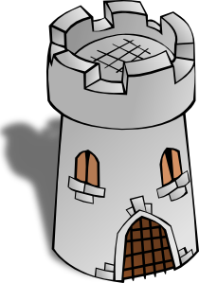
La plaza tiene una torre,
la torre tiene un balcón,
El balcón tiene una dama,
La dama una blanca flor…
Notes:
Images from www.clker.com or www.pixabay.com are in the public domain
Images are animated to support the meaning. Elicit from students the meaning of ‘tiene’, which they first learnt in term 1.1 week 4. This lesson is term 1.2 week 6. There have been several opportunities to revisit parts of ‘TENER’. Ask them why they think ‘tiene’ is missing from line 4 of the poem (i.e. to maintain the rhythm/flow), and where it would have gone, if the writer had included it.

Slide 42
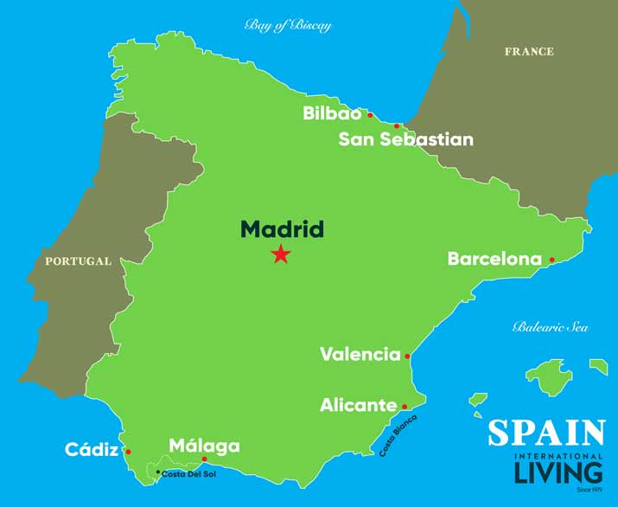
El autor: Antonio Machado (1875-1913)
Biografía
Nace en Valencia
Estudia en Madrid
Viaja mucho a Francia
Habla francés
Intereses
La memoria
La reflexión
El romance
Image by spainisculture is licensed under CC BY-SA 4.0
Nick Avery & Rachel Hawkes
Notes:
We can give details of his life in the present tense. Students can read aloud (whole class) to practise SSC knowledge.
Students could be asked to guess what ‘nace’ means – in context of ‘biografía’, they should be able to guess
Students could also be asked
Valencia está en el sur o en el norte? (See Spanish SoW, lesson 1)

Slide 43
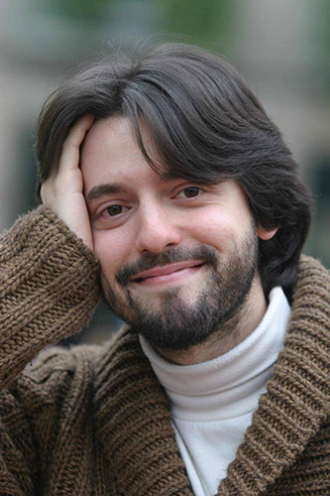
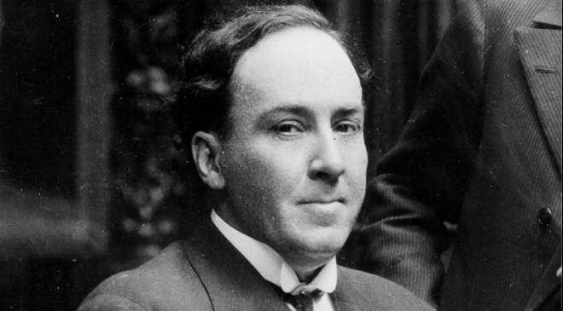
¿Quién es Antonio Machado?
A
C
B
Nick Avery & Rachel Hawkes
Notes:
Image sources:
A: Photo by Luis Angelis licensed under CC BY-SA 4.0 and retrieved from https://www.worldliteraturetoday.org/blog/news-and-events/award-winning-argentinean-spanish-writer-speak-ou
B: Photo by EFE, is licensed under CC BY-SA 4.0 and retrieved from http://www.spainisculture.com/en/artistas_creadores/antonio_machado.html
C: Photo by US library of Congress is licensed under CC BY-SA 4.0 and retrieved from https://www.loc.gov/item/n79079153/mario-vargas-llosa-peru-1936/
Photo A too young, too recent (colour photo!). Photo B and C both black and white, so might be options. Students might look at the way they are dressed to guess.
In B (the correct photo) he also seems calm and composed, which is in tune with the interests mentioned on the last slide.

Slide 44
¿Cómo está en la foto?
Está serio
Está alegre
Está raro
Nick Avery & Rachel Hawkes
Notes:
Photo by EFE, is licensed under CC BY-SA 4.0 and retrieved from http://www.spainisculture.com/en/artistas_creadores/antonio_machado.html
Recycle personality adjectives seen in Spanish SoW, weeks 2 & 3

Slide 45
Palabras importantes
plaza (f) | square
balcón (m) | balcony
dama(f) | lady
blanco | white
flor (f) | flower
torre | tower
caballero (m) | gentleman, knight
su | his/her/its
quién | who
saber / sabe | to know / knows
pasar / pasa | to pass / passes
llevar / lleva | to carry, to wear / carries, wears
Nick Avery & Rachel Hawkes
Notes:
Frequency ratings of key vocabulary: plaza [806]; balcón [3133]; dama [2062]; blanco [372]; flor [739]; torre [2138]; caballero [2056]; su [12]; quién [132]; saber [44]; llevar [101]; pasar [68]

Slide 46
Ahora escuchar el poema
¿Cómo está la narradora?
tonta
rara
alegre
nerviosa
tranquila
seria
escuchar
Nick Avery & Rachel Hawkes
Notes:
There are two versions here – one in a happy-sounding voice (alegre) and one in a serious voice (seria) Students could be encouraged to write down any words they hear and understand in the poem – to practise their SSC knowledge. They could even then compare what they have with their partners and see if they can reform any full lines from the poem (in a dictogloss style task). The intention is not to spend too long on that at this stage, however.
Alternative, additional version:
https://www.youtube.com/watch?v=fgcyPadvZjA

Slide 47
Completa esta parte del poema con LA o UNA
La plaza tiene ____ torre, ____ torre tiene un balcón,
una
La
escribir
Nick Avery & Rachel Hawkes
Notes:
Draw out and make explicit the difference in meaning between ‘la’ and ‘una’, eliciting an English translation of each of the lines from this and the next two slides.

Slide 48
Completa esta parte del poema con EL o UN
La torre tiene ___ balcón, ___ balcón tiene una dama,
un
El
escribir
Nick Avery & Rachel Hawkes
Notes:
Active choice required between definite article (el) and indefinite article (un). We have separated parts of the poem to ask only for a choice between definite and indefinite, rather than between masculine and feminine.

Slide 49
Completa esta parte del poema con LA o UNA
el balcón tiene ____ dama, ____ dama una blanca flor.
una
La
escribir
Nick Avery & Rachel Hawkes

Slide 50
dos posibilidades
una adaptación oral del poema en grupo
una versión moderna (escrita) del poema
Nick Avery & Rachel Hawkes

Slide 51
Text title | La plaza tiene una torre
Author | Antonio Machado
Suggested teaching | Y7 Term 1.1 Week 6
Number of lessons | 2 lessons (50-60 minutes)
Text composition
Total number of words (including words that are repeated) | 53
% known words (if following NCELP SOW) | 45%
% words in most frequent 1000 words* | 77.4%
% words in most frequent 2000 words* | 77.4%
% words in most frequent 3000 words* | 92.5%
% words outside of most frequency 5000 words* | ---

Slide 52
Text title | L’homme qui te ressemble
Author | René Philombe
Suggested teaching slot | Year 7 Term 3 Week 2
Number of lessons | Two lessons of 50 - 60 minutes
Text composition
Total number of words (including words that are repeated) | 136
% known words (if following NCELP SOW) | 70%
% words in most frequent 1000 words* | 85%
% words in most frequent 2000 words* | 91%
% words in most frequent 3000 words* | 95.3%
% words outside of most frequency 5000 words* | 4.7%
*Word-frequency data source: Londsale, D., & Le Bras, Y. (2009). A Frequency Dictionary of French: Core vocabulary for learners London: Routledge.

Slide 53
Vers 1
J’ai frappé à ta porte
J’ai frappé à ton cœur
Pour avoir bon lit
Pour avoir bon feu
Pourquoi me repousser?
Ouvre-moi, mon frère.
Notes:
Attribution: Please emoji
Twitter [CC BY 4.0 (https://creativecommons.org/licenses/by/4.0)] https://upload.wikimedia.org/wikipedia/commons/f/ff/Twemoji_1f64f.svg
Whole class opportunity to read verse 1 aloud with the teacher. Elicit meanings and clarify any unknown vocabulary that has not yet been understood, i.e. arrive at a working English translation orally with the whole class. Pay particular attention to the translation of ‘à’ which students have met as ‘to’. Here it means ‘at’ (or possibly even ‘on’ with heart). Draw out also the meaning of ‘ton/ta’ and clarify the two forms seen here. Students have met ‘mon, ma, mes’ and should be encouraged to make the link and explain their understanding.
Give students another opportunity to read aloud the first verse in pairs, a line each. Encourage them to read expressively, thinking about the meaning.

Slide 54
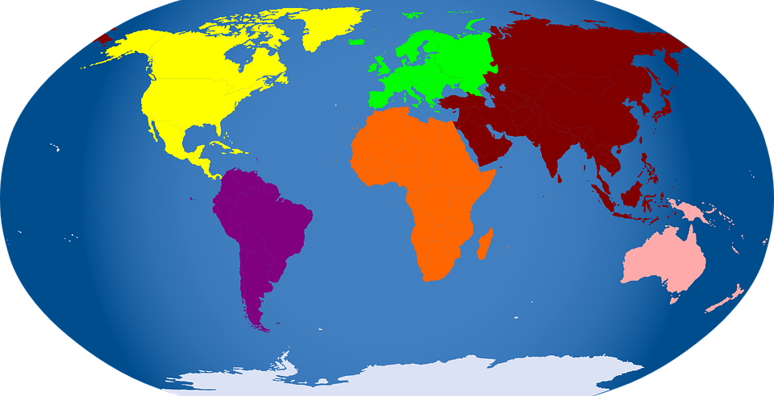
Pourquoi me demander
Si je suis d’Afrique
Si je suis d’Amérique
Si je suis d’Asie
Si je suis d’Europe?
Ouvre-moi, mon frère.
Vers 2
Notes:
Whole class opportunity to read verse 2 aloud with the teacher. Pictures give additional cues to meaning. Pay particular attention to the new word ‘si’and ‘de’, which students only know as ‘faire de la/du’ or as negative particle e.g. Je n’ai pas de pommes. Here they need to recognise that d’ = de and that the meaning is ‘from’. It is worth asking if they remember other uses/meanings of ‘de’. They will learn that it means ‘of’ from the next verse.

Slide 55
Ouvre-moi ta porte
Ouvre-moi ton cœur
Car je suis un homme
l’homme de tous les temps
l’homme de tous les cieux
l’homme qui te ressemble!....
Vers 5
Notes:
Text comprehension
Many words are repeated from earlier in the poem in different combinations in the final verse. The new words are: car, tous les temps, tous les cieux, and the phrase ‘qui te ressemble’.

Slide 56
How?
L1 translation can be efficient for establishing form-meaning link initially.
Seeing and hearing words in context then becomes important to develop depth of knowledge (collocation, shades of meaning, etc.).
Multiple exposures and use are important to consolidate knowledge and develop fluency, anywhere between 5 – 20 encounters. (Nation, 2001:81)
This could be done at home, even in advance of a lesson (‘flipped learning’) and mediated by technology (e.g. Memrise, Quizlet)
For high-frequency words, spontaneous target language interaction and ‘reading for interest’ may help with this.
Notes:
As regards the initial establishment of the initial form-meaning link, there is substantial evidence supporting the provision of L2-L1 pairs, rather than L2-picture pairs (Lotto & de Groot, 1998) or L2-based context or meanings (Prince, 1996; Ramachandran & Rahim, 2004).
Once the link is established, attention can be given to learning more contextualised types of word knowledge, and it becomes important to encounter the new lexical items in L2 contexts. An important finding is that reading-while-listening is generally superior to reading-only in promoting vocabulary learning (Amer, 1997; Brown, Waring & Donkaewbua, 2008) Where a word is often used across different topics, care should be taken to build these links explicitly, building depth – ensuring that learners recognise them readily in more than one topic area. A useful approach here is to use a range of texts of different styles (literary extracts, poems, songs) which provide additional exposures in less familiar contexts, allowing the form-meaning link to strengthen.
5-20 is quite some range - It is not straightforward to say how many repeated encounters with a given word are necessary to learn it. Nation's (2001, p.81) review of several studies gives a range of 5 - 20 encounters. Most important, however, is that recycling of language is crucial, if it is not to be forgotten. Most forgetting occurs soon after the learning session, so the first recyclings are particularly important and need to occur quickly (Baddeley, 1990). Schmitt suggests we think in terms of 8-10 exposures. Planning for and monitoring this is important.

Slide 57
How?
Allowing time to forget and then deliberately and systematically revisiting and recycling is crucial.
This requires more planning and monitoring than a space-limited textbook course can display on its pages.
‘Recycling is necessary, and if it is neglected, many partially learned words will be forgotten, wasting all the effort already put into learning them ... Recycling has to be consciously built into vocabulary learning programs, and teachers must guard against presenting lexical items once and then forgetting about them, or else their students will likely do the same.’ (Schmitt, 2008:343)

Slide 58
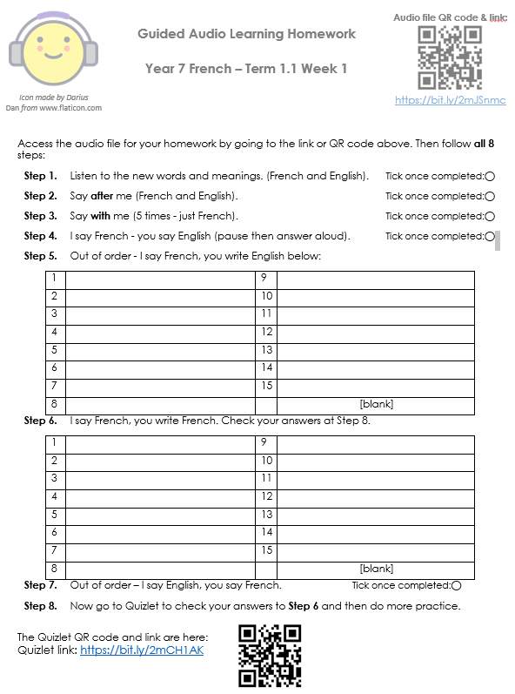
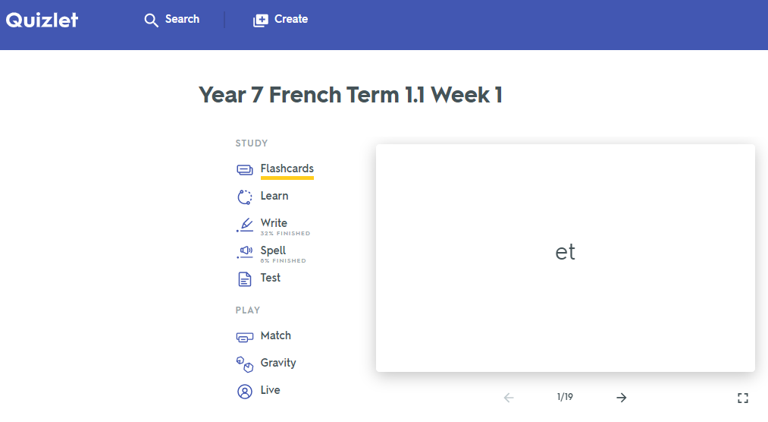
Quizlet / Audio learning homework
Notes:
Link to audio file: https://bit.ly/2mJSnmc
Link to Quizet vocabulary set: https://bit.ly/2mCH1AK

Slide 59
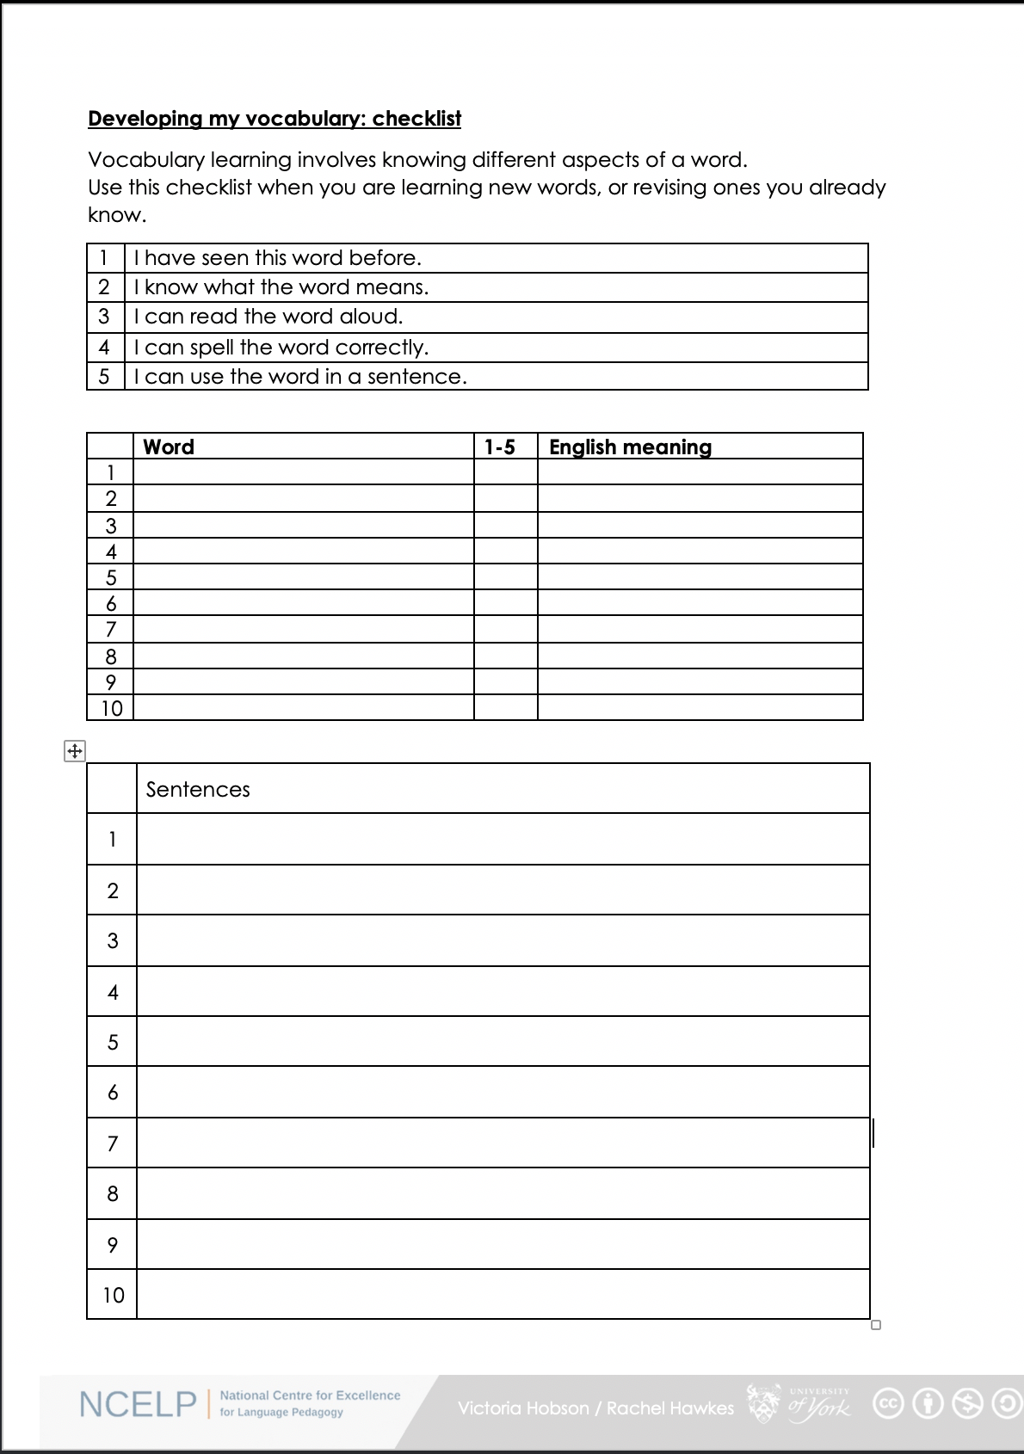
Vocabulary checklist
1. I have seen this word before.
2. I know what the word means.
3. I can read the word aloud.
4. I can spell the word correctly.
5. I can use the word in a sentence.
6. For nouns, I know the gender and the correct word for ‘the’
Notes:
This sheet could be part of a homework task for Week 7 vocabulary, if desired (or a previous week – In week 7 students should also be revisiting Week 3 vocabulary). Scroll down for the link to this resource.
Vocabulary learning involves knowing different aspects of a word. Students can use this checklist when to check what they know when they are learning new words, or revising ones they already know.
For each word the checklist asks students to asses whether the following statement apply:
1. I have seen this word before.
2. I know what the word means.
3. I can read the word aloud.
4. I can spell the word correctly.
5. I can use the word in a sentence.
Students then translate the word and try to use it in a sentence.
We suggest giving students a print out of the template they can refer to throughout the year.
A word template is available on the NCELP resource portal.
https://resources.ncelp.org/concern/resources/gf06g264k?locale=en

Slide 60
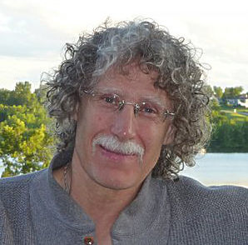
How can they best learn the words?
Four (five?) ‘learning partners’:
Teachers
Students
Materials writers
Researchers
Parents
‘Given the magnitude of the lexical learning task, it is unlikely that it can be achieved without strong and active contributions from all four members of this learning partnership.’ (Schmitt, 2008:333)
Notes:
Make clear that we will return to this more fully in the half-days and TRGs… Give out Handout 4: OASIS summary of Schmitt (2008) article. Review article
Instructed second language vocabulary learning. Language Teaching Research 12,3 (2008); pp. 329–363

Slide 61
What do we know about vocabulary learning?

Slide 62
Some research- and practice-informed answers
Vocabulary learning is a strong indicator of performance, in aural and written modalities.
Currently, learners appear to know (after five years’ secondary learning) far fewer words than is ideal.
Learners need to know as many words as possible(!), but 2000 would indicate a much stronger basis for GCSE proficiency.
Vocabulary selection should balance frequency, GCSE specification, range and personal interest.
Verbs can be under-represented in text books.
Topic-based vocabulary lists of one single word class are not optimal
Rachel Hawkes / Robert Woore

Slide 63
Some answers [cont’d]
There is no single, best strategy for learning vocabulary
Errorless teaching techniques (when pupils are unambiguously told the meaning of a new word) are effective…
providing they are followed by opportunities to use the new words in comprehension, and then productively.
The more times a pupil is required to recall a word, the more securely it will move into the long term memory.
Production tasks in which pupils use new words in sentences they compose themselves serve to strengthen vocabulary knowledge.
Genuine information gap activities are very helpful in assisting memorisation.
Plentiful opportunities to encounter words in multiple contexts deepen vocabulary knowledge
Careful, planned use of ICT can be effective.
Rachel Hawkes / Robert Woore

Slide 64
FAQs in school this year!
What is the essential knowledge in your subject?
Why are you teaching it in this order?
Is teaching clear and do learners understand?
Do they remember more, know more and can they do more? (And how do you know?)

Slide 65
Ofsted new framework
NCELP
Vocabulary
teaching of ten new words, on average, per week (assuming a curriculum model of two lessons per week),
in sets of words from different parts of speech,
including the most common verbs,
and selected on the basis of word frequency
and additionally informed by scrutiny of the awarding body vocabulary lists, learner choice, context appropriateness
revisited systematically within a week, a month, a term, a year
making strategic, planned use of CALL (quizlet / audio learning homework)
400 words end Y7, 1000-1200 end Y9, 2000 end Y11
careful thinking about what students will know and be able to do at the end points
subject content that has been identified as most useful
logical progression, systematic and sufficiently explicit teaching to enable all pupils to acquire the intended knowledge and skills (p.44, Ofsted, 2019).
Judgements about impact will come from the following sources:
the progress that students make in terms of knowing more, remembering more and being able to do more
discussions with students about what they remember from the content they have studied
Notes:
Ofsted, (2019). School Inspection Handbook, September 2019, 190024, www.gov.uk/government/organisations/ofsted.
What are you teaching them? Why teach that?
What order are you teaching it in? Why in that order?
How do you know they’re learning it / remembering it / able to use it?

Slide 66
Vocabulary and Memory
Davies, M, & Davies, K.H. (2018). A Frequency Dictionary of Spanish: Core Vocabulary for Learners. Routledge. Häcker, M. (2008). Eleven pets and 20 ways to express one's opinion: the vocabulary learners of German acquire at English secondary schools, The Language Learning Journal, 36:2, 215-226. Jones, R.L. & Tschirner, E. (2006). A frequency dictionary of German: core vocabulary for learners. Routledge. Lonsdale, D. & Le Bras, Y. (2009) A Frequency dictionary for French. Routledge. Milton, J. (2006). Language Lite? Learning French Vocabulary in School. Journal of French Language Studies, 16,187-205. Milton, J. (2009). Measuring second language vocabulary acquisition. Multilingual Matters Milton, J. (2013). Measuring the contribution of vocabulary knowledge to proficiency in the four skills. Eurosla Monographs Series 2, 57-78. http://www.eurosla.org/monographs/EM02/Milton.pdf
Schmitt, N. (2008). Review Article. Instructed second language vocabulary learning. Language Teaching Research, 12(3), 329–363. https://doi.org/10.1177/1362168808089921 Swan, M. (2008). Talking Sense about Learning Strategies, RELC, Vol 39(2), 262-273.
Without grammar very little can be conveyed,
without vocabulary nothing can be conveyed.
David Wilkins
Rachel Hawkes

Slide 67
GCSE frequency lists
https://resources.ncelp.org/
Frequency data have been added to AQA GCSE vocabulary lists for French, German and Spanish [Sources: A Frequency Dictionary of Spanish: Core Vocabulary for Learners (Davies & Davies, 2018); A Frequency Dictionary of German (Jones & Tschirner, 2006) and A Frequency Dictionary of French (Londsale & Le Bras, 2009), published by Routledge.]
The lists are available in a variety of formats: Excel (full list), Word – A-Z, by topic, by parts of speech
Teachers may use the frequency data to:
inform the SOW design
stimulate interest amongst pupils (and teachers!)
teach multiple meanings of the same word
teach vocabulary in multiple word class clusters
teach relations between words within word families
teach cognate patterns
highlight differences between high frequency words and awarding body lists
Notes:
GCSE Frequency lists are on the NCELP portal for French, German, Spanish

