Slide 1
Vocabulary
Y7 French
Term 1.1 - Week 6
Victoria Hobson / Rachel Hawkes / Emma Marsden /
Stephen Owen
Date updated: 23/02/20

Slide 2
Vocabulary introduction
Vocabulaire
le ou la?
fille
voiture
médecin
professeur
chose
règle
chambre
chanteur
chien
livre
personne
femme
vélo
garçon
le
la
Notes:
Presentation/introduction to the active nouns from the tasks that follow.
Here, pupils should predict to which word for ‘the’ each noun will fly to –le or la? This slide has the words as text. The next slide has the nouns as pictures to stimulate recall of the words themselves as well as their gender.
It is anticipated that the meaning of many/most of these nouns will be known, as many are included as from previous vocab sets/for pre-learning for this lesson and will have been encountered and practised for pronunciation, meaning and gender, but not with the matching word for ‘the’.

Slide 3
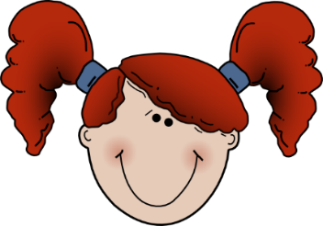
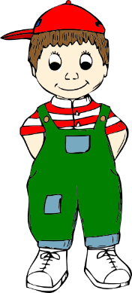
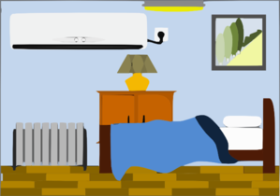
Vocabulaire
le ou la?
le
la
Notes:
Revisiting the active nouns (either nouns from this week’s vocab set or nouns from previous weeks’ sets) for the tasks that follow. Here, pupils should predict to which word for ‘the’ each noun will fly to –le or la? and try to recall the French for each noun at the same time.

Slide 4
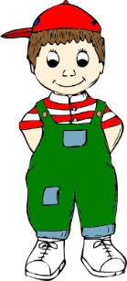
Vocabulary introduction
Vocabulaire
Trouve l’intrus!
1.
4.
le
le
la
le
la
la
2.
5.
le
la
le
la
le
le
3.
6.
der
la
la
le
la
la
le
Notes:
Presentation/introduction to the nouns from the tasks that follow.
Here, pupils find the odd one out by identifying the gender of each noun.

Slide 5
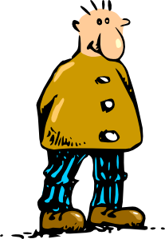
La pronunciation!
l’animal
l’acteur
l’enfant
l’idée
l’ami
l’amie
l’ordinateur
l’homme
Notes:
Teachers could use this slide to reinforce the pronunciation of nouns students know so far where l’ is needed, in a listen and repeat style, then ask students to say the word before the text appears.

