Slide 1
Vocabulary
Y7 French
Term 1.2 - Week 5
Victoria Hobson / Emma Marsden
Date updated: 24/04/20

Slide 2
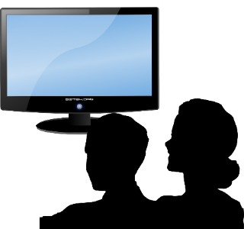
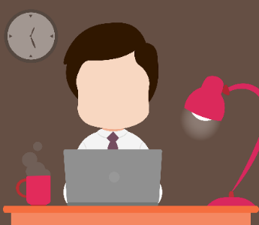
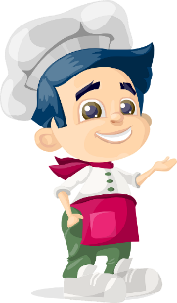
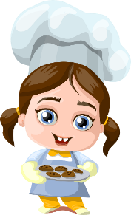
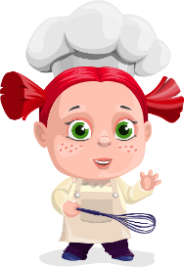
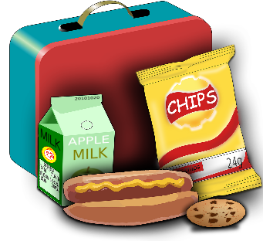
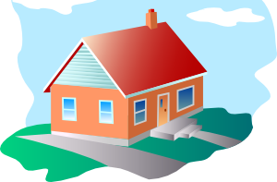
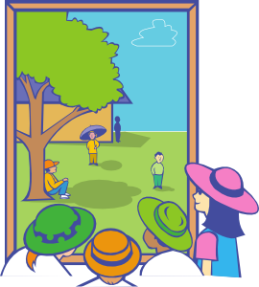
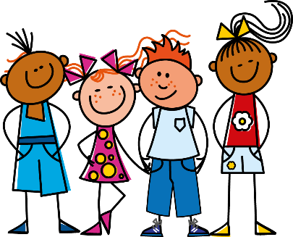
Vocabulaire
regarder
marcher
travailler
préparer
le déjeuner
la maison
dehors
la télé
le film
nous
Notes:
Pupils should be familiar with this vocabulary as it will have been practised in the audio homework from the week before. This slide is, therefore, a whole class check on whether they have done their homework.
Teachers could use this slide to check the knowledge among the students by asking them to give the French for each image to refresh their understanding, asking individual students, then by removing the French to see if pupils can then give the French for the images. Making this time limited adds to the interest. Eg give students 60 seconds. (see next slide).

Slide 3
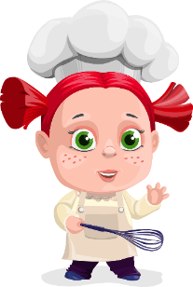
60
regarder
marcher
travailler
préparer
Secondes
le déjeuner
la maison
dehors
0
la télé
le film
nous
DÉBUT
Notes:
In pairs students have a minute to give the French for the images (either written in books/mini-whiteboards or orally to each other, depending on what the teacher wishes the focus to be).

Slide 4
Il aime travailler dehors.
Il aime regarder le film.
Elle aime marcher dehors.
Il aime la maison.
Il aime le film.
Elle aime travailler.
Elle aime regarder la télé.
Il aime préparer le déjeuner.
He likes to watch the film.
She likes to walk outside.
He likes the film.
She likes to work.
She likes to watch tv.
He likes the house.
He likes to work outside.
He likes to prepare lunch.
Notes:
Teachers could also further extend this vocab activity by asking students to translate a variety of sentences that start with:
elle aime / il aime (This verb and these verb endings have also been seen before)
Modelled first by the teacher: (students translate either written in ex books or mini whiteboards)
Acceptable translations also include watching / walking /preparing etc. as well as to watch / to walk / to prepare
il aime le film
elle aime regarder la télé
elle aime marcher dehors
il aime la maison
il aime préparer le déjeuner
elle aime travailler
il aime regarder le film
il aime travailler dehors

Slide 5
Français | Anglais
Il aime la maison. | He likes the house.
Elle aime travailler. | She likes to work.
Il aime regarder le film. | He likes to watch the film.
Il aime travailler dehors. | He likes to work outside.
Elle aime regarder la télé. | She likes to watch tv.
Il aime préparer le déjeuner. | He likes to prepare lunch.
Elle aime marcher dehors. | She likes to walk outside.
Il aime le film. | He likes the film.
60
Secondes
0
DÉBUT
Notes:
Then follow this with a pair work back-translation.
Pairs could compete against each other.
Partner B sits with their back to the board. Partner A says the English. If partner B translates the sentence successfully they get the point, if not partner A gives the translation and keeps the point. Pairs can ask in any order. After a minute pairs swap round.

