Slide 1
The National Centre for Excellence for Language Pedagogy (NCELP): Linking research on language learning
and teaching with classroom practice
and curriculum design
Prof. Emma Marsden,
Director NCELP
University of York

Slide 2
The logic driving NCELP’s activities
Improve pedagogy (something that is within our powers)
Helps language development
Gives learners sense of progression, improves self-efficacy
Increases intrinsic motivation to study a language at GCSE

Slide 3
Some evidence about links between pedagogy and motivation
Learners’ perceptions of ‘ease’ and sense of ‘achievement following effort’ lead to increased motivation
Graham (2004)
Just telling learners “FLs are useful” does not influence uptake;
perceptions of lessons & achievement, and personal relevance count most
Taylor & Marsden (2014) OASIS summary
Not being able to ‘sound out’ words is de-motivating
Erler & Macaro (2012) OASIS summary
Notes:
A role for research in articulating & changing pedagogy
But research is difficult to:
get hold of
get time to read
get training to understand

Slide 4
research-informed, teacher-informed, co-delivered professional development and resources.
Specialist Teachers deliver training to four hub schools. Via Monthly Teacher Research Groups, lesson observation & discussion, resource creation, annual Hub conference
NCELP delivers monthly half-day CPD on research & resources to Specialist Teachers
NCELP residential for Specialist Teachers
What is NCELP and what is it doing?
Notes:
Began with Teaching Schools Council Report, published Nov 2016
The DfE issued an Invitation to Tender for Centre for Excellence, June 2018
Centre began 10 months ago in December 2018

Slide 5
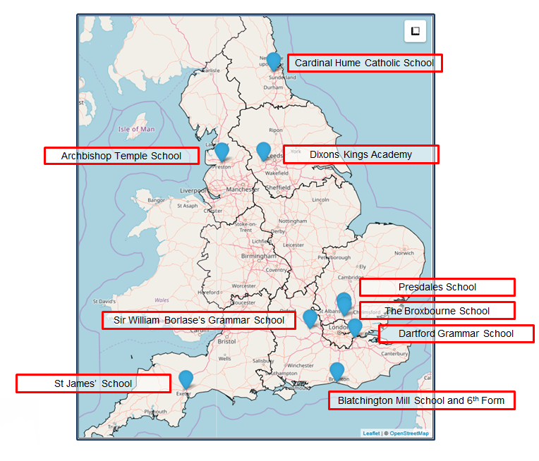
The Nine Lead Schools
Working with 9 Hubs:
9 Lead Schools each with 4 hub schools
Dartford Grammar School, Dartford
Dixons Kings Academy, Bradford
Presdales School, Ware, Hertfordshire
Sir William Borlase’s Grammar School, Marlow
St James’ School, Exeter
The Broxbourne School, Broxbourne, Hertfordshire
Archbishop Temple School, Preston
Blatchington Mill School and Sixth Form, Hove
Cardinal Hume Catholic School, Gateshead

Slide 6
NCELP team
Research and CPD specialists
Prof Suzanne Graham (University of Reading) KS2-3 transition, literature, meaningful practice Dr Rowena Kasprowicz (University of Reading) KS2 knowledge about language, grammar René Koglbauer (University of Newcastle) School FL policy, leadership training, CALL David Shanks (Harris Federation) School FL policy, CALL, differentiation Dr Robert Woore (University of Oxford) Teaching and learning phonics, reading, vocabulary
Director: Prof Emma Marsden (University of York)
Co-Director: Dr Rachel Hawkes (Comberton Academy Trust)
Resource developers
Dr Inge Alferink Nick Avery
Natalie Finlayson
CPD providers
Victoria Hobson Stephen Owen
Management and administration
Ann Mannion, Heather Bradley, Wendy Burns
Tech team for Gaming Grammar
Andy Wood Dr Nick Sephton
Tech team, Resource Portal
Dr Frank Feng Dr Sebastian Pelucha

Slide 7
Approaches to pedagogy
Notes:
Before I describe NCELP’s work, I would like to put FL language learning in context
In order to justify why we have taken many of our decisions

Slide 8
Putting classroom FL learning in context…
In your home language:
Have 17,520 hours exposure by age 4 (Roffwarg et al., 1966)
Hear 2,000 -15,000 words a DAY (Weisleder & Fernald, 2013)
Have 3,000 - 5,000 spoken words before learn to read
Foreign language in England:
429 hours in KS3 + KS4 combined (ages 11-16)
Learn 4-10 words an hour
Conscious learners
We can rely little on innate linguistic or implicit learning
short cuts, anyone?!
DeKeyser, 2015 & 2017
Notes:
General cognitive models of learning emphasize the role of knowledge
Given this very limited time, we need short cuts to this knowledge – we need to be extremely efficient – every decision about which words to teach, which sounds to practice and which grammar to focus on. So what do we choose out of the huge range of

Slide 9
What do we want to teach?
What does it mean to be competent in a language?
Bachman (1990)
Canale & Swain (1980)
Organisational Competence
Grammatical Competence
Textual Competence
Pragmatic Competence
Illocutionary Competence
Sociolinguistic Competence
Morphology
Syntax
Vocab
Phonology/
Graphology
Cohesion
Rhetoric
Functions of language
Register/
Genre / Dialect
Notes:
NCELP: defining this body of knowledge and providing planned and meaningful practice

Slide 10
NCELP pedagogy
Pupils need to gain systematic knowledge of the vocabulary, grammar, and sound and spelling systems (phonics) of their new language, and how these are used by speakers of the language. They need to reinforce this knowledge with extensive planned practice and use it in order to build the skills needed for communication. (MFL Pedagogy Review, p.3)
Phonics
Vocabulary
Grammar
Planned and sequenced meaningful practice

Slide 11
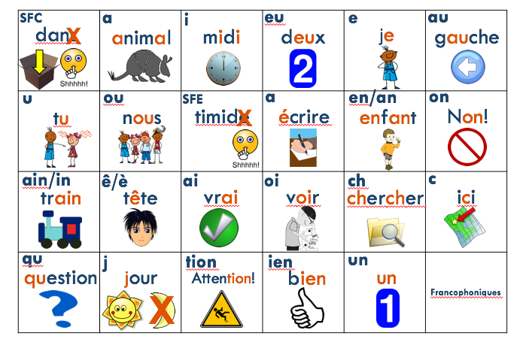
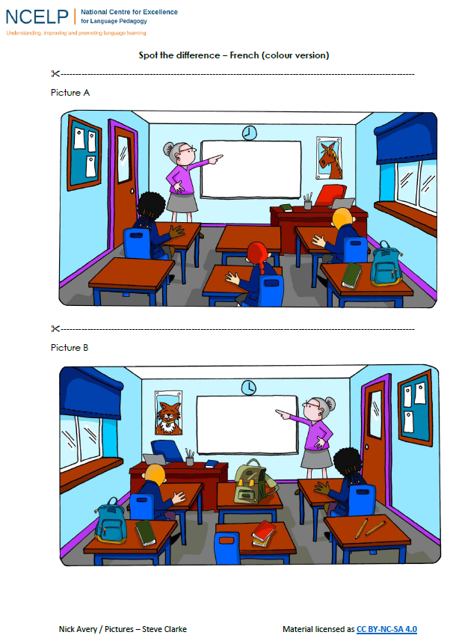
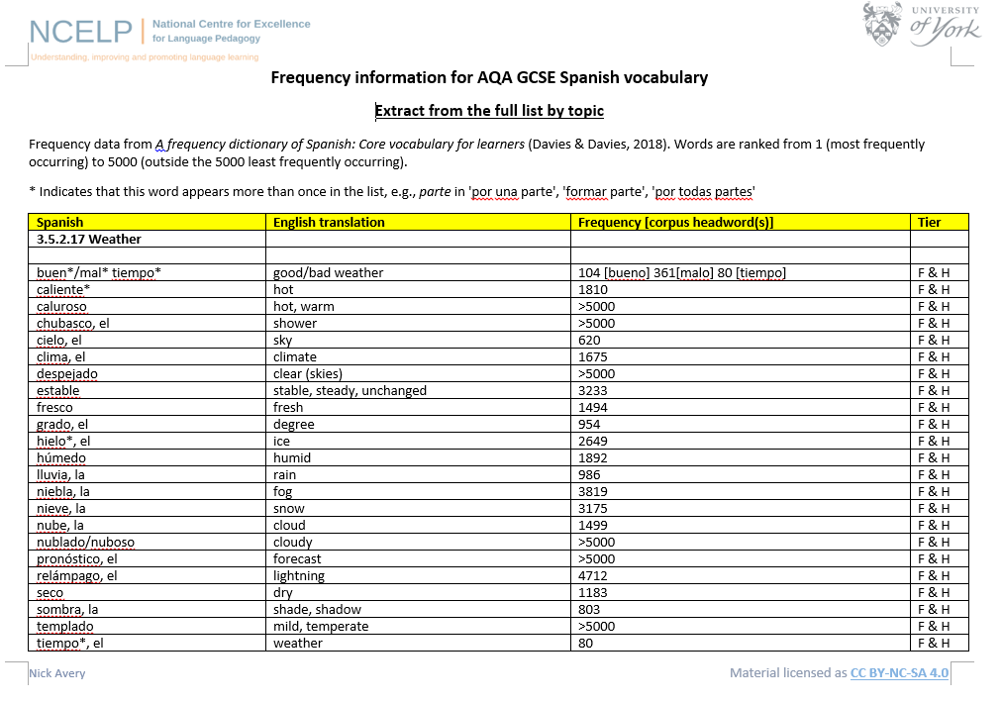
OASIS: https://oasis-database.org
Open Accessible Summaries in Language Studies
Notes:
Many of the resources that are on our database are linked to summaries of relevant research. Of course, the summaries do not provide a direct link – they provide an opportunity for teachers to reflect on some of the evidence informing the resources.

Slide 12
PHONICS
selection & sequencing of symbol-sound correspondences (SSCs)
high-frequency ‘source’ and ‘cluster’ words
staged roll out, with more intensive initial practice
and systematic revisiting
much more time for French
Erler, L. and Macaro, E. (2012) ‘Decoding Ability in French as a Foreign Language and Language Learning Motivation’. The Modern Language Journal, 95(4): 496-518.
Porter, A.M. (2014) An early start to French literacy: Learning the spoken and written word simultaneously in English primary schools. PhD thesis, University of Southampton.
Woore, R. (2007) ‘“Weisse Maus in Meinem Haus”: Using Poems and Learner Strategies to Help Learners Decode the Sounds of the L2’. Language Learning Journal, vol. 35, no. 2, pp. 175-188.
Woore, R. (2009) ‘Beginners’ progress in decoding L2 French: some longitudinal evidence from English Modern Foreign Languages classrooms’. Language Learning Journal, vol. 37, no. 1, pp. 3-18.
Woore, R. (2010) ‘Thinking aloud about L2 decoding: an exploration into the strategies used by beginner learners when pronouncing unfamiliar French words’. Language Learning Journal, vol. 38, no. 1, pp. 3-17.
Woore, R. (2014) ‘Beginner learners’ progress in decoding L2 French: transfer effects in typologically similar L1-L2 writing systems’. Writing Systems Research, volume 4(2): 167-189.
Woore, R (2018) ‘Learners’ pronunciations of familiar and unfamiliar French words: what can they tell us about phonological decoding in an L2?’ The Language Learning Journal, 46(4):456-69.
Woore, R., Graham, S., Porter, A., Courtney, L. and Savory, C. (2018) Foreign Language Education: Unlocking Reading (FLEUR) - A study into the teaching of reading to beginner learners of French in secondary school. https://ora.ox.ac.uk/objects/uuid:4b0cb239-72f0-49e4-8f32-3672625884f0

Slide 13
Why teach phonics in a foreign language?
without explicit phonics teaching, decoding (letters to sounds) limited (
decoding associated positively with motivation
helps access new written and spoken language autonomously and accurately
supports vocabulary learning
https://resources.ncelp.org/

Slide 14
SFC
a
i
eu
e
au
 |  |  |  |  | Francophoniques
dans
je
X
animal
midi
deux
gauche
u
ou
SFE
a
en/an
on
nous
timide
écrire
enfant
Non!
tu
X
ain/in
ê/è
ai
oi
ch
c
train
tête
vrai
voir
chercher
ici
qu
j
tion
ien
un
question
jour
Attention!
bien
un
X

Slide 15
VOCABULARY
selection informed by ‘high frequency’
including a verb lexicon
sets of mixed word classes
developing depth of knowledge (e.g., revisiting, information gaps)
Davies, M, & Davies, K.H. (2018). A Frequency Dictionary of Spanish: Core Vocabulary for Learners. Routledge. Häcker, M. (2008). Eleven pets and 20 ways to express one's opinion: the vocabulary learners of German acquire at English secondary schools, The Language Learning Journal, 36:2, 215-226. Jones, R.L. & Tschirner, E. (2006). A frequency dictionary of German: core vocabulary for learners. Routledge. Lonsdale, D. & Le Bras, Y. (2009) A Frequency dictionary for French. Routledge. Marsden, E., & David, A. (2008). Vocabulary use during conversation: a cross-sectional study of development from year 9 to year 13 among learners of Spanish and French. Language Learning Journal, 36(2), 181-198.
Milton, J. (2006). Language Lite? Learning French Vocabulary in School. Journal of French Language Studies, 16,187-205. Milton, J. (2013). Measuring the contribution of vocabulary knowledge to proficiency in the four skills. Eurosla Monographs Series 2, 57-78. http://www.eurosla.org/monographs/EM02/Milton.pdf
Schmitt, N. (2008). Review Article. Instructed second language vocabulary learning. Language Teaching Research, 12(3), 329–363. https://doi.org/10.1177/1362168808089921 Swan, M. (2008). Talking Sense about Learning Strategies, RELC, Vol 39(2), 262-273.
Notes:
High frequency – so, the most likely to be the most useful

Slide 16
GRAMMAR
Provide explicit but succinct description of grammatical feature
Practice understanding grammar in ‘input’ (reading / listening)
Learners ‘actively recall’ and ‘choose’ which grammar to use (reducing mechanical formulaic repetition)
Practice in range of contexts – aural & written
Use standard grammatical terminology
(KS2 knowledge)
DeKeyser, R. (2005). What makes second-language grammar learning difficult? A review of issues. Language Learning, 55, 1-25. https://doi.org/10.1111/j.0023-8333.2005.00294.x
DeKeyser, R. (2015). Skill acquisition theory. In B. VanPatten & J. Williams (Eds.), Theories in second language acquisition: An introduction (pp. 94–112). London, UK: Routledge.
DeKeyser, R., & Prieto Botana, G. (2015). The effectiveness of processing instruction in L2 grammar acquisition: A narrative review. Applied Linguistics, 36, 290–305. Ellis, N. (2006). Selective attention, and transfer phenomena in L2 acquisition: Contingency, cue competition, salience, interference, overshadowing, blocking, and perceptual learning. Applied Linguistics, 27(2), 164-194. Lichtman, K. (2016). Age and learning environment: Are children implicit second language learners? Journal of Child Language, 43, 707-730. https://doi.org/10.1017/S0305000915000598 Marsden, E. (2006). Exploring input processing in the classroom: An experimental comparison of processing instruction and enriched input. Language Learning, 56, 507–566. Norris, J. & Ortega, L. (2001). Does type of instruction make a difference? Substantive findings from a meta-analytic review. Language Learning, 51, 157-213. https://doi.org/10.1111/j.1467-1770.2001.tb00017.x VanPatten, B. (2002). Processing instruction: An update. Language Learning, 52(4), 755-803.
Notes:
To illustrate, I will show some of the kinds of activities we are moving away from – as sometimes to define something, it is useful to look at what it is NOT.

Slide 17
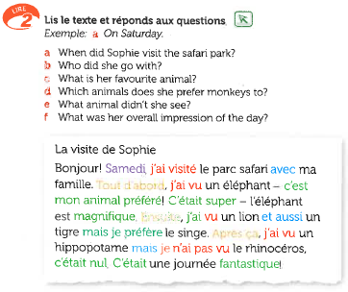
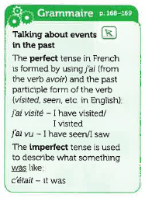
Allez 1 (p. 46)
Notes:
This reading tasks asks learners questions about a text in the past tense which requires them only to understand key nouns Samedi and elephant – in fact the unit was about the past tense and right after this task, the text book provides a full writing activity to write their own account in the past tense.

Slide 18
After 29 weeks = 43 hours of French instruction
plus a few hours at primary school for some children
Pupils were shown two written sentences, with open slots for “friend’s name” and “number of years”
Pupils told:
“This means ‘My best friend is called X. I have known her for Y years’.
Write it down and learn it with the other phrases for the test next week”
Notes:
Learning whole chunks and phrases without de-composing the component parts

Slide 19
After about 15 hours of teaching…
Notes:
Overload with grammar - too much all at once
With little practice

Slide 20
Notes:
With early practice peppered with irregulars, straightaway (far too soon)

Slide 21
Brief example of NCELP short grammar practice
Initial practice of a grammar feature in ‘input language’
This person is talking about what she normally does at the weekend and what she did last weekend. Decide which she is talking about
The only clue is whether you hear “je” (something happens regularly) or “j’ai” (past).
1. Normalement Le weekend dernier 2. Normalement Le weekend dernier 3. Normalement Le weekend dernier
4. Normalement Le weekend dernier …
Removed temporal adverb
→ presence/absence of auxiliary identifies the tense
(Marsden, 2006)
Notes:
Here is an example of withholding the ‘clues’ that can take learner attention away from grammatical structure and enable them to get at the meaning through other means – e.g. the time phrase as in this example
Can be applied to a very wide range of grammatical systems, both morphology and syntax, including S V inversion, verb 2nd
and
Note in this example, we kept main verb constant (e.g. fais vs. fait), so the past participle can’t even give the tense away (tense is conveyed by that auxiliary – not the past participle, which can be used in lots of other tenses (future perfect) and as an adjective etc)

Slide 22
Planned sequencing and revisiting in the Scheme of Work
Grammar thread driving KS3 (not textbook, topics, or GCSE tests)
Mapped out for years 7, 8, 9
Small sets of vocabulary
Learned before lesson using tech (Quizlet + audio homeworks)
Grammar practised in lesson with these vocabulary sets
Whole NCELP lessons available in ppts:
Practice in actively recalling phonics, grammar & vocabulary
…in different modalities and modes
integrating ‘skills’ (dictogloss)
Time built in for tests & exploiting texts.
Search for:
“week 1 Spanish” OR “week 7 French” OR
“week 4 German” resources.ncelp.org
Notes:
NCELP have also created production activities that TRAP the form – make it essential.
This draws on a huge body of research about task design to help teachers design tasks that really try to coerce (elicit) certain forms. The aim is to avoid mechanical repetition that doesn’t require active choice of grammar or vocabulary, and that doesn’t force recall of specific grammar.
We are also selecting and developing classroom-ready ‘challenging texts’.

Slide 23
Notes:
Grammar spine leading the way
Vocab sets – mixed classes
Which vocab will be renewed (about one a month, about once a term)
Phonics- which will be taught
Context- purpose – describing location of things and people
Grammar tracking – gives an overview of what will be taught each week

Slide 24
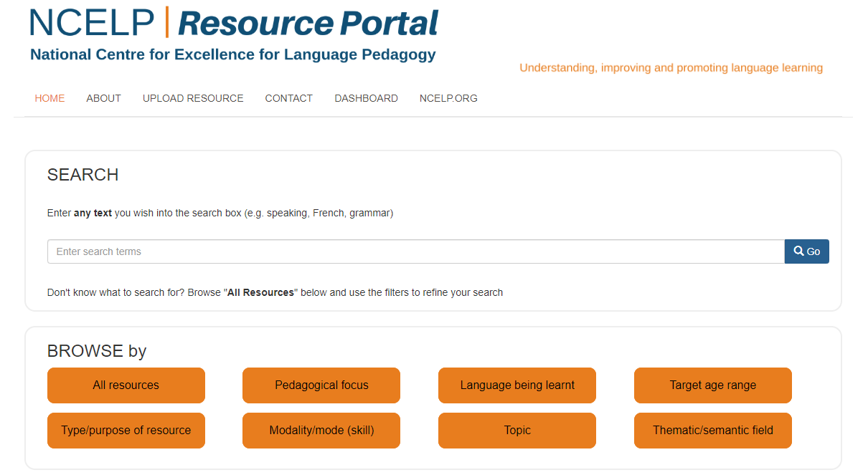
https://resources/ncelp.org/
Notes:
Fully searchable and has all of the CPD ppts that have been delivered, all of the rationale documents mentioned, and all of the resources.
This is all freely accessible to any teacher, any school, not just those involved in the project.

Slide 25
Search for:
“week 1 Spanish” resources.ncelp.org

Slide 26
How’s it going so far? (…NCELP is 10 months old!)
Among 165 teachers in our network, in an anonymous survey:
91%: “NCELP resources are useful”
85%: “confident in delivering the recommendations of the MFL Pedagogy Review”
Notes:
165 / 193

Slide 27
Next steps for NCELP
Autumn term 2019
Trialing of online grammar digital game, with individualized feedback
Fully resourcing Scheme of Work for year 7
Materials creation project with schools
Adapting Scheme of Work in network schools
CPD: Use of target lang, Technology for vocab; alignment with OFSTED framework
Spring term 2020
CPD: Error correction; KS2-3 transition; Knowledge of English grammar from KS2
Summer & Autumn terms 2020
Developing year 8 & 9 SoW and resources

Slide 28
Questions? Comments?

Slide 29
References (for those without links to OASIS summaries)
Bachman, L. (1990) Communicative language ability in Bachman, L. Fundamental Considerations in Language Testing, Cambridge University Press, chapter 4, pp. 81-109
Canale, M. & Swain, M. (1980). Theoretical bases of communicative approaches to second language teaching and testing. Applied Linguistics, 1, 1-44.
Collins, L., & Muñoz, C. (2016). The foreign language classroom:Current perspectives and future considerations. The Modern Language Journal, 100(1), 133-147.
DeKeyser, R. (2015). Skill acquisition theory. In B. VanPatten & J. Williams (Eds.), Theories in second language acquisition: An introduction (pp. 94-112). London: Routledge.
DeKeyser, R. (2017). Knowledge and skill in ISLA. In S. Loewen and M. Sato (Eds.), Routledge Handbook of Instructed Second Language Acquisition (pp. 15–32). London: Routledge.
Graham, S. J. (2004) Giving up on modern foreign languages? Students' perceptions of learning French. The Modern Language Journal, 88 (2). pp. 171-191
Maley, A. 2016. ‘“More research is needed”—a mantra too far?’. Humanising Language Teaching 18/3. Available at http://www.hltmag.co.uk/jun16/mart01. htm#C12 (accessed on 15 May 2017).
Medgyes, P., 2017. The (ir)relevance of academic research for the language teacher. ELT Journal, 71(4), pp.491-498.
Roffwarg, H. P., Muzio, J. N., & Dement, W. C. (1966). Ontogenetic development of the human sleep dream cycle. Science, 152, 604–618.
Weisleder, A & Fernald, A. (2013) Talking to children matters: Early language experience strengthens processing and builds vocabulary. Psychological Science 24 i11, 2143-2152

