Slide 1
Parejas famosas
regular verbs in 3rd person singular vs plural PAST preterite (-ó, -aron)
subject pronouns él, ella, ellos, ellas
Year 10 Term 1.1 Week 7
Louise Caruso / Amanda Izquierdo / Mollie Bentley-Smith
Artwork: Mark Davies
Date updated 01/03/23
Notes:
Artwork by Mark Davies. All additional pictures selected are available under a Creative Commons license, no attribution required.
Learning outcomes (lesson 1):
Possessive adjective 'su' with meaning 'their’
regular verbs in 3rd person singular vs plural PAST preterite (-ó, -aron)
yes-no Qs with raised intonation
awareness raising of 'did' auxiliary
subject pronouns él, ella, ellos, ellas
possessive adjectives su vs sus (with meaning 'his', 'her', 'its')
possessive adjectives: vuestro/vuestra/vuestros/vuestras
Phonics: [ja], [jo], [ju] vs [ga], [go], [gu]
Word frequency (1 is the most frequent word in Spanish):
New vocabulary: casarse [650]; contar² (to tell) [172]; equilibrar [1157]; se [27]; esposa [1083]; gusto¹ (pleasure) [890]; papel² (role) [793]; bueno* (well...)[98]; intj.: ¡adiós! [2309] (9) /H only: enamorarse (de) [1783]; fijar, fijarse¹ (to notice) [681]; esposo [1913]; matrimonio [1151]; nacimiento [1750] (6)
Thematic revisited vocabulary: juntos [149]; amor [283]; pareja [893]; actor [1533]; actriz [3567]; hijo [140]; marido [965]; mujer [120]; tratar [141]; novia [1996]; novio [1322]; realizar [205]; entrar [207]; mundo [123]; olvidar [415]; aceptar [433]; regresar [573]; contestar [669]; amar [700]; enviar [704]; tele [4880], televisión [825]; paso [279]; atrás [599]; carrera [481]; ¿Cómo es? [n/a]; protagonista [1926]; besar [1591]; raíz [1304]; notar [696]; hermoso [980]; altura [970]; recorrer [697]; pasado [932]; isla [810]; abierto [654] (36)
Spaced repetition: doler [1629]; recomendar [1247]; repetir [512]; alumno [862]; boca [465]; cita¹ (appointment) [2002]; cuello [1298]; derecho [1334]; diente [1365]; error [886]; espalda [942]; hospital [1050]; rodilla [1839]; fumar [1883]; información [326]; vuelo [1739]; europeo [721] (17) /H only: asegurar [497]; exigir [854]; nos [52]; os [695]; hombro [1146]; nariz [1570]; justo [1782]; mío [676]; suyo [1002]; tuyo [1717] (10)
Revisited function words: su [12]; ellas [72]; ellos [9]; alguien [346]; vuestro [1748] (5)
Source: Davies, M. & Davies, K. (2018). A frequency dictionary of Spanish: Core vocabulary for learners (2nd ed.). Routledge: London
The frequency rankings for words that occur in this PowerPoint which have been previously introduced in NCELP resources are given in the NCELP SOW and in the resources that first introduced and formally re-visited those words.
For any other words that occur incidentally in this PowerPoint, frequency rankings will be provided in the notes field wherever possible.

Slide 2
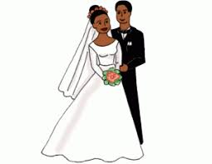
Vocabulario
Vocabulario
hablar
To tell, telling
role
to get
married
goodbye
casarse
contar
¡adiós!
el papel
pleasure
well…
to balance,
balancing
wife
la esposa
equilibrar
el gusto
bueno
Notes:
Timing: 3 minutes
Aim: to present new vocabulary items with their meanings as isolated nouns, before learning these as part of idiomatic expressions with ‘tener’.
Procedure:
1. Present the Spanish orally.
2. Students listen and repeat each word.
3. Elicit the English after each item.

Slide 3
Vocabulario
hablar
¡adiós!
role
well...
pleasure
goodbye
to balance
to tell
wife
to get married
Notes:
Timing: 1 minutes [1/8]
Aim: to promote recognition of the meanings of the vocabulary items.
Procedure:
1. students say the English for the image/word in Spanish on the slide

Slide 4
Vocabulario
hablar
To tell, telling
contar
role
well...
pleasure
goodbye
to balance
to tell
wife
to get married
Notes:
Timing: 1 minutes [2/8]
Aim: to promote recognition of the meanings of the vocabulary items.
Procedure:
1. students say the English for the image/word in Spanish on the slide

Slide 5
Vocabulario
hablar
casarse
role
well...
pleasure
goodbye
to balance
to tell
wife
to get married
Notes:
Timing: 1 minutes [3/8]
Aim: to promote recognition of the meanings of the vocabulary items.
Procedure:
1. students say the English for the image/word in Spanish on the slide

Slide 6
Vocabulario
hablar
well…
bueno
role
well…
pleasure
goodbye
to balance
to tell
wife
to get married
Notes:
Timing: 1 minutes [4/8]
Aim: to promote recognition of the meanings of the vocabulary items.
Procedure:
1. students say the English for the image/word in Spanish on the slide

Slide 7
Vocabulario
hablar
equilibrar
role
well...
pleasure
goodbye
to balance
to tell
wife
to get married
Notes:
Timing: 1 minutes [5/8]
Aim: to promote recognition of the meanings of the vocabulary items.
Procedure:
1. students say the English for the image/word in Spanish on the slide

Slide 8
Vocabulario
hablar
la esposa
role
well...
pleasure
goodbye
to balance
to tell
wife
to get married
Notes:
Timing: 1 minutes [6/8]
Aim: to promote recognition of the meanings of the vocabulary items.
Procedure:
1. students say the English for the image/word in Spanish on the slide

Slide 9
Vocabulario
hablar
pleasure
el gusto
role
well...
pleasure
goodbye
to balance
to tell
wife
to get married
Notes:
Timing: 1 minutes [7/8]
Aim: to promote recognition of the meanings of the vocabulary items.
Procedure:
1. students say the English for the image/word in Spanish on the slide

Slide 10
Vocabulario
hablar
role
el papel
role
well...
pleasure
goodbye
to balance
to tell
wife
to get married
Notes:
Timing: 1 minutes [8/8]
Aim: to promote recognition of the meanings of the vocabulary items.
Procedure:
1. students say the English for the image/word in Spanish on the slide

Slide 11
Vocabulario
Vocabulario
hablar
To tell, telling
role
to get
married
goodbye
casarse
contar
¡adiós!
el papel
pleasure
well…
to balance,
balancing
wife
la esposa
equilibrar
el gusto
bueno
Notes:
Timing: 1 minute
Aim: to promote recall of the vocabulary items in Spanish.
Procedure:
1. Students say the Spanish for the picture that disappears each time. The English prompt for the picture remains in place to reduce the cognitive load (memorisation of the pictures and their positions on the slide is not required).

Slide 12
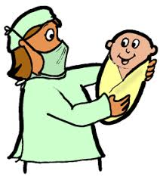
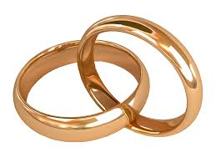
Vocabulario
Vocabulario
hablar
Higher
to fall in
love with
husband
enamorarse de
el esposo
to notice,
to pay attention
birth,
origin
marriage
el matrimonio
fijarse
el nacimiento
Notes:
HIGHER
Timing: 3 minutes
Aim: to present new vocabulary items with their meanings as isolated nouns, before learning these as part of idiomatic expressions with ‘tener’.
Procedure:
1. Present the Spanish orally.
2. Students listen and repeat each word.
3. Elicit the English after each item.

Slide 13
Vocabulario
Vocabulario
hablar
Higher
el esposo
to fall in love with
to notice
marriage
birth, origin
husband
Notes:
Timing: 1 minutes [1/5]
Aim: to promote recognition of the meanings of the vocabulary items.
Procedure:
1. students say the English for the image/word in Spanish on the slide

Slide 14
Vocabulario
Vocabulario
hablar
Higher
enamorarse (de)
to fall in love with
to notice
marriage
birth, origin
husband
Notes:
Timing: 1 minutes [2/5]
Aim: to promote recognition of the meanings of the vocabulary items.
Procedure:
1. students say the English for the image/word in Spanish on the slide

Slide 15
Vocabulario
Vocabulario
hablar
Higher
fijarse
to fall in love with
to notice
marriage
birth, origin
husband
Notes:
Timing: 1 minutes [3/5]
Aim: to promote recognition of the meanings of the vocabulary items.
Procedure:
1. students say the English for the image/word in Spanish on the slide

Slide 16
Vocabulario
Vocabulario
hablar
Higher
el matrimonio
to fall in love with
to notice
marriage
birth, origin
husband
Notes:
Timing: 1 minutes [4/5]
Aim: to promote recognition of the meanings of the vocabulary items.
Procedure:
1. students say the English for the image/word in Spanish on the slide

Slide 17
Vocabulario
Vocabulario
hablar
Higher
el nacimiento
to fall in love with
to notice
to fix
marriage
birth, origin
husband
Notes:
Timing: 1 minutes [5/5]
Aim: to promote recognition of the meanings of the vocabulary items.
Procedure:
1. students say the English for the image/word in Spanish on the slide

Slide 18
Vocabulario
Vocabulario
hablar
Higher
to fall in
love with
husband
enamorarse de
el esposo
To notice,
noticing
birth,
origin
marriage
el matrimonio
fijarse
el nacimiento
Notes:
Timing: 1 minute
Aim: to promote recall of the vocabulary items in Spanish.
Procedure:
1. Students say the Spanish for the picture that disappears each time. The English prompt for the picture remains in place to reduce the cognitive load (memorisation of the pictures and their positions on the slide is not required).

Slide 19
Talking about what people did in the past Using the 3rd person preterite endings –ó / -aron
gramática
Remember that in Spanish the –ar verb endings change depending on who the verb refers to.
To mean ‘s/he’ or ‘it’ for a completed action in the past, remove –ar and add _____ (with accent!).
-ó
Note that the reflexive pronoun ‘se’ moves to the front of the verb
contar
casarse
(s/he or it told)
(s/he or it got married)
Contó = _____________________
se casó = ______________________.
To mean ‘they’ for a completed action in the past, remove –ar and add –aron.
Equilibrar
equilibr
equilibraron
(they balanced)
Notes:
Timing: 2 minutes
Aim: to recap 1st person singular form of preterite for –ar verbs (-ó) and 3rd person plural preterite (-aron)
Procedure:
1. Go through the grammar explanation with students, revealing each new sentence on a mouse click.

Slide 20
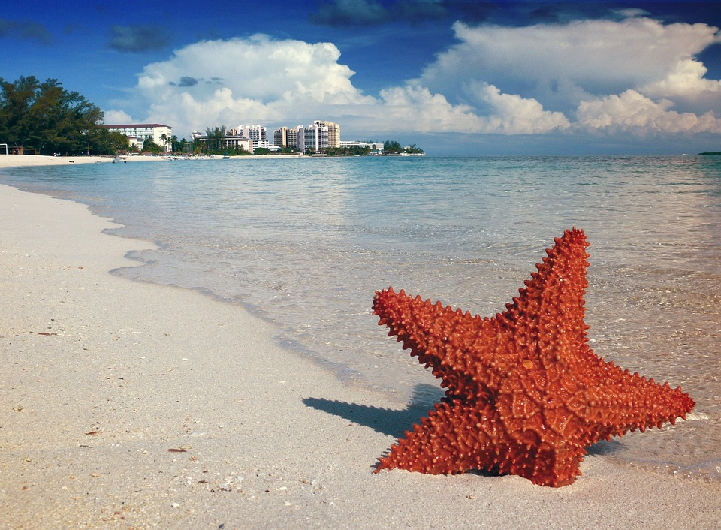
Las vidas de dos actores famosos Penélope Cruz y Javier Bardem
leer
 | uno | los dos
Lee las frases y marca. ¿Es uno o los dos?
Carlos Delgado; CC-BY-SA
1. Ganaron un Óscar en 2007 y 2008.
2. Entraron en el cine estadounidense casi al mismo tiempo.
3. Estudió italiano porque quería un papel en una película italiana.
4. Besaron en la boca a Scarlett Johanson en una película.
5. Aceptó un papel muy difícil en una película sobre una historia real.
6. Se casaron en la casa de un amigo que está en las Bahamas.
7. Contó que, para uno de sus papeles, se llenó de dulces para pesar más.
8. Olvidó parte de su texto cuando trabajó en una película de James Bond.
Notes:
Timing: 8 minutes
Aim: to practise recognition of 3rd person preterite endings (-ó and –aron) in the singular and plural in the written modality
Procedure:
Read the sentence
Tick the correct column according to whether the sentence is written about one of the celebrities or both of them.
Click to reveal the answers. Teachers may wish to elicit the English meaning of some of the phrases with some of this week’s vocabulary.
Image of Javier Barden and Penélope Cruz by Carlos Delgado available at: https://commons.wikimedia.org/wiki/File:Premios_Goya_2018_-_Javier_Bardem_y_Pen%C3%A9lope_Cruz.jpg. This file is licensed under the Creative Commons Attribution-Share Alike 4.0 International license.

Slide 21
Talking about who does the action Using personal pronouns in 3rd person
leer
In Spanish, we use personal pronouns to give emphasis or to present a contrast between different people doing different things.
él
ella
To say ‘he’ in Spanish we use _____ and to say ‘she’ we use ____.
En su primera película juntos, él tenía 21 años pero ella tenia sólo 16 años.
In their first film together, he was 21 years old but she was only 16.
ellos
To say ‘they’ in Spanish say ______ for male persons and mixed groups and _____ for all female groups.
ellas
Ellos son los padres de mi esposa, ellas son sus amigas y ellos sus hermanos.
They are my wife’s parents, they are her friends and they are her brothers.
Notes:
Timing: 2 minutes
Aim: to recap personal pronouns ‘él’, ‘ella’, ‘ellos’ and ‘ellas’.
Procedure:
1. Go through the grammar explanation with students, revealing each new sentence on a mouse click.

Slide 22
Las vidas de dos actores famosos Penélope Cruz y Javier Bardem
*el escenario (H) = stage
escuchar/leer
A. Escucha y marca la opción correcta.
Una persona | Varias personas
B. ¿Quién es la persona?
1
1. Trabajaron juntos en una película en los años noventa.
2. Llegó a Estados Unidos sola para empezar su carrera allí.
2
3
3. Un amigo de Bono, del grupo U2, bailó en el escenario* durante su concierto.
4. Después de hacer la película, “Todos los caballos bellos”, tomó la decision de ser vegetariana.
4
5. En la película Agentes 335, las cinco protagonistas inteligentes y hermosas evitaron la Tercera Guerra Mundial.
5
6
6. Los dos se enamoraron en 2007 en la película de Vicky, Cristina, Barcelona. (H)
Notes:
[1/2]
Timing: 12 minutes
Aim: to recognise 3rd person preterite endings –ó and –aron and connect them with the correct subject pronouns:‘él’, ‘ella’, ‘ellos’ or ‘ellas’
Procedure:
Listen to the audio.
Tick the correct column according to whether student hear the verb in the 3rd person preterite singular (-ó) or plural (-aron)
Click to reveal the transcript and the answers.
On the next slide, students then decide if the subject of the sentence is ‘él’, ‘ella’, ‘ellos’ or ‘ellas’
Click to reveal the answers.
Transcript:
Trabajaron juntos en una película en los años noventa.
Llegó a Estados Unidos sola para empezar su carrera allí.
Un amigo de Bono, del grupo U2, bailó en el escenario* durante su concierto.
Después de hacer la película, “Todos los caballos bellos”, tomó la decision de ser vegetariana.
En la película Agentes 335, las cinco protagnistas inteligentes y hermosas evitaron la Tercera Guerra Mundial.
Los dos se enamoraron en 2007 durante la filmación de Vicky Cristina Barcelona. (H)

Slide 23
Las vidas de dos actores famosos Penélope Cruz y Javier Bardem
escuchar/leer
*el escenario = stage
B. Ahora lee las frases. ¿Es él, ella, ellos o ellas?
1. Trabajaron juntos en una película en los años noventa.
1
ellos
2. Llegó a Estados Unidos sola para empezar su carrera allí.
2
ella
3. Un amigo de Bono, del grupo U2, bailó en el escenario* durante su concierto.
él
3
4
4. Después de hacer la película, “Todos los caballos bellos”, tomó la decisión de ser vegetariana.
ella
5. En la película Agentes 335, cinco protagonistas inteligentes y hermosas evitaron la Tercera Guerra Mundial.
5
ellas
6
6. Los dos se enamoraron en 2007, cuando trabajaron en la película Vicky, Cristina, Barcelona. (H)
ellos
Notes:
[2/2]

Slide 24
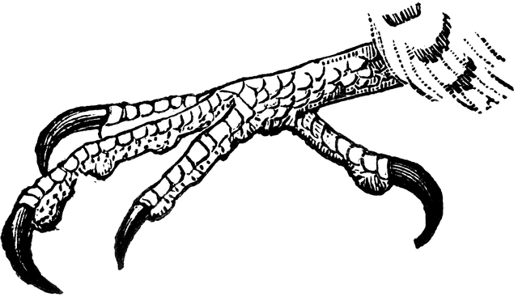
¿Qué sonido es?
escuchar
1
Escucha el audio. ¿Cuál es la palabra que escuchas?
A
B
jarra
garra
[jug]
[claw]
Notes:
[1/11]
Timing: 5 minutes
Aim: to recognise the difference between SSCs [j] and [g] in words containing [ja], [jo], [ju] vs [ga], [go], [gu]
Procedure:
Before beginning the activity, students should write down numbers 1-11.
The procedure is the same for each of the 11 slides in this activity.
Teacher clicks on the number button in the top left to play the Spanish audio of one of the words displayed on the screen.
Students write down A or B, depending on which word they believe they heard.
Teacher clicks to reveal the answer before moving on to the next slide.
Note:
Most words in this activity are not known to students. They are not expected to learn these words, which have simply been used to demonstrate the target SSCs.
Transcript:
jarra
gota
Jandía
gusto
liga
higo
dijo
paja
soja
Lugo
joya
Frequency of unknown/glossed words (1 is the most frequent word in Spanish):
dijo [31]; Gandía [>5000]; garra [4958]; gota [2391]; Goya [>5000]; higo [>5000]; Jandía [>5000]; jarra [>5000]; jota [>5000]; joya [3292]; liga [2313]; lija [>5000]; Lugo [>5000]; lujo [2240]; paga [>5000]; paja [3876]; soga [>5000]; soja [>5000]

Slide 25
¿Qué sonido es?
escuchar
2
Escucha el audio. ¿Cuál es la palabra que escuchas?
A
B
gota
jota
[drop]
[letter J]
Notes:
[2/11]

Slide 26
¿Qué sonido es?
escuchar
3
Escucha el audio. ¿Cuál es la palabra que escuchas?
A
B
Gandía
Jandía
[city in Valencian community]
[peninsula on Fuerteventura]
Notes:
[3/11]

Slide 27
¿Qué sonido es?
escuchar
4
Escucha el audio. ¿Cuál es la palabra que escuchas?
A
B
gusto
justo
[pleasure]
[fair, just]
Notes:
[4/11]

Slide 28
¿Qué sonido es?
escuchar
5
Escucha el audio. ¿Cuál es la palabra que escuchas?
A
B
liga
lija
[league]
[sandpaper]
Notes:
[5/11]

Slide 29
¿Qué sonido es?
escuchar
6
Escucha el audio. ¿Cuál es la palabra que escuchas?
A
B
higo
hijo
[fig]
[son, child]
Notes:
[6/11]

Slide 30
¿Qué sonido es?
escuchar
7
Escucha el audio. ¿Cuál es la palabra que escuchas?
A
B
digo
dijo
[I say]
[he/she/it said]
Notes:
[7/11]

Slide 31
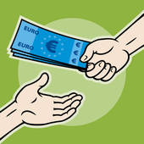
¿Qué sonido es?
escuchar
8
Escucha el audio. ¿Cuál es la palabra que escuchas?
A
B
paja
paga
[straw]
[s/he pays]
Notes:
[8/11]

Slide 32
¿Qué sonido es?
escuchar
9
Escucha el audio. ¿Cuál es la palabra que escuchas?
A
B
SOYA
soga
soja
[rope]
[soya]
Notes:
[9/11]

Slide 33
¿Qué sonido es?
escuchar
10
Escucha el audio. ¿Cuál es la palabra que escuchas?
A
B
lujo
Lugo
[luxury]
[city in Galicia, Spain]
Notes:
[10/11]

Slide 34
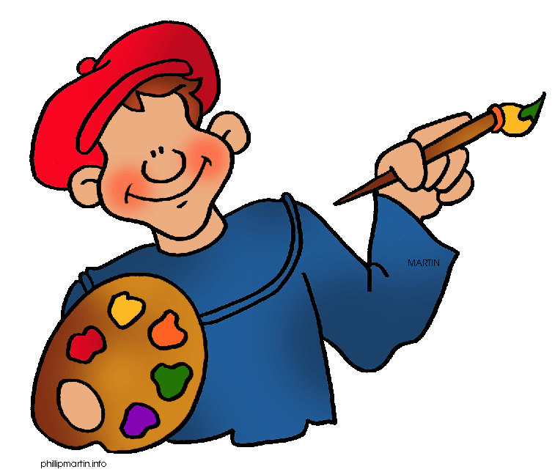
¿Qué sonido es?
escuchar
11
Escucha el audio. ¿Cuál es la palabra que escuchas?
A
B
joya
Goya
[jewel]
[famous Spanish artist]
Notes:
[11/11]

Slide 35
hablar / escuchar
Vocabulario
hablar/escuchar
*secundario = supporting (actor)
Estudiante A
 | Lee las frases en la lista
1 | Javier Bardem es el hijo de Pilar Bardem, una actriz famosa.
2 | Dejó de ser pintor para tener una larga carrera como actor.
3 | Penélope Cruz ganó el Oscar a la mejor actriz secundaria*.
4 | Estos dos actores están juntos. Es una pareja muy popular.
 | j | g
1
1
2
2
3
3
4
4
Notes:
Timing: 5 minutes
Aim: to practice vocabulary and phonics
Procedure:
Students work in pairs.
Student A reads their phrases in Spanish.
Student B writes down all the words with the relevant SSCs.
Then, students swap roles.
Frequency of unknown vocabulary:
secundario [2046]

Slide 36
hablar / escuchar
Vocabulario
hablar/escuchar
Estudiante B
 | Lee las palabras en la lista
1 | Me gusta el director Pedro Almódovar pero prefiero sus películas más viejas.
2 | El protagonista de una película es el personaje más importante.
3 | Cuando era joven saber cosas sobre la gente famosa era un gusto.
4 | Sin embargo, ahora no me fijo en sus vidas.
 | j | g
1
1
2
2
3
3
4
4
Notes:
Speaking cards

Slide 37
Vocabulario
hablar/escuchar
*secundario = supporting (actor)
Estudiante A - Solución
 | Lee las frases en la lista
1 | Javier Bardem es el hijo de Pilar Bardem, una actriz famosa.
2 | Dejó de ser pintor para tener una larga carrera como actor.
3 | Penélope Cruz ganó el Oscar a la mejor actriz secundaria*.
4 | Estos dos actores están juntos. Es una pareja muy popular.
 | j | g
1
1
2
2
3
3
4
4
gusta
viejas
protagonista
personaje
joven
gusto
sin embargo
fijo
Notes:
ANSWER SLIDE

Slide 38
Estudiante B - Solución
Vocabulario
hablar/escuchar
 | Lee las palabras en la lista
1 | Me gusta el director Pedro Almódovar pero prefiero sus películas más viejas.
2 | El protagonista de una película es el personaje más importante.
3 | Cuando era joven saber cosas sobre la gente famosa era un gusto.
4 | Sin embargo, ahora no me fijo en sus vidas.
 | j | g
1
1
2
2
3
3
4
4
Javier
hijo
dejó
larga
ganó
mejor
juntos
pareja
Notes:
ANSWER SLIDE

Slide 39
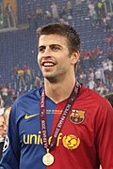
Hablamos sobre personas famosas: Penélope Cruz, Javier Bardem, Gerard Piqué and Shakira.
Javier y Pénelope
hablar / escuchar
Persona A: tiene la primera parte de unas frases en inglés. Debes decir las frase en español.
Carlos Delgado; CC-BY-SA
Persona B: escucha la primera parte de cada frase en español. ¿Es singular o plural? Debes completar la frase con la frase más apropiada* y la forma correcta del verbo.
Gerard Piqué
Shakira
¡Atención! ¿Es singular? → -ó
¿Es plural? → -aron
Persona A: escribe la segunda parte de su frase en inglés.
Ejemplo:
*apropiado = appropriate
Estudiante A
El actor y su mujer…
Estudiante B
… participaron en un progama de televisión.
 | Lee las frases en español
1 | The actor and his wife… _________________________________
5 | … participated in a TV program.
… participated in a TV programme.
Notes:
Timing: 10 minutes
Aim: to use the new grammar and vocabulary in oral production; to further practise listening out for 3rd person singular and plural verb endings –e and –en and connecting these with their meanings.
Procedure:
The teacher runs through the worked example with students on this slide, making clear that students need to start each phrase with a verb, not a pronoun.
In the paired activity, student A reads the sentences aloud in Spanish. Student B and responds with the most appropriate second part of the sentence and using the correct form of the verb in the preterite with the -ó or –aron ending. Note that the focus here is to use the verb correctly in the preterite tense, i.e. it’s less important to select the correct sentence ending.
Student A records the second part of the sentence in English.
Students then swap roles.
The next two slides are student cards, followed by two answer slides.
Note that the focus of the activity here is the preterite tense in the 3rd person, the use of ‘su’ and this week’s vocabulary, students should be have a go and focus on communicating their meaning using the target grammar / vocabulary and know that it is ok to make mistakes when they are completing speaking practice activities.
Frequency of unknown vocabulary:
apropiado [3136]

Slide 40
Persona A
Persona B
 | Lee las primeras partes de las frases en español
1 | Gerard Piqué and Shakira… __________________________________
2 | Penélope and Javier… __________________________________
3 | The actor… __________________________________
4 | The actress… __________________________________
5 | The artist, Shakira… __________________________________
 | Lee las primeras partes de las frases en español
1 | The actresses… __________________________________
2 | Salma Hayek… __________________________________
3 | The artist, Shakira… __________________________________
4 | The football player... __________________________________
5 | Penélope Cruz… __________________________________
Notes:
SPEAKING CARDS - DO NOT DISPLAY DURING ACTIVITY.

Slide 41
Persona A
*el matrimonio = marriage (H)
Persona B
*el escenario = stage (H)
 | Lee las segundas partes de las frases en español
1 | … answered questions about the role of women in television.
2 | …supported Penélope Cruz during a visit to Los Angeles.
3 | … told the audience (the public) about her marriage* to Gerard Piqué.
4 | …started his career in Barcelona.
5 | … answered questions about a new film.
 | Lee las segundas partes de las frases en español
1 | … spent 11 years together.
2 | …. got married at a friend’s house on an island in the Bahamas.
3 | … entered the stage* with his wife who is beautiful.
4 | … kissed her husband for the first time in the film.
5 | … balanced her career in music with her personal life.
Notes:
SPEAKING CARDS - DO NOT DISPLAY DURING ACTIVITY.

Slide 42
Respuestas: persona A
*el escenario = stage (H)
*el matrimonio = marriage (H)
 | Lee las primeras partes de las frases en español
1 | Gerard Piqué and Shakira…
2 | Penélope and Javier…
3 | The actor…
4 | The actress…
5 | The artist, Shakira...
… spent 11 years together.
Gerard Piqué y Shakira pasaron once años juntos.
… got married at a friend’s house on an island in the Bahamas.
Penélope y Javier se casaron en la casa de un amigo en una isla en las Bahamas.
… entered the stage* with his wife who is beautiful.
El actor entró al escenario con su mujer que es hermosa.
… kissed her husband for the first time in the film.
La actriz besó a su marido por primera vez en la película.
… balanced her career in music with her personal life.
La artista, Shakira, equilibró su carrera en música con su vida personal.
Notes:
ANSWERS
The teacher can use this slide to give students feedback on their answers. Answers are animated to appear one by one.
Note that the focus of the activity here is the preterite tense in the 3rd person, the use of ‘su’ and this week’s vocabulary. Correction should focus on these grammar features as at this level, errors may occur in other parts of the sentence.

Slide 43
Respuestas: Persona B
 | Lee las primeras partes de las frases en español
1 | The actresses…
2 | Salma Hayek…
3 | The artist, Shakira…
4 | The football player...
5 | Penélope Cruz…
… answered questions about the role of women in television.
Las actrices contestaron preguntas sobre el papel de las mujeres en televisón.
…supported Penélope during a visit to Los Angeles.
Salma Hayek apoyó a Penélope durante una visita a L.A.
… told the audience (the public) about her marriage* to G. Piqué.
La artista, Shakira, contó al público sobre su matrimonio a Gerard Piqué.
…started his career in Barcelona.
El jugador de fútbol empezó su carrera en Barcelona.
… answered questions about a new film.
Penélope Cruz contestó preguntas sobre una película nueva.
Notes:
ANSWERS
The teacher can use this slide to give students feedback on their answers. Answers are animated to appear one by one.

Slide 44
Parejas famosas
Possessive adjective 'su' with meaning 'their’
yes-no Qs with raised intonation
awareness raising of 'did' auxiliary
possessive adjectives su vs sus (with meaning 'his', 'her', 'its')
Year 10 Term 1.1 Week 7 – Lesson 2
Louise Caruso / Amanda Izquierdo
Molly Bentley-Smith
Artwork: Mark Davies
Date updated 19/1/22
Notes:
Artwork by Mark Davies. All additional pictures selected are available under a Creative Commons license, no attribution required.
Learning outcomes (lesson 2):
Possessive adjective 'su' with meaning 'their’
regular verbs in 3rd person singular vs plural PAST preterite (-ó, -aron)
yes-no Qs with raised intonation
awareness raising of 'did' auxiliary
subject pronouns él, ella, ellos, ellas
possessive adjectives su vs sus (with meaning 'his', 'her', 'its')
possessive adjectives: vuestro/vuestra/vuestros/vuestras
Phonics: [ja], [jo], [ju] vs [ga], [go], [gu]
Word frequency (1 is the most frequent word in Spanish):
New vocabulary: casarse [650]; contar² (to tell) [172]; equilibrar [1157]; se [27]; esposa [1083]; gusto¹ (pleasure) [890]; papel² (role) [793]; bueno* (well...)[98]; intj.: ¡adiós! [2309] (9) /H only: enamorarse (de) [1783]; fijar, fijarse¹ (to notice) [681]; esposo [1913]; matrimonio [1151]; nacimiento [1750] (6)
Thematic revisited vocabulary: juntos [149]; amor [283]; pareja [893]; actor [1533]; actriz [3567]; hijo [140]; marido [965]; mujer [120]; tratar [141]; novia [1996]; novio [1322]; realizar [205]; entrar [207]; mundo [123]; olvidar [415]; aceptar [433]; regresar [573]; contestar [669]; amar [700]; enviar [704]; tele [4880], televisión [825]; paso [279]; atrás [599]; carrera [481]; ¿Cómo es? [n/a]; protagonista [1926]; besar [1591]; raíz [1304]; notar [696]; hermoso [980]; altura [970]; recorrer [697]; pasado [932]; isla [810]; abierto [654] (36)
Spaced repetition: doler [1629]; recomendar [1247]; repetir [512]; alumno [862]; boca [465]; cita¹ (appointment) [2002]; cuello [1298]; derecho [1334]; diente [1365]; error [886]; espalda [942]; hospital [1050]; rodilla [1839]; fumar [1883]; información [326]; vuelo [1739]; europeo [721] (17) /H only: asegurar [497]; exigir [854]; nos [52]; os [695]; hombro [1146]; nariz [1570]; justo [1782]; mío [676]; suyo [1002]; tuyo [1717] (10)
Revisited function words: su [12]; ellas [72]; ellos [9]; alguien [346]; vuestro [1748] (5)
Source: Davies, M. & Davies, K. (2018). A frequency dictionary of Spanish: Core vocabulary for learners (2nd ed.). Routledge: London
The frequency rankings for words that occur in this PowerPoint which have been previously introduced in NCELP resources are given in the NCELP SOW and in the resources that first introduced and formally re-visited those words.
For any other words that occur incidentally in this PowerPoint, frequency rankings will be provided in the notes field wherever possible.

Slide 45
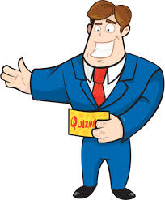
Vocabulario
escuchar
*programa de juegos = game show
*pista = hint
Ayuda a las personas famosas a ganar el programa de juegos*. Escucha las pistas*, elige una palabra y escribe los números correctos.
A
C
1 _
2 _
3 _
C
D
4 _
5 _
 | A | B | C | D
 | recomendar | olvidar | casarse | doler
 | la esposa | el mundo | el hospital | el actor
 | la televisión | el vuelo | el diente | la isla
 | la entrevista | la cita | el papel | la pareja
 | fumar | repetir | equilibrar | entrar
B
1
2
3
4
5
Notes:
1/2
Timing: 6 minutes
Aim: to revise a mix of new and revisited vocabulary
Procedure:
1. Click on the action buttons to hear the definitions.
2. Students decide if the answer is in column A, B, C or D. They will write down the correct letter for each definition to form a code.
3. Teacher clicks anywhere in the slide to reveal the answers.
Transcript:
Cuando no te acuerdas de algo.
Vas a este lugar cuando tienes dolor o cuando estás enfermo.
Es algo que está en la boca.
Dos personas que están saliendo juntas.
Hacer algo otra vez.

Slide 46
Vocabulario
*programa de juegos = game show
*pista = hint
escuchar
Ayuda a las personas famosas a ganar el programa de juegos*. Escucha las pistas*, elige una palabra y escribe los números correctos.
€€€€€€€€€€
A
B
6 _
7 _
8 _
D
¡GANÁIS!
C
A
 | A | B | C | D
 | el derecho | la isla | el cuello | el hijo
 | contar | contestar | aceptar | amar
 | justo | europeo | abierto | hermoso
 | el matrimonio | el raíz | la rodilla | la nariz
 | enviar | realizar | asegurar | exigir
9 _
10 _
€€€€€€€€€€
6
7
8
9
10
Notes:
2/2
Transcript:
6) Algo básico que todos merecemos, por ejemplo el poder de votar.
7) Responder una pregunta.
8) Otra palabra para precioso.
9) Una parte de la pierna.
10) Otra palabra para mandar.

Slide 47
Talking about his or her things Using possessive adjectives ‘su’ and ‘sus’
gramática
To say ‘his’, ‘her’ or ‘its’ before a singular or uncountable noun we use ‘su’. It does not matter whether the noun is masculine or feminine.
His / her / its role is important.
Su papel es importante.
To say ‘his’, ‘her’ or ‘its’ before a plural noun use ‘sus’.
His / her / its eyes are beautiful.
Sus ojos son hermosos.
Notes:
Timing: 2 minutes
Aim: to recap ‘su’ and ‘sus’.
Procedure:
1. Click to reveal each new part of explanation of ‘su’ and ‘sus’ and then the examples. Each example and answer is revealed by a click, so teachers can ask students for the answers.
2. Click to show explanation of ‘su’ or ‘sus’ and how this will inform the verb choice between ‘es’ or ‘son’.

Slide 48
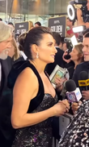
Entrevista con Penélope
escuchar
Escucha al presentador.
Habla sobre el programa de hoy, pero hay un problema con el micrófono.
¿Qué significan las palabras subrayadas*?
¿Cómo termina cada frase?
 | a) papel en la película, Madre Paralelas. | b)papeles más importantes.
 | a) temas más importantes. | b)popularidad en el mundo de hoy.
 | a) amigo, Pedro Almódovar. | b)proyectos futuros.
 | b)esfuerzos para proteger los océanos | a) trabajo para el proteger los océanos
 | a) vidas profesionales | b) vida juntos.
 | a) pareja | b) hijos
1
En la entrevista Penelope Cruz habla, sobre su…
interview
role
2
Consideramos su…
3
Hablamos también de sus…
world
4
Escuchamos sobre el marido, actor Javier Bardem, y sus…
husband
actor
5
Por supuesto cuenta todo sobre su…
tells
together
6
Comparte los mejores momentos con sus…
partner
children
*subrayado = underlined
Notes:
Timing: 7 minutes
Aim: to recognise ‘su’ and ‘sus’ in a spoken text; to recognise this week’s vocabulary in context.
Procedure:
Listen to the first part of the message
Depending on whether ‘su’ or ‘sus’ is used, select the correct option to finish the sentence.
Click to reveal the answers
Elicit the translation of the underlined words
Click to reveal the answers
Transcript:
En la entrevista Penelope Cruz habla, sobre su…
Consideramos su …
Hablamos también de sus…
Escuchamos sobre el marido, actor Javier Bardem, y sus …
Por supuesto cuenta todo sobre su…
Finalmente comparte los mejores momentos de la vida con sus…
Photo of Penélope Cruz by Beto Pasillas available at : https://commons.wikimedia.org/wiki/File:Pen%C3%A9lope_Cruz_Goldeb_Globes_2019.png This file is licensed under the Creative Commons Attribution 3.0 Unported license.
Frequency of unknown vocabulary:
subrayar [2881]

Slide 49
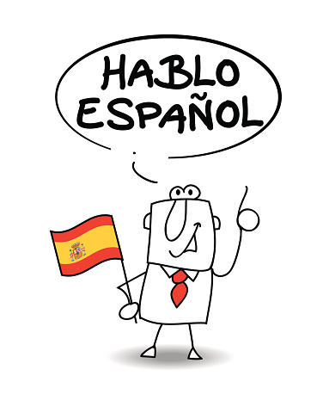
Talking about their things Using possessive adjectives ‘su’ and ‘sus’
gramática
¡Ojo! As su(s) has different meanings, you may need context to know if it refers to she, he, it or their.
‘su’and ‘sus’ also mean ‘their’ referring to something that belongs to more than one person. Again, it is used for both masculine and feminine nouns.
Their children speak Spanish.
Sus hijos hablan español.
Their wives are good friends.
Sus mujeres son buenas amigas.
Notes:
Timing: 2 minutes
Aim: to recap ‘su’ and ‘sus’.
Procedure:
1. Click to reveal each new part of explanation of ‘su’ and ‘sus’ and then the examples. Each example and answer is revealed by a click, so teachers can ask students for the answers.
2. Click to show explanation of ‘su’ or ‘sus’ and how this will inform the verb choice between ‘es’ or ‘son’.

Slide 50
Piqué en la tele
Lee la información sobre el programa de televisón.
leer
¿Qué significa ‘su’ / ‘sus’ en cada frase?
 | his | her | its | their
1. Hoy tenemos en el estudio a Gerard Piqúe. Su carrera empezó en FC Barcelona donde su abuelo era el vicepresidente.
2. Empezó a jugar en el FC Barcelona en sus categorías inferiores.
3. Más tarde, Piqué participó en la selección española más famosa en la historia, por su victoria en la Copa Mundial* en 2010.
4. Su ex pareja es una artista colombiana.
5. Canta desde muy joven. Sus canciones son famosas en todo el mundo.
6. Pasaron once años de sus vidas juntos. Sus hijos se llaman Milan y Sasha.
7. Anunciaron su separación en junio.
8. Piqué ahora tiene una pareja nueva. Su novia se llama Clara Chía Martí.
Notes:
Timing: 7 minutes
Aim: to understand from the context of the sentence, the meaning of ‘su’ and ‘sus’
Procedure:
Read the sentence
Tick the meaning of ‘su’ according to context of the text.
Click to reveal the answers.
Photo of Gerard Piqué by Galkiux and available at: https://commons.wikimedia.org/wiki/File:Piqu%C3%A9.jpg This file is licensed under the Creative Commons Attribution 2.0 Generic license.

Slide 51
How to ask questions in Spanish Using verbs in questions
gramática
When asking questions in English, we often use ‘do’ (or ‘did’) before the subject.
Example:
Did you buy a watch?
Spanish doesn’t have a word for ‘do’ or ‘did’ in questions. Only the main verb is used.
Ejemplos:
1
¿Aceptó el papel?
¿Recomendaron esta película?
2
Did s/he accept the role?
Did theyrecommend this film?
Notes:
Timing: 2 minutes
Aim: to help students prepare for the productive elements of the next task by recapping Spanish question formation. Students often find it difficult to construct questions by translating from English prompts, as the translation is often not literal.
Procedure:
Click to go through this slide’s explanation and examples.
Audio is provided to model the intonation (see note below).
Note: the teacher could also highlight the fact that Spanish questions have raised intonation at the end. This distinguishes them from statements.

Slide 52
Question intonation
How to ask questions in Spanish Using verbs in questions
How to ask questions in Spanish Using verbs in questions
Remember that to ask a question in Spanish, you use the same verb, but with raised intonation.
Listen and compare:
1
Besó a la actriz en la fiesta.
S/he kissed the actress at the party.
2
¿Besó a la actriz en la fiesta?
Did s/he kiss the actress at the party?
3
¿Quién besó a la actriz en la fiesta?
Who kissed the actress at the party?
Notes:
Grammar recap slide
Timing: 2 minute
Aim: to remind students of English vs Spanish question formation differences, in particular the use of the auxiliary ‘do’ (which becomes ‘did’ in past).
Procedure:
Click to reveal each part of the explanation.

Slide 53
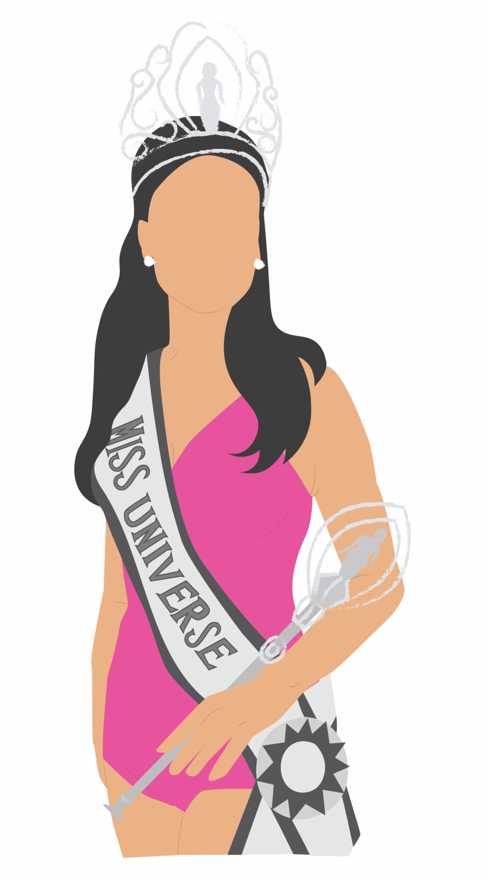
Una historia de amor
escuchar
Daniel y Lucía hablan sobre una noticia.
Escucha las frases de la conversación. ¿Es pregunta o no?
1
5
4. Un amigo envió el vídeo en un grupo de WhatsApp.
7. ¿Trataron la noticia también en la tele?
8. Un presentador realizó una entrevista.
2
6
*el secreto = secret
3
7
4
8
(H) Extension: transcribe sentences 4, 7 and 8, substituting the verb with the words ‘enviar’, ‘tratar’ and ‘realizar’ in their correct form. Click the audio buttons to check your answers.
4
7
8
Notes:
Timing: 7 minutes
Aim: to practise recognising questions in spoken language by listening for intonation
Procedure:
Listen to each audio.
Point out that students will hear the word ‘secreto’ in questions 6 and it’s meaning in English (‘secreto’ will be introduced in 11.1.2.2)
Tick if the sentence is a question / cross if it’s not.
Click to reveal the answers
Transcript:
Miss Argentina y Miss Puerto Rico se casaron.
¿Lo anunciaron en sus redes sociales con un vídeo?
¿Alguien te contó la noticia?
Un amigo mandó/envió el vídeo en un grupo de WhatsApp.
Empezaron a salir en 2020.
¿Guardaron el secreto durante años?
¿Hablaron de/trataron la noticia también en la tele?
Un presentador organizó/realizó una entrevista.
https://www.theguardian.com/world/2022/nov/03/beauty-queens-miss-puerto-rico-miss-argentina-married

Slide 54
Una historia de amor
leer/escuchar
Lee la conversación entre Daniel y Lucía.
Encuentra todos los verbos en el pasado. Usa un color diferente para los verbos en singular y los verbos en plural.
Estoy leyendo algo interesante:
Miss Argentina y Miss Puerto Rico se casaron.
¿Lo anunciaron en sus redes sociales con un vídeo?
¿Alguien te contó la noticia?
Un amigo mandó (_______) el vídeo en un grupo de WhatsApp.
No presentaron su relación en público hasta el día de la boda, pero empezaron a salir/ (_______) en 2020.
¿Guardaron el secreto* durante años?
(envió)
(H) Extension: escribe las palabras siguientes en el espacio correcto.
envió
se enamoraron
matrimonio
trataron
realizó
(se enamoraron) en 2020
Sí. Las otras modelos que participaron en el mismo concurso* publicaron mensajes de apoyo y les desearon suerte en su futuro (_______) . ¿Hablaron de (_______) la noticia también en la tele?
Un presentador organizó (_____) una entrevista. Las dos esposas mostraron alegría.
(matrimonio)
(trataron)
(realizó)
Notes:
Timing: 5 minutes
Aim: to practise recognising questions in spoken language by listening for intonation
Procedure:
Read and listen to the conversation between Daniel and Lucía in full.
Highlight all of the verbs in the preterite tense, using a different colour for plural and singular verbs.
Click to reveal the answers.

Slide 55
Una historia de amor
leer
¿Qué acuerdas desde la conversación? ¿Puedes terminar las frases en inglés?
Miss Argentina and Miss Puerto Rico…
A friend of Daniel …
The couple started going out in ….
But didn’t go public with their relationship until...
Other models that participated in the same competition….
During the television interview the two…
got married.
sent him the video in Whatsapp.
2020.
their wedding day.
sent messages of support and wished them luck.
looked happy.
Notes:
OPTIONAL
Timing: 3 minutes
Aim: to understand the details of a short text.
Procedure:
In pairs or as a class, finish the sentences according to the conversation on the previous slide.
Click to reveal the suggested answers.

Slide 56
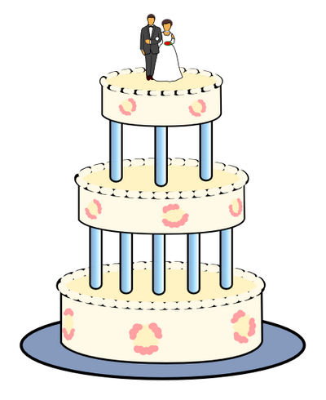
Hablamos sobre una boda.
hablar / escuchar
Persona A: dice la frase en español a Persona B.
¡Atención! ¿Es singular? → -ó
¿Es plural? → -aron
Persona B: escribe la frase en inglés. Termina la frase con ‘?’ si es una pregunta o ‘.’ si no es una pregunta.
Ejemplo:
¿Besó a su mujer?
Estudiante A
Estudiante B
 | Lee las frases en español
1 | Did she kiss her wife?
5 | Did she kiss her wife?
Notes:
Timing: 10 minutes
Aim: to use the new grammar and vocabulary in oral production; to further practise listening out for 3rd person singular and plural verb endings –ó and –aron and connecting these with their meanings.
Procedure:
The teacher runs through the worked example with students on this slide, making clear that students need to start each phrase with a verb, not a pronoun.
In the paired activity, student A reads the sentences aloud in Spanish. Student B responds with the most appropriate second part of the sentence using the correct form of the verb in the preterite with the -ó or –aron ending.
Student A records the second part of the sentence in English.
Students then swap roles.
Finally, students can compare their answers to see if they are correct.
Teacher shows answer slides.

Slide 57
Persona A:
Persona B:
escribir/hablar
 | En inglés
1 | She kissed her wife.
2 | Did they announce their news on social media?
3 | Did they get married yesterday?
4 | She told you the news.
5 | They talked about their marriage on TV (H).
 | En inglés
1 | Did she get married to Miss Argentina?
2 | Did she tell you the news?
3 | The couple showed their happiness.
4 | Their friends sent messages of support.
5 | Did they fall in love in 2020?
Notes:
DO NOT SHOW DURING ACTIVITY / ONLY SHOW DURING FEEDBACK
Target phrases in Spanish:
Persona A:
Besó a su mujer.
¿Anunciaron su noticia en las redes sociales?
¿Se casaron ayer?
Te contó la noticia.
Hablaron sobre su matrimonio en la television.
Persona B:
¿Se casó con Miss Argentina?
¿Te contó la noticia?
La pareja mostró su alegría.
Sus amigos mandarin/enviaron mensajes de apoyo.
¿Se enamoraron en 2020?

Slide 58
Artistas conocidos
possessive adjectives: vuestro/vuestra/vuestros/vuestras
Year 10 Term 1.1 Week 7 – Lesson 3
Louise Caruso / Amanda Izquierdo
Artwork: Mark Davies
Date updated 02/03/23
Notes:
Artwork by Mark Davies. All additional pictures selected are available under a Creative Commons license, no attribution required.
Learning outcomes (lesson 3):
Possessive adjective 'su' with meaning 'their’
regular verbs in 3rd person singular vs plural PAST preterite (-ó, -aron)
yes-no Qs with raised intonation
awareness raising of 'did' auxiliary
subject pronouns él, ella, ellos, ellas
possessive adjectives su vs sus (with meaning 'his', 'her', 'its')
possessive adjectives: vuestro/vuestra/vuestros/vuestras
Phonics: [ja], [jo], [ju] vs [ga], [go], [gu]
Word frequency (1 is the most frequent word in Spanish):
New vocabulary: casarse [650]; contar² (to tell) [172]; equilibrar [1157]; se [27]; esposa [1083]; gusto¹ (pleasure) [890]; papel² (role) [793]; bueno* (well...)[98]; intj.: ¡adiós! [2309] (9) /H only: enamorarse (de) [1783]; fijar, fijarse¹ (to notice) [681]; esposo [1913]; matrimonio [1151]; nacimiento [1750] (6)
Thematic revisited vocabulary: juntos [149]; amor [283]; pareja [893]; actor [1533]; actriz [3567]; hijo [140]; marido [965]; mujer [120]; tratar [141]; novia [1996]; novio [1322]; realizar [205]; entrar [207]; mundo [123]; olvidar [415]; aceptar [433]; regresar [573]; contestar [669]; amar [700]; enviar [704]; tele [4880], televisión [825]; paso [279]; atrás [599]; carrera [481]; ¿Cómo es? [n/a]; protagonista [1926]; besar [1591]; raíz [1304]; notar [696]; hermoso [980]; altura [970]; recorrer [697]; pasado [932]; isla [810]; abierto [654] (36)
Spaced repetition: doler [1629]; recomendar [1247]; repetir [512]; alumno [862]; boca [465]; cita¹ (appointment) [2002]; cuello [1298]; derecho [1334]; diente [1365]; error [886]; espalda [942]; hospital [1050]; rodilla [1839]; fumar [1883]; información [326]; vuelo [1739]; europeo [721] (17) /H only: asegurar [497]; exigir [854]; nos [52]; os [695]; hombro [1146]; nariz [1570]; justo [1782]; mío [676]; suyo [1002]; tuyo [1717] (10)
Revisited function words: su [12]; ellas [72]; ellos [9]; alguien [346]; vuestro [1748] (5)
Source: Davies, M. & Davies, K. (2018). A frequency dictionary of Spanish: Core vocabulary for learners (2nd ed.). Routledge: London
The frequency rankings for words that occur in this PowerPoint which have been previously introduced in NCELP resources are given in the NCELP SOW and in the resources that first introduced and formally re-visited those words.
For any other words that occur incidentally in this PowerPoint, frequency rankings will be provided in the notes field wherever possible.

Slide 59
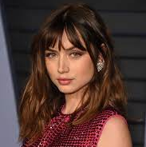
Un festival
Ana de Armas
hablar / escuchar / escribir
Persona A
Persona B
✄
Ana de Armas es una actriz cubana-española. Comenzó su carrera muy joven como protagonista de la película Una Rosa de Francia. También trabaja en los programas de televisión pero no le gustaban los papeles que tenía. Por eso, _____ a los Estados Unidos donde aprendió inglés. En 2019, casi ____ el Globo de Oro a la _____ actriz de comedia o musical. Quiere ________ a las _______ latinas que pueden tener éxito en Hollywood en el futuro.
Ana de Armas es una actriz cubana-española. Comenzó su carrera muy _____ como ____________ de la película Una Rosa de Francia. También _________ en los programas de televisión pero no le ________ los papeles que tenía. Por eso, viajó a los Estados Unidos donde aprendió inglés. En 2019, casi ganó el Globo de Oro a la mejor actriz de comedia o musical. Quiere asegurar a las mujeres latinas que pueden tener éxito en Hollywood en el futuro.
Notes:
Do not display during the activity.
Timing: 5 minutes
Aim: speaking, listening and writing practice with strong vowels
Procedure:
Students take it in turns to read out the text to their partner.
The partner listens and completes their version of the text, which is missing words with pairs of ‘strong’ vowels. These are [ee], [eo], [ae], [oe].
Students can then give each other feedback on their respective parts (now showing each other their versions of the text, if helpful).
Notes:
1. In previous resources, students have sometimes only needed to complete the missing letters in a word. However, a number of words here are cognates and could be completed without listening if the rest of the letters in the word were to be provided.
2. The most challenging part of this text may be the phrase (“la dejan caer”). During feedback it is worth exploring students’ comprehension of the pre-verbal object pronoun (“¿qué significa ‘la’ aquí?”) and dejar + infinitive (dejar has been taught in this way with the meaning ‘let’, but has also been taught as ‘leave’, so understanding of the context is also needed).
Frequency of unknown/glossed words (1 is the most frequent word in Spanish):
extraordinario [1346]; real [444]; poema [1430]; traer [342]; poesía [1282]; vídeo [1180]; caer [251]; poseer [969]; desear [542]; héroe [2242]

Slide 60
Mira las palabras en color rojo. ¿Cómo las dices correctamente?
¿Cual es la palabra del texto para cada una de estas palabras en inglés?
women
young
to assure
she travelled
main character (H)
she works
she didn’t like
she won
best
Leer/hablar
Ana de Armas es una actriz cubana-española. Comenzó su carrera muy joven como protagonista de la película Una Rosa de Francia. También trabaja los programas de televisión pero no le gustaban los papeles que tenía.
Por eso, viajó a los Estados Unidos donde aprendió inglés. En 2019, casi ganó el Globo de Oro a la mejor actriz de comedia o musical. Quiere asegurar a las mujeres latinas que pueden tener éxito en Hollywood en el futuro.
mujeres
joven
asegurar
viajó
protagonista
trabaja
no le gustaban
ganó
mejor
Notes:
Timing: 5 minutes
Aim: to ensure understanding of the text; to distinguish between the [j + vowel] and [g + vowel] sounds.
Procedure:
The teacher brings up a list of words in English that feature in the text and have the [j + vowel] or [g + vowel] sounds in Spanish.
Students then work with a partner to decide how to pronounce each word, focusing on the difference between these sounds.
Finally, students have to say the word in Spanish from the text to match each of the words in English.

Slide 61
How to say ‘your’ Possessive adjectives [revisited]
iAtención! This is different from ‘vosotros’ (which means ‘you all’).
gramática
tu
In Spanish, there are two ways to say ‘your’: _____ and _________.
vuestro
For two or more people, use __________.
vuestro
Vuestro is used for a singular or uncountable masculine noun.
1
Vuestro hijo pasó unos días en el hospital→
Your son spent a few days in hospital.
Vuestra is used for a plural masculine noun.
¿Cómo es vuestra casa? →
What is your house like?
2
Vuestros is used for a plural masculine noun.
Your husbands are friends.
3
Vuestros maridos son amigos. →
Vuestras is used for a plural feminine noun.
4
Hoy hablamos de vuestras carreras . →
We will talk about your careers.
Notes:
Timing: 3 minutes
Aims: to recap ‘vuestro’ in all of its forms.
Procedure:
Click to bring up the explanation.
Elicit translations of examples from students.

Slide 62
Vuestros, vuestras…
Glossary:
mejor* = best
el público = audience
leer / escribir
Lee estas frases de una entrevista y elige la opción correcta.
Publicaron una noticia sobre el nacimiento de vuestros hijos.
Preguntó sobre los mejores* momentos de vuestra carrera.
El director habló sobre vuestro papel en la película.
Los periodistas esperaron fuera de vuestra casa para hacer preguntas.
Mostró imágenes de vuestras vacaciones en la playa.
Celebraron vuestros premios de cine con el público*.
El autor necesitó vuestra opinión para escribir el libro.
Cambió el diálogo de vuestros personajes.
____.
_______.
casa
personajes
carrera
opinión
premios
papel
vacaciones
hijos
_____
____
___________
_______
_______
_________.
Notes:
Timing: 5 minutes
Aim: to recognise different forms of the possessive “vuestro” and the grammatical implications of each form.
Procedure:
Students write down numbers 1-8.
Students then write the word that is missing from each of the 8 sentences, choosing from the nouns in the red box to the right. (Teacher should remind students to pay attention to the number and gender of “vuestro” before each gap to help them decide.)
Teacher clicks to reveal each answer, one at a time. If there is time, teacher could check students’ understanding of each sentence at the same time.
Frequency of unknown/glossed words (1 is the most frequent word in Spanish):
mejor [116]

Slide 63
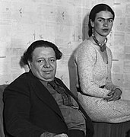
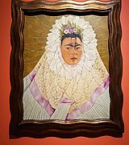
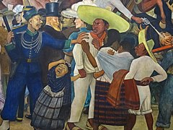
Frida Kahlo y Diego Rivera
escribir
Escribe las frases en inglés.
1. ¿ Cuándo se casaron Frida y Diego por primera vez? ¿1929?
2. Se casaron otra vez y pasaron el resto de sus vidas juntos.
3. Después de un accidente, Frida pasó meses en su cama con dolor en la espalda, el cuello, la pierna y el pie derecho.
4. Diego y Frida tenían una relación abierta, pero Frida lo dejó cuando besó a su hermana.
5. Diego contó que amó mucho a su esposa.
6. Salma Hayek aceptó el papel en la película ‘Frida’ en 2002.
7. ¿Cuál es vuestra opinión sobre su arte?
When did Frida y Diego get married for the first time? 1929?
Look at the verb endings to know who did the action.
They got married again and spent the rest of their lives together .
Remember, ‘su’ can mean ‘his’, ‘her’, ‘its’ or ‘their’
After an accident, F. spent months in her bed with pain in her back, neck, leg and her right foot.
Diego and Frida had an open relationship, but Frida left him when he kissed her sister.
Diego said that he loved his wife lot.
Salma Hayek accepted a role in the film ‘Frida’ in 2002.
What’s the difference between ‘tu’ and ‘vuestro’?
What is your (pl) opinion about their art?.
Notes:
Note: this is a Foundation version of the task. The animated callouts are presented as static tip boxes on the handouts.
Timing: 10-12 minutes Aim: to practise written production of language and structures from this week and prior learning. Procedure: 1. Students translate the seven sentences from Spanish to English 2. Students can peer mark this task (at the start of next lesson, perhaps). Note: this task deliberately targets words and grammar from this week, whilst including other previously taught language, which is not credited in the markscheme. Students should write full, coherent sentences, but they should also be clear which words are targeted. Each underlined section is worth 1 point, giving a total of 20 for the task. [Note that ‘su’ meaning his/her should be credited only once, though it appears in three different sentences (3, 4 and 5). To earn the point for sentence 1, students must have ‘did’ and ‘get married’.]
Teachers may consider it useful to include summary tasks like this (either weekly or fortnightly), recording the scores and sharing them with students and parents (e.g., on the schools online data system). The tasks provide a very useful regular snapshot of student effort and progress over time. In our department, we have teacher-marked every 1/3 of these tasks, with peer marking for the rest. We have generally considered that 14+/20 is a benchmark for good progress, whilst regular scores of >12 are of concern.
Information source: https://es.wikipedia.org/wiki/Frida_Kahlo#Primer_matrimonio_con_Diego_Rivera_(1929-1939)
Frida and Diego photo by an unknown author and is in the public domain. It is available at: https://commons.wikimedia.org/w/index.php?search=frida+diego&title=Special:MediaSearch&go=Go&type=image
Frida self-portrait image by Ambra 75 available at : https://commons.wikimedia.org/wiki/File:Mostra_di_Frida_Kahlo_al_Mudec_di_Milano_3_maggio_2018_(16).jpg. Licence: Creative Commons Attribution-Share Alike 4.0 International license.
Section of a mural by Diego Rivera image by Adam Jones: https://commons.wikimedia.org/wiki/File:Detail_of_Diego_Rivera_Mural_-_Dream_of_a_Sunday_Afternoon_in_Alameda_Park_-_Diego_Rivera_Mural_Museum_-_Mexico_City_-_Mexico_-_09_(20642333531).jpg Licence: Creative Commons Attribution-Share Alike 2.0 Generic license.

Slide 64
Frida Kahlo y Diego Rivera
escribir
Escribe las frases en inglés.
Higher
1. ¿ Cuándo se casaron Frida y Diego por primera vez? ¿1929?
2. Se casaron otra vez y pasaron el resto de sus vidas juntos.
3. Después de un accidente, Frida pasó meses en su cama con dolor en la espalda, el cuello, la pierna los hombros y el pie derecho.
4. Diego y Frida tenían una relación abierta, pero Frida lo dejó cuando besó a su hermana.
5. Diego, su esposo, contó que enamorarse de Frida cambió su vida.
6. ¿Cuál es vuestra opinión sobre su arte?
7. Salma Hayek realizó el papel como protagonista en la película ‘Frida’.
When did Frida y Diego get married for the first time? 1929?
Look at the verb endings to know who did the action.
They got married again and spent the rest of their lives together .
After an accident, F. spent months in her bed with pain in her back, neck, leg, shoulders and right foot.
Remember, ‘su’ can mean ‘his’, ‘her’, ‘its’ or ‘their’
Diego and Frida had an open relationship, but Frida left him when he kissed her sister.
D. her husband, said that falling in love with F. changed his life.
What’s the difference between ‘tu’ and ‘vuestro’?
What is your (pl) opinion about their art?
Salma Hayek carried a role as main character in the film ‘Frida’.
Notes:
Note: this is a Higher version of the task. The animated callouts are presented as static tip boxes on the handouts.
Timing: 10-12 minutes Aim: to practise written production of language and structures from this week and prior learning. Procedure: 1. Students translate the seven sentences from Spanish to English 2. Students can peer mark this task (at the start of next lesson, perhaps). Note: this task deliberately targets words and grammar from this week, whilst including other previously taught language, which is not credited in the markscheme. Students should write full, coherent sentences, but they should also be clear which words are targeted. Each underlined section is worth 1 point, giving a total of 20 for the task. [Note that to earn the point for sentence 1, students must have ‘did’ and ‘get married’.]
Teachers may consider it useful to include summary tasks like this (either weekly or fortnightly), recording the scores and sharing them with students and parents (e.g., on the schools online data system). The tasks provide a very useful regular snapshot of student effort and progress over time. In our department, we have teacher-marked every 1/3 of these tasks, with peer marking for the rest. We have generally considered that 14+/20 is a benchmark for good progress, whilst regular scores of >12 are of concern.
Information source: https://es.wikipedia.org/wiki/Frida_Kahlo#Primer_matrimonio_con_Diego_Rivera_(1929-1939)
Frida and Diego photo by an unknown author and is in the public domain. It is available at: https://commons.wikimedia.org/w/index.php?search=frida+diego&title=Special:MediaSearch&go=Go&type=image
Frida self-portrait image by Ambra 75 available at : https://commons.wikimedia.org/wiki/File:Mostra_di_Frida_Kahlo_al_Mudec_di_Milano_3_maggio_2018_(16).jpg. Licence: Creative Commons Attribution-Share Alike 4.0 International license.
Section of a mural by Diego Rivera image by Adam Jones: https://commons.wikimedia.org/wiki/File:Detail_of_Diego_Rivera_Mural_-_Dream_of_a_Sunday_Afternoon_in_Alameda_Park_-_Diego_Rivera_Mural_Museum_-_Mexico_City_-_Mexico_-_09_(20642333531).jpg Licence: Creative Commons Attribution-Share Alike 2.0 Generic license.

Slide 65
Estudia este vocabulario:
Foundation
Higher
New
Revisit
Notes:
Homework slide
Students have 2 sets of vocabulary to study: a set of new vocabulary to be introduced in the next lesson and a set of revisited vocabulary from Year 9.

