Slide 1
Gender identity and expression: Drag montréalaise
regular verbs (all) in the imperfect tense vs present tense (je, tu, il/elle/on)
SSCs [ai], [é]
Y9 French
Term 2.2 - Week 3 - Lesson 43
Louise Bibbey / Natalie Finlayson
Artwork by: Chloé Motard
Date updated: 08/08/2022
Notes:
Artwork by Chloé Motard. All additional pictures selected are available under a Creative Commons license, no attribution required.
Native-speaker teacher feedback provided by Sarah Brichory.
With thanks to Rachel Hawkes for her input on the lesson material.
Learning outcomes (lesson 1):
Introduce the tu forms of regular verbs in the imperfect tense
Revisit SSCs [ai] and [é] and link these with the imperfect tense endings and -ER past participle ending respectively.
Revisit the je, il/elle and on forms of regular verbs in the imperfect tense
Revisit gender neutral pronouns and use with third person singular forms
Word frequency (1 is the most frequent word in French):
9.2.2.3 (introduce) participer à [670], artiste [1797], concours [1375], défi [1728], diversité [2537], émission [1074], genre [556], personnage [1449], sexe [1691], scène [794], spectacle [1687], annuel [1674], culturel [1495], non-binaire [n/a], transgenre [n/a]
9.2.1.6 (revisit) approcher [1576], avoir besoin de [n/a] téléphoner (à) [2448], voler (à) [1610], moi [131], toi [510], proche [838], crime [819], fréquence [2178], responsabilité [694], sécurité [478], vol [1531], criminel [1411], après [82], avant [40], selon [240]
9.1.2.3 (revisit) commander [959], réserver [695], addition [>5000], carte² [955], choix [436], nuit [580], restaurant [2336], réception [1926], service [203], table [1019], leur [35], leurs [n/a], votre [214], vos [n/a]
The frequency rankings for words that occur in this PowerPoint which have been previously introduced in NCELP resources are given in the NCELP SOW and in the resources that first introduced and formally re-visited those words.
For any other words that occur incidentally in this PowerPoint, frequency rankings will be provided in the notes field wherever possible.
The additional English meanings of the following words have been added to Quizlet since the creation of this resource:
annuel – annual, yearly

Slide 2
ai
vrai
Notes:
Timing: 1 minute [1/5]
Aim: To consolidate SSC [ai]
Procedure: 1. Present the letter(s) and say the [ai] sound first, on its own. Students repeat it with you. 2. Bring up the word ”vrai” on its own, say it, students repeat it, so that they have the opportunity to focus all of their attention on the connection between the written word and its sound.
3. A possible gesture for this would be to mime a ‘tick’.
4. Roll back the animations and work through 1-3 again, but this time, dropping your voice completely to listen carefully to the students saying the [ai] sound, pronouncing ”vrai” and, if using, doing the gesture.
Word frequency (1 is the most frequent word in French):
vrai [292].
Source: Londsale, D., & Le Bras, Y. (2009). A Frequency Dictionary of French: Core vocabulary for learners London: Routledge.

Slide 3
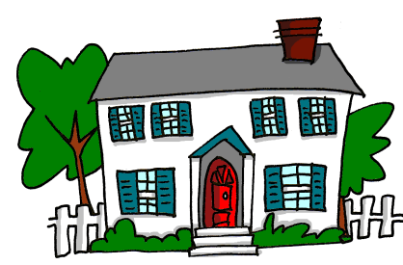
ai
maison
raison
[reason]
mauvais
vrai
faire
[bad]
semaine
[to do]
[week]
Notes:
[3/5]
Aim: To consolidate SSC [ai]
Procedure:
1. Introduce and elicit the pronunciation of the individual SSC [ai] and then the source word again ‘vrai’ (with gesture, if using). 2. Then present and elicit the pronunciation of the five cluster words.
The cluster words have been chosen for their high-frequency, from a range of word classes, with the SSC (where possible) positioned within a variety of syllables within the words (e.g. initial, 2nd, final etc.). Additionally, we have tried to use words that build cumulatively on previously taught SSCs (see the Phonics Teaching Sequence document) and do not include new SSCs. Where new SSCs are used, they are often consonants which have a similar symbol-sound correspondence in English.
Word frequency (1 is the most frequent word in French): maison [325]; raison [72] mauvais [274]; faire [25]; semaine [245]; vrai [292]. Source: Londsale, D., & Le Bras, Y. (2009). A Frequency Dictionary of French: Core vocabulary for learners London: Routledge.

Slide 4
é/-er/-ez
écrire
Notes:
[2/5]
Aim: To consolidate SSC [é]
Procedure: 1. Present the letter(s) and say the [é] sound first, on its own. Students repeat it with you. 2. Bring up the word ”écrire” on its own, say it, students repeat it, so that they have the opportunity to focus all of their attention on the connection between the written word and its sound.
3. A possible gesture for this would be to mime the act of writing (onto the palm of the other hand perhaps). 4. Roll back the animations and work through 1-3 again, but this time, dropping your voice completely to listen carefully to the students saying the [é] sound, pronouncing ”écrire” and, if using, doing the gesture.
Word frequency (1 is the most frequent word in French):
écrire [382] Source: Londsale, D., & Le Bras, Y. (2009). A Frequency Dictionary of French: Core vocabulary for learners London: Routledge.

Slide 5
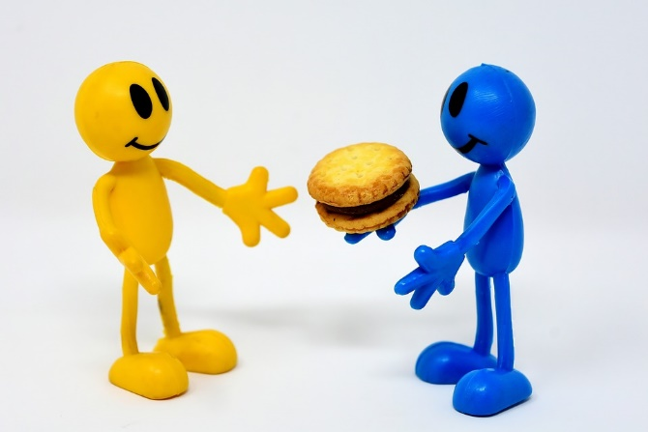
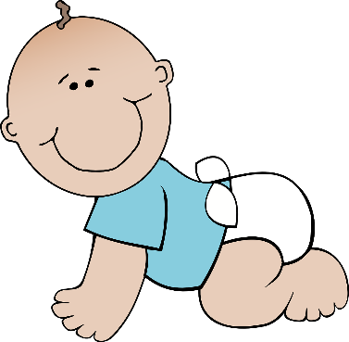
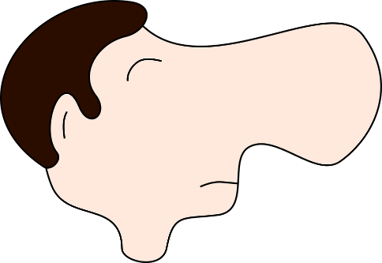
é/-er/-ez
bébé
donner
nez
parler
écrire
aller
[to go]
Notes:
[4/5]
Aim: To consolidate SSC [é]
Procedure:
1. Introduce and elicit the pronunciation of the individual SSC [é] and then the source word again ‘écrire’ (with gesture, if using). 2. Then present and elicit the pronunciation of the five cluster words.
The cluster words have been chosen for their high-frequency, from a range of word classes, with the SSC (where possible) positioned within a variety of syllables within the words (e.g. initial, 2nd, final etc.). Additionally, we have tried to use words that build cumulatively on previously taught SSCs (see the Phonics Teaching Sequence document) and do not include new SSCs. Where new SSCs are used, they are often consonants which have a similar symbol-sound correspondence in English.
Word frequency (1 is the most frequent word in French): écrire [382]; bébé [>5000]; aller [55] donner [46]; nez [2661]; parler [106]. Source: Londsale, D., & Le Bras, Y. (2009). A Frequency Dictionary of French: Core vocabulary for learners London: Routledge.

Slide 6
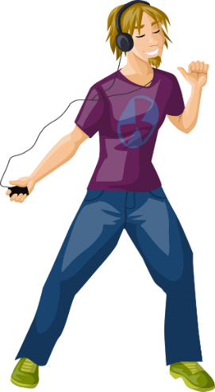
Imperfect forms and past participles: [é] vs [ai]
grammaire
Listen to these examples to hear the difference between the [é] of a past participle in the perfect tense, and the [ai] in the ending of the imperfect tense.
Perfect tense:
a one-off event in the past
On a parlé
[we talked]
J’ai chanté
[I sang]
Here, we see a ‘perfect’ example of the importance of phonics! The difference between the [é] and [ai] sounds may be subtle, but the change in meaning is significant.
Il a dansé
[he danced]
Je chantais
[I used to sing]
On parlait
[we used to talk]
Imperfect tense: something which used to happen all the time
Il dansait
[he used to dance]
Notes:
Timing: 5 minutes [1/2]
Aim: To recap the difference in usage between perfect tense (for one-off events in the past) and imperfect tense (for habitual actions in the past); to draw attention to the difference in pronunciation between -é at the end of a past participle and -ais/-ait at the end of the imperfect form; to highlight the link between phonics and meaning; to prepare students for the grammar point covered later in the lesson.
Procedure:
1. Click to reveal text and pictures.
2. Click on the French text to hear a native speaker say perfect and imperfect forms of the same verb. Note that the [ai] in j’ai is pronounced like [é].
3. Draw attention to the English definitions, and click to reveal reminder about the difference between in use between the perfect and imperfect tenses.
4. Click to reveal information on the importance of phonics in this case, where a slight sound change carries a significant meaning change.
Transcript:
1. on a parlé
2. on parlait
3. j’ai chanté
4. je chantais
5. il a dansé
6. il dansait

Slide 7
Past participle or imperfect?
Remember! -é = past participle = one-off action
-ait = imperfect form = repeated action
*faisait = used to make, do
écouter
Écoute les deux phrases. On a fait quoi une seule fois? On faisait quoi tout le temps ? Écris le verbe auxiliaire si nécessaire.
1A
Il a dansé toute la nuit.
?
1B
Il dansait toute la nuit.
?
1 A/B
2A
Elle chantait des chansons.
?
2B
Elle a chanté des chansons.
?
2 A/B
3A
Il gagnait des compétitions.
?
3B
Il a gagné des compétitions.
?
3 A/B
4A
Elle a participé à Drag Race.
?
4B
Elle participait à Drag Race.
?
4 A/B
5A
Il trouvait des champions.
?
5B
Il a trouvé des champions.
?
5 A/B
Notes:
Timing: 2 minutes
Aim: To apply phonics knowledge to the recognition of past participles and imperfect tense forms; to connect the sound –é with a part participle form; to illustrate the difference between phonics and meaning in preparation for practising this distinction more in lesson 2.
NB: The distinction exemplified here is particularly pronounced in Canadian and Parisian French, and less so in other areas of mainland France. Students will hear an example of the Canadian accent later in this lesson.
Procedure:
1. Click to bring up the reminder of the rule if necessary.
2. Click on the number boxes to hear sentences A and B. In each case, the past participle or imperfect form is covered with a beep.
3. Students decide which letter (A or B) represents the one-off action, and which represents the repeated action, adding the auxiliary a where necessary.
4. Click to reveal answers and click on the number/letter boxes on the right to hear the versions without beeps.
Transcript:
Il [a] dansé toute la nuit / Il [-] dansait toute la nuit. (A= une fois, B = tout le temps)
Elle [-] chantait des chansons / Elle [a] chanté des chansons. (A = tout le temps, B= une fois)
Il [-] gagnait des compétitions / Il [a] gagné des compétitions. (A = tout le temps, B= une fois)
Elle [a] participé à Drag Race / Elle [-] participait à Drag Race. (A= une fois, B = tout le temps)
Il [-] trouvait des champions / Il [a] trouvé des champions. (A = tout le temps, B= une fois)
Word frequency of (near) cognates used (1 is the most frequent word in French):
compétition [2651], champion [2443], danser [2934], verbe [>5000], auxiliaire [>5000], nécessaire [451]

Slide 8
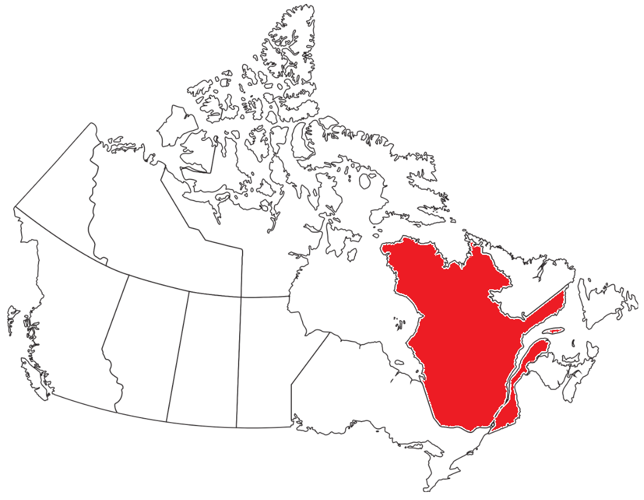
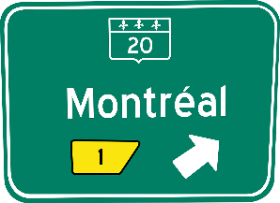
Montréal: a pioneering, diverse Canadian city
info
The French name of the city is Montréal.
How do you think it is pronounced?
Comme tu le sais, les habitants de la province de Québec au Canada parlent anglais et français.
Selon moi, Montréal est une ville vibrante, libérale et diversifiée. Le choix des événements et des spectacles est riche ici !
Le premier drag-show à Montréal a lieu* en 1928. En 1958, les hommes homosexuels peuvent pour la première fois danser ensemble à Montréal. Mais les actes homosexuels restent illégaux au Canada jusqu'à* 1969.
*a lieu = takes place
*mariage de fait = common-law marriage
* jusqu'à = until
En 1999, le Canada devient le premier pays au monde à autoriser* les mariages de fait* pour les couples de même sexe.
Notes:
Timing: 4 minutes
Aim: To provide background information on Montreal, with a focus on bilingualism, diversity and its position as a pioneering city of equality.
Procedure:
Show students the maps of Canada and Quebec. Remind students that Quebec is on the east coast.
Remind students that Quebec is the only Canadian province with French as its sole official language (they first encountered this in 9.1.1.6).
Click to run through the text boxes. Clarifying the meaning of the cognates. Whole-class sight translation or individual written summary of each point in English.
The URL below links to view a short video on Montreal drag-queens which exemplifies some pronunciation differences in Canadian French, e.g. chanson (0:04), naturellement (0:44), vingt ans (1:25): https://www.youtube.com/watch?v=xtj6QDSAyg8
Click again to reveal a box highlighting the difference between the English and French pronunciations of Montreal. Click on the French flag to hear it pronounced by a native speaker. This provides a segue into the following slide with more information about Montreal.
Transcript:
Montréal
Word frequency of unknown words used (1 is the most frequent word in French):
mariage [1210], avoir lieu [8, 117], jusque [134]
Source: Lonsdale, D., & Le Bras, Y. (2009). A Frequency Dictionary of French: Core vocabulary for learners London: Routledge.
Word frequency of cognates used (1 is the most frequent word in French):
riche [599], acte [492], homosexuel [3501], illégal [2640], vibrant [>5000], libéral [>5000], diversifié [>5000], autoriser [989], danser [2934]
Source: Lonsdale, D., & Le Bras, Y. (2009). A Frequency Dictionary of French: Core vocabulary for learners London: Routledge.

Slide 9
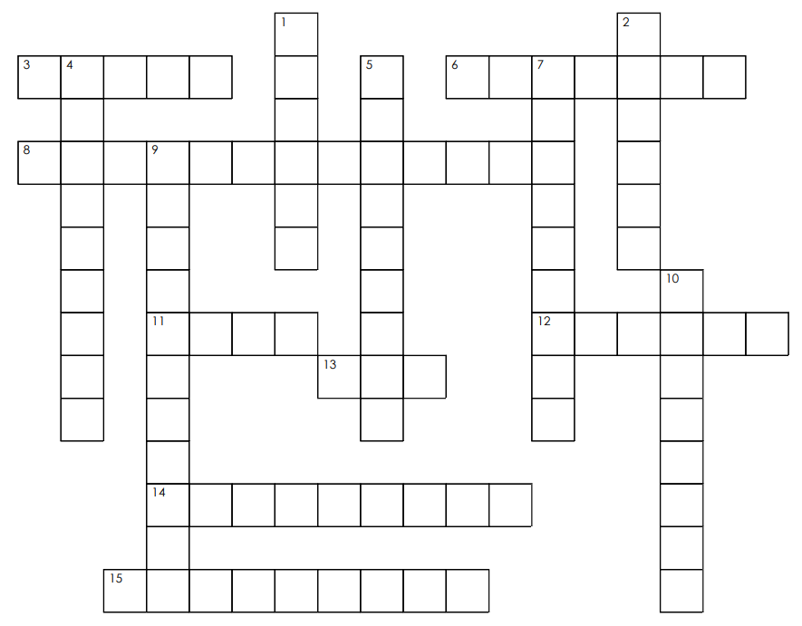
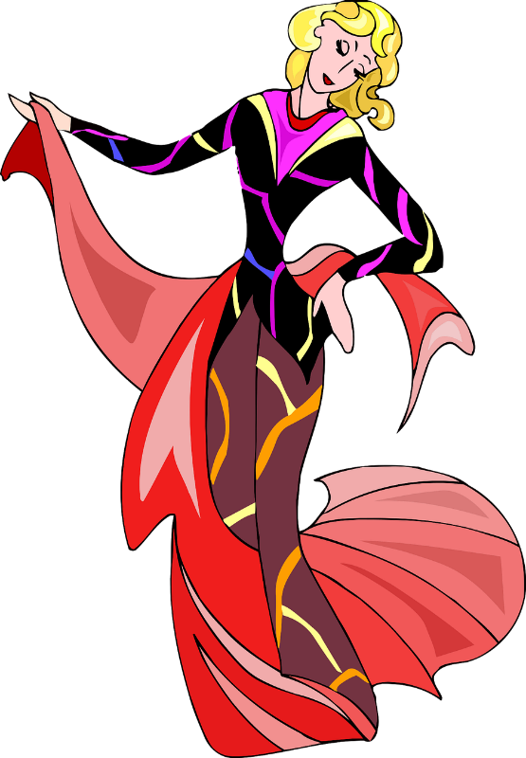
Mots-croisés: crossword
lire
h
a
v
e
n
e
e
d
o
f
16
Across:
3. scène
6. concours
8. participer à
11. spectacle
12. annuel
13. sexe
14. diversité
émission
avoir besoin de
a
g
Fill in the crossword with the English translations of the French vocabulary
s
c
e
n
e
r
c
c
o
n
t
e
s
17
t
h
t
h
o
n
h
p
a
r
t
i
c
i
p
a
t
e
i
n
d
e
l
r
s
r
b
e
f
l
a
t
a
i
r
t
e
n
c
n
c
n
s
h
o
w
t
a
n
n
u
a
l
Down:
1. artiste
2. genre
4. défi
5. personnage
7. non-binaire
9. transgenre
10. culturel
17. vol
g
g
s
e
x
r
l
e
e
r
y
t
n
u
d
i
v
e
r
s
i
t
y
r
e
a
p
r
o
g
r
a
m
m
e
l
Notes:
Timing: 5 minutes
Aim: Written recognition of new words in this week’s vocabulary set.
Procedure:
Students complete the crossword, reading the clues in French, and writing or saying the answers in English. Students could write the clue numbers and complete the crossword individually, or work in groups to contribute answers orally.
Click to reveal the English translation of each word in sequence.

Slide 10
L'identité et l'expression de genre
marche des fiertés = pride biologique = biological correspondre à = correspond to
écouter
1
*La Marche des Fiertés LGBT is Paris’ Gay Pride event, which takes place every summer. The parade travels through the centre of the city, ending at a square called Place de la République. It is a national event aimed at combatting homophobia and transphobia.
On peut regarder un spectacle de drag-queen au Cabaret Mado à Montréal.
2
Rita Baga est une artiste et personnage très important de la scène culturelle LGBTQ+ à Montréal.
3
Rita Baga a participé à un concours de drag-queen à la télé.
4
C’est une émission qui célèbre la diversité.
5
La marche des fiertés* est un évènement annuel important pour la communauté LGBTQ+.
6
Une personne transgenre a une identité de genre qui ne correspond* pas au sexe biologique*.
7
Il peut être un défi de communiquer son identité de genre aux autres.
challenge
to participate in
artist
diversity
transgender
genre
scene
programme
character
show
contest
cultural
annual
sex
Notes:
Timing: 6 minutes
Aim: Aural recognition of this week’s new vocabulary in context. Introduction to the LGBTQ+ scene in Montreal and some inclusive language use.
Procedure:
1. Click on the audio. Students will hear the sentences in full.
2. After each sentence is heard, the teacher asks the students to pick which words in French they heard from the English translations in the boxes.
3. The teacher then clicks to reveal the full sentence.
4. Oral translation of full sentences.
Transcript:
1. On peut regarder un spectacle de drag-queen au Cabaret Mado à Montréal.
2. Rita Baga est une artiste et personnage très important de la scène culturelle LGBTQ+ à Montréal.
3. Rita Baga a participé à un concours de drag-queen à la télé.
4. C’est une émission qui célèbre la diversité.
5. La marche des fiertés est un évènement annuel important pour la communauté LGBTQ+.
6. Une personne transgenre a une identité de genre qui ne correspond pas au sexe biologique.
7. Il peut être un défi de communiquer son identité de genre aux autres.
Word frequency of cognates used (1 is the most frequent word in French):
identité [1437], biologique [2781], correspondre [1415]
Source: Lonsdale, D., & Le Bras, Y. (2009). A Frequency Dictionary of French: Core vocabulary for learners London: Routledge.

Slide 11
L’imparfait (tu)
grammaire
You already know how to form the imperfect tense with je and il/elle/on:
Present tense nous form: approchons disons finissons
Remove –ons: approch- dis- finiss-
Add –ais (je) or –ait (il/elle/on): j’approchais je disais je finissais il approchait elle disait on finissait
Good news! The tu form of the imperfect is the same as the je form.
Je travaillais à la réception. I used to work at reception.
Tu travaillais à la réception. You used to work at reception.
To make it a question, raise your voice (as in the perfect tense).
Tu travaillais à la réception ? Did you used to work at reception?
Remember! There is no word for ‘did’ in French. The change in intonation alone tells us that this is a question.
Notes:
Timing: 2 minutes
Aim: To introduce the tu form of the imperfect tense; to introduce intonation questions in the imperfect tense; to revise je and il/elle/on forms in the imperfect tense.
Procedure:
1. Click through the information on the slide. Recap present tense nous forms of all regular verb groups if needed.
2. Teacher to read out the last example with focus on raised intonation. Students repeat.

Slide 12
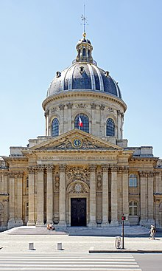
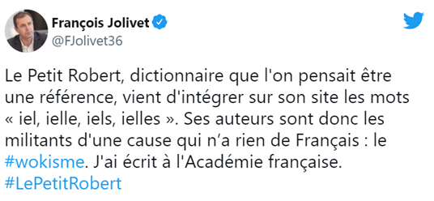
L’imparfait (pronoms neutres)
The Académie française is an organisation responsible for regulating the French language.
Its members are known as les immortels. They are sometimes described as les gardiens de la langue française.
info
Verbs with gender neutral pronouns take the il/elle/on endings:
Chaque matin, iel commandait un café. They used to order coffee every morning.
The pronouns iel, ielle, iels and ielles are starting to become more widely-used in French. To reflect the increase in usage, particularly among younger generations, the words were recently added to the Petit Robert, a major French dictionary.
The development has been criticised by some who oppose the addition of new words to the French language.
Notes:
Timing: 3 minutes
Aim: To introduce use of gender-neutral pronouns with third person singular verb forms; to introduce students to the concept of language change; cultural awareness: Académie française.
Procedure:
1. Click to bring up the example of a gender neutral pronoun used with the -ait ending in imparfait. Students first encountered gender neutral pronouns in French in 9.1.1.1.
2. Clarify the pronunciation of the four gender neutral pronouns (like the word ‘yell’). To listen to examples of pronunciation, see the Petit Robert entry here: https://dictionnaire.lerobert.com/definition/iel
3. Click to bring up the note about the addition of iel to the Petit Robert. If students are not familiar with it, the teacher could bring up the online version to show the class. Introduce the idea of language change as variation in the features of a language over time to reflect its usage in society.
4. Click to bring up the note on some controversy around the move, and again to bring up the tweet from François Jolivet (https://en.wikipedia.org/wiki/Fran%C3%A7ois_Jolivet) and then the note about the Académie française. With a bit of help with some phrases (venir de, n’avoir rien de) students should be able to get the gist of Jolivet’s comment. They may pick up on his somewhat ironic use of the word ‘wokisme’ ! At higher levels, interested students may have some thoughts to offer on the dichotomy between language change and preservation of the historical roots of a language.
5. Invite students to think about other aspects of language change they have noticed in English, French or another language.
Here are some links to articles on the matter:
https://www.lemonde.fr/societe/article/2021/11/17/le-robert-confirme-l-ajout-du-pronom-iel-dans-son-edition-en-ligne_6102440_3224.html
https://dictionnaire.lerobert.com/dis-moi-robert/raconte-moi-robert/mot-jour/pourquoi-le-robert-a-t-il-integre-le-mot-iel-dans-son-dictionnaire-en-ligne.html
Word frequency of (near) cognates used (1 is the most frequent word in French):
immortel [>5000], gardien [1924]
Source: Lonsdale, D., & Le Bras, Y. (2009). A Frequency Dictionary of French: Core vocabulary for learners London: Routledge.

Slide 13
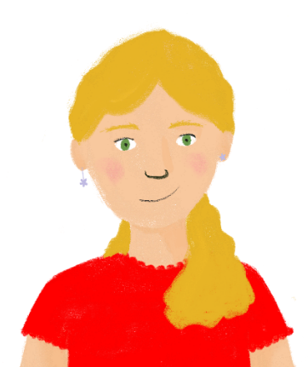
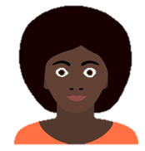
Les pronoms* neutres
pronom = pronoun | genré = gendered de plus en plus = more and more
lire
Morgan, une personne non-binaire, arrive de l’Angleterre dans la classe de Léa. Léa a des questions sur les pronoms neutres en français et en anglais.
1. Salut Morgan ! Quels pronoms utilises-tu ?
2. Bonjour ! Je préfère ‘iel’. Quels sont tes pronoms ?
Tu/Je
tu/on ?
4. Non - il y a déjà un pronom neutre en anglais. On dit ‘they’ pour une personne non-binaire. Mais il n’y avait pas un mot comme ça en français. On a créé un nouveau mot alors.
j’/il
On/tu
3. J’ utilise ‘elle’. Tu utilisais ‘iel’ en Angleterre aussi?
J’/tu
Tu/on
tu/il
5. Oui, c’est vrai – ‘leur’ et ‘leurs’ sont des mots neutres, mais ‘elles’ et ‘ils’ sont genrés*. Tu disais quoi avant ?
6. Pendant longtemps, je demandais le pronom ‘on.’ Après, j’ utilisais ‘iel’ seulement avec mes amis proches dans la communauté non-binaire. Maintenant, on trouve ce pronom de plus en plus* dans la langue générale, mais la fréquence d’utilisation est moins qu’en anglais et chacun a ses préférences personnelles.
je/on
j’/on
On/tu
tu/on
chacun/tu
Notes:
Timing: 8 minutes [1/2]
Aim: written recognition of singular forms of verbs in the present and imperfect tenses; cultural awareness (inclusive language); reading comprehension.
Procedure:
1. Students read the text, and choose the missing pronouns based on the verb endings. Note that there are a mix of verbs in the present and imperfect.
2. Click to reveal missing pronouns.
3. Draw attention to the very last sentence. It is important to note that although iel is becoming more widely used, it is not integrated into the language in the same way that they is commonly used in English. There are many different gender-neutral pronouns, and not all people who identify as non-binary use a gender-neutral pronoun. It is important to ask individuals how they would like to be addressed, using phrases such as Quels pronoms utilises-tu and Quels sont tes pronoms ? as exemplified above.
See here for more information:
https://divergenres.org/wp-content/uploads/2021/04/guide-grammaireinclusive-final.pdf
https://lavieenqueer.wordpress.com/2018/07/26/petit-dico-de-francais-neutre-inclusif/
4. Click again to reveal comprehension questions.
5. Answers are on the next slide.
6. As a follow-up discussion, invite students to share any information about inclusivity in other languages they know.
Word frequency of (near) cognates used (1 is the most frequent word in French): neutre [2785], préférence [2970], personnel [398], rare [1233], exemple [259]
Source: Londsale, D., & Le Bras, Y. (2009). A Frequency Dictionary of French: Core vocabulary for learners London: Routledge.
Word frequency of unknown words used (1 is the most frequent word in French): genré [>5000], pronom [>5000]
Source: Londsale, D., & Le Bras, Y. (2009). A Frequency Dictionary of French: Core vocabulary for learners London: Routledge.

Slide 14
Les pronoms* neutres
pronom = pronoun | genré = gendered de plus en plus = more and more
lire
1. What differences between the French and English languages does Morgan mention?
2. What does Morgan say about their preferred pronouns a) in the past, and b) now?
English already had a gender neutral pronoun (they) and French does not
A new word was created in French
Ils and elles (the French translations for plural ‘they’) are gendered words
Iel is rarer in French than ‘they’ is in English
they used to use ‘they’ in England
they used to ask for the pronoun on to be used in France
they used to use iel only with close friends in the non-binary community
now, they prefer iel
Notes:
[2/2]
Answers appear on clicks.

Slide 15
Grammaire: Qu’est-ce qu’il y a dans la boîte?*
la boîte = box
écrire
1
2
3
4
5
6
7
8
Notes:
Timing: 8 minutes [1/9]
Aim: Written production of sentences with a range of regular verbs in the imperfect tense (je, tu, il/elle/on).
Procedure:
Ask students to give a number in French between 1 and 8.
Click on the box to jump to a translation task.
Students translate the English sentence into French using the imperfect tense. This can be done on mini-whiteboards. The boxes contain a mix of statements and (intonation) questions to prime students for the speaking activity that follows.
Click to reveal the answer.
Students are awarded five points for a correct stem, 5 points for a correct ending, and 5 bonus points if the whole sentence is correct.
Students write down their scores and add them up at the end.
Word frequency (1 is the most frequent word in French):
word [3835]
Source: Londsale, D., & Le Bras, Y. (2009). A Frequency Dictionary of French: Core vocabulary for learners London: Routledge.

Slide 16
Qu’est-ce qu’il y a dans la boîte?
écrire
Challenge 1
Traduis la phrase en français.
I used to come to Montreal often.
Je venais souvent à Montréal.
15 points:
5 points for a correct stem [ven-]
5 points for a correct imperfect ending [-ais]
5 points for 100% correct sentence
retour
Notes:
Slide 2 of 9

Slide 17
Qu’est-ce qu’il y a dans la boîte?
écrire
Challenge 2
Traduis la phrase en français.
He used to prepare a new menu each week.
Il préparait une nouvelle carte chaque semaine.
15 points:
5 points for a correct stem [prépar-]
5 points for a correct imperfect ending [-ait]
5 points for 100% correct sentence
retour
Notes:
Slide 3 of 9

Slide 18
Qu’est-ce qu’il y a dans la boîte?
écrire
Challenge 3
Traduis la phrase en français.
You used to read lots of books.
Tu lisais beaucoup de livres.
15 points:
5 points for a correct stem [lis-]
5 points for a correct imperfect ending [-ais]
5 points for 100% correct sentence
retour
Notes:
Slide 4 of 9

Slide 19
Qu’est-ce qu’il y a dans la boîte?
écrire
Challenge 4
Traduis la phrase en français.
Did she used to win lots of competitions?
Elle gagnait beaucoup de concours?
15 points:
5 points for a correct stem [gagn-]
5 points for a correct imperfect ending [-ait]
5 points for 100% correct sentence
retour
Notes:
Slide 5 of 9

Slide 20
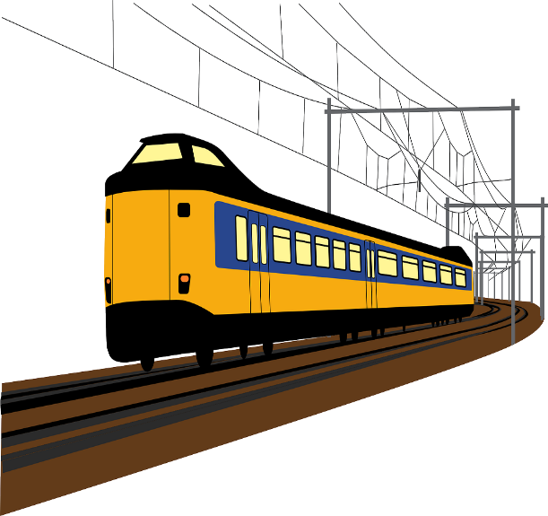
Qu’est-ce qu’il y a dans la boîte?
écrire
Challenge 5
Traduis la phrase en français.
I used to take the train to Montreal.
Je prenais le train pour Montréal.
15 points:
5 points for a correct stem [pren-]
5 points for a correct imperfect ending [-ais]
5 points for 100% correct sentence
retour
Notes:
Slide 6 of 9

Slide 21
Qu’est-ce qu’il y a dans la boîte?
écrire
Challenge 6
Traduis la phrase en français.
Did he used to participate in lots of shows?
Il participait à beaucoup de spectacles?
15 points:
5 points for a correct stem [particip-]
5 points for a correct imperfect ending [-ait]
5 points for 100% correct sentence
retour
Notes:
Slide 7 of 9

Slide 22
Qu’est-ce qu’il y a dans la boîte?
écrire
Challenge 7
Traduis la phrase en français
Did you used to write books?
Tu écrivais des livres?
15 points:
5 points for a correct stem [écriv-]
5 points for a correct imperfect ending [-ais]
5 points for 100% correct sentence
retour
Notes:
Slide 8 of 9

Slide 23
Qu’est-ce qu’il y a dans la boîte?
écrire
Challenge 8
Traduis la phrase en français.
Did she used to leave early?
Elle partait tôt ?
15 points:
5 points for a correct stem [part-]
5 points for a correct imperfect ending [-ait]
5 points for 100% correct sentence
retour
Notes:
Slide 9 of 9

Slide 24
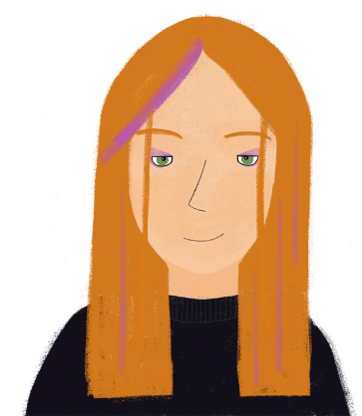
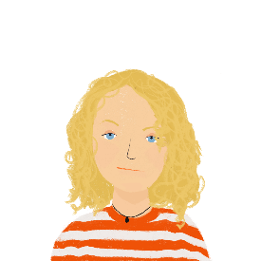
Puissance 4 !
la boîte = box
le camarade = (class)mate
faisait = used to do
parler
On passait du temps comment pendant son enfance ? Parle avec tes camarades*. Qui faisait* quoi dans ta classe ? Utilise l’imparfait.
Aligne quatre boîtes* pour gagner !
Oui, j’apprenais l’allemand.
Non, mais je nourrissais mon chien.
learn/ language
feed/cat
Tu apprenais une langue ?
Tu nourrissais un chat ?
use/ computer
read/novels
Notes:
Timing: 8 minutes [1/3]
Aim: Spoken comprehension and production of questions and statements with singular forms of verbs in the imperfect tense.
Procedure:
1. Print and distribute the rolecards on the next slide.
2. Explain to students that they are going to play Puissance 4 (French name for ‘connect 4) by asking and answering questions in the imperfect tense to find out who used to do what as a child. Note the use of plural pronouns votre and vos to address the class as a whole. Check understanding.
3. Demonstrate the activity using this slide to exemplify one example of an affirmative answer and one example of a negative answer. Clarify that students have to tick four boxes in a row (horizontally, vertically, or diagonally) by finding students who did do each activity to win.
4. At lower levels, students should practise answering yes/no questions with yes/no statements, as illustrated in the first example. At more advanced levels, encourage students to give more information in their answers (Oui, j’appartenais à un club d’hockey…).
5. The first student to connect 4, and report their answers in 3rd person singular statements about their classmates, is the winner.
6. Suggested questions can be found on the last slide in this lesson.
Word frequency of (near) cognates used (1 is the most frequent word in French): neutre [2785], préférence [2970], personnel [398], rare [1233], aligner [3021]
Source: Londsale, D., & Le Bras, Y. (2009). A Frequency Dictionary of French: Core vocabulary for learners London: Routledge.
Word frequency of unknown words used (1 is the most frequent word in French): boîte [1771], camarade [2825]
Source: Londsale, D., & Le Bras, Y. (2009). A Frequency Dictionary of French: Core vocabulary for learners London: Routledge.

Slide 25
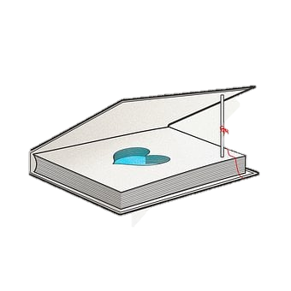
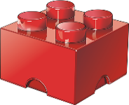
Puissance 4 !
parler
play/ football
watch/TV programmes
play/ football
watch/TV programmes
phone/friends
send/letters
phone/friends
send/letters
belong to/ club
ask/lots of questions
belong to/ club
ask/lots of questions
write/stories
sleep/a lot
write/stories
sleep/a lot
take out/ dog
build/ things
feed/ cat
learn/ language
take out/ dog
build/ things
feed/ cat
learn/ language
participate in/ competitions
use/ computer
participate in/ competitions
use/ computer
eat/ice cream
read/novels
eat/ice cream
read/novels
Notes:
[2/3]
Rolecards for printing

Slide 26
Puissance 4 !
parler
Tu téléphonais à tes amis ?
Tu jouais au foot ?
Tu envoyais des lettres ?
Tu regardais des émissions ?
Tu écrivais des histoires ?
Tu dormais beaucoup ?
Tu appartenais à un club ?
Tu posais beaucoup de questions ?
Tu sortais le chien ?
Tu construisais des choses ?
Tu nourrissais le chat ?
Tu apprenais une langue ?
Tu mangeais une glace ?
Tu participais aux concours ?
Tu utilisais un ordinateur ?
Tu lisais des romans ?
play/ football
watch/TV programmes
phone/friends
send/letters
belong to/ club
ask/lots of questions
write / stories
sleep/a lot
take out/ dog
build/ things
feed/ cat
learn/ language
participate in/ competitions
use/ computer
eat/ice cream
read/novels
Notes:
[3/3]
Suggested questions

Slide 27
Talking about what happened once vs all the time
regular verbs in the imperfect tense (habitual events with 'used to' equivalent in English vs specific past events) (je, tu, il/elle/on)
Word pattern: -al ➜ -el
Y9 French
Term 2.2 - Week 3 - Lesson 44
Louise Bibbey / Natalie Finlayson
Artwork by: Chloé Motard
Date updated: 08/08/2022
Notes:
Artwork by Chloé Motard. All additional pictures selected are available under a Creative Commons license, no attribution required.
Native-speaker teacher feedback provided by Sarah Brichory.
With thanks to Rachel Hawkes for her input on the lesson material.
Learning outcomes (lesson 2):
Introduce the –al ➔ -el word pattern
Revisit –ER perfect tense forms
Introduce the use of the imperfect tense for one-off actions vs the prefect tense for ongoing actions.
Word frequency (1 is the most frequent word in French):
9.2.2.3 (introduce) participer à [670], artiste [1797], concours [1375], défi [1728], diversité [2537], émission [1074], genre [556], personnage [1449], sexe [1691], scène [794], spectacle [1687], annuel [1674], culturel [1495], non-binaire [n/a], transgenre [n/a]
9.2.1.6 (revisit) approcher [1576], avoir besoin de [n/a] téléphoner (à) [2448], voler (à) [1610], moi [131], toi [510], proche [838], crime [819], fréquence [2178], responsabilité [694], sécurité [478], vol [1531], criminel [1411], après [82], avant [40], selon [240]
9.1.2.3 (revisit) commander [959], réserver [695], addition [>5000], carte² [955], choix [436], nuit [580], restaurant [2336], réception [1926], service [203], table [1019], leur [35], leurs [n/a], votre [214], vos [n/a]
The frequency rankings for words that occur in this PowerPoint which have been previously introduced in NCELP resources are given in the NCELP SOW and in the resources that first introduced and formally re-visited those words.
For any other words that occur incidentally in this PowerPoint, frequency rankings will be provided in the notes field wherever possible.
The additional English meanings of the following words have been added to Quizlet since the creation of this resource:
annuel – annual, yearly

Slide 28
Vocabulaire: cognates
I’m English!
parler
Je suis français!
All these words are cognates in English and French. Read the English words and say the French versions.
Cognates are like peas in a pod. They look almost identical… but they can sound very different!
sexual
sexuel
artist
l’artiste
transgender
transgenre
participate in
participer à
diversity
la diversité
scene
la scène
cultural
culturel
annual
annuel
Notes:
Timing: 2 minutes
Aim: Oral practice of pronunciation differences between the cognates and near-cognates in this week’s vocabulary set.
Procedure:
1. Ask students to read the word in English, then try to say the French translation.
2. Click on the French word to hear it being said by a native speaker. Students repeat.
3. Click to reveal the definition of cognates, which serves as a segue to the word pattern activity.
Transcript:
sexuel
transgenre
la diversité
culturel
l’artiste
participer à
la scène
annuel

Slide 29
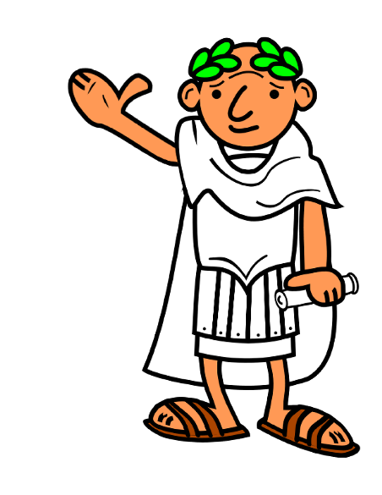
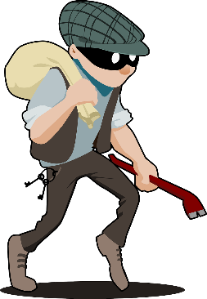
Word patterns: -al ➜ -el
My style is very individualis!
vocabulaire
Many English adjectives ending in -al end in -el.
The -al and -el endings come from the Latin endings -alis and -ellus, e.g., floralis ➜ floral.
Remember to change the word order! Most adjectives in French come after the noun (except B.A.G.S. adjectives)
Most French adjectives ending in -al also end with -al in English, e.g., royal(e) ➜ royal.
However, many English adjectives ending in -al change to -el in French. For feminine adjectives, the ending becomes -elle, e.g.:
an industrial building ➜
un bâtiment industriel
a criminal person ➜
une personne criminelle
Notes:
Timing: 6 minutes [1/2]
Aim: To introduce the -al → -el word pattern; to revise the -el → -elle adjectival agreement rule; to revise pre- and post-nominal adjective placement rues.
Procedure:
1. Click through the information on this slide. Remind students of adjectival agreement and placement rules.
2. Move to the next slide. Ask students to predict the French translations of the English word pairs. Remind students to pay attention to feminine endings and word order. This can be done orally, or with mini-whiteboards. If doing this in writing, students will need to be made aware of the n→nn spelling change in professionnel, exceptionnel, traditionnel in advance.
3. Click to reveal the correct answers. Click again to reveal the note on the n→nn spelling change.
Word frequency of cognates used (1 is the most frequent word in French):
tempête [2695], circonflexe [>5000], accent [1694]
Source: Lonsdale, D., & Le Bras, Y. (2009). A Frequency Dictionary of French: Core vocabulary for learners London: Routledge.

Slide 30
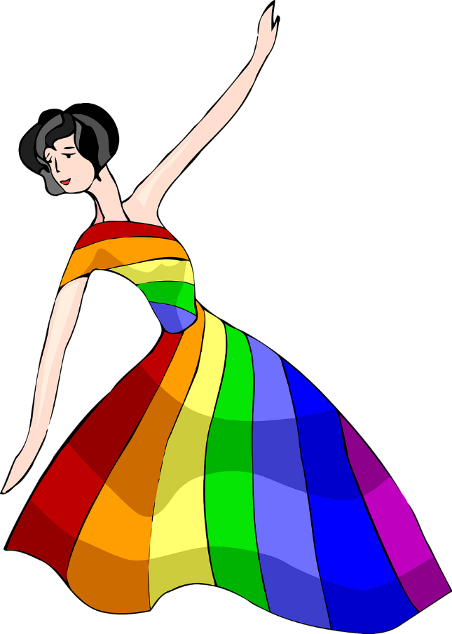
Word patterns: -al ➜ -el
Now practise the word patterns by translating the English word pairs into French.
vocabulaire
English word pair
French noun
French word pair
Notice the spelling difference with words containing -n-. One -n- in English, two in French!
annual event
événement (m)
événement annuel
personal safety
sécurité (f)
sécurité personnelle
official responsibility
responsabilité (f)
responsabilité officielle
professional artist
artiste (m)
artiste professionnel
exceptional service
service (m)
service exceptionnel
individual character
personnage (m)
personnage individuel
sexual identity
identité (f)
identité sexuelle
traditional custom
coutume (f)
coutume traditionnelle
Notes:
[2/2]
Word frequency (1 is the most frequent word in French):
coutume [3228]
Word frequency of cognates used (1 is the most frequent word in French):
évènement [>5000], officiel [996], professionnel [1000], exceptionnel [1255], individuel [1812], identité [1437], traditionnel [1574]
Source: Lonsdale, D., & Le Bras, Y. (2009). A Frequency Dictionary of French: Core vocabulary for learners London: Routledge.

Slide 31
Just once or all the time?
grammaire
As you know, you need present tense of avoir + past participle to form the perfect tense:
avoir: j’ai tu as il/elle/on a
nous avons vous avez ils/elles ont
past participles:
e.g. visiter
→ j’ai visité
I visited
-ER verbs: stem + é
We use the perfect tense to talk about specific or one-off events and actions that happened in the past.
You also know how to form the imperfect tense:
Stem of present tense ‘nous’ form + -ais (je/tu form) or + -ait (il/elle/on form)
e.g. regarder → nous
regardons
regardais
→ elle regardait
She used to watch
We use the imperfect tense to talk about events and actions that used to happen regularly in the past.
Notes:
Timing: 4 minutes [1/2]
Aim: To recap the forms and meanings of the two past tenses (perfect and imperfect tenses) and contrast these in more detail.
Procedure:
1. Click to reveal information about, and examples of, tense formation.
2. Move to next slide to reveal information about, and examples of, tense use.
3. Students complete a short comparative exercise to highlight the cross-linguistic difference between French and English past tenses.

Slide 32
Just once or all the time?
The imperfect is sometimes found with time expressions which describe how often something happened, like toujours, parfois and chaque année.
grammaire
We know that the imperfect tense tells us what used to happen over a period of time.
Le lundi, je jouais dans l'orchestre. I used to play in the orchestra on Mondays.
We use the past perfect to talk about things that happened once.
Une fois, j’ai joué dans un orchestre. I played in an orchestra once.
This can be challenging because we always use time expressions or context to show the difference in English. In French, we can express the same idea using the verb only.
The perfect is sometimes found with time expressions which describe when something happened, like hier and l’année dernière.
 | just once | all the time | can’t tell
elle chantait
il a mangé du sushi
I did gymnastics
How often do these things happen?
Notes:
[2/2]

Slide 33
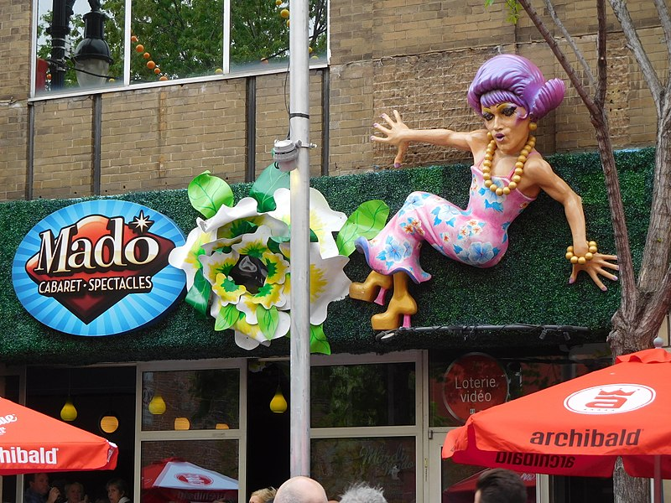
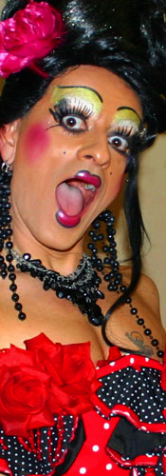
Cabaret Mado à Montréal
au début = at the beginning
démarrer = to start, set up
lire
What is happening now (present)? What happened once in the past (perfect) ? What used to happen regularly (imperfect) ?
Tâche 1: Trouve tous les verbes dans le texte. Tu vas trouver onze verbes au total.
Le Cabaret Mado présente des spectacles 6 soirs par semaine, 52 semaines par an. L'hôtesse , Mado Lamotte, est une icône de la scène LGBTQ+ montréalaise. Luc Provost a créé ce personnage drag queen il y a 26 ans. Luc chantait à l’école et il a étudié le théâtre à l’Université du Québec.
Mado est entrée en scène en juillet 1987. Au début*, elle dansait et présentait des bingos dans les bars Montréalais. Elle a démarré* le cabaret Mado en 2002. Pendant près de 15 ans, elle organisait « Mascara », un des plus importants spectacles du drag dans le monde avec plus de 100 artistes. Elle écrivait des articles pour les magazines et journaux LGBTQ+, comme « Fugues » et « ici Montréal ».
Le Cabaret Mado présente des spectacles 6 soirs par semaine, 52 semaines par an. L'hôtesse , Mado Lamotte, est une icône de la scène LGBTQ+ montréalaise. Luc Provost a créé ce personnage drag queen il y a 26 ans. Luc chantait à l’école, et il a étudié le théâtre à l’Université du Québec à Montréal.
Mado est entrée en scène en juillet 1987. Au début*, elle dansait et présentait des bingos dans les bars Montréalais. Elle a démarré* le cabaret Mado en 2002. Pendant près de 15 ans, elle organisait « Mascara », un des plus importants spectacles du drag dans le monde avec plus de 100 artistes. Elle écrivait des articles pour les magazines et journaux LGBTQ+, comme « Fugues » et « ici Montréal ».
Notice the pronoun changes from il (when talking about Luc) to elle (when talking about Mado). Feminine agreement is needed when talking about Luc’s drag persona.
Notes:
Timing: 10 minutes [1/3]
Aim: Written recognition of the present, imperfect and perfect tenses and connecting these with meaning (ongoing events, regular past events, one-off or completed past events); reading comprehension; connecting the imperfect and perfect tenses with general and specific time phrases.
Procedure:
1. Students read the text and circle all the verbs they spot.
2. Click to reveal the solution. Clarify the three different types of tense represented in the passage, and the meaning of the verbs.
3. Click to reveal the second task. Students make notes under the three headings in English.
4. Click to reveal the note on pronoun change and past participle agreement.
5. Move to the next slide and reveal the answers to the comprehension part on clicks.
6. Proceed to the final slide in the set and draw attention to the times phrases and the tenses with which they appear. On clicks, notes appear to walk students through the
Word frequency of unknown words used (1 is the most frequent word in French): démarrer [2851]
Source: Londsale, D., & Le Bras, Y. (2009). A Frequency Dictionary of French: Core vocabulary for learners London: Routledge.
Word frequency of (near) cognates used (1 is the most frequent word in French): presenter [209], hôtesse (hôte) [3780], icône [>5000], montréalaise [>5000], drag queen [>5000], théâtre [1701], au début [n/a], danser [2934], bingo [>5000], bar [3012], cabaret [>5000], article [604], magazine [2033]
Source: Londsale, D., & Le Bras, Y. (2009). A Frequency Dictionary of French: Core vocabulary for learners London: Routledge.
Image attribution:
https://commons.wikimedia.org/wiki/File:Cabaret_Mado_-_02.jpg
https://fr.wikipedia.org/wiki/Mado_Lamotte

Slide 34
Cabaret Mado à Montréal
au début = at the beginning
démarrer = to start, set up
lire
What is happening now (present)? What happened once in the past (perfect) ? What used to happen regularly (imperfect) ?
Happening now
Cabaret Mado presents shows 6 nights a week, 52 weeks a year
The hostess/Mado is an LGBT+ icon in Montreal
Happened once in the past
Luc Provost created this drag character
Luc Provost studied theatre at university
Mado entered the (drag) scene
Happened regularly in the past
Luc Provost used to sing at school
Mado used to dance and present bingo nights in bars in Montreal
Mado used to organise ‘Mascara,’ one of the biggest drag shows in the world
Mado used to write news/magazine articles
Notes:
[2/3]

Slide 35
Cabaret Mado à Montréal
au début = at the beginning
démarrer = to start, set up
lire
General time phrases (unspecified periods, longer periods) are often used with the imperfect tense.
If there is no time phrase, the verb form alone tells you whether something happened regularly or not.
Specific time phrases (number of years, dates) are normally used with the perfect tense.
What kind of time phrases appear beside the two types of past tense?
Le Cabaret Mado présente des spectacles 6 soirs par semaine, 52 semaines par an. L'hôtesse , Mado Lamotte, est une icône de la scène LGBTQ+ montréalaise. Luc Provost a créé ce personnage drag queen il y a 26 ans. Luc chantait à l’école et il a étudié le théâtre à l’Université du Québec à Montréal.
Mado est entrée en scène en 1987. Au début*, elle dansait et présentait des bingos dans les bars Montréalais. Elle a démarré* le cabaret Mado en 2002. Pendant près de 15 ans, elle organisait « Mascara », un des plus importants spectacles du drag dans le monde avec plus de 100 artistes. Elle écrivait des articles pour les magazines et journaux LGBTQ+, comme « Fugues » et « ici Montréal ».
Le Cabaret Mado présente des spectacles 6 soirs par semaine, 52 semaines par an. L'hôtesse , Mado Lamotte, est une icône de la scène LGBTQ+ montréalaise. Luc Provost a créé ce personnage drag queen il y a 26 ans. Luc chantait à l’école et il a étudié le théâtre à l’Université du Québec à Montréal.
Mado est entrée en scène en 1987. Au début*, elle dansait et présentait des bingos dans les bars Montréalais. Elle a démarré* le cabaret Mado en 2002. Pendant près de 15 ans, elle organisait « Mascara », un des plus importants spectacles du drag dans le monde avec plus de 100 artistes. Elle écrivait des articles pour les magazines et journaux LGBTQ+, comme « Fugues » et « ici Montréal ».
Le Cabaret Mado présente des spectacles 6 soirs par semaine, 52 semaines par an. L'hôtesse , Mado Lamotte, est une icône de la scène LGBTQ+ montréalaise. Luc Provost a créé ce personnage drag queen il y a 26 ans. Luc chantait à l’école et il a étudié le théâtre à l’Université du Québec à Montréal.
Mado est entrée en scène en juillet 1987. Au début*, elle dansait et présentait des bingos dans les bars Montréalais. Elle a démarré* le cabaret Mado en 2002. Pendant près de 15 ans, elle organisait « Mascara », un des plus importants spectacles du drag dans le monde avec plus de 100 artistes. Elle écrivait des articles pour les magazines et journaux LGBTQ+, comme « Fugues » et « ici Montréal ».
Le Cabaret Mado présente des spectacles 6 soirs par semaine, 52 semaines par an. L'hôtesse , Mado Lamotte, est une icône de la scène LGBTQ+ montréalaise. Luc Provost a créé ce personnage drag queen il y a 26 ans. Luc chantait à l’école et il a étudié le théâtre à l’Université du Québec à Montréal.
Mado est entrée en scène en juillet 1987. Au début*, elle dansait et présentait des bingos dans les bars Montréalais. Elle a démarré* le cabaret Mado en 2002. Pendant près de 15 ans, elle organisait « Mascara », un des plus importants spectacles du drag dans le monde avec plus de 100 artistes. Elle écrivait des articles pour les magazines et journaux LGBTQ+, comme « Fugues » et « ici Montréal ».
Le Cabaret Mado présente des spectacles 6 soirs par semaine, 52 semaines par an. L'hôtesse , Mado Lamotte, est une icône de la scène LGBTQ+ montréalaise. Luc Provost a créé ce personnage drag queen il y a 26 ans. Luc chantait à l’école et il a étudié le théâtre à l’Université du Québec à Montréal.
Mado est entrée en scène en juillet 1987. Au début*, elle dansait et présentait des bingos dans les bars Montréalais. Elle a démarré* le cabaret Mado en 2002. Pendant près de 15 ans, elle organisait « Mascara », un des plus importants spectacles du drag dans le monde avec plus de 100 artistes. Elle écrivait des articles pour les magazines et journaux LGBTQ+, comme « Fugues » et « ici Montréal ».
Notes:
[3/3]

Slide 36
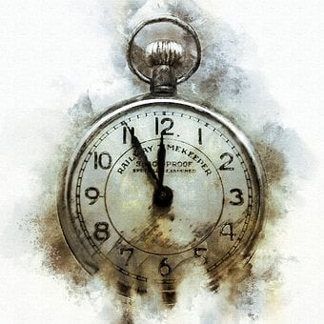
Les indications de temps
lire
Voici des indications de temps que tu connais. On utilise ces expressions avec l’imparfait, le passé composé ou les deux?
il y a cinq minutes
il y a cinq minutes
normalement
normalement
chaque semaine
en hiver
le 31 juillet
chaque semaine
en hiver
pendant les vacances
le 31 juillet
mercredi dernier
le mercredi
le mercredi
mercredi dernier
passé composé
pendant les vacances
imparfait
Notes:
Timing: 3 minutes
Aim: To connect the imperfect and perfect tenses with general and specific time phrases.
Procedure:
1. Check students understand the meaning of each time phrase.
2. Invite students to consider whether they think the time phrase is likely to be followed by a description of something that happened once, or something that happened regularly.
3. Students might find it useful to translate the phrases in English and decide whether ‘used to’ is a plausible fit with the sentence starter. Point out that in some cases, both options are possible.
4. Answers revealed on clicks.
Word frequency (1 is the most frequent word in French):
Source: Londsale, D., & Le Bras, Y. (2009). A Frequency Dictionary of French: Core vocabulary for learners London: Routledge.

Slide 37
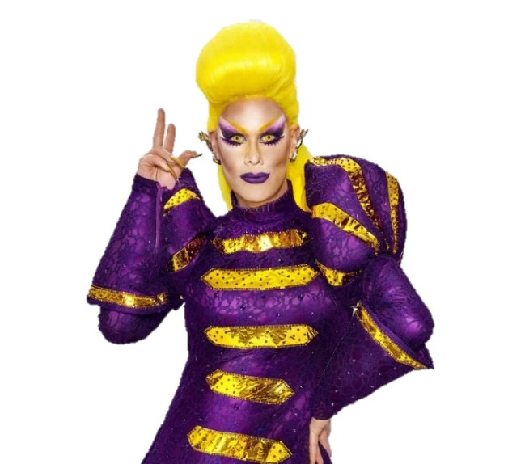
Rita Baga : drag montréalaise
la gloire = fame, glory
au cours de = over, during
écouter
Rita Baga, c’est l’alter égo de Jean-François Guèvremont. C’est aussi une artiste et personnage très important de la scène culturelle LGBTQ+ du Québec. Écoute son histoire et remplis les blancs !
Tu vas entendre un accent québécois !
 | quand ? | Passé composé ou imparfait ?
 | avant la gloire* | travaillait comme directeur pour le festival Fierté Montréal
 | de 2015 à 2018
 | un jour | a téléphoné pour dire : « tu dois faire de la drag » !
 | tous les jours
 | au cours de* l'été 2020 | a participé à l’émission de télévision “Canada’s Drag Race”
 | chaque été
 | Dans la 1ère émission | créait des “looks” et complétait des défis
 | chaque semaine
 | chaque fois | a gagné la deuxième place
 | le 3 septembre 2020
1
travailler
2
téléphoner
3
participer
4
créer
compléter
5
gagner
Notes:
Timing: 12 minutes [1/2, version 1]
NB1: This text is a simplified version of an authentic interview. As a result, the text contains a number of cognates which students have not yet learned. Written summaries of the relevant verb phrases for which students must listen are therefore provided in the infinitive.
The full interview can be found here: https://www.facebook.com/watch/?v=541816656300248&extid=1cBnzrXfqazFpLMJ
NB2: A more challenging version of this activity, in which the auxiliary verb is obscured, may be found on the next slide.
Aims: Aural recognition of perfect and imperfect verb forms and connecting these with time phrases and meaning (specific vs habitual actions in the past); cultural awareness: regional accents; listening comprehension.
Procedure:
1. Check students understand the background information and task instructions. Check the cognates in the right-hand column are understood. Check students understand the time phrases, and recognise which is likely to go with a habitual action, and which with a one-off event.
2. Tell students they are going to hear the text read in a Canadian accent.
3. Click on a number to hear the sentence without the time phrase. NB: As this is the first time students have heard a longer text in Québécois, they may need to hear the recordings more often than usual. Student write down the form of the verb they hear (in either passé composé or imparfait).
4. Give students a few seconds to decide, based on their answer, which time phrase must complete the sentence before moving on to the next example. Alternatively, you may wish to carry out and correct the listening part of the task first, before asking students to choose the time phrase as reading comprehension. This option may be more suitable for lower levels
5. Answers appear on clicks. For each example, the verb form appears first, followed by the time phrase.
6. Move to slide 39 for the dictogloss part of the activity.
Transcript:
1. [Avant la gloire], Jean-François Guèvremont travaillait comme directeur pour Fierté Montréal, un festival annuel québécois qui célébrer la diversité sexuelle et de genre.
2. [Un jour], son ami a téléphoné pour dire : « tu es super expressif, tu dois absolument faire de la drag ! » et Rita Baga est née.
3. [Au cours de l'été 2020], Rita Baga a participé à l’émission de télévision “Canada’s Drag Race”.
4. [Chaque semaine], elle créait des “looks” et complétait des défis.
5. [Le 3. septembre 2020], elle a gagné la deuxième place. Rita Baga est la première drag francophone à devenir finaliste du concours.
Word frequency of cognates used (1 is the most frequent word in French): drag [>5000], [3858], montréalaise [>5000], alter égo [>5000], gloire [3287], super [2993], expressif [>5000], finaliste [>5000], accent [1694]
Source: Londsale, D., & Le Bras, Y. (2009). A Frequency Dictionary of French: Core vocabulary for learners London: Routledge.
Word frequency of unknown words used (1 is the most frequent word in French): gloire [3287]
Source: Londsale, D., & Le Bras, Y. (2009). A Frequency Dictionary of French: Core vocabulary for learners London: Routledge.

Slide 38
Rita Baga : drag montréalaise
Remember! Only verbs ending in SSC [é] need avoir.
la gloire = fame, glory
au cours de = over, during
écouter
Rita Baga, c’est l’alter égo de Jean-François Guèvremont. C’est aussi une artiste et personnage très important de la scène culturelle LGBTQ+ du Québec. Écoute son histoire et remplis les blancs !
Tu vas entendre un accent québécois !
 | quand ? | [é] ou [ai] ? | avoir ?
 | avant la gloire | travaillait comme directeur pour le festival Fierté Montréal
 | de 2015 à 2018
 | un jour | a téléphoné pour dire : « tu dois faire de la drag » !
 | tous les jours
 | au cours de l'été 2020 | a participé à l’émission de télévision “Canada’s Drag Race”
 | chaque été
 | Dans la 1ère émission | créait des “looks” et complétait des défis
 | chaque semaine
 | chaque fois | a gagné la deuxième place
 | le 3 septembre 2020
1
travaill__
2
téléphon__
3
particip__
4
cré__
complét__
5
gag__
Notes:
[1/2, version 2]
In this more complex version of the activity on the previous slide, the auxiliary verb is obscured, and students must use their SSC knowledge . This version of the activity is recommended for advanced students, though the teacher might find it interesting to use it with lower levels to demonstrate that the difference in pronunciation between the –é and –ait endings. NB: The distinction exemplified here is particularly pronounced in Canadian and Parisian French, and less so in other areas of mainland France. Slide 8 may be used to introduce the concept of regional variation in pronunciation.
Procedure:
1. Check students understand the background information and task instructions. Check the cognates in the right-hand column are understood. Check students understand the time phrases, and recognise which is likely to go with a habitual action, and which with a one-off event.
2. Tell students they are going to hear the text read in a Canadian accent.
3. Click on a number to hear the sentence without the time phrase and with the auxiliary verb obscured. NB: As this is the first time students have heard a longer text in Québécois, they may need to hear the recordings more often than usual. Student write down the form of the verb they hear (either past participle or imparfait form), and add the auxiliary verb (a) if necessary.
4. Give students a few seconds to decide, based on their answer, which time phrase must complete the sentence before moving on to the next example. Alternatively, you may wish to carry out and correct the listening part of the task first, before asking students to choose the time phrase as reading comprehension.
5. Answers appear on clicks. For each example, the verb form appears first, followed by the auxiliary, and finally the time phrase.
6. Move to the last slide in the sequence. Play each segment of the text again, this time with the time phrase included. Draw attention from the shift from the il pronoun used to refer to Jean-François, and the elle pronoun when referring to Rita Baga. Students summarise each sentence in English to complete a mini dictagloss.
7. Suggested answers to the dictagloss may be found on the last slide of this sequence.
Transcript:
1. [Avant la gloire], Jean-François Guèvremont […] travaillait comme directeur pour Fierté Montréal, un festival annuel québécois qui célébrer la diversité sexuelle et de genre.
2. [Un jour], son ami [a] téléphoné pour dire : « tu es super expressif, tu dois absolument faire de la drag ! » et Rita Baga est née.
3. [Au cours de l'été 2020], Rita Baga [a] participé à l’émission de télévision “Canada’s Drag Race”.
4. [Chaque semaine], elle […] créait des “looks” et […] complétait des défis.
5. [Le 3. septembre 2020], elle [a] gagné la deuxième place. Rita Baga est la première drag francophone à devenir finaliste du concours.
Word frequency of cognates used (1 is the most frequent word in French): drag [>5000], [3858], montréalaise [>5000], alter égo [>5000], super [2993], expressif [>5000], finaliste [>5000], accent [1694]
Source: Londsale, D., & Le Bras, Y. (2009). A Frequency Dictionary of French: Core vocabulary for learners London: Routledge.
Word frequency of unknown words used (1 is the most frequent word in French): gloire [3287]
Source: Londsale, D., & Le Bras, Y. (2009). A Frequency Dictionary of French: Core vocabulary for learners London: Routledge.

Slide 39
Rita Baga : drag montréalaise
la gloire = fame, glory est née = was born
au cours de = over, during
écouter
Rita Baga, c’est l’alter égo de Jean-François Guèvremont, artiste et personnage très important de la scène culturelle LGBTQ+ du Québec. Écoute son histoire et remplis les blancs !
Jean-François Guèvremont worked as the manager of Fierté Montréal, an annual event celebrating sexual/gender diversity.
1
Notice the pronunciation of vingt in Québécois!
2
His friend called one day and said he was very expressive and should do drag. Rita Baga was born.
3
Over the summer of 2020, Rita Baga participated in the TV series Canada’s Drag Race.
4
Every week, she created looks and completed challenges.
5
In December 2020, she won second place. Rita Baga is the first French-speaking drag queen to be a finalist in the competition.
Notes:
[2/2] Suggested answers to dictagloss activity.
At lower levels, display the transcript below for extra support. All students will need some extra help with est née in the second sentence.
Ask students whether they notice any differences between the French and Québécois accents. They may not recognise the word vingt! Nasal vowels are pronounced quite differently (see the example video linked in the notes to slide 7). However, as there are not many nasal vowels in this text, students may find the Québécois accent easier to understand. They may describe it as slower, more pronounced/enunciated or more softly spoken/sing-song-like.
Procedure:
1. Play each segment of the text again, this time with the time phrase included. Draw attention from the shift from the il pronoun used to refer to Jean-François, and the elle pronoun when referring to Rita Baga.
2. Students summarise each sentence in English to complete a mini dictagloss.
3. Click to reveal suggested solutions in English.
Transcript:
1. Avant la gloire, Jean-François Guèvremont travaillait comme directeur pour Fierté Montréal, un festival annuel québécois qui célébrer la diversité sexuelle et de genre.
2. Un jour, son ami a téléphoné pour dire : « tu es super expressif, tu dois absolument faire de la drag ! » et Rita Baga est née.
3. Au cours de l'été 2020, Rita Baga a participé à l’émission de télévision “Canada’s Drag Race”.
4. Chaque semaine, elle créait des “looks” et complétait des défis.
5. Le 3. septembre 2020, elle a gagné la deuxième place. Rita Baga est la première drag francophone à devenir finaliste du concours.

Slide 40
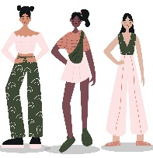
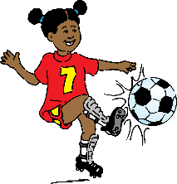
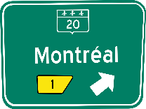
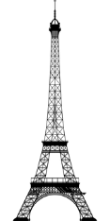
Une fois ou tous les temps ?
parler
Travaille avec un(e) partenaire.
J’ ________ souvent des histoires de crime.
[lire]
[all the time]
Je lisais souvent d’histoires de crime.
I used to read lots of crime stories… all the time!
Tu ________ des nuits à Paris.
[passer]
[just once]
Tu as passé des nuits à Paris.
You spent some nights in Paris … just once!
Notes:
Timing: 5 minutes
[1/5]
Aim: Oral production and aural recognition of sentences in the perfect and imperfect tenses, and connecting these with meaning (things that happened just once vs all the time).
Procedure:
1. Print the cards on the next two slides and cut them out.
2. Shuffle the sets, and put them face down between two players. Tell students that they are playing against other pairs in the class. The aim is to work together to be the first pair to sort the cards into two piles of nine activities (nine which happened once, and nine which happened all the time).
3. Demonstrate the activity using this slide. Players take it in turns to choose a card and read it aloud, filling the gap with the correct form of the verb given in brackets. At higher levels, encourage students to apply their phonics knowledge to the pronunciation of -é and -ais/-ait at the end of the past participle and imperfect forms if they are finding the task straightforward. However, students who pronounce both forms as [-é] should not be penalised.
4. The listening player translates the sentence, and decides whether their partner is talking about something that used to happen (imperfect tense), or something that happened just once (perfect tense).
5. If they answer correctly, the card is placed in the appropriate pile. If they answer incorrectly, the card goes back to the bottom of the pile.
6. The first time to correctly sort the cards into piles wins.
7. Solutions are provided on the penultimate slides of this sequence.

Slide 41
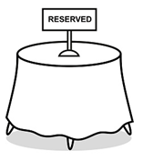
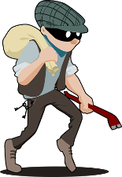
Phonétique
Au club, il ________ de la musique.
[écouter]
[all the time]
J’ ________ une
belle chanson.
[apprendre]
[just once]
Tu ________ une table au restaurant local. [réserver]
[all the time]
Au club, il ________ de la musique.
[écouter]
[just once]
On ________ ensemble l’année dernière.
[parler]
[all the time]
Tu ________ une table au restaurant local.
[réserver]
[just once]
J’ ________ des belles chansons.
[apprendre]
[all the time]
On ________ ensemble l’année dernière.
[parler]
[just once]
Il ________ de l’argent.
[voler]
[all the time]
Notes:
[2/5]
To be printed out and cut into cards for pairs speaking activity

Slide 42
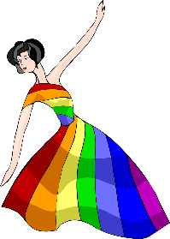
Phonétique
Il ________ de l’argent.
[voler]
[just once]
Tu ________ des concours.
[gagner]
[all the time]
Tu ________ un spectacle.
[regarder]
[just once]
On ________ l’addition.
[partager]
[all the time]
Tu ________
le concours!
[gagner]
[just once]
Il ________ le bus à Montréal.
[prendre]
[all the time]
On ________ l’addition.
[partager]
[just once]
Tu ________ souvent
des spectacles.
[regarder]
[all the time]
Il ________ le bus à Montréal.
[prendre]
[just once]
Notes:
[3/5]
To be printed out and cut into cards for pairs speaking activity

Slide 43
Phonétique
Au club, il écoutait de la musique.
[écouter]
[all the time]
J’ai appris une
belle chanson.
[apprendre]
[just once]
Tu réservais une table au restaurant local. [réserver]
[all the time]
Au club, il a écouté de la musique.
[écouter]
[just once]
On parlait ensemble l’année dernière.
[parler]
[all the time]
Tu as réservé une table au restaurant local.
[réserver]
[just once]
J’apprenais des belles chansons.
[apprendre]
[all the time]
On a parlé ensemble l’année dernière.
[parler]
[just once]
Il volait de l’argent.
[voler]
[all the time]
Notes:
[4/5]
To be printed out and cut into cards for pairs speaking activity

Slide 44
Phonétique
Il a volé de l’argent.
[voler]
[just once]
Tu gagnais des concours.
[gagner]
[all the time]
Tu as regardé un spectacle.
[regarder]
[just once]
On partageait l’addition.
[partager]
[all the time]
Tu as gagné
le concours!
[gagner]
[just once]
Il prenait le bus à Montréal.
[prendre]
[all the time]
On a partagé l’addition.
[partager]
[just once]
Tu regardais souvent
des spectacles.
[regarder]
[all the time]
Il a pris le bus à Montréal.
[prendre]
[just once]
Notes:
[5/5]
To be printed out and cut into cards for pairs speaking activity

Slide 45
Dans le passé …
*faisais = used to make, do
écrire
Complète les phrases en. Inscris des activités que tu as fait une fois (perfect), et des activités que tu faisais* tous les temps (imperfect).
Attention aux indications de temps !
Chaque année …
Hier …
Le printemps dernier …
Normalement …
Comme enfant …
Le week-end …
Ce matin …
Le lundi …
Il y a dix minutes …
je visitais Londres.
j’ai regardé une émission intéressante à la télé.
Notes:
Timing: 8 minutes
Aim: Semi-structured writing practice in a mix of past tenses (perfect and imperfect); connecting verb tenses with time phrases which indicate one-off and habitual actions.
Procedure:
1. Students read the sentence beginnings. Check comprehension by asking students whether the time phrases are likely to start a sentence about something that happened once (perfect tense) or something that happened all the time (imperfect).
2. Click to reveal suggested answers for 1 and 2 only.
3. Students write their own answers for 1 and 2 using the tenses exemplified, and proceed to complete sentences 4-9 on their own.
3. At lower levels, you may wish to add some known verbs to this slide for students to use as prompts. At higher levels, encourage students to use a dictionary to identify the verbs they need to talk about their circumstances, and manipulate them accordingly.
Word frequency of cognates used (1 is the most frequent word in French): compléter [2034], activité [452], indication [2546]
Source: Londsale, D., & Le Bras, Y. (2009). A Frequency Dictionary of French: Core vocabulary for learners London: Routledge.

Slide 46
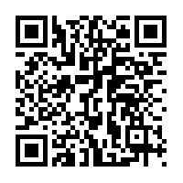
Devoirs
Vocabulary Learning Homework (Y9, Term 2.2, Week 4)
Quizlet link: Y9 Term 2.2 Week 4
Quizlet QR code:

