Slide 1
Talking about what has happened (2) : Crime
Use of emphatic pronouns moi and toi after prepositions
SSC [oi]
Y9 French
Term 2.1 - Week 6 - Lesson 37
Author names: Catherine Morris/Catherine Salkeld
Artwork by: Chloé Motard
Date updated: 04/02/22
Notes:
Artwork by Chloé Motard. All additional pictures selected are available under a Creative Commons license, no attribution required.
Native speaker feedback provided by Sarah Brichory.
With thanks to Rachel Hawkes and Emma Marsden for their input on the lesson material.
Learning outcomes (lesson 1):
Consolidation of SSC [oi]
Introduction of use of emphatic pronouns moi and toi after prepositions
Word frequency (1 is the most frequent word in French):
9.2.1.6 (introduce) approcher [1576], téléphoner (à) [2448], voler (à) [1610], moi [131], toi [510], selon [240], proche [838], après [82], avant [40], fréquence [2178], sécurité [478], responsabilité [694], avoir besoin de [183/2], criminel [1411], crime [819], vol [1531]
9.1.2.7 (revisit) contenir [1033], air [761], bonheur [1948], symbole [1427], souvenir [616], vent [1307], fort [107], long, longue [202], vers [182], Afrique [n/a], Asie [n/a], Europe [n/a]
9.1.1.7 (revisit) mettre, met, mets [27], remettre, remet, remets [156], perdre [250], campagne [666], dollar [432], habitant [1333], fleuve [2893], lac [3121], population [509], province [861], sac [2343] jamais [179]
Source: Lonsdale, D., & Le Bras, Y. (2009). A Frequency Dictionary of French: Core vocabulary for learners London: Routledge.
The frequency rankings for words that occur in this PowerPoint which have been previously introduced in NCELP resources are given in the NCELP SOW and in the resources that first introduced and formally re-visited those words.
For any other words that occur incidentally in this PowerPoint, frequency rankings will be provided in the notes field wherever possible.

Slide 2
oi
[to see]
voir
Notes:
Timing: 1 minute
Aim: To consolidate SSC [oi]
Procedure: 1. Present the letter(s) and say the [oi] sound first, on its own. Students repeat it with you. 2. Bring up the word ”voir” on its own, say it, students repeat it, so that they have the opportunity to focus all of their attention on the connection between the written word and its sound.
3. A possible gesture for this would be to put one’s hand above one’s brow (as if to shade one’s view) and pretend to be seeing something far off. 4. Roll back the animations and work through 1-3 again, but this time, dropping your voice completely to listen carefully to the students saying the [oi] sound, pronouncing ”voir” and, if using, doing the gesture.
Word frequency (1 is the most frequent word in French):
voir [69].
Source: Lonsdale, D., & Le Bras, Y. (2009). A Frequency Dictionary of French: Core vocabulary for learners London: Routledge.

Slide 3
oi
droite
avoir
[to have]
to see
voir
Au revoir !
trois
Pourquoi ?
[why?]
Notes:
Timing: 1 minute
Aim: To consolidate SSC [oi]
Procedure:
1. Introduce and elicit the pronunciation of the individual SSC [oi] and then the source word again ‘voir’ (with gesture, if using). 2. Then present and elicit the pronunciation of the five cluster words.
The cluster words have been chosen for their high-frequency, from a range of word classes, with the SSC (where possible) positioned within a variety of syllables within the words (e.g. initial, 2nd, final etc.). Additionally, we have tried to use words that build cumulatively on previously taught SSCs (see the Phonics Teaching Sequence document) and do not include new SSCs. Where new SSCs are used, they are often consonants which have a similar symbol-sound correspondence in English.
Word frequency (1 is the most frequent word in French): droite [1293]; avoir [8] au revoir [n/a]; pourquoi[193]; trois[115]; voir [69]. Source: Londsale, D., & Le Bras, Y. (2009). A Frequency Dictionary of French: Core vocabulary for learners London: Routledge.

Slide 4
SSC [oi]
écouter
phrase | combien ?
1
2
3
Combien de fois entend-on SSC [oi] ?
1
On ne peut pas choisir ses voisins.
You cannot choose your neighbours.
2
François a deux mois pour écrire l'histoire.
Francois has two months to write the story.
3
Le roi voit pourquoi la reine a écrit la loi.
The king sees why the queen wrote the law.
Notes:
Timing: 3 minutes
Aim: Recognise SSC [oi] in spoken language
Procedure:
1. Click audio buttons to hear sentences in French
2. Students tally how many times they hear SSC [oi] in each sentence
3. Elicit answers one by one
4. Click to reveal sentences with [oi] highlighted (and English translations)
Transcript:
1. On ne peut pas choisir ses voisins.
2. François a deux mois pour écrire l'histoire.
3. Le roi voit pourquoi la reine a écrit la loi.
Word frequency (1 is the most frequent word in French): voisin [979], roi [1364], reine [2809], loi [267]
Source: Lonsdale, D., & Le Bras, Y. (2009). A Frequency Dictionary of French: Core vocabulary for learners London: Routledge.

Slide 5
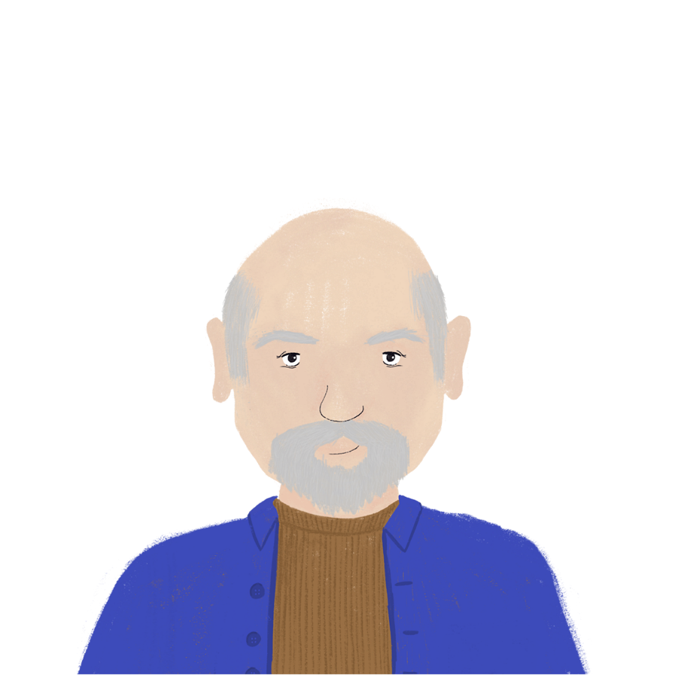
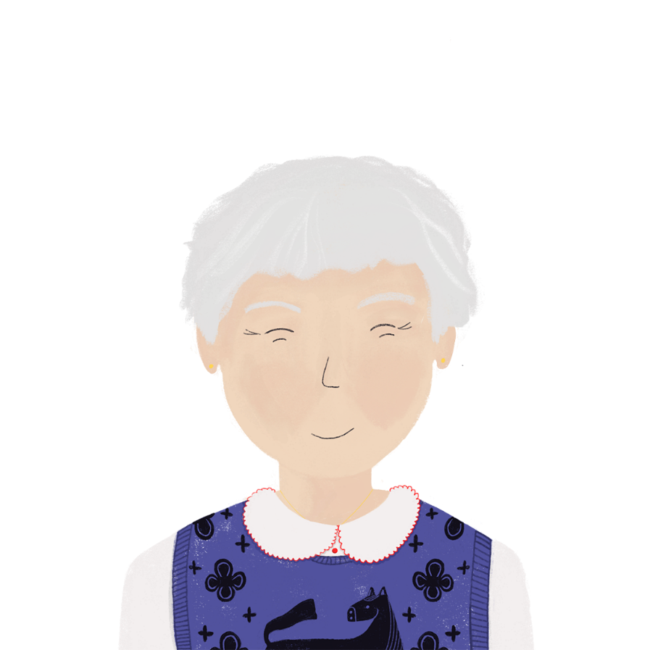
Bastien oublie* les mots
parler
*oublier = to forget
Quel est le mot quand on prend une chose à une personne ?
Tu veux dire voler
Notes:
Timing: 8 minutes (2 slides)
Aim: recognition of new vocabulary from French definitions
Procedure:
1. Click through the example on this slide first to model the task.
2. Split the class into pairs.
3. Use the prompt cards on the next slide (do not show to the class).
Note: if students have not engaged in the vocabulary pre-learning an alternative activity might be preferable at this point in the lesson, i.e. a presentation and rehearsal of the new vocabulary. This activity could then be reserved for revisiting at a later moment.

Slide 6
Partenaire A
Prendre une chose à une personne (voler)
Ce n’est pas loin, c’est … (proche)
On peut faire ça avec un portable (téléphoner)
Ce n’est pas moi, c’est … (toi)
Ce mot décrit le passé … (avant)
Combien de fois (la fréquence)
Quand il n’y a pas de danger (la sécurité)
Quand on doit faire une chose (la responsabilité)
Partenaire B
Ce mot décrit qui a dit une chose (selon)
Quand on va plus proche (approcher)
Ce n’est pas toi, c’est … (moi)
Ce mot décrit le futur … (après)
C’est plus fort que ‘vouloir’ (avoir besoin de)
Si on fait un crime, on est … (criminel)
Une chose contre les règles (le crime)
Quand on prend une chose sans demander à la personne (le vol)
Notes:
prompt cards on next slide (do not show to the class)

Slide 7
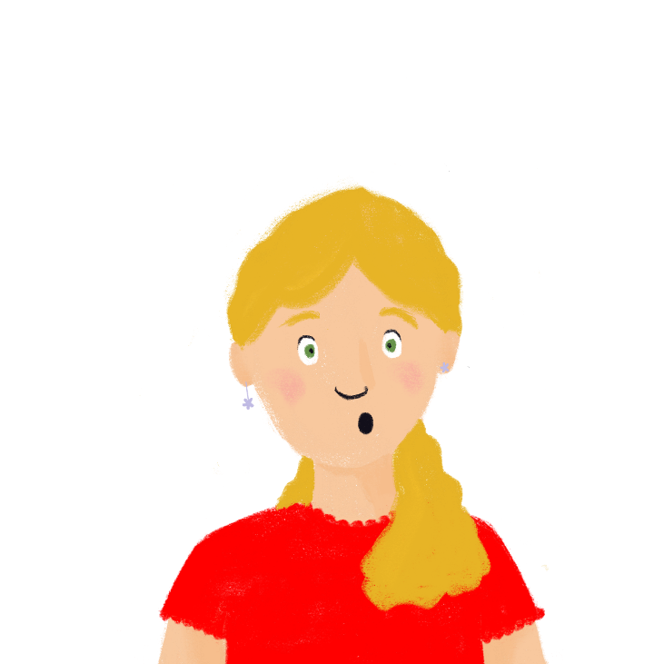
Léa est victime d’un délit*
*le délit = less serious crime
*le délinquant = person who has committed un délit
*le poste de police = police station
*augmenter = to increase
lire
Lis le texte et réponds aux questions.
Un délinquant* a volé les portables à mon père et à moi ! ll a approché de notre voiture avant le vol. J’ai besoin de mon portable. Je veux téléphoner à la police ! Selon toi, le poste de police* est proche d’ici ? La police a la responsabilité de la sécurité. La fréquence de crime augmente* toujours après le printemps.
What happened to Léa? Somebody stole from her.
How does she know who did it? He approached the car.
What does she need? Her phone.
What does she want to do? Telephone the police.
What does she ask about the police station? Whether it’s near to here.
What always happens after spring? The rate of crime increases.
In French, le crime is only used for serious crimes that would result in a prison sentence of at least ten years. A less serious crime is called un délit.
Notes:
Timing: 7 minutes
Aim: comprehension of new vocabulary in context
Procedure:
1. Students read text. Opportunity for questions if they don’t understand.
2. Click to bring up questions.
3. Elicit answers from students.
4. Click to bring up answers one by one.
Word frequency of cognates (1 is the most frequent word in French): police [829], victime [697]
Word frequency of unknown words (1 is the most frequent word in French): délit [3166], délinquant [4394], poste [489], augmenter [823]
Source: Lonsdale, D., & Le Bras, Y. (2009). A Frequency Dictionary of French: Core vocabulary for learners London: Routledge.
Source for ‘crime increases after spring’ based on crime being higher in warmer weather https://www.bbc.co.uk/news/uk-44821796

Slide 8
Prepositions
grammaire
Prepositions tell us how a noun is related to another noun, often in terms of place or time. How many prepositions can you remember? Write three lists:
place
time
other
chez
derrière
à
pour
Some prepositions don’t fit neatly into a category.
à
devant
entre
avec
sous
entre
après
contre
sur
près de
avant
sans
selon
Notes:
Timing: 2 minutes
Aim: Recap of prepositions
Procedure:
Click to reveal explanation and the three titles.
Students list prepositions they can remember.
Click to reveal suggested answers. Students may have remembered more than those listed, but this slide concentrates on the prepositions most likely to be used with emphatic pronouns, which are introduced on the next slide.

Slide 9
Emphatic pronouns
grammaire
Moi and toi are emphatic pronouns. We use them after prepositions.
Le chien mange après moi.
The dog eats after me.
Selon toi, le lac est beau ?
According to you, is the lake beautiful?
Nous arrivons avant toi.
We arrive before you.
As-tu besoin de moi aujourd’hui ?
Do you need me today ?
Notes:
Timing: 2 minutes
Aim: Introduction of emphatic pronouns moi and toi
Procedure:
1. Click to reveal explanations and examples.
2. Ensure understanding.

Slide 10
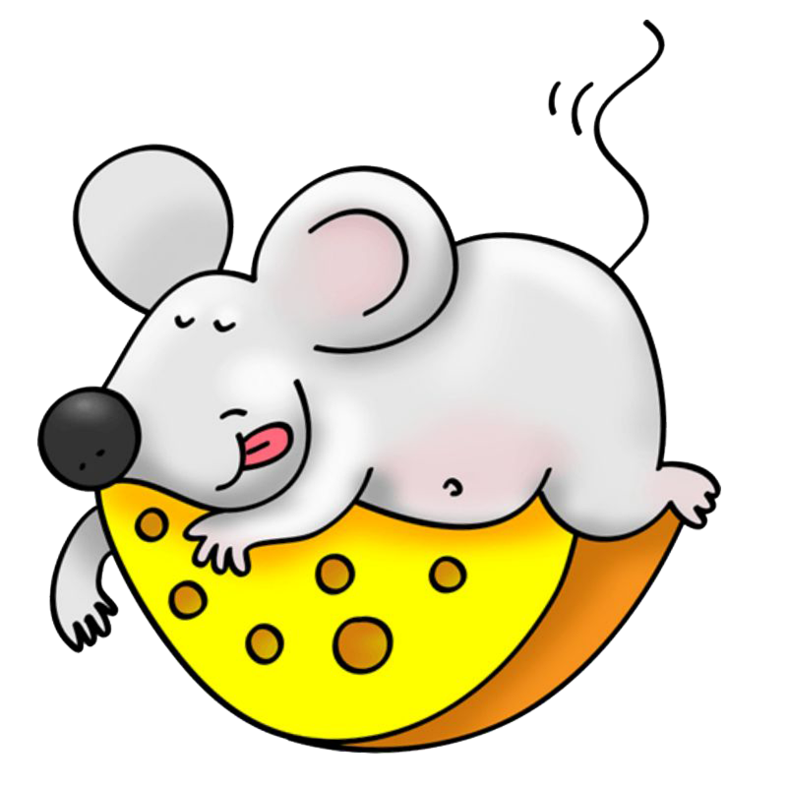
Emphatic pronouns
grammaire
Choisis le bon mot.
Je vais au cinéma avec tu/toi.
Je mange du pain et tu/toi manges du fromage.
Tu as un cadeau pour je/moi ?
Tu aimes le fleuve mais je/moi préfère le lac.
Tu ne dois pas partir sans je/moi !
Selon tu/toi, il y a un vent fort aujourd’hui ?
toi
tu
moi
je
moi
toi
Notes:
Timing: 4 minutes
Aim: Written production of emphatic pronouns in context
Procedure:
1. Students replace the nouns in bold with an emphatic pronoun.
2. Click to reveal answers.
3. Ensure understanding.

Slide 11
Emphatic pronouns
Traduis les phrases en français.
grammaire
According to me, there is an atmosphere of happiness here.
The cat always comes towards you!
Do you want to go in before me?
What time are you going home?
According to you, does she look like her dad?
Who arrived after you?
I have a present for you!
He never goes to Africa without me.
Watch out! There’s a dog in front of you!
Do you want to go to the cinema with me?
Selon moi, il y a un air de bonheur ici.
Le chat vient toujours vers toi !
Veux-tu entrer avant moi ?
À quelle heure vas-tu chez toi ?
Selon toi, ressemble-t-elle à son père ?
Qui est arrivé après toi ?
J’ai un cadeau pour toi !
Il ne va jamais en Afrique sans moi.
Attention ! Il y a un chien devant toi !
Veux-tu aller au cinéma avec moi ?
Notes:
Timing: 12 minutes
Aim: Written production of emphatic pronouns in context
Procedure:
1. Students translate the sentences into French.
2. Click to reveal answers.
3. Ensure understanding.

Slide 12
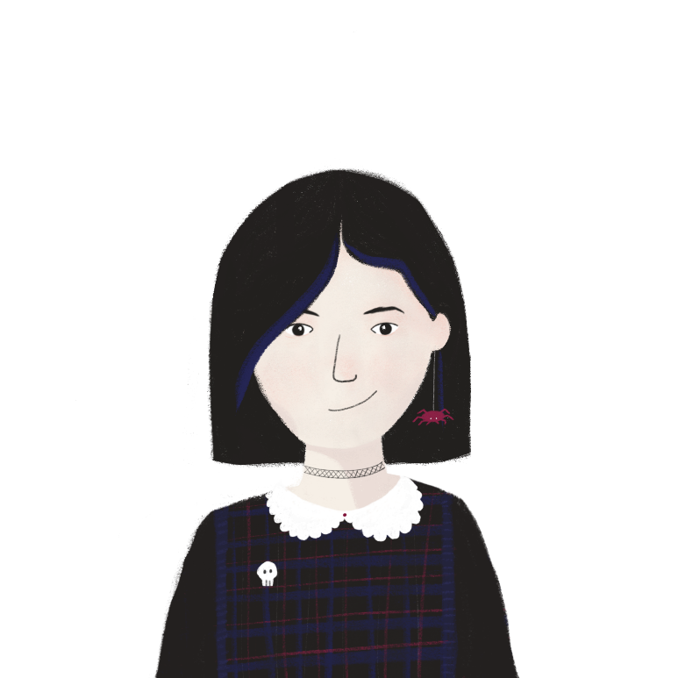
Décrire un crime
parler
Partenaire A travaille pour la police. Partenaire B téléphone à la police et décrit un crime.
Peux-tu décrire le crime ?
Il y a une femme qui vole des vélos.
Description of crime:
Description of criminal:
Location of criminal:
Il y a une femme [who is stealing bikes].
Notes:
Timing: 10 minutes
Aim: Oral production of emphatic pronouns, relative pronoun qui, verb + à + noun, and verb + de+ noun
Procedure:
Print rolecards. Students work in pairs.
Model task using this slide.
3. Partner B is a police officer, and asks appropriate questions to find out the details on their card.
4. Partner A completes the sentences on their card to answer Partner B’s questions.
5. Student swop roles.
6. Suggested answers on slide 13.

Slide 13
Décrire un crime
parler
PARTENAIRE A
Tu regardes un crime et tu téléphones à la police ! Réponds aux questions de ton/ta partenaire.
Il y a une femme [who is stealing money from the bank]. Elle montre son sac à [the man who works in the bank]. [He gives money to the criminal (f.).]
Elle porte un chapeau noir [that is too big.]
[She is approaching the door in front of me!]
…………………………………………………………………
Tu travailles pour la police. Trouve l’information et écris des notes en anglais :
Description of crime:
Description of criminal:
Location of criminal:
PARTENAIRE B
Tu travailles pour la police. Trouve l’information et écris des notes en anglais :
Description of crime:
Description of criminal:
Location of criminal:
……………………………………………………………………….
Tu regardes un crime et tu téléphones à la police ! Réponds aux questions de ton/ta partenaire.
Il y un homme [who is stealing a car in front of the shop]. Il demande la clé à la femme [who is behind me]. [She is giving the key to the man.]
Il ressemble à l’homme [who manages the shop!]
[He is showing the key to the people in the street.]
Notes:
FOR PRINTING – DO NOT DISPLAY DURING THE TASK

Slide 14
Décrire un crime
parler
PARTENAIRE A
Il y a une femme qui vole de l’argent à la banque ! Elle montre son sac à l’homme qui travaille dans la banque. Il donne de l’argent à la criminelle.
Elle porte un chapeau noir qui est trop grand.
Elle approche la porte devant moi !
…………………………………………………………
Peux-tu décrire le crime ?
Peux-tu décrire la criminelle ?
Où est-il ?
PARTENAIRE B
Peux-tu décrire le crime ?
Peux-tu décrire le criminel ?
Où est-elle ?
………………………………………………………….. Il y a un homme qui vole une voiture devant le magasin ! Il demande la clé à la femme qui est derrière moi. Elle donne la clé à l’homme.
Il ressemble à l’homme qui gère le magasin !
Il montre la clé aux gens dans la rue.
Notes:
SUGGESTED ANSWERS

Slide 15
Talking about what has happened (2) : Crime
Verbs with à and de before a noun
Use of emphatic pronouns moi and toi after prepositions
SSC [oi]
Y9 French
Term 2.1 - Week 6 - Lesson 38
Author names: Catherine Morris/Catherine Salkeld
Artwork by: Chloé Motard
Date updated: 12/02/22
Notes:
Artwork by Chloé Motard. All additional pictures selected are available under a Creative Commons license, no attribution required.
Native speaker feedback provided by Sarah Brichory.
With thanks to Rachel Hawkes and Emma Marsden for their input on the lesson material.
Learning outcomes (lesson 2):
Consolidation of SSC [oi]
Consolidation of verbs with à and de before a noun
Introduction of use of emphatic pronouns moi and toi after prepositions
Word frequency (1 is the most frequent word in French):
9.2.1.6 (introduce) approcher [1576], téléphoner (à) [2448], voler (à) [1610], moi [131], toi [510], selon [240], proche [838], après [82], avant [40], fréquence [2178], sécurité [478], responsabilité [694], avoir besoin de [183/2], criminel [1411], crime [819], vol [1531]
9.1.2.7 (revisit) contenir [1033], air [761], bonheur [1948], symbole [1427], souvenir [616], vent [1307], fort [107], long, longue [202], vers [182], Afrique [n/a], Asie [n/a], Europe [n/a]
9.1.1.7 (revisit) mettre, met, mets [27], remettre, remet, remets [156], perdre [250], campagne [666], dollar [432], habitant [1333], fleuve [2893], lac [3121], population [509], province [861], sac [2343] jamais [179]
Source: Lonsdale, D., & Le Bras, Y. (2009). A Frequency Dictionary of French: Core vocabulary for learners London: Routledge.
The frequency rankings for words that occur in this PowerPoint which have been previously introduced in NCELP resources are given in the NCELP SOW and in the resources that first introduced and formally re-visited those words.
For any other words that occur incidentally in this PowerPoint, frequency rankings will be provided in the notes field wherever possible.

Slide 16
oi
droite
avoir
[to have]
to see
voir
Au revoir !
trois
Pourquoi ?
[why?]
Notes:
Timing: 2 minutes
Aim: To consolidate SSC [oi]
Procedure:
1. Introduce and elicit the pronunciation of the individual SSC [oi] and then the source word again ‘voir’ (with gesture, if using). 2. Then present and elicit the pronunciation of the five cluster words.
The cluster words have been chosen for their high-frequency, from a range of word classes, with the SSC (where possible) positioned within a variety of syllables within the words (e.g. initial, 2nd, final etc.). Additionally, we have tried to use words that build cumulatively on previously taught SSCs (see the Phonics Teaching Sequence document) and do not include new SSCs. Where new SSCs are used, they are often consonants which have a similar symbol-sound correspondence in English.
Word frequency (1 is the most frequent word in French): droite [1293]; avoir [8] au revoir [n/a]; pourquoi[193]; trois[115]; voir [69]. Source: Lonsdale, D., & Le Bras, Y. (2009). A Frequency Dictionary of French: Core vocabulary for learners London: Routledge.

Slide 17
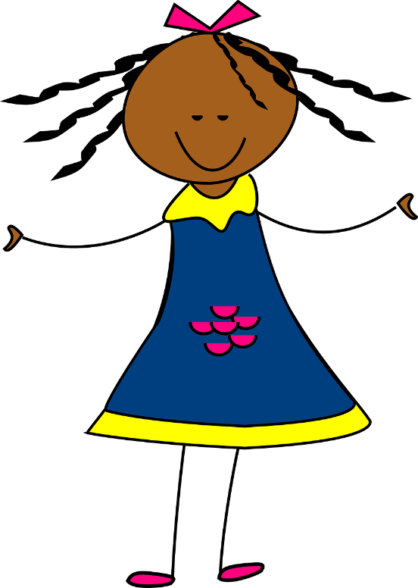
Des virelangues avec [oi]
lire / parler
Parle aussi vite que possible!
Excusez-moi mademoiselle,
éloignez le doigt de la framboise.
[Excuse me miss, move your finger
away from the raspberry.]
A
B
C
Notes:
Timing: 5 mins for 3 slides
Aim: Practise pronunciation of SSC [oi] in the form of tongue twisters
Procedure:
1. Students read the sentences aloud, aiming for accurate pronunciation as quickly as possible.
2. Click audio buttons to hear three different speeds (A = slowest, C = fastest)
3. Repeat on next three slides for three more tongue twisters
Transcript:
Excusez-moi mademoiselle, éloignez le doigt de la framboise.
Word frequency (1 is the most frequent word in French): excuser [1987], mademoiselle [3148], éloigner [1541], framboise [>5000]
Source: Londsale, D., & Le Bras, Y. (2009). A Frequency Dictionary of French: Core vocabulary for learners London: Routledge.

Slide 18
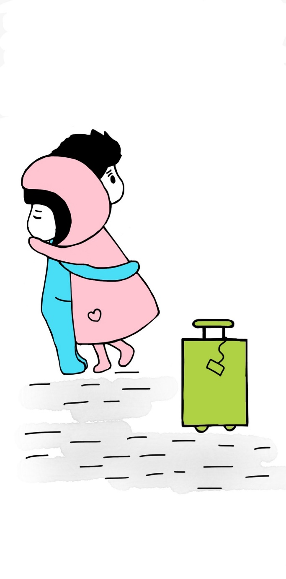
Des virelangues avec [oi]
lire / parler
Parle aussi vite que possible!
On se dit au revoir le soir, toutefois on va se revoir.
[We say goodbye in the evening,
nevertheless we will see each other again.]
A
B
C
Notes:
Slide 2/3
Aim: Practise pronunciation of SSC [oi] in the form of tongue twisters
Procedure:
1. Students read the sentences aloud, aiming for accurate pronunciation as quickly as possible.
2. Click audio buttons to hear three different speeds (A = slowest, C = fastest)
3. Repeat on next three slides for three more tongue twisters
Transcript:
On se dit au revoir le soir, toutefois on va se revoir.
Word frequency (1 is the most frequent word in French): se [17], toutefois [770], revoir [1274]
Source: Londsale, D., & Le Bras, Y. (2009). A Frequency Dictionary of French: Core vocabulary for learners London: Routledge.

Slide 19
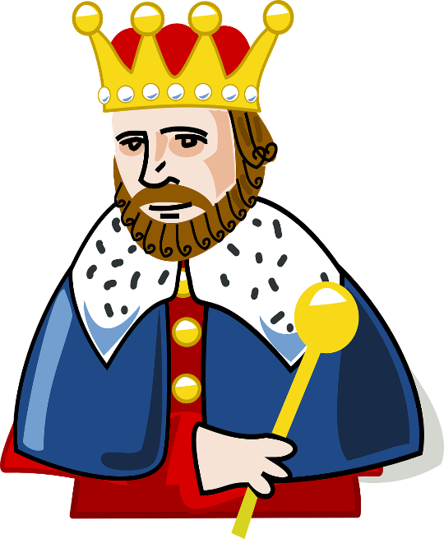
Des virelangues avec [oi]
lire / parler
Parle aussi vite que possible!
Il fait froid lorsqu’on s'assoit à la droite du roi.
[It is cold when you sit to the right of the king.]
A
B
C
Notes:
Slide 3/3
Aim: Practise pronunciation of SSC [oi] in the form of tongue twisters
Procedure:
1. Students read the sentences aloud, aiming for accurate pronunciation as quickly as possible.
2. Click audio buttons to hear three different speeds (A = slowest, C = fastest)
3. Repeat on next three slides for three more tongue twisters
Transcript:
Il fait froid lorsque on s'assoit à la droite du roi.
Word frequency (1 is the most frequent word in French): lorsque [256], se [17]. asseoir [1360], roi [1364]
Source: Londsale, D., & Le Bras, Y. (2009). A Frequency Dictionary of French: Core vocabulary for learners London: Routledge.

Slide 20
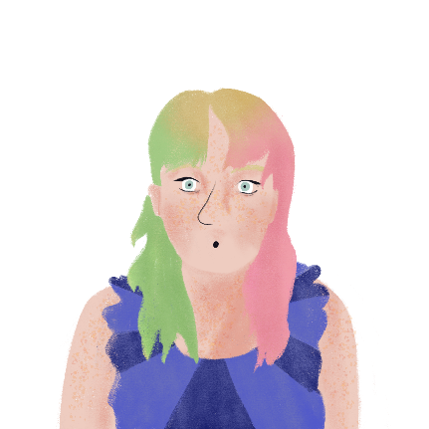
La fréquence de crime
Léa et Stéphanie écrit des messages sur le crime. Lis et réponds aux questions en anglais.
lire
Il y a beaucoup de vols ici à Paris ! On a besoin de faire attention à la sécurité. Je lis un article dans le journal qui dit que la fréquence de crime à Paris est deux fois plus haute que dans les autres régions. Selon toi, il y a moins de criminels à la campagne ?
How does the crime rate in Paris compare to other regions?
How does Léa know?
How did Stéphanie find out about crime in Touraine?
What two types of theft are common in Touraine?
What must you do if you’re a tourist in a café?
twice as high
She’s reading an article
She phoned her friend who works for the police there.
fraud and stealing from tourists
keep your phone and money close
Selon moi, c’est plus sûr en Touraine. J’ai regardé l’article avant toi, et j’ai téléphoné à un ami qui travaille pour la police à Loches, une petite ville en Touraine. Il dit qu’il n’y a pas beaucoup de criminels en Touraine, mais il y a des gens qui volent de l’argent par l’escroquerie*. Après le printemps, il faut expliquer aux touristes qui viennent qu’ils ont la responsabilité d’empêcher les vols. Tu dois savoir qu’une personne qui approche ta table dans un café peut être un voleur*, et tu dois avoir ton portable et ton argent toujours proche de toi.
*l’escroquerie (f.) = fraud
*le voleur = thief
Notes:
Timing: 10 minutes
Aim: Written comprehension of new vocabulary in context
Procedure:
Students read the messages and answer the questions in English.
Click to reveal answers.
Ensure understanding.
Word frequency of unknown words used (1 is the most frequent word in French): escroquerie [>5000], voleur [3163]
Word frequency of cognates used (1 is the most frequent word in French):
article [604], police [829], touriste [2653]
Source: Lonsdale, D., & Le Bras, Y. (2009). A Frequency Dictionary of French: Core vocabulary for learners London: Routledge.

Slide 21
Verbs + à/de + noun
grammaire
Remember, some verbs are followed by à or de before a noun. The forms of à and de change before masculine and plural nouns:
Il envoie la lettre au professeur
He sends the letter to the teacher.
Elle donne les glaces aux garçons.
She gives the ice creams to the boys.
Nous jouons du piano.
We play the piano.
Que pensez-vous des livres ?
What do you think of the books?
Notes:
Timing: 1 minute
Aim: Recap of verb + à + noun and verb + de + noun
Procedure:
Click to reveal explanations and examples.
Ensure understanding.

Slide 22
Un vol
écouter
Deux hommes qui travaillent pour la police parlent d’une vidéo du vol des portables de Léa et son père. Écoute et choisis le bon mot.
Q |  |  | anglais | R
 | père | voiture | approaches the car
 | portable | porte | knocks on the door
 | délinquant | homme | doesn’t pay attention to the criminal
 | homme | mère | is showing a photo to the mother
 | délinquant | homme | answers the man
 | délinquant | homme | gives her phone to the criminal
 | père | mère | steals the phone from the father
 | homme | professeur | looks like the man who lives near here
1
1
2
2
3
3
4
4
5
5
6
6
7
7
8
8
Notes:
Timing: 10 minutes
Aim: Aural recognition of verb + à + noun and verb + de + noun
Procedure:
1. Click the buttons on the left to play audio.
2. Students tick the correct word.
3. Click to reveal answers.
4. Students listen again and write the English.
5. Click to check answers.
6. Click the buttons on the right to play full audio.
Transcript:
L’homme approche de la [voiture].
Il frappe à la [porte].
Le père ne fait pas attention au [délinquant]
parce qu’il montre une photo à la [mère],
mais la fille répond à l’[homme].
Elle donne son portable au [délinquant],
et il vole le portable au [père].
Le délinquant ressemble à l’[homme] qui habite proche d’ici.

Slide 23
Une interview
Lis l’interview et écris V (vrai) ou F (faux) pour chaque phrase.
lire
Philippe, tu fais un long voyage. As-tu des amis avec toi ?
Oui, j’ai deux amis qui voyagent avec moi. Nous allons avoir de bons souvenirs ! Nous avons un sac qui contient des symboles de nos voyages en Afrique, en Asie, et en Europe, et maintenant nous visitons la campagne de la province de Québec.
Selon toi, le crime est-il un danger pour les jeunes qui voyagent ?
Oui, mais nous faisons attention à la sécurité. Nous ne sommes jamais seuls. Mes amis ne sortent jamais sans moi. J’ai toujours mon portable avec moi, et je mets mes dollars dans un sac, mais si je perds une de ces choses, je peux emprunter un portable ou de l’argent à mes amis.
Connais-tu une personne qui est allée au Québec avant toi ?
Non, mais mon frère veut venir au Canada après moi. Selon moi, il va aimer les habitants qui montrent la cuisine québécoise aux étrangers. La population québécoise fait des plats qui sont délicieux !
Philippe is travelling alone.
He has been to Africa.
He can always make a phone call, even if he loses his phone.
His brother has been to Canada.
He doesn’t like the food in Quebec.
He thinks his brother will agree with him about the food.
F
V
V
F
F
V
Notes:
Timing: 10 minutes
Aim: Written recognition of emphatic pronouns moi and toi, verb + à + noun, and verb + de + noun
Procedure:
1. Students read the interview and decide whether each statement is true or false.
2. Click to reveal answers.
3. Oral translation of text.

Slide 24
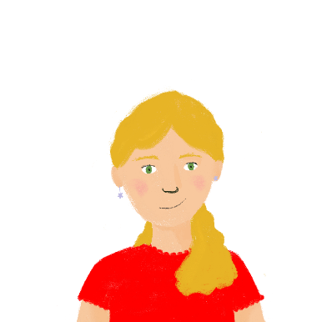
La sécurité
*le conseil = piece of advice
écrire
Léa a trouvé un article en anglais qui donne des conseils* pour combattre le crime. Traduis l’article en français.
La sécurité pour les jeunes
Tu dois toujours avoir ton portable avec toi.
S’il y a un vol, tu ne dois jamais approcher la personne qui vole.
Tu dois téléphoner à la police pour dire « il y a un vol près de moi ! ».
Tu dois vite remettre ton portable dans ton sac.
Tu dois envoyer un message à un ami qui est près de toi pour dire « tu ne dois pas partir sans moi ! ».
Safety for young people
You must always have your phone with you.
If there is a theft, you must never approach the person who is stealing.
You must phone the police to say « there is a theft near me! ».
You must put your phone back in your bag quickly.
You must send a message to a friend who is near you to say « you must not leave without me! ».
Notes:
Timing: 10 minutes
Aim: Written production of emphatic pronouns moi and toi, relative pronoun qui, verb + à + noun, and verb + de + noun
Procedure:
1. Students translate the text into French.
2. Click to check the answers.
Word frequency of unknown words used (1 is the most frequent word in French): conseil [577]
Source: Lonsdale, D., & Le Bras, Y. (2009). A Frequency Dictionary of French: Core vocabulary for learners London: Routledge.

Slide 25
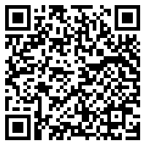
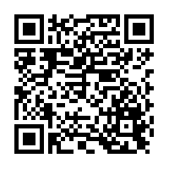
Devoirs
Vocabulary Learning Homework (Y9, Term 2.2, Week 1)
Audio file
Audio file QR code:
Quizlet link
Quizlet QR code:
In addition, revisit: Year 9 Term 1.2 Week 7
Year 9 Term 1.1 Week 7
Notes:
The answer sheet for the 9.2.2.1 vocabulary learning homework is here: https://resources.ncelp.org/concern/resources/c534fq30w?locale=en

