Slide 1
NCELP Grammar TRG
Notes:
PRIOR TO THE TRG SESSION: Hub teachers must have read the two handouts (Handout 1: What determines the difficulty of grammar. Handout 2: Principles of teacher grammar) and the 5 OASIS SUMMARIES before attending the TRG session, as these handouts form the basis of the discussion throughout the session.

Slide 2
Aims of the session
Develop an understanding of the research evidence relating to L2 grammar teaching and learning
Develop more concrete ideas for teaching grammar, including how to introduce, embed and consolidate, and extend grammar knowledge
Explore some of the NCELP resources and approaches for grammar learning
Understand the ways in which you will work with the Lead Schools to develop practice in this area
Rowena Kasprowicz & Emma Marsden
Notes:
Introduction to TRG: Aims of this session

Slide 3
Content of the session
Key issue 1: What grammar to teach and when
(determining the difficulty of grammar; order of teaching; setting and managing expectations)
2. Key issue 2: Principles of how to teach grammar (and the concerns!)
Summary of key principles for grammar teaching
Sample resources
Hands-on classroom activity development
Grammar teaching discussion document for observing lessons
Update on scheme of work
Rowena Kasprowicz & Emma Marsden
Notes:
Content of the session
Parts 1 - 3 should take about 45 minutes – these are the ground work, about underpinning principles.
Please ensure we move on to parts 4 - 7 as these include examples of resources and hands on activities.
Suggested timings for delivering the TRG. NB Please amend depending on the length of your session. This suggested timing assumes a 3 hour session:
1: Brief summary of key principles: max 5 minutes – just read it through - all this will be covered again in the session
2. Key issue 1 – about 20 minutes, including handout 1 (determining difficulty)
3. Key issue 2 – about 25 minutes, including handout 2 (principles of teaching) and ‘concerns’ (the activity critiquing grammar presentation and practice in some textbooks)
4. Sample resources – about 1 hour 15 mins in total – depending on the languages of the teachers you have, but try to present examples of each language, and examples of morphology (inflections for person, number, tense) and syntax (questions, negation).
The question word slides should also be shown. These are important, and they link to the vocabulary CPD, and will be necessary for when more complex questions are being taught.
5. Hands-on activities and resource development - about 30 minutes (15 mins on listening and/or reading; 15 mins on speaking and/or writing)
6. Grammar teaching discussion (observation record) – about 20 minutes, including discussion
7. Update on SoW – no more than 5 minutes – keep this brief – it could turn into a long discussion but there will be opportunity for this in later CPD
Summary of what covered at end - 5 minutes
This leaves a bit of time for slippage and extra discussion/ questions etc. but not much at all! Pace will be important, as always.
Please remind them to complete the feedback survey at the end – your Hub teachers should have received a link. If they can complete the survey there and then, that would be ideal.

Slide 4
Key issues
Key issue 1: What order should grammar be taught in?
What determines the difficulty of grammar?
What grammar can we expect learners to use, and when?
Key issue 2: What are the best ways to teach grammar?
Effective ways to introduce, embed and consolidate, and extend grammar
Rowena Kasprowicz & Emma Marsden
Notes:
We will cover these key areas
So the first Key issue relates to the notion of progression: what should be taught when, what can we expect learners to learn, when – that is, can we determine the difficulty of grammar to put it in a sensible order for teaching?
The second key issue is about effective methods for teaching grammar

Slide 5
Key issues: But first… is grammar teaching useful? Yes!
Even after 100s of hours of exposure to an L2, learners still struggle with certain grammar
Lots of evidence that explicitly teaching grammar can be beneficial
Explicitly teaching grammar tends to be more effective than waiting for learners to pick up grammatical patterns themselves
Brief description of the grammar before practice can speed up the rate of learning
(e.g. Kasprowicz & Marsden, 2018; Lichtman, 2016; Marsden, 2006; Norris & Ortega, 2001; Schmidt, 1990; Spada & Tomita, 2010; White, Spada, Lightbown, & Ranta, 1991)
For evidence, see summaries of research into grammar teaching: on OASIS or NCELP Resource Portal.
Rowena Kasprowicz & Emma Marsden
Notes:
We first just emphasise the importance of explicit grammar teaching. It is important to point this out because: whether or not to teach grammar has been under debate for several decades in foreign language education and, as a result, messages have not always been clear in policy documents, in textbooks, or across different schools and classrooms.
Point out that the 4 references in bold are those that are included in the 5 OASIS summaries that were sent to Hub teachers before the TRG session.

Slide 6
Key issue 1: What order should grammar be taught in?
There is little strong evidence to support one prescribed order for teaching grammar
Many factors affect what can effectively be taught and learnt and when (e.g. the grammar feature, learner characteristics, task modality, context)
But we do know…
The introduction of whole ‘paradigms’ at once has little support from research
Learners can only pay attention to a limited number of features at any one time
Introducing and practising pairs of grammar features with contrasting meanings (or functions) can lead to accurate understanding and production of the grammar features.
Regular practice and re-visiting are necessary
(DeKeyser, 2005; DeKeyser, 2015; Ellis, 2006; Mitchell, Myles, & Marsden, 2019; VanPatten, 2004)
Rowena Kasprowicz & Emma Marsden
Notes:
Summarising What we know (or don’t know!) about the order grammar should be taught
*Re. bullet point 2 - On next slide going to talk more about factors that can make grammar difficult to learn.
Reference in bold is included in the 5 OASIS summaries that will be sent to teachers for the TRG sessions
Some extra information for the TRG deliverers about the avoidance of whole paradigms. There is no need to dwell on this but we put it here for your information, in case Hub teachers ask. This is a really important message and should not be diluted, as hedging is likely to reduce the clarity and impact of the message. The evidence and arguments for this are also explained in the ‘what makes grammar difficult’ document. The evidence is multi-layered, drawn from multiple sources and even multiple disciplines.
Explicit information (i.e., ’rules about language’) in and of itself, no matter when, how or what is taught, is not as effective as the practice itself. Whether explicit information is given as a whole paradigm or whether it is before or after practice, or given by teachers or worked out by learners is less important than the nature and the amount of practice. It is the practice that has been found to help: Making grammar essential for comprehension and production is where the most benefits lie (not in the explicit information) – so, in a way, this debate is not important, and, if dwelt upon, could seriously detract attention from the much, much more important messages. But for the sake of argument… here are some additional points:
Explicit information is prone to decay over time.
Explicit information alone does not result in evidence of learning in different contexts, modes and modalities (evidence from the old grammar translation approaches).
The usefulness of explicit information is very variable for different learners.
There is ample evidence in cognitive psychology and language learning research that presenting whole new sets (of anything) all at once cannot be expected to result in robust or reliable learning in the longer term.
The conceptual and formal complexity of (and, often, lack of familiarity with) morphology is an additional reason not to expect ‘whole paradigms’ per se to really show many learning benefits, compared to other more conceptually-oriented presentations, which focus on the meaning and function of grammar.
Languages are not learnt in whole sets as these are artificially put together by grammarians (that are based on the early teaching of Latin).
There is evidence from cognitive linguistics that it is awareness and understanding of concepts that are often not reliably, overtly expressed in the L1 (such as plurality of subjects; temporal such as ‘complete in the past’; or ‘doubt’; habituality) that can help learning. ‘Paradigms’ (within one of these ‘concepts’, such as ‘past complete’) do not serve the aim of teaching learners about the function of grammar.
In a time-poor classroom, giving (a lot of) explicit information is unlikely to be an efficient use of time
It risks confusing or overloading many learners during the initial presentation stages
It sets unrealistic expectations about what has really been learnt.
Grammar is learnt by frequent re-visiting and practising, and its success depends on a much wider range of factors than ‘whether the inflections happen to fit together in one paradigm’.
By sending the message that whole paradigm teaching is very unlikely to be effective (in terms of robust, reliable learning, in all modes and modalities, in the long term memory), we are helping teachers to set their expectations more realistically.

Slide 7
Key issue 1 (continued): What grammar can we expect learners to use, and when?
Learners need to understand the meaning (or function) of grammar before producing it
There is often a difference between the grammar learners understand (in reading or listening) and the grammar learners can produce accurately (in speech or writing)
The grammar learners can produce in writing is often different from the grammar they can use in (more spontaneous) speaking
Once knowledge has been practised, it can become “skill-specific”
This means that it can be less useful for other skills: if it has been practised and proceduralised for one purpose, the knowledge is less transferable to other purposes
Therefore, learners need lots of practice in both modalities (oral and written) and both modes (comprehension and production)
(Bui & Skehan, 2018; DeKeyser, 2015; Mitchell, Myles, & Marsden, 2019; VanPatten, 2004)
Rowena Kasprowicz & Emma Marsden
Notes:
Key issue 1: What we can expect from learners

Slide 8
Key issue 1, (continued): Determining the difficulty of grammar
What determines the difficulty of grammar?
Summing up the last two slides, please review the Handout 1, “What determines the difficulty of grammar in a second language?”
Discussion around Handout 1:
Which grammar features do your pupils (in years 7, 8 & 9) find difficult?
How do you know they find it difficult? Across all modalities/modes?
Based on the factors mentioned in the handout, why do you think those features cause difficulty?
Rowena Kasprowicz & Emma Marsden
Notes:
Key Issue 1: Determining the difficulty of grammar (going deeper on the key recommendations from NCELP)
Direct Hub teachers to Handout [1] What determines the difficulty of grammar in a second language. They should have been sent this ahead of the TRG session and been asked to read it. But give time for the Hub teachers to skim through again to refresh themselves (about 5 or 10 minutes) and ask questions.
REFLECTION QUESTIONS:
Ques 1) which grammar features do your pupils particularly struggle with? Based on the factors mentioned in the handout, discuss why the features mentioned cause particular difficulty.
Ques 2) Follow on question: what does the information in this sheet mean for ordering/SoW planning? More difficulty could mean teach it later OR introduce it sooner, of course! Sooner, with lots of revisiting and practice, might help to give more exposure; BUT if it is too conceptually or formally (e.g. the form of new sounds or spellings) difficult, then sooner might NOT be sensible before other types of knowledge are in place.
The important point is: having some understanding of difficulty helps manage our expectations – it is essential for when we are testing knowledge and it informs our thinking about what we teach and how we teach it.
Note that once the Hub teachers have seen the example resources, some possible orders for teaching pairs of features will start to emerge – NB this only becomes really apparent after seeing some sequences, later in the session.

Slide 9
Key issue 2:
What are the best ways to teach grammar?
Summary of key recommendations:
i. Provide a short description of the grammar before practice in the input
ii. Regularly strip out all other cues so that the learner has to pay attention to the grammar and its meaning in the input (in reading and listening)
iii. Establish grammatical knowledge in reading and listening before expecting learners to produce the grammar in writing and speaking
iv. Gradually move from scaffolded production practice to more meaningful, freer production practice
v. Regularly re-visit the grammar feature, in different contexts, with different vocabulary
Read Handout 2
“Principles of teaching grammar”
Discussion around Handout 2: 1) Which elements do you think align with practice in your school?
2) Which elements do you think will be more challenging to establish in your schools?
Rowena Kasprowicz & Emma Marsden
Notes:
Key recommendations about how grammar should be taught
Allow time to remind themselves of the content of Handout 2. ‘Principles of teaching grammar’. This will probably take around 5-10 minutes. They should have been sent them before the session, so this is a chance to skim them and remind themselves.
Show the summary of key recommendations on the slide, before starting the discussion
Then host a short discussion – encourage the Hub teachers to reflect on challenges in their own context.
This might also elicit some challenges that you (STs) have encountered in implementing NCELP’s recommendations following the Grammar CPD.
Keep the discussion about challenges quite short so that it moves quite soon in to focusing on textbooks – the next activity.

Slide 10
Key issue 2: Effective ways of teaching grammar What are the concerns?
Review excerpts from a textbook (see Handouts 3 to 5 with examples)
Reflect on some concerns about how grammar is often presented and practised.
Keep a look out for potential problems, such as :
whole paradigms at once
no or little active (=forced) practice to link grammar to meaning in input
jumping straight from explanation or mere ‘exposure’ to production
production practice that is mechanical, e.g.,
doesn’t force learners to actively choose which grammar is needed;
practice with just a small, fixed set of vocabulary.
Rowena Kasprowicz & Emma Marsden
Notes:
Handout 3, 4, 5– printed excerpts from textbooks (3 A3 print outs – one for each language)
In the light of the handout you have just read about principles of grammar teaching, reflect on discussion about common difficulties / challenges with the way grammar is presented in textbooks.
Give Hub teachers the opportunity to review and discuss the textbook excerpts, before displaying and talking through the concerns listed on the slide.
Please see slides 172, 173, 174 with annotated versions of the textbook excerpts, which highlight some of the key concerns explained on the slide and below.
The handouts are the excerpts that were used at the Residential. These textbook example activities illustrate 5 key concerns:
INPUT BASED ACTIVITIES THAT DON’T ACTUALLY ORIENT/FORCE LEARNERS’ ATTENTION ON THE GRAMMAR, AS THEY ALLOW THEM TO ANSWER WITHOUT REALLY HAVING TO ATTEND TO THE FEATURE
WHOLE PARADIGMS BEING PRESENTED ALL AT ONCE with no clear follow up to practise them all in meaningful ways
SWIFT MOVES FROM GRAMMAR EXPLANATION TO PRODUCTION PRACTICE;
PRODUCTION PRACTICE THAT IS ‘MECHANICAL’ – THE ACTIVITIES DON’T FORCE THE LEARNER TO ACTIVELY CHOOSE BETWEEN DIFFERENT GRAMMATICAL FEATURES (E.G. THEY MIGHT SAY ‘DESCRIBE WHAT YOU DID LAST WEEKEND’ OR ‘DESCRIBE YOUR FRIEND’S APPEARNACE’ OR ‘YOUR IDEAL X’ – BUT THEY DON’T ENSURE DIFFERENT FEATURES NEED TO BE ACTIVELY CHOSEN (INSTEAD, LEARNERS CAN COPY FROM A FRAME, OR MECHANICALLY REPEAT A PATTERN THEY HAVE JUST BEEN TOLD ABOUT, WITHOUT CONNECTING TO A MEANING (OR FUNCTION) EACH TIME THEY USE IT).
PRACTICE IS JUST WITH A SMALL SET OF VOCABULARY WITHIN ONE TOPIC E.G. ‘PAS’ JUST PRACTISED WITH ‘AIMER’, OR PAST TENSE (EVEN PERHAPS IN ONE OR TWO ‘PERSONS’) WITH JUST 3 OR 4 VERBS ABOUT HOLIDAY ACTIVITIES AND THEN NOT REVISITED LATER WITH A WIDER RANGE OF VERBS
It might be helpful to explain that when we talk about textbooks, we note that:
They are space-limited and they should not represent all the teaching that needs to take place. Using them requires judicious selection, omission, independent planning. Teachers should not feel that they need to slavishly follow the book's own SOW, cramming the pages in without really thinking about what is realistic for learners to learn. Planning should always 'step away from the textbook', whichever textbook it is, both longer term planning but also day-to-day reflection about the sort of opportunities for practice that learners need (this applies to all of our strands: phonics, vocabulary, grammar and MP).

Slide 11
Summary of key principles for teaching grammar
To help learners connect grammatical features to their meaning (or function) in order to develop accurate use across modalities (oral and written) and modes (comprehension and production), it is important to:
Focus on pairs or very small sets of features and avoid introducing and practising whole paradigms at once, especially in the early stages.
Provide a short, explicit explanation
Strip out other cues so that the learner has to pay attention to the grammar and its meaning in the input (reading / listening)
Establish and practise grammatical knowledge in reading and listening
Give plenty of practice in producing the grammar in writing and speaking activities that make the grammar matter to communicate meaning
Gradually move from scaffolded production practice to more meaningful, freer production practice
Rowena Kasprowicz & Emma Marsden
Notes:
Summary of parts 1 and 2: Aims of teaching grammar and six key considerations
NB: These are NCELP’s key ‘take-home’ messages and recommendations for grammar learning
Give teachers a chance to read through these key principles and recommendations. Before moving onto the next section containing example resources which exemplify these key principles.
*explanation first – most reliable for most learners most of the time
*Pre-emptive – anticipating the features learners will have difficulty with

Slide 12
Content of sample resources
Explanation
Reading
Listening
Writing (controlled)
Speaking (controlled)
Rowena Kasprowicz & Emma Marsden
Notes:
How to teach and learn grammar
We now provide examples of sequences of activities for each of the languages: Spanish, French & German
For each language we will present at least one full sequence:
Explanation
Reading
Listening
Writing (controlled)
Speaking (controlled)
But we will also provide examples of other grammar features, to show how the principles can be extended to a range of features, modes, modalities.
We give examples of 1) verb morphology (that is, verb inflections for person, number, tense) and 2) for syntax (S V order in French) and negation in Spanish.
NCELP also have developed or are currently developing materials for adjectival agreement, for articles, for aspect (imperfect in French - whether something is ongoing or complete).

Slide 13
Example resources for French
Explanation
Reading
Listening
Writing (controlled)
Speaking (controlled)
Rowena Kasprowicz & Emma Marsden
Notes:
How to teach and learn grammar
Go through and discuss example sequence of resources in each language (different grammar features across the three languages).
Please note: There will always be a ‘vocabulary challenge’ with the move from input (R/L) activities to production (W/S) activities, in terms of the vocabulary (nouns, prepositions, adjectives etc) that will be needed for production activities.
The aim is to let learners try to recall the necessary vocabulary (i.e., not always provide whole speaking or writing frames for everything).
But, where necessary, more scaffolding is possible (we have provided lists of vocabulary for teachers to use with selected pupils, perhaps)
Try to focus on rewarding the grammar point under focus, and not worry too much about everything else being accurate . If we want everything to be accurate all the time, this is what leads to very rigid formulae teaching, and the over-use of strict writing frames that don’t provide any desirable difficulty for the learners.
In other words:
The key is that learners are getting the grammatical markers correct and pulling out the verbs from memory. Support with the other vocabulary is ok (particularly in the earlier controlled production activities) and some errors in this other vocabulary can be tolerated (e.g., adjectival agreement if that hasn’t been taught yet).
Try to aim for ‘desirable difficulty’ and resist the temptation to use lots of frames and holistic phrases.
We will now look at an example sequence of resources for French. We have an example to show you about syntax (question formation, using SV inversion).

Slide 14
Statements vs. Questions
‘You’. 2nd person singular

Slide 15
Extending phase: French
Characteristics of ‘extension’ can include one or more of:
The same grammar but with new vocabulary
new to this sequence of activities, but already familiar to the learners
or, in some situations, a few items of vocabulary could even be entirely new
Providing less support for the learners
Including practice of other grammar features that have been learned previously
Rowena Kasprowicz & Emma Marsden
Notes:
Example of an activity that could be seen as in ‘extending phase’ : Providing examples of meaningful practice, with new vocabulary and little or no support.

Slide 16
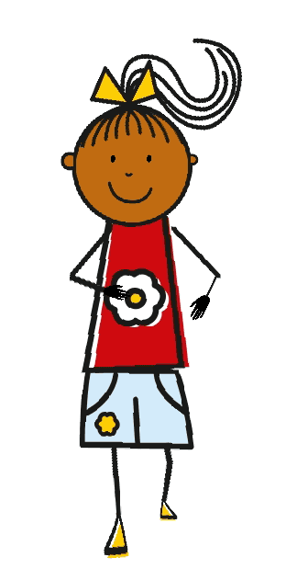
A
B
C
D
E
Victoria Hobson / Emma Marsden / Rowena Kasprowicz / Juliet Park
Notes:
Example of an activity that could be seen as in ‘extending phase’ : Providing examples of meaningful practice, with new vocabulary and little or no support.
EXTENSION with other vocabulary.
This slide challenges the learners’ ability to apply the statement vs question formation with other activities that have not yet been revised.
Note, some learners may need to see some vocabulary first.
Remember, the focus here is on word order, so if pupils don’t shorten the verb from the infinitive to the 2nd person singular, you can gently correct it but don’t get distracted from the main purpose of this activity. There are other opportunities to work more on verb endings, but in this activity, try to focus on whether or not the word order and intonation express a question or a statement.
This session could then lead to pairwork activities (“Bingo” and “All Activities”).

Slide 17
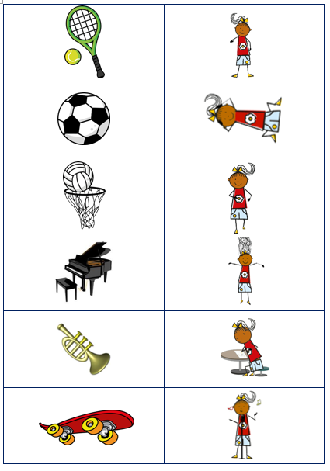
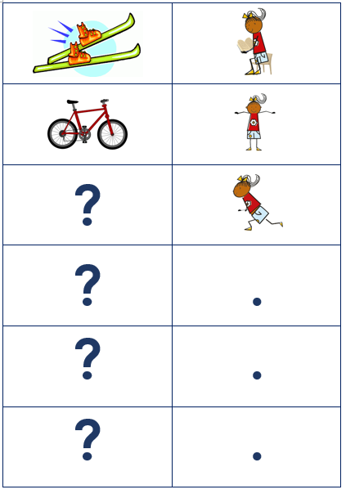
Pair Work
Bingo cards (see next slide)
All activities cards →
Victoria Hobson / Emma Marsden / Rowena Kasprowicz / Juliet Park
Notes:
BINGO, forcing learners to produce and notice word order to indicate questions.
Hand out Bingo cards to learners in pairs, one receives the Partner A cards and one receives the Partner B cards. Each learner should first of all fill in appropriate sentences for each picture in the top grid, taking note of whether it is a question (question mark) or a statement (tick). Once the learners have filled in the cards, they should take it in turns to read at random one of the statements from the eight pictures. Using the bottom grid, the partner should listen to each utterance, work out which picture is being referred to and then add a tick or a question mark. They should take it in turns to do this and once all eight utterances have been read out they should check their answers to see if they have added the correct symbol.
ALL ACTIVITIES, forcing learners to produce and notice word order to indicate questions
Learners could then be given the All Activities cards which contain all images plus full stops and question mark. Students could put the punctuation symbols upside down into one pile and turn the activity cards upside down into another. Each learner should take it in turns to select a card from each pile and either read the activity as a statement or a question! Their partner has to answer ‘oui’ or ’non’ if it is a question. But if it is a statement, they do not need to answer.
You could ask them to use robotic voices when they make their statements or questions, so that their partner really has to listen out for the word order, and can’t use intonation as a clue at all.
They should replace the punctuation cards underneath the pack each time.

Slide 18
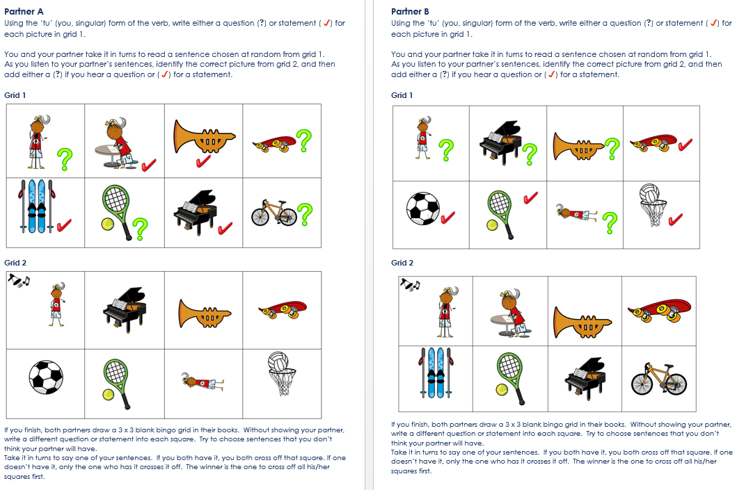
Notes:
Screen shot of the Bingo game

Slide 19
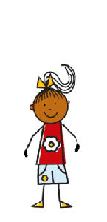
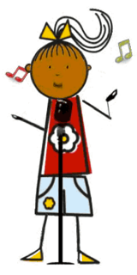
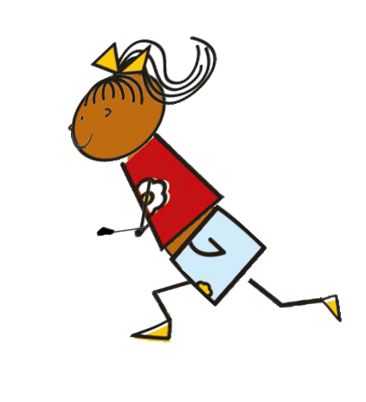
jouer au basket
jouer au football
jouer au tennis
jouer de la trompette
jouer du piano
faire du skate
faire du vélo
faire du ski
chanter
marcher
dessiner
courir
nager
sauter
Victoria Hobson / Emma Marsden / Rowena Kasprowicz / Juliet Park
Notes:
Vocab help sheet
Some students may need reference to the infinitives during the pair work activities.
Verb frequency rankings (1 is the most common word in French): jouer (219); faire (25); chanter (1820); marcher (1532); dessiner (2086); courir (1447); nager (>5000); sauter (2114).
Source: Londsale, D., & Le Bras, Y. (2009). A Frequency Dictionary of French: Core vocabulary for learners London: Routledge.

Slide 20
Example resources for German
Explanation
Reading
Listening
Writing (controlled)
Speaking (controlled)
Rowena Kasprowicz & Emma Marsden
Notes:
How to teach and learn grammar
Now going to look at sequence of activities for teaching the perfect tense in German

Slide 21
German – Perfect tense
Explanation and activities

Slide 22
Example resources for Spanish & How to create a grammar sequence
Explanation
Reading
Listening
Writing (controlled)
Speaking (controlled)
Rowena Kasprowicz & Emma Marsden
Notes:
We’re now going to look at a sequence of resources for teaching Reflexive ‘me’ in Spanish.
This sequence will also explain ‘How to create a grammar sequence’. The sequence of resources has been annotated to illustrate useful features to think about and include when designing new grammar teaching resources, based on NCELP’s recommendations.
As you go through this next sequence of resources: you can first discuss the content of the resource itself (as with the previous sequences), and then show the annotations explaining how the resource was created.

Slide 23
Reflexive ‘me’:
Doing something to yourself

Slide 24
Use of standard grammatical terminology is fine. This draws on and extends knowledge from KS2.
Reference can be made to pupils’ L1. This is especially useful if there are L1-L2 differences.
Provide a short, explicit explanation of meaning (or function) and form.
It is fine to teach part of a rule and then add a variation later. Teachers can decide whether to include the ‘something to know more later’ in their explanation.
Bold / underlining can be used to highlight L1-L2 grammatical connections.
Focus on a pair or very small set of features (e.g. verb with reflexive ‘me’ vs verb without reflexive ‘me’), particularly at the early stages. Examples are essential!
Notes:
Show the grammar explanation first, then click to display the annotations.
Teachers can skip the speech bubble if they wish. It is ok to teach part of a rule and then add a variation later. Or you might want to mention this here now. Either way, just giving this information here or not, won’t make much difference to learning, as the pupils will just practise the reflexive pronoun ‘before the verb’ here.

Slide 25
Use of animation: the teacher clicks to reveal the English translation (needs to be in a separate textbox to enable animation).
This allows for interactive elicitation during the explanation.
Notes:
Ask the pupils: Imagine: When might you say ‘I talk to myself’ ?!
When might you say you ‘write to yourself’? Ever write yourself reminders, or send yourself a text to remind yourself to do something?
You will get some fun answers. The idea is to convey that ‘notion’ of reflexiveness.
It can be applied to any verb, really! You just need a context for it to make sense.

Slide 26
Further examples are optional. Here we use them to show that many common verbs can be reflexive.
A one-slide explanation is sufficient to introduce most grammar features.
Notes:
Notice that in English, we don’t always say the reflexive pronoun - we assume it!

Slide 27
Esteban is a carer and has written an anonymous article about his daily life.
Some language might be missing.
leer
Read the sentences and tick true or false.
1. Me levanto a las ocho
 | True | False
2. Despierto a las siete.
Esteban gets up at eight am
✔
Esteban wakes up at seven am.
✔
3. Lavo a las nueve.
4. Saco fotos
He washes someone else at nine am.
✔
5. Me preparo un café
He takes photos of himself.
✔
6. Llamo
He makes someone else a coffee.
✔
7. Me escribo
He calls someone else.
✔
8. Enseño español
He writes to someone else.
✔
9. Quemo
He teaches himself Spanish.
✔
10. Me presento
He burns something (!)
✔
He introduces himself to someone.
✔
Nick Avery / Emma Marsden / Rachel Hawkes
Notes:
This slide shows the reading activity. The next slide explains key features of the task.
Verb frequency rankings (1 is the most frequent word in Spanish):
levantar [354]; despertar [894]; lavar [1676]; sacar [273]; preparer [570]; llamar [122]; escribir [198]; enseñar [610]; quemar [1648]; presentar [235].
Source: Davies, K. and Davies, K. (2018). A frequency dictionary of Spanish: Core vocabulary for learners (2nd ed.). London: Routledge

Slide 28
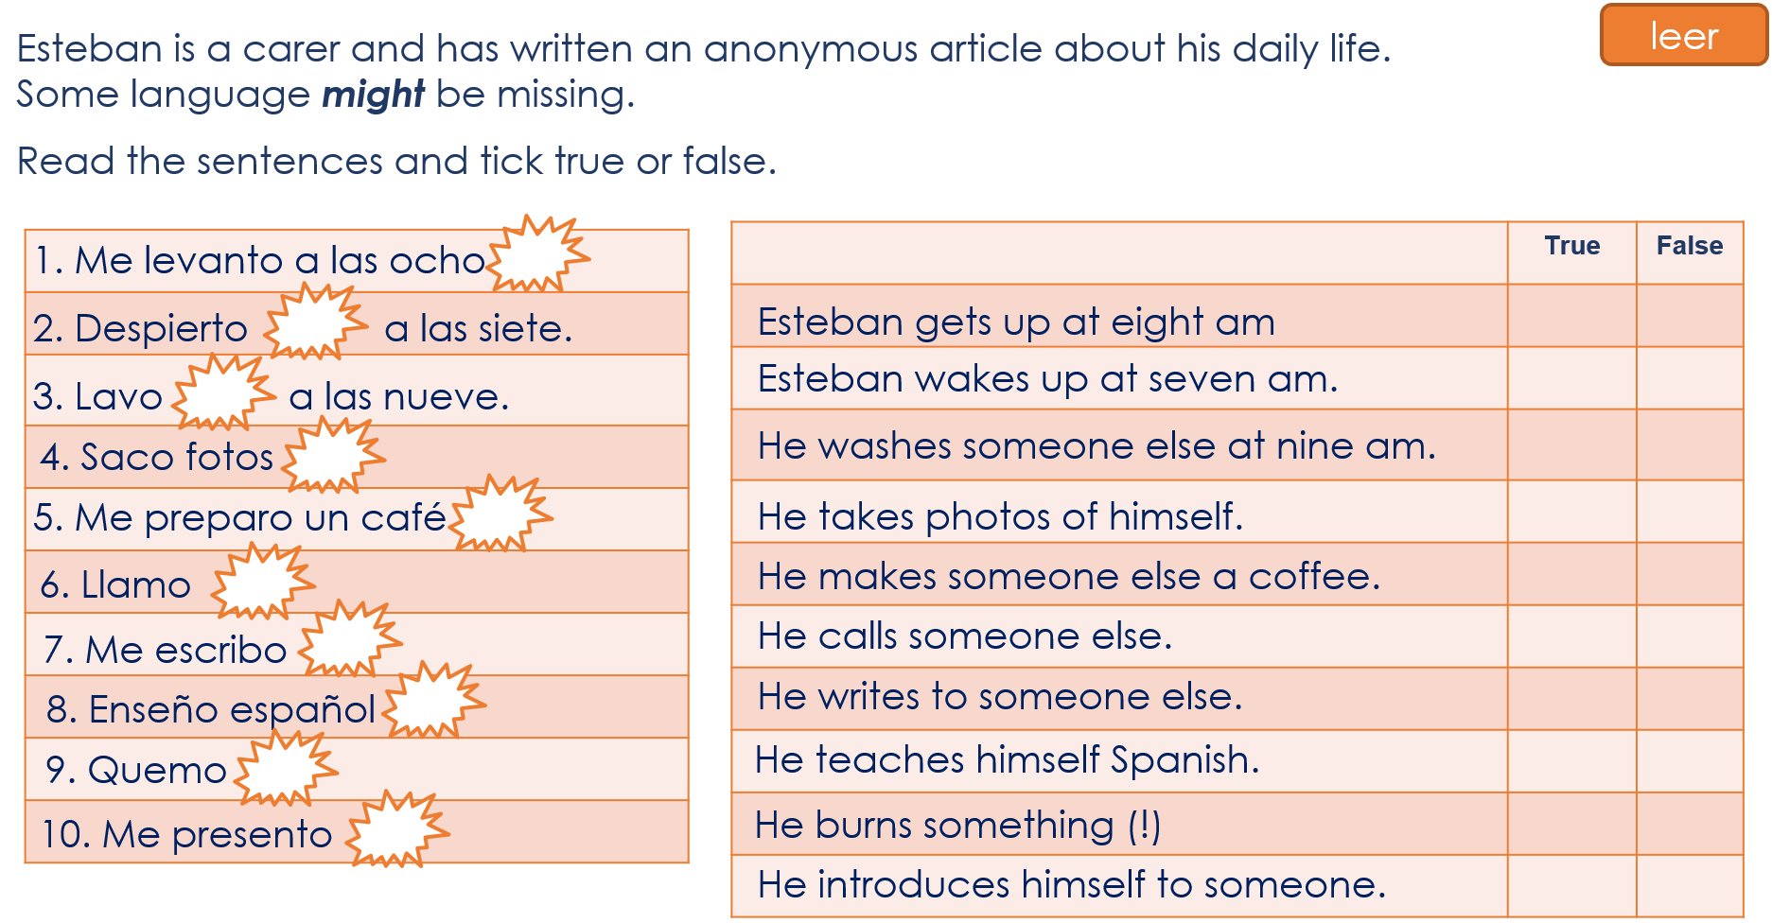
Wherever possible, use meaningful contexts.
Begin with reading and listening activities to establish and practise grammatical knowledge.
Remove cues so that learners have to pay attention to the grammar feature to complete activity.
Tip: Part of a sentence can be ‘missing’. In this case, we removed the names of the people who were the objects of the action as this is an obvious cue for understanding ‘action done to other person’.
Statements in true/false activity require an active choice between ‘action done to self’ and ‘action done to other person’.
Notes:
Click to display each annotation

Slide 29
The tables for most practice activities are simple. Students can simply write 1-10 in their books to avoid printing!
Notes:
*Explain listening activity and then click to display annotation.
Blank grid for students. In this activity, students hear a verb with or without reflexive pronoun ‘me’ and have to decide which of two pictures matches it.
Each pair of pictures depicts (1) ‘action being done to (my)self’ and (2) ‘action being done to another person / thing’.
Note that part of each sentence is ‘missing’ and students only hear the verb, with or without reflexive pronoun. This is done to remove non-grammatical cues that learners often rely on for meaning (e.g. an object after a transitive verb).
Verb frequency rankings (1 is the most common word in Spanish): escribir [198]; sacar [273]; preguntar [219]; quemar [1648]; llamar [122]; lavar [1676]; secar [2239]; mirar [125]; levantar [354]; presentar [235].
Source: Davies, M. & Davies, K. (2018). A frequency dictionary of Spanish: Core vocabulary for learners (2nd ed.). London: Routledge.
Transcript. 1. me escribo *noise* / 2. me saco fotos *noise* / 3. pregunto *noise* / 4. quemo *noise* / 5. llamo *noise* / 6. me lavo *noise* / 7. seco *noise* / 8. miro *noise* / 9. me levanto *noise* / 10. me presento *noise*

Slide 30
Example item for listening
An action button can be inserted to play audio in powerpoints (go to insert -> shapes -> action button). Consider using orange to make it stand out.
An active choice is required between the meanings represented by the two pictures (‘action done to self’ versus ‘action done to other person’).
Most NCELP listening and reading practice activities have around 10 items.
It is important to vary the order of picture (a) and (b). E.g. If (a) is always the ‘action done to self’, learners might not have to look at both pictures in order to make a decision.
Notes:
Annotations for listening activity slides.

Slide 31
Ticks can be animated so that students can be given item-by-item feedback.
NB Ticks may need to be within their own textbox for animation to work.
Notes:
Annotations for listening activity answer slide.

Slide 32
Wherever possible, animate instructions so that they appear line by line.
This makes them easier for learners to follow.
Notes:
*Explain writing activity and then click to display annotation.
Students will need to write ‘a mi abuelo’ if the action is done to the grandfather.
Note that in this activity Student A and B’s cards have the same actions – the only difference is the ‘receiver’ of the action.
The activity is designed in this way so that students can then compare what their characters do afterwards (see slide 20).

Slide 33
High-frequency language is chosen for the activity. NCELP word frequency lists can be used to check this.
Note that the prompt cards do not have any Spanish on. We can expect learners to recall the target language themselves here, having already encountered it in the reading/listening activities. The following slide offers help if needed.
Students A and B can exchange information about the same activities, but with differences in meaning that are conveyed by the grammar feature (e.g. reflexive vs non-reflexive meaning).
The same can be done for differences in tense (e.g. past vs present), person (e.g. I vs s/he), number (e.g. singular vs plural) and others.
Notes:
*Show the activity cards for student A and student B. Then click to display the annotations.
Verb frequency rankings: levantar [354]; preparar [570]; sacar [273]; lavar [1676]; escribir [198]; enseñar [610].

Slide 34
This slide can be used as a “revision and knowledge check” before the main activity.
Notes:
Vocabulary support slide for writing activity.
Click to show annotation.

Slide 35
The prompt cards can be designed for learners to complete a grid of four columns (like this one) or a grid of just two columns (Margarita, Simón only)
Here we included four because, at this stage of the activity, the two students are completing the grid together and so can be challenged a little more.
Notes:
*Explain the grid and then click to show annotations.
Blank grid for students
The prompt cards should be turned over when they complete this grid as they should be comparing each other’s sentences. Afterwards, they can turn cards back over to check answers.

Slide 36
The actions on the prompt cards for speaking/listening are the same as in the previous activity (so the lexicon is known), but information about ‘action done to self’ vs ‘action done to other’ has been changed.
But, vocabulary can be varied if other previously learnt words can be used in a meaningful context with reflexive and non-reflexive meaning.
Notes:
Activity cards for Speaking/Listening activity.
Show activity cards and then click to show the annotations.
NB The verbs have been kept the same as in the writing activity, but absence/presence of reflexive pronoun on the prompt cards has been changed.
Verb frequency rankings: levantar [354]; preparar [570]; sacar [273]; lavar [1676]; escribir [198]; enseñar [610].

Slide 37
Here, students have (near-)identical grids; the only difference is ‘himself’ / ‘herself’.
When the response grid for Student A and B is the same, it can be displayed on the board and copied into pupils’ books, rather than printed.
Notes:
On completion of the grid, students can be asked to compare grids and find which two activities they both do to themselves (answer: prepare, coffee, write)

Slide 38
Further resources: Resources portal
Other grammar resources available here: https://resources.ncelp.org
Searchable database.
You will get alerts when new material has been uploaded.
For now, continue to use: https://ncelp.org/resources/resource-portal/
For the phonics, vocabulary, grammar, and residential materials
Eventually, all will be put on the database, and so searchable(☺), using fine-grained search terms and/or the title of the document.
Rowena Kasprowicz & Emma Marsden
Notes:
Show the Resources portal, if there is internet. Explore what is available. Stress we are adding things every day! And teachers in the network will receive alerts when new things arrive!
See also the RESOURCES tab, under Resources Portal, under Grammar

Slide 39
Hands on: Developing resources (R & L)
Activity: Develop a grammar activity
Use the principles you’ve seen illustrated.
Perhaps choose one of the problematic grammar features discussed earlier. Warning! the principles can’t always be applied easily, e.g. to gender on articles in French or German (one coming soon on the portal!). Perhaps think about tense (present versus past, or present versus future)?
Reminders:
Practise pairs of grammar features with contrasting meanings (or functions)
Strip out all other cues that might stop the learner focussing on the grammar features, so that the target grammar features are task-essential
(e.g. a car horn covers the subject pronoun, or a paint splodge obscures the temporal adverb, a
computerised voice strips out intonation that might give a clue to interrogatives)
Make sure that the activities actually provide the feature you are focusing on in the input and make learners use it to interpret meaning
Rowena Kasprowicz & Emma Marsden
Notes:
Developing resources for grammar teaching
About 15 minutes
Now we have reviewed a sequence of grammar teaching resources in each of the three languages.
We are now going to spend some time developing ideas for other resources.
Activity: Split the teachers into 4 groups, working individually or in pairs, to design a R or L or S or W activity (i.e., one activity each). Only a few items need to be designed for each type of activity, e.g., about five example items to illustrate the general point and design of the activity. Allow time for feedback to discuss the activities that have been created, always keeping in mind the key grammar teaching principles discussed in the session. Allow plenty of time for discussing ideas, coming up with example activities and reviewing and discussing together.
This slide provides reminders for those who wish to develop a listening or reading activity for one of the problematic grammatical features discussed earlier in the session (see slides 6 to 8 and discussion of Handout 1). The next slide provides reminders about W and S activities.
If they suggest gender on articles, try to steer them on to something more concrete and more straightforward to do using the principles and examples they have seen today. But, please note, NCELP are putting a resource on the portal very soon relating to gender in articles.
However, adjectival agreement for gender IS very doable with the kind of L & R activities we have seen here today. For example, the learners hear an adjective (with either a masculine or a feminine agreement) and then have to decide does it belong to the man (e.g. Mr Trump!) or the woman (his wife!).

Slide 40
Hands on: Developing resources (W & S)
Activity: From the examples provided, choose a pair of grammar features in one of the languages and design a writing or speaking activity to add to the sequence.
Reminders:
Make sure the target grammar features are task-essential
Use a meaningful context, where the speaker (or writer) is using the grammar to communicate a message that the listener (or reader) needs to understand
Try to avoid providing all of the language that is needed. Encourage learners to try to recall key verbs etc.
Pictures can be used to prompt particular words, so that learners are given some ideas about what to say
Rowena Kasprowicz & Emma Marsden
Notes:
Developing resources for grammar teaching
About 15 minutes
Activity: Split the teachers into 4 groups, working individually or in pairs, to design one of: a R or L or S or W activity.
This slide provides reminders for those who wish to develop a controlled production practice activity.
2 examples of input practice are provided (one from French, one from Spanish), for one pair of grammar features (or just choose one language if there is consensus in the group). In the slides that follow are L/R activities for tú/vosotros in Spanish and tu/vous in French. Teachers could try to develop W/S tasks to follow on from these.
Teachers can choose one and then develop a writing and/or speaking activity to practise that pair of grammar features.
Key principle: learners must actively select which grammar they need - not a mechanical repetition of one pattern
Getting the grammar right must matter for communication – their partner or the teacher or the other children in the class should have some reciprocal listening or reading activity that demonstrates that the learners who are PRODUCING the grammar have successfully communicated their message - using the grammar. Recall the response grids that were used in the activities you saw just now.

Slide 41
Talking to others: tu and vous
2nd person singular vs 2nd person plural

Slide 42
Talking to ‘you’ vs more than one ‘you’: Verbs with ‘tú’ and ‘vosotros’

Slide 43
Question words! What, when, why, which…
Question words cross over the vocabulary and grammar strands
To teach the formation of wh-questions, learners first need secure knowledge of the question words themselves!
But... common chunks (formulae) often give misleading evidence about the meaning of question words e.g.,
quel age as-tu? ‘quel’ doesn’t generally express English ‘how’!
comment tu t’appelles? ‘comment’ doesn’t usually express English ’what’!
(If such chunks of language are taught, learners need help breaking down such chunks)
Learners need to know the more ‘reliable’ words for frequent question words
Rowena Kasprowicz & Emma Marsden
Notes:
NB: The French versions of two PPTs are inserted here – Questions words introduction and Questions words practice. The equivalent resources exist (and have been uploaded already) for Spanish and German.

Slide 44
French Question words Learning Routine
Images - Steve Clarke

Slide 45
French question words Practice
Images - Steve Clarke

Slide 46
Content of sample resources
Explanation
Reading
Listening
Writing (controlled)
Speaking (controlled)
Rowena Kasprowicz & Emma Marsden
Notes:
How to teach and learn grammar
We now provide examples of sequences of activities for each of the languages: Spanish, French & German
For each language we will present at least one full sequence:
Explanation
Reading
Listening
Writing (controlled)
Speaking (controlled)
But we will also provide examples of other grammar features, to show how the principles can be extended to a range of features, modes, modalities.
We give examples of 1) verb morphology (that is, verb inflections for person, number, tense) and 2) for syntax (S V order in French) and negation in Spanish.
NCELP also have developed or are currently developing materials for adjectival agreement, for articles, for aspect (imperfect in French - whether something is ongoing or complete).

Slide 47
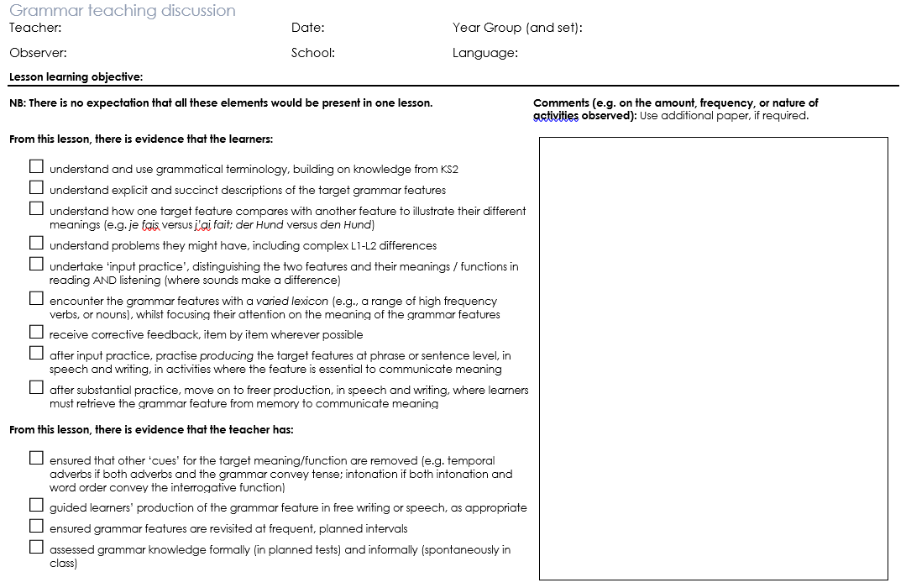
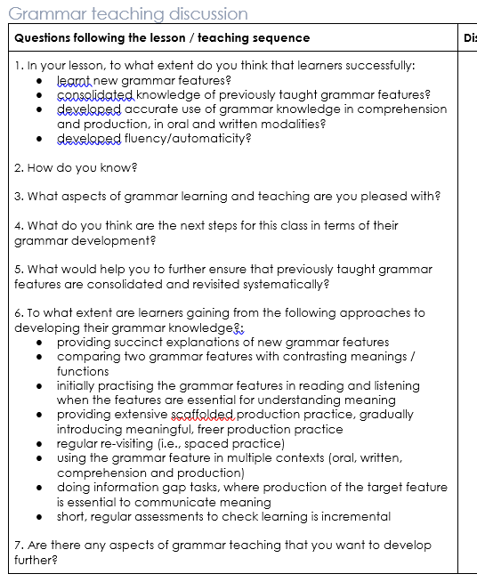
How to teach and learn grammar
In the Autumn, we will be exploring “What children bring with them from KS2”
Emma Marsden / Rowena Kasprowicz
Notes:
Grammar teaching discussion document.
In this session we have explored the key principles underpinning NCELP’s recommendations for teaching grammar, and explored lots of resources for teaching different bits of grammar across the three languages.
Handout 6a is the Grammar teaching discussion document that capture the key grammar teaching recommendations. This can be used to guide and structure discussions about grammar teaching amongst the Lead and Hub schools.
Handout 6a – Grammar teaching discussion (and handout 6b: grammar teaching discussion sheet incl. VEO tags)
Allow time for teachers to read this document. They will not have seen it before but will be familiar with the lay out.
Explain that Autumn term will include session on knowledge about language from KS2. So more information on this to come.
Discussion / any questions – this should align with what we covered in the earlier parts today

Slide 48
Learners…
Introducing the grammar knowledge
understand and use grammatical terminology, building on knowledge from KS2
understand explicit and succinct descriptions of the target grammar features
understand how one target feature compares with another feature to illustrate their different meanings (e.g. je fais versus j’ai fait; der Hund versus den Hund)
understand problems they might have, including complex L1-L2 differences
Embedding and Consolidating: Practice
undertake ‘input practice’, distinguishing the two features and their meanings / functions in reading AND listening (where sounds make a difference)
encounter the grammar features with a varied lexicon (e.g., a range of high frequency verbs, or nouns), whilst focusing their attention on the meaning of the grammar features
receive corrective feedback, item by item wherever possible
after input practice, practise producing the target features at phrase or sentence level, in speech and writing, in activities where the feature is essential to communicate meaning
Extending
after substantial practice, move on to freer production, in speech and writing, where learners must retrieve the grammar feature from memory to communicate meaning
Teachers…
ensured that other ‘cues’ for the target meaning/function are removed (e.g. temporal adverbs if both adverbs and the grammar convey tense; intonation if both intonation and word order convey the interrogative function)
guided learners’ production of the grammar feature in free writing or speech, as appropriate
ensured grammar features are revisited at frequent, planned intervals
assessed grammar knowledge formally (in planned tests) and informally (spontaneously in class)
Rowena Kasprowicz / Emma Marsden
Notes:
How to teach and learn grammar
This slide takes the statements from the Grammar Teaching Discussion document and puts them into phases of grammar learning. The different phases are not clear cut, they definitely merge in to each other: you practise when you are establishing knowledge for the first time, and consolidating knowledge is often also extending it.
Many activities can be repeated for different purposes, depending on how well the grammar is already embedded. These ways of working with grammar are intended to broaden thinking about the range of opportunities we give learners in and outside the classroom.

Slide 49
Update about Scheme of Work
Resources shared so far through the TRG sessions are activity ideas for you to be trying with your classes, largely fitting them around your current plans.
By the end of Summer term 2019: draft SoW for years 7 and 8 French
By the start of Autumn term 2019: draft SoW for KS3 all three languages
Not expecting schools to abandon current SoW!
We would only suggest “switch to NCELP SoW” once we have a full set of supporting resources in place
Rowena Kasprowicz / Emma Marsden
Notes:
NB: It’s important to say that the SOW development is ongoing - hope to have draft in one language, for year 7 and hopefully also 8, by end of summer term.
Version in all three languages by end of summer holidays.
In this TRG session we have introduced ideas, principles, and resources for teachers to try out and integrate for grammar teaching.
Please note, 2: NCELP’s current aim is to get resources and basic principles communicated - so when the SoW is in a fuller draft, it will make sense and won’t be arriving in a vacuum, but will have lots of resources to support it and you will understand the principles that underpin it and be able to create materials easily and implement the ideas ‘on the hoof’ during lessons.
In practical terms, resources and the SoW are having to be developed in tandem, and will be released as they are ready.

Slide 50
Summary of the session
Please complete the short feedback survey!
✓
Key issue 1: What grammar to teach and when
(determining the difficulty of grammar, order of teaching, setting expectations)
Key issue 2: Principles of how to teach grammar (and the concerns!)
Summary of key principles for grammar teaching
Sample resources
Hands-on classroom activity development
Grammar teaching discussion document for observing lessons
Update on scheme of work
✓
✓
✓
✓
✓
✓
Rowena Kasprowicz / Emma Marsden
Notes:
Summarise what has been covered today
Please remind Hub teachers to complete the feedback survey – this should have been sent to them by email.
Ideally they would complete it in the session, at the very end on their devices, so that we get more responses.

Slide 51
Conclusion and next steps
Cascade to colleagues in your departments
Plan and resource Keep in touch with each other and your lead school, sharing anything you create (or adapt from an NCELP resource). NCELP resources will be added frequently to Resource Portal.
If teachers create their own resources, please send to enquiries@ncelp.org.uk – we can help with copyright free images / audio recordings etc. If the aim is to have the resources uploaded on to the Portal, NCELP will edit and give feedback.
Teach and reflect Make grammar teaching the focus of your next planned visit / observation. Use the observation schedule as a planning tool and focus for discussion. Share the completed document with us enquiries@ncelp.org.uk .
Video parts of lessons where you focus on grammar If possible, video parts of your lessons. Upload to VEO and tag.
Remind yourself of your next key dates: Meaningful Practice TRG Hub Day 1
Rachel Hawkes / Emma Marsden

Slide 52
References
Bui, G., & Skehan, P. (2018). Complexity, fluency and accuracy. In J. Liontas (Ed.), TESOL encyclopedia of English language teaching (pp.1-7). Hoboken, NJ: John Wiley & Sons,
DeKeyser, R. (2005). What makes learning second-language grammar difficult? A review of issues. Language Learning, 55(S1), 1-25.
DeKeyser, R. (2015). Skill acquisition theory. In B. VanPatten & J. Williams (Eds.), Theories in second language acquisition: An introduction (pp. 94–112). London, UK: Routledge. Mitchell, Myles & Marsden, E. (2018).
Ellis, N. (2006). Selective attention, and transfer phenomena in L2 acquisition: Contingency, cue competition, salience, interference, overshadowing, blocking, and perceptual learning. Applied Linguistics, 27(2), 164-194.
Kasprowicz, R. & Marsden, E. (2018). Towards ecological validity in research into input-based practice: Form spotting can be as beneficial as form-meaning practice. Applied Linguistics, 39(6), 886-911.
Lichtman, K. (2016). Age and learning environment: Are children implicit second language learners? Journal of Child Language, 43, 707-730.
Marsden, E. (2006). Exploring input processing in the classroom: An experimental comparison of processing instruction and enriched input. Language Learning, 56, 507–566.
Mitchell, R., Myles, F. & Marsden, E. (2019) Second Language Learning Theories. New York: Routledge.
Norris, J., & Ortega, L. (2001). Does type of instruction make a difference? Substantive findings from a meta-analytic review. Language Learning, 51(S1), 157-213.
Schmidt, R. (1990). The role of consciousness in second language learning. Applied Linguistics, 11(2), 129-158.
Spada, N., & Tomita, Y. (2010) Interactions between type of instruction and type of language feature: A meta-analysis. Language Learning, 60(2), 263-308.
VanPatten, B. (2004). Input processing in SLA. In, VanPatten, B. (ed.), Processing instruction: Theory, research, and commentary. Mahwah, NJ: Lawrence Erlbaum Associates.
White, L., Spada, N., Lightbown, P., & Ranta, L. (1991). Input enhancement and L2 question formation. Applied Linguistics, 12(4), 416-432.
Rowena Kasprowicz / Emma Marsden
Notes:
Selection of relevant research references. References in bold are the 5 OASIS summaries which will be sent out for the TRG meetings.

