Slide 1
Kiffe kiffe demain: Text exploitation
Indefinite adjectives
SSCs [oi], [-oin]
Y9 French
Term 3.2 - Week 7 - Lesson 71
Author name(s): Catherine Salkeld / Louise Bibbey
Artwork by: Chloé Motard
Date updated: 08/08/22
Notes:
Artwork by Chloé Motard. All additional pictures selected are available under a Creative Commons license, no attribution required.
Native teacher feedback provided by Stephanie Schmitt.
With thanks to Rachel Hawkes for her input on lesson material.
Learning outcomes (lesson 1):
Introduction of SSC [-oin]
Consolidation of SSC [oi]
Introduction of indefinite adjectives
Word frequency (1 is the most frequent word in French):
9.3.2.7 (introduce) banlieue, raconter, surprendre, couler, l'immeuble, écrivain, tour, cou, pauvre, doux, jaloux
9.3.2.3 (revisit) se demander [80], se lever [837], loger [3060], s’organiser [701], se sentir [536], se trouver [83], association [956], conflit [864], crise [765], actuel [584], grave [443], afghan [>5000], Afghanistan [>5000]
9.3.1.2 (revisit) encourager [1434], obliger [499], me [61], te [207], difficulté [564], objectif [518], recherche [357], résultat [428], clair [335], supplémentaire [1267], presque [481]
Source: Lonsdale, D., & Le Bras, Y. (2009). A Frequency Dictionary of French: Core vocabulary for learners London: Routledge.
The frequency rankings for words that occur in this PowerPoint which have been previously introduced in NCELP resources are given in the NCELP SOW and in the resources that first introduced and formally re-visited those words.
For any other words that occur incidentally in this PowerPoint, frequency rankings will be provided in the notes field wherever possible.
The additional English meanings of the following words have been added to Quizlet since the creation of this resource:
raconteur – to tell a story, to narrate

Slide 2
oi
[to see]
voir
Notes:
Timing: 1 minute
Aim: To introduce/consolidate SSC [oi]
Procedure: 1. Present the letter(s) and say the [oi] sound first, on its own. Students repeat it with you. 2. Bring up the word ”voir” on its own, say it, students repeat it, so that they have the opportunity to focus all of their attention on the connection between the written word and its sound.
3. A possible gesture for this would be to put one’s hand above one’s brow (as if to shade one’s view) and pretend to be seeing something far off. 4. Roll back the animations and work through 1-3 again, but this time, dropping your voice completely to listen carefully to the students saying the [oi] sound, pronouncing ”voir” and, if using, doing the gesture.
Word frequency (1 is the most frequent word in French):
voir [69].
Source: Londsale, D., & Le Bras, Y. (2009). A Frequency Dictionary of French: Core vocabulary for learners London: Routledge.

Slide 3
oi
droite
avoir
[to have]
to see
voir
Au revoir !
trois
Pourquoi ?
[why?]
Notes:
Timing: 2 minutes
Aim: To introduce/consolidate SSC [oi]
Procedure:
1. Introduce and elicit the pronunciation of the individual SSC [oi] and then the source word again ‘voir’ (with gesture, if using). 2. Then present and elicit the pronunciation of the five cluster words.
The cluster words have been chosen for their high-frequency, from a range of word classes, with the SSC (where possible) positioned within a variety of syllables within the words (e.g. initial, 2nd, final etc.). Additionally, we have tried to use words that build cumulatively on previously taught SSCs (see the Phonics Teaching Sequence document) and do not include new SSCs. Where new SSCs are used, they are often consonants which have a similar symbol-sound correspondence in English.
Word frequency (1 is the most frequent word in French): droite [1293]; avoir [8] au revoir [n/a]; pourquoi[193]; trois[115]; voir [69]. Source: Londsale, D., & Le Bras, Y. (2009). A Frequency Dictionary of French: Core vocabulary for learners London: Routledge.

Slide 4
oin
besoin
[need]
Notes:
Timing: 1 minute
Aim: To introduce SSC [oin]
Procedure: 1. Present the letter(s) and say the [oin] sound first, on its own. Students repeat it with you. 2. Bring up the word ”besoin” on its own, say it, students repeat it, so that they have the opportunity to focus all of their attention on the connection between the written word and its sound.
3. A possible gesture for this would be [cuddling]. 4. Roll back the animations and work through 1-3 again, but this time, dropping your voice completely to listen carefully to the students saying the [oin] sound, pronouncing ”besoin” and, if using, doing the gesture.
Word frequency (1 is the most frequent word in French):
besoin [183]
Source: Londsale, D., & Le Bras, Y. (2009). A Frequency Dictionary of French: Core vocabulary for learners London: Routledge.

Slide 5
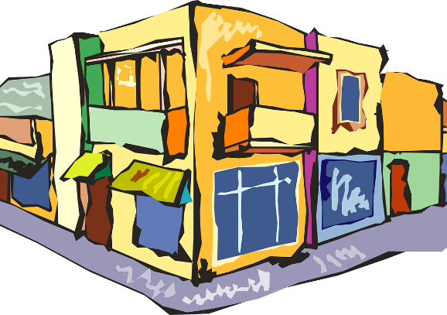
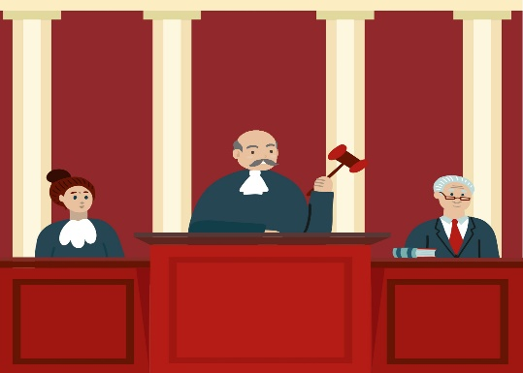
oin
coin
point
[corner]
[dot]
témoin
besoin
joindre
[witness]
[to join]
moins
[less]
Notes:
Timing: 2 minutes
Aim: To introduce SSC [oin]
Procedure:
1. Introduce and elicit the pronunciation of the individual SSC [oin] and then the source word again ‘besoin’ (with gesture, if using). 2. Then present and elicit the pronunciation of the five cluster words.
The cluster words have been chosen for their high-frequency, from a range of word classes, with the SSC (where possible) positioned within a variety of syllables within the words (e.g. initial, 2nd, final etc.). Additionally, we have tried to use words that build cumulatively on previously taught SSCs (see the Phonics Teaching Sequence document) and do not include new SSCs. Where new SSCs are used, they are often consonants which have a similar symbol-sound correspondence in English.
Word frequency (1 is the most frequent word in French): coin [341]; point [97]; témoin [1055]; joindre [1320]; moins [62]; Source: Londsale, D., & Le Bras, Y. (2009). A Frequency Dictionary of French: Core vocabulary for learners London: Routledge.

Slide 6
[oi] ou [-oin] ?
écouter / écrire
Écoute et coche le bon mot.
 | oi | -oin
 | mois | moins
 | joie | joint
 | pois | poing
 | loi | loin
 | fois | foin
 | soi | soin
1
2
3
4
5
6
Notes:
Timing: 4 minutes
Aim: Aural recognition of SSCs [oi] and [-oin]
Procedure:
1. Click the buttons to play the audio.
2. Students tick which word they hear.
3. Click to reveal answers.
Transcript:
moins
joie
pois
loin
fois
soin
Word frequency of unknown words used (1 is the most frequent word in French): joie [1984], joint [>5000], pois [>5000], poing [3889], loi [267], foin [>5000], soi [1365]
Source: Lonsdale, D., & Le Bras, Y. (2009). A Frequency Dictionary of French: Core vocabulary for learners London: Routledge.

Slide 7
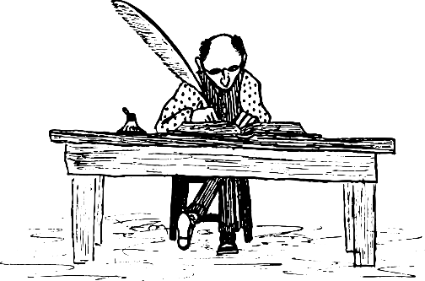
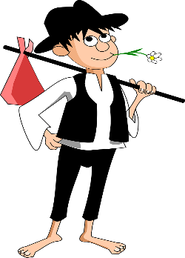
Vocabulaire
écouter
B
C
la banlieue
1
G
A
Écoute. C’est quel mot ?
raconter
2
F
surprendre
3
H
couler
4
E
D
E
F
G
l’immeuble
5
K
l’écrivain
6
A
la tour
7
C
le cou
8
B
H
I
J
K
pauvre
9
D
some
doux
10
J
quelques
11
I
Notes:
Timing: 4 minutes
Aim: Aural recognition of this week’s vocabulary set
Procedure:
1. Click the buttons to play audio.
2. Students listen and write the letter of the matching picture.
3. Click to check answers.
Transcript:
la banlieue
raconter
surprendre
couler
l'immeuble
l'écrivain
la tour
le cou
pauvre
doux
jaloux
quelques

Slide 8
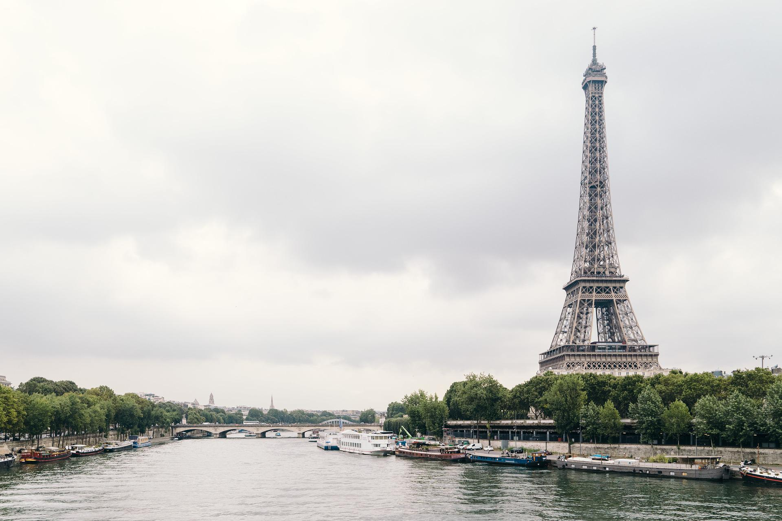
Paris
écrire
Quels mots peut-on utiliser pour parler de Paris ?
Écris une liste.
les habitants
la capitale
l’île
les artistes
le métro
les parisiens
la ville
les parcs
européen
la tour Eiffel
la culture
historique
la France
la Seine
le fleuve
Notes:
Timing: 4 minutes
Aim: Recall of known vocabulary
Procedure:
1. Students write a list of words they associate with Paris. They can work in pairs.
2. Ask students for words.
3. Click to reveal suggested answers.
Word frequency of cognates used (1 is the most frequent word in French): capitale [1818], parisien [2549], metro [3227]
Source: Lonsdale, D., & Le Bras, Y. (2009). A Frequency Dictionary of French: Core vocabulary for learners London: Routledge.

Slide 9
Faïza Guène
Lis le texte et écris ‘Vrai’ ou ‘Faux’. Corrige les phrases qui ne sont pas vraies.
lire
Faïza Guène est une écrivaine française. Elle a grandi dans la banlieue de Paris avec des parents algériens. Elle avait de bons résultats aux examens et son professeur de français l’encourageait à écrire. Elle a commencé à étudier à l’université, mais elle se demandait si elle voulait continuer. Elle a décidé de quitter l’université quand elle avait dix-neuf ans. Elle a écrit plusieurs romans sur le conflit des cultures et les difficultés quotidiennes des immigrants de l’Afrique du Nord qui se trouvent à Paris. Il est clair qu’elle comprend la crise d’identité des gens qui viennent de la même région qu’elle : elle n’a pas besoin de faire beaucoup de recherches supplémentaires. Son premier roman s’appelle Kiffe kiffe* demain. Il raconte à la première personne l’histoire de Doria, une fille de quinze ans qui se sent marocaine*, mais aussi française.
Vrai
Faux – elle a grandi à Paris.
Faux – elle avait de bons résultats
Vrai
Faux – ils ont des difficultés
Faux – elle connaît bien l’expérience de la communauté des immigrants
La famille de Faïza Guène vient d’Algérie.
Faïza habitait en Algérie quand elle était petite.
Elle trouvait les examens difficiles.
Elle n’a pas fini l’université.
La vie est facile pour les immigrants à Paris.
Elle doit chercher beaucoup d’informations pour pouvoir écrire sur la vie des immigrants.
*kiffer = to love (slang)
*marocain = Moroccan
Notes:
Timing: 5 minutes
Aim: Written recognition of new and revisited vocabulary in context
Procedure:
1. Students read the text and decide whether each statement is true or false.
2. Students correct the false sentences.
3. Click to reveal answers.
Word frequency of unknown words used (1 is the most frequent word in French):
kiffer [>5000], marocain [3469]
Word frequency (1 is the most frequent word in French): immigrant [4352], identité [1437]
Source: Lonsdale, D., & Le Bras, Y. (2009). A Frequency Dictionary of French: Core vocabulary for learners London: Routledge.

Slide 10
Kiffe Kiffe demain
*argotique = slang
*ceux = those
*le coin = corner
lire
Lis l’extrait. Doria explique les idées que sa mère avait sur la France avant d’arriver dans la banlieue parisienne en 1984. Trouve les mots argotiques*.
Ma mère, elle s’imaginait que la France, c’était comme dans les films en noir et blanc des années soixante. Ceux* avec l’acteur beau gosse qui raconte toujours un tas de trucs mythos à sa meuf, une cigarette au coin* du bec.
gob
girlfriend/woman
good-looking guy
a load of stuff that isn’t true
(le) bec
(la) meuf
(le) beau gosse
un tas de trucs mythos
Qu’est-ce que tu penses de cette image de la France ? C’est réaliste ?
Selon toi, comment la mère de Doria va-t-elle se sentir quand elle arrive? Parle avec ton/ta partenaire.
Notes:
Timing: 4 minutes
Aim: Written comprehension and inference
Procedure:
1. Students read the text and find the slang words.
2. Click to reveal answers.
3. Students discuss in pairs how realistic they think this image of France is and how they think Doria’s mother will feel when she sees the real France. Can be extended to a class discussion.
Note: One of the book’s major themes is the experience of immigrants in the Parisian banlieue, and how it meets – or doesn’t meet – their expectations.
Permissions sought and agreement in process
Word frequency of unknown words used (1 is the most frequent word in French): argotique [>5000], ceux [ce 12], coin [1798], gosse [3631], tas [2723], truc [1991], mytho [>5000], meuf [>5000], bec [>5000]
Word frequency of cognates used (1 is the most frequent word in French):
s’imaginer [840], cigarette [2855]
Source: Lonsdale, D., & Le Bras, Y. (2009). A Frequency Dictionary of French: Core vocabulary for learners London: Routledge.

Slide 11
Une visite à la tour Eiffel
Doria raconte la première fois que sa mère a visité la tour Eiffel. Trouve les synonymes.
lire
Comme Maman est encore en vacances jusqu’à la semaine prochaine, on a décidé d’aller se balader toutes les deux dans Paris. La tour Eiffel, c’était la première fois qu’elle la voyait en vrai alors qu’elle habite à une demi-heure depuis* presque vingt ans. Autrement, c’était à la télé, au JT* de treize heures, le lendemain du jour de l’an quand elle est illuminée* et qu’à ses pieds, des gens font la fête, s’embrassent, et se bourrent la gueule. En tout cas, elle était vachement impressionnée*.
Ça doit faire peut-être deux ou trois fois notre bâtiment, non ?
Je lui ai répondu que c’était sûrement ça. Sauf* que notre immeuble et la cité en général, ils suscitent moins d’intérêt auprès des touristes.
la banlieue
consomment beaucoup d’alcool
causent
chez les
font la bise
faire une promenade
le jour après le premier janvier
trente minutes
très
la cité
se bourrer la gueule
susciter
auprès des
s’embrasser
se balader
le lendemain du jour de l’an
trente minutes
vachement
*depuis = since
*le JT (journal télévisé) = TV news
*illuminer = to light up
*impressionner = to impress
*sauf = except
*consommer = to consume
La mère de Doria n’a jamais visité la tour Eiffel avant ce jour.
Ça te surprend ?
Parle avec ton/ta partenaire.
Notes:
Timing: 8 minutes
Aim: Written comprehension and inference
Procedure:
1. Students read the text and find the synonyms.
2. Click to reveal answers.
3. Students discuss in pairs the fact that Doria’s mother has lived near the Eiffel Tower for twenty years, but never seen it until now. Why do they think that is? Can extend to a class discussion.
Note: This passage is significant in the novel because it shows how immigrants like Doria and her mother rarely have the same experience of Paris as people who live more centrally. It illustrates how those who live in the banlieue are marginalized: they are overlooked by visitors to Paris, as well as by inhabitants of central Paris, and society in general. It would be worth pointing out to students that banlieue has a more specific meaning than ‘suburbs’ when it is used in a Parisian context: it is used to refer to run-down council estates that are largely populated by low-income immigrants who have no other option.
Word frequency of unknown words used (1 is the most frequent word in French):
se balader [>5000], demi-heure [3338], depuis [96], JT [n/a], lendemain [1258], illuminée (illuminer) [>5000], s’embrasser [3102], se bourrer [>5000], gueule [3015], vachement [>5000], impressionnée (impressionner) [3055], sauf [476], susciter [1027], auprès [614]
Word frequency of cognates used (1 is the most frequent word in French): alcool [2465], causer [1089], cas [137], intérêt [315], touriste [2653]
Source: Lonsdale, D., & Le Bras, Y. (2009). A Frequency Dictionary of French: Core vocabulary for learners London: Routledge.

Slide 12
La banlieue
parler
Doria décrit l’ambiance* de la banlieue. Elle crée une impression positive ou négative ? Comment ? Parle avec ton/ta partenaire.
Dehors, il faisait gris* comme la couleur de béton* des immeubles et il pleuvait* à très fines gouttes*, comme si Dieu nous crachait dessus*.
le temps est…
Je pense que les gens qui habitent dans la banlieue sont…
*l’ambiance (f.) = atmosphere
*gris = grey
*le béton = concrete
*pleuvoir = to rain
*cracher dessus = to spit on
les couleurs sont…
Elle pense que Dieu…
Notes:
Timing: 3 minutes
Aim: Written comprehension and analysis of the text
Procedure:
1. Students read the extract.
2. Students discuss what impression of the banlieue it gives. How? Why? Can be extended to a class discussion.
Note: This is another reflection of the plight of the banlieue and its residents. Their surroundings reflect the perceived banality of their existence, contrasted with the bright lights and beautiful buildings of central Paris. Doria expresses the frustrations of being part of a marginalized community.
Word frequency of unknown words used (1 is the most frequent word in French): ambiance [4025], gris [2769], béton [4146], pleuvoir [4586], goutte [4337], cracher [>5000], dessous [1629]
Source: Lonsdale, D., & Le Bras, Y. (2009). A Frequency Dictionary of French: Core vocabulary for learners London: Routledge.

Slide 13
Indefinite adjectives
grammaire
You already know some indefinite adjectives:
chaque
each
plusieurs
several
même(s)
same
autre(s)
other
tout le, toute la
whole
tous les, toutes les
all
Remember, indefinite adjectives go before the noun they describe.
Tout le agrees in number and gender. Même and autre agree for number. Chaque and plusieurs always stay the same.
Another indefinite adjective is quelques, which means some.
Quelques agrees in number, so it is usually plural.
quelques difficultés
some difficulties
quelques garçons
some boys
Notes:
Timing: 2 minutes
Aim: Recap of indefinite adjectives and introduction of quelque
Procedure:
1. Click to reveal explanations and examples, eliciting English where possible.
2. Ensure understanding.

Slide 14
La vie à Paris
écrire
quelques
quelques
tous
tous
même
autres
Remplis les blancs.
__________ personne à Paris a une expérience personnelle de la ville.
Presque __________ les touristes pensent que Paris est une belle ville.
__________ groupes d’immigrants habitent dans la banlieue.
Ils n’ont pas la _________ expérience que les touristes. Ils ont _________ difficultés.
Les immigrants à Paris viennent de __________ pays africains, et _________ immigrants sont d’__________ pays comme l’Afghanistan.
Les immigrants afghans n’ont pas la __________ expérience que les immigrants des anciennes colonies françaises, parce que __________ ne parlent pas le français.
chaque
plusieurs
plusieurs
même
Chaque
tous
Plusieurs
même
quelques
plusieurs
quelques
autres
même
tous
Notes:
Timing: 6 minutes
Aim: Written production of indefinite adjectives in context
Procedure:
1. Students read the sentences and choose indefinite adjectives to fill the gaps. Note: both plusieurs and quelques would make sense in some of the gaps.
2. Click to reveal answers.
3. Oral translation of sentences.
Word frequency of cognates used (1 is the most frequent word in French): personnel [398], touriste [2653], immigrant [4352], africain [2289]
Source: Lonsdale, D., & Le Bras, Y. (2009). A Frequency Dictionary of French: Core vocabulary for learners London: Routledge.

Slide 15
Kiffe kiffe demain: Text exploitation
Indefinite adjectives
SSCs [oi], [-oin]
Y9 French
Term 3.2 - Week 7 - Lesson 72
Author name(s): Catherine Salkeld / Louise Bibbey
Artwork by: Chloé Motard
Date updated: 08/08/22
Notes:
Artwork by Chloé Motard. All additional pictures selected are available under a Creative Commons license, no attribution required.
Native teacher feedback provided by Stephanie Schmitt.
With thanks to Rachel Hawkes for her input on lesson material.
Learning outcomes (lesson 2):
Consolidation of SSC [-oin]
Consolidation of SSC [oi]
Practice of indefinite adjectives
Note: There is no expectation that all the material here will be covered in detail in the final lesson of the year. Students could:
Do just the Seine reading and then complete the quiz and perhaps finish with a short piece of writing about Paris using any language they know. OR Do one of the poems in a little more detail
OR
Read both poems and do the Venn diagram comparison and then discussion
OR
If they have access to computers/ipads there could be a different option – have a limited time to prepare themselves for a quiz about Paris, and then do the quiz (this following the phonics and Seine reading)
Word frequency (1 is the most frequent word in French):
9.3.2.7 (introduce) banlieue, raconter, surprendre, couler, l'immeuble, écrivain, tour, cou, pauvre, doux, jaloux
9.3.2.3 (revisit) se demander [80], se lever [837], loger [3060], s’organiser [701], se sentir [536], se trouver [83], association [956], conflit [864], crise [765], actuel [584], grave [443], afghan [>5000], Afghanistan [>5000]
9.3.1.2 (revisit) encourager [1434], obliger [499], me [61], te [207], difficulté [564], objectif [518], recherche [357], résultat [428], clair [335], supplémentaire [1267], presque [481]Source: Londsale, D., & Le Bras, Y. (2009). A Frequency Dictionary of French: Core vocabulary for learners London: Routledge.
The frequency rankings for words that occur in this PowerPoint which have been previously introduced in NCELP resources are given in the NCELP SOW and in the resources that first introduced and formally re-visited those words.
For any other words that occur incidentally in this PowerPoint, frequency rankings will be provided in the notes field wherever possible.
The additional English meanings of the following words have been added to Quizlet since the creation of this resource:
raconteur – to tell a story, to narrate

Slide 16
oi
[to see]
voir
Notes:
Timing: 1 minute
Aim: To introduce/consolidate SSC [oi]
Procedure: 1. Present the letter(s) and say the [oi] sound first, on its own. Students repeat it with you. 2. Bring up the word ”voir” on its own, say it, students repeat it, so that they have the opportunity to focus all of their attention on the connection between the written word and its sound.
3. A possible gesture for this would be to put one’s hand above one’s brow (as if to shade one’s view) and pretend to be seeing something far off. 4. Roll back the animations and work through 1-3 again, but this time, dropping your voice completely to listen carefully to the students saying the [oi] sound, pronouncing ”voir” and, if using, doing the gesture.
Word frequency (1 is the most frequent word in French):
voir [69].
Source: Londsale, D., & Le Bras, Y. (2009). A Frequency Dictionary of French: Core vocabulary for learners London: Routledge.

Slide 17
oi
droite
avoir
[to have]
to see
voir
Au revoir !
trois
Pourquoi ?
[why?]
Notes:
Timing: 2 minutes
Aim: To introduce/consolidate SSC [oi]
Procedure:
1. Introduce and elicit the pronunciation of the individual SSC [oi] and then the source word again ‘voir’ (with gesture, if using). 2. Then present and elicit the pronunciation of the five cluster words.
The cluster words have been chosen for their high-frequency, from a range of word classes, with the SSC (where possible) positioned within a variety of syllables within the words (e.g. initial, 2nd, final etc.). Additionally, we have tried to use words that build cumulatively on previously taught SSCs (see the Phonics Teaching Sequence document) and do not include new SSCs. Where new SSCs are used, they are often consonants which have a similar symbol-sound correspondence in English.
Word frequency (1 is the most frequent word in French): droite [1293]; avoir [8] au revoir [n/a]; pourquoi[193]; trois[115]; voir [69]. Source: Londsale, D., & Le Bras, Y. (2009). A Frequency Dictionary of French: Core vocabulary for learners London: Routledge.

Slide 18
oin
besoin
[need]
Notes:
Timing: 1 minute
Aim: To introduce SSC [oin]
Procedure: 1. Present the letter(s) and say the [oin] sound first, on its own. Students repeat it with you. 2. Bring up the word ”besoin” on its own, say it, students repeat it, so that they have the opportunity to focus all of their attention on the connection between the written word and its sound.
3. A possible gesture for this would be [cuddling]. 4. Roll back the animations and work through 1-3 again, but this time, dropping your voice completely to listen carefully to the students saying the [oin] sound, pronouncing ”besoin” and, if using, doing the gesture.
Word frequency (1 is the most frequent word in French):
besoin [183]
Source: Londsale, D., & Le Bras, Y. (2009). A Frequency Dictionary of French: Core vocabulary for learners London: Routledge.

Slide 19
oin
coin
point
[corner]
[dot]
témoin
besoin
joindre
[witness]
[to join]
moins
[less]
Notes:
Timing: 2 minutes
Aim: To introduce SSC [oin]
Procedure:
1. Introduce and elicit the pronunciation of the individual SSC [oin] and then the source word again ‘besoin’ (with gesture, if using). 2. Then present and elicit the pronunciation of the five cluster words.
The cluster words have been chosen for their high-frequency, from a range of word classes, with the SSC (where possible) positioned within a variety of syllables within the words (e.g. initial, 2nd, final etc.). Additionally, we have tried to use words that build cumulatively on previously taught SSCs (see the Phonics Teaching Sequence document) and do not include new SSCs. Where new SSCs are used, they are often consonants which have a similar symbol-sound correspondence in English.
Word frequency (1 is the most frequent word in French): coin [341]; point [97]; témoin [1055]; joindre [1320]; moins [62]; Source: Londsale, D., & Le Bras, Y. (2009). A Frequency Dictionary of French: Core vocabulary for learners London: Routledge.

Slide 20
[oi] ou [-oin] ?
lire / parler
The SSC [-oin] is a nasal sound, but only when it is followed by a consonant.
When it is followed by a vowel, it sounds like [oi] followed by [n].
moins
moine
[less]
[monk]
Notes:
Timing: 1 minute
Aim: Introduction of [-oin] before a vowel
Procedure:
1. Click to reveal examples and explanations.
2. Click the example words to hear a native speaker recording.
3. Ensure understanding.
Transcript:
moins
moine
Word frequency of unknown words used (1 is the most frequent word in French): moine [4339]
Source: Lonsdale, D., & Le Bras, Y. (2009). A Frequency Dictionary of French: Core vocabulary for learners London: Routledge.

Slide 21
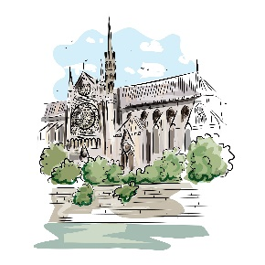
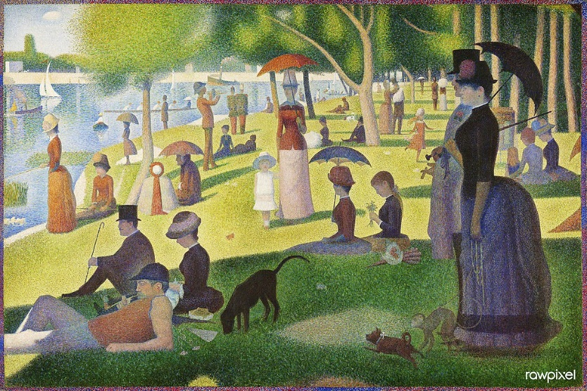
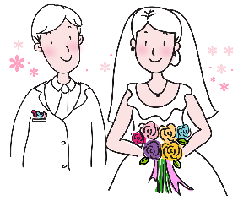
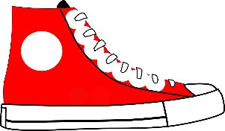
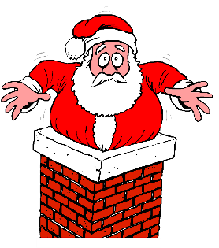
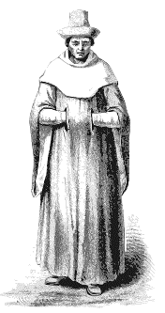
[oi] ou [-oin] ?
lire / parler
patrimoine
[heritage]
avoine
[oats]
rond-point
[roundabout]
néanmoins
[nevertheless]
60
Pointillism is a painting technique that uses dots to make a picture.
It was developed in France in the late 19th century by Georges Seurat and Paul Signac.
This is a painting of an island in the Seine by Georges Seurat.
pointure
[shoe size]
adjoint
[deputy]
conjoint
[spouse]
moine
[monk]
pointu
[pointed]
secondes
moineau
[sparrow]
shampooing
[shampoo]
lointain
[distant]
coincé
[stuck]
chanoine
[canon - religious person]
pointillisme
[pointillism]
0
Macédoine
[Macedonia]
DÉBUT
Notes:
Timing: 3 minutes
Aim: Oral practice of SSC [-oin] before consonants and vowels
Procedure:
1. Students try to say all the words before the timer ends.
2. Click on each word to hear native speaker pronunciation.
3. After clicking on pointillisme, click also on its image to bring up further information about this artistic style.
Transcript:
moine
pointu
avoine
coincé
moineau
adjoint
lointain
conjoint
chanoine
pointure
pointillisme
néanmoins
Macédoine
shampooing
patrimoine
rond-point
Word frequency of unknown words used (1 is the most frequent word in French): moine [4339], pointu [>5000], avoine [>5000], coincé (coincer) [3289], moineau [>5000], adjoint [2532], lointain [2933], conjoint [3317], chanoine [>5000], pointure [>5000], pointillisme [>5000], néanmoins [1271], Macédoine [>5000], shampooing [>5000], poinsettia [>5000], patrimoine [2530], rond-point [>5000]
Source: Lonsdale, D., & Le Bras, Y. (2009). A Frequency Dictionary of French: Core vocabulary for learners London: Routledge.
A Sunday on La Grande Jatte (1884) by Georges Seurat. Original from The Art Institute of Chicago. Digitally enhanced by rawpixel. (50434734621).jpg by Rawpixel Ltd is licensed under CC BY 2.0

Slide 22
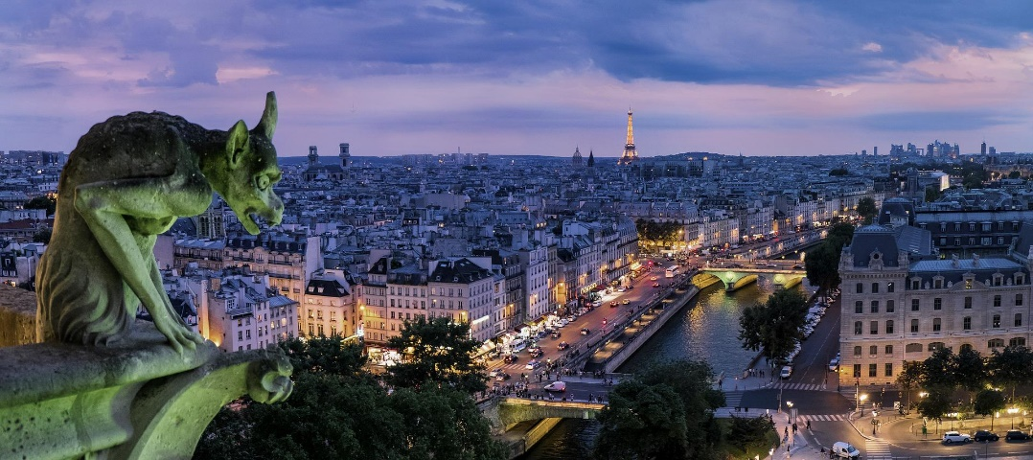
La Seine
lire
Remplis les blancs.
La Seine est un fleuve dans [1] __________ de la France. Il est [2] __________ qui coule dans Paris, où il y a trente-sept [3] __________ qui le traversent. Les parisiens se sentent très [4] __________ de la Seine, et elle est très présente dans la littérature, l’art, et [5] __________. Elle passe [6] __________ beaucoup de sites touristiques*, comme la tour Eiffel, le Musée* d’Orsay, le Louvre, et la cathédrale Notre-Dame.
le nord
le fleuve
ponts
fiers
le cinéma
devant
ponts
le cinéma
devant
fiers
le fleuve
le nord
*touristique = touristy
*le musée = museum
Notes:
Timing: 5 minutes
Aim: Written recognition of vocabulary in context
Procedure:
1. Students read the text and choose the words to fill the gaps.
2. Click to reveal answers.
3. Oral translation of text.
Word frequency of unknown words used (1 is the most frequent word in French): touristique [3818], musée [2216]
Source: Lonsdale, D., & Le Bras, Y. (2009). A Frequency Dictionary of French: Core vocabulary for learners London: Routledge.

Slide 23
Chanson de la Seine – Jacques Prévert
Lis le poème avec ton/ta partenaire. Où sont les rimes ?
lire
un vêtement
La Seine a de la chance
Elle n'a pas de soucis*
Elle se la coule douce
Le jour comme la nuit
Et elle sort de sa source
Tout doucement sans bruit
Et sans se faire de mousse*
Sans sortir de son lit
Elle s'en va vers la mer
En passant par Paris
La Seine a de la chance
Elle n'a pas de soucis
Et quand elle se promène
Tout le long de ses quais
Avec sa belle robe verte
Et ses lumières dorées
Notre-Dame jalouse
Immobile et sévère
Du haut de toutes ses pierres
La regarde de travers
mais la Seine s'en balance*
Elle se la coule douce
Le jour comme la nuit
Et s'en va vers le Havre
Et s'en va vers la mer
En passant comme un rêve
Au milieu des mystères
Des misères de Paris.
jaune-orange
La Seine a de la chance
Elle n'a pas de soucis*
Elle se la coule douce
Le jour comme la nuit
Et elle sort de sa source
Tout doucement sans bruit
Et sans se faire de mousse*
Sans sortir de son lit
Elle s'en va vers la mer
En passant par Paris
La Seine a de la chance
Elle n'a pas de soucis
Et quand elle se promène
Tout le long de ses quais
Avec sa belle robe verte
Et ses lumières dorées
Notre-Dame jalouse
Immobile et sévère
Du haut de toutes ses pierres
La regarde de travers
mais la Seine s'en balance*
Elle se la coule douce
Le jour comme la nuit
Et s'en va vers le Havre
Et s'en va vers la mer
En passant comme un rêve
Au milieu des mystères
Des misères de Paris.
presque en silence
une ville dans le nord de la France
*le souci = worry
*se faire de mousse = to make a fuss
*la lumière = light
*la pierre = rock, stone
*s’en balancer = to not care
*au milieu de = in the middle of
elle fait une promenade
les difficultés de la vie
les chemins à côté du fleuve
Notes:
Timing: 8 minutes
Aim: Written comprehension of literary text
Procedure:
1. Students read the poem aloud in pairs, noting where the rhymes are.
2. Click the button to listen to the recording and check.
3. Click to reveal the poem colour-coded for the rhymes. Internal rhymes are also highlighted: more confident students may discuss these.
3. Click to reveal definitions for the words in bold and elicit English from students.
4. Click to reveal answers.
5. Discuss personification of the Seine and Notre Dame.
Transcript:
La Seine a de la chance
Elle n'a pas de soucis
Elle se la coule douce
Le jour comme la nuit
Et elle sort de sa source
Tout doucement sans bruit
Et sans se faire de mousse
Sans sortir de son lit
Elle s'en va vers la mer
En passant par Paris
La Seine a de la chance
Elle n'a pas de soucis
Et quand elle se promène
Tout le long de ses quais
Avec sa belle robe verte
Et ses lumières dorées
Notre-Dame jalouse
Immobile et sévère
Du haut de toutes ses pierres
La regarde de travers
mais la Seine s'en balance
Elle se la coule douce
Le jour comme la nuit
Et s'en va vers le Havre
Et s'en va vers la mer
En passant comme un rêve
Au milieu des mystères
Des misères de Paris.
Word frequency of cognates used (1 is the most frequent word in French):
source [817], immobile [4463], sévère [1733] , mystère [2777]
Word frequency of unknown words used (1 is the most frequent word in French): Seine [n/a], doucement [3242], bruit [1524], mousse [>5000], souci [1556], se promener [2928], quai [3354], robe [2864], lumière [1059], doré [4833], Notre-Dame [n/a], pierre [1767], travers [661], se balancer [4548], le Havre [n/a], milieu [479], misère [2332]
Source: Lonsdale, D., & Le Bras, Y. (2009). A Frequency Dictionary of French: Core vocabulary for learners London: Routledge.
Permissions sought and agreement in progress

Slide 24
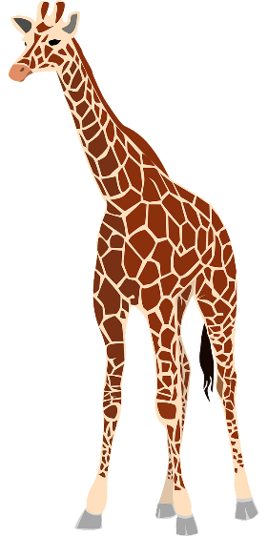
La Tour Eiffel – Maurice Carême
Écoute et lis le poème.
lire
Pourquoi l’écrivain parle-t-il d’une girafe ?
Pourquoi décrit-il les gens comme des insectes ?
Mais oui, je suis une girafe
M’a raconté la tour Eiffel
Et si ma tête est dans le ciel,
C’est pour mieux brouter les nuages*,
Car ils me rendent* éternelle.
quand un animal mange une plante
Mais j’ai quatre pieds bien assis*
Dans une courbe* de la Seine.
On ne s’ennuie pas* à Paris.
Les femmes, comme des phalènes*,
Les hommes comme des fourmis,
Glissent* sans fin entre mes jambes
Et les fous*, les plus ingambes,
Montent et descendent le long
De mon cou comme des frelons*.
La nuit, je lèche les étoiles*.
*le nuage = cloud, *rendre = to make, *assis = seated, *la courbe = curve, *s’ennuyer = to get bored, *la phalène = moth, *la fourmi = ant, *glisser = to slip, *le fou = mad person, *le frelon = hornet, *l’étoile (f.) = star, *apercevoir = to notice, *rien = nothing
actifs
Et si l’on m’aperçoit* de loin
C’est que très souvent j’en avale*
Une sans avoir l’air de rien*.
Maurice Carême
Le mât de cocagne
© Fondation Maurice Carême
toucher avec la langue
Notes:
Timing: 8 minutes
Aim: Written comprehension of literary text
Procedure:
1. Click to listen to the poem. Students can follow the text.
2. Click to reveal definitions for the words in bold and elicit English from students.
3. Students discuss the imagery in pairs, using the questions in the bubble as a prompt. Can be extended to a class discussion.
La tour Eiffel – extrait de « Le mât de cocagne »
© Fondation Maurice Carême, tous droits réservés
Word frequency of cognates used (1 is the most frequent word in French):
girafe [>5000], éternel [3433], insecte [>5000]
Word frequency of unknown words used (1 is the most frequent word in French):
brouter [>5000], nuage [3219], rendre [85], assis [>5000], courbe [4108], s’ennuyer [3480], phalène [>5000], fourmi [>5000], glisser [2544], fou [1357], ingambe [>5000], frelon [>5000], lécher [>5000], étoile [2776], apercevoir [1891], rien [168]
Source: Lonsdale, D., & Le Bras, Y. (2009). A Frequency Dictionary of French: Core vocabulary for learners London: Routledge.

Slide 25
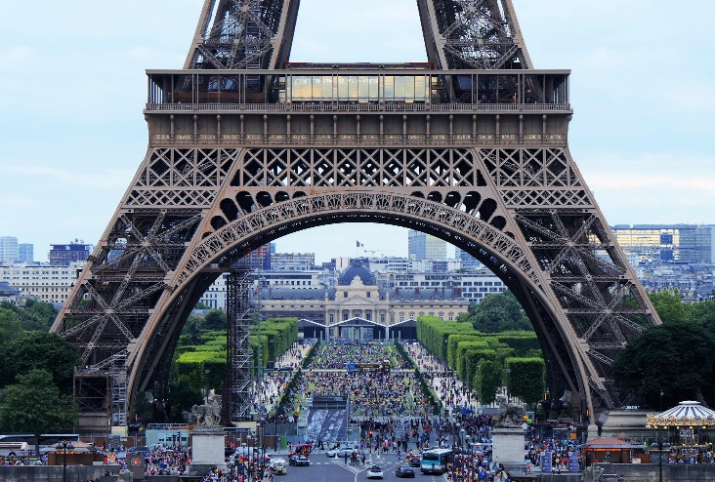
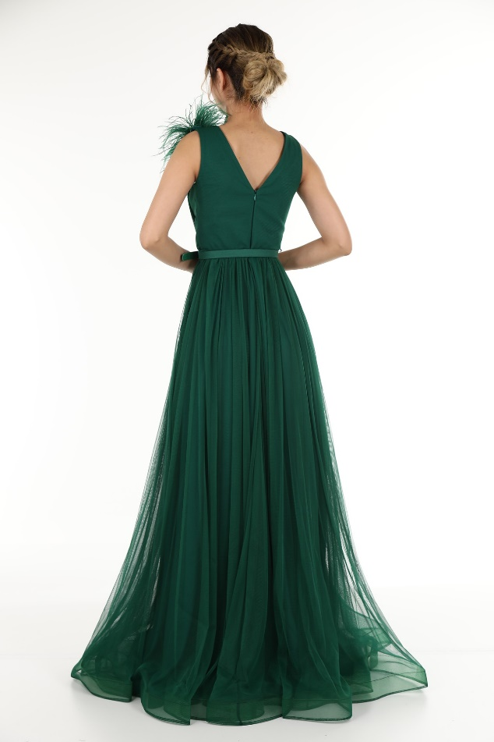
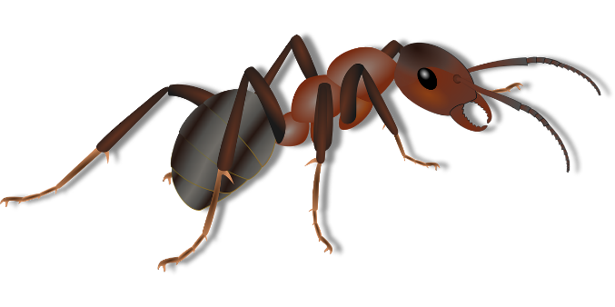
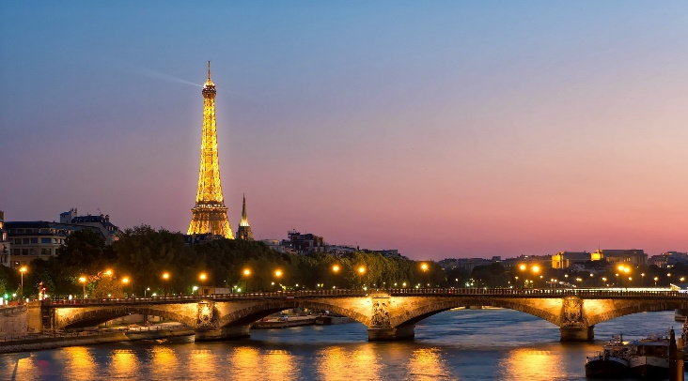
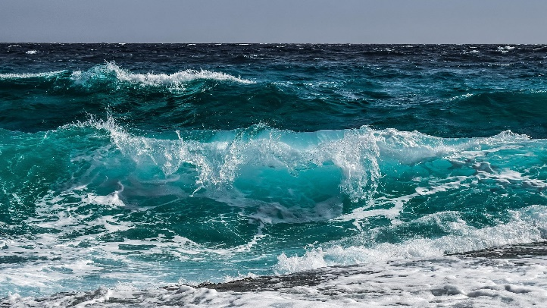
Les deux poèmes
parler
Quelles images vont avec quel poème ?
Notes:
Timing: 2 minutes [slide 1/2]
Aim: Comprehension of images in poems
Procedure:
Students decide which pictures go with which poem. Some pictures could relate to both poems.
Check answers on next slide.
Word frequency of cognates used (1 is the most frequent word in French): image [659]
Source: Lonsdale, D., & Le Bras, Y. (2009). A Frequency Dictionary of French: Core vocabulary for learners London: Routledge.

Slide 26
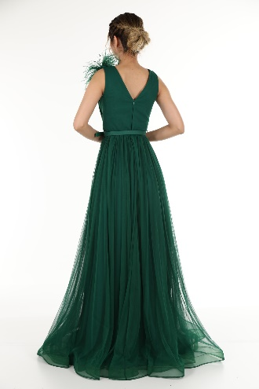
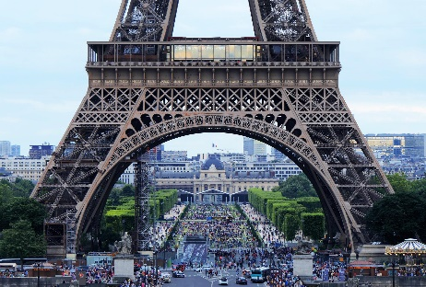
Les deux poèmes
parler
Quelles images vont avec quel poème ?
Chanson de la Seine
La Tour Eiffel
Notes:
[slide 2/2]

Slide 27
Les deux poèmes
parler
Quelles sont les différences et les similarités entre les deux poèmes ?
Parle avec ton/ta partenaire.
Chaque poème…
Tous les deux poèmes…
la même idée
Ce poème contient plusieurs images de…
L’autre poème…
Notes:
Timing: 6 minutes
Aim: Oral production of indefinite adjectives and discussion of literary texts
Procedure:
1. Students use the phrases provided to discuss differences and similarities between the two poems.
Word frequency of cognates used (1 is the most frequent word in French): différence [738], similarité [>5000], image [659]
Source: Lonsdale, D., & Le Bras, Y. (2009). A Frequency Dictionary of French: Core vocabulary for learners London: Routledge.

Slide 28
Un quiz
Vrai ou faux ?
lire
*le pantalon = trousers
Les parisiens ont toujours aimé la tour Eiffel.
2. À Paris, il y a plus de chiens que d’enfants.
3. Jusqu’à 2012, il y avait une loi qui interdisait les pantalons* pour les femmes.
On utilise toutes les stations de métro.
Il y a des îles à Paris.
Faux – quand on a construit la tour Eiffel en 1889, elle n’était pas populaire.
Vrai – il y a 300.000 chiens et 150.000 enfants.
Vrai – mais il y a longtemps, la police a décidé d’oublier cette loi.
Faux – il y a quatorze stations qu’on n’utilise pas en ce moment.
Vrai – il y a deux îles naturelles – l’Île de la Cité et l’Île Saint-Louis - et une île artificielle – l’Île aux Cygnes dans la Seine. La cathédrale de Notre-Dame se trouve sur l’Île de la Cité.
Notes:
Timing: 10 minutes (two slides)
Aim: Written comprehension and cultural information
Procedure:
1. Students decide whether each statement is true or false, and vote with hands up or mini whiteboards.
2. Click to reveal answers and extra information.
3. Elicit translations of the information.
Word frequency (1 is the most frequent word in French): pantalon [4670]
Source: Lonsdale, D., & Le Bras, Y. (2009). A Frequency Dictionary of French: Core vocabulary for learners London: Routledge.

Slide 29
Un quiz
Vrai ou faux ?
lire
*l’œuvre (f.) = work (of art)
6. Il y a une plage à Paris.
7. Il n’y a pas de parc à Paris.
8. Le Louvre est très petit.
9. On ne peut pas regarder toutes les œuvres du Louvre.
10. On ne peut pas visiter la cathédrale de Notre-Dame en ce moment.
Vrai – ils ont créé une plage à côté de la Seine.
Faux – il y a 450 parcs et jardins.
Faux – il contient plus de 500.000 œuvres*.
Vrai – il y a seulement 35.000 œuvres dans les salles publiques.
Vrai – on a fermé la cathédrale après un feu en 2019, mais on peut faire une promenade dehors pour regarder le bâtiment.
Notes:
Slide 2/2

Slide 30
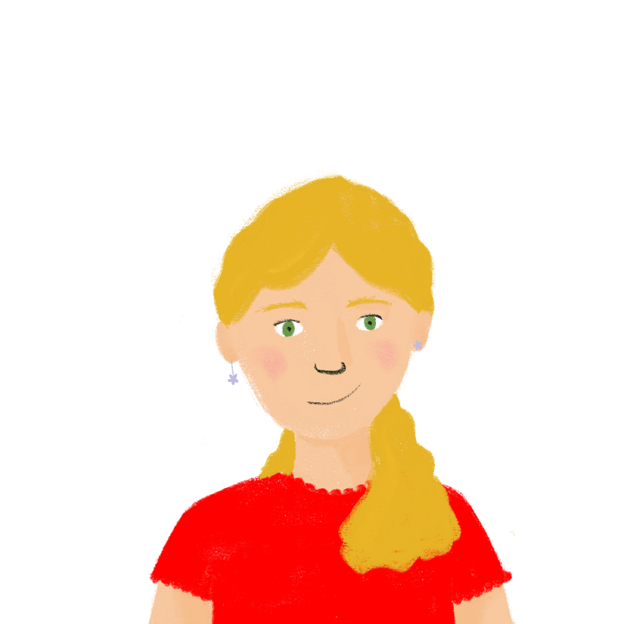
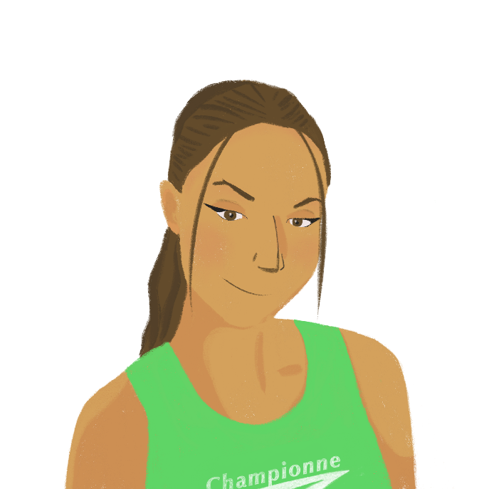
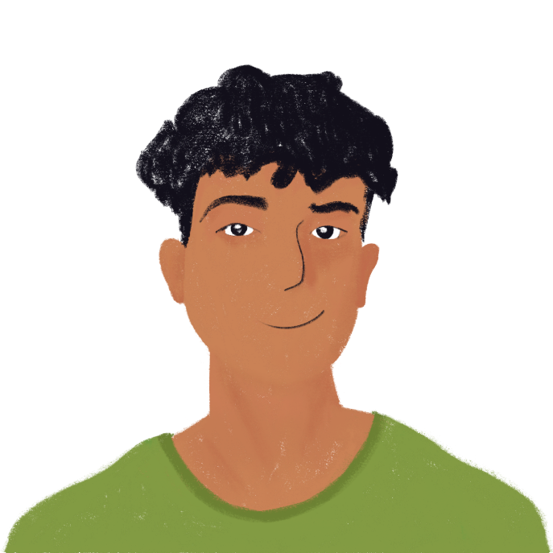
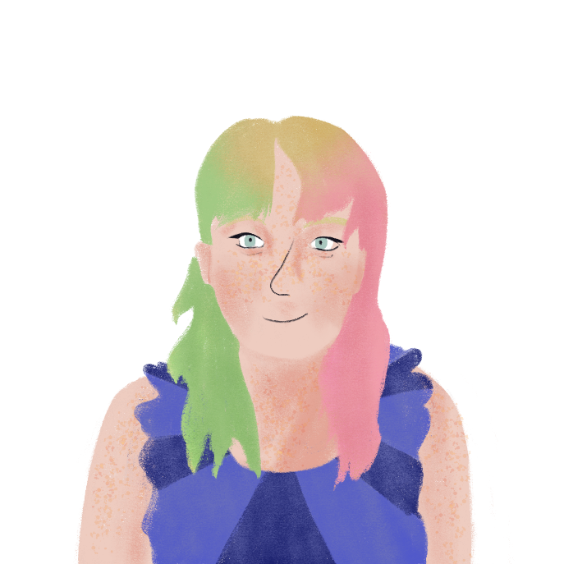
Bonnes vacances !
Why not explore Paris with a virtual tour on this website? There are lots of landmarks and attractions to choose from!
https://en.parisinfo.com/what-to-do-in-paris/info/guides/virtual-visit-paris

