Slide 1
Talking about universal experiences: La pandémie de covid-19
impersonal expressions: il est + adjective + de
verbs with à and de before an infinitive
impersonal pronoun on
Y9 French
Term 3.1 - Week 5 - Lesson 55
Author name: Natalie Finlayson / Louise Bibbey
Artwork by: Chloé Motard
Date updated: 08/08/2022
Notes:
Artwork by Chloé Motard. All additional pictures selected are available under a Creative Commons license, no attribution required.
Native speaker feedback provided by Stephanie Schmitt.
With thanks to Rachel Hawkes for her input on the lesson material.
Learning outcomes (lesson 1):
Introduction of impersonal expressions with il est + adjective + de
Revision of verbs with à and de before an infinitive
Revision of impersonal pronoun on
Word frequency (1 is the most frequent word in French):
9.3.1.5 (introduce): annuler [2002], arriver² à [172], continuer (à/de) [113], décider (de) [165], essayer (de) [303], voler² [1610], bise [>5000], isolement [4033], masque [3856], pandémie [>5000], vaccin [>5000], vol² [1531], impossible [652], interdit [4451], mondial [549], nécessaire [451]
9.2.2.3 (revisit): participer à [670], artiste [1797], concours [1375], défi [1728], diversité [2537], émission [1074], genre [556], personnage [1449], sexe [1691], scène [794], spectacle [1687], annuel [1674], culturel [1495], non-binaire [>5000], transgenre [>5000]
9.2.1.3 (revisit): entrer [337], monter [853], retourner [990], tomber [547], après-midi [596], attente [936], corps [561], doigt [1938], dos [1672], médicament [1954], pied [626], santé [641], situation [223], soir [397], urgence [1199], faible [723], seulement [130], trop [195]
Source: Lonsdale, D., & Le Bras, Y. (2009). A Frequency Dictionary of French: Core vocabulary for learners London: Routledge.
The frequency rankings for words that occur in this PowerPoint which have been previously introduced in NCELP resources are given in the NCELP SOW and in the resources that first introduced and formally re-visited those words.
For any other words that occur incidentally in this PowerPoint, frequency rankings will be provided in the notes field wherever possible.
The additional English meanings of the following words have been added to Quizlet since the creation of this resource:
arriver à + infinitive - to manage to, to succeed in
continuer (à/de + infinitive) – to continue, to carry on
nécessaire – necessary, required
mondial - global, worldwide
interdit – not allowed, prohibited, banned

Slide 2
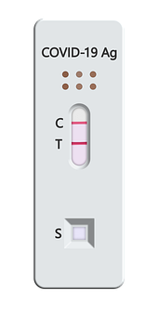
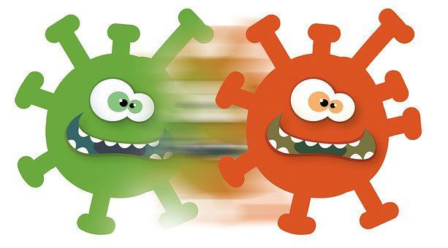
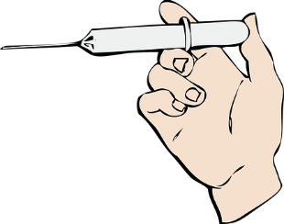
Le vocabulaire de la pandémie
parler
Plusieurs mots sont proches de l'anglais. Mais quelle est la prononciation en français ?
Attention ! The -s is not an SFC.
la distanciation sociale
le covid-19
le test
le virus
Attention ! The -cc- sounds like English.
la vaccination
le variant
la quarantaine
l’épidémie
Notes:
Timing: 5 minutes
Aim: Revisit several SSC; reading aloud; scene setting and introducing some cognates and near cognates relevant to the theme (some of which are used later in the lesson); pronunciation of written cognates.
Procedure:
1. In pairs, students read the words and consider which SSCs are similar to English, and which are different. Click to reveal the bubbles with additional support for unknown SSCs and exceptions.
2. Students practise reading the words aloud.
3. Click on a picture to hear a word read aloud by a native speaker. Students repeat. Note that there is some debate over the gender of covid-19; the masculine form is more widely used in everyday conversation, but l’Academie Francaise favour a feminine article as in line with the rule which determines the gender of acronyms (coronavirus disease – la maladie). We have opted for the masculine here as it is the form students are more likely to encounter, but either form is accepted.
Transcript
le covid-19 le test le virus la distanciation sociale
le vaccination
le variant
le quarantaine
l’épidémie
Word frequency of cognates used (1 is the most frequent word in French):
prononciation [>5000], covid-19 [>5000], test [1788], virus [3382], distanciation [>5000], vaccination [>5000], variant [>5000], quarantaine [4288], épidémie [4283] Source: Lonsdale, D., & Le Bras, Y. (2009). A Frequency Dictionary of French: Core vocabulary for learners London: Routledge.

Slide 3
Association de mots
lire
IMPORTANT
COVID
CONCLUDE
AIRPORTS
CANNOT HAPPEN
MAKE AN EFFORT
THE FACE
WORLDWIDE
continuer can be followed by both ‘à’ and ‘de’! continuer à + something that started happening recently continuer de + something that has been happening for a long time and doesn’t stop
Quels mots associes-tu avec …
1. le vol | 2. continuer (à/de) | 3. mondial | 4. nécessaire
5. interdit | 6. le masque | 7. annuler | 8. la bise
9. arriver à | 10. essayer (de) | 11. le vaccin | 12. la pandémie
13. l'isolement (m.) | 14. décider (de) | 15. impossible | 16. voler
1. le vol | 2. continuer (à/de) | 3. mondial | 4. nécessaire
5. interdit | 6. le masque | 7. annuler | 8. la bise
9. arriver à | 10. essayer (de) | 11. le vaccin | 12. la pandémie
13. l'isolement (m.) | 14. décider (de) | 15. impossible | 16. voler
1. le vol | 2. continuer (à/de) | 3. mondial | 4. nécessaire
5. interdit | 6. le masque | 7. annuler | 8. la bise
9. arriver à | 10. essayer (de) | 11. le vaccin | 12. la pandémie
13. l'isolement (m.) | 14. décider (de) | 15. impossible | 16. voler
1. le vol | 2. continuer (à/de) | 3. mondial | 4. nécessaire
5. interdit | 6. le masque | 7. annuler | 8. la bise
9. arriver à | 10. essayer (de) | 11. le vaccin | 12. la pandémie
13. l'isolement (m.) | 14. décider (de) | 15. impossible | 16. voler
1. le vol | 2. continuer (à/de) | 3. mondial | 4. nécessaire
5. interdit | 6. le masque | 7. annuler | 8. la bise
9. arriver à | 10. essayer (de) | 11. le vaccin | 12. la pandémie
13. l'isolement (m.) | 14. décider (de) | 15. impossible | 16. voler
1. le vol | 2. continuer (à/de) | 3. mondial | 4. nécessaire
5. interdit | 6. le masque | 7. annuler | 8. la bise
9. arriver à | 10. essayer (de) | 11. le vaccin | 12. la pandémie
13. l'isolement (m.) | 14. décider (de) | 15. impossible | 16. voler
1. le vol | 2. continuer (à/de) | 3. mondial | 4. nécessaire
5. interdit | 6. le masque | 7. annuler | 8. la bise
9. arriver à | 10. essayer (de) | 11. le vaccin | 12. la pandémie
13. l'isolement (m.) | 14. décider (de) | 15. impossible | 16. voler
1. le vol | 2. continuer (à/de) | 3. mondial | 4. nécessaire
5. interdit | 6. le masque | 7. annuler | 8. la bise
9. arriver à | 10. essayer (de) | 11. le vaccin | 12. la pandémie
13. l'isolement (m.) | 14. décider (de) | 15. impossible | 16. voler
1. le vol | 2. continuer (à/de) | 3. mondial | 4. nécessaire
5. interdit | 6. le masque | 7. annuler | 8. la bise
9. arriver à | 10. essayer (de) | 11. le vaccin | 12. la pandémie
13. l'isolement (m.) | 14. décider (de) | 15. impossible | 16. voler
The verbs listed here with ‘à’ and ‘de’ are followed by another verb in long form (infinitive).
décider de can also be followed by a noun (to decide on something)
Notes:
Timing: 4 minutes
Aim: Written recognition of new vocabulary; building associations between concepts.
Procedure:
1. Read through the words, drawing particular attention to the French pronunciation of SSCs in near-cognates which differ cross-linguistically (e.g., continuer, nécessaire, interdit, arriver, vaccin, pandémie, isolement, decider, impossible. Students repeat.
2. Click to reveal a yellow box with a concept in English. Tell students to look for French words that they associate with the concept, and write down the corresponding numbers.
3. Click to reveal some suggested answers. Note that given the subjectivity in this type of exercise, students will inevitably find other associations than those shown here, e.g. masque for airports. Teachers should use their discretion where a convincing case is made.
4. Click to clear the board and reveal another concept in English.
5. Repeat steps 2-4 for a total of 8 concepts.
6. Click to reveal a reminder about verbs with ‘à’ and ‘de’ followed by an infinitive. This grammar point was introduced in the previous week (Y9, T3.1, W5) and is recapped in the exercise on the next slide.
7. We have taken the decision to introduce continuer à and continuer de in the same lesson as we felt the difference was best explained in a contrast. To help students memorise the difference, use the mnemonic continuer de/doesn’t stop, or use alphabetical order (a – started recently; d – started further in the past). An example of each scenario would be continuer de with the effects of the ongoing pandemic, and continuer à with the process of learning the words in this set, introduced just this week. At KS3, however, we recommend tolerance in production (i.e., not penalising use of à rather than de and vice versa).
Word frequency of cognates (1 is the most frequent word in French):
association [956], associer [1422] Source: Lonsdale, D., & Le Bras, Y. (2009). A Frequency Dictionary of French: Core vocabulary for learners London: Routledge.

Slide 4
essayer (de)
[to try (to) | trying (to)]
essaie/essaye (de)
[tries (to) | is trying (to)]
Notes:
Timing: 2 minutes [1/6]
Aim: to introduce the verb essayer (de) more explicitly. Essayer (de) is one of the NCELP prototypical verbs in French. Prototypical verbs are common verbs that illustrate the typical characteristics of a class of verb – the French prototypical verbs contain examples of regular/weak verbs, but also common examples of changes to the stem. All 15 prototypical verbs will be introduced early on using the same format. Both long form (infinitive) and short form (3rd person singular) are introduced in order to familiarise students with various forms of the same verb.
Procedure
Bring up the word essayer (de) on its own, say it, students repeat it, and remind them of the phonics. Draw attention to the pronunciation of [ay], which is an SSC students have not yet encountered.
Try to elicit the meaning from the students. Students have had explicit teaching that the present tense in French communicates two different present tense meanings in English. This reinforces that learning. Emphasise the two meanings for the short form, reminding students that French only has one form and does not have a direct equivalent of the grammar for ‘is + ing’, the continuous form (as covered in previous weeks).
Bring up the picture, and, if using gestures, a possible gesture would be to try to push or lift something heavy.
Then bring up the English translations. Emphasise the two meanings for the infinitive.
Bring up the short form essaie/essaye (de) say it, students repeat it. Draw attention to the two possible spellings of the short from, which are pronounced the same way.
Try to elicit the meaning from the students. Emphasise the two meanings for the short form.

Slide 5
essayer (de)
[to try (to) | trying (to)]
essaie/essaye (de)
[tries (to) | is trying (to)]
Notes:
Cycle through the long and short form again.

Slide 6
essaie/essaye (de)
[tries (to) | is trying (to)]
J’essaie d’être calme sur scène.
[I try to | I am trying to be calm on stage.]
Notes:
Introduce the short form in a sentence.

Slide 7
essayer (de)
[to try (to) | trying (to)]
Il faut essayer d’être calme sur scène.
[You have to try to be calm on stage.]
Notes:
Introduce the long form in a sentence.

Slide 8
essaie/essaye (de)
[tries (to) | is trying (to)]
essaie
J’ d’être calme sur scène.
[I try to | I am trying to be calm on stage.]
Notes:
Cycle through the short form in context again.

Slide 9
essayer (de)
[to try (to) | trying (to)]
Il faut d’être calme sur scène.
essayer
[You have to try to be calm on stage.]
Notes:
Cycle through the long form in context again.

Slide 10
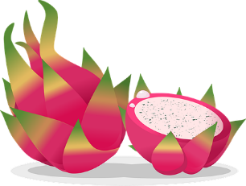
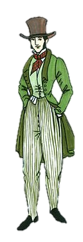
Des verbes avec ‘à’ et ‘de’
lire
The four new verbs in this weeks set can be used with or without the preposition.
Que font-ils ? Complète les phrases.
1. L’artiste décide de … a) participer au concours annuel. b) maintenant.
2. Je continue … a) l’attente. b) dormir.
3. Tu essayes … a) représenter la diversité culturelle. b) un nouveau fruit.
4. Elle arrive … a) finir ses devoirs. b) tôt.
5. On essaye d’ … a) éliminer des inégalités entre les sexes. b) un manteau vert.
6. Nous arrivons à … a) faire progresser l'égalité des genres. b) en retard.
7. Vous continuez à … a) votre promenade dans la forêt. b) marcher.
8. Il décide de … a) la couleur de sa chambre. b) retourner.
Both answers are correct here as décider de can be followed by either a noun or a verb.
Notes:
Timing: 4 minutes
Aim: To revise constructions with verbs that sometimes take prepositions à and de (first introduced in the previous week 9.3.1.4); written recognition of this week’s new verbs in context.
Procedure:
1. Remind students that these four verbs must be followed by either à or de if they are to precede a second verb.
2. Students read the first half of the sentences and decide, based on the presence or absence of a preposition, what the second half must be.
3. Teacher elicits answers by asking students to say (in English) what is happening in each case, e.g. ‘what is the artist doing?’
4. Click to reveal answers.
Word frequency of cognates (1 is the most frequent word in French): compléter [2034], préposition [>5000], verbe [>5000], représenter [293], éliminer [1454], inégalité [3145], progresser [856], égalité [1898]
Source: Londsale, D., & Le Bras, Y. (2009). A Frequency Dictionary of French: Core vocabulary for learners London: Routledge.

Slide 11
Des gros titres
probablement = probably | privé = private
obligatoire = obligatory | parfait = perfect
écouter
“I CAN’T KISS YOU ON THE CHEEK, THERE’S COVID”: THE PERFECT EXCUSE
COVID-19 PANDEMIC CONTINUES TO AFFECT GLOBAL ECONOMY
GOVERNMENT DECIDES ON TEN DAYS’ ISOLATION FOR EVERY PERSON WITH A POSITIVE TEST
A
B
MASKS ARE BECOMING OBLIGATORY ALL OVER FRANCE ON MONDAY
BEACHES, PARKS AND GARDENS BANNED IN QUIBERON IN THE EVENINGS
C
D
E
THE VERY RICH ARE MANAGING TO FLY IN PRIVATE JETS
F
IMPOSSIBLE TO TRAVEL: MORE THAN 7,000 FLIGHTS CANCELLED ON CHRISTMAS WEEKEND
COVID-19 VACCINE: A THIRD DOSE “PROBABLY” NECESSARY
H
G
1
2
3
4
5
6
7
8
Notes:
Timing: 8 minutes
Aim: Oral recognition of new vocabulary in context; working with (adapted) authentic texts to hear covid-19 vocabulary in context; cultural awareness: style of French newspaper headlines.
Procedure:
Ask students to guess what the activity title means. They have encountered the word gros with the translation ‘fat’ before.
Explain that students are going to hear eight French headlines read aloud and that they will have to match what they hear with the English translation. The headlines contain a mixture of known vocabulary, new vocabulary and (near-)cognates. NCELP does not normally recommend including unknown cognates in listening exercises, but it should be possible for students to recognise these in this instance as the English translations are displayed. All headlines are authentic headlines (or adapted versions) taken from the covid-19 section of Le Monde. Links to the articles are provided below. All words in this week’s new set are included with the exception of essayer, which is practised separately (see set of verb slides commencing on next slide) on account of its unusual spelling variation and inclusion of unknown SSC [ay].
Give students a minute to familiarise themselves with the English headlines. Explain that Quiberon is a part of Brittany.
Click on a number to hear a French headline read aloud. Students write the number of the equivalent English translation.
On clicks, the correct answers spin in order of audio.
Click to play the audio again. Students read along.
Transcript:
Vaccin contre le covid-19 : une troisième dose « probablement » nécessaire (G)
Impossible de voyager: on annule plus de 7,000 vols le week-end de Noël (H)
Lundi, le masque devient obligatoire à l’école dans toute la France (D)
La pandémie de covid-19 continue d’affecter l’économie mondiale (B)
Le gouvernement décide d’un isolement de dix jours pour toute personne avec un test positif (C)
« Je ne peux pas faire la bise, il y a le Covid » : l’excuse parfaite (A)
Les très riches arrivent à voler en jets privés (F)
Plages, parcs et jardins interdits le soir à Quiberon (E)
Word frequency of unknown words (1 is the most frequent word in French):
probablement [903], obligatoire [2524], parfait [1600], privé [1401]
Source: Lonsdale, D., & Le Bras, Y. (2009). A Frequency Dictionary of French: Core vocabulary for learners London: Routledge.
Word frequency of cognates (1 is the most frequent word in French):
titre [399], Covid [n/a], dose [4229], week-end [2475], affecter [1396], économie [387], gouvernement [160], test [1788], excuse [1839], riche [599], jet [4454] Source: Lonsdale, D., & Le Bras, Y. (2009). A Frequency Dictionary of French: Core vocabulary for learners London: Routledge.
Sources
1. https://www.lemonde.fr/planete/article/2021/04/16/vaccin-contre-le-covid-19-une-troisieme-dose-de-pfizer-probablement-necessaire-assure-le-pdg_6076973_3244.html
2. https://www.lemonde.fr/planete/article/2021/12/25/covid-19-dans-le-monde-plus-de-4-500-vols-annules-le-week-end-de-noel-la-chine-en-alerte_6107282_3244.html
3. https://www.lemonde.fr/education/article/2021/11/10/covid-19-le-masque-redevient-obligatoire-a-l-ecole-dans-toute-la-france-a-partir-de-lundi_6101560_1473685.html
4. https://www.lemonde.fr/economie/article/2022/01/17/la-pandemie-de-covid-19-continue-de-menacer-la-reprise-economique-mondiale_6109806_3234.html
5. https://www.lemonde.fr/politique/article/2021/07/14/covid-19-le-gouvernement-envisage-d-imposer-un-isolement-de-dix-jours-pour-toute-personne-dont-le-test-est-positif_6088251_823448.html
6. https://www.lemonde.fr/m-perso/article/2021/03/25/je-peux-pas-il-y-a-le-covid-l-excuse-parfaite_6074462_4497916.html
7. https://www.lemonde.fr/economie/article/2021/11/17/avec-la-pandemie-de-covid-19-les-riches-privilegient-l-aviation-d-affaires_6102393_3234.html
8. https://www.lemonde.fr/planete/article/2020/07/26/coronavirus-plages-parcs-et-jardins-interdits-le-soir-a-quiberon_6047341_3244.html

Slide 12
il est + adjective + de
grammaire
In grammar, the word ‘impersonal’ does not mean ‘unfriendly!’ It means that a statement applies to everyone, rather than a specific person or group.
You already know how to use an impersonal pronoun, ‘on’, to talk about what people in general do. It is followed by a verb in short form:
On porte des masques ici. People wear masks here.
Another way to talk about how things are for people in general is to use an impersonal expression with il est + adjective + de:
Il est nécessaire de porter des masques ici. It is necessary to wear masks here.
Like verbs with de, impersonal expressions with de are followed by verbs in long form.
Adjectives in impersonal phrases are always in the masculine form.
In impersonal phrases with il est + adjective + de, ‘il’ normally means ‘it’ (and never means ‘he’).
Notes:
Timing: 3 minutes
Aim: to recap the structure of impersonal phrases with on and introduce the structure of impersonal phrases with il est + adjective + de.

Slide 13
il est + adjective + de
parler
il est
+
adjective
+
de
+
long form (infinitive)
Attention !
The English translation for il est interdit de is a little different.
Il est interdit de monter sur les pyramides !
Climbing on the pyramids is forbidden!
it is
+
adjective
+
to
+
verb
How would you say …
il est
important
facile
utile
impossible
possible
bon
difficile
de
d'
monter
tomber
entrer
essayer
participer
poser des questions
retourner
it is
important
difficult
useful
possible
good
easy
impossible
to
enter
participate
go up
ask questions
return
try
fall
Notes:
Timing: 3 minutes
Aim: Oral production of impersonal phrases with il est + adjective + de + infinitive
Procedure:
Invite students to provide a French equivalent of the orange English construction.
Click to reveal. Draw attention to the parallels between the English and French structures.
Click to reveal an impersonal expression in English.
In pairs, students produce a French equivalent phrase.
Click to reveal.
Repeat steps 3-5 for 7 phrases in total.
Click to reveal the bubble explaining the exception il est interdit de which takes a slightly different structure in its most idiomatic English translation.
Word frequency of cognates (1 is the most frequent word in French):
pyramide [>5000] Source: Lonsdale, D., & Le Bras, Y. (2009). A Frequency Dictionary of French: Core vocabulary for learners London: Routledge.

Slide 14
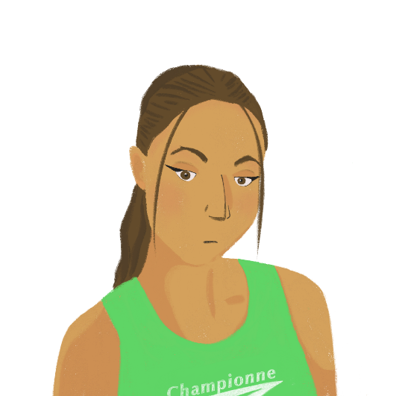
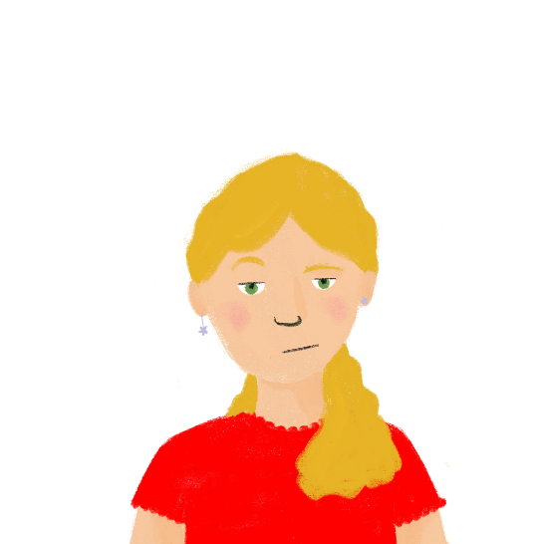
Les règles covid en France
*passe sanitaire = proof of vaccination or negative test *le couvre-feu = curfew
lire
Océane et Léa parlent des défis de la pandémie. Que disent-elles ? Complète les phrases. Quelles règles sont les mêmes qu’en Angleterre, et quelles règles sont différentes ?
1. Il est difficile de sortir en France en ce moment.
5. Il est interdit de manger ou boire dans le cinéma et dans le train.
1. On/il est difficile de
5. On/il est interdit de
On respecte une distanciation d’un mètre entre les personnes.
2. On/il est impossible de
6. On ne peut pas voyager.
6. On/il est important de
7. Il est nécessaire d’ annuler beaucoup de vols.
3. Il est possible de participer aux activités sociales avec un passe sanitaire*.
7. On/il est nécessaire d’
3. On/il est possible de
8. On
sait que les règles sont importantes, mais c’est une situation difficile.
8. On/il est essentiel de
4. Mais, on a un couvre-feu* à 18 heures.
4. Mais, on/il est bizarre d’
Notes:
Timing: 8 minutes
Aim: Written recognition of impersonal pronoun on + short form and impersonal expressions with il est + adjective + de + long form; listening comprehension; cultural awareness: similarities and differences between COVID laws in France and the UK.
Procedure:
1. Students read the non-bolded parts of the sentences and decide whether on or an impersonal expression must precede them, based on the verb form they see.
2. Answers revealed on clicks.
3. Students sketch two columns headed les mêmes and différentes. They re-read the sentences, decide whether the rules are have also been in place in England at some point, and write and English summary of each rule in the appropriate column.
4. Answers may be found on the next slide.
Word frequency of unknown words (1 is the most frequent word in French):
couvre-feu [>5000], sanitaire [4501]
Source: Lonsdale, D., & Le Bras, Y. (2009). A Frequency Dictionary of French: Core vocabulary for learners London: Routledge.
Word frequency of cognates (1 is the most frequent word in French):
certificat [3604], bizarre [2756], essentiel [675], mètre [1534], respecter [673], distanciation [>5000], passe [4295] Source: Lonsdale, D., & Le Bras, Y. (2009). A Frequency Dictionary of French: Core vocabulary for learners London: Routledge.

Slide 15
Les règles du covid en France
lire
les mêmes
différentes
not possible to travel
necessary to cancel a lot of flights
social distancing of 1 metre
possible to participate in social events with a passe sanitaire
18.00 curfew
eating and drinking in cinemas and trains is banned
Notes:
[2/2]
Answers revealed on clicks.

Slide 16
Faire la bise ou ne pas faire la bise?
*la joue = cheek
écouter
La bise, c’est une salutation française. On fait une bise dans l’air à côté de la joue.*
Quel effet a la pandémie sur cette tradition ? Écoute, complète et réponds aux questions.
1
on / il est nécessaire de
2
on / il est naturel de
3
on / il est possible de
4
on / il est normal de
5
on / il est interdit de
6
on / il est impossible de
7
on / il est triste de
8
on / il est heureux de
Notes:
Timing: 8 minutes [1/2]
Aim: Aural recognition of of impersonal pronoun on + short form and impersonal expressions with il est + adjective + de + long form; listening comprehension; cultural awareness: la bise.
Procedure:
1. Check students understand what is meant by faire la bise from the introductory text and picture.
2. Click on the numbers to hear sentences with the pronoun ‘on’ or impersonal expression obscured.
3. Students must listen to the form of the verb after the beep to decide whether on or an impersonal expression is missing.
4. Click to reveal answers one by one.
5. Move to the next slide for the comprehension part of the activity.
6. A short supplementary video about the effects of the pandemic on la bise (mix of English and French with English subtitles) can be found here: https://www.france24.com/en/video/20210929-france-la-bise-makes-a-comeback-as-pandemic-recedes
Transcript:
1. En France, [on] fait la bise pour dire bonjour et au revoir.
2. [Il est naturel de] faire la bise plusieurs fois par jour avec sa famille et ses amis.
3. Parfois, [on] dit bonjour à ses collègues comme ça aussi.
4. En général, [on] fait deux bises, mais ça dépend de la région.
5. Pendant la pandémie, [il est interdit d’]être à moins d'un mètre d’autres personnes.
6. Donc, [il est impossible de] continuer à faire des bises en ce moment.
7. [Il est triste de] penser qu’on perd cette vieille tradition.
8. Mais [on] croit que les personnes qui ont eu le vaccin vont recommencer à faire des bises.
Word frequency of unknown words (1 is the most frequent word in French):
joue [3932] Source: Lonsdale, D., & Le Bras, Y. (2009). A Frequency Dictionary of French: Core vocabulary for learners London: Routledge.
Word frequency of cognates (1 is the most frequent word in French):
salutation [>5000], effet [173], compléter [2034], normal [833], mètre [1534] Source: Lonsdale, D., & Le Bras, Y. (2009). A Frequency Dictionary of French: Core vocabulary for learners London: Routledge.

Slide 17
Bise ou pas bise ?
*la joue = cheek
écouter
La bise, c’est une salutation française. On fait une bise dans l’air à côté de la joue.*
Quel effet a la pandémie sur cette tradition ? Écoute, complète et réponds aux questions.
1
You can kiss someone’s cheeks to say both ‘hello’ and ‘goodbye’.
T
T
2
You often kiss the cheeks of friends and family.
F
3
You can’t kiss the cheeks of colleagues.
F
4
The number of kisses is the same all over France.
T
5
You must be at least one metre away from other people.
F
6
You can continue kissing people on the cheeks for now.
F
7
Kissing people on the cheeks is a recent craze in France.
F
8
People who have had the vaccine are going to stop doing ‘la bise’.
Notes:
Timing: 8 minutes [2/2]
Procedure:
1. Click on the numbers to hear the sentence read in full.
2. Students decide whether the accompanying statement is true or false.
3. Click to reveal answers.
Transcript:
1. En France, on fait la bise pour dire bonjour et au revoir.
2. Il est naturel de faire la bise plusieurs fois par jour avec sa famille et ses amis.
3. Parfois, on dit bonjour à ses collègues comme ça aussi.
4. En général, on fait deux bises, mais ça dépend de la région.
5. Pendant la pandémie, il est interdit d’être à moins d'un mètre des autres personnes.
6. Donc, il est impossible de continuer à faire des bises en ce moment.
7. Il est triste de penser qu’on perd cette vieille tradition.
8. Mais on croit que les personnes qui ont eu le vaccin vont recommencer à faire des bises.
Word frequency of unknown words (1 is the most frequent word in French):
joue [3932] Source: Lonsdale, D., & Le Bras, Y. (2009). A Frequency Dictionary of French: Core vocabulary for learners London: Routledge.
Word frequency of cognates (1 is the most frequent word in French):
salutation [>5000], effet [173], compléter [2034], normal [833], mètre [1534] Source: Lonsdale, D., & Le Bras, Y. (2009). A Frequency Dictionary of French: Core vocabulary for learners London: Routledge.

Slide 18
Les effets positifs de la pandémie
Remember! Adjectives in impersonal phrases are in the masculine form.
écrire
Noura essaie d’avoir une attitude positive. Elle écrit quoi ? Complète les phrases.
1. J’ai le temps de regarder des émissions intéressantes. (interesting)
2. On arrive à rester en contact. Il est facile de parler sur Zoom. (easy)
3. Je suis heureuse parce que mon papa travaille à la maison. (happy)
4. Il est bon de passer plus de temps avec sa famille. (good)
5. Il est nécessaire de devenir une élève plus indépendante. (necessary)
6. Nous apprenons des compétences importantes pour la vie. (important)
7. Il y a de grands avantages (m.) pour l’environnement. (big)
8. Il est intéressant de savoir qu’il y a moins de pollution maintenant. (interesting)
9. Je pense que les gens deviennent plus proches. (close)
10. Il est naturel d’aider les autres pendant une crise*mondiale. (natural)
___________
___________
______
______
________
__________
____
_______
__________
______
*crise = crisis
Notes:
Timing: 5 minutes
Aim: Written production of adjectives as noun complements and in impersonal phrases; revision of adjective agreement.
Procedure:
1. Remind students that all adjectives in impersonal phrases are in masculine form, whereas adjectives that describe a noun must agree with the gender and number of that noun.
2. Students read the sentences and decide which adjectives are part of impersonal phrases, and which are noun complements.
3. Students translate the orange adjectives into French, and add agreements where necessary.
4. Answers revealed on clicks.
5. Whole class translation.
Word frequency of unknown words (1 is the most frequent word in French): crise [765]
Source: Londsale, D., & Le Bras, Y. (2009). A Frequency Dictionary of French: Core vocabulary for learners London: Routledge.
Word frequency of cognates (1 is the most frequent word in French): contact [894], effet [173], compléter [2034], indépendant [954], avantage [900], environnement [945], pollution [3073]
Source: Londsale, D., & Le Bras, Y. (2009). A Frequency Dictionary of French: Core vocabulary for learners London: Routledge.

Slide 19
Talking about universal experiences: La pandémie de covid-19
impersonal expressions: il est + adjective + de
impersonal phrases, weather expressions
word pattern: noun root + -al → adj
SSCs [a] and [au]
Y9 French
Term 3.1 - Week 5 - Lesson 56
Author name: Natalie Finlayson and Louise Bibbey
Artwork by: Chloé Motard
Date updated: 08/08/2022
Notes:
Artwork by Chloé Motard. All additional pictures selected are available under a Creative Commons license, no attribution required.
Native speaker feedback provided by Stephanie Schmitt.
With thanks to Rachel Hawkes for her input on the lesson material.
Learning outcomes (lesson 2):
Consolidation of impersonal verbs with adjectives + de
Revision of impersonal phrases: il (n)'y a/avait (pas), il (ne) faut (pas), weather expressions
Introduction of word pattern: noun root + al → adj
Word frequency (1 is the most frequent word in French):
9.3.1.5 (introduce): annuler [2002], arriver² à [172], continuer (à/de) [113], décider (de) [165], essayer (de) [303], voler² [1610], bise [>5000], isolement [4033], masque [3856], pandémie [>5000], vaccin [>5000], vol² [1531], impossible [652], interdit [4451], mondial [549], nécessaire [451]
9.2.2.3 (revisit): participer à [670], artiste [1797], concours [1375], défi [1728], diversité [2537], émission [1074], genre [556], personnage [1449], sexe [1691], scène [794], spectacle [1687], annuel [1674], culturel [1495], non-binaire [>5000], transgenre [>5000]
9.2.1.3 (revisit): entrer [337], monter [853], retourner [990], tomber [547], après-midi [596], attente [936], corps [561], doigt [1938], dos [1672], médicament [1954], pied [626], santé [641], situation [223], soir [397], urgence [1199], faible [723], seulement [130], trop [195]
Source: Lonsdale, D., & Le Bras, Y. (2009). A Frequency Dictionary of French: Core vocabulary for learners London: Routledge.
The frequency rankings for words that occur in this PowerPoint which have been previously introduced in NCELP resources are given in the NCELP SOW and in the resources that first introduced and formally re-visited those words.
For any other words that occur incidentally in this PowerPoint, frequency rankings will be provided in the notes field wherever possible.
The additional English meanings of the following words have been added to Quizlet since the creation of this resource:
arriver à + infinitive - to manage to, to succeed in
continuer (à/de + infinitive) – to continue, to carry on
nécessaire – necessary, required
mondial - global, worldwide
interdit – not allowed, prohibited, banned

Slide 20
a
animal
Notes:
Timing: 1 minute [1/4]
Aim: To consolidate SSC [a]
Procedure: 1. Present the letter(s) and say the [a] sound first, on its own. Students repeat it with you. 2. Bring up the word ”animal” on its own, say it, students repeat it, so that they have the opportunity to focus all of their attention on the connection between the written word and its sound.
3. A possible gesture for this would be to mimic an animal’s motion, perhaps holding ones arms and hands close to the chest as ‘paws’. 4. Roll back the animations and work through 1-3 again, but this time, dropping your voice completely to listen carefully to the students saying the [a] sound, pronouncing ”animal” and, if using, doing the gesture.
Word frequency (1 is the most frequent word in French):
animal [1002]
Source: Londsale, D., & Le Bras, Y. (2009). A Frequency Dictionary of French: Core vocabulary for learners London: Routledge.

Slide 21
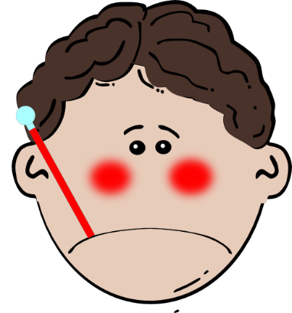
a
ça va ?
table
animal
malade
sac
mal
[badly]
Notes:
[3/4]
Aim: To consolidate SSC [a]
Procedure:
1. Introduce and elicit the pronunciation of the individual SSC [a] and then the source word again ‘animal’ (with gesture, if using). 2. Then present and elicit the pronunciation of the five cluster words.
The cluster words have been chosen for their high-frequency, from a range of word classes, with the SSC (where possible) positioned within a variety of syllables within the words (e.g. initial, 2nd, final etc.). Additionally, we have tried to use words that build cumulatively on previously taught SSCs (see the Phonics Teaching Sequence document) and do not include new SSCs. Where new SSCs are used, they are often consonants which have a similar symbol-sound correspondence in English.
Word frequency (1 is the most frequent word in French): animal [1002]; ça va? [54 (cela), 53 (aller)]; malade [1066] mal [277]; table [1019]; sac [2343] Source: Londsale, D., & Le Bras, Y. (2009). A Frequency Dictionary of French: Core vocabulary for learners London: Routledge.

Slide 22
au
[au/eau]
gauche
Notes:
[2/4]
Aim: To consolidate SSC [au]
Procedure: 1. Present the letter(s) and say the [au] sound first, on its own. Students repeat it with you. 2. Bring up the word ”gauche” on its own, say it, students repeat it, so that they have the opportunity to focus all of their attention on the connection between the written word and its sound.
3. A possible gesture for this would be to point to the students’ left (teacher’s right!) to indicate this direction. 4. Roll back the animations and work through 1-3 again, but this time, dropping your voice completely to listen carefully to the students saying the [au] sound, pronouncing ”gauche” and, if using, doing the gesture.
Word frequency (1 is the most frequent word in French):
gauche [607].
Source: Londsale, D., & Le Bras, Y. (2009). A Frequency Dictionary of French: Core vocabulary for learners London: Routledge.

Slide 23
au
faux
bateau
[au/eau]
beau
eau
gauche
aussi
[also]
Notes:
[4/4]
Aim: To consolidate SSC [au]
Procedure:
1. Introduce and elicit the pronunciation of the individual SSC [au] and then the source word again ‘gauche’ (with gesture, if using). 2. Then present and elicit the pronunciation of the five cluster words.
The cluster words have been chosen for their high-frequency, from a range of word classes, with the SSC (where possible) positioned within a variety of syllables within the words (e.g. initial, 2nd, final etc.). Additionally, we have tried to use words that build cumulatively on previously taught SSCs (see the Phonics Teaching Sequence document) and do not include new SSCs. Where new SSCs are used, they are often consonants which have a similar symbol-sound correspondence in English.
Word frequency (1 is the most frequent word in French): gauche [607]; aussi [44]; faux [555] bateau [1278]; beau [393]; eau [475] Source: Londsale, D., & Le Bras, Y. (2009). A Frequency Dictionary of French: Core vocabulary for learners London: Routledge.

Slide 24
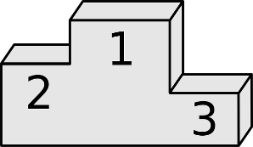
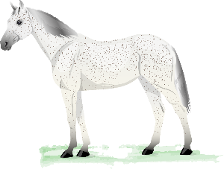
Un ou deux ?
Remember!
-al → -aux
phonétique
1
5
2
6
3
7
4
8
Notes:
Timing: 4 minutes
Aim: Aural recognition of words containing SSCs [a] and [au], and connecting this with meaning (singular or plural forms of verbs and adjectives).
Procedure:
1. Click on a button to hear a noun phrase with the number (un or deux) obscured.
2. Students decide based on the ending of the noun or adjective whether the statement refers to the picture on the left or on the right. In examples 1-4, students must listen to the form of the noun (the adjectival forms sound identical in both singular and plural). In examples 5-8, students must listen to the form of the adjective (the nominal forms sound identical in both singular and plural). The first example in each set (1 for nouns and 5 for adjectives) contain known words only. The other examples contain a mix of known words and unknown words which can be inferred from the pictures.
3. Answers are revealed on clicks, together with the full audio.
Transcript:
1. [Deux] petits hôpitaux.
2. [Un] métal cher.
3. [Un] cheval blanc.
4. [Deux] grands rivaux.
5. [Un] concours mondial.
6. [Deux] spectacles géniaux.
7. [Deux] problèmes environnementaux.
8. [Un] petit déjeuner continental.
Word frequency of unknown words (1 is the most frequent word in French):
cheval [2220], génial [3872]
Source: Lonsdale, D., & Le Bras, Y. (2009). A Frequency Dictionary of French: Core vocabulary for learners London: Routledge.
Word frequency of cognates (1 is the most frequent word in French):
métal [2793], rival [3758], environnemental [3548], continental [4846] Source: Lonsdale, D., & Le Bras, Y. (2009). A Frequency Dictionary of French: Core vocabulary for learners London: Routledge.

Slide 25
Word patterns
info
le centre
l’hiver (m)
le triomphe
l’idée
la musique
le virus
central
hivernal
triomphal
idéal
musical
viral
le théâtre
la médicine
la nation
le monde
le gouvernement
théâtral
médical
national
mondial
gouvernemental
1. The French adjectives above have -al endings. They all have nouns as their root.
Use your dictionary to find the nouns they are formed from.
2. Then, match your nouns with the most closely associated word or phrase below.
Sometimes, changing a noun to an adjective this way is as simple as adding -al to the end of the noun, e.g. la nation → national. Sometimes, -al replaces the final letter or letters, e.g., le centre → central, la musique → musical.
The part of the word before –al is the root.
l’hôpital
tous les pays
la France
il neige
la pandémie
penser
la médicine
le monde
la nation
l’hiver (m)
le virus
l’idée
un instrument
la victoire
le président
dans la ville
le spectacle
la musique
le triomphe
le gouvernement
le centre
le théâtre
Notes:
Timing: 5 minutes
Aim: to introduce the ‘noun root + -al as adjective’ word pattern; dictionary skills.
Procedure:
Students complete part 1 of the task by using a dictionary to find the form of the noun from which each adjective in dark blue is derived. Explain to students that they will need to use a dictionary to find the form because the root cannot always be found by simply removing –al; there is often an added letter on an irregularity. Explain to students that they should start by looking up what is left of the word once –al is removed, and take it from there. They should be able to guess the meaning of the noun from their knowledge of English and French, which should help them locate the form.
Answers revealed on clicks. As the answers are revealed, have students give English translations for both the adjective and the noun. Note the different translations of –al: central/central; hivernal/wintry; triumphal/triumphant; théâtral/theatrical
If time permits, students can apply the new words they have uncovered in the associations exercise in part 2.
Click to reveal answers.
Click again to reveal a bubble with details on forming –al adjectives from nouns. It is not expected that students will be able to produce these at this stage, so the bubble is for info only.
Word frequency of unknown words (1 is the most frequent word in French): hivernal [>5000], triumphal [>5000], théâtral [>5000] Source: Lonsdale, D., & Le Bras, Y. (2009). A Frequency Dictionary of French: Core vocabulary for learners London: Routledge.
Word frequency of cognates (1 is the most frequent word in French): central [992], viral [>5000], médical [1556], musical [3168], gouvernemental [1908], victoire [1373], président [268] Source: Lonsdale, D., & Le Bras, Y. (2009). A Frequency Dictionary of French: Core vocabulary for learners London: Routledge.

Slide 26
Articulate! – le vocabulaire
écrire
Écris les mots en français.
annuler
arriver (à)
to cancel, cancelling
to manage to, succeed in
non-binary
non-binaire
continuer (à/de)
to continue to, continuing to
le personnage
character
décider (de)
To decide to, on
transgenre
transgender
essayer (de)
to try to, trying to
voler
to steal, to fly
faire la bise
to kiss on the cheek, kissing on the cheek
l’isolation (f)
isolation
le masque
face mask
la pandémie
pandemic
mondial
global
la bise
kiss on the cheek
nécessaire
necessary
le vol
theft, flight
impossible
impossible
interdit
not allowed
la santé
health
Notes:
Timing: 6 minutes [1/4]
Aim: Oral and written production of this week’s new and revisited vocabulary; circumlocution practice.
Procedure: 1. Explain to students that they are going to play a game of Articulate in French in groups of 4. 2. First students make their own game cards by translating the words on this slide into French (3 minutes).
3. Click to reveal answers.
4. Move to the next slide to present the oral part of the task.

Slide 27
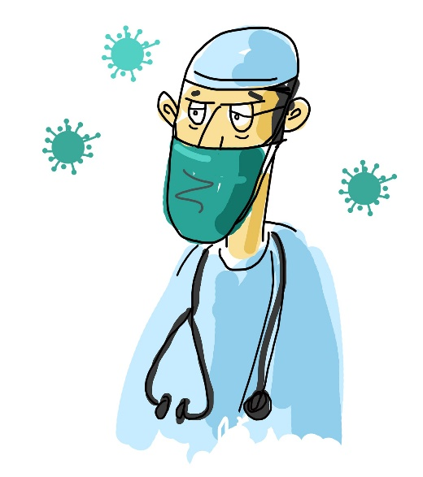
Articulate! Le jeu
*reconnaître = recognise
parler
On joue par groupes de quatre.
Une paire joue contre l'autre paire.
Le premier joueur doit choisir un mot de la liste.
Il/elle doit décrire le mot à son/sa partenaire sans dire le mot.
Le/la partenaire doit essayer de reconnaître* le mot.
La paire qui a le plus de bonnes réponses gagne.
Exemple: le masque:
« On porte ça pour empêcher une maladie »
Notes:
[2/4]
This task can be done with three levels of challenge:
High challenge: Students take a French word and describe it in French without the aid of additional clues.
Medium challenge: Students translate the printed English clues (slide 28) to their partner, who guesses the French word.
Low challenge: Students can read the printed French clues to their partner (slide 29), who guesses the French word.
Procedure: 1. Students work in pairs together with another pair.
2. The first player in each pair chooses a word on the list and tries to describe it without using the word itself (use the example on the slide to demonstrate).
3. The listening player in each pair tries to guess which word on the list is being described. They can have two guesses at most! If the word is guessed correctly, it is crossed off the list and the team scores a point. The opposing team can police this!
4. Play passes to the listening player who now chooses a new word.
5. Students repeat steps 2-4 for a total of three minutes. The easiest words will be snapped up first, so the game gets harder as it goes on.
6. The team with the most points after 3 minutes is the winner.
Word frequency of unknown words (1 is the most frequent word in French):
joueur [2003], reconnaître [221]
Source: Lonsdale, D., & Le Bras, Y. (2009). A Frequency Dictionary of French: Core vocabulary for learners London: Routledge.
Word frequency of cognates (1 is the most frequent word in French): paire [3926] Source: Lonsdale, D., & Le Bras, Y. (2009). A Frequency Dictionary of French: Core vocabulary for learners London: Routledge.

Slide 28
Articulate! English clues
parler
annuler
to decide to not do an activity (verb)
arriver (à)
to do well (pass an exam, for example)(verb)
non-binaire
not a boy, not a girl
(adjective)
continuer (à/de)
to do the same thing again (verb)
le personnage
a person in a film or book (noun)
décider (de)
to make a decision (verb)
transgenre
a person’s gender identity (identité) does not correspond to (correspond à) their sex (adjective)
essayer (de)
make an effort (verb)
voler
to take without asking/ to make a journey in a plane (verb)
faire la bise
saying hello in France (verb)
l’isolation (f)
staying alone when we are ill (noun)
le masque
we wear this to prevent an illness (noun)
la pandémie
an illness which is everywhere in the world (noun)
mondial
in all the countries (adjective)
la bise
we do this to say hello in France (noun)
nécessaire
essential
(adjective)
le vol
taking without asking/ a journey in a plane (noun)
impossible
very, very difficult; we cannot do it (adjective)
interdit
you must not do this (adjective)
la santé
not having an illness (noun)
Notes:
[3/4]
For printing: clues in English
Word frequency of cognates (1 is the most frequent word in French): identité [1437], correspondre [1415] Source: Lonsdale, D., & Le Bras, Y. (2009). A Frequency Dictionary of French: Core vocabulary for learners London: Routledge.

Slide 29
Articulate! French clues
parler
annuler
décider de ne pas faire une activité (verbe)
arriver (à)
faire bien (réussir un examen, par exemple)(verbe)
non-binaire
pas un garçon, pas une fille
(adjective)
continuer (à/de)
faire encore la même chose (verbe)
le personnage
une personne dans un film ou un livre (nom)
décider (de)
faire une décision (verbe)
transgenre
l’identité de genre d’une personne ne correspond pas à son sexe (adjective)
essayer (de)
faire un effort (verbe)
voler
prendre sans demander/ faire un voyage dans un avion (verbe)
faire la bise
dire bonjour en France (verbe)
l’isolement (f)
rester seul quand on est malade (nom)
le masque
on porte ça pour empêcher une maladie (nom)
la pandémie
une maladie qui est partout dans le monde (nom)
mondial
dans tous les pays (adjective)
la bise
on fait ça pour dire bonjour en France (nom)
nécessaire
essentiel (adjective)
le vol
prendre sans demander/ un voyage dans un avion (nom)
impossible
très, très difficile; on ne peut pas faire ça (adjective)
interdit
il ne faut pas faire ça (adjective)
la santé
n’avoir pas une maladie (nom)
Notes:
[4/4]
For printing: clues in French

Slide 30
Impersonal expressions
grammaire
As we have seen, il est can be used with an adjective and a verb in long form (infinitive) to talk about how things are for people in general.
You know some other impersonal expressions with il:
il y a - there is, there are
il n’y a pas - there isn’t, there aren’t
il y avait - there was, there were
il n’y avait pas - there wasn’t, there weren’t il faut + verb (long form) - it is necessary to, you must
il ne faut pas + verb (long form) - you must not
il fait beau/mauvais - the weather is good/bad
il fait froid/chaud - it is hot/cold
il est 1/2/3 heures - it is 1/2/3 o’clock
In impersonal phrases, ‘il’ never means ‘he’. It often means ‘it’, but does not refer to a specific person or thing.
Notes:
Timing: 3 minutes
Aim: Revision of known impersonal phrases with il as an impersonal pronoun.
Procedure:
Students translate the French impersonal expressions into English.
Answers revealed on clicks.

Slide 31
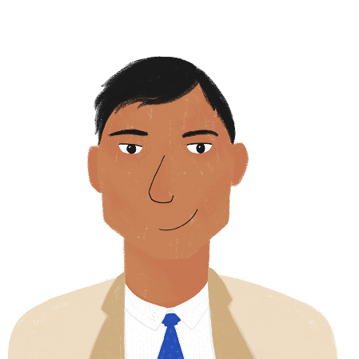
Le télétravail
*la chambre d’amis = spare room *coûteux = costly
lire
Noura est heureuse que son papa travaille à la maison, mais elle sait qu’il y a des défis. Que dit-elle sur le télétravail ? Quelles sont les expressions impersonnelles ?
What applies to people in general, and what applies just to Bilal?
Fais deux listes. Comment traduit-on ‘il’ dans chaque cas ?
En ce moment, mon papa fait du télétravail. [1] Il est homme d'affaires et [2] il gère une petite entreprise. [3] Il est possible de bien travailler en télétravail, mais [4] il faut être organisé. [5] Il a un bureau et un ordinateur dans notre chambre d’amis* et [6] il travaille de 9h. à 18h. À 18h, [7] il ferme la porte et [8] il est interdit d’entrer. [9] Il est nécessaire de séparer la vie professionnelle de la vie familiale. [10] Il est heureux parce qu’[11] il peut passer plus de temps avec sa famille et [12] il est moins coûteux* de faire du télétravail. [13] Il ne doit pas prendre le train. Mais [14] il est difficile de travailler seul. [15] Il y a un risque d'isolement.
Notes:
Timing: 8 minutes
Aim: to distinguish between use of il as a subject pronoun and as an impersonal subject in a variety of contexts; reading comprehension.
Procedure:
1. Students read the text, focussing on the different uses of il (highlighted in bold).
2. Students write down the numbers that appear next to examples of impersonal phrases.
3. Click to reveal answers.
4. Students sketch two columns headed ‘people in general’ and ‘just Bilal’.
5. Students write an English equivalent of each numbered expression in the correct column, paying careful attention to the translation of il itself in each case.
6. Suggested answers appear on the next slide.
Word frequency of unknown words (1 is the most frequent word in French):
télétravail [>5000], chambre d’amis [n/a], coûteux [3149]
Source: Lonsdale, D., & Le Bras, Y. (2009). A Frequency Dictionary of French: Core vocabulary for learners London: Routledge.
Word frequency of cognates (1 is the most frequent word in French):
séparer [946], professionnel [1000], expression [952], impersonnel [>5000], cas [130] Source: Lonsdale, D., & Le Bras, Y. (2009). A Frequency Dictionary of French: Core vocabulary for learners London: Routledge.

Slide 32
Le télétravail
*la chambre d’amis = spare room
lire
people in general
just Bilal
it is possible to work well from home
you must/it is necessary to be organised
entering (the spare room) is forbidden
it is necessary to separate professional life and family life
it is cheaper to work from home
it is difficult to work alone
there is a risk of isolation
he is a businessman
he manages a small business
he has a desk and a computer (in the spare room)
he works from 9.00 - 18.00
he shuts the door at 18.00
he is happy
he can spend more time with his family
he does not have to take the train
Notes:
[2/2]
Answers revealed on clicks.

Slide 33
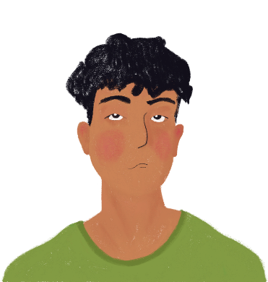
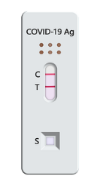
Amir est malade
*test antigénique = lateral flow test
*dédié = dedicated
*symptôme = symptom
écouter
Amir a fait un test antigénique* et le résultat est positif. Sa mère décide de téléphoner à un numéro dédié* aux questions sur covid-19. Parlent-ils Amir (il) or people in general (il est +adj + verb) ?
[-] / est important de
1
[-] / est possible de
2
[-] / est normal d’
3
[-] / est natural de
4
[-] / est triste de
5
[-] / est bon de
6
[-] / est nécessaire de
7
[-] / faut
8
Notes:
Timing: 8 minutes [1/2]
Aim: To distinguish orally between the verb in short form after il as a subject pronoun and long form after il as an impersonal pronoun; listening comprehension.
Procedure:
1. Demonstrate the pronunciation of written cognate symptôme (students have not yet encountered SSC [ym].
2. Click on a number to hear a sentence with a beep after il and before the verb.
3. Based on the verb form they hear (long or short) students decide whether the beep is covering an impersonal expression or not.
4. Answers revealed on clicks.
Transcript:
1. Il [-] a eu le vaccin ?
2. Oui, il a eu sa deuxième dose. Il [est possible de] devenir très malade ?
3. Il [est normal d’]avoir des symptômes.
4. Il [-] est faible ?
5. Oui, et il [-] a chaud et mal partout au corps.
6. D’accord. Il [-] peut prendre des médicaments pour ça.
7. Il [est nécessaire de] rester en isolement pendant combien de temps ?
8. Pendant dix jours, il [faut] téléphoner au SAMU dans une situation d'urgence.
Word frequency of unknown words (1 is the most frequent word in French):
SAMU [n/a], dédié [dédier - 4008]
Source: Lonsdale, D., & Le Bras, Y. (2009). A Frequency Dictionary of French: Core vocabulary for learners London: Routledge.
Word frequency of cognates (1 is the most frequent word in French):
résultat [428], test [1788], dose [4229], symptôme [4095], normal [833], antigénique [>5000] Source: Lonsdale, D., & Le Bras, Y. (2009). A Frequency Dictionary of French: Core vocabulary for learners London: Routledge.

Slide 34
Amir est malade
*symptôme = symptom
*SAMU (service d'aide médicale d'urgence) = ambulance
écouter
Écoute le dialogue encore une fois et réponds aux questions.
1
1. How many doses of the vaccine has Amir had? (1)
Two
2. What symptoms does Amir have? (3)
Weak, hot, pain all over his body
3. What advice does the service give? (3)
Take medication, isolate for ten days, call SAMU in an emergency.
2
3
Notes:
[2/2]
Procedure:
1. Remind students of the meaning of the SAMU acronym (they first came across this in 9.2.1.3).
2. Click on the numbers to hear full sentences (no beeps).
3. Students take notes in English. Explain that the number in brackets is the total number of pieces of information required.
4. Answers revealed on clicks.
Transcript:
1. Il a eu le vaccin ? Oui, il a eu le deuxième dose. Il est possible de devenir très malade ?
3. Il est normal d’avoir des symptômes. Il est faible ? Oui, et il a chaud et mal partout au corps.
5. D’accord. Il peut prendre des médicaments pour ça. Il est nécessaire de rester en isolement pendant combien de temps ? Pendant dix jours, il faut téléphoner au SAMU dans une situation d'urgence.
Word frequency of unknown words (1 is the most frequent word in French):
SAMU [n/a]
Source: Lonsdale, D., & Le Bras, Y. (2009). A Frequency Dictionary of French: Core vocabulary for learners London: Routledge.
Word frequency of cognates (1 is the most frequent word in French):
dose [4229], symptôme [4095], normal [833] Source: Lonsdale, D., & Le Bras, Y. (2009). A Frequency Dictionary of French: Core vocabulary for learners London: Routledge.

Slide 35
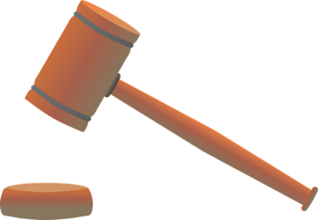
Des lois* françaises bizarres
*la loi = law | *l’OVNI = UFO
Châteauneuf-du-Pape* = a French town
parler
Il y a beaucoup de vieilles lois bizarres en France!
Travaille avec un(e) partenaire pour trouver dix lois bizarres.
… conduire un OVNI à Châteauneuf-du-Pape !
Il est interdit de …
PARTENAIRE B
a) … conduire un OVNI* à Châteauneuf-du-Pape*
b) … mange des poissons rouges
PARTENAIRE A
1. Il est interdit de …
Notes:
Timing: 8 minutes [1/3]
Aim: Oral production and comprehension of impersonal structures with on + short form and il est + adjective + de + long form
Procedure:
1. Print and distribute the role cards on the following slide.
2. Explain to students that they are going to work together to match up sentence sections to reveal ten weird French laws. Use this slide to model the task.
3. Partner A begins by reading the beginning of a sentence.
4. Partner B decides, based on whether they hear pronoun on or il est + adjective + de, whether the second half of the sentence is the option which begins with the verb in long or short form and reads it aloud.
5. As a pair, students work out the meaning of the weird law.
6. Repeat steps 3-5 for four more weird laws.
7. Partners swap roles, and repeat steps 3-6.
8. The ten weird laws are presented in full on the last slide in this sequence.
Word frequency of unknown words (1 is the most frequent word in French):
loi [267], OVNI [n/a]
Source: Lonsdale, D., & Le Bras, Y. (2009). A Frequency Dictionary of French: Core vocabulary for learners London: Routledge.
Word frequency of cognates (1 is the most frequent word in French):
bizarre [2756] Source: Lonsdale, D., & Le Bras, Y. (2009). A Frequency Dictionary of French: Core vocabulary for learners London: Routledge.

Slide 36
Des lois bizarres françaises
parler
PARTENAIRE A *le cochon = pig
1. Il est interdit de … 6. a) … construit un pont en août. b) … prendre une photo de la tour Eiffel le soir.
2. On … 7. a) … doit acheter un billet de train pour son chat. b) … dormir pendant une heure l’après-midi.
3. Il est nécessaire de … 8. a) … dormir sur le dos. b) … donner le nom ‘Napoléon’ à un cochon.*
4. Il est possible de … 9. a) … ne peut pas trouver du ketchup à l’école. b) … partager un fromage avec ses amis.
5. On … 10. a) … quitter son partenaire s’il ou si elle regarde b) … commence l’école à l’âge de deux ans. trop le foot.
PARTENAIRE B *la gare = train station
1. a) … faire la bise à la gare.* b) … nourrit son chien avant 7h . 6. Il est interdit de …
2. a) … manger du pain avec ses doigts. b) … ne doit pas manger à son bureau. 7. On …
3. a) … porte un chapeau le dimanche. b) … jouer de la musique française à la radio. 8. Il est impossible de …
4. a) … voler de l'argent à sa famille. b) … va à l’école seulement deux fois par semaine. 9. On …
5. a) … jouer du piano avec ses pieds. b) … ne peut pas prendre une photo de la police. 10. Il est possible de …
Notes:
[2/3] DO NOT DISPLAY – ROLECARDS FOR PRINTING
Word frequency of unknown words (1 is the most frequent word in French):
cochon [4947]
Source: Lonsdale, D., & Le Bras, Y. (2009). A Frequency Dictionary of French: Core vocabulary for learners London: Routledge.
Word frequency of cognates (1 is the most frequent word in French):
tour [523], âge [502], ketchup [>5000], gare [2581] Source: Lonsdale, D., & Le Bras, Y. (2009). A Frequency Dictionary of French: Core vocabulary for learners London: Routledge.

Slide 37
Des lois bizarres françaises
parler
Il est interdit de … faire la bise à la gare.*
On … ne doit pas manger à son bureau.
Il est nécessaire de … jouer de la musique française à la radio.
Il est possible de … voler de l'argent à son famille.
On … ne peut pas prendre une photo de la police.
Il est interdit de … prendre une photo de la tour Eiffel le soir.
On … doit acheter un billet de train pour son chat.
Il est impossible de … donner le nom ‘Napoléon’ à un cochon.*
On … ne peut pas trouver du ketchup à l’école.
Il est possible de … quitter son partenaire s’il ou elle regarde trop de foot.
*le cochon = pig | *la gare = train station
Notes:
[3/3]
Answers revealed on clicks.
Whole class translation into English.

Slide 38
Défis personnels du covid-19
écrire
Quels sont les défis du covid-19 pour toi ? Et quelles sont les solutions ?
Écris quatre phrases avec ‘on’, et quatre phrases avec ‘il + est + adjectif + de.’
1. On annule tous les concerts !
‘on’ + short form
2. Mais il est possible de regarder des spectacles sur internet.
‘il est + adjective + de’ + long form
Chercher des mots dans un dictionnaire !
Notes:
Timing: 7 minutes
Aim: written production of impersonal structures with on + short form and il est + adjective + de + long form; guided free production
Procedure:
1. Check students understand the task instructions.
2. Click to reveal two example sentences and a reminder of the associated rules.
3. Students write eight sentences, using a dictionary to create texts personalised to their circumstances.
Word frequency of cognates (1 is the most frequent word in French):
adjectif [>5000], dictionnaire [4094] Source: Lonsdale, D., & Le Bras, Y. (2009). A Frequency Dictionary of French: Core vocabulary for learners London: Routledge.

Slide 39
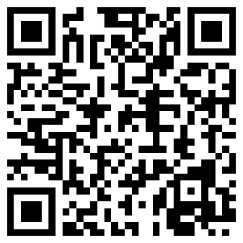
Devoirs
Vocabulary Learning Homework (Y9, Term 3.1, Week 6)
Student worksheet
Quizlet link
Quizlet QR code:
Notes:
The answer sheet for the 9.3.1.5 vocabulary learning homework is here: Resource | French SOW Y9 Term 3.1 Week 6 - vocabulary learning homework answers | ID: 9p290c22f | NCELP

