Slide 1
Distinguishing between 'you' meaning one person and 'you' meaning more than one person
Saying ‘you’ – singular and plural
-ER verbs (vous)
SSC [i] [revisited]
Y7 French
Term 1.2 - Week 7 - Lesson 27
Stephen Owen / Emma Marsden / Kirsten Somerville / Catherine Morris Artwork by: Chloé Motard
Date updated: 28/07/2021
Notes:
Artwork by Chloé Motard. All additional pictures selected are available under a Creative Commons license, no attribution required.
Learning outcomes (lesson 1):
Revisiting of the SSC [i]
Introduction of the pronoun vous meaning ‘you’ plural (in contrast with English, which has only one word for ‘you’)
Introduction of the plural vous form of regular –ER verbs
Word frequency (1 is the most frequent word in French):
7.1.2.7 (introduce) fermer [757], regarder² [425], vous¹ [50], chemise [3892], classe [778], fenêtre [1604], porte [696], salle [812], silence [1281], tableau [1456], bien [47]
7.1.2.4 (revisit) demander [80], donner [46], montrer [108], cadeau [2298], penser [116], exemple [259], raison [72], aujourd'hui [233], normalement [2018], que¹ [9], à² [4]
7.1.1.6 (revisit) acteur [1152], actrice [1152], anglais² [784], fille¹ [629], français² [251], garçon [1599], médecin [827], mot [220], personne¹ [84], phrase [2074], le [1], la [1], les [1], en¹ [7]
Source: Londsale, D., & Le Bras, Y. (2009). A Frequency Dictionary of French: Core vocabulary for learners London: Routledge.
The frequency rankings for words that occur in this PowerPoint which have been previously introduced in NCELP resources are given in the NCELP SOW and in the resources that first introduced and formally re-visited those words.
For any other words that occur incidentally in this PowerPoint, frequency rankings will be provided in the notes field wherever possible.

Slide 2
i
midi
Notes:
Timing: 1 minute
Aim: To consolidate SSC [i]
Procedure: 1. Present the letter(s) and say the [i] sound first, on its own. Students repeat it with you. 2. Bring up the word ”midi” on its own, say it, students repeat it, so that they have the opportunity to focus all of their attention on the connection between the written word and its sound.
3. A possible gesture for this would be to draw a circle representing a clock face with one hand, with the other arm and hand pointing straight up (representing the hands on 12) within the circle. 4. Roll back the animations and work through 1-3 again, but this time, dropping your voice completely to listen carefully to the students saying the [i] sound, pronouncing ”midi” and, if using, doing the gesture.
Word frequency (1 is the most frequent word in French):
midi [2483].
Source: Londsale, D., & Le Bras, Y. (2009). A Frequency Dictionary of French: Core vocabulary for learners London: Routledge.

Slide 3
i
midi
Notes:
With sound and no pictures to focus all attention on the sound-symbol correspondence.

Slide 4
i
midi
Notes:
Without sound to elicit pronunciation (without first hearing the teacher).
Teacher to elicit pronunciation by asking “Comment dit-on …"

Slide 5
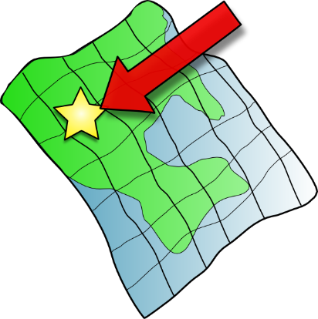
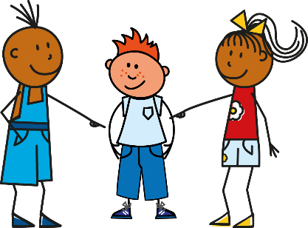
i
petit
lit
midi
ici
qui ?
il
?
Notes:
Timing: 2 minutes
Aim: To consolidate SSC [i]
Procedure:
1. Introduce and elicit the pronunciation of the individual SSC [i] and then the source word again ‘midi’ (with gesture, if using). 2. Then present and elicit the pronunciation of the five cluster words.
The cluster words have been chosen for their high-frequency, from a range of word classes, with the SSC (where possible) positioned within a variety of syllables within the words (e.g. initial, 2nd, final etc.). Additionally, we have tried to use words that build cumulatively on previously taught SSCs (see the Phonics Teaching Sequence document) and do not include new SSCs. Where new SSCs are used, they are often consonants which have a similar symbol-sound correspondence in English.
Word frequency (1 is the most frequent word in French): midi [2483]; petit [138]; lit [1837] ici [167]; il[13]; qui [14]. Source: Londsale, D., & Le Bras, Y. (2009). A Frequency Dictionary of French: Core vocabulary for learners London: Routledge.

Slide 6
i
petit
lit
midi
ici
qui ?
il
Notes:
With sound and no pictures to focus all attention on the sound-symbol correspondence.

Slide 7
i
petit
lit
midi
ici
qui ?
il
Notes:
Without sound to elicit pronunciation (without first hearing the teacher).
Teacher to elicit pronunciation by asking “Comment dit-on …"

Slide 8
[i] ou [e] ?
écouter
Translate the story into English:
 |  | [i] [e] [i] et [e]
 |  | [i] [e] [i] et [e]
Are you having a sad week?
Tu are doing an activity.
1
[i] et [e]
5
[i]
Here’s an idea:
« Goodbye, friends ! »
2
[i]
6
[i] et [e]
You look outside…
« I’m going for a walk. »
3
[e]
7
[e]
It’s nice weather at the moment!
4
[i] et [e]
8
It’s a nice story.
[i]
Notes:
Timing: 5 minutes
Aim: translation of known vocabulary in context
Procedure:
Suggested translation. In the absence of time phrases, students may be able to justify using the present simple or continuous in English. Note the freer translation of passer as ‘have’ in this context.
Click to bring up the English.
Transcript:
Tu passes une semaine triste ?
Voici une idée :
Tu regardes dehors…
Il fait beau en ce moment !
Tu fais une activité.
« Au revoir, les amis ! »
« Je fais une promenade. »
C’est une histoire sympathique.

Slide 9
Vocabulaire
parler
le tableau
board
la classe
class
la porte
door
determiner
+ noun
la salle
room
la chemise
shirt
le silence
silence
la fenêtre
window
fermer
to close, closing
verb
regarder
to watch, to look at
adverb
bien
good, well
pronoun
vous
you (plural)
Notes:
Timing: 5 minutes
Aim: to practise the words from this week’s new vocab set
Procedure:
Click to bring up the word in French and model its pronunciation, eliciting the French pronunciation from students as whole class repetition.
Click to bring up the English translation.
Once all the words are displayed on the screen, with French and English, check the students know what type (part of speech) these words are (this will be useful later and is revision). This is illustrated by the animations.
Further practise recall of meanings in English by clicking to remove the English translations one by one in a final round of practice.
(See next slide for animations for English to French practice).

Slide 10
Vocabulaire
parler / écrire
le tableau
board
la classe
class
la porte
door
la salle
room
la chemise
shirt
le silence
silence
la fenêtre
window
fermer
to close, closing
regarder
to watch, to look at
bien
good, well
vous
you (plural)
Notes:
Timing: 5 minutes
Aim: to practise vocab recall (English to French) in both the oral and written modalities
Procedure:
Click to bring up the word in English.
Students can say the French as a whole class, to their partner or individually to the teacher.
Click to bring up the French.
Repeat for all 11 words.
Click to disappear the French words one at a time at random.
Students can then write the word in French.

Slide 11
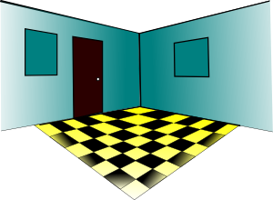
Vocabulaire
lire
Odd One Out
parler
la fenêtre
la chemise
la salle
le silence
la porte
le silence
[today]
[example]
[sentence]
[reason]
aujourd’hui is a time phrase
l’exemple
aujourd’hui
l’anglais
la phrase
la raison
[to close, closing]
le tableau is a noun not a verb
[board]
fermer
demander
regarder
donner
le tableau
Notes:
Timing: 2 minutes
Aim: to further practise recognition of vocabulary, to also include words from this week’s revisited sets.
Procedure:
Elicit the French for the images on each row.
Students identify the odd one out per row.
Click to reveal the answers (first French translation, then odd one out per row)

Slide 12
Vocabulary introduction
Vocabulaire
lire
Où vont les mots ?
fenêtre
regarder
phrase
demander
tableau
fermer
chemise
donner
verb
noun
Notes:
Timing: 2 minutes
Aim: to further practise understanding of meanings and word classes of words from this week’s new and revisited vocab sets.
Procedure:
Give students a minute’s thinking time in pairs to give the meanings in English of these words and their word class: either verb or noun.
Elicit the English from students to ensure whole class understanding.
Then click on the word to reveal its word class (this allows answers to be given in any order).

Slide 13
Talking to others: tu and vous
Talking to others: tu and vous
grammaire
To say ‘you (plural)’ + regular -ER verb in French, the verb is the short form and ends in -ez.
For example:
‘You’ to one person → ‘You’ to more than one person
jouer
tu joues → vous jouez
manger
tu manges → vous mangez
The following activities will allow you to practise recognising the 'ez' on the vous form!
Notes:
Timing: 2 minutes
Aim: to introduce second person singular and second person plural forms of regular –ER verbs in the present tense.
Procedure:
Click to bring up the explanation.
Model the pronunciation of the –ez ending carefully before moving on.

Slide 14
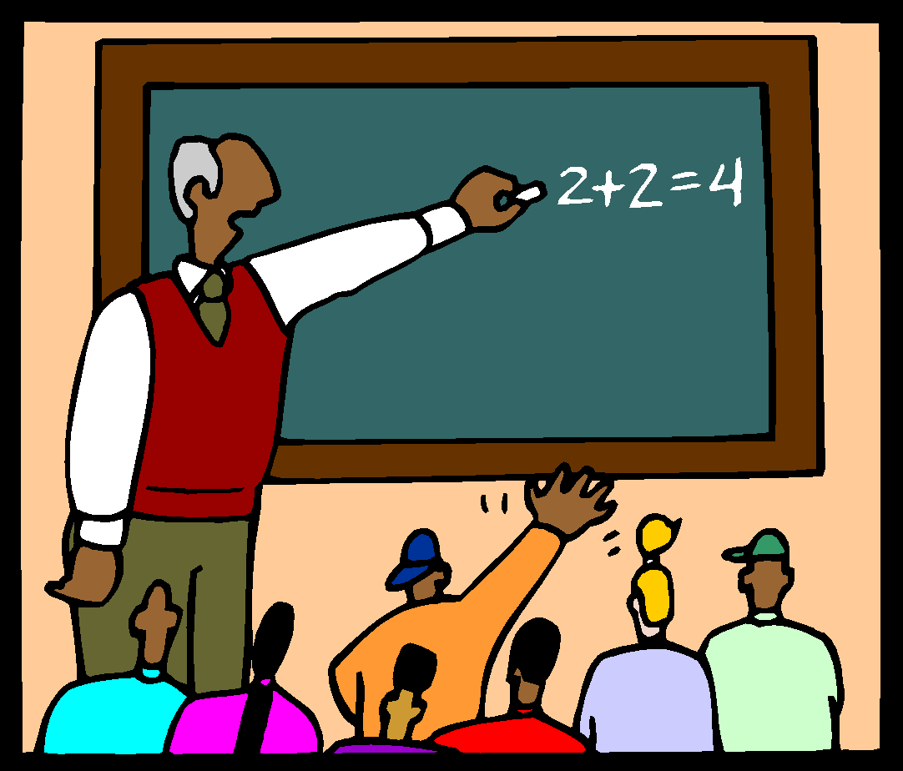
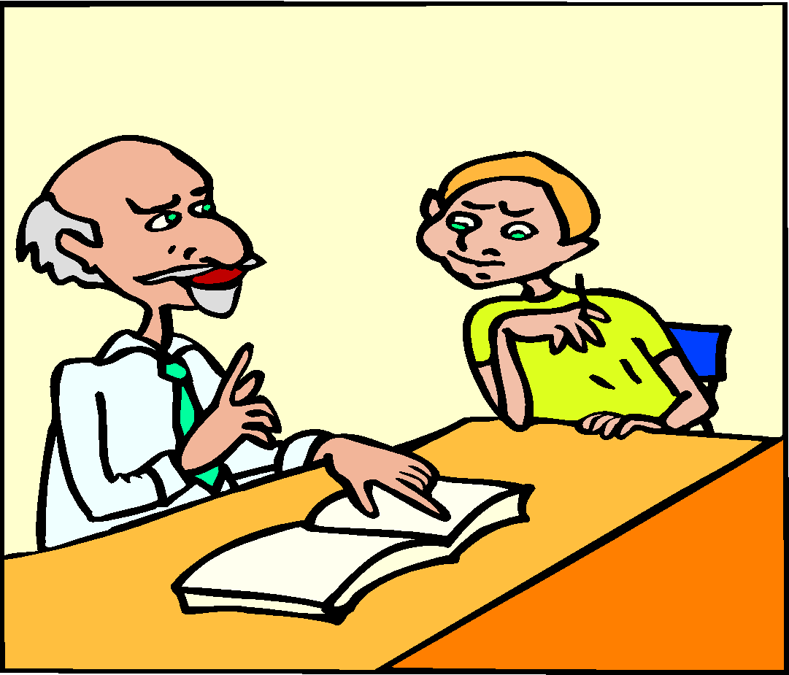
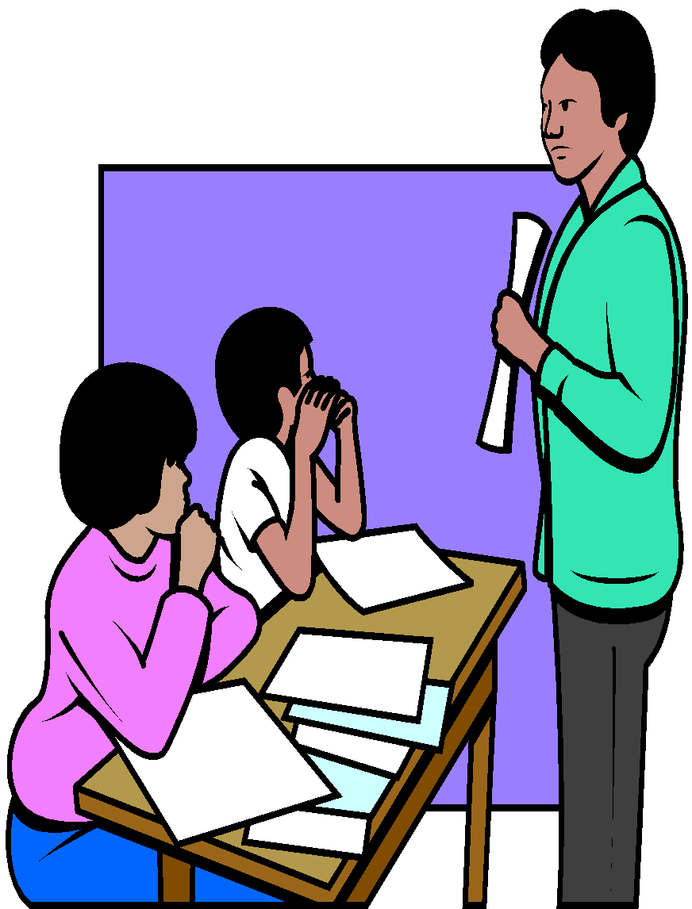
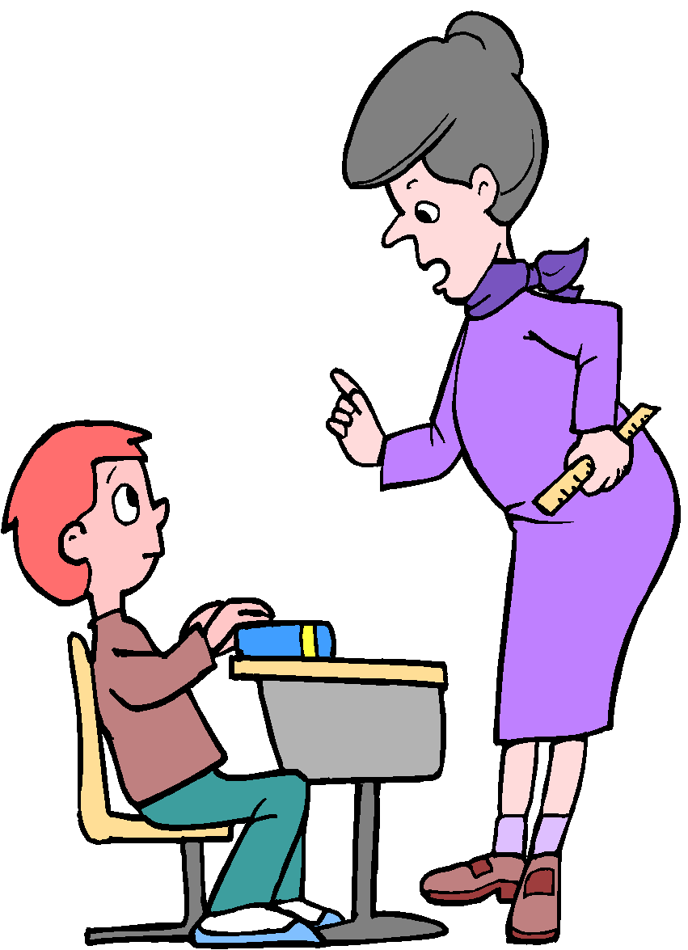
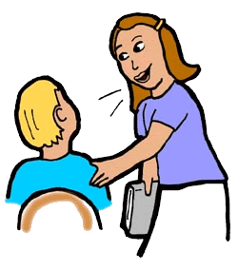
Grammaire
When you hear ‘-ez' you know it is 'plural you'
écouter
Is the teacher talking to several pupils (vous) or just one (tu)? Écris tu ou vous.
1
5
2
6
3
7
4
8
Notes:
Timing: 5 minutes
Aim: to practise recognising second person singular and plural forms of –ER verbs when listening. The lesson buzzer in the audio recording stops students hearing the whole message, so students’ only clue is the verb ending -e/-ez.
Procedure:
Click on the number trigger to play the audio.
Students listen to the verb and decide if the teacher is talking to several pupils (‘vous’) or just one (‘tu’).
(see next slide for the answers)
Transcript:
[…] regardez le problème.
[…] restes en silence.
[…] trouves la solution ?
[…] cochez la réponse.
[…] manges en classe.
[…] parlez en anglais.
[…] écoutez l'histoire ?
[…] travailles avec un partenaire.

Slide 15
Grammaire - réponses
When you hear ‘-ez' you know it is 'plural you'
écouter
Is the teacher talking to several pupils (vous) or just one (tu)? Écris tu ou vous.
1
vous
5
tu
2
tu
6
vous
3
tu
7
vous
4
vous
8
tu
Notes:
Answer slide
Timing: 2 minute
Aim: to practise recognising second person singular and plural forms of –ER verbs when listening.
Procedure:
Click to bring up the answers.
Teachers can choose to click on the number trigger to play the audio in full to have the students hear the verb plus the subject pronoun.
Transcript:
Vous regardez le problème.
Tu restes en silence.
Tu trouves la solution ?
Vous cochez la réponse.
Tu manges en classe.
Vous parlez en anglais.
Vous écoutez l'histoire ?
Tu travailles avec un partenaire.

Slide 16
Talking to others: tu and vous
Talking to others: tu and vous
lire
Who is being asked a question:
‘tu’ (you- one person) or ‘vous’ (you - more than one person)?
 |  | You - one person (tu) | You - more than one (vous)
1 | …… regardes un film ?
2 | …… écoutez la radio ?
3 | …… étudies le français ?
4 | …… chantes bien !
5 | …… étudiez l’anglais ?
6 | …… fermes la porte ?
7 | …… regardez la télé ?
Notes:
Timing: 5 minutes
Aim: to practise recognising second person singular and plural forms of –ER verbs when reading.
Procedure:
Students read each sentence and decide who is being asked a question: ‘tu – you singular’ or ‘vous – you plural’.
Click to bring up the answers 1-7.
Teachers may want to elicit translations of each question in English before moving on.
(The exercise continues on the next slide: numbers 8-14.)

Slide 17
Talking to others: tu and vous
Talking to others: tu and vous
lire
Who is being asked a question:
‘tu’ (you- one person) or ‘vous’ (you - more than one person)?
 |  | You - one person (tu) | You - more than one (vous)
8 | …… fermez la fenêtre ?
9 | …… aimes le livre ?
10 | …… trouvez la salle ?
11 | …… donnez un cadeau à Sophie ?
12 | …… montres l’exemple à la classe ?
13 | ....... portes une chemise ?
14 | …… demandes un ordinateur ?
Notes:
Timing: 5 minutes
Continuation of previous exercise 8-14.

Slide 18
Distinguishing between ‘you’ meaning one person and ‘you’ meaning more than one person
Saying ‘you’ – singular and plural
-ER verbs (vous)
SSC [i] [revisited]
Y7 French
Term 1.2 - Week 7 - Lesson 28
Stephen Owen / Emma Marsden / Kirsten Somerville / Catherine Morris Artwork by: Chloé Motard
Date updated: 28/07/2021
Notes:
Artwork by Chloé Motard. All additional pictures selected are available under a Creative Commons license, no attribution required.
Learning outcomes (lesson 2):
Consolidation of SSC [i]
Consolidation of the pronoun vous, meaning ‘you’ plural (in contrast with English, which has only one word for ‘you’)
Consolidation of the plural vous form of regular –ER verbs
Word frequency (1 is the most frequent word in French):
7.1.2.7 (introduce) fermer [757], regarder² [425], vous¹ [50], chemise [3892], classe [778], fenêtre [1604], porte [696], salle [812], silence [1281], tableau [1456], bien [47]
7.1.2.4 (revisit) demander [80], donner [46], montrer [108], cadeau [2298], penser [116], exemple [259], raison [72], aujourd'hui [233], normalement [2018], que¹ [9], à² [4]
7.1.1.6 (revisit) acteur [1152], actrice [1152], anglais² [784], fille¹ [629], français² [251], garçon [1599], médecin [827], mot [220], personne¹ [84], phrase [2074], le [1], la [1], les [1], en¹ [7]
Source: Londsale, D., & Le Bras, Y. (2009). A Frequency Dictionary of French: Core vocabulary for learners London: Routledge.
The frequency rankings for words that occur in this PowerPoint which have been previously introduced in NCELP resources are given in the NCELP SOW and in the resources that first introduced and formally re-visited those words.
For any other words that occur incidentally in this PowerPoint, frequency rankings will be provided in the notes field wherever possible.

Slide 19
i
petit
lit
midi
ici
qui ?
il
?
Notes:
Timing: 2 minutes
Aim: To consolidate SSC [i]
Procedure:
1. Introduce and elicit the pronunciation of the individual SSC [i] and then the source word again ‘midi’ (with gesture, if using). 2. Then present and elicit the pronunciation of the five cluster words.
The cluster words have been chosen for their high-frequency, from a range of word classes, with the SSC (where possible) positioned within a variety of syllables within the words (e.g. initial, 2nd, final etc.). Additionally, we have tried to use words that build cumulatively on previously taught SSCs (see the Phonics Teaching Sequence document) and do not include new SSCs. Where new SSCs are used, they are often consonants which have a similar symbol-sound correspondence in English.
Word frequency (1 is the most frequent word in French): midi [2483]; petit [138]; lit [1837] ici [167]; il[13]; qui [14]. Source: Londsale, D., & Le Bras, Y. (2009). A Frequency Dictionary of French: Core vocabulary for learners London: Routledge.

Slide 20
i
petit
lit
midi
ici
qui ?
il
Notes:
With sound and no pictures to focus all attention on the sound-symbol correspondence.

Slide 21
i
petit
lit
midi
ici
qui ?
il
Notes:
Without sound to elicit pronunciation (without first hearing the teacher).
Teacher to elicit pronunciation by asking “Comment dit-on …"

Slide 22
Phonétique
parler
action
ancien
60
fille
il
oui
animal
secondes
idée
petit
machine
rapide
livre
0
DÉBUT
Notes:
Timing: 1 minute
Aim: to practise pronunciation of this week’s target SSC [i]
Procedure:
Students take it in turns to try to pronounce correctly as many words as they can to a partner in one minute.
The two words at the top of the slide recall the SSCs of the previous week (‘-tion’ and ‘-ien’), though focusing on the ‘i’ sound within these this time.
Word frequency (1 is the most frequent word in French): fille [629], livre [358], ancien [392], il [13], oui [284], animal [1002], idée [239], machine [1294], petit [138], rapide [672], action [355]
Source: Londsale, D., & Le Bras, Y. (2009). A Frequency Dictionary of French: Core vocabulary for learners London: Routledge.

Slide 23
Vocabulaire
écrire
1 | C’est habituel.
2 | avoir une opinion
3 | la justification
4 | Je trouve ___ c’est bien !
5 | Il fait un film.
6 | Elle fait un film.
7 | un être humain
8 | Le dictionnaire a ça.
9 | Tu es malade ? Écoute le…
10 | la date présente
11 | femme/fille, homme/______
12 | Un paragraphe a ça.
 | N | O | R | M | A | L | E | M | E | N | T
 |  |  |  |  | P | E | N | S | E | R
 |  |  | R | A | I | S | O | N
 |  |  |  |  |  | Q | U | E
 |  | A | C | T | E | U | R
A | C | T | R | I | C | E
 |  |  | P | E | R | S | O | N | N | E
 |  |  |  | M | O | T
 | M | É | D | E | C | I | N
 |  |  | A | U | J | O | U | R | D’ | H | U | I
 | G | A | R | Ç | O | N
 |  | P | H | R | A | S | E
Notes:
Timing: 10 minutes
Aim: to revise the meaning and spelling of some of this week’s revisited vocabulary
Procedure:
Students write 1-12 and try to spell out the words that match the clue in French.
Click to reveal the missing letters (covered by white boxes, which disappear one by one on successive clicks).
The letters in the orange box spell out ‘les questions’, which sets up for the question-based speaking activities that follow.
Word frequency of near-cognates used: (1 is the most frequent word in French):
habituel [1347], opinion [777], justification [3846], humain [286], dictionnaire [4094], date [660], present [216], paragraphe [2126]
Source: Londsale, D., & Le Bras, Y. (2009). A Frequency Dictionary of French: Core vocabulary for learners London: Routledge.

Slide 24
Talking to others: tu and vous
Talking to others: tu and vous
grammaire
To say ‘you (plural)’ + regular -ER verb in French, the verb is the short form and ends in -ez.
For example:
‘You’ to one person → ‘You’ to more than one person
jouer
tu joues → vous jouez
manger
tu manges → vous mangez
The following speaking and writing activities will allow you to practise these verb forms!
Notes:
Timing: 1 minute
Aim: to recap second person singular and second person plural forms of regular –ER verbs in the present tense ahead of the production activities.
Procedure:
Click to bring up the explanation.
Draw attention to the pronunciation of the –ez ending once again.

Slide 25
Talking to others: tu and vous
Talking to others: tu and vous
écouter / parler
Partenaire A (Task 1)
Ask your partner questions using the prompts below, but don’t say ‘tu’ or ‘vous’.
e.g. [Tu] écoutes la radio? or [Vous] chantez bien?
 |  | You - one person (tu) | You - more than one (vous)
1 | écouter la radio ?
2 | chanter bien ?
3 | manger un fruit ?
4 | donner un cadeau ?
5 | étudier le français ?
6 | regarder le tableau ?
7 | parler à la fille ?
Notes:
Timing (slides 23-31): 15 minutes
Aim: to practise receptive and productive knowledge of second person singular and second person plural forms of regular –ER verbs in the present tense in the oral modality.
(Student A task sheet 1)
Procedure:
Partner A has to formulate each question correctly from the infinitive and complement shown, either using the ‘tu’ form or the ‘vous’ form as indicated. However, the subject pronoun must not be said to Partner B (whose task is explained on the next slide). This is so that the partner has to notice the ‘-ez’ ending.
This slide could be printed for the partners to work from/annotate.
Differentiated versions of these tasks follow this sequence of slides, and may be substituted for students who would benefit from a greater degree of challenge. (See slides 32-39.)
Note: This activity revises question formation using intonation only. The students experienced this in the listening and reading activities in lesson 1. Remind them that they should raise their voice when they ask these questions.
Note: Remind students that the –ER ending on the infinitives in their prompts on the slide actually sound just like the –EZ ending. –er and –ez both sound the same when pronounced. These SSCs were introduced in the phonics work for Term 1.1, Week 5.

Slide 26
Talking to others: tu and vous
Talking to others: tu and vous
écouter / parler
Partenaire B (Task 1)
Decide whether you partner is asking questions to a group (vous) or only you (tu).
Number the questions in the order your partner says them.
Order |  | You - one person (tu) | You - more than one (vous)
 | talk to the girl?
 | look at the board?
 | study French?
 | listen to the radio?
 | sing well?
 | give a present?
 | eat fruit?
Notes:
(Student B task sheet 1)
Partner B has to tick whether each question said by Partner A is to one person (‘tu’) or to more than one person (‘vous’).
S/he then has to write the number of each question in the first column, alongside its English translation, so that the order in which the questions have been asked is apparent.
This means that Partner B not only has to listen for the verb form used; the vocabulary of the question also has to be processed.

Slide 27
Talking to others: tu and vous
Talking to others: tu and vous
écouter / parler
Solution Task 1
Order |  | You - one person (tu) | You - more than one (vous)
7 | talk to the girl?
6 | look at the board?
5 | study French?
1 | listen to the radio?
2 | sing well?
4 | give a present?
3 | eat fruit?
Notes:
Answer slide.

Slide 28
Talking to others: tu and vous
Talking to others: tu and vous
écouter / parler
Partner A (Task 2)
Ask your partner questions using the prompts below, but don’t say ‘tu’ or ‘vous’.
e.g. [Tu] écoutes la radio? or [Vous] chantez bien?
 |  | You - one person (tu) | You - more than one (vous)
1 | travailler à l’école ?
2 | demander la raison ?
3 | trouver la solution ?
4 | marcher dehors ?
5 | porter un uniforme ?
6 | rester à la maison ?
7 | préparer le déjeuner ?
Notes:
Partners swap roles
(Student A task sheet 2)

Slide 29
Talking to others: tu and vous
Talking to others: tu and vous
écouter / parler
Partenaire B (Task 2)
Decide whether you partner is asking questions to a group (vous) or only you (tu).
Number the questions in the order your partner says them.
Order |  | You - one person (tu) | You - more than one (vous)
 | walk outside?
 | work at school?
 | prepare lunch?
 | ask the reason?
 | stay at home?
 | find a solution?
 | wear a uniform?
Notes:
(Student B task sheet 2)

Slide 30
Talking to others: tu and vous
Talking to others: tu and vous
écouter / parler
Solution Task 2
Order |  | You - one person (tu) | You - more than one (vous)
4 | walk outside?
1 | work at school?
7 | prepare lunch?
2 | ask the reason?
6 | stay at home?
3 | find a solution?
5 | wear a uniform?
Notes:
Answer slide

Slide 31
Talking to others: tu and vous
Talking to others: tu and vous
écouter / parler / écrire
Partenaire A (Task 1)
Ask your partner questions using the prompts below, but don’t say ‘tu’ or ‘vous’.
e.g. [Tu] écoutes la radio? or [Vous] chantez bien?
 |  | You - one person (tu) | You - more than one (vous)
1 | listen to the radio?
2 | sing well?
3 | eat fruit?
4 | give a present?
5 | study French?
6 | look at the board?
7 | talk to the girl?
Notes:
Differentiated version
Timing (slides 32-39): 15 minutes
Aim: to practice receptive and productive knowledge of second person singular and second person plural forms of regular –ER verbs in the present tense.
In this more challenging version of Task 1, students formulate the question in French indicated by the prompt in English, using either the ‘tu’ form or the ‘vous’ form as also indicated.
As before, the subject pronoun must not be said to the listener.
(Student A task sheet 1)
Procedure:
Partner A has to formulate each question correctly from the infinitive and complement shown, either using the ‘tu’ form or the ‘vous’ form as indicated. However, the subject pronoun must not be said to Partner B (whose task is explained on the next slide). This is so that the partner has to notice the ‘-ez’ ending.
This slide could be printed for the partners to work from/annotate.
Note: This activity revises question formation using intonation only. The students experienced this in the listening and reading activities in lesson 1. Remind them that they should raise their voice when they ask these questions.
Note: Remind students that the –ER ending on the infinitives in their prompts on the slide actually sound just like the –EZ ending. –er and –ez both sound the same when pronounced. These SSCs were introduced in the phonics work for Term 1.1, Week 5.

Slide 32
Talking to others: tu and vous
Talking to others: tu and vous
écouter / parler / écrire
Partenaire B (Task 1)
Decide whether your partner is asking questions to a group (vous) or only you (tu).
Then write down the whole question in French.
 | question (en français!) | You - one person (tu) | You - more than one (vous)
1
2
3
4
5
6
7
Notes:
(Student B task sheet 1)
Partner B has to tick whether each question said by Partner A is to one person (‘tu’) or to more than one person (‘vous’), as before.
However, s/he then has to transcribe (write in French) each question they have heard in French.
This means that Partner B does not only have to listen for the verb form used; the vocabulary of the question also has to be processed and the correct French reproduced in writing.

Slide 33
Talking to others: tu and vous
Talking to others: tu and vous
écouter / parler / écrire
Solution Task 1
 |  | You - one person (tu) | You - more than one (vous)
1 | Vous écoutez la radio ?
2 | Tu chantes bien ?
3 | Tu manges un fruit ?
4 | Vous donnez un cadeau ?
5 | Tu étudies le français ?
6 | Tu regardes le tableau ?
7 | Vous parlez à la fille ?
Notes:
Answer slide

Slide 34
Talking to others: tu and vous
Talking to others: tu and vous
écouter / parler / écrire
Partenaire A (Task 2)
Ask your partner questions using the prompts below, but don’t say ‘tu’ or ‘vous’.
e.g. [Tu] écoutes la radio? or [Vous ] chantez bien?
 |  | You - one person (tu) | You - more than one (vous)
1 | work at school?
2 | ask the reason?
3 | find the solution?
4 | walk outside?
5 | wear a uniform?
6 | stay at home?
7 | prepare lunch?
Notes:
Partners swap roles
(Student A task sheet 2)

Slide 35
Talking to others: tu and vous
Talking to others: tu and vous
écouter / parler / écrire
Partenaire B (Task 2)
Decide whether your partner is asking questions to a group (vous) or only you (tu).
Then write down the whole question in French.
 | question (en français!) | You - one person (tu) | You - more than one (vous)
1
2
3
4
5
6
7
Notes:
(Student B task sheet 2)

Slide 36
Talking to others: tu and vous
Talking to others: tu and vous
écouter / parler / écrire
Solution Task 2
 |  | You - one person (tu) | You - more than one (vous)
1 | Vous travaillez à l’école ?
2 | Vous demandez la raison ?
3 | Tu trouves la solution ?
4 | Tu marches dehors ?
5 | Tu portes un uniforme ?
6 | Vous restez à la maison ?
7 | Tu prépares le déjeuner ?
Notes:
Answer slide

Slide 37
Talking to others: tu and vous
écrire
Write questions to both one person and a group using the verbs below.
You can choose what other vocabulary to use! Écris en français !
Infinitive verb | You - one person (tu) | You - more than one (vous)
écouter
regarder
manger
jouer
demander
parler
trouver
Notes:
Timing: 10 minutes
Aim: written production practice of second person singular and second person plural of regular –ER verbs in the present tense.
Procedure:
Students now use each verb in the table – all of which have been presented and practised over the past four weeks – to write one question in French in the ‘tu’ form, and another in the ‘vous’ form.
Students choose which other words to include in their sentences, and should be advised to review the vocabulary previously learnt (and, if appropriate, to consult a dictionary to search for any new vocabulary items needed).

Slide 38
Answering others: je and nous
écrire
Oui, je regarde un film.
__
__
Tu regardes la télé ?
Non, j’ écoute la radio.
__
__
Oui, nous jouons à la maison.
____
_____
Vous jouez à la maison ?
Non, nous jouons dehors.
____
_____
Notes:
Timing: 2 minutes
Aim: to recap first person singular and first person plural forms of regular –ER verbs, ahead of the final written production activity.
Procedure:
1. Click to bring up the first question (in second person singular).
2. Click to bring up the first model answer. Elicit responses from students (subject of the verb with correct ending).
3. Click to reveal the answers.
4. Click to bring up a second model answer, again eliciting responses from students to highlight correct subject and verb form. This examples models a negative response to the question, without the need to use ne…pas, which students are yet to learn.
5. Repeat as above to model questions and answers using ‘vous’ and ‘nous’.

Slide 39
Answering others: je and nous
écrire
Write an answer to each question below. You can choose what other vocabulary to use!
 | Question | Réponse
1 | Vous travaillez à l’école ?
2 | Vous demandez la raison ?
3 | Tu trouves la solution ?
4 | Tu marches dehors ?
5 | Tu portes un uniforme ?
6 | Vous restez à la maison ?
7 | Tu prépares le déjeuner ?
Notes:
Timing: 5 minutes
Aim: to practice choosing the correct verb form in response to questions asked in second person singular and second person plural, thereby combining learning from 7.1.2.5 (‘je’/’nous’ forms of –ER verbs in the present tense).
Procedure:
Students write an answer to each question.
Students’ creativity can be encouraged here by advising them to review previously learnt vocabulary from across the series of lessons with –ER verbs and, if appropriate, to consult a dictionary to search for any new vocabulary items needed.

Slide 40
Gaming Grammar
Gaming Grammar
Relevant mini game(s):
Verbs (present): 1st person singular/plural (Verb agreement (present))
Verbs (present): 2nd person singular/plural (Verb agreement (present))
Verbs (present): 3rd person singular/plural (Verb agreement (present))
Notes:
This slide links to Gaming Grammar login screen. The appropriate mission can then be selected from the menu page.
Students will progress through the game at their own rate; teachers should use the teacher interface to check progress. This will help to inform future lesson planning.

Slide 41
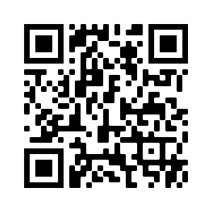
Devoirs
Vocabulary Learning Homework (Term 2.1, Week 1)
Audio file
Audio file QR code:
Student worksheet
Quizlet link
In addition, revisit: Term 1.2 Week 5
Term 1.1 Week 7

