Slide 1
Talking about more than one thing
Plural nouns with –es
Plural nouns with –s (revisited)
SSC [que]
Y7 Spanish
Term 1.2 - Week 2 - Lesson 17
Nick Avery / Rachel Hawkes Artwork: Mark Davies
Date updated: 16/08/20
Notes:
Learning outcomes (lesson 1):
Introduction of SSC [que]
Introduction of plural nouns with -es
Consolidation of plural nouns with –s
Consolidation of TENER
Word frequency (1 is the most frequent word in Spanish):
7.1.2.2 (introduce) uno [425]; dos [64]; tres [134]; cuatro [241]; cinco [284]; seis [438]; siete [603]; ocho [641]; nueve [991]; diez [449]; once [1700]; doce [1138]; color [358]; plan [625]; flor [739]; autor/a [513]; profesor/a [501]; director/a [592]; número [324]
7.1.1.6 (revisit) ¿quién? [289]; hablar [90]; comprar [361]; bailar [1323]; llegar [75]; escuchar [281]; amiga [1172]; música [340]; tarde¹ [392]; temprano [1578]; importante [171]; bien [78]; con [14]; otra vez [59-vez]; pareja¹ [892]
7.1.1.1 (revisit) estar [21]; estoy; estás; está; norte [624]; sur [661]; Inglaterra [N/A]; España [N/A]; ¿dónde? [161] en [5]; hola [1245]; hasta luego [luego-150]
Source: Davies, M. & Davies, K. (2018). A frequency dictionary of Spanish: Core vocabulary for learners (2nd ed.). Routledge: London

Slide 2
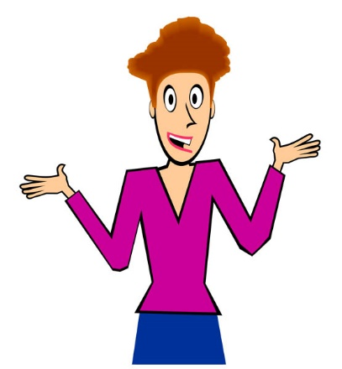
que
porque
Nick Avery
Notes:
Introduce and elicit the pronunciation of the individual SSC ‘que’ and then present and practise the pronunciation of the source word ‘porque’.
A possible gesture for this source word would be to rotate your index fingers in a clockwise direction, akin to miming a wheel in forward motion.
Whilst abstract, this is a gesture often used in the classroom to encourage learners to justify their opinions with reasons. NB: The English meaning ‘because’ should be clearly given to ensure secure word-meaning mapping.

Slide 3
que
porque
Nick Avery
Notes:
Repeat the sound and elicit the source word.

Slide 4
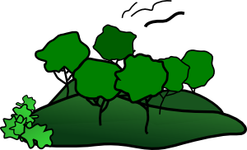
que
parque
pequeño
porque
¿qué?
querer
[because]
[to want]
quedar
[to meet up; stay; suit]
Nick Avery
Notes:
Introduce and elicit the pronunciation of the individual SSC ‘que’ and then the source word again (with gesture, if using). Then present and elicit the pronunciation of the five cluster words.
The cluster words have been chosen for their high-frequency, from a range of word classes, with the SSC (where possible) positioned within a variety of syllables within the words (e.g. initial, 2nd, final etc.). Additionally, we have tried to use words that build cumulatively on previously taught SSCs (see the Phonics Teaching Sequence document) and do not include new SSCs. Where new SSCs are used, they are often consonants which have a similar symbol-sound correspondence in English.

Slide 5
que
parque
pequeño
porque
¿qué?
querer
quedar
Nick Avery
Notes:
Without the images, students focus this time again closely on the SSC and the cluster words.

Slide 6
que
parque
pequeño
porque
¿qué?
querer
quedar
Nick Avery
Notes:
Without the images or sound, students have to pronounce the words themselves.

Slide 7
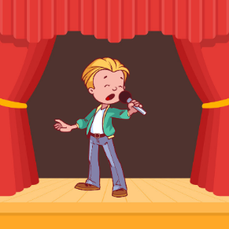
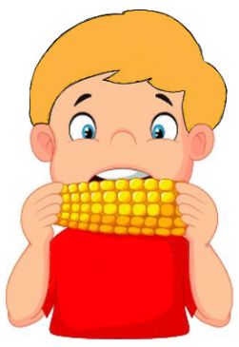
escuchar / escribir
¿QUE, CA o CO?
1
3
que
par____
__ntar
ca
5
que
pe____ño
2
4
[to want]
que
co
___rer
__mer
Notes:
Phonics practice activity [1/2]
Timing: 5 minutes
Aim: to practice mapping the sound of [ca], [co] and [que] to their spellings
Procedure:
1. Students write 1-5.
2. Students listen and write the missing letters.
3. Teacher checks answers
Note: a variation of this activity is on slides 7-8 (students write the full word)
Word frequency (1 is the most frequent word in Spanish): pequeño [202]; querer [58]; parque [1354]; cantar [717]; comer [347]
Source: Davies, M. & Davies, K. (2018). A frequency dictionary of Spanish: Core vocabulary for learners (2nd ed.). Routledge: London

Slide 8
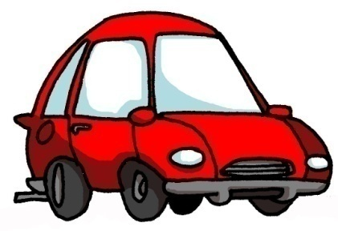
escuchar / escribir
¿QUE, CA o CO?
Con ketchup
6
8
¿qué?
co
__n
10
co
__che
7
[street]
9
[to remain; stay; suit]
ca
__lle
que
___dar
Notes:
Phonics practice activity [2/2]
Word frequency (1 is the most frequent word in Spanish): qué [50]; quedar [100]; con [14]; calle [269]; coche [1190]
Source: Davies, M. & Davies, K. (2018). A frequency dictionary of Spanish: Core vocabulary for learners (2nd ed.). Routledge: London

Slide 9
escuchar / escribir
¿QUE, CA o CO?
1
3
parque
cantar
5
pequeño
2
4
[to want]
comer
querer
Notes:
VARIATION
Timing: 5 minutes
Aim: to practice mapping the sound of [ca], [co] and [que] to their spellings
Procedure:
1. Students write 1-5.
2. Students listen and write the full words.
3. Teacher checks answers
Note: a variation of this activity is on slides 7-8 (students write the full word)
Word frequency (1 is the most frequent word in Spanish): pequeño [202]; querer [58]; parque [1354]; cantar [717]; comer [347]
Source: Davies, M. & Davies, K. (2018). A frequency dictionary of Spanish: Core vocabulary for learners (2nd ed.). Routledge: London

Slide 10
escuchar / escribir
¿QUE, CA o CO?
Con ketchup
6
8
¿qué?
con
10
coche
7
[street]
9
[to remain; stay; suit]
calle
quedar
Notes:
Phonics practice activity [2/2]
Word frequency (1 is the most frequent word in Spanish): qué [50]; quedar [100]; con [14]; calle [269]; coche [1190]
Source: Davies, M. & Davies, K. (2018). A frequency dictionary of Spanish: Core vocabulary for learners (2nd ed.). Routledge: London

Slide 11
Vocabulario
hablar
 | Español | Inglés
1 | uno | one
2 | dos | two
3 | tres | three
4 | cuatro | four
5 | cinco | five
6 | seis | six
7 | un color | colour
8 | un plan | plan
9 | una flor | flower
10 | un autor | male author
11 | un profesor | male teacher
60
Segundos
0
INICIO
Notes:
Vocabulario
Timing: 1-4 minutes Aim: To reactivate and strengthen vocabulary knowledge. Procedure: Round 1: Look at the Spanish, recall the English meanings, saying them aloud. [1 minute] Round 2: Look at the English, recall the Spanish meanings, saying them aloud. [1 minute] Repeat for two further minutes, to speed up recall.
Note: the introduction of new vocabulary this week is staggered over the two lessons. This includes feminine forms of nouns (profesora, autora).
Word frequency (1 is the most frequent word in Spanish): uno [425]; dos [64]; tres [134]; cuatro [241]; cinco [284]; seis [438]; color [358]; plan [625[; flor [739]; autor [513]; profesor [501]
Source: Davies, M. & Davies, K. (2018). A frequency dictionary of Spanish: Core vocabulary for learners (2nd ed.). Routledge: London

Slide 12
leer
¿Cómo se dice en español?
two
six
plan
flower
three
dos
seis
el plan
la flor
tres
five
colour
four
male author
one
cinco
el color
cuatro
uno
el autor
male teacher
el autor | cinco | uno | el color | seis | el profesor
cuatro | el plan | tres | dos | la flor
el profesor
Notes:
Vocabulary practice slide
Timing: 5 minutes
Aim: to practice recognising the meanings of the new Spanish words
Procedure:
1. Click to bring up the English word.
2. Choose the correct Spanish word from those in the grid.
3. Teachers may wish to remove the option grid to challenge a higher-achieving group.
Word frequency (1 is the most frequent word in Spanish): uno [425]; dos [64]; tres [134]; cuatro [241]; cinco [284]; seis [438]; color [358]; plan [625[; flor [739]; autor [513]; profesor [501]
Source: Davies, M. & Davies, K. (2018). A frequency dictionary of Spanish: Core vocabulary for learners (2nd ed.). Routledge: London

Slide 13
Talking about more than one thing: Plural nouns with -es
Many Spanish nouns end in a vowel (like ‘o’ and ‘a’)
To talk about these in the plural (more than one), add –s to the end of the noun.
Tengo plantas.
→ I have plants.
If the noun ends in a consonant (like ‘n’ or ‘r’), add –es to the end.
For example:
Tengo planes.
→ I have plans.
Tengo flores.
→ I have flowers.
Notes:
Grammar explanation slide
Timing: 1 minute
Note:
1. Students following the SoW should be familiar with the first half of the explanation. After ‘tengo plantas’, the teacher can elicit more examples of nouns that pluralise by adding –s to the singular form (e.g. bicicleta, teléfono, cámara, cama, casa, pregunta).
2. For now, we simply treat ‘autores’ and ‘profesores’ in their plural form as masculine (i.e. male teachers, male authors). In lesson 2, we will introduce rules regarding the biological gender marking on plural nouns.

Slide 14
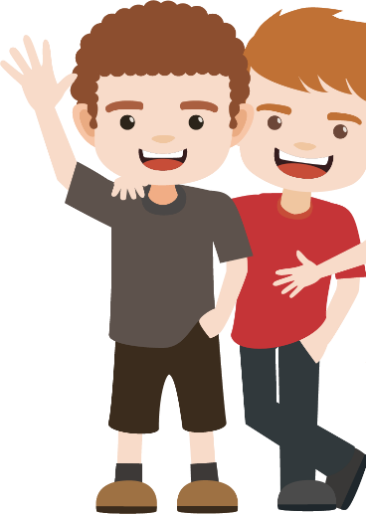
leer
Andrés describe a un amigo.
Lee el español.
Which word is missing?
Marca la letra correcta (A o B).
A | B
1. Juan estudia con seis
s.
1
amigo
autor
2. Habla con con cinco
es.
‘Señor’ means ‘Mr.’.
It can also mean ‘man’. More on this next week!
2
profesor
amiga
3. Está en un barco de dos
es.
3
cama
color
4. No lleva
s.
4
camisa
flor
5. Llega con cuatro
5
gato
señor
es.
Notes:
Reading activity [1/2]
Timing: 8 minutes (slides 12-13)
Aim: to practise distinguishing between nouns that pluralise with –s and -es
Procedure:
1. Students write 1-10 (the activity goes over two slides).
2. They read each sentence and decide what the missing noun must be (see right hand side).
3. They write ‘A’ or ‘B’.
4. Teacher checks answers, eliciting the meanings of the sentences (slide 14 can be used to check answers to this).
Word frequency (1 is the most frequent word in Spanish): amigo [210]; autor/a [513]; profesor/a [501]; color [358]; cama [609]; camisa [1873]; flor [739]; señor¹ [201]; gato [1728]
Source: Davies, M. & Davies, K. (2018). A frequency dictionary of Spanish: Core vocabulary for learners (2nd ed.). Routledge: London

Slide 15
leer
Andrés describe a un amigo.
Lee el español.
Which word is missing?
A | B
Marca la letra correcta (A o B).
6. Tiene cinco
s.
6
tarea
plan
7. No compra
es.
7
producto
hotel
8. Tiene amigos en cuatro
es.
8
barco
capital
9
cosa
flor
9. Necesita dos
s.
10
lugar
calle
10. Usa una bici en tres
es.
Notes:
Reading activity [2/2]
Note: We selected two additional words here that would support practice of the grammar: ‘hotel’ and ‘capital’. These were also chosen for their frequency and because they are English-Spanish cognates. In item 10, ‘calle’ and ‘lugar’ were previously encountered as phonics words.
Word frequency (1 is the most frequent word in Spanish): tarea [995]; producto [394]; plan [625]; flor [739]; barco [1384]; calle [269]; cosa [69]; lugar [144]; hotel [1163]; capital [581]
Source: Davies, M. & Davies, K. (2018). A frequency dictionary of Spanish: Core vocabulary for learners (2nd ed.). Routledge: London

Slide 16
¿Cómo se dice en inglés?
leer
“Estudia con seis amigos.”
S/he studies with six friends.
“Está en un barco de dos colores.”
S/he is in a two-colour boat.
“Tiene cinco tareas hoy.”
S/he has five tasks today.
“Llega con cuatro señores.”
S/he arrives with four men.
“Usa una bici en tres lugares.”
S/he uses a bike in three places.
Notes:
This slide can be used to check understanding of the meanings of the sentences used in the previous activity.
Click on the orange bar (in any order) to bring up the English translation.

Slide 17
escuchar / escribir
Escucha.
Marca la opción correcta.
Escucha otra vez.
noun ends in -s | noun ends in -es
Escribe las palabras.
1
1.tres tareas
2
2. seis profesores
3
3. cinco cosas
4
4. dos colores
5
5. cuatro planes
6
6. unos periódicos
7
7. unas flores
8
8. unas preguntas
9
9. unos autores
10
10. unas palabras
Notes:
Two-part listening task
Aim: to practise ‘listening out’ for noun endings and to practise writing the new words (transcription)
Procedure:
1. Play the audio. Decide if the noun ends in –s or –es (this is a simple ‘listening out’ for the form).
2. Students listen again and write what they hear (transcribing both the number and plural noun).
Note: Higher-achieving groups may be able to complete both parts as they listen.
Transcript:
1.tres tareas
2. seis profesores
3. cinco cosas
4. dos colores
5. cuatro planes
6. unos periódicos
7. unas flores
8. unas preguntas
9. unos autores
10. unas palabras
Word frequency (1 is the most frequent word in Spanish): autor/a [513]; profesor/a [501]; color [358]; flor [739]; tarea [995]; plan [625]; cosa [69]; periódico [1026]; pregunta [507]; palabra [192]
Source: Davies, M. & Davies, K. (2018). A frequency dictionary of Spanish: Core vocabulary for learners (2nd ed.). Routledge: London

Slide 18
Using your prompt cards, take turns to tell your partner how many of each thing you have.
escuchar / hablar
Tengo tres bolsas.
Persona A
Tengo dos bolsas.
Persona B
Complete your response grid after each exchange.
Me
My partner
Example (Persona A):
Who has more bags?
Notes:
Paired speaking/listening activity
Instruction slide
Note:
Teachers can use this to model the interaction in the activity
Note that the final two prompt cards elicits ‘tiene’ (e.g. Tengo un libro. Tiene cuatro autores). It may be useful to tell students that they will use this previously taught verb in the task, in addition to ‘tengo’.

Slide 19
Student A – I have…
Student B – I have…
four tasks.
two (male) teachers.
three shirts.
five plans today.
six flowers.
four newspapers in Spanish.
a book – it has two (male) authors.
a pen – it has five colours.
three tasks.
four (male) teachers.
two shirts.
six plans today.
three flowers.
five newspapers in Spanish.
a book – it has six (male) authors.
a pen – it has two colours.
Notes:
DO NOT DISPLAY THIS SLIDE A printer-friendly version of these prompt cards is available in Word format.

Slide 20
ANSWERS
Student A
Student B
Who… | me | my partner
me | my partner
has more tasks?
has more (male) teachers?
has more shirts?
has more plans today?
has more flowers?
has more newspapers in Spanish?
has the book with more authors?
has the pen with more colours?
Notes:
ANSWERS

Slide 21
Talking about more than one thing [2]
Gender of plural nouns
Plural nouns with –es (cont.)
SSC [que] (cont.)
Y7 Spanish
Term 1.2 - Week 2 - Lesson 18
Nick Avery / Rachel Hawkes Artwork: Mark Davies
Date updated: 16/08/21
Notes:
Learning outcomes (lesson 2):
Consolidation of SSC [que] Consolidation of plural nouns with –s and -es
Consolidation of TENER
Word frequency (1 is the most frequent word in French):
7.1.2.2 (introduce) uno [425]; dos [64]; tres [134]; cuatro [241]; cinco [284]; seis [438]; siete [603]; ocho [641]; nueve [991]; diez [449]; once [1700]; doce [1138]; color [358]; plan [625]; flor [739]; autor/a [513]; profesor/a [501]; director/a [592]; número [324]
7.1.1.6 (revisit) ¿quién? [289]; hablar [90]; comprar [361]; bailar [1323]; llegar [75]; escuchar [281]; amiga [1172]; música [340]; tarde¹ [392]; temprano [1578]; importante [171]; bien [78]; con [14]; otra vez [59-vez]; pareja¹ [892]
7.1.1.1 (revisit) estar [21]; estoy; estás; está; norte [624]; sur [661]; Inglaterra [N/A]; España [N/A]; ¿dónde? [161] en [5]; hola [1245]; hasta luego [luego-150]
Source: Davies, M. & Davies, K. (2018). A frequency dictionary of Spanish: Core vocabulary for learners (2nd ed.). Routledge: London

Slide 22
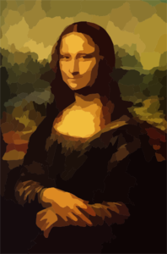
QUE
CO
CU
[to want]
A
B
C
D
escuchar
querer
comer
pequeño
E
F
G
H
[with]
coche
parque
documento
con
I
cultura
Notes:
Phonics practice activity
Timing: 5 minutes
Aim: to recall the missing the SSCs (and to successfully map their sound to spelling, if a prompt is needed)
Procedure:
1. Teachers ask students to write A-I the missing SSC (obscured by paw print) for each word.
2. Teachers click on the pictures to play the word if the students need an extra prompt.
3. Clicking on the paw prints will remove them, revealing the answer.

Slide 23
colour
vocabulario
uno
cuatro
la flor
el plan
tres
el profesor
cinco
el autor
el color
seis
dos
Notes:
Vocabulary recap
Timing: 5 minutes (slides 21-31)
Aim: to identify the Spanish word with the same meaning as the English in the centre

Slide 24
two
vocabulario
uno
cuatro
la flor
el plan
tres
el profesor
cinco
el autor
el color
seis
dos

Slide 25
six
vocabulario
uno
cuatro
la flor
el plan
tres
el profesor
cinco
el autor
el color
seis
dos

Slide 26
male teacher
vocabulario
uno
cuatro
la flor
el plan
tres
el profesor
cinco
el autor
el color
seis
dos

Slide 27
three
vocabulario
uno
cuatro
la flor
el plan
tres
el profesor
cinco
el autor
el color
seis
dos

Slide 28
plan
vocabulario
uno
cuatro
la flor
el plan
tres
el profesor
cinco
el autor
el color
seis
dos

Slide 29
male author
vocabulario
uno
cuatro
la flor
el plan
tres
el profesor
cinco
el autor
el color
seis
dos

Slide 30
one
vocabulario
uno
cuatro
la flor
el plan
tres
el profesor
cinco
el autor
el color
seis
dos

Slide 31
four
vocabulario
uno
la flor
el plan
cuatro
tres
el profesor
cinco
el autor
el color
seis
dos

Slide 32
flower
vocabulario
uno
cuatro
la flor
el plan
tres
el profesor
cinco
el autor
el color
seis
dos

Slide 33
five
vocabulario
uno
cuatro
la flor
el plan
tres
el profesor
cinco
el autor
el color
seis
dos

Slide 34
Vocabulario
hablar
 | Español | Inglés
1 | siete | seven
2 | ocho | eight
3 | nueve | nine
4 | diez | ten
5 | once | eleven
6 | doce | twelve
7 | una autora | female author
8 | una profesora | female teacher
9 | un director | male director, headteacher
10 | una directora | female director, headteacher
60
Segundos
0
INICIO
Notes:
Vocabulario
Timing: 1-4 minutes Aim: To reactivate and strengthen vocabulary knowledge.
Procedure: Round 1: Look at the Spanish, recall the English meanings, saying them aloud. [1 minute] Round 2: Look at the English, recall the Spanish meanings, saying them aloud. [1 minute] Repeat for two further minutes, to speed up recall.
Note: the introduction of new vocabulary this week is staggered over the two lessons.
Word frequency (1 is the most frequent word in Spanish): siete [603]; ocho [641]; nueve [991]; diez [449]; once [1700]; doce [1138]; la autora [513]; la profesora [501]; el director [592]; la directora [592]
Source: Davies, M. & Davies, K. (2018). A frequency dictionary of Spanish: Core vocabulary for learners (2nd ed.). Routledge: London

Slide 35
Talking about more than one thing: Gender and plural nouns
To talk about male and female people together, Spanish often uses the masculine form of the noun.
In English, we don’t always make this clear either!
We often refer to ‘friends’ without saying if they are boys or girls.
“Tengo tres amigos.” can mean:
I have 3 (male) friends.
OR
I have 3 (male and female) friends.
To refer to two or more females, use the feminine form in the plural.
“Tengo tres amigas.”
I have 3 (female) friends.
Notes:
Grammar explanation slide
Timing: 2 minutes
Note: Students will later also learn that
some nouns don’t pluralise in the two ways they have learnt so far (e.g. actriz -> actrices)
some nouns don’t have different forms for masculine and feminine (asistente, estudiante, ayudante, cantante etc.)

Slide 36
leer
Lee el texto.
Marca la opción correcta.
Estudio en una escuela. Está en Granada y ¡es enorme! Tiene dos directoras y once profesores de español también. La clase de español es excelente, pero no estudio mucho porque tengo doce amigas y ¡hablo mucho en clase!
Hoy tengo historia. Estudio con seis amigos de Inglaterra. Es importante llevar un libro a clase, pero no es un libro pequeño - ¡tiene nueve autores!
 | Female only | Male only / male & female
headteachers
Spanish teachers
friends in Spanish class
friends in history class
authors of history book
How many?
1
2
2
11
3
12
4
6
5
9
Notes:
Reading activity
Timing: 10 minutes
Aim: to begin to read Spanish beyond the sentence level; to practise working out the biological gender of plural nouns
Procedure:
1. Students write 1-5.
2. Students read the text and decide on the biological gender of the nouns.
3. They look again and decide how many of each noun there are.
4. Teachers check answers.
Notes:
This fully readable text includes nearly 100% previously taught language. There is one near-cognate (‘clase’) and two phonics words introduced this week (porque, pequeño) are included. The text could also be used for a dictation.
Word frequency (1 is the most frequent word in Spanish): autor/a [513]; profesor/a [501]; director/a [592]; amigo [210]
Source: Davies, M. & Davies, K. (2018). A frequency dictionary of Spanish: Core vocabulary for learners (2nd ed.). Routledge: London

Slide 37
escuchar
Escucha.
Escucha otra vez.
Marca la opción correcta.
Escribe el número correcto.
Female only | Male only / male & female
How many?
El número
3
1
10
2
2
10
3
8
8
12
9
3
9
11
4
7
5
2
6
7
7
12
8
11
Notes:
Listening activity
Timing: 8 mins
Aim: to practise understanding biological gender of plural nouns; to practise understanding numbers in the oral modality
Procedure:
1. Students write 1-8.
2. Students listen. For each item, they note if it’s ‘female only’ or ‘male only / male & female’
3. Students listen again. This time, they note the number.
Note: Remove the box with the number options if your class does not need this additional support.
Transcript:
tres profesoras
diez profesores
ocho directores
nueve directoras
dos amigos
siete amigas
doce autoras
once autores

Slide 38
Poema: una persona extraordinaria
escuchar
Escucha.
Escribe la letra correcta.
A
Llega con tres directores.
Compra libros de doce autores.
Estudia inglés con nueve profesores.
Pero, ¡no es todo!
Lleva una camisa de ocho colores.
Compra un bouquet de siete flores.
Y habla con seis actores.
1
D
B
2
G
C
3
A
4
B
D
5
F
E
6
C
F
7
E
Full poem
G
Notes:
Listening activity - poem
Timing: 8 minutes
Aim: to identify the line of the poem heard in the audio; to understand the meaning of each line
Procedure:
1. Students first listen and decide which sentence of the poem they hear (these are in jumbled order).
2. The teacher then clicks on ‘full poem’ to hear it in order (answers can be checked).
3. Then, line by line, ask students for a translation of the poem.
Note.
1. The vocabulary has been previously been taught, except for ‘todo’. This will be introduced in Y7 Term 3.2. Students won’t be expected to produce it on their own here (see next slide).
2. The noun ‘actor’ wasn’t used for preceding grammar-focused activities, but was chosen here as it is frequent [1533] and also a cognate. Bouquet is also a cognate / loan word that is common in English.
Photos by Shubham Bochiwal & Uljana Maljutina on Unsplash

Slide 39
arrives with
3 headteachers
hablar
buys books
12 authors
studies English with 9 teachers
But that’s not all!
wears a shirt
8 colours
buys a bouquet
7 flowers
speaks with
6 actors
*all = todo
Notes:
Narration activity - poem
Aim: to use the prompt cards to produce the sentences of the poem orally
Procedure:
In pairs, students decide together on a new order of sentences (writing the order, 1-7, on the prompt cards). This will generate a new version of the poem.
They then take turns to read a sentence aloud (in sequence).
Note:
1. A printable version of these cards is available in Word format.
2. Alternative: students change the numbers in the original for a different number between 2 and 12 and then take turns to read aloud.

Slide 40
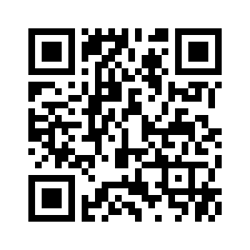
Deberes
Vocabulary Learning Homework (Y7, Term 1.2, Week 3)
Audio file
Audio file QR code:
Student worksheet
Quizlet link
In addition, revisit: Term 1.1 Week 7
Term 1.1 Week 2

