Slide 1
Reflexive ‘me’:
Doing something to yourself

Slide 2
Doing something to yourself : Reflexive ‘me’
Sometimes, the ‘doer’ (subject) and ‘receiver’ (object) of an action are the same person.
For example, ‘I hurt myself’ or ‘he hits himself’
Words like ‘myself’ or ‘himself’ are called reflexive pronouns.
Spanish also has reflexive pronouns.
When you do something to yourself, use ‘me’ before a verb.
Look at the difference between:
Lavo el coche
Me lavo
Something to know for later!
Reflexive pronouns can go after the infinitive form of a verb.
For now, we will just practise reflexives when they come before verbs.
→ I wash the car
→ I wash myself
Nick Avery / Emma Marsden / Rachel Hawkes
Notes:
Teachers can skip the speech bubble if they wish. It is ok to teach part of a rule and then add a variation later. Or you might want to mention this here now. Either way, just giving this information here or not, won’t make much difference to learning, as the pupils will just practise the reflexive pronoun ‘before the verb’ here.

Slide 3
Almost any verb can be ‘reflexive’!
hablar - to talk
hablo con mi amigo
me hablo
sacar fotos – to take photos
saco fotos de mi amigo
me saco fotos
escribir – to write
escribo a mi hermano
me escribo
→ I talk with my friend
→ I talk to myself
→ I take photos of my friend
→ I take photos of myself
→ I write to my brother
→ I write to myself
Nick Avery / Emma Marsden / Rachel Hawkes
Notes:
Ask the pupils: Imagine: When might you say ‘I talk to myself’ ?!
When might you say you ‘write to yourself’? Ever write yourself reminders, or send yourself a text to remind yourself to do something?
You will get some fun answers. The idea is to convey that ‘notion’ of reflexiveness.
It can be applied to any verb, really! You just need a context for it to make sense.

Slide 4
lavar – to wash
lavo el perro
me lavo
levantar – to lift / get up / raise
levanto la mano
me levanto
despertar – to wake up
despierto a mi madre
me despierto
In English, we don’t always say the reflexive pronoun!
The ‘reflexive meaning’ is just assumed.
→ I wash the dog
→ I wash [myself]
→ I lift up/raise my hand
→ I get [myself] up
→ I wake my mum up
→ I wake [myself] up
Nick Avery / Emma Marsden / Rachel Hawkes
Notes:
Notice that in English, we don’t always say the reflective pronoun - we assume it!

Slide 5
Esteban is a carer and has written an anonymous article about his daily life.
Some language might be missing.
leer
Read the sentences and tick true or false.
1. Me levanto a las ocho
 | True | False
2. Despierto a las siete.
Esteban gets up at eight am
✔
Esteban wakes up at seven am.
✔
3. Lavo a las nueve.
4. Saco fotos
He washes someone else at nine am.
✔
5. Me preparo un café
He takes photos of himself.
✔
6. Llamo
He makes someone else a coffee.
✔
7. Me escribo
He calls someone else.
✔
8. Enseño español
He writes to someone else.
✔
9. Quemo
He teaches himself Spanish.
✔
10. Me presento
He burns something (!)
✔
He introduces himself to someone.
✔
Nick Avery / Emma Marsden / Rachel Hawkes
Notes:
Verb frequency rankings (1 is the most frequent word in Spanish):
levantar [354]; despertar [894]; lavar [1676]; sacar [273]; preparer [570]; llamar [122]; escribir [198]; enseñar [610]; quemar [1648]; presentar [235].
Source: Davies, K. and Davies, K. (2018). A frequency dictionary of Spanish: Core vocabulary for learners (2nd ed.). London: Routledge

Slide 6
Listen to the sentences. You will hear the start of the sentence. The rest is missing.
Decide whether the start of the sentence matches picture A or B.
 | Picture A | Picture B
1
2
3
4
5
6
7
8
9
10
escuchar
Nick Avery / Emma Marsden / Rachel Hawkes
Notes:
Blank grid for students. In this activity, students hear a verb with or without reflexive pronoun ‘me’ and have to decide which of two pictures matches it.
Each pair of pictures depicts (1) ‘action being done to (my)self’ and (2) ‘action being done to another person / thing’.
Note that part of each sentence is ‘missing’ and students only hear the verb, with or without reflexive pronoun. This is done to remove non-grammatical cues that learners often rely on for meaning (e.g. an object after a transitive verb).
Verb frequency rankings (1 is the most common word in Spanish): escribir [198]; sacar [273]; preguntar [219]; quemar [1648]; llamar [122]; lavar [1676]; secar [2239]; mirar [125]; levantar [354]; presentar [235].
Source: Davies, M. & Davies, K. (2018). A frequency dictionary of Spanish: Core vocabulary for learners (2nd ed.). London: Routledge.
Transcript. 1. me escribo *noise* / 2. me saco fotos *noise* / 3. pregunto *noise* / 4. quemo *noise* / 5. llamo *noise* / 6. me lavo *noise* / 7. seco *noise* / 8. miro *noise* / 9. me levanto *noise* / 10. me presento *noise*

Slide 7
1
1a.
1b.
Note to self
Don’t forget the bills!
Hi Maria,
Don’t forget the bills!
escuchar
Nick Avery / Emma Marsden / Rachel Hawkes
Notes:
Audio: me escribo Click on the orange number to hear the audio, twice.

Slide 8
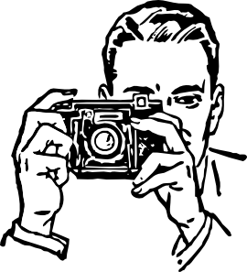
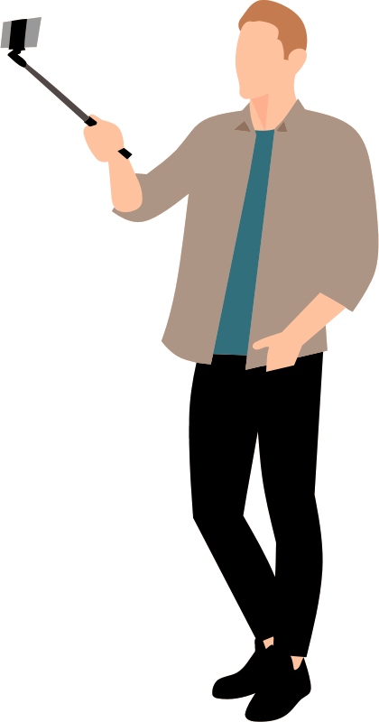
2
2a.
2b.
escuchar
Nick Avery / Emma Marsden / Rachel Hawkes
Notes:
Audio: me saco fotos

Slide 9
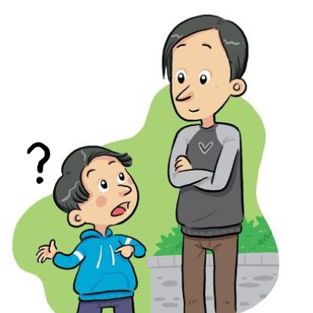
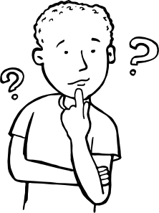
3
3a.
3b.
hmm
escuchar
Nick Avery / Emma Marsden / Rachel Hawkes
Notes:
Audio: pregunto

Slide 10
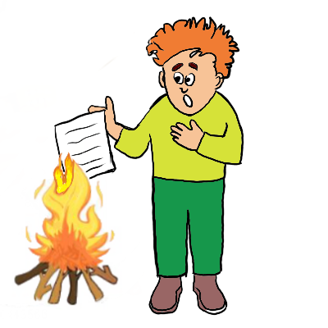
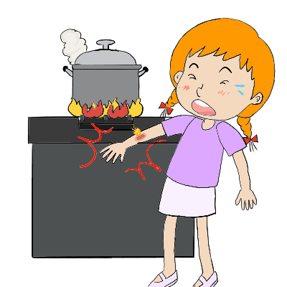
4
4a.
4b.
escuchar
Nick Avery / Emma Marsden / Rachel Hawkes
Notes:
Audio: me quemo

Slide 11
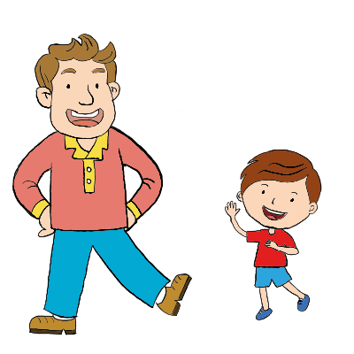
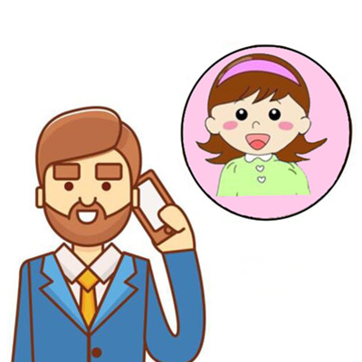
5
5a.
5b.
Hi, I’m called…
escuchar
Nick Avery / Emma Marsden / Rachel Hawkes
Notes:
Audio: llamo

Slide 12
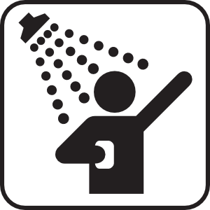
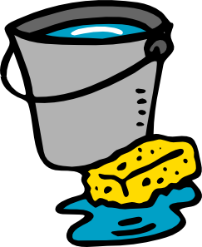
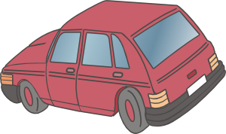
6
6a.
6b.
escuchar
Nick Avery / Emma Marsden / Rachel Hawkes
Notes:
Audio: me lavo

Slide 13
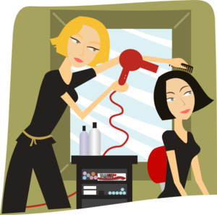
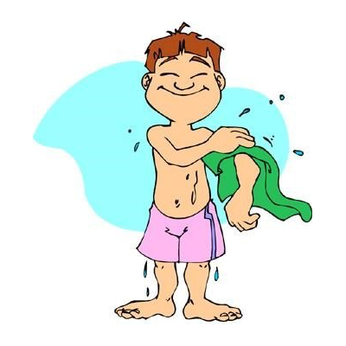
7
7a.
7b.
escuchar
Nick Avery / Emma Marsden / Rachel Hawkes
Notes:
Audio: seco

Slide 14
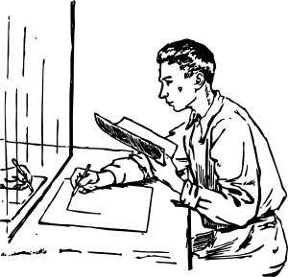
8
8a.
8b.
escuchar
Nick Avery / Emma Marsden / Rachel Hawkes
Notes:
Audio: me miro

Slide 15
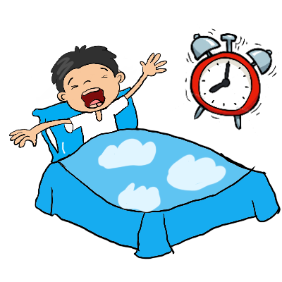
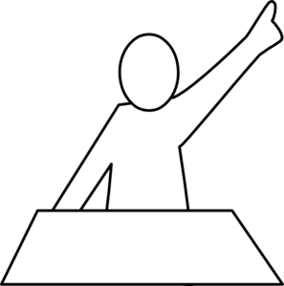
9
9a.
9b.
escuchar
Nick Avery / Emma Marsden / Rachel Hawkes
Notes:
Audio: levanto

Slide 16
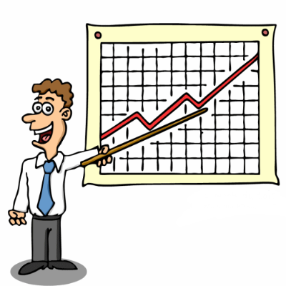
10
10a.
10b.
escuchar
Nick Avery / Emma Marsden / Rachel Hawkes
Notes:
Audio: me presento

Slide 17
ANSWERS
 | Picture A | Picture B
1
2
3
4
5
6
7
8
9
10
✔
✔
✔
✔
✔
✔
✔
✔
✔
✔
escuchar
Nick Avery / Emma Marsden / Rachel Hawkes
Notes:
Answers

Slide 18
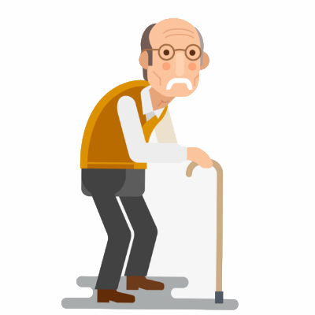
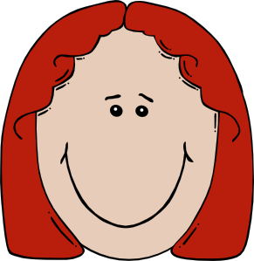
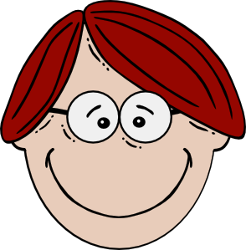
Looking after my Grandpa
Margarita and Simón spend a lot of time looking after their elderly Grandpas.
They also find time to do things themselves.
What do they do to help? And what do they do themselves?
Student A: you are Margarita. Write 6 sentences using the cards.
Student B: you are Simón. Write 6 sentences using the cards.
Afterwards, compare your answers and complete the grid together.
escribir
Nick Avery / Emma Marsden / Rachel Hawkes
Notes:
Students will need to write ‘a mi abuelo’ if the action is done to the grandfather.
Note that in this activity Student A and B’s cards have the same actions – the only difference is the ‘receiver’ of the action.
The activity is designed in this way so that students can then compare what their characters do afterwards (see slide 20).

Slide 19
Student A
You are Margarita
Using the prompt cards, write six sentences about things you do to yourself and your Grandpa each day.
(myself)
get up
prepare coffee
take photos
(myself)
(myself)
teach Spanish
wash
write
escribir
Nick Avery / Emma Marsden / Rachel Hawkes
Notes:
Verb frequency rankings: levantar [354]; preparar [570]; sacar [273]; lavar [1676]; escribir [198]; enseñar [610].

Slide 20
Student B
You are Simón.
Using the prompt cards, write six sentences about things you do to yourself and your Grandpa each day.
(myself)
(myself)
get up
prepare coffee
take photos
(myself)
teach Spanish
wash
write
escribir
Nick Avery / Emma Marsden / Rachel Hawkes

Slide 21
Need help?
get up – levantar
prepare coffee – preparar café
take photos – sacar fotos
teach Spanish – enseñar español
wash – lavar
write – escribir
escribir
Nick Avery / Emma Marsden / Rachel Hawkes

Slide 22
Compare the sentences that you and your partner have written.
Complete the grid together.
 | Margarita | Simón | Both | Neither
Who gets their Grandpa up?
Who prepares coffee for him/herself?
Who takes photos of him/herself?
Who teaches Grandpa Spanish?
Who washes their Grandpa?
Who writes (notes) to him/herself?
leer
Nick Avery / Emma Marsden / Rachel Hawkes
Notes:
Blank grid for students
The prompt cards should be turned over when they complete this grid as they should be comparing each other’s sentences. Afterwards, they can turn cards back over to check answers.

Slide 23
ANSWERS
Compare the sentences that you and your partner have written.
Complete the grid together.
 | Margarita | Simón | Both | Neither
Who gets their Grandpa up?
Who prepares coffee for him/herself?
Who takes photos of him/herself?
Who teaches Grandpa Spanish?
Who washes their Grandpa?
Who writes (notes) to him/herself?
✓
✓
✓
✓
✓
✓
leer
Nick Avery / Emma Marsden / Rachel Hawkes
Notes:
ANSWERS
The prompt cards should be turned over at this point and only used to check once they have compared their answers.

Slide 24
Student A
You are Margarita
Using the prompt cards, tell your partner six things you do to yourself and your Grandpa each day.
(myself)
(myself)
get up
prepare coffee
take photos
(myself)
teach Spanish
wash
write
hablar / escuchar
Nick Avery / Emma Marsden / Rachel Hawkes
Notes:
NB The verbs have been kept the same as in the writing activity, but absence/presence of reflexive pronoun on the prompt cards has been changed.
Verb frequency rankings: levantar [354]; preparar [570]; sacar [273]; lavar [1676]; escribir [198]; enseñar [610].

Slide 25
Student B
You are Simón.
Using the prompt cards, tell your partner six things you do to yourself and your Grandpa each day.
(myself)
(myself)
get up
prepare coffee
take photos
(myself)
(myself)
teach Spanish
wash
write
hablar / escuchar
Nick Avery / Emma Marsden / Rachel Hawkes
Notes:
NB The verbs have been kept the same as in the previous writing activity, but absence/presence of reflexive pronoun on the prompt cards has been changed.

Slide 26
 | does it to herself | does it to Grandpa
get up
prepare coffee
take photos
teach Spanish
wash
write
speaking / listening
Nick Avery / Emma Marsden / Rachel Hawkes
Notes:
Student B grid - blank

Slide 27
ANSWERS
 | does it to herself | does it to Grandpa
get up
prepare coffee
take photos
teach Spanish
wash
write
✓
✓
✓
✓
✓
✓
speaking / listening
Nick Avery / Emma Marsden / Rachel Hawkes
Notes:
Student B grid – answers
On completion of the grid, students can be asked to compare grids and find which two activities they both do to themselves (answer: prepare coffee, write)

Slide 28
 | does it to himself | does it to Grandpa
get up
prepare coffee
take photos
teach Spanish
wash
write
speaking / listening
Nick Avery / Emma Marsden / Rachel Hawkes
Notes:
Student A grid - blank

Slide 29
ANSWERS
 | does it to himself | does it to Grandpa
get up
prepare coffee
take photos
teach Spanish
wash
write
✓
✓
✓
✓
✓
✓
speaking / listening
Nick Avery / Emma Marsden / Rachel Hawkes
Notes:
Student A grid - answers
On completion of the grid, students can be asked to compare grids and find which two activities they both do to themselves (answer: prepare coffee, write)

