Slide 1
Deutsch - Y7
Phonics – SSC ‘O’
Notes:
Frequency rankings (1 is the most common word in German):
wohnen [380] schreiben [245] spielen [197] reden [356] lernen [203] machen [49] Montag [794] die Aufgabe [317] im Klassenzimmer [609/619] im Unterricht [1107] in der Schule [208] mit Freunden [13/327] er [20] sie [10]
Source: Jones, R.L. & Tschirner, E. (2006). A frequency dictionary of German: core vocabulary for learners. Routledge

Slide 2
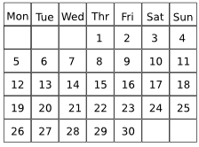
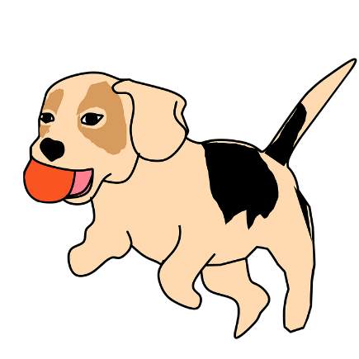
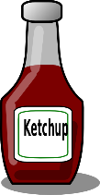
o
wohnen
Montag
wo?
ohne
holen
Million
Notes:
Introduce and elicit the pronunciation of the individual SSC ‘wo’ and then the source word again (with gesture, if using). Then present and elicit the pronunciation of the five cluster words. The cluster words have been chosen for their high-frequency, from a range of word classes, with the SSC (where possible) positioned within a variety of syllables within the words(e.g. initial, 2nd, final etc..) and additionally, we have tried to use words that build cumulatively on previously taught SSCs (see the Phonics Teaching Sequence document) and do not include new SSCs. Where new SSCs are used, they are often consonants which have a similar symbol-sound correspondence in English.
Word frequency rankings (1 is the most common word in German): wo? [94]; wohnen [380] Montag [794]; ohne [119]; Million [206]; holen [640]. Source: Jones, R.L. & Tschirner, E. (2006). A frequency dictionary of German: core vocabulary for learners. Routledge

Slide 3
o
wohnen
Montag
wo?
ohne
holen
Million
Notes:
Without sound to elicit the pronunciation.

Slide 4
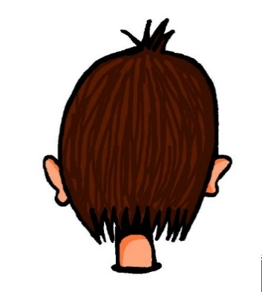
o
wollen
Woche
Kopf
offen
kommen
[to come]
noch
[still]
Notes:
Introduce and elicit the pronunciation of the individual SSC ‘O’ and then the source word again (with gesture, if using). Then present and elicit the pronunciation of the five cluster words. The cluster words have been chosen for their high-frequency, from a range of word classes, with the SSC (where possible) positioned within a variety of syllables within the words(e.g. initial, 2nd, final etc..) and additionally, we have tried to use words that build cumulatively on previously taught SSCs (see the Phonics Teaching Sequence document) and do not include new SSCs. Where new SSCs are used, they are often consonants which have a similar symbol-sound correspondence in English.
Word frequency rankings (1 is the most common word in German): Kopf [279]; wollen [65] Woche [209]; offen [382]; noch [37]; kommen [61]. Source: Jones, R.L. & Tschirner, E. (2006). A frequency dictionary of German: core vocabulary for learners. Routledge

Slide 5
o
wollen
Woche
Kopf
offen
kommen
[to come]
noch
[still]
Notes:
Without sound to elicit the pronunciation.

Slide 6
Lang oder kurz?
 | wo? | Kopf
1
2
3
4
Notes:
Hör die Wörter an. Ist die O wie ‘wo?’ (lang) oder wie ‘Kopf’ (kurz)?
noch
ohne
Million
wollen
Lang oder kurz? (long or short) - listening task to identify if the vowel is long or short.

Slide 7
Antworten
 | wo? | Kopf
1
2
3
4
noch
ohne
Million
wollen
Inge Alferink / Rachel Hawkes
Notes:
Antworten
noch
ohne
Million
wollen

Slide 8
1
Das Wasser ist kalt.
2
Die Woche ist lang.
3
Mein Kopf ist nicht klein.
4
Das Haustier holt den Ball.
5
Mein Freund kommt am Montag.
Notes:
Optional transcription task to revisit vocabulary and practise SSC knowledge.
This task also recycles key vocabulary from Week 5.

