Slide 1
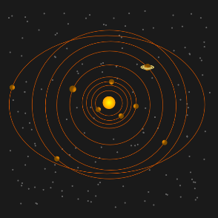
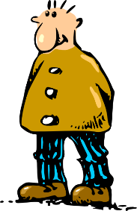
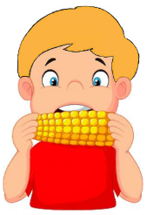
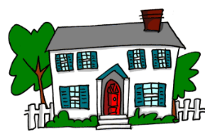
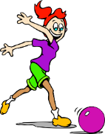
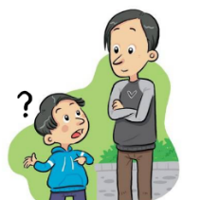
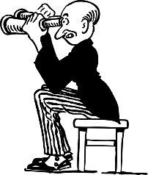
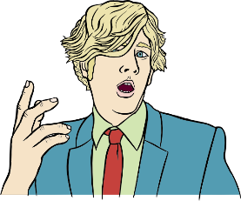
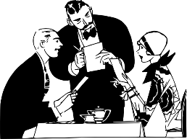
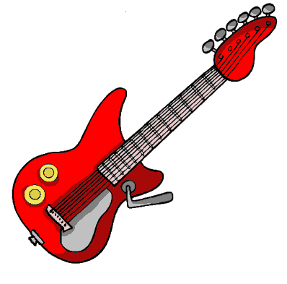
a
e
i
o
u
ll
libro
alto
elefante
idea
yo
universo
llamar
l
ca
co
cu
ce
ci
z
MADRID 1KM
casa
comer
cuerpo
cerca
cierto
zona
ga
go
gu
ge
gi
j
ganar
gol
preguntar
gente
imaginar
ojo
ñ
mano
v
celebrar
rr
pero
h
porque
qui
guerra
gui
español
n
ver
b
perro
r
hablar
que
quiero
gue
guitarra
Notes:
Click on the letter(s) to hear the SSC sound alone, and then either the picture or the word to hear the SOURCE word itself. Suggestions for gestures to accompany each source word can be found in the Spanish_SSC_Source_Words PPT, in the notes under each slide.

