Slide 1
Être: Je suis & tu es
To be | being: I am & you are
Notes:
This series of activities is compatible with the NCELP Scheme of Work for year 7, term 1.

Slide 2
I am & you are
‘am’ and ‘are’
are part of the verb ‘to BE’
In French, to say ‘I am’, use je suis.
This is the first person singular of the verb être.
To say ‘you are’, use tu es. This is the second person singular.
Remember, don’t pronounce the ‘s’
Silent Final Consonant!
Je suis
Je suis français.
I am French.
Je suis petit.
I am small.
Je suis malade.
I am unwell.
Tu es
Remember, don’t pronounce the ‘s’.
Silent Final Consonant!
Tu es français.
You are French.
Tu es petit.
You are small.
Tu es malade.
You are unwell.
Victoria Hobson / Emma Marsden
Notes:
Read this out to students so that they know exactly how to pronounce the French.
At the end, remind them to not sound out the ‘s’ at the end of ‘es’ and ‘suis’

Slide 3
Opposites attract?
Lire
You have read interviews where boys discuss their friendship. Look at the verb. Work out whether ‘I…’ or ‘you...’ is being described. Then, write the English adjectives. Are the friends similar or different?
Interview 1 |  | Interview 2
1 | es grand | 5 | suis grand
2 | suis petit | 6 | es petit
3 | suis anglais | 7 | es français
4 | es français | 8 | suis anglais
Interview 1
Interview 2
small
big
big
small
I
You
I
You
English
French
English
French
Victoria Hobson
Notes:
Pupils write: Interview 1 1
2
3
4 Interview 2 1
2
3
4
They write ‘je’ or ‘tu’ and the English adjective.
Teachers may want to mention to pupils that both friends are boys. So, the adjectives (grand, petit) match match the masculine noun (there is no ‘e’ on the end). Do not dwell on it as the pupils will do more practice on this soon.
Interview 1: The friends are different
Interview 2: The friends are different

Slide 4
Hit or miss?
Écouter
You are in a noisy café. You can only hear parts of the conversations. Listen carefully to the verb. Is the person is describing themselves (‘I’…) or the person they are talking to (‘you…’)?
I
You
I
I
You
1
5
2
6
3
7
4
8
Victoria Hobson
Notes:
This could be printed off as an answer grid or answers could just be jotted down on paper.
Then give feedback for each item (I or you) (using the next slide)
Using the next slide, ask students to write down in English the meaning of the eight adjectives for each item, as quick vocab practice. These adjectives will be known by Week 2, lesson 1. Although cool is not on the list, this is a cognate.
TRANSCRIPT
[noise] es grand
[noise] suis petit
[noise] suis anglais
[noise] es cool
[noise] suis malade
[noise] es calme
[noise] es aimable
[noise] suis français
Sound effect by Tristan Lohengrin : https://www.tristanlohengrin.com/

Slide 5
Hit or miss?
Écouter
You are in a noisy café. You can only hear parts of the conversations. Listen carefully to the verb. Is the person is describing themselves (‘I’…) or the person they are talking to (‘you…’)?
1 | es grand |  |  | 5 | suis malade
2 | suis petit |  |  | 6 | es calme
3 | suis anglais |  |  | 7 | es aimable
4 | es cool |  |  | 8 | suis français
I
You
I
You
Victoria Hobson
Notes:
[noise] es grand
[noise] suis petit
[noise] suis anglais
[noise] es cool
[noise] suis malade
[noise] es calme
[noise] es aimable
[noise] suis français

Slide 6
Talking! Parler!
Parler
Pick a pronoun (‘je’ or ‘tu’).
Pick an adjective.
Create a sentence.
Partner A
Remember, don’t pronounce the ‘s’
Silent Final Consonant!
“Tu es
français.”
Partner B
Translate into English
“You are French.”
Victoria Hobson
Notes:
See separate set of cards (word doc)
Note: The cards do not have to be printed, but they provide a model for the speaking activity. Pupils can easily be given one sheet of A4 white paper, fold it in half (lengthways), then again in half (widthways), then again into three, so that 12 equal-sized rectangular shapes are created. In 3 of them, they write ‘I’, in 3 others, they write ‘you’, then they write: ill, cool, big, small, English, French once on each of the other six. They tear (with or without use of a ruler, and certainly no scissors – it doesn’t need to be neat!). The first time students create their own flashcards takes about 5 mins, but they get quicker and quicker. It saves copying, cutting…
Separate the cards into two piles – one pile of the pronoun pictures (‘I’ and ‘you’) and one pile of adjectives.
Partner A picks a pronoun (I or you) and then an adjective; partner B gives the translation.
Remind the pupils not to pronounce the final ‘s’ on ‘suis’ and ‘es’. This shouldn’t be a problem as they have had lots of exposure to the spoken form by now in the listening activity.
Students then swap roles.
Pairs can time themselves, repeating the activity to see how quickly they can complete all the sentences and translations.
With each new game, different sentences will be generated.
Note: the pupils will be creating sentences as per the cards only, and so will not need the feminine form of the adjectives.

Slide 7
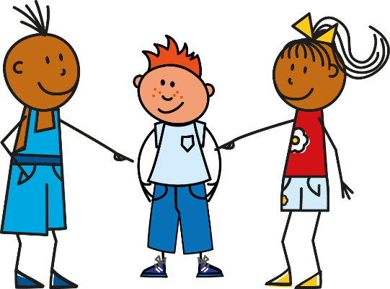
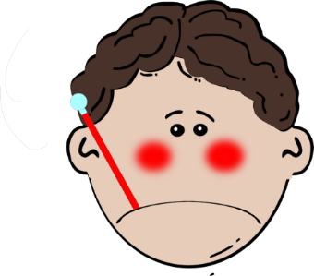
Writing! Écrire!
Écrire
Victoria Hobson
Notes:
On mini whiteboards or paper, students write the sentence generated on each click of the powerpoint.
After each of the first few items, check that the pupils are writing je suis and tu es correctly.

