Slide 1
Vocabulary
Y7 Spanish
Term 2.1 - Week 2 - Lesson 31
Victoria Hobson / Rachel Hawkes / Nick Avery
Date updated: 30/03/2019

Slide 2
Vocabulario
60
 | Español | Inglés
1 | el perro | dog
2 | el abuelo | grandad
3 | la abuela | grandma
4 | bastante | quite, fairly
5 | el primo | male cousin
6 | la prima | female cousin
7 | artístico | artistic
8 | hermoso | beautiful, handsome
9 | activo | active
10 | fuerte | strong
Segundos
0
INICIO
Notes:
Vocabulary practice slide Pupils either work by themselves or in pairs, reading out the words and recapping their English meaning (1 minute). Then the English meanings are removed and they try to recall them, looking at the Spanish (1 minute). Then the Spanish meanings are removed and they to recall them, looking at the English (1 minute) Further rounds of learning can be facilitated by one pupil turning away from the board, and his/her partner asking him/her the meanings. This activity can work from L2 → L1 or L1 → L2.
Vocabulary frequency rankings (1 is the most common word in Spanish):
perro [888]; abuelo [4796]; abuela [717]; primo [1451]; prima [3051]; bastante [308]; hermoso [980]; activo [1278]; artístico [1402]; fuerte [435].

Slide 3
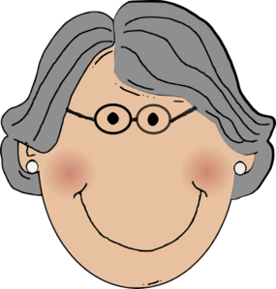
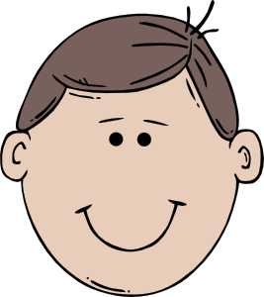
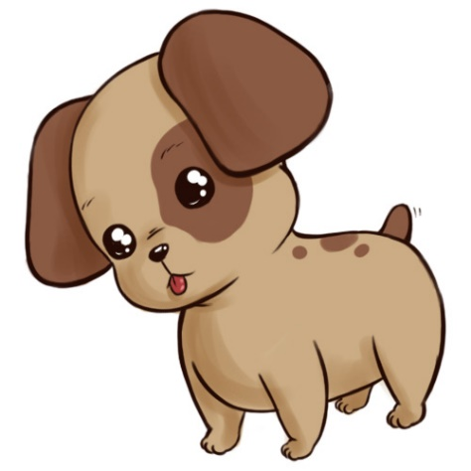
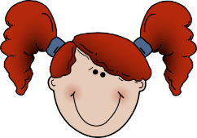
Soy Isobel, hablo de mi familia.
el tío = uncle
la tía = auntie
el abuelo
Paco
la abuela
Sofia
Carlos
la tía
el tío
Ana
Emilia
Martín
el perro
Chu-chu
el primo
la prima
Luca
Lorena
Isobel
Notes:
Teachers can use this next series of slides to embed this week’s vocabulary whilst revising adjective agreement.
Teachers could begin by clarifying who is who to revise the family members. Students could be asked to write the name of the person, with the correct word in Spanish e.g Paco = el abuelo etc. Or this could be done orally – in pairs give the Spanish and then the teacher takes feedback by asking ¿Quién es Paco? etc.
Note: ‘tío’ and ‘tía’ are included in this activity to support the recycling of adjectives. Since they aren’t vocabulary items this week, a gloss is provided.

Slide 4
Isobel
El perro es bonito.
Es bonito… ¿la abuela, la prima o el perro?
Paco
Sofia
Carlos
Ana
Emilia
Martín
Chu-chu
Luca
Lorena
Notes:
A sentence appears to describe a member of the family. Students use the clue by looking at the adjective ending to give their answer. Students can either write the response in their ex.books/on mini-whiteboards or say the answer out loud as a choral response.
The Spanish then appears so feedback can be given, plus this offers an opportunity for teachers to check understanding by asking for the English.

Slide 5
Isobel
Es activa… ¿el abuelo, la tía o el perro?
La tía es activa.
Paco
Sofia
Carlos
Ana
Emilia
Martín
Chu-chu
Luca
Lorena

Slide 6
Isobel
Es hermosa… ¿el abuelo, la abuela o el tío?
La abuela es hermosa.
Paco
Sofia
Carlos
Ana
Emilia
Martín
Chu-chu
Luca
Lorena

Slide 7
Isobel
Es artístico… ¿la prima, el primo o la tía?
El primo es artístico.
Paco
Sofia
Carlos
Ana
Emilia
Martín
Chu-chu
Luca
Lorena

Slide 8
Isobel
Es hermoso… ¿la prima, el tío o la tía?
El tío es hermoso.
Paco
Sofia
Carlos
Ana
Emilia
Martín
Chu-chu
Luca
Lorena

Slide 9
Isobel
Es famosa… ¿la prima, el abuelo o el tío?
La prima es famosa.
Paco
Sofia
Carlos
Ana
Emilia
Martín
Chu-chu
Luca
Lorena

Slide 10
Isobel
El abuelo/la abuela/la prima es fuerte.
Es fuerte… ¿la abuela, el abuelo o la prima?
Paco
Sofia
Carlos
Ana
Emilia
Martín
Chu-chu
Luca
Lorena
Notes:
Remind students that ‘fuerte’ can refer to any of them (in the same way as other adjectives they have seen, like ‘alegre’, ‘interesante’).

