Slide 1
Who does what?
Long (infinitive) and short (3rd person singular) forms of several high-frequency weak verbs
SSC long and short [o]
Y7 German
Term 1.2 - Week 1 - Lesson 15
Leigh McClelland
Artwork: Steve Clarke
Date updated: 15/12/21
Notes:
Artwork by Steve Clarke. All additional pictures selected are available under a Creative Common license; no attribution required.
Learning outcomes (lesson 1):
Introduction of SSC - long and short [o]
Introduction of long (infinitive) and short (3rd person singular) forms of several high-frequency weak verbs
Word frequency (1 is the most frequent word in German):
7.1.2.1 (introduce) lernen [288] machen [58] reden [368] schreiben [184] spielen [205] wohnen [560] Aufgabe [256] Klassenzimmer [>5009] Montag [794] Unterricht1 [1823] mit1 [13] im Klassenzimmer [n/a] im Unterricht [n/a] in der Schule [n/a] mit Freunden [n/a]
7.1.1.5 (revisit) haben, hat [6] er1 [15] sie1 [7] wer? [149] Freund [273] Fußball [1277] Haus [159] Haustier [>5009] Lehrer [695] Wasser [245] Welt [164] Wort [194] wahr [737] nicht wahr? [n/a]
Ist es warm/kalt heute?
Source: Jones, R.L. & Tschirner, E. (2019). A frequency dictionary of German: core vocabulary for learners. Routledge

Slide 2
o
wo?
Notes:
Timing: 1 minute
Aim: To introduce/consolidate SSC [o]
Procedure: 1. Present the letter(s) and say the [o] sound first, on its own. Students repeat it with you. 2. Bring up the word ”wo” on its own, say it, students repeat it, so that they have the opportunity to focus all of their attention on the connection between the written word and its sound.
3. A possible gesture for this would be to mime looking for someone.
4. Roll back the animations and work through 1-3 again, but this time, dropping your voice completely to listen carefully to the students saying the [o] sound, pronouncing ”wo” and, if using, doing the gesture. Word frequency (1 is the most frequent word in German): wo? [94]
Source: Jones, R.L. & Tschirner, E. (2006). A frequency dictionary of German: core vocabulary for learners. Routledge

Slide 3
o
wo?
Notes:
With sound and no pictures to focus all attention on the sound-symbol correspondence.

Slide 4
o
wo?
Notes:
Without sound to elicit pronunciation (without first hearing the teacher).
Teacher to elicit pronunciation by asking “Wie sagt man…”

Slide 5
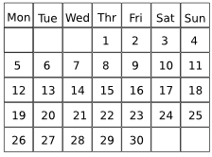
o
wohnen
Montag
wo?
ohne
holen
Million
Notes:
Timing: 2 minutes
Aim: To introduce/consolidate SSC [o]
Procedure:
Introduce and elicit the pronunciation of the individual SSC [o] and then the source word again ‘wo’ (with gesture, if using).
Then present and elicit the pronunciation of the five cluster words.
The cluster words have been chosen for their high-frequency, from a range of word classes, with the SSC (where possible) positioned within a variety of syllables within the words (e.g. initial, 2nd, final etc.). Additionally, we have tried to use words that build cumulatively on previously taught SSCs (see the Phonics Teaching Sequence document) and do not include new SSCs. Where new SSCs are used, they are often consonants which have a similar symbol-sound correspondence in English.
Word frequency (1 is the most frequent word in German): wo? [94]; wohnen [380] Montag [794]; ohne [119]; Million [206]; holen [640]. Source: Jones, R.L. & Tschirner, E. (2006). A frequency dictionary of German: core vocabulary for learners. Routledge

Slide 6
o
wohnen
Montag
wo?
ohne
holen
Million
Notes:
With sound and no pictures to focus all attention on the sound-symbol correspondence.

Slide 7
o
wohnen
Montag
wo?
ohne
holen
Million
Notes:
Without sound to elicit pronunciation (without first hearing the teacher).
Teacher to elicit pronunciation by asking “Wie sagt man…”.

Slide 8
o
Kopf
Notes:
Timing: 1 minute
Aim: To introduce/consolidate SSC [o]
Procedure: 1. Present the letter(s) and say the [o] sound first, on its own. Students repeat it with you. 2. Bring up the word ”Kopf” on its own, say it, students repeat it, so that they have the opportunity to focus all of their attention on the connection between the written word and its sound.
3. A possible gesture for this would be to tap the top of your head.
4. Roll back the animations and work through 1-3 again, but this time, dropping your voice completely to listen carefully to the students saying the [o] sound, pronouncing ”Kopf” and, if using, doing the gesture. Word frequency (1 is the most frequent word in German): Kopf [279] Source: Jones, R.L. & Tschirner, E. (2006). A frequency dictionary of German: core vocabulary for learners. Routledge

Slide 9
o
Kopf
Notes:
With sound and no pictures to focus all attention on the sound-symbol correspondence.

Slide 10
o
Kopf
Notes:
Without sound to elicit pronunciation (without first hearing the teacher).
Teacher to elicit pronunciation by asking “Wie sagt man…”

Slide 11
o
wollen
Woche
Kopf
offen
kommen
[to come]
noch
[still]
Notes:
Timing: 2 minutes
Aim: To introduce/consolidate SSC [o]
Procedure:
Introduce and elicit the pronunciation of the individual SSC [o] and then the source word again ‘Kopf’ (with gesture, if using).
Then present and elicit the pronunciation of the five cluster words.
The cluster words have been chosen for their high-frequency, from a range of word classes, with the SSC (where possible) positioned within a variety of syllables within the words (e.g. initial, 2nd, final etc.). Additionally, we have tried to use words that build cumulatively on previously taught SSCs (see the Phonics Teaching Sequence document) and do not include new SSCs. Where new SSCs are used, they are often consonants which have a similar symbol-sound correspondence in English.
Word frequency (1 is the most frequent word in German): Kopf [279]; wollen [65] Woche [209]; offen [382]; noch [37]; kommen [61]. Source: Jones, R.L. & Tschirner, E. (2006). A frequency dictionary of German: core vocabulary for learners. Routledge

Slide 12
o
wollen
Woche
Kopf
offen
kommen
noch
Notes:
With sound and no pictures to focus all attention on the sound-symbol correspondence.

Slide 13
o
wollen
Woche
Kopf
offen
kommen
noch
Notes:
Without sound to elicit pronunciation (without first hearing the teacher).
Teacher to elicit pronunciation by asking “Wie sagt man…”

Slide 14
Vokabeln
sprechen
wohnen oder spielen?
Notes:
Timing: 6 minutes (all 12 slides)
Aim: To consolidate the vocabulary that students will have learnt in advance of the lesson. Procedure: 1. Students are asked to look at the two choices and choose the one that best fits the picture that appears.
2. Answers are highlighted with a star on your click.

Slide 15
Vokabeln
sprechen
im Unterricht oder in der Schule?
Notes:
As for previous slide.

Slide 16
Vokabeln
sprechen
im Klassenzimmer oder spielen?
Notes:
As for previous slide.

Slide 17
Vokabeln
sprechen
lernen oder reden?
Notes:
As for previous slide.

Slide 18
Vokabeln
sprechen
im Unterricht oder spielen?
Notes:
As for previous slide.

Slide 19
Vokabeln
sprechen
Montag oder die Aufgabe?
Notes:
As for previous slide.

Slide 20
Vokabeln
sprechen
machen oder spielen?
Notes:
As for previous slide.

Slide 21
Vokabeln
sprechen
lernen oder schreiben?
Notes:
As for previous slide.

Slide 22
Vokabeln
sprechen
schreiben oder mit Freunden?
Notes:
As for previous slide.

Slide 23
Vokabeln
sprechen
Montag oder mit Freunden?
Notes:
As for previous slide.

Slide 24
Vokabeln
sprechen
schreiben oder spielen?
Notes:
As for previous slide.

Slide 25
Vokabeln
sprechen
machen oder Montag?
Notes:
As for previous slide.

Slide 26
Vokabeln
sprechen
 | Word | English meaning
1 | wohnen | to live
2 | schreiben | to write
3 | spielen | to play
4 | reden | to talk
5 | lernen | to learn
6 | machen | to do
7 | die Aufgabe | task
8 | Montag | Monday
9 | im Klassenzimmer | in the classroom
10 | im Unterricht | in lessons
11 | in der Schule | in school
12 | mit Freunden | with friends
Notes:
Timing: 2-4 minutes Aim: To reactivate and strengthen vocabulary knowledge.
Note: Students pre-learn their vocabulary on Quizlet, additionally completing several tasks to build their knowledge. This task assists recall of the new vocabulary. Procedure: Round 1: Look at the German, recall the English meanings, saying them aloud. [1 minute] Round 2: Look at the English, recall the German meanings, saying them aloud. [1 minute] Repeat for two further minutes, to speed up recall.

Slide 27
Grammatik
sprechen
in der Schule
lernen
Notes:
Timing: 5 minutes (all 6 slides) Aim: To practise sentence-building with the vocabulary learnt this week.
Note: This is also an opportunity to volunteer the German vocabulary independently without support.
Procedure: 1. Students are asked to pair up two or three things, forming infinitive phrases and signposting how the items they have learnt for homework will be blended to form sentences in this lesson.
2. The German appears underneath item by item on your clicks.

Slide 28
Grammatik
sprechen
eine Aufgabe
im Unterricht
machen
Notes:
As for previous slide.

Slide 29
Grammatik
sprechen
mit Freunden
reden
Notes:
As for previous slide.

Slide 30
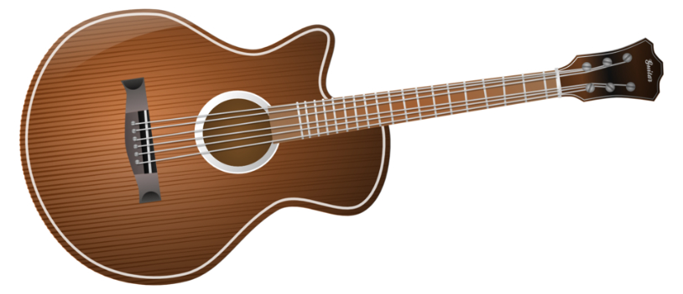
Grammatik
sprechen
Gitarre
spielen
Notes:
As for previous slide.

Slide 31
Grammatik
sprechen
in Berlin
wohnen
Notes:
As for previous slide.

Slide 32
Grammatik
sprechen
auf Deutsch
schreiben
Notes:
As for previous slide.

Slide 33
Dictionary verb vs he/she form
Grammatik
Only the infinitive form of a verb appears in the dictionary.
e.g. wohnen (to live / living), lernen (to learn / learning)
To say what he/she does or is doing, use er (he), sie (she)
and change the ending from -en to -t:
There is only one present tense in German!
wohnen – Er wohnt in Berlin.
(He lives in Berlin / He is living in Berlin.)
lernen – Sie lernt Gitarre.
(She learns guitar / She is learning guitar.)
How many are there in English?
Notes:
Timing: 2 minutes Aim: To explain how the dictionary form of the verb (infinitive) relates to the third person singular form. Procedure: 1. Click to animate the explanation.
2. Check students’ understanding at each stage.

Slide 34
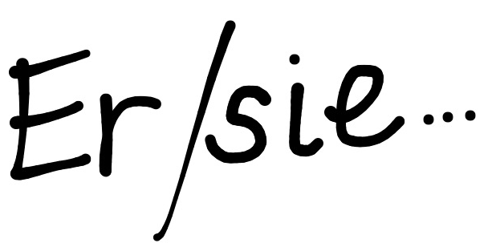
Grammatik
sprechen
… oder da?
Hier …?
machen
Notes:
Timing: 6 minutes (all 12 slides) Aim: To consolidate understanding of the dictionary form of the verb (infinitive) and the third person singular form. Procedure: 1. Students must predict whether the verb at the bottom of the screen will be found in the dictionary or after er/sie.
2. The word moves on your click to indicate the correct answer.

Slide 35
Grammatik
sprechen
… oder da?
Hier …?
haben
Notes:
As for previous slide.

Slide 36
Grammatik
sprechen
… oder da?
Hier …?
schreibt
Notes:
As for previous slide.

Slide 37
Grammatik
sprechen
… oder da?
Hier …?
spielen
Notes:
As for previous slide.

Slide 38
Grammatik
sprechen
… oder da?
Hier …?
sein
Notes:
As for previous slide.

Slide 39
Grammatik
sprechen
… oder da?
Hier …?
ist
Notes:
As for previous slide.

Slide 40
Grammatik
sprechen
… oder da?
Hier …?
redet
Notes:
As for previous slide.

Slide 41
Grammatik
sprechen
… oder da?
Hier …?
wohnen
Notes:
As for previous slide.

Slide 42
Grammatik
sprechen
… oder da?
Hier …?
sagt
Notes:
As for previous slide.

Slide 43
Grammatik
sprechen
… oder da?
Hier …?
kommt
Notes:
As for previous slide.

Slide 44
Grammatik
sprechen
… oder da?
Hier …?
spielt
Notes:
As for previous slide.

Slide 45
Grammatik
sprechen
… oder da?
Hier …?
reden
Notes:
As for previous slide.

Slide 46
Grammatik
sprechen
Was ist hier komisch?
spielen
schreiben
wohnen
reden
lernen
machen
er/sie spielt
er/sie schreibt
er/sie wohnt
er/sie redet
er/sie lernt
er/sie macht
Notes:
Timing: 2 minutes Aim: To explain that ‘reden’ works slightly differently from the other verbs in that it retains an –e to enable an ending to be sounded.
Procedure: 1. Ask students which of the verbs featured is different from the others.
2. Click to highlight the difference with ‘redet’.
3. Point out that some other verbs also behave like this – e.g. finden, arbeiten, etc.

Slide 47
Grammatik
hören
Infinitiv | Er/Sie
Noch einmal, bitte!
1
to learn / learning
2
plays / is playing
3
has
4
to talk / talking
5
to say / saying
6
lives / is living
7
learns / is learning
8
to write / writing
9
does/makes
10
to come / coming
Notes:
Timing: 7 minutes Aim: To practise recognising infinitive and third person singular forms of verbs.
Procedure: 1. Students listen to the verb, decide first if it is infinitive or s/he form, then write the English translation (e.g. 1. to learn, 2. plays)
2. It is worth doing the first two with students as examples, and giving feedback before doing the remainder.
3. Audio is activated by clicking the numbered button.
4. Students can be encouraged to ask for a repeat, if they need to hear it again: ‘Noch einmal, bitte’. They have just met ‘noch’ meaning ‘still’. Here the phrase means ‘one time more/again, please’ or literally, ‘still one time, please’. This recycles ‘bitte’, which they encountered a few weeks ago, and of course they know ‘ein’.
A prompt is on the slide to teach this phrase, with an image to remind them what it means.
Transcript: 1. lernen 2. spielt
3. hat 4. reden
5. sagen
6. wohnt
7. lernt
8. schreiben
9. macht
10. kommen

Slide 48
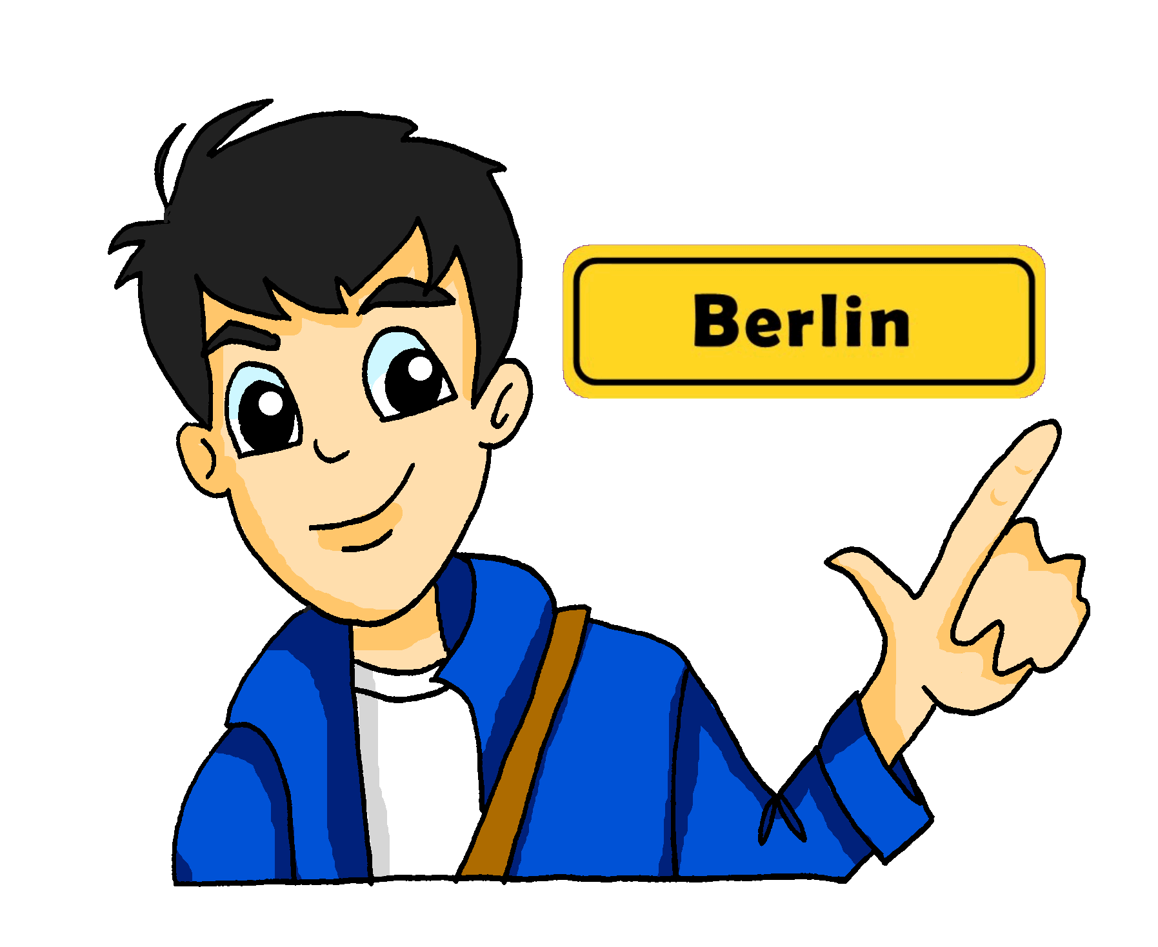
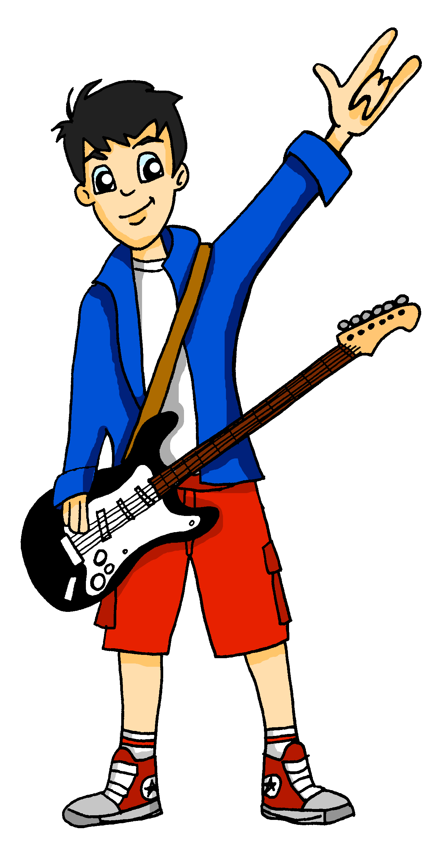
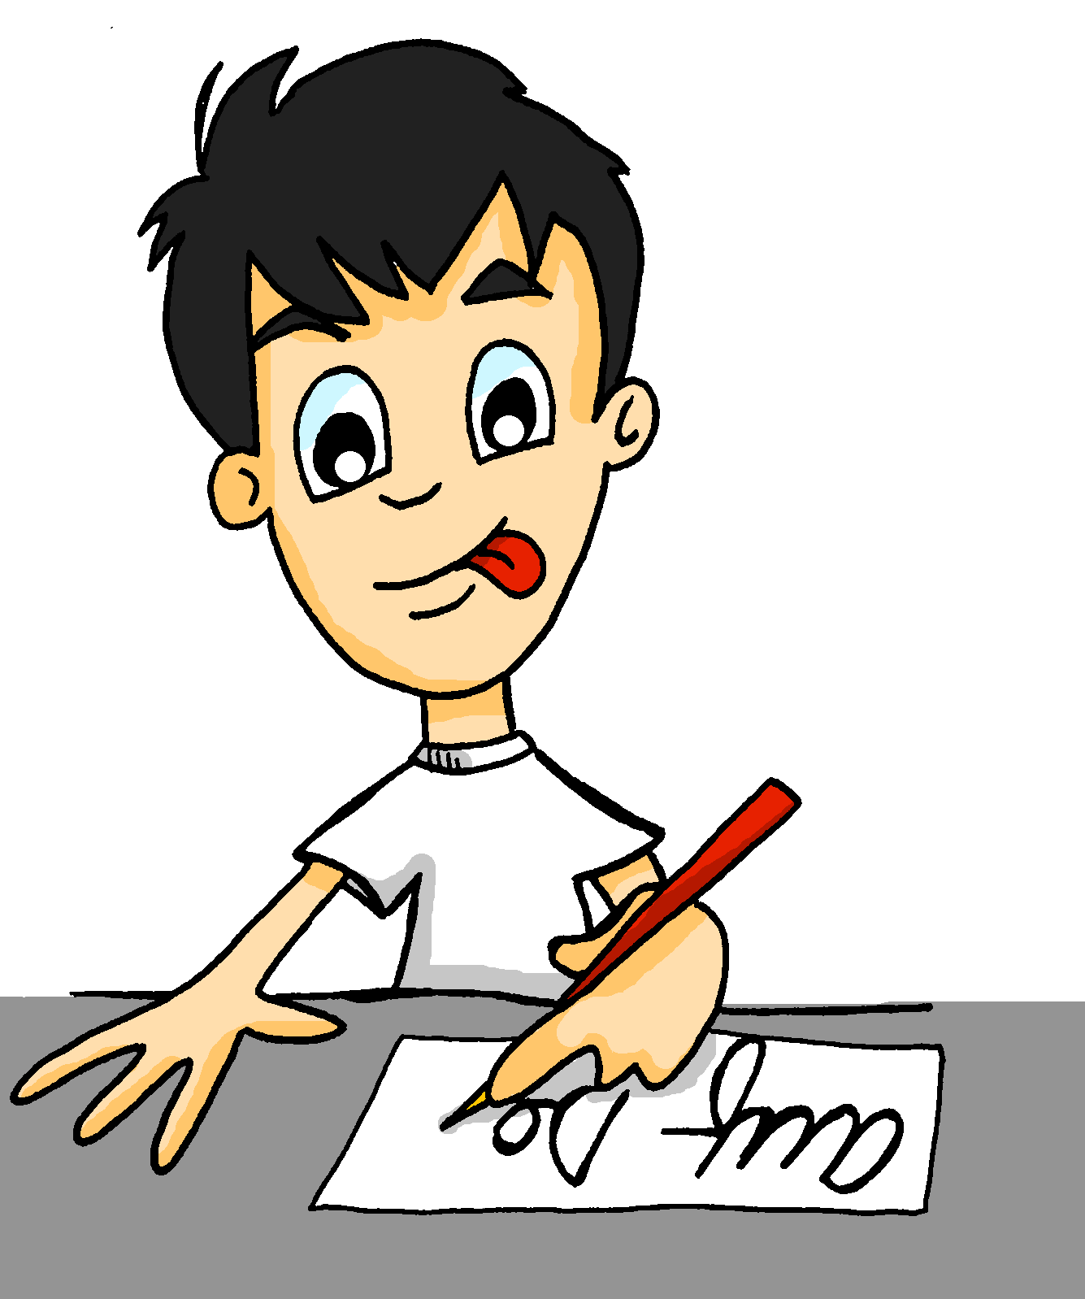
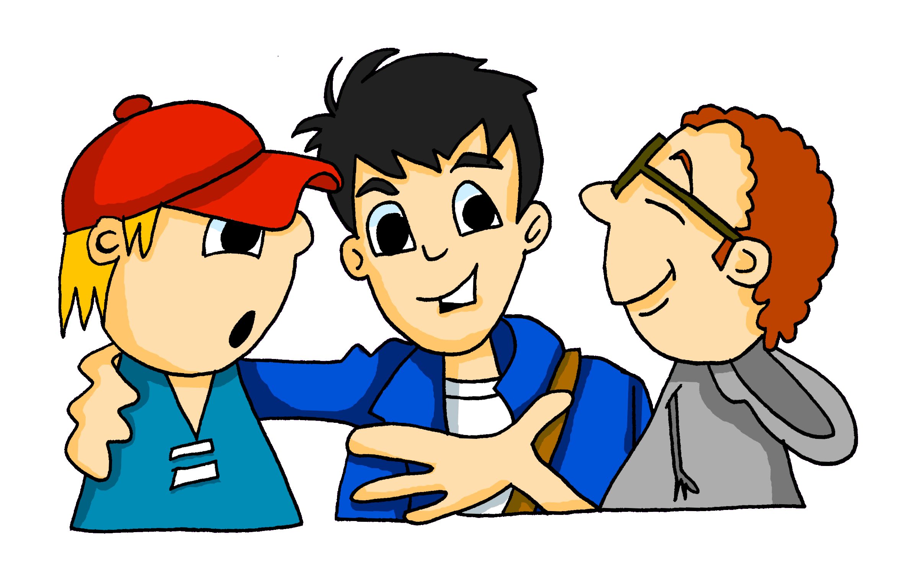
Grammatik
1
sprechen
Notes:
Timing: 2 minutes Aim: To practise listening for verbs in the third person singular.
Procedure: 1. Pictures appear one by one on your clicks with audio.
2. Students listen and translate the sentences into English (aural translation).
Transcript: Wolfgang wohnt in Berlin. Er lernt in der Schule. Er macht eine Aufgabe im Unterricht. Er schreibt auf Deutsch. Er spielt Gitarre. Er redet mit Freunden.
Word frequency (1 is the most frequent word in German): Gitarrre [>4034] Deutsch [>4034] Source: Jones, R.L. & Tschirner, E. (2011). A frequency dictionary of German: core vocabulary for learners. Routledge

Slide 49
Grammatik
2
sprechen
Notes:
Timing: 2 minutes Aim: To practise listening for verbs in the third person singular. Procedure: 1. Students hear a version of Wolfgang’s Montag, but it is in a different order. They must order their 6 cards (see separate attachment with cards to print and cut up – 3 sets per page, easy to slice into 3 and then Students can cut up their own).
2. The order is shown on individual clicks when the audio has been played and the activity completed. This first time there are complete sentences.
Transcript:
Er spielt Gitarre. Er macht eine Aufgabe im Unterricht. Er redet mit Freunden. Er lernt in der Schule. Er wohnt in Berlin. Er schreibt auf Deutsch.

Slide 50
Grammatik
3
sprechen
Notes:
Timing: 2 minutes Aim: To practise listening for verbs in the third person singular. Procedure: 1. Now students must order their cards hearing only the verbs.
2. The pictures then appear on consecutive clicks so that students can check their answers.
Transcript: Er macht… Er redet... Er spielt... Er wohnt... Er lernt ... Er schreibt...

Slide 51
Grammatik
4
hören
Notes:
Timing: 2 minutes Aim: To practise listening for verbs in the third person singular.
Procedure: 1. Now Students must order their cards hearing only the verbs.
2. This version is at faster pace. Note: There is an even faster version (shorter pauses) activated using the button on bottom right.
3. The pictures then appear on consecutive clicks so that students can check their answers.
Transcript: Er schreibt... Er wohnt... Er macht… Er lernt ... Er redet... Er spielt...

Slide 52
Schreiben: Wolfgangs Montag
schreiben
Schreib ein Verb!
1
ist
Es ____ Montag .
Notes:
Timing: 4 minutes (all 8 slides) Aim: To provide production practice with the verb forms learned.
Procedure: 1. Students must now focus on reproducing verbs in the he/she/it form. This activity can be done on mini whiteboards or in exercise books.
2. Answers appear on your click.

Slide 53
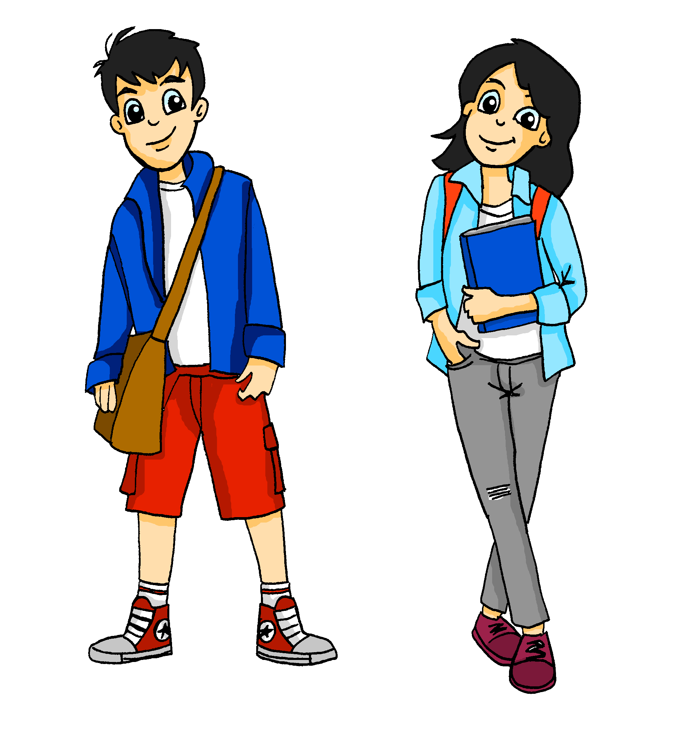
Schreiben: Wolfgangs Montag
schreiben
Schreib ein Verb!
2
ist
Hier ____ Wolfgang !
Notes:
As for previous slide.

Slide 54
Schreiben: Wolfgangs Montag
schreiben
Schreib ein Verb!
3
wohnt
Er _______ in Berlin .
Notes:
As for previous slide.

Slide 55
Schreiben: Wolfgangs Montag
schreiben
Schreib ein Verb!
4
lernt
Er _______ in der Schule .
Notes:
As for previous slide.

Slide 56
Schreiben: Wolfgangs Montag
schreiben
Schreib ein Verb!
5
macht
Er _______ eine Aufgabe im Unterricht .
Notes:
As for previous slide.

Slide 57
Schreiben: Wolfgangs Montag
schreiben
Schreib ein Verb!
6
schreibt
Er_________ auf Deutsch.
Notes:
As for previous slide.

Slide 58
Schreiben: Wolfgangs Montag
schreiben
Schreib ein Verb!
7
spielt
Er _______ Gitarre.
Notes:
As for previous slide.

Slide 59
Schreiben: Wolfgangs Montag
schreiben
Schreib ein Verb!
8
redet
Er _______ mit Freunden.
Notes:
As for previous slide.

Slide 60
Who does what?
Long (infinitive) and short (3rd person singular) forms of several high-frequency weak verbs
SSC long and short [o]
Y7 German
Term 1.2 - Week 1 - Lesson 16
Leigh McClelland
Artwork: Steve Clarke
Date updated: 15/12/21
Notes:
Artwork by Steve Clarke. All additional pictures selected are available under a Creative Common license; no attribution required.
Learning outcomes (lesson 1):
Consolidation of SSC - long and short [o]
Consolidation of long (infinitive) and short (3rd person singular) forms of several high-frequency weak verbs
Word frequency (1 is the most frequent word in German):
7.1.2.1 (introduce) lernen [288] machen [58] reden [368] schreiben [184] spielen [205] wohnen [560] Aufgabe [256] Klassenzimmer [>5009] Montag [794] Unterricht1 [1823] mit1 [13] im Klassenzimmer [n/a] im Unterricht [n/a] in der Schule [n/a] mit Freunden [n/a]
7.1.1.5 (revisit) haben, hat [6] er1 [15] sie1 [7] wer? [149] Freund [273] Fußball [1277] Haus [159] Haustier [>5009] Lehrer [695] Wasser [245] Welt [164] Wort [194] wahr [737] nicht wahr? [n/a]
Ist es warm/kalt heute?
Source: Jones, R.L. & Tschirner, E. (2019). A frequency dictionary of German: core vocabulary for learners. Routledge

Slide 61
Lang oder kurz?
hören
 | wo? | Kopf
1
2
3
4
Notes:
Timing: 3 minutes Aim: To practise differentiating between long and short [o]. Procedure: 1. Students listen and tick the appropriate column, according to the [o] sound.
2. The answers appear on the following slide.
Transcript: 1. noch
2. ohne
3. Million
4. wollen

Slide 62
Lang oder kurz?
hören
 | wo? | Kopf
1
2
3
4
noch
ohne
Million
wollen
Notes:
Timing: 1 minute Aim: To display the answers to the activity on the previous slide.
Procedure: 1. Click to bring up the answers and the actual words.

Slide 63
ein Kreuzworträtsel
Vokabeln
1
 |  |  | R | E | D | E | N
 |  |  | S | P | I | E | L | E | N
 | S | C | H | R | E | I | B | E | N
 |  |  |  | H | A | U | S
 |  | F | R | E | U | N | D
 |  |  |  |  | F | U | ß | B | A | L | L
M | O | N | T | A | G
 |  |  |  | M | A | C | H | E | N
 |  |  | H | A | B | E | N
 |  |  |  | L | E | R | N | E | N
machen
2
lernen
3
Freund
4
Montag
reden
5
6
schreiben
haben
7
8
FuBball
wohnen
9
spielen
10
Notes:
Timing: 8 minutes Aim: To practise written production of some of this week’s new and revisited vocabulary, in response to aural cues. Procedure: 1. Click to listen to each clue.
2. Students write the answers, choosing from the options shown (these could be removed to make the slide more challenging). 3. The letters top to bottom in the column indicated spell the noun die Aufgabe, one of this week’s new words.
4. Click for each word answer. 5. Ensure all meanings all clear.
Transcript: 1. mit Freunden [reden]
2. Tennis [spielen] 3. ein Buch [schreiben]
4. im [Haus] wohnen
5. Das ist mein [Freund]
6. [FuBball] spielen
7. Mein Lieblingstag ist nicht [Montag]
8. eine Aufgabe [machen]
9. ein Haustier [haben]
10. in der Schule [lernen]

Slide 64
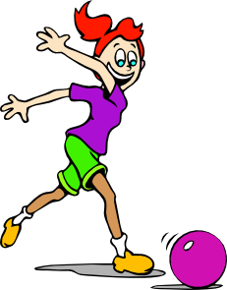
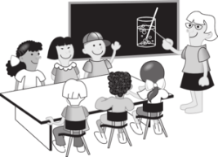
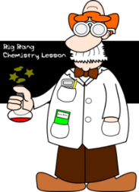
Wie schreibt man das?
schreiben
A
B
C
D
[classroom]
[to play]
[teacher]
[isn’t it?]
E
F
G
H
[with]
[lesson]
[world]
[who?]
I
J
K
L
[has]
[word]
[water]
[true]
Notes:
Timing: 6 minutes (including answers)
Aim: To revise in productive mode/written modality 12 items of vocabulary from this week’s new and revisited sets, within a limited time frame.
Procedure:
1. Write A-L in books.
2. Click / press enter to flash a picture. It will disappear after 3 seconds. Note that the pictures do not appear in alphabetical order, to increase the challenge.
3. Write down the German word before the picture has faded away. 4. Ensure that gender/definite articles are known for any words that are nouns.
5. The answers are displayed on the next slide.

Slide 65
Wie schreibt man das?
Antworten:
schreiben
A
B
C
D
das
Klassenzimmer
spielen
der Lehrer
nicht wahr?
E
F
G
H
mit
der Unterricht
die Welt
wer?
I
J
K
L
hat
das Wort
das Wasser
wahr
Notes:
Answer slide
Procedure:
1. Click twice to reveal all answers.

Slide 66
Grammatik
schreiben
1
Das Wasser ist kalt.
2
Die Woche ist lang.
3
Mein Kopf ist nicht klein.
4
Das Haustier holt den Ball.
5
Mein Freund kommt am Montag.
Notes:
Timing: 6 minutes Aim: To revisit vocabulary and practise SSC knowledge.
Procedure: 1. Click on the audio buttons to play the sentences, which students transcribe.
2. Click to bring up the answers one by one.
Transcript: 1. Das Wasser ist kalt.
2. Die Woche ist lang.
3. Mein Kopf ist nicht klein.
4. Das Haustier holt den Ball.
5. Mein Freund kommt am Montag.
Word frequency (1 is the most frequent word in German): Source: Jones, R.L. & Tschirner, E. (2011). A frequency dictionary of German: core vocabulary for learners. Routledge

Slide 67
Was macht Mia?
lesen
Schreib 4 Sachen auf Englisch.
Es ist Montag und Mia hat Schule, aber Montag ist nicht Mias Lieblingstag…
Sie macht eine Englischaufgabe falsch - sie redet mit Freunden im Unterricht und schreibt auf Deutsch, nicht auf Englisch! Das ist ein Problem! Ein Freund spielt Gitarre im Klassenzimmer, aber Mia spielt nicht. Sie singt ein Lied.
Sie ist eine super Sängerin!
1. She does an English task wrong.
2. She talks to friends in lessons.
3. She writes in German, (not in English).
4. She sings a song.
Notes:
Timing: 5 minutes Aim: To practise noticing the feminine form of the third person plural (sie). Procedure: 1. Students read the text and note four things about Mia (Wolfgang’s twin) in English.
2. Click on the audio button to hear a recording of the text as well.
3. Click to bring up the answers.

Slide 68
Grammatik
Sprechen: Was macht Wolfgang/Mia?
sprechen
Gitarre
auf Deutsch
im Unterricht
im Klassenzimmer
in der Schule
mit Freunden
eine Aufgabe
in Berlin
Text
Er/Sie
lernt
spielt
schreibt
wohnt
redet
macht
Notes:
Timing: 6 minutes Aim: To practise making sentences using the third person singular. Procedure: 1. One pupil asks a question and the other responds with the correct pronoun and a combination that makes sense!

Slide 69
Grammatik
Sprechen: Was macht Wolfgang/Mia?
sprechen
Schreiben: Was macht Wolfgang/Mia?
Gitarre
Deutsch
Unterricht
Klassenzimmer
Schule
Freunden
Aufgabe
Berlin
lernen
spielen
schreiben
wohnen
reden
machen
Notes:
Timing: 10 minutes Aim: To practise writing sentences using the third person singular. Procedure: 1. Students must change the infinitive into the he/she form of the verb and combine it with an item of vocabulary, making the necessary additions to make it make complete sense.
2. Students could use mini-whiteboards to enable teachers to check accuracy and students to edit quickly if necessary.
3. Teacher can cue each ‘round’ of single sentence production by asking ‘Was macht Mia?’ or ‘Was macht Wolfgang?’ to check knowledge or ‘er’ and ‘sie’.

Slide 70
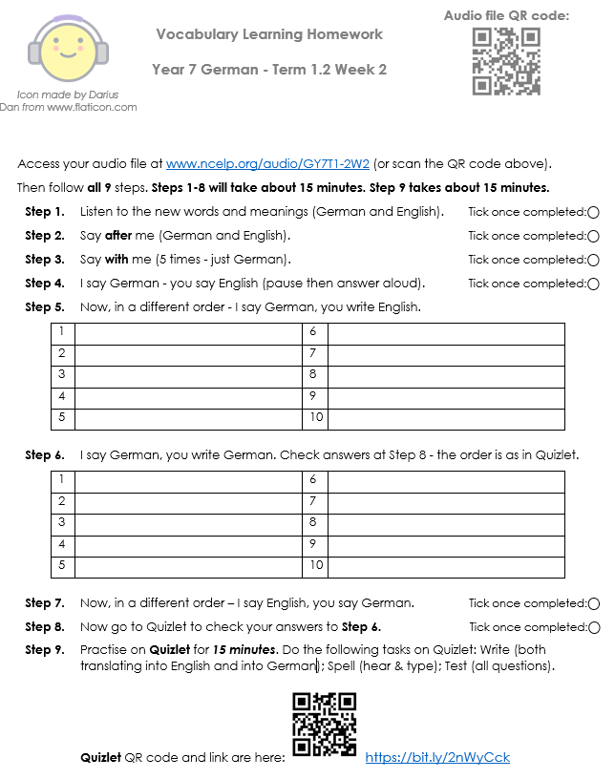
Vocabulary learning homework
Notes:
Timing: 5 minutes Aim: To introduce the vocabulary learning homework sheet.
Procedure: 1. Talk students through the process for using the vocabulary learning homework sheet, demonstrating the various links embedded within the document.

Slide 71
Hausaufgaben
Vocabulary Learning Homework (Y7, Term 1.2, Week 2)
Audio file
Audio file QR code:
Student worksheet
Quizlet link
In addition, revisit: Term 1.1 Week 5

