Slide 1
A trip to a theme park
Demonstrative adjectives:
‘este’ and ‘esta’ [revisited]
‘ese’ and ‘esa’
Y9 Spanish
Term 3.2 – Week 3 – Lesson 65
Author name(s): Louise Caruso / Nick Avery Artwork: Mark Davies
Date updated: 07/07/22
Notes:
Artwork by Mark Davies. All additional pictures selected are available under a Creative Commons license, no attribution required.
With thanks to Rachel Hawkes for her input on the lesson material and Blanca Román for native teacher feedback.
Learning outcomes (lesson 1):
Introduction of demonstrative adjectives ‘ese’ and ‘esa’
Consolidation of demonstrative adjectives ‘este’ and ‘esta’
Consolidation of SER and ESTAR in 3rd person singular present tense (es, está)
Consolidation of SSC [cu]+vowel
Consolidation of numbers
Word frequency (1 is the most frequent word in Spanish):
9.3.2.3 (introduce): faltar [524]; restaurante [2636]; aire [aire-401]; México [N/A]; recuerdo [771]; sitio [477]; talla [4056]; ese [35]; esa [35]; esos [35]; esas [35]; maravilloso [1527]; por supuesto [530]; hambre [1262]; sed [2214]; cola [1867]; roto [>5000]; gratis [>5000]
Note: words in bold are introduced this lesson; other words will be introduced in lesson 2
9.3.1.3 (revisit): era [7]; eras [7]; escritor [864]; artista [817]; dueño [1239]; metro [798]; agradable [1997]; transporte [1400]; moderno [861]; posible [427]; popular [790]; normal [1000]; optimista [1025]; cierto[159]; buen [103]; gran [66]; mal [360]; único² [213]
9.2.2.3 (revisit): animar [1630]; anunciar [785]; cerrar [521]; charlar [2968]; llover [2134]; notar [696]; (prestar) atención [atención-489]; regresar [573]; boda [2473]; espectáculo [1622]; golpe [746]; llegada [1604]; olor [1070]; sabor [2108]; enseguida [2866]; mundial [572]; en este momento [momento-121]; de repente [repente-1805]
Source: Davies, M. & Davies, K. (2018). A frequency dictionary of Spanish: Core vocabulary for learners (2nd ed.). Routledge: London
The frequency rankings for words that occur in this PowerPoint which have been previously introduced in NCELP resources are given in the NCELP SOW and in the resources that first introduced and formally re-visited those words.
For any other words that occur incidentally in this PowerPoint, frequency rankings will be provided in the notes field wherever possible.

Slide 2
Cua, cue, cui
hablar / escuchar
Escucha la pronunciación:
A
cua
B
cue
C
cui
¿Cómo pronuncias estas palabras?
cuándo
frecuencia
cuarenta
adecuado
circuito
cuerpo
cuidar
acuesta
Notes:
Timing: 2 minutes
Aim: to revisit the sounds ‘cua’, ‘cue’ and ‘cui’ in preparation for the next activity.
Procedure:
Play each recording to model the sounds. Students repeat after each sound is played.
Then, words containing these sounds will appear one by one with further clicks. Students say each word out loud chorally.
Frequency of unkwnown words:
adecuado [1223]; frecuente [1309]; circuito [3172]

Slide 3
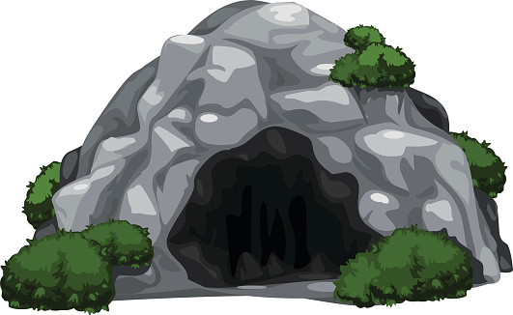
¿Cuánto cuesta…?
hablar / escuchar
Persona A: Pregunta a tu compañera/a cuánto cuesta el objeto.
Ejemplo:
una entrada a la cueva
¿Cuánto cuesta una entrada a la cueva?
€12
[entry to the cave]
precio: ______
Persona B: Debes decir el precio en español.
Ejemplo:
Doce euros.
12 euros
[entry to the cave]
Persona A escribe el precio.
Después Persona B pregunta y Persona A contesta.
Notes:
Timing: 6 minutes (slides 3 – 8) Aim:
i) to practise gain confidence and fluency in oral production of SSC [cu]+vowel (cua, cue, cui)
ii) to practise producing and understanding a range of previously taught numbers (mostly 1-29)
Procedure:
Click to reveal each part of the explanation slide with the students. Check understanding via oral translation of the example into English.
Student A turns away from the board and asks Student B questions based on his/her six cards (slide 3). All questions begin with ‘¿Cuánto cuesta…?’. Glosses are provided for unknown words.
Teacher brings up slide 4. Person B listens, looks at the prices displayed on the board and then says the price for the relevant card in Spanish.
Person A then writes the price down in the space provided on his/her prompt card.
Students swap roles. The teacher displays slide 6 on the board.
Use slide 7 to provide feedback.
Frequency of unknown words:
cueva [4480]; objeto [567]

Slide 4
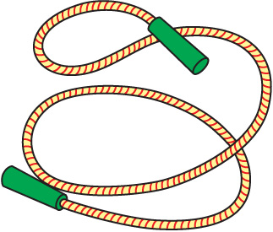
¿Cuánto cuesta…?
hablar / escuchar
Persona A
1
4
una cuerda
un libro de cuentos
[rope]
precio: ______
[story book]
precio: ______
2
5
un viaje de cuatro días
un recuerdo
[4-day journey]
precio: ______
[souvenir]
precio: ______
3
6
un cuarto kilo de maíz
un cuadro
[a quarter of a kilo of corn]
[painting, picture]
precio: ______
precio: ______
Notes:
Person A prompt cards (to ask person B questions)
Frequency of unknown words and cognates:
cuadro [1017]; kilo [2934]; maíz [2981]; cuento [853]

Slide 5
Person B
¿Cuánto cuesta…?
hablar / escuchar
Persona B
1
4
9 euros
7 euros
[rope]
[story book]
2
5
93 euros
4 euros
[4-day journey]
[souvenir]
3
6
24 euros
[a quarter of a kilo of corn]
2 euros
[painting, picture]
Notes:
Person B prompt cards (to give Person A the prices)

Slide 6
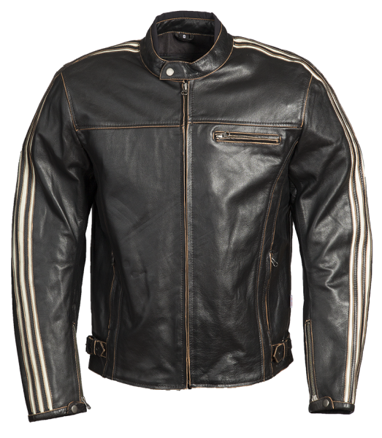
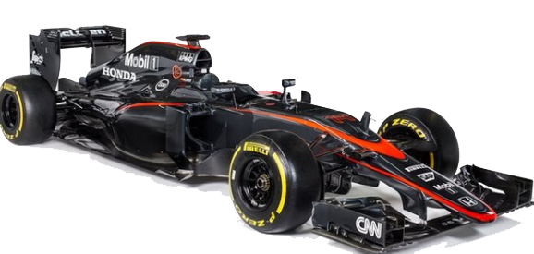
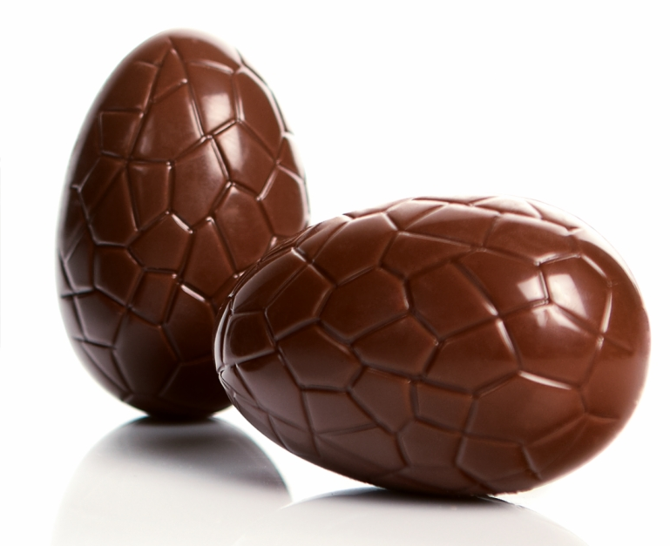
¿Cuánto cuesta…?
hablar / escuchar
Persona B
7
una chaqueta de cuero
10
un viaje a Ecuador
precio: ______
precio: ______
[leather jacket]
[a trip to Ecuador]
8
una entrada a un circuito de Fórmula -1
11
una crema para el cuerpo
[admission to a formula 1 circuit]
precio: ______
[body cream]
precio: ______
9
un huevo de Pascua
12
una licuadora
[a blender,
food processer]
[Easter egg]
precio: ______
precio: ______
Notes:
Person B prompt cards (to ask person A questions)
Frequency of unknown words and cognates:
chaqueta [4565]; circuito [3172]; Pascua [>5000]; Ecuador [>5000]; crema [4138]; licuadora [>5000]

Slide 7
Persona A
¿Cuánto cuesta…?
hablar / escuchar
Persona A
7
10
29 euros
195 euros
[leather jacket]
[a trip to Ecuador]
8
11
[admission to a formula 1 circuit]
28 euros
5 euros
[body cream]
9
12
9 euros
[a blender,
food processer]
15 euros
[Easter egg]
Notes:
Person A prompt cards (to give person B the prices)

Slide 8
Solución
hablar / escuchar
Persona A
Persona B
una cuerda
9 euros
una chaqueta de cuero
29 euros
1
7
un viaje de cuatro días
una entrada a un circuito de Fórmula-1
93 euros
28 euros
2
8
3
un cuadro
9
un huevo de Pascua
9 euros
24 euros
un libro de cuentos
7 euros
un viaje a Ecuador
195 euros
4
10
una crema para el cuerpo
un recuerdo
4 euros
5 euros
5
11
un cuarto kilo de maíz
2 euros
una licuadora
15 euros
6
12
Notes:
Answer slide
Note: students could also be challenged to spell the numbers correctly.

Slide 9
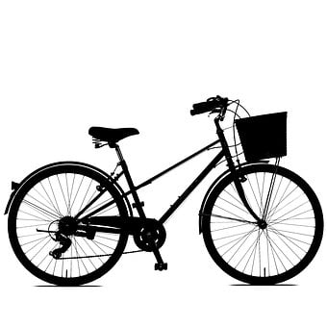
Vocabulario
hablar
5
Segundos
[artist]
[transport]
[writer]
el/la artista
el transporte
el escritor,
la escritora
0
INICIO
Notes:
[1/8]
Timing: 3 min Aim: to practise productive (oral) recall of three words from this week’s revisited set of Y7 and Y8 vocabulary within a given time.
Procedure:
1. Say all three words before three seconds elapse.
2. Click to reveal answers.
3. Repeat if additional practice needed.

Slide 10
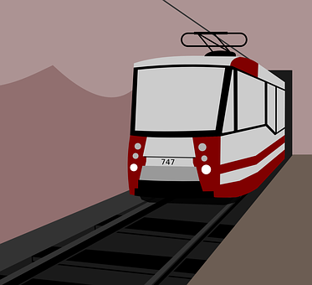
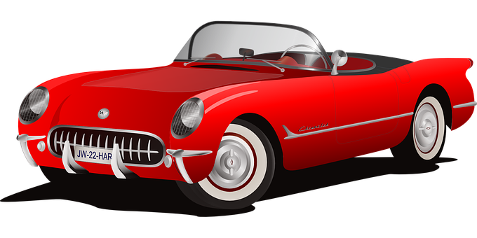
Vocabulario
hablar
5
Segundos
pleasant
[owner]
agradable
el metro
el dueño,
la dueña
0
INICIO
Notes:
[2/8]

Slide 11
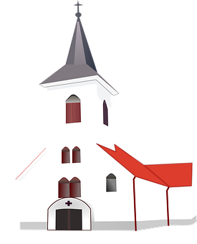
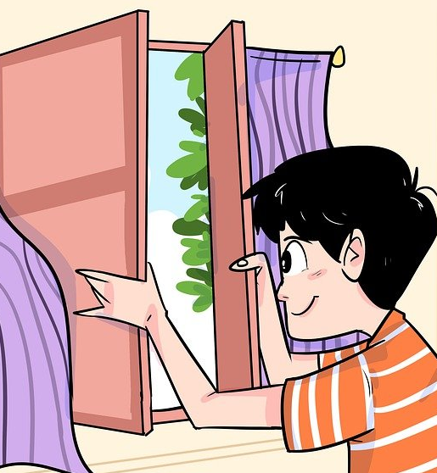
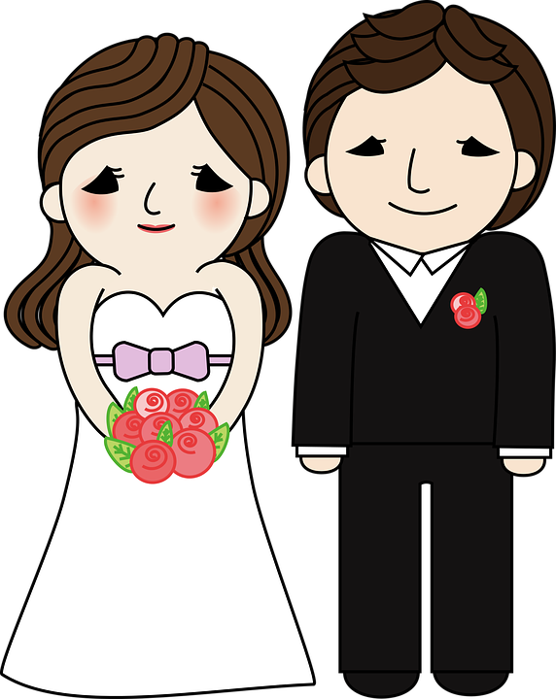
Vocabulario
hablar
5
certain, true
Segundos
[wedding]
[to close, closing]
cierto,
cierta
la boda
cerrar
0
INICIO
Notes:
[3/8]

Slide 12
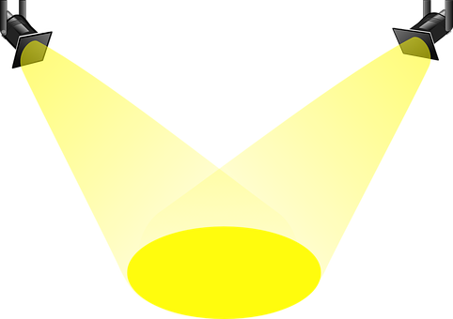
Vocabulario
hablar
5
to pay attention, paying attention
[to chat, chatting]
[show]
charlar
prestar atención
el espectacúlo
0
INICIO
Notes:
[4/8]

Slide 13
Vocabulario
hablar
¿Cómo se dice ‘It is raining’?
5
Está lloviendo.
normal
Segundos
[to announce, announcing]
[to rain, raining]
anunciar
llover
normal
0
INICIO
Notes:
[5/8]

Slide 14
Vocabulario
hablar
¿Qué significa ‘un problema a nivel mundial’?
5
a global / worldwide problem
to cheer up, encourage
Segundos
[taste]
[worldwide]
el sabor
mundial
animar
0
INICIO
Notes:
[6/8]

Slide 15
Vocabulario
hablar
This is more common in Latin America.
Another word for ‘to return’ is __________.
5
‘volver’
to notice, noticing
to return, returning
Segundos
[hit, bang]
notar
regresar
el golpe
0
INICIO
Notes:
[7/8]

Slide 16
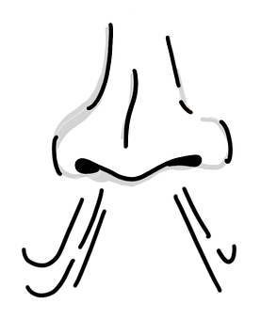
Vocabulario
hablar
5
suddenly
Segundos
straight away
[the smell]
enseguida
el olor
de repente
0
INICIO
Notes:
[8/8]

Slide 17
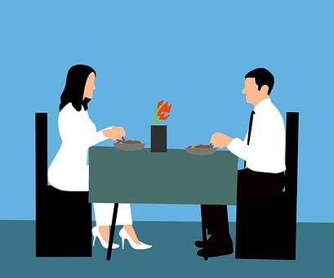
Vocabulario
[1/2]
leer / hablar
‘Aire’ is often used in the phrase ‘al aire libre’, meaning ‘outdoor’ (or ‘open air’):
una actividad al aire libre = an outdoor activity
una mesa al aire libre = an outdoor table
marvellous, wonderful
maravilloso, maravillosa
air
el aire
México
el restaurante
[Mexico]
[restaurant]
In English, we say ‘to be thirsty’.
In Spanish, they use the verb ‘tener’ (to have).
e.g. I am thirsty = Tengo sed (literally, ‘I have thirst’)
thirst
la sed
el recuerdo
$5
[souvenir]
Notes:
Vocabulary introduction and practice slide [1/2]
Timing: 3 minutes
Aim: to introduce new vocabulary.
Procedure 1. Pupils either work by themselves or in pairs, reading out the words and recapping their English meaning (1 minute). 2. Then the teacher removes the English words or pictures (one by one) and they try to recall the English orally (chorally), looking at the Spanish (1 minute). 3. Then the Spanish meanings are removed (one by one) and they to recall them orally (again, chorally), looking at the English (1 minute) 4. Optionally, further rounds of learning can be facilitated by one pupil turning away from the board, and his/her partner asking him/her the meanings (‘¿Cómo se dice X en español?’). This activity can work from L2 → L1 or L1 → L2.

Slide 18
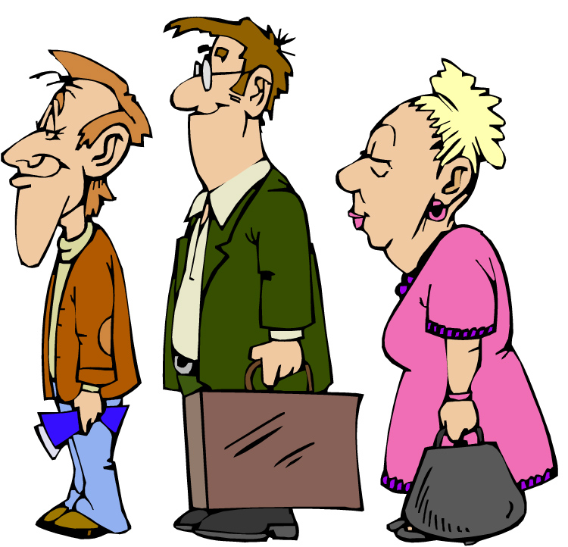
Vocabulario
[2/2]
leer / hablar
With this meaning, ‘faltar’ is used in the 3rd person (with the ending –a or –an):
e.g. Falta pan = There isn’t any bread
e.g. Faltan huevos = There aren’t any eggs
la cola
faltar
[to be missing, being missing]
[queue]
iAtención! Femenine words that start with stressed ‘h’ or ‘a’ use the definite article ‘el’ to ease pronunciation!
e.g. el agua, el ala (ala = wing)
el sitio
Of course!
por supuesto
[place]
In English, we say ‘to be hungry’.
In Spanish, they use the verb ‘tener’.
e.g. I am hungry = Tengo hambre
(literally, ‘I have hunger’)
XL
la talla
hunger
el hambre
[size]
Notes:
[2/2]
Frequency of unknown words:
ala [1995]

Slide 19
Distinguishing one thing from another Demonstrative adjectives
gramática
As you know, demonstrative adjectives (e.g. ‘this’ and ‘that’) are used to distinguish one thing from another.
este
In Spanish, to say ‘this’ for a singular masculine noun, use ______.
1
Compré este recuerdo para mi abuelo.
I bought this souvenir for my grandad.
To say ‘that’ for singular masculine noun, use ‘ese’.
2
En ese sitio hay un buen ambiente.
In that place there is a good atmosphere.
Notes:
Timing: 2 minutes
Aim: to recap the demonstrative adjective ‘este’ and introduce ‘ese’.
Procedure: click to go through the explanations and examples.

Slide 20
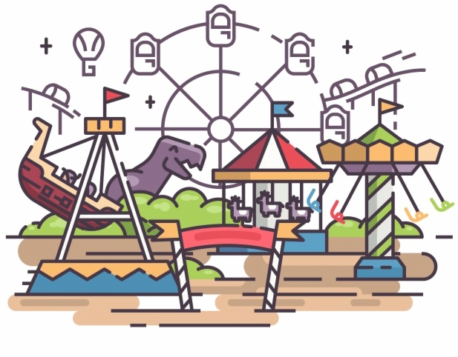
En el parque de atracciones
*la atracción = attraction, ride
leer
*el fantasma = ghost
Hugo y Daniel están en un parque de atracciones.
Lee las frases y completa la tabla.
‘this’ | ‘that’
1. ¿Te gusta ese tipo de atracción*? – Por supuesto.
5. Tengo sed, pero en este café faltan botellas de agua.
1
2. ¿Te da miedo este tren fantasma*? – iSí!
6. Con este tiempo no tengo ganas de hacer actividades al aire libre.
2
3
4
3. ¿Comemos en este sitio? –
Sí, tengo hambre.
7. Quiero comprar ese recuerdo para mi padre.
5
6
4. Quiero ir al otro lado del parque. ¿Cogemos ese autobús? – Vale.
8. ¿Quieres ver ese espectáculo a las once? Parece maravilloso.
7
8
Notes:
Timing: 7 minutes
Aim: to practise recognising the meanings of este and ese (reading activity).
Procedure:
Go through the instructions with students. Ask students what they think ‘parque de atracciones’ might mean (students have learnt the –ción suffix before). The clip art might also be a clue here. Ensure that it is clear to all students that this refers to a theme park.
Highlight the meaning of the glossed words.
Students copy the grid and complete it, paying attention to the verbs in each sentence.
Click to give students item-by-item feedback and elicit oral translations of each sentence.
Frequency of unknown words and cognates:
fantasma [2514]; atracción [3473]

Slide 21
Distinguishing one thing from another Demonstrative adjectives
gramática
You have seen that the singular masculine word for ‘this’ is ______ and for ‘that’ is ______.
‘este’
‘ese’
esta
In Spanish, to say ‘this’ for a singular feminine noun, use ‘______’.
1
Esta zona del parque se llama México.
This area of the park is called Mexico.
To say ‘that’ for singular feminine noun, use ‘esa’.
2
Esa señora trabaja aquí.
That lady works here.
Notes:
Timing: 2 minutes
Aim: to recap the demonstrative adjectives ‘este’ and ‘esa’
Procedure: click to go through the explanations and examples.

Slide 22
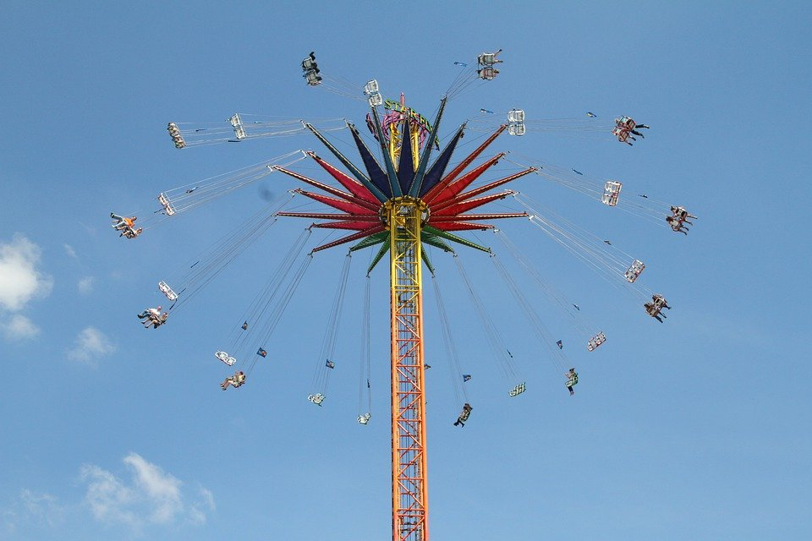
En el parque de atracciones Escucha y elige ‘this’ o ‘that’. Después escucha y completa la frase en inglés.
escuchar
 | this | that
shop
souvenirs
1
That _______ sells ___________.
girl
tickets
2
That _____ is already buying ________.
3
lady
maps
This ______ is handing out _______ of the park.
4
food
strange
taste
This _______ has a _________ _______.
writer
marvellous
stories
5
That _______ writes ___________ _______.
artist
This _______ is very well-known in _________.
6
Mexico
photo
me
laugh
7
That ________ makes _____ _______.
8
queue
too
That ________ is _____ _______.
long
Notes:
Timing: 8 minutes
Aim: to practise recognition of the meanings of ‘esta’ and ‘esa’ (listening activity)
Procedure:
Students write 1-8 and copy the two-column grid into their books.
Click the number button to play the recording.
Students listen carefully and tick the column with the meaning that matches what they hear in the audio. This will be based on whether they hear ‘esta’ (this) or ‘esa’ (that).
Click to reveal the sentence scaffolding for the English translations.
Students listen again and complete the missing parts of the translation. They need only write the missing words.
The answers are revealed by clicking.
Transcript:
Esa tienda vende recuerdos.
Esa chica ya está comprando entradas.
Esta señora reparte planos del parque.
Esta comida tiene un sabor raro.
Esa escritora escribe historias maravillosas.
Esta artista es muy conocida en México.
Esa foto me da risa.
Esa cola es demasiado larga.
Images are in the public domain and free to use:
https://publicdomainvectors.org/en/free-clipart/Theme-park-under-a-blue-sky-vector-graphics/33653.html
https://pixabay.com/es/photos/feria-de-naranjas-parque-tem%c3%a1tico-6987813/
Frequency of unknown words and cognates:
atracción [3473]

Slide 23
Comparing things Regular comparatives [revisited]
gramática
In English we often use ‘more … than’ or ‘less ... than’ with an adjective to make comparisons.
más
adjective
que
To say ‘more … than’ in Spanish, use _____ + __________ + _____.
This theme park is more modern than others.
In English we also sometimes add –er to mean ‘more’ (e.g. smaller).
más moderno que
Este parque de atracciones es ____________________ otros.
menos
adjective
que
To say ‘less … than’ in Spanish, use the words use ________ + __________ + _____.
This dish is less healthy than the first one.
menos sano que
To say ‘the first one’, put an article
(e.g., el/la) before ‘primero’.
Este plato es __________________ el primero.
Notes:
Timing: 2 minutes
Aim: to recap regular Spanish comparatives with ‘más que’ and ‘menos que’
Procedure:
Teachers click to go through the slide. Gaps are left for students to provide answers which will be revealed with a click.
Notes:
1. The slide could easily be adapted for a higher-ability group so that students have to provide the full sentence when prompted.
2. Teachers could optionally ask students here how to say ‘better than’ and ‘worse than’ (these were also introduced last week). These irregular comparatives will also be recapped in this lesson’s activities.

Slide 24
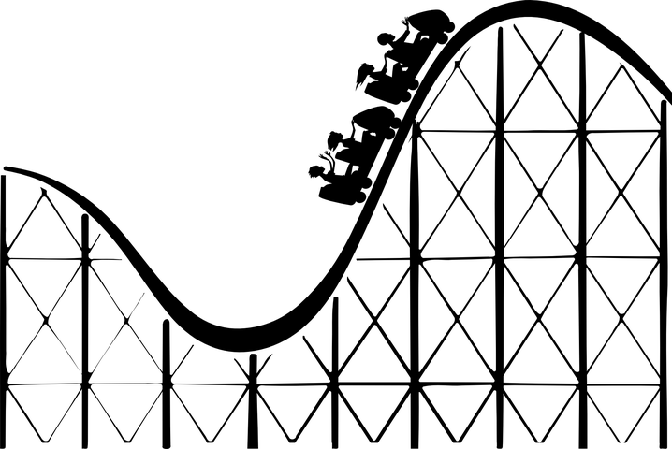
¡Lucía y Nadia también están en el parque de atracciones! Están mirando el plano Lee la conversación. Escribe 1-9 y ‘este’, ‘esta’, ‘ese’ o ‘esa’.
leer
[1/2]
A la una de la tarde…
Lucía: iMe encanta (1) este / esta sitio! Es maravilloso.
Nadia: iSí, cierto! Tengo ganas de subir a (2) ese / esa montaña rusa*. Es más rápida que las otras atracciones. ¿Vamos?
Lucía: Por supuesto. Pero tengo hambre, primero quiero comer algo.
Nadia: Vale. (3) Este / esta restaurante está más cerca que los otros así que podemos comer aquí. También hay mesas al aire libre y tienen comida mexicana.
Lucía: Me parece bien. Además, en este momento no hay cola.
*la atracción = ride
*la montaña rusa = rollercoaster
Notes:
Slide 1/2
Timing: 7 minutes
Aim:
to practise recognising the gender of nouns ending in –o and –a
to use gender marking on nouns to identify the correct demonstrative adjective
to consolidate understanding of comparatives and new vocabulary
Procedure:
Click to show the instructions and then the reading passage and the table which the students can copy out.
Students write either ‘este’ or ‘esta’ for each number.
Students can listen to the conversation to check answers. Click on the audio player (top right of the slide).
Answers are also shown in the text by clicking.
The next slide continues to exploit the text with an activity where students translate five comparative sentences into English.
Frequency of unknown words:
atracción [3473]; montaña rusa [N/A]

Slide 25
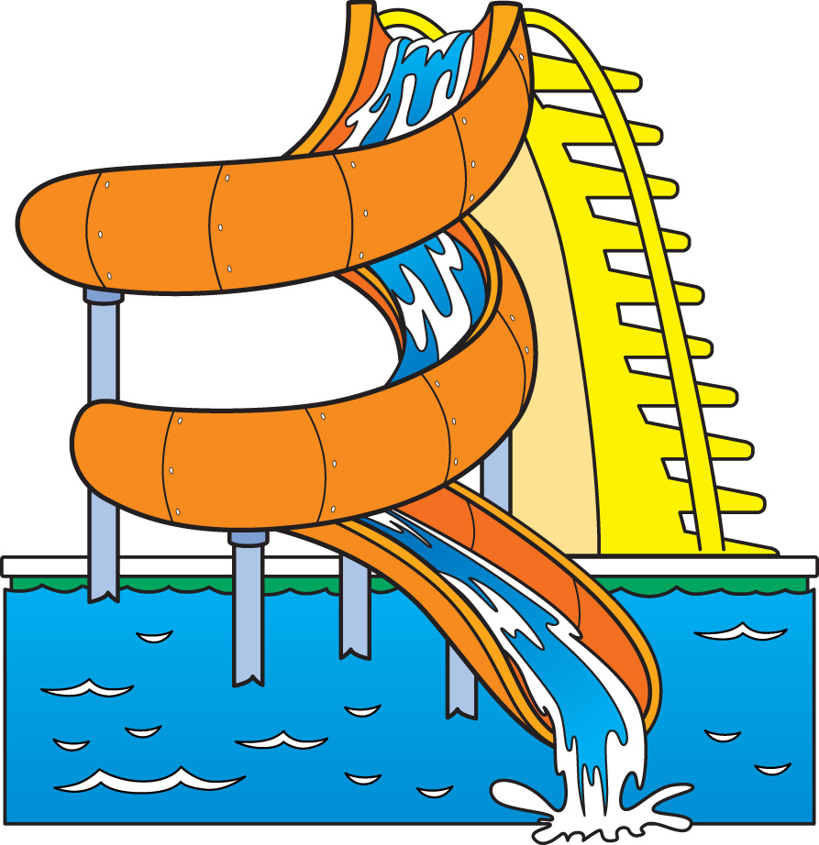
[2/2]
A las cuatro de la tarde…
leer
Nadia: ¡Mira (4) ese / esa chico! ¿Es tu hermano?
Lucía: iSí! Daniel, ¿qué te pasó?
Daniel: Estaba en un barco en (5) ese / esa atracción de agua*. Estaba charlando con Hugo cuando, de repente, sentí un golpe de otro barco y me caí* al agua. Necesito cambiarme, pero me faltan unos pantalones secos.
Nadia: ¿Por qué no compras algo en (6) este / esta tienda? Aquí venden ropa y quizás tienen pantalones en tu talla.
Daniel: Sí, buena idea. Aquí la ropa parece más cara que en la ciudad, pero no quiero pasar toda la tarde mojado*.
*la atracción de agua = water ride
*me caí = I fell
*mojado = wet
Notes:
Slide 2/2
Frequency of unknown words:
caer [251]; atracción [3473]; mojado [3376]

Slide 26
Ahora traduce estas frases comparativas al inglés.
leer / escribir
1. Esa montaña rusa* es más rápida que las otras atracciones.
2. Este restaurante está más cerca que los otros.
3. Esta ropa parece menos cara que en la ciudad.
4. Ese sitio es mejor que antes porque tiene mesas al aire libre.
5. Esa comida es peor que la comida en el colegio.
That rollercoaster is faster than the other rides.
?
This restaurant is closer than than the others.
?
This clothing seems less expensive than in the city.
?
That place is better than before because it has outdoor tables.
?
?
That food is worse than the food at school.
*la atracción = ride
*la montaña rusa = rollercoaster
Notes:
Timing: 4 minutes
Aim: to consolidate understanding of regular and irregular comparatives
Procedure:
Students translate these sentences that from the previous text. Sentences 1-3 are taken directly from the text. Sentence 4-5 are included to check understanding of the irregular comparatives ‘mejor que’ and ‘peor que’ as these will feature in the next activity.
Click to reveal the answers.
Frequency of unknown words: atracción [3473]; montaña rusa [N/A]

Slide 27
Una tarde en el parque de atracciones
*cafe = el café
escribir / hablar
*ride = la atracción
Usa las palabras para hacer una frase en español.
That (m) | boy | is (trait) | less full than | the cafe*
That (f) | ride* | is (state) | less expensive than | the first one (f)
 | size | seems | bigger than | the Mexican food
 | food |  | less happy than | the t-shirt
 | souvenir |  | healthier than | the price in your city
 | place |  | worse than | his friend (f)
 | restaurant |  | faster than | the park in my town
 |  |  | better than | the other one (f)
Ese chico está menos contento que su amiga.
Ese recuerdo es menos caro que la camiseta.
Esa atracción es más rápida que la otra.
Esa talla parece mejor que la primera.
Ese sitio es más grande que el parque en mi pueblo.
Esa comida parece más sana que la comida mexicana.
Ese restaurante está menos lleno que el café.
Notes:
Timing: 10 minutes
Aim:
i) to write sentences using the demonstrative adjectives ‘ese’ and ‘esa’ and comparatives, using the prompts.
ii) to practise producing new and revisited vocabulary in writing.
Procedure:
The teacher brings up each combination of sentence parts
Students can be asked to write the Spanish on mini-whiteboards or in their books, then volunteer the answer orally.
Students could then create a number of their own sentences, using new combinations of words in the grid. Students can be encouraged to use the rectangles that haven’t yet been used (‘worse than’, ‘in price in your city’).
After writing the even sentences, the teacher could encourage an oral simultaneous translation task, where students say a sentence and their partner translates it. Some may find this challenging to do on the spot, so this oral component could be done by some students, while other students continue to practise writing.
A final question could involve the teacher writing a sentence down from the elements provided, but not showing it. Every student also writes down one sentence, trying to use their sixth sense to make it as similar as possible to the teacher’s sentence. Great minds think alike!
Sentences:
That food seems healthier than the Mexican food. (Esa comida parece más sana que la comida mexicana.)
That place is bigger than the park in my town. (Este sitio es más grande que el parque en mi pueblo.)
That ride is faster than the other one. (Esta atracción es más rápida que la otra.)
That souvenir is less expensive than the t-shirt. (Ese recuerdo es menos caro que la camiseta.)
That boy is less happy than his friend (m). (Ese chico está menos contento que su amigo.)
That size is better than the first one. (Esa talla es mejor que la primera).
That restaurant is less full than the café. (Ese restaurante está menos lleno que el café.)
Frequency of unknown words:
atracción [3473]; café [961]

Slide 28
Asking questions at a market
Demonstrative adjectives:
‘estos’ and ‘estas’ [revisited]
‘esos’ and ‘esas’
Y9 Spanish
Term 3.2 – Week 3 – Lesson 66
Author name(s): Louise Caruso / Nick Avery Artwork: Mark Davies
Date updated: 10/05/22
Notes:
Artwork by Mark Davies. All additional pictures selected are available under a Creative Commons license, no attribution required.
With thanks to Rachel Hawkes for her input on the lesson material and Blanca Román for native teacher feedback.
Learning outcomes (lesson 1):
Introduction of demonstrative adjectives ‘esos’ and ‘esas’
Consolidation of demonstrative adjectives ‘ese’ and ‘esa’
Consolidation of SER and ESTAR in 3rd person plural present tense (son, están)
Consolidation of number agreement
Consolidation of SSC [cu]+vowel
Word frequency (1 is the most frequent word in Spanish):
9.3.2.3 (introduce): faltar [524]; restaurante [2636]; aire [aire-401]; México [N/A]; recuerdo [771]; sitio [477]; talla [4056]; cola [1867]; ese [35]; esa [35]; esos [35]; esas [35]; maravilloso [1527]; por supuesto [530]; hambre [1262]; sed [2214]; roto [>5000]; gratis [>5000]
Note: words in bold are introduced in this lesson.
9.3.1.3 (revisit): era [7]; eras [7]; escritor [864]; artista [817]; dueño [1239]; metro [798]; agradable [1997]; transporte [1400]; moderno [861]; posible [427]; popular [790]; normal [1000]; optimista [1025]; cierto[159]; buen [103]; gran [66]; mal [360]; único² [213];
9.2.2.3 (revisit): animar [1630]; anunciar [785]; cerrar [521]; charlar [2968]; llover [2134]; notar [696]; (prestar) atención [atención-489]; regresar [573]; boda [2473]; espectáculo [1622]; golpe [746]; llegada [1604]; olor [1070]; sabor [2108]; enseguida [2866]; mundial [572]; en este momento [momento-121]; de repente [repente-1805]
Source: Davies, M. & Davies, K. (2018). A frequency dictionary of Spanish: Core vocabulary for learners (2nd ed.). Routledge: London
The frequency rankings for words that occur in this PowerPoint which have been previously introduced in NCELP resources are given in the NCELP SOW and in the resources that first introduced and formally re-visited those words.
For any other words that occur incidentally in this PowerPoint, frequency rankings will be provided in the notes field wherever possible.

Slide 29
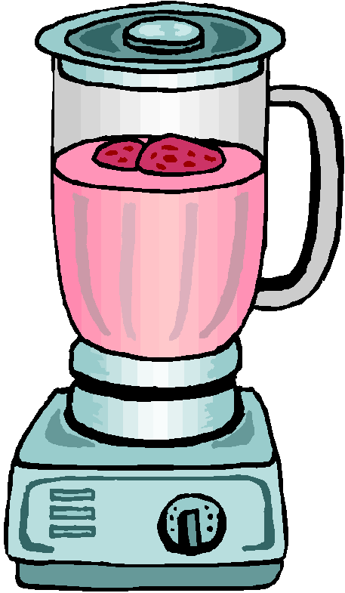
hablar
leer / hablar
iA hablar!
¿Cuántos recuerdos compró Conchi en Ecuador? iCincuenta!
1
2
3
¿Cuántos recuerdos compró Conchi en Ecuador? iCincuenta! También compró cuatro licuadoras y cuarenta cuerdas.
1
2
3
*la cuerda = rope
*la licuadora = blender
¿Cuántos recuerdos compró Conchi en Ecuador? iCincuenta! También compró cuatro licuadoras, cuarenta cuerdas, cuatro libros de cuentos y un cuarto kilo de maíz.
1
2
3
*el maíz = corn
*el cuento = story, tale
*el cuarto = quarter
Notes:
A tonguetwister
Timing: 5 mins
Aim: to gain confidence in practising the SSC [cu] + vowel in sentences
Procedure:
The teacher first asks students to read the short text and think about what it means.
The teacher reads the text aloud in fragments, eliciting the meanings from students. Note that all words have been previously taught as vocabulary items or used for phonics practice.
Students then practise saying the sentence in pairs, at increasing speed.
The teacher can challenge students to listen to a native speaker read the text at three different speeds (1=slow; 3=very fast). Each time, students can be challenged to say it at the same speed.
Frequency of unknown words and cognates:
kilo [2934]; maíz [2981]; cuento [853]; Ecuador [>5000]; licuadora [>5000]

Slide 30
Vocabulario
escuchar / leer
[1/8]
Escucha y elige una opción para completar cada frase.
1
guapo
agradable
cierto
?
The beach is a very pleasant place.
posible
Notes:
Slide 1/8
Timing: 5 minutes
Aim: aural recognition of this week’s revisited vocabulary.
Procedure:
1. Ask students to note down which word completes Daniel’s sentence.
2. Click to reveal the answers.
Transcript:
1. La playa es un lugar muy…

Slide 31
Vocabulario
escuchar / leer
[2/8]
Escucha y elige una opción para completar cada frase.
2
tu mejor amigo ahora?
tus mejores amigos ahora?
tu mejor amigo cuando vivías en Inglaterra?
?
Who was your best friend when you lived in England?
tus mejores amigos cuando vivías en Inglaterra?
Notes:
Slide 2/8
Transcript:
2. ¿Quién era…

Slide 32
Vocabulario
escuchar / leer
[3/8]
Escucha y elige una opción para completar cada frase.
3
transporte
alegre
fuerte
?
My Dad is a great man.
hombre
Notes:
Slide 3/8
Transcript:
3. Mi padre es un gran

Slide 33
Vocabulario
escuchar / leer
[4/8]
Escucha y elige una opción para completar cada frase.
4
golpe
olor
sabor
?
All of a sudden I heard a bang.
escribe
Notes:
Slide 4/8
Transcript:
4. De repente oí un…

Slide 34
Vocabulario
escuchar / leer
[5/8]
Escucha y elige una opción para completar cada frase.
5
metro
espectáculo
moderno
?
In my city the transport is very modern.
cierto
Notes:
Slide 5/8
Transcript:
5. En mi ciudad el transporte es muy…

Slide 35
Vocabulario
escuchar / leer
[6/8]
Escucha y elige una opción para completar cada frase.
6
de la estación
del tren
de la playa
?
I’m waiting for the arrival of the train.
del mar
Notes:
Slide 6/8
Transcript:
6. Estoy esperando la llegada…

Slide 36
Vocabulario
escuchar / leer
[7/8]
Escucha y elige una opción para completar cada frase.
7
optimista
azul
contra
?
In general I’m an optimistic person.
viva
Notes:
Slide 7/8
Transcript:
7. En general soy una persona…

Slide 37
Vocabulario
escuchar / leer
[8/8]
Escucha y elige una opción para completar cada frase.
8
consejo
dueño
único
?
Look at the grey sky. The weather is bad today.
tiempo
Notes:
Slide 8/8
Note: two meanings of ‘único’ have previously been taught ‘unique’ (after noun) and ‘only’ (before noun). It is worth checking students’ knowledge of these here. For example, ask ‘¿Cómo se dice ‘a unique person’ en español?’ and ‘¿Cómo se dice ‘the only person’ en español?
Transcript:
8. Mira el cielo gris. Hoy hace mal…

Slide 38
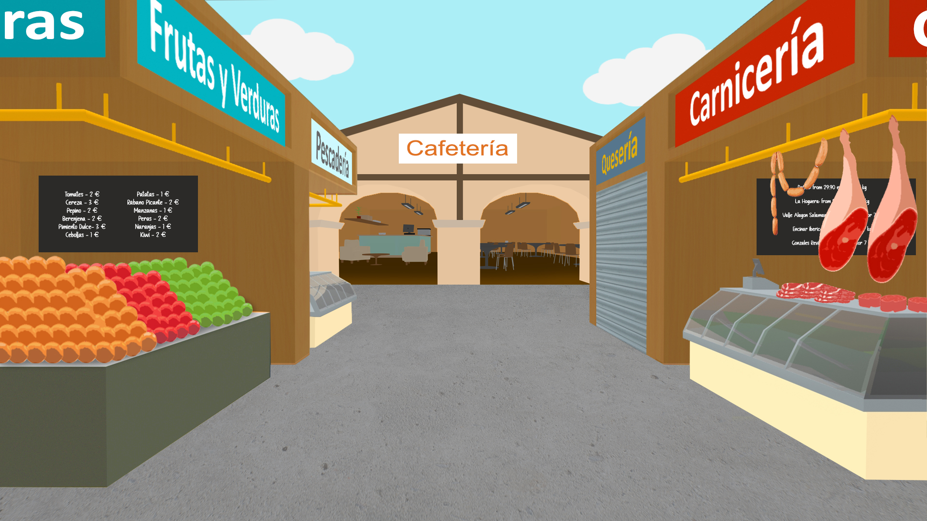
Precios en el mercado
¿Cómo se dice ‘31 coins’ en español?
hablar
treinta y una monedas
1
2
3
4
5
€30
€31
€40
€50
€60
treinta euros
treinta y un euros
cuarenta euros
cincuenta euros
sesenta euros
6
Remember, ‘cien’ is used only to mean ‘one hundred’. ‘Ciento’ is used to mean ‘one hundred and…’.
7
8
9
10
€70
€80
€90
€100
€101
setenta euros
ochenta euros
noventa euros
cien euros
ciento un euros
Notes:
Timing: 3 minutes
Aim: to practise productive recall of a range of previously taught numbers (30-101)
Procedure:
Students recall how to say the numbers on the price tags.
Students write down the numbers or say them to a partner.
Click to reveal the answers.

Slide 39
Distinguishing one thing from another Demonstrative adjectives
gramática
As you know, demonstrative adjectives (e.g. ‘this’ and ‘that’) are used to distinguish one thing from another.
ese
In Spanish, to say ‘that’ for a singular masculine noun, use ______.
1
¿Eras el dueño de ese restaurante?
Were you the owner of that restaurant?
2
To say ‘those’ for a plural masculine noun, use ‘esos’.
Esos sitios son muy buenos.
Those places are very good.
As you know, all adjectives need to agree with the gender and number of the subject of the sentence.
Notes:
Timing: 2 minutes
Aim:
to recap the demonstrative adjective ‘ese’
to introduce the demonstrative adjective ‘esos’
Procedure:
Click to go through the explanations and examples.
Highlight in the examples that there is number agreement between the adjective(s) and noun. This will be a focus of the next activity.

Slide 40
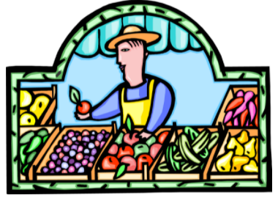
En el mercado
Lee las frases. Elige la forma correcta del nombre.
También, elige una opción (a-g) para completar la frase.
iAtención! Hay varias posibilidades.
leer
1
Ese vestido de boda / vestidos…
a
…son muy bonitos.
2
Esos bolígrafo/ bolígrafos…
b
…están a mitad de precio.
3
Ese recuerdos / recuerdo…
c
…es muy popular.
*roto, rota = broken
4
Esos relojes / reloj…
d
…no está roto*.
5
Esos libro / libros…
e
…cuesta nueve euros.
f
*gratis = free
6
Ese juego/ juegos…
…es gratis.*
7
Esos planos de México / plano de México…
g
…cuestan diecisiete euros.
Notes:
Timing: 6 minutes
Aim:
i) to practise adjective-noun number agreement with ‘ese’ and ‘esos’ (reading activity)
ii) to consolidate knowledge of subject-verb agreement
Procedure:
Students write 1-7 in their books.
They look at the start of each sentence and decide whether the noun should be singular or plural.
Give feedback. Click to reveal each correct (underlined) answer.
Students then decide on a possible sentence ending. They can simply write a letter (a-g). Note, there are multiple possible answers here. The animation sequence therefore doesn’t bring up answers for this part of the activity. Elicit a range of possible responses and give feedback.
Draw students’ attention to the word ‘gratis’, a new vocabulary item this week. Explain to students that this adjective doesn’t change for singular and plural nouns. ‘Roto/a’ is also new. This adjective needs to agree with the gender and number of the noun and takes ‘estar’.
Optionally, as an extension, students could be asked to think of some of their own sentence endings using other 3rd person singular and plural forms of verbs.

Slide 41
Distinguishing one thing from another Demonstrative adjectives
gramática
As you know, demonstrative adjectives (e.g. ‘this’ and ‘that’) are used to distinguish one thing from another.
esa
1
In Spanish, to say ‘that’ for a singular feminine noun, use ______.
Esa guitarra está rota.
That guitar is broken.
2
To say ‘those’ for a plural feminine noun, use ‘esas’.
Esas tallas son demasiado pequeñas.
Those sizes are too small.
As you know, all adjectives need to agree with the gender and number of the subject of the sentence.
Notes:
Timing: 2 minutes
Aim:
to recap the demonstrative adjective ‘esa’
to introduce the demonstrative adjective ‘esas’
Procedure:
Teachers click to go through the explanations and examples.
Teachers could highlight in the examples that there is gender agreement between the adjective and noun. This will be a focus of the next activity.

Slide 42
leer / escuchar
Daniel y Ana van de compras. Escucha las preguntas.
Completa la pregunta con la palabra correcta.
¿Cuánto es/son? Escribe el precio (e.g. €26).
A | B
camisa | camisas
pintura* | pinturas*
bolsas | bolsa
cajas | caja
flor | flores
planta | plantas
pelota | pelotas
Opciones (¡Atención! Hay un precio extra):
1
1
€47
€33
€24
€100
2
2
€100
3
3
€62
€62
€59
4
4
€24
5
5
€33
€47
€101
€71
6
6
€71
7
7
€101
la pintura = painting
Notes:
Timing: 8 min
Aim:
i) to identify the correct noun by recognising number marking on ‘esa’ and ‘esas’
ii) to practise aural recognition of numbers
Procedure:
Go through the instructions with students. Ask them to write 1-7 in their books.
Click the orange action buttons. Students listen and decide how the question must end. They can simply write ‘A’ or ‘B’.
Click to reveal each the beige action buttons. Click again to reveal each answer. The beige buttons can be used to facilitate feedback here.
Click to start the next part of the activity. A set of price tags will appear on animation. These are the answer options that students can choose from.
Students listen again (beige action buttons). This time, they need to identify the price (number) in the audio.
Click to reveal answers. In feedback, ask if any prices are surprising (e.g. 71 euros might seem a lot for a plant!)
Differentiation: remove the price tags from the screen when doing the activity with a higher-achieving group. This will challenge students more.
Transcript (orange buttons):
¿Cuánto cuestan esas…
¿Cuánto cuestan esas…
¿Cuánto cuesta esa…
¿Cuánto cuestan esas…
¿Cuánto cuestan esas…
¿Cuánto cuesta esa…
¿Cuánto cuesta esa…
Transcript (beige buttons):
¿Cuánto cuestan esas camisas? – 47 euros
Cuánto cuestan esas pinturas? – 100 euros
¿Cuánto cuesta esa bolsa? – 62 euros
¿Cuánto cuestan esas cajas? – 24 euros
¿Cuánto cuestan esas flores? – 33 euros
¿Cuánto cuesta esa planta? – 71 euros
¿Cuánto cuesta esa pelota? – 101 euros
Frequency of unknown words:
Pintura [964]

Slide 43
Persona A: lee la pregunta en español.
hablar / escuchar
Preguntas en el mercado
To ask for a price, you can either use
‘cuánto cuesta…’ or ‘cuánto es…’.
For a plural noun, use
‘cuánto cuestan…’ or ‘cuánto son…’.
Persona B: mira las tarjetas. ¿Es ‘A’ or ‘B’? Say the words below the picture in Spanish.
¿Cuánto es ese reloj?
Treinta euros.
Un ejemplo
Persona A (pregunta):
Persona B (escucha y mira las tarjetas):
How much is that watch?
A
B
30 euros
__________
Say:
30 euros
60 euros
Notes:
Timing: 10 minutes (slides 43-46)
Aims:
i) to practise production and comprehension of ‘ese’, ‘esa’, ‘esos’, ‘esas’ and vocabulary
ii) to practise number agreement on nouns (plural –s and –es)
Procedure:
This is the example slide to explain the activity. Click to go through the example step by step.
Person A begins the activity by orally translating the question into Spanish. All questions begin with ‘how much is/are’ and then prompt ‘that’ or ‘those’ + noun.
Person B listens to Person A’s question and works out which image the question refers to. S/he then orally translates the price below the correct picture into Spanish. Person A writes this next to the question on his/her prompt card.
Students swap roles after doing the first 6.
The answers to the activity are shown on slide 46.
Note: across the activity all four adjectives (ese, esa, esos, esas) are practised, but each person will only be practising with two at a time (i.e., ese vs esos for the first six items, then esa vs esas for the second six items).

Slide 44
Persona A
hablar
How much are those books?
How much is that sweet?
How much are those pens?
How much is that wedding dress?
How much are those souvenirs?
How much is that watch?
Persona B
How much are those bags?
How much is that shirt?
How much is that guitar?
How much are those boxes?
How much are those drinks?
How much is that t-shirt in size small?
Notes:
Prompt cards
DO NOT DISPLAY IN CLASS
Target sentences:
Person A
¿Cuánto son esos libros?
¿Cuánto es ese dulce?
¿Cuánto son esos bolígrafos?
¿Cuánto ese ese vestido de boda?
¿Cuánto son esos recuerdos?
¿Cuánto es ese reloj?
Person B
¿Cuánto son esas bolsas?
¿Cuánto es esa camisa?
¿Cuánto es esa guitarra?
¿Cuánto son esas cajas?
¿Cuánto son esas bebidas?
¿Cuánto es esa camiseta en talla pequeña?

Slide 45
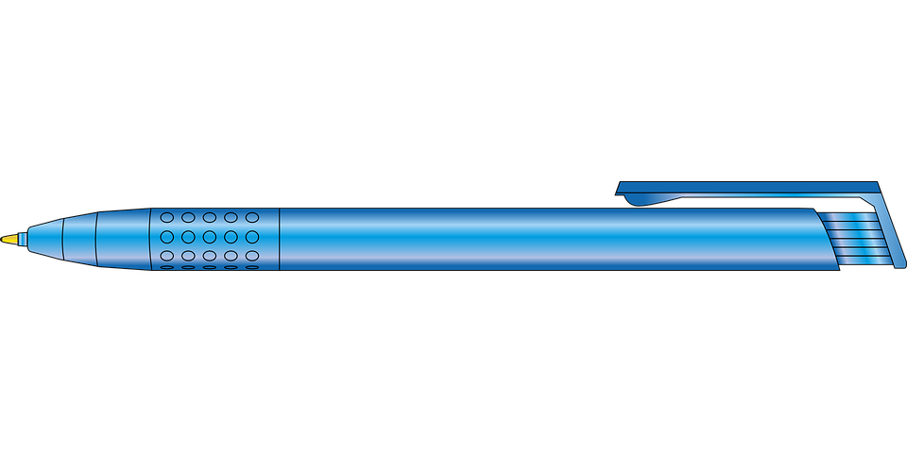
1.
A
[book]
B
[books]
4.
A
[wedding dress]
B
[wedding dresses]
€14
€27
€80
€150
2.
A
[dulce]
B
[dulces]
5.
A
[souvenir]
B
[souvenirs]
€3
€13
€8
€12
3.
A
[pen]
B
[pens]
6.
A
[watch]
B
[watches]
€5
€10
€61
€71
Notes:
Person B
DO NOT SHOW THIS SLIDE DURING THE ACTIVITY

Slide 46
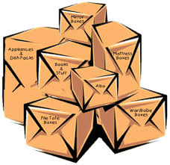
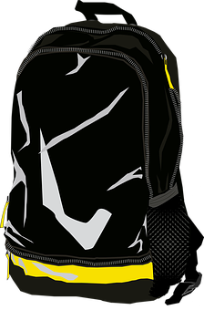
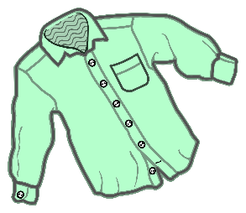
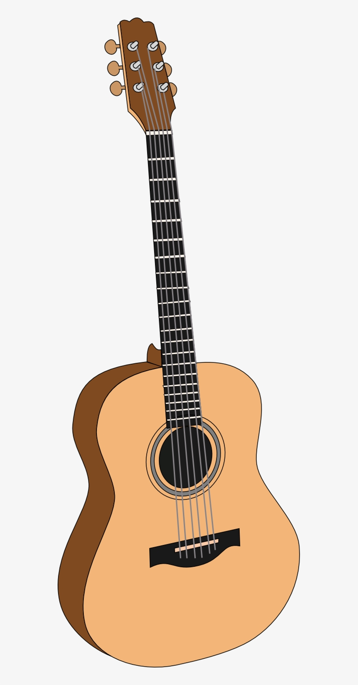
1.
A
[bag]
B
[bags]
4.
A
[box]
B
[boxes]
€66
€98
€9
€13
2.
A
[shirt]
B
[shirts]
5.
A
[drink]
B
[drinks]
€34
€57
€5
€11
3.
A
[guitar]
B
[guitars]
6.
A
[t-shirt in a small size]
B
[t-shirts in a small size]
€100
€110
€25
€42
Notes:
Person A
DO NOT SHOW THIS SLIDE DURING THE ACTIVITY

Slide 47
Respuestas
hablar / escuchar / escribir
Persona A:
1. Veintisiete euros.
2. Tres euros.
3. Diez euros.
4. Ochenta euros.
5. Doce euros.
6. Setenta y uno euros.
Persona B:
1. Noventa y ocho euros.
2. Treinta y cuatro euros.
3. Cien euros.
4. Trece euros.
5. Once euros.
6. Veinticinco euros.
Notes:
Answers for the speaking, listening and writing

Slide 48
Deberes
Vocabulary Learning Homework (Y9, Term 3.2, Week 4)
Audio file
Audio file QR code:
Student worksheet
Quizlet link
Notes:
Answers available here: https://resources.ncelp.org/concern/resources/m613n073b?locale=en

