Slide 1
Describing locations
Estar: to be, being [location]
I am & he/she is
Notes:
Vocabulary for Week 1:
dónde [161]; estar [21]; estoy; estás; está; en [5]; Inglaterra [proper noun - N/A]; España [proper noun - N/A]; el [1]; norte [624]; sur [661]; Granada [N/A]; San Sebastián [N/A]
Source: Davies, M. & Davies, K. (2018). A Frequency Dictionary of Spanish: Core vocabulary for learners (2nd ed.) London: Routledge.

Slide 2
estar
[to be | being] (location, state)
está
[is] (location, state)
Notes:
This slide has animation and audio. Use to present the infinitive and 3rd person singular of ESTAR, with English meanings. Cue students to repeat the words.

Slide 3
estar
[to be | being] (location, state)
está
[is] (location, state)
Notes:
Elicit the English meanings.

Slide 4
está
[is] (location, state)
Madrid está en España.
[Madrid is in Spain.]
Notes:
Present the sentence and elicit the English translation. This is unlikely to cause students any difficulty and is like to be confidence-building for them to translate the meaning so easily. Of course, should learners find it difficult, simply provide the English. The aim here is to provide concrete examples of ESTAR forms in use.

Slide 5
estar
[to be | being] (location, state)
Pablo quiere estar en España.
[Pablo wants to be in Spain.]
Notes:
Present the sentence and elicit the English translation. Quiere has not been taught. We don’t expect students necessarily to be able to guess this (though they may well), so continue to provide the English translation, swiftly.

Slide 6
está
[is] (location, state)
Madrid ___ en España.
está
[Madrid is in Spain.]
Notes:
This slide elicits the 3rd person singular from students, first. Then it presents the English sentence for translation. Students may well be able to do this straightaway. However, a staggered version is provided, whereby the sentence minus the verb is given (a sound effect is heard in place of the verb). Finally the full sentence is provided again.

Slide 7
estar
[to be | being] (location, state)
estar
Pablo quiere ____ en España.
[Pablo wants to be in Spain.]
Notes:
This slide elicits Spanish the infnitive from students, first. Then it presents the English sentence for translation. Versions provided as in the previous slide.

Slide 8
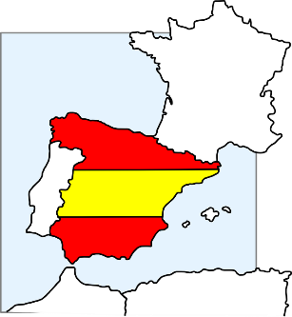
Está en Inglaterra.
¿Dónde está Granada?
Está en España.
hablar
Notes:
In the next series of slides we extend practice to names of cities (with lots of 'a' and not too many other tricky SSCs) - and ask ¿Dónde está? - answers will be Inglaterra / España.
Ask students to pronounce the English towns in a Spanish way - see what they come up with (a good way to assess some prior knowledge of phonics/Spanish).
We need to deal explicitly with the fact that 'está' stands for two words in English, here - it and is.
In the verb slides, we translate 'está' as 'is' and then show it with subjects Madrid and Pablo. Here we see it for the first time meaning 'it is'
As Inglaterra and España are key vocabulary from week 1, these slides at this point ask about the location of different cities (which are either in England or Spain) - just a few but to practise chorally - teacher-fronted. This will provide another useful practice opportunity for both está and the two countries. A couple of the places aren't obvious, so there is genuinely new/surprising info added in here. Note that ‘rr’ and ‘ñ’ are new SSC. Some brief attention will need to be given to RR in Inglaterra and Ñ in España, before they are more formally introduced and practised. It can be quite fun for students to practise rolling the RR! And if students can say ‘lasagne’ they can say ‘España’.

Slide 9
¿Dónde está Córdoba?
Está en Inglaterra.
Está en España.
hablar

Slide 10
Está en Inglaterra.
¿Dónde está Camborne?
Está en España.
hablar
Notes:
After revealing the answer, ask students to pronounce Camborne in a Spanish way - see what they come up with (a good way to assess some prior knowledge of phonics/Spanish).

Slide 11
Está en Inglaterra.
¿Dónde está Pamplona?
Está en España.
hablar

Slide 12
Está en Inglaterra.
¿Dónde está Kendal?
Está en España.
hablar

Slide 13
Está en Inglaterra.
¿Dónde está Salamanca?
Está en España.
hablar

Slide 14
Está en Inglaterra.
¿Dónde está Aspatria?
Está en España.
hablar

Slide 15
Está en Inglaterra.
¿Dónde está Maldon?
Está en España.
hablar

Slide 16
Está en Inglaterra.
¿Dónde está Soria?
Está en España.
hablar

Slide 17
Está en Inglaterra.
¿Dónde está Cantabria?
Está en España.
hablar

Slide 18
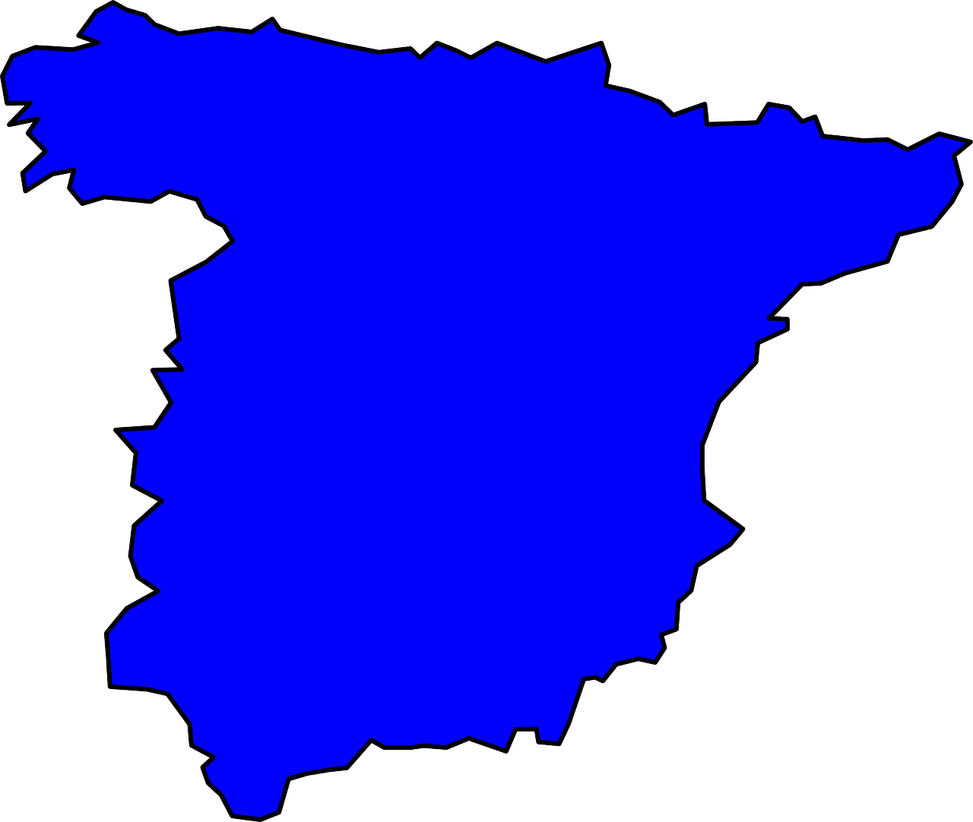
Bilbao
San Sebastián
¿Dónde está el palacio Miramar?
el museo Guggenheim
el palacio Miramar
Barcelona
Madrid
el camp Nou
el museo del Prado
la Sagrada Familia
el Bernabeu
Córdoba
la Mezquita-Catedral
Está en San Sebastián.
Granada
la Alhambra
escuchar, leer y hablar
Victoria Hobson
Notes:
Here, the teacher reads the question which appears on the click, students then have to identify the city and try to pronounce it, focusing on the ‘a’ sound. Elicit choral responses (all students speaking at the same time) to give them more confidence. Reinforce the phonic awareness by re-stating the answer yourself when it appears. This activity also familiarises students with the landmarks which are referred to in the later listening and reading activities which follow.
Students may also want to tell you if they have visited these places and this task offers an independent learning opportunity for students to find out more about these (and other) famous places in Spain after the lesson.

Slide 19
Bilbao
San Sebastián
¿Dónde está la Alhambra?
el museo Guggenheim
el palacio Miramar
Barcelona
Madrid
el camp Nou
el museo del Prado
la Sagrada Familia
el Bernabeu
Córdoba
la Mezquita-Catedral
Está en Granada.
Granada
la Alhambra
escuchar, leer y hablar
Victoria Hobson

Slide 20
Bilbao
San Sebastián
¿Dónde está el Bernabeu?
el museo Guggenheim
el palacio Miramar
Barcelona
Madrid
el camp Nou
el museo del Prado
la Sagrada Familia
el Bernabeu
Córdoba
la Mezquita-Catedral
Está en Madrid.
Granada
la Alhambra
escuchar, leer y hablar
Victoria Hobson

Slide 21
Bilbao
San Sebastián
¿Dónde está el museo Guggenheim?
el museo Guggenheim
el palacio Miramar
Barcelona
Madrid
el camp Nou
el museo del Prado
la Sagrada Familia
el Bernabeu
Córdoba
la Mezquita-Catedral
Está en Bilbao.
Granada
la Alhambra
escuchar, leer y hablar
Victoria Hobson

Slide 22
Bilbao
San Sebastián
¿Dónde está el museo del Prado?
el museo Guggenheim
el palacio Miramar
Barcelona
Madrid
el camp Nou
el museo del Prado
la Sagrada Familia
el Bernabeu
Córdoba
la Mezquita-Catedral
Está en Madrid.
Granada
la Alhambra
escuchar, leer y hablar
Victoria Hobson

Slide 23
Bilbao
San Sebastián
¿Dónde está el camp Nou?
el museo Guggenheim
el palacio Miramar
Barcelona
Madrid
el camp Nou
el museo del Prado
la Sagrada Familia
el Bernabeu
Córdoba
la Mezquita-Catedral
Está en Barcelona.
Granada
la Alhambra
escuchar, leer y hablar
Victoria Hobson

Slide 24
Bilbao
San Sebastián
¿Dónde está la Mezquita-Catedral?
el museo Guggenheim
el palacio Miramar
Barcelona
Madrid
el camp Nou
el museo del Prado
la Sagrada Familia
el Bernabeu
Córdoba
la Mezquita-Catedral
Está en Córdoba.
Granada
la Alhambra
escuchar, leer y hablar
Victoria Hobson

Slide 25
Bilbao
San Sebastián
¿Dónde está la Sagrada Familia?
el museo Guggenheim
el palacio Miramar
Barcelona
Madrid
el camp Nou
el museo del Prado
la Sagrada Familia
el Bernabeu
Córdoba
la Mezquita-Catedral
Está en Barcelona.
Granada
la Alhambra
escuchar, leer y hablar
Victoria Hobson

Slide 26
Estar: I am & he/she is
In Spanish, the verb estar means to be when describing location.
Estoy
I am
Está
he / she is
Estoy en España.
I am in Spain.
Está en España.
He / she is in Spain.
Victoria Hobson
Notes:
Here, make reference to that fact that está has just been practised to mean ‘is’ and ‘it is’. Now draw students’ attention to its translation as he/she is.
Note: This is the first time in this lesson that students need to write. Probably the best time to hand out exercise books. This may mean that one or two activities will move from this lesson into the next.

Slide 27
Cartas postales
Read the postcards. Who is where? estoy (I am) or está (he/she is).
Write: 1. I am OR he/she is.
Victoria Hobson

Slide 28
4)
1)
I am
I am
Está en el palacio
Miramar.
Estoy en el museo del
Prado.
he/she is
he/she is
2)
5)
I am
I am
Estoy en el museo
Guggenheim.
Estoy en el Bernabeu.
he/she is
he/she is
3)
I am
6)
I am
Está en La Alhambra.
Está en el Campo
Nou.
he/she is
he/she is

Slide 29
Escuchar
I am | he is | City
1
Granada
2
Madrid
3
Barcelona
4
San Sebastián
5
Bilbao
6
Córdoba
7
Madrid
8
Barcelona
Sofia misses her boyfriend! She explains why - (estoy – I am), and (está - he is). Listen. Write ‘I’ or ‘he’ (and second time, the city.)
Victoria Hobson
Notes:
TRANSCRIPT
Está en la Alhambra
Estoy en el museo del Prado
Estoy en el campo Nou
Está en el palacio Miramar
Estoy en el museo Guggenheim
Está en la Mesquita-Catedral
Está en el Bernabeu
Estoy en la Sagrada Familia
Teachers can simply ask students to write the answers in their exercise books or on mini-whiteboards. No need for students to copy out the table.

Slide 30
¡A hablar!
Partner A
(verb) +(city)
Granada
Está
en Granada.
Partner B
translation
He is in Granada.
Victoria Hobson
Notes:
See separate set of cards (word doc) OR
Students make these cards themselves i.e. fold A4 paper so it makes 12 rectangles - write 'I' x 3, he/she x 3, then 6 cities that they remember. They could all do this so that they have 24 playing cards in total, when put together - good practice for spelling / memory / sounding out city names as they write them. Then they play the game as described below:
1 Separate the cards into two piles – verbs and cities.
2 Partner A picks a verb and then a city, says the Spanish sentence. 3 Partner B translates into English. 4 Players then swap roles. If pairs time themselves, they can then repeat the activity to see how quickly they can complete all the sentences and translations. With each new game, different sentences will be generated.

Slide 31
Describing locations
Estar: to be, being [location]
I am & you are

Slide 32
Estar: I am & you are
Estar means…
to be when describing location.
Está
it / he / she is
Estoy
I am
To say you are, use estás.
Estás
you are
Estás en España.
You are in Spain.
Estás en el norte.
You are in the north.
Victoria Hobson
Notes:
The animations enable teachers to elicit answers from students that revisit last lesson’s learning of ESTAR. Then present the new form ‘estás’. Elicit the translations of the examples from students. Note: students will not yet know ‘norte’ but it is a near-cognate and part of this week’s learning.

Slide 33
You and your friend have a busy week ahead. Write where each one of you is each day, in English. Use a ? when no info is given.
Leer
2019 | septiembre |  | septiembre
lunes | ……estoy en casa …estás en España… | viernes | …estás en Inglaterra ………………………… ………………………..
martes | ..estás en Granada.. .estoy en el norte… | sábado | ………………….…….. ……estoy en Madrid
miércoles | ….estoy en Valencia …estás en el sur… | domingo | .estoy en la cama… ………………………………………………
jueves | ….estás en casa…………… | Notas
You are
6
10
I am
Mon
Tues
Weds
Thurs
Fri
Sat
Sun
at home
in Spain
in the north
in Granada
7
11
in Valencia
in the south
?
at home
?
in England
8
12
in Madrid
?
in bed
?
9
İFiestas en
octubre!
Victoria Hobson
Notes:
Note: casa and cama are cluster words for the first SSC and will be known to students from their phonics learning for Week 1. Norte has been met on the previous slide. It is likely that students will work out the meaning of ‘sur’ as a result, but as they will need to write the English in this task, it will be apparent if they don’t know it.

Slide 34
Escuchar
Sofia chats to her friend Clara about where they both are on holiday. She uses ‘estoy’ (I am) for herself and ‘estás’ (you are) for Clara. Sometimes she mentions her brother instead so put a ? for Clara.
You are
I am
Sofía | Clara
1
Madrid
Valencia
2
San Sebastián
?
3
England
Spain
4
Barcelona
Granada
5
the south
?
6
Granada
Bilbao
7
the north
the south
8
Spain
?
?
Victoria Hobson
Notes:
Explain these instructions very carefully to the students. Suggest that they write a question mark when Clara’s whereabouts are unknown,
Although students hear three verbs throughout the activity, they are only being asked to attend to estoy and estás. They can disregard está. (Although this will be known to them from the previous lesson). The idea of using a third verb here is to ensure they maintain their focus on the verb to identify the place. If no third verb was used, students could listen to the first verb to work out the answer and then just listen to the place in the second part of the sentence.
TRANSCRIPT
estás en Valencia y estoy en Madrid
está en Bilbao y estoy en San Sebastián
estoy en Inglaterra y estás en España
estoy en Barcelona y estás en Granada
está en el norte y estoy en el sur
estás en Bilbao y estoy en Granada
estoy en el norte y estás en el sur
está en Inglaterra y estoy en España
Accept answers written in Spanish for north/south/England/Spain.

Slide 35
İA hablar!
Partner A
(verb) +(location)
Estás
en el norte.
translation
Partner B
You are in the north.
Notes:
See separate set of cards (word doc) OR
Students make these cards themselves i.e. fold A4 paper so it makes 12 rectangles - write 'I' x 3, he/she x 3, then 6 cities that they remember. They could all do this so that they have 24 playing cards in total, when put together - good practice for spelling / memory / sounding out city names as they write them. Then they play the game as described below:
1 Separate the cards into two piles – verbs and cities.
2 Partner A picks a verb and then a city, says the Spanish sentence. 3 Partner B translates into English. 4 Players then swap roles. If pairs time themselves, they can then repeat the activity to see how quickly they can complete all the sentences and translations. With each new game, different sentences will be generated.

Slide 36
¡A escribir!!
1
Estás en España.
Victoria Hobson
Notes:
Students use mini whiteboards to write the sentences generated by the images. Note: These slides include all three forms of ESTAR learnt in Week 1.

Slide 37
¡A escribir!
2
Estás en el norte.
Victoria Hobson
Notes:
Students use mini whiteboards to write the sentences generated by the images.

Slide 38
İA escribir!
3
Estoy en Inglaterra.
Victoria Hobson
Notes:
Students write the sentences generated by the images in exercise books/mini-whiteboards.

Slide 39
¡A escribir!
4
Madrid
Está en Madrid.
Victoria Hobson

Slide 40
¡A escribir!
5
S
Estoy en el sur.
Victoria Hobson
Notes:
Students use mini whiteboards to write the sentences generated by the images.

Slide 41
¡A escribir!
6
Granada
Estoy en Granada.
Victoria Hobson
Notes:
Students use mini whiteboards to write the sentences generated by the images.

Slide 42
¡A escribir!
7
Estás en Inglaterra.
Victoria Hobson
Notes:
Students use mini whiteboards to write the sentences generated by the images.

Slide 43
¡A escribir!
8
Está en España.
Victoria Hobson
Notes:
Students write the sentences generated by the images in exercise books/mini-whiteboards.

