Slide 1
What? When? How? Why? Teaching students to ask questions
The Language Show 2021
Presenter: Rachel Hawkes Date updated: 06/11/21
Notes:
Hello. My name is Rachel Hawkes. I’m currently seconded from my school for four days a week to work as co-director at NCELP, and in this presentation I'm going to talk about teaching students how to ask (and answer) questions.
I am going to draw on NCELP resources, but I’m also going to share resources from my trust’s new primary schemes of work, as these also include quite a lot of teaching about questions. Before we get underway, I want to thank all of the NCELP team for the hard work and dedication that have gone into the NCELP project to date. In particular, with reference to the resource creation side of things I want to give a shout out to all the NCELP resources developers and Professor Emma Marsden, director of NCELP. And very importantly, I also want to thank all of our lead and hub school teachers who started trialling the resources around 18 months ago and who have now adopted the SOW in Y7, and some in Y8.
What? When? How? Why? Teaching students to ask questions.
The ability to understand and ask questions is fundamental to meaningful interaction. In a time-limited classroom language learning context, what is the most effective way to teach questions to our students, so that they can initiate and respond without a written script, and so that they are making clear progress towards asking what they want to ask? How does the ability to ask questions ‘off the top of your head’ relate to learner motivation? This session shares resources for developing the core knowledge needed for independent spoken interaction over the three years of KS3.

Slide 2
Session overview
Curriculum policy
Student motivation
Current issues
Sequencing the teaching of questions
Input practice
Structured production
Freer production
Spontaneity
The role of chunks

Slide 3
KS2 Programme of study
parler 1/8
Listening 1) Listen and show understanding by joining in and responding 2) Link the sound, spelling and meaning of words
Speaking 1) Ask and answer questions 2) Express opinions 3) Ask for clarification and help 4) Speak in sentences 5) Describe people, places, things
Grammar 1) Gender of nouns
2) Singular and plural forms 3) Adjectives (place and agreement) 4) Conjugation of key verbs
Reading 1) Read and show understanding of phrases and simple texts 2) Read aloud with accurate pronunciation 3) Use a dictionary
Writing 1) Write phrases from memory 2) Adapt phrases to create new sentences. 3) Describe people, places, things
Notes:
So, here we have the KS2 Programme of Study - condensed in note form, but nothing is omitted. We can easily identify the requirement that pupils are taught to ask and answer questions.

Slide 4
KS3 Programme of study
parler 1/8
The national curriculum for languages aims to ensure that all pupils:
speak with increasing confidence, fluency and spontaneity, finding ways of communicating what they want to say, including through discussion and asking questions, and continually improving the accuracy of their pronunciation and intonation
The proposed new subject content for GCSE:
Students should be able to use the language they are learning both receptively and productively, in spoken and written forms, for a range of audiences and purposes, in different genres and in formal and informal contexts which are relevant to their current and future needs and interests, having regard to the likely experiences of a wide social range. They should be able to recall and use language in familiar and new situations and be able to move between the language they are learning and English.
Notes:
And here we have the aims for speaking as set out in the KS3 Programme of Study. It also mentions asking questions.
The proposed new subject content talks about using spoken language productively for a range of purposes, including informal contexts that are relevant to their current needs and interests. That sounds like it could be a spoken conversational interaction with questions and answers to me. Later it refers to undertaking role play simulating a context such as a social conversation and answering questions about a visual stimulus such as a photograph.
Perhaps it could be clearer and perhaps the final version will be, but whatever the case, it’s clear just from the grammar appendices that we are expected to teach, and students are expected to learn how to use questions:

Slide 5
proposed new GCSE subject content
parler 1/8
The grammar appendices list:
French
Interrogatives expressed through:
intonation with SV word order, including when followed by a wh-word (i.e., question words including ‘how’);
(wh-word followed by) est-ce que followed by SV word order;
(wh-word followed by) VS word order
German
Interrogatives expressed through:
VS word order
question words followed by VS word order
Spanish
Interrogatives expressed through:
intonation, including when followed by a wh-word (i.e., question words including ‘how’)
wh-word (i.e., question words including ‘how’) followed by VS word order, including where the overt subject is only sometimes required (e.g., ¿Dónde está (Daniel)? ¿Qué hace (la chica)?)
Notes:
These are the relevant parts of the grammar appendices from the proposed new GCSE subject content.

Slide 6
Session overview
Curriculum policy
Student motivation
Current issues
Sequencing the teaching of questions
Input practice
Structured production
Freer production
Spontaneity
The role of chunks

Slide 7
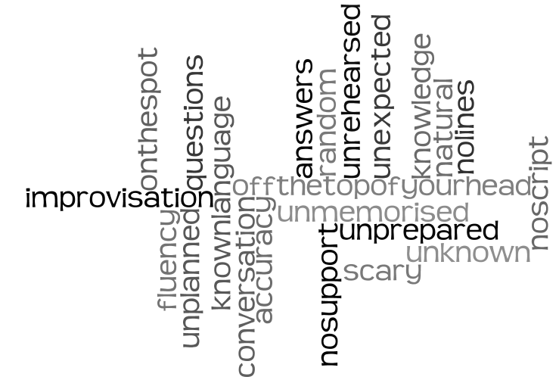
Student motivation
parler 1/8
What do you think “unplanned” or “spontaneous” speaking means?
289 students aged 11 – 15 from 5 different secondary schools were asked:
Their answers highlighted:
a) Lack of prior preparation
b) Absence of written support
c) The immediacy of the experience
d) Like a conversation
e) Not knowing the questions/answers in advance
Linked Up Project Analysis, May 2010
Notes:
I haven’t done any research exploring a potential connection between motivation and the ability to ask questions in the L2. Going back a while, however, I did gather some student responses to a short questionnaire about unplanned speaking. They suggest that students associate unprepared, unwritten questions with spontaneity.

Slide 8
Student motivation
parler 1/8
"Because in real life you don't know what the other person is going to say."
2/3 students asked equated unplanned speaking with ‘real life’ activity.
Why do you think unplanned or spontaneous speaking is an important focus in language learning?
Students reported that what they can do without notes/preparation is what they 'truly' know.
"To make sure you definitely know it and are able to have conversations without reading off a sheet."
They also mentioned the link between spontaneous speaking and increased confidence.
Linked Up Project Analysis, May 2010
Notes:
And in a follow question asking why unplanned speaking might be an important focus in language learning, students said things like: [cue animation]
So there is the suggestion here at least that a degree of confidence in asking and answering questions (at least in speaking) may be motivational. Plus, I don’t know any teachers who would say that they didn’t want to promote confident communication in their classrooms. And we can see that the ability to initiate with a question, as well as the ability to respond readily to a question is part of that confident communication.

Slide 9
Session overview
Curriculum policy
Student motivation
Current issues
Sequencing the teaching of questions
Input practice
Structured production
Freer production
Spontaneity
The role of chunks

Slide 10
Current issues
Intonation (SV)
Intonation + wh- word final
Intonation + fronted wh-word (SV)
Tu aimes le sport?
Tu es comment?
Comment ça va?
C’est quand, ton anniversaire?
Inversion (VS)
Inversion + wh-word (VS)
As-tu des freres et soeurs?
Quel age as-tu?
Tu aimes le sport?
Comment t’appelles-tu?
Tu es comment?
Est-ce que… (SV)
Est-ce que + wh-word (SV)
As-tu des freres et soeurs?
C’est quand, ton anniversaire?
Comment t’appelles-tu?
Quel age as-tu?
Comment ça va?
Notes:
So what might the issues be with this. Let’s start by looking at some questions. How many different types of question can we see here?
And there are two types that aren’t represented here, too: Est-ce que and est-ce que + question word.
The only way that students can learn these is by memorising them as set phrases. There is no system for pupils to lock onto, here. There is too much variety in the question formation for pupils to spot a pattern that they could then apply to other words to make more questions like this.
These are all taken from one page in a Y7 textbook in term 1.
And this is part of what is meant in the PR when it says:

Slide 11
Current issues
Grammatical knowledge of a language is cumulative. Sometimes, course books overlook this and do not build knowledge consistently or cumulatively.
In these cases pupils are simply confused because they are taught disjointed segments of grammar at different points and are not given the chance to build and consolidate a larger grammatical system.
TSC (Teaching Schools Council). (2016). Modern Foreign Languages Pedagogy Review.

Slide 12
Session overview
Curriculum policy
Student motivation
Current issues
Sequencing the teaching of questions
Input practice
Structured production
Freer production
Spontaneity
The role of chunks

Slide 13
Sequencing the teaching
The Pedagogy Review suggests the following steps for each new feature:
1. An explicit but succinct description of the grammatical feature to be taught 2. Practice in understanding the new feature in listening and reading 3. Structured practice in speaking and writing that enables learners to focus all their attention on the new feature 4. Freer practice – noting that in unplanned speaking tasks, there is still likely to be a level of error, as the lack of thinking time places the most pressure on working memory.
TSC (Teaching Schools Council). (2016). Modern Foreign Languages Pedagogy Review.
Notes:
All this to suggest that pupils may benefit if we sequence the teaching of questions, in the same way as we would sequence the teaching of any other linguistic content, thinking carefully about how which and how many patterns to present, and in which order, then giving pupils ample practice time to develop confidence with understanding and producing each pattern, and apply it to different lexis (words).
Let’s look at how this might look at primary.

Slide 14
Sequencing the teaching
parler 1/8
Y3/4 WK3
Y3/4 WK5
Y3/4 WK6
Notes:
Lower key stage 2 might start with raised intonation questions. The essential pattern here is that the question pattern is the same as the basic sentence pattern of subject, then verb. The difference is that the intonation goes up at the end to denote a question.
Notice that we are working with etre to start off with so instead of the ‘do you’…cross-linguistic difficulty it is a matter of syntax. English tends to invert. Am I … Are you ..? And French keeps the words in the same order but uses intonation instead.

Slide 15
Sequencing the teaching
parler 1/8
Y3/4 WK8
Y3/4 WK9
Y3/4 WK10
Y3/4 WK11
Notes:
However, when we introduce nouns and indefinite articles and start using avoir, the English that we translate the same French pattern with changes: Tu as un chien? Do you have a dog?
This is quite different from: Tu es drole? Are you funny? It’s really worth considering the cross-linguistic differences with each new feature and being prepared to put in lots of practice activities.
So we can see that by the end of Term 1, pupils have practised raised intonation question with the singular persons of etre – je, tu, il, elle and c’est. They have also practised them with avoir – j’, tu, il, elle. In addition we have just started to add question words to the end of raised intonation questions: c’est quoi ? and then extended this to Tu as quoi ? Il a quoi ?
At least half of the weeks in the first term focus on practising question formation. And we start with activities in listening and reading.

Slide 16
Session overview
Curriculum policy
Student motivation
Current issues
Sequencing the teaching of questions
Input practice
Structured production
Freer production
Spontaneity
The role of chunks

Slide 17
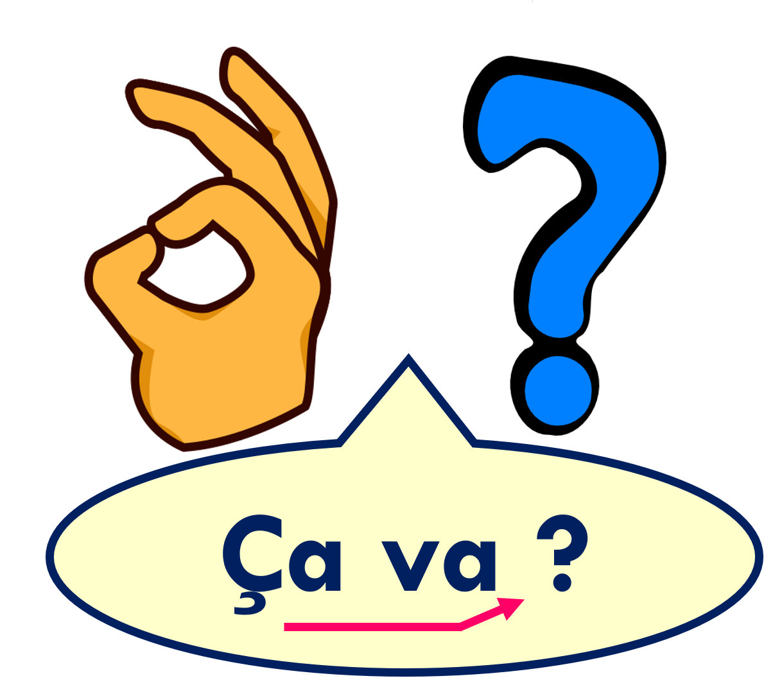
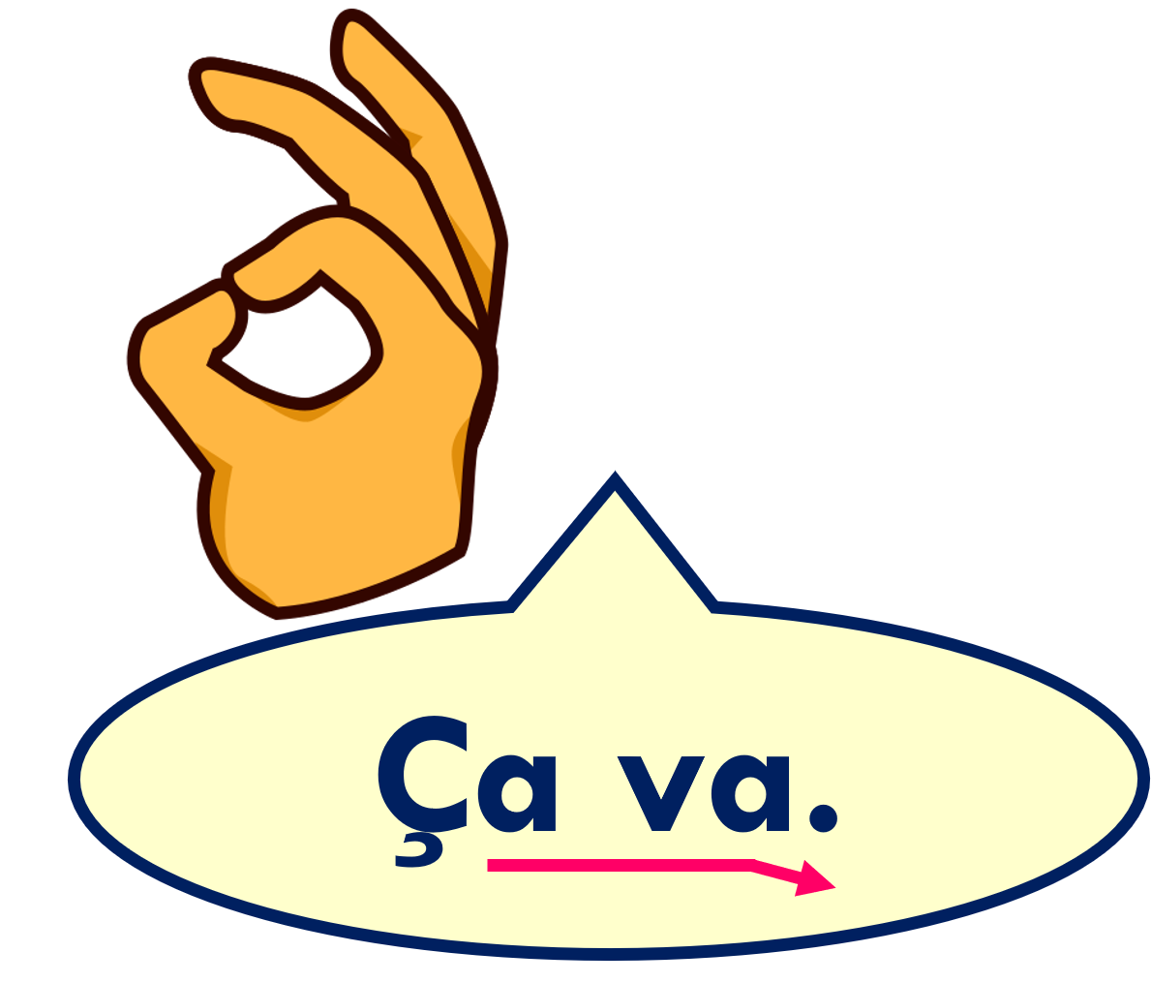
Creating questions [1/2]
To turn a statement into a question, just raise your voice at the end.
The ‘hook’ under the c changes a hard c into a soft c, pronounced s. It is called a cedilla.
This is a common way to ask ‘How are you?’ in French.
It’s going ok.
Is it going ok?
Notes:
Use this recap ahead of FOLLOW UP 3.
Timing: 1 minute (two slides)
Aim: to recap how to form intonation questions from statements.
Procedure:
Click to present information.
2. Elicit English translations for the French examples provided. 3. The video versions can be replayed as many times as required, to practise the different intonation.
Note: Raised intonation questions will be practised formally again in Week 5.

Slide 18
Creating questions [2/2]
It’s going well.
Is it going well?
It’s going badly.
Is it going badly?
Notes:
[2/2]

Slide 19
Follow up 3:
Écoute. Écris la bonne lettre.
Madame Dior likes asking rhyming questions.
Listen to the name. Which rhyming question (A, B, C) does she ask?
écouter
1
2
3
4
5
6
A
Lucas, ça va ?
C
Pascal, ça va mal ?
A | Ça va ?
B | Ça va bien ?
C | Ça va mal ?
B
Fabien, ça va bien ?
B
Jocelyn, ça va bien ?
A
Noah, ça va ?
C
Chantal, ça va mal ?
Notes:
Week 3
Timing: 5 minutes
Aim: to practise matching word final sounds heard in unfamiliar words with familiar written words that have the same sound.
Procedure:
Click to listen to each name.
Pupils decide which of the three questions rhymes with the name heard and write the correct letter.
Click to reveal answers.
Click again on each speech bubble to hear the full question.
Transcript: 1. Lucas, [ça va] ? 2. Pascal, [ça va mal] ? 3. Fabien, [ça va bien] ? 4. Jocelyn, [ça va bien] ? 5. Noah, [ça va] ? 6. Chantal, [ça va mal] ?

Slide 20
écouter
Follow up 2 : Écoute. C’est qui ?
A) Tick ‘I’, ‘you’, ‘he’ or ‘she’.
Write . or ?
B) Écris le numéro.
Listen again. Which question has the following adjectives?
 | I | You | She | He
Ex
sad
small
amusing
tall
English
5
1
4
2
3
Ex.
4
1
3
5
6
2
6
Notes:
This is a listening activity from week 5. By this stage pupils have learnt the 4 pronouns I, you, he, she and the corresponding forms of etre, as well as several adjectives.
In previous weeks we have practised pairs of forms. In this revisiting activity, pupils have to identify the right person and whether it is a statement or question (and then the adjective, too).
Timing: 5 minutes
Aim: to practise aural understanding of pronouns je, tu, il, elle, question and statement intonation and a range of adjectives.
Procedure:
1. Pupils either draw a table (Ex., 1-6 vertically, I, you, she, he and ./? horizontally) or are given a handout.
2. Click to listen to the example, then bring up the answer (he, full stop).
3. Click to listen to items 1-6.
4. Pupils record the person and the type of utterance.
5. Click to provide answers.
6. Click to bring up Part B. Listen and identify when the adjectives are mentioned.
7. Click to correct.
Transcript:
Ex. Il est amusant.
Tu es grand?
Je suis anglaise.
Elle est grande.
Tu es petite.
Je suis triste?
Il est anglais.
20

Slide 21
Asking questions
Remember! To change a statement into a yes/no question, raise your voice at the end:
J’ai un livre.
J’ai un livre ?
I have a book.
Do I have a book ?
Tu as un livre.
Tu as un livre ?
You have a book.
Do you have a book?
In English, we add ‘do’, in French we just make our voice go up.
Notes:
Week 10
Timing: 2 minutes
Aim: to revisit how to form intonation questions and intonation questions.
Procedure:
Click to present the information.
Elicit the English at each stage from pupils after presenting the French examples.

Slide 22
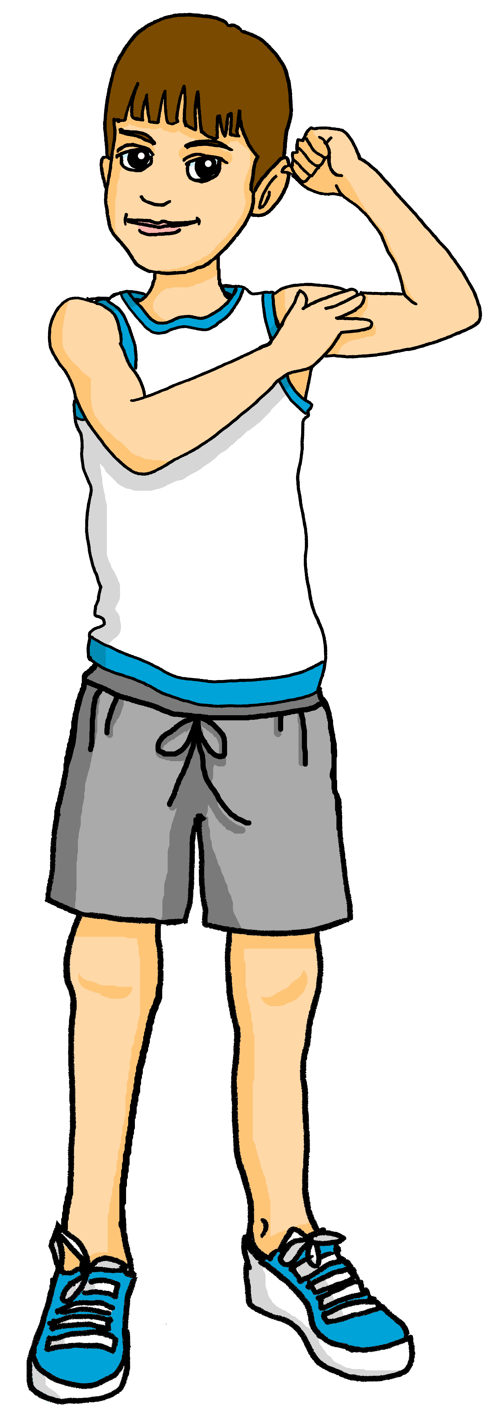
écouter
Une excursion à la montagne
Pierre prépare le sac. But he has lots of questions.
Is he asking himself ‘Do I..?’ or ‘Do you..?
Écris 1 – 8 et ‘Do I have?’ ou ‘Do you have?’ et l’objet en anglais.
 | Do I have…? | Do you have…? | ???
 |  |  | an orange
 |  |  | a game
 |  |  | a pen
 |  |  | a bottle
 |  |  | a pencil
 |  |  | a rule
 |  |  | a book
 |  |  | a rubber
1
1
2
2
3
3
4
4
5
5
6
6
7
7
8
8
Notes:
Week 10
Timing: 7 minutes
Aim: to practise aural recognition of ‘j’ai’ and ‘tu as’ in questions and aural comprehension of 8 previously taught nouns.
Procedure:
Read the title and click to bring up the instructions.
Clarify the task. Pupils write Do I have or Do you have and the noun in English.
Click to bring up the answers to part 1 first.
Listen again for the nouns.
Pupils write the correct noun.
Click to correct.
Transcript:
[beep] as une orange ? [beep] ai un jeu ? [beep] ai un stylo ?
[beep] as une bouteille ? [beep] as un crayon ? [beep] ai une règle ?
[beep] as un livre ? [beep] as une gomme ?
Transcript 2:
tu as une orange ? j’ai un jeu ?
j’ ai un stylo ? tu as une bouteille ?
tu as un crayon ? j’ai une règle ?
tu as un livre ? tu as une gomme ?
22

Slide 23
Follow up 2:
Une excursion à la montagne.
Lis. Pierre is a bit worried. He messages Yves. Is he checking ‘you have’ with Yves or saying what Sophie (another friend) has.
lire
1
4
Elle a un livre.
Tu as un stylo.
◆
◆
Complète les deux listes.
2
5
Yves (you have)
 | ______
 | ______
 | ______
Sophie (she has)
 | ______
 | ______
 | ______
Elle a une bouteille.
◆
Tu as un crayon.
◆
a pen
a bottle
a pencil
a rubber
3
6
an ex. book
a book
Elle a une gomme.
◆
Tu as un cahier.
◆
Notes:
Timing: 5 minutes
Aim: to practise written comprehension of tu as and elle a plus 8 nouns.
Procedure:
1. Explain the scenario. 2. Pupils decide who is referred to in each message and what is talked about.
3. They write this in two lists.
4. Click to check answers.

Slide 24
German KS3 SOW
lesen / schreiben
Questions are practised explicitly in 65/114 teaching weeks over KS3, which is in 57% all lessons.

Slide 25
Zorg redet mit Wolfgang
hören
Zorg ist in Berlin und redet mit Wolfgang am Telefon. Frage oder Satz? Schreib 1-8.
 |  | Frage | Satz
 | Macht es dort viel Spaß?
 | Wir bekommen viele Hausaufgaben.
 | Hörst du mich?
 | Ist est dort sehr kalt?
 | Bist du schon im Hotel?
 | Du gehst später mit Mia ins Kino.
 | Du nimmst jetzt die U-Bahn.
 | Dauert es lange?
1
2
3
4
5
6
7
8
Notes:
Timing: 5minutes Aim: To revisit word order in yes/no questions in the oral modality. Question intonation is absent from the audio to compel learners to attend to the word order in questions. Procedure: 1. Write 1-8.
2. Listen and write Frage or Satz for each utterance. Note: remind students that Zorg does not have human intonation when he speaks so all of his utterances are flat. To identify the questions, students will need to pay attention to the word order.
3. Check each answer. The full text (with correct punctuation) is revealed, too.
4. Ask students to pronounce each question with correct intonation.
5. Elicit English meanings.
Transcript: 1. Macht es dort viel Spaß. 2. Wir bekommen viele Hausaufgaben. 3. Hörst du mich. 4. Ist es dort sehr kalt. 5. Bist du schon im Hotel. 6. Du gehst später mit Mia ins Kino. 7. Du nimmst jetzt die U-Bahn. 8. Dauert es lange.
Word frequency (1 is the most frequent word in German):
machen [49] bekommen [234] nehmen [139] dauern [696]

Slide 26
W-Fragen und WO2
Grammatik
To ask an open question, we place a question word directly in front of the verb:
The word order in w-questions is similar to that of statements in word order 2.
Wann gehst du in die Bibliothek? Am Donnerstag gehe ich in die Bibliothek.
Question Statement
Closed
Gehst du in die Bibliothek?
Are you going to the library?
Wo
Open
Wann gehst du in die Bibliothek?
When are you going to the library?
Notes:
Timing: 3 minutes
Aim: To explain open (wh-) questions.
Procedure:
1. Cycle through the information on the slide using the animation sequence.
2. Teacher to draw attention to word order: VSO for closed questions, Question word + VSO or VO for open questions.
3. Several examples using previously taught question words are given in German. Teacher elicits the meaning in English.
This primes for the question generation task later this lesson.

Slide 27
Wie läuft’s?
Mia schreibt mit Heidi.
Siehst du eine Frage (?) oder einen Satz (./!) ?
lesen
1. Mia: Na Heidi, wie läuft’s? Wo bist du? Im Eiscafé?
4. Heidi: Japp.
Aber jetzt braucht Wolfgang einen Hut.
7. Mia: Mmmm … ich weiss nicht, sorry!! Wie findest du Wolfgang?
__
__
__
2. Heidi: Also … im Moment stehe ich im Supermarkt.
5. Mia: Was?? Nein ... nie trägt Wolfgang einen Hut!
8. Heidi: Ach, oft finde ich ihn ganz toll. Aber ... er ist ein bisschen unorganisiert.
__
__
__
6. Heidi: Tja … plötzlich trägt er einen.
Wo kann er hier einen Hut finden?
3. Mia: Oh! Wann gehst du Eis essen? Es wird spät …
__
__
9. Mia: Mm. Heute ist er ziemlich nervös. Er mag dich sehr, Heidi!
__
__
Notes:
Timing: 5 minutes
Aim: This acustomise students to seeing WO2 in both written statements and written questions.
Procedure:
1. To complete the task, students write 1-9 and either ? for a question, or ./! for a statement.
2. Using the vocabulary in the text messages, they must decide whether the sentence they are reading is a question or a statement. The word order will not help them here – remind students that these are not all questions. They will need to understand the meaning of the sentences to work out if they are questions or statements, as there aren’t easy word order cues to tell them.
3. Students have not yet met cognates nervös [2930] and unorganisiert [>4034] (they have previously encountered the cognate verb organisieren [1163] and may recognise the meaning, here, particularly as they are following the Wolfgang and Heidi storyline). Students have not yet been taught the personal object pronoun dich [212]. It will likely be understood in context, here. Teachers may want to draw attention to it, though it is not crucial for task completion. Teacher might also like to point out, and clarify the meaning of, conversation fillers na [267], also [40], japp [n/a], tja [2211] and ach [404].
4. Teachers could extend the task by eliciting oral translations so that students can get used to moving between the two languages, and hearing/noting the difference in word order.
5. Answers appear on clicks.
Note: In this sequence there are several instances of ‘in’ plus Row 3 (dative) e.g., im Eiscafé, im Supermarkt. This will obviously not be a barrier to understanding, as the meaning of ‘in’ is transparent. This week students are likely to ignore the changes in article that they encounter, but they can be considered useful ‘priming’ for next week’s teaching which focuses explicitly on the two prepositions ‘in’ and ‘auf’ with Row 2 (accusative) and Row 3 (dative).
Word frequency (1 is the most frequent word in German):
nervös [2930] unorganisiert [>4034] dich [212] na [267] also [40] japp [n/a] tja [2211] and ach [404]
Source: Jones, R.L & Tschirner, E. (2011). A frequency dictionary of German: Core vocabulary for learners. London: Routledge.

Slide 28
Session overview
Curriculum policy
Student motivation
Current issues
Sequencing the teaching of questions
Input practice
Structured production
Freer production
Spontaneity
The role of chunks

Slide 29
Follow up 4
Pupil A says six names. Pupil B listens and responds with a question or statement that rhymes.
parler
60
Pupil A
1 | Madame Vidal
2 | Adrian
3 | Duval
4 | Nicolas
5 | Jacquelin
6 | Tara
Pupil B
1 | Jocelyn
2 | Chantal
3 | Noah
4 | Julien
5 | Abrial
6 | Lara
S
0
DÉBUT
Notes:
Week 3
Time: 5 minutes
Aim: to practise aural production of the questions and statements from this week’s lesson.
Pupil B turns away from the board. S/he needs something to write on. S/he numbers 1 – 6 and puts a ? or a full stop by each number to prompt him/herself as to which type of utterance to use when s/he hears the name.
Click for Pupil A’s six names to appear. Pupil A reads name to his/her partner.
3. Pupil B listens and responds with an rhyming question (ça va, ça va bien, ça va mal).
4. Pupil A listens and writes in English what is said to him/her – paying attention to whether it is a question or statement.
5. Partner B turns back and pupils compare notes to check that they have the same punctuation written down.
6. Pupils then swap roles and repeat the task with the 2nd set of prompts.

Slide 30
Creating questions
To turn a statement into a question, just raise your voice at the end.
Je suis ici.
Je suis ici ?
I am here.
Am I here?
To say he is, use il est.
Il est là.
Il est là ?
Notice that there is a space before a ? in French and also before a ! e.g. Salut !
He is there.
Is he there?
To say she is, use elle est.
Elle est là.
Elle est là ?
She is there.
Is she there?
Notes:
Week 5
Use this recap ahead of FOLLOW UP 4.
Timing: 1 minute
Aim: to recap how to form intonation questions from statements.
Procedure:
Click to present information.
2. Elicit English translations for the French examples provided.

Slide 31
Follow up 4 : Question ou phrase?
parler
1
Elle est calme
5
Elle est méchante
3
2
Il est intelligent
6
Il est triste
S
3
Il est malade
7
Elle est amusante
4
Elle est grande
8
Elle est petite
0
DÉBUT
Notes:
Week 5
Timing: 5 minutes
Aim: to practise oral production of statements and intonation questions (and again with a time limit).
Procedure:
Explain to the class that half will speak and half will listen, then they will swap.
Half of the class turns away from the board.
Click to bring up the punctuation for number 1. Pupils say the question.
The listening half responds, saying ‘question’. Alternatively, they could put up the right hand for questions, left hand for statements.
Continue with items 2-4.
Swap roles and complete items 5-8.
With the whole class facing the board, complete all items again, this time clicking Début to start a 3-second timer each time, to speed up production.

Slide 32
Follow up 4:

Écris des réponses.
C’est une banane ?
C’est une orange ?
écrire
1 _____________________________
4 _____________________________
Non, c’est une orange.
Non, c’est un ballon.
C’est un jeu ?
C’est mardi ?
2 _____________________________
5 _____________________________
Non, c’est un stylo.
Non, c’est vendredi.
FRI
C’est une peluche ?
C’est un cahier ?
3 _____________________________
6 _____________________________
Non, c’est un sac.
Oui, c’est un cahier.
Notes:
Week 8
Timing: 10 minutes (or 5 minutes for 3 sentences)
Aim: to practise written production of this week’s new language.
Procedure:
1. Tell pupils they need to answer the yes/no questions in full sentences in French, and according to the pictures. 2. Elicit the meaning of the first question: Is it a banana? 3. Ensure pupils are clear how to answer: No, it’s an orange. 4. Elicit the French for ‘no’, ‘it is’, ‘an orange’. 5. Given pupils a minute to write their sentence. 6. Reveal the answer. 7. Continue for items 2 – 6.

Slide 33
lesen / schreiben / hören / sprechen
Ein Interview. Lesen → Schreiben: Was sind die Fragen? Hören: Richtig? p/X Sprechen: Antworten geben
Sebastian Vettel
Ich wohne in Thurgau, in der Schweiz. Ich finde es sehr schön dort.
Ich fahre Formel-Eins.
Ich spreche vier Sprachen: Deutsch, Englisch, ein bisschen Italienisch und ein bisschen Französisch.
Ich fahre einmal pro Jahr in Urlaub.
Ich fahre immer mit meiner Familie zusammen.
Ich habe nie Angst!
1
2
3
4
Sebastian Vettel
5
6
*der Job - job / *pro Jahr - per year
Notes:
Timing: 15 minutes
Aim: To give extended practice in understanding a range of previously taught strong and weak verbs in 1st 2nd and 3rd person singular forms.
Procedure:
1. Students read the interview answers.
2. They then try to write questions that would give these answers. 3. They then listen to the questions (to check their work) - either listen to the full interview (Q&A) which is activated by clicking on the name Sebastian Vettel, or click the numbered buttons to hear each question separately 4. They then listen to the questions again - teacher clicks each numbered question and students can answer chorally There are several possibilities for answering the questions: i. They turn away from the board and try to answer as Sebastian Vettel ii. They continue facing the board, but instead answer for themselves iii. They turn away from the board, and answer for themselves. Suggested questions / Transcript 1. Wo wohnst du? 2. Was ist dein Job? 3. Wieviele Sprachen sprichst du? 4. Wie oft fährst du in Urlaub? 5. Mit wem fährst du? 6. Wie oft hast du Angst?
Note: Students have previously learnt Angst vor and have revised that for this week.
All of the details are authentic and come from several online sources.
Word frequency (1 is the most frequent word in German):
Formel-Eins [>5009] pro [412]
Source: Jones, R.L & Tschirner, E. (2011). A frequency dictionary of German: Core vocabulary for learners. London: Routle

Slide 34
Aktivitäten im Schwarzwald [5/8]
schreiben
[Schwarzwalder
Kirschtorte]
[durch den Park]
I / I have
you / you have
she / she has
[ins Kanu]
[mit der Bahn]
climb / climbed
he / he has
Did I / Have I
[schöne Lieder]
[Tee]
Did you / Have you
Did she / Has she
Bin ich ins Kanu gestiegen?
[mit dem Flugzeug]
[Tischtennis]
Did he / Has he

Slide 35
Aktivitäten im Schwarzwald [16/8]
schreiben
[Schwarzwalder
Kirschtorte]
[durch den Park]
I / I have
you / you have
she / she has
[ins Kanu]
[mit der Bahn]
travel / travelled
he / he has
Did I / Have I
[schöne Lieder]
[Tee]
Did you / Have you
Bist du mit der Bahn gefahren?
Did she / Has she
[mit dem Flugzeug]
[Tischtennis]
Did he / Has he

Slide 36
Aktivitäten im Schwarzwald [7/8]
schreiben
[Schwarzwalder
Kirschtorte]
[durch den Park]
I / I have
you / you have
she / she has
[ins Kanu]
[mit der Bahn]
hike / hiked
he / he has
Did I / Have I
[schöne Lieder]
[Tee]
Did you / Have you
Did she / Has she
Ist sie durch den Park gewandert?
[mit dem Flugzeug]
[Tischtennis]
Did he / Has he

Slide 37
Aktivitäten im Schwarzwald [8/8]
schreiben
[Schwarzwalder
Kirschtorte]
[durch den Park]
I / I have
you / you have
she / she has
[ins Kanu]
[mit der Bahn]
play / played
he / he has
Did I / Have I
[schöne Lieder]
[Tee]
Did you / Have you
Did she / Has she
Hat er Tischtennis gespielt?
[mit dem Flugzeug]
[Tischtennis]
Did he / Has he

Slide 38
Ein Interview mit Mia
lesen / schreiben
1
1: Hallo, wie geht’s?
Mia: Gut, danke.
2: Wie heißt du?
Mia: Ich heiße Mia.
3: Seit wann bist du hier?
Mia: Ich bin seit gestern Abend hier.
4: Welche Bands hast du schon gehört?
Mia: Ich habe schon die Bands Mondlicht und Terraforming gehört.
5: Wie hast du sie gefunden?
Mia: Ich habe sie ganz toll gefunden. Mondlicht ist meine Lieblingsband.
6: Spielst du ein Instrument?
Mia: Ja, ich spiele Klarinette und ich habe früher in einem Chor gesungen.
7: Wann hast du mit der Klarinette angefangen?
Mia: Ich habe vor drei Jahren mit der Klarinette angefangen.
8: Hörst du lieber klassische Musik oder Popmusik?
Mia: Ich höre lieber Popmusik, aber ich spiele lieber klassische Musik.
9: Was wirst du heute noch machen?
Mia: Heute werde ich noch viele Bands hören und vielleicht auch tanzen!
Was hat der Interviewer gefragt? Schreib die Fragen (1-9) auf.
2
3
4
5
6
7
8
9
Notes:
Timing: 6 minutes Aim: To practise question formation. Procedure:
1. Students read each answer and attempt to provide the question that would have elicited it.
2. Click to make the correct questions appear one by one. 3. For reinforcement, click the numbered buttons to hear the questions. Alternatively, take part in the full interview, using the player (bottom right of the slide). The questions are heard one by one, with a space for answering. Students can do this, chorally, to practise reading aloud for fluency.
Word frequency of cognate words (1 is the most frequent word in German):
Band [>5000]
Source: Jones, R.L & Tschirner, E. (2019). A frequency dictionary of German: Core vocabulary for learners. London: Routledge.

Slide 39
Ein Interview mit einer Sängerin
schreiben
* On tour – auf Tour
Du arbeitest für eine englische Zeitung und du machst ein Interview mit einer deutschen Sängerin.
Lies deine Notizen und bereite deine Interviewfragen vor. Was willst du fragen?
Find out:
1. how the concert was today
2. whether she thinks she sang well
3. how many songs she has written this year
4. what is more important, the music or the text?
5. whether she likes going on tour*
6. when her band will go on tour again
Notes:
Timing: 7 minutes
Aim: To practise writing questions in the du-form in four tenses (present, imperfect, perfect, future).
Procedure:
1. Ensure students understand the context.
2. Ask which form of address they think they should use. Say that the singer is young, still a teenager (→ du form more likely in this context).
3. Check students know which pieces of information require yes/no questions, and which require information questions. Differentiation: Recap the structure of each question type and the question words if necessary.
4. Students write questions in German. 5. Suggested answers appear on the following slide.

Slide 40
Session overview
Curriculum policy
Student motivation
Current issues
Sequencing the teaching of questions
Input practice
Structured production
Freer production
Spontaneity
The role of chunks

Slide 41
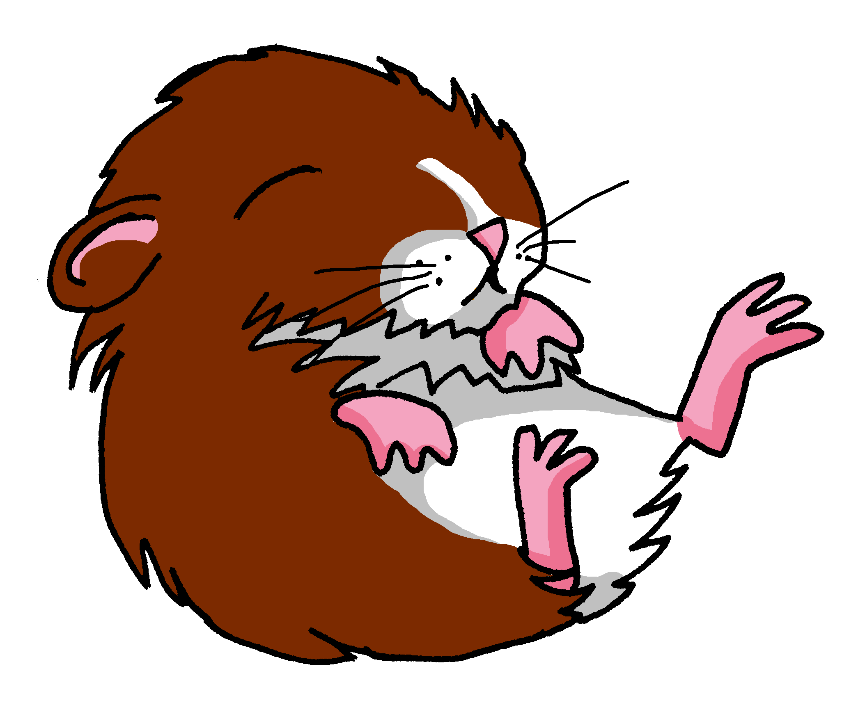
Follow up 4: Écris une lettre (A, B, C ou D).
Your partner will ask you questions to guess which bag you have chosen.
parler
Sac A
Sac B
‘Do you have…..?’
Yes. No.
Sac C
Sac D
Notes:
Timing: 5 minutes
Aim: to practise oral production of tu as in raised intonation questions, and this week’s vocabulary items.
Procedure: 1. Pupil A chooses (in secret) a bag, A, B, C or D.. 2. Pupil B asks questions to guess which bag A has chosen. 3. When B correctly guesses, pupils swap and repeat the task. Note: for lower proficiency pupils, teachers could add vocabulary support to the right hand side, though the aim should be to remove or partially obscure it on subsequent rounds of activity.

Slide 42
Was meinst du?
schreiben
Schreib die Antworten. Benutz die Wörter in Klammern*.
1. Wie findest du Mathe? [leicht/schwer fallen]
2. Meinst du, dass Musik ein lustiges Fach ist? [glauben, dass]
3. Glaubst du, du kriegst zu viele Hausaufgaben? [denken, kriegen]
4. Gefällt dir Englisch? Warum / warum nicht? [gefallen, weil]
5. Was fehlt dir am Wochenende? [fehlen]
6. Glaubst du, Sport ist wichtig? [glauben, denn]
7. Denkst du, dass du genug Freizeit hast? [meinen, dass]
8. Welche Aktivität gefällt dir? [gern, weil]
*Klammern = brackets
Notes:
Timing: 8 minutes Aim: To practise using the grammar and vocabulary introduced in this sequence in a semi-scaffolded task. Procedure: 1. Read the questions and write answers using the words in brackets.
Word frequency (1 is the most frequent word in German):
8.2.1.2 (introduce) fehlen [420] gefallen [601] dass [22] schwer [257]
8.1.2.5 (revisit) Aktivität [1422] gern [278]

Slide 43
Antworten [1/2]
schreiben
1. Wie findest du Mathe? [leicht/schwer fallen]
Mathe fällt mir …
2. Meinst du, dass Musik ein lustiges Fach ist? [glauben, dass]
Ja/Nein, ich glaube, dass Musik ……….. ist.
3. Glaubst du, du kriegst zu viele Hausaufgaben? [denken, kriegen]
Ja/Nein, ich denke, ich kriege…..
4. Gefällt dir Englisch? Warum / warum nicht? [gefallen, weil]
Ja/Nein, Englisch gefällt mir (nicht), weil/denn...
Notes:
ANSWER SLIDE [1/2] Timing: 2 minutes Procedure: 1. Display the answers. 2. Tell students that these suggestions are to model the overall sentence structure of possible answers and that there are different ways to finish the answers, of course.

Slide 44
Antworten [1/2]
schreiben
5. Was fehlt dir am Wochenende? [fehlen]
…fehlt/fehlen mir OR Mir fehlt/fehlen…
6. Glaubst du, Sport ist wichtig? [glauben, denn]
Ja/Nein, ich glaube, Sport ist (nicht) wichtig, denn…
7. Denkst du, dass du genug Freizeit hast? [meinen, dass]
Ja/Nein, ich meine, dass ich (nicht) genug Freizeit habe.
8. Welche Aktivität gefällt dir? [gern, weil]
Ich (schwimme) gern, weil...
*Klammern = brackets
Notes:
ANSWER SLIDE [2/2] Procedure: 1. Display the answers. 2. Tell students that these suggestions are to model the overall sentence structure of possible answers and that there are different ways to finish the answers, of course.

Slide 45
Ich bin glücklich, wenn…
schreiben / sprechen
Schreib, wenn du glücklich bist, und wenn andere glücklich sind. Dann sprich mit einem Partner. Zum Beispiel:
......, wenn die Sonne scheint.
Wann bist du glücklich?
Wann ist dein Hund / deine Katze glücklich?
......, wenn es leckeres Essen gibt.
Wann sind deine Eltern glücklich?
....., wenn ich meine Hausaufgaben mache.
Wann sind deine Freunde glücklich?
..., wenn wir uns treffen.
Wann ist dein Lehrer / deine Lehrerin glücklich?
..., wenn ich gerne Deutsch spreche! ☺
Notes:
Timing: 13 minutes Aim: to practise written, then spoken production, in a more open-ended, personal response task that brings together this week’s content and prior learning.
Procedure: 1. Students take some time to think and write their ideas down for when they and others are happy. Some ideas are provided on the slide. 2. Then they can work with a partner or go round the classroom asking others and answering other’s questions.

Slide 46
Session overview
Curriculum policy
Student motivation
Current issues
Sequencing the teaching of questions
Input practice
Structured production
Freer production
Spontaneity
The role of chunks

Slide 47
Spontaneity
Sometimes meaningful contexts arise spontaneously in the classroom, and when this happens the opportunity can be taken to introduce previously unknown language, e.g., where the circumstance facilitates understanding or increases the need to understand. p.14
Expect students to initiate with simple language
Teach clarification questions, practise and encourage their use (e.g., ¿Cómo se dice…?)
TSC (Teaching Schools Council). (2016). Modern Foreign Languages Pedagogy Review.

Slide 48
Session overview
Curriculum policy
Student motivation
Current issues
Sequencing the teaching of questions
Input practice
Structured production
Freer production
Spontaneity
The role of chunks

Slide 49
‘Chunks’ as communication strategies
Chunks are most beneficial when they:
lead to more interaction
increase comprehensibility of the input
They will typically:
be questions that seek clarification [Is it….? How do you say / spell? Repeat, please]
indicate comprehension breakdown [I don’t understand, I don’t know, I am not sure]
extend interactions [I think… And you? What do you think?]
Include simple and clear component parts that beginner learners will be able to identify and re-use
contain high-frequency language
Notes:
Interaction (e.g., between learners, between learner and teacher, or between a learner and native speaker) is thought to lead to better learning than conditions where there is no interaction (see Loewen & Sato, 2018 for a review). This is thought to be because breakdowns and repairs in communication then lead to better understanding, and if you understand something you are more likely to learn it (Long, 1985, 1996). Where learners are able to interact they understand more and learn better (Pica, Young & Doughty, 1987; Vos et al., 2018). It is important to encourage learners to ask questions (e.g., Can you repeat X? What does X mean?). Teachers can make good use of contexts that arise spontaneously for this kind of practice, both for known language and/or occasionally the introduction of new language.

Slide 50
Session overview
Curriculum policy
Student motivation
Current issues
Sequencing the teaching of questions
Input practice
Structured production
Freer production
Spontaneity
The role of chunks

Slide 51
What? When? How? Why? Teaching students to ask questions
The Language Show 2021
https://ncelp.org/professional-development/
For primary SOW and resources:
https://rachelhawkes.com
For this presentation and secondary resources:
https://ncelp.org/news-events/
Presenter: Rachel Hawkes Date updated: 06/11/21

