Slide 1
Vocabulary
Y7 Spanish
Term 3.1 - Week 3
Author names: Nick Avery / Rachel Hawkes
Date updated: 16/05/20
Notes:
Source of frequency rankings: Davies, M. & Davies, K. (2018). A frequency dictionary of Spanish: Core vocabulary for learners (2nd ed.). London: Routledge

Slide 2
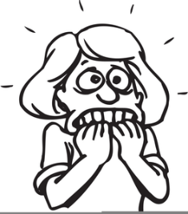
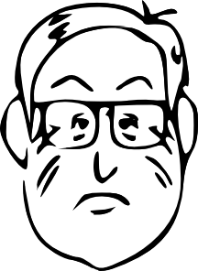
¿Cómo se dice en español?
n_ _ _ _ _ _ _
nerviosa
guapo
g_ _ _ _
a_ _ _ _ _
activo
r_ _ _
[active]
[strange]
raro
[nice]
simpático
[silly]
tonto
s_ _ _ _ _ _ _ _
t_ _ _ _
[calm]
tranquila
feliz
t_ _ _ _ _ _ _ _
f_ _ _ _
serio
aburrido
[serious]
s_ _ _ _
a_ _ _ _ _ _ _
Notes:
This vocabulary revision slide refreshes students’ knowledge of ten previously taught adjectives that will be used in this lesson (see full lesson 3.1.3) for practice of ser vs estar.
Click on each rounded rectangle to reveal the missing letters.
In this lesson students will also need to think about gender agreement, so also ask them to produce the correct adjective ending for the male/female characters in the images. Also ask which adjective ending doesn’t change (feliz).
Weeks in which vocabulary items were taught:
nervioso, tonto, raro, serio, tranquilo – 1.1.2
guapo, simpático – 1.1.3
activo – 2.1.2
feliz, aburrido – 2.2.5
Clipart from http://www.clker.com/and http://clipart-library.com/

Slide 3
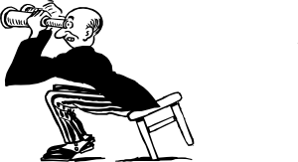
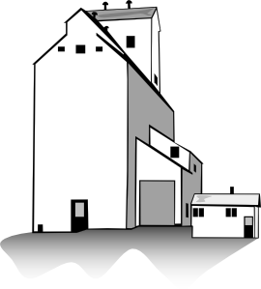
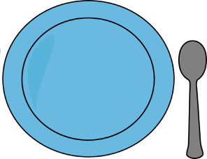
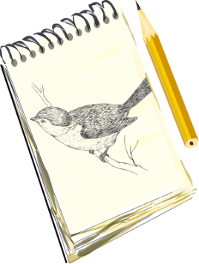
¿Qué es, y cómo es?
escribir
[interesting]
Es una película interesante.
Es un bolígrafo amarillo.
Es una p_ _ _ _ _ _ _ i_ _ _ _ _ _ _ _ _ _
1
Es un b_ _ _ _ _ _ _ _ a_ _ _ _ _ _ _
5
[beautiful]
Es un edificio feo.
2
Es un e_ _ _ _ _ _ _ f_ _
Es una v_ _ _ _ h_ _ _ _ _ _
6
Es una vista hermosa.
[ugly]
Es un periódico barato.
3
Es un p_ _ _ _ _ _ _ _ b_ _ _ _ _
Es un p_ _ _ _ a_ _ _
7
Es un plato azul.
[cheap]
Es una ventana grande.
4
Es una v_ _ _ _ _ _ g_ _ _ _ _
Es un d_ _ _ _ _ f_ _ _ _ _
Es un dibujo famoso.
8
[big]
[famous]
Notes:
Vocabulary revision activity. This activity revisits a number of previously taught nouns and adjectives. It can be used to also remind students of post-nominal position of adjectives in Spanish and gender agreement (where relevant).
Extension: ask students for their own examples of such noun-verb combinations.
Word, when previously taught and frequency ranking:
bolígrafo 1.1.4 [>5000]
amarillo 2.1.3 [1381]
edifico 1.2.6 [857]
feo 1.2.4 [2373]
periódico 1.1.5 [1026]
barato 1.2.4 [2164]
película 1.2.6 [543]
interesante 1.2.6 [616]
vista 1.2.6 [408]
hermoso 2.1.2 [980]
plato 1.2.6 [1808]
azul 2.1.3 [811]
dibujo 2.1.4 [1726]
famoso 1.2.4 [997]

