Slide 1
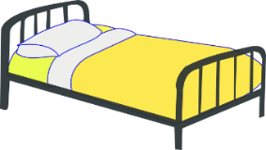
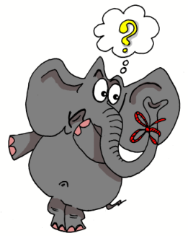
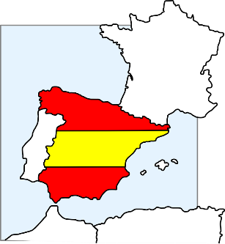
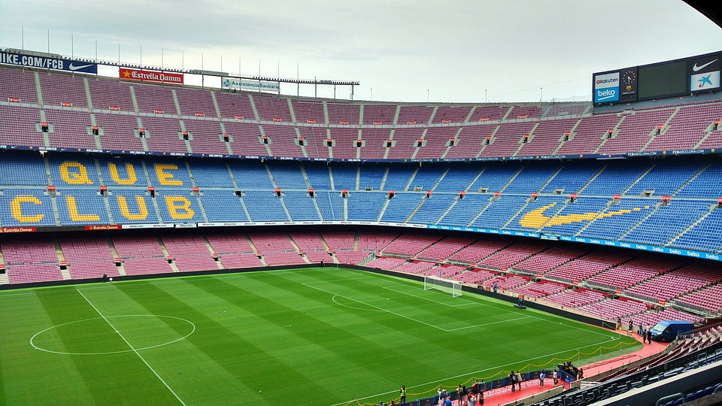
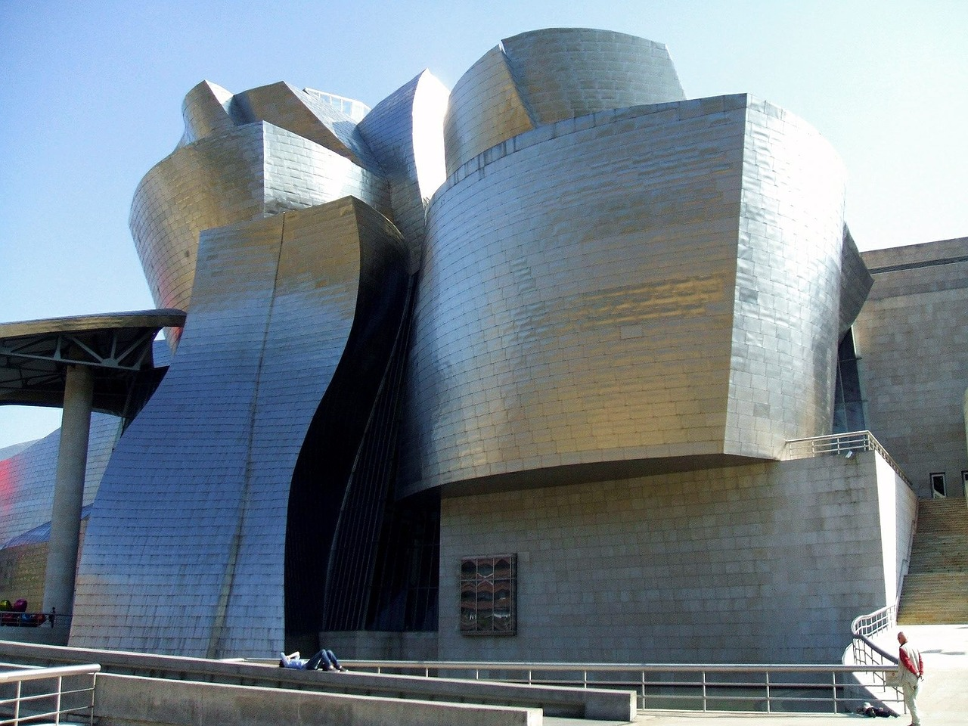
T1.1 Semana 1: Describing places and locations
Self-access lesson 1
1. Write out each word in your book, filling in the missing letters. Pronounce them out loud. Use the pictures to help you remember the English meaning. Write the English meaning next to each word in your book.
1 _ lto | 4 _m_r
2 c_m_ | 5 c_s_
3 _gosto | 6 n_d_
∅
1 y_ | 4 _lvidar
2 p_c_ | 5 s_l_
3 c_n | 6 d_s
Con ketchup
[little]
2. Write out the following explanation in your book, filling in the missing words.
ESTAR - to __ (location)
In Spanish, the ____ estar means to be when describing _______.something is.
Verb _______ [to be, being]
estoy | I ___
_____ | you are
está | __ / ___ / __ is
______ en España. I am in Spain. Estás __ Madrid. ___ ___ in Madrid. ____ en Perú. He / she is in Perú.
3. Practise this vocabulary out loud. Cover the English meanings. Start by reading the Spanish aloud. Say or think the English meaning. Check the English. Then swap so you cover the Spanish, look at the English and say each Spanish word from memory. Then write down the three words that you find trickiest to remember.
estar | to be, being (location/state)
estoy | I am (location/state)
estás | you are (location/state)
está | s/he is, it is (location/state)
¡Hasta luego! | see you later
¿dónde? | where?
norte | north
sur | south
en | in, on
hola | hello
Inglaterra | England
España | Spain
4 Look, say, cover, write, check the three words you have chosen.
5. ¿Dónde? (Where?) Read the sentences. Write I, you, or he/she/it and the correct letter A-F.
1 Estás en el Campo Nou.
2 Está en el museo Guggenheim.
3 Estoy en Inglaterra.
4 Está en el norte.
5 Estoy en el sur.
6 Estás en España.
A | B | C
D | E | F
S
6. Write three sentences contrasting where you are and where your friend is. Use estoy (I am) and está (he/she is). Decide if you or your friend gets to be in the more interesting location each time. Example: Estoy en Madrid y está en casa.
‘y’ means ‘and’. Pronounce it ‘ee’
7. If you can, exchange written sentences with a partner, via email. Read your partner’s sentences. Is he/she or his/her friend in the more interesting place each time?
Notes:
Possible changes to differentiate for different classes. Task 1 1. Pictures are jumbled up - they could be in the right order. [Easier] 2. The two sets could be combined so that ‘a’ and ‘o’ SSC are all together in one task 1-12. [Harder] Note: This is the first ever cover lesson so there is a rationale for keeping things straightforward!

