Slide 1
Vocabulary
Nick Avery & Rachel Hawkes
Date updated: 10/12/2019

Slide 2
¿Qué es?
vocabulario
revista
un
una
un
una
barco
libro
un
una
Notes:
Images retrieved from https://unsplash.com/ (freely usable images)

Slide 3
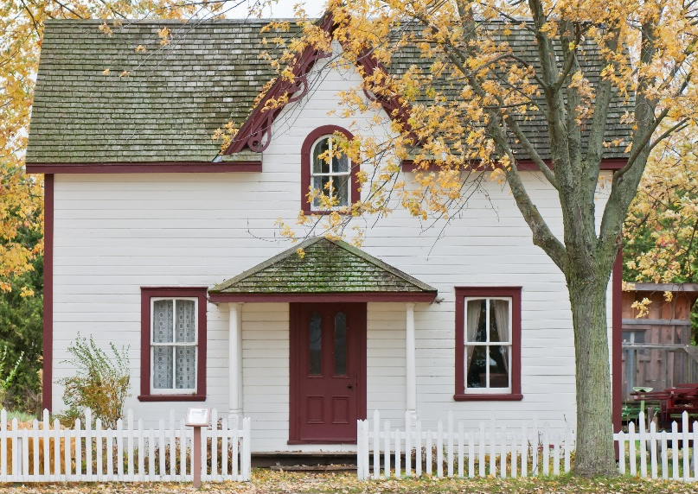
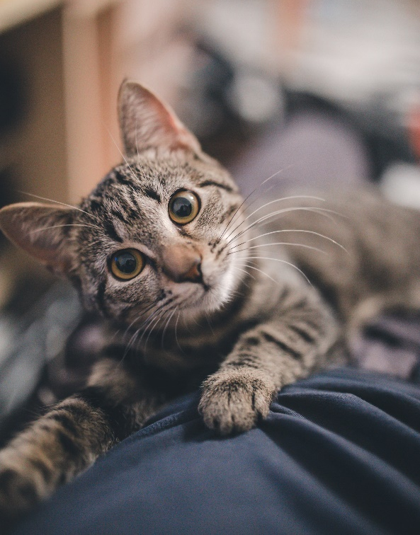
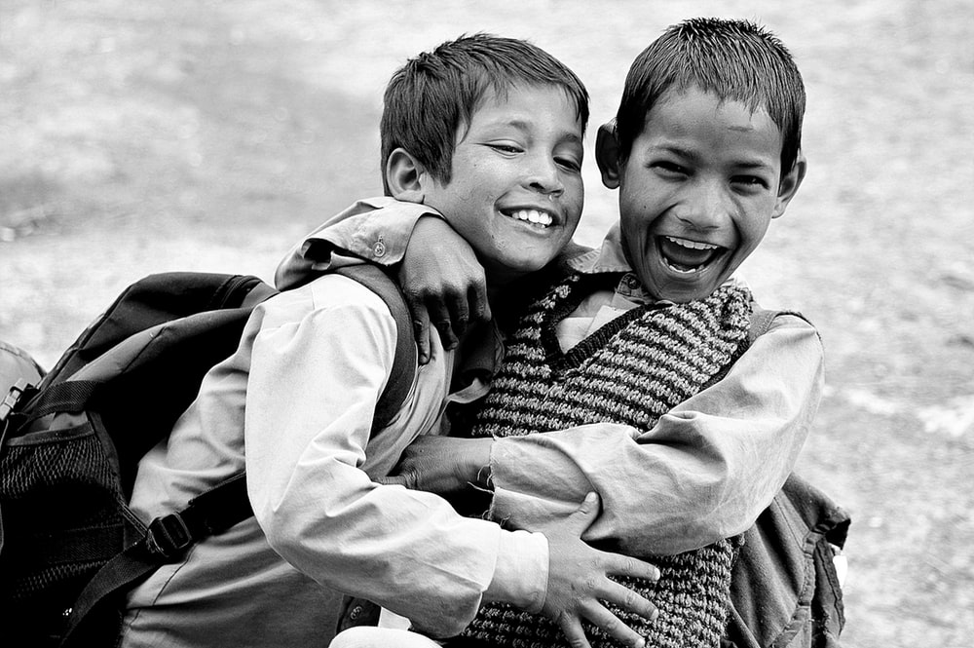
¿Qué es?
vocabulario
casa
un
una
gato
un
una
amigo
un
una
Notes:
Revision of previously taught vocabulary

Slide 4
Vocabulario
 | Word | English meaning
1 | ¿quién? | who?
2 | hablar | to speak, speaking
3 | comprar | to buy, buying
4 | bailar | to dance, dancing
5 | llegar | to arrive, arriving
6 | escuchar | to listen, listening
7 | una amiga | a friend (female)
8 | música | music
9 | tarde | late
10 | temprano | early
11 | bien | well
12 | con | with
60
0
INICIO
Notes:
Vocabulary practice slide Pupils either work by themselves or in pairs, reading out the words and studying their English meaning (1 minute). Then the English meanings are removed and they try to recall them, looking at the Spanish (1 minute). Then the Spanish meanings are removed and they to recall them, looking at the English (1 minute) Further rounds of learning can be facilitated by one pupil turning away from the board, and his/her partner asking him/her the meanings. This activity can work from L2 → L1 or L1 → L2.

Slide 5
llegar
[to arrive | arriving]
llega
[arrives | s/he arrives]
Notes:
Introducing the verb ‘llegar’ more explicitly. ‘Llegar’ is one of the 25 most frequently used verbs in Spanish. Both long form (infinitive) and short form (3rd person singular) are introduced in order to familiarise students with various forms of the same verb.
Bring up the word ‘llegar’ on its own, say it, students repeat it, and remind them of the phonics. Draw attention to the SSC [LL].
Try to elicit the meaning from the students.
Then bring up the English translations. Emphasise the two meanings for the infinitive.
Bring up the short form ‘llega’, say it, students repeat it. Draw attention to the SSC [LL].
Try to elicit the meaning from the students. Emphasise the two meanings for the infinitive and 3rd person singular.
Note: in this week of the NCELP SoW, five new verbs are introduced. We only include verb presentation slides for two of these to avoid verb presentation becoming too repetitive and time-consuming.

Slide 6
llegar
[to arrive | arriving]
llega
[arrives | s/he arrives]
Notes:
Cycle through the long and short form again.

Slide 7
llega
[arrives]
Sara llega temprano.
[Sarah arrives early.]
Notes:
Introduce the short form in a sentence.

Slide 8
llegar
[to arrive | arriving]
Es importante llegar temprano.
[It’s important to arrive early.]
Notes:
Introduce the long form in a sentence.

Slide 9
llega
[arrives | s/he arrives]
Sara ______ temprano.
llega
[Sarah arrives early.]
Notes:
Cycle through the short form in context again.

Slide 10
llegar
[to arrive | arriving]
llegar
Es importante ______ temprano.
[It’s important to arrive early.]
Notes:
Cycle through the long form in context again.

Slide 11
comprar
[to buy | buying]
compra
[buys | s/he buys]
Notes:
Introducing the verb ‘comprar’ more explicitly. ‘Comprar’ is one of the NCELP 15 prototypical verbs in Spanish. Prototypical verbs are common verbs that illustrate the typical characteristics of a class of verb. Both long form (infinitive) and short form (3rd person singular) are introduced in order to familiarise students with various forms of the same verb.
Bring up the word ‘comprar’ on its own, say it, students repeat it, and remind them of the phonics. Draw attention to phonics SSC [CO].
Try to elicit the meaning from the students.
Bring up the picture, and, if using gestures, a possible gesture would be to hold out your hand, as if you were buying something.
Then bring up the English translations. Emphasise the two meanings for the infinitive and 3rd person singular.
Bring up the short form ‘compra’, say it, students repeat it. Draw attention to phonics SSC [CO].
Try to elicit the meaning from the students. Emphasise the two meanings for the short form.

Slide 12
comprar
[to buy | buying]
compra
[buys | s/he buys]
Notes:
Cycle through the long and short form again.

Slide 13
compra
[buys | s/he buys]
Sara compra una revista.
[Sarah buys a magazine.]
Notes:
Introduce the short form in a sentence.

Slide 14
comprar
[to buy | buying]
Es normal comprar una revista.
[It’s normal to buy a magazine.]
Notes:
Introduce the long form in a sentence.

Slide 15
compra
[buys | s/he buys]
compra
Sara ________ una revista.
[Sarah buys a magazine.]
Notes:
Cycle through the short form in context again.

Slide 16
comprar
[to buy | buying]
comprar
Es normal _________ una revista.
[It’s normal to buy a magazine.]
Notes:
Cycle through the long form in context again.

Slide 17
una amiga
bailar
¿quién?
hablar
música
escuchar
comprar
temprano
tarde
llegar
bien
con
to arrive
Notes:
Further vocabulary practice. This elicits pronunciation of the new language as well as meaning recognition.

Slide 18
una amiga
bailar
¿quién?
hablar
música
escuchar
comprar
temprano
tarde
llegar
bien
con
well

Slide 19
una amiga
bailar
¿quién?
hablar
música
escuchar
comprar
temprano
tarde
llegar
bien
con
who?

Slide 20
una amiga
bailar
¿quién?
hablar
música
escuchar
comprar
temprano
tarde
llegar
bien
con
to listen

Slide 21
una amiga
bailar
¿quién?
hablar
música
escuchar
comprar
temprano
tarde
llegar
bien
con
to speak

Slide 22
una amiga
bailar
¿quién?
hablar
música
escuchar
comprar
temprano
tarde
llegar
bien
con
early

Slide 23
una amiga
bailar
¿quién?
hablar
música
escuchar
comprar
temprano
tarde
llegar
bien
con
music

Slide 24
una amiga
bailar
¿quién?
hablar
música
escuchar
comprar
temprano
tarde
llegar
bien
con
to buy

Slide 25
una amiga
bailar
¿quién?
hablar
música
escuchar
comprar
temprano
tarde
llegar
bien
con
late

Slide 26
una amiga
bailar
¿quién?
hablar
música
escuchar
comprar
temprano
tarde
llegar
bien
con
a friend (female)

Slide 27
una amiga
bailar
¿quién?
hablar
música
escuchar
comprar
temprano
tarde
llegar
bien
con
with

Slide 28
una amiga
bailar
¿quién?
hablar
música
escuchar
comprar
temprano
tarde
llegar
bien
con
to dance

Slide 29
tarde
hablar
C
← palabras en español
A
B
amiga
D
F
¿quién?
E
comprar
con
buy
with
H
who?
G
I
female friend
J
late
K
to speak
L
palabras en inglés →
Notes:
Snap! Each letter disappears then is obscured again on second click
This is also a way to practise the alphabet – encourage students to say a letter aloud to reveal the word behind it.
A-F: tarde, hablar, amiga, ¿quien?, comprar, con
G-L: buy, with, who?, female friend, late, to speak

Slide 30
llegar
Ñ
← palabras en español
M
bailar
bien
N
O
música
escuchar
P
temprano
Q
music
well
early
R
S
T
U
to arrive
to dance
V
to listen
W
palabras en inglés →
Notes:
Snap (cont.)
M-Q: llegar, bailar, bien, música, escuchar, temprano
R-W: music, well, early, to arrive, to dance, to listen
Finish the alphabet (ask students which letters are missing). These are X, Y and Z.

