Slide 1
Yes/no questions
In Spanish, change a statement into a question by raising your voice at the end:
Spanish uses two question marks – the one at the front is upside down!
Statement
Eres alegre.
You are cheerful.
Question
¿Eres alegre?
Are you cheerful?

Slide 2
Escuchar y escribir
Paulina is describing someone she has just met. Her friend Clara is asking her questions. Who is talking each time? Write Paulina or Clara.
 | Paulina | Clara
1
¿Es famoso?
2
Es simpatico.
3
Es interesante.
4
¿Es guapo?
5
¿Es alto?
6
Es bajo.
7
Es alegre.
8
¿Es tranquilo?
Victoria Hobson
Notes:
TRANSCRIPT
¿Es famoso?
Es simpatico
Es interestante
¿Es guapo?
¿Es alto?
Es bajo
Es alegre
¿Es tranquilo?
Remind students that when giving a statement, the intonation will be flat and when asking a question they will hear a raised intonation.
Students could be asked to write what they hear during the second listening.

Slide 3
¿Quién soy?
Hablar
Partner A
Partner B
Soy (+ adjective)
¿Eres (+ name)?
Sí / No
Victoria Hobson
Notes:
Explain the title of the slide – who am I? Explain the two component parts of the phrase.
Teachers may wish to use this slide to model/aid the instructions for the pair work before displaying the master, slide 29. Note: Students have been using flat intonation of statements in their speaking tasks so far, for I am, you are and s/he is. As per the explanation on slide 28, here they use the same word order but raised intonation to turn the statement into a question. Model this with the class a few times, contrasting flat/raised intonation. In subsequent weeks, yes/no questions using intonation will continue to be used.
1. Give students 30 seconds to write down 8 names (mixture of boys/girls). Alternatively, use the final slide in this PPT to allocate 8 names to each student.
2. Work in pairs. Partners take it in turns to select a name from their own list. They give a sentence to describe themselves (Soy…).
3. The other player has to identify who is being described, using raised question intonation.
Explain to the pupils that they have to pronounce the adjective correctly, with the correct ending, otherwise their partner cannot guess who they are.
4. The aim is to work with your partner, to identify all 16 people as quickly as possible.
Students put their hands up when they have finished.
Note: alegre and interesante have been included deliberately here. Students may have to guess twice to get this identity.
At the end of the game, point out to them that grammar features (in this case masc/fem adjective endings) often help us to pinpoint the correct meaning more quickly, but not always!
Note: the pronunciation of names gives an opportunity for decoding. Names have been chosen for re-vising vowels, and a few consonants that students have met in passing, J, R.
Adjectives used in the task: alto, bajo, guapo, alegre, simpático, tranquilo, famoso, interesante

Slide 4
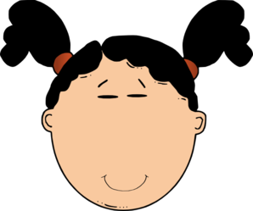
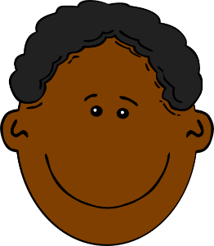
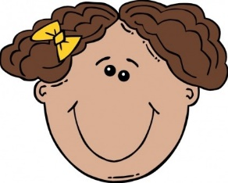
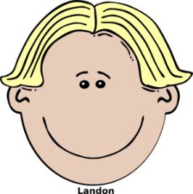
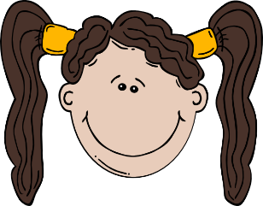
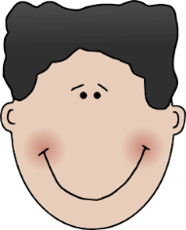
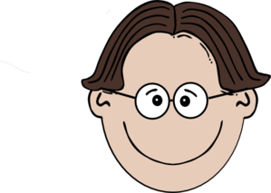
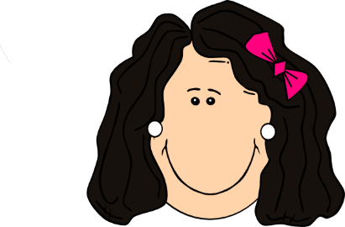
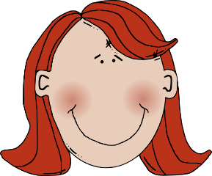
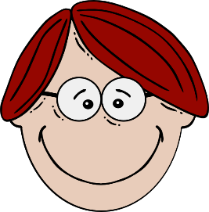
Paco
Elena
Clara
Pablo
(quiet, calm)
(quiet, calm)
(famous)
(interesting)
Irene
David
Serena
Rafa
(tall)
(short)
(tall)
(good-looking)
Juan
Carlos
Arturo
(short)
(nice)
(cheerful)
(famous)
Clementina
Fidelia
Alma
Raúl
Belén
(interesting)
(nice)
(good-looking)
(cheerful)
Victoria Hobson
Notes:
Quién soy? Who am I?
Master (Slide 29) – display this on the IWB whilst the speaking activity is taking place.

Slide 5
Hablar
Paco
Pablo
.
?
(quiet, calm)
(interesting)
Rafa
David
.
?
(tall)
(short)
Juan
Arturo
.
?
(nice)
(famous)
Carlos
Raúl
.
?
(cheerful)
(good-looking)
Victoria Hobson
Notes:
Go fish!
Copy this slide twice and the next slide twice for every four students in your class.
Use the cards on this slide and the next. Each pack, for every four students, should have 32 cards.
Show the students this slide and the next to explain the game to them.
Tell the pupils:
Some cards are statements with full stops, and some cards are questions with question marks.
All the cards are about boys and so the adjectives have to agree.
AIM: Students need to find pairs of cards: both cards with the question or both cards with the statement. The aim is to be the first to ‘get rid’ of all their cards by finding the matching pairs.
Students play in groups of four.
Students shuffle the cards and deal FIVE cards to each player. They leave the remaining cards in the centre of the desk, face down.
If they already have a pair in what they were dealt, they put that pair down on the desk, face down in front of them.
They have to use intonation correctly to get the exact card that they want.
EXAMPLE:
If a student has the statement card: Carlos cheerful . then they need the matching statement card: Carlos cheerful .
The student says ‘Carlos es alegre’ without raised intonation.
If a student has the question card: Carlos cheerful ? then they need the matching question card: Carlos cheerful ?
The student says ‘¿Carlos es alegre?’ with raised intonation.
The dealer starts the game. Students can choose who to ask. If the person asked has the card, they must give it. If not, the student takes a card from the pool in the middle. If a match is found, either from the person asked or from the pool, the player receives another go. Students go round clockwise.

Slide 6
Hablar
Paco
Pablo
?
.
(quiet, calm)
(interesting)
Rafa
David
?
.
(tall)
(short)
Juan
Arturo
?
.
(nice)
(famous)
Carlos
Raúl
?
.
(cheerful)
(good-looking)
Victoria Hobson
Notes:
See previous slide for instructions.
This slide is for copying.

Slide 7
Hablar
Elena
Clara
(quiet, calm)
?
.
(famous)
Irene
Serena
?
.
(tall)
(good-looking)
Alma
Clementina
?
(short)
.
(nice)
Fidelia
Belén
?
.
(interesting)
(cheerful)
Victoria Hobson
Notes:
Then practise with the feminine version.
This will revise pronunciation of feminine endings.
Tell the pupils: All the cards are about girls and so the adjectives have to agree.
Copy this slide twice and the next slide twice for every four students in your class.
Each pack, for every four students, should have 32 cards.
Extension: Once the masculine and feminine sets have been used separately, the sets could be merged together. However, this will generate extra cognitive load as students will have to use both raised intonation and produce adjectival endings to succeed in the task.

Slide 8
Hablar
Elena
Clara
(quiet, calm)
.
?
Irene
Serena
.
?
(tall)
Alma
Clementina
.
?
(nice)
Fidelia
Belén
.
?
(interesting)
(cheerful)
Victoria Hobson
Notes:
See previous slide for instructions.
This slide is for copying.

