Slide 1
Session 4: Grammar: contrasting pairs, making the most of input
Presenter: Rachel Hawkes
Date updated: 29.05.21
Notes:
Images from www.pixabay.com – no attribution required.
This session aims to develop understanding of a research- and practice-informed approach to selecting, sequencing, and teaching grammar. The principles draw on research about how learners attend to and process the input they hear and read, how they retain information, and the role of practice.

Slide 2
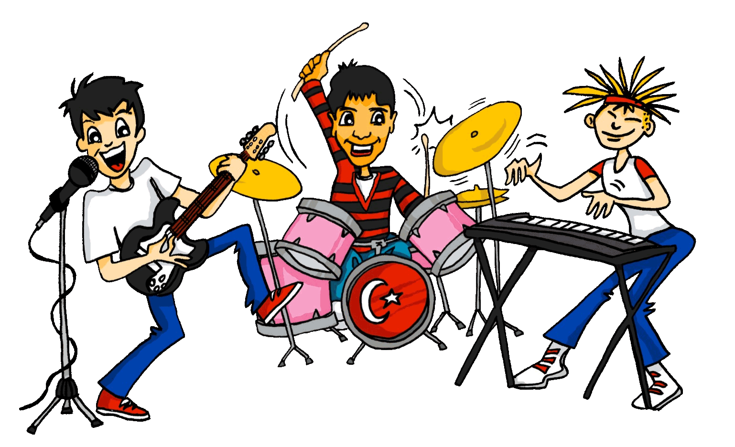
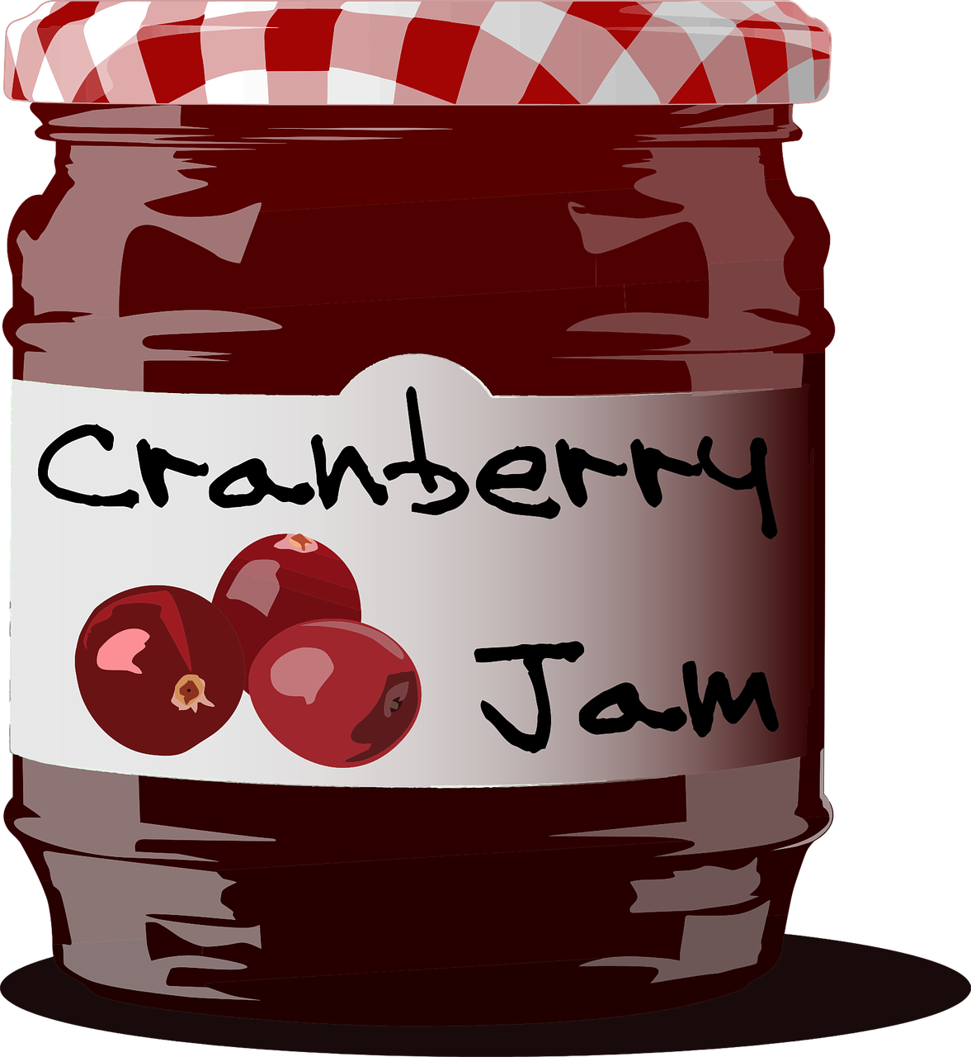
Grammar
"Only by putting words in sentences are we able to make sense of them… Grammar is the study of how sentences mean, and how the bits of sentences mean. And that is why it helps."
Crystal, 2016, p.29
Notes:
Why grammar? Why explicit grammar? Why explicit grammar in a particular way or with particular features in the teaching?
Let’s start with a David Crystal definition of grammar’s importance. Words without sentences lack elements of meaning, are likely to be ambiguous, or the communication unclear. Gives example of jam - two nouns, one verb – meanings completely different. Using grammar (both to understand and to create meaning) is about communication meaning clearly, then. When we think about grammar, and grammatical accuracy, we’re often implicitly thinking about production, and then with 2nd language learning, inevitably about mistakes. But actually knowing grammar well is just as much, if not more, about understanding meaning clearly.
David Crystal: “Nobody would ever doubt the importance of ‘meaning’ in educational practice. Meaning is why we communicate – to understand each other, enjoy each other’s company, build social rapport, obtain emotional support. We need to follow and interpret what other people do when they talk or write, and make ourselves clear and effective when we carry out these tasks ourselves. It’s sometimes thought that meaning is nothing to do with grammar, that it is just a matter of vocabulary. When we say we’re going to ‘look the meaning of a word up in a dictionary’ we give that impression. But it’s a misleading impression. A word on its own conveys little meaning.

Slide 3
Meaningful practice
Practice is a ‘learning journey’ between the first encounter with new language and its fully independent use (Marsden & Hawkes, 2020, p.1).
involves intentional engagement in a wide range of activities (DeKeyser, 2007)
needs to be frequent, yet spaced, and involve different modalities (oral, written)
should involve opportunities to connect new forms with their meanings
But meaningful grammar practice is difficult!
we naturally rely on vocabulary to understand meaning (VanPatten, 2002; 2017)
difficult to make attention to meaning essential – ‘mechanical’ tasks
consequent perceptions of grammar as ‘dull’ and meaningless
Notes:
And so the practice of grammar needs to be meaningful practice. One way of conceptualising ‘practice’ is to think of it as a journey with a new feature, all the way from an initial encounter to being able to use it independently, with minimal effort. In a foreign language setting, this usually requires intentional engagement in a range of activities – activities which also need to be sufficiently frequent, yet spaced, and involve activities in both the oral and written modalities of language use. Crucially, practice should ensure that meaning is always in focus, and indeed the connection between new forms and their meanings should be central to completing the activity.
But in grammar practice, it is particularly difficult to make meaning matter! One reason for this is that we naturally rely on vocabulary (and real-world expectations) to access meaning, so it might not be necessary to pay attention to a grammar feature. (For example temporal adverbs can make it unnecessary to learn that a verb ending marks a particular tense.) When meaning isn’t an essential part of grammar practice, it is easy for tasks to become ‘mechanical’ (predictable, and possible to complete without understanding the meaning of the grammar). This is partly why grammar is seen as the ‘dull’ part of language.

Slide 4
Principles for grammar practice
50+ experimental studies, including:
French verb inflections with 11 to 14 yr olds (Marsden, 2006)
German case marking with 9 to 11 yr olds (Kasprowicz & Marsden, 2017)
‘pairs’ of features (with contrasting meanings or functions) are practised together
e.g., in Spanish, 1st person singular present (-o) vs past preterite (-é)
activities that make form-meaning connections essential to task completion
e.g., look at verb ending; decide if the event happened yesterday or happens regularly
other cues for understanding meaning may need to be removed (e.g., time markers)
learners are given plenty of initial comprehension practice (reading and listening)
later moving to production (speaking and writing)
the initial comprehension practice is likely to benefit production (Kasprowicz & Marsden, 2018, McManus & Marsden, 2019)
(e.g., Marsden, 2006; Kasprowicz & Marsden 2018; VanPatten & Cadierno, 1993; VanPatten & Oikkenon, 1996)
Notes:
So what can we do to make grammar practice meaningful and effective? There are many factors that affect what can be effectively learnt, and when, but here are some general principles drawn from research in second language learning. Over 50 experimental studies (intervention and control group) have been done over the past 20-30 years.
The first is to practise pairs of features together. For example, two verb endings can be ‘paired up’ to juxtapose two meanings (or functions). Practising a whole new set of features together, e.g., a full range of verb endings, is unlikely to lead to be effective, as it is beyond what most learners can pay attention to at any one time.
The practice itself should require attention to form and meaning. A simple example could be to read sentences with two types of verb ending and decide, in each case, when an action occurred.
It may be necessary to remove other cues from the sentence, such as time markers, as these otherwise give the answer away.
There should be plenty of initial reading and listening practice with the new features before production, and there is evidence that this controlled approach can actually make the production practice more successful.

Slide 5
Curriculum design take-aways
Phonics - working with unknown words
Vocabulary - shortcut to systematic revisiting
Grammar - input practice before production

Slide 6
Me llamo Mia y vivo en Arequipa, en Perú. Tengo catorce años. Tengo dos hermanos y una hermana.
Me llamo Daniel y vivo en Bogotá, en Colombia. Tengo trece años. Tengo dos hermanas y un hermanastro.
Me llamo Santi y vivo en Montevideo, en Uruguay. Tengo once años. No tengo hermanos. Soy hijo único.
1 _________ lives in Colombia.
2 Mia lives in _________.
3 _________ is eleven years old.
4 Mia has two _________ and one _______.
5 _________ has no brothers or sisters.
6 Daniel has two _________ and one_______.
Notes:
And if we turn to ‘tener’ I haven’t been able to find a published resource that has listening, reading, speaking and writing practice tasks that focus on understanding and using TENER. It’s straightforward to find texts that feature TENER (alongside other features - e.g. reflexive verbs, ER-regular verbs, plural and singular nouns, definite and indefinite articles.
There are six examples of the verb tener in these texts. How many of them are task essential? Which questions require students to know that ‘tengo’ means ‘I have’? And what do we do about that fact that in three of these six examples, ‘tengo’ actually translates as ‘I am’.
In these texts we have a number of grammar features represented but none of them is task essential.
To what extent do reading (and listening) comprehension tasks like this support students’ learning of grammar? In this typical reading comprehension task, it is very easy to avoid any engagement beyond the lexis, i.e., avoid processing, therefore avoid learning, the grammar. Could we make more efficient use of limited lesson time (i.e. get more learning for our time!) if we could include listening and reading tasks that make the grammar essential. How might they look?

Slide 7
Example of: Listening – where attention is oriented to the meaning of the grammar

Slide 8
En la maleta…Mrs Organised is going on holiday with Mr Organised. Who has what in each suitcase? Tick I have or you have.
I have
you have
 |  | Object | Description
1
boat
fantastic
2
bicycle
white
3
cat
mad (now)
4
book
famous
5
coin
new
6
bed
high
7
pen
famous
8
camera
new
escuchar y escribir
Victoria Hobson / Nick Avery
Notes:
Teachers need not print the slide. Students could use their ex books to write their responses.
Ask students if there are any surprising items in their suitcases (gato, barco!). In checking the descriptions, students might be encouraged to notice adjective agreement (from the previous week). This point may only need to be noted in passing, or teachers may wish to make more of the explanation as a teaching point, depending on the profile of the group.
See if students can distinguish the temporary state in item 3 (“está loco”) from the general attributes (‘es famoso’, ‘es blanco’ in the others)
To focus on sound-spelling correspondences, students could also listen again and transcribe the sentences.
TRANSCRIPT:
Tengo un barco. Es fantástico.
Tienes una bicicleta. Es blanca.
Tienes un gato. Está loco.
Tengo un libro. Es famoso.
Tengo una moneda. Es nueva.
Tienes una cama. Es alta.
Tengo un bolígrafo. Es famoso.
Tienes una cámara. Es nueva.

Slide 9
Example of: Reading – where attention is oriented to the meaning of the grammar

Slide 10
Their children are also going. Their daughter is messaging her brother. Write who has what in the correct column.
 |  | Daughter (‘I’) | Her brother (‘you’)
1 | Tengo una moneda y un bolígrafo
 | Tienes una bicicleta y una cámara
2 | Tienes una casa y un gato
 | Tengo una cámara y una moneda
3 | Tienes una cama y un libro
 | Tengo un gato y una cámara
4 | Tengo un libro y un bolígrafo
 | Tienes un barco y una casa
5 | Tienes una cama y un barco
 | Tengo una bicicleta y una casa
6 | Tienes un gato y un libro
 | Tengo un libro y una moneda
coin
pen
bike
camera
camera
coin
house
cat
cat
camera
bed
book
book
pen
boat
house
bike
house
bed
boat
book
coin
cat
book
leer
Victoria Hobson / Nick Avery
Notes:
Teachers need not print the slide. Students could use their ex books to write their responses. Students do not need to copy out the whole table.

Slide 11
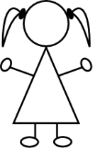
Pepe is talking to a friend (‘you’)about belongings. Pepe also mentions what his sister Paula has. Write the item in English that each person has.
 |  | Pepe |  | Paula
1 | Tiene un barco y tengo una cámara.
2 | Tengo una bicicleta y tienes un libro.
3 | Tiene una casa y tengo un barco.
4 | Tengo una moneda y tiene un bolígrafo.
5 | Tengo un gato y tienes una cama.
6 | Tiene una bicicleta y tengo una cama.
You have
she has
I have
leer
Notes:
Students need to pay close attention to the instructions.
By now, students will be very familiar with the vocabulary plus the three singular parts of tener, which have up to now featured in pairs. In this activity, all sentences have ‘tengo’, but not all have ‘tiene’ – some have ‘tienes’ instead. In this way, students have to pay close attention to both the verb form and the item. NB: Of course there are only two items mentioned each time so one person is not mentioned in each question.
Students do not need a copy of this slide. They can write I, you, she at the top of the page, 1-6 down the side and the English words in the correct places.

Slide 12
Example of: Speaking – where learners have to ‘choose’ which grammar to use and their partner must understand that grammar …selecting between the pairs of features they have just been practising in the input

Slide 13
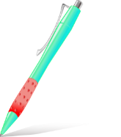
Partner A
1)
2)
3)
4)
5)
Partner B
………………….a house
………………….a bike
…………………..a pen
………………….a boat
……………….a camera
S/he has
I have
You have
S/he has
I have
Victoria Hobson / Nick Avery
Notes:
Prompt cards (see accompanying Word doc for printable version). Alternatively students could write the answers in their ex books and the cards used again.
Partner A says their sentence to partner B in Spanish. Partner B listens carefully and then writes the verb accordingly.
Note: the layout of the task as it is includes an additional level of challenge, as Partner B’s items are not on the page in numerical order. This forces Partner B to attend to the meaning of the noun and the verb form at the same time. If felt to be too challenging, the items can be edited to follow the same order as Partner A’s items 1-5.

Slide 14
Partner B
1)
2)
3)
4)
5)
Partner A
………………….a cat
………………….a book
…………………..a pen
………………….a coin
……………….a bed
You have
You have
S/he has
I have
S/he has
Victoria Hobson / Nick Avery
Notes:
Printable student prompt cards. Alternatively students could write the answers in their ex books and the cards used again.
Partner B says their sentence to partner A in Spanish. Partner A listens carefully and then writes the verb accordingly.
Note: the layout of the task as it is includes an additional level of challenge, as Partner B’s items are not on the page in numerical order. This forces Partner B to attend to the meaning of the noun and the verb form at the same time. If felt to be too challenging, the items can be edited to follow the same order as Partner A’s items 1-5.

Slide 15
Example of: Writing – where learners have to ‘choose’ which grammar to use, selecting between the pairs of features they have just been practising in the input

Slide 16
¿Cómo es España?
old
cheap
strange
Completa las frases.
escribir
beautiful
calm
small
famous
old
expensive
beautiful
Barcelona y San Sebastián son
1) _______________________________ bonitos.
Bilbao es
2) ____________________ barato.
Bilbao y Barcelona son
3) __________________________ antiguos.
famous
calm
strange
San Sebastián es
4) ________________________ pequeño.
Zaragoza y San Sebastián son
5) ______________________________ tranquilos.
Bilbao y Zaragoza son
6) ________________________ raros.
Notes:
Year 7 Spanish Term 1.2 week 4 - Using ‘es’ and ‘son’ & adjective number agreement (-s) as complement to verb.
Resource Teacher Notes
Ask students to translate the title as it contains core vocabulary introduced this week (¿Cómo es?)
Notice that the Spanish adjectives are already provided. In lesson 1 we want students to focus on the correct use of es/son and the meaning of the new adjectives. In lesson 2, students will focus on manipulating their endings to reflect number (and gender) agreement.
Image courtesy www.pinterest.com (no author found).

Slide 17
What does an excellent languages curriculum look like?
a planned approach to teaching and embedding the sound-writing relationship
a carefully selected core vocabulary (including verbs), based on frequency of use
a clear, progressive, sequenced teaching of grammar, including the chance to process input for meaning
frequent, planned opportunities for recall, repetition, reuse in a variety of contexts leading over time to mastery
opportunities to encounter and practise language in engaging contexts, with a particular focus on cultural knowledge
a maximal approach to integrating both receptive and productive modes of language use (i.e. the four ‘skills’)
Notes:
If I’m asked what an excellent languages curriculum looks like, these are the things I think we can say:
a planned approach to teaching and embedding the sound-writing relationship
a carefully selected core vocabulary (including verbs), based on frequency of use
a clear, progressive, sequenced teaching of grammar, including the chance to process input for meaning
frequent, planned opportunities for recall, repetition, reuse in a variety of contexts leading over time to mastery
opportunities to encounter and practise language in engaging contexts, with a particular focus on cultural knowledge
a maximal approach to integrating both receptive and productive modes of language use (i.e. the four ‘skills’)

Slide 18
QUESTIONS?

Slide 19
Where to find more resources
NCELP resource portal
https://resources.ncelp.org/
Hundreds of freely accessible lessons
Other resources including professional development material
Rationale documents (e.g. principles for teaching grammar and meaningful practice)
Gaming grammar
Digital game with activities in a ‘spy mission’ context
Reading and listening-based grammar practice
Allows teachers to track student progress
Notes:
To find other examples, I’d recommend going to the NCELP resource portal. All resources are freely available and also include professional development material such as rationale documents for grammar teaching and meaningful practice.
NCELP colleagues have also produced a digital game called Gaming Grammar that has listening and reading activities, based on a spy mission context, that are in line with the principles I’ve discussed here. Teachers can also track student progress, and this is something could be done both remotely and in class.

Slide 20
Next steps – further support
660 teachers outside the network on our regular mailing list
Some schools using and/or adapting the NCELP SOW and resources
New Getting into NCELP area of the website
Notes:
NCELP is a pilot project, set up to work intensively with 45 schools nationally, in the first phase. We have used the website, the resource portal, our mailing list and around 40 external presentations to date, to reach out to schools more widely.
So far, this has meant that… around 6000 teachers have attended one of our external events.

Slide 21
Further support [2]
NCELP alignment with wider policy (ECF, Ofsted) and pedagogy (Rosenshine)
Support for the GCSE Subject Content consultation
Notes:
Two further areas of support that are very recent additions to the website are a collection called NCELP alignment with wider policy, which brings together previous work on Ofsted framework with more recent work on the Early Career Framework and the Rosenshine principles. And at the same time we have put up a screencast and analysis documents as support to engage with the GCSE Subject Content consultation. There is a 60-minute screencast comparing the 2015 and the draft 2021 Subject Content that I would commend to you. I would strongly encourage people to get involved. There is still time!

Slide 22
References
DeKeyser, R. (2007). Practice in a second language: Perspectives from applied linguistics and cognitive psychology. New York: Cambridge University Press.
Kasprowicz, R. & Marsden E. (2018). Towards ecological validity in research into input-based practice: Form spotting can be as beneficial as form-meaning practice. Applied Linguistics, 39(6), 886-911.
Marsden, E. (2006). Exploring input processing in the classroom: An experimental comparison of processing instruction and enriched input. Language Learning, 56, 507-566.
Marsden, E. & Hawkes, R. (2020). Meaningful practice: Definitions, rationales and principles. National Centre for Excellence in Language Pedagogy.
McManus, K. & Marsden, E. (2019). Using explicit instruction about L1 to reduce crosslinguistic effects in L2 grammar learning: Evidence from oral production in L2 French. The Modern Language Journal, 103(2), pp. 459-480
VanPatten, B. (2002). Processing instruction: An update. Language Learning, 52(4), 755-803.
VanPatten, B. (2017). Processing Instruction. In Loewen, S. & Sato, M. (Eds.) The Routledge Handbook of Instructed Second Language Acquisition (pp. 166-180).
VanPatten, B. & Cadierno, T. (1993). Input processing and second language acquisition: A role for instruction. The Modern Language Journal, 77(1), pp.45-57.
VanPatten, B. & Oikkenon, S. (1998). Explanation versus structured Input in processing instruction. Studies in Second Language Acquisition, 18(4), 495-510.

