Slide 1
What is she doing? What are they doing? Narrating other people's actions
Present tense verbs ‘s/he’and ‘they’: 3rd person singular and plural
Y7 German
Term 2.2 - Week 5 - Lesson 49
Jenny Hopper / Rachel Hawkes / Stephen Owen
Artwork: Steve Clarke
Date updated: 20/12/21
Notes:
Artwork by Steve Clarke. All additional pictures selected are available under a Creative Commons license, no attribution required.
Learning outcomes (lesson 1):
Revisiting of long and short vowels – a, e ,i, o, u
Consolidation of present tense strong verbs in 3rd person singular
Word frequency (1 is the most frequent word in German):
7.2.2.5 (introduce) halten [155] lassen [83] nehmen [142] danach [457] dann [41] deshalb [229] schließlich [351] spät(er) [169] zuerst [880] 7.2.2.3 (revisit) fahren¹ [215] geben [49] helfen [338] laufen [252] schlafen [679] vergessen [584] mir [63] Geld [235] Urlaub [1570] Zeitung [670] fast [202]
7.2.1.2 (revisit) null [1680] eins [774] zwei [70] drei [106] vier [200] fünf [274] sechs [428] sieben [611] acht [645] neun [1053] zehn [312] elf [1507] zwölf [1080]
Source: Jones, R.L & Tschirner, E. (2019). A frequency dictionary of German: Core vocabulary for learners. London: Routledge.
The frequency rankings for words that occur in this PowerPoint which have been previously introduced in NCELP resources are given in the NCELP SOW and in the resources that first introduced and formally re-visited those words.
For any other words that occur incidentally in this PowerPoint, frequency rankings will be provided in the notes field wherever possible.

Slide 2
Wie sagt man das?
German vowels (with or without umlauts) can be ____ or ____ .
short
long
Vowels are short when followed by more than one __________, e.g., lassen, trinken, Kirche, fünf.
consonant
Vowels are long when:
there is a double ______
or when followed by the letter ___
or by a single ___________
vowel (no examples of ‘uu’ in German)
‘h’, e.g., Uhr, nehmen
consonant, e.g., absolut, spät.
Notes:
Timing: 3 minutes
Aim: To revisit short and long vowels in German.
Note: Students met this concept in Week 1, when they were taught the long/short ‘a’ SSC. It is revisited here, with further explanation. The next two slides will practise differentiating these sounds in the source words, and then in some city/town names.
Procedure:
1. Cycle through the information on the slide using the animation sequence.
2. Students supply the information orally to fill the underlined gaps, based upon what they should know.
2. Clicking fills the gaps in each line to confirm.

Slide 3
Phonetik
e
e
a
a
sagen
kalt
geben
denken
i
i
o
o
u
wir
u
finden
wo?
Kopf
ü
ü
ö
du
ö
Punkt
Tür
fünf
ä
ä
schön
plötzlich
spät
lächeln
Notes:
Timing: 3 minutes
Aim: To practise long and short vowel sounds in German in familiar words, with audio.
Procedure:
1. Students should listen and repeat.

Slide 4
Phonetik
e
e
a
a
sagen
kalt
geben
denken
i
i
o
o
u
wir
u
finden
wo?
Kopf
ü
ü
ö
ö
fünf
du
Punkt
Tür
ä
ä
schön
plötzlich
spät
lächeln
Notes:
Timing: 3 minutes
Note: This version of the slide is without audio.
Procedure:
1. Students should chant the words chorally first, as they appear, then perhaps individually (the teacher quizzing students on individual words; it will be important to continue to juxtapose the long and short forms of each vowel in this practice).

Slide 5
Phonetik
hören
Wie sagt man das?
 | i [lang] | i [kurz]
Linz
Ingolstadt
Iserlohn
Interlaken
Innsbruck
 | o [lang] | o [kurz]
Iserlohn
Ingolstadt
Oberammergau
Oldenburg
Ottendorf
1
1
2
2
3
3
4
4
5
5
Notes:
Timing: 5 minutes
Aim: To recap long and long and short [i] and [o].
Note: Towns listed are from Germany, Austria and Switzerland. Students may like to do an extension research task to identify which towns they know (e.g from the football team) and/or where the towns are situated.
Procedure:
1. Students are asked to listen and decide if they hear long or short ‘i’ and ‘o’.
2. The city names appear together with the answer. 3. Students can have one minute in pairs to re-read aloud all the cities for additional practice.
Note: Students are not expected to transcribe the cities.

Slide 6
Phonetik
lesen / sprechen
Wie sagt man das?
 | a [lang] | a [kurz]
Hamburg
Graz
Kassel
Hannover
Aachen
 | e [lang] | e [kurz]
Genf
Bremen
Gelsenkirchen
Essen
Regensburg
1
1
2
2
3
3
4
4
5
5
Notes:
Timing: 5 minutes
Aim: To recap long and short ‘a’ and ‘e’.
Procedure:
1. Students are asked to read aloud each city, either chorally or in pairs. The table prompts ‘lang’ and ‘kurz’ are there to remind students to think about their vowels before saying them.
2. Audio to check is then available upon clicking each word, and answers are animated.
Note: Two of the towns have examples of both long and short ‘e’.
Towns listed are from Germany, Austria and Switzerland. As an additional self-study task, students may like to do an extension research task to identify which towns they know (e.g from the football team) and/or where the towns are situated.

Slide 7
Vokabeln
60
 | Deutsch | Englisch
1 | lassen | to leave, leaving
2 | nehmen | to take, taking
3 | halten | to stop, stopping
4 | führen | to lead, leading
5 | dann | then
6 | zuerst | first
7 | später | later
8 | danach | after it, afterwards
9 | schließlich | in the end, finally
10 | deshalb | for that reason
Sekunden
0
LOS!
Notes:
Timing: 3 minutes
Aim: To practise receptive and productive recall of this week’s new words.
Procedure:
1. Students either work by themselves or in pairs, reading out the words and studying their English meaning (1 minute). 2. Then the English meanings are removed and they try to recall them, looking at the German (1 minute). 3. Then the German meaning are removed and they to recall them, looking at the English (1 minute) 4. Further rounds of learning can be facilitated by one student turning away from the board, and his/her partner asking him/her the meanings. This activity can work from L2 → L1 or L1 → L2.

Slide 8
Strong verbs: I, you, he/she/it
For strong verbs, you change the vowel for the du and er/sie/es forms:
schlafen
to sleep/sleeping
ich schlafe
I sleep/am sleeping
du schläfst
you sleep/are sleeping
er/sie schläft
he/she sleeps/is sleeping
Notes:
Timing: 2 minutes
Aim: To recap the grammar taught and practised previously, concerning the stem change and endings for singular strong verb forms in German, prior to the introduction of the third person plural form later in this sequence.
Procedure:
1. Cycle through the information on the slide using the animation sequence.

Slide 9
nehmen
[to take | taking]
nimmt
[takes | is taking]
Notes:
Timing: 3 minutes for sequence of six verbs
Aim: To introduce the verb nehmen more explicitly.
Note: Nehmen is one of the 25 most frequently used verbs in German. All 25 most frequent verbs will be introduced early on using the same format. Both long form (infinitive) and short form (3rd person singular) are introduced in order to familiarise students with various forms of the same verb.
Procedure:
Bring up the word nehmen on its own, say it, students repeat it, and remind them of the phonics. Draw attention to the long [e].
Try to elicit the meaning from the students. Students have had explicit teaching that the present tense in German communicates two different present tense meanings in English. This reinforces that learning. Emphasise the two meanings for the short form, reminding students that German only has one form and does not have a direct equivalent of the grammar for ‘is + ing’, the continuous form (as covered in previous weeks).
Bring up the picture, and, if using gestures, a possible gesture would be to mime receiving something in the hand.
Then bring up the English translations. Emphasise the two meanings for the infinitive.
Bring up the short form nimmt, say it, students repeat it.
Try to elicit the meaning from the students. Emphasise the two meanings for the short form.

Slide 10
nehmen
[to take | taking]
nimmt
[takes | is taking]
Notes:
Cycle through the long and short form again.

Slide 11
nimmt
[takes | is taking]
Sie nimmt den Bus.
[She takes | is taking the bus.]
Notes:
Introduce the short form in a sentence.

Slide 12
nehmen
[to take | taking]
Sie kann den Bus nehmen.
[She can take the bus.]
Notes:
Introduce the long form in a sentence.

Slide 13
nimmt
[takes | is taking]
Sie nimmt den Bus.
[She takes | is taking the bus.]
Notes:
Cycle through the short form in context again.

Slide 14
nehmen
[to take | taking]
Sie kann den Bus nehmen.
[She can take the bus.]
Notes:
Cycle through the long form in context again.

Slide 15
lassen
[to leave | leaving]
lässt
[leaves | is leaving]
Notes:
Timing: 3 minutes for sequence of six verbs
Aim: To introduce the verb lassen more explicitly.
Note: Lassen is one of the 25 most frequently used verbs in German. All 25 most frequent verbs will be introduced early on using the same format. Both long form (infinitive) and short form (3rd person singular) are introduced in order to familiarise students with various forms of the same verb.
Procedure:
Bring up the word lassen on its own, say it, students repeat it, and remind them of the phonics. Draw attention to [ss].
Try to elicit the meaning from the students. Students have had explicit teaching that the present tense in German communicates two different present tense meanings in English. This reinforces that learning. Emphasise the two meanings for the short form, reminding students that German only has one form and does not have a direct equivalent of the grammar for ‘is + ing’, the continuous form (as covered in previous weeks).
Bring up the picture, and, if using gestures, a possible gesture would be to mime leaving something somewhere.
Then bring up the English translations. Emphasise the two meanings for the infinitive.
Bring up the short form lässt, say it, students repeat it. Draw attention to [ä].
Try to elicit the meaning from the students. Emphasise the two meanings for the short form.

Slide 16
lassen
[to leave | leaving]
lässt
[leaves| is leaving]
Notes:
Cycle through the long and short form again.

Slide 17
lässt
[leaves | is leaving]
Sie lässt das Handy zu Hause.
[She leaves | is leaving the phone at home.]
Notes:
Introduce the short form in a sentence.

Slide 18
lassen
[to leave | leaving]
Sie muss das Handy zu Hause lassen.
[She must leave the phone at home.]
Notes:
Introduce the long form in a sentence.

Slide 19
lässt
[leaves | is leaving]
Sie lässt das Handy zu Hause.
[She leaves | is leaving the phone at home.]
Notes:
Cycle through the short form in context again.

Slide 20
lassen
[to leave | leaving]
Sie muss das Handy zu Hause lassen.
[She must leave the phone at home.]
Notes:
Cycle through the long form in context again.

Slide 21
halten
[to stop | stopping]
hält
[stops | is stopping]
Notes:
Timing: 3 minutes for sequence of six verbs
Aim: To introduce the verb halten more explicitly.
Procedure:
Bring up the word halten on its own, say it, students repeat it, and remind them of the phonics. Draw attention to short [a].
Try to elicit the meaning from the students. Students have had explicit teaching that the present tense in German communicates two different present tense meanings in English. This reinforces that learning. Emphasise the two meanings for the short form, reminding students that German only has one form and does not have a direct equivalent of the grammar for ‘is + ing’, the continuous form (as covered in previous weeks).
Bring up the picture, and, if using gestures, a possible gesture would be to walk a couple of steps then make an obvious stop.
Then bring up the English translations. Emphasise the two meanings for the infinitive.
Bring up the short form hält, say it, students repeat it. Draw attention to [ä].
Try to elicit the meaning from the students. Emphasise the two meanings for the short form.

Slide 22
halten
[to stop | stopping]
hält
[stops | is stopping]
Notes:
Cycle through the long and short form again.

Slide 23
hält
[stops | is stopping]
Der Bus hält.
[The bus stops | is stopping.]
Notes:
Introduce the short form in a sentence.

Slide 24
halten
[to stop | stopping]
Der Bus kann nicht hier halten.
[The bus cannot stop here.]
Notes:
Introduce the long form in a sentence.

Slide 25
hält
[stops | is stopping]
Der Bus hält.
[The bus stops | is stopping.]
Notes:
Cycle through the short form in context again.

Slide 26
halten
[to stop | stopping]
Der Bus kann hier nicht halten.
[The bus cannot stop here.]
Notes:
Cycle through the long form in context again.

Slide 27
Vokabeln - Verben
N
O
laufen
läuft
fahren
fährt
Q
nehmen
nimmt
P
vergessen
vergisst
R
helfen
hilft
S
essen
isst
T
U
schlafen
schläft
halten
hält
V
lassen
lässt
Z
haben
hat
W
Y
gehen
geht
machen
macht
X
gibt
geben
Notes:
Timing: 5 minutes
Aim: To practise recall of the third person singular form of verbs.
Note: This is a reversed version of the verbs task from last week’s sequence, 2.2.4. This time students are presented with infinitives and need to write down the 3rd person form. We use letters of the alphabet again to support teacher elicitation of the answers, but this week the remaining letters N - Z. We include 10 previously taught strong verbs and three verbs that are not strong verbs (two week and one irregular (haben), as this is the third week of working with strong verbs.
Procedure:
1. Students are presented with infinitives and need to write down the 3rd person form.
2. Students can then be prompted to say both the 3rd person form and the infinitive. E.g. Teacher - N Student - läuft, laufen 3. Teachers can vary the order of the letters, as the answers are triggered to appear by clicking on each letter. 4. Alternatively, students can nominate a letter and give the two verb forms themselves.

Slide 28
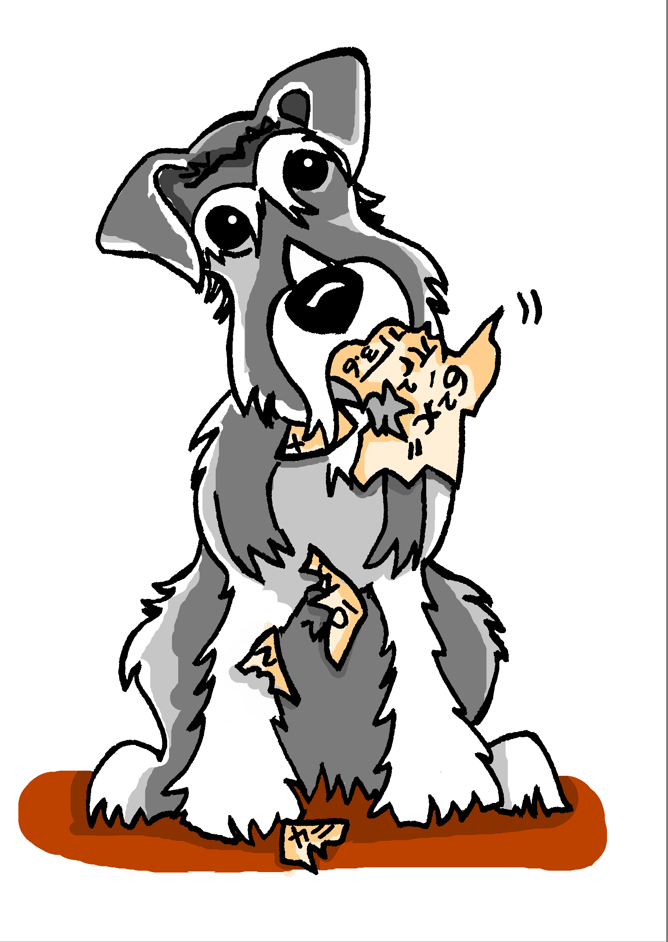
Es ist Montag
Wolfgang redet über Mias Schultag. Was sagt er?
hören / lesen
1
Sie _______ in die Schule.
Sie _______ Matheunterricht aber sie __________ die Hausaufgaben!
Sie _______ nach Hause und _______ die Hausaufgaben!
Sie _______ spät ins Bett und _______.
Mias Hund ______ die Hausaufgaben!
2
3
4
5
essen | schlafen | fahren | haben | laufen | vergessen | machen | gehen
Notes:
Timing: 5 minutes
Aim: To practise using the third person singular form of verbs in context.
Note: This gapped reading exercise challenges students to insert the correct form of the verb into each gap. It is not an input processing task, as students have, in previous lessons, had practice in differentiating between 1st and 3rd singular person strong forms, and 1st and 2nd person singular strong forms. Here, students need to understand the language in the whole sentence, recognise which verb they need, and recall from memory the 3rd person singular forms. Verb prompts are given, in a jumbled order, in the infinitive form.
Procedure:
1. Students read the sentences, select the appropriate verb to fill each gap, and put it into the correct form.
Optional: They can hear the text with the gaps bleeped out on this slide; the following slide displays the answers with the complete audio sentences.
Transcript:
1. Sie [fährt] in die Schule.
2. Sie [hat] Matheunterricht aber sie [vergisst] die Hausaufgaben!
3. Sie [läuft] nach Hause und [macht] die Hausaufgaben!
4. Sie [geht] spät ins Bett und [schläft].
5. Mias Hund [isst] die Hausaufgaben.

Slide 29
Es ist Montag
Wolfgang redet über Mias Schultag. Was sagt er?
hören / lesen
1
Sie fährt in die Schule.
Sie hat Matheunterricht aber sie vergisst die Hausaufgaben!
Sie läuft nach Hause und macht die Hausaufgaben!
Sie geht spät ins Bett und schläft .
Mias Hund isst die Hausaufgaben!
2
3
4
5
essen | schlafen | fahren | haben | laufen | vergessen | machen | gehen
Notes:
Timing: 2 minutes
Aim: To reveal the answers to the activity on the previous slide (with audio recordings of the complete sentences).
Procedure:
1. Students can be asked to state the full sentence before hearing the audio, for increased challenge. 2. Click to bring up the answers one by one.
Transcript:
1. Sie fährt in die Schule.
2. Sie hat Matheunterricht aber sie vergisst die Hausaufgaben!
3. Sie läuft nach Hause und macht die Hausaufgaben!
4. Sie geht spät ins Bett und schläft.
5. Mias Hund isst die Hausaufgaben.

Slide 30
Was macht Wolfgang/Mia?
sprechen
Er/Sie
zu Hause
nach Hause
das Auto
im Bett
das Handy
den Bus
im Garten
das Buch
laufen
helfen
fahren
vergessen
lassen
nehmen
schlafen
halten
Notes:
Timing: 5 minutes
Aim: To provide production practice (speaking) with strong verb forms.
Procedure:
1. Pairwork: One student asks a question and the other responds with the correct pronoun and a combination that makes sense!
2. Alternate roles. 3. Additional challenge – verbs and nouns can be crossed off as the task proceeds. When it’s no longer possible for one partner to make a meaningful sentence, the other has won. 4. The task can be repeated.
Beispiel: Student A: Was macht Mia? Student B: Sie lässt das Handy im Garten! Was macht Wolfgang? Student A: Er hilft zu Hause.

Slide 31
What is she doing? What are they doing? Narrating other people's actions
Present tense verbs ‘s/he’and ‘they’: 3rd person singular and plural
Y7 German
Term 2.2 - Week 5 - Lesson 50
Jenny Hopper / Rachel Hawkes / Stephen Owen
Artwork: Steve Clarke
Date updated: 20/12/21
Notes:
Artwork by Steve Clarke. All additional pictures selected are available under a Creative Commons license, no attribution required.
Learning outcomes (lesson 2):
Revisiting of long and short vowels – a, e ,i, o, u
Introduction of 3rd person plural (weak and strong verbs, with focus on the latter)
Word frequency (1 is the most frequent word in German):
7.2.2.5 (introduce) halten [155] lassen [83] nehmen [142] danach [457] dann [41] deshalb [229] schließlich [351] spät(er) [169] zuerst [880] 7.2.2.3 (revisit) fahren¹ [215] geben [49] helfen [338] laufen [252] schlafen [679] vergessen [584] mir [63] Geld [235] Urlaub [1570] Zeitung [670] fast [202]
7.2.1.2 (revisit) null [1680] eins [774] zwei [70] drei [106] vier [200] fünf [274] sechs [428] sieben [611] acht [645] neun [1053] zehn [312] elf [1507] zwölf [1080]
Source: Jones, R.L & Tschirner, E. (2019). A frequency dictionary of German: Core vocabulary for learners. London: Routledge.
The frequency rankings for words that occur in this PowerPoint which have been previously introduced in NCELP resources are given in the NCELP SOW and in the resources that first introduced and formally re-visited those words.
For any other words that occur incidentally in this PowerPoint, frequency rankings will be provided in the notes field wherever possible.

Slide 32
Was passt nicht in die Reihe?
1
Phonetik
1.
Saal
deshalb
sagen
2.
bisschen
Familie
trinken
3.
sechs
elf
zehn
4.
schlafen
halten
lassen
5.
nehmen
geben
helfen
Notes:
Timing: 5 minutes (both slides)
Aim: To practise (reading) recognition of long and short German vowels.
Note: Words are taken from this week’s three vocabulary sets and additionally from phonics cluster words.
Procedure:
1. Students should be encouraged to practise pronouncing these words out loud, individually or in pairs, to decide which is the odd one out in each row (Reihe). Students have met this task type before and the instruction ‘Was passt nicht?’ Teachers can elicit the instruction meaning from students. 2. Answers are animated to shade the odd one out. 3. Teachers may want to elicit meanings, though they will only expect students to know those that are in this week’s sequence.

Slide 33
Was passt nicht in die Reihe?
2
Phonetik
6.
offen
groß
locker
7.
zuerst
hundert
Uhr
8.
mögen
zwölf
öffnen
9.
spät
fährt
lässt
10.
führen
Küche
fünf
Notes:
This slide continues the exercise from the previous one.

Slide 34
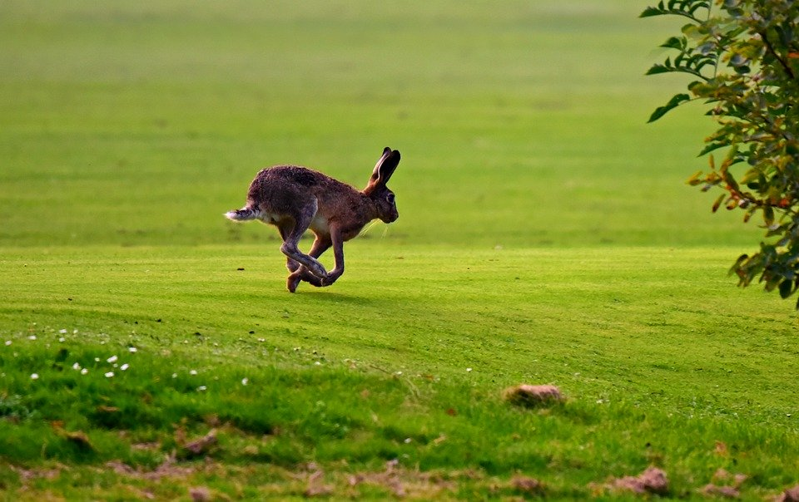
Zungenbrecher [1]
Phonetik
1
Auf dem Rasen rasen Hasen, atmen rasselnd durch die Nasen.
2
Notes:
Timing: 3 minutes
Aim: To practise production of long and short ‘a’ sounds.
Note: ‘atmen’ does not follow the standard rules, owing to its Sanskrit origins.
Procedure:
1. Students listen to either the slower [1] or the faster [2] version of the tonguetwister (or both in turn), then try to say it chorally or in pairs.
Transcription:
Auf dem Rasen rasen Hasen, atmen rasselnd durch die Nasen.
Translation: On the lawn hares are racing, breathing raspingly/noisily through their noses.
Word frequency (1 is the most frequent word in German):
der Rasen [>4029]; rasen [>4029]; atmen [2454]; durch [56]; rasselnd[>4029] die Nase [1530]
Source: Jones, R.L & Tschirner, E. (2011). A frequency dictionary of German: Core vocabulary for learners. London: Routledge.

Slide 35
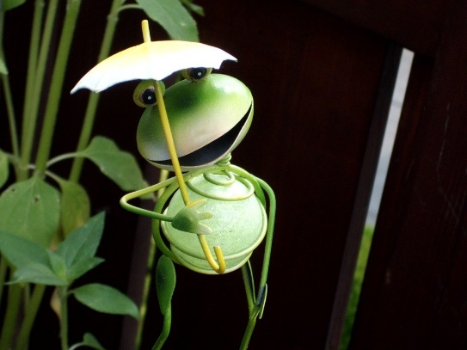
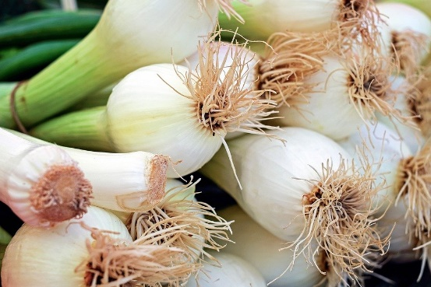
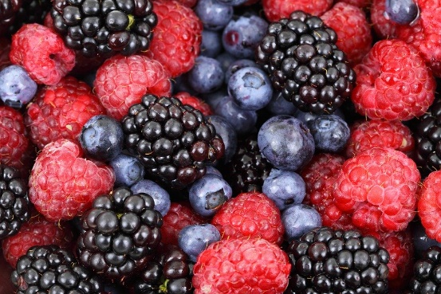
Zungenbrecher [2]
Phonetik
1
2
Fromme Frösche fressen
frische Frühlingszwiebeln,
aber freche Frösche fressen
frische Früchte.
Notes:
Timing: 3 minutes
Aim: To practise production of the following SSCs: o - ö - i - ü – e.
Procedure:
1. Students listen to either the slower [1] or the faster [2] version of the tongutwister (or both in turn), then try to say it chorally or in pairs.
Transcription:
Fromme Frösche fressen
frische Frühlingszwiebeln,
aber freche Frösche fressen
frische Früchte.
Translation:
Pious frogs eat
fresh spring onions,
but eat naughty frogs
fresh fruits.
Word frequency (1 is the most frequent word in German):
fromm [>4029] Frosch [>4029] fressen [3448] frisch [1297] Frühling [3975] Zwiebel [3382] aber [32] frech [>4029] Frucht [3876]
Source: Jones, R.L & Tschirner, E. (2011). A frequency dictionary of German: Core vocabulary for learners. London: Routledge.

Slide 36
Strong and weak verbs
Grammatik
‘s/he’ versus ‘they’
For weak verbs:
For strong verbs:
for ‘they’, simply add back the ‘en’.
no vowel change for ‘they’ form.
sie / er singt
s/he sings
sie / er läuft
s/he runs
sie singen
they sing
sie laufen
they run
The ‘they’ form of haben is formed in the same way:
sie haben = they have
The ‘they’ form is identical to the infinitive!
Notes:
Timing: 2 minutes
Aim: To introduce the third person plural form of the verb, for both weak and strong verbs.
Procedure:
1. Cycle through the information on the slide using the animation sequence.

Slide 37
hören und lesen
Wer macht was im Osterlaub? Nur Mia, oder Mia und Wolfgang?
hören / lesen
Remember: sie means both ‘she’ and ‘they’!
 |  | nur Mia | M & W
1
Sie bleiben nicht zu Hause.
2
Sie spielen in einer Band.
3
Sie schreibt die Musik.
4
Sie fahren nach Österreich.
5
Sie geben ein Konzert in Wien.
6
Sie nehmen den Zug.
7
Sie schläft im Zug.
8
Sie lässt die Noten* zu Hause!
*die Noten - written music
Notes:
Timing: 8 minutes
Aim: To provide practice in distinguishing between third person singular and plural verb forms (listening).
Procedure:
1. Students listen and use the form of the verb to determine whether the subject of the German sentence (sie) refers to Mia alone (‘she’) or Mia and Wolfgang together (‘they’). They tick the appropriate column.
2. The answers are animated and appear upon successive mouse clicks. The sentences also appear in written form – students could translate these into English.
Transcript:
1. Sie bleiben nicht zu Hause.
2. Sie spielen in einer Band.
3. Sie schreibt die Musik.
4. Sie fahren nach Österreich.
5. Sie geben ein Konzert in Wien.
6. Sie nehmen den Zug.
7. Sie schläft im Zug.
8. Sie lässt die Noten zu Hause.
Notes:
1. Konzert [1721] is used here as a near cognate but will be taught explicitly next week. 2. Numbers are also to be revisited this week. Teachers can use this task to elicit numbers explicitly from students. For example: Teacher - Sie fahren nach Österreich. Welche Nummer ist das?

Slide 38
eine Musiktournee
die Musiktournee – concert tour allein – alone, ohne – without plötzlich - suddenly
hören / lesen
1
2
3
4
5
6
7
8
Listen to the text and make notes in German. Then try to write what you heard in sentences.
Wolfgang und Mia haben fast zwei Wochen frei und machen zusammen eine Musiktournee. Wolfgang fährt mit Freunden. Er hat kein Geld. Mia nimmt allein den Bus und liest Zeitung.
Wolfgang und Mia spielen beide in einer Band. Wolfgang spielt Gitarre, aber es gibt ein Problem! Wolfgang lässt die Gitarre leider zu Hause. Deshalb kann er das Konzert nicht spielen! Mia findet das schlecht! Sie hat Angst! Was können sie jetzt machen? Sie müssen das Konzert geben. Ohne Gitarre! Eins, zwei, drei, vier...! Es sind viele Leute dort aber sie finden das Konzert nicht gut! Mia und Wolfgang laufen danach zum Hotel. Mia ist sehr müde und hat dann Kopfschmerzen. Sie schläft.
Sie fahren schließlich beide nach Hause. Der Bus hält plötzlich und was sehen sie da? Ach, die Gitarre!
Notes:
Timing: 25 minutes Note: an extended time is allocated to dictogloss tasks, to allow for maximum exploitation of the text.
Aim: To provide a dictogloss activity.
Procedure:
1. Students listen to the text and make notes in German.
2. They then try to reconstruct it in sentences.
3. The first mouse click displays this simple instruction; the second displays the German text, for verification of students’ versions.
4. Students can then read the text whilst listening to the audio recording. This helps to develop their segmentation skills, improving their ability to listen and understand when there is no text to support them. The teacher would use the full audio version for this, pausing it for students to say the next word or the previous word. Teachers could also pause strategically and ask for alternative words from students.
Note: To play the whole recording (for segmentation practice), click on the audio player icon (top right of slide). To play the eight sections of the text separately (for the dictogloss), click on the action buttons 1-8 above the text. 5. Finally, students translate the whole text into English. Transcript:
Wolfgang und Mia haben fast zwei Wochen frei und machen zusammen eine Musiktournee. / Wolfgang fährt mit Freunden. Er hat kein Geld. Mia nimmt allein den Bus und liest Zeitung.
Wolfgang und Mia spielen beide in einer Band. Wolfgang spielt Gitarre, aber es gibt ein Problem! Wolfgang lässt die Gitarre leider zu Hause. / Deshalb kann er das Konzert nicht spielen! Mia findet das schlecht! / Sie hat Angst! Was können sie jetzt machen? Sie müssen das Konzert geben. Ohne Gitarre! / Eins, zwei, drei, vier...! Es sind viele Leute dort aber sie finden das Konzert nicht gut! / Mia und Wolfgang laufen danach zum Hotel. Mia ist sehr müde und hat dann Kopfschmerzen. Sie schläft. /
Sie fahren schließlich beide nach Hause. Der Bus hält plötzlich und was sehen sie da? Ach, die Gitarre!

Slide 39
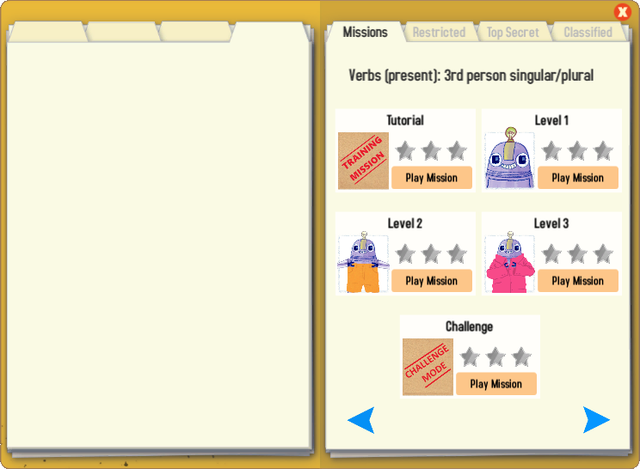
Gaming Grammar
Try the following Gaming Grammar missions to practise:

Slide 40
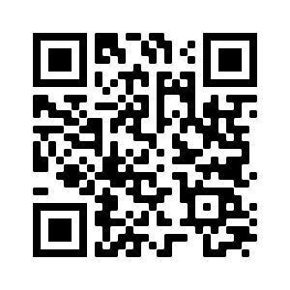
Hausaufgaben
Vocabulary Learning Homework (Term 3.1, Week 1)
Audio file
Audio file QR code:
Student worksheet
Quizlet link
In addition, revisit: Term 2.2 Week 4
Term 2.1 Week 1
Notes:
Use this slide to set the homework.

