Slide 1
An Introduction to the Key Stage 4 Scheme of Work
German
Presenter: Charlotte Moss
Notes:
Hello and welcome to this introduction to the Key Stage 4 German Scheme of Work.

Slide 2
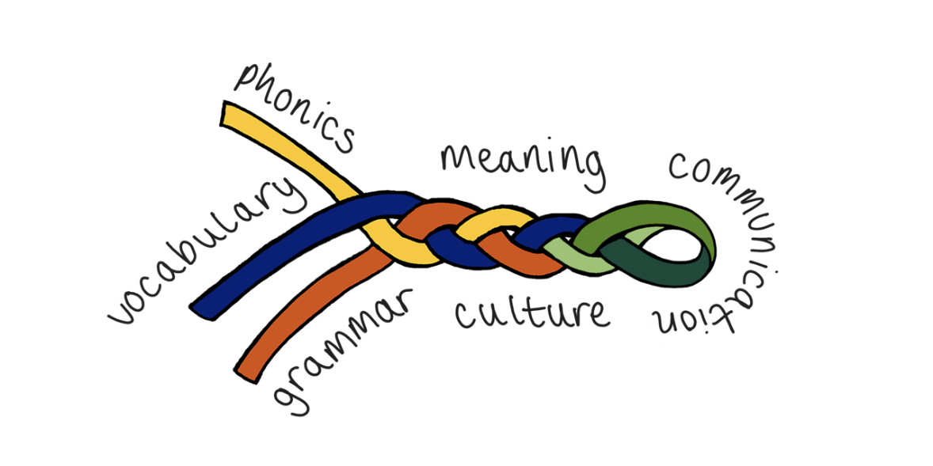
This session
Walk through of Key Stage 4 German SoW document
Presentation of Key Stage 4 sample resources based on SoW
NCELP Resource Portal
Notes:
This presentation is in three parts.
In part one I will talk about the excel file that contains the German Scheme of Work and talk you through the different tabs and the information that these contain.
In part two I’m going to showcase a selection of activities that we use at Key Stage 4, looking at how these cater for different proficiency levels and help to prepare students for the new GCSE exam.
In part three I will show you where you can find these resources on the NCELP resource portal so that you can browse them at a later date. If you’re interested in French or Spanish then you can find similar presentations about those schemes of work on our portal.

Slide 3
Tabs in the NCELP KS4 SOW
Y10 and Y11 Grammar Overviews
GCSE SOW
Phonics Tracker
GCSE German Grammar Tracker
KS4 Resources
GCSE List
KS3 Revisits
GCSE Revision Weeks
Notes:
When you download and open the Key Stage 4 Scheme of Work in excel, you will see that it has a series of coloured tabs at the bottom. The first two tabs are the Y10 and Y11 grammar week by week overviews of the new and revisited grammar points that provide the structure for that week’s teaching. We will now look at each of these tabs in turn.

Slide 4
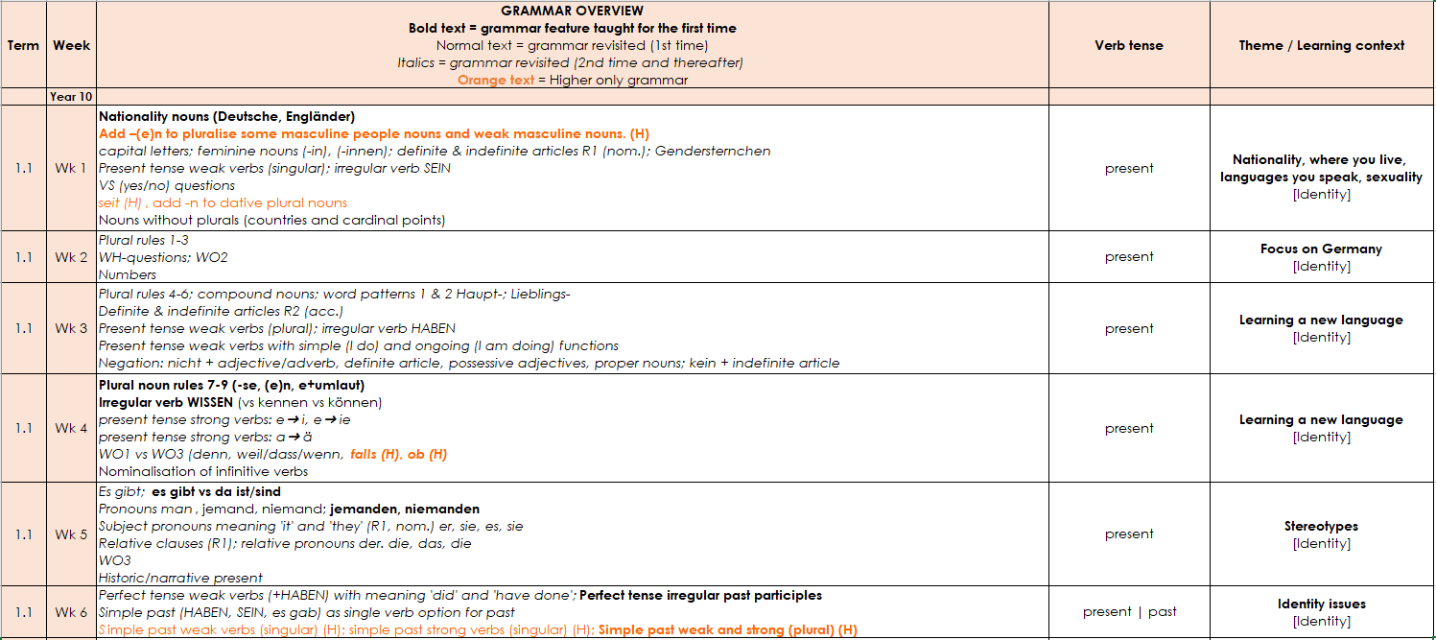
Y10 Grammar Overview
This column gives the learning context.
This column denotes the focus tense for that week.
New grammar features are in bold type.
Higher only features are in orange and followed by (H).
It also gives a GCSE theme.
There are five themes in our SOW:
Identity, Everyday living, My future, Exploring,
Global matters.
There is continuity from KS3. All non-bold text shows previously-taught knowledge.
Italics denotes grammar revisited a 2nd time or more.
Revision and test weeks have been built into the SOW.
Notes:
This is the Y10 Grammar Overview tab. [Click]
There is continuity in the content from Key Stage 3. All non-bold text shows previously-taught knowledge.
[Click]
New grammar features are in bold type.
[Click]
Higher only features are in orange and followed by an H in brackets.
[Click]
Italics denotes grammar revisited a 2nd time or more.
[Click]
This column denotes the main tense that is in focus for each week.
[Click]
This column gives the learning context.
[Click]
It also gives a GCSE theme.
[Click]
There are five themes in our SOW: Identity | Everyday living | My future | Exploring | Global matters.
[Click]
At the end of Term 1, there is a revision week followed by a test week. Revision weeks and assessment will aim to recap and assess knowledge all of the new grammar content, phonics and vocabulary covered since the start of the year or since the last assessment week. There are two further revision and assessment fortnights built into the scheme of work in Term 2.2 week 1 (just after the February half term) and Term 3.2 week 1 (just after May half term). Of course, teachers may wish to move these to align with school reporting deadlines or Y10 mock exams.
[Click]

Slide 5
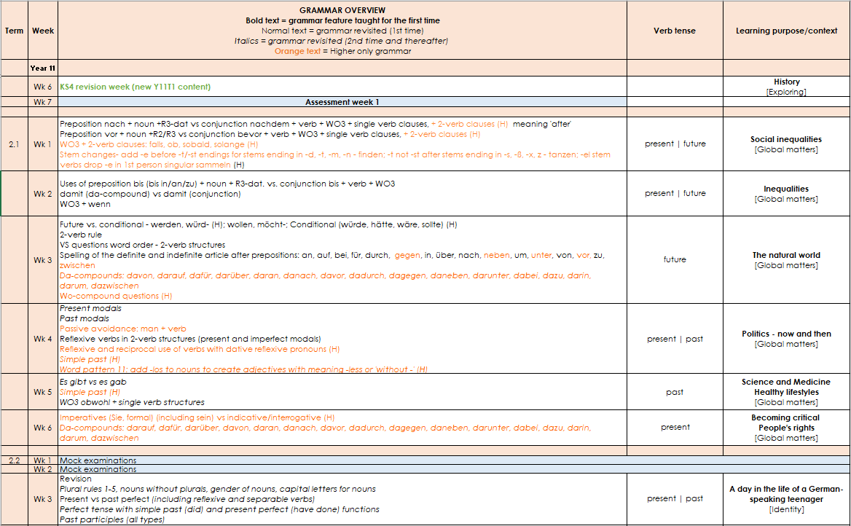
Y11 Grammar Overview
The Y11 week by week overview follows the same structure as the Y10 overview.
No new content is taught after February half term.
The GCSE content to be revised is divided up over the final 9 weeks, where the focus is exam practice.
Notes:
Let’s move on to Y11. This is the Y11 Grammar Overview tab. [Click] The Y11 week by week overview follows the same structure as the Y10 one.
[Click]
No new content is taught after February half term.
[Click]
The GCSE content to be revised is divided up over the final 9 weeks, where the focus is exam practice.
[Click]

Slide 6
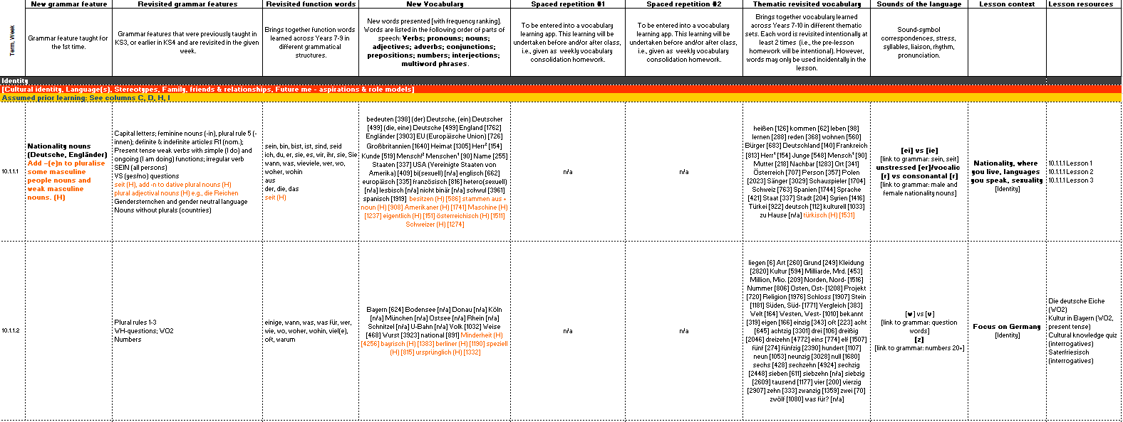
GCSE SOW
The new vocabulary column contains all words that are new to KS4.
1st and 2nd revisits of new KS4 words.
These columns repeat the grammar information from the overview, new and revisited respectively.
There are superscript numbers for words with multiple meanings.
Revisited thematic vocabulary from KS3.
Higher only vocabulary is in orange font.
This column lists all of the function words taught at KS3 and revisited at KS4.
Notes:
Let’s now look at the GCSE scheme of work tab. As you would expect, this is full and detailed. [Click]
These two columns repeat the grammar information from the overview, new KS4 and revisited KS3 grammar respectively. [Click] This column lists all of the function words (the words that are compulsory for all awarding bodies to include) which were already taught at KS3 and will be revisited at KS4. They recur multiple times each and are listed every time, for transparency.
[Click]
The new vocabulary column contains all words that are new to KS4.
[Click]
Higher only vocabulary is in orange font.
[Click]
The next two columns show the spaced revisiting schedule for the new KS4 words, which are first revisited after three weeks, and revisited for a 2nd time after nine weeks. [Click]
The final vocabulary column sets out the words taught at KS3 that have been selected for revisiting in that particular week. All KS3 words are intentionally revisited three times each across KS4, twice as part of themed teaching weeks and again as part of the final nine-week revision schedule in the lead up to the exams. [Click]
Words followed by a superscript number show whether it is the first, second or even third definition of the word to be introduced.
[Click]

Slide 7
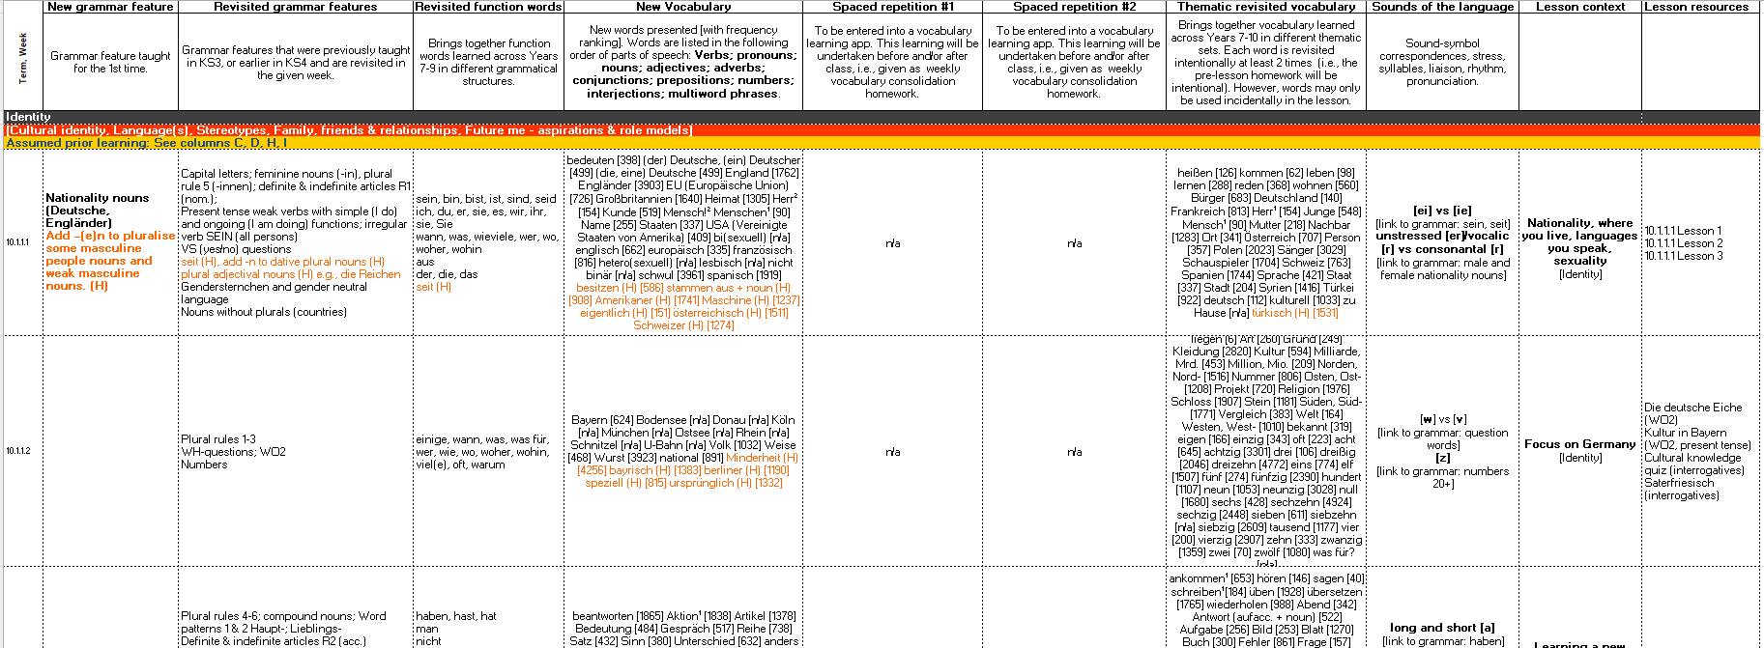
GCSE SOW continued…
Phonics, stress patterns and intonation
Weekly context
GCSE theme
Each row on the SOW represents one week of teaching, notionally 3 x 50 minute lessons.
Resources
All lesson resources will be free and fully adaptable by teachers for use in their contexts.
Notes:
[Click] Phonics are set out in the Sounds of the language column, which also includes other elements such as intonation and stress patterns in German. All sounds were taught at Key Stage 3, so at Key Stage 4 we revisit the SSCs (sound-symbol correspondences) each week linked to a relevant grammar feature. [Click]
The Lesson context column details the weekly lesson context as well as the overarching GCSE theme it belongs to.
[Click]
The Lesson resources tab indicates the materials that are available for that week.
[Click]
Each row on the SOW represents one week of teaching, notionally 3 x 50 minute lessons.
[Click]
As for Key Stage 3, all Key Stage 4 lesson resources will be free and fully adaptable by teachers for use in their contexts.
[Click]

Slide 8
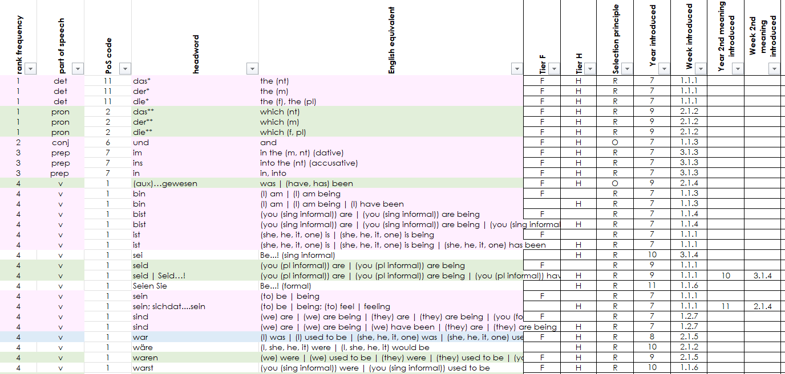
GCSE List
Words shaded in:
Pink – Y7, Blue – Y8, Green – Y9
No shading – KS4 Y10 & Y11
The list can be easily filtered for:
part of speech,
F/H tier,
R (required), O (optional), C (culture), MWP (multiword phrase).
Notes:
The GCSE List tab is a full word list for GCSE, and it is the word list that Eduqas will be using for its new suite of GCSE exams.
[Click]
As the list is in excel it can be easily sorted or filtered, making it easy to customise the display to show:
[Click]
the different parts of speech,
[Click]
all the F or H words,
[Click]
all the ‘R’ (required words – these are the words that are 100% common to all awarding bodies),
the O (optional words) – these are the remaining words up to a total of 1200 F / 1700 H words, of which at least 85% items come from a list of the most common 2000 words, and up to 15% may be of any frequency.
You can also see the ‘C’ (20 cultural terms) and ‘MWP’ (30 Multiword phrases) that make up the final totals of 1250 and 1750.
[Click]
These two columns give the year and the week when words were/are taught,
[Click]
and 2nd and 3rd meanings of words are taught and tracked separately.
[Click]
Words shaded in pink were first taught in year 7, in blue in year 8, in green in year 9 and where there is no shading these are KS4 words.

Slide 9
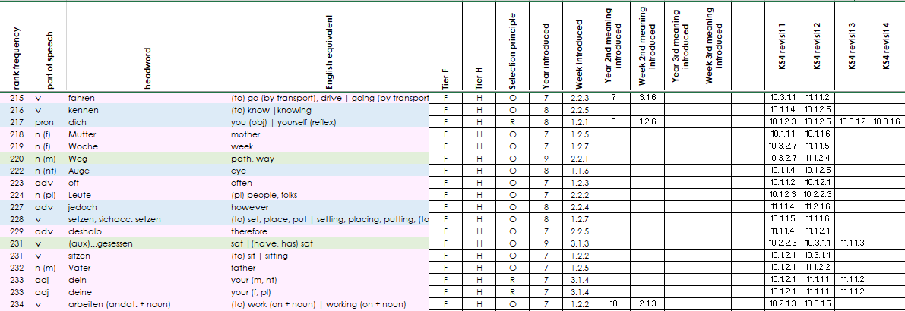
KS3 revisits
Notes:
This is the KS3 revisits tab.
[Click]
The final two columns show where words from key stage 3 are revisited in key stage 4. Each word will be revisited at least twice.
[Click]

Slide 10
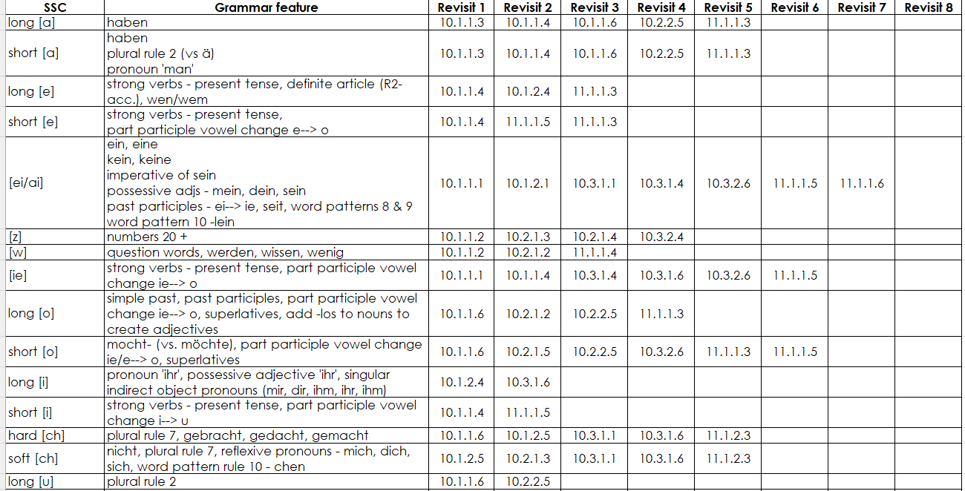
Phonics tracker
Here we have listed all of the SSCs/stress patterns, and the grammar features that will be revisited.
Notes:
Let’s move on to the phonics tracker.
[Click]
Here we show when each of the SSCs and stress patterns will be revisited and which grammar features it is relevant to in those weeks.

Slide 11
Grammar tracker
Details of when the grammar will be/was introduced
Details of revisits
List of features included in the GCSE subject content
Tier
Hyperlinks to previous resources
Notes:
[Click]
This is the grammar tracker, organised by tier
[Click]
The grammar tracker tab lists all of the grammar features included in the GCSE subject content
[Click]
and details when they are introduced and revisited.
[Click]
The document also contains hyperlinks to resources which taught and revisited the grammar at Key Stage 3, so the teacher can see the depth in which the feature was covered and the context in which it was practised.
[Click]

Slide 12
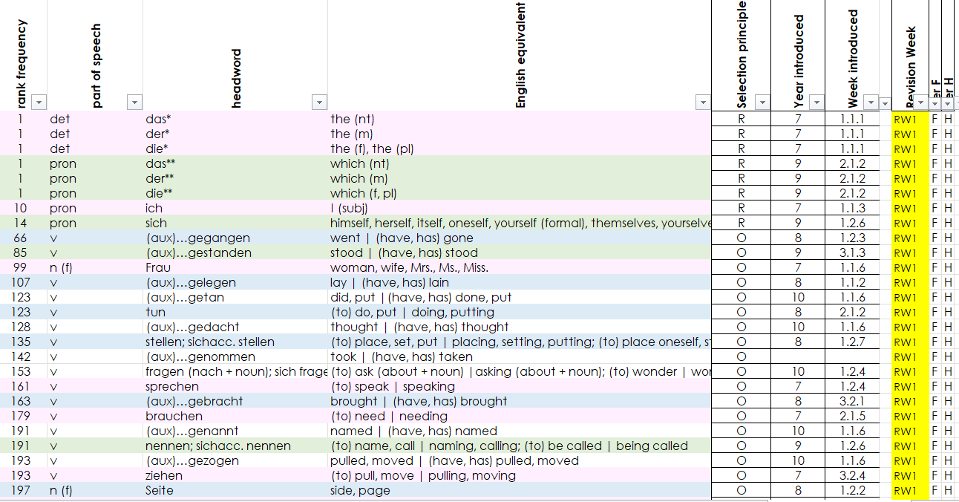
GCSE revision weeks
The final tab shows the words that are covered in each of the 9 revision weeks.
Notes:
[Click]
The GCSE revision weeks tab shows which words are to be covered in each of the 9 revision weeks.

Slide 13
KS4 Resources
Clicking on the hyperlink takes you directly to the resource on the NCELP Resource Portal.
Notes:
And finally, the KS4 Resources tab contains links to the lesson resource for each week and any accompanying homework and answer sheets and Quizlet sets.
[Click]
Clicking on the hyperlink takes you directly to the resource on the NCELP resource portal.
[Click]

Slide 14
This session
Walk through of Key Stage 4 German SoW document
Presentation of Key Stage 4 sample resources based on SoW
NCELP Resource Portal
Notes:
I’m going to showcase a selection of Key Stage 4 resources to help to prepare students for the new GCSE exam.

Slide 15
Identität: Länder, Sprachen, Nationalitäten
Y10 Term 1.1 Week 1
Janine Turner / Rachel Hawkes
Artwork: Steve Clarke
Date updated: 07/09/22
Notes:
All lessons have a title slide. The underslide notes give an overview of the week’s language content - the new and thematic revisited vocabulary, phonics and revisited function words. This sample is taken from the Year 10 Week 1, lesson 1 resource. This week we revise some key knowledge about nouns to lead into the introduction of nationality nouns, which are new to KS4. [Click]
……………………………………………………………………………………………………………………………………………………………………………………………………………………………..
Artwork by Steve Clarke. All additional pictures selected are available under a Creative Commons license, no attribution required.
Native-speaker teacher feedback provided by Stephanie Cross.
Learning outcomes (lesson 1): Revisit key noun knowledge: definite and indefinite articles (R1-nom.), use of capital letters Revisit formation of feminine person nouns (add –in to masculine person nouns) Revisit plural rule 5 (add –nen to feminine person nouns ending in –in) Revisit present tense weak verbs with simple (I do) and ongoing (I am doing) functions Revisit irregular verb SEIN (all persons) Revisit VS (yes/no) questions Revisit the knowledge that some nouns do not have a plural form (e.g., countries) Introduce nationality nouns and their use in German
Phonics: [ei] vs [ie] link to grammar: sein, seit; unstressed [er]/vocalic [r] vs consonantal [r] Word frequency (1 is the most frequent word in German):
New vocabulary: bedeuten [398] (der) Deutsche, (ein) Deutscher [499] (die, eine) Deutsche [499] England [1762] Engländer [3903] EU (Europäische Union) [726] Großbritannien [1640] Heimat [1305] Herr2 [154] Kunde [519] Mensch!2 Menschen1 [90] Name [255] Staaten [337] USA (Vereinigte Staaten von Amerika) [409] bi(sexuell) [n/a] englisch [662] europäisch [335] französisch [816] hetero(sexuell) [n/a] lesbisch [n/a] nicht binär [n/a] schwul [3961] spanisch [1919] besitzen (H) [586] stammen aus + noun (H) [908] Amerikaner (H) [1741] Maschine (H) [1237] eigentlich (H) [151] österreichisch (H) [1511] Schweizer (H) [1274]
Thematic revisited vocabulary: heißen [126] kommen [62] leben [98] lernen [288] reden [368] wohnen [560] Bürger [683] Deutschland [140] Frankreich [813] Herr [154] Junge [548] Mensch | Mensch! [90] Mutter [218] Nachbar [1283] Ort [341] Österreich [707] Person [357] Polen [2023] Sänger [3029] Schauspieler [1704] Schweiz [763] Spanien [1744] Sprache [421] Staat [337] Stadt [204] Syrien [1416] Türkei [922] deutsch [112] kulturell [1033] zu Hause [n/a] türkisch (H) [1531] Revisited function words: sein, bin, bist, ist, sind, seid, ich, du, er, sie, es, wir, ihr, sie, Sie, wann, was, wieviele, wer, wo, woher, wohin, aus, der, die, das, seit (H)
Source: Jones, R.L & Tschirner, E. (2019). A frequency dictionary of German: Core vocabulary for learners. London: Routledge.
The frequency rankings for words that occur in this PowerPoint which have been previously introduced in NCELP resources are given in the NCELP SOW and in the resources that first introduced and formally re-visited those words.
For any other words that occur incidentally in this PowerPoint, frequency rankings will be provided in the notes field wherever possible.

Slide 16
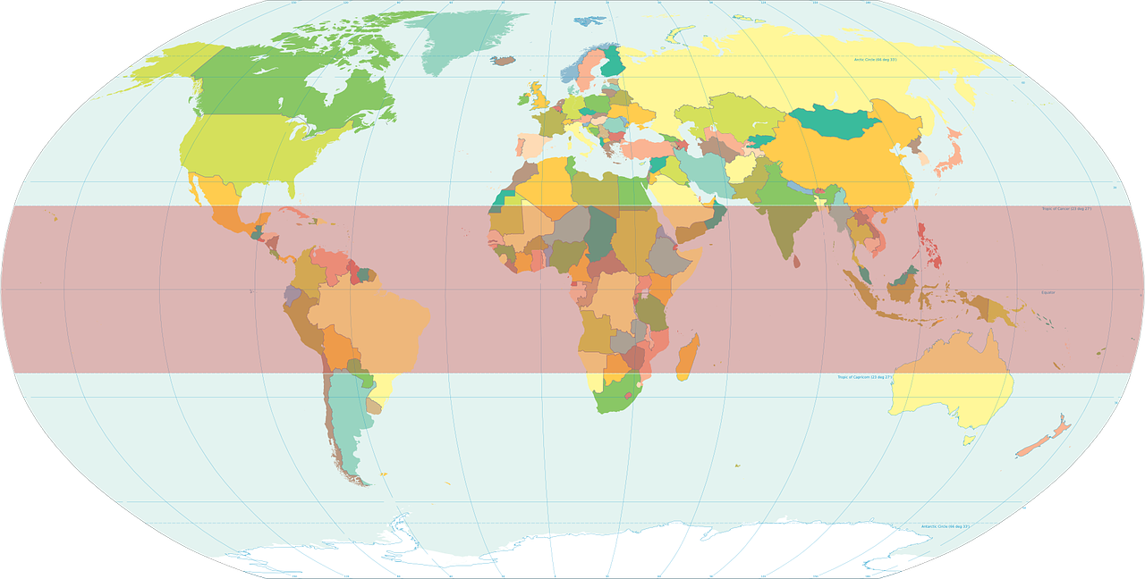
Wo in der Welt?
Großbritannien: Das sind drei Länder – England, Schottland und Wales. Das Vereinigte Königreich (UK): Das sind vier Länder – England, Schottland, Wales und Nordirland.
Auftakt
Kategorisiere die Wörter.
Kontinent | Land | Sprache | Anderes
Nordamerika
Deutschland
Deutsch
Großbritannien
Europa
Schweiz
Englisch
die Europäische Union
Österreich
Südamerika
die Vereinigten Staaten von Amerika (USA)
Die Europäische Union hat 27 Länder.
England
Nordamerika
Deutsch
Schweiz
Österreich
Deutschland
Großbritannien
die Vereinigten Staaten von Amerika (USA)
Europa
Englisch
England
die Europäische Union
Südamerika
Notes:
Lessons often start with a relevant activity that students can do, independently, on arrival to the lesson. In this brief categorisation activity, we revisit some previously taught vocabulary and introduce new, associated words.[click] …………………………………………………………………………………………………………………………………………………
Timing: 5 minutes Aim: to revisit previously taught vocabulary and introduce some new words associated with the theme of countries and languages. Procedure: 1. Students categorise the words into Kontinent, Land, Sprache, Anderes categories.
2. Play the 1.5 minute music clip to time the activity (icon bottom right)
3. Elicit responses by category. Click on the word (it disappears and reappears in the right category).
4. Click to provide further information about Großbritannien and die Europäische Union.

Slide 17
Nationality nouns [1]
Grammatik
All German nouns start with a capital letter, wherever they are in a sentence:
Which nouns do this in English?
Welche Sprache ist das?
Which language is that?
Proper nouns – e.g., countries and languages, but also nationality adjectives.
Compare how we describe nationality in English and German:
Ich bin Engländer.
I am English.
These are adjectives. But in German, we use nationality adjectives for things, not people: Das Buch ist deutsch. Der Text ist englisch. Note: no capital letters on adjectives.
Er ist Deutscher.
He is German.
But: ‘Ich lerne Deutsch.’ ‘Ich spreche Englisch.’ Languages are noun forms of nationality adjectives.
These are nouns; literally, Deutscher means ‘a German male’.
Notes:
We then introduce new information about nationality nouns, contrasting them with the form and use of nationality adjectives in German. [Click]
Timing: 3 minutes (two slides) Aim: to recap knowledge about German nouns; to introduce new information about German nationality nouns and contrast with English. Procedure: 1. Click to present the information step by step.
2. Elicit the English translations for the German examples given.

Slide 18
Nationality nouns [2]
Grammatik
This is the same pattern for most male → female person nouns:
Schüler → Schülerin
In German, add –er to the country to form many masculine nationality nouns.
Add –in for the feminine nationality noun.
Schweiz
➜
Schweizer
➜
Schweizerin
Österreich
➜
Österreicher
➜
Österreicherin
Some nationality nouns add an umlaut or add (or lose) a letter:
Remember how the [r] sound changes: r in the middle of words is produced at the back of the throat.
England
➜
Engländer
➜
Engländerin
Amerika
➜
Amerikaner
➜
Amerikanerin
Some nationality nouns are formed differently:
Deutschland
➜
Deutscher
➜
Deutsche
As you would expect, country nouns have no plurals.
Notes:
On this second grammar slide, we set out some clear examples of a pattern for nationality nouns, together with variations and a key exception. As at KS3, the brief explicit grammar explanations precede the all-important input practice activities. They raise awareness that supports the effectiveness of the input practice that now follows. [click]
[2/2]

Slide 19
Der Eurovision Song Contest
hören
Beim Eurovision Song Contest (ESC) ist Englisch jetzt die Lieblingssprache. Aber die Teilnehmer kommen aus so vielen Ländern.
Du hörst jetzt einige ESC-Fakten. Sprache/Adjektiv oder Nationalität? Welches Wort ist richtig?
1
Deutsch | Deutscher
5
Englisch | Engländer
2
Spanisch | Spanierin
6
Französisch | Französin
3
Schweden | schwedisch
7
Österreicherin | österreichisch
4
Turke | Türkisch
8
Englisch | Engländer
Notes:
New grammar features are always practised in input first, listening or reading or often both. This type of activity contrasts two forms, compelling students to choose based on the new information they have been presented with. Here, students decide between nationality person noun and language (or nationality adjective). [click]
Timing: 6 minutes Aim: to practise distinction between German nationality and adjectives or nominalised adjectival language nouns and their different use (for people and languages) in the oral modality. Procedure: 1. Set the context with students by reading the title and opening information.
2. Ensure that the task instructions are clear.
3. Click to listen to each sentence. Students select the nationality or language noun
4. Click to elicit answers, correct and give appropriate feedback to students.
1. Der Sänger Malik Harris ist [Deutscher].
2. 2022 singt Chanel ihren Songtext auf [Spanisch].
3. Agnetha, Anni-Frid, Benny und Björn sind [Schweden].
4. Bis 2003 hatte die Türkei die Tradition, nur auf [Türkisch] zu sprechen.
5. Aber 2003 singt die Sängerin, Sertab Erener auf [Englisch] - und sie gewinnt!
6. Celine Dion, die 1988 für die Schweiz gewinnt, singt auf [Französisch].
7. Conchita Wurst, die Gewinnerin aus dem Jahr 2014, ist [Österreicherin].
8. Der Kommentator, Graham Norton spricht [Englisch].

Slide 20
lesen
Der Eurovision Song Contest
Beim Eurovision Song Contest ist Englisch jetzt die Lieblingssprache. Aber die Teilnehmer kommen aus so vielen Ländern!
Sprache/Adjektiv oder Nationalität? Welches Wort ist richtig?
Der Sänger Malik Harris aus dem Jahr 2021 ist deutsch|Deutscher.
2022 singt Chanel ihren Songtext auf Spanisch|Spanierin.
Agnetha, Anni-Frid, Benny und Björn sind Schweden|schwedisch.
Bis 2003 hatte die Türkei die Tradition, nur auf Turke|Türkisch zu sprechen.
Aber 2003 singt die Sängerin, Sertab Erener auf Englisch|Engländerin – und sie gewinnt!
Celine Dion, die 1988 für die Schweiz gewinnt, singt auf Französisch | Französin.
Conchita Wurst, die Gewinnerin aus dem Jahr 2014 ist Österreicherin|österreichisch.
Der Kommentator, Graham Norton spricht Englisch|Engländer.
.
.
.
.
.
Notes:
This is the answer slide, but it also offers the option to teachers to practise the new knowledge in a reading activity, if the previous listening activity was too challenging for the class. In our resources we aim to cater for mixed classes of Foundation and Higher students, as well as set classes. We often provide alternative versions of activities or suggestions for meeting different learners’ needs under the slides. [click]
…………………………………………………………………………………………………………………………………………………………………….
ANSWERS
Note: if preferred, this slide could be used (instead of the previous listening slide) as a reading comprehension.
Timing: 2 minutes Procedure: 1. Elicit complete sentences from students in German.
2. Click to reveal the correct noun/noun/adjective and give feedback, as appropriate.
3. Elicit English meanings of each sentence to consolidate understanding of the grammar feature, the vocabulary and the content of the sentences.
4. Click to provide the additional information about Swiss German.
1. Der Sänger Malik Harris ist [Deutscher].
2. 2022 singt Chanel ihren Songtext auf [Spanisch].
3. Agnetha, Anni-Frid, Benny und Björn sind [Schwede].
4. Bis 2003 hatte die Türkei die Tradition, nur [Türkisch] zu sprechen.
5. Aber 2003 spricht die Sängerin, Sertab Erener [Englisch] - und sie gewinnt!
6. Celine Dion, die 1988 für die Schweiz gewinnt, singt auf [Französisch].
7. Conchita Wurst, die Gewinnerin aus dem Jahr 2014, ist [Österreicher/in].
8. Der Kommentar, Graham Norton spricht [Englisch].

Slide 21
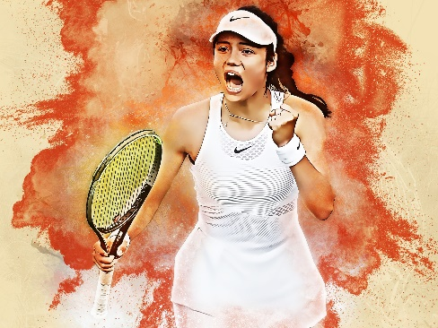
Sieger* bei Wimbledon
der Sieger - winner
lesen
Wimbledon ist ein sehr internationales Tennisturnier*.
Hier spricht man so viele Sprachen, hier gibt es so viele Nationalitäten.
Lies die Statistiken und schreib die fehlenden Wörter:
Der ___________(1) Roger Federer spricht ___________(2) in Wimbledon, aber zu Hause kann er natürlich auch Deutsch und ____________(3) sprechen.
Viele ___________ (4), wie John McEnroe und Pete Sampras, haben hier gewonnen, und die _________ (5), Venus und Serena Williams, haben 12 Mal gewonnen*.
Ein __________(6), Boris Becker, hat Wimbledon dreimal gewonnen.
Bis heute hat kein _____________ (7)Wimbledon gewonnen.
Die 18-jährige*________ (8) Emma Raducanu musste 2021 im Achtelfinale aufgeben, weil sie krank war.
1
2
3
4
5
das Turnier – tournament jährig – year-old gewonnen – won das Achtelfinale – last 16
Französisch
Engländer
Deutsch
Deutscher
Schweizer
Englisch
Amerikaner
Engländerin
Amerikanerinnen
Österreicher
Notes:
For example, we provide two versions of this activity. This is a reading gap fill, with jumbled German answers provided. [click]
………………………………………………………………………………………………………………………………………………………………………………………
Note: This is the comprehension version of the task (lower challenge). See next slide for a more challenging written production version.
Timing: 8 minutes
Aim: to practise written comprehension of nationality and language nouns and their use.
Procedure: 1. Introduce the task and ensure that both context and task are clear.
2. Tell students that there are more words than they need; each word is used only once.
3. Students write 1 – 8 and the correct missing nationality or language.
4. Elicit sentences orally from students, then click the audio buttons to listen and check.
Note: some cultural / general knowledge is expected in this task as not every answer can be worked out linguistically. Teachers could respond to students’ knowledge gaps by giving players’ countries of origin. e.g., Roger Federer kommt aus der Schweiz. Boris Becker kommt aus Deutschland. With these two pieces of information, students know enough to complete the task. Alternatively, teachers could provide the nationality information with the country flags, as on the next slide.

Slide 22
Sieger* bei Wimbledon
der Sieger - winner
schreiben
Wimbledon ist ein sehr internationales Tennisturnier*.
Hier spricht man so viele Sprachen, hier gibt es so viele Nationalitäten.
Lies die Statistiken und schreib die fehlenden Wörter:
Der ___________(1) Roger Federer spricht ___________(2) in Wimbledon, aber zu Hause kann er natürlich auch Deutsch und ____________(3) sprechen.
Viele ___________ (4), wie John McEnroe und Pete Sampras, haben hier gewonnen, und die _________ (5), Venus und Serena Williams, haben 12 Mal gewonnen*.
Ein __________(6), Boris Becker, hat Wimbledon dreimal gewonnen.
Bis heute hat kein _____________ (7)Wimbledon gewonnen.
Die 18-jährige*________ (8) Emma Raducanu musste 2021 im Achtelfinale aufgeben, weil sie krank war.
1
2
3
4
5
das Turnier – tournament jährig – year-old gewonnen – won das Achtelfinale – last 16
Notes:
This higher challenge version requires students to produce the missing German nationality and language nouns. [click]
………………………………………………………………………………………………………………………………………………………………………………….
Note: This is the production version of the task (higher challenge). See previous slide for a less challenging written comprehension version.
Timing: 8 minutes
Aim: to practise written production of nationality and language nouns and their use.
Procedure: 1. Introduce the task and ensure that both context and task are clear.
2. Students write 1 – 8 and the correct missing nationality or language.
3. Elicit sentences orally from students, then click the audio buttons to listen and check.
Note: here the cultural/general knowledge needed for the task has been provided by the country flags. This is to reduce the cognitive load and free up students’ capacity to focus on written production of the key language.

Slide 23
Sieger* bei Wimbledon
der Sieger - winner
lesen
Wimbledon ist ein sehr internationales Tennisturnier*.
Hier spricht man so viele Sprachen, hier gibt es so viele Nationalitäten.
Lies die Statistiken und schreib die fehlenden Wörter:
Schweizer
Englisch
Der ___________(1) Roger Federer spricht ___________(2) in Wimbledon, aber zu Hause kann er natürlich auch Deutsch und ____________(3) sprechen.
Viele ___________ (4), wie John McEnroe und Pete Sampras, haben hier gewonnen, und die _________________ (5), Venus und Serena Williams, haben 12 Mal gewonnen*.
Ein __________(6), Boris Becker, hat Wimbledon dreimal gewonnen.
Bis heute hat kein _____________ (7)Wimbledon gewonnen.
Die 18-jährige* ___________ (8) Emma Raducanu musste 2021 im Achtelfinale aufgeben, weil sie krank war.
1
Französisch
Amerikaner
2
Amerikanerinnen
3
Deutscher
4
Österreicher
Engländerin
5
das Turnier – tournament jährig – year-old gewonnen – won das Achtelfinale – last 16
Deutscher
Französisch
Engländer
Deutsch
Schweizer
Englisch
Amerikaner
Engländerin
Amerikanerinnen
Österreicher
Notes:
The same answer slide can be used for both versions of the task. [click]
ANSWERS
Timing: 2 minutes
Procedure: 1. Elicit sentences orally from students, then click the audio buttons to listen and check.
2. Click to provide written confirmation of the answers.

Slide 24
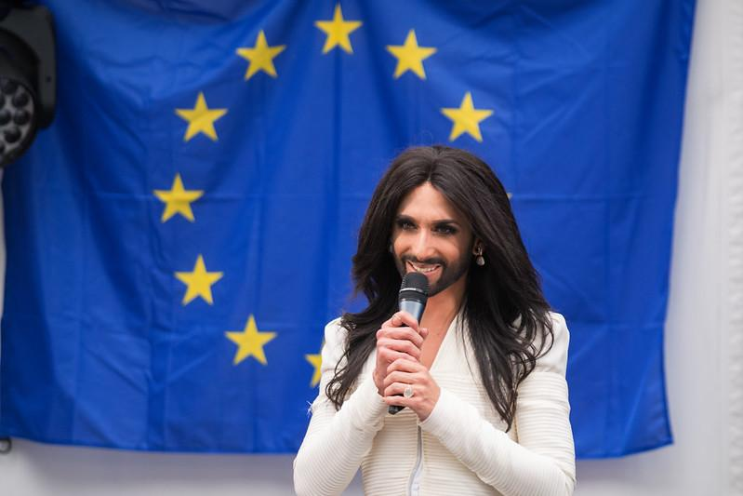
Online-Austausch
Du hast ein Profil geschrieben. Lies deinen Text vor. Dann beantworte die Fragen von deinem/deiner Partner*in.
sprechen
Ich heiße Tom, aber mein Name ist auch Conchita, wenn ich in Shows singe. Österreich ist meine Heimat und ich habe hier studiert. Conchita ist keine Österreicherin, sie ist in Südamerika geboren. Ich singe sehr gern Lieder und ich habe in einer Boyband gesungen, aber jetzt arbeite ich solo. 2014 habe ich den Eurovision Song Contest gewonnen.
Ich heiße Ben Neumann, ich bin 16 Jahre alt und ich bin Surfer. Und ich bin blind. Bei jedem Wetter surfe ich auf dem Fluss Eisbach hier in München. Er fließt* durch den Englischen Garten. Als ich klein war, bin ich Ski gefahren. Dann hat ein Gendefekt mich blind gemacht. Ich höre das Wasser und ich verstehe das Wasser, wenn ich surfe.
fließen – to flow
Notes:
This read aloud task that students complete in pairs, and then listen and check, comes with suggested follow up questions for the teacher to ask the students. There are a mixture of questions that follow up on the detail in the text and those that build more generally from the theme. This type of task normalises unprepared speaking, a major part of the new GCSE speaking assessment. [click]
……………………………………………………………………………………………………………………………………………………………………………………………………….
Timing: 7 minutes Aim: to practise read aloud of a short text in German, including several examples of this week’s target SSC [ei] and [ie]; to practise asking and answering questions; to learn about two German-speaking personalities.
Procedure: 1. Student A reads the first text aloud. 2. Student B then asks four questions to follow up. These can pick up on details from the text or can be more general. Some example questions are: Wann heißt er Conchita? Wo ist Toms/seine Heimat? (Wo ist Tom geboren?) Ist Conchita Österreicherin? Singt sie in einer Band? Was hat sie 2014 gemacht? Singst du auch gern? Was singst du? Wer ist dein Lieblingssänger/deine Lieblingssängerin/Band? Hörst du oft Musik? 3. Students swap roles for the 2nd text. 4. Some suggested questions for the 2nd text are as follows: Wie alt ist Ben? Ist er Sänger? Wo wohnt er? Wo surft er? Wo ist der Fluss? Fährt er Ski? Warum/warum nicht?
Was ist wichtig, wenn Ben surft? Warum?
Hast du Surfen gemacht?
Was ist dein Lieblingssport?
5. If desired, click on the image to hear the text read aloud by a native speaker. This ‘listen and check’ stage could follow the initial read aloud activity.
Image attribution: "Eurovision winner: Conchita Wurst at the European Parliament" by European Parliament is licensed under CC BY-NC-ND 2.0, Ben Neumann by Simon at Riverbreak Magazine

Slide 25
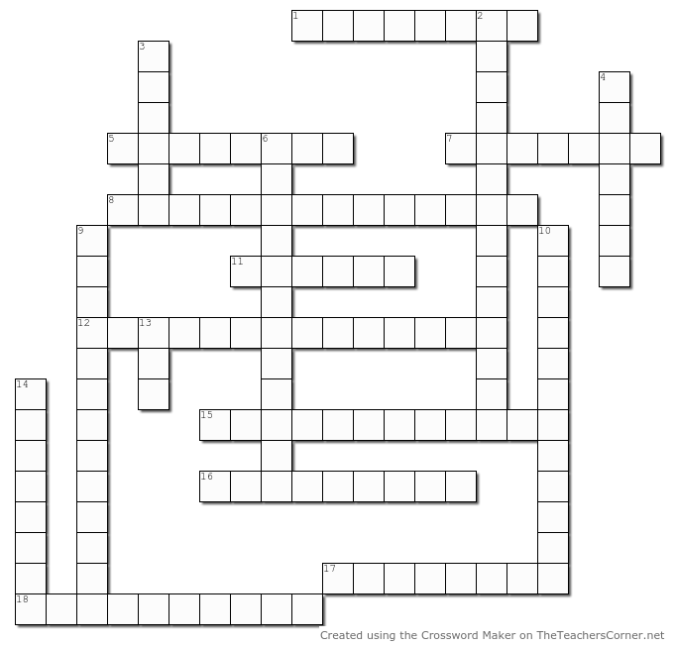
Identität
c
u
s
t
o
m
e
r
Vokabeln
t
u
Across:
1. der Kunde
5. Heimat
7. spanisch, Spanisch
8. (ein) Engländer
11. französisch, Französisch
12. (eine) Deutsche
15. Menschen
16. Herr 17. bi(sexuell) 18. nicht binär
o
r
l
o
e
h
o
m
e
l
a
n
d
S
p
a
n
i
s
h
w
e
b
a
n
E
n
g
l
i
s
h
m
a
n
i
G
e
n
h
a
r
F
r
e
n
c
h
e
n
e
m
u
t
a
G
e
r
m
a
n
w
o
m
a
n
e
Down:
2. Europäische Union
3. besitzen
4. lesbisch
6. (ein) Deutscher
9. Großbritannien
10. hetero(sexuell)
13. schwul 14. europäisch
t
a
n
i
r
E
y
o
o
u
B
h
u
m
a
n
b
e
i
n
g
s
r
r
a
e
o
i
g
e
n
t
l
e
m
a
n
x
p
t
u
e
a
a
a
i
b
i
s
e
x
u
a
l
n
o
n
-
b
i
n
a
r
y
Notes:
Vocabulary practice tasks continue to be very important. At early stages with new words, written comprehension is practised, for example in this crossword activity. [click]
Timing: 5 minutes
Aim: to practise written recognition of new words in this week’s vocabulary set.
Procedure:
Students complete the crossword, reading the clues in German, and writing or saying the answers in English. Students could write the clue numbers and complete the crossword individually, or work in groups to contribute answers orally. There should be a space between words for multiple word answers. Circulate to check students’ work.
Click to reveal the English translation of each word in the crossword and elicit the target German word, chorally, from students. Click again to indicate (with a tick) the German word.
Note: there is a pdf version of this crossword if teachers prefer to print paper copies.
Answers:
1. customer 2. European Union 3. to own 4. lesbian 5. homeland 6. a German man 7. Spanish 8. an English man 9. Great Britain 10. heterosexual 11. French 12. a German woman 13. gay 14. European 15. human beings 16. gentleman (note that students are learning this 2nd meaning of Herr this week, having previously learnt the meaning Mr.) 17. bisexual 18. non-binary

Slide 26
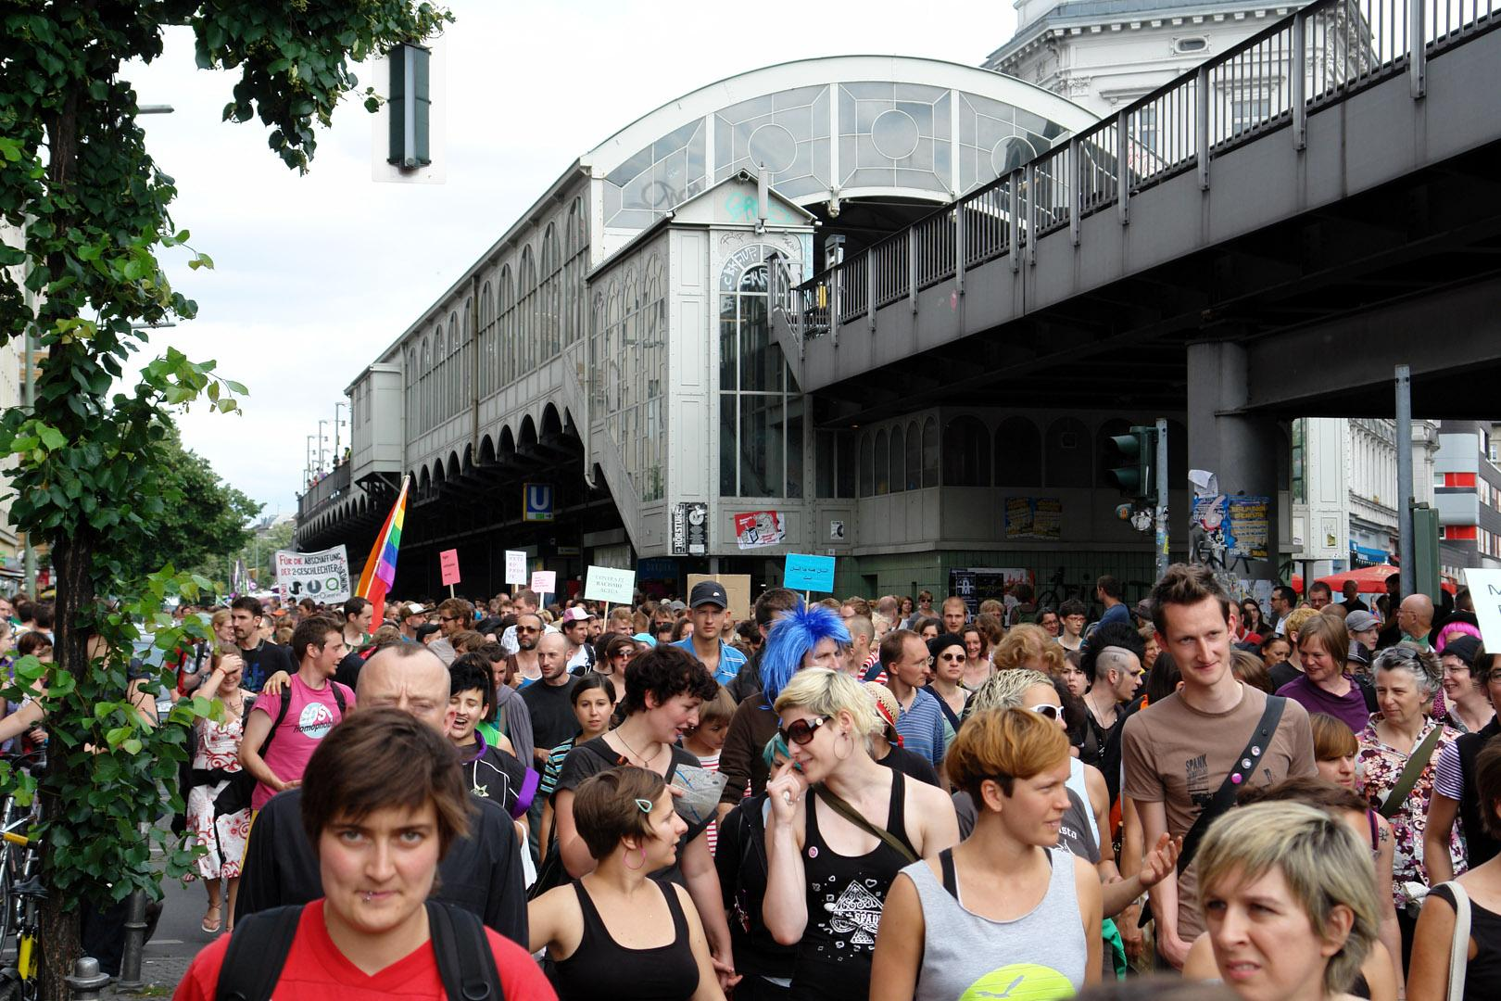
Christopher Street Parade
friedlich – peacefully unabhängig – independently
hören
Hör zu. Schreib die fehlenden Wörter auf Deutsch. Wie heißen sie auf Englisch?
The first Christopher Street Day (CSD) took place in Berlin in 1979. The name remembers the first rebellion by homosexual and other minority groups in Christopher Street, New York in 1961. Now almost every large city in Germany celebrates CSD, on different weekends in July and August. CSDs are both political parades and carnival processions. There is a party atmosphere but also a serious intent to raise awareness about LGBTQ rights.
1
20.000 Menschen gehen am 3. Juli 2022 in Graz auf die Straße.
2
Schwule, Lesbische, Nicht-binäre und Bisexuelle, sowie auch Heterosexuelle kommen zusammen, und sie marschieren friedlich durch die Stadt.
3
Sie stammen aus allen Ländern der Welt: aus den Vereinigten Staaten von Amerika, aus Großbritannien, aus der Europäischen Union.
4
Alle wollen an einem sonnigen Tag im Volkspark feiern, im Namen von Toleranz und von der Liebe.
5
Alle Menschen der Welt, unabhängig* von ihrer sexuellen Orientierung, sollen ihre Liebe feiern können.
6
Dieses Parkfest in Graz macht den Volksgarten für spanische, französische und österreichische Besucher zu einem safer Space!
Austrian
bisexuals
non-binary
come from
heterosexual people
EU
people
USA
French
gay people
lesbians
Great Britain
Spanish
people
name
Notes:
And here we practise aural comprehension of 15 new words for this week. This text also introduces the context for this lesson – gender identity and inclusive language use. [click]
…………………………………………………………………………………………………………………………………………………………………………………………………
Timing: 6 minutes
Aim: to practise aural recognition of 15 words from this week’s new vocabulary in context; to introduce the context for this lesson – gender identity and inclusive language use.
Procedure:
1. Click on the numbered audio buttons to hear each sentence. Students will hear the sentences in full.
2. After each sentence is heard, the teacher asks the students to say which words in German they heard from the English translations in the boxes.
3. The teacher then clicks to reveal the full sentence.
4. Oral translation of full sentences.
Transcript:
20.000 Menschen gehen am 3. Juli 2022 in Graz auf die Straße.
Schwule, Lesbische, Nicht-binäre und Bisexuelle, sowie auch Heterosexuelle kommen zusammen, und sie marschieren friedlich durch die Stadt.
Sie stammen aus allen Ländern der Welt: aus den Vereinigten Staaten von Amerika, aus Großbritannien, aus der Europäischen Union.
Alle wollen an einem sonnigen Tag im Volkspark feiern, im Namen von Toleranz und von der Liebe.
Alle Menschen der Welt, unabhängig von ihrer sexuellen Orientierung, sollen ihre Liebe feiern können.
Dieses Parkfest in Graz macht den Volksgarten für spanische, französische und österreichische Besucher zu einem safer Space!
Note: stammen and österreichisch are H only words.
Source: RosaLila PantherInnen - Mehr als 10.000 Menschen verwandelten Graz in ein buntes Meer der Vielfalt (homo.at)
Word frequency of unknown words and cognates used (1 is the most frequent word in German):
marschieren [4544] sonnig [n/a] Toleranz [4798] Volk [1032] unabhängig [751] Orientierung [3185]
Source: Lonsdale, D., & Le Bras, Y. (2009). A Frequency Dictionary of French: Core vocabulary for learners London: Routledge.
Image attribution: "File:Transgenialer CSD 2009 06.jpg" by Michael F. Mehnert is licensed under CC BY 3.0.

Slide 27
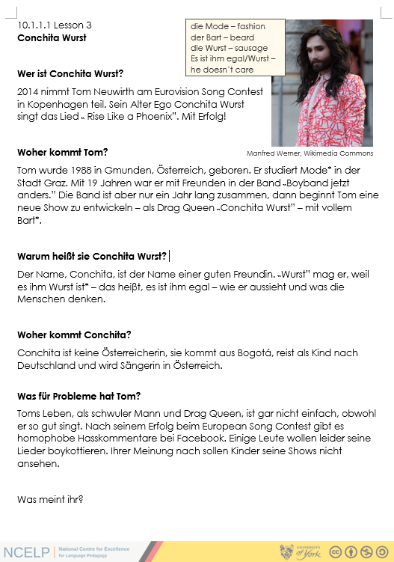
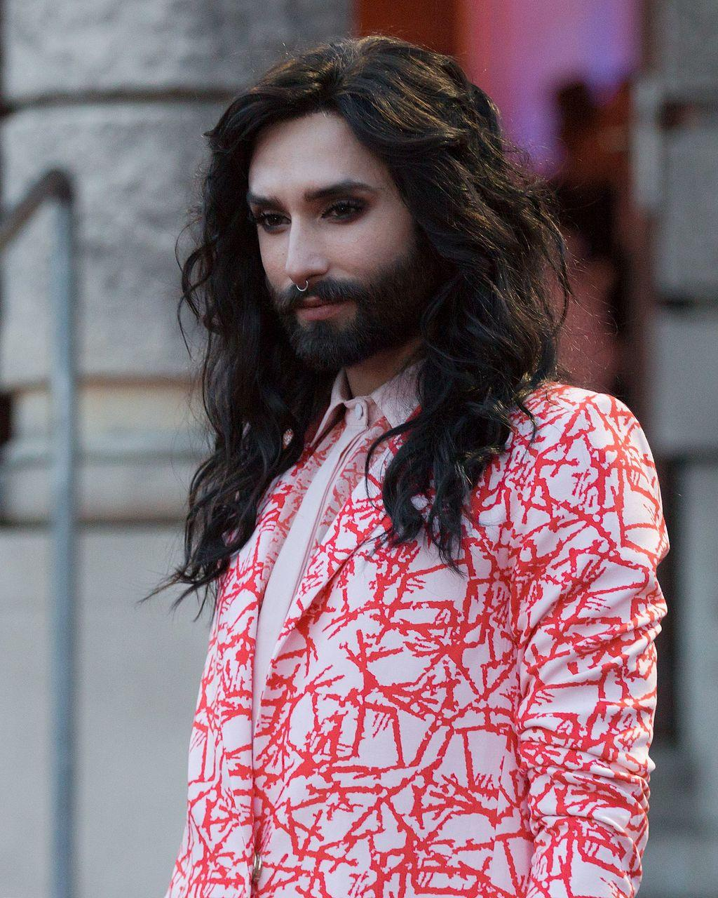
Conchita Wurst [1/2]
hören|lesen
die Mode – fashion der Bart – beard
Wer ist Conchita Wurst?
2014 nimmt Tom Neuwirth am Eurovision Song Contest in Kopenhagen teil. Sein Alter Ego Conchita Wurst singt das Lied ˵Rise Like a Phoenix”. Mit Erfolg!
Woher kommt Tom?
Tom wurde 1988 in Gmunden, Österreich, geboren. Er studiert Mode* in der Stadt Graz. Mit 19 Jahren war er mit Freunden in der Band ˵Boyband jetzt anders.” Die Band ist aber nur ein Jahr lang zusammen, dann beginnt Tom eine neue Show zu entwickeln – als Drag Queen ˵Conchita Wurst” – mit vollem Bart*.
Manfred Werner, Wikimedia Commons
Notes:
A feature of KS4 resources is the frequent use of more extended texts. For practical reasons, we often provide the text and questions as a separate worksheet resource. [click]
Timing: 5 minutes (with potential to extend work on the text for homework) Aim: to practise aural comprehension of language and structures from this week and prior learning. Procedure: 1. Click to play audio. Students listen and read.
2. Teachers ask the two questions. Students answer concisely – e.g., Sie ist Sängerin, Sie ist das Alter Ego von Tom Neuwirth. Er ist Österreicher.
Note: answers are not provided as several different answers are valid, here. 3. Teachers may wish to ask further questions to draw out comprehension of the text, time permitting.
4. Move on to slide 2
Transcript:
2014 nimmt Tom Neuwirth am Eurovision Song Contest in Kopenhagen teil. Sein Alter Ego Conchita Wurst singt das Lied ˵ Rise Like a Phoenix”. Mit Erfolg!
Tom wurde 1988 in Gmunden, Österreich, geboren. Er studiert Mode* in der Stadt Graz. Mit 19 Jahren war er mit Freunden in der Band ˵Boyband jetzt anders.” Die Band ist aber nur ein Jahr lang zusammen, dann beginnt Tom eine neue Show zu entwickeln - als Drag Queen ˵Conchita Wurst” – mit vollem Bart*.
Word frequency of unknown words and cognates used (1 is the most frequent word in German):
Bart [n/a] Mode [3867] Show [3367] Alter Ego [n/a] Drag Queen [n/a] homophob [n/a] Hasskommentar [n/a] boykottieren [n/a]
Source: Jones, R.L & Tschirner, E. (2019). A frequency dictionary of German: Core vocabulary for learners. London: Routledge.
Proper nouns: Tom Neuwirth, Conchita, Eurovision Song Contest, Kopenhagen, Gmunden, Bogota, Facebook
Image attribution: Manfred Werner - CC by-sa 4.0, CC BY-SA 4.0 via Wikimedia Commons Source: https://de.wikipedia.org/wiki/Conchita_Wurst

Slide 28
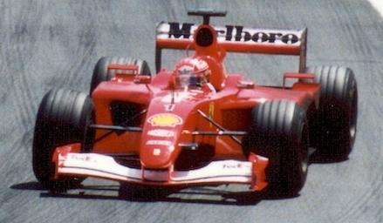
Michael Schumacher
hospital – das Krankenhaus
schreiben
Do you need a preposition if the action is finished?
Schreib die Sätze auf Deutsch.
1. Michael Schuhmacher was an F1 driver for 17 years.
2. In 2013, the German has a ski accident.
3. Since 2013, he has not been driving.
4. He was in a hospital* in Grenoble for a year.
5. In 2021, Netflix makes a film, which is in English, German and French.
6. There are interviews with three Englishmen, Bernie Eccleston, Damon Hill and David Coulthard.
7. Does Schuhmacher speak now? Unfortunately, the answer is no.
This nationality noun behaves like an adjective. Think: the German (citizen) → der ……… (Bürger)
Michael Schumacher war 17 Jahre lang F1-Fahrer.
2001, Canada
2013 hat der Deutsche einen Skiunfall.
Remember! Use the present tense with the preposition since in German.
Seit 2013 fährt er nicht.
Er war ein Jahr in einem Krankenhaus in Grenoble.
Do you need to add anything to R3 (dat.) plural nouns?
2021 macht Netflix einen Film, der auf Englisch, Deutsch und Französich ist.
Es gibt Interviews mit drei Engländern, Bernie E, Damon H and David C.
Remember how to form yes/no questions in German.
Spricht Schuhmacher jetzt? Leider ist die Antwort nein.
Notes:
This prose translation task targets written production of words and grammar from this week, whilst including other previously taught language, which is not credited in the mark scheme. Each underlined section is worth 2 points, giving a total of 20 for the task. The idea is that students attempt full sentences, but they should also be clear which words are targeted. This is the Higher version of the task. [click]
……………………………………………………………………………………………………………………………………………………………………………………
Note: this is a Higher version of the task. The animated callouts are presented as static tip boxes on the handouts.
Timing: 10-12 minutes Aim: to practise written production of language and structures from this week and prior learning. Procedure: 1. Students translate the seven sentences from English into German. 2. Students can peer mark this task (at the start of next lesson, perhaps). Note: this task deliberately targets words and grammar from this week, whilst including other previously taught language, which is not credited in the markscheme. Students should attempt full sentences, but they should also be clear which words are targeted. Each underlined section is worth 2 points, giving a total of 20 for the task. Markscheme: 2 points – message communicated accurately 1 point – message communicated 0 – message not communicated Note that item 4 repeats the same target structure as item 1. This is a 2nd chance for students to get the 2 points for this structure. If they get it right in both items, they still receive two points (i.e., they do not score 22/20).
Teachers may consider it useful to include summary tasks like this (either weekly or fortnightly), recording the scores and sharing them with students and parents (e.g., on the schools online data system). The tasks provide a very useful regular snapshot of student effort and progress over time. In our department, we have teacher-marked every 1/3 of these tasks, with peer marking for the rest. We have generally considered that 14+/20 is a benchmark for good progress, whilst regular scores of >12 are of concern.
Image attribution: Paul Lannuier from Sussex, NJ, USA, CC BY-SA 2.0 via Wikimedia Commons
Source: https://de.wikipedia.org/wiki/Michael_Schumacher

Slide 29
Michael Schumacher
Think about the R1 (nom.) adjective ending here: → ein ………….. F1 Fahrer.
schreiben
Schreib die Sätze auf Deutsch.
1. Michael Schuhmacher was a German F1 driver.
2. His wife Corinna is also German.
3. Is he driving F1 now?
4. No, in 2013, the German had a ski accident.
5. In 2021, Netflix makes a film in English, German and French.
6. The Englishmen Bernie Eccleston, Damon Hill and David Coulthard give interviews.
7. Does Schuhmacher speak in the film? Unfortunately not.
Use the nationality noun here. Do you need the masculine or feminine version?
Michael Schumacher war ein deutscher F1-Fahrer.
2001, Canada
Seine Frau Corinna ist auch Deutsche.
Remember! There’s only one present tense in German. And how do you create yes/no questions?
Fährt er F1 jetzt?
Many nationality nouns are the country + -er, often with an umlaut.
Nein, 2013 hatte der Deutsche einen Skiunfall.
2021 macht Netflix einen Film auf Englisch, Deutsch und Französich.
Die Engländer, Bernie E, Damon H and David C geben Interviews.
Another yes/no question. There’s no room for ‘does’ in German questions!
Spricht Schuhmacher im Film? Leider nicht.
Notes:
This is a Foundation version of the task. The animated callouts are presented as static tip boxes on the separate handouts. [click] …………………………………………………………………………………………………………………………………………………………………………………………….
Timing: 10-12 minutes Aim: to practise written production of language and structures from this week and prior learning. Procedure: 1. Students translate the seven sentences from English into German. 2. Students can peer mark this task (at the start of next lesson, perhaps). Note: this task deliberately targets words and grammar from this week, whilst including other previously taught language, which is not credited in the markscheme. Students should attempt full sentences, but they should also be clear which words are targeted. Each underlined section is worth 2 points, giving a total of 20 for the task. Markscheme: 2 points – message communicated accurately 1 point – message communicated 0 – message not communicated Note that item 4 repeats the same target structure as item 1. This is a 2nd chance for students to get the 2 points for this structure. If they get it right in both items, they still receive two points (i.e., they do not score 22/20).
Teachers may consider it useful to include summary tasks like this (either weekly or fortnightly), recording the scores and sharing them with students and parents (e.g., on the schools online data system). The tasks provide a very useful regular snapshot of student effort and progress over time. In our department, we have teacher-marked every 1/3 of these tasks, with peer marking for the rest. We have generally considered that 14+/20 is a benchmark for good progress, whilst regular scores of >12 are of concern.
Image attribution: Paul Lannuier from Sussex, NJ, USA, CC BY-SA 2.0 via Wikimedia Commons
Source: https://de.wikipedia.org/wiki/Michael_Schumacher

Slide 30
This session
Walk through of Key Stage 4 German SoW document
Presentation of Key Stage 4 sample resources based on SoW
NCELP resource portal
Notes:
Having looked at a few sample resources, I’m now going to show you our free resources and how to access them on the NCELP portal.

Slide 31
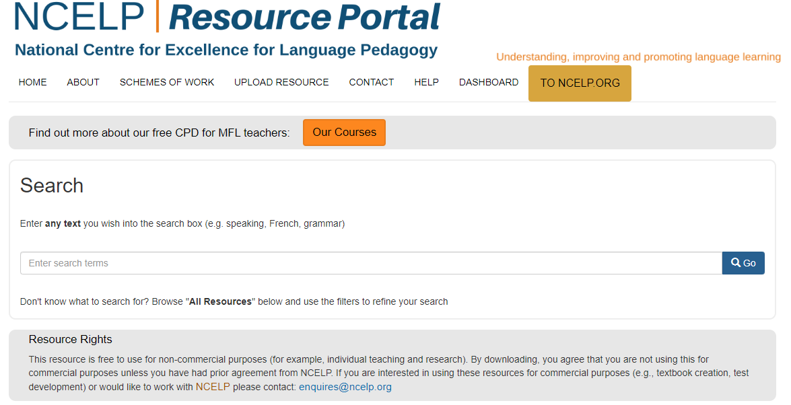
NCELP Resource Portal
German SOW Y10
https://resources.ncelp.org/
Notes:
This is our resource portal. It contains schemes of work, lessons, homeworks, assessments, language guides and CPD materials.
There are different options for accessing the resources.
[Click]
You can type what you are looking for into the search bar.
[click]
For example, German SOW Y10 will bring up any resources for Year 10 German.

Slide 32
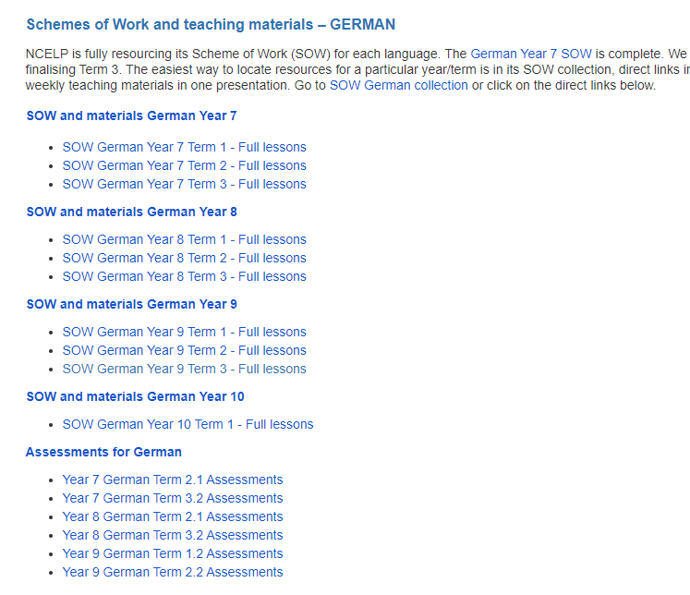
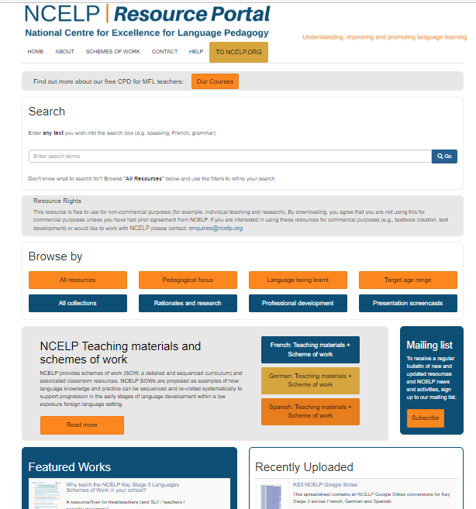
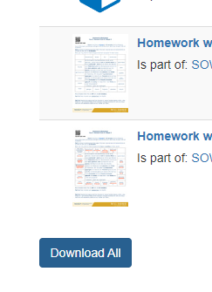
NCELP Resource Portal
Click on the All collections tab and scroll to the bottom to see the SOW and all materials collections.
Scroll to the bottom of the page and click to download all.
Click on a link to find all the resources for that term.
https://resources.ncelp.org/
Notes:
However if you scroll down, you can see there are different methods of browsing and including by collection.
[Click]
Click on the All collections tab and scroll to the bottom to see the SOW and all materials collections.
[Click]
Click on a link to find all the resources for that term.
[Click]
Then scroll to the bottom of the page and click to download all.

Slide 33
This session
Walk through of Key Stage 4 German SoW document
Presentation of Key Stage 4 sample resources based on SoW
NCELP Resource Portal
Notes:
That brings us to the end of this presentation. We hope you’ve found it a useful starting point for using NCELP resources.

