Slide 1
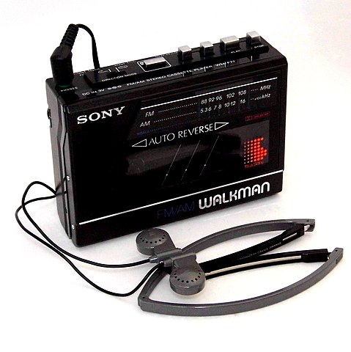
Please answer in the chat
Q1: What links the following images?
Computer Assisted Language Learning (CALL)
&
Vocabulary
Online Hub Day Friday 3rd July 2020
Session 2: 10-11am
David Shanks
@HFLanguages
Image attributions in slide notes
Notes:
This is a session about how digital technologies can support language learning. We will consider a range of areas but there will be a focus on vocabulary learning, particularly outside the classroom in order to see how we might best support students to learn and retain vocabulary in the long-term, whilst operating within a time-limited teaching context.
Image attributions, clockwise from top left:
1. Emoji One, Emojione 1F4DD, CC BY-SA 4.0. https://commons.wikimedia.org/wiki/File:Emojione_1F4DD.svg
2. Pixabay License. Free for commercial use. No attribution required. https://pixabay.com/photos/people-woman-frame-camera-shutter-2574337/ https://pixabay.com/service/license/
3. Trougnouf (Benoit Brummer), Steam locomotive Haine-Saint-Pierre No. 1378-1922 in Baasrode-Noord train station, Dendermonde (DSCF0566), CC BY-SA 4.0. https://commons.wikimedia.org/wiki/File:Steam_locomotive_Haine-Saint-Pierre_No._1378-1922_in_Baasrode-Noord_train_station,_Dendermonde_(DSCF0566).jpg
4. Joe Haupt from USA, Vintage Sony Walkman, FM-AM Stereo Cassette Player, Model WM-F77, Made In Japan, Circa 1986 (44032204520), CC BY-SA 2.0. https://commons.wikimedia.org/wiki/File:Vintage_Sony_Walkman,_FM-AM_Stereo_Cassette_Player,_Model_WM-F77,_Made_In_Japan,_Circa_1986_(44032204520).jpg

Slide 2

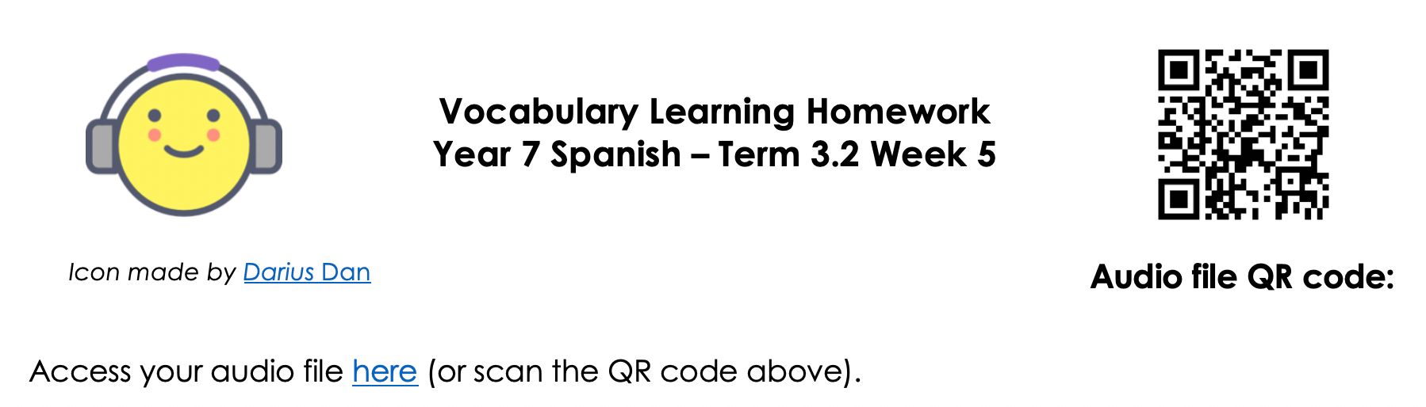

Session Outline
Models for the use of technology in education
CALL benefits and trends
Practical examples of CALL, linked to NCELP work:
  Technology Facilitated Oral Homework
  NCELP’s Guided Vocabulary Learning Homework
  Quizlet and NCELP’s vocabulary sets
  CALL in context – Jenny @SWBGS
  (Duolingo)
David Shanks

Slide 3
Technophiles vs Technophobes?
Is technology a silver bullet for language learning?
(The Guardian, 2014)
France bans mobile phones in schools
…The government has banned mobile phones in schools for all pupils up to the age of 15.
(BBC, 2018)
David Shanks

Slide 4
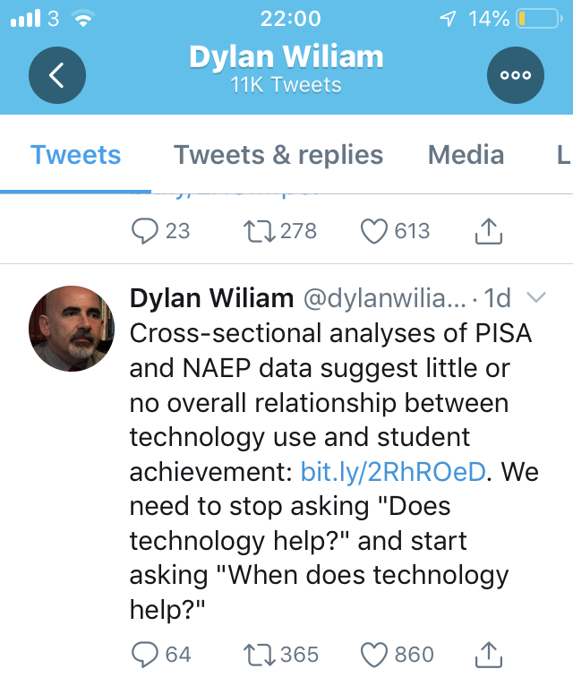
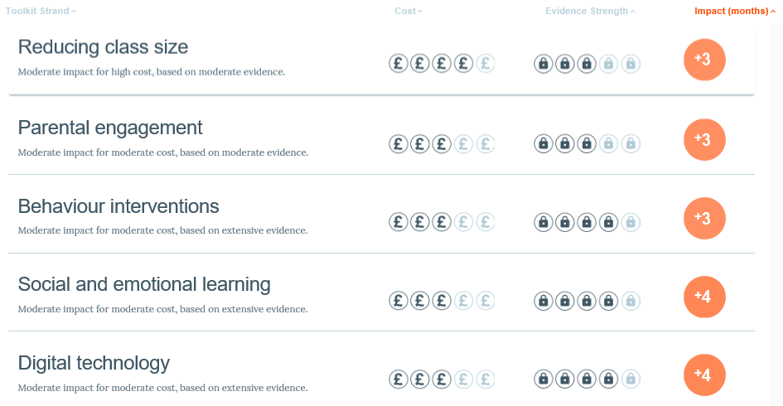
The Bigger Picture - Debate
(Reboot Foundation, 2019)
(Education Endowment Foundation, 2019)
David Shanks
Notes:
NAEP = National Assessment of Educational Progress (USA); PISA = Programme for International Student Assessment

Slide 5
A Reminder!
Technology is nothing more and nothing less than the application of technical knowledge for practical purposes
When used effectively:
  It improves and streamlines processes, facilitating the completion of tasks more effectively and easily.
  It allows us to do things that would be inconceivable without the use of technology. (Picardo, 2017)
David Shanks

Slide 6

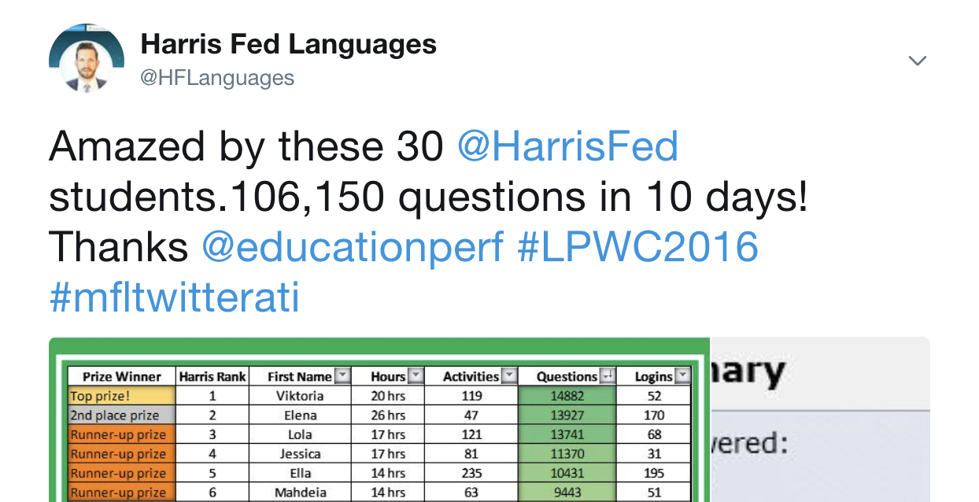
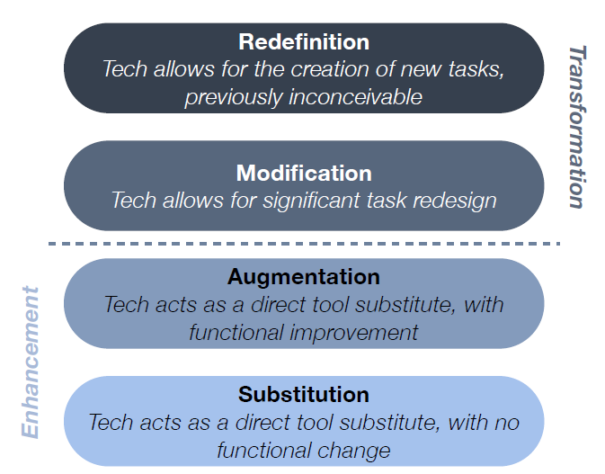
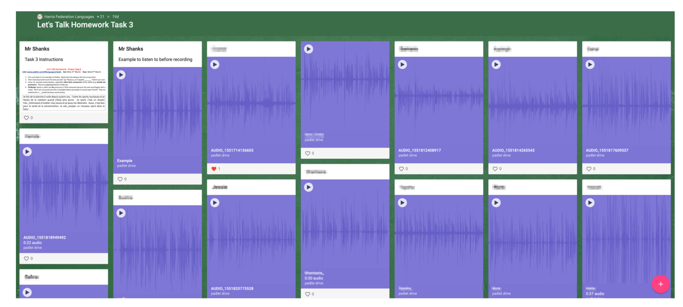
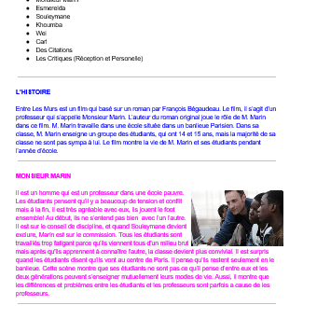
The SAMR Model
Access out of class
(Puentedura, 2010)
David Shanks

Slide 7
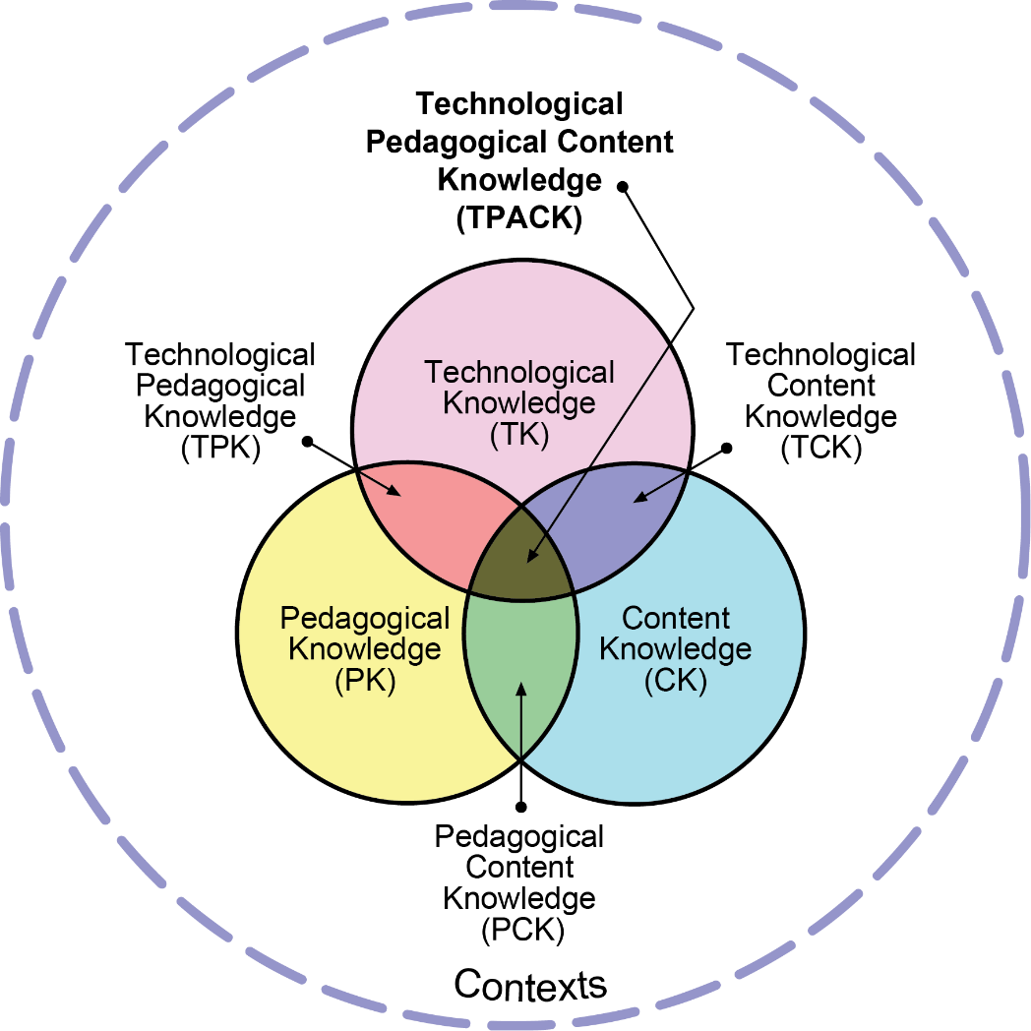
The TPACK Model
What messages can we take from this model?
Importance of integrating PK, CK, TK
Need to know the tech…
…but that alone is not sufficient
How does the tech support our pedagogy?
Who chooses the content? PVG? Frequency?
PK & CK can lead to informed tech choices
Importance of context
(TPACK.org, 2012)
David Shanks

Slide 8
Some Benefits of CALL
Increased motivation, differentiation, interaction with L2 and native speakers, positive association with attainment (BECTA, 2004)
Automated, immediate feedback
Complex competencies broken down – short term goals
Evidence of achievement or progress – metacognition (familiar, mastered, %, ●●● )
Gamification and competition can increase motivation
Restructuring / retesting the same content in new ways
Increasing ability to work across modes & modalities (audio in/out, multimedia)
Out of class learning – very significant in a time-poor context
Points 2-5 may overlap with learning preferences of some boys in MFL
Time efficiencies and ease of recycling/adapting for teachers
David Shanks

Slide 9

Trends in CALL
Proliferation of Open Educational Resources
Blending Formal and Informal Learning
Data-driven Technology
(learning analytics, adaptive learning)
Mobile Learning
Immersive Technology
(Adams-Becker et al., 2016)
90% of households in the UK have internet access (Ofcom, 2018)
Proliferation of Internet-connected mobile devices: 80% of 8-11s making use of tablets (Ofcom, 2016)
Mobile device recording capabilities, increasing connectivity speeds
Be acutely aware of digital equity and inclusion. Have alternative provisions.
David Shanks

Slide 10

Covid-19 CALL Trends
Little or no IT access at home is a challenge for around one quarter of pupils. Disadvantaged students disproportionately affected (Lucas et al., 2020)
Lots of free trials!
Simple approaches to remote teaching: Use asynchronous learning. Short videos. (Daniels, 2020)
Every cloud…
  increase in access to tech?
  upskilling of teachers and students
  school VLEs, systems for remote teaching & learning
  Technology in Language Teaching(TILT) Webinars!
David Shanks

Slide 11
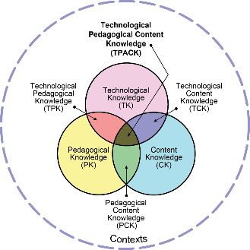
Pedagogy First
As computer technology is constantly developing, it is clear that the effectiveness of CALL cannot reside in the medium itself, as it is always changing; rather, effectiveness must be judged in how these technologies are put to use in ways that are consistent with theoretical and pedagogical development and education.
(Smith, 2015)
CALL is not just about the technology, app, platform or website being used, it is “a dynamic complex in which technology, theory, and pedagogy are inseparably interwoven.”
(Garrett, 2009)
David Shanks

Slide 12
From the MFL Pedagogy Review:
A planned approach to teaching vocabulary, grammar and phonics…should be supplemented by additional, attractive resources, including ICT…
ICT has also been shown to be very effective in the field of vocabulary, provided that it is used as an aid to teaching rather than a replacement for it. This all requires very careful planning.
[Students] should have opportunities to interact with native speakers, both in person and through video links.
Question for MFL leaders from PR: how is ICT being used to reinforce and support teaching?
David Shanks

Slide 13
Practical CALL examples with a focus on NCELP principles

Slide 14
Chat Question
Please answer in the chat
Q2: What technology (hardware, software, apps, websites, platforms etc) do you use in your MFL teaching context?
Pause and reflect…
What informed your decision to use that tech?
Does it have a pedagogical rationale?
Do you have control over the language content?
Does it streamline processes?
Consider the tech in relation to TPACK & SAMR?

Slide 15
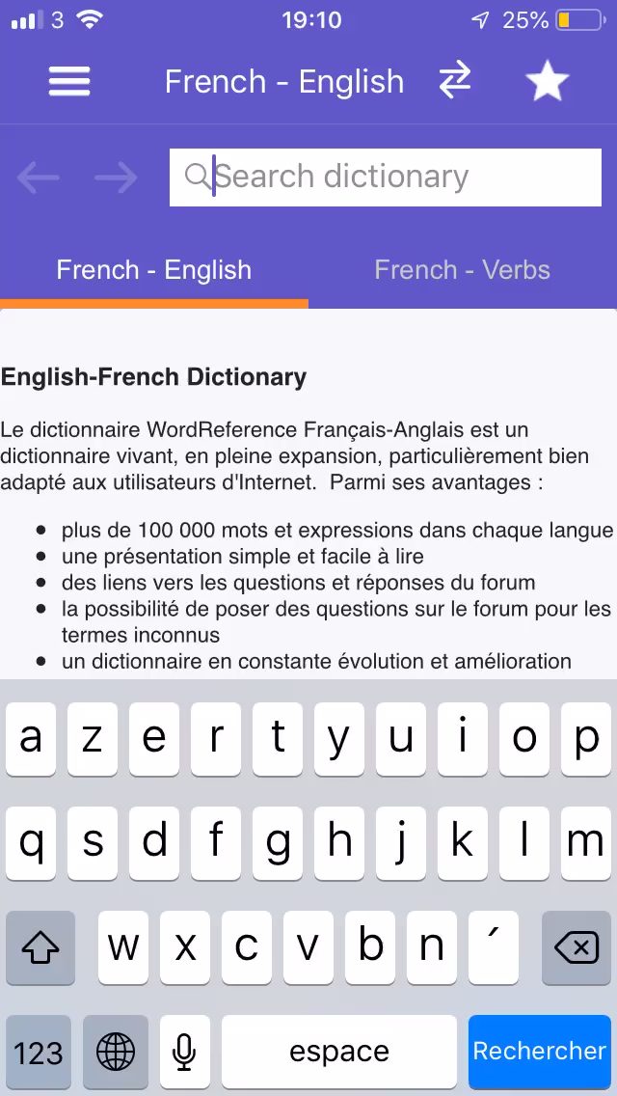
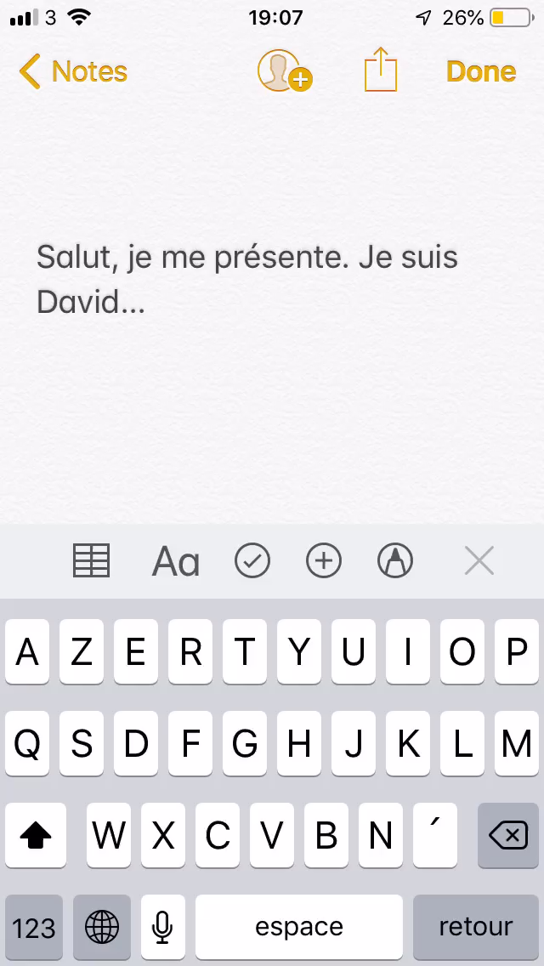
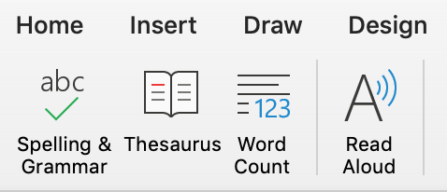
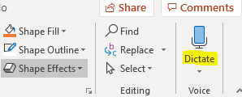
Supporting Phonics / SSC
Microsoft Word, Powerpoint, OneNote
David Shanks

Slide 16
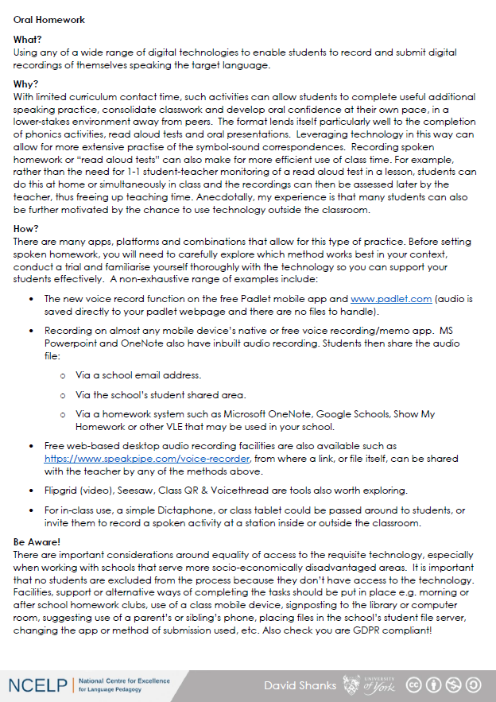
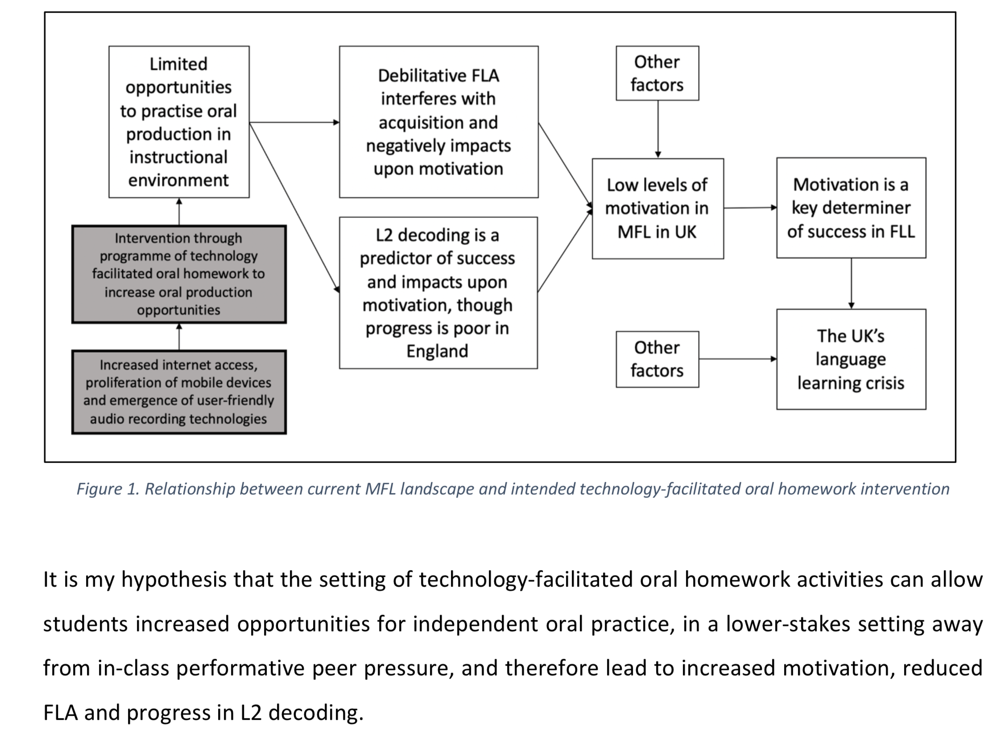
Technology-Facilitated Oral Homework
Oral Homework Overview Guide
(David Shanks, MA dissertation, 2019)
David Shanks

Slide 17
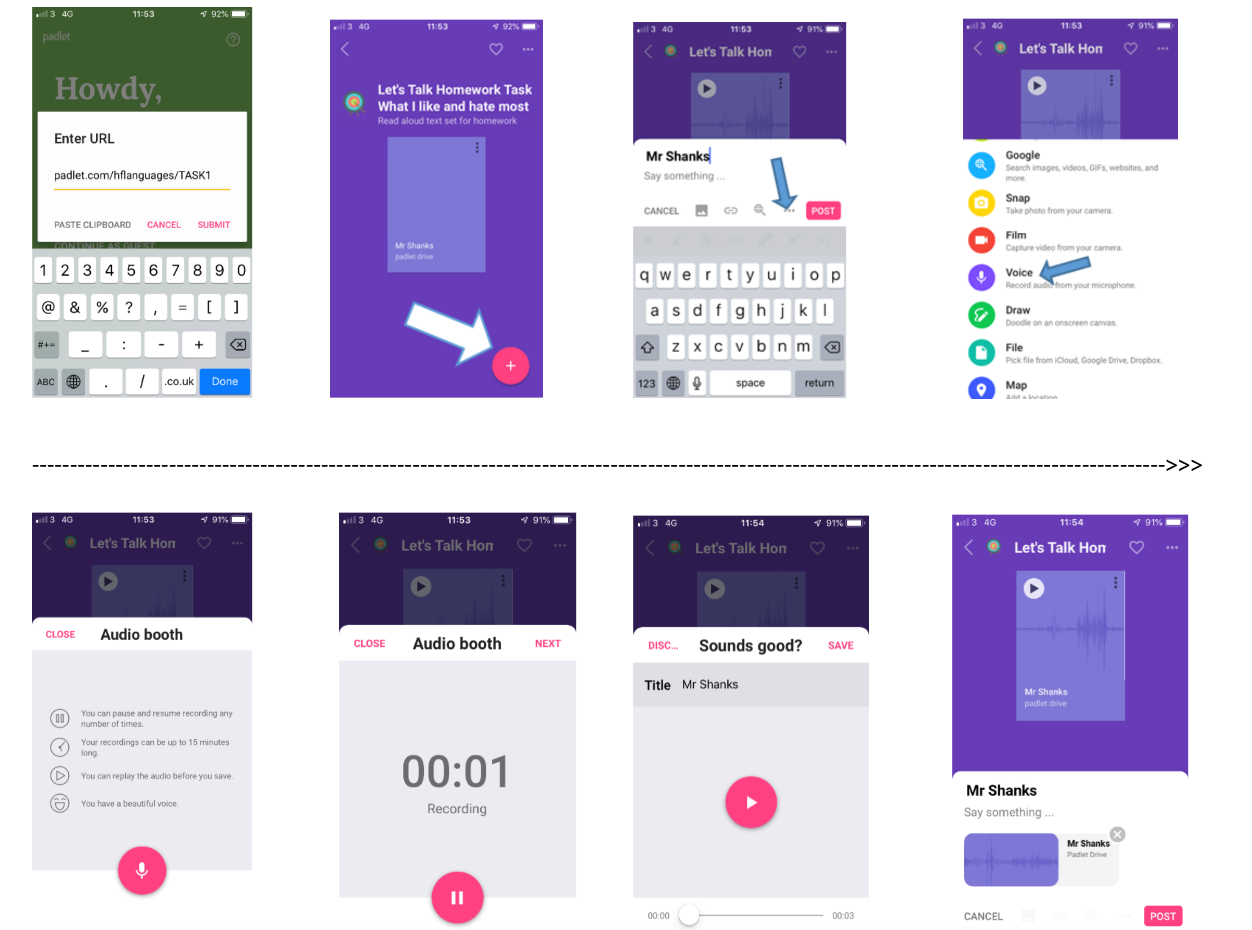
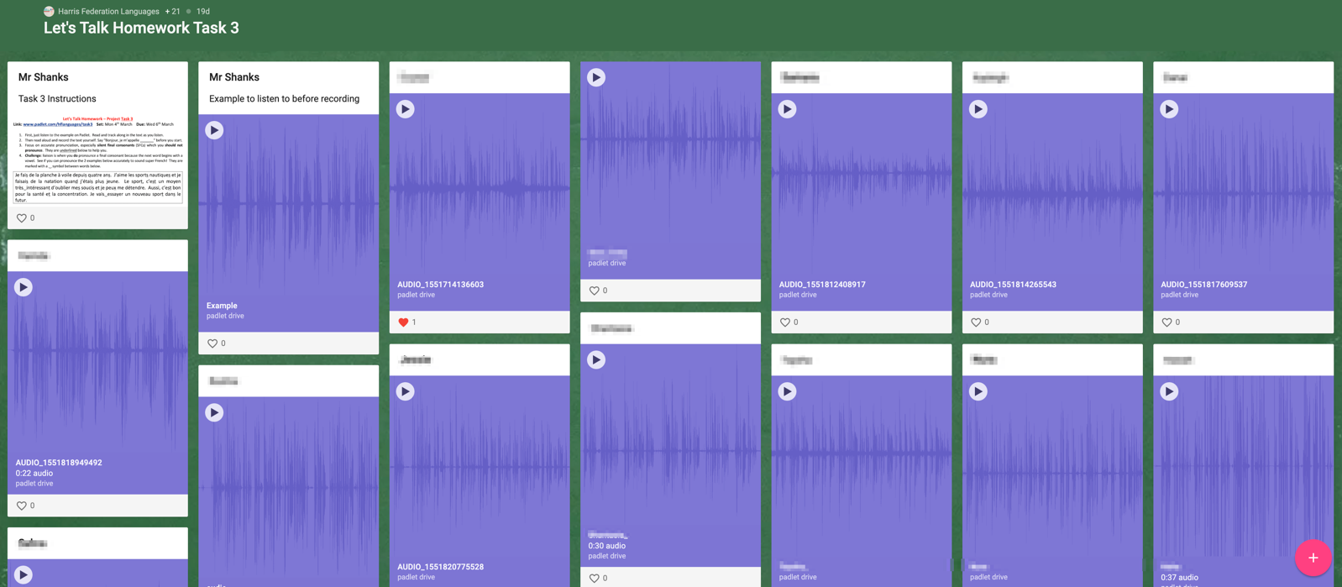
Case Study (Padlet.com)
David Shanks

Slide 18
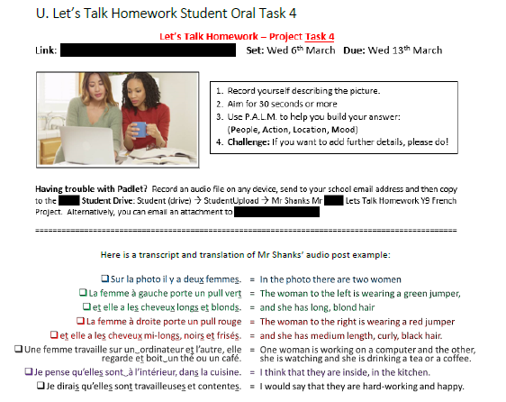
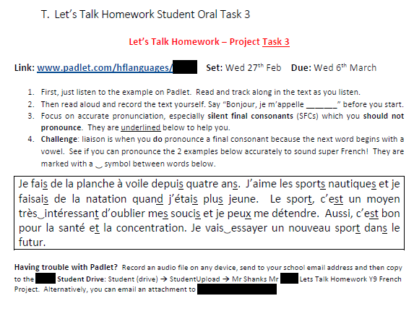
Example Tasks
David Shanks

Slide 19
Case Study Findings (1)
David Shanks

Slide 20
Case Study Findings (2)
David Shanks

Slide 21
Case Study Findings (3)
Case study found a strong pedagogical rationale for oral homework:
  “Oral homework has the potential to open the door to increased motivation, reduced FLA, improved decoding/pronunciation, greater self-efficacy and more self-regulated learners”
When I speak French I feel like I'm not pronouncing it properly, and I get really anxious that people will judge me and the teacher will probably say I didn't do it correctly. (Student A)
[Motivation for speaking has] increased definitely and I've noticed a couple of students who have been a lot more forthcoming with speaking in lessons (Teacher)
I first say it in front of my sister to see how I sound then I try and record, and if I don't like how I sound I'll delete it, and just keep on doing that until I'm actually happy with what I recorded. (Student B)
…for the tongue twisters I had to record like ten different times. (Student C)
David Shanks

Slide 22
Other TFOH tools
David Shanks

Slide 23
Other TFOH tools
Adding audio in PowerPoint or OneNote
Vocaroo.com
Extemporeapp.com
Flipgrid.com
Lingt.com
Online-voice-recorder.com
Padlet.com
Qwiqr.education
Showbie.com
Built-in / free sound recorder apps
David Shanks

Slide 24
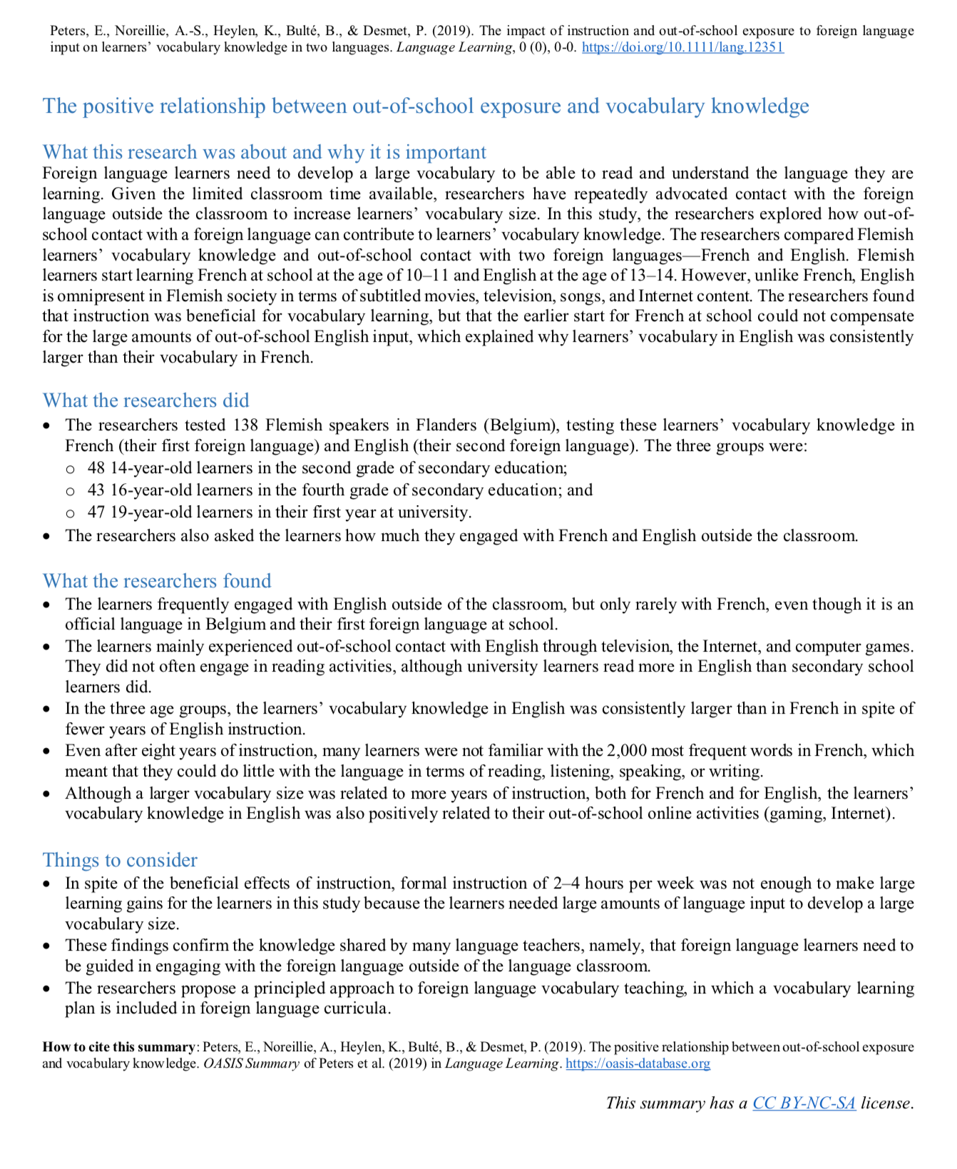

CALL and Vocabulary
The positive relationship between out-of-school exposure and vocabulary knowledge.
(Peters et al., 2019)
Researchers have repeatedly advocated contact with the foreign language outside the classroom to increase learners’ vocabulary size
Even after eight years of instruction, many learners were not familiar with the 2,000 most frequent words in French, which meant that they could do little with the language
In spite of the beneficial effects of instruction, formal instruction of 2–4 hours per week was not enough to make large learning gains
Resulting suggestions:
  foreign language learners need to be guided in engaging with the foreign language outside of the language classroom.
  The researchers propose a principled approach to foreign language vocabulary teaching, in which a vocabulary learning plan is included in foreign language curricula.
oasis-database.org
David Shanks

Slide 25
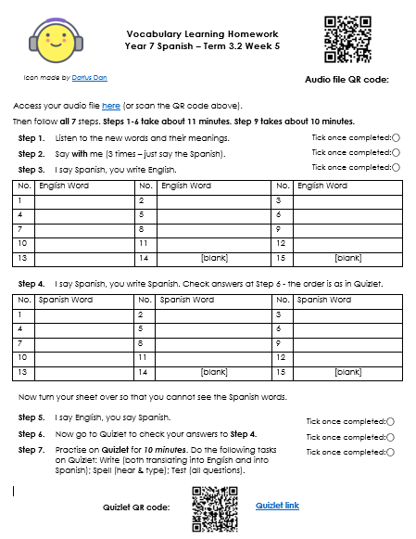

Guided Vocabulary Learning Homework
“foreign language learners need to be guided in engaging with the foreign language outside of the language classroom” Peters et al. (2019) →
Listen (TL and English)
Say with me (3 times - just TL).
I say TL, you write English.
I say TL, you write TL
I say English, you say TL
Self-assess step 4 using Quizlet
Practise on Quizlet (Write, Spell, Test)
Idea from Leigh McClelland, Cam Academy Trust

Slide 26

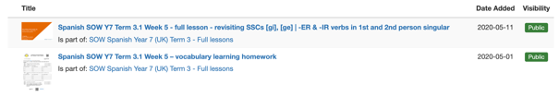
Guided Vocabulary Learning Homework
resources.ncelp.org
Leigh McClelland, Cam Academy Trust

Slide 27
Quizlet Poll
How familiar are you with Quizlet?
  Never heard of it!
  I’ve heard of it, but never used it
  I used to use it, but stopped
  I use it occasionally
  I use it regularly with certain classes
  I use it in an embedded, consistent way across all classes
  I’m a Quizlet Ambassador!
David Shanks

Slide 28

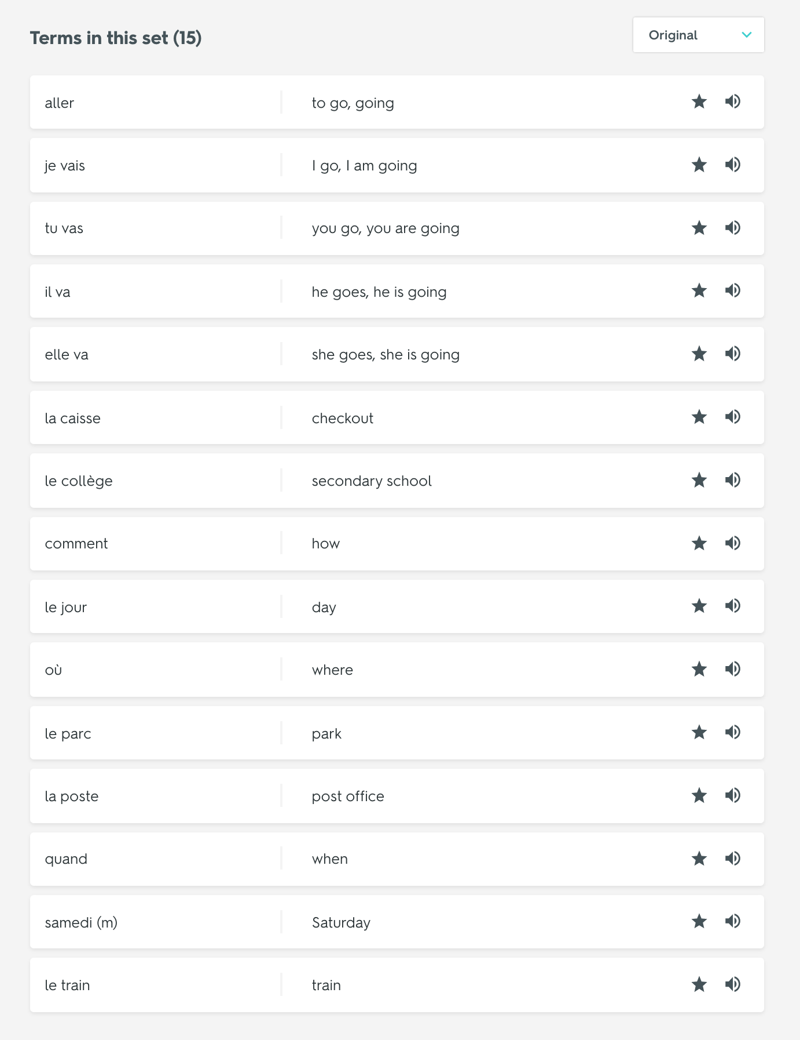
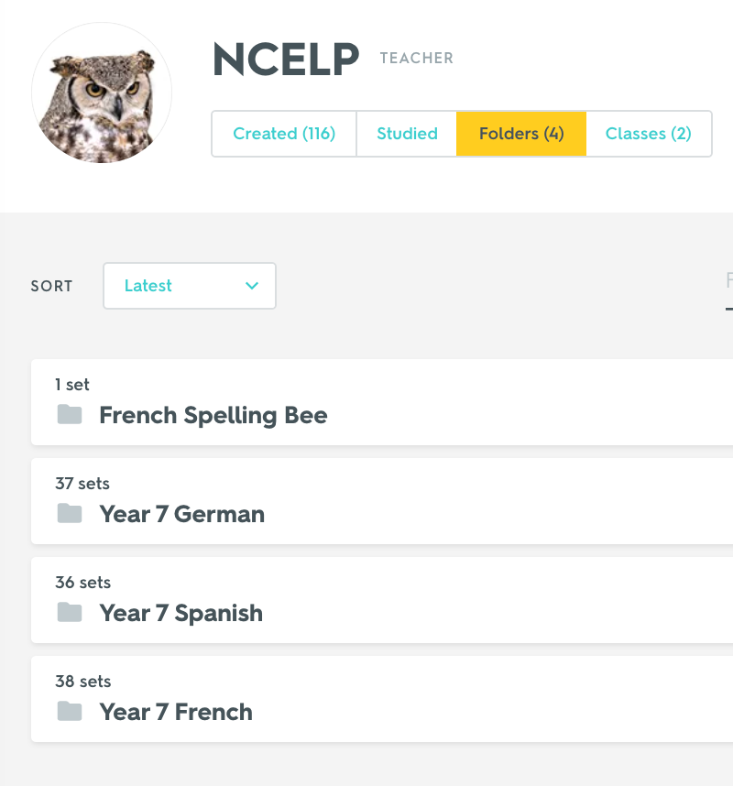
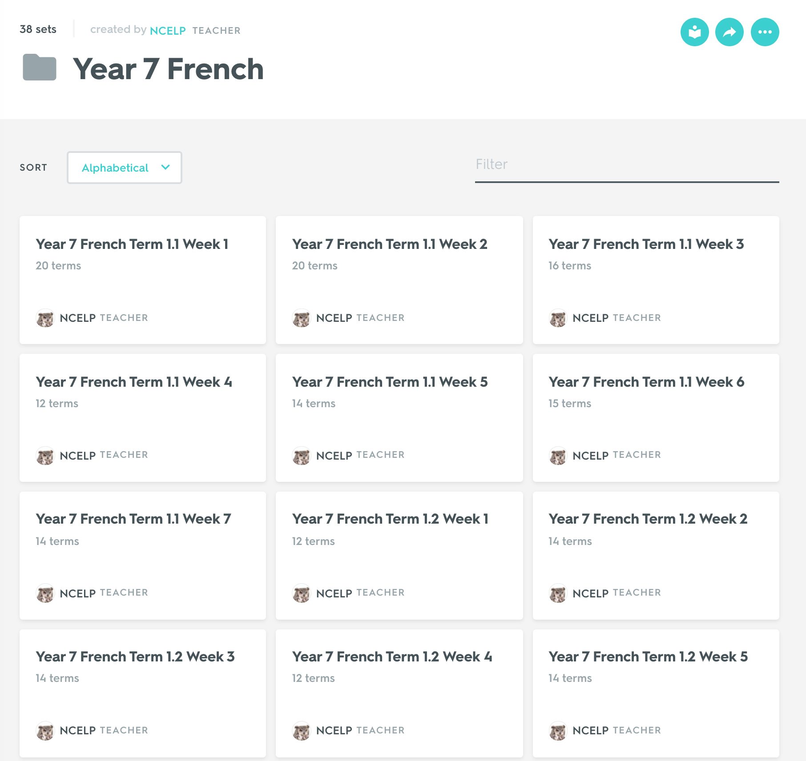
Quizlet - Digital Flashcards Sets
quizlet.com/NCELP/folders
David Shanks

Slide 29
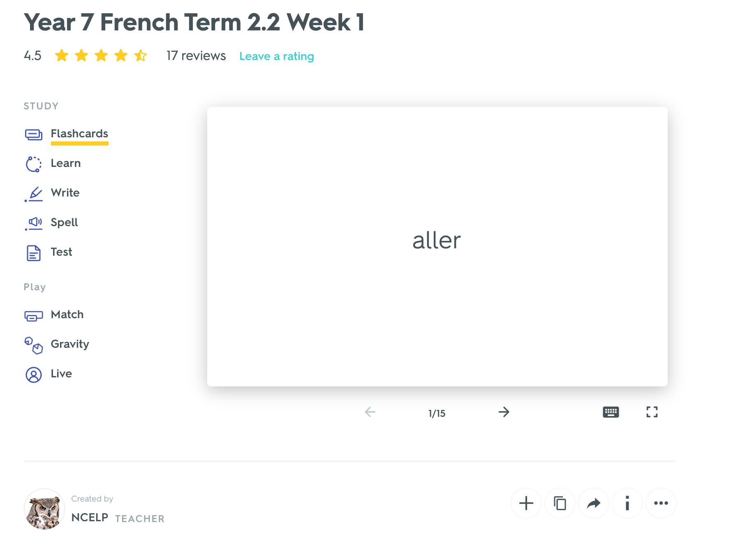
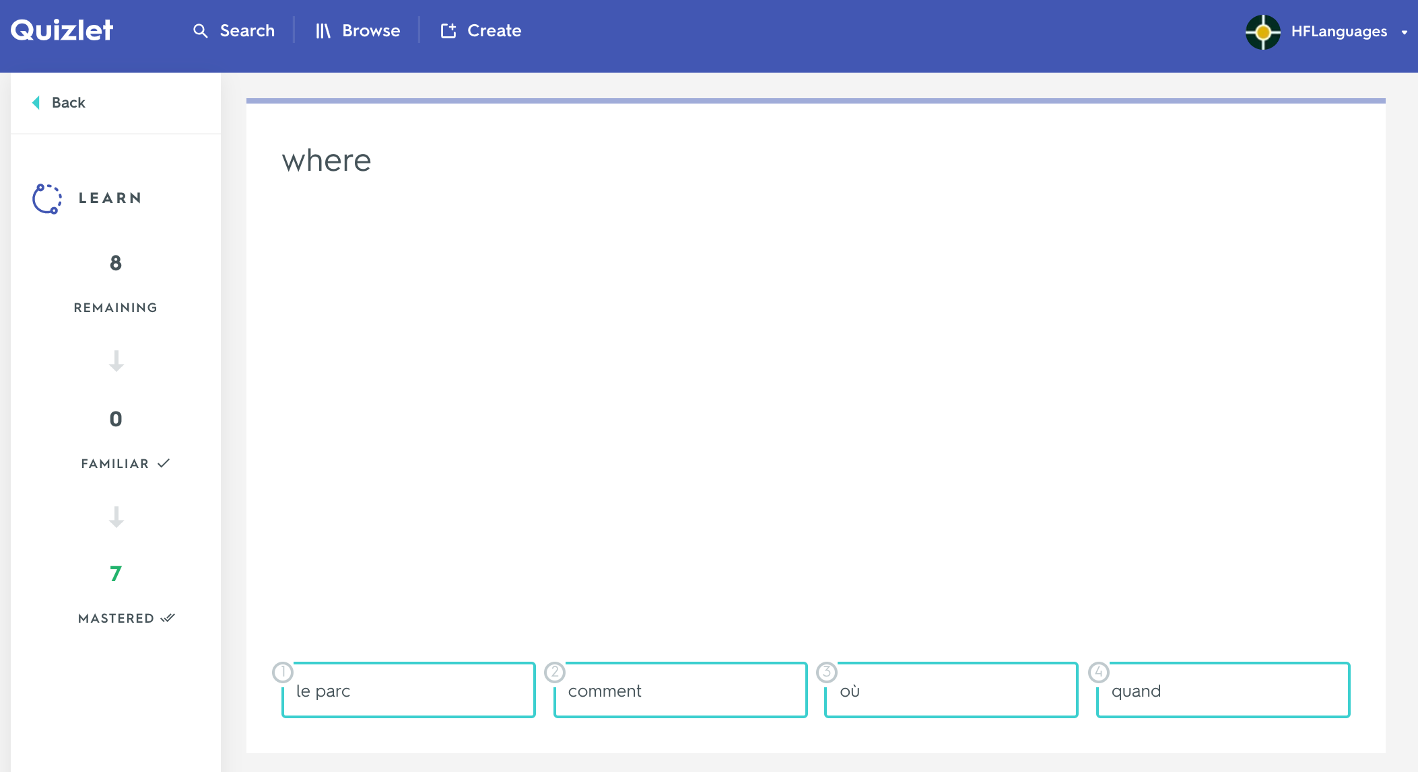
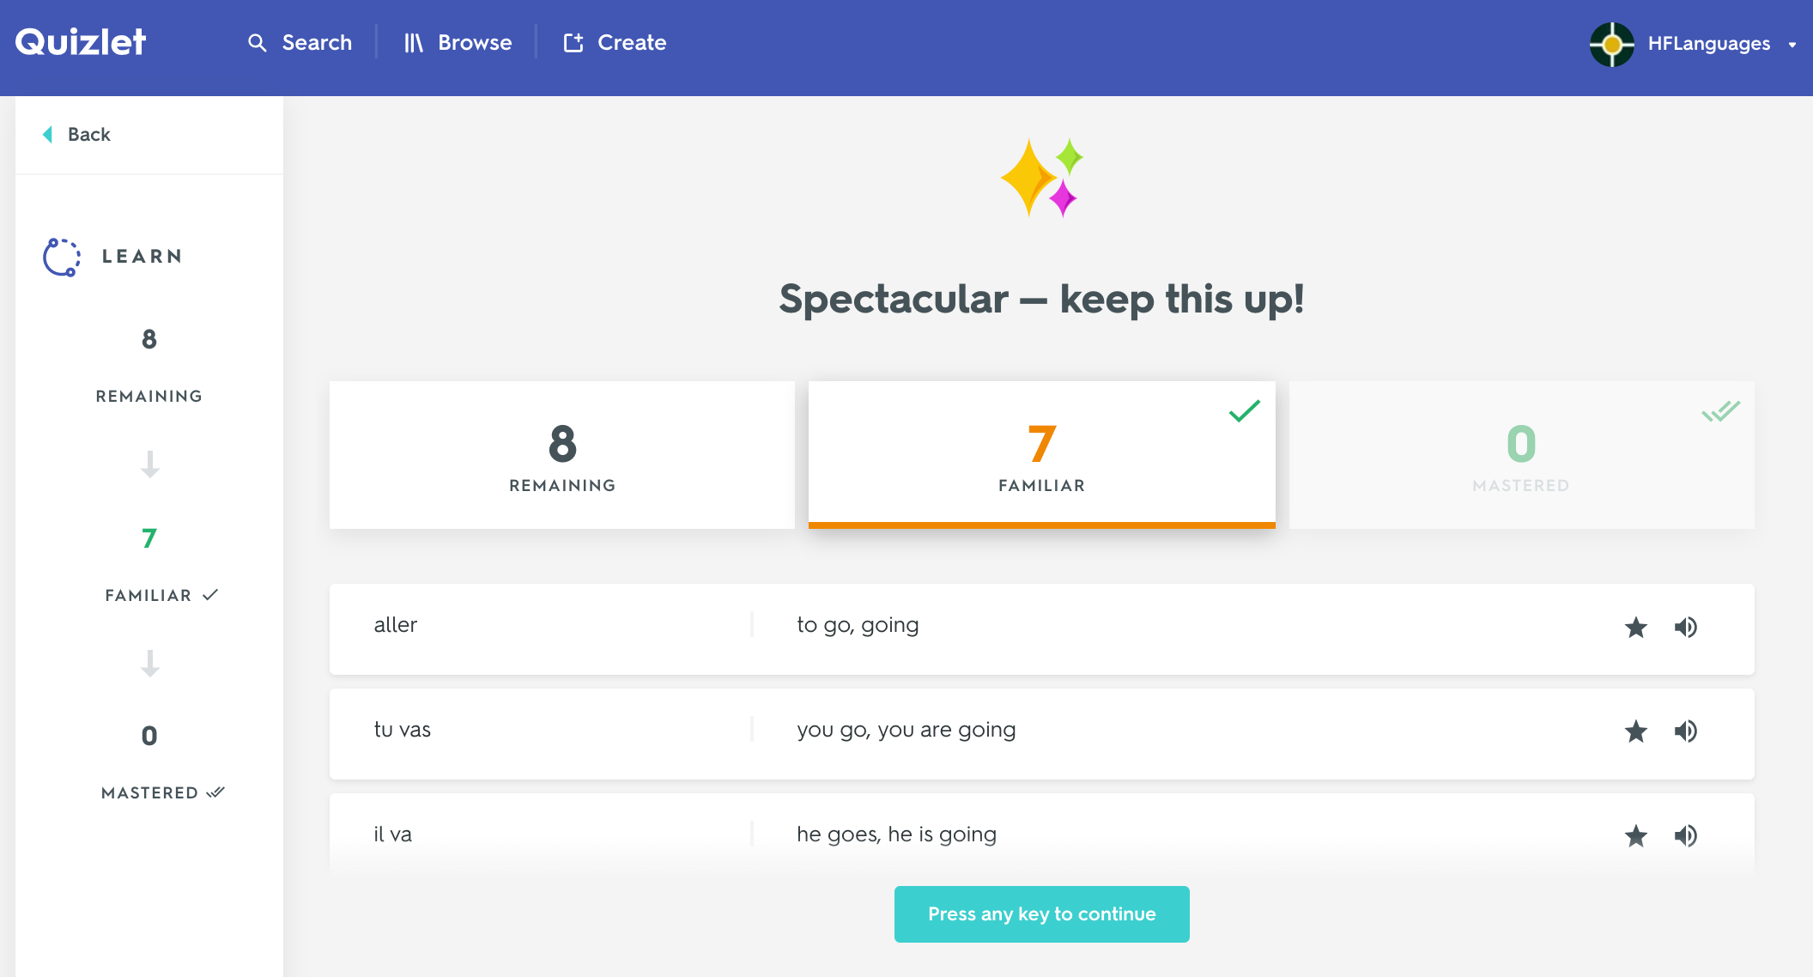
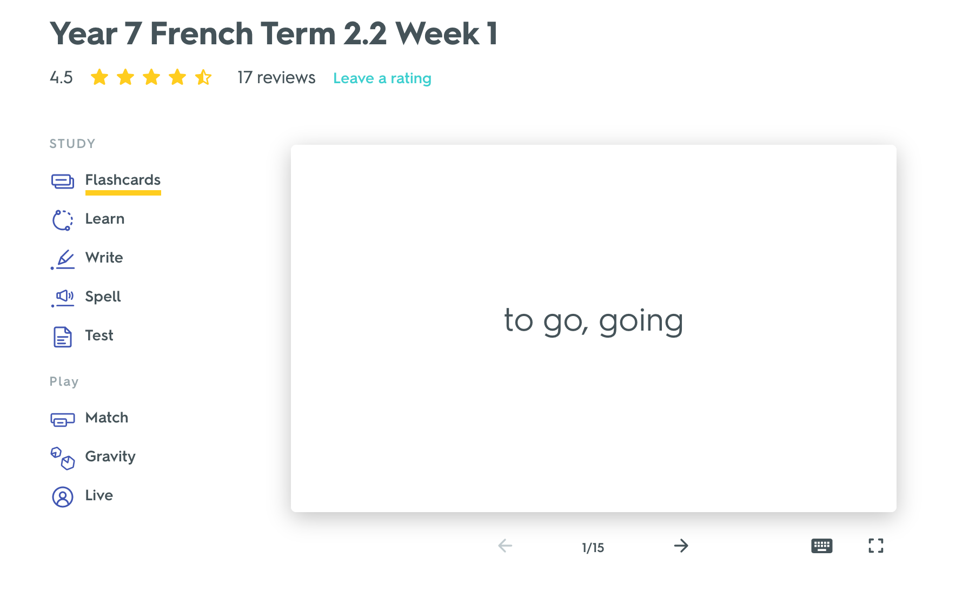
Y7 French 2.2 Week 1
David Shanks

Slide 30
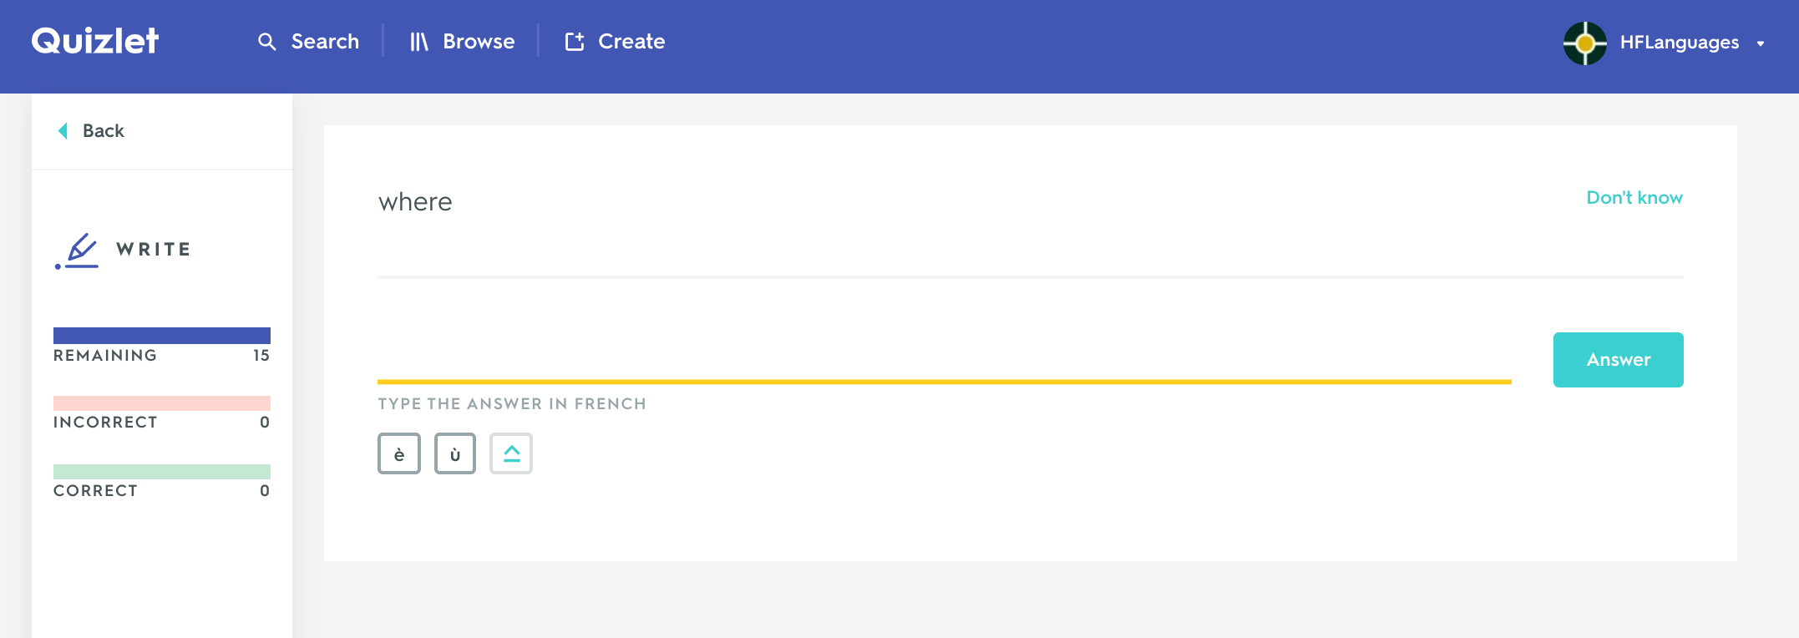
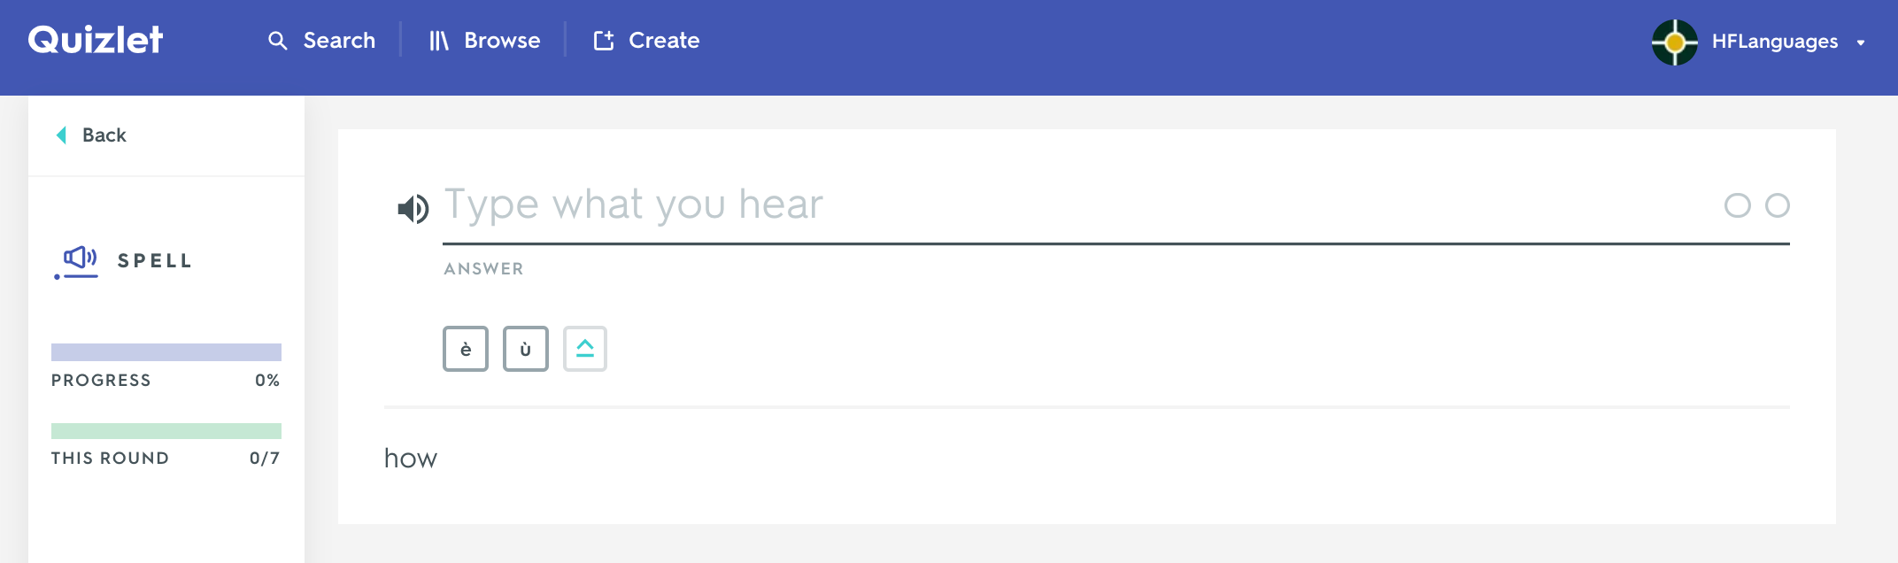
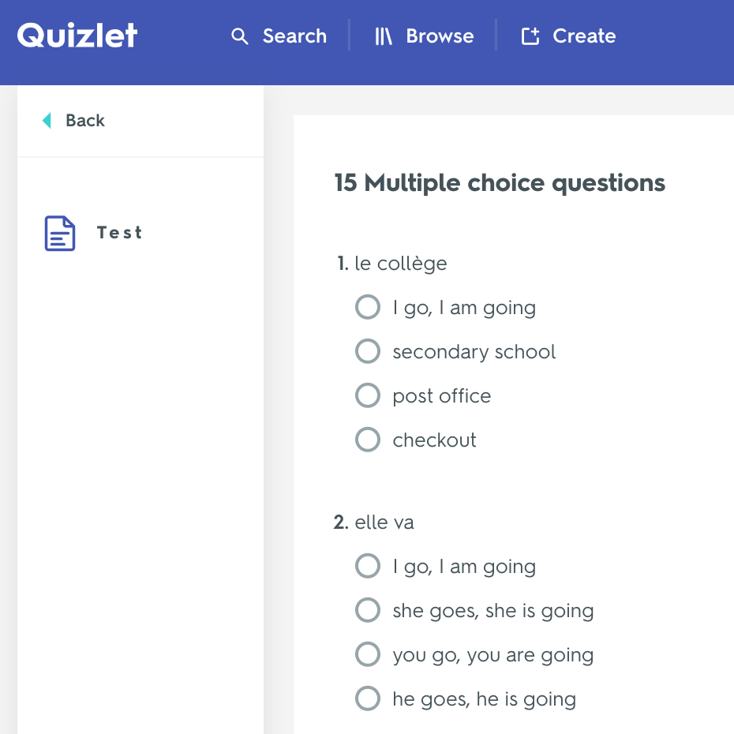
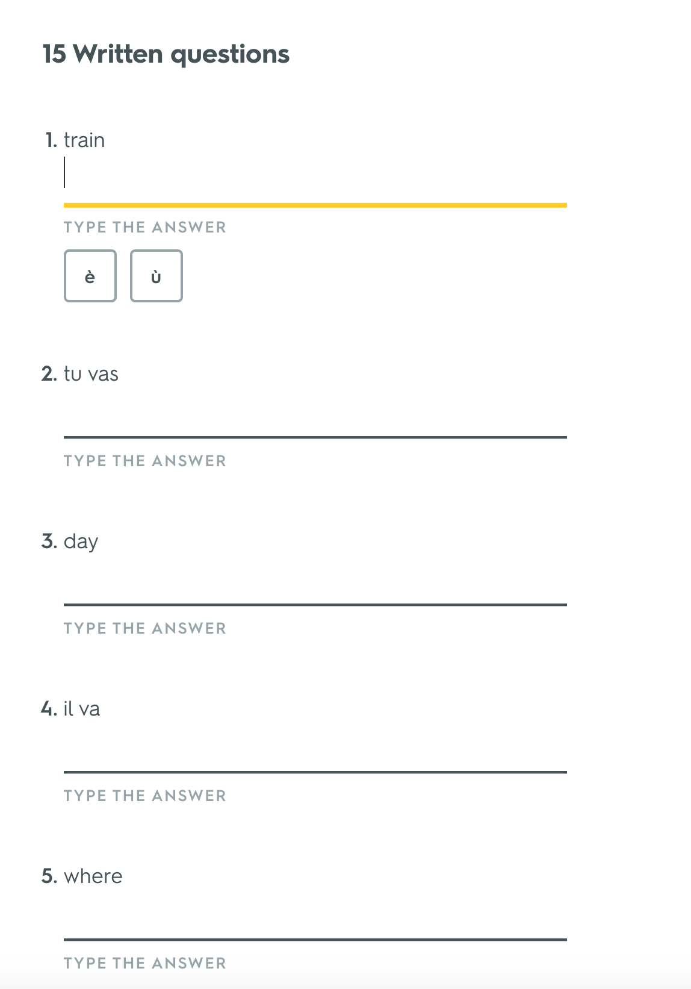
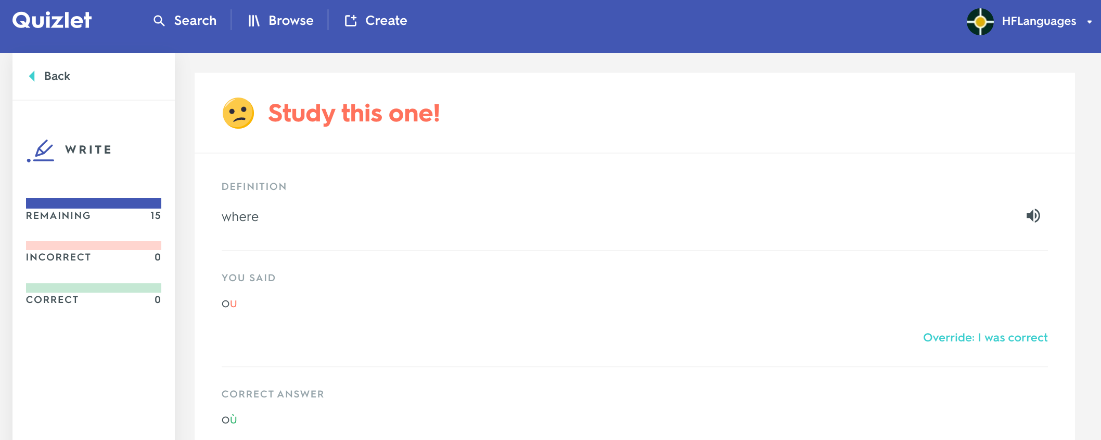

Quizlet examples
David Shanks

Slide 31
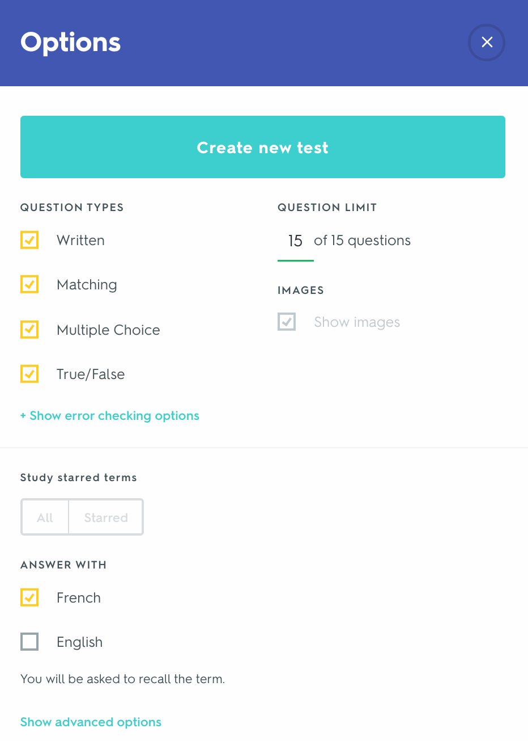
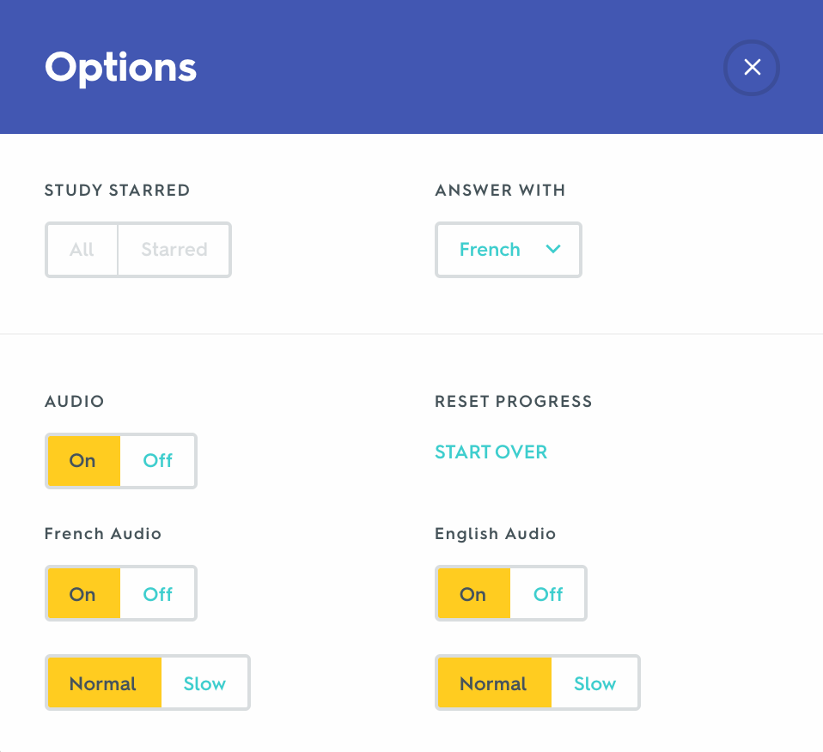
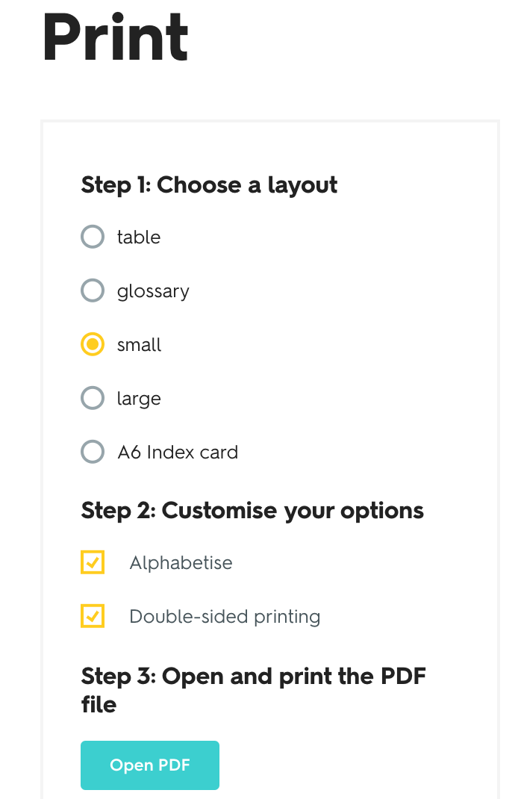
Customisation
David Shanks

Slide 32
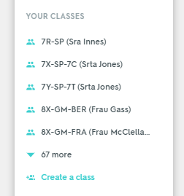
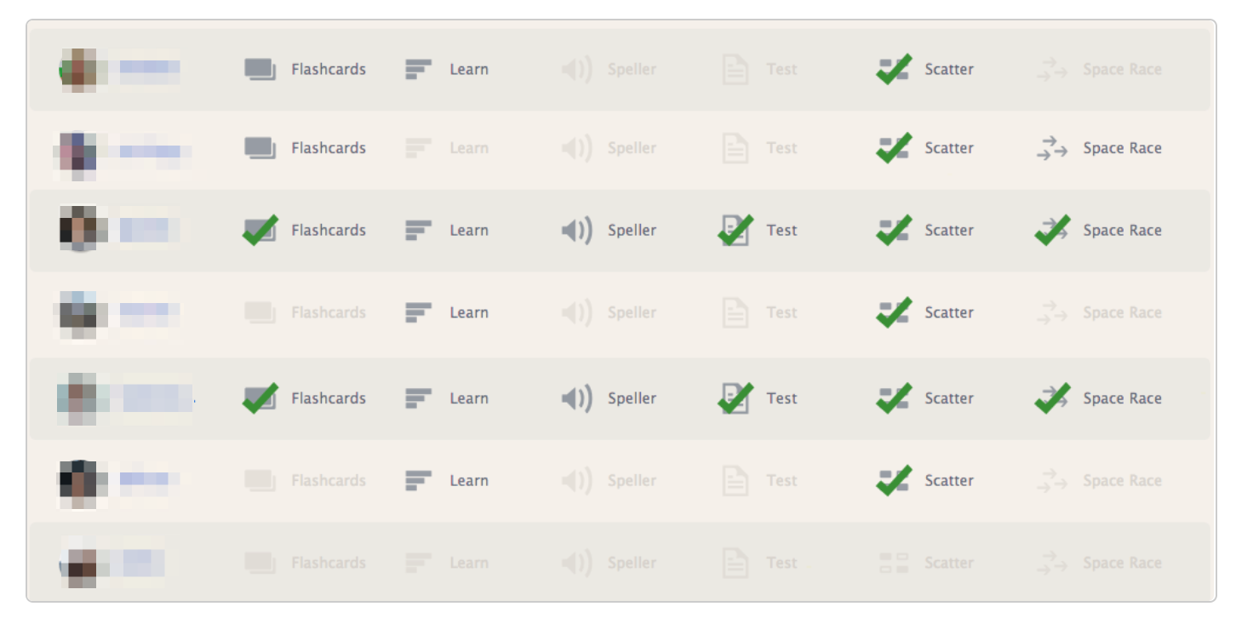
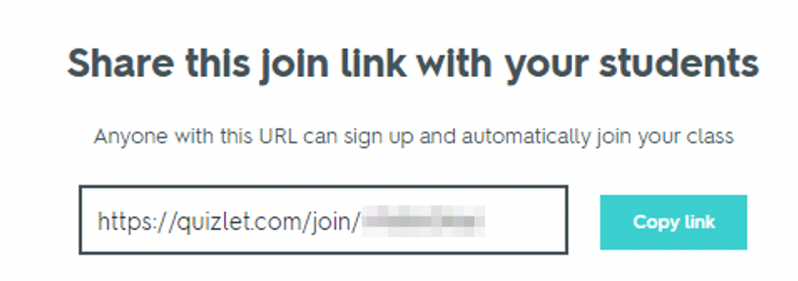
Classes and Tracking Progress
David Shanks

Slide 33
Quizlet – Further Info
resources.ncelp.org
NCELP’s Quizlet Guide
https://quizlet.com/NCELP
Sets are linked & referenced in SOW, lessons, resource logs & Guided Vocabulary Learning Homework worksheets
Quizlet teacher account info (£35.99 per year)
Teaching support guides from Quizlet
David Shanks

Slide 34
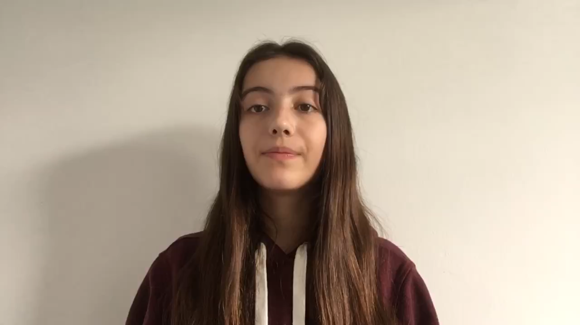
CALL in Context @SWBGS
Jenny Hopper

Slide 35
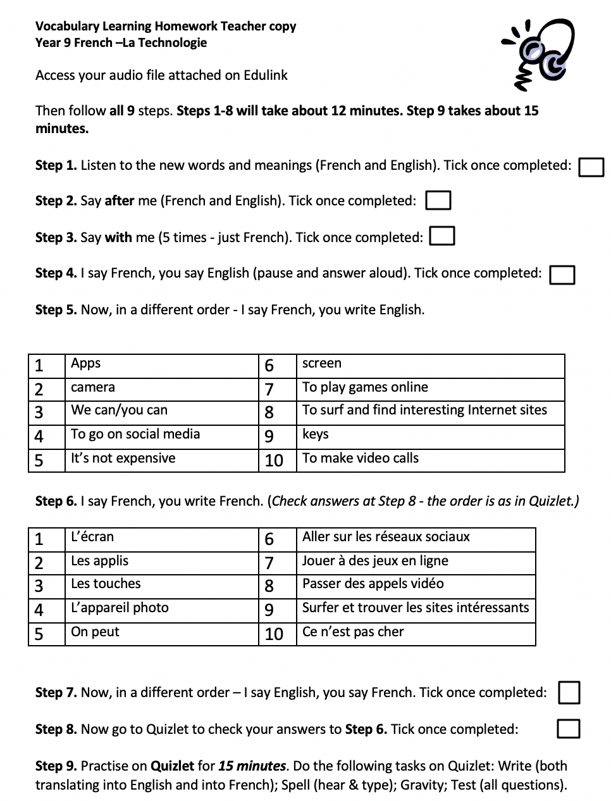
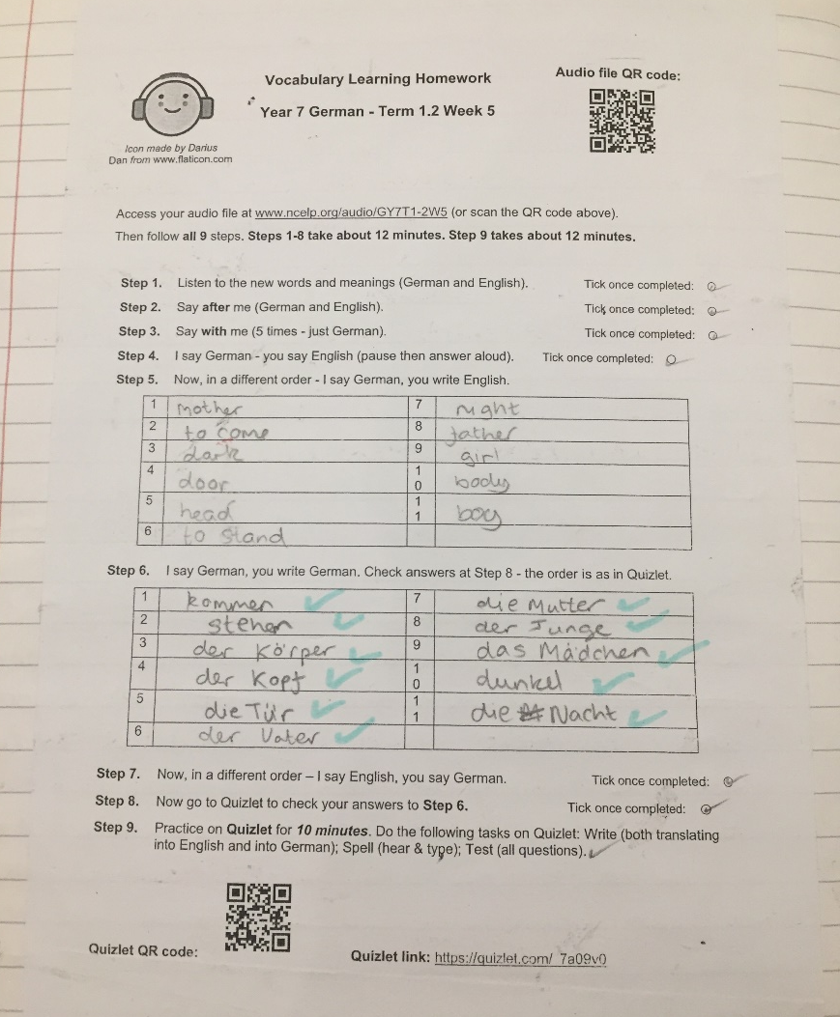
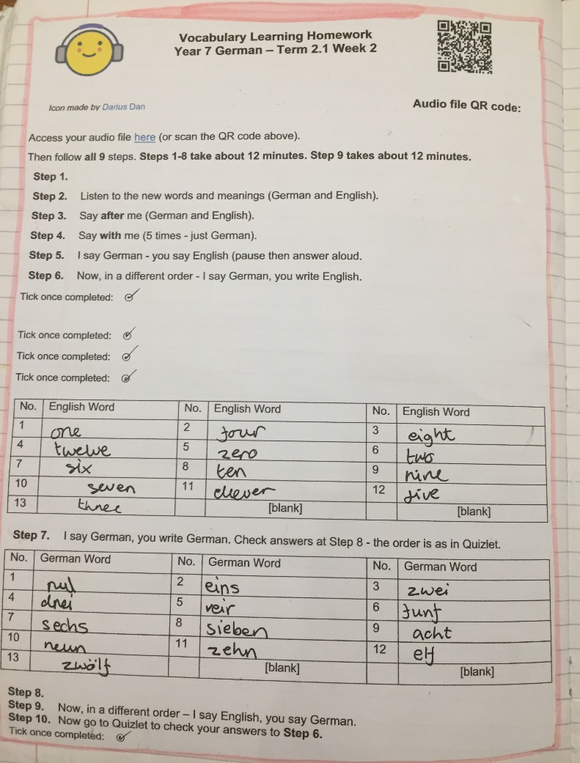
Guided Vocabulary Learning Homework
Juliet Davies @Presdales School
Jenny Hopper

Slide 36
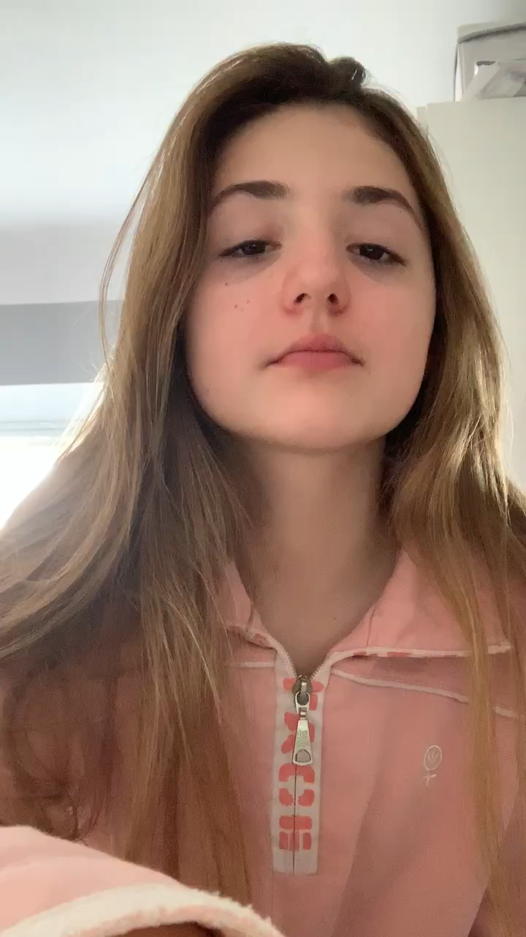
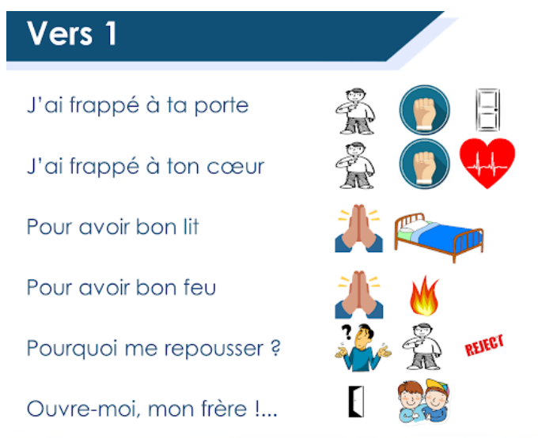
Oral Homework 1
French SOW Y7 Term 3.2 Week 7 - L'homme qui te ressemble (René Philombé)
Jenny Hopper

Slide 37

Oral Homework 2
German SOW Y7 Term 3.1 Week 1 – Word Order 2
Jenny Hopper

Slide 38
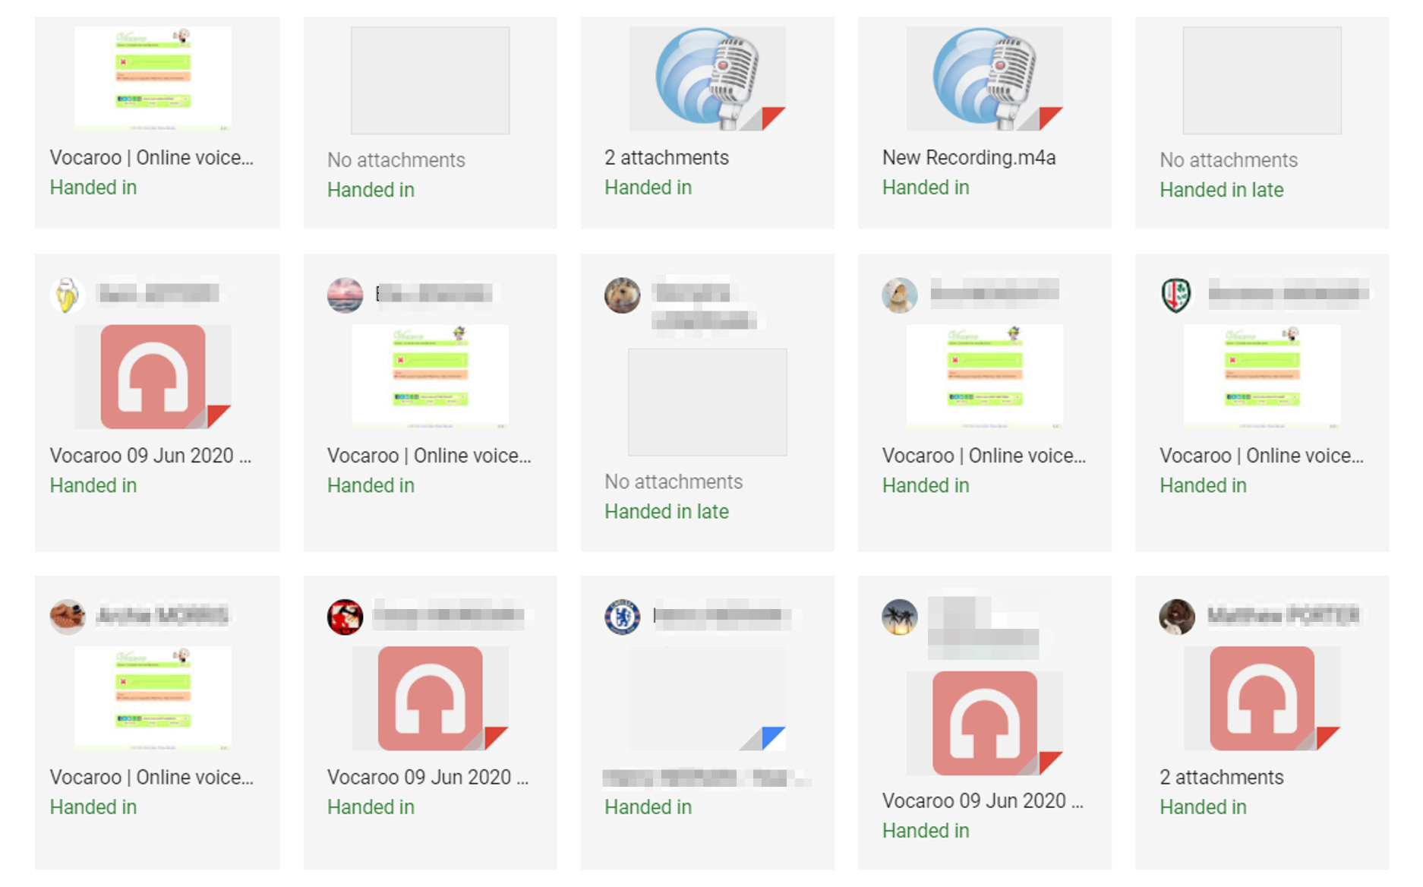
Varied Recording Methods
Jenny Hopper

Slide 39
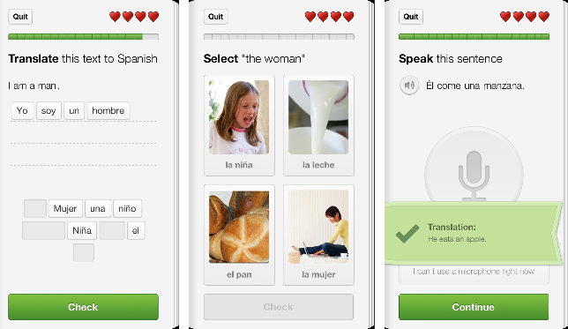
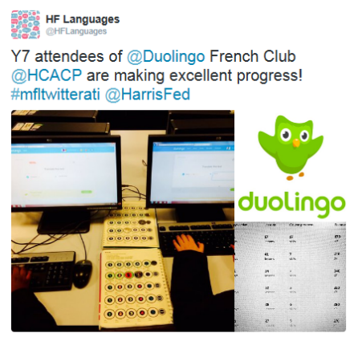

Duolingo.com
Free mobile and web-based language learning platform
Strong gamification and recycling structure (Duolingo nags!)
Variety of translation, reading, listening and speaking activities.
Clean and intuitive environment/user interface
schools.duolingo.com dashboard for managing students and setting tasks
Excellent for signposting students (independent learning, open-ended HW)
Duolingo Clubs/Competitions can be a great initiative for raising profile of MFL
Often updated and developed: Stories, Podcasts
Limitation = fixed content determined by Duolingo course structure
A free ALL Webinar and goodies available here:
www.all-london.org.uk/site/index.php/webinar-david-shanks-duolingo
David Shanks

Slide 40
Summary
Does technology help? When does technology help?
Manifold potential benefits of CALL, when used effectively
Put pedagogy first!
SAMR – what does technology bring to the table?
TPACK – the interplay between tech, (NCELP) pedagogy and content
TFOH, Guided Vocabulary Learning Homework, Quizlet & CALL in context
Harnessing CALL for vocabulary acquisition and out of lesson work
Digital equity
Now commit – what are your CALL next steps in your context? Be S.M.A.R.T.
David Shanks

Slide 41

Q&A
David Shanks

Slide 42
References
Adams-Becker, S., Rodriguez, J. C., Estrada, V., & Davis, A. (2016). Innovating Language Education: An NMC Horizon Project Strategic Brief. Retrieved from https://www.nmc.org/publication/2016-nmc-strategic-brief-innovating-language-education/
Daniel, S. J. (2020). Education and the COVID-19 pandemic. Prospects, 1-6. retrieved from https://link.springer.com/content/pdf/10.1007/s11125-020-09464-3.pdf
Education Endowment Foundation. (2019). Digital Technology - Sutton Trust-Education Endowment Foundation Teaching and Learning Toolkit. Retrieved from https://educationendowmentfoundation.org.uk/evidence-summaries/teaching-learning-toolkit/
Garrett, N. (2009). Computer‐assisted language learning trends and issues revisited: Integrating innovation. The modern language journal, 93, 719-740.
Lucas, M., Nelson, J. and Sims, D. (2020). Schools’ Responses to Covid-19: Pupil Engagement in Remote Learning. Slough: NFER. Retrieved from https://www.nfer.ac.uk/media/4073/schools_responses_to_covid_19_pupil_engagement_in_remote_learning.pdf
Peters, E., Noreillie, A., Heylen, K., Bulté, B., & Desmet, P. (2019). The positive relationship between out-of-school exposure and vocabulary knowledge. OASIS Summary of Peters et al. (2019) in Language Learning. https://oasis-database.org
Picardo, J. (2017). Using Technology in the Classroom. London: Bloomsbury.
Puentedura, R. (2010). SAMR and TPCK: Intro to advanced practice. Retrieved from http://hippasus.com/resources/sweden2010/SAMR_TPCK_IntroToAdvancedPractice.pdf
Reboot Foundation. (2019). Does Educational Technology Help Students Learn? An analysis of the connection between digital devices and learning. Retrieved from https://reboot-foundation.org/does-educational-technology-help-students-learn/
Smith, B. (2015). Technology in language learning: An overview. Routledge.
TPACK. (2012). TPACK Explained: The Seven Components of TPACK. Retrieved from http://tpack.org
Williams, M. (2014). Is technology a silver bullet for language teaching and learning? The Guardian. Retrieved from https://www.theguardian.com/teacher-network/teacher-blog/2014/may/12/technology-language-teaching-learning-pedagogy
David Shanks

Slide 43

Computer Mediated Communication (CMC)
www.etwinning.net
David Shanks

