Slide 1
Saying who receives the action: ‘lo’ and ‘la’ in object-first sentences PART 4: The presence of subject pronouns in SVO (Subject-Verb-Object) order (e.g. ella llama al hombre)
Nick Avery and Emma Marsden

Slide 2
Saying who does / receives the action: using ‘lo’ and ‘la’ (part 4)
Sometimes, to avoid confusion about who is the ‘doer’, the subject pronoun (e.g. he, she) is used before the verb.
Compare:
1. La llama el hombre.
2. Ella llama al hombre.
→ The man calls her.
→ She calls the man.
Nick Avery / Emma Marsden
Notes:
This final part is the most challenging. Students will have to pay attention to whether the pronoun before the verb refers to the subject (e.g. ella) or the object (e.g. la).

Slide 3
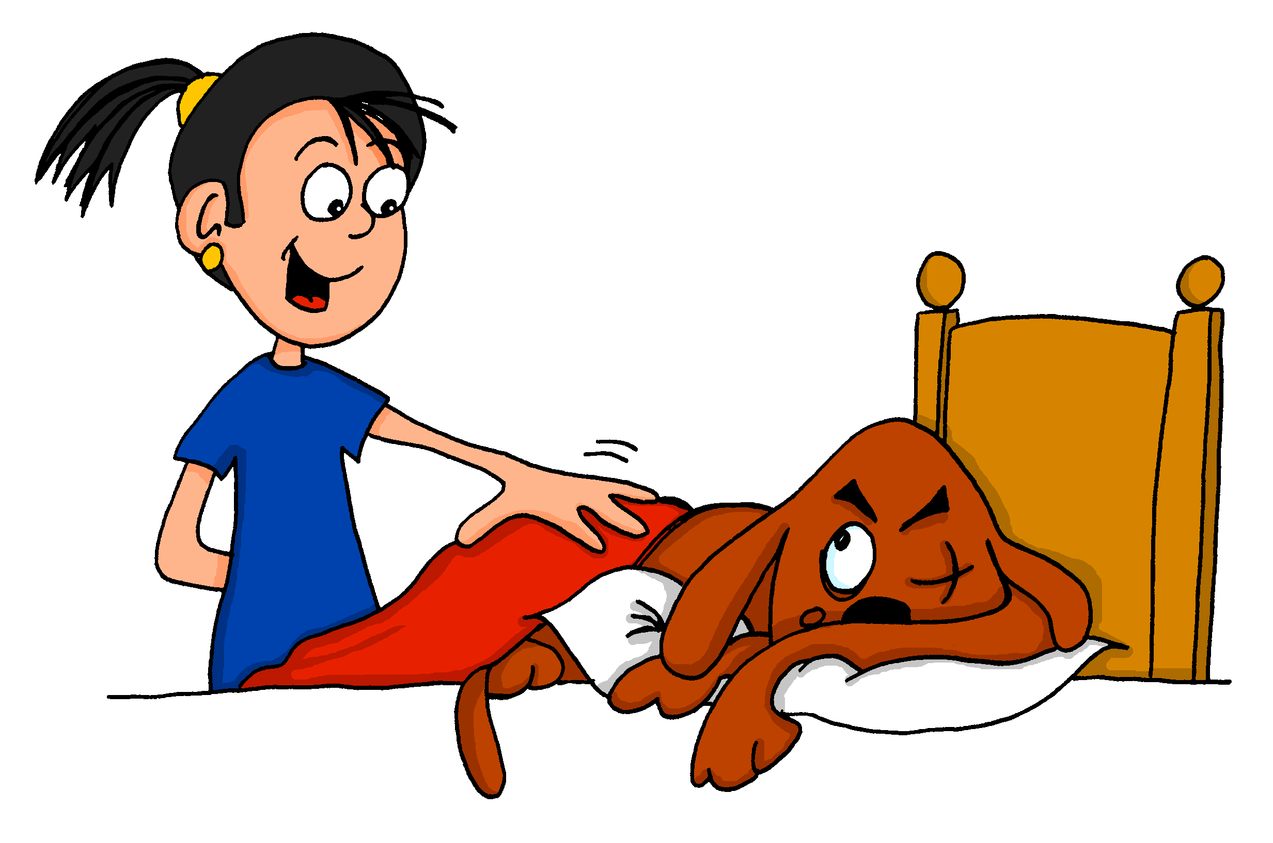
Remember this pair? Look at the picture and decide which sentence is correct.
 |  | True
1.
Ella despierta a Monty.
La despierta Monty.
leer
Nick Avery / Emma Marsden

Slide 4
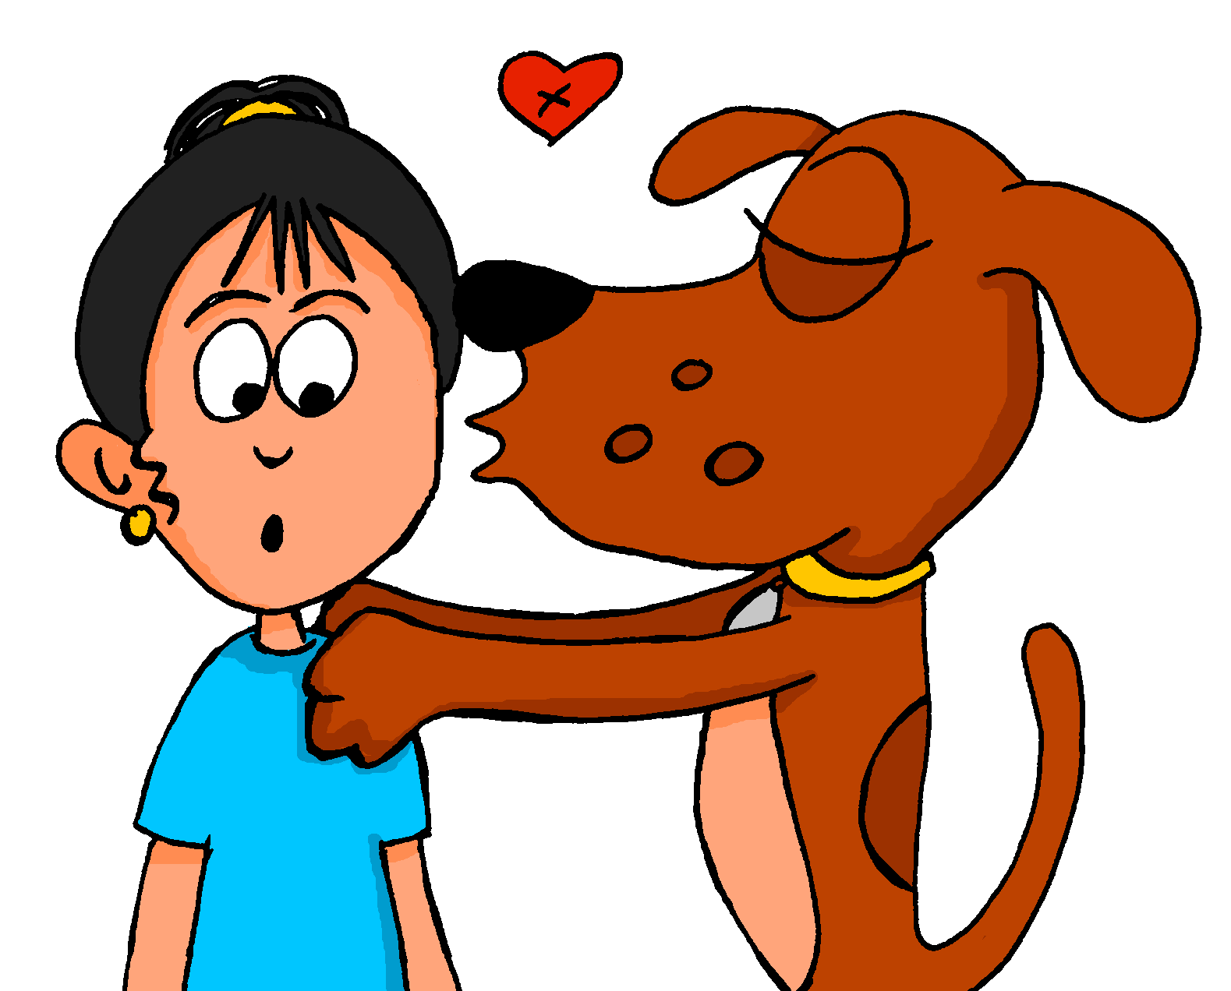
 |  | True
2.
La besa Monty.
Ella besa a Monty.
leer
Nick Avery / Emma Marsden

Slide 5
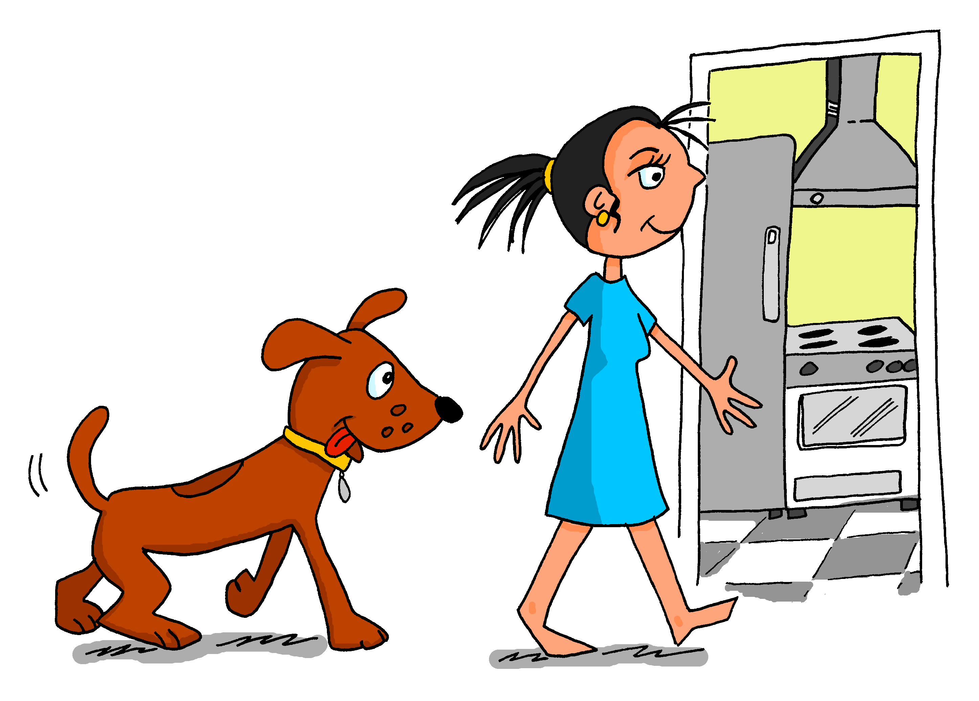
 |  | True
3.
Ella sigue a Monty.
La sigue Monty.
leer
Nick Avery / Emma Marsden

Slide 6
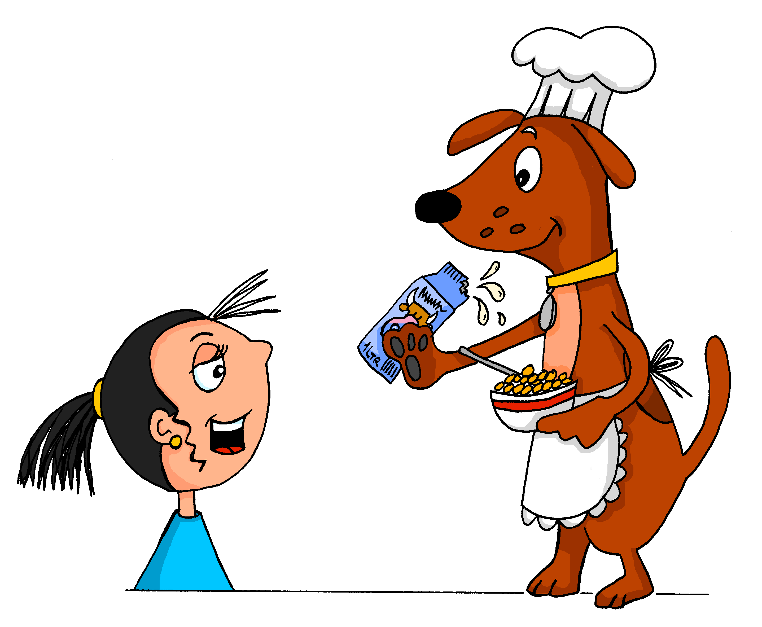
 |  | True
4.
Ella observa atentamente a Monty.
La observa atentamente Monty.
leer
Nick Avery / Emma Marsden

Slide 7
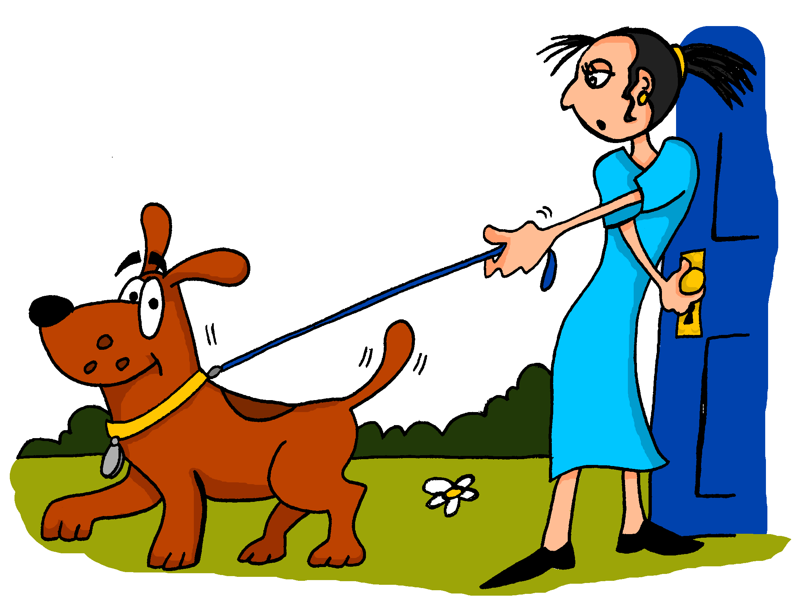
 |  | True
5.
La saca de la casa Monty.
Ella saca a Monty de la casa.
leer
Nick Avery / Emma Marsden
Notes:
Note: She i

Slide 8
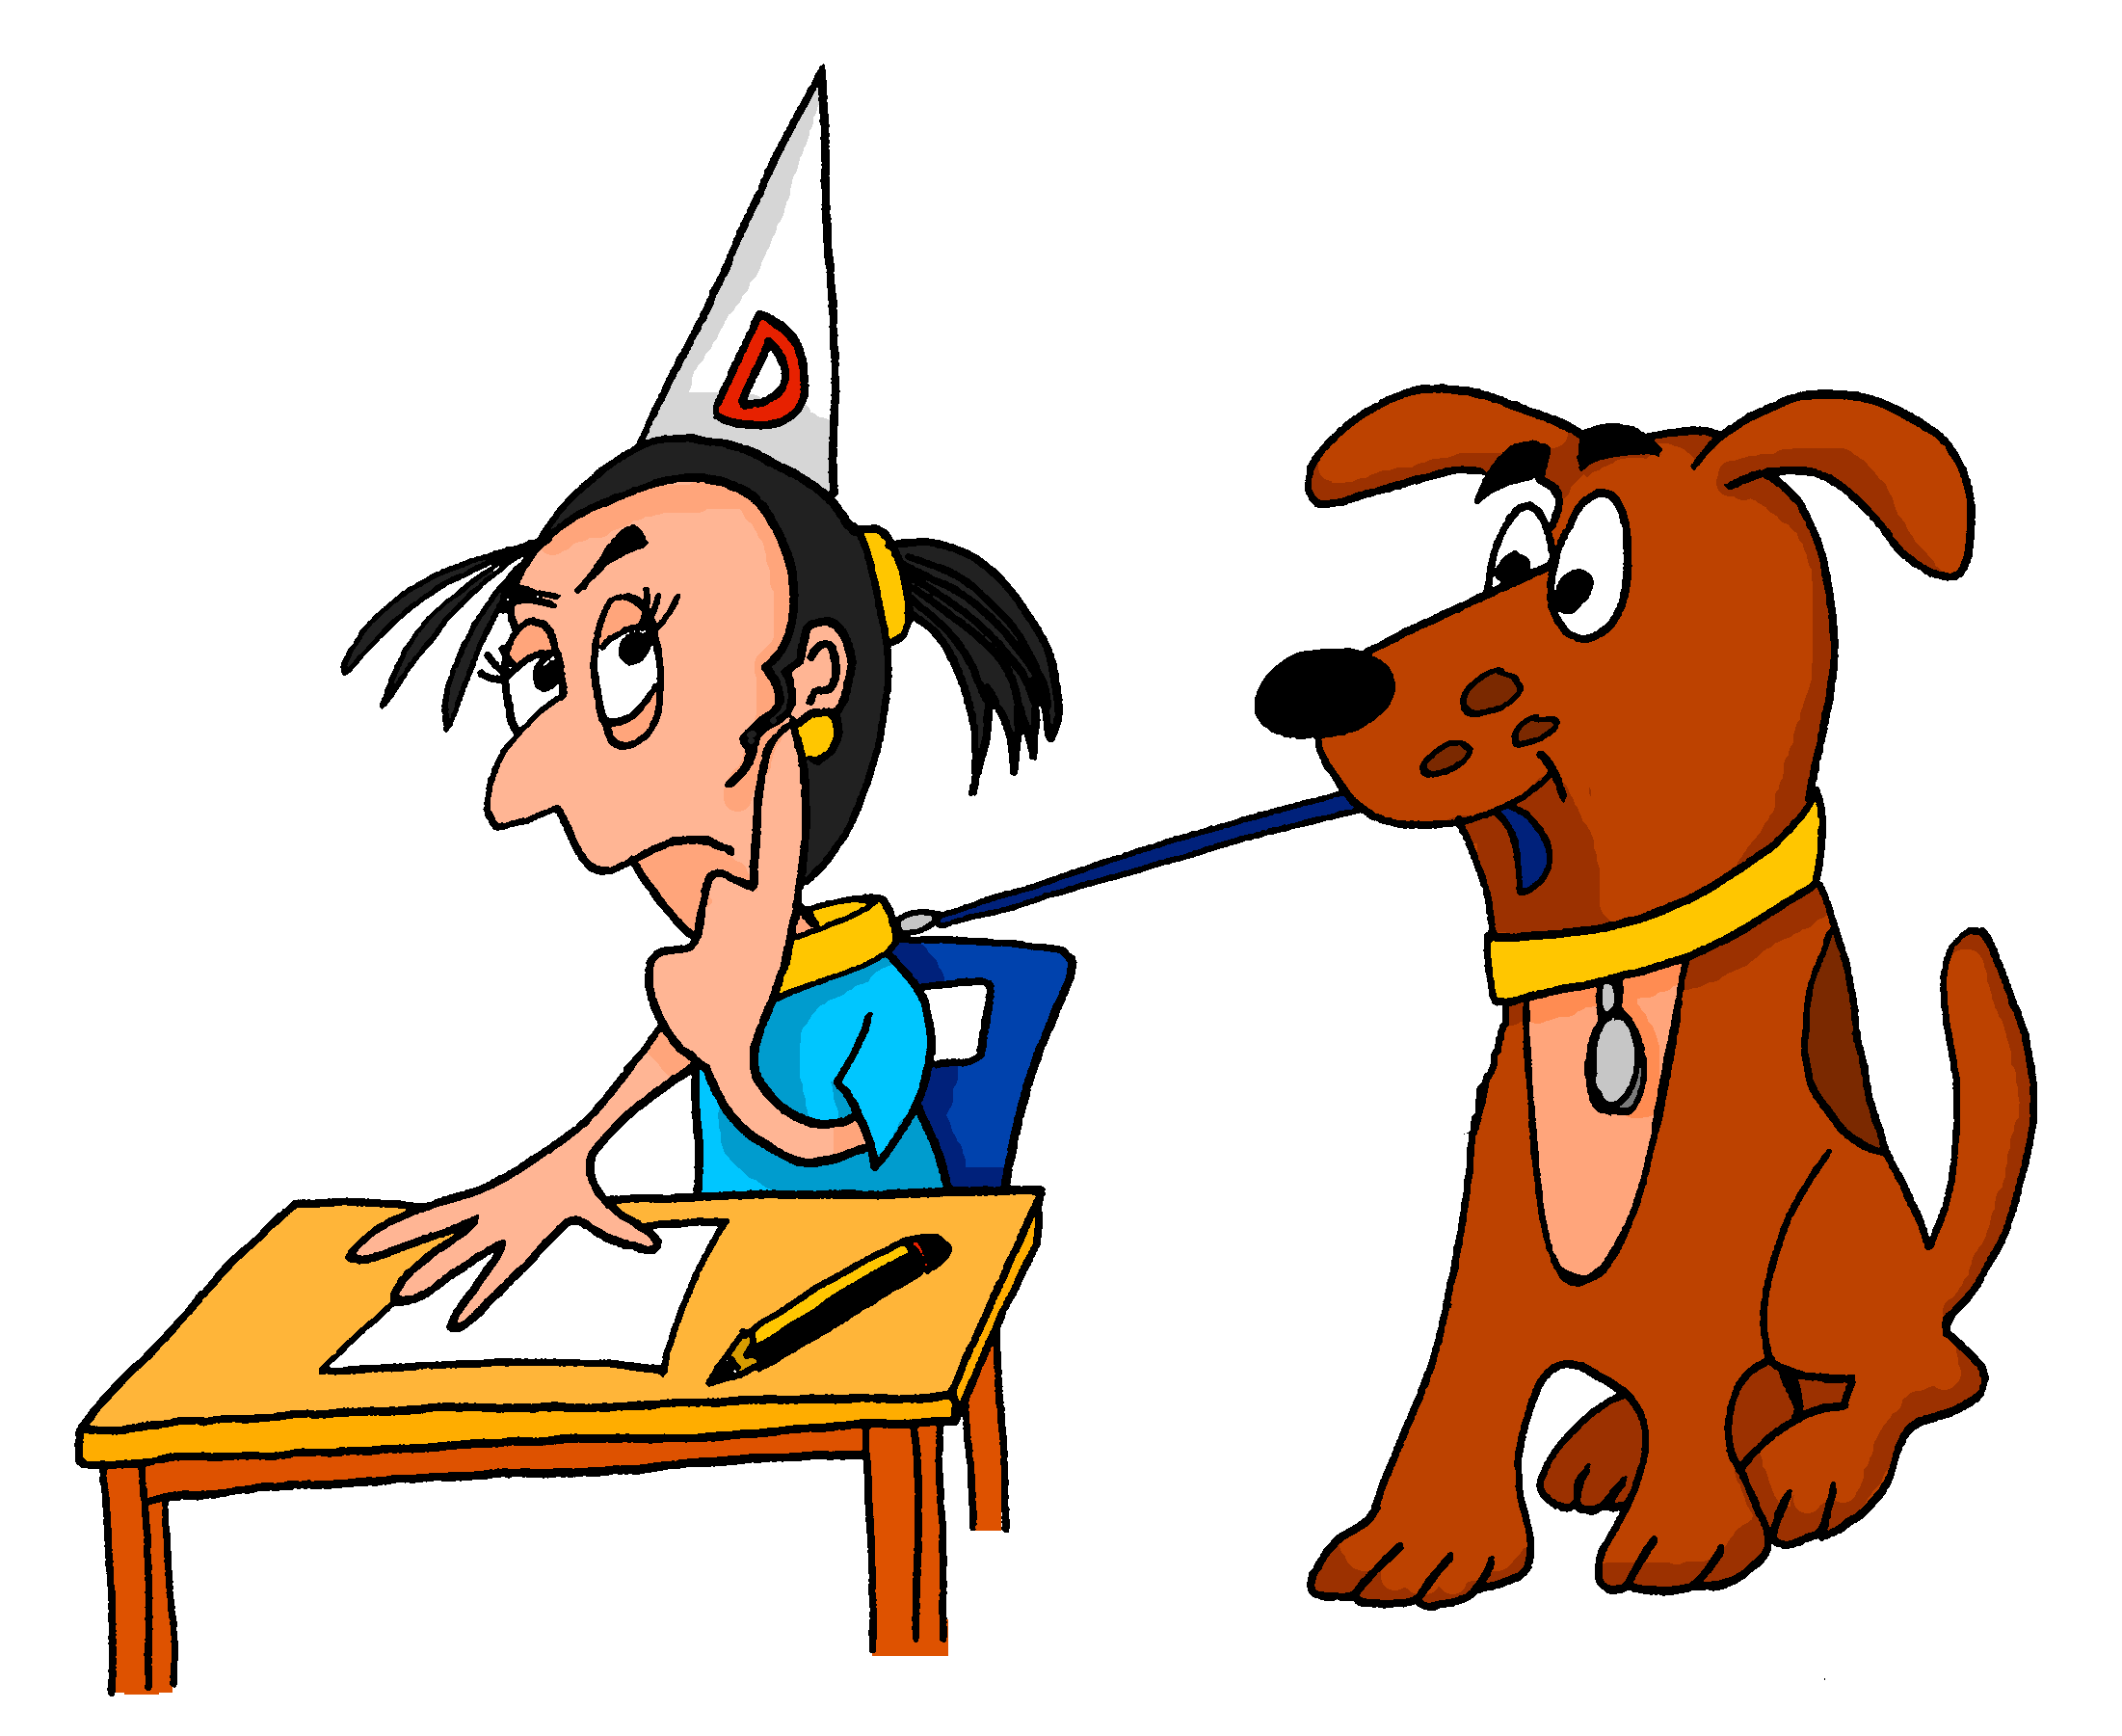
 |  | True
6.
Ella lleva a Monty al colegio.
La lleva al colegio Monty.
leer
Nick Avery / Emma Marsden

Slide 9
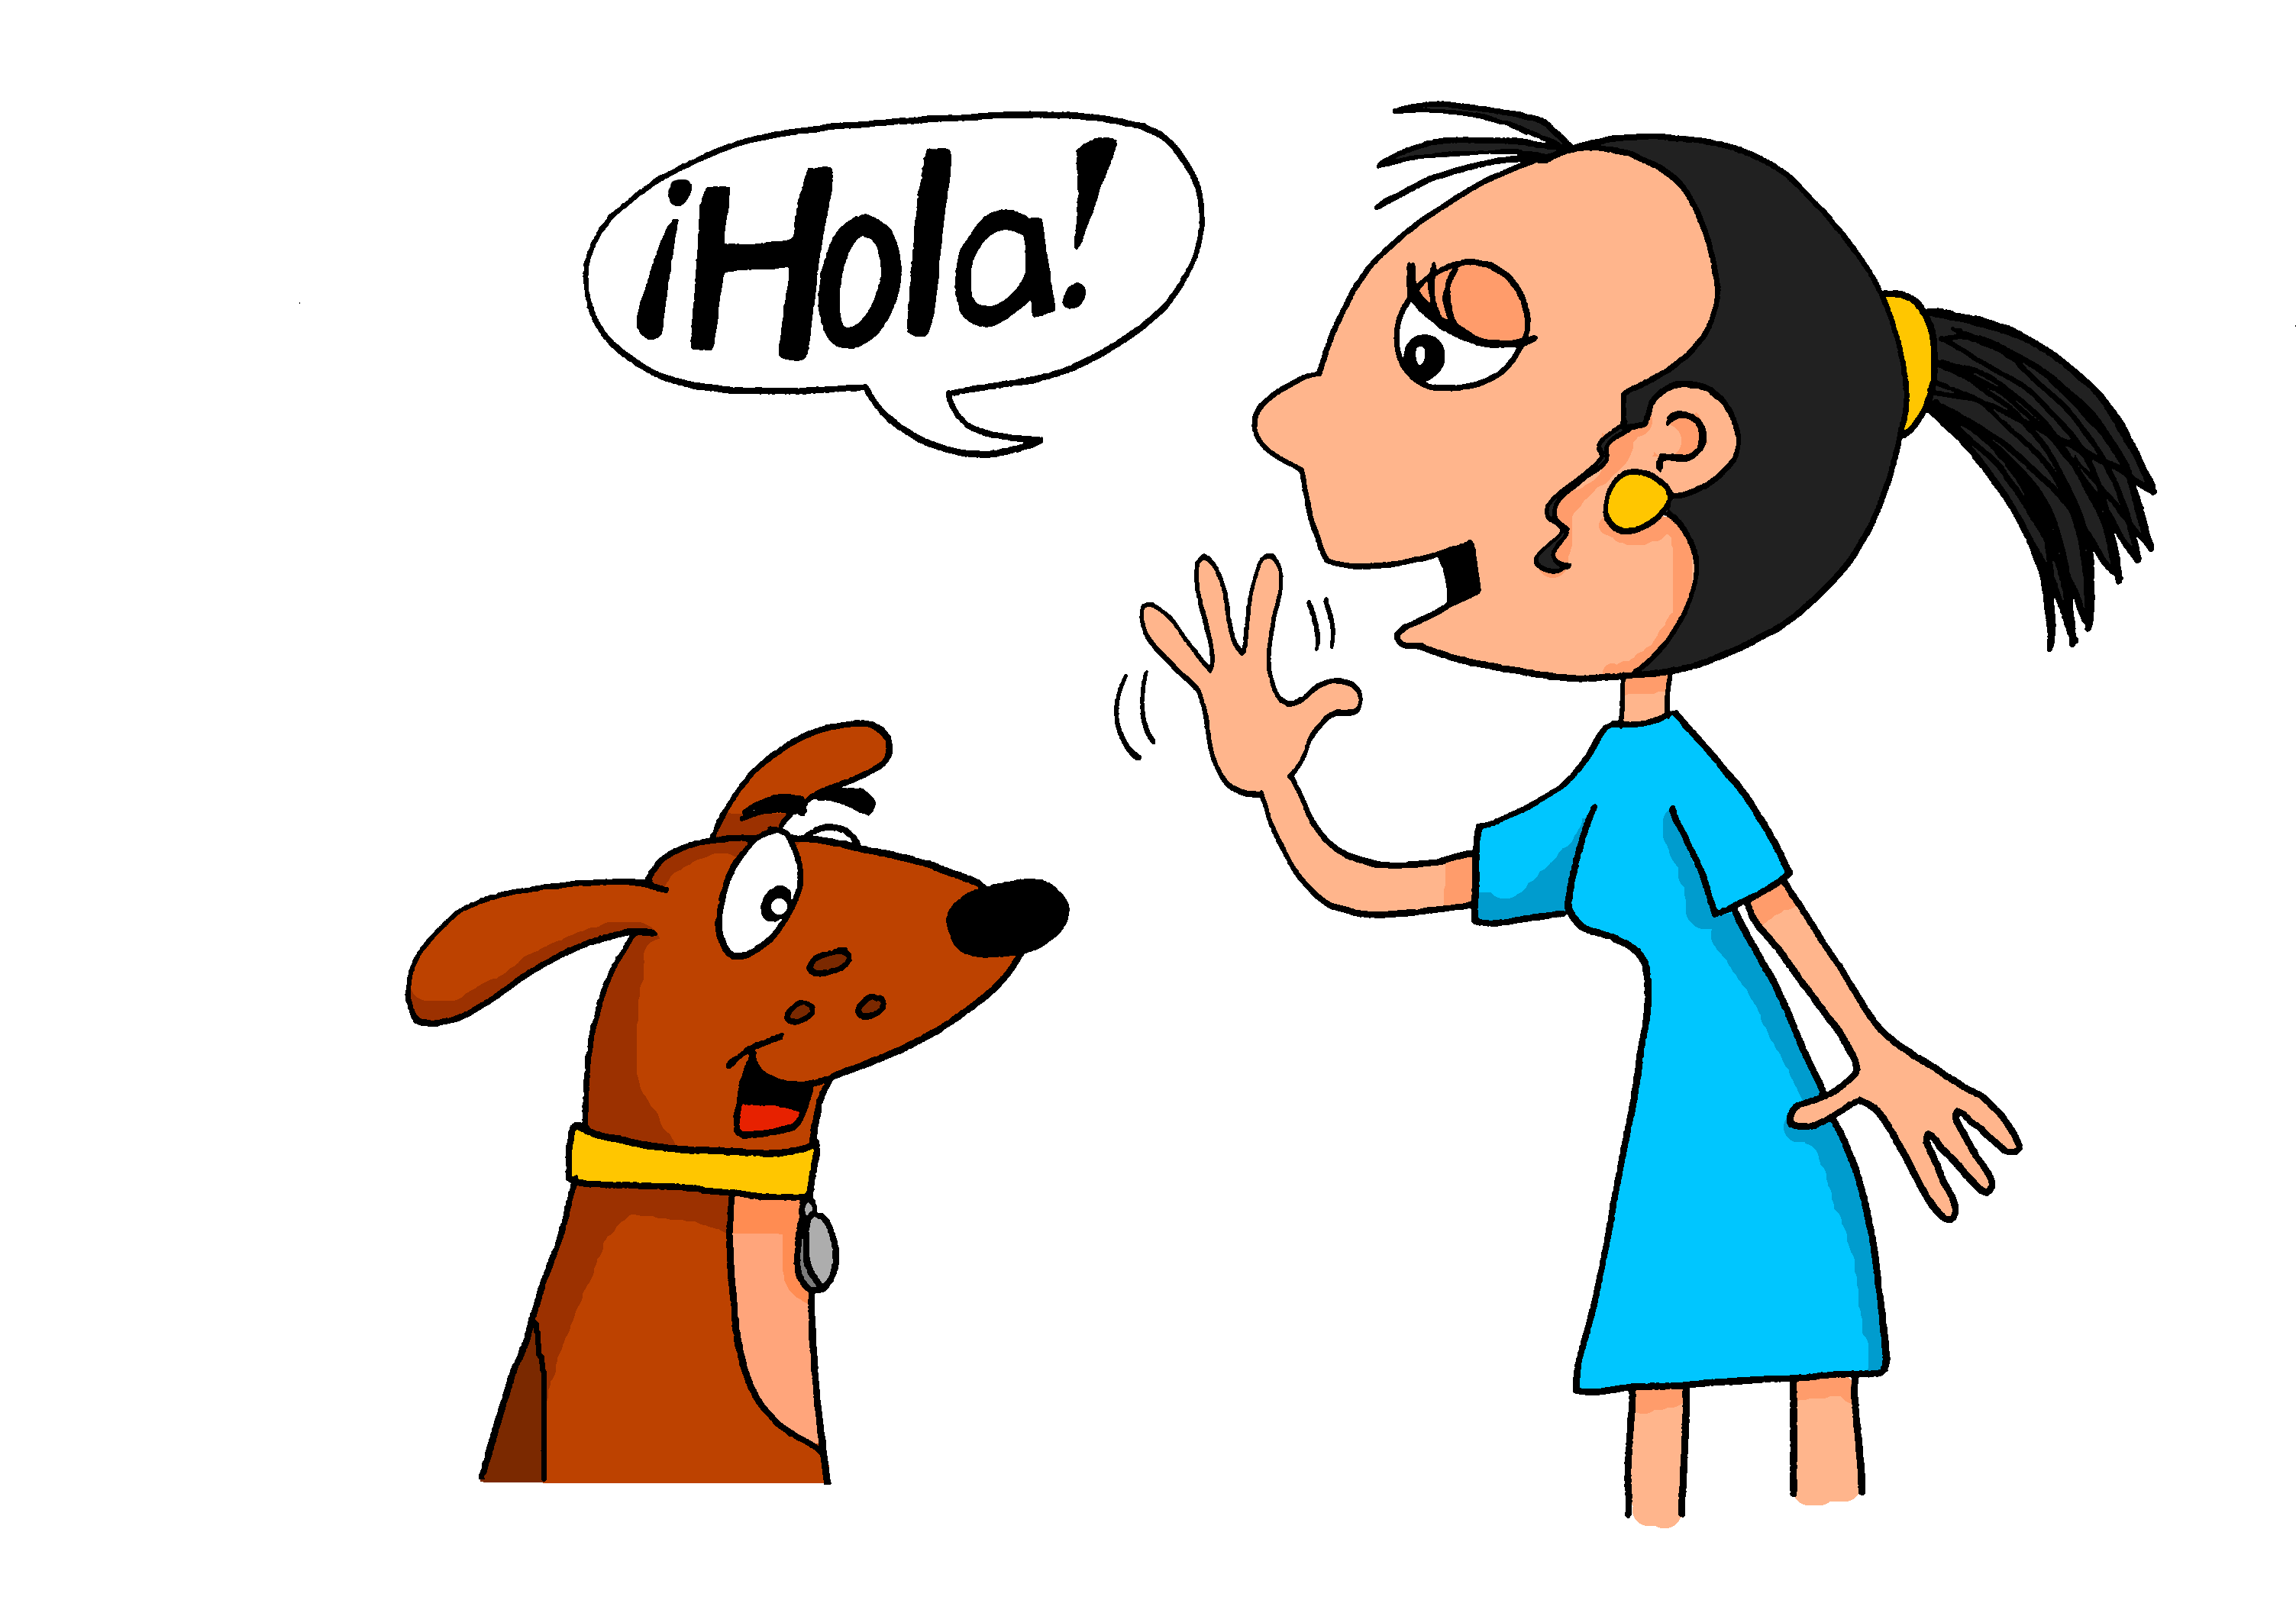
 |  | True
7.
Ella saluda a Monty.
La saluda Monty.
leer
Nick Avery / Emma Marsden

Slide 10
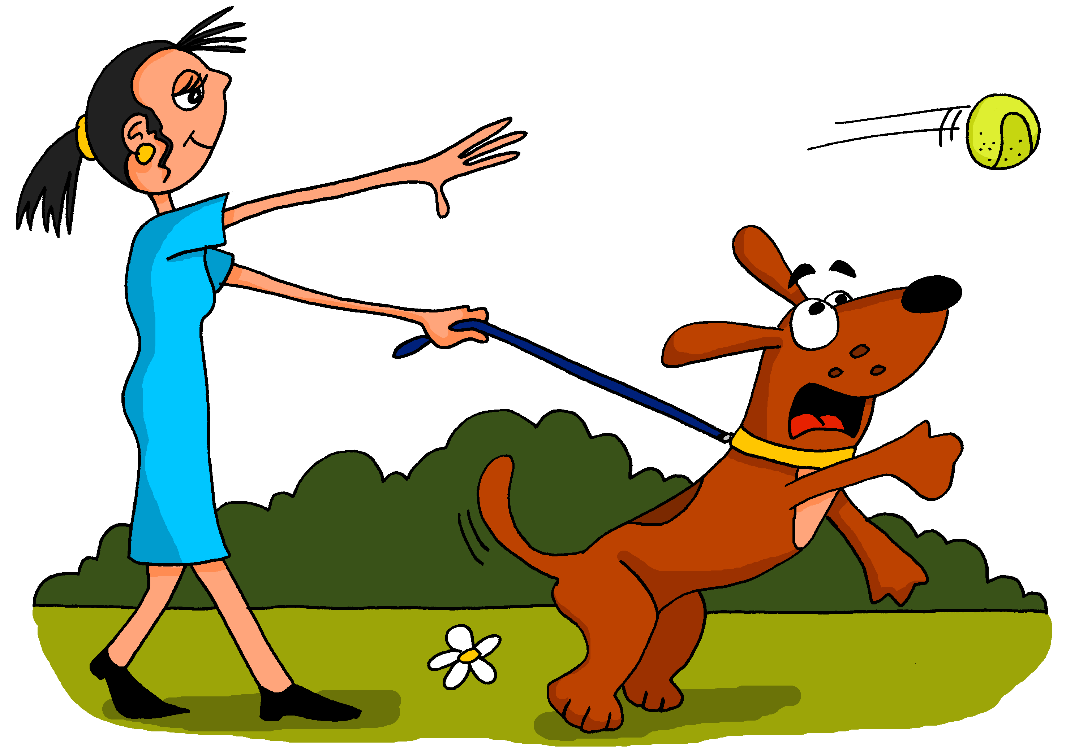
 |  | True
8.
Ella lleva a Monty al parque.
La lleva al parque Monty.
leer
Nick Avery / Emma Marsden

Slide 11
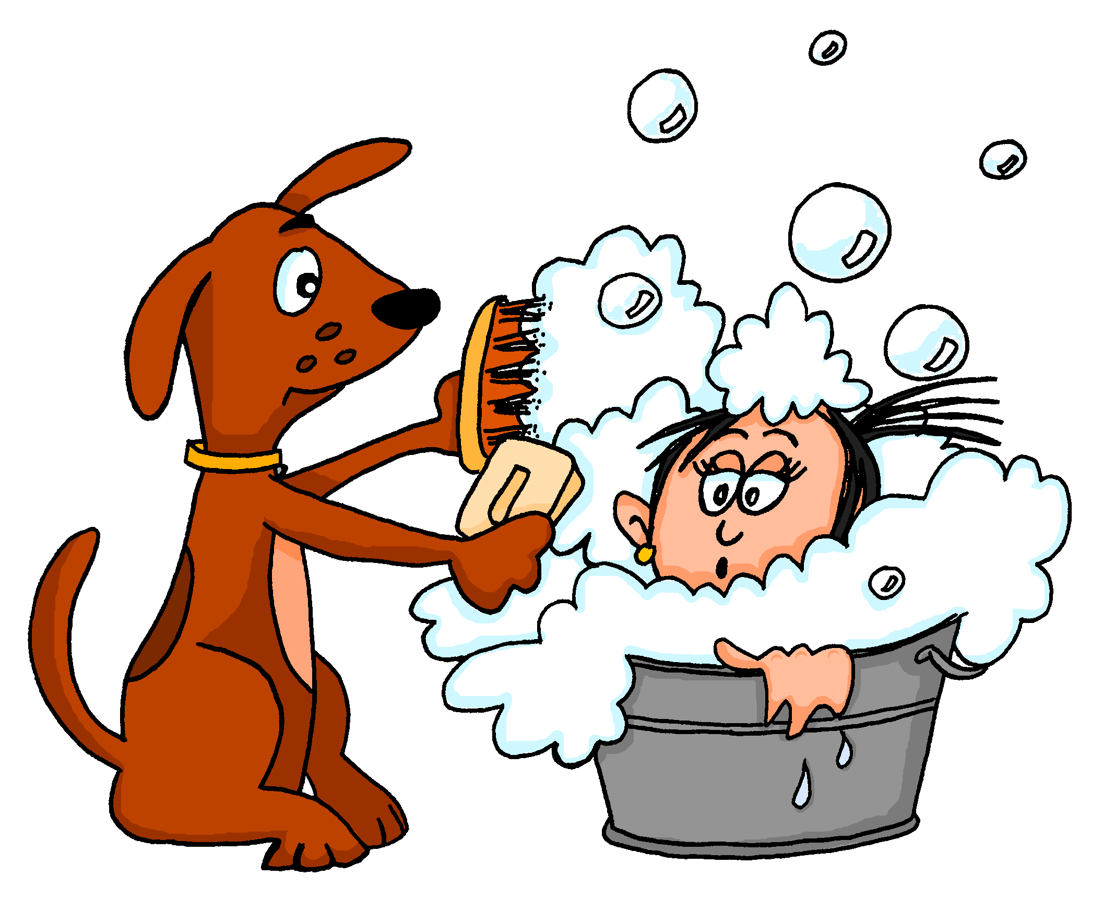
 |  | True
9.
La lava Monty con mucho jabón.
Ella lava a Monty con mucho jabón.
leer
Nick Avery / Emma Marsden

Slide 12
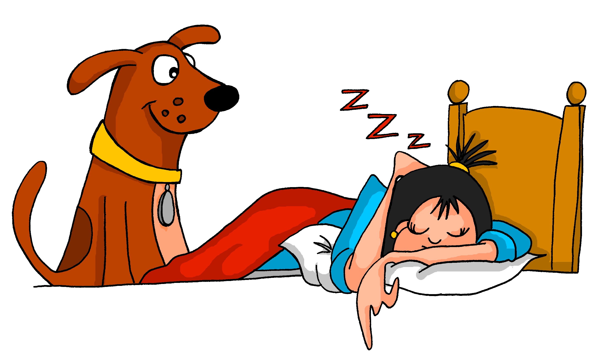
 |  | True
10.
La observa Monty cuando duerme.
Ella observa a Monty cuando duerme.
leer
Nick Avery / Emma Marsden

Slide 13
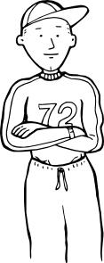
Brotherly love
leer
Esteban and his twin brother are always helping each other out!
Read the sentences about what they do.
Tick which statement is true.
 |  | True
1.
2.
3.
4.
5.
He calls his brother.
His brother calls him.
He takes his brother to school.
His brother takes him to school.
1 | Él llama al hermano.
2 | Lo lleva al colegio el hermano.
3 | Lo ayuda el hermano con los deberes.
4 | Él ayuda al hermano en el jardín.
5 | Lo cuida el hermano.
His brother helps him with homework.
He helps his brother with homework.
He helps his brother in the garden.
His brother helps him in the garden.
He looks after his brother.
His brother looks after him.
Nick Avery / Emma Marsden
Notes:
Note: Animations are set up so that the teacher offers whole class feedback after each answer. (If desired, teachers just need to re-order the animations by clicking on ‘Animation Pane’ and moving all the ‘pictures’ to the end so that the English sentences appear first, students complete all of the task, and then the teacher corrects all answers with the class).
Word frequency rankings (1 is the most common word in Spanish):
Verbs: llamar [122]; llevar [101; ayudar [328]; cuidar [751]
Nouns: hermano [333]; deber [2187]; jardín [1195].

Slide 14
Brotherly love?
 |  | True
6.
7.
8.
9.
10.
His brother wakes him up.
He wakes his brother up.
He gets his brother up.
His brother gets him up.
6 | Él despierta a su hermano.
7 | Lo levanta su hermano.
8 | Lo observa su hermano cuando juega al tenis.
9 | Él saluda a su hermano todos los días.
10 | Lo respeta mucho su hermano.
He watches his brother play tennis.
His brother watches him play tennis.
He greets his brother every day.
His brother greets him every day.
His brother really respects him.
He really respects his brother.
leer
Nick Avery / Emma Marsden
Notes:
Note: The animations here are set up so that students complete questions 6-10 independently, and then check them in whole class feedback with the teacher.
Word frequency rankings (1 is the most common word in Spanish):
Verbs: despertar [894]; levantar [354]; observar [556]; saludar [1575]; respetar [1191; jugar [356].
Nouns: tenis [4856]; día [65].

Slide 15
Now complete the translations about Esteban and his older brother.
His brother calls him
1) _____________su hermano.
Lo llama
He takes his brother to school.
2) _____________a su hermano al colegio.
(Él) lleva
He helps his brother with the homework.
3) _____________a su hermano con los deberes.
(Él) ayuda
Nick Avery / Emma Marsden
escribir
Nick Avery / Emma Marsden

Slide 16
Now complete the translations about Esteban and his older brother.
His brother helps him in the garden.
4) _____________su hermano en el jardín.
Lo ayuda
He looks after his brother.
5) _____________a su hermano.
(Él) cuida
His brother wakes him up.
6) _______________su hermano.
Lo despierta
escribir
Nick Avery / Emma Marsden

Slide 17
Now complete the translations about Esteban and his older brother.
He gets his brother up.
7) ______________ a su hermano.
(Él) levanta
He watches his brother play tennis.
8) ________________a su hermano cuando juega al tenis.
(Él) observa
His brother greets him.
9) _______________su hermano.
Lo saluda
He respects his brother
10) _______________a su hermano.
(Él) respeta
escribir
Nick Avery / Emma Marsden

