Slide 1
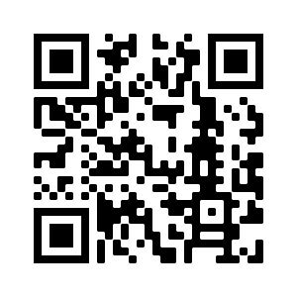
Devoirs
Vocabulary Learning Homework (Term 3.2, Week 3)
Audio file
Audio file QR code:
Student worksheet
Quizlet link
In addition, revisit: Term 3.1 Week 4
Term 2.2 Week 4

