Slide 1
French Question words Learning Routine
Images - Steve Clarke

Slide 2
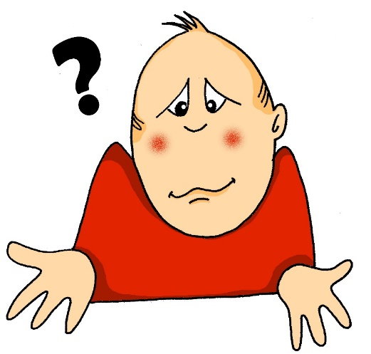
comment?
how?
Rachel Hawkes / Emma Marsden

Slide 3
comment?
how?
Rachel Hawkes / Emma Marsden

Slide 4
comment?
how?
Comment vas-tu au collège?
[How do you go to school?]
Rachel Hawkes / Emma Marsden

Slide 5
comment?
how?
__________vas-tu au collège?
Comment
[How do you go to school?]

Slide 6
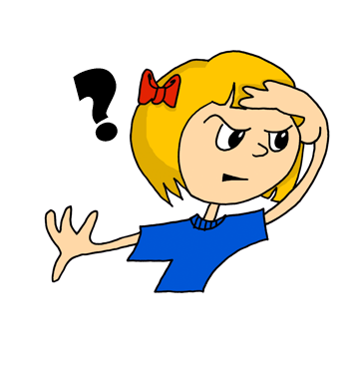
où?
where?
Rachel Hawkes / Emma Marsden

Slide 7
où?
where?
Rachel Hawkes / Emma Marsden

Slide 8
où?
where?
Où est Amélie?
[Where is Amélie?]
Rachel Hawkes / Emma Marsden

Slide 9
où?
where?
___ est Amélie?
Où
[Where is Amélie?]

Slide 10
quand?
when?
Rachel Hawkes / Emma Marsden

Slide 11
quand?
when?
Rachel Hawkes / Emma Marsden

Slide 12
quand?
when?
Quand commence le film?
[When does the film start?]
Rachel Hawkes / Emma Marsden

Slide 13
quand?
when?
_______ commence le film?
Quand
[When does the film start?]

Slide 14
qui?
who?
Rachel Hawkes / Emma Marsden

Slide 15
qui?
who?
Rachel Hawkes / Emma Marsden

Slide 16
qui?
who?
Qui est ton prof de maths?
[Who is your maths teacher?]
Rachel Hawkes / Emma Marsden

Slide 17
qui?
who?
___ est ton prof de maths?
Qui
[Who is your maths teacher?]

Slide 18
que?
what?
Rachel Hawkes / Emma Marsden

Slide 19
que?
what?
Rachel Hawkes / Emma Marsden

Slide 20
que?
what?
Que fais-tu?
[What do you do/are you doing?]
Rachel Hawkes / Emma Marsden

Slide 21
que?
what?
____ fais-tu?
Que
[What do you do/are you doing?]

Slide 22
pourquoi?
why?
Rachel Hawkes / Emma Marsden

Slide 23
pourquoi?
why?
Rachel Hawkes / Emma Marsden

Slide 24
pourquoi?
why?
Pourquoi aimes-tu ça?
[Why do you like that?]
Rachel Hawkes / Emma Marsden

Slide 25
pourquoi?
why?
_________ aimes-tu ça?
Pourquoi
[Why do you like that?]

Slide 26
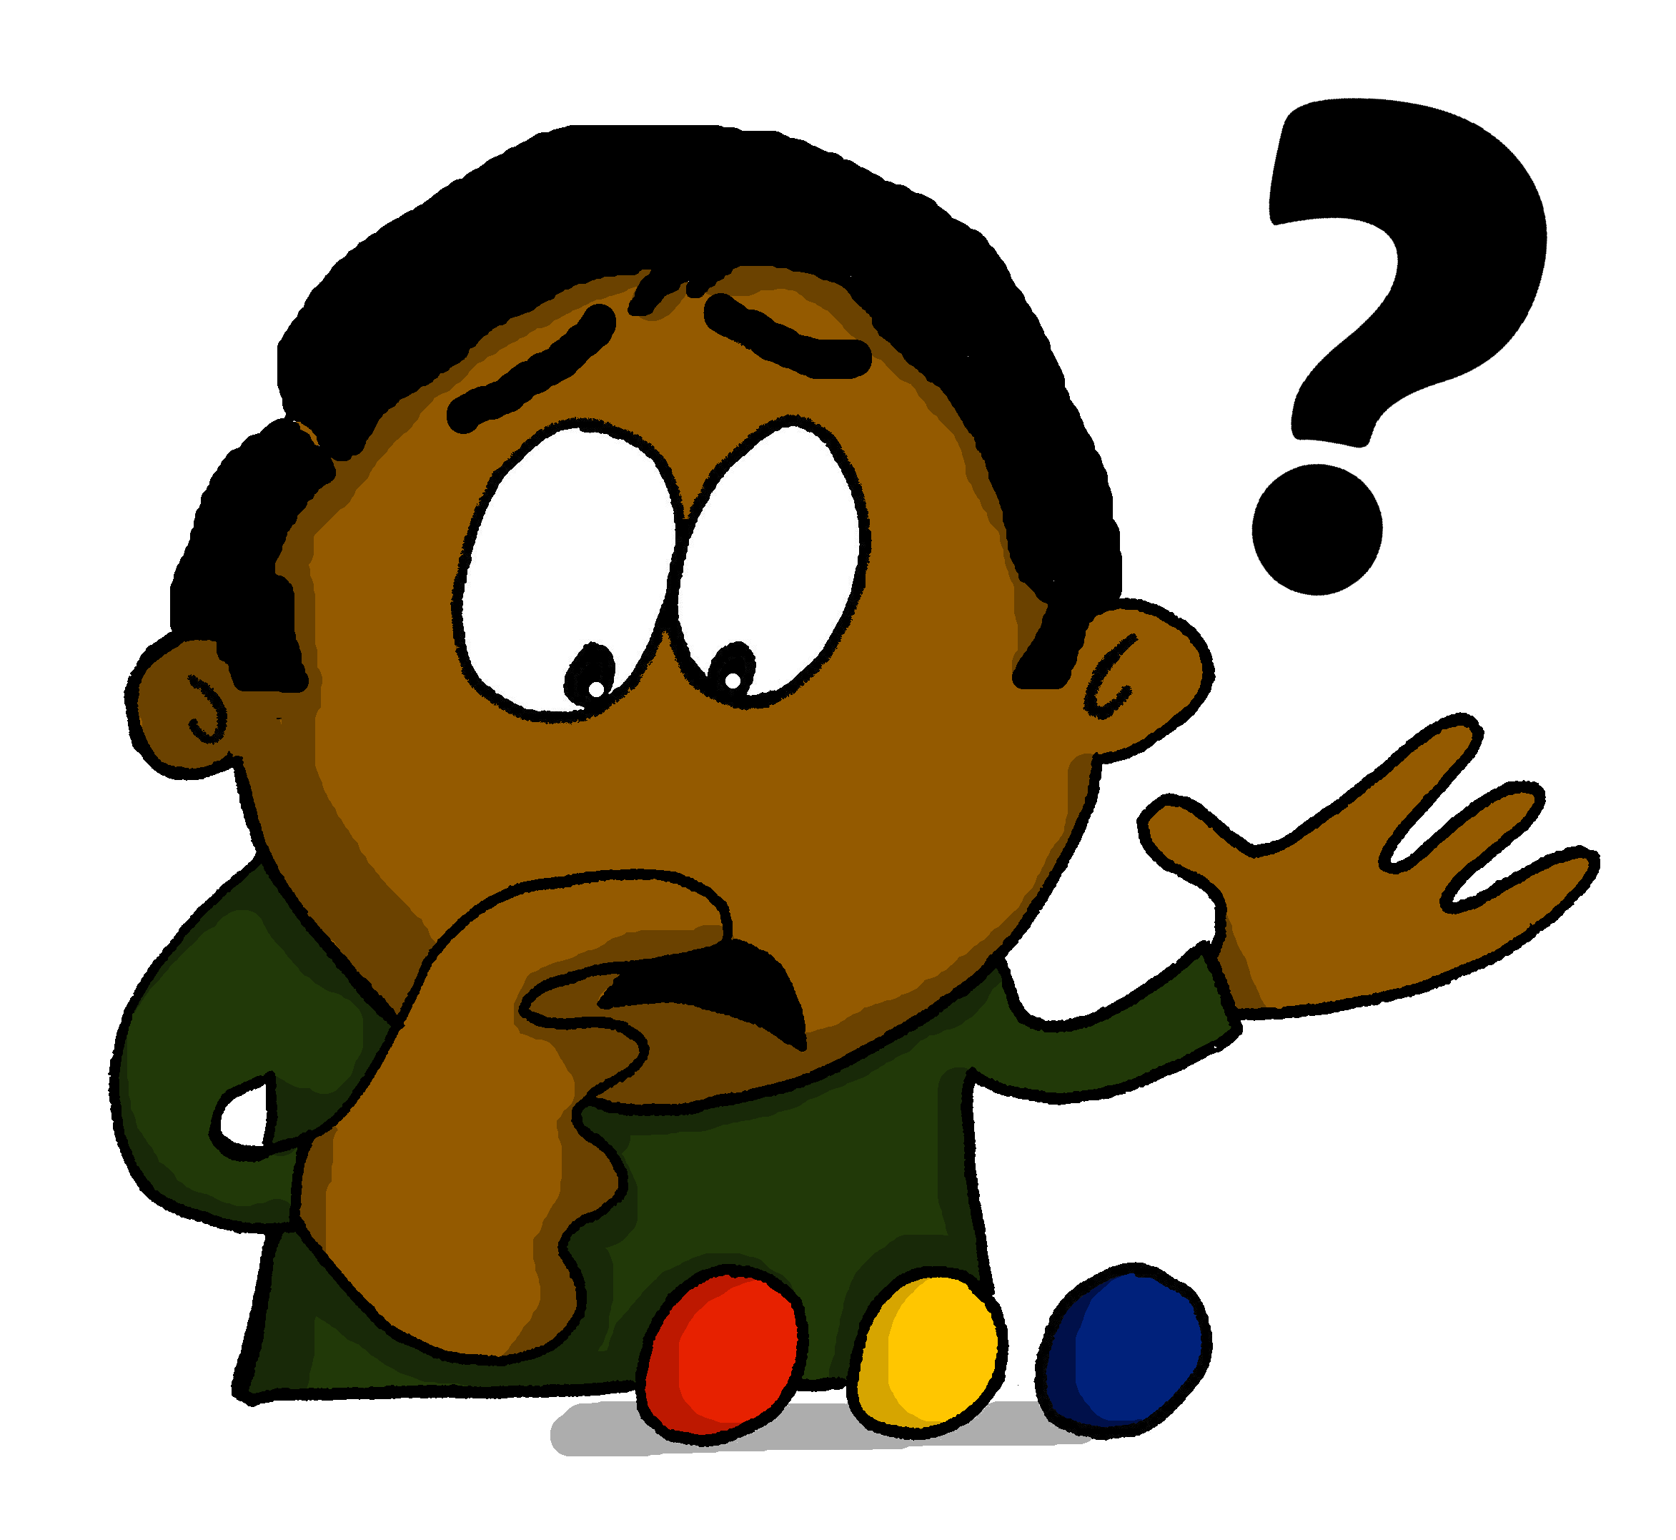
quel?
which?
Rachel Hawkes / Emma Marsden

Slide 27
quel?
which?
Rachel Hawkes / Emma Marsden

Slide 28
quel?
which?
Quel est ton mot préféré?
[Which is your favourite word?]
Rachel Hawkes / Emma Marsden

Slide 29
quel?
which?
_____ est ton mot préféré?
Quel
[Which is your favourite word?]

Slide 30
quelle?
which?
Rachel Hawkes / Emma Marsden

Slide 31
quelle?
which?
Rachel Hawkes / Emma Marsden

Slide 32
quelle?
which?
Quelle photo aimes-tu?
[Which photo do you like?]
Rachel Hawkes / Emma Marsden

Slide 33
quelle?
which?
_______ photo aimes-tu?
Quelle
[Which photo do you like?]

Slide 34
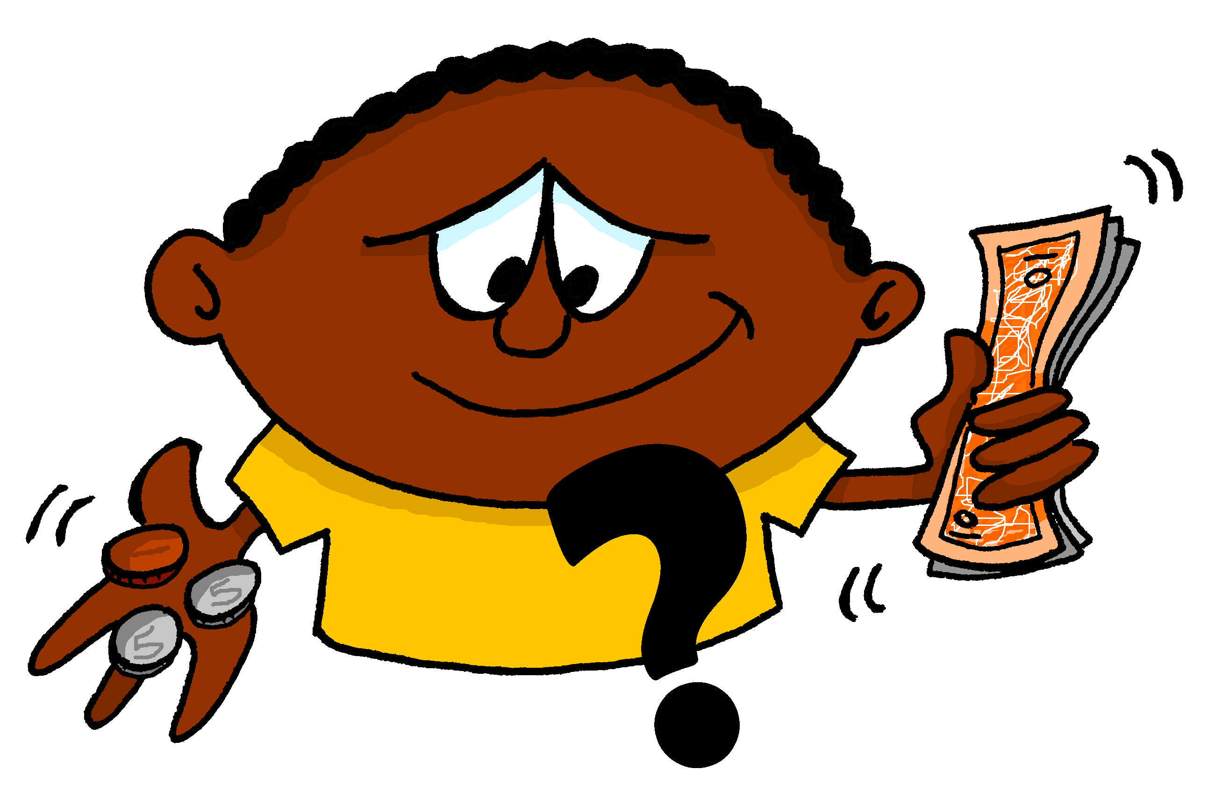
combien?
how much?
how many?
Rachel Hawkes / Emma Marsden

Slide 35
combien?
how much?
how many?
Rachel Hawkes / Emma Marsden

Slide 36
combien?
how much?
how many?
Combien de chiens as-tu?
[How many dogs do you have?]
Rachel Hawkes / Emma Marsden

Slide 37
combien?
how much?
how many?
_________ de chiens as-tu?
Combien
[How many dogs do you have?]

