Slide 1
Communicating in other languages [1]
verbs like entendre (present) (je, tu, il/elle)
SSCs open [eu/œu] and [eu] revisited
Y8 French
Term 3.1 - Week 4 - Lesson 55
Victoria Hobson / Catherine Morris / Amber Dudley
Artwork by: Chloé Motard
Date updated: 09/07/21
Notes:
Artwork by Chloé Motard. All additional pictures selected are available under a Creative Commons license, no attribution required.
Native speaker feedback provided by Sarah Brichory.
With thanks to Rachel Hawkes for her input on the lesson material.
Learning outcomes (lesson 1):
Consolidation of SSCs open [eu/œu] and [eu]
Introduction of verbs like entendre (je, tu, il/elle) in the present tense
Word frequency (1 is the most frequent word in French):
8.3.1.4 (introduce) dépendre (de) [313], entendre [159], répondre (à) [200], annonce [1887], conversation [1747], espagnol² [1666], message [792], soleil [1713], temps² [65], espagnol¹ [1666], Espagne [n/a]
8.2.2.3 (revisit) feu [786], hôpital [1308], jeu [291], journal [420], oiseau [2435], réseau [721], autre [28], même [42], idéal [1429], international [282], local [622], plusieurs [213], social [301]
8.1.2.7 (revisit) acheter [636], coûter [984], peser [1584], eau [475], euro [1753], exercice2 [1290], fromage [4475], glace [2580], pain [2802], natation [>5000], poisson [1616], sport [2011], travail [153]
Source: Londsale, D., & Le Bras, Y. (2009). A Frequency Dictionary of French: Core vocabulary for learners London: Routledge.
The frequency rankings for words that occur in this PowerPoint which have been previously introduced in NCELP resources are given in the NCELP SOW and in the resources that first introduced and formally re-visited those words.
For any other words that occur incidentally in this PowerPoint, frequency rankings will be provided in the notes field wherever possible.

Slide 2
open eu/œu
cœur
Notes:
Timing: 1 minute
Aim: To consolidate SSC open [eu]/[œu]
Procedure: 1. Present the letter(s) and say the open [eu]/[œu] sound first, on its own. Students repeat it with you. 2. Bring up the word ”cœur” on its own, say it, students repeat it, so that they have the opportunity to focus all of their attention on the connection between the written word and its sound.
3. A possible gesture for this would be to put your hand on your chest over your heart. 4. Roll back the animations and work through 1-3 again, but this time, dropping your voice completely to listen carefully to the students saying the open [eu]/[œu] sound, pronouncing ”cœur” and, if using, doing the gesture.
Word frequency (1 is the most frequent word in French):
cœur [568]
Source: Londsale, D., & Le Bras, Y. (2009). A Frequency Dictionary of French: Core vocabulary for learners London: Routledge.

Slide 3
open eu/œu
acteur
neuf
9
jeune
cœur
sœur
[young]
[sister]
erreur
[mistake]
Notes:
Timing: 2 minutes
Aim: To consolidate SSC open [eu]/[œu]
Procedure:
Introduce and elicit the pronunciation of the individual SSC open [eu]/[œu] and then the source word again ‘œil’ (with gesture, if using). Then present and elicit the pronunciation of the five cluster words. The cluster words have been chosen for their high-frequency, from a range of word classes, with the SSC (where possible) positioned within a variety of syllables within the words (e.g. initial, 2nd, final etc.). Additionally, we have tried to use words that build cumulatively on previously taught SSCs (see the Phonics Teaching Sequence document) and do not include new SSCs. Where new SSCs are used, they are often consonants which have a similar symbol-sound correspondence in English.
Word frequency (1 is the most frequent word in French): acteur [1552]; cœur [568]; jeune [152]; erreur [612]; neuf [787]; sœur [1558]. Source: Londsale, D., & Le Bras, Y. (2009). A Frequency Dictionary of French: Core vocabulary for learners London: Routledge.

Slide 4
eu
deux
Notes:
Timing: 1 minute
Aim: To consolidate SSC [eu]
Procedure: 1. Present the letter(s) and say the [eu] sound first, on its own. Students repeat it with you. 2. Bring up the word ”deux” on its own, say it, students repeat it, so that they have the opportunity to focus all of their attention on the connection between the written word and its sound.
3. A possible gesture for this would be to hold up two fingers (N.B. palm of the hand facing the class!). 4. Roll back the animations and work through 1-3 again, but this time, dropping your voice completely to listen carefully to the students saying the [eu] sound, pronouncing ”deux” and, if using, doing the gesture.
Word frequency (1 is the most frequent word in French):
deux [41].
Source: Londsale, D., & Le Bras, Y. (2009). A Frequency Dictionary of French: Core vocabulary for learners London: Routledge.

Slide 5
eu
jeudi
lieu
[place]
deux
feu
jeu
un peu
[a little]
Notes:
Timing: 2 minutes
Aim: To consolidate SSC [eu]
Procedure:
1. Introduce and elicit the pronunciation of the individual SSC [eu] and then the source word again ‘deux’ (with gesture, if using). 2. Then present and elicit the pronunciation of the five cluster words.
The cluster words have been chosen for their high-frequency, from a range of word classes, with the SSC (where possible) positioned within a variety of syllables within the words (e.g. initial, 2nd, final etc.). Additionally, we have tried to use words that build cumulatively on previously taught SSCs (see the Phonics Teaching Sequence document) and do not include new SSCs. Where new SSCs are used, they are often consonants which have a similar symbol-sound correspondence in English.
Word frequency (1 is the most frequent word in French): deux {41]; jeudi[1112]; lieu [117] feu [786]; un peu [138/91]; jeu [291]. Source: Londsale, D., & Le Bras, Y. (2009). A Frequency Dictionary of French: Core vocabulary for learners London: Routledge.

Slide 6
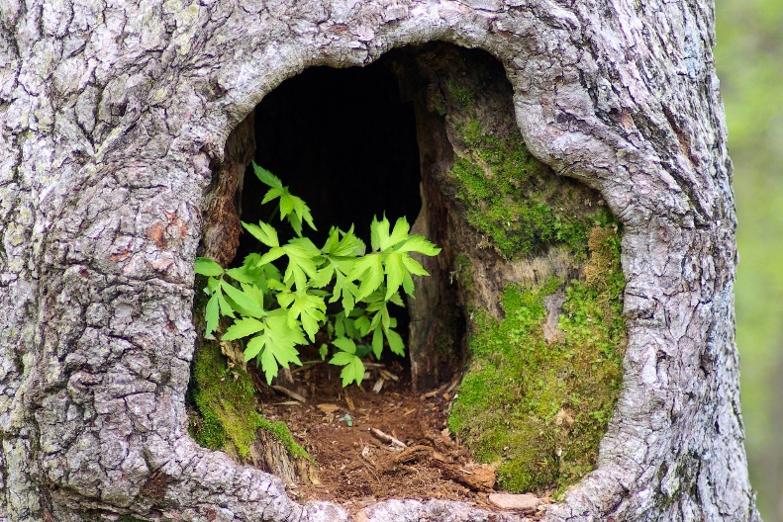
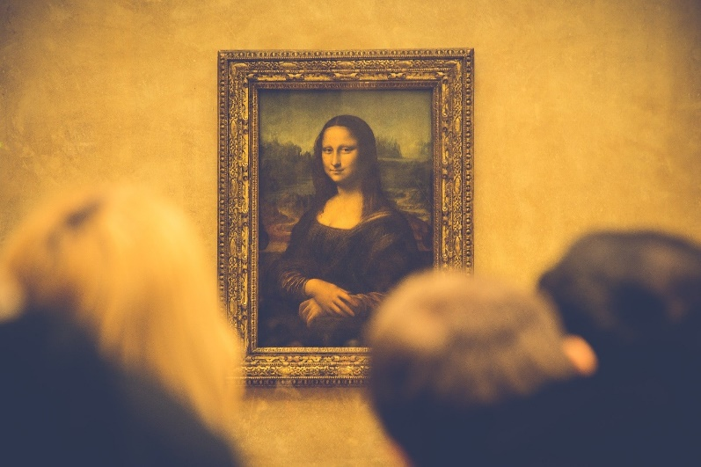
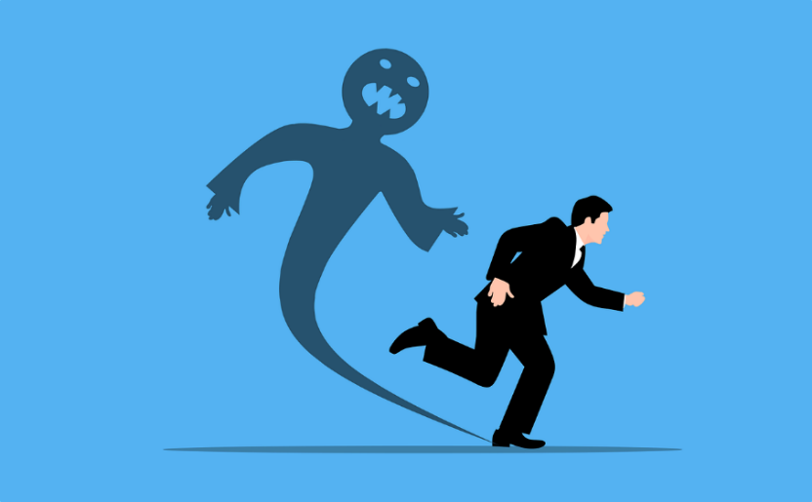
Phonétique
écouter
Écoute les mots et choisis la bonne SSC.
 | en français | en anglais | open [eu/œu] | [eu]
 | la peur | fear
 | adieu | goodbye
 | l’œuvre | work of art
 | le pneu | tyre
 | l’œuf | egg
 | les yeux | eyes
 | creux | hollow
 | la fleur | flower
1
__
2
___
3
___
4
___
5
___
6
__
7
__
8
__
Notes:
Timing: 5 minutes
Aim: Aural recognition of SSCs open [eu]/[œu] and [eu].
Procedure:
1. Click the number to play the audio.
2. Students choose which SSC the word contains.
3. Click to reveal answers.
Transcript:
la peur
adieu
l’œuvre
le pneu
l’œuf
les yeux
creux
la fleur
Word frequency of unknown words used (1 is the most frequent word in French): peur [755]; adieu [3968]; œuvre [331]; pneu [4514]; œuf [2685]; yeux [>5000]; creux [3508]; fleur [2305]
Source: Londsale, D., & Le Bras, Y. (2009). A Frequency Dictionary of French: Core vocabulary for learners London: Routledge.

Slide 7
Vocabulaire
écouter
J.
F
Écoute et écris la bonne lettre.
Spanish (adj)
1
2
G
G.
3
D
to depend on,
depending on
B.
4
E
H.
C
5
A.
to respond to, responding
to
6
J
C.
7
A
F.
8
H
9
I
time, weather
to hear, hearing
B
10
D.
11
K
I.
K.
E.
Notes:
Timing: 3 minutes
Aim: Aural recognition of words in this week’s vocabulary set.
Procedure:
1. As this vocabulary set contains l’Espagne, epagnol, and l’espagnol, the teacher may wish to start with a recap of the differences between these three words, and discuss how they might be represented here.
2. Click on a number trigger to hear words pronounced by a native speaker.
3. Students write 1-11 and the appropriate letter.
4. Click to reveal the answers.
5. Click on the words again. Students repeat. Pay special attention to pronuncuation of la conversation, which is a written cognate but not a spoken one.
Transcript:
1. répondre à
2. espagnol
3. le message
4. entendre
5. l’annonce
6. le soleil
7. dépendre de
8. l’Espagne
9. le temps
10. la conversation
11. l’espagnol
Word frequency of cognates used (1 is the most frequent word in French): lettre [480]
Source: Londsale, D., & Le Bras, Y. (2009). A Frequency Dictionary of French: Core vocabulary for learners London: Routledge.

Slide 8
Mot de passe
lire
La détective cherche le mot de passe. Tu peux aider ?
le message
espagnol(e)
ultrasecret
entendre
le soleil
Le mot a la SSC:
Ce n’est pas un adjectif.
Ce n’est pas une forme de communication.
C’est un pays.
l'annonce (f)
répondre
l'espagnol (m)
la conversation
dépendre
le temps
l'Espagne (m)
Notes:
Timing: 6 minutes (for 3 slides)
Aim: Semantic, grammatical and phonetic categorisation of words in this week’s vocabulary set.
Procedure:
1. Ask students to draw on their existing knowledge of English and French to work out the meanings of mot de passe and ultrasecret.
2. Students to write down all the words in their books.
3. On clicks, the clues appear. Reveal these one by one, giving students time to score out words that don’t fit the given category.
4. Move to the next slide to check the answers. Elicit responses by asking e.g. ‘quels mots sont des verbes?’ On clicks, groups of words eliminated at each stage disappear, until only the solution remains.
5. Once all clues have been revealed, ask students ‘c’est quoi le mot de passe?’
6. Click again to reveal answers to each clue, leaving the answer to the end
Transcript:
[s]
Word frequency of cognates used (1 is the most frequent word in French): détective [>5000], passe [4295], adjectif [>5000], forme [369], communication [1036]
Source: Londsale, D., & Le Bras, Y. (2009). A Frequency Dictionary of French: Core vocabulary for learners London: Routledge.

Slide 9
Mot de passe
lire
La détective cherche le mot de passe. Tu peux aider ?
le soleil
espagnol(e)
ultrasecret
le message
entendre
répondre
C’est un mot en bleu.
C’est un nom.
Ce n’est pas un pays.
On trouve ça dans un journal.
l'annonce (f)
l'espagnol (m)
la conversation
le temps
dépendre
l'Espagne (m)
Notes:
Word frequency of cognates used (1 is the most frequent word in French): détective [>5000], passe [4295]
Source: Londsale, D., & Le Bras, Y. (2009). A Frequency Dictionary of French: Core vocabulary for learners London: Routledge.

Slide 10
Mot de passe
lire
La détective cherche le mot de passe. Tu peux aider ?
le message
espagnol(e)
ultrasecret
le soleil
entendre
Ce n’est pas une chose jaune.
Le mot a la SSC:
C’est un mot en orange.
Il fait beau/mauvais.
l'annonce (f)
répondre
l'espagnol (m)
la conversation
dépendre
le temps
l'Espagne (m)
Notes:
Transcript:
[em/en]
Word frequency of cognates used (1 is the most frequent word in French): orange [3912]
Source: Londsale, D., & Le Bras, Y. (2009). A Frequency Dictionary of French: Core vocabulary for learners London: Routledge.

Slide 11
entendre
[to hear | hearing]
entend
[hears | is hearing]
Notes:
Timing: 3 minutes for sequence of six verbs
Aim: to introduce the verb entendre more explicitly. Both long form (infinitive) and short form (3rd person singular) are introduced in order to familiarise students with various forms of the same verb.
Procedure
Bring up the word entendre on its own, say it, students repeat it, and remind them of the phonics. Draw attention to SSC [en] and SFe.
Try to elicit the meaning from the students. Students have had explicit teaching that the present tense in French communicates two different present tense meanings in English. This reinforces that learning. Emphasise the two meanings for the short form, reminding students that French only has one form and does not have a direct equivalent of the grammar for ‘is + ing’, the continuous form (as covered in previous weeks).
Bring up the picture, and, if using gestures, a possible gesture would be to take one hand to the ear to indicate hearing.
Then bring up the English translations. Emphasise the two meanings for the infinitive.
Bring up the short form entend, say it, students repeat it. Draw attention to [en] and SFC.
Try to elicit the meaning from the students. Emphasise the two meanings for the short form.

Slide 12
entendre
[to hear | hearing]
entend
[hears | is hearing]
Notes:
Cycle through the long and short form again.

Slide 13
entend
[hears | is hearing]
Elle entend des annonces.
[She hears | is hearing announcements.]
Notes:
Introduce the short form in a sentence.

Slide 14
entendre
[to hear | hearing]
Elle peut entendre des annonces.
[She can/is able to hear announcements.]
Notes:
Introduce the long form in a sentence.

Slide 15
entend
[hears | is hearing]
entend
Elle des annonces.
[She hears | is hearing announcements.]
Notes:
Cycle through the short form in context again.

Slide 16
entend
[hears | is hearing]
Elle peut des annonces.
entendre
[She can/is able to hear announcements.]
Notes:
Cycle through the long form in context again.

Slide 17
Verbes avec à
grammaire
Notice: the verb ‘to answer’ is not followed by a preposition in English. It still needs one in French!
Répondre à = to reply to / to answer someone or something.
Je réponds à la question.
= I’m answering the question.
Remember:
la / le→ l’ before a word beginning with a vowel/h.
Tu réponds à l’enfant.
= You are replying to the child.
Il répond au message.
= He’s replying to the message.
à + le → au
Elle répond aux questions.
= She answers the questions.
à + les → aux
Notes:
Timing: 2 minutes
Aim: to recap forms of à + definite article in preparation for use with new verb répondre. To raise awareness of cross-linguistic differences in preposition use.
Procedure:
1. Click to bring up the explanations, paying special attention to the different prepositions used with these words in English and French.
2. This should be revision for students, so the English appears first with the expectation that students will produce oral translations in the L2.

Slide 18
Verbes avec de
Notice: the preposition used with this verb is different from English.
grammaire
Dépendre de = to depend on someone or something.
Remember:
de + le → du
de + les → des
Je dépends de la voiture.
= I depend on the car.
Tu dépends de l’équipe.
= You’re depending on the team.
Elle dépend du professeur.
= She’s depending on the teacher.
Il dépend des journaux locaux.
= He depends on the local newspapers.
Notes:
Timing: 2 minutes
Aim: to recap forms of de + definite article in preparation for use with new verb dépendre. To raise awareness of cross-linguistic differences in preposition use.
Procedure:
1. Click to bring up the explanations, paying special attention to the different prepositions used with these words in English and French.
2. This should be revision for students, so the English appears first with the expectation that students will produce oral translations in the L2.

Slide 19
Verbes avec à/de
écouter
Écoute et choisis la réponse correcte.
 |  | Réponse
1 | Elle dépend des | parents
 |  | argent
2 | Je réponds au | fille
 |  | message
3 | Tu dépends de la | travail
 |  | voiture
4 | Il répond à l’ | élève
 |  | question
 |  | Réponse
5 | Je dépends du | journal
 |  | directrice
6 | Tu réponds aux | annonces
 |  | questions
7 | Il dépend de l’ | hôpital
 |  | oiseaux
8 | Elle répond à la | enfant
 |  | partenaire
1
5
2
6
3
7
4
8
Notes:
Timing: 5 minutes
Aim: aural recognition of forms of prepositions à and de + definite article with new verbs répondre and dépendre and connecting these with meaning. This activity can easily be adapted for lower-level classes by removing the audio buttons and the squares covering the transcriptions to make it a reading activity.
Procedure:
1. Click numbers to hear audio.
2. Students write the correct noun depending on the preceding form of à or de.
3. Click to bring up the answers and transcriptions.
4. Click on the answer bubble to hear full audio.
5. Elicit oral translation.
Transcript:
1. Elle dépend des [parents].
2. Je réponds au [message].
3. Tu dépends de la [voiture].
4. Il répond à l’[’élève]
5. Je dépends du [journal]
6. Tu réponds aux [annonces].
7. Il dépend de l’[hôpital].
8. Elle répond à la [partenaire].

Slide 20
Verbs like entendre
Remember! The je, tu
and il/elle forms of these words all sound the same. The –s is an SFC.
grammaire
You already know three verbs which end in –RE instead of –ER or –IR:
tu a _ _ _ _ _ _ _
tu apprends
il/elle c _ _ _ _ _ _ _
je p_ _ _ _ _
il/elle comprend
je prends
I am taking
you learn
he/she understands
Verbs like entendre are another type of –RE verb.
They follow the same pattern in the je, tu and il/elle forms:
entendre
to hear, hearing
dépendre
to depend, depending
répondre
to reply, to answer
je _ _ _ _ _ _
j’entends
je dépends
j’_ _ _ _ _ _ _ _
je réponds
je _ _ _ _ _ _ _ _ _
tu _ _ _ _ _ _
tu entends
tu dépends
tu _ _ _ _ _ _ _ _
tu réponds
tu _ _ _ _ _ _ _ _ _
il/elle entend
il/elle dépend
il/elle répond
il/elle _ _ _ _ _
il/elle _ _ _ _ _ _ _
il/elle _ _ _ _ _ _ _ _
Notes:
Timing: 3 minutes
Aim: to recap students’ knowledge of the present tense singular forms of prendre/apprendre/comprendre in preparation for applying this knowledge to verbs like entendre (dépendre and répondre).
Procedure:
1. Elicit the French and English from students as per the prompts on the slide.
2. Reveal the answers on mouse clicks.
3. Teacher says some of the forms aloud to demonstrate SFC –s on the je and tu forms. Students repeat.

Slide 21
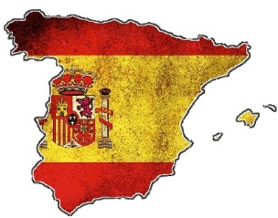
Amir et son nouveau ami Pep
Salut d’ Espagne!
lire
Amir reste chez son ami Pep à Barcelone en Espagne.
Il aime écrire des cartes postales pour parler de ses voyages ! Qui fait quoi, Amir ou Pep ? Coche et écris l’activité en anglais !
 |  | I | he
1. | Ici à Barcelone, je prends le métro partout. C’est très rapide!
2. | Dans la station de métro, j’entends des annonces.
3. | Mais je comprends très peu.
4. | Pep comprend l’espagnol parce qu’il vient de la région.
5. | Au collège je réponds aux questions de mon prof en espagnol mais ici les personnes locales parlent trop vite !
6. | Il répond à chacun pour aider.
7. | Après, il prend le temps pour parler lentement en espagnol.
8. | Il aime aider et j’ apprends beaucoup de nouveaux mots.
Notes:
Timing: 8 minutes
Aim: written recognition of 1st and 3rd person singular forms of verbs like entendre, and connecting these with meaning. Written recognition of new vocabulary in longer contexts (reading comprehension).
Procedure:
1. Students read the sentences and use their knowledge of verb forms to decide whether Amir is referring to himself or to Pep.
2. Students then sketch a 2x2 grid with the headings ‘Amir’ and ‘Pep’. They write English bullet points to describe what each person is doing.
3. Click on the flags to reveal the correct pronoun.
4. Move on to the next slide to bring up answers to the comprehension element.
5. Use the picture of the underground in Barcelona to offer some cultural insight into the city.
Word frequency (1 is the most frequent word in French): Barcelone [>5000], station [1399], région [241], postal [3625], métro [3227]
Source: Londsale, D., & Le Bras, Y. (2009). A Frequency Dictionary of French: Core vocabulary for learners London: Routledge.

Slide 22
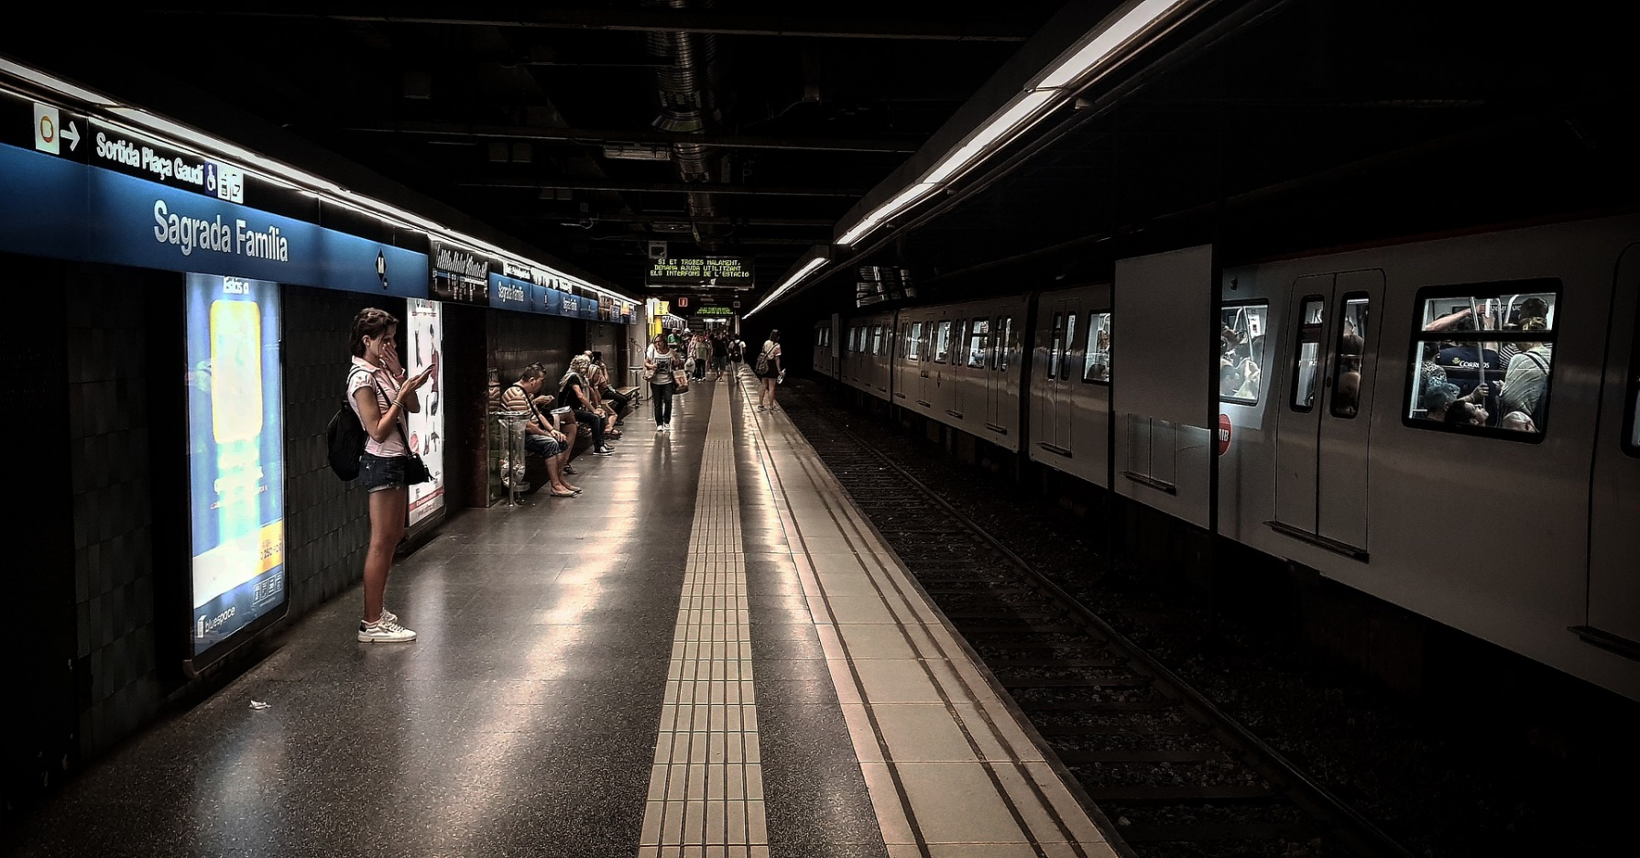
Amir et son nouveau ami Pep
Salut d’ Espagne!
lire
Qui fait quoi ?
Amir | Pep
takes the metro
understands Spanish
hears announcements in the metro station
replies to everyone
takes the time to speak slowly
understands very little
likes to help
Le métro est un train souterrain (underground), comme à Londres et à Paris.
answers questions in Spanish at school
is learning lots of new words
Notes:
Answer slide for the comprehension part of the activity on the previous slide.
Word frequency of unknown words used (1 is the most frequent word in French): souterrain [4544]
Source: Londsale, D., & Le Bras, Y. (2009). A Frequency Dictionary of French: Core vocabulary for learners London: Routledge.

Slide 23
Conversations avec Pep
* le tramway
= tram
écouter / écrire
Amir pose des questions à Pep. Il parle d’Océane aussi. Écoute et écris le verbe.
 | verbe en français
1
prend
2
prends
 | verbe en français
3
prend
5
comprends
4
entends
6
répond
7
dépend
8
réponds
Notes:
Timing: 5 minutes
NB: See next slide for an option for higher ability levels in which students write the whole sentence/question.
Aim: oral recognition and written production of singular forms of verbs like entendre in a longer context. Raising awareness that the je, tu and il/elle forms of verbs like entendre sound the same.
Procedure:
1. Click on a button to hear the audio.
2. Students listen to the sentence and transcribe the verb they hear, taking care to write the appropriate SFCs at the end of each verb. Remind students that although the verb forms sound the same, the spelling will vary depending on the pronoun which precedes them.
3. Answers revealed on clicks.
4. Oral translation of the full sentence.
Transcript:
tu prends le métro pour aller au collège à Nice
Je prends le bus pour aller au collège.
Océane prend le tramway.
Tu entends l’annonce ?
Oui, mais je ne comprends pas le message.
Océane répond très vite à tes messages !
Oui, elle dépend de ce voyage pour avoir un cadeau de Barcelone.
Je réponds moins vite, en général.
Word frequency of near-cognates used (1 is the most frequent word in French): tramway [>5000], verbe [>5000], bus [4027]
Source: Londsale, D., & Le Bras, Y. (2009). A Frequency Dictionary of French: Core vocabulary for learners London: Routledge.

Slide 24
Conversations avec Pep
* le tramway
= tram
écouter / écrire
Amir pose des questions à Pep. Il parle d’Océane aussi. Écoute et écris la phrase.
 | phrase ou question complète en français
1
Tu prends le metro pour aller au collège à Nice ?
2
Je prends le bus pour aller au collège.
3
Océane prend le tramway.
4
Tu entends l’annonce ?
5
Oui, mais je ne comprends pas le message.
6
Océane répond très vite à tes messages !
7
Oui, elle dépend de ce voyage pour avoir un cadeau de Barcelone.
8
Je réponds moins vite, en général.
Notes:
NB: see previous slide for an option for lower ability levels in which students write just the verb.
Aim: oral recognition and written production of singular forms of verbs like entendre in a longer context. Raising awareness that the je, tu and il/elle forms of verbs like entendre sound the same.
Procedure:
1. Click on a button to hear the audio.
2. Students listen to the sentence and transcribe it, taking care to write the appropriate SFCs at the end of each verb. Remind students that although the verb forms sound the same, the spelling will vary depending on the pronoun which precedes them.
3. Answers revealed on clicks. 4. Oral translation of the full sentence.
Transcript:
Tu prends le métro pour aller au collège à Nice.
Je prends le bus pour aller au collège.
Océane prend le tramway.
Tu entends l’annonce ?
Oui, mais je ne comprends pas le message.
Océane répond très vite à tes messages !
Oui, elle dépend de ce voyage pour avoir un cadeau de Barcelone.
Je réponds moins vite, en général.
Word frequency of near-cognates used (1 is the most frequent word in French): tramway [>5000], verbe [>5000], bus [4027]
Source: Londsale, D., & Le Bras, Y. (2009). A Frequency Dictionary of French: Core vocabulary for learners London: Routledge.

Slide 25
Communicating in other languages [1]
Verbs like entendre (present) (je, tu, il/elle)
SSCs open [eu/œu] and [eu]
Y8 French
Term 3.1 - Week 4 - Lesson 56
Victoria Hobson / Catherine Morris / Amber Dudley
Artwork by: Chloé Motard
Date updated: 09/07/21
Notes:
Artwork by Chloé Motard. All additional pictures selected are available under a Creative Commons license, no attribution required.
Native speaker feedback provided by Sarah Brichory.
With thanks to Rachel Hawkes her input on the lesson material.
Learning outcomes (lesson 2):
Introduction of SSCs open [eu/œu] and [eu]
Consolidation of verbs like entendre (je, tu, il/elle) in the present tense
Word frequency (1 is the most frequent word in French):
8.3.1.4 (introduce) dépendre (de) [313], entendre [159], répondre (à) [200], annonce [1887], conversation [1747], espagnol² [1666], message [792], soleil [1713], temps² [65], espagnol¹ [1666], Espagne [n/a]
8.2.2.3 (revisit) feu [786], hôpital [1308], jeu [291], journal [420], oiseau [2435], réseau [721], autre [28], même [42], idéal [1429], international [282], local [622], plusieurs [213], social [301]
8.1.2.7 (revisit) acheter [636], coûter [984], peser [1584], eau [475], euro [1753], exercice2 [1290], fromage [4475], glace [2580], pain [2802], natation [>5000], poisson [1616], sport [2011], travail [153]
Source: Londsale, D., & Le Bras, Y. (2009). A Frequency Dictionary of French: Core vocabulary for learners London: Routledge.
The frequency rankings for words that occur in this PowerPoint which have been previously introduced in NCELP resources are given in the NCELP SOW and in the resources that first introduced and formally re-visited those words.
For any other words that occur incidentally in this PowerPoint, frequency rankings will be provided in the notes field wherever possible.

Slide 26
Phonétique
parler
Partners say alternate sentences while the other counts the SSCs they hear.
 |  | open [eu/œu] | [eu]
 | Léa dit adieu à son vieux grand-père à deux heures. | 1 | 3
 | Antoine choisit une seule fleur bleue à neuf heures. | 4 | 1
 | Le chef travailleur donne un copieux déjeuner à la neuvième personne dans la queue. | 2 | 3
 | Le jeune pêcheur va au fleuve parce qu’il veut prendre plusieurs poissons. | 4 | 1
A
B
A
B
Notes:
Timing: 2 minutes
Aim: Oral production of sentences containing SSCs open [eu]/[œu] and [eu].
Procedure:
1. Student B turns away from the board.
2. Click to reveal partner A’s first sentence.
3. Partner A reads the sentence aloud while student B counts the total number of open [eu]/[œu] and [eu] they hear.
4. Click to reveal answer.
5. Student A then turns away from the board.
6. Repeat steps 2-4.
7. Repeat for the second pair of sentences.
8. The next slide contains English translations of the sentences with the SSC highlighted in different colours.
Word frequency of unknown words used (1 is the most frequent word in French): adieu [3968]; fleur [2305]; neuvième [>5000]; queue [3255]; pêcheur [2759]; fleuve [2893]; poisson [1616]
Source: Londsale, D., & Le Bras, Y. (2009). A Frequency Dictionary of French: Core vocabulary for learners London: Routledge.

Slide 27
Phonétique
parler
 |  | open [eu/œu] | [eu]
 | Léa dit adieu à son vieux grand-père à deux heures. (Léa says goodbye to her old grandad at two o’clock.) | 1 | 3
 | Antoine choisit une seule fleur bleue à neuf heures. (Antoine choses a single blue flower at nine o’clock.) | 4 | 1
 | Le chef travailleur donne un copieux déjeuner à la neuvième personne dans la queue. (The hard-working chef gives a generous lunch to the ninth person in the queue.) | 2 | 3
 | Le jeune pêcheur va au fleuve parce qu’il veut prendre plusieurs poissons. (The young fisherman goes to the river because he wants to take several fish.) | 4 | 1
A
B
A
B
Notes:
Answers to previous slide with translations and SSCs highlighted.

Slide 28
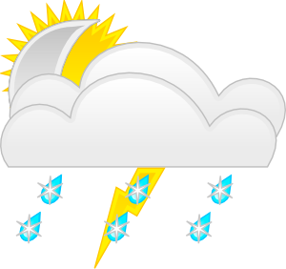
Vocabulaire
Vocabulaire
parler
le
la
Notes:
Timing: 1 minute
Aim: Oral production of new nouns in this week’s set. Procedure: 1. Words appear on separate mouse clicks. Students say the word (chorally) with its definite article. 2. On second click, the noun moves into the ‘appropriately gendered’ mouth. Answers:
la conversation
le message
le soleil
l’Espagne (f)
le temps

Slide 29
Vocabulaire
parler 1/8
Vocabulaire
parler
Vocabulaire
3
J’entends la musique.
Secondes
0
DÉBUT
Notes:
Timing: 1 minute (for 4 slides)
Aim: Oral recall of the remaining new words from this week’s set within a given time.
Procedure:
1. Click début to start the timer.
2. Students fill the blank in the sentence before the seconds elapse.
3. Click to reveal answer.

Slide 30
Vocabulaire
parler 1/8
Vocabulaire
parler
Vocabulaire
3
Secondes
Je n’aime pas entendre des annonces à la télé.
0
DÉBUT

Slide 31
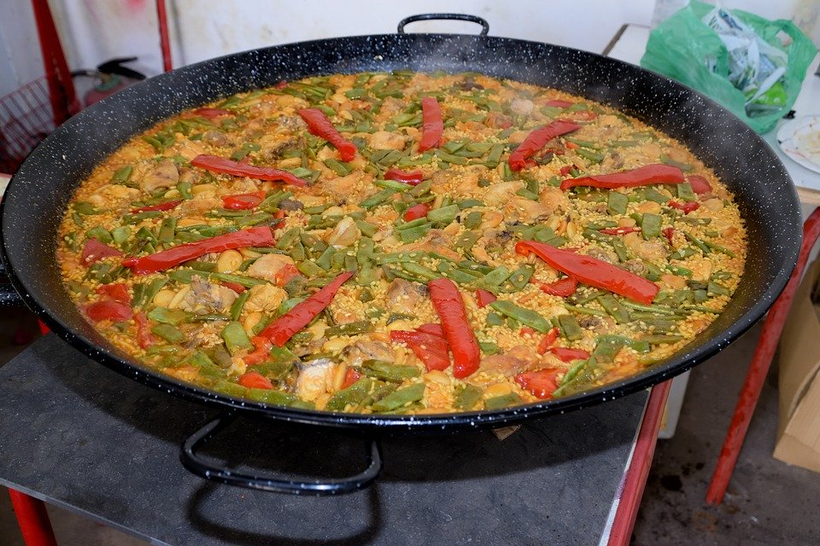
Vocabulaire
parler 1/8
Vocabulaire
parler
Vocabulaire
3
La paella est un repas espagnol.
Secondes
0
DÉBUT
Notes:
Word frequency of glossed cognates used: (1 is the most frequent word in French): paella [>5000]
Source: Londsale, D., & Le Bras, Y. (2009). A Frequency Dictionary of French: Core vocabulary for learners London: Routledge.

Slide 32
Vocabulaire
parler 1/8
Vocabulaire
parler
Vocabulaire
3
L’enfant dépend de ses parents.
Secondes
0
DÉBUT

Slide 33
Un message pour Océane
écrire
Spanish (lang)
respond
Bonjour Océane ! Je réponds en retard à ton message – désolé ! J’adore Barcelone ! Les repas espagnols sont délicieux et il y a beaucoup de soleil. Si le temps est bon samedi, on va aller à la plage. Dans les annonces, j’entends plusieurs langues en même temps - l’espagnol et le catalan. Le catalan, c’est une autre langue officielle d’Espagne qu’on parle à Barcelone. Je ne comprends pas les conversations en catalan - je dépends de Pep pour ça !
1
2
Spanish (adj)
3
Spain
4
5
the weather
6
7
conversation
8
message
9
hear
depend
10
11
sun
announcements
Notes:
Timing: 5 minutes
Aim: Reading comprehension and written production of the words in this week’s vocabulary set in context.
Procedure:
1. Check understanding of the surrounding context. Draw attention to the use of temps, used here with its first meaning (time). Students may need some extra help with the preposition in en même temps.
2. Students fill the gaps by choosing an appropriate word from the list on the right and writing the French translation. Encourage students to narrow down the options by focusing on the words which surround each number. E.g. for number 1, ask: ‘What type of word is like to come after je and before an adverb?’ For number 2, ask: ‘What type of word is likely to come after a possessive adjective?’
3. Click to reveal answers one by one.
Word frequency of cognates used (1 is the most frequent word in French):
texte [632], catalan [>5000], délicieux [>5000], adorer [2322]
Source: Londsale, D., & Le Bras, Y. (2009). A Frequency Dictionary of French: Core vocabulary for learners London: Routledge.

Slide 34
Vocabulaire
Lis et remplis les blancs.
parler 1/8
Un cadeau pour Océane
lire
Vocabulaire
Je veux acheter un cadeau de Barcelone pour Océane. Elle aime
faire du sport et elle fait beaucoup d’exercice. Elle fait du yoga et de la natation chaque samedi. Peut-être qu’elle trouve intéressant un livre sur l’histoire des Jeux olympiques ? C’est un cadeau idéal, mais ça coûte vingt euros. C’est très cher, désolé Océane ! Je dois trouver un autre cadeau. Alors, je vais aller au supermarché. J’ai sept euros, il y a quoi ? De l’eau, de la glace, du fromage, du pain ou du poisson ? Mais, ça pèse beaucoup …Attends ! Il y a une annonce… un feu dans le rayon* jeux vidéos ! On doit sortir vite du magasin ! Je suis vraiment** désolé Océane !
*department **truly
fromage autre natation eau sport idéal feu poisson euros glace pain acheter exercice
Notes:
Timing: 5 minutes
Aim: Written recognition of the vocabulary from 8.1.2.4 & 8.2.1.5 within a text level reading exercise.
Procedure:
Students read the text and complete the sentence with the correct missing word from the selection in the text box underneath the text.
Click on the shape to reveal the word.
Word frequency of glossed words/cognates used: (1 is the most frequent word in French): vraiment [532]; rayon [2926]; olympique [3199].
Source: Londsale, D., & Le Bras, Y. (2009). A Frequency Dictionary of French: Core vocabulary for learners London: Routledge.

Slide 35
Langue, adjectif ou nationalité?
parler 1/8
grammaire
Attention!
After parler, the definite article is normally missing:
Elle parle espagnol.
What does the word espagnol mean?
With a definite article, l’espagnol is a noun meaning the Spanish language:
Antoine apprend l’espagnol au lycée. Antoine is learning Spanish at high school.
Without an article, espagnol is an adjective describing someone or something that comes from Spain. It adds an –e when describing feminine nouns:
Maya est espagnole et elle a un livre espagnol. Maya is Spanish and she has a Spanish book.
With a capital letter, un Espagnol is a noun meaning a person from Spain:
Il y a deux Espagnols au collège. There are two Spanish people at secondary school.
Attention!
Like other nouns referring to people, we add an –e when a female person is talked about and –s in the plural.
Compare …
Je suis anglais(e) - I am English
Je suis Anglais(e) - I am an Englishman/Englishwoman
Notes:
Timing: 3 minutes
Aim: To recap the difference between words for languages, adjectives and nationalities, which look very similar. Teacher may wish to introduce this topic by asking students to recall what they already know about l’anglais/anglaise(e), le français/français(e), l’allemande/allemand(e) and l’italien/italien(ne).
Prodedure:
1. Click to bring up the explanations.

Slide 36
Langue, adjectif ou nationalité?
parler 1/8
lire
Lis les phrases. Les mots en orange représentent-ils des langues, des adjectifs ou des personnes?
Coche le bon verbe !
 |  | entendre (langue) | dépendre de + nom (adjectif) | répondre à (personne)
1. | Amir entend l’espagnol en vacances.
2. | Il répond à une Française.
3. | Noura entend l’anglais au collège.
4. | Elle dépend du temps espagnol.
4. | Mon voyage dépend de l’annonce italienne.
5. | Je répond aux Italiens.
6. | Amandine dépend d’un dictionnaire anglais.
7. | Elle entend l’anglais au supermarché.
_______
_____________
_______
_________________
____________________
___________
_______________________
_______
Notes:
Timing: 5 minutes
Aim: To help students distinguish between languages, adjectives and nationalities using their knowledge of word forms, rather than context.
Procedure:
1. Check that students understand the task instructions.
2. Check that students understand that a form of entendre fits a gap before a language, a form of dépendre de + noun fits a gap before an adjective, and a form of répondre à fits a gap before a person.
3. Remind students that it is the form of the word after the gap that will give them the information they need to complete the sentence.
4. Give students 3 minutes to complete the task. They can sketch a table in their answer books.
5. Answers revealed on clicks.
Word frequency of cognates used in the task instructions: (1 is the most frequent word in French): orange [3912], représenter [293], verbe [>5000], adjectif [>5000]
Source: Londsale, D., & Le Bras, Y. (2009). A Frequency Dictionary of French: Core vocabulary for learners London: Routledge.

Slide 37
Question vs Statement
Question vs statement
écouter
Il répond vite à mes messages.
[He responds quickly to my messages.]
…
Notes:
Timing: 3 minutes for 6 slides
Aim: To present examples of liaison in inversion questions with verbs like entendre in the third person.
Procedure:
Click to reveal example.
Click on audio button to listen again.
Transcript
Il répond vite à mes messages.

Slide 38
Question vs Statement
Question vs statement
écouter
Répond-il vite à tes messages ?
[Does he respond quickly to your messages?]
…
Notes:
Transcript
Répond-il vite à tes messages ?

Slide 39
Question vs Statement
Question vs statement
écouter
Elle dépend des hôpitaux locaux.
[She’s depending on the local hospitals.]
Notes:
Transcript
Elle dépend des hôpitaux locaux.

Slide 40
Question vs Statement
Question vs statement
écouter
Dépend-elle des hôpitaux locaux ?
[Is she depending on the local hospitals?]
Notes:
Transcript
Dépend-elle des hôpitaux locaux ?

Slide 41
Question vs Statement
Question vs statement
écouter
Elle entend les annonces.
[She hears the announcements.]
Notes:
Transcript
Elle entend les annonces.

Slide 42
Question vs Statement
Question vs statement
écouter
Entend-elle les annonces ?
[Does she hear the announcements?]
Notes:
Transcript
Entend-elle les annonces?

Slide 43
Ils parlent d’Océane
Ils parlent d’Océane
écouter
Formule des questions avec inversion. Où est ‘elle’ ?
a
[1] comprend [2] l’espagnol ?
[1] apprend [2] l’anglais et l’italien.
Intéressant ! [1] prend [2] des livres italiens en vacances ?
Oui, et [1] entend [2] souvent la langue à Nice puisque c’est à la frontière.
Ah ! [1] répond [2] aux questions en italien alors.
[1] dépend [2] d’un dictionnaire ?
Non, normalement [1] comprend [2] des phrases sans dictionnaire.
b
c
d
e
f
g
Notes:
Timing: 5 minutes
Aim: Written recognition of verbs like entendre in statements (slient final –d) and inversion questions (final –d is pronounced). Oral production of inversion questions with verbs like entendre (focus on liaison).
Procedure:
1. Using their knowledge of inversion question formation, students decide whether they think the pronoun elle appears in position 1 or 2.
2. Working in pairs, students take it in turns to read the sentences aloud, paying close attention to the pronunciation of –d in each case. NB: the activity is designed so that students say two questions and two statements each.
3. Click on a letter to hear the sentence said aloud.
4. Answers (including pronouns) appear on the following slide.
Transcript:
a) Comprend-elle l’espagnol ?
b) Elle apprend l’anglais et l’italien.
c) Intéressant ! Prend-elle des livres italiens en vacances ?
d) Oui, et elle entend souvent la langue à Nice puisque c’est à la frontière.
e) Ah ! Elle répond aux questions en italien alors.
f) Dépend-elle d’un dictionnaire ?
g) Non, normalement elle comprend des phrases sans dictionnaire.
Word frequency of cognates used in the task instructions: (1 is the most frequent word in French): dictionnaire [4094], formuler [1949], inversion [>5000]
Source: Londsale, D., & Le Bras, Y. (2009). A Frequency Dictionary of French: Core vocabulary for learners London: Routledge.

Slide 44
Ils parlent d’Océane
Ils parlent d’Océane
écouter
Réponses
a
Comprend-elle l’espagnol ?
Elle apprend l’anglais et l’italien.
Intéressant ! Prend-elle des livres italiens en vacances ?
Oui, et elle entend souvent la langue à Nice puisque c’est à la frontière.
Ah ! Elle répond aux questions en italien alors.
Dépend-elle d’un dictionnaire ?
Non, normalement elle comprend des phrases sans dictionnaire.
b
c
d
e
f
g
Notes:
Answers to the activity on the previous slide.
Transcript:
a) Comprend-elle l’espagnol ?
b) Elle apprend l’anglais et l’italien.
c) Intéressant ! Prend-elle des livres italiens en vacances ?
d) Oui, et elle entend souvent la langue à Nice puisque c’est à la frontière.
e) Ah ! Elle répond aux questions en italien alors.
f) Dépend-elle d’un dictionnaire ?
g) Non, normalement elle comprend des phrases sans dictionnaire.

Slide 45
Phrase ou question ?
Exemple
écrire
 | au
aux | de l’ | des
du | à la | à l’
 | de la
I
.
you
answer the telephone
depends on the local hospitals
she
?
he
Elle dépend des hôpitaux locaux.
Réponds-tu au téléphone ?
Notes:
Timing: 6 minutes (9 slides)
Aim: written production of verbs like entendre and forms of de/à in sentences and questions with subject-verb inversion.
Procedure:
1. Use this slide to model both answer requirements. Highlight to students that, here, they are practicing subject-verb inversion question types.
2. Cycle through slides 33-30. Students write the sentence/question with the correct choice of verb in the correct person.
3. The answer is revealed on a mouse click.
4. Teacher draws attention the liaison in the inversion questions to prime for the activities which follow.

Slide 46
Phrase ou question ? [1/8]
écrire
 | au
aux | de l’ | des
du | à la | à l’
 | de la
I
.
you
am answering the messages
she
?
he
Je réponds aux messages.

Slide 47
Phrase ou question ? [2/8]
écrire
 | au
aux | de l’ | des
du | à la | à l’
 | de la
I
.
you
depends on the mobile phone
she
?
he
Dépend–il du portable ?

Slide 48
Phrase ou question ? [3/8]
écrire
 | au
aux | de l’ | des
du | à la | à l’
 | de la
I
.
you
answers the pupil
she
?
he
Il répond à l’élève.

Slide 49
Phrase ou question ? [4/8]
écrire
 | au
aux | de l’ | des
du | à la | à l’
 | de la
I
.
depends on the international work
you
she
?
he
Elle dépend du travail international.

Slide 50
Phrase ou question ? [5/8]
écrire
 | au
aux | de l’ | des
du | à la | à l’
 | de la
I
.
you
are answering the questions
she
?
he
Réponds-tu aux questions ?

Slide 51
Phrase ou question ? [6/8]
écrire
 | au
aux | de l’ | des
du | à la | à l’
 | de la
I
.
you
depend on the money
she
?
he
Dépends-tu de l’argent ?

Slide 52
Phrase ou question ? [7/8]
écrire
 | au
aux | de l’ | des
du | à la | à l’
 | de la
I
.
you
replies to the announcement
she
?
he
Il répond à l’annonce.

Slide 53
Phrase ou question ? [8/8]
écrire
 | au
aux | de l’ | des
du | à la | à l’
 | de la
I
.
you
depends on the social networks
she
?
he
Dépend-elle des réseaux sociaux ?

Slide 54
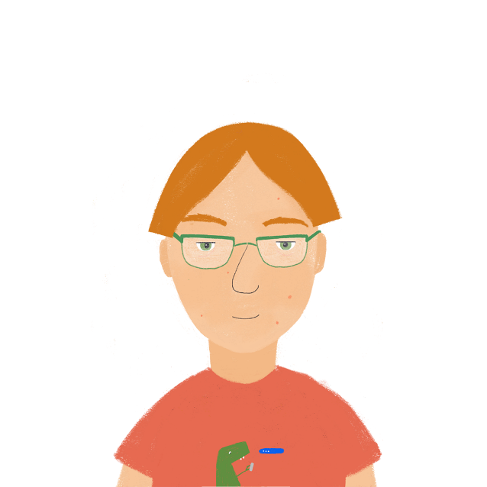
Qui répond à / dépend de quoi ?
parler
*commencer = to start
Partenaire A commence* la phrase. Il/elle ne dit pas le nom!
Puis, Partenaire B finit la phrase avec le bon nom.
Je réponds à la…
… professeure
0 | I reply to | message | teacher
Notes:
Timing: 7 minutes
Aim: Oral production of sentences containing singular forms of dépendre de and répondre à followed by a definite article.
Procedure:
1. Use this slide to model the task. On a click, the beginning of the sentences appears. Ask students what the end of the sentence must be, using the form of à + definite article to inform their choices.
2. Print and distribute the role cards found on slides 59-60 (print 4 per page). Partner A starts the sentences, finishing with the preposition and article (before the noun).
3. Partner B finishes the sentences using the noun indicated by the preposition and article.
4. Partners swap roles after four sentences.
5. Model answers revealed on the slide 61.
Word frequency of cognates used (1 is the most frequent word in French):
commencer [139] Source: Londsale, D., & Le Bras, Y. (2009). A Frequency Dictionary of French: Core vocabulary for learners London: Routledge.

Slide 55
Partenaire A
Begin sentences 1-4.
Complete sentences 5-8.
parler
1 | I’m replying to the | conversation
2 | He depends on the | newspaper
3 | She’s replying to the | teacher (m)
4 | You depend on the | hospitals
5 | I depend on the | network | hospital
6 | He replies to the | announcement | message
7 | She depends on the | game | games
8 | You reply to the | headmaster | headmistress
Notes:
Partner B rolecard

Slide 56
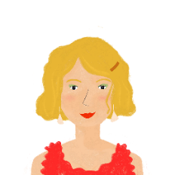
Partenaire B
Complete sentences 1-4.
Begin sentences 5-8.
parler
5 | I depend on the | network
6 | He replies to the | announcement
7 | She depends on the | games
8 | You reply to the | headmistress
1 | I’m replying to the | message | conversation
2 | He depends on the | newspaper | newspapers
3 | She’s replying to the | teacher (m) | teacher (f)
4 | You depend on the | hospitals | water
Notes:
Partner A rolecard

Slide 57
Réponses
parler
1. Je réponds à la conversation.
2. Il dépend du journal.
3. Elle répond au professeur.
4. Tu dépends des hôpitaux.
5. Je dépends du réseau.
6. Il répond à l’annonce.
7. Elle dépend des jeux.
8. Tu réponds à la directrice.

Slide 58
Gaming Grammar
Gaming Grammar
Relevant mini game(s):
Verbs (present): 1st person singular/plural (Verb agreement (present))
Verbs (present): 2nd person singular/plural (Verb agreement (present))
Verbs (present): 3rd person singular/plural (Verb agreement (present))
Preposition (to the): Gender (Prepositions)
Notes:
This slide links to Gaming Grammar login screen. The appropriate mission can then be selected from the menu page.
Students will progress through the game at their own rate; teachers should use the teacher interface to check progress. This will help to inform future lesson planning.

Slide 59
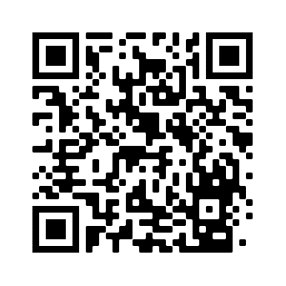
Devoirs
Vocabulary Learning Homework (Y8, Term 3.1, Week 5)
Quizlet link: Y8 Term 3.1 Week 5
Quizlet QR code:
In addition, revisit: Y8 Term 3.1 Week 1
Y8 Term 2.1 Week 1
Notes:
The answer sheet for the Y8, Term 3.1, Week 5 vocabulary learning HW is here: https://resources.ncelp.org/concern/resources/kw52j893k?locale=en

