Slide 1
Phonics
SSC [ST-]
Y7 German
Term 3.1 - Week 3 - Lesson 53
Mel Yates / Stephen Owen / Rachel Hawkes
Date updated: 04/05/20
Notes:
Learning outcomes (lesson 1)
Introduction of SSC [st]

Slide 2
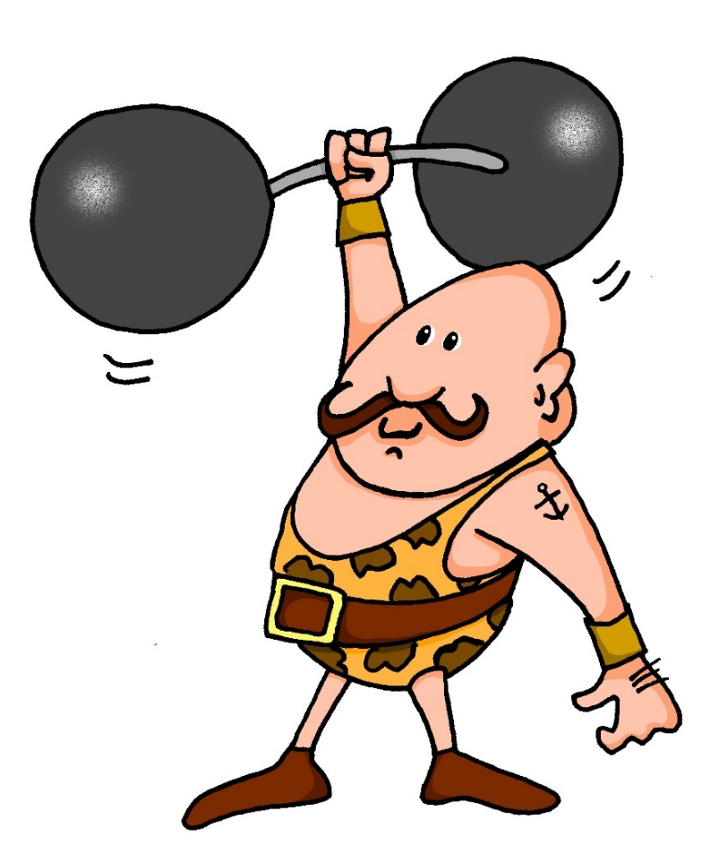
st-
stark
Notes:
Introduce and elicit the pronunciation of the individual SSC ‘st-’ and then present and practise the pronunciation of the source word ‘stark’.
A possible gesture for this would be to mime lifting dumbells by clenching your fists and raising them above your head.

Slide 3
st
Straße
stehen
stark
Stadt
verstehen
bestimmt
[to understand]
[certain/special/specific]
Notes:
Introduce and elicit the pronunciation of the individual SSC ‘st’ and then the source word again (with gesture, if using). Then present and elicit the pronunciation of the five cluster words. The cluster words have been chosen for their high-frequency, from a range of word classes, with the SSC (where possible) positioned within a variety of syllables within the words (e.g. initial, 2nd, etc.) and additionally, we have tried to use words that build cumulatively on previously taught SSCs (see the Phonics Teaching Sequence document) and do not include new SSCs. Where new SSCs are used, they are often consonants which have a similar symbol-sound correspondence in English.
Word frequency rankings (1 is the most common word in German): stark [207]; Straße [355] stehen [87]; verstehen [222]; bestimmt [226]; Stadt [186]. Source: Jones, R.L. & Tschirner, E. (2006). A frequency dictionary of German: core vocabulary for learners. Routledge

Slide 4
st
Straße
stehen
stark
Stadt
verstehen
bestimmt
Notes:
Without pictures to focus on the SSC alone.

Slide 5
st
Straße
stehen
stark
Stadt
verstehen
bestimmt
Notes:
Without sound to elicit the pronunciation.

Slide 6
SCH oder ST?
hören und schreiben
Sch
___ulfach
st
__reng
1
6
__ehen
st
sch
Ge ___enk
2
7
St
__ück
sch
3
8
Deut___
sch
____reiben
Gut ___ein
sch
4
9
st
Flei ___
Kun__
sch
5
10
Notes:
To challenge students further, ask them to turn away from the board to complete the task and write the whole word independently. This allows for differentiation through more/less support. If the whole class is high attaining, then the prompts can be removed from the slide, of course. Teachers should elicit meanings to confirm vocabulary knowledge. They should also point out that the –st in Kunst is pronounced as in English, to reinforce the fact that it is only a ‘sht’ sound at the beginning of word.
Frequency rankings of vocabulary featured (1 is the most common word in German):
das Schulfach [208/698] 2.1.3
stehen [87] 1.2.5
das Stück [417] 1.2.6
schreiben [245] 1.2.1
das Fleisch [1624] 2.2.4
streng [1224] 2.1.4
das Geschenk [2610] 2.1.1
das Deutsch [105] 2.1.3
der Gutschein [78/3025] 2.1.1
die Kunst [468] 2.1.3

Slide 7
SCH oder ST?
hören und schreiben
Schulfach
streng
1
6
stehen
Geschenk
2
7
Stück
Deutsch
3
8
schreiben
Gutschein
4
9
Fleisch
Kunst
5
10
Notes:
Same task, but answers appear as a whole word, rather than just the target graphemes. Teachers should elicit meanings to confirm vocabulary knowledge. They should also point out that the –st in Kunst is pronounced as in English, to reinforce the fact that it is only a ‘sht’ sound at the beginning of word.
Frequency rankings of vocabulary featured (1 is the most common word in German):
das Schulfach [208/698] 2.1.3
stehen [87] 1.2.5
das Stück [417] 1.2.6
schreiben [245] 1.2.1
das Fleisch [1624] 2.2.4
streng [1224] 2.1.4
das Geschenk [2610] 2.1.1
das Deutsch [105] 2.1.3
der Gutschein [78/3025] 2.1.1
die Kunst [468] 2.1.3

