Slide 1






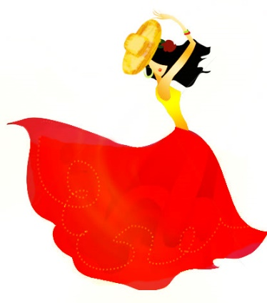

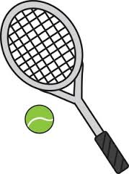








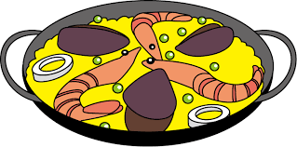


Español
Year 7 Language Guide
Nombre: ………………………………………
Profesor/a: ……………………………………
Last updated: 14/09/20

Slide 2
Contents
Themes overview | 2 | HACER, WH-questions Asking and answering questions | 27-8
Phonics | 3 -6 | Present tense: -AR [we -amos] Saying what you do with others | 29
ESTAR [location] Describing places and location | 7 | Modal verb PODER Saying what people can do | 30
ESTAR [state] What someone is like today | 8 | Modal verb DEBER Saying what people must do | 31
SER [attributes] What someone is like in general | 9-10 | ESTAR [location],‘del’ & ‘de la’ Describing places and locations | 32-3
TENER, singular indefinite articles Saying what people have | 11-12 | SER [somos], ESTAR [estamos] Saying what people are like | 34
TENER, plural indefinite articles Asking yes/no questions Saying what people have | 13 | Present tense: -AR [they -an] Describing activities [travel] | 35
Present tense: -AR regular verbs Saying what people do | 14-16 | Un hombre sin cabeza | 36
Negative ‘no What people do & don’t do | 17 | Repaso | 37
Plural nouns with -es Numbers and more than one thing | 18 | Present tense: -ER & -IR regular Saying what people do | 38-40
Hay Saying what there is around you | 19 | Repaso - Present tense | 41
Son, es, hay Saying what there is and describing it | 20 | mi vs mis, tu vs tus Describing people and possessions | 42
Singular definite article Talking about the location of things | 21 | IR When and where people go | 43
Plural definite article Describing a place | 22 | IR + infinitive Talking about future plans | 44
DAR / QUERER Giving and wanting - festive seasons & relations | 23 | La playa | 45
La plaza tiene una torre | 24 | Repaso | 46
TENER Talking about family | 25 | Spelling Bee | 47-52
Adjectives after the noun Describing people and places | 26

Slide 3
Overview
Overview | Theme / Topic
Autumn Term 1 | Describing places and location Saying what someone is like at the moment Saying what someone is like in general Saying what people have Saying what people do
Autumn Term 2 | Saying what people do and don't do Numbers ( 1 to 12) and talking about more than one thing Saying what there is around you and describing it Talking about the location of things Describing a place Giving and wanting (festive season and family)
Spring Term 1 | Describing family Describing some natural wonders of the Spanish-speaking world Asking and answering questions Talking about what you do with others (rural life)
Spring Term 2 | Talking about what people can do Contrasting what people must, can and want to do Places and locations Saying what people are like today vs in general
Summer Term 1 | Describing activities (travel) Describing what people do Describing what people do (technology
Summer Term 2 | Describing people and possessions Describing when and where people go Describing future plans

Slide 4

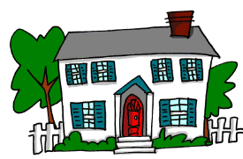

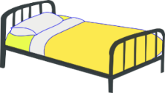



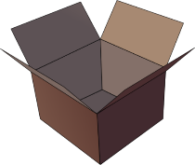





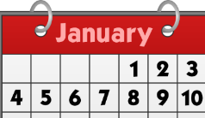






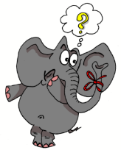






Phonics
The good news is that there are clear rules about how Spanish sounds are spelled. Of course, people have different accents, depending on where they come from or their background, but the basic patterns between sounds and their spellings are regular and quite easy to learn compared to some other languages.
Vowels
Each of the five vowels has its own sound:
a as in hat
e as in pet
i as in feet
o as in clock
u as in boot
[nothing]
[to love]
∅
nada
cama
casa
amar
agosto
[to be]
[to have]
estar
espalda
tener
papel
en
Sin ketchup
ir
interesante
lista
primero
sin
Con ketchup
[little]
dos
olvidar
poco
solo
con
[a; an]
[place]
[a lot]
[never]
un
mundo
lugar
mucho
nunca
3

Slide 5
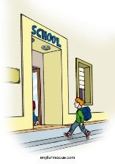







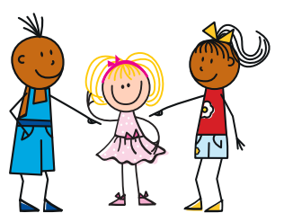


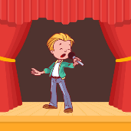

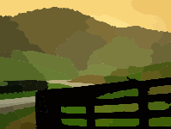


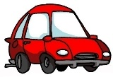




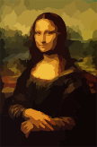





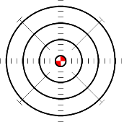


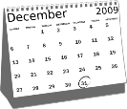






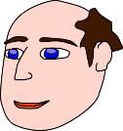
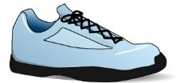
Double ll, as in calle, is very different to a single l.
In most parts of Spain it sounds like the letter “y” in English.
www.englishrescue.com
llegar
llave
amarillo
palabra
lista
luz
llevar
ella
[then]
luego
salir
[street]
£
cantar
calle
$
cara
cambiar
campo
Con ketchup
[how…?]
con
coche
¿cómo?
blanco
costa
cultura
escuchar
escuela
cuadro
cuatro
[to need]
[to seem; appear]
[necessary]
centro
necesitar
doce
parecer
necesario
[city]
[to say; tell]
decir
ciencias
ciudad
cine
diciembre
[to start]
voz
4
cabeza
empezar
zapato
diez

Slide 6











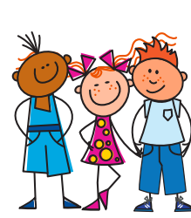



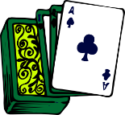






















[to want]
querer
pequeño
equipo
izquierda
[to meet up]
[calm, tranquil]
quedar
parque
¿qué?
tranquilo
quince
¿quién?
SUNDAY
[place]
gato
amiga
regalo
lugar
jugar
[with me]
[something]
conmigo
largo
algo
domingo
juego
[sure, safe]
segundo
seguro
¡mucho gusto!
gesto
argentino
[generalmente]
imagen
recoger
generalmente
47
48
Versión original
página
elegir
religión
original
colegio
[to leave]
rojo
5
julio
dejar
mujer
mejor

Slide 7
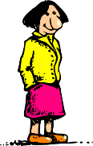


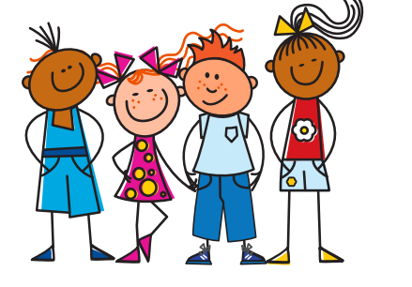

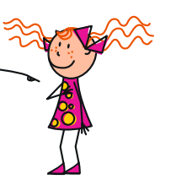


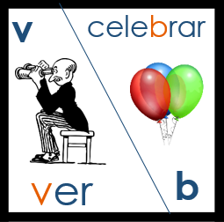
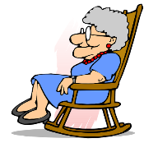







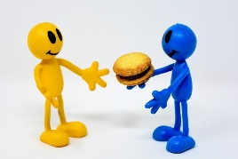

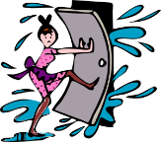











Ñ is a separate letter in Spanish. It is pronounced like
the ni in onion.
2020
año
señora
noche
nosotros
[morning; tomorrow]
[to have]
mañana
niña
montaña
nada
tener
poner
[pretty]
verdad
verano
abuela
bonito
[to live]
[to know]
[quite]
verde
vivir
joven
saber
deber
bastante
correr
cerrar
abrir
dar
@
[about; on top of]
barrio
correo
correcto
seria
sobre
rico
H is silent in Spanish.
Imagine it’s not there.
[to do]
hijo
helado
hacer
hospital
¡hasta luego!
6

Slide 8
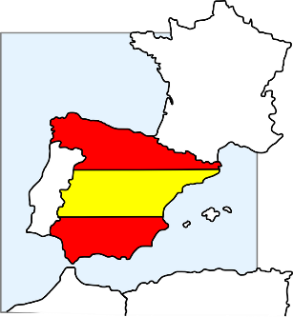
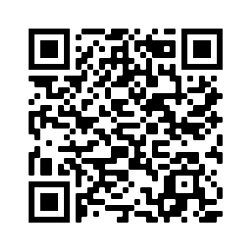
T1.1 Semana 1
Gramática
ESTAR - to be (location)
In Spanish, the verb estar means to be when describing location.
Verb ESTAR [to be, being]
estoy | I am
estás | you are
está | he/she/it is
for LOCATION
Estoy en España. I am in Spain. Estás en Madrid. You are in Madrid. Está en Perú. He / she is in Perú.
Describing places and locations
Vocabulario
vb
vb
vb
vb
nm
nm
nf
nf
adv
prep
estar | to be, being (location/state)
estoy | I am (location/state)
estás | you are (location/state)
está | s/he is, it is (location/state)
norte | north
sur | south
Inglaterra | England
España | Spain
¿dónde? | where?
en | in, on
hola | hello
¡Hasta luego! | see you later

Slide 9

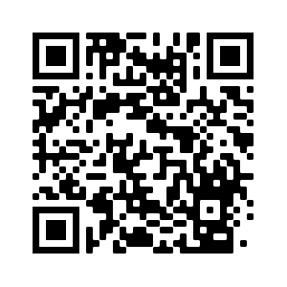
T1.1 Semana 2
Gramática
ESTAR - to be (mood or temporary state)
In Spanish, the verb estar also means to be when describing mood or temporary state.
In English, we often use a verb with ‘-ing’ to talk about a temporary state
(‘right now’).
Estoy nervioso. Estás tonto. Está raro.
I am feeling nervous.
You are being silly.
He is acting strange.
Adjectives
In Spanish, adjectives that end in ‘o’ change to an ‘a’ when the person being described is female.
Masculine
Está nervioso.
He is (feeling)nervous.
Feminine
Está nerviosa.
She is (feeling)nervous.
Saying what someone is like at the moment
Vocabulario
adj
adj
adj
adj
adj
adj
adj
adj
adv
adv
adv
blanco | white
listo | ready
nervioso | nervous
raro | strange
seguro | sure, certain
serio | serious
tonto | silly
tranquilo | calm, tranquil
¿Cómo? | How? Sorry?
hoy | today
muy | very
¿Cómo se dice en inglés? | How do you say it in English?
¿Cómo se dice en español? | How do you say it in Spanish?
no, sí | no, yes
¿Cómo se dice…?

Slide 10
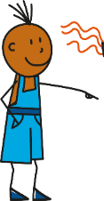
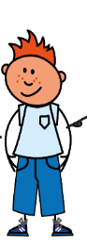

T1.1 Semana 3
Gramática
SER - to be (general attribute)
In Spanish, the verb ser means to be when describing
general traits or characteristics.
Not just feeling cheerful today, but generally a cheerful person!
Soy alegre. Eres alegre. Es alegre.
I am cheerful.
You are cheerful.
He/ She / It is cheerful.
Adjectives
We know that adjectives that end in ‘o’ change to an ‘a’ when the person being described is female.
Masculine
Es simpático.
He/She/It is cheerful!
He is nice.
Feminine
Es simpática.
She is nice.
Note: when the adjective ends in ‘e’, there is no change. → Es alegre.
Asking yes/no questions
In Spanish, change a statement into a question by raising your voice at the end:
Statement
Eres alegre.
You are cheerful.
¿Eres alegre?
Question
Are you cheerful?
Spanish uses two question marks – the one at the front is upside down!

Slide 11
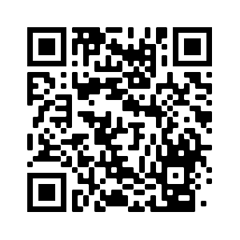
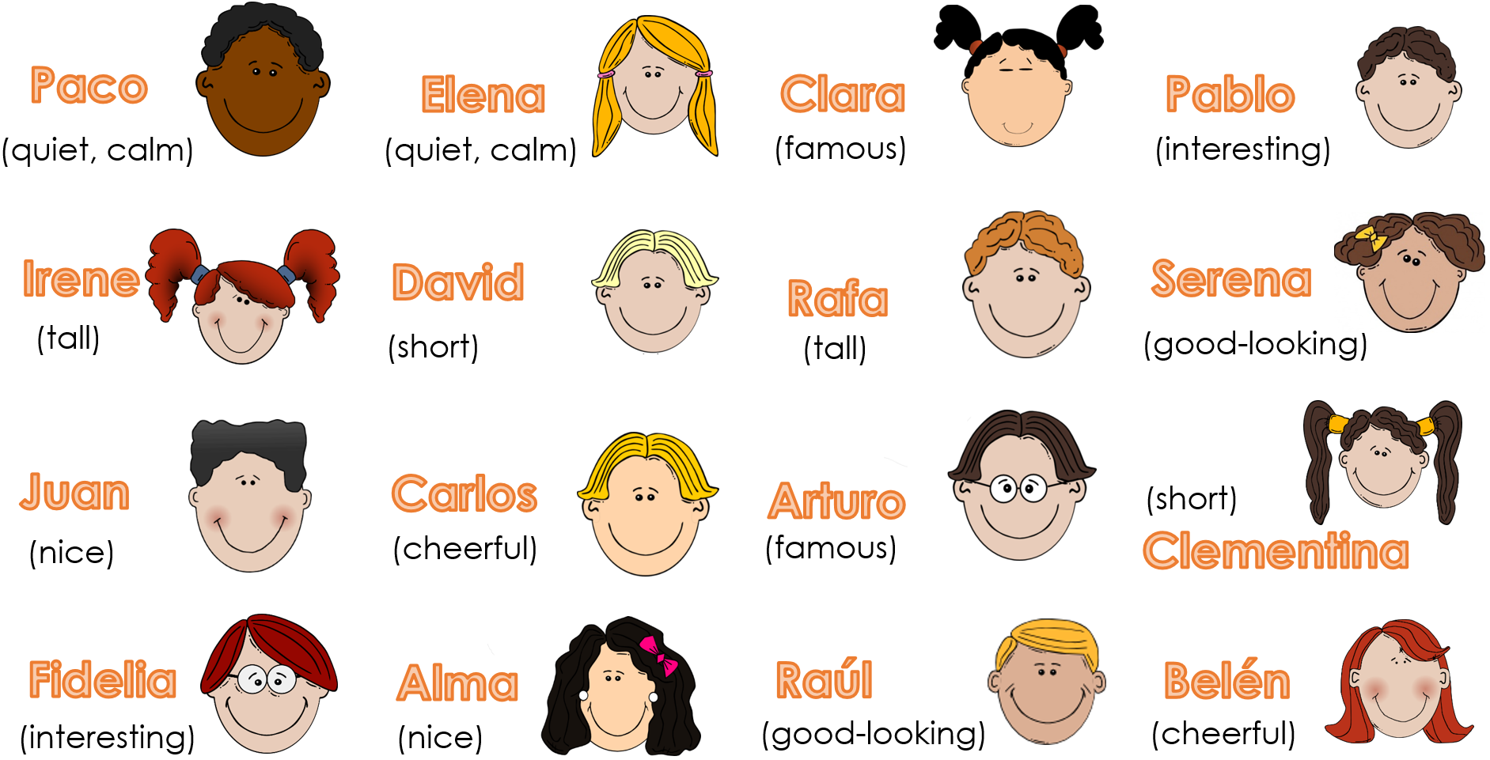
Saying what someone is like generally
Vocabulario
vb
vb
vb
vb
vb
nm
adj
adj
adj
adj
adj
adj
conj
ser | to be, being (trait)
soy | I am (trait)
eres | you are (trait)
es | s/he is, it is (trait)
marca | mark (verb)
una opción | an option
alegre | cheerful
alto | tall
bajo | short
correcto | correct
guapo | good-looking
simpático | nice, friendly
y | and
Describe these people. Pay attention to the adjective!

Slide 12




T1.1 Semana 4
Gramática
Gender and singular nouns
Things, as well as people, have a gender in Spanish. This means that they are either masculine or feminine:
Masculine
Feminine
un elefante | an elephant
un lugar | a place
un mundo | a world
una llave | a key
una idea | an idea
una casa | a house
To say a (or an) in Spanish before a noun, you use un or una, depending on whether the noun is masculine or feminine.
Most Spanish nouns that end in -o are masculine, and most ending in -a are feminine:
un libro
una palabra una lista
Others have to be learnt: e.g. una luz
This is grammatical gender - it is not connected to the noun’s meaning!
Note: ‘a’ is called the indefinite article
TENER - to have
In Spanish, the verb tener means to have.
Verb TENER [to have, having]
tengo | I have
tienes | you have
tiene | he/she/it has
Tengo una idea. I have an idea. Tienes una casa. You have a house. Tiene un libro. S/he/it has a house.

Slide 13
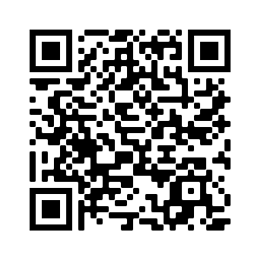
Saying what people have
Vocabulario
vb
vb
vb
vb
vb
pron
nm
nf
nm
nf
nf
nf
nm
nf
nf
nm
nf
nm
adj
art
tener | to have, having
tengo | I have
tienes | you have
tiene | s/he has, it has
lee | read
¿qué? | what?
barco | boat
bicicleta | bicycle
bolígrafo | pen
cama | bed
cámara | camera
casa | house
gato | cat
frase | phrase, sentence
letra | letter
libro | book
moneda | coin
papel | paper
nuevo | new
un, una | a
¿Tienes un bolígrafo?
Revisit vocab 1.1.1
Write the nouns above in the correct columns below:
masculine -o (un) | feminine -a (una) | could be either (m/f)

Slide 14

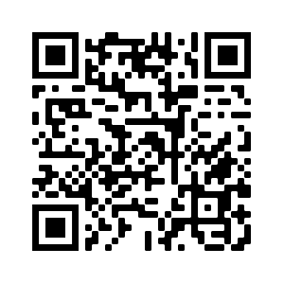


T1.1 Semana 5
T1.1 Semana 5
Gramática
Plural nouns and indefinite articles (unos / unas)
To talk about something in the plural (more than one), Spanish often adds an ‘s’ to the end of the noun.
Tengo un barco.
I have a boat.
Tengo dos barcos.
I have two boats.
To mean ‘some’ before a plural noun, use unos or unas.
Tengo un libro.
I have a book.
I have some books.
Tengo unos libros.
Tengo una moneda.
I have a coin.
Tengo unas monedas.
I have some coins.
Saying what people have
Vocabulario
nm
nf
nm
nf
nm
nf
nf
nf
nf
nm
adv
un amigo | a male friend
una botella | a bottle
un caballo | a horse
una palabra | word
un periódico | a newspaper
una planta | a plant
una pregunta | a question
una revista | a magazine
una tarea | a task
un teléfono | a telephone
también | also, too
Revisit vocab 1.1.2
For plural masculine nouns, use _____ to mean ‘some’.
For plural feminine nouns, use ______ to mean ‘some’.
Write in Spanish:
some tasks |  | some phones
some horses |  | some bottles

Slide 15
T1.1 Semana 6
Gramática
-ar verbs: infinitive and 3rd person singular
The infinitive form of a verb is the form you see in a dictionary.
In English, this is often written ‘to + verb’.
In Spanish, the infinitive of the verb often ends in –ar.
For example:
Es importante escuchar.
It’s important to listen.
You can also begin a sentence with the infinitive:
Escuchar es importante.
Listening is important.
So, the infinitive often describes the general meaning of the verb.
To mean ‘s/he’ or ‘it’ with a verb, the verb ending changes to –a.
For example:
Escucha música.
S/he listens to music.
In Spanish, the verb ending tells us this. There is usually no need for the word ‘s/he’.
In English, we say ‘he’ or ‘she’ to say who does the action.
Write in Spanish:
1 It’s important to dance.
2 She arrives early.
3 He talks with a partner.
4 It’s important to talk.
5 It’s also important to listen.
6 Who talks well?
7 He arrives late.

Slide 16
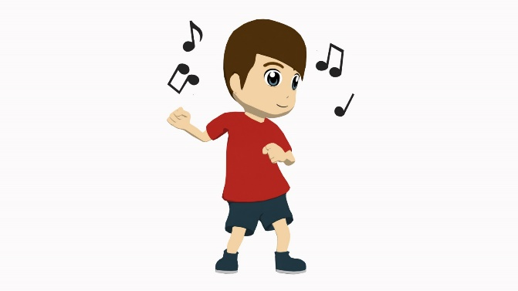
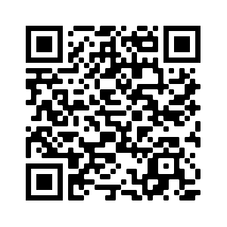
Saying what people do
Vocabulario
vb
vb
vb
vb
vb
pron
nf
nf
nf
adj
adv
adv
adv
prep
bailar | to dance
comprar | to buy
escuchar | to listen
hablar | to speak, to talk
llegar | to arrive
¿quién? | who?
una amiga | a female friend
la música | music
una pareja | a pair
importante | important
bien | well
temprano | early
tarde | late
con | with
otra vez | again
¡Otra vez, por favor!
Vocabulary learning involves knowing different aspects of a word.
Use this checklist:
1. I have seen this word before.
2. I know what the word means.
3. I can read the word aloud.
4. I can spell the word correctly.
5. I can use the word in a sentence.
6. For nouns, I know the gender and the correct word for ‘the’.
Revisit vocab 1.1.3

Slide 17
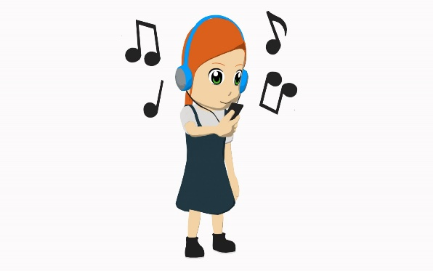
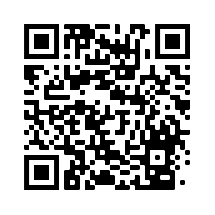
T1.1 Semana 7
Gramática
Regular -ar verbs in the present tense: 1st 2nd & 3rd person singular
Many Spanish infinitives end in –ar.
The verb ending changes depending on who the verb refers to.
Escucha música.
S/he listens to music.
Escucho música.
I listen to music.
To mean ‘I’ with an –ar verb, remove –ar and add –o.
escuchar
escucho
I listen
This part of the verb is called the ‘stem’.
To mean ‘you’ (singular), remove –ar from the infinitive and add –as.
escuchar
escuchas
you listen
you speak
hablar
hablas
Necesito papel.
Saying what I and others do
Vocabulario
vb
vb
vb
llevar | to wear, wearing
necesitar | to need, needing
usar | to use, using
(una) ayuda | (a) help
una bolsa | a bag
una camisa | a shirt
una cosa | a thing
nm
nm
nm
nm
adv
un producto | a product
un vaso | a glass
un voluntario | a volunteer
un zapato | a shoe
luego | then
gracias | thanks
de nada | you’re welcome
nf
nf
nf
nf
Revisit vocab 1.1.4

Slide 18




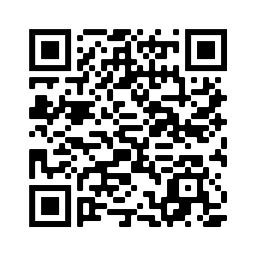
T1.2 Semana 1
Gramática
Using the negative ‘no’
In Spanish, to say what you or others don’t do, put ‘no’ before the verb. This makes a negative.
Compro música.
No compro música.
→ I buy music.
→ I don’t buy music.
This works for any verb and any person (e.g., I, you, s/he).
Necesitas un libro.
No necesitas un libro.
→You need a book.
→You don’t need a book.
Yes / no questions’
Change a statement into a question by raising your voice at the end:
Statement
Compras zapatos.
You buy shoes.
Do you buy shoes?
Question
¿Compras zapatos?
Saying what I and others don’t do
Vocabulario
vb
vb
vb
nm
nm
nm
nf
nm
nm
caminar | to walk
estudiar | to study
entiendo | I understand
el arte | art
el español | Spanish
el inglés | English
la ciencia | science
el grupo | group
el silencio | silence
nm
nf
nf
adj
adj
conj
conj
señor | sir, Mr.
señora | madam, Mrs.
verdadero/a | true
falso/a | false
mucho | much, a lot
pero | but
o | or
perdón | sorry
no | no, not
Revisit vocab 1.1.5

Slide 19
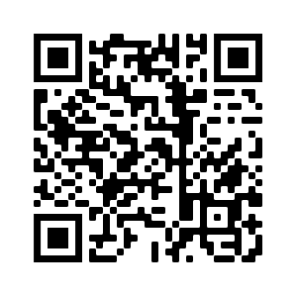








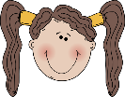


T1.2 Semana 2
Gramática
Plural of nouns
Spanish nouns ending in a vowel (like ‘o’ and ‘a’) add -s:
Tengo plantas.
→ I have plants.
If the noun ends in a consonant (like ‘n’ or ‘r’), add –es to the end.
Tengo una flor. I have a flower.
Tengo flores. I have flowers.
Tengo un plan. I have a plan.
Tengo planes. I have plans.
Gender and plural nouns
To talk about male and female people together, Spanish often uses the masculine form of the noun.
“Tengo tres amigos.” can mean:
I have 3 (male) friends.
OR
I have 3 (male and female) friends.
To refer to two or more females, use the feminine form in the plural:
“Tengo tres amigas.”
Revisit vocab 1.1.6 & 1.1.1
Talking about more than one thing
Vocabulario
uno | 1 | siete | 7
dos | 2 | ocho | 8
tres | 3 | nueve | 9
cuatro | 4 | diez | 10
cinco | 5 | once | 11
seis | 6 | doce | 12
un número |  | a number
nm
nm
nm/f
nf
nm
nm/f
un autor / una autora | author
un color | colour
un director/ una directora | a head teacher
una flor | a flower
un plan | a plan
un profesor / una profesora | a teacher

Slide 20
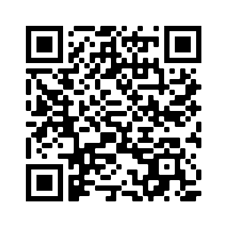
T1.2 Semana 3
Gramática
Hay - ‘there is’ and ‘there are’
To say ‘there is’ or ‘there are’ in Spanish, use the word ‘hay’.
Hay un gato.
→ There is a cat.
Hay unos gatos.
→ There are some cats.
Sentences with ‘hay’ often start with ‘en’.
En clase hay un profesor.
→ In class there is a teacher.
Sentences with ‘tiene’ don’t normally start with ‘en’.
La clase tiene un profesor.
→ The class has a teacher.
Using ‘es’ or ‘está’
To say where something or someone is, use ‘está’.
→ There is a boy. He is in Paris.
Hay un chico. Está en Paris.
→ There is a girl. She is here.
Hay una chica. Está aquí.
To say how something or someone is generally, use ‘es’.
→ There is a boy. He is tall.
Hay un chico. Es alto.
Hay una chica. Es seria.
→ There is a girl. She is serious.
Hay una mesa. Es blanca.
→ There is a table. It is white.
Saying what there is around you
Vocabulario
vb
vb
nm
nf
nf
nf
nf
hay | there is / are
mirar | to look, looking
un chico | a boy
una chica | a girl
una clase | a class
una mesa | a table
una persona | a person
nf
nf
nf
adv
adv
nm
nf
una puerta | a door
una silla | a chair
una ventana | a window
allí | there
aquí | here
(un) señor | Mr, man
(una) señora | Mrs, woman
Revisit vocab 1.1.7 & 1.1.2

Slide 21
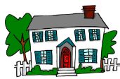
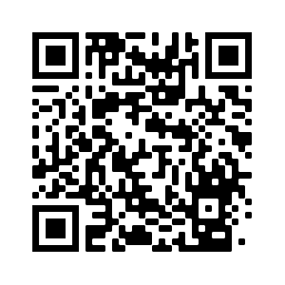
T1.2 Semana 4
Gramática
Using ‘es’ and ‘son’
To describe someone or something in general, use ‘es’.
Hay una casa. Es cara. → There is a house. It is expensive.
To describe two or more people or things in general, use ‘son’.
Hay unas casas. Son caras.
→ There are some houses. They are expensive.
Adjectives
Spanish adjectives change depending on whether the noun is singular (one) or plural (more than one).
Hay una casa. Es cara.
→ There is a house. It is expensive.
Hay unas casas. Son caras.
→ There are some houses. They are expensive.
So, if the adjective refers to a plural noun, add an -s.
Describing what there is around you
Vocabulario
vb
adj
adj
adj
adj
adj
adj
adj
adj
adj
adj
son | they are (trait)
antiguo | old, ancient
barato | cheap
bonito | pretty
bueno | good
caro | expensive
famoso | famous
feo | ugly
malo | bad
pequeño | small
rico | rich
¿Cómo es? | What is s/he like? What is it like?
Revisit vocab 1.2.1 & 1.1.3

Slide 22
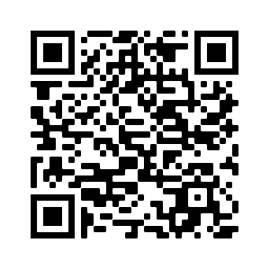
T1.2 Semana 5
Gramática
The definite articles ‘el’ and ‘la’
‘the’
All nouns have a gender in Spanish.
Spanish has two genders: masculine and feminine.
To say ‘the’ before a noun, use ‘el’ or ‘la’.
Masculine nouns
Feminine nouns
la
the church
el
iglesia
banco
the bank
el
the shop
teatro
la
the theatre
tienda
the market
plaza
mercado
el
la
the square
The words ‘un’ and ‘una’ (a, an) often appear with ‘el’ and ‘la’ (the).
Hay is always followed by ‘un’ or ‘una’ (not ‘el’ or ‘la’)
For example:
En Girona, hay un mercado y una iglesia.
El mercado es barato y la iglesia es antigua.
Revisit vocab 1.2.2 & 1.1.4
Talking about the location of things
Vocabulario
nm
nm
nf
nf
nf
nm
nm
nf
el banco | bank
el centro | centre
la ciudad | city
la escuela | school
la iglesia | church
el mercado | market
el museo | museum
la plaza | square
nf
nm
nf
adv
adv
prep
art
art
la respuesta | answer
el teatro | theatre
la tienda | shop
cerca | close, near
lejos | far
entre | between
el | the (m)
la | the (f)

Slide 23

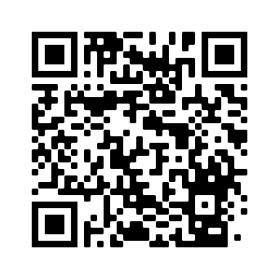
T1.2 Semana 6
Gramática
‘the’
The plural definite article
To say ‘the’ before a singular noun, use ‘el’ or ‘la’.
To say ‘the’ before a plural noun (more than one), use ‘los’ or ‘las’.
Masculine nouns
Feminine nouns
los
pueblos
the villages
las
películas
the films
los
the teams
las
vistas
the views
equipos
the buildings
los
edificios
the islands
las
islas
Nouns ending in a consonant
If a noun ends in a consonant, remember we do not just add ‘s’ but ‘es’:
el profesor
los profesores
la ciudad
las ciudades
el autor
los autores
las flores
la flor
Describing a place
Vocabulario
nm
nm
nf
nf
nf
nm
nm
nm
nf
adj
adj
prep
el edificio | building
el equipo | team
la familia | family
la isla | island
la película | film
el plato | plate, dish
el pueblo | town
el trabajo | job
la vista | view
grande | big
interesante | interesting
de | of
Los edificios son grandes.
The article, noun and adjective are all plural.
Revisit vocab 1.2.3 & 1.1.5

Slide 24


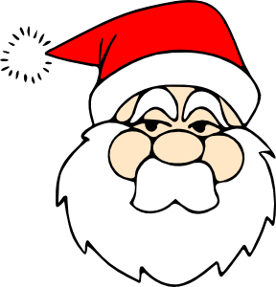
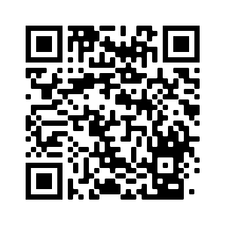
T1.2 Semana 7
Gramática
Using the verbs ‘dar’ and ‘querer’
verb DAR [to give, giving]
doy | I give
das | you give
da | he/she/it gives
verb QUERER [to want, wanting]
quiero | I want
quieres | you want
quiere | he/she/it wants
Da un regalo.
S/he gives a present.
¡Quiero un teléfono!
I want a phone!
Talking about giving and wanting
Vocabulario
vb
vb
vb
vb
vb
vb
vb
vb
nm
nf
nf
nm
nm
prep
dar | to give, giving
doy | I give
das | you give
da | s/he gives, it gives
querer | to want, wanting
quiero | I want
quieres | you want
quiere | s/he wants, it wants
el hermano | brother
la hermana | sister
la madre | mother
el padre | father
el regalo | present
a | to
¿Qué quieres?
Quiero un mérito
Revisit vocab 1.2.4 & 1.1.6

Slide 25




T2.1 Semana 1
Revisit vocab 1.2.5 & 1.1.6
La plaza tiene una torre (Antonio Machado)
La plaza tiene una torre,
la torre tiene un balcón,
el balcón tiene una dama,
la dama una blanca flor.
Ha pasado un caballero
- ¡quién sabe por qué pasó! -
y se ha llevado la plaza,
con su torre y su balcón,
con su balcón y su dama,
su dama y su blanca flor.
vb
vb
nf
adj
saber | to know
pasar | to pass
la torre | tower
su | his, her, its

Slide 26




T2.1 Semana 2
Gramática
Using the verb TENER
Verb TENER [to have, having]
tengo | I have
tienes | you have
tiene | he/she/it has
tenemos | we have
tienen | they have
Tenemos dos primos. We have two cousins. Tienen un gato. They have a cat.
Talking about family
Vocabulario
vb
vb
nm
nf
nm
nm
nf
nm
adj
adj
adj
adv
tenemos | we have
tienen | they have
el abuelo | grandfather
la abuela | grandmother
el perro | dog
el primo | male cousin
la prima | female cousin
el trabajo | job, work
activo | active
fuerte | strong
hermoso | beautiful
bastante | quite
Revisit vocab 1.2.6 & 1.1.7

Slide 27



T2.1 Semana 3
Gramática
Adjectives after the noun
In English the adjective comes before the noun.
In Spanish, many adjectives follow the noun:
un profesor nervioso
a nervous male teacher
a calm male director/headteacher
un director tranquilo
una autora importante
an important female author
una flor blanca
a white flower
Necesito un cuaderno nuevo.
Describing people and places
Vocabulario
nm
nm
nf
nm
nm
adj
adj
adj
adj
adj
adj
adv
el árbol | tree
el lugar | place
la naturaleza | nature
el pájaro | bird
el río | river
amarillo | yellow
azul | blue
genial | great
rojo | red
verde | green
mucho | much, a lot (of)
solo | only
Revisit vocab 1.2.7 & 1.2.1

Slide 28







T2.1 Semana 4
Gramática
HACER - to do
verb HACER [to do, make]
hago | I do
haces | you do
hace | he/she/it does
Hago deporte. I do sport.
Haces dinero. You make money.
¿Qué hace? What does s/he do?
Hace karate. S/he does karate.
Question words
¿Dónde? – Where?
¿Cómo? – How?
¿Qué? – What?
¿Cuándo? – When?
¿Cuánto? – How much?
¿Cuántos/as? – How many?
¿Quién(es)? Who?
¿Cuál(es)? – Which (one/s)?
‘Cuál(es)’ is never followed directly by a noun.
Use ‘qué’ to say ‘which + noun’.
¿Qué libro tienes? (Which book do you have?)
¿Cuál es la persona con el libro? (Which is the person with the book?)
¿Cuáles son las personas con el libro? (Which are the people with the book?)

Slide 29



Asking and answering questions
Vocabulario
vb
vb
vb
vb
pron
nf
nm
nm
nm
nf
nf
nf
adj
adv
prep
hacer | to do, to make
hago | I do, I make
haces | you do, you make
hace | s/he does, s/he makes
cuál | which
la actividad | activity
los deberes | homework
el deporte | sport
el dibujo | drawing
la mañana | morning
la noche | night
la tarde | afternoon, evening
cuánto | how much, how many
cuándo | when
para | for
Revisit vocab 2.1.1 & 1.2.2
To say ‘in the morning/afternoon’ or ‘at night’, Spanish often uses the word ‘por’.
It is also correct to say ‘en la mañana / tarde / noche’ in some Spanish-speaking countries.
E.g. ‘Estudio por la mañana’ = I study in the morning.
T2.1 Semana 5 & 6: Revision and assessment
Notes:
Imagen de Krithika Parthasarathy en Pixabay

Slide 30



T2.2 Semana 1
Gramática
Present tense -ar verbs: 1st person plural (we) → -amos
Remember that present tense –ar verbs change depending on who the verb refers to.
Llego tarde.
I arrive late.
Llegamos tarde.
We arrive late.
To mean ‘we’ with an –ar verb, remove –ar and add –amos to the stem.
compr-
compramos
we buy
comprar
hablar
habl-
hablamos
we speak
Talking about what you do with other people
Vocabulario
vb
vb
vb
vb
vb
nm
nm
nf
nm
adj
adj
Revisit vocab 2.1.2 & 1.2.3
buscar | to look for, looking for
descansar | to rest, resting
pasar | to spend (time)
preparar | to prepare, preparing
trabajar | to work
el animal | animal
el campo | countryside
la comida | food
el tiempo | time
junto | together
solo | alone
‘Junto’ normally refers
to more than one thing or
person, so usually appears with
an –s at the end
(e.g., juntos, juntas).
Notes:
Bild von Faissal Aghsaine auf Pixabay

Slide 31


T2.2 Semana 2
Gramática
Using modal verb ‘poder’
After ‘poder’, use an infinitive verb to say what you can / are able to do:
verb PODER [can, to be able to]
puedo | I can, am able to
puedes | you can, are able to
puede | he/she/it can, is able to
Puedo pedir papel.
I can ask for paper.
Puedes participar.
You can participate.
Puede preguntar algo.
S/he can ask something.
‘Poder’ is also used for making requests and asking permission:
¿Puedo trabajar con un compañero?
Can I work with a friend?
Describing what people can / are able to do
Vocabulario
vb
vb
vb
vb
vb
vb
vb
vb
vb
nm nf
nm
nm
cambiar | to change, changing
jugar | to play, playing
participar | to participate, participating
pedir | to ask for, asking for
preguntar | to ask, asking
poder | to be able to, can
puedo | I am able to, I can
puedes | you are able to, you can
puede | s/he is able to, s/he can
el compañero la compañera | classmate (m) classmate (f)
el favor | favour
el material | material
Revisit vocab 2.1.3 & 1.2.4
¿Puedo ir a los servicios?

Slide 32



T2.2 Semana 3
Gramática
Using modal verb ‘deber’
See classroom language En clase [5]
After ‘deber’, use an infinitive verb to say what you must do:
verb DEBER [must, to have to]
debo | I must, have to
debes | you must, have to
debe | he/she/it must, has to
Debo limpiar el suelo.
I must clean the floor.
Debes lavar la ropa.
You must wash the clothing.
Debe preparar la comida.
S/he must prepare the food.
Describing what people must do
Vocabulario
vb
vb
vb
vb
vb
vb
vb
nf
nm
nf
nm
adj
conj
conj
deber | must, to have to
debo | I must, have to
debes | you must, have to
debe | he/she/it must, has to
lavar | to wash, washing
limpiar | to clean, cleaning
sacar | to take out, taking out
la basura | rubbish
el coche | car
la ropa | clothing
el suelo | floor
otro | another, other
aunque | although
si | if
el lunes | Monday
el martes | Tuesday
el miércoles | Wednesday
el jueves | Thursday
el viernes | Friday
el sábado | Saturday
el domingo | Sunday
To say ‘on’ a day just use ‘el’ or ‘los’:
(On) Saturday = el sábado
(On) Saturdays = los sábados
No capital letters on days in Spanish!
Otro needs to agree:
‘Otro chico’ – another boy
‘Otra chica’ – another girl
‘Otros regalos’ – other presents
‘Otras vistas’ – other views
Revisit vocab
2.1.4 & 1.2.5

Slide 33


T2.2 Semana 4
Gramática
Using ‘del’ and ‘de la’
You can give locations using adverbs like ‘cerca’ or ‘lejos’.
You often use ‘de’ after them to refer to a person, place or thing:
Ana está cerca de Madrid.
Ana is near (to) Madrid.
Sara está cerca de Diego.
Sara is near (to) Diego.
To refer to singular masculine nouns change de + el to ‘del’:
Ana está cerca del museo.
Ana is near (to) the museum.
To refer to singular feminine nouns use ‘de la’.
Ana está cerca de la plaza.
Ana is near (to) the square.
In English we use several words for ‘de’: near (to), far (from), in front (of).
Or no word: under (-), behind (-), outside (-)
Using ‘estamos’ and ‘están’
Use the verb ‘estar’ to talk about locations.
Verb ESTAR [to be, being]
estoy | I am
estás | you are
está | he/she/it is
estamos | we are
están | they are
To say ‘we are’ with a place or location, say ‘estamos’.
Estamos en un café.
We are in a café.
To say ‘they are’ with a place or location, say ‘están’.
Están en el centro.
They are in the centre.
Notes:
Creative Commons Zero - CC0
www.pixabay.com

Slide 34

Describing places and locations
Vocabulario
vb
vb
nf
nm
nm
nm
nm
adv
adv
adv
adv
estamos | we are (location/state)
están | they are (location/state)
la estación | station
el coche | car
el este | East
el oeste | West
el tren | train
debajo de | under
delante de | in front of
detrás de | behind
fuera de | outside of
How well do you know the words we have learned so far this year?
Go back through your language guide and use this checklist for each week’s vocabulary from Term 1:
1. I have seen this word before.
2. I know what the word means.
3. I can read the word aloud.
4. I can spell the word correctly.
5. I can use the word in a sentence.
6. I know the gender of nouns.
Revisit vocab
2.2.1 & 1.2.6

Slide 35




T2.2 Semana 5
Gramática
Using ‘somos’ and ‘estamos’
In Spanish there are two verbs for ‘to be’: SER and ESTAR.
We use ser to describe general traits or characteristics and estar to describe temporary states, moods (and location).
Somos tranquilos.
Estamos tranquilos.
We are calm. (calm people in general)
We are calm. (feeling calm at the moment)
Some adjectives have different meanings when used with ser and estar. For example: moreno / loco / aburrido
Somos morenos. – We are dark-skinned/dark-haired.
Estamos morenos. – We are tanned/brown.
Note: ser loco is only used in Spain to refer to people who are clinically insane. It has a broader use in much of Latin America, but if you want to say someone is crazy, use ‘estar’.
Somos aburridos. – We are boring.
Estamos aburridos. – We are bored.
Somos locos. – We are insane.
Estamos locos. – We are acting crazy.
Saying what people are like today vs in general
Vocabulario
vb
adj
adj
adj
adj
adj
adv
somos | we are (trait)
aburrido | boring, bored
claro | light (colour), clear
loco | insane, crazy
moreno | dark-haired, dark-skinned, tanned
oscuro | dark
como | like
Revisit vocab
2.2.2 & 1.2.7
zzz
zzz

Slide 36


T3.1 Semana 1
Gramática
Present tense -ar verbs: 3rd person plural (they) → -an
Remember that present tense –ar verbs change depending on who the verb refers to.
Viaja a Francia.
S/he travels to France.
Viajan a Francia.
They travel to France.
To mean ‘they’ with an –ar verb, remove –ar and add –an to the stem.
organizar
organiz-
organizan
they organise
saclar
sac-
sacan
they take (something) out
Describing activities (travel)
Vocabulario
vb
vb
vb
nm
nf
nm
nm
nf
nf
adj
adj
prep
adv
adv
disfrutar | to enjoy, enjoying
montar | to ride, riding
viajar | to travel, travelling
agosto | August
Francia | France
julio | July
el mar | sea
la montaña | mountain
las vacaciones | holidays
cada | each, every
alto | tall, high
de | of, from
durante | during
normalmente | usually, normally
Revisit vocab
2.2.3 & 2.1.1
Notes:
Imagen de Clker-Free-Vector-Images en Pixabay

Slide 37


T3.1 Semana 2
Un hombre sin cabeza
(Armando José Sequera)
Un hombre sin cabeza
no puede usar sombrero.
Pero éste no es
su mayor problema:
no puede pensar,
no puede leer,
no puede cantar,
no puede comer
No puede escuchar,
ni puede entender,
que para amar y besar
cabeza debe tener.
vb
vb
nm
nf
prep
pensar | to think, thinking
amar | to love, loving
el hombre | man
la cabeza | head
sin | without
Revisit vocab 2.2.4 & 2.1.2

Slide 38
T3.1 Semana 3
Present tense: -ar regular verbs and FIVE irregular verbs
Choose five regular -AR verbs and ESTAR, SER, TENER, HACER, DAR. Write them and the English below. Then write a sentence with each verb, in the present tense.
Use a variety of subjects: I, you, s/he, they.
 | Word | English meaning
1
2
3
4
5
6
7
8
9
10
1 | I have seen this word before.
2 | I know what the word means.
3 | I can read the word aloud.
4 | I can spell the word correctly.
5 | I can use the word in a sentence.
Revisit vocab 2.2.5 & 2.1.3
 | Sentences
1
2
3
4
5
6
7
8
9
10
T3.2 Semana 1 & 2: Revision and assessment

Slide 39

T3.1 Semana 4
Gramática
-er verbs and -ir verbs: infinitive and 3rd person singular
In Spanish, many infinitives end in -ar. Others end in -er and -ir.
Remember: the infinitive describes the general meaning of the verb:
escuchar to listen, listening -ar verb
beber to drink, drinking -er verb
escribir to write, writing -ir verb
Es importante beber agua.
It’s important to drink water.
You can also begin a sentence with the infinitive:
Drinking water is important.
Beber agua es importante.
In Spanish, all verbs change depending on who the verb refers to.
To mean ‘s/he’ or ‘it’ with an -er or -ir verb, add –e to the stem:
beber
beb-
Bebe agua.
S/he drinks water.
escribir
escrib-
Escribe un libro.
S/he writes a book.
Describing what people do
Vocabulario
vb
vb
vb
vb
nf
nf
beber | to drink, drinking
comer | to eat, eating
leer | to read, reading
vivir | to live, living
el agua | water
la carne | meat
nm
nf
nf
adv
adv
el ejercicio | exercise
la fruta | fruit
la leche | milk
a veces | sometimes
nunca | never
Revisit vocab 3.1.1 & 2.1.4

Slide 40





T3.1 Semana 5
Gramática
-er verbs and -ir verbs: 1st and 2nd person singular
Remember!
The verb ending changes depending on who the verb refers to.
To mean ‘I’ with an –er and -ir verb, add –o to the stem.
This part of the verb is called the ‘stem’.
correr
corro
I run
escribir
escribo
I write
To mean ‘you’ (singular), add –es to the stem.
correr
corres
you run
escribir
escribes
you write
Describing what people do
Vocabulario
vb
vb
vb
nm
nf
nm
nm
nf
nm
adv
adv
aprender (a) | to learn, learning (to)
correr | to run, running
escribir | to write, writing
algo | something
la carta | letter
el chino | Chinese
el idioma | language
la mujer | woman
el parque | park
después | after, afterwards
siempre | always
Revisit vocab 3.1.2 & 2.2.1

Slide 41

T3.1 Semana 6
Gramática
-er verbs and -ir verbs: 3rd person singular and plural
Remember!
To say ‘s/he/it’ with -er and -ir regular verbs, add -e to the stem.
To say ‘they’ with -er and -ir verbs, add -en to the stem.
lee
s/he/it reads
leer
leen
they read
recibir
recibe
s/he/it receives
reciben
they receive
To ask ‘yes/no’ questions, just raise your voice at the end:
Statement
Leen un mensaje. – They read a message.
¿Leen un mensaje? – Do they read a message?
Question
Describing what people do [technology]
Vocabulario
vb
vb
vb
nm
nf
nm
nm
adj
adj
abrir | to open, opening
recibir | to receive, receiving
responder | to respond, responding
el correo | mail
la llamada | call
el mensaje | message
el ordenador | computer
electrónico | electronic
todo | all
Revisit vocab 3.1.4 & 2.2.2
Todo needs to agree:
‘Todo el tiempo’ – all the time
‘Toda la familia’ – all the family
‘Todos los trabajos’ – all the jobs
‘Todas las vistas’ – all the views
To say ‘email’, use ‘correo electrónico’.

Slide 42
T3.2 Semana 1 & 2
Present tense: -ar, -er and -ir regular verbs
Choose ten regular verbs - a mixture of -ar, -er and -ir verbs. Write them and the English below. Then write a sentence with each verb, in the present tense.
Use a variety of subjects: I, you, s/he, they.
 | Word | English meaning
1
2
3
4
5
6
7
8
9
10
1 | I have seen this word before.
2 | I know what the word means.
3 | I can read the word aloud.
4 | I can spell the word correctly.
5 | I can use the word in a sentence.
Revisit vocab 3.1.5 & 2.2.3
 | Sentences
1
2
3
4
5
6
7
8
9
10
T3.2 Semana 1 & 2: Revision and assessment

Slide 43





T3.2 Semana 3
Gramática
mi vs mis, tu vs tus
Use mi (my) and tu(your) before all singular nouns:
mi coche my car
tu coche your car
mi bicicleta my bike
tu bicicleta your bike
But use mis (my) and tus(your) before all plural nouns:
mis coches my cars
tus coches your cars
mis bicicletas my bikes
tus bicicletas your bikes
Describing people and possessions
Vocabulario
nf
nf
nm
nm
adj
adj
adj
adv
la llave | key
la calle | street
el móvil | phone
el niño | child
perdido | lost
mi, mis | my
tu, tus | your
completamente | completely
Revisit vocab 3.1.6 & 2.2.4

Slide 44


T3.2 Semana 4
Gramática
IR - to go
verb IR [to go, going]
voy | I go
vas | you go
vas | he/she/it goes
Voy a la estación.
I go to the station.
Vas a la ciudad.
You go to the town.
Va a la casa.
S/he goes to the house.
Using ‘al’ and ‘a la’
To say ‘to’, use ‘a’.
To say ‘to the’ with singular masculine nouns change a + el to ‘al’:
Ana va al museo.
Ana goes to the museum.
To say ‘to the’ with singular feminine nouns use ‘a la’.
Ana goes to the square.
Ana va a la plaza.
Describing when and where people go
Vocabulario
vb
vb
vb
vb
nm
nm
nm
nf
nm
nm
nf
prep
ir | to go, going
voy | I go
vas | you go
va | s/he/it goes
el barrio | neighbourhood
enero | January
febrero | February
Italia | Italy
el problema | problem
el día | day
la playa | beach
al | to the (m)
Revisit vocab 3.2.1 & 2.2.5

Slide 45


T3.2 Semana 5
Gramática
IR - to go
verb IR [to go, going]
voy | I go
vas | you go
vas | he/she/it goes
vamos | we go
To state a future intention, use the present tense of IR plus ‘a’ and an infinitive verb:
Voy a visitar Italia.
I am going to visit Italy.
Vas a disfrutar Francia.
You are going to enjoy France.
Va a viajar a España.
S/he is going to travel to Spain.
¡Vamos a descubrir el mundo!
We are going to discover the world!
Talking about future plans
Vocabulario
vb
vb
vb
nm
nm
nm
nm
nf
adj
adv
vamos | we go
descubrir | to discover
visitar | to visit
marzo | March
abril | April
el extranjero | abroad
el mundo | world
la parte | part
divertido | fun
mañana | morning, tomorrow
conj
porque | because
¿por qué…? | why…?
Revisit vocab 3.2.3 & 3.1.1
Notes:
Imagen de mohamed Hassan en Pixabay

Slide 46






T3.2 Semana 6
La playa (Juan Guinea Díaz)
La playa en verano
Las olas del mar
La brisa, un helado
Saltar y nadar
Comida en el patio
Melón y sandía
Papá con su radio
Siesta al mediodía
El cubo y la pala
Enormes castillos
Paseo por la playa
El cielo amarillo
El pelo enredado
La arena y la sal
Dedos arrugados
Cenar en el bar
La ventana abierta
Dormir con la abuela
La playa desierta
Cubierta de estrellas.
vb
vb
nm
nm
cenar | to have dinner
dormir | to sleep
el pelo | hair
el cielo | sky
Notes:
Quizlet set https://quizlet.com/_6sqlfw?x=1jqt&i=23ko

Slide 47
T3.2 Semana 7
Modal verbs in 3rd person plural
Remember!
‘S/he/it wants’ is ‘quiere’.
‘S/he/it must, has to’ is debe’.
‘S/he/it can, is able to’ is ‘puede’.
To say ‘they’ with these verbs, add -en to the same stem (the same ending you saw for other verbs ending in –er and –ir).
quier-
quieren
they want
deb-
deben
they must, have to
pued-
pueden
they are able to, can
Write six sentences using deber, poder, and querer.
3 sentences should refer to ‘s/he/it’.
3 should refer to ‘they’.
 | Sentences
1
2
3
4
5
6

Slide 48


The Foreign Language Spelling Bee - Stage 1: Class competition
El abecedario español
A a | J hotta | R erray
B bey | K ka | S essay
C thay | L elley | T tay
D day | M emmay | U oo
E ey | N ennay | V oobay
F effey | Ñ ennyay | W oobay dobblay
G hey | O o | X ekeess
H achay | P pey | Y yey
I ee | Q koo | Z theta
You can pass at any time, but must say pass in Spanish.
Accents and other punctuation (note: not question marks) must be spelt in the following way:
  Accent – tilde / acento
  Space – espacio
  Pass – paso
  Hyphen – guión
1 | estar | to be (location, state)
2 | está | is (location, state)
3 | ¿dónde? | where?
4 | en | in, on
5 | estoy | I am (location/state)
6 | yo | I
7 | ¿cómo? | how?
8 | hoy | today
9 | nervioso | nervous
10 | tranquilo | calm
11 | serio | serious
12 | raro | strange
13 | tonto | silly, stupid
14 | blanco | white
15 | muy | very
16 | y | and
17 | ser | to be (traits)
18 | es | is (traits)
19 | alegre | cheerful
20 | simpático | nice
21 | guapo | good-looking
22 | alto | tall
23 | bajo | short (height)
24 | Inglaterra | England
25 | España | Spain
26 | la casa | house
27 | la cama | bed
28 | el norte | north
29 | el sur | south
30 | nuevo | new
31 | tener | to have, having
32 | tiene | has
33. | un gato | a cat
34 | una cámara | a camera
35 | ¿qué? | what?
36 | las matemáticas | maths
37 | la planta | plant
38 | la palabra | word
39 | el teléfono | telephone
40 | también | also, too
41 | el amigo | friend (male)
42 | el caballo | horse
43 | la tarea | task
44 | la revista | magazine
45 | una pregunta | a question
46 | con | with
47 | llegar | to arrive, arriving
48 | llega | arrives
49 | hablar | to speak, speaking
50 | habla | speaks

Slide 49
Stage 2: School competition
51 | escuchar | to listen, listening
52 | escucha | listens
53 | la amiga | friend (female)
54 | la música | music
55 | ¿quién? | who?
56 | la tarde | afternoon
57 | usar | to use, using
58 | usa | uses
59 | llevar | to wear, wearing
60 | lleva | wears
61 | comprar | to buy, buying
62 | compra | buys
63 | bailar | to dance, dancing
64 | baila | dances
65 | una cosa | a thing
66 | necesitar | to need, needing
67 | el zapato | shoe
68 | mucho | a lot
69 | Señora | Mrs
70 | Señor | Mr
71 | inglés | English
72 | español | Spanish
73 | la ciencia | science
74 | uno | one
75 | dos | two
76 | tres | three
77 | cuatro | four
78 | cinco | five
79 | seis | six
80 | siete | seven
81 | ocho | eight
82 | nueve | nine
83 | diez | ten
84 | once | eleven
85 | doce | twelve
86 | allí | there
87 | aquí | here
88 | la mesa | table
89 | un libro | a book
90 | una persona | a person
91 | el chico | boy
92 | la chica | girl
93 | la puerta | door
94 | la iglesia | church
95 | el mercado | market
96 | la plaza | town square
97 | el museo | museum
98 | el centro | centre
99 | la ciudad | town
100 | la escuela | school (primary)

Slide 50
Stage 2: Cont’d
101 | interesante | interesting
102 | grande | big
103 | la familia | family
104 | el pueblo | village, small town
105 | el equipo | team
106 | dar | to give, giving
107 | da | gives
108 | el padre | father
109 | la madre | mother
110 | el hermano | brother
111 | quiero | I want
112 | la clase | class
113 | un perro | a dog
114 | negro | black
115 | diferente | different
116 | la página | page
117 | un lugar | a place
118 | rojo | red
119 | lejos | far
120 | azul | blue
121 | verde | green
122 | amarillo | yellow
123 | el deporte | sport
124 | cantar | to sing, singing
125 | canta | sings
126 | descansar | to rest, resting
127 | descansa | rests
128 | hacer | to do, make
129 | hace | does, makes
130 | la mañana | morning, tomorrow
131 | la noche | night
132 | trabajar | to work, working
133 | trabaja | works
134 | para | for
135 | ¿cual? | which?
136 | ¿cuánto? | how much?
137 | ¿cuántos? | how many?
138 | necesario | necessary
139 | ganar | to win, winning
140 | la comida | food
141 | el campo | countryside
142 | el fútbol | football
143 | una historia | a story
144 | jugar | to play, playing
145 | juega | plays
146 | la religión | religion
147 | participar | to participate
148 | solo | alone
149 | sacar | to take (out)
150 | saca | takes (out)

Slide 51
Stage 3: Regional competition
151 | la semana | week
152 | el coche | car
153 | cerca | near
154 | la montaña | mountain
155 | durante | during
156 | mirar | to watch, look at
157 | mira | watches, looks at
158 | la televisión | TV
159 | julio | July
160 | viajar | to travel
161 | el año | year
162 | el país | country
163 | la costa | coast
164 | el sol | sun
165 | otro | other, another
166 | disfrutar | to enjoy, ,enjoying
167 | lunes | Monday
168 | martes | Tuesday
169 | miércoles | Wednesday
170 | jueves | Thursday
171 | viernes | Friday
172 | sábado | Saturday
173 | domingo | Sunday
174 | la lengua | language, tongue
175 | el parque | park
176 | algo | something
177 | escribir | to write, writing
178 | escribe | writes
179 | aprender | to learn, learning
180 | aprende | learns
181 | correr | to run, running
182 | corre | runs
183 | recibir | to receive, receiving
184 | recibe | receives
185 | abrir | to open, opening
186 | abre | opens
187 | leer | to read, reading
188 | lee | reads
189 | responder | to answer, answering
190 | nunca | never
191 | siempre | always
192 | a veces | sometimes
193 | una vez | one time, once
194 | el día | day
195 | ver | to see, seeing
196 | ve | sees
197 | decidir | to decide, deciding
198 | decide | decides
199 | comprender | to understand, understanding
200 | comprende | understands

Slide 52
Stage 4: National competition
201 | el regalo | present
202 | la imagen | picture
203 | elegir | to choose, choosing
204 | primero | first
205 | la calle | street
206 | luego | then
207 | segundo | second
208 | ir | to go, going
209 | va | goes
210 | pasar | to pass, spend time
211 | pasa | passes, spends time
212 | el tiempo | time, weather
213 | pero | but
214 | una idea | an idea
215 | gracias | thank you
216 | sin | without
217 | dejar | to leave, leaving
218 | deja | leaves
219 | estudiar | to study, studying
220 | estudia | studies
221 | el colegio | school
222 | el profesor | teacher
223 | el nombre | name
224 | mi | my
225 | tu | your
226 | su | his/her/their
227 | ayudar | to help, helping
228 | ayuda | helps
229 | él | he
230 | ella | she
231 | tú | you (singular)
232 | pequeño | small
233 | a menudo | often
234 | normalmente | normally
235 | el mes | month
236 | el verano | summer
237 | el invierno | winter
238 | esto | this
239 | casi | almost
240 | la hermana | sister
241 | el hijo | son
242 | la hija | daughter
243 | la abuela | grandma
244 | trece | thirteen
245 | catorce | fourteen
246 | quince | fifteen
247 | veinte | twenty
248 | treinta | thirty
249 | cuarenta | forty
250 | cincuenta | fifty

Slide 53
Stage 4: Cont’d
251 | sesenta | sixty
252 | setenta | seventy
253 | ochenta | eighty
254 | noventa | ninety
255 | poder | to be able, can
256 | puede | is able, can
257 | querer | to want, love
258 | quiere | wants, loves
259 | saber | to know (how), knowing (how)
260 | sabe | knows (how)
261 | el hombre | man
262 | la mujer | woman
263 | decir | to say, tell
264 | dice | says, tells
265 | creer | to believe, believing
266 | cree | believes
267 | pensar | to think, thinking
268 | piensa | thinks
269 | ¿cuándo? | when?
270 | ayer | yesterday
271 | llamar | to call, calling
272 | llama | calls
273 | vivir | to live, living
274 | vive | lives
275 | comer | to eat, eating
276 | come | eats
277 | beber | to drink, drinking
278 | bebe | drinks
279 | salir | to go out, going out
280 | sale | goes out
281 | la izquierda | left
282 | la derecha | right
283 | seguir | to continue, continuing
284 | sigue | continues
285 | gris | grey
286 | cambiar | to change, changing
287 | cambia | changes
288 | terminar | to finish, finishing
289 | empezar | to start, starting
290 | porque | because
291 | ¿por qué? | why
292 | quedar | to remain, arrange to meet
293 | generalmente | generally
294 | preguntar | to ask, asking
295 | la gente | people
296 | recoger | to pick up, picking up
297 | el gesto | gesture
298 | imaginar | to imagine, imagining
299 | caminar | to walk, walking
300 | el mensaje | message

