Slide 1
Phonics: SSCs [e] and [i]
Author name(s): Victoria Hobson, Rachel Hawkes
Date updated: 10/01/2020
Notes:
Learning outcomes (lesson 1)
Introduction of SSC : [j]
Introduction of plural definite article
Frequency rankings of vocabulary introduced this week (1 is the most common word in Spanish):
vocab set: pueblo [244]; equipo [373]; trabajo [152]; edificio [857]; plato [1808]; familia [233]; película [543]; vista [408]; isla [810]; grande [66]; interesante [616];
Frequency rankings of vocabulary revisited this week (1 is the most common word in Spanish):
1.2, week 3 hay [13]; mesa [525]; silla [1271]; ventana [752]; puerta [274]; chica [1129]; persona [108]; chico [727]; aquí [130]; allí [197]; clase [320]; por ejemplo [ejemplo - 187]
1.1, week 4 tener [19]; tengo; tiene; tienes; moneda [1577]; cama [609]; casa [106]; cámara [903]; bicicleta [3684]; libro [230]; barco [1384]; bolígrafo [>5000]; gato [1728]; ¿qué? [50]; nuevo [94]; un/a [6]; lee [209]; frase [1036]; letra [977]
PLEASE REMOVE THESE NOTES FROM LESSON MATERIALS
1/ The main title of the sequence on this title slide is the context/purpose of language use (function). This is in larger font (about 40pt), the grammar point in smaller font below (about 28 pt) 2/ At the bottom of the slide we have the year, language, term, week and lesson in a larger font (18 pt), and the names below in a smaller font on the title slide only (14/16 pt) Please ensure you update these details. 3/ Note that this template contains a title slide to insert where lesson 1 ends and lesson 2 starts.
4/ We will not insert separate Phonics / Vocabulary / Grammar dividers in the full lesson resource, but please add an appropriate title slide to the separate PVG resources, when you create them. Note: When you copy/paste the title slide to a new presentation, you need to choose option ‘Keep source formatting’ when you right click to insert it. 5/ Where it makes sense to do so, name the slide appropriately (e.g. Vocabulaire). In most cases we will use the L2 for this, using previously taught language. This is part of a deliberate, planned use of L2 strategy. (E.g. Was ist das? What is that? or ¿Dónde está? Where is it?) However, it is paramount that students understand readily any language we put on the slides (whether in L2 or L1) so please consider all use of language carefully.
6/ Top right we label the activity with a mode/modality in L2, where appropriate (e.g. escuchar/ écrire).
7/ It is impossible to adapt a PPT Master Slide to correctly format a table or a new text box. For that reason, I’ve created Slide 5 below, which has a prototype table / text box / listening action buttons, which can be copied / pasted onto any slide. (Delete it from your lesson material if not used, of course).
8/ This template also includes a homework slide template, for ease.

Slide 2
e
¡A pronunciar!
e
elefante
Notes:
All pictures selected are available under a Creative Common license, no attribution required. This is the first 10-minute phonics sequence for the sound ‘e’
Introduce and elicit the pronunciation of the individual SSC ‘e’ and then present and practise the pronunciation of the source word ‘elefante’.
A possible gesture for this source word would be to extend your arm and swing back your hand, as if it were the end of an elephant trunk
Say and repeat the word. Ensure pupils know the meaning (use usual routine for this – e.g. ¿Qué significa’? ‘elefante’, sí, es correcto. However, with cognates and/or such concrete nouns that there will be no question as to meaning, there is no need to ask, for the sake of asking.

Slide 3
e
¡A pronunciar!
e
elefante
Notes:
Repeat the ‘e’ sound and elicit the source word.

Slide 4
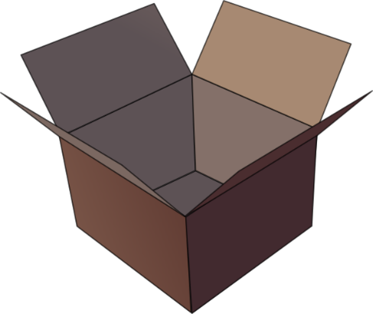
e
¡A pronunciar!
e
papel
en
espalda
tener
elefante
[to have]
estar
[to be]
Notes:
Introduce and elicit the pronunciation of the individual SSC ‘e’ and then the source word again (with gesture, if using). Then present and elicit the pronunciation of the five cluster words.
The cluster words have been chosen for their high-frequency, from a range of word classes, with the SSC (where possible) positioned within a variety of syllables within the words(e.g. initial, 2nd, final etc..) and additionally, we have tried to use words that build cumulatively on previously taught SSCs (see the Phonics Teaching Sequence document) and do not include new SSCs. Where new SSCs are used, they are often consonants which have a similar symbol-sound correspondence in English.
Word frequency rankings: elefante [>5000]; papel [393]; espalda [942]; estar [21]; en [5]; tener [19] Source: Davies, M. & Davies, K. (2018). A Frequency Dictionary of Spanish: Core vocabulary for learners (2nd ed.) London: Routledge.

Slide 5
e
¡A pronunciar!
e
papel
en
espalda
elefante
tener
estar
Notes:
Without the images, students focus this time again closely on the SSC and the cluster words.

Slide 6
e
¡A pronunciar!
e
papel
en
espalda
elefante
tener
estar
Notes:
Without the images and sound, students have to pronounce the words themselves.

Slide 7
¡A pronunciar!
i
i
idea
Notes:
Introduce and elicit the pronunciation of the individual SSC ‘i’ and then present and practise the pronunciation of the source word ‘idea’.
A possible gesture for this source word would be to
Bring a single finger to the temple of your head
Quickly move the finger horizontally away from the head
Use facial expressions to convey the positive surprise of a ‘lightbulb’ moment

Slide 8
¡A pronunciar!
i
i
idea
Notes:
Repeat the sound and elicit the source word.

Slide 9
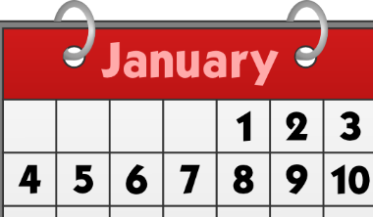
i
¡A pronunciar!
i
lista
ir
idea
interesante
sin
primero
Sin ketchup
Notes:
Introduce and elicit the pronunciation of the individual SSC ‘i’ and then the source word again (with gesture, if using). Then present and elicit the pronunciation of the five cluster words.
The cluster words have been chosen for their high-frequency, from a range of word classes, with the SSC (where possible) positioned within a variety of syllables within the words(e.g. initial, 2nd, final etc..) and additionally, we have tried to use words that build cumulatively on previously taught SSCs (see the Phonics Teaching Sequence document) and do not include new SSCs. Where new SSCs are used, they are often consonants which have a similar symbol-sound correspondence in English.
Word frequency rankings: idea [248]; lista [1189]; ir [33]; interesante [617]; primero [82]; sin [54] Source: Davies, M. & Davies, K. (2018). A Frequency Dictionary of Spanish: Core vocabulary for learners (2nd ed.) London: Routledge.

Slide 10
i
¡A pronunciar!
i
lista
ir
idea
interesante
sin
primero
Notes:
Without the images, students focus this time again closely on the SSC and the cluster words.

Slide 11
i
¡A pronunciar!
i
lista
ir
idea
interesante
sin
primero
Notes:
Without the images or sound, students have to pronounce the words themselves.

