Slide 1
Grammar
Tu versus vous (plural)
Y7 French
Term 1.2 - Week 7
Stephen Owen / Emma Marsden
Date updated: 07/01/20

Slide 2
Talking to others: tu and vous = YOU
To say ‘you (plural)’ + regular -ER verb in French, the verb is the short form and ends in -ez.
For example:
‘You’ to one person → ‘You’ to more than one person
jouer
tu joues → vous jouez
manger
tu manges → vous mangez
The following activities will allow you to practise recognising the 'ez' on the vous form!
Emma Marsden / Stephen Owen
Notes:
This slide is the animated explanation of the difference between the present tense second person singular and second person plural forms of verbs – the grammar focus for this week. The pronunciation of the ‘vous’ form ending should be practised, with students repeating several times. The listening and reading activities which follow then give students practice in spotting this verb ending in the oral modality.
NOTE: ensure that all pupils know that ‘tu’ and ‘vous’ mean ‘you’. Explain that English only has one form for ‘you’ - English does not have a word for ‘plural you’. You could add that in the United States, some people use ‘y’all’ to mean ‘you for more than one person’. English is quite unusual in not having a word for plural ‘you’.
NOTE: point out to the students that the s at the end of the verb is not pronounced. Ask them why. It is because of the Silent Final Consonant.
NOTE: Point out that the verb ending for ‘you singular’ (an ‘s’) is only noticeable in writing, in how it is spelt. When you hear the verb, there is no difference from the plain short form!

Slide 3
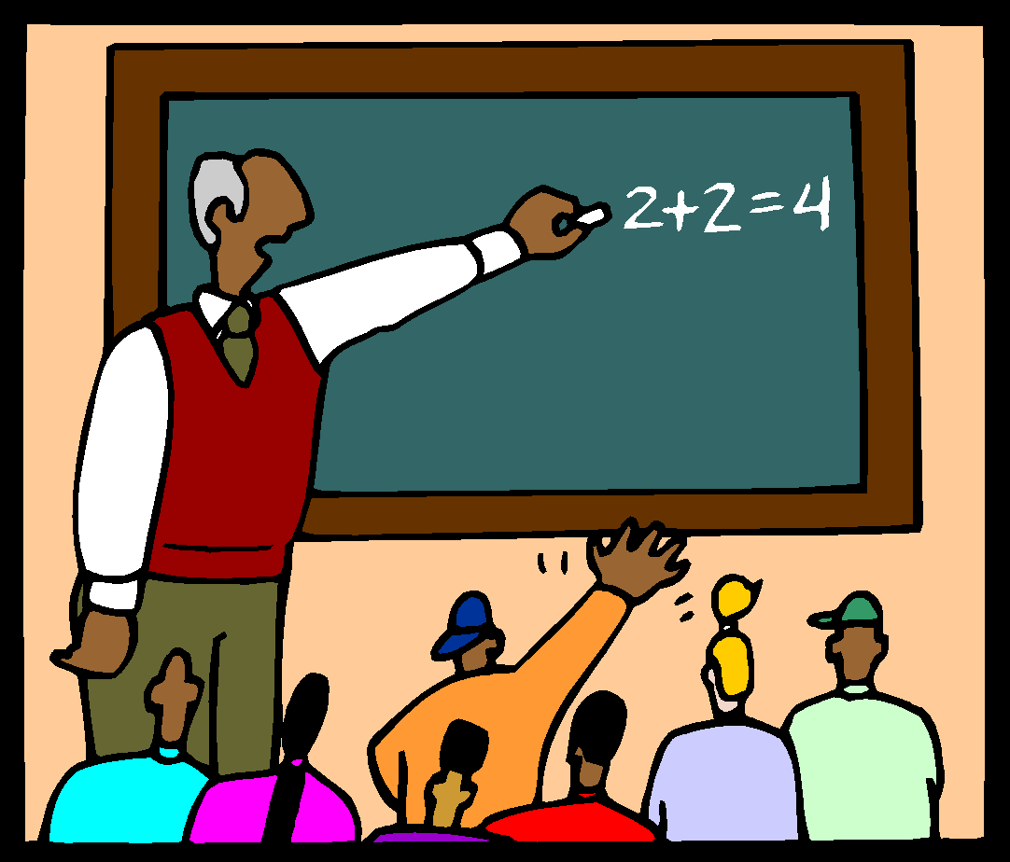
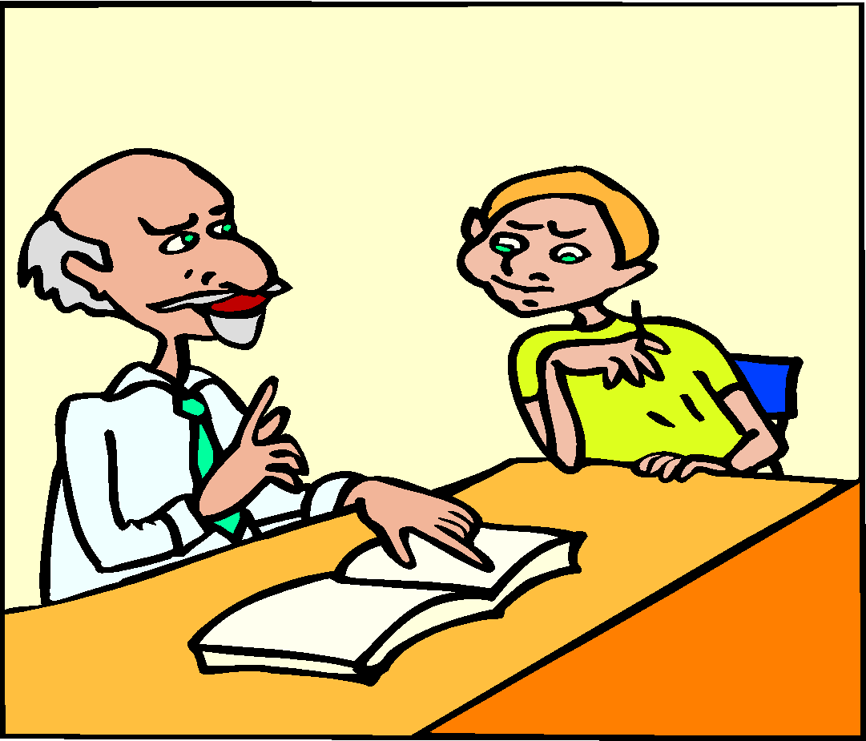
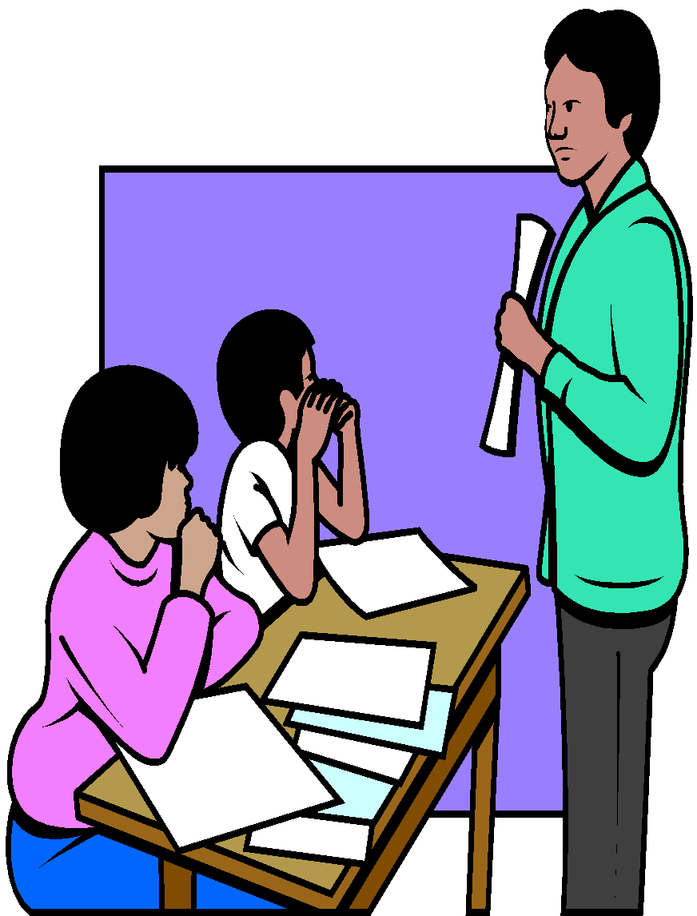
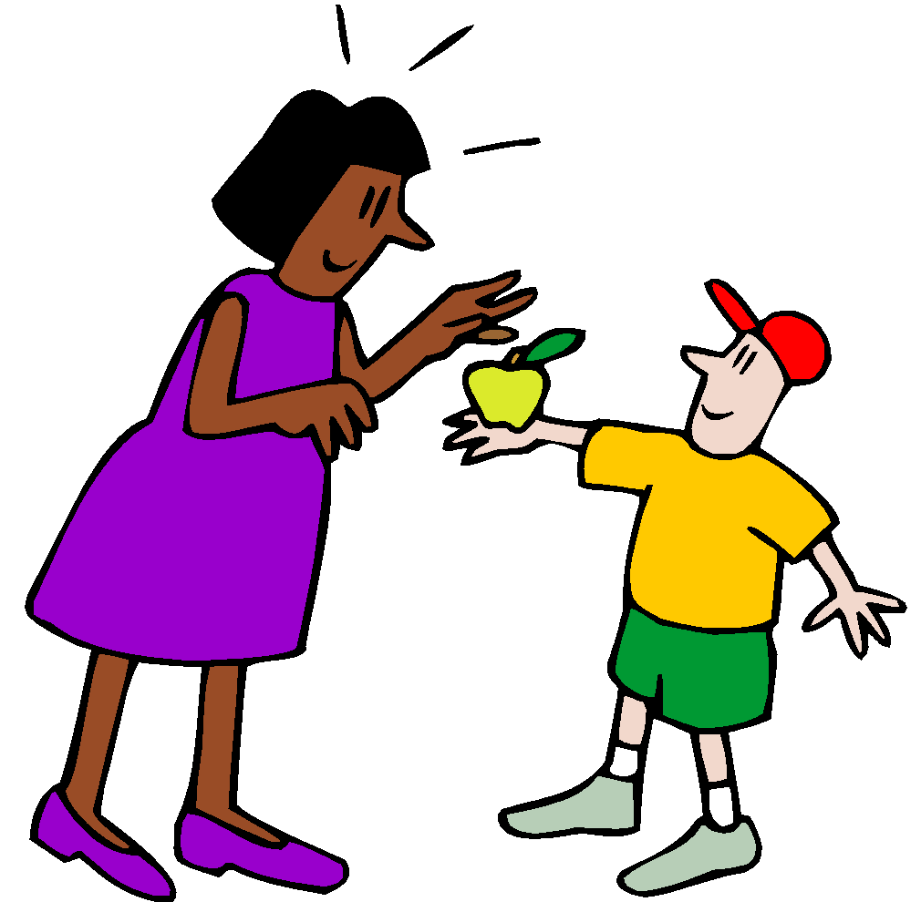
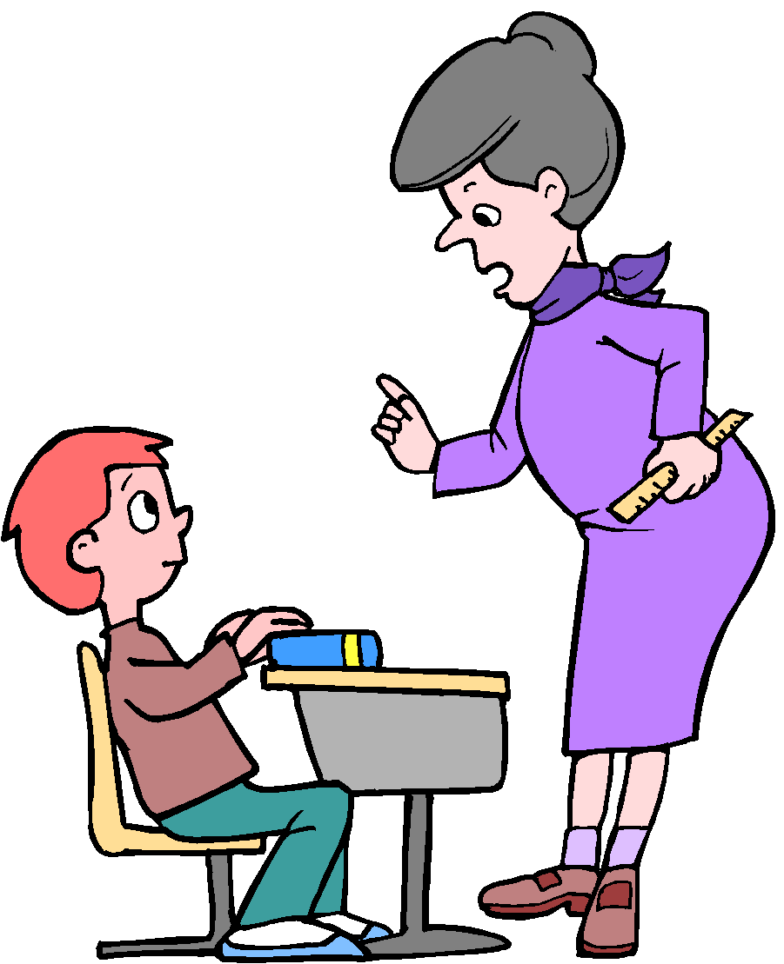
écouter
En classe
Is the teacher talking to several pupils (vous) or just one (tu)? Écris tu ou vous.
1
vous
4
vous
2
tu
5
tu
3
tu
6
vous
When you hear 'ez' you know it is 'plural you'
7
vous
Notes:
This exercise requires the learner to listen for the verb form to determine whether one person is being addressed, or more than one person. The exercise previously published on the NCELP Resource portal (in support of the earlier CPD session) has been adapted here, so that it only features vocabulary already presented in the scheme of work (including some of the new vocabulary for this week).
The lesson buzzer in the audio recording stops students hearing the whole message, so their only clue is the verb ending -ez.
N.B. There are some highly frequent irregular verbs featured in the listening and reading activities of this sequence. These are useful to know, in terms of their meaning, as part of the lexicon at this stage. However, they will not feature in the production tasks which follow later on – these will use regular –ER verbs to avoid making the tasks too difficult for students.
Transcript
The start of each sentence is missing, obscured by a “buzzer”.
Decide whether each sentence starts with “Tu…” OR “Vous…”.
1) …regardez le problème.
2) …restes en silence.
3) …ouvres le livre.
4) …écrivez au tableau ?
5) …manges en classe.
6) …parlez en anglais.
7) …écoutez l'histoire ?
Frequency
Verb frequency rankings (1 is the most common word in French): regarder [425]; rester [100]; ouvrir [257]; écrire [382]; manger [1338]; parler [106]; écouter [429].
Source: Londsale, D., & Le Bras, Y. (2009). A Frequency Dictionary of French: Core vocabulary for learners London: Routledge.

Slide 4
lire
Talking to others: tu and vous - YOU
Who is being asked a question:
‘tu’ (you- one person) or ‘vous’ (you - more than one person)?
 |  | You - one person (tu) | You - more than one (vous)
1 | ……regardes un film?
2 | ……écoutez la radio?
3 | ……étudies le français?
4 | ……chantes bien!
5 | ……étudiez l’anglais?
6 | ……écoutes de la musique?
7 | ……regardez la télé?
Notes:
This reading exercise requires the learner to notice the form of the verb (specifically the –ez of the vous form) as the only means of obtaining the correct answer. The exercise previously published on the NCELP Resource portal (in support of the earlier CPD session) has been adapted here, so that it only features vocabulary already presented in the scheme of work (including some of the new vocabulary for this week), plus two sports that are cognates. To complete the task, students can simply work from the board, writing the question numbers in their books, and either ‘tu – you singular’ or ‘vous – you plural’ for each question. Alternatively, the slide may be printed out for students.
The exercise continues on the next slide.
Frequency
regarder [425]; écouter [429]; étudier [960]; chanter [1820]; film [848]; radio [1526]; français [251]; bien [47]; anglais [784]; musique [1139]; télé(vision) [2746].
Source: Londsale, D., & Le Bras, Y. (2009). A Frequency Dictionary of French: Core vocabulary for learners London: Routledge.

Slide 5
Talking to others: tu and vous - YOU
lire
Who is being asked a question:
‘tu’ (you- one person) or ‘vous’ (you - more than one person)?
 |  | You - one person (tu) | You - more than one (vous)
8 | …… jouez au football ?
9 | …… ouvres le livre ?
10 | …… avez un animal ?
11 | …… donnez un cadeau à Sophie ?
12 | …… joues au tennis ? ……
13 | ....... mets une chemise ?
14 | …… as un ordinateur?
Notes:
This is the continuation of the activity on the previous slide.
Irregular forms such as ‘ouvres’, ‘mets’ and ‘as’ feature towards the end of the exercise. Point out to students that the ‘tu’ form ends in ‘-s’ for all French verbs for ‘you singular’. The first three persons (singular) of avoir have already been taught, of course, in 1.1 Weeks 3 & 4. These irregulars are only used in the listening and reading activities of this sequence – being more difficult for students to produce correctly, they are not used in the production activities next lesson.
Frequency
avoir [8]; mettre [27]; donner [46]; ouvrir [257]; jouer [219]; animal [1002]; ordinateur [2201]; chemise [3892]; cadeau [2298]; ]; livre [358]; tennis [3857]; foot(ball) [2602].
Source: Londsale, D., & Le Bras, Y. (2009). A Frequency Dictionary of French: Core vocabulary for learners London: Routledge.

Slide 6
parler et écouter
Talking to others: tu and vous - YOU
Partenaire A (Task 1)
Ask your partner questions using the prompts below, but don’t say ‘tu’ or ‘vous’.
e.g. [Tu] écoutes la radio? or [Vous] chantez bien?
 |  | You - one person (tu) | You - more than one (vous)
1 | écouter la radio ?
2 | chanter bien ?
3 | manger un fruit ?
4 | donner un cadeau ?
5 | étudier le français ?
6 | regarder la télé ?
7 | jouer au football ?
Notes:
We use only regular –ER verbs for the production phase of the lesson sequence. This paired speaking activity revisits vocabulary from the previous week. There are two tasks, to permit each partner to play both roles.
Partner A has to formulate each question correctly from the infinitive and complement shown, either using the ‘tu’ form or the ‘vous’ form as indicated. However, the subject pronoun must not be said to Partner B (whose task is explained on the next slide). This is so that the partner has to notice the ‘-ez’ ending.
This slide could be printed for the partners to work from/annotate.
N.B. Differentiated versions of these tasks follow this sequence of slides, and may be substituted for students who would benefit from a greater degree of challenge.
Note: This activity revises question formation using intonation only. The students experienced this in the listening and reading activities in lesson 1. Remind them that they should raise their voice when they ask these questions.
Note: Remind students that the –ER ending on the infinitives in their prompts on the slide actually sound just like the –EZ ending. –er and –ez both sound the same when pronounced. These SSCs were introduced in the phonics work for Term 1.1, Week 5.

Slide 7
Talking to others: tu and vous - YOU
parler et écouter
Partenaire B (Task 1)
Decide whether you partner is asking questions to a group (vous) or only you (tu).
Number the questions in the order your partner says them.
Order |  | You - one person (tu) | You - more than one (vous)
 | play football?
 | watch TV?
 | study French?
 | listen to the radio?
 | sing well?
 | give a present?
 | eat fruit?
Notes:
Partner B has to tick whether each question said by Partner A is to one person (‘tu’) or to more than one person (‘vous’).
S/he then has to write the number of each question in the first column, alongside its English translation, so that the order in which the questions have been asked is apparent.
This means that Partner B does not only have to listen for the verb form used; the vocabulary of the question also has to be processed.
This slide could be printed for the partners to work from/annotate.

Slide 8
Talking to others: tu and vous
parler et écouter
Talking to others: tu and vous - YOU
Solution (Task 1)
Order |  | You - one person (tu) | You - more than one (vous)
7 | play football?
6 | watch TV?
5 | study French?
1 | listen to the radio?
2 | sing well?
4 | give a present?
3 | eat fruit?
Notes:
This is the solution to the task.
This slide may be displayed on the screen following the exercise, to assist students in checking their work.

Slide 9
parler et écouter
Talking to others: tu and vous - YOU
Partenaire A (Task 2)
Ask your partner questions using the prompts below, but don’t say ‘tu’ or ‘vous’.
e.g. [Tu] écoutes la radio? or [Vous] chantez bien?
 |  | You - one person (tu) | You - more than one (vous)
1 | travailler à l’école ?
2 | demander la raison ?
3 | trouver la solution ?
4 | marcher dehors ?
5 | porter un uniforme ?
6 | rester à la maison ?
7 | préparer le repas ?
Notes:
The partners now swap roles.
The new Partner A has to formulate each question correctly from the infinitive and complement shown, either using the ‘tu’ form or the ‘vous’ form as indicated.
However, the subject pronoun must not be said to Partner B (whose task is explained on the next slide).
This activity revisits vocabulary from previous weeks.
This slide could be printed for the partners to work from/annotate.

Slide 10
Talking to others: tu and vous - YOU
parler et écouter
Partenaire B (Task 2)
Decide whether you partner is asking questions to a group (vous) or only you (tu).
Number the questions in the order your partner says them.
Order |  | You - one person (tu) | You - more than one (vous)
 | walk outside?
 | work at school?
 | prepare the meal?
 | ask the reason?
 | stay at home?
 | find a solution?
 | wear a uniform?
Notes:
Partner B has to tick whether each question said by Partner A is to one person (‘tu’) or to more than one person (‘vous’).
S/he then has to write the number of each question in the first column, alongside its English translation, so that the order in which the questions have been asked is apparent.
This means that Partner B does not only have to listen for the verb form used; the vocabulary of the question also has to be processed.
This slide could be printed for the partners to work from/annotate.

Slide 11
Talking to others: tu and vous - YOU
parler et écouter
Solution (Task 2)
Order |  | You - one person (tu) | You - more than one (vous)
4 | walk outside?
1 | work at school?
7 | prepare the meal?
2 | ask the reason?
6 | stay at home?
3 | find a solution?
5 | wear a uniform?
Notes:
This is the solution to the task.
This slide may be displayed on the screen following the exercise, to assist students in checking their work.
Differentiated versions of these tasks now follow, and may be substituted for students who would benefit from a greater degree of challenge.

Slide 12
Talking to others: tu and vous - YOU
parler, écouter, écrire
Partenaire A (Task 1)
Ask your partner questions using the prompts below, but don’t say ‘tu’ or ‘vous’.
e.g. [Tu] écoutes la radio? or [Vous] chantez bien?
 |  | You - one person (tu) | You - more than one (vous)
1 | listen to the radio?
2 | sing well?
3 | eat fruit?
4 | give a present?
5 | study French?
6 | watch TV?
7 | play football?
Notes:
In this more challenging version of Task 1, Partner A has to formulate the question in French indicated by the prompt in English, using either the ‘tu’ form or the ‘vous’ form as also indicated.
As before, the subject pronoun must not be said to Partner B (whose task is explained on the next slide).
Note: This activity revises question formation using intonation only. The students experienced this in the listening and reading activities in lesson 1. Remind them that they should raise their voice when they ask these questions.
This slide could be printed for the partners to work from/annotate.

Slide 13
Talking to others: tu and vous - YOU
parler, écouter, écrire
Partenaire B (Task 1)
Decide whether you partner is asking questions to a group (vous) or only you (tu).
Then write down the whole question in French.
 | question (en français!) | You - one person (tu) | You - more than one (vous)
1
2
3
4
5
6
7
Notes:
In this more challenging version of Task 1, Partner B has to tick whether each question said by Partner A is to one person (‘tu’) or to more than one person (‘vous’), as before.
However, s/he then has to transcribe (write in French) each question they have heard in French.
This means that Partner B does not only have to listen for the verb form used; the vocabulary of the question also has to be processed and the correct French reproduced in writing.
This slide could be printed for the partners to work from/annotate.

Slide 14
Talking to others: tu and vous - YOU
parler, écouter, écrire
Solution (Task 1)
 |  | You - one person (tu) | You - more than one (vous)
1 | Vous écoutez la radio ?
2 | Tu chantes bien ?
3 | Tu manges un fruit ?
4 | Vous donnez un cadeau ?
5 | Tu étudies le français ?
6 | Tu regardes la télé ?
7 | Vous jouez au foot ?
Notes:
This is the solution to the task.
This slide may be displayed on the screen following the exercise, to assist students in checking their work.

Slide 15
Talking to others: tu and vous - YOU
parler, écouter, écrire
Partenaire A (Task 2)
Ask your partner questions using the prompts below, but don’t say ‘tu’ or ‘vous’.
e.g. [Tu] écoutes la radio? or [Vous ] chantez bien?
 |  | You - one person (tu) | You - more than one (vous)
1 | work at school?
2 | ask the reason?
3 | find the solution?
4 | walk outside?
5 | wear a uniform?
6 | stay at home?
7 | prepare the meal?
Notes:
The partners now swap roles.
In this more challenging version of Task 2, Partner A has to formulate the question in French indicated by the prompt in English, using either the ‘tu’ form or the ‘vous’ form as also indicated.
As before, the subject pronoun must not be said to Partner B (whose task is explained on the next slide).
This slide could be printed for the partners to work from/annotate.

Slide 16
Talking to others: tu and vous - YOU
parler, écouter, écrire
Partenaire B (Task 2)
Decide whether you partner is asking questions to a group (vous) or only you (tu).
Then write down the whole question in French.
 | question (en français!) | You - one person (tu) | You - more than one (vous)
1
2
3
4
5
6
7
Notes:
In this more challenging version of Task 2, Partner B has to tick whether each question said by Partner A is to one person (‘tu’) or to more than one person (‘vous’), as before.
However, s/he then has to transcribe (write in French) each question that they heard in French.
This means that Partner B does not only have to listen for the verb form used; the vocabulary of the question also has to be processed and the correct French reproduced in writing.
This slide could be printed for the partners to work from/annotate.

Slide 17
Talking to others: tu and vous - YOU
parler, écouter, écrire
Solution (Task 2)
 |  | You - one person (tu) | You - more than one (vous)
1 | Vous travaillez à l’école ?
2 | Vous demandez la raison ?
3 | Tu trouves la solution ?
4 | Tu marches dehors ?
5 | Tu portes un uniforme ?
6 | Vous restez à la maison ?
7 | Tu prépares le repas ?
Notes:
This is the solution to the task.
This slide may be displayed on the screen following the exercise, to assist students in checking their work.
Differentiated versions of these tasks now follow, and may be substituted for students who would benefit from a greater degree of challenge.

Slide 18
Talking to others: tu and vous - YOU
écrire
Write questions to both one person and a group using the verbs below.
You can choose what other vocabulary to use! Écris en français !
Infinitive verb | You - one person (tu) | You - more than one (vous)
écouter
regarder
manger
jouer
demander
parler
trouver
Emma Marsden / Stephen Owen
Notes:
Students now use each verb – all of which have been presented and practised over the past four weeks – to write one question in French in the ‘tu’ form, and another in the ‘vous’ form.
The questions should be written in the appropriate boxes of the printed version of this slide.
Students choose which other words to include in their sentences, and should be advised to review the vocabulary previously learnt (and, if appropriate, to consult a dictionary to search for any new vocabulary items needed).
This slide could be printed for the partners to work from/annotate; alternatively, students could complete the exercise in their books.

Slide 19
Talking to others: tu and vous - YOU
écrire
Write an answer to each question below. You can choose what other vocabulary to use!
Remember! When writing verbs with 'je' (I), you do not add an 's' to the end of the verb.
 | Question | Réponse
1 | Vous travaillez à l’école ?
2 | Vous demandez la raison ?
3 | Tu trouves la solution ?
4 | Tu marches dehors ?
5 | Tu portes un uniforme ?
6 | Vous restez à la maison ?
7 | Tu prépares le repas ?
Notes:
Students now write an answer to each question, as asked by their partner. Remind them that when writing in the first person singular they do not add an 's' to the end of the verb.
This slide could be printed for the partners to work from/annotate; alternatively, students could complete the exercise in their books.

