Slide 1
Vocabulary
Victoria Hobson & Nick Avery
Dated updated: 25/11/2019

Slide 2
Vocabulario
 | Español | Inglés
1 | el pueblo | town, village
2 | el equipo | team
3 | el trabajo | work, job
4 | el edificio | building
5 | el plato | plate, dish
6 | la familia | family
7 | la película | film
8 | la vista | view
9 | la isla | island
10 | grande | big
11 | interesante | interesting
60
Segundos
0
INICIO
Notes:
Vocabulary practice slide Pupils either work by themselves or in pairs, reading out the words and recapping their English meaning (1 minute). Then the English meanings are removed and they try to recall them, looking at the Spanish (1 minute). Then the Spanish meaning are removed and they to recall them, looking at the English (1 minute) Further rounds of learning can be facilitated by one pupil turning away from the board, and his/her partner asking him/her the meanings. This activity can work from L2 → L1 or L1 → L2.
Vocabulary frequency rankings (1 is the most common word in Spanish):
pueblo [244]; equipo [373]; trabajo [152]; edificio [857]; plato [1808]; familia [233]; película [543]; vista [408]; isla [810]; grande [66]; interesante [616];
Source: Davies, M. & Davies, K. (2018). A frequency dictionary of Spanish: Core vocabulary for learners (2nd ed.). London: Routledge.

Slide 3
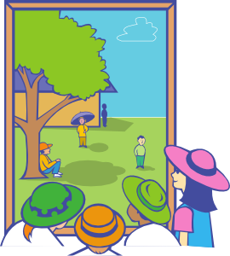
Vocabulario
el plato
el trabajo
el pueblo
el edificio
el equipo
la familia
la vista
la película
la isla
big
interesting
grande
interesante
Notes:
This slide presents the vocabulary for this week. Students should know this already so it offers an opportunity as a quick in-class check.

Slide 4
Vocabulario
big
interesting
interesting
big
big
El plato es grande.
El trabajo es interesante.
El pueblo es interesante.
El edificio es grande.
El equipo es grande.
big
interesting
interesting
big
La familia es grande.
La vista es interesante.
La película es interesante.
La isla es grande.
Notes:
This slide practises the nouns for this week with the adjectives in short sentences. There are various ways to use this activity:
Students write (either in ex. books or mini whiteboards) the correct sentence.
Pairs turn to each other to say the sentence
Students all say the sentence out loud as a choral response
4) Pairs take it in turns to translate the sentence to their partner. Partner A gives the Spanish and partner B then translates. (Partner B looks away from the board). After all 9 partners swap roles. Players can keep a tally of how many sentences they translate correctly.

Slide 5
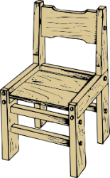
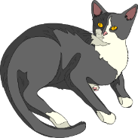
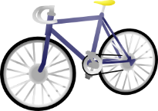
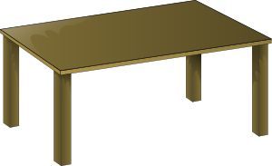
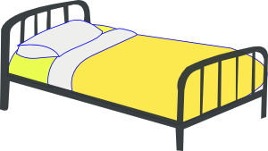
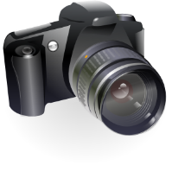
Vocabulary introduction
Vocabulario – pilla al intruso
Vocabulary Introduction
1.
4.
los
los
las
los
las
las
[teams]
[towns]
2.
5.
los
las
los
las
los
los
[jobs]
3.
6.
der
las
las
los
las
las
los
Notes:
Find the odd one out
The words included in this activity are largely from weeks 1.1.4 and 1.2.3, which were revisited as part of last week’s homework.
Students will need to use their word knowledge (gender) to work out the answer. Here, the word is not supplied so they will have to retrieve the vocabulary from memory. This highlights to students how gender, not just meaning, is important when learning vocabulary.

Slide 6
 |  |  | el | la | los | las
1 | películas
2 | equipos
3 | platos
4 | edificio
5 | familia
6 | pueblos
7 | vistas
8 | isla
9 | trabajo
Vocabulario
films
teams
plates, dishes
building
family
towns, villages
views
island
work, job
Notes:
A quick starter style activity to practise all four words for the to reconnect with the previous lesson’s teaching point before picking up again with the definite article. Students tick the correct box (or write the correct word in their ex. books if teachers do not wish to print the table).
Teachers can also use this as an opportunity to practise vocabulary and refresh the meaning of these words by quickly asking students to give the English during the feedback.

