Slide 1
Être: je suis & il/elle est
To be: I am & he/she is + adjective
Notes:
This series of activities is compatible with the NCELP Scheme of Work for year 7, term 1.

Slide 2
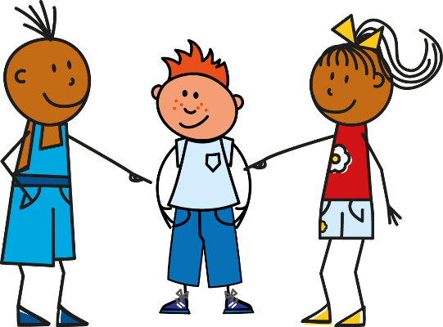
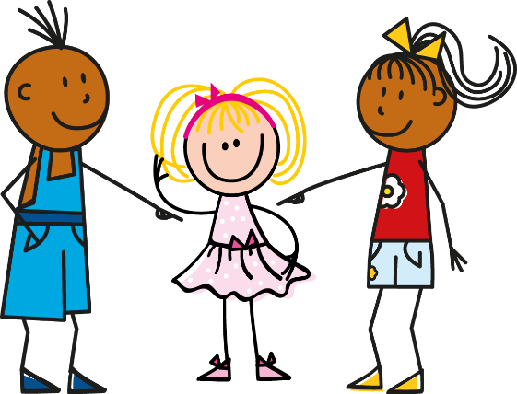
I am & s/he is
‘am’ and ‘is’ are part of the verb ‘to be’ (être)
In French, use je suis to say ‘I am.’
For ‘he is’, use il est.
For ‘she is’, use elle est.
Je suis
Il est
Elle est
Je suis malade.
Il est malade.
Elle est malade.
I am unwell.
He is unwell.
She is unwell.
Notes:
Read out the slide to the pupils, so that they are sure how to pronounce ‘suis’ and ‘est’.
Tell the pupils very briefly about the ‘silent final consonant’ rule – we don’t pronounce the ‘s’ or the ‘t’ on the end of the verbs. There will be more practice on this this week.
Remind the pupils that ‘am’ and ‘is’ are part of the English verb ‘be’ – this is a very irregular verb in English! And it is irregular in French too!
Tell the pupils, in this series of activities we will only use ‘il’ which means ‘he’.
We will practise the word for ‘she’ (elle) in later activities.

Slide 3
Mon compagnon idéal
Lire
You are reading a blog. Some of the text has not downloaded properly. Is the person is talking about himself or his ideal penfriend? Look carefully at the verb.
1 | đĦĦċđø est cool |  |  | 5 | đĦĦċđø suis grand
2 | đĦĦċđø est français |  |  | 6 | đĦĦċđø est grand
3 | đĦĦċđø suis anglais |  |  | 7 | đĦĦċđø suis aimable
4 | đĦĦċđø est sportif |  |  | 8 | đĦĦċđø suis amusant
He (friend)
He (friend)
I
I
Victoria Hobson
Notes:
You will notice that this activity uses two cognates (cool and sporty) and also two adjectives that are not yet in the NCELP SoW for week 1, but do appear in week 2. As this is a grammar activity, it is fine to have these words appear here – they may be explained briefly in passing, and the students may learn them incidentally, but they are not the focus of this activity.
We have chosen to have just masculine adjectival agreement, to keep the language simple at this stage. Adjectival agreement is introduced later. This means that we have to have ‘He’ in the partner column.

Slide 4
Me, or the dog?!
Écouter
You hear a man arguing with his partner about their dog! Bits of the conversation are not clear. When is the man talking about himself (‘I am …’) and when about the dog (‘he is …’)? Write 1-8, and ‘I’ or ‘he’.
1
5
2
6
3
7
4
8
Victoria Hobson
Notes:
TRANSCRIPT
[noise] est méchant
[noise] suis aimable
[noise] est aimable
[noise] est amusant
[noise] suis amusant
[noise] suis intelligent
[noise] est stupide
[noise] suis calme
Note that all the adjectives are compatible with a male noun (the dog). This is so that we steer clear of adjectival agreement for now.

Slide 5
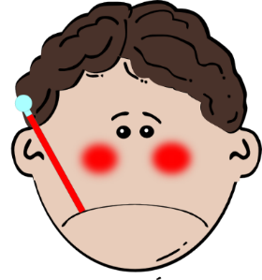
Parlez!
Parler
Picks a verb + adjective
Partner A
“Il est
malade."
Partner B
Translates
“He is unwell.”
Victoria Hobson
Notes:
See separate set of cards (word doc)
Note: The cards do not have to be printed, but they provide a model for the speaking activity. Pupils can easily be given one sheet of A4 white paper, fold it in half (lengthways), then again in half (widthways), then again into three, so that 12 equal-sized rectangular shapes are created. In 3 of them, they write ‘I’, in 3 others, they write ‘he’, then they write: ill, cool, big, small, English, French once on each of the other six. They tear (with or without use of a ruler, and certainly no scissors – it doesn’t need to be neat!). The first time students create their own flashcards takes about 5 mins, but they get quicker and quicker. It saves copying, cutting…
Separate the cards into two piles: one pile of pronouns (“I” and ”he”) and one pile of adjectives. (Take care to not include any of the ‘tu’ cards, which look a bit similar!)
Partner A picks a verb and then an adjective, partner B gives the translation. Players can then swap roles.
Pairs of students can time themselves, and then repeat the activity to see how quickly they can complete all the sentences and translations. With each new game, different sentences will be generated.
NB Only ‘il est’ is practised here, to eliminate the need for adjective agreement to reduce cognitive load. Adjective agreement is practised as a separate teaching points in two sets of activities for Year7 Week 1 and Year 7 Week 2.
Depending on the learners in your class and the time available, you could explain that the title of this slide (Parlez) is an instruction to more than one person: Talk! Or just ignore it for now, as it is not central to the activity.

Slide 6
Écrivez!
Écrire
Victoria Hobson
Notes:
Each click on the powerpoint produces a new combination of a pronoun (I or he) plus adjective.
Using mini whiteboards/paper as the teacher sees fit, students write each sentence that is generated after each click on the powerpoint.
Feedback could be given after the first two or three to check that all learners are producing ‘je suis’ or ‘il est’ correctly.
NB Only ‘il est’ is practised here, to eliminate the need for adjective agreement to reduce cognitive load. Adjective agreement is practised as a separate teaching points in two sets of activities for Year7 Week 1 and Year 7 Week 2.

