Slide 1
Talking about doing and making things
faire for English equivalents ‘do’ and ‘make’ only followed by le/la/l’/les (je, il/elle)
intonation questions with question words
SSC [ain/in]
Y7 French
Term 1.1 - Week 7 - Lesson 13
Victoria Hobson / Stephen Owen / Catherine Morris
Artwork by: Chloé Motard
Date updated: 01/11/21
Notes:
Learning outcomes (lesson 1):
Introduction of SSC [ain/in]
Introduction of first and third person singular forms of faire
Word frequency (1 is the most frequent word in French):
7.1.1.7 (introduce) faire [25], fais [25], fait [25], ça [54], activité [452], courses [1289], cuisine [2618], devoirs [39], lit [1837], ménage [2326], modèle [958], d'accord [736], quoi [297]
7.1.1.4 (revisit) as [8], livre [358], ordinateur [2201], vélo [4594], voiture [881], cher [803], chère [803], moderne [1239], rapide [672], voici [1103], oui [284], non [75], comment ça s'écrit?
Source: Londsale, D., & Le Bras, Y. (2009). A Frequency Dictionary of French: Core vocabulary for learners London: Routledge.

Slide 2
ain/in
train
Notes:
Timing: 1 minute
Aim: To introduce SSC [ain/in]
Procedure: 1. Present the letter(s) and say the [ain/in] sound first, on its own. Students repeat it with you. 2. Bring up the word ”train” on its own, say it, students repeat it, so that they have the opportunity to focus all of their attention on the connection between the written word and its sound.
3. A possible gesture for this would be to move both arms simultaneously forwards and back in a circular motion, simulating the motion of train wheel connecting rods.
4. Roll back the animations and work through 1-3 again, but this time, dropping your voice completely to listen carefully to the students saying the [ain/in] sound, pronouncing ”train” and, if using, doing the gesture.
Word frequency (1 is the most frequent word in French):
train [232]. Source: Londsale, D., & Le Bras, Y. (2009). A Frequency Dictionary of French: Core vocabulary for learners London: Routledge.

Slide 3
ain/in
train
Notes:
With sound and no pictures to focus all attention on the sound-symbol correspondence.

Slide 4
ain/in
train
Notes:
Without sound to elicit pronunciation (without first hearing the teacher).
Teacher to elicit pronunciation by asking “Comment dit-on …"

Slide 5
ain/in
fin
matin
[end]
vingt
train
main
maintenant
[now]
Notes:
Timing: 2 minutes
Aim: To introduce SSC [ain/in]
Procedure:
1. Introduce and elicit the pronunciation of the individual SSC [ain/in] and then the source word again ‘train’ (with gesture, if using). 2. Then present and elicit the pronunciation of the five cluster words.
The cluster words have been chosen for their high-frequency, from a range of word classes, with the SSC (where possible) positioned within a variety of syllables within the words (e.g. initial, 2nd, final etc.). Additionally, we have tried to use words that build cumulatively on previously taught SSCs (see the Phonics Teaching Sequence document) and do not include new SSCs. Where new SSCs are used, they are often consonants which have a similar symbol-sound correspondence in English.
Word frequency (1 is the most frequent word in French): fin [111]; matin [442] vingt[1273]; maintenant [192]; main [418]; train [232]. Source: Londsale, D., & Le Bras, Y. (2009). A Frequency Dictionary of French: Core vocabulary for learners London: Routledge.

Slide 6
ain/in
fin
matin
vingt
train
main
maintenant
Notes:
With sound and no pictures to focus all attention on the sound-symbol correspondence.

Slide 7
ain/in
fin
matin
vingt
train
main
maintenant
Notes:
Without sound to elicit pronunciation (without first hearing the teacher).
Teacher to elicit pronunciation by asking “Comment dit-on …"

Slide 8
Phonétique
écouter
Listen carefully and find the words you hear in this sea of vocabulary.
1
2
3
4
5
6
A) certain
D) simple
B) cercle
C) certes
E) couronne
J) magasin
H) magistrat
F) cousin
[crown]
[shop]
G) niveau
I) magazine
L) latin
O) gant
[level]
[glove]
N) prince
K) gain
Q) prends
M) éclat
P) latte
[take]
[flash]
[board]
Notes:
Timing: 5 minutes
Aim: Aural recognition of words containing SSC [ain/in] from a pool of distractors. This trains students to associate the process of looking for a certain letter combination when they hear a sound.
Procedure: 1. Click on boxes to play the words.
2. Students note down the letter next to the word they hear. Tell students that to find the word quickly they should focus on the position of [ain/in] in the word they hear, and look for words with the letters in the same position. Time limits or a competitive element could be added to speed this up, helping automisation of the sound-symbol connection.
3. Elicit answers for some alphabet practice by asking ‘c’est quoi?’
4. Answers revealed on clicks.
Transcript:
prince (N)
cousin (F)
certain (A)
latin (L)
magasin (J)
gain (K)
Word frequency (1 is the most frequent word in French): certain [110], cercle [2258], certes [1021], simple [212], cousin [3387], couronne [3700] éclat [3515], latin [1844], prince [2610], gant [>5000], magasin [1736], magistrat [4282], vain [2971], niveau [328], magazine [2033], latte [>5000], prendre [43]
Source: Londsale, D., & Le Bras, Y. (2009). A Frequency Dictionary of French: Core vocabulary for learners London: Routledge.

Slide 9
Tennis phonétique
parler
Say the words in any order, but don’t repeat any words!
60
main
certain
humain
instinct
[hand]
marin
urbain
cousin
secondes
[sailor]
gain
latin
assassin
soudain
[suddenly]
magasin
américain
[shop]
lapin
prince
0
bulletin
[rabbit]
DÉBUT
Notes:
Timing: 3 minutes
Aim: To correctly pronounce cognates and near-cognates containing [ain/in] in a set amount of time. Raising awareness of the difference in the English and French pronunciation of this SSC.
Procedure: 1. Students pair up and work in two teams of two.
2. Start the timer. The first pair says alternate words over one minute’s intensive practice. They can call the words in any order but cannot repeat a word already said.
3. The other team listens and tries to catch out their opponents by listening for any words pronounced the ‘English’ way. If this happens, the first team must start again! 4. After 60 seconds, restart the timer and swap roles.
5. The team with the longest streak wins!
Word frequency (1 is the most frequent word in French): certain [110], humain [286], marin [418], urbain [2215], soudain [2310], américain [374], gain [2420], bulletin [3233], latin [1844], prince [2610], instinct [4482], marin [2101], lapin [n/a], cousin [3387], magasin [1736], assassin [3781]
Source: Londsale, D., & Le Bras, Y. (2009). A Frequency Dictionary of French: Core vocabulary for learners London: Routledge.

Slide 10
Tennis phonétique
parler
Say the words in alphabetical order.
60
main
certain
humain
instinct
[hand]
marin
urbain
cousin
secondes
[sailor]
gain
latin
assassin
soudain
[suddenly]
magasin
américain
[shop]
lapin
prince
0
bulletin
[rabbit]
DÉBUT
Notes:
Timing: 3 minutes
Aim: To correctly pronounce cognates and near-cognates containing [ain/in] in a set amount of time. Raising awareness of the difference in the English and French pronunciation of this SSC.
Procedure: As previous, but in alphabetical (rather than random) order. This is an added challenge, but the words are the same, helping automisation of SSC production.

Slide 11
faire
faire
[to do, make | doing, making]
fait
[does, makes | is doing, making]
Notes:
Timing: 3 minutes for sequence of six verbs
Aim: to introduce the verb faire more explicitly. Faire is one of the 25 most frequently used verbs in French. All 25 most frequent verbs will be introduced early on using the same format. Both long form (infinitive) and short form (3rd person singular) are introduced in order to familiarise students with various forms of the same verb.
Procedure
Bring up the word faire on its own, say it, students repeat it, and remind them of the phonics.
Try to elicit the meaning from the students. Students have had explicit teaching that the present tense in French communicates two different present tense meaning in English. This reinforces that learning. Emphasise the two meanings for the short form, reminding students that French only has one form and does not have a direct equivalent of the grammar for ‘is + ing’, the continuous form (as covered in previous weeks).
Then bring up the English translations. Emphasise the two meanings for the infinitive.
Bring up the short form fait, say it, students repeat it. Draw attention to SFC.
Try to elicit the meaning from the students. Emphasise the two meanings for the short form.

Slide 12
faire
faire
[to do, make | doing, making]
fait
[does, makes | is doing, making]
Notes:
Cycle through the long and short form again.

Slide 13
fait
faire
[to do, make | doing, making]
Léa fait la cuisine.
[Léa does | is doing the cooking.]
Notes:
Introduce the short form in a sentence.

Slide 14
faire
faire
[to do, make | doing, making]
Léa aime faire la cuisine.
[Léa likes doing the cooking.]
Notes:
Introduce the long form in a sentence.

Slide 15
fait
fait
[does, makes | is doing, making]
fait
Léa la cuisine.
[Léa does the cooking.]
Notes:
Cycle through the short form in context again.

Slide 16
faire
faire
[to do, make | doing, making]
faire
Léa aime la cuisine.
[Léa likes doing the cooking.]
Notes:
Cycle through the long form in context again.

Slide 17
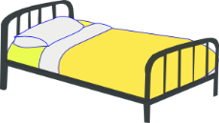
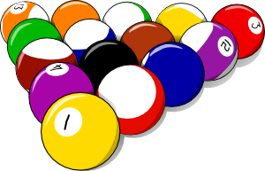
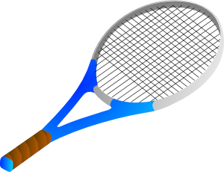
Vocabulaire
parler
faire le lit
faire le ménage
faire la cuisine
faire le modèle
faire une activité
faire les courses
faire les devoirs
Notes:
Timing: 3 minutes
Aim: To draw students’ attention to the two translations of ‘make’ and ‘do’.
Procedure:
To ensure that English meanings are transparent and that students are fully aware of when they use ‘do’ and ‘make’ in English, it is worth eliciting English translations explicitly, here.
Teachers can then use this slide to introduce the vocabulary in a listen and repeat style, if not already pre-learnt.
Reading and writing activities follow which practise the verb faire in first and third person singular. NB this teaching point does not offer a listening and speaking opportunity because of the same pronunciation of the forms for both meanings.

Slide 18
Vocabulaire
écouter
Qui fait quoi?
 | Il/ elle fait… | Extra info
Léa | le lit, les devoirs, la cuisine | Elle a un ordinateur, elle fait la cuisine le week-end
Amandine | les courses, la cuisine | Elle a une voiture Normalement elle fait la cuisine
Romain | le ménage | Il lit un livre intéressant
Notes:
Timing: 5 minutes
Aim: Practice listening skills. Identify this week’s vocabulary and use of verb ‘faire’
Procedure:
Students listen to the audio for each person. Audio can be paused after each phrase and replayed if needed.
Students should note what each person does as well as any extra information they hear. The extra information contains some unknown vocabulary (see below), but students should be able to work out the key information from context.
Click first to reveal what they do and then to reveal the extra information. Explain any unknown vocabulary.
Transcript:
Léa: Je fais le lit et je fais les devoirs sur l’ordinateur. Le week-end, je fait la cuisine.
Amandine: J’ai une voiture et je fais les courses. Normalement, je fais la cuisine.
Romain: Je fais le ménage et je lis un livre intéressant.
Word frequency of unknown vocabulary used (1 is the most frequent word in French): sur [16], week-end [2475], normalement [2018]
Source: Londsale, D., & Le Bras, Y. (2009). A Frequency Dictionary of French: Core vocabulary for learners London: Routledge.

Slide 19
The verb ‘faire’ – to do/make
grammaire
SFC
In French we use the verb faire to say to do and to make.
je fais
I do / I make
il fait
he does / makes
elle fait
she does / makes
Stephen Owen
Notes:
Timing: 2 minutes
Aim: This week we are focussing initially on the first and third person singular forms of ‘faire’, and these are presented here.
Procedure:
1. Click to reveal the conjugations and meanings of the verb

Slide 20
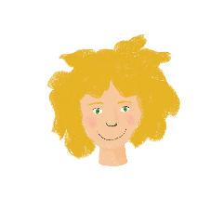
Qui fait quoi ?
lire
Léa writes what she does at home and what her mum does. Who does what? Léa (I…) or her mum (she…).
1 | fais la cuisine. |  |  | 5 | fait un effort.
2 | fais le modèle. |  |  | 6 | fais les devoirs.
3 | fait le ménage. |  |  | 7 | fait une activité.
4 | fais le lit. |  |  | 8 | fait les courses.
je
elle
je
elle
Notes:
Timing: 5 minutes
Aim: Written recognition of the first and third person singular forms of ‘faire’, and connecting these with meaning.
Procedure:
1. Students read the parts of sentences they can see and tick who they think it applies to. They should use their knowledge of verb forms to decide.
2. Answers revealed on clicks.
Word frequency of unknow near-cognates used (1 is the most frequent word in French): effort [388]
Source: Londsale, D., & Le Bras, Y. (2009). A Frequency Dictionary of French: Core vocabulary for learners London: Routledge.

Slide 21
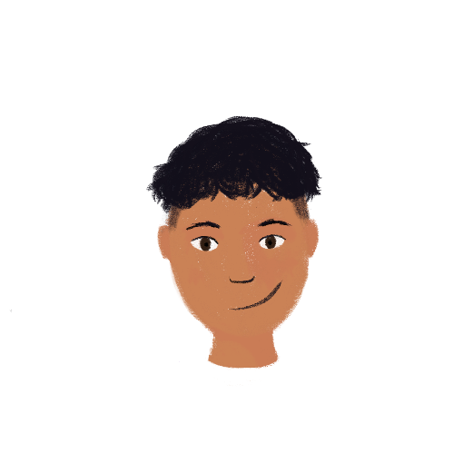
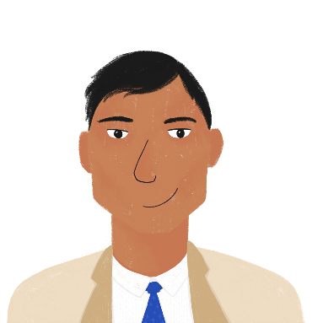
Qui fait quoi ?
écrire
Tu es Amir. Tu écris un e-mail. Écris 5 phrases avec ‘je’ (Amir) ou ‘il’ (papa).
1)
2)
5)
3)
4)
1
2
3
4
5
Je fais le lit.
Il fait le ménage.
Je fais la cuisine.
Je fais les devoirs.
Il fait les courses.
Notes:
Timing: 5 minutes
Aim: written production of vocabulary and the first and third person singular forms of faire.
Procedure:
Check understanding of the rubric, given in French. Students know these words from previous learning.
Use stressed intonation and strategic pointing (i.e. at Amir or his dad) to ensure that the instruction for the task is understood.
Do the first one together as an example, ensuring students focus on the verb ending as well as the pronoun, when feedback on the first answer is given.
Then give students time to do questions 2-5, before checking them together.
Word frequency of unknow near-cognates used in task instructions (1 is the most frequent word in French): e-mail [>388], papa [2458],
Source: Londsale, D., & Le Bras, Y. (2009). A Frequency Dictionary of French: Core vocabulary for learners London: Routledge.

Slide 22
Questions with quoi
parler
As you know, you can turn a statement into a question by raising your pitch:
Statement: Il fait le lit. He’s making the bed.
He makes the bed.
Question: Il fait le lit ? Is he making the bed?
Does he make the bed?
This type of question is a yes/no question.
To get more information about a situation, we need to add a question word.
In French, the question word comes at the end of intonation questions:
Il fait quoi ? What is he doing/making?
__________
Remember!
There is no word for ‘do’ in French.
__________
Notes:
Timing: 3 minutes
Aim: To revise intonation questions (yes/no) and to learn positioning of quoi in an intonation question to elicit more information.

Slide 23
Questions with quoi
parler
Léa is asking Amir about his sister Noura. What is she asking? Form questions with quoi.
Elle est quoi ?
Elle a quoi ?
Elle fait quoi ?
Elle écoute quoi ?
________________
________________
Elle est petite !
Elle a un livre !
Elle fait le modèle!
Elle écoute la radio.
________________
________________
Notes:
Timing: 3 minutes
Aim: Oral production of information questions with raised intonation and quoi. Revision of 3rd person singular form of verbs encountered so far.
Procedure:
Students pair up and take it in turns to play the role of Léa (asking questions) and Amir (answering questions). Remind students that the question word is the last word in the sentence, which is different to English. Remind students to pay attention to their intonation.
Click to reveal solutions.

Slide 24
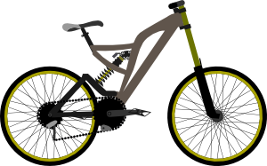
C’est quoi ?
lire
Some people are boasting about what they have. What is being described?
Tu as quoi ?
J’ai un ordinateur moderne et cher.
J’ai un vélo. C’est cool et rapide.
Oui, mais j’ai une voiture.
C’est plus rapide et plus cher qu’un vélo !
Notes:
Timing: 3 minutes
Aim: Revision of some of this week’s revisited vocabulary.
Procedure:
1. Students read the sentences and decide what is being described. They should use their knowledge of grammar to help them (masculine and feminine adjectives and determiners)
2. Click to reveal the answers.
Word frequency of unknown cognates used (1 is the most frequent word in French): cool [>5000]
Source: Londsale, D., & Le Bras, Y. (2009). A Frequency Dictionary of French: Core vocabulary for learners London: Routledge.

Slide 25
Talking about doing and making things
faire for English equivalents ‘do’ and ‘make’ only followed by le/la/l’/les (je, tu)
SSC [è/ê]
Y7 French
Term 1.1 - Week 7 - Lesson 14
Victoria Hobson / Stephen Owen / Catherine Morris
Artwork by: Chloé Motard
Date updated: 28/07/21
Notes:
Learning outcomes (lesson 2):
Introduction of SSC [è/ê]
Introduction of first and second person singular forms of faire
Word frequency (1 is the most frequent word in French):
7.1.1.7 (introduce) faire [25], fais [25], fait [25], ça [54], activité [452], courses [1289], cuisine [2618], devoirs [39], lit [1837], ménage [2326], modèle [958], d'accord [736], quoi [297]
7.1.1.4 (revisit) as [8], livre [358], ordinateur [2201], vélo [4594], voiture [881], cher [803], chère [803], moderne [1239], rapide [672], voici [1103], oui [284], non [75], comment ça s'écrit?
Source: Londsale, D., & Le Bras, Y. (2009). A Frequency Dictionary of French: Core vocabulary for learners London: Routledge.

Slide 26
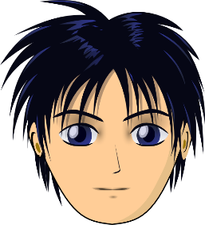
ê/è
[head]
tête
Notes:
Timing: 1 minute
Aim: To introduce SSC [ê/è]
Procedure: 1. Present the letter(s) and say the [ê/è] sound first, on its own. Students repeat it with you. 2. Bring up the word ”tête” on its own, say it, students repeat it, so that they have the opportunity to focus all of their attention on the connection between the written word and its sound.
3. A possible gesture for this would be to point to one’s head.
4. Roll back the animations and work through 1-3 again, but this time, dropping your voice completely to listen carefully to the students saying the [ê/è] sound, pronouncing ” tête” and, if using, doing the gesture.
Word frequency (1 is the most frequent word in French):
tête [343]. Source: Londsale, D., & Le Bras, Y. (2009). A Frequency Dictionary of French: Core vocabulary for learners London: Routledge.

Slide 27
ê/è
tête
Notes:
With sound and no pictures to focus all attention on the sound-symbol correspondence.

Slide 28
ê/è
[head]
tête
Notes:
Without sound to elicit pronunciation (without first hearing the teacher).
Teacher to elicit pronunciation by asking “Comment dit-on …"

Slide 29
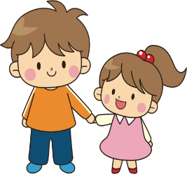
ê/è
fête
frère
[head]
collège
tête
être
[to be]
problème
Notes:
Timing: 2 minutes
Aim: To introduce SSC [ê/è]
Procedure:
1. Introduce and elicit the pronunciation of the individual SSC [ê/è] and then the source word again ‘tête’ (with gesture, if using). 2. Then present and elicit the pronunciation of the five cluster words.
The cluster words have been chosen for their high-frequency, from a range of word classes, with the SSC (where possible) positioned within a variety of syllables within the words (e.g. initial, 2nd, final etc.). Additionally, we have tried to use words that build cumulatively on previously taught SSCs (see the Phonics Teaching Sequence document) and do not include new SSCs. Where new SSCs are used, they are often consonants which have a similar symbol-sound correspondence in English.
Word frequency (1 is the most frequent word in French): fête [1490]; frère [1043] collège [2116]; problème [188]; être[5]; tête [343]. Source: Londsale, D., & Le Bras, Y. (2009). A Frequency Dictionary of French: Core vocabulary for learners London: Routledge.

Slide 30
ê/è
fête
frère
collège
tête
être
problème
Notes:
With sound and no pictures to focus all attention on the sound-symbol correspondence.

Slide 31
ê/è
fête
frère
collège
tête
être
problème
Notes:
Without sound to elicit pronunciation (without first hearing the teacher).
Teacher to elicit pronunciation by asking “Comment dit-on …"

Slide 32
Phonétique
Phonétique
écouter
These words look like English but are pronounced differently.
Écoute. C’est [è/ê] ou [é] ?
 | è/ê | é
suprême
poète
thé
forêt
héros
 | è/ê | é
conquête
égyptien
ministère
scène
intérêt
1
_
6
_
2
_
7
_
3
_
8
_
4
_
9
_
5
_
10
_
_
Notes:
Timing: 5 minutes
Aim: Aural recognition of [è/ê]. Contrast with [é] introduced in 1.1.5. Awareness-raising of the difference in pronunciation between various accents on the letter ‘e’.
Procedure:
Click on a number to hear the full word.
Students write 1-10 and [è/ê] or [é].
Answers revealed on clicks (first tick, then the gap in the word is filled).
Check meaning of the words. It might be interesting for students to guess which English letter is often replaced with the French letter ê in cognate words (s)
Transcript:
suprême
poète
thé
forêt
héros
conquête
égyptien
ministère
scène
intérêt
Word frequency (1 is the most frequent word in French): suprême [2022], poète [2307], thé [3517], forêt [1724], héros [1883], conquête [3177], égyptien [4137], ministère [910], scène [794], intérêt [315]
Source: Londsale, D., & Le Bras, Y. (2009). A Frequency Dictionary of French: Core vocabulary for learners London: Routledge.

Slide 33
Phonétique
Phonétique
parler
Say only the words containing SSC [è/ê].
A | honnête | théorie | système | émotion | créature
B | céréale | extrême | sincère | helicoptère | poète
A | égyptien | thé | mystère | épidémie | caractère
B | planète | créature | barrière | crème | émotion
A | helicoptère | sincère | kilomètre | carrière | céréale
B | épidémie | sphère | carrière | émotion | atmosphère
A | honnête | théorie | système | émotion | créature
B | céréale | extrême | sincère | hélicoptère | poète
A | égyptien | thé | mystère | épidémie | caractère
B | planète | créature | barrière | crème | émotion
A | hélicoptère | sincère | kilomètre | carrière | céréale
B | épidémie | sphère | carrière | émotion | atmosphère
Notes:
Timing: 5 minutes
Aim: To recognise and correctly pronounce unknown words containing [è/ê]. Awareness-raising of the difference in pronunciation between various accents on the letter ‘e’. Awareness raising of cross-linguistic pronunciation differences in near-cognate words. The words chosen contain sounds that are equivalent (or very similar) to English SSCs, as well as known SSCs, so that students can focus fully on [è/ê] (allowances are made for English pronunciation of [r], which is covered in year 8).
Procedure:
1. Students partner up and label themselves A and B.
2. They then treat the table as a script, but have to make sure they only pronounce the words containing SSC [è/ê]. By skipping over the words containing an [é], students learn to associate the grave accent and circumflex with a different set of sounds from the acute accent.
3. A challenge could be to get through the table as fast as possible without making a mistake.
4. Click to reveal the words students should have said in bold.
5. Click on the words with an [è/ê] to hear them pronounced by a native speaker. Students repeat.
6. Clarify meanings.
Transcript and word frequency (1 is the most frequent word in French): honnête [2405], théorie [1773], système [289], émotion [1854], créature [4407], céréale [4983], extrême [1270], sincère [3180], helicoptère [n/a], poète [2307], égyptien [4137], thé [3517], mystère [2777], épidémie [4203], caractère [927], planète [1875], barrière [2438], crème [4748], kilomètre [1435], carrière [1247], sphere [4209], atmosphère [2493]
Source: Londsale, D., & Le Bras, Y. (2009). A Frequency Dictionary of French: Core vocabulary for learners London: Routledge.

Slide 34
The verb ‘faire’ – to do/make
grammaire
SFC
To say you do / you make we use tu fais:
We have already learnt the following forms of the verbs faire:
je fais
tu fais
you do / make
I do / I make
il fait
he does / makes
elle fait
she does / makes
Stephen Owen
Notes:
Timing: 3 minutes
Aim: Introduction of second person singular form of ‘faire’.

Slide 35
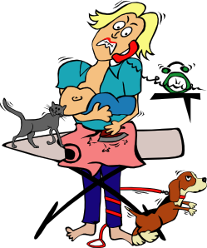
Vocabulaire
lire
Léa’s mum writes a ‘to do’ list for Léa’s dad, with tasks for him and for Léa. The list got torn.
Qui fait quoi ? Tu (papa) ou elle (Léa)?
tu (you)
elle (she)
fais les devoirs
A
B
C
D
E
F
G
H
fais le modèle
fait le ménage
fais la cuisine
fais un effort
fait le lit
fait une activité
fait les courses
Notes:
Timing: 5 minutes
Aim: Written recognition of second and third person forms of ‘faire’. Connecting these with meaning.
Procedure:
Students write 1-8 and tu or il. Remind them it is the form of faire that gives them this information.
2. Answers revealed on clicks.
3. Check meanings.
Word frequency of unknown near-cognates used in task activity (1 is the most frequent word in French): effort [388]
Source: Londsale, D., & Le Bras, Y. (2009). A Frequency Dictionary of French: Core vocabulary for learners London: Routledge.

Slide 36
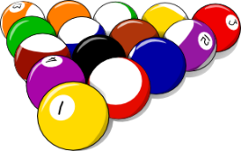
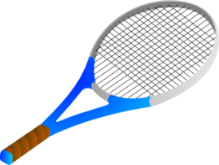
C’est une question ?
écouter
Léa’s dad is a bit confused! He checks his understanding of the to-do list.
Is he making a statement about these things, or asking a question? Write ‘?’ or ‘.’
.
?
?
.
?
.
1
2
3
4
5
6
Notes:
Timing: 5 minutes
Aim: To differentiate aurally between statements and intonation questions. Aural vocabulary recognition.
Procedure:
1. Click on a number to hear a question or statement. The sentences do not match the picture order, so students must use their vocabulary knowledge to decide where to write their answer. In their books, they can just write e.g. ‘1. bed, statement’
2. Elicit answers by pointing to a picture and asking ‘C’est une question ?’
3. Students reply with ‘oui’ or ‘non’.
Transcript:
1. Elle fait le lit.
2. Tu fais une activité ?
3. Tu fais les devoirs ?
4. Tu fais le ménage.
5. Elle fait la cuisine ?
6. Elle fait les courses.
Word frequency of unknown near-cognates used in task activity (1 is the most frequent word in French):
papa [2458], question [144]
Source: Londsale, D., & Le Bras, Y. (2009). A Frequency Dictionary of French: Core vocabulary for learners London: Routledge.

Slide 37
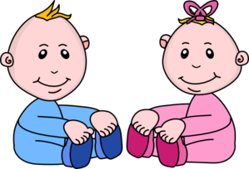
Vocabulaire
écrire
Use the picture prompts to write questions and answers. If mum does the task, write ‘elle…+ verb’. For dad, write ‘il…+ verb’.
?
?
?
Tu fais le lit?
Non! Il fait le lit.
Non! Elle fait la cuisine.
Tu fais la cuisine?
Non! Il fait les courses.
Tu fais les courses?
?
?
?
Non! Elle fait les devoirs.
Tu fais les devoirs?
Tu fais le ménage?
Non! Il fait le ménage.
Tu fais le modèle?
Non! Elle fait le modèle.
Notes:
Timing: 5 minutes
Aim: Written production of the second and third person singular forms of ‘faire’ together with this week’s vocabulary.
Procedure:
Students write the correct questions and answers into the speech bubbles to practise 2nd and 3rd person singular of faire.
Do the first one with students as a worked example to model the task.
Students have been taught yes/no questions. Elicit the meaning of the first question, if needed, as a reminder.

Slide 38
C’est qui ? C’est quoi ?
parler / écrire
Je fais les courses.
Notes:
Timing: 5 minutes for seven slides
Aim: Written or spoken consolidation of vocabulary and grammar learned this week.
Procedure:
Click to reveal an image representing a pronoun and an imagine representing an activity.
Students write or say the French.

Slide 39
C’est qui ? C’est quoi ?
parler / écrire
Elle fait les devoirs.

Slide 40
C’est qui ? C’est quoi ?
parler / écrire
Tu fais le ménage.

Slide 41
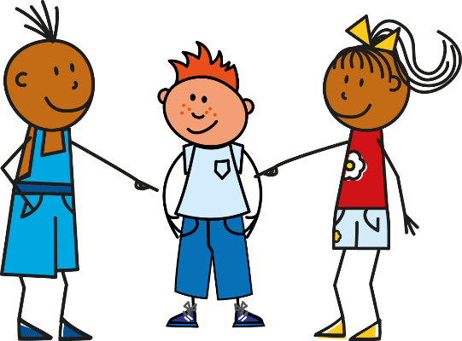
C’est qui ? C’est quoi ?
parler / écrire
Il fait une activité.

Slide 42
C’est qui ? C’est quoi ?
parler / écrire
Je fais la cuisine.

Slide 43
C’est qui ? C’est quoi ?
parler / écrire
Tu fais le modèle.

Slide 44
C’est qui ? C’est quoi ?
parler / écrire
Je fais le lit.

Slide 45
Qui fait quoi ? Partenaire A
parler / écouter / écrire
 | Tu fais … |  | Il/elle fait …
Work with a partner. Parle !
Answer their questions about what you are doing using oui and non.
Now find out what they are doing by asking Tu fais + noun ?
Now write 5 sentences describing what your partner is doing. Écris !
____
____
[activity]
[activity]
____
____
____
____
____
Notes:
Timing: 15 minutes
Aim: Oral/written production and aural comprehension of grammar and vocabulary learned this week.
Procedure:
1. Partner A faces the board. Partner B turns away from the board and looks at their grid (see next slide) on a separate screen (or, print grids for both students).
2. Partner B asks intonation questions about each item on the list. Partner A answers ‘oui’ or ‘non’. NB: the items appear in a different order on the two students’ lists so that students must listen closely to the vocabulary used.
3. Partner A asks intonation questions about each item on the list. Partner B answers ‘oui’ or ‘non’.
4. Peer-correction of answers.
5. Click to reveal the next task instruction. Students write sentences in the third person to describe what their partner is doing.

Slide 46
Qui fait quoi ? Partenaire B
parler / écouter / écrire
 | Il/elle fait … |  | Tu fais …
Work with a partner.
Find out what they are doing by asking Tu fais … + noun ?
Now answer their questions about what you are doing using oui and non.
Now write 5 sentences describing what your partner is doing. Écris !
____
____
____
____
____
____
[activity]
____
Notes:
This is partner B’s role card for the activity on the previous slide.

Slide 47
Gaming Grammar
Gaming Grammar
Relevant mini game(s):
Definite articles: Gender (Article Agreement)
Verbs (present): 1st person singular/plural (Verb agreement (present))
Verbs (present): 2nd person singular/plural (Verb agreement (present))
Verbs (present): 3rd person singular/plural (Verb agreement (present))
Notes:
This slide links to Gaming Grammar login screen. The appropriate mission can then be selected from the menu page.
Students will progress through the game at their own rate; teachers should use the teacher interface to check progress. This will help to inform future lesson planning.

Slide 48
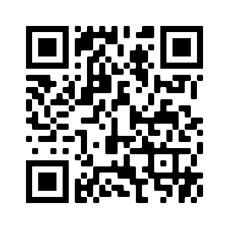
Devoirs
Vocabulary Learning Homework (Y7, Term 1.2, Week 1)
Audio file
Audio file QR code:
Student worksheet
Quizlet link
In addition, revisit: Term 1.1 Week 5

