Slide 1
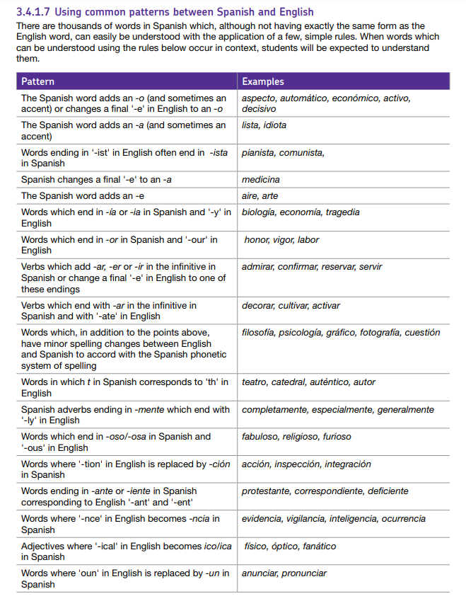
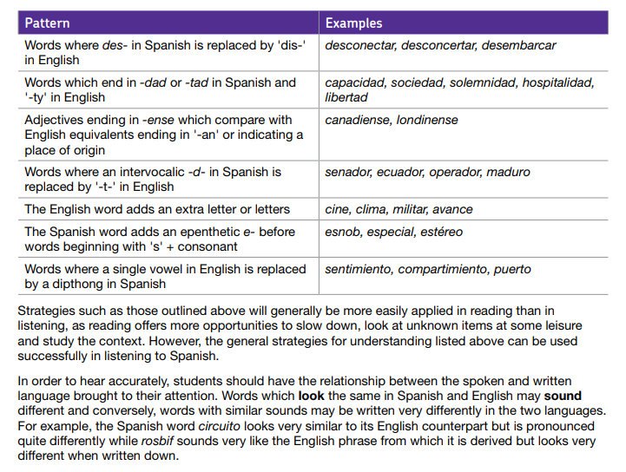
Common word patterns
“When words that can be understood using these rules occur in context, students will be expected to understand them.” AQA Specification section 3.4.1.17
Rachel Hawkes
Notes:
The following activities have been created using the common patterns between Spanish and English detailed in the AQA specification. The activities provide opportunities to: - make connections and understand patterns between Spanish and English - practise those links by translating Spanish → English and English → Spanish
- consolidate their SSC (phonics) knowledge by reading the words / sentences aloud - reinforce their knowledge of spelling and pronunciation rules (e.g. single vs double consonants in writing and syllable stress in speaking)

Slide 2
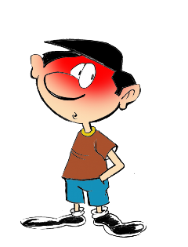
1
English → Spanish → English
-id at the end of the word often changes to -ido
The boy is timid
El chico es tímido
What would the following words be in Spanish?
solid
rapid
valid
Choose one and write a sentence in Spanish.
Translate these sentences.
1. El ácido es rojo.
2. The acid is a liquid.
Notice that you also add a tilde (accent) on the first vowel, i.e., tímido
Rachel Hawkes
Notes:
Working with Spanish-English words patterns
In this set, there are 11 patterns explored in this way, and a 12th task, which recaps all of the patterns met. The idea is that each pattern is given 10 minutes in tutor time (so NOT taking time out of L2 lessons!) each week, so that this set represents a term’s worth of activities. They are written so that non-linguist tutors can deliver them.
Word frequency: tímido [3607]; ácido [2932]; líquido [1382]; sólido [2420]; rápido [879]; válido [3114] Further words with the same pattern: estúpido [2596]; espléndido [3964]; rígido [3421]
Source: Davies, M. & Davies, K. (2018). A frequency dictionary of Spanish: Core vocabulary for learners (2nd ed.). London: Routledge.

Slide 3
1
ANSWERS
El ácido es rojo.
The acid is a liquid.
solid
rapid
valid
The acid is red.
El ácido es un líquido.
sólido
rápido
válido
Pronounce the words. Normally, you stress the penultimate syllable, but the ‘tilde’ tells you to stress a different syllable.
Rachel Hawkes

Slide 4
2
English → Spanish → English
-ous at the end of the word often changes to -oso
The singer is famous
El cantante es famoso
What would the following words be in Spanish?
numerous
precious
religioso
Choose one and write a sentence in Spanish.
Translate these sentences.
1. Mi hermanos es estudioso y ambicioso.
2. My dog is fabulous.
Rachel Hawkes
Notes:
Working with Spanish-English words patterns
In this set, there are 11 patterns explored in this way, and a 12th task, which recaps all of the patterns met. The idea is that each pattern is given 10 minutes in tutor time (so NOT taking time out of L2 lessons!) each week, so that this set represents a term’s worth of activities. They are written so that non-linguist tutors can deliver them.
Word frequency: famoso [997]; fabuloso [3676]; estudioso [>5000]; ambicioso [4991]; numeroso [1104]; precioso [1776]; religioso [821] Further words with the same pattern: generoso [3193] delicioso [3388]
Source: Davies, M. & Davies, K. (2018). A frequency dictionary of Spanish: Core vocabulary for learners (2nd ed.). London: Routledge.

Slide 5
2
ANSWERS
Mi hermano es estudioso y ambicioso.
My dog is fabulous.
numerous
precious
religious
My brother is studious and ambitious.
Mi perro es fabuloso.
numeroso
precioso
religioso
What minor spelling changes do you notice in no.1?
studious → estudioso/a
ambitious → ambicioso/a
Don’t forget to pronounce the words.
Rachel Hawkes

Slide 6
3
English → Spanish → English
-tion at the end of the word often changes to -ción
That is the exception to the rule.
Esa es la excepción a la regla.
Translate these sentences.
Me gusta la ficción.
Fiction with action is great!
What would the following words be in Spanish?
situation
education
information
Choose one and write a sentence in Spanish.
With abstract nouns in Spanish you usually need the definite article (word for ‘the’).
But good news! All –ción words are feminine so use la for the. (with = con)
Rachel Hawkes
Notes:
Working with Spanish-English words patterns
In this set, there are 11 patterns explored in this way, and a 12th task, which recaps all of the patterns met. The idea is that each pattern is given 10 minutes in tutor time (so NOT taking time out of L2 lessons!) each week, so that this set represents a term’s worth of activities. They are written so that non-linguist tutors can deliver them.
Word frequency: excepción [1935]; ficción [2916]; acción [404]; situación [285]; educación [490]; información [326]; Further words with the same pattern: relación [272] condición [418] población [454] (more changes in this one!); atención [489]; investigación [511] función [527] organización [531] producción [566]; comunicación [619]; dirección [646]; posición [667]; institución [697]; elección [754]; construcción [793]; nación [823]; solución [836]; formación [874]; generación [925]; creación [979]; conversación [989] For more like this that are within the most frequent 2000 words, see https://resources.ncelp.org/concern/resources/0c483j381?locale=en
Source: Davies, M. & Davies, K. (2018). A frequency dictionary of Spanish: Core vocabulary for learners (2nd ed.). London: Routledge.

Slide 7
3
ANSWERS
Me gusta la ficción.
Fiction with action is great!
situation
education
information
I like fiction.
La ficción con la acción es estupenda.
(la) situación
(la) educación
(la) información
Pronounce the words. Normally, you stress the penultimate syllable, but the ‘tilde’ tells you to stress the final syllable in these words.
Rachel Hawkes

Slide 8
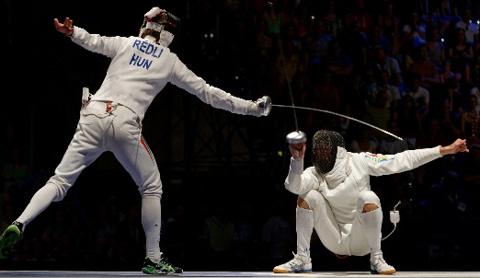
4
English → Spanish → English
-ary at the end of the word often changes to -ario
My adversary is very strong.
Mi adversario es muy fuerte.
What would the following words be in Spanish?
commentary
necessary
literary diary
Which of these are nouns and which are adjectives?
Translate these sentences.
Necesito un diccionario.
My dictionary is great.
Remember that in Spanish we ONLY double the consonants in CaRoLiNa, and no others!
© Marie-Lan Nguyen / Wikimedia Commons
Rachel Hawkes
Notes:
Working with Spanish-English words patterns
In this set, there are 11 patterns explored in this way, and a 12th task, which recaps all of the patterns met. The idea is that each pattern is given 10 minutes in tutor time (so NOT taking time out of L2 lessons!) each week, so that this set represents a term’s worth of activities. They are written so that non-linguist tutors can deliver them.
Word frequency: adversario [4660]; diccionario [3844]; necesario [362]; comentario [497] diario [966/1422] literario [1203] Further words with the same pattern: contrario [656] secretario [1315] extraordinario [1346] universitario [1369] escenario [1392] revolucionario [1727] solitario [2020] itinerario [>5000]; ordinario [3810]; vocabulario [>5000];
Source: Davies, M. & Davies, K. (2018). A frequency dictionary of Spanish: Core vocabulary for learners (2nd ed.). London: Routledge.

Slide 9
4
ANSWERS
Necesito un diccionario.
My dictionary is great.
comment/feedback
necessary
literary
diary
I need a dictionary.
Mi diccionario es estupendo.
(el) comentario
necesario
literario
(el) diario
Nouns: commentary, diary Adjectives: necessary, literary
Don’t forget to pronounce the words.
Rachel Hawkes

Slide 10
5
English → Spanish → English
-ph in a word often changes to -f
Elephants never forget.
Los elefantes nunca olvidan.
What would the following words be in Spanish?
telephone
photo
biography phrase
Choose one and write a sentence in Spanish.
Translate these sentences.
Me encanta la física.
La filosofía es bastante complicada.
This time you need to make other small changes at the end of words, too: e → o y → ía
Rachel Hawkes
Notes:
Working with Spanish-English words patterns
In this set, there are 11 patterns explored in this way, and a 12th task, which recaps all of the patterns met. The idea is that each pattern is given 10 minutes in tutor time (so NOT taking time out of L2 lessons!) each week, so that this set represents a term’s worth of activities. They are written so that non-linguist tutors can deliver them.
Word frequency: elefante [>5000]; física [>5000]; filosofía [1374]; teléfono [866] foto [882] frase [1036] biografía [4236] Further words in most frequent 2000 words with the same pattern: físico [702] fotografía [1350] fenómeno [1229] fase [1620] triunfo [1800] catástrofe [4329]
Source: Davies, M. & Davies, K. (2018). A frequency dictionary of Spanish: Core vocabulary for learners (2nd ed.). London: Routledge.

Slide 11
5
ANSWERS
Me encanta la física.
La filosofía es bastante complicada.
telephone
photo
biography
phrase
I love physics.
Philosophy is quite complicated.
(el) teléfono
(la) foto
(la) biografía
(la) frase
Pronounce the words. Normally, you stress the penultimate syllable, but the ‘tilde’ tells you to stress a different syllable.
Rachel Hawkes

Slide 12
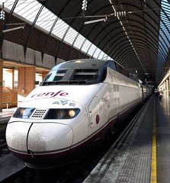
6
English → Spanish → English
-ty at the end of a word often changes to -dad
The AVE is a high-velocity train.
El AVE es un tren de alta velocidad.
What would the following words be in Spanish?
reality activity society
Choose one and write a sentence in Spanish.
Translate these sentences.
Cambridge es una ciudad muy histórica.
Cambridge has a famous university.
NB: All –dad words in Spanish are feminine, so use ‘la’ for ‘the’ and ‘una’ for ‘a’.
Rachel Hawkes
Notes:
Working with Spanish-English words patterns
In this set, there are 11 patterns explored in this way, and a 12th task, which recaps all of the patterns met. The idea is that each pattern is given 10 minutes in tutor time (so NOT taking time out of L2 lessons!) each week, so that this set represents a term’s worth of activities. They are written so that non-linguist tutors can deliver them.
Word frequency: velocidad [1142]; ciudad [178]; university [387]; realidad [260] actividad [344] sociedad [353] Further words in most frequent 2000 words with the same pattern: necesidad [431] cantidad [459] posibilidad [461] comunidad [523] seguridad [538] oportunidad [564] autoridad [569] capacidad [633] calidad [637] unidad [848] responsabilidad [915] actualidad [1291] entidad [1407] personalidad [1550] humanidad [1553] oscuridad [1625] identidad [1806]
Source: Davies, M. & Davies, K. (2018). A frequency dictionary of Spanish: Core vocabulary for learners (2nd ed.). London: Routledge.

Slide 13
6
ANSWERS
Cambridge es una ciudad muy histórica.
Cambridge has a famous university.
reality
activity
society
Cambridge is a very historic city.
Cambridge tiene una universidad famosa.
(la) realidad
(la) actividad
(la) sociedad
NB: All –dad words in Spanish are feminine, so use ‘la’ for ‘the’ and ‘una’ for ‘a’.
Rachel Hawkes

Slide 14
7
English → Spanish → English
-y at the end of a word often changes to –ia or -ía
Macbeth is a tragedy in five acts.
Macbeth es una tragedia en cinco actos.
What would the following words be in Spanish?
memory company energy
Choose one and write a sentence in Spanish.
Translate these sentences.
1. La historia es fascinante. 2. I like biology.
Remember that in Spanish we ONLY double the consonants in CaRoLiNa, and no others!
Rachel Hawkes
Notes:
Working with Spanish-English words patterns
In this set, there are 11 patterns explored in this way, and a 12th task, which recaps all of the patterns met. The idea is that each pattern is given 10 minutes in tutor time (so NOT taking time out of L2 lessons!) each week, so that this set represents a term’s worth of activities. They are written so that non-linguist tutors can deliver them.
Word frequency: tragedia [2371]; biología [3982]; historia [186]; memoria [827]; compañía [638] energía [664] Further words in most frequent 2000 words with the same pattern: industria [1016] victoria [1266] tendencia [1287] frecuencia [1309] estrategia [1460] democracia [1484] agencia [1834] gloria [1915] economía [747] teoría [851] tecnología [1048] fotografía [1350] filosofía [1374] categoría [1470] galería [2330]
Source: Davies, M. & Davies, K. (2018). A frequency dictionary of Spanish: Core vocabulary for learners (2nd ed.). London: Routledge.

Slide 15
7
ANSWERS
La historia es fascinante.
I like biology.
memory
company
energy
History is fascinating.
Me gusta la biología.
(la) memoria
(la) compañía
(la) energía
Pronunciation! Usually, stress the penultimate syllable. When the word ends in –ía, stress the í because of the ‘tilde’. → la biología but la historia.
Rachel Hawkes

Slide 16
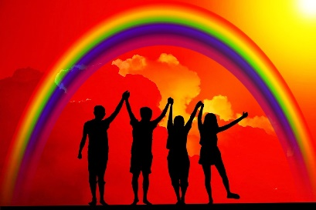
8
English → Spanish → English
-ence or -ance at the end of a word often changes to -encia or -ancia.
Tolerance stops violence.
La tolerancia detiene la violencia.
What would the following words be in Spanish?
independence importance distance
Choose one and write a sentence in Spanish.
Translate these sentences.
1. Disneyworld es una experiencia fantástica. 2. In my opinion, intelligence is not very important.
NB: Remember that we usually need the definite article (the) with abstract nouns in Spanish.
Rachel Hawkes
Notes:
Working with Spanish-English words patterns
In this set, there are 11 patterns explored in this way, and a 12th task, which recaps all of the patterns met. The idea is that each pattern is given 10 minutes in tutor time (so NOT taking time out of L2 lessons!) each week, so that this set represents a term’s worth of activities. They are written so that non-linguist tutors can deliver them.
Word frequency: tolerancia [4396]; violencia [1100] experiencia [416]; inteligencia [1721]; importancia [662]; independencia [1690] distancia [944] Further words in most frequent 2000 words with the same pattern: existencia [953] influencia [990] referencia [1335] competencia [1410] conferencia [1594] ausencia [1618] resistencia [1767] evidencia [2175]circunstancia [1137] diferencia [533] presencia [615] ciencia [738] consecuencia [773] conciencia [946] sustancia [1876]
Source: Davies, M. & Davies, K. (2018). A frequency dictionary of Spanish: Core vocabulary for learners (2nd ed.). London: Routledge.

Slide 17
8
ANSWERS
Disneyworld es una experiencia fantástica.
In my opinion, intelligence is not very important.
independence
importance
distance
Disneyworld is a fantastic experience.
En mi opinión, la inteligencia no es muy importante.
(la) independencia
(la) importancia
(la) distancia
NB: Remember that we usually need the definite article (the) with abstract nouns in Spanish.
Rachel Hawkes

Slide 18
9
English → Spanish → English
-ate at the end of a VERB often changes to -ar.
What is that? I want to investigate!
¿Qué es eso? ¡Quiero investigar…!
What would the following words be in Spanish?
indicate participate communicate celebrate
Choose two and write a sentence in Spanish.
Translate these sentences.
1. Quiero crear un dibujo. 2. A veces es difícil motivarme.
Remember that in Spanish we ONLY double the consonants in CaRoLiNa, and no others!
Rachel Hawkes
Notes:
Working with Spanish-English words patterns
In this set, there are 11 patterns explored in this way, and a 12th task, which recaps all of the patterns met. The idea is that each pattern is given 10 minutes in tutor time (so NOT taking time out of L2 lessons!) each week, so that this set represents a term’s worth of activities. They are written so that non-linguist tutors can deliver them.
Word frequency: investigar [1571]; crear [239] motivar [2752]; indicar [526]; comunicar [1275]; participar [593] celebrar [886] Further words in most frequent 2000 words with the same pattern: demostrar [563] facilitar [1666] separar [805] calcular [1947] estimar [1754] integrar [1305] eliminar [1263] incorporar [1249] contemplar [1108] orientar [635] obligar [658] liberar [1968]
Source: Davies, M. & Davies, K. (2018). A frequency dictionary of Spanish: Core vocabulary for learners (2nd ed.). London: Routledge.

Slide 19
9
ANSWERS
Quiero crear un dibujo.
A veces es difícil motivarme.
indicate
participate
communicate
celebrate
I want to create a picture.
Sometimes it’s difficult to motivate myself.
indicar
participar
comunicar
celebrar
Did you write ‘comunicar’ with double ‘m’? What rule do you know for double consonants in Spanish?
Rachel Hawkes

Slide 20
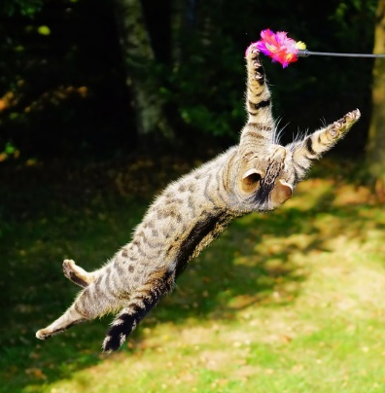
10
English → Spanish → English
-ic at the end of an ADJECTIVE often changes to -ico.
This cat is very acrobatic!
¡Este gato es muy acrobático!
What would the following words be in Spanish?
public historic economic
Choose one and write a sentence in Spanish.
Translate these sentences.
1. Inglaterra es un país democrático. 2. My pet is very artistic.
Remember that Spanish adjectives agree for number and gender in their ending!
You usually need to add a ‘tilde’ as well!
Rachel Hawkes
Notes:
Working with Spanish-English words patterns
In this set, there are 11 patterns explored in this way, and a 12th task, which recaps all of the patterns met. The idea is that each pattern is given 10 minutes in tutor time (so NOT taking time out of L2 lessons!) each week, so that this set represents a term’s worth of activities. They are written so that non-linguist tutors can deliver them.
Word frequency: investigar [1571]; acrobático [>5000] democrático [1637]; artístico [1402] económico [312]; público [329]; histórico [830] Further words in most frequent 2000 words with the same pattern: electrónico [1619] científico [1067] clásico [1078] básico [1156] católico [1362] especíico [1394] eléctrico [1411] auténtico [1737] crítico (noun) [1868] plástico [1962] mágico [2518] romántico [2698] académico [2124]
Source: Davies, M. & Davies, K. (2018). A frequency dictionary of Spanish: Core vocabulary for learners (2nd ed.). London: Routledge.

Slide 21
10
ANSWERS
Inglaterra es un país democrático.
My pet is very artistic.
public
historic
economic
England is a democratic country.
Mi mascota/animal es muy artística/o.
público
histórico
económico
Did you add a ‘tilde’ in the right place? Try pronouncing the words. Which syllable do you stress?
Rachel Hawkes

Slide 22
11
English → Spanish → English
-ly at the end of an ADVERB often changes to -mente.
Normally I don’t have my hair like this!
¡Normalmente no tengo el pelo así!
What would the following words be in Spanish?
really totally finally directly exactly Choose one and write a sentence in Spanish.
Translate these sentences.
1. Me encanta la fruta, especialmente las naranjas. 2. Generally I don’t play rugby.
The last two on the list need an extra ‘a’ in the middle, too.
Rachel Hawkes
Notes:
Working with Spanish-English words patterns
In this set, there are 11 patterns explored in this way, and a 12th task, which recaps all of the patterns met. The idea is that each pattern is given 10 minutes in tutor time (so NOT taking time out of L2 lessons!) each week, so that this set represents a term’s worth of activities. They are written so that non-linguist tutors can deliver them.
Word frequency: normalmente [1696]; especialmente [757] generalmente[1387]; realmente [382] totalmente [839]; finalmente [948]; directamente [1193] exactamente [1082] Further words in most frequent 2000 words with the same pattern: correctamente [4173] prácticamente [1131] probablemente [1339] completamente [1185] inmediatamente [1469] absolutamente [1480] aproximadamente [1502] rápidamente [1509] perfectamente [1561] naturalmente [1832] lentamente [1843] evidentemente [1974] principalmente [1657]
Source: Davies, M. & Davies, K. (2018). A frequency dictionary of Spanish: Core vocabulary for learners (2nd ed.). London: Routledge.

Slide 23
11
ANSWERS
Me encanta la fruta, especialmente las naranjas.
Generally I don’t play rugby.
really
totally
finally
directly
exactly
I love fruit, especially oranges.
Generalmente no juego al rugby.
realmente
totalmente
finalmente
directamente
exactamente
Try pronouncing all the words.
Rachel Hawkes

Slide 24
12
Here is a selection of words with the word patterns you have seen this term:
secretario
físico
demostrar
cantidad
delicioso
estúpido
científico
contrario
existencia
separar
fenómeno
generoso
industria
necesidad
relación
influencia
básico
condición
categoría
espléndido
Work out the meaning. Pronounce the words. Choose two words and write sentences in Spanish.
Notes:
All words are within the 2000 most frequently occurring words in Spanish. Source: Davies, M. & Davies, K. (2018). A frequency dictionary of Spanish: Core vocabulary for learners (2nd ed.). London: Routledge.

Slide 25
12
ANSWERS
cognate pattern | Spanish word 1 | English | Spanish word 2 | English
id → ido | estúpido |  | espléndido
ous → oso | delicioso |  | generoso
tion → ción | relación |  | condición
ary → ario | contrario |  | secretario
ph → f | físico |  | fenómeno
ty → dad | necesidad |  | cantidad
y → ia / ía | industria |  | categoría
ence/ance → encia / ancia | existencia |  | influencia
ate → ar | separar |  | demostrar
ic → ico | científico |  | básico
stupid
splendid
delicious
generous
relationship
condition
contrary
secretary
physical
phenomenon
necessity
quantity
industry
category
existence
influence
separate
demonstrate
scientific
basic

