Slide 1
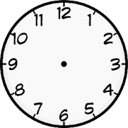
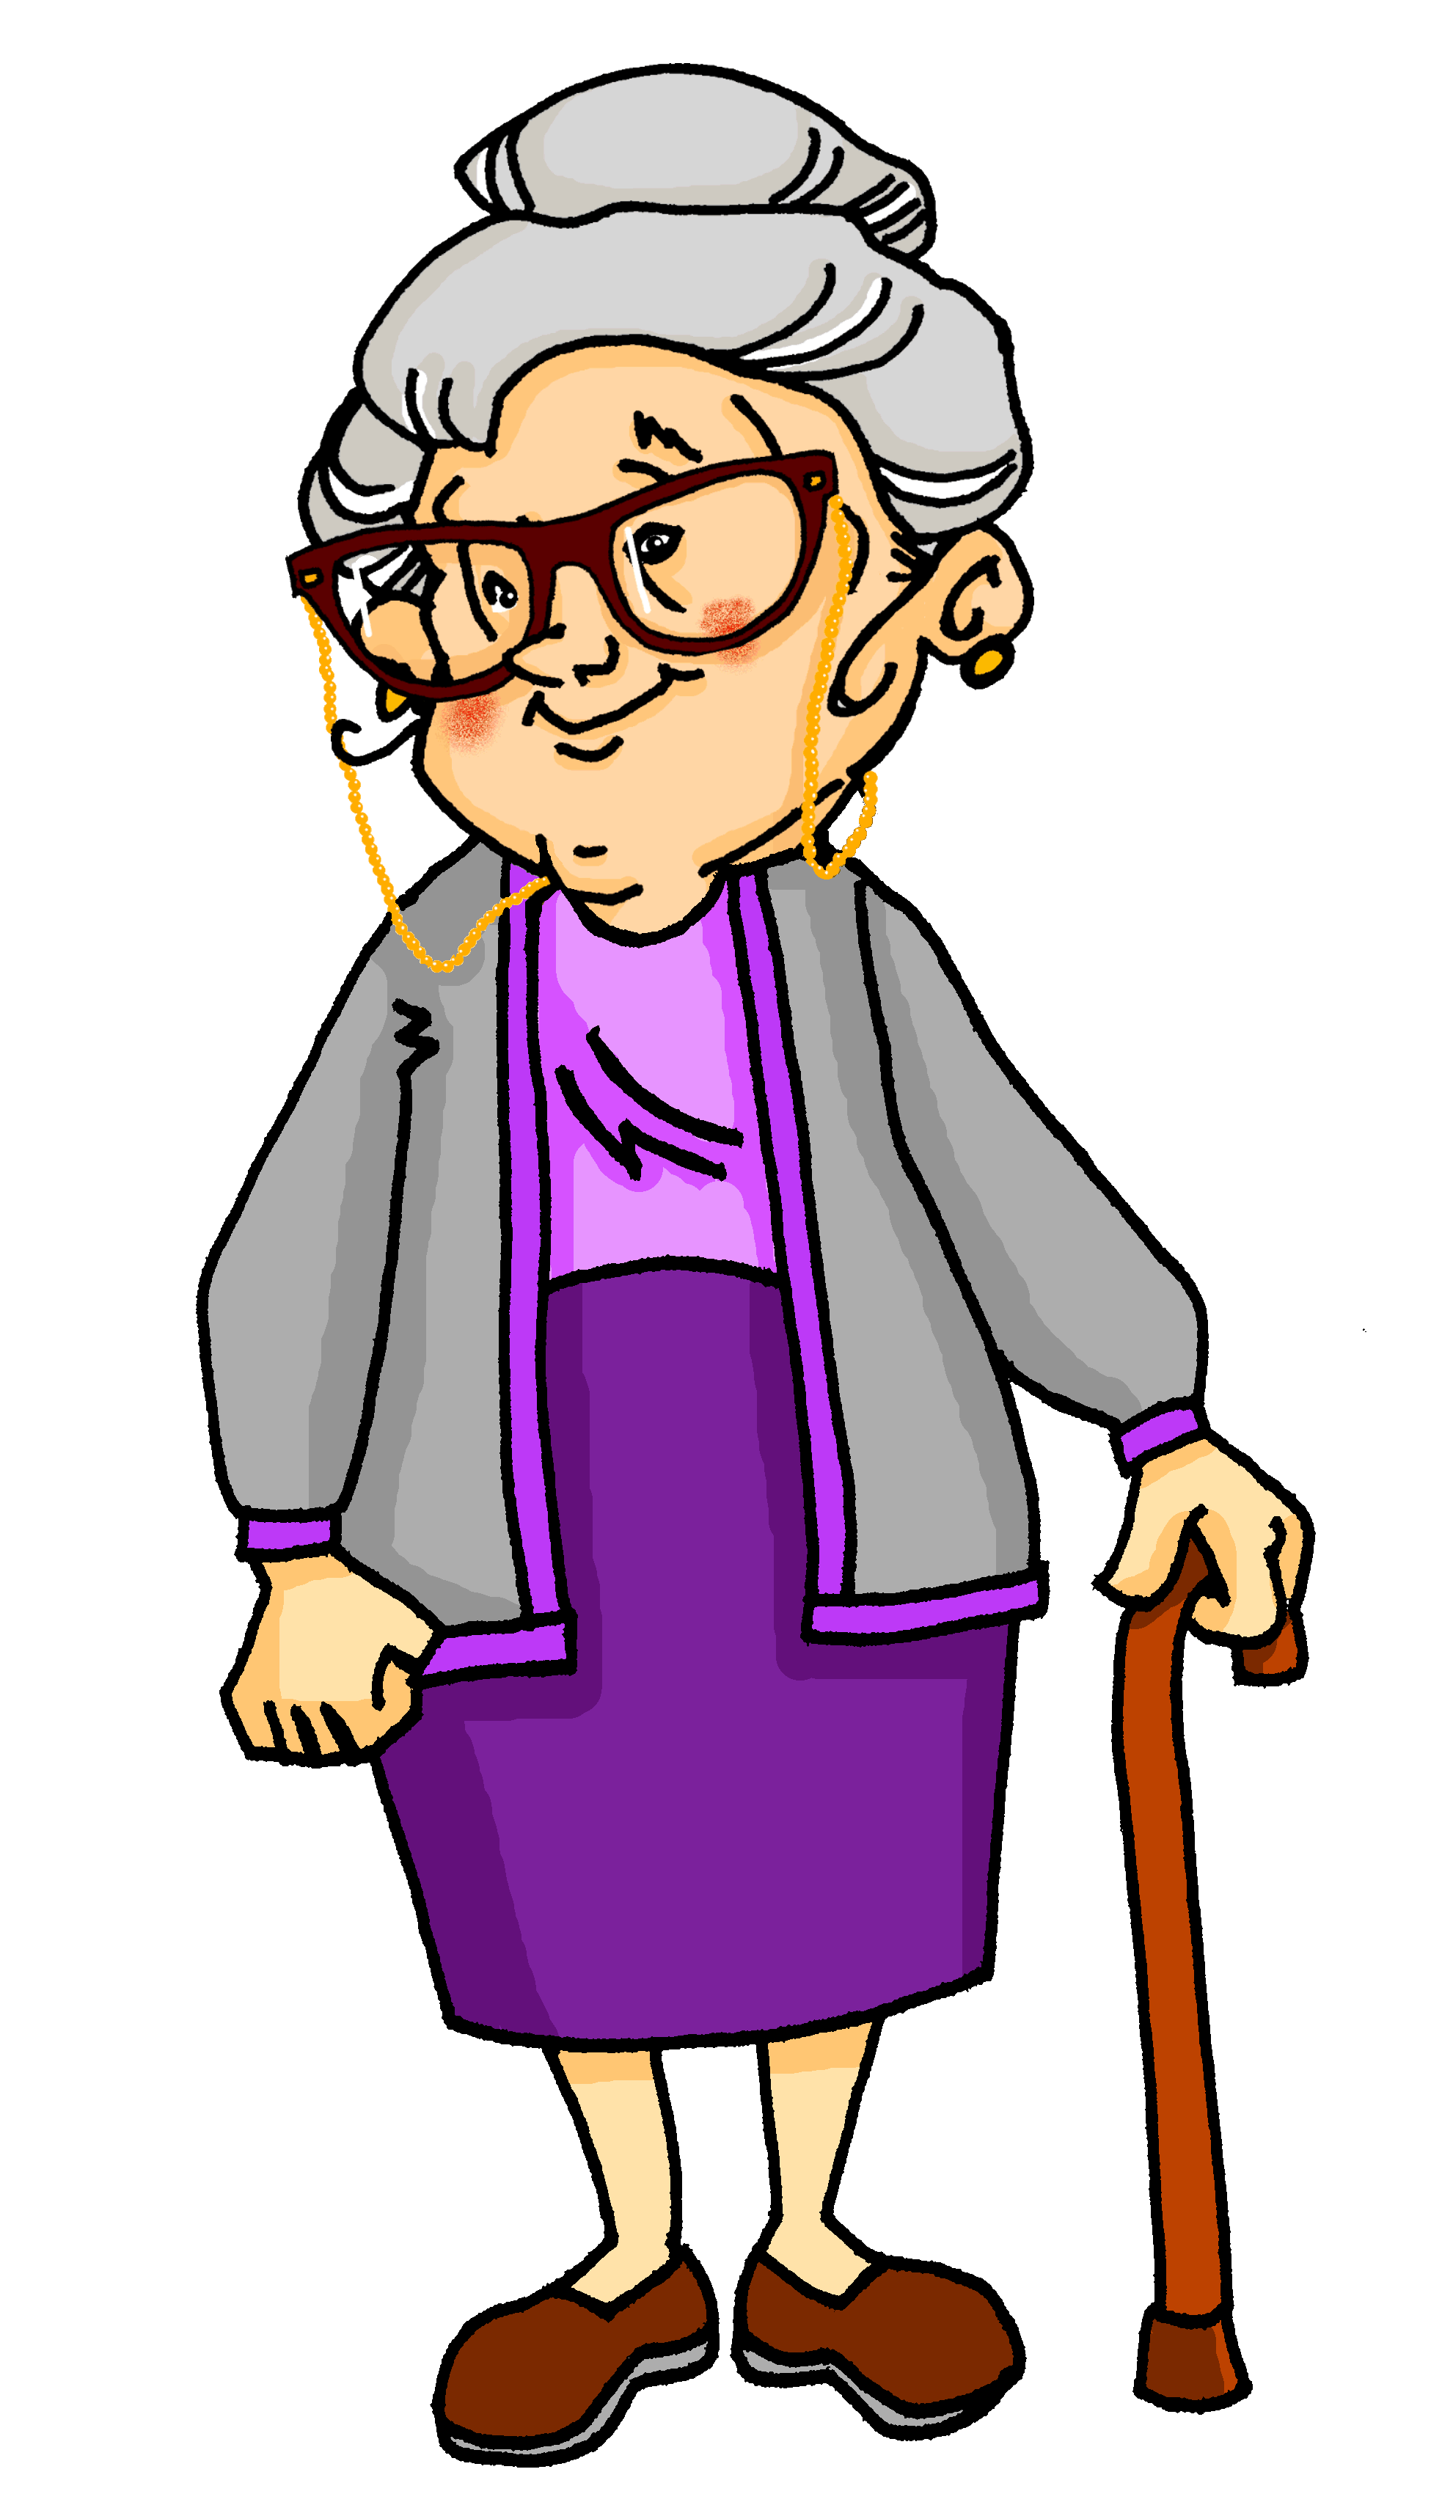
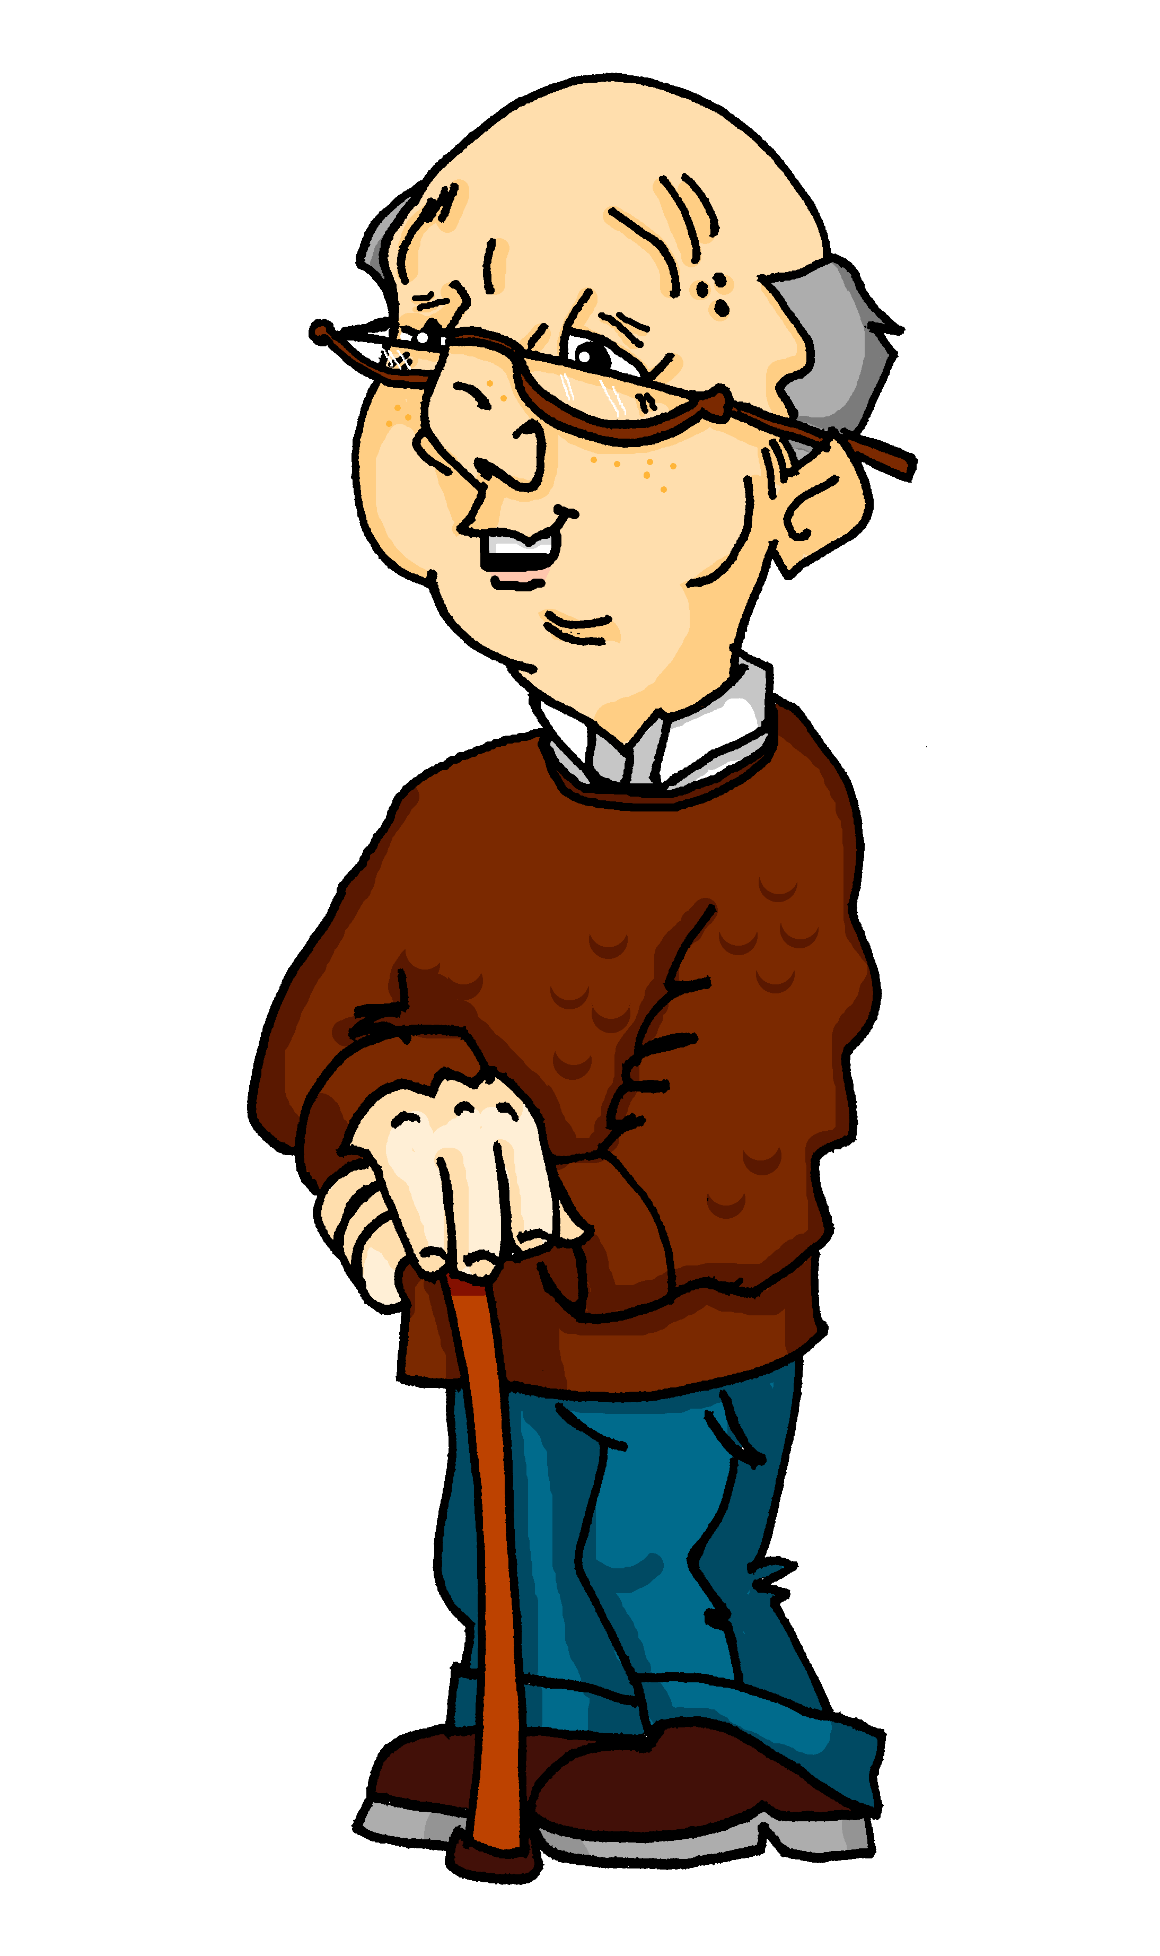
Partner(in) A
bought a present
did an art course
ate cake
took photos
drank tea
caught a fish
went to café
went to beach
Partner(in) B
did a yoga course
drank coffee
went to beach
went to cinema
went to café
ate cake
bought trousers
took photos

