Slide 1
Activity and timing: what you did when
Revisit (past) perfect tense Telling time: half past the hour
SSC [y]
Y8 German
Term 3.2 - Week 1 - Lesson 61
Author name(s): Heike Krüsemann / Rachel Hawkes
Artwork: Steve Clarke
Date updated: 21/07/21
Notes:
Artwork by Steve Clarke. All additional pictures selected are available under a Creative Commons license, no attribution required.
Native-speaker teacher feedback provided by Stephanie Cross.
Learning outcomes (lesson 1):
Introduction of SSC [y]
Revisit ways to say you: du, Sie, man Revisit perfect tense with sein and haben Introduction to half past the hour
Word frequency (1 is the most frequent word in German):
8.3.2.1 (introduce) bringen [153] gebracht [153] verlieren [313] verloren [313] Insel [1029] Meer [852] Reise [734] Wind [1124] halb [443] stark [178] nach² [34]
8.3.1.4 (revisit) planen [579] werden [8] wirst [8] wird [8] Ausflug [4014] Boot [2109] Essen² [323] Eintritt [4102] Karte² [1191]Kurs [1549] Preis² [334] bald [503] vielleicht [145]
8.2.2.2 (revisit) annehmen [523] anschauen [949] aufhören [995] aufstehen [966] aussehen [277] fangen [2044] rufen [531] schauen [510] Preis¹ [334]
Source: Jones, R.L & Tschirner, E. (2019). A frequency dictionary of German: Core vocabulary for learners. London: Routledge.
The frequency rankings for words that occur in this PowerPoint which have been previously introduced in NCELP resources are given in the NCELP SOW and in the resources that first introduced and formally re-visited those words.
For any other words that occur incidentally in this PowerPoint, frequency rankings will be provided in the notes field wherever possible.

Slide 2
y
Sounds the same as long or short [ü]
typisch
Notes:
Timing: 1 minute
Aim: To introduce SSC [y]
Procedure: 1. Present the letter(s) and say the [y] sound first, on its own. Students repeat it with you. Tell students it is the same as the long or short [ü] in German. 2. Bring up the word ”typisch” on its own, say it, students repeat it, so that they have the opportunity to focus all of their attention on the connection between the written word and its sound. Ensure that students understand the meaning ‘typical’ or ‘typically’ i.e. drinking tea is typically English.
3. A possible gesture for this would be to mime drinking tea.
4. Roll back the animations and work through 1-3 again, but this time, dropping your voice completely to listen carefully to the students saying the [y] sound, pronouncing ”typisch” and, if using, doing the gesture. Word frequency (1 is the most frequent word in German): typisch [1109] Source: Jones, R.L & Tschirner, E. (2019). A frequency dictionary of German: Core vocabulary for learners. London: Routledge.

Slide 3
y
typisch
Notes:
Without sound to elicit pronunciation (without first hearing the teacher).
Teacher to elicit pronunciation by asking “Wie sagt man…”

Slide 4
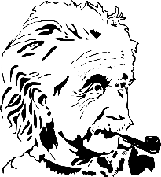
y
Physik
Rhythmus
typisch
1 2& 3& 4
olympisch
System
Typ
[system]
[type]
Notes:
Timing: 3 minutes
Aim: To introduce SSC [y] – pronounced as long or short [ü]
Procedure:
Introduce and elicit the pronunciation of the individual SSC [y] and then the source word again ‘typisch’ (with gesture, if using).
Typisch/typical is a problematic concept – you may want to briefly discuss this with students. To avoid unhelpful German stereotyping, a common stereotype of British culture is used: a cup of tea. You could problematise this as ‘although not everyone in the UK drinks tea, many people around the world associate a cup of tea with British culture’, etc. The cup of tea has the advantage that it also works well as a gesture (pick up imaginary cup of tea with thumb and forefinger lifting and tilting it towards your mouth, little finger pointing away in ‘mock-posh gesture’).
Then present and elicit the pronunciation of the five cluster words.
The cluster words have been chosen for their high-frequency, from a range of word classes, with the SSC (where possible) positioned within a variety of syllables within the words (e.g. initial, 2nd, final etc.). Additionally, we have tried to use words that build cumulatively on previously taught SSCs (see the Phonics Teaching Sequence document) and do not include new SSCs. Where new SSCs are used, they are often consonants which have a similar symbol-sound correspondence in English.
Word frequency (1 is the most frequent word in German): typisch [1109] Physik [1917] Rhythmus [3823] System [384] Typ (type) [907]
Source: Jones, R.L. & Tschirner, E. (2019). A frequency dictionary of German: core vocabulary for learners. Routledge

Slide 5
y
Physik
Rhythmus
typisch
1 2& 3& 4
olympisch
System
Typ
[system]
[type]
Notes:
Without sound to elicit pronunciation (without first hearing the teacher).
Teacher to elicit pronunciation by asking “Wie sagt man…”

Slide 6
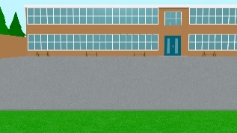
Phonetik
Hör zu. Wie sagt man das? Wie im Deutschen oder im Englischen? Schreib 1-8 und Deutsch oder Englisch.
hören
 | Handy
 | analytisch
 | symbolisch
 | Yeti
 | Hey
 | Physik
 | Party
 | Gymnasium
As you have seen, German [y] is usually pronounced the same as long or short [ü]. However, for words that come from English, initial or final [y] is often pronounced as in English, e.g., das Baby.
1
2
3
4
5
6
7
8
Gymnasium ist ein falscher Freund!
das Gymnasium = grammar school
Notes:
Timing: 5 minutes Aim: To distinguish between German and English [y]. Procedure: 1. Click sound button, students transcribe word and tick whether they hear German or English [y]. Note: lower proficiency students can just decide whether they hear German or English. Alternatively teachers can tweak the slide to provide parts of each word, as desired.
2. Click to reveal transcribed word and tick.
Transcript:
Handy
analytisch
symbolisch
Yeti
Hey
Physik
Party
Gymnasium
Word frequency (1 is the most frequent word in German): Baby [2297] analytisch [2986] Gymnasium [3081] Hey [1143] symbolisch [3913] Yeti [>5009] Source: Jones, R.L. & Tschirner, E. (2019). A frequency dictionary of German: core vocabulary for learners. Routledge

Slide 7
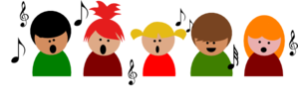
Phonetik [1/3]
Sag die Wörter. Ist die SSC [y] wie oder ?
lesen / sprechen
10
Sekunden
die City
die Hymne
das Baby
0
LOS!
Notes:
Timing: 1 minute (for three slides) Aim: Practise [y] SSC Procedure: 1. Chorally, students read out the words, paying attention to the two different pronunciations of [y]. 2. The timer is just to provide a clean start, and an approximate time to say 3 x words. 3. Click on either the word or the picture to hear the word pronounced. Note: as practised in the previous activity, although all these words are cognates or near-cognates with English, it is the initial or final [y] that is pronounced as in English.
Word frequency of unknown or cognate words (1 is the most frequent word in German):
City [2163] Hymne [>5009] Baby [2297] Source: Jones, R.L. & Tschirner, E. (2019). A frequency dictionary of German: core vocabulary for learners. Routledge

Slide 8
Phonetik [2/3]
Sag die Wörter. Ist die SSC [y] wie oder ?
lesen / sprechen
10
Sekunden
das Symbol
Yoga
olympisch
0
LOS!
Notes:
Word frequency of unknown or cognate words (1 is the most frequent word in German):
Symbol [2570] Yoga [>5009] olympisch [2469] Source: Jones, R.L. & Tschirner, E. (2019). A frequency dictionary of German: core vocabulary for learners. Routledge

Slide 9
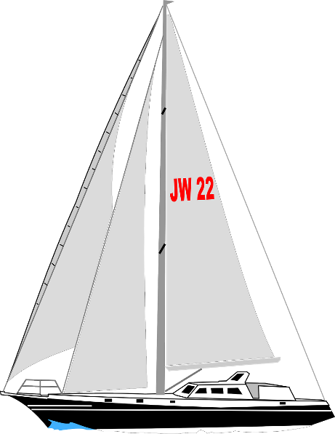
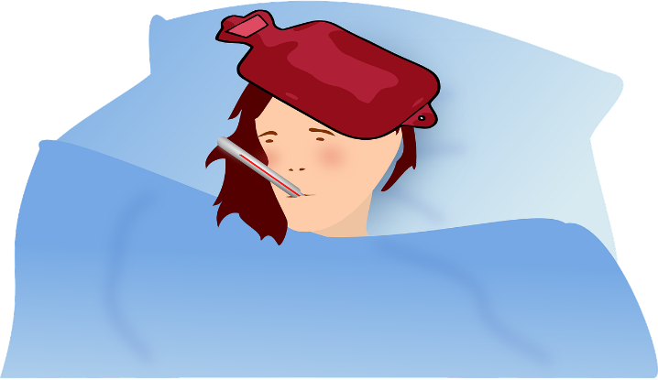
Phonetik [3/3]
Sag die Wörter. Ist die SSC [y] wie oder ?
lesen / sprechen
10
Sekunden
das Symptom
physikalisch
die Yacht
0
LOS!
Notes:
Word frequency of unknown or cognate words (1 is the most frequent word in German):
Symptom [2570] physikalisch [1164] Yacht [>5009] Source: Jones, R.L. & Tschirner, E. (2019). A frequency dictionary of German: core vocabulary for learners. Routledge

Slide 10
English → German
Remember! Words ending in –ic or -ical
often change to -isch in German.
A cup of tea is typical.
Eine Tasse Tee ist typisch.
English
German
dynamic
dynamisch
1.
2.
3.
4.
systematic
systematisch
analytical
analytisch
symbolic
symbolisch
Notes:
Timing: 2 minutes
Note: Students were introduced to this pattern in 8.2.1.6.
Aim: To develop knowledge of word patterns within German, using examples with the new [y] SSC.
Procedure: 1. Click to present the pattern and examples.
2. Elicit the German –isch ending from the English –ic or –ical. 3. Repeat the pronunciation of all four German words again, paying particular attention to the [y].
Word frequency: typisch [1109] dynamisch [3302] systematisch [2170] analytisch [2986] symbolisch [3913]
Source: Jones, R.L. & Tschirner, E. (2019). A frequency dictionary of German: core vocabulary for learners. Routledge

Slide 11
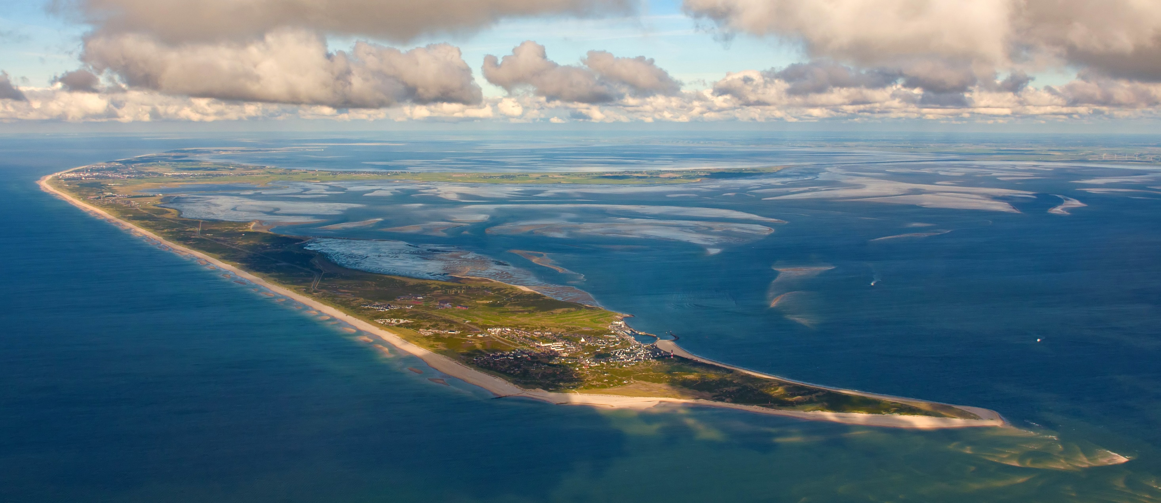
Opa und Oma auf Sylt
Wo ist das? In der Karibik? Im Pazifik?
lesen
Note: der See = lake das Meer = sea but … die See = sea
__
__
__ ____
__
Sylt ist eine Insel an der Nordseeküste.
Sie ist für den 40 Kilometer langen Weststrand bekannt.
By Ralf Roletschek - Own work, CC BY-SA 3.0
Notes:
By Ralf Roletschek - Own work, CC BY-SA 3.0, https://commons.wikimedia.org/w/index.php?curid=28817842 Timing: 1 minute Aim: to set the context for the lesson, and provide one more word with the SSC [y], the name of the island Sylt. Procedure: 1. Ensure that students understand Mia’s questions.
2. Click to present the information about Sylt.
3. Elicit an oral translation in English for the two sentences. Students know Nord and See (but as lake). They also know West and Strand, but still may need support to unpack the compound nouns.
4. Present and elicit the information about the difference between der See, das Meer and die See. 5. Ensure that students know that Sylt is where Opa and Oma are.
Word frequency of unknown words and cognates (1 is the most frequent word in German): Karibik [>5009] Pazifik [>5009] Küste [2628] See [1317] (Students know der See = lake)
Source: Jones, R.L. & Tschirner, E. (2019). A frequency dictionary of German: core vocabulary for learners. Routledge

Slide 12
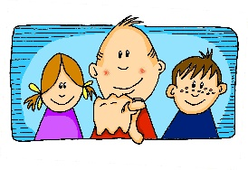
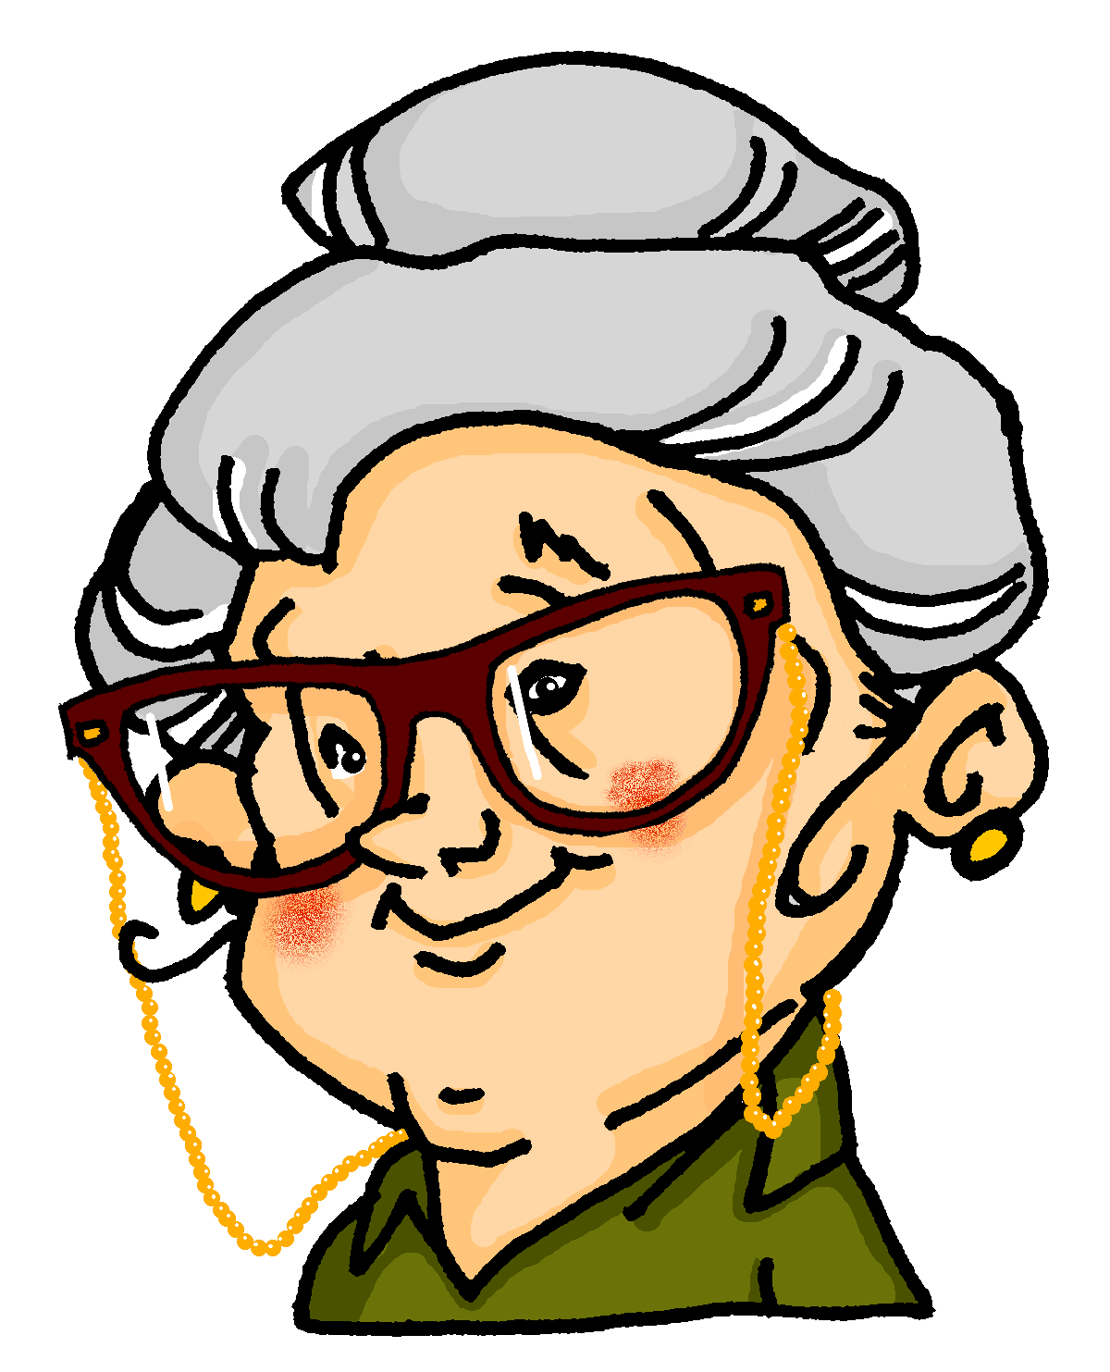
Pronomen - du, Sie, man
Grammatik
You have already met three words for you in German:
Ja!
Perfect tense with haben
Perfect tense with sein
Du bist noch nicht nach Schottland gefahren. ☹
du
Du hast mir sehr geholfen, Mia!
__
___
Frau Meyer, Sie haben auch viel für mich gemacht!
_____
Sie sind schon nach Sylt gefahren, nicht wahr?
Sie
___
Man hat dieses Jahr viel Wind auf Sylt erlebt!
Man ist diesen Sommer nicht so oft an den Strand gegangen.
man
__
_
Remember! der Mann = man man = one, you, people in general
Man is always singular, even when it means people. Use it with the same verb form as er, sie, es.
Notes:
Timing: 2 minutes Aim: to recap the three forms of ‘you’ that students have been taught, and to remind them of the matching forms of haben and sein, used in the perfect tense. Procedure: 1. Click through the animations.
2. Elicit an oral explanation from students about when to use ‘du’ (you, singular, informal – someone you know) and ‘Sie’ (you, singular/plural, formal – someone older that you don’t know (well).
3. Elicit also the appropriate parts of haben and sein that go with these persons of the verb.

Slide 13
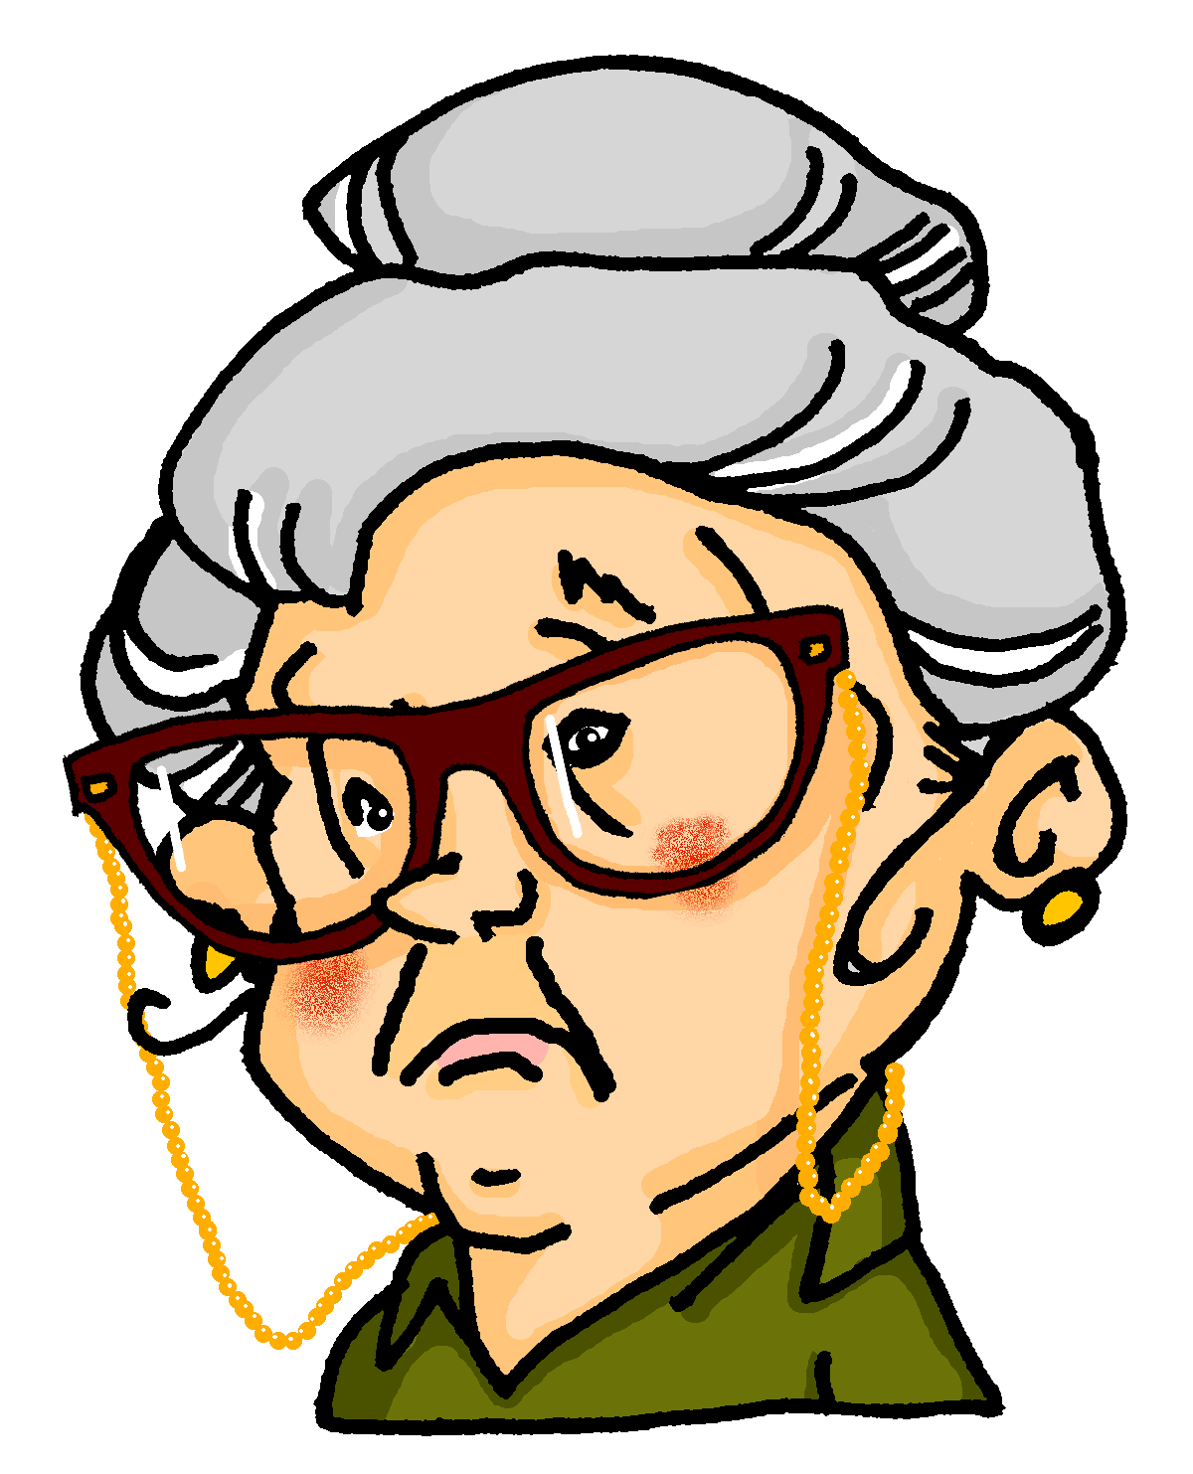
Mia und Andrea reden mit Oma
hören
Hör zu. Wer fragt Oma was? Schreib 1-8 und Mia, Andrea oder ?
 |  | Mia | Andrea | ?
 | Was ist los? Haben Sie etwas verloren?
 | Wie war die Reise? Was haben Sie schon gemacht?
 | Hast du die Bootsfahrt auf dem Meer gemacht?
 | Was haben Sie zum Ausflug mitgenommen?
 | Wie hat man den Ausflug organisiert?
 | Wie lange bist du mit dem Boot gefahren?
 | Sind Sie schon essen gegangen?
 | Kannst du mir bitte etwas von Sylt mitbringen?
Was ist los? – What’s up?
1
2
3
4
5
6
7
8
Notes:
Timing: 8 minutes Aim: To differentiate aurally between hast, hat, haben and bist, ist, sind and connect the auxiliary verb forms with the correct meaning of you. Procedure: 1. Ensure that students understand that Mia addresses her Oma as du, but Andrea uses Sie to address her. The ? is for questions using man, which could be asked by either Mia or Andrea.
2. Click to play each sentence.
3. Students listen out for the part of haben or sein that indicates who is asking Oma the question. Note: the final sentence uses a present modal kannst.
4. Click to bring up the ticks.
5. Click each tick to hear the full sentence. 6. Students transcribe the full sentence in German. 7. Click to reveal the sentences and elicit the English meanings.
Transcript: 1. Was ist los? Haben [Sie] etwas verloren? 2. Wie war die Reise? Was haben [Sie] schon gemacht? 3. Hast [du] die Bootsfahrt auf dem Meer gemacht? 4. Was haben [Sie] zum Ausflug mitgenommen? 5. Wie hat [man] den Ausflug organisiert? 6. Wie lange bist [du] mit dem Boot gefahren? 7. Sind [Sie] schon essen gegangen? 8. Kannst [du] mir bitte etwas von Sylt mitbringen? English translations: 1. What’s up / What’s the matter? Have you lost something? 2. How was the trip? What have you done already? 3. Did you do the boat trip on the sea? 4. What did you take with you for the trip? 5. How did people/they organise the trip? / How was the trip organised? 6. How long did go out on the boat for? 7. Have you already been out to eat? 8. Can you please bring me something from Sylt?
Answers:
Andrea
Andrea
Mia
Andrea
?
Mia
Andrea
Mia Word frequency of unknown words and cognates (1 is the most frequent word in German): los [659] Source: Jones, R.L. & Tschirner, E. (2019). A frequency dictionary of German: core vocabulary for learners. Routledge

Slide 14
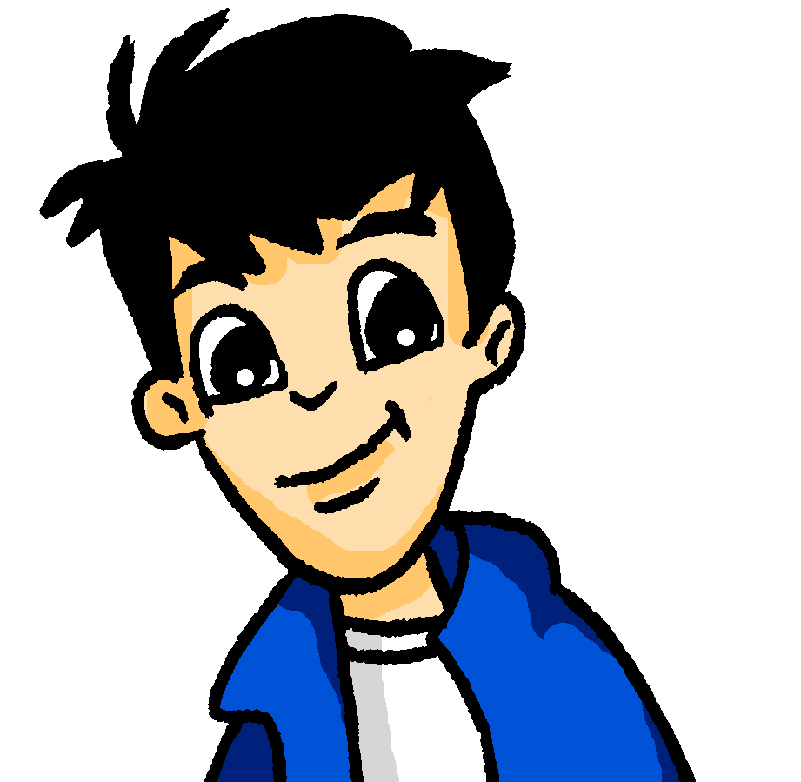
das Perfekt mit haben
Remember: - Sie haben with a capital is you (polite) have, - sie haben without a capital is they have,
- sie hat is she has.
Grammatik
As you know, the perfect tense generally uses the present tense of the verb ‘to have’ together with a past participle:
ich habe
aus dem Fenster geschaut.
___
I looked out of the window.
du hast
You called ‘Hello!’
___
‘Hallo!’ gerufen.
er/sie/es/man hat
___
die Reise geplant.
He/She/It/You(one) planned the journey.
wir haben
ein Hotel gesucht.
We looked for a hotel.
___
Sie haben
___
uns geholfen.
You helped us.
sie haben
___
uns ein tolles Zimmer gefunden.
They found us a great room.
Notes:
Timing: 3 mins (two slides) Aim: to recap the previously taught parts of sein and haben and revisit their use in the perfect tense, whilst revisiting some of this week’s vocabulary. Procedure: 1. Click through the animations.
2. Elicit the parts of haben (and sein on the next slide) and the English translations of the examples.

Slide 15
das Perfekt mit sein
Grammatik
With certain verbs of movement to a destination, use the present tense of ‘sein’ and a past participle:
ich bin
___
nach unten gegangen.
I went downstairs.
du bist
durch den Wald gewandert.
You walked through the forest.
___
er/sie/es/man ist
___
fast ins Wasser gefallen.
He/She/It/You(one) nearly fell into the water.
wir sind
mit der Bahn gefahren.
We went by rail.
___
Sie sind
You (formal) flew.
___
geflogen.
sie sind
___
am Strand geblieben.
They remained at the beach.
Remember: also use sein with bleiben.
Notes:
Continuation of the previous activity

Slide 16
Oma schreibt eine Antwort
das WLAN – Wi-Fi
lesen
Das WLAN* im Hotel ist heute nicht so gut.
Deshalb schreibt Oma ihre Antwort.
Ich habe nichts verloren! Der Opa ist in die Stadt gegangen und dort hat er die Eintrittskarten für das Museum verloren. Sie haben 40 Euro gekostet! ☹ Gestern haben wir die Bootsfahrt auf dem Meer gemacht. Wir sind drei Stunden gefahren und es hat viel Spaß gemacht. Danach war ich müde und ich bin eine Weile im Hotelzimmer geblieben. Am Abend sind neue Gäste im Hotel angekommen. Die Wagners habe ich super nett gefunden. Wir werden morgen vielleicht mit ihnen essen gehen…
1 __
2 _
Leider hatte sie ein kleines Problem …
3 __
4 ___
5 ___
Schreib 1-10 und die richtige Verbform von sein oder haben.
6__
7_
8__
9__
10 __
der Gast – guest
Notes:
Timing: 7 minutes Aim: A referential activity to practise written comprehension of perfect tense. Procedure: 1. Students write 1-10 and the missing part of sein or haben based on cues from the pronoun and the past participle.
2. Click to reveal the missing verb forms.
3. Students have two minutes to arrive at an oral translation of the text.
4. Elicit English meanings of each sentence from students, orally. (See English translation below).
Full text: Ich habe nichts verloren! Der Opa ist in die Stadt gegangen und dort hat er die Eintrittskarten für das Museum verloren. Sie haben 40 Euro gekostet! ☹ Gestern haben wir die Bootsfahrt auf dem Meer gemacht. Wir sind drei Stunden gefahren und es hat viel Spaß gemacht. Danach war ich müde und ich bin eine Weile im Hotelzimmer geblieben. Am Abend sind neue Gäste im Hotel angekommen. Die Wagners habe ich super nett gefunden. Wir werden morgen vielleicht mit ihnen essen gehen…
English translation: I didn’t lose anything! Grandpa went to town and he lost the museum tickets there. They cost 40 euros! Yesterday we went on the boat trip on the sea. We went for three hours and it was a lot of fun. Afterwards I was tired and I stayed in my room for a while. In the evening new guests arrived at the hotel. I found the Wagners really nice. Tomorrow we will maybe go out to dinner with them… Word frequency (1 is the most frequent word in German): Gast [577] Source: Jones, R.L. & Tschirner, E. (2019). A frequency dictionary of German: core vocabulary for learners. Routledge

Slide 17
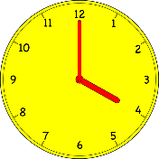
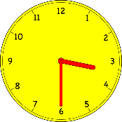
Wie spät ist es?
Wie sagt man das auf Englisch?
Vokabeln
Es ist vier Uhr.
You know to use Uhr to mean o’clock:
It is four o’clock.
Es ist halb vier.
Use halb (half) to mean half to the next hour:
It is half past three (half to four).
You can also tell time using the 24-hour clock:
Es ist vier Uhr.
With on the hour time before midday, it is the same as the 12-hour clock.
It is four o’clock.
Es ist drei Uhr dreißig.
Remember: Um before o’clock means ‘at’:
um drei Uhr – at three o’clock
It is three thirty.
With other times, just replace : with the word Uhr. 18:15 → Achtzehn Uhr fünfzehn.
Notes:
Timing: 2 minutes Aim: To recap the use of Uhr and um for telling time, and to introduce the use of halb for half-past in the 12-hour clock and the structure of the 24-hr clock.
Procedure: 1. Cycle through the explanations and examples using the animated sequence.
2. Elicit the English from students.

Slide 18
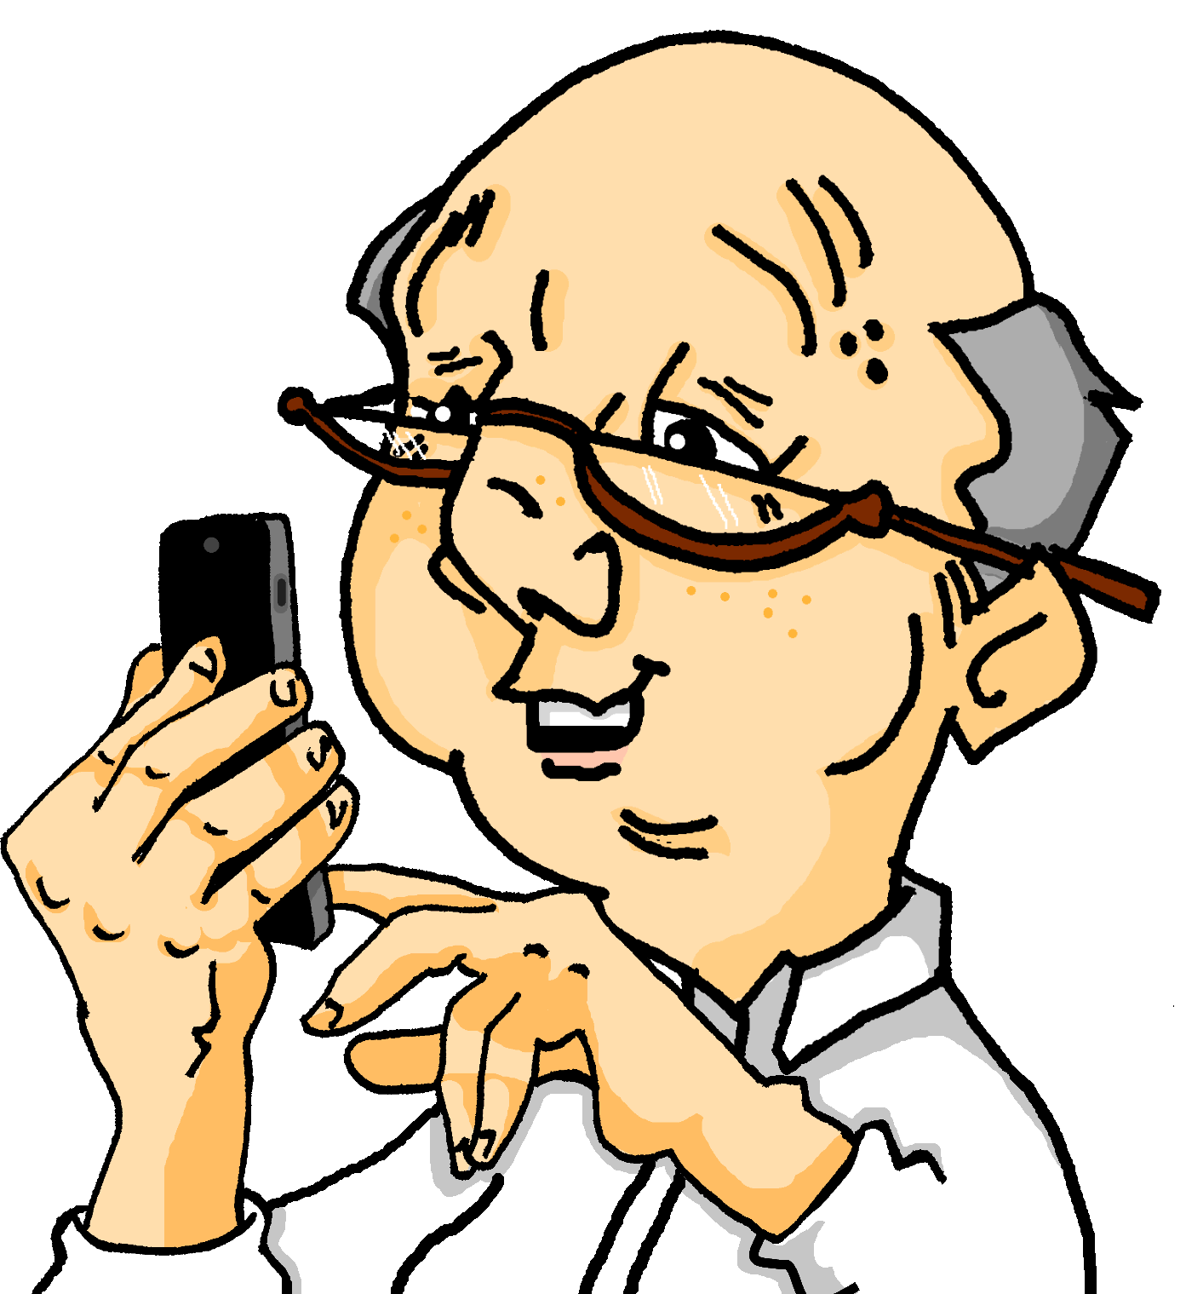
Wie spät ist es?
Let’s practise!
hören
Durst haben – to be thirsty
Wann hat Opa was gemacht? Hör zu. Schreib 1-6, die Uhrzeit und die Aktivität auf Englisch.
When? | What? | Why?
9:30
went to bed
was so tired
3:30
drank tea
was thirsty
10:30
went to yoga course
wants to keep fit
2:30
went to the café
strong wind at the beach
4:30
planned a trip
wants to go on a boat trip
5:30
got up
planned to go for a walk
1
2
3
4
5
6
Notes:
Timing: 8 mins Aim: To understand half past the hour times in the context of more extended sentences, together with a range of past tense activities and reasons. Procedure: 1. Click to listen.
2. Students write the time (in digits).
3. Click to listen again. Students check their time, and record the activity and the reason in English, if able.
4. Click to check answers.
Note: There is a differentiated version with multiple choice answers provided on the next slide. Additional differentiation could be created by providing students with some details up front.
Transcript: 1. Um halb zehn bin ich ins Bett gegangen, weil ich so müde war. 2. Am Nachmittag um halb vier habe ich Tee getrunken, weil ich Durst hatte. 3. Am Morgen um halb elf bin ich zum Yogakurs gegangen, denn ich will fit bleiben. 4. Am Nachmittag um halb drei bin ich ins Café gegangen, weil es einen starken Wind am Strand gab.
5. Um halb fünf habe ich eine Reise geplant, denn ich will am Mittwoch einen Bootsausflug machen. 6. Heute bin ich früh um halb sechs aufgestanden, denn ich habe eine Wanderung ans Meer geplant.
Word frequency (1 is the most frequent word in German): Durst [>5009] Source: Jones, R.L. & Tschirner, E. (2019). A frequency dictionary of German: core vocabulary for learners. Routledge

Slide 19
Wie spät ist es?
Let’s practise!
hören
Durst haben – to be thirsty
Wann hat Opa was gemacht? Hör zu. Schreib die Uhrzeit (1-6) und die Aktivität (A-F) und den Grund (rot, …).
When?
1
2
3
4
5
6
What?
A
B
C
D
E
F
Why?
2:30
went to yoga course
was so tired
4:30
planned a trip
wants to go on a boat trip
5:30
went to bed
strong wind at the beach
9:30
drank tea
wants to keep fit
3:30
got up
was thirsty
10:30
went to the café
planned to go for a walk
1
4, C, rot
2
5, D, blau
3
6, A, gelb
4
1, F, weiß
5
2, B, grün
6
3, E, braun
Notes:
This is the more straightforward version.
Timing: 8 mins Aim: To understand half past the hour times in the context of more extended sentences, together with a range of past tense activities and reasons. Procedure: 1. Play audio.
2. Students listen and note the number of the time they hear. 3. They then listen again and identify the what? and the why? and write the appropriate letter and colour.
3. Click to check answers.
Transcript: 1. Um halb zehn bin ich ins Bett gegangen, weil ich so müde war. 2. Am Nachmittag um halb vier habe ich Tee getrunken, weil ich Durst hatte. 3. Am Morgen um halb elf bin ich zum Yogakurs gegangen, denn ich will fit bleiben. 4. Am Nachmittag um halb drei bin ich ins Café gegangen, weil es einen starken Wind am Strand gab.
5. Um halb fünf habe ich eine Reise geplant, denn ich will am Mittwoch einen Bootsausflug machen. 6. Heute bin ich früh um halb sechs aufgestanden, denn ich habe eine Wanderung ans Meer geplant.
Answers:
9.30 (4), went to bed (C), was so tired (red)
3.30 (5), drank Tee (D), was thirsty (blue)
10.30 (6), went to yoga course (A), want to keep fit (yellow)
4. 2.30 (1), went to the café (F), strong wind at the beach (white)
4.30 (2), planned a trip (B), wants to go on a trip (green)
5.30 (3), got up (E), want to go for a walk on the mudflats / at the seaside (brown)

Slide 20
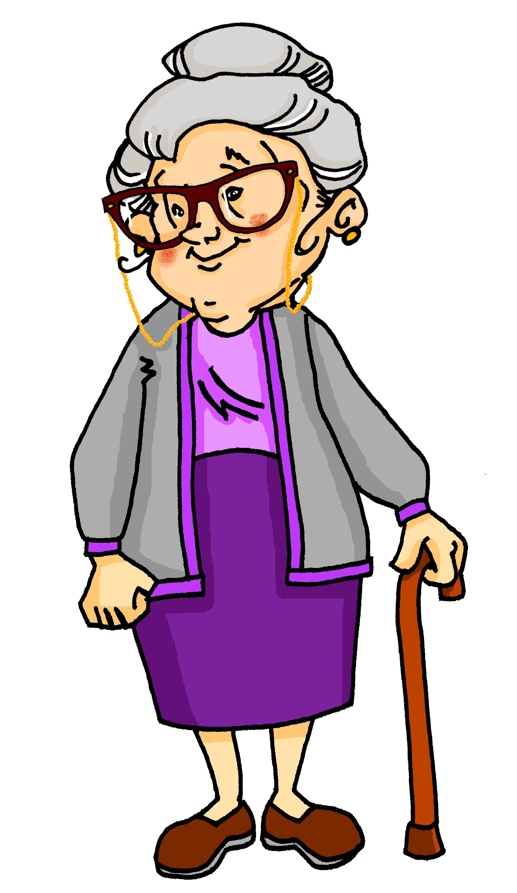
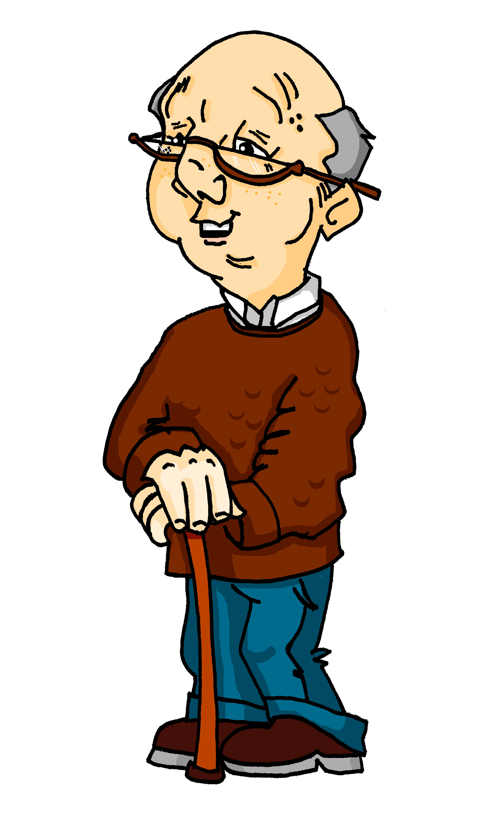
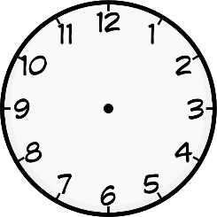
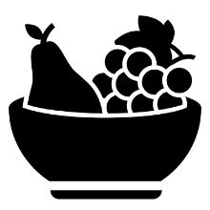
Was haben sie gemacht?
sprechen
Oma hat heute den Tag alleine verbracht. Opa auch.
By chance, they did a few of the same things at the same time.
Compare Oma and Opa’s activities and timings to find the THREE overlap activities.
Partner / Partnerin A
Partner / Partnerin B
Um halb sieben hat Oma Obst gegessen.
Um halb acht hat Opa Obst gegessen.
Notes:
Timing: 8 minutes (this slide models the activity) Aim: Oral production of on the hour and half past time with the perfect tense. This is a spot the difference task (information gap). Students work in pairs. Each student has a sheet with eight cards. Partners exchange information to find the three same activities they did at the same time.
Procedure: 1. Use this slide to model the task (click to reveal pictures and model questions/answers).
2. Distribute the sheets on the next two slides.
3. Student A narrates an activity that Oma did.
4. Student B checks if the information on his/her card is the same and responds accordingly. 5. The student B offers a piece of information and so on until all cards have been discussed and the differences found.

Slide 21
Partner(in) A
sprechen
bought a present
did an art course
ate cake
took photos
drank tea
caught a fish
went to café
went to beach
Notes:
NOT FOR DISPLAY DURING THE ACTIVITY This slide and the next are available as handouts.
The three activities in common, at the same time are: ate cake, went to café, took photos Common activities at different times: went to beach Common time for different activity: 5:30 drank tea / coffee, 11:30 did a yoga / art course Completely different activities and times: Oma caught a fish bought a present Opa bought some trousers went to cinema

Slide 22
Partner(in) B
sprechen
did a yoga course
drank coffee
went to beach
went to cinema
went to café
ate cake
bought trousers
took photos
Notes:
NOT FOR DISPLAY DURING THE ACTIVITY

Slide 23
Location and direction: where you went, where you were
Revisit (past) perfect tense, in and auf, weil and denn
Revisit SSC [u], [ü] and [y]
Y8 German
Term 3.2 - Week 1 - Lesson 61
Author name(s): Heike Krüsemann / Rachel Hawkes
Artwork: Steve Clarke
Date updated: 21/07/21
Notes:
Artwork by Steve Clarke. All additional pictures selected are available under a Creative Commons license, no attribution required.
Native-speaker teacher feedback provided by Stephanie Cross.
Learning outcomes (lesson 1):
Consolidation of SSC [u], [ü] and [y]
Revisit prepositions in and auf with R2 (acc.) and R3 (dat.) Revisit weil + WO3, denn + WO1
Word frequency (1 is the most frequent word in German):
8.3.2.1 (introduce) bringen [153] gebracht [153] verlieren [313] verloren [313] Insel [1029] Meer [852] Reise [734] Wind [1124] halb [443] stark [178] nach² [34]
8.3.1.4 (revisit) planen [579] werden [8] wirst [8] wird [8] Ausflug [4014] Boot [2109] Essen² [323] Eintritt [4102] Karte² [1191] Kurs [1549] Preis2 [334] bald [503] vielleicht [145]
8.2.2.2 (revisit) annehmen [523] anschauen [949] aufhören [995] aufstehen [966] aussehen [277] fangen [2044] rufen [531] schauen [510] Preis¹ [334]
Source: Jones, R.L & Tschirner, E. (2019). A frequency dictionary of German: Core vocabulary for learners. London: Routledge.
The frequency rankings for words that occur in this PowerPoint which have been previously introduced in NCELP resources are given in the NCELP SOW and in the resources that first introduced and formally re-visited those words.
For any other words that occur incidentally in this PowerPoint, frequency rankings will be provided in the notes field wherever possible.

Slide 24
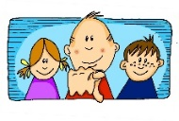
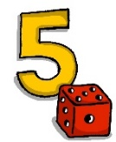
Phonetik [u], [ü], [y]
lesen / sprechen
Sag die Wörter. Wie schnell kannst du das?
Tür
du
ü
u
y
typisch
Punkt
fünf
u
ü
Notes:
Timing: 1 minute Aim: To reactivate SSC knowledge of long and short [u], [ü], and [y]. Procedure: 1. Click and elicit the SSC and the source word from students. 2. If required, the SSC and the picture can be clicked to hear the audio. 3. Give students 30 seconds to say the words as fast as they can, one after the other.

Slide 25
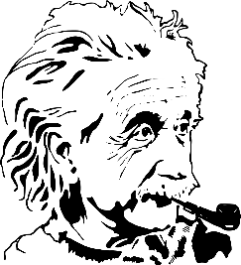
Phonetik [1/3]
Sag den Satz. Wie schnell kannst du das?
lesen / sprechen
10
1
2
In Ulm und um Ulm und um Ulm herum.
3
In Ulm and round Ulm and around Ulm.
Sekunden
Ulm ist eine Stadt in Süddeutschland und die Geburtsstadt von Albert Einstein.
0
LOS!
Notes:
Timing: 1 minute (for three slides) Aim: To apply SSC knowledge in the oral production of longer sentences. Procedure: 1. Students read the tongue twister aloud. The 10-second timer is an additional spur to speeding up oral production. 2. Listen and check (three different speeds). 3. Clarify meaning, using the cultural information about Ulm. 4. Repeat the steps for the next two slides.
Word frequency of unknown or cognate words (1 is the most frequent word in German):
herum [3033] Source: Jones, R.L. & Tschirner, E. (2019). A frequency dictionary of German: core vocabulary for learners. Routledge

Slide 26
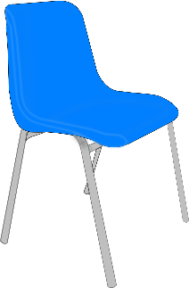
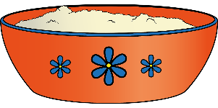
Phonetik [2/3]
Sag den Satz. Wie schnell kannst du das?
lesen / sprechen
10
Fünf Schüler dürfen über Pfützen hüpfen, dann müde auf fünf grünen Stühlen sitzen und fünf Schüsseln* süße Grütze* schlürfen.
1
2
Five pupils are allowed to hop over puddles, then sit, tired, on five green chairs, and slurp five bowls of sweet porridge.
3
Sekunden
die Schüssel – bowl die Grütze – porridge
0
LOS!
Notes:
Word frequency of unknown or cognate words (1 is the most frequent word in German):
Grütze [>5009] hüpfen [>5009] Pfütze [>5009] schlürfen [>5009] Schüssel [>5009] Stuhl [1661] süß [2796] Source: Jones, R.L. & Tschirner, E. (2019). A frequency dictionary of German: core vocabulary for learners. Routledge

Slide 27
Phonetik [3/3]
Sag den Satz. Wie schnell kannst du das?
lesen / sprechen
10
Ein Fuß zwei Füße
Ein Gruß zwei Grüße
Ein Fluss zwei Flüsse
Ein Schluss.
1
Hallo!
Hallo!
Hallo!
2
3
Sekunden
0
LOS!
Notes:
Word frequency of unknown or cognate words (1 is the most frequent word in German):
Fuß [573] Gruß [4722] Schluss [1030] Source: Jones, R.L. & Tschirner, E. (2019). A frequency dictionary of German: core vocabulary for learners. Routledge
Translation, in case needed: One/A foot, two feet One/A greeting, two greetings One/A river, two rivers An end.

Slide 28
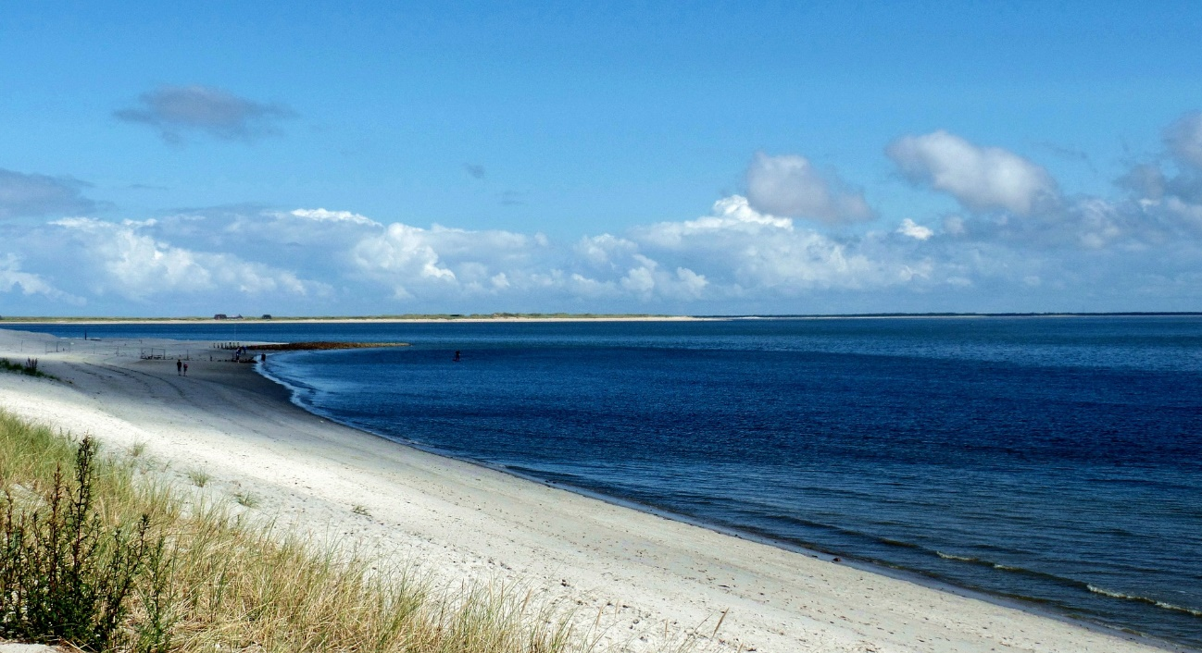
Welches Bild ist das?
sprechen
Wie heißt das auf Deutsch?
 | 1 | 2 | 3
A
B
C
soon
to look like
bald
strong
aussehen
stark
annehmen
anschauen
vielleicht
to accept
to watch, look at
perhaps
wird
aufstehen
aufhören
becomes, will
to get up
to stop
Notes:
Timing: 3 minutes
Aim: Oral recall of nine words from this week’s vocabulary sets.
Procedure:
1. Whole class choral activity. Students should volunteer a letter/number combination relating to a square on the grid.
2. The whole class then says the translation.
3. Click the blue box to reveal answer.
4. If the majority of the class says the correct answer, click the yellow box to reveal part of the underlying image.
5. Students guess what the image represents (Strand auf Sylt).

Slide 29
Wie heißt das auf Englisch?
Vokabeln
Five words in this week’s vocabulary sets have more than one meaning:
das Essen
die Karte
der Preis
nach
vor
_ _, _ _ _ _ _ _ _
ago
ticket
prize
_ _ _
food
_ _ _ _ _ _
_ _ _ _ _
_ _ _ _
to, towards
meal
price
after
in front of
_ _ _ _
menu
_ _ _ _ _ _ _ _ _
_ _ _ _
_ _ _ _ _
_ _ _ _ _
before
_ _ _ _ _ _
When you encounter these words it’s important to select the right meaning.
Notes:
Timing: 2 minutes Aim: To introduce the concept words with multiple meanings using examples from this week’s new vocabulary set. Procedure: 1. Cycle through the information point by point. 2. Use the prompts to elicit the meanings from students, where known. They are going to encounter all of these words again in the next task.

Slide 30
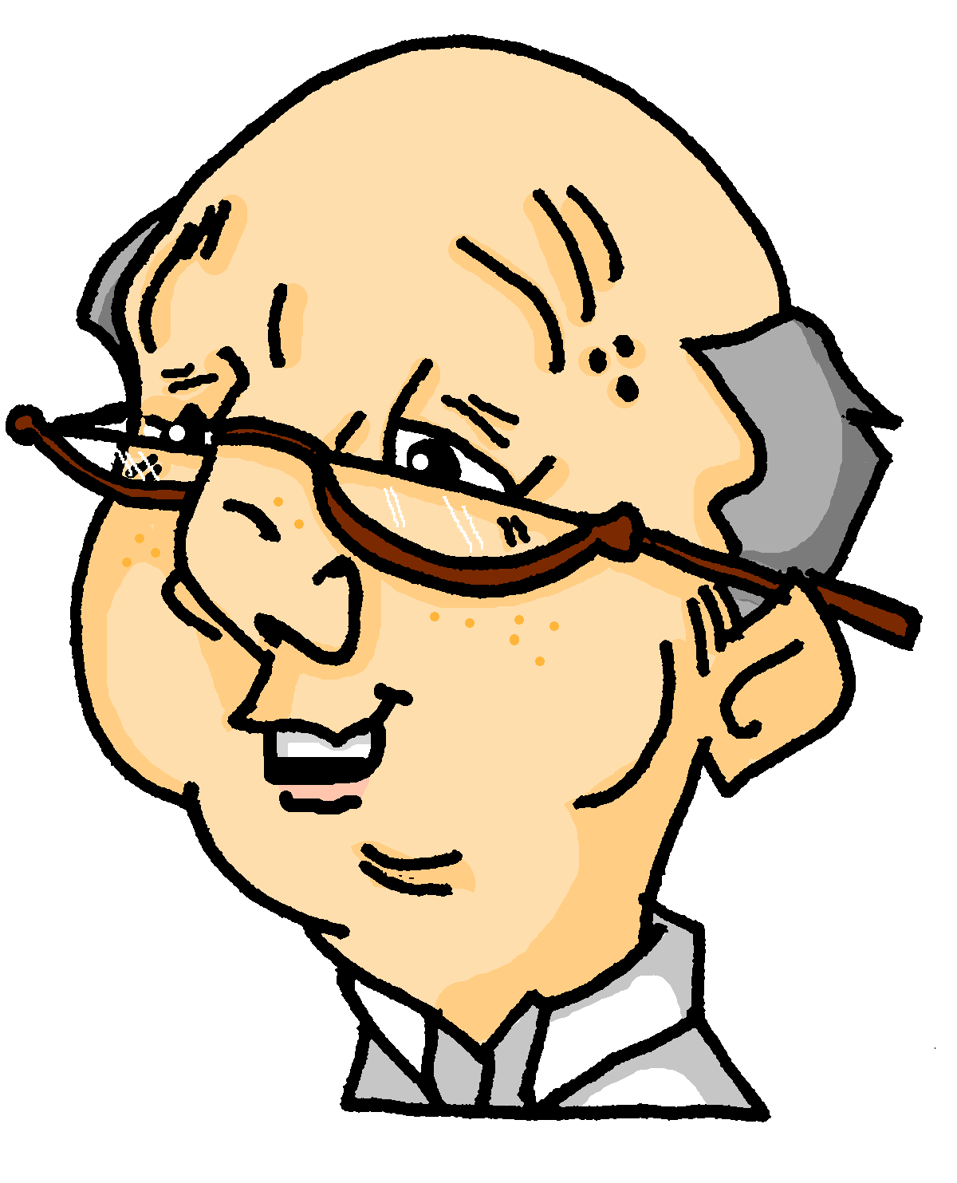
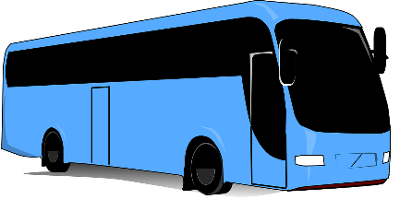
Wie heißt das auf Englisch? [1/8]
lesen
1. Was hat Opa gewonnen?
A
B
€ 200
1
einen
Preis
Opa hat ________ ______________ gewonnen.
Notes:
Timing: 8 minutes [8 slides] Aim: To recall the correct meaning and forms of a set of known vocabulary items in a sentence context choosing the correct meaning of the two they know. Procedure: 1. Students match the missing word to one of the pictures, thereby choosing the correct meaning for the sentence. 2. Elicit the correct English translation, orally.
3. Click to reveal the gapped German sentence. 4. Students say (or write) the missing words. 5. Click again to reveal the target word, with the appropriate article and case. Note: this task can usefully be differentiated: 1. Selecting the correct word meaning is written recognition. 2. Producing the English translation is receptive recall. 3. Producing (in written or oral modality) the missing words is productive recall that also revisits grammar features associated with using those words in a sentence (i.e. indefinite article, R2 (accusative) object). 4. Producing the full sentence, including the missing words is a further challenge, revisiting further grammar features and vocabulary.
If needed, lower proficiency learners could be supported by providing the German word (der Preis), as they still need to process the meaning of the question, specifically ‘gewonnen’ to arrive at the correct word meaning.

Slide 31
Wie heißt das auf Englisch? [2/8]
lesen
2. Wann muss man da sein?
A
B
Uhr
2
Um zwei ______ muss man da sein.

Slide 32
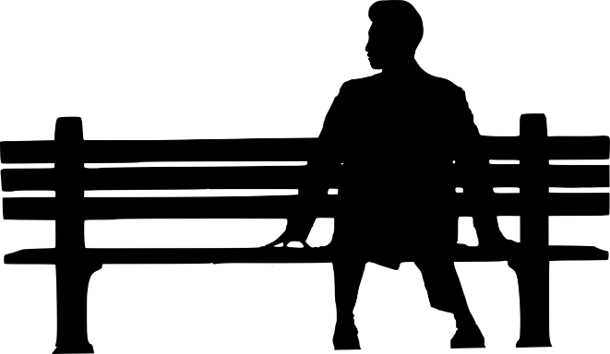
Wie heißt das auf Englisch? [3/8]
lesen
3. Wo ist der Treffpunkt?
[market square]
[room, space]
A
B
3
am
Marktplatz
Der Treffpunkt ist _____ ______________.

Slide 33
Wie heißt das auf Englisch? [4/8]
lesen
4. Wird man die Tour zu Fuß machen?
[drive the bus]
[travel by bus]
A
B
mit
Bus
fahren
4
dem
Nein, man wird _____ ____ _____ _________.

Slide 34
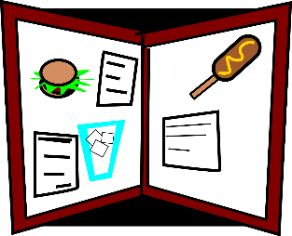
Wie heißt das auf Englisch? [5/8]
lesen
5. Was ist das Problem? Was hat Opa gemacht?
A
B
5
die
Karten
Opa hat ________ ______________ verloren.

Slide 35
Wie heißt das auf Englisch? [6/8]
lesen
6. Wann will Oma einkaufen gehen?
Auf Wiedersehen! Tschüss!
A
B
[after the tour]
[to Berlin]
nach
der
Tour
Oma will ______ _____ ______ einkaufen gehen.
6

Slide 36
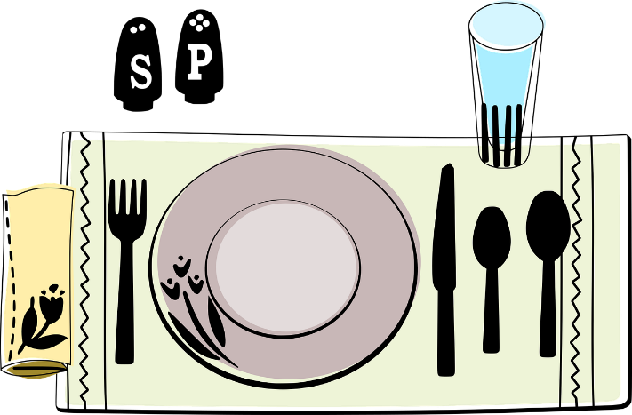
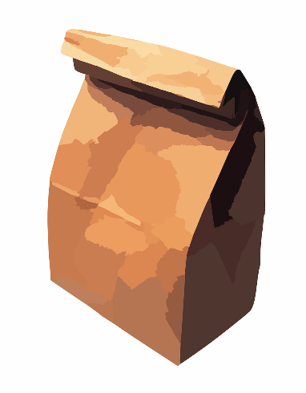
Wie heißt das auf Englisch? [7/8]
lesen
7. Was muss man noch zum Ausflug mitbringen?
[a meal]
[food]
A
B
7
Essen
Man muss __________ mitbringen.

Slide 37
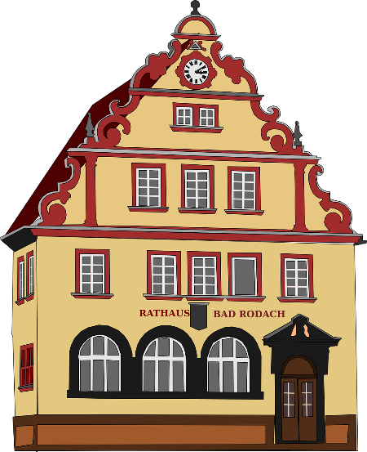
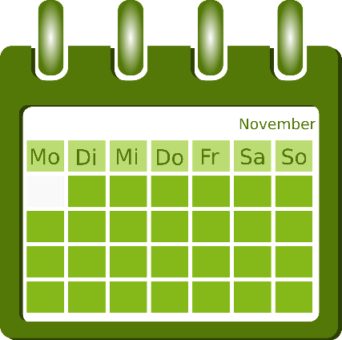
Wie heißt das auf Englisch? [8/8]
lesen
Reiseführer –
travel guide, leader
8. Wo finden sie den Reiseführer*?
[… ago]
[in front of]
A
B
vor
der
Uhr
8
Sie finden ihn _____ ____ _____.

Slide 38
Wie spät ist es?
Vokabeln
Es ist zwei Uhr.
It is two o’clock.
You know to use Uhr to mean o’clock:
Es ist fünf nach zwei.
It is five past two.
In 12-hour clock, use nach (after)to mean past:
Use vor (before)to mean to:
Es ist fünf vor zwei.
It is five to two.
With nach and vor you don’t need Uhr.
Remember, for 24-hour clock, just replace : with Uhr
Es ist zwei Uhr fünf.
It is two o five.
2:05
1:55
Es ist ein Uhr fünfundfünzig.
It is one fifty-five.
Notes:
Timing: 3 minutes Aim: To explain the use of nach and vor with 12-hour clock time. Procedure: 1. Cycle through the explanations and examples using the animated sequence.

Slide 39
Was sagt der Reiseführer?
Like in English, the way you greet people in German differs depending on the time of day.
Vokabeln
Remember: It is der Morgen, der Tag, der Abend, but die Nacht. Wie sagt man ‘midday’ auf Deutsch?
der Mittag
Wann? | before midday | midday – 6p.m. | 6p.m. - bedtime | wishing someone goodbye and a good sleep
Wo?
Guten Morgen!
Guten Tag!
Guten Abend!
Gute Nacht!
R2 (acc.) masculine adjective ending.
Why ‘guten’? The idea is that it’s short for a whole sentence:
INDIRECT OBJECT
DIRECT OBJECT
SUBJECT
VERB
Ich
wünsche
dir / Ihnen
einen guten Tag.
I
wish
(to) you
a good day.
Notes:
Timing: 7 minutes (two slides) Aim: To present four greetings explicitly and then (on the next slide) practise aural comprehension of times with vor and nach, relating them to typical greetings at these times of day.
Procedure (this slide): 1. Click to play each time. 2. Students select the greeting the Reiseführer will use to greet passengers at these times.
3. Click to move to the next slide.
The task can be differentiated like this:
1. No need to write the time, students just identify the appropriate greeting.
2. In addition to the greeting, students note down the exact time of day.
3. In addition, students also offer the equivalent time in 24-hr clock.
E.g. Number 1 – they would say / write: Es ist vierzehn Uhr dreißig.

Slide 40
Was sagt der Reiseführer?
hören
Hör zu. Schreib 1 – 8 und die richtigen Wörter.
 | Was sagt er? | 12 Uhr | 24 Uhr
 |  | 2:30 p.m. | es ist vierzehn Uhr dreißig
 |  | 11:10 a.m. | es ist elf Uhr zehn
 |  | -- | --
 |  | 8:40 p.m. | es ist zwanzig Uhr vierzig
 |  | 5:30 p.m. | es ist siebzehn Uhr dreißig
 |  | 08:50 a.m. | es ist acht Uhr fünfzig
 |  | 7:05 p.m. | es ist neunzehn Uhr fünf
 |  | 12:00 p.m. | es ist zwölf Uhr
1
Guten Tag!
2
Guten Morgen!
3
Gute Nacht!
4
Guten Abend!
5
Guten Tag!
6
Guten Morgen!
7
Guten Abend!
8
Guten Tag!
Notes:
Aim: To practise aural comprehension of times with vor and nach, relating them to typical greetings at these times of day.
Procedure: 1. Click to play each time. 2. Students select the greeting the Reiseführer will use to greet passengers at these times.
The task can be differentiated like this:
1. No need to write the time: students just identify the appropriate greeting.
2. In addition to the greeting, students note down the exact time of day.
3. In addition, students also offer the equivalent time in 24-hr clock.
E.g. Number 1 – they would say / write: Es ist vierzehn Uhr dreißig.
Transcript: 1. Es ist nachmittags halb drei. 2. Es ist morgens zehn nach elf.
3. Schlafen Sie gut!
4. Es ist abends zwanzig vor neun.
5. Es ist nachmittags halb sechs.
6. Es ist morgens zehn vor neun.
7. Es ist abends fünf nach sieben.
8. Es ist zwölf Uhr Mittag.
Answers:
Guten Tag
Guten Morgen
Gute Nacht
Guten Abend
Guten Tag
Guten Morgen
Guten Abend
Guten Tag

Slide 41
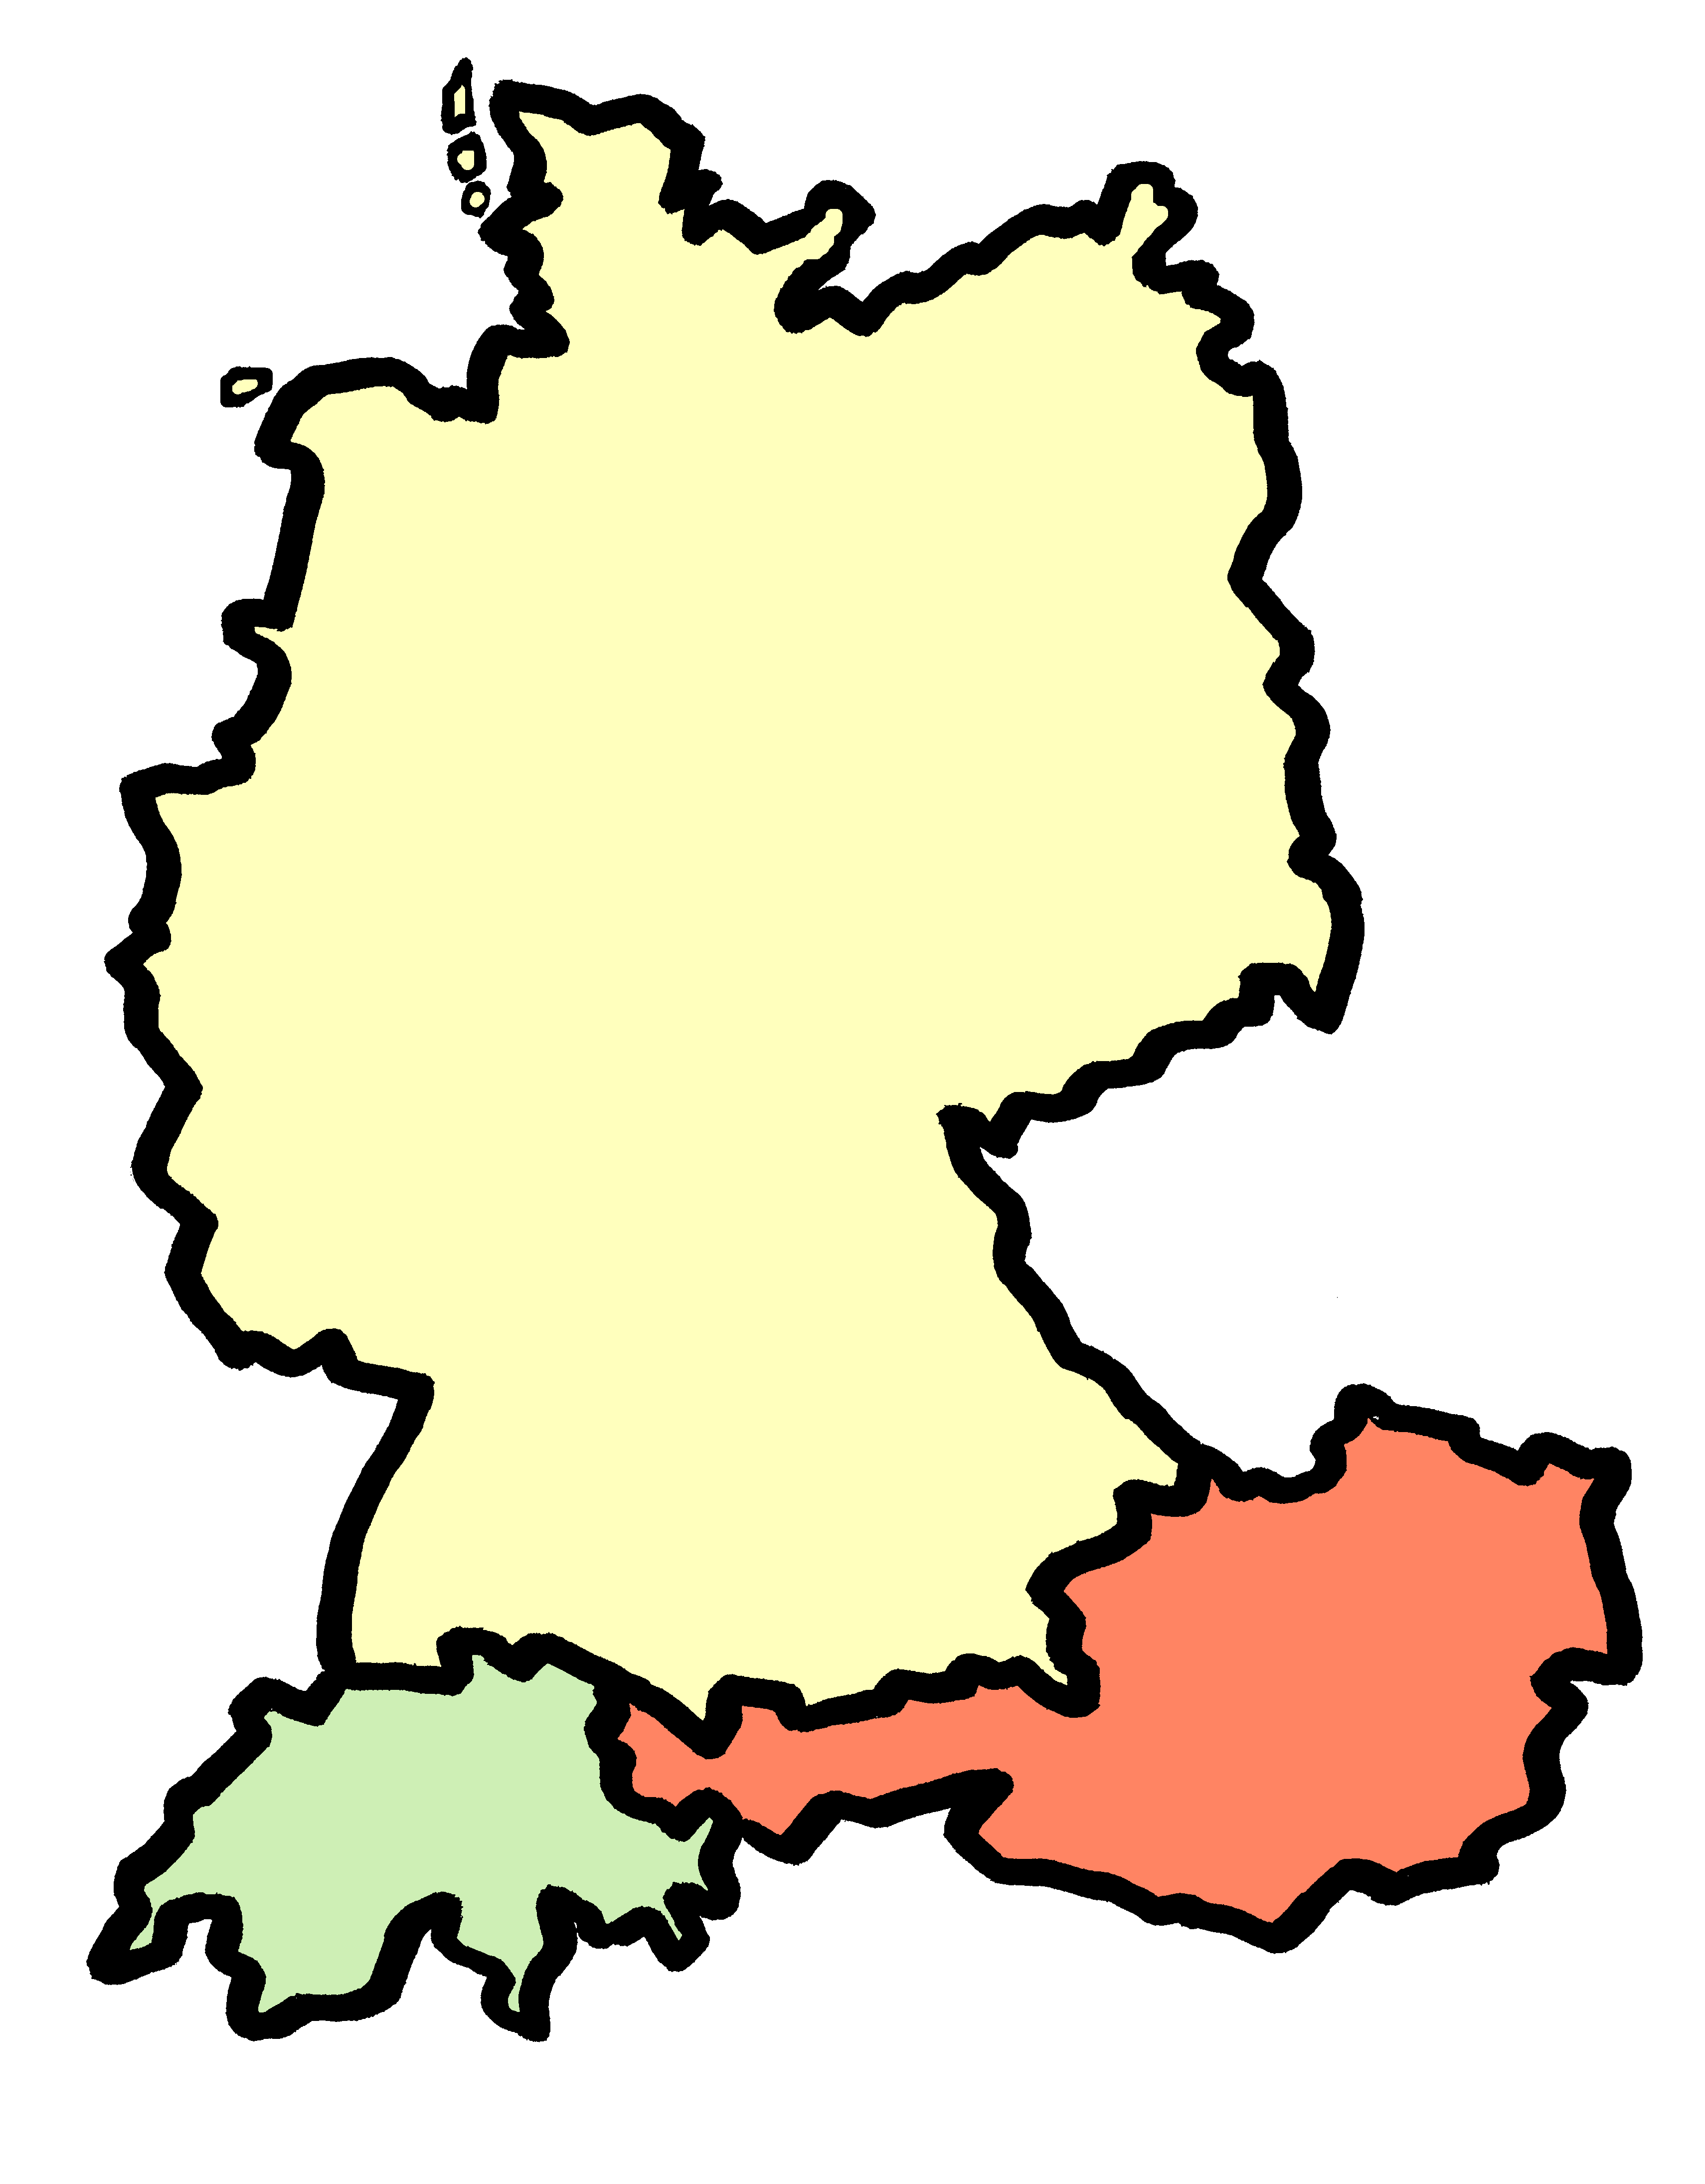
Begrüßungen
Begrüßungen – hellos
hören
 | Was? | Wo? | Formal | Informal
1
Hallo
Nord
2
Grüß Gott
Süd
3
Servus
Süd
4
Moin
Nord
5
Moin Moin
Nord
Süd
6
Grüezi
7
Hoi
8
Sali
9
Salü
Notes:
Optional additional slides on hellos and goodbyes in Germany, Austria and Switzerland. Note that, as this lesson is revisiting, teachers may prefer to do these greetings tasks instead of: i. slides 47-49 (revision of prepositions +R2/R3 in listening) 10 minutes ii. slide 50 (numbers revision) 5 minutes iii. slides 51-52 (vocabulary revision reading) 5 minutes Of these, the listening is the most challenging activity and could be omitted for lower proficiency groups.
Timing: 6 minutes (three slides) Aim: To practise the application of SSC knowledge with unfamiliar words and to extend cultural knowledge, revising in addition five country/area vocabulary items (Deutschland, Nord-, Süd, Österreich, die Schweiz).
Procedure: 1. Students write 1-9 and the table headings. 2. Elicit the five possible areas where the greetings might be used, using the map. 3. Click to play audio of greetings.
4. Students try to write each greeting (Was?).There is some application of SSC knowledge here, but note that [oi] is not an SSC that students have encountered, as it is rare – they will naturally write [eu] or [äu] here, and should be praised for doing so. 5. They think about where the greeting might be used, and whether it sounds formal or informal. 6. Click to reveal full answers after each greeting, as this is new knowledge.
Transcript: 1. Hallo!
2. Grüß Gott!
3. Servus!
4. Moin!
5. Moin moin!
6. Grüezi
7. Hoi
8. Sali
9. Salü

Slide 42
Begrüßungen
Begrüßungen – hellos
lesen / sprechen
How are you? (informal)
What’s up? / What’s wrong?
You alright? All good?
Yeah, all good.
How are you? (formal)
Alles klar?
Ja, alles klar.
Was ist los?
Wie geht es dir?
Wie geht es Ihnen?
You know Wie geht’s? How’s it going? The longer versions literally mean How goes it to you?
Notes:
Continuation of the previous activity Procedure: 1. Tell students that greetings are typically followed up by additional expressions. 2. Click on the speech bubble to play the greeting and elicit the English meaning of each. 3. Remind them that they learnt ‘Wie geht’s?’ early in Y7 and make the connection with the two new expressions, here.
Transcript:
Alles klar? Ja, alles klar. Was ist los?
Wie geht es dir?
Wie geht es Ihnen?

Slide 43
Verabschiedungen
Verabschiedungen – goodbyes
hören
 | Was? | Wo? | Formal | Informal
 | Tschüs(s)
 | Adieu
 | Lebwohl
 | Auf Wiedersehen
 | Ciao/Tschau
Nord
1
2
3
Süd
4
5
Notes:
Continuation of the previous activity This time the additional information is already given, and students transcribe the goodbyes only. Transcript: 1. Tschüs
2. Adieu 3. Lebwohl 4. Auf Wiedersehen 5. Ciao/ Tschau

Slide 44
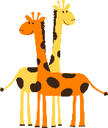
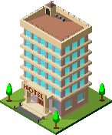
In / auf + R2 and R3
Remember, in das changes to ins.
Grammatik
Remember, Row 2 is used when describing motion into / onto something:
Row 1:
der Zoo
die Insel
das Hotel
Row 2:
Er geht…
in den Zoo
auf die Insel
ins Hotel
in einen Zoo
auf eine Insel
in ein Hotel
Row 3 is used when describing location in or on something:
Row 3:
Er ist…
im Zoo
auf der Insel
im Hotel
Remember, in dem changes to im.
in einem Zoo
auf einer Insel
in einem Hotel
Notes:
Timing: 3 minutes
Aim: Summarising the changes to the article for Row 2 and Row 3, reiterating when to use each.
Procedure: 1. Click on the mouse to animate the explanation.
2. Ensure student understanding at each stage.
Word frequency (1 is the most frequent word in German):
sein [3] (ich bin, du bist, er/sie/es ist, wir sind) Schule [208]
Note: the vocabulary for this week is revisited from Y7. The frequencies given are from the frequency list used for the Y7 German SOW:
Jones, R.L & Tschirner, E. (2009). A frequency dictionary of German: Core vocabulary for learners. London: Routledge.

Slide 45
Was erzählt die Reiseführerin? [1/2]
hören
Wo sind sie/wohin fahren sie? Schreib den Ort (zwei pro Satz!) und movement / no movement.
 | place | movement | no movement
1a | island of Sylt
1b | hotel
2a | island of Sylt
2b | coast
3a | beach
3b | museum
4a | sea
4b | town
die Küste – coast
1
2
3
4
Notes:
Timing: 7 minutes Aim: Practise the use of in, an and auf with movement – R2 (acc.) – and without movement – R3 (dat.). Procedure: 1. Ensure students know that they are not going to hear the verbs of location or movement, but that it is the article that follows in, an or auf that indicates movement or no movement.
2. Ensure they know that there will be two places to listen out for in each sentence. 3. Do the first one and check the answers. 4. Then perhaps proceed with items 2 – 4 before checking those, depending on the class. 5. Items 5 – 8 are on the next slide.
Transcript:
1. Wir [fahren bald] auf die Insel Sylt, und wir [waren vorher] im Hotel.
2. Wir [sind] jetzt auf der Insel Sylt, also [sind] wir an der Küste.
3. Wir [fahren] erst an den Strand, und dann [fahren] wir ins Museum.
4. Jetzt [sind] wir richtig am Meer, bald [fahren] wir in die Stadt. continued on the next slide for 5-8 Word frequency of unknown words and cognates (1 is the most frequent word in German):
Küste [2628] Source: Jones, R.L. & Tschirner, E. (2019). A frequency dictionary of German: core vocabulary for learners. Routledge

Slide 46
Was erzählt die Reiseführerin? [2/2]
hören
 | place | movement | no movement
5a | zoo
5b | park
6a | market square
6b | swimming pool
7a | library
7b | station
8a | street/road
8b | hotel
der Zoo – zoo
5
6
7
8
Notes:
Continuation of the activity
Transcript:
5. Jetzt [sind] wir am Zoo, und am Nachmittag [gehen] wir in den Park.
6. Morgen [sind] wir erst am Marktplatz, und dann [gehen] wir ins Schwimmbad.
7. Wir [gehen danach] in die Bibliothek. Am Ende [sind] wir am Bahnhof, denn wir sagen dort ‚Tschüss‘.
8. Oh, hier [sind] wir auf der richtigen Straße - jetzt [geht es] ins Hotel!
Word frequency of unknown words and cognates (1 is the most frequent word in German):
der Zoo [>5009] Source: Jones, R.L. & Tschirner, E. (2019). A frequency dictionary of German: core vocabulary for learners. Routledge

Slide 47
Vokabeln
Opa und Oma suchen ihren Strandkorb* aber sie sehen die Nummern nicht richtig.
hören
Strandkörbe sind typisch auf Sylt. Der Strandkorb schützt vor dem starken Wind am Strand.
Hör zu. Schreib 1- 8 und A,B,C… und die richtige Nummer auf.
Beispiel: 1 = E, 316
137
209
523
_ _7
_0_
_ _3
217
B
C
D
2_ _
A
7
3
122
2
158
_2_
_ _8
445
8
316
4_ _
1
5
3_ _
F
E
G
H
2
6
1
5
4
6
3
7
4
8
Notes:
Timing: 5 minutes Aim: To practise aural comprehension of larger numbers. Procedure: 1. Ensure students understand the reference to Strandkorb and elicit the English meaning of the cultural explanation. 2. Click the audio button to listen to each number.
3. Students write down the letter of the matching Strandkorb, and the full number if they can. Note – that this task could be differentiated even further by removing the single digit number prompts.
4. Click to reveal answers 1-8 in the order in which they were heard (and written down).
Transcript:
1. 316
2. 209
3. 137
4. 122
5. 158
6. 445
7. 523
8. 217

Slide 48
Wie war der Tag?
lesen
Opa und Oma sitzen am Strand.
Oma schreibt eine Postkarte, aber… sie hat ein kleines Problem mit ihrem Kaffee…!
Notes:
Timing: 30 seconds Aim: To provide the context for the reading / writing task that follows. Procedure: 1. Students translate the scenario orally.
Word frequency of unknown or cognate words (1 is the most frequent word in German): Postkarte [>5009] Source: Jones, R.L. & Tschirner, E. (2019). A frequency dictionary of German: core vocabulary for learners. Routledge

Slide 49
Wie war der Tag?
lesen / schreiben
genießen – to enjoy
Grüße aus Sylt! Wir sitzen am Strand und genießen die frische Luft, weil der Wind jetzt gar nicht so stark ist. Heute morgen sind wir mit dem Touristenbus gefahren. Die Reiseführerin hat uns viel über Sylt erzählt. Dieser Ort gefällt uns sehr, denn man kann hier so viel machen. Heute Abend werden wir mit den Wagners ins Restaurant gehen. Wir brauchen noch zwei Wochen, um alles zu machen!
-1-
Schreib 1-12 und die fehlenden Wörter.
-2-
-3-
-4-.
-5-
Remember: weil → Word Order 3 denn → Word Order 1
-6-
-7-
-8-
-9-
-10-
-11-
-12-
Notes:
Note: The next slide has a supported version of the activity, with the 12 words provided in a table. Timing: 5 minutes Aim: To practise recall and production of a range to vocabulary and grammar features in a longer text. Procedure: 1. Students use their knowledge of vocabulary and structures to work out the words (and forms) of the missing items 1-12.
2. Click to reveal answers.
3. Teacher to check comprehension of any items, as appropriate to the needs of the class. If earlier tasks have been omitted, there may be time to elicit an oral translation of the text.
Word frequency of unknown and cognate words (1 is the most frequent word in German): genießen [1557] Bus [1562] Führer [2684] Restaurant [1802] Tourist [1318] Source: Jones, R.L. & Tschirner, E. (2019). A frequency dictionary of German: core vocabulary for learners. Routledge
Translation: Greetings from Sylt. We’re sitting at the beach and enjoying the fresh air, because now the wind is not nearly as strong. This morning we went on the tourist bus. The travel guide told us a lot about Sylt. We like the place a lot, as you can do so much here. This evening we are going to go to a restaurant with the Wagners. We need two more weeks, to do everything!

Slide 50
Wie war der Tag?
lesen / schreiben
genießen – to enjoy
Grüße aus Sylt! Wir sitzen am Strand und genießen die frische Luft, weil der Wind jetzt gar nicht so stark ist. Heute morgen sind wir mit dem Touristenbus gefahren. Die Reiseführerin hat uns viel über Sylt erzählt. Dieser Ort gefällt uns sehr, denn man kann hier so viel machen. Heute Abend werden wir mit den Wagners ins Restaurant gehen. Wir brauchen noch zwei Wochen, um alles zu machen!
-1-
Schreib 1-12 und die fehlenden Wörter.
-2-
-3-
-4-.
-5-
Remember: weil → Word Order 3 denn → Word Order 1
-6-
-7-
-8-
-9-
-11-
hat | denn | sind | am
der | ins | dieser | werden
gefahren | frische | machen | ist
-10-
-12-
Notes:
Note: This slide is the supported version of the activity. Timing: 5 minutes Aim: To practise recall and production of a range of vocabulary and grammar features in a longer text. Procedure: 1. Students use their knowledge of vocabulary and structures to work out the words (and forms) of the missing items 1-12.
2. Click to reveal answers.
3. Teacher to check comprehension of any items, as appropriate to the needs of the class. If earlier tasks have been omitted, there may be time to elicit an oral translation of the text.
Word frequency of unknown and cognate words (1 is the most frequent word in German): genießen [1557] Bus [1562] Führer [2684] Restaurant [1802] Tourist [1318] Source: Jones, R.L. & Tschirner, E. (2019). A frequency dictionary of German: core vocabulary for learners. Routledge
Translation: Greetings from Sylt. We’re sitting at the beach and enjoying the fresh air, because now the wind is not nearly as strong. This morning we went on the tourist bus. The travel guide told us a lot about Sylt. We like the place a lot, as you can do so much here. This evening we are going to go to a restaurant with the Wagners. We need two more weeks, to do everything!

Slide 51
Einen Ort beschreiben
schreiben
Schreib einen kurzen Text. Beschreib einen Ort.
It can be any place you know well, your home town or somewhere you have visited.
Beantworte diese Fragen:
Wie heißt der Ort und wo liegt er?
Wann hast du diesen Ort besucht?
Wie bist du dahin gefahren?
Wie war die Reise? Warum?
Was hast du dort gemacht?
Gefällt dir dieser Ort? Warum / warum nicht?
Extra - Write up to ten word prompts. - Record yourself describing the visit to the place you wrote about. - Send your recording to your teacher.
Notes:
Timing: 2 minutes to explain the task (plus time to write at home) Aim: To apply language knowledge in a freer context in the written modality. Procedure: 1. Explain the task and elicit the meanings of the bullet points.
2. Suggest that students write either 1 or 2 sentences per bullet.
3. Encourage them to focus on their use of the perfect tense, and the prepositions in, auf, an with R2/R3.
4. Suggest they give at least one time of day.
5. Remind them to give two reasons (bullets 4 and 6 require them)

Slide 52
Hausaufgaben
Year 8 German Term 3.2 Week 2 (Y7 Mashup A)
Year 8 German Term 3.2 Week 2 (Y7 Mashup B)
Year 8 German Term 3.2 Week 2 (Y7 Mashup C)
Year 8 German Term 3.2 Week 2 (Y7 Mashup D)

Slide 53
Hausaufgaben
Year 8 German Term 3.2 Week 2 (Y7 Mashup A)
Year 8 German Term 3.2 Week 2 (Y7 Mashup B)
Year 8 German Term 3.2 Week 2 (Y7 Mashup C)
Year 8 German Term 3.2 Week 2 (Y7 Mashup D)

