Slide 1
Saying what people have
avoir (nous, vous)
SSC [au] [revisited]
s-liaison
Y7 French
Term 2.1 - Week 3 - Lesson 33
Natalie Finlayson / Emma Marsden / Rachel Hawkes
Artwork by: Chloé Motard
Date updated: 04/08/2022
Notes:
Artwork by Chloé Motard. All additional pictures selected are available under a Creative Commons license, no attribution required.
Learning outcomes (lesson 1):
Introduction of first and second person plural forms of avoir
Consolidation of SSC [au]
Introduction of s-liaison
Word frequency (1 is the most frequent word in French):
7.2.1.3 (introduce) avons [8], avez [8], ont [8], enfant [126], famille [172], problème [188], difficile [296], ici [167], très [66], aussi [44], pour¹ [10], dans [11]
7.1.2.7 (revisit) fermer [757], regarder² [425], vous¹ [50], chemise [3892], classe [778], fenêtre [1604], porte [696], salle [812], silence [1281], tableau [1456], bien [47]
7.1.2.2 (revisit) bateau [1287], magasin [1736], numéro [766], promenade [>5000], question [144], réponse [456], visite [1072], voyage [904], beau [393], mauvais¹ [274], de¹ [2], en² [7], Paris [n/a], Londres [n/a]
Source: Londsale, D., & Le Bras, Y. (2009). A Frequency Dictionary of French: Core vocabulary for learners London: Routledge.
The frequency rankings for words that occur in this PowerPoint which have been previously introduced in NCELP resources are given in the NCELP SOW and in the resources that first introduced and formally re-visited those words.
For any other words that occur incidentally in this PowerPoint, frequency rankings will be provided in the notes field wherever possible.
The additional English meanings of the following words have been added to Quizlet since the creation of this resource: problème (problem, issue)

Slide 2
au
[au/eau]
gauche
Notes:
Timing: 1 minute
Aim: To introduce/consolidate SSC [au]
Procedure: 1. Present the letter(s) and say the [au] sound first, on its own. Students repeat it with you. 2. Bring up the word ”gauche” on its own, say it, students repeat it, so that they have the opportunity to focus all of their attention on the connection between the written word and its sound.
3. A possible gesture for this would be to point to the students’ left (teacher’s right!) to indicate this direction. 4. Roll back the animations and work through 1-3 again, but this time, dropping your voice completely to listen carefully to the students saying the [au] sound, pronouncing ”gauche” and, if using, doing the gesture.
Word frequency (1 is the most frequent word in French):
gauche [607].
Source: Londsale, D., & Le Bras, Y. (2009). A Frequency Dictionary of French: Core vocabulary for learners London: Routledge.

Slide 3
au
[au/eau]
gauche
Notes:
With sound and no pictures to focus all attention on the sound-symbol correspondence.

Slide 4
au
[au/eau]
gauche
Notes:
Without sound to elicit pronunciation (without first hearing the teacher).
Teacher to elicit pronunciation by asking “Comment dit-on …"

Slide 5
au
faux
bateau
[au/eau]
beau
eau
gauche
aussi
[also]
Notes:
Timing: 2 minutes
Aim: To introduce/consolidate SSC [au]
Procedure:
1. Introduce and elicit the pronunciation of the individual SSC [au] and then the source word again ‘gauche’ (with gesture, if using). 2. Then present and elicit the pronunciation of the five cluster words.
The cluster words have been chosen for their high-frequency, from a range of word classes, with the SSC (where possible) positioned within a variety of syllables within the words (e.g. initial, 2nd, final etc.). Additionally, we have tried to use words that build cumulatively on previously taught SSCs (see the Phonics Teaching Sequence document) and do not include new SSCs. Where new SSCs are used, they are often consonants which have a similar symbol-sound correspondence in English.
Word frequency (1 is the most frequent word in French): gauche [607]; aussi [44]; faux [555] bateau [1278]; beau [393]; eau [475] Source: Londsale, D., & Le Bras, Y. (2009). A Frequency Dictionary of French: Core vocabulary for learners London: Routledge.

Slide 6
au
faux
bateau
[au/eau]
beau
eau
gauche
aussi
Notes:
With sound and no pictures to focus all attention on the sound-symbol correspondence.

Slide 7
au
faux
bateau
[au/eau]
beau
eau
gauche
aussi
Notes:
Without sound to elicit pronunciation (without first hearing the teacher).
Teacher to elicit pronunciation by asking “Comment dit-on …"

Slide 8
Phonétique
écouter / parler
Do these place names contain the sound [au]? Écoutez et cochez.
 |  | Oui | Non
 | Bordeaux
 | Gren o ble
 | C o rse
 | Beauvais
 | L au sanne
 | O rléans
 | Aix-en-Pr o vence
 | Monaco
1
____
2
____
3
____
4
____
The letter ‘o’ is sometimes (but not always!) pronounced like [au] too.
5
____
6
____
7
____
8
____
Notes:
Timing: 5 minutes
Aim: Oral recognition of SSC [au].
The exercise also provides an opportunity to review SFCs (Bordeaux, Beauvais, Orléans) and the previously studied SSCs [é] (Orléans), [en] (Aix-en-Provence) and [ai] (Beauvais, Aix-en-Provence).
Procedure:
1. The place names are heard on individual number clicks. To allow students to compare the sounds, it is recommended that the teacher cycles through the recordings (from 1-8) at least twice.
2. Teacher reveals answers on clicks. Teacher to highlights the fact that some place names, (Bordeaux, Monaco) contain both sounds, and that the letter ‘o’ is not always pronounced [au] (this will be explored further in Year 8). Teacher can illustrate this by giving examples of previously encountered words such as modèle, école, ordinateur …
3. Teacher elicits pronunciation by pointing at the word and asking ‘Comment dit-on numéro un, deux…’
4. Teacher plays each place name again, and students repeat chorally.
Transcript:
Bordeaux
Grenoble
Corse
Beauvais
Lausanne
Aix-en-Provence
Orléans
Monaco

Slide 9
Vocabulaire
Vocabulaire
lire / parler
dans
Complète la liste avec les mots corrects.
1) les parents, la famille, l’enfant
2) à l'école, à la maison, ici
3) méchant, mauvais, difficile
4) et, dans, aussi, pour
5) la solution, la question, le problème
6) extrêmement, particulièrement, très
ici
_________________,
_________________
pour
_________________
aussi
la famille
_________________
le problème
_________________,
_________________
_________________
très
_________________
difficile
_________________
l’enfant
Notes:
Timing: 3 minutes
Aim: Written recognition of pre-learned vocabulary items and building associations with vocabulary from previous weeks.The semantic categorisation element helps students consider the broader definitions of vocabulary items and organises vocabulary knowledge in the memory, enabling recall in appropriate contexts. The exercise prepares students for the segmentation task which appears in the next lesson.
Procedure:
1. Students work in pairs to facilitate discussion. They write the words which they consider the best match in the gaps.
2. Teacher elicits answers by pointing at e.g. question 2 and asking ‘C’est quoi, la solution?’ Students volunteer answer ‘C’est ici’ etc.
3. Teacher reveals the answers and pronounces the word again. Teacher draws attention to the position of the stress in the cognate words, which is different from English (difficile, problème, famille). Students repeat.
4. Teacher and students discuss as a class why e.g. ici fits here. By explaining and justifying their choices, students engage in creative processing of the vocabulary items, which helps retention.
Note: students have not yet encountered cognates extrêmement and particulièrement, included here to complement très as no other intensifiers have previously been introduced. Before beginning the exercise, the teacher should clarify the meaning of these words by asking students where they have seen a word ending in –ment before normalement/normally, and asking what they think the –ment suffix is equivalent to in English (-ly). From this information, they should be able to work out the meaning of the new words (extremely, particularly).
Suggested justifications:
family members / people / nouns
locations / places / words that describe where you are
words used to say things are negative / negative opinions of things / adjectives
linking words / words that introduce ideas
problems and solutions / questions and answers / abstract nouns
words that emphasise something / intensifiers
Word frequency of cognates used (1 is the most frequent word in French): extrêmement [1545], particulièrement [779]
Source: Londsale, D., & Le Bras, Y. (2009). A Frequency Dictionary of French: Core vocabulary for learners London: Routledge.

Slide 10
Saying what people have: nous and vous
avoir: nous and vous
grammaire
As you know, the verb avoir changes form to match the subject.
J’ai des chiens. Tu as des chiens. Il/elle a des chiens.
I have dogs. You have dogs. He/she has dogs.
To say ‘we’ + avoir (first person plural):
Nous avons des chiens. We have dogs.
To say ‘you’ (more than one person) + avoir (second person plural):
Vous avez des chiens. You (plural) have dogs.
__
__
__
__
__
Notes:
Timing: 3 minutes
Aim: To present the 1st and 2nd person plural forms of avoir.
Procedure:
1. Teacher to remind students of the meaning of the pronouns nous and vous.
2. Teacher to remind students of the meaning of the indefinite plural article des. The examples illustrate its absence in English. Note the SFC in the plural chiens.
3. Teacher to point out that avoir is irregular in French. As with être, there is a different form for each pronoun.
NB: The liaison which occurs in nous avons and vous avez is explained in the next slide.

Slide 11
La liaison
La liaison
prononciation
Nous avons des chiens. We have dogs.
The final –s in avons is a Silent Final Consonant.
But …
Nous avons des chiens. We have dogs.
The final consonant in nous is not an SFC!
Because the -s is followed by a vowel, it is pronounced like the English ‘z’.
This pronunciation change is known as liaison.
Notes:
Timing: 2 minutes
Aim: To introduce the concept of liaison when –s appears before a vowel.
NB: Pronunciation practice of nous avons and vous avez appears in the slides that follow.

Slide 12
Avoir: nous and vous
avoir: nous and vous
parler
nous avons
we have
Notes:
Timing: 5 minutes for 14 slides.
Procedure:
1. Listen and repeat.
2. Highlight that nous avons sounds like one word, rather than two.

Slide 13
Avoir: nous and vous
parler
avoir: nous and vous
Avoir: nous and vous
vous avez
you (pl) have
Notes:
Procedure:
1. Listen and repeat.
2. Highlight that vous avez sounds like one word, rather than two.

Slide 14
Avoir: nous and vous
avoir: nous and vous
parler
Avoir: nous and vous
nous avons
we have
Notes:
Procedure:
1. Listen and repeat.
2. Highlight that nous avons sounds like one word, rather than two.

Slide 15
Avoir: nous and vous
avoir: nous and vous
parler
Avoir: nous and vous
vous avez
you (pl) have
Notes:
Procedure:
1. Listen and repeat.
2. Highlight that vous avez sounds like one word, rather than two.

Slide 16
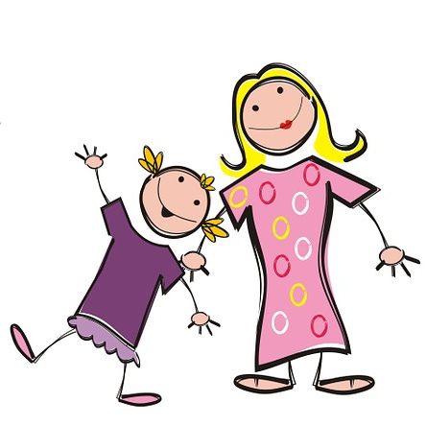
Avoir: nous and vous
avoir: nous and vous
parler
Avoir: nous and vous
Nous avons deux sœurs.
We have two sisters.
Notes:
Note the SFC in the plural noun.
Procedure:
1. Listen and repeat.
2. Ask students to translate the sentence.
3. Reveal picture on a click, ask students to check their translations.
4. Reveal English translation on click.

Slide 17
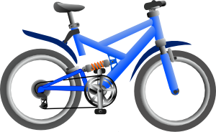
Avoir: nous and vous
avoir: nous and vous
parler
Avoir: nous and vous
Vous avez des vélos.
You (pl) have bikes.
Notes:
Note the SFC in the plural noun.
Procedure:
1. Listen and repeat.
2. Ask students to translate the sentence.
3. Reveal picture on a click, ask students to check their translations.
4. Reveal English translation on click.

Slide 18
Avoir: nous and vous
avoir: nous and vous
parler
Avoir: nous and vous
Nous avons des rêves.
We have dreams.
Notes:
Note the SFC in the plural noun.
Procedure:
1. Listen and repeat.
2. Ask students to translate the sentence.
3. Reveal picture on a click, ask students to check their translations.
4. Reveal English translation on click.

Slide 19
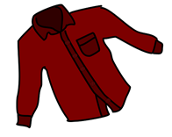
Avoir: nous and vous
avoir: nous and vous
parler
Avoir: nous and vous
Vous avez des chemises.
You (pl) have shirts.
Notes:
Listen and repeat.
Procedure:
1. Listen and repeat.
2. Ask students to translate the sentence.
3. Reveal picture on a click, ask students to check their translations.
4. Reveal English translation on click.

Slide 20
Avoir: nous and vous
avoir: nous and vous
parler
Avoir: nous and vous
Nous avons un problème.
We have a problem.
Notes:
An example with nous avons + un to further illustrate liaison before indefinite article.
NB: Teacher to explain to students that they may also hear ‘avons un(e)’ without the liaison, as both pronunciations are considered correct and pronunciation varies by individual speaker. The liaison is included here to provide maximal practice opportunities for students to recognise both variants.
Procedure:
1. Listen and repeat.
2. Ask students to translate the sentence.
3. Reveal picture on a click, ask students to check their translations.
4. Reveal English translation on click.

Slide 21
Avoir: nous and vous
avoir: nous and vous
parler
Avoir: nous and vous
Vous avez des enfants.
You (pl) have children.
Notes:
Note the SFC in the plural noun.
Procedure:
1. Listen and repeat.
2. Ask students to translate the sentence.
3. Reveal picture on a click, ask students to check their translations.
4. Reveal English translation on click.

Slide 22
Avoir: nous and vous
avoir: nous and vous
parler
Avoir: nous and vous
Nous avons une famille.
We have a family.
Notes:
An example with nous avons + une to further illustrate liaison before indefinite article.
NB: Teacher to explain to students that they may also hear ‘avons un(e)’ without the liaison, as both pronunciations are considered correct and pronunciation varies by individual speaker. The liaison is included here to provide maximal practice opportunities for students to recognise both variants.
Procedure:
1. Listen and repeat.
2. Ask students to translate the sentence.
3. Reveal picture on a click, ask students to check their translations.
4. Reveal English translation on click.

Slide 23
Avoir: nous and vous
avoir: nous and vous
parler
Avoir: nous and vous
Vous avez une maison.
You (pl) have a house.
Notes:
An example with vous avez + une to illustrate lack of liaison before indefinite article.
NB: Teacher to explain to students that they may also hear ‘avez un(e)’ without the liaison, as both pronunciations are considered correct and pronunciation varies by individual speaker. The liaison is included here to provide maximal practice opportunities for students to recognise both variants.
Procedure:
1. Listen and repeat.
2. Ask students to translate the sentence.
3. Reveal picture on a click, ask students to check their translations.
4. Reveal English translation on click.

Slide 24
Avoir: nous and vous
avoir: nous and vous
parler
Nous avons une solution.
We (pl) have a solution.
Notes:
An example with nous avez + une to illustrate lack of liaison before indefinite article.
NB: Teacher to explain to students that they may also hear ‘avons un(e)’ without the liaison, as both pronunciations are considered correct and pronunciation varies by individual speaker. The liaison is included here to provide maximal practice opportunities for students to recognise both variants.
Procedure:
1. Listen and repeat.
2. Ask students to translate the sentence.
3. Reveal picture on a click, ask students to check their translations.
4. Reveal English translation on click.

Slide 25
Avoir: nous and vous
avoir: nous and vous
parler
Vous avez une solution.
You (pl) have a solution.
Notes:
NB: Teacher to explain to students that they may also hear ‘avez un(e)’ without the liaison, as both pronunciations are considered correct and pronunciation varies by individual speaker. The liaison is included here to provide maximal practice opportunities for students to recognise both variants.
Procedure:
1. Listen and repeat.
2. Ask students to translate the sentence.
3. Reveal picture on a click, ask students to check their translations.
4. Reveal English translation on click.

Slide 26
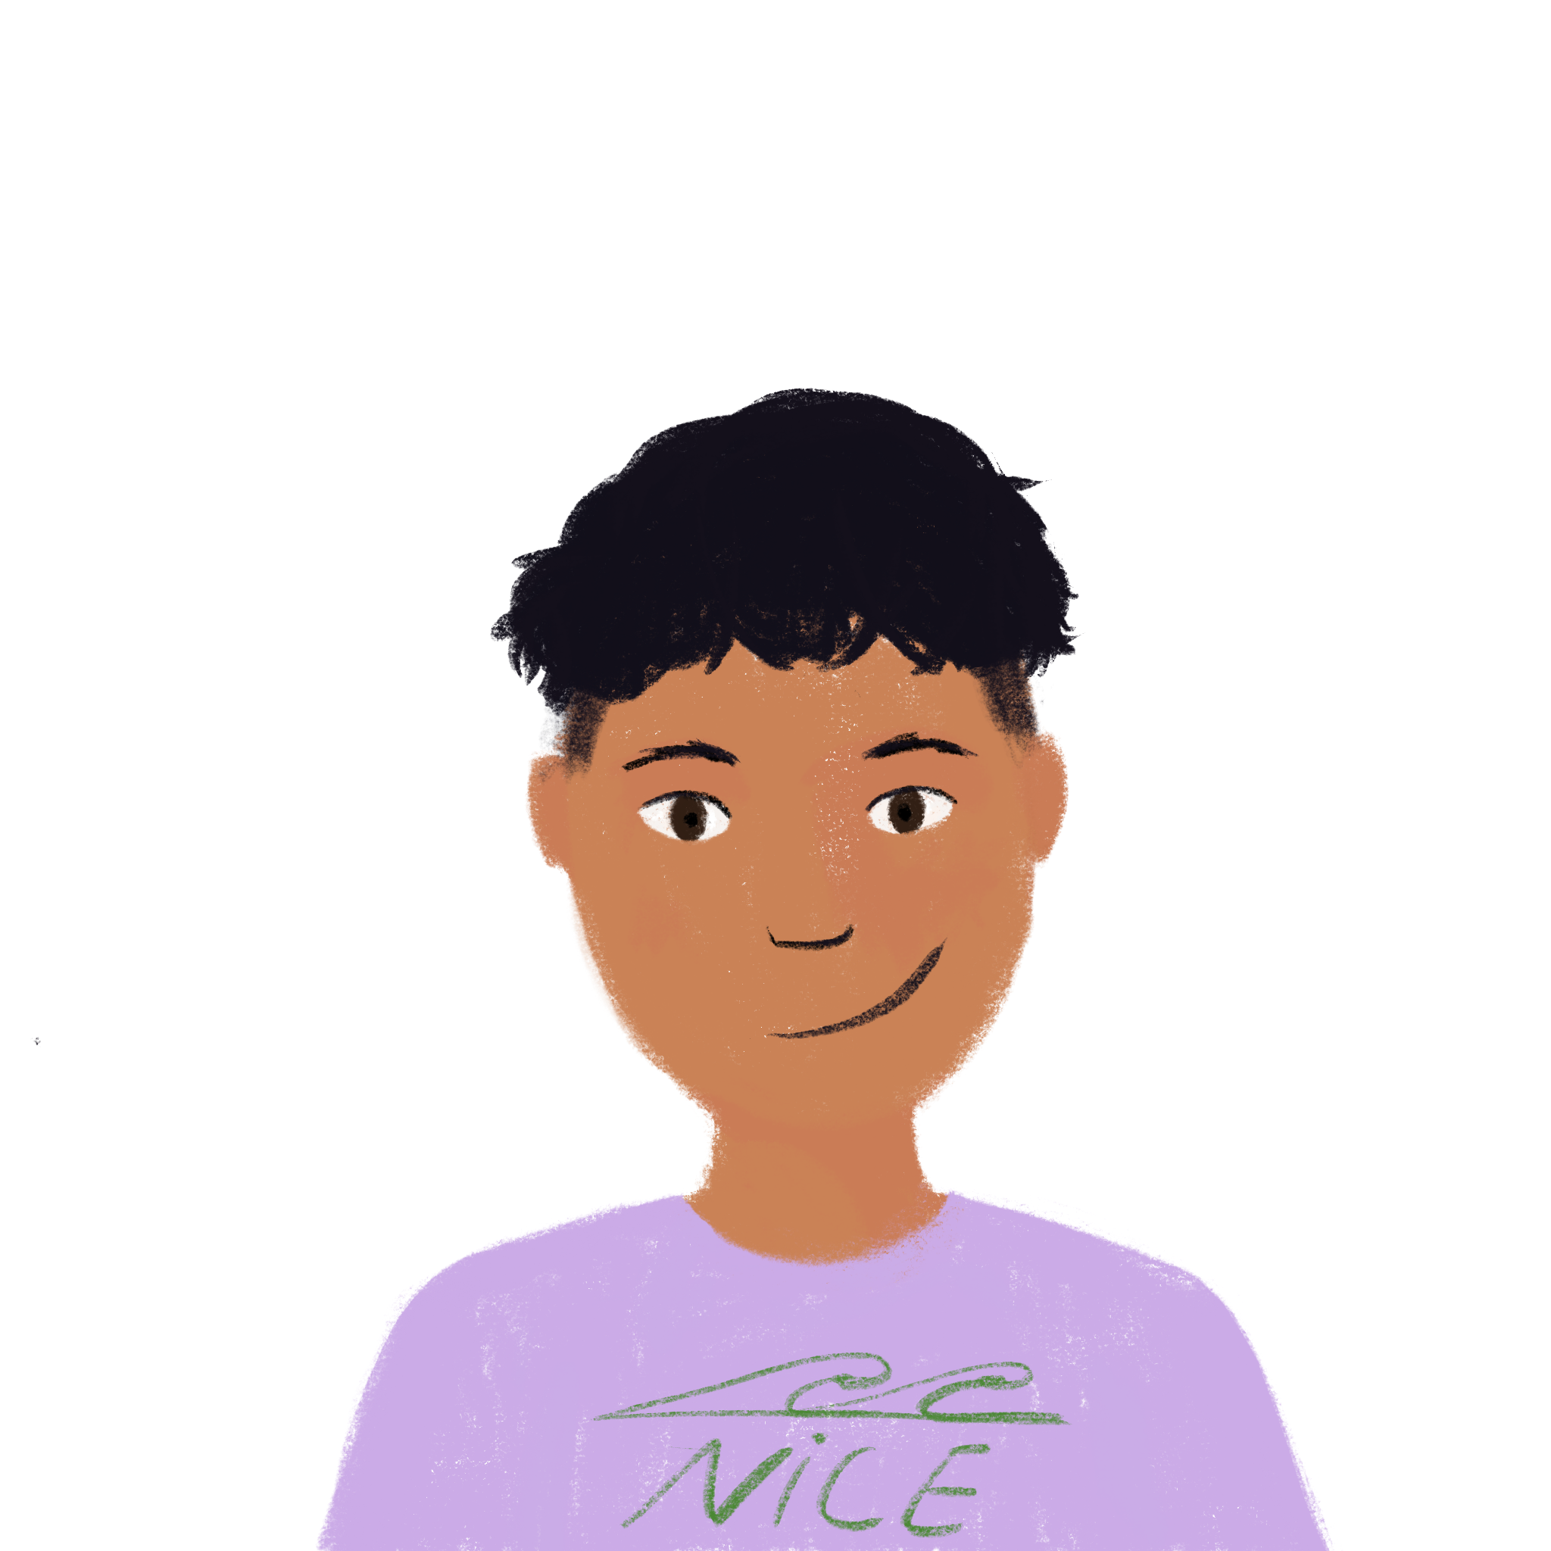
Deux villes françaises
Deux villes françaises
* d’accord - okay
lire
Students in Paris and Nice are chatting about their cities. Both groups think their city is best!
Who has what in their city? Lis et écris nous (we) ou vous (you pl.)
@6ème_paris: Nous avons la Tour Eiffel et l'Arc de Triomphe ici!
@6ème_nice: Oui, vous avez des monuments mais nous avons le ciel bleu ici!
@6ème_paris: D’accord*, vous avez la Méditerranée et des bateaux, mais nous avons une histoire riche!
@6ème_nice: OK, vous avez une culture unique. Mais nous avons les Alpes ici!
@6ème_paris: Bah … nous avons des restaurants excellents et des magasins modernes!
@6ème_nice: Euh … nous avons des restaurants excellents et des magasins modernes aussi!
______
______
______
______
______
______
______
______
______
Notes:
Timing: 5 minutes
Aim: Written recognition of the 1st and 2nd person plural forms of avoir.
Procedure:
1. Students complete the activity by simply writing nous, vous, nous etc. in their workbooks, using their knowledge of forms of avoir to guide them.
2. They address the ‘who has what?’ part of the question by writing the items down in English.
3. Answers revealed on individual clicks. Teacher elicits answers by pointing at a gap and asking ‘Nous ou vous?’ Then s/he elicits the English for ‘who has what’.
4. Teacher to draw attention to the following points:
Ville is a false friend – teacher to ask students what they think the word might mean, given the context, and correct/explain as appropriate. La ville [260] is introduced as a vocabulary item in 2.2.2.
French spelling/pronunciation of la Tour Eiffel, l’Arc de Triomphe and les Alpes.
6ème – touch briefly on structure of the French school system. Explain that these students will be around the same age as students in Year 7 in the UK.
Students have not yet encountered cognates riche, culture or unique, but should be able to infer the meanings.
Students have not yet encountered an irregular plural ending – point this out and the SFC in bateaux. Ask students what they think this word means. Explain that some nouns have irregular plural endings, and that further examples will be encountered in future weeks.
Answers: 1. Nous – Eiffel tower, Arc de Triomphe 2. Vous – monuments, nous – blue sky 3. Vous – sand, boats, nous – rich history 4. Vous – unique culture, nous – Alps 5. Nous – excellent restaurants and modern shops 6. Nous – excellent restaurants and modern shops
Note:
Last week, students were taught regular plural adjective agreement as complement to the verb être. They have previously been taught postnominal adjective agreement with singular nouns. (Week 1.1.4). Teacher to draw students’ attention to the spelling of ‘excellents’ and ‘modernes’ and elicit the reason for this.
Word frequency of cognates used (1 is the most frequent word in French): monument [4113], d’accord [736], Méditerranée [n/a], riche [599], culture [913], unique [402], restaurant [2336], excellent [1225]
Source: Londsale, D., & Le Bras, Y. (2009). A Frequency Dictionary of French: Core vocabulary for learners London: Routledge.

Slide 27
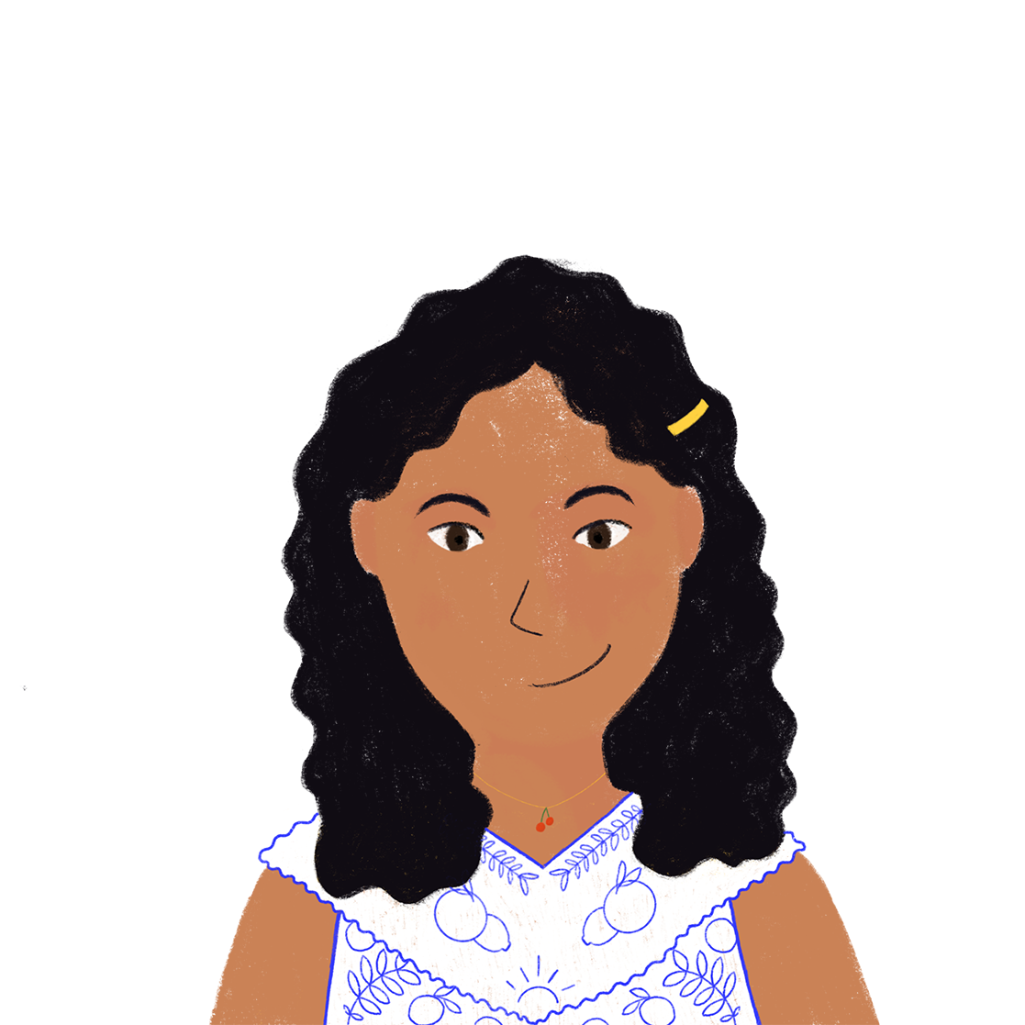
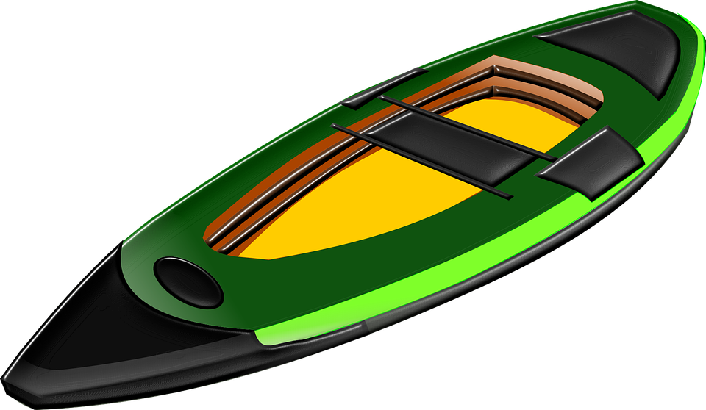
Deux chambres différentes
écouter
Noura and Amir are speaking to their cousins about their rooms. Who has what? Coche.
 | Noura et Amir (nous - we) | les cousins (vous – you pl.)
 | Noura et Amir (nous - we) | les cousins (vous – you pl.)
Notes:
Timing: 8 minutes
Aim: Aural recognition of 1st and 2nd person plural forms of avoir.
Procedure:
1. Press the play button to hear a monologue with the pronouns obscured.
2. Using their knowledge of verb forms to help them, students tick whether they think each item belongs to Noura and Amir (nous) or their cousins (vous).
3. Answers on next slide. Full verb forms appear on clicks.
Transcript (plays on clicking the play button):
[beep] avons des livres et [beep] avons aussi une radio. [beep] avez un vélo et [beep] avons un kayak. [beep] avons des lits bleus et [beep] avez des lits verts. [beep] avez des T-shirts et [beep] avons des chemises. [beep] avez une télé et [beep] avons un ordinateur. [beep] avez deux ordinateurs mais [beep] avons un chien!
Word frequency of cognates used (1 is the most frequent word in French): différent [350], cousin [3387], kayak [>5000], T-shirt [>5000],
Source: Londsale, D., & Le Bras, Y. (2009). A Frequency Dictionary of French: Core vocabulary for learners London: Routledge.

Slide 28
Deux chambres
Deux chambres différentes
écouter
Noura and Amir are speaking to their cousins about their rooms. Who has what? Coche.
 | Noura et Amir (nous - we) | les cousins (vous – you pl.)
 | Noura et Amir (nous - we) | les cousins (vous – you pl.)
Notes:
Answers to the activity on the previous slide. Full dialogue (including pronouns) appears on a click.
Transcript:
Nous avons des livres et nous avons aussi une radio. Vous avez un vélo et nous avons un kayak. Nous avons des lits bleus et vous avez des lits verts. Vous avez des T-shirts et nous avons des chemises. Vous avez une télé et nous avons un ordinateur. Vous avez deux ordinateurs mais nous avons un chien!

Slide 29
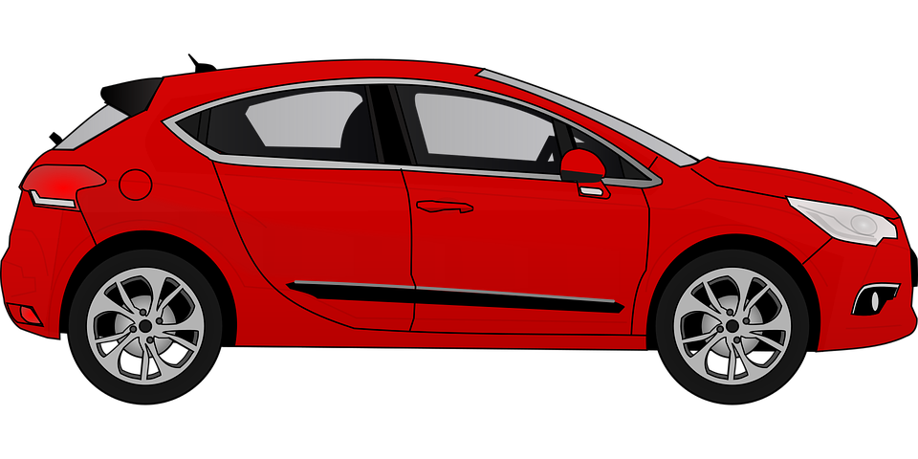
Nous ou vous ?
Nous ou vous ?
écouter / parler (1/2)
Who has what? Étudiant(e) A parle. Étudiant(e) B écoute et écris ‘nous’ ou ‘vous’.
nous (we) vous (you pl.)
nous (we) vous (you pl.)
nous (we) vous (you pl.)
nous (we) vous (you pl.)
nous (we) vous (you pl.)
nous (we) vous (you pl.)
nous (we) vous (you pl.)
nous (we) vous (you pl.)
nous (we) vous (you pl.)
nous (we) vous (you pl.)
nous (we) vous (you pl.)
nous (we) vous (you pl.)
Notes:
Timing: 8 minutes
Aim: Oral production of sentences containing 1st and 2nd person plural forms of avoir.
Procedure:
1. Before beginning the activity, the teacher may wish to:
revise use of un/une and des, ensuring students know when to use each here;
remind students to be aware of liaison use. A mixture of definite and indefinite articles are included here so students have to think about whether a liaison is required or not.
2. Teacher distributes 2.1.3 grammar practice role cards, found on the portal alongside this sequence, among students.
3. Student A reads the sentences on their card, omitting the pronoun in brackets. Student B writes nous or vous in their workbooks.
4. Answers revealed on clicks.
5. Teacher says each sentence again. Students repeat.
(Optional writing activity) Both students write two sentences, one beginning with nous and the other with vous, summarising who has what.
Transcript (student A):
[Nous] avons une télé.
[Nous] avons des portables.
[Vous] avez des radios.
[Nous] avons un bateau.
[Vous] avez une voiture.
[Nous] avons des livres.

Slide 30
Nous ou vous ?
Nous ou vous ?
écouter / parler (2/2)
Who has what? Étudiant(e) A parle. Étudiant(e) B écoute et écris ‘nous’ ou ‘vous’.
nous (we) vous (you pl.)
nous (we) vous (you pl.)
nous (we) vous (you pl.)
nous (we) vous (you pl.)
nous (we) vous (you pl.)
nous (we) vous (you pl.)
nous (we) vous (you pl.)
nous (we) vous (you pl.)
nous (we) vous (you pl.)
nous (we) vous (you pl.)
nous (we) vous (you pl.)
nous (we) vous (you pl.)
Notes:
Procedure:
1. Student A reads the sentences on their card, omitting the pronoun in brackets.
2. Student B writes nous or vous in their workbooks.
3. Answers revealed on clicks.
4. Teacher says each sentence again. Students repeat.
5. (Optional writing activity) Both students write two sentences, one beginning with nous and the other with vous, summarising who has what.
Transcript (student B):
[Nous] avons une télé.
[Vous] avez des portables.
[Nous] avons des radios.
[Vous] avez un bateau.
[Nous] avons une voiture.
[Nous] avons des livres.

Slide 31
Vocabulaire
lire, écrire, parler
?
1. problématique
2. je fais un ____ à Paris
3. parler, écouter, lire et …
4. le contraire: faire beau
5. je porte …
6. je fais … dans le parc
7. faire les courses
8. un véhicule
9. le prof écrit au …
10. bon
 |  |  | U
U | N | E
F | A | I | R
 |  |  |  |  | D | I | F | F | I | C | I | L | E
 |  |  | U | N |  | V | O | Y | A | G | E
 |  |  |  |  | É | C | R | I | R | E
 | F | A | I | R | E |  | M | A | U | V | A | I | S
N | E |  | C | H | E | M | I | S | E
P | R | O | M | E | N | A | D | E
E |  | L | E | S |  | M | A | G | A | S | I | N | S
 |  |  |  | L | E |  | B | A | T | E | A | U
 |  |  |  | T | A | B | L | E | A | U
 |  |  |  |  | B | I | E | N
Notes:
Timing: 8 minutes
Aim: Written recognition and production of the remaining words in this week’s vocabulary sets. NB: a more complex version of this task, in which only the first letter of each word is given, can be found on the next slide. Note: The clues, which relate to the words directly to their right, contain some cognates, the meanings of which may not be clear to all students. Teacher should draw attention to problématique, contraire, parc and véhicule and ask students for potential English translations.
Procedure: 1. Teacher asks question / gives clue in French as per 1-10 on slide. 2. Student(s) volunteer(s) the answer (e.g. difficile).
3. Teacher repeats the answer, and draws attention to any pronunciation points (note the SFC on mauvais, magasins and the eau SSC on bateau and tableau, which is this week’s phonics focus). 4. Teacher asks ‘Comment ça s'écrit?’ 5. Students in chorus (slowly and steadily) respond to spell out the answer: D – I – F – F – I – C – I – L – E. As students spell the word, teacher reveals each letter on a click.
6. By working out the answers to the clues and spelling out the words correctly, students create the near-cognate formidable. Teacher to explain that this is an appropriate praise word for completing a task correctly!
Word frequency of unknown vocabulary and cognates used (1 is the most frequent word in French): problématique [4066], contraire [619], parc [1240], véhicule [1959], formidable [2722]
Source: Londsale, D., & Le Bras, Y. (2009). A Frequency Dictionary of French: Core vocabulary for learners London: Routledge.

Slide 32
Vocabulaire
lire, écrire, parler
?
1. problématique
2. je fais un ____ à Paris
3. parler, écouter, lire et …
4. le contraire: faire beau
5. je porte …
6. je fais … dans le parc
7. faire les courses
8. un véhicule
9. le prof écrit au …
10. bon
 |  |  | U
U | N | E
F | A | I | R
 |  |  |  |  | D | I | F | F | I | C | I | L | E
 |  |  | U | N |  | V | O | Y | A | G | E
 |  |  |  |  | É | C | R | I | R | E
 | F | A | I | R | E |  | M | A | U | V | A | I | S
N | E |  | C | H | E | M | I | S | E
P | R | O | M | E | N | A | D | E
E |  | L | E | S |  | M | A | G | A | S | I | N | S
 |  |  |  | L | E |  | B | A | T | E | A | U
 |  |  |  | T | A | B | L | E | A | U
 |  |  |  |  | B | I | E | N
Notes:
Differentiated version of the activity on the previous slide.
Note: a less complex version of this task, in which several letters of each word are given, can be found on the previous slide.

Slide 33
Saying what people have
avoir (ils/elles)
SSC [au] [revisited]
s-liaison
Y7 French
Term 2.1 - Week 3 - Lesson 34
Natalie Finlayson / Emma Marsden / Rachel Hawkes
Artwork by: Chloé Motard
Date updated: 04/08/2022
Notes:
Artwork by Chloé Motard. All additional pictures selected are available under a Creative Commons license, no attribution required.
Learning outcomes (lesson 1):
Introduction of third person plural forms of avoir
Consolidation of SSC [au]
Consolidation of s-liaison
Word frequency (1 is the most frequent word in French):
7.2.1.3 (introduce) avons [8], avez [8], ont [8], enfant [126], famille [172], problème [188], difficile [296], ici [167], très [66], aussi [44], pour¹ [10], dans [11]
7.1.2.7 (revisit) fermer [757], regarder² [425], vous¹ [50], chemise [3892], classe [778], fenêtre [1604], porte [696], salle [812], silence [1281], tableau [1456], bien [47]
7.1.2.2 (revisit) bateau [1287], magasin [1736], numéro [766], promenade [>5000], question [144], réponse [456], visite [1072], voyage [904], beau [393], mauvais¹ [274], de¹ [2], en² [7], Paris [n/a], Londres [n/a]
Source: Londsale, D., & Le Bras, Y. (2009). A Frequency Dictionary of French: Core vocabulary for learners London: Routledge.
The frequency rankings for words that occur in this PowerPoint which have been previously introduced in NCELP resources are given in the NCELP SOW and in the resources that first introduced and formally re-visited those words.
For any other words that occur incidentally in this PowerPoint, frequency rankings will be provided in the notes field wherever possible.
The additional English meanings of the following words have been added to Quizlet since the creation of this resource: problème (problem, issue)

Slide 34
Phonétique
Partenaire A
écouter / écrire
1
3
A | beau | se | causer
B | beau | seau | caser
C | bas | seau | caser
A | peu | veau | poivron
B | peau | va | pauvre
C | peau | veau | poivron
[self]
[to cause]
[a little]
[to place]
[skin]
[goes]
[poor]
[bottom]
[to place]
[skin]
2
4
A | gâche | jaune | faux
B | gauche | jaune | feu
C | gauche | jeune | faux
A | soif | haute | eau
B | sauf | haute | eu
C | sauf | hâte | eau
[wastes]
[thirst]
[high]
[left]
[except]
[high]
[was]
[left]
[except]
[haste]
Notes:
Timing: 5 minutes
Aim: Oral production and recognition of SSC [au] in minimal pairs with SSCs [e], [a], [e] and [oi]
Procedure:
1. Print or sketch the role cards found on slide 36. These show the lines of words each partner needs to read.
2. Students word in pairs. Give each student a role card and tell them they need to read only the line of text indicated on their card.
3. Student A reads first. Bring up this slide (34). Starting with box 1, student A reads the line of words indicated by the letter on their rolecard.
4. Student B write whether they hear row A, B or C in each case.
5. Answers revealed on clicks.
6. Bring up the next slide (35). Students swap roles.
7. Repeat steps 1-5.
Word frequency of unknown words used (1 is the most frequent word in French): se [17], causer [1089], caser [>5000], bas [468], gâcher [4623], gauche [607], peu [91], veau [>5000], poivron [>5000], peau [2122], pauvre [699], soif [4659], sauf [476], haut [264], hâte [3460], eu [avoir-8]
Source: Londsale, D., & Le Bras, Y. (2009). A Frequency Dictionary of French: Core vocabulary for learners London: Routledge.

Slide 35
Phonétique
Partenaire B
écouter / écrire
1
3
A | beau | seau | caser
B | bas | seau | caser
C | beau | se | causer
A | peau | veau | pauvre
B | peu | veau | poivron
C | peau | va | pauvre
[to place]
[skin]
[poor]
[bottom]
[to place]
[a little]
[self]
[to cause]
[skin]
[goes]
[poor]
2
4
A | gauche | jeune | faux
B | gauche | jeune | feu
C | gâche | jaune | faux
A | sauf | hâte | eau
B | soif | haute | eu
C | soif | haute | eau
[left]
[except]
[haste]
[left]
[thirst]
[high]
[was]
[wastes]
[thirst]
[high]

Slide 36
Phonétique
Rolecards
écouter / écrire
Partner A: 1A, 2C, 3A, 4B
Partner A: 1A, 2C, 3A, 4B
Partner A: 1A, 2C, 3A, 4B
Partner A: 1A, 2C, 3A, 4B
Partner A: 1A, 2C, 3A, 4B
Partner A: 1A, 2C, 3A, 4B
Partner A: 1A, 2C, 3A, 4B
Partner A: 1A, 2C, 3A, 4B
Partner A: 1A, 2C, 3A, 4B
Partner A: 1A, 2C, 3A, 4B
Partner A: 1A, 2C, 3A, 4B
Partner A: 1A, 2C, 3A, 4B
Partner B: 1B, 2B, 3A, 4C
Partner B: 1B, 2B, 3A, 4C
Partner B: 1B, 2B, 3A, 4C
Partner B: 1B, 2B, 3A, 4C
Partner B: 1B, 2B, 3A, 4C
Partner B: 1B, 2B, 3A, 4C
Partner B: 1B, 2B, 3A, 4C
Partner B: 1B, 2B, 3A, 4C
Partner B: 1B, 2B, 3A, 4C
Partner B: 1B, 2B, 3A, 4C
Partner B: 1B, 2B, 3A, 4C
Partner B: 1B, 2B, 3A, 4C
Notes:
For printing: role cards for the activity on slides 34-36.

Slide 37
Vocabulaire
Vocabulaire
écouter / parler / écrire (1/2)
Vocabulaire
Étudiant(e) A
Lis l’histoire.
Étudiant(e) B
Écoute. Complète les phrases.
Le frère de Lucille a un problème.
Il a un cadeau intèressant pour Lucille.
C’est un serpent!
Mais Lucille préfère les chiens. Elle demande
un chien aussi.
C’est une situation difficile pour la famille!
___ __________
Use aussi (also) at the end of a sentence.
The word order is different from English.
_____
_____
_____
___ __________ !
Notes:
Timing: 6 minutes
Aim: Aural recognition, pronunciation and spelling of words in this week’s vocabulary set.
Procedure:
1. Teacher distributes 2.1.3 vocabulary practice role cards (uploaded as a word document together with this resource) to students.
2. Teacher explains that student A is going to read their story first. Student B listens, and writes the words they hear.
3. Teacher elicits answers from the full group, practising pronunciation again. Answers revealed on clicks.
4. On revealing answer, teacher to spend some time discussing the position of aussi in the sentence (normall at the end of the sentence, unlike in English).
Notes:
The stories are composed entirely of known vocabulary items nd cognates, and have been designed so that students cannot guess what the missing word must be from context.
Students have not yet encountered préférer [597], but should be able to work out the meaning from the cognate. The third person form Lucille préfère gives students the opportunity to practise pronunciation of SSCs [é] and [è].
Word frequency of cognates used (1 is the most frequent word in French): serpent [>5000], situation [223]
Source: Londsale, D., & Le Bras, Y. (2009). A Frequency Dictionary of French: Core vocabulary for learners London: Routledge.

Slide 38
Vocabulaire
Vocabulaire
écouter / parler / écrire (2/2)
Vocabulaire
Vocabulaire
Étudiant(e) B
Lis l’histoire.
Étudiant(e) A
Écoute. Complète les phrases.
Marc est dans la classe d’Amir. Il étudie l’anglais ici.
Mais Marc a un problème. Il trouve l’anglais très difficile.
Marc travaille bien en classe et il fait les devoirs chaque semaine aussi. Il parle très bien anglais!
C’est un enfant intelligent!
_____
___ .
Use très (very) before an adjective or adverb to add emphasis.
The word order is the same as in English.
___ _______
____
________ .
____
____
___ _______
Notes:
Procedure:
1. Teacher explains that student B is now going to read their story. Student A listens, and writes the words they hear.
2. Teacher elicits answers from the full group, practising pronunciation again. 3. Answers revealed on clicks.
4. Teacher to draw attention to the difference in meaning between the use of the article in Il étudie l’anglais, and the lack of an article in il parle très bien anglais. Teacher to explain the difference in meaning - l’anglais is a school subject, anglais is a language.
5. On revealing answer, teacher to spend some time discussing the position of très in the sentence (directly before an adjective or adverb, as in English).
Note:
The stories are composed entirely of known vocabulary items and cognates, and have been designed so that students cannot guess what the missing word must be from context.
Word frequency of cognates used (1 is the most frequent word in French): serpent [>5000], situation [223], classe [778]
Source: Londsale, D., & Le Bras, Y. (2009). A Frequency Dictionary of French: Core vocabulary for learners London: Routledge.

Slide 39
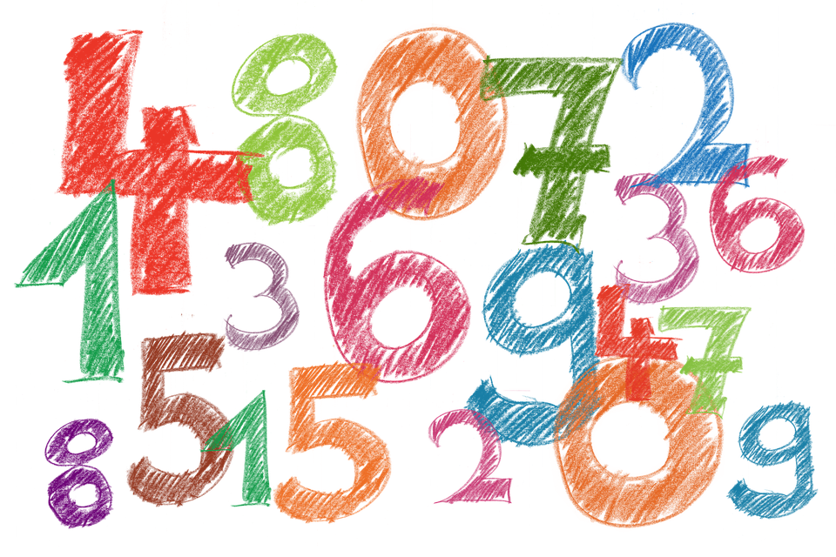
Vocabulaire
parler
to look at, looking at
C’est quoi en français ?
London
to close, closing
of
room
silence
?
in, by
trip
Notes:
Timing: 3 minutes
Aim: Oral production of some of the words in this weeks revisited vocabulary sets.
Procedure:
Teachers point at a picture or English word.
As a class or in pairs/small groups, students try to be the first to say the words in French.
Word frequency (1 is the most frequent word in French): fermer [757], regarder² [425], fenêtre [1604], porte [696], salle [812], silence [1281], voyage [904], visite [1072], de¹ [2], en² [7], Londres [n/a], question [144], numéro [766]

Slide 40
Avoir: ils and elles
avoir: ils and elles
grammaire
Avoir: ils and elles
Avoir: nous and vous
To say one person has something, use il (m.) or elle (f.) with the correct form of avoir.
Il a des chiens. Elle a des chiens.
He has dogs. She has dogs.
To say ‘they’ + avoir (third person plural):
Ils ont des chiens. They (m. pl.) have dogs.
They (mixed pl.) have dogs.
Elles ont des chiens. They (f. pl.) have dogs.
Marc et Léa ont des chiens. Noura and Amir have dogs.
__
__
The final –t in ont
is a Silent Final Consonant.
The final consonant in ils and elles is not an SFC here! Because the -s is followed by a vowel, liaison occurs.
__
__
___________
Notes:
Timing: 2 minutes
Aim: To present the 3rd person plural forms of avoir.
Procedure
1. Teacher recaps the meaning of the pronouns ils and elles.
2. Teacher to remind students of the meaning of the pronouns ils and elles. Teacher to highlight that groups of named people (e.g. Noura and Amir) also need the 3rd person plural form.
3. Teacher to remind students of the meaning of the indefinite plural article des. The examples given illustrate its absence in English. Note the SFC in the plural chiens.
4. Teacher to point out that avoir is irregular in French. As with être, there is a different form for each pronoun.
5. Teacher to draw attention to the pronunciation (SFC on the verb, but not the pronoun). Explain that a liaison sometimes occurs when SFCs appear before a vowel, and that this can lead to a change in pronunciation in the consonant (here, like the English ‘z’.) Additional pronunciation practice of nous avons and vous avez appears in the slides that follow.

Slide 41
Avoir: ils and elles
avoir: ils and elles
parler
Avoir: nous and vous
ils ont
they (m or m/f) have
Notes:
Timing: 4 minutes for 12 slides
Procedure:
Listen and repeat.
Highlight that ils ont sounds like one word, rather than two.

Slide 42
Avoir: ils and elles
avoir: ils and elles
parler
Avoir: ils and elles
Avoir: nous and vous
elles ont
they (f) have
Notes:
Procedure:
Listen and repeat.
Highlight that elles ont sounds like one word, rather than two.

Slide 43
Avoir: ils and elles
avoir: ils and elles
parler
Avoir: ils and elles
Avoir: nous and vous
ils ont
they (m or m/f) have
Notes:
Procedure:
Listen and repeat.
Highlight that ils ont sounds like one word, rather than two.

Slide 44
Avoir: ils and elles
avoir: ils and elles
parler
Avoir: ils and elles
Avoir: nous and vous
elles ont
they (f) have
Notes:
Procedure:
Listen and repeat.
Highlight that elles ont sounds like one word, rather than two.

Slide 45
Avoir: ils and elles
avoir: ils and elles
parler
Avoir: ils and elles
Avoir: nous and vous
Ils ont deux sœurs.
They (m/f) have two sisters.
Notes:
Procedure:
1. Listen and repeat. Note the SFC in the plural noun.
2. Ask students to translate the sentence.
3. Reveal picture on a click, ask students to check their translations.
4. Reveal English translation on click.

Slide 46
Avoir: ils and elles
avoir: ils and elles
parler
Avoir: ils and elles
Avoir: nous and vous
Elles ont des vélos.
They (f) have bikes.
Notes:
Procedure:
Listen and repeat. Note SFC in plural noun.
Ask students to translate the sentence.
Reveal picture on a click, ask students to check their translations.
Reveal English translation on click.

Slide 47
Avoir: ils and elles
avoir: ils and elles
parler
Avoir: ils and elles
Avoir: nous and vous
Ils ont des rêves.
They (m/f) have dreams.
Notes:
Procedure:
1. Listen and repeat. Note SFC in plural noun
2. Ask students to translate the sentence.
3. Reveal picture on a click, ask students to check their translations.
4. Reveal English translation on click.

Slide 48
Avoir: ils and elles
avoir: ils and elles
parler
Avoir: ils and elles
Avoir: nous and vous
Elles ont des chemises.
They (f) have shirts.
Notes:
Procedure:
Listen and repeat. Note SFC in plural noun.
Ask students to translate the sentence.
Reveal picture on a click, ask students to check their translations.
Reveal English translation on click.

Slide 49
Avoir: ils and elles
avoir: ils and elles
parler
Avoir: ils and elles
Avoir: nous and vous
Ils ont un problème.
They (m) have a problem.
Here, there is a liaison between –t and the vowel which follows.
Notes:
Procedure:
1. Listen and repeat. Example with ils ont + un to illustrate –t liaison.
2. Ask students to translate the sentence.
3. Reveal picture on a click, ask students to check their translations.
4. Reveal English translation on click.

Slide 50
Avoir: ils and elles
avoir: ils and elles
parler
Avoir: ils and elles
Avoir: nous and vous
Elles ont une maison.
They (f) have a house.
Notes:
Procedure:
1. Listen and repeat. An example with elles ont + une to illustrate t- liaison.
2. Ask students to translate the sentence.
3. Reveal picture on a click, ask students to check their translations.
4. Reveal English translation on click.

Slide 51
Avoir: ils and elles
avoir: ils and elles
parler
Avoir: ils and elles
Avoir: nous and vous
Elles ont une famille.
They (f) have a family.
Notes:
Procedure:
1. Listen and repeat. An example with elles ont + une to illustrate t- liaison.
2. Ask students to translate the sentence.
3. Reveal picture on a click, ask students to check their translations.
4. Reveal English translation on click.

Slide 52
Avoir: ils and elles
avoir: ils and elles
parler
Avoir: ils and elles
Avoir: nous and vous
Ils ont un enfant.
They (m, m/f) have a child.
Notes:
Procedure:
1. Listen and repeat. An example with ils ont + un to illustrate -t liaison.
2. Ask students to translate the sentence.
3. Reveal picture on a click, ask students to check their translations.
4. Reveal English translation on click.

Slide 53
Il, elle, ils ou elles?
Q
A
écouter, écrire et parler
Whose things are these? Écoute, écris et parle!
Ils ont
une voiture.
elle (she)
ils (they)
Notes:
Timing: 5 minutes for 7 slides
Aim: Aural recognition of avoir in the 3rd person singular and 3rd person plural.
Procedure:
1. Click ‘Q’ in the top right to hear the audio with the pronoun obscured.
2. Students listen and decide whether they hear the third person singular or plural form of avoir. Students write what they hear in their workbooks.
3. Teacher elicits the answer by asking ‘Elle ou ils?’ Tell students they should answer in a full sentence, and pay attention to any necessary liaisons.
4. Students respond ‘Ils ont une voiture.’
5. Answer revealed on click.
6. Teacher clicks on ‘A’ in the top right to play the recording including the pronoun. Students repeat for additional pronunciation practice.
Transcript
Q. [beep] ont une voiture.
A. Ils ont une voiture.

Slide 54
Il, elle, ils ou elles?
Q
A
écouter, écrire et parler
Whose things are these? Écoute, écris et parle!
Il a
une idée
il (he)
elles (they)
Notes:
Transcript
Q. [beep] a une idée.
A. Il a une idée.

Slide 55
Il, elle, ils ou elles?
Q
A
écouter, écrire et parler
Whose things are these? Écoute, écris et parle!
Elle a
un bateau.
elle (she)
elles (they)
Notes:
Transcript
Q. [beep] a un bateau.
A. Elle a un bateau.

Slide 56
Il, elle, ils ou elles?
Q
A
écouter, écrire et parler
Whose things are these? Écoute, écris et parle!
Ils ont
une chambre.
il (he)
ils (they)
Notes:
Transcript
Q. [beep] ont une chambre.
A. Ils ont une chambre.

Slide 57
Il, elle, ils ou elles?
Q
A
écouter, écrire et parler
Whose things are these? Écoute, écris et parle!
Elles ont
un livre.
il (he)
elles (they)
Notes:
Transcript
Q. [beep] a un livre.
A. Elles ont un livre.

Slide 58
Il, elle, ils ou elles?
Q
A
écouter, écrire et parler
Whose things are these? Écoute, écris et parle!
Elle a
un chien.
elle (she)
ils (they)
Notes:
Transcript
Q. [beep] a un chien.
A. Elle a un chien.

Slide 59
Il, elle, ils ou elles?
Q
A
écouter, écrire et parler
Whose things are these? Écoute, écris et parle!
Elles ont
un ordinateur.
elle (she)
elles (they)
Notes:
Transcript
Q. [beep] ont un ordinateur.
A. Elles ont un ordinateur.

Slide 60
Vocabulaire
Une situation d'urgence à l'école
lire, écouter et parler
Écoute et lis l’histoire.
1
2
3
4
5
6
7
Les professeurs de 6ème organisent un concert pour les enfants. Le concert est grand et important et les enfants sont très enthousiastes.
Les chanteurs sont drôles et très amusants. Ils chantent en anglais. Mais les professeurs ont un problème. Les chanteurs sont malades! La situation est très difficile.
Les professeurs ont une idée. Ils sont drôles et amusants, et ils parlent très bien anglais aussi …
Les professeurs portent des uniformes violets et ils chantent au concert. Ils sont des acteurs fantastiques!
Les enfants sont contents. La solution est super!
Notes:
Timing: 5 minutes
Aim: Developing segmenting scales (splitting up the audio into words).
This segmentation task is the first in a series of exercises relating to this longer text. The meaning of the text as a whole will be considered in the translation exercise which follows.
Procedure:
1. Teachers play the recording (clicking on numbers 1-7) whilst students read the text.
2. The audio is paused just before the words in bold, then resumes with the next audio button. (There is also a complete audio version of the full text - top of the screen, inserted with a player function, so it can be started and stopped).
3. The teacher then asks: a/ What is the next word? The students then read the next word out loud, practising segmentation skills. Check that students understand the meaning. b/ What type of word is it? The students then identify the word as a noun, verb, adjective or adverb, practising grammar knowledge. c/ What other word could be used instead? The students then offer an alternative word of the same word class that makes sense in context, practising vocabulary knowledge. Some suggestions below:
Le concert est petit/intéressant/super/excellent
Les chanteurs sont drôles et très sympas
Ils chantent en français
La situation est mauvaise/intéressante
Les professeurs ont une solution
Les professeurs d’anglais portent des chemises violets
Transcript:
Les professeurs de 6ème organisent un concert pour les enfants. Le concert est grand et important et les enfants sont très enthousiastes.
Les chanteurs sont drôles et très amusants. Ils chantent en anglais. Mais les professeurs ont un problème. Les chanteurs sont malades! La situation est très difficile. Les professeurs ont une idée. Ils sont drôles et amusants, et ils parlent très bien anglais aussi …
Les professeurs portent des uniformes violets et ils chantent au concert. Ils sont des acteurs fantastiques!
Les enfants sont contents. La solution est super!
Word frequency of cognates used (1 is the most frequent word in French): situation [223], urgence [1199], organiser [701], concert [1697], important [215], enthousiaste [4287], violet [>5000], fantastique [4107]
Source: Londsale, D., & Le Bras, Y. (2009). A Frequency Dictionary of French: Core vocabulary for learners London: Routledge.

Slide 61
Vocabulaire
Une situation d'urgence à l'école
lire
Trouve 16 verbes dans le texte.
Les professeurs de 6ème organisent un concert pour les enfants. Le concert est grand et important et les enfants sont très enthousiastes.
Les chanteurs sont drôles et très amusants. Ils chantent en anglais. Mais les professeurs ont un problème. Les chanteurs sont malades! La situation est très difficile.
Les professeurs ont une idée. Ils sont drôles et amusants, et ils parlent très bien anglais aussi …
Les professeurs portent des uniformes violets et ils chantent au concert. Ils sont des acteurs fantastiques!
Les enfants sont contents. La solution est super!
Notes:
Timing: 5 minutes
Aim: Written recognition of verb forms. All verbs included are regular in the present tense, with the exception of être and avoir. Remind students of the –ent ending on regular verbs in the third person plural, and that forms of être and avoir are also verbs. Point out that ‘to be’ and ‘to have’ are English verbs.
Procedure:
1. Students locate the verbs and indicate these by circling/underlining on a printed copy, or by writing a list in their workbooks.
2. Answers on next slide.

Slide 62
Vocabulaire
Une situation d'urgence à l'école
lire
Trouve 16 verbes dans le texte.
Les professeurs de 6ème organisent un concert pour les enfants. Le concert est grand et important et les enfants sont très enthousiastes.
Les chanteurs sont drôles et très amusants. Ils chantent en anglais. Mais les professeurs ont un problème. Les chanteurs sont malades! La situation est très difficile.
Les professeurs ont une idée. Ils sont drôles et amusants, et ils parlent très bien anglais aussi …
Les professeurs portent des uniformes violets et ils chantent au concert. Ils sont des acteurs fantastiques!
Les enfants sont contents. La solution est super!
Notes:
Teacher to check that the meaning of the verbs is known.

Slide 63
Vocabulaire
Une situation d'urgence à l'école
traduire
Écris l’histoire en anglais! Attention aux verbes au présent! Simple or continuous?
Les professeurs de 6ème organisent un concert pour les enfants. Le concert est grand et important et les enfants sont très enthousiastes.
Les chanteurs sont drôles et très amusants. Ils chantent en anglais. Mais les professeurs ont un problème. Les chanteurs sont malades! La situation est très difficile.
Les professeurs ont une idée. Ils sont drôles et amusants, et ils parlent très bien anglais aussi …
Les professeurs portent des uniformes violets et ils chantent au concert. Ils sont des acteurs fantastiques!
Les enfants sont contents. La solution est super!
Notes:
Timing: 10 minutes
Aim: L2 -> L1 translation.
Procedure:
1. Teacher to tell students to think carefully about how to translate the verbs into English. Recap the difference between the simple and continuous forms in English, and remind students that one form in French translates two in English. Students always have to decide between simple and continuous forms when translating into English.
2. Students attempt translation individually at first, and then compare translations with a partner.
Note: The text can easily be divided up (with one half of the class working on the first page, and the other on the second).

Slide 64
Vocabulaire
Here, the verb is in the continuous form because the action is current and ongoing.
Une situation d'urgence à l'école
traduire
Écris l’histoire en anglais! Attention aux verbes au présent! Simple or continuous?
Les professeurs de 6ème organisent un concert pour les enfants.
Le concert est grand et important et les enfants sont très enthousiastes.
Les chanteurs sont drôles et très amusants.
Ils chantent en anglais.
Mais les professeurs ont un problème. Les chanteurs sont malades!
La situation est très difficile.
The Year 7 teachers are organising a concert for the children.
The concert is big and important and the students are very enthusiastic.
The singers are funny and very entertaining.
They sing in English.
But the teachers have a problem.
The singers are ill!
The situation is very difficult.
Here, the verb is in the simple form because the action is routine.
Notes:
Note: This is answer slide 1 of 2. Procedure:
1. Suggested English sentences appear on clicks. Teacher can present these suggested translations after eliciting suggestions from students. Teacher may wish to collect ideas from the class and come up with a class translation on the board instead, stressing that there could be several solutions, and to encouraging/praising structurally sound alternative suggestions.
2. Teacher draws attention to the verb translation. Simple or continuous in English?

Slide 65
Vocabulaire
Une situation d'urgence à l'école
traduire
Écris l’histoire en anglais! Attention aux verbes au présent! Simple or continuous?
Here, the verb is in the simple form because the action is routine.
Les professeurs ont une idée.
Ils sont drôles et amusants, et ils parlent très bien anglais aussi …
Les professeurs portent des uniformes violets et ils chantent au concert.
Ils sont des acteurs fantastiques!
Les enfants sont contents.
La solution est super!
The teachers have an idea.
They are funny and entertaining, and they speak English very well too …
The teachers wear/are wearing purple uniforms and sing/are singing at the concert. They are fantastic actors!
The children are happy.
The solution is brilliant!
Here, the verbs can be either in the simple or continuous form. What difference does the tense make to the meaning?
Notes:
Note: This is answer slide 2 of 2.
Teacher to discuss the difference in meaning between wear/are wearing and sing/are singing. Our choices in English can be subjective – here choosing to use the continuous form conveys immediacy/it is happening right now! it's so exciting! its a narrative device that we have in English.

Slide 66
Vocabulaire
Une situation d'urgence à l'école
écrire
Imagine you are telling the story from the teacher’s point of view. What changes?
Les professeurs de 6ème organisent un concert à l'école. Le concert est grand et important et les enfants sont enthousiastes.
Les chanteurs sont drôles et amusants. Ils chantent en anglais. Mais les professeurs ont un problème. Les chanteurs sont malades! La situation est problematique.
Les professeurs ont une idée. Ils sont drôles et amusants aussi, et ils parlent anglais …
Les professeurs portent des uniformes violets et ils chantent au concert. Ils sont des bons acteurs!
Les enfants sont contents. La solution est super!
Nous organisons un concert pour les enfants. Le concert est grand et important et les enfants sont très enthousiastes.
Nous avons une idée. Nous sommes drôles et amusants, et nous parlons très bien anglaise aussi …
Nous portons des uniformes violets et nous chantons au concert. Nous sommes des acteurs fantastiques!
Les enfants sont contents. La solution est super!
Les chanteurs sont drôles et très amusants. Ils chantent en anglais. Mais nous avons un problème. Les chanteurs sont malades! La situation est très difficile.
Notes:
Timing: 5 minutes
Aim: changing verbs and subjects from 3rd person plural to first person plural.
Procedure:
Teacher to remind students that not all verbs and subjects need to change, only those relating to the teachers (highlighted in the text).
Note that a mix of full nouns and pronouns are used to remind students that both require the third person plural form.
Answers to individual paragraphs revealed on clicks.

Slide 67
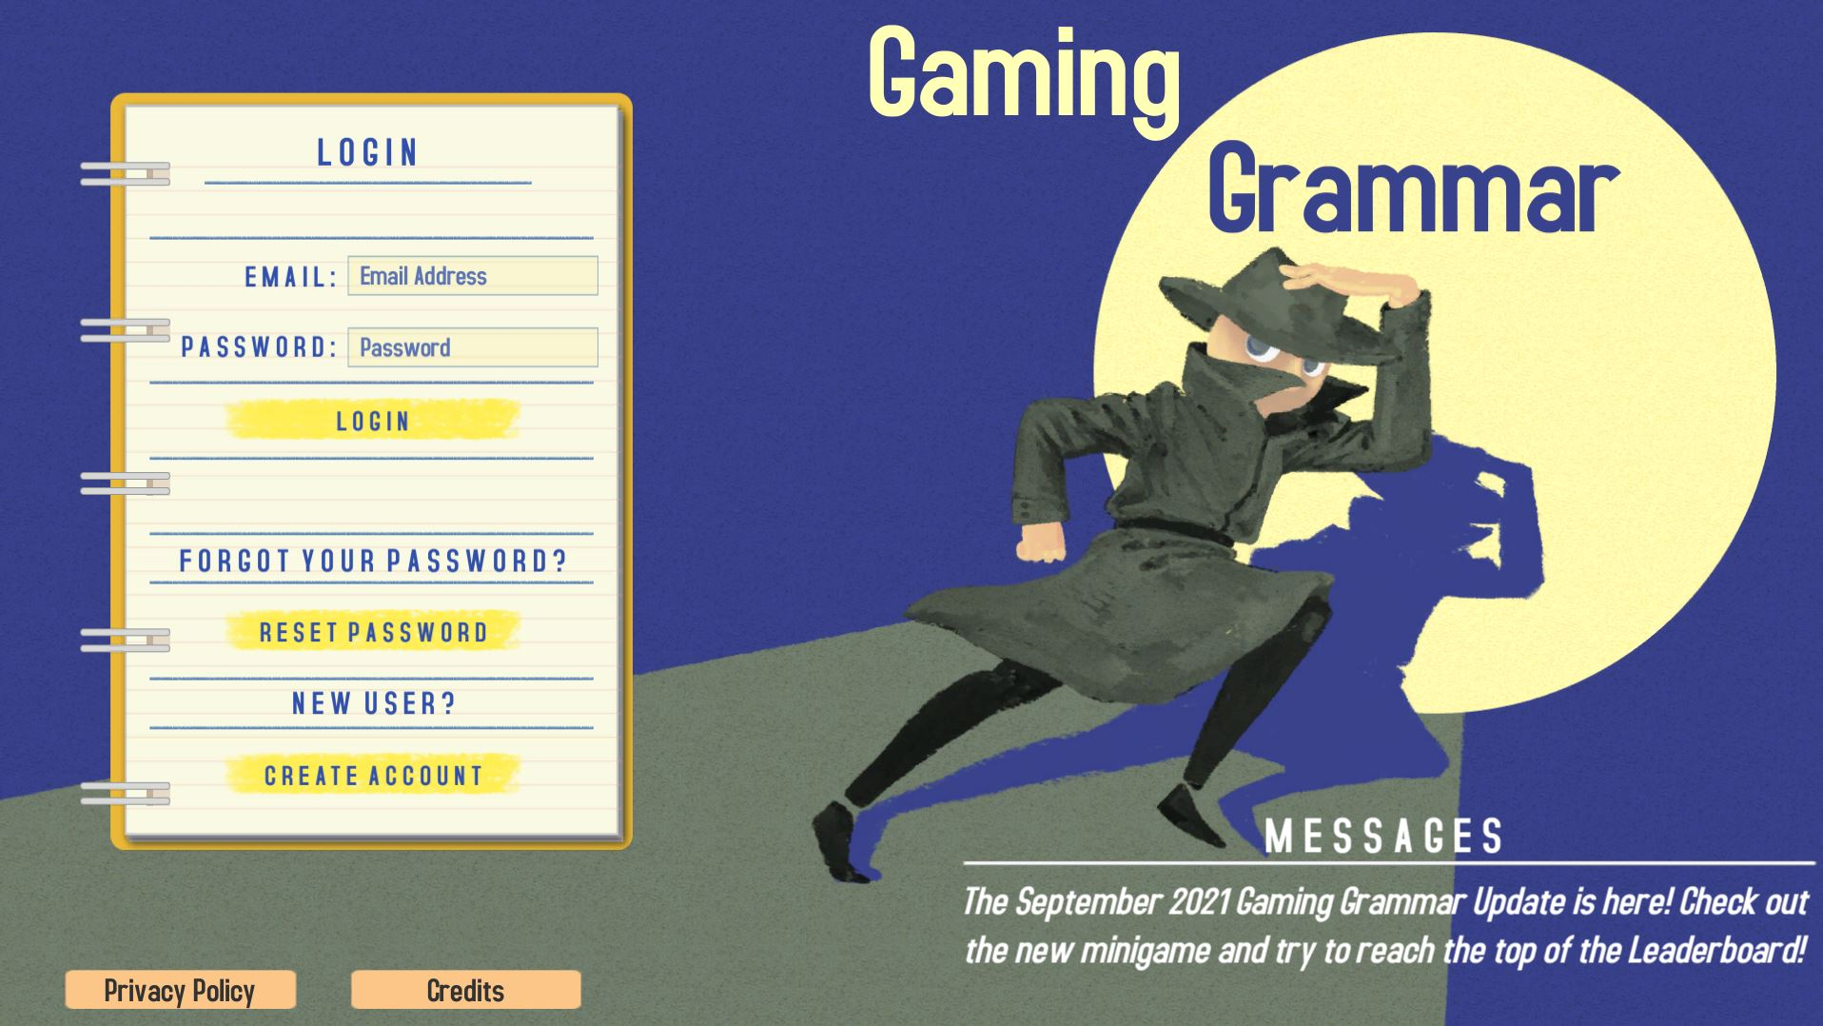
Gaming Grammar
Gaming Grammar
Relevant mini game(s):
Indefinite articles: Gender (Article agreement)
To have and to be: 1st person and 3rd person singular
Notes:
This slide links to Gaming Grammar login screen. The appropriate mission can then be selected from the menu page.
Students will progress through the game at their own rate; teachers should use the teacher interface to check progress. This will help to inform future lesson planning.

Slide 68
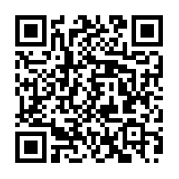
Devoirs
Vocabulary Learning Homework (Y7, Term 2.1, Week 4)
Audio file
Audio file QR code:
Student worksheet
Quizlet link
In addition, revisit: Term 2.1 Week 1
Term 1.2 Week 3
Notes:
Note to resource creators: links needs to be properly formatted as hyperlinks (copy url, select target text, right click, and add hyperlink), do not paste the website url directly on the slide. The student worksheet link to the resource portal needs to be formatted like the other links on the slide; if this is done correctly there is no need to shorten the url.

