Slide 1
Saying what people do
-ar verbs: infinitive & 3rd person singular (-a)
singular indefinite articles [revisited]
SSC [cu] + vowel
Y7 Spanish
Term 1.1 - Week 6 - Lesson 11
Nick Avery / Rachel Hawkes
Artwork: Mark Davies
Date updated: 11/01/21
Notes:
Learning outcomes (lesson 11):
Introduction of SSC [cu] + vowel (cue/cua/cui)
Introduction of -ar verbs; infinitive & 3rd singular (-a)
Consolidation of singular indefinite article (un/una)
Word frequency (1 is the most frequent word in Spanish):
7.1.1.6 (introduce) ¿quién? [289]; hablar [90]; comprar [361]; bailar [1323]; llegar [75]; escuchar [281]; amiga [1172]; música [340]; tarde¹ [392]; temprano [1578]; importante [171]; bien [78]; con [14]; otra vez [59-vez]; pareja¹ [892]
7.1.1.3 (revisit) ser [7]; soy; eres; es; alegre [2081]; simpático [3349]; guapo [4192]; alto¹ [231]; bajo¹ [236]; y [4]; marca [marcar-993]; correcto [1467]; opción [1175]
Source: Davies, M. & Davies, K. (2018). A frequency dictionary of Spanish: Core vocabulary for learners (2nd ed.). Routledge: London

Slide 2
cue
escuela
CUE
cuerpo
[body]
cuadro
CUA
cuatro
to look after;
take care of
¡cuidado!
CUI
cuidar
[careful!]
Notes:
Timing: 2 minutes
Aim: To introduce SSCs [cue], [cua], [cui]
Procedure:
Introduce and elicit the pronunciation of the individual SSCs and then the source words (with gesture, if using).
Then present and elicit the pronunciation of the cluster word.
The cluster words have been chosen for their high-frequency, from a range of word classes, with the SSC (where possible) positioned within a variety of syllables within the words (e.g. initial, 2nd, final etc.). Additionally, we have tried to use words that build cumulatively on previously taught SSCs (see the Phonics Teaching Sequence document) and do not include new SSCs. Where new SSCs are used, they are often consonants which have a similar symbol-sound correspondence in English.
Word frequency (1 is the most frequent word in Spanish): cuerpo [232], escuela [424]; cuatro [241], cuadro [1017]; cuidar [751], cuidado [1822] Source: Davies, M. & Davies, K. (2018). A frequency dictionary of Spanish: Core vocabulary for learners (2nd ed.). Routledge: London

Slide 3
¿CUE, CUA o CUI?
escuchar / escribir
¡cui
[to look after; take care of]
___dado!
1
3
5
es____la
cue
cui
___dar
2
4
6
cue
____tro
___rpo
cua
cua
___dro
Notes:
Phonics practice activity (transcription)
Timing: 4 minutes
Aim: to practise mapping from sound to spelling
Procedure:
1. Click on the orange number next to each picture to hear the corresponding word.
2. Learners then write down the missing letters in the word
Transcript:
escuela
cuatro
cuidar
cuadro
cuidado
cuerpo
Word frequency (1 is the most frequent word in Spanish): cuerpo [232], escuela [424], cuatro [241], cuadro [1017], cuidar [751], cuidado [1822]
Source: Davies, M. & Davies, K. (2018). A frequency dictionary of Spanish: Core vocabulary for learners (2nd ed.). Routledge: London

Slide 4
¿CUE, CUA o CUI?
escuchar / escribir
1
¡cuidado!
3
[to look after; take care of]
5
escuela
cuidar
6
2
4
cuatro
cuadro
cuerpo
Notes:
Variation: same task as on the previous slide, but students have to write the whole word.

Slide 5
¿Qué es?
hablar
revista
un
una
un
una
barco
libro
un
una
Notes:
Vocabulary revision activity
Timing: 2 minutes
Aim: to recall the 6 words in the images and their gender
Procedure:
Bring up the image
Elicit the Spanish word.
Click to reveal it.
Click again to reveal the correct indefinite article
Note: These words will be needed in the listening / speaking activity later in lesson 1, so it’s worth re-visiting them here.
Images retrieved from https://unsplash.com/ (freely usable images)

Slide 6
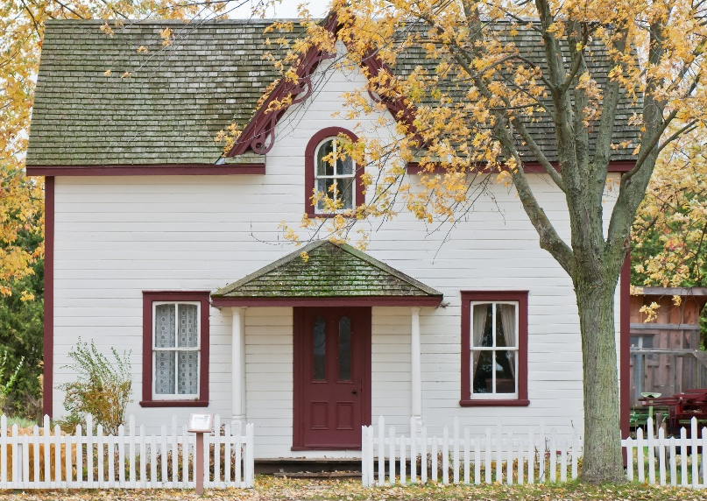
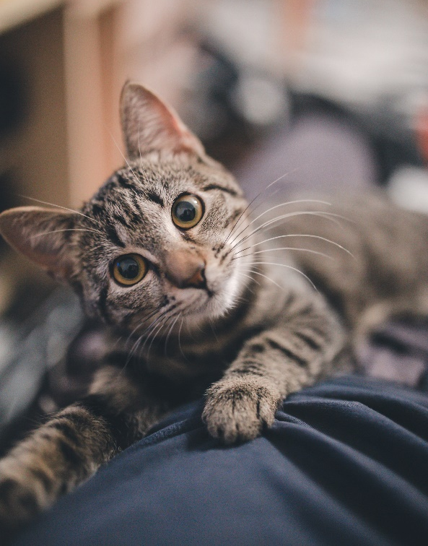
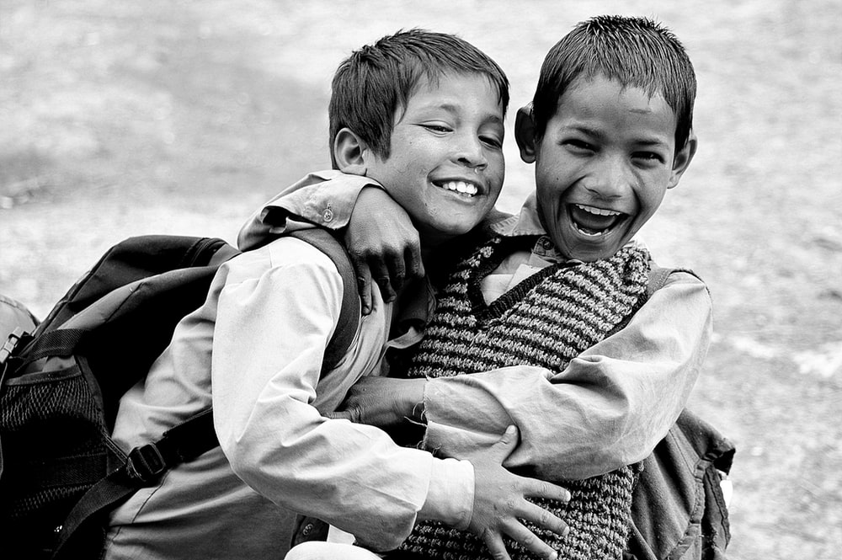
¿Qué es?
hablar
casa
un
una
gato
un
una
amigo
un
una

Slide 7
Vocabulario
 | Word | English meaning
1 | ¿quién? | who?
2 | hablar | to speak, speaking
3 | comprar | to buy, buying
4 | bailar | to dance, dancing
5 | llegar | to arrive, arriving
6 | escuchar | to listen, listening
7 | una amiga | a friend (female)
8 | música | music
9 | tarde | late
10 | temprano | early
11 | bien | well
12 | con | with
60
Want to say where you arrive?
Use llegar + a + place
0
INICIO
Notes:
Vocabulario
Timing: 1-4 minutes Aim: To reactivate and strengthen vocabulary knowledge. Procedure: Round 1: Look at the Spanish, recall the English meanings, saying them aloud. [1 minute] Round 2: Look at the English, recall the Spanish meanings, saying them aloud. [1 minute] Repeat for two further minutes, to speed up recall.
Note: here we draw attention to construction ‘llegar a’, which will appear later in the second lesson

Slide 8
llegar
llegar
[to arrive | arriving]
llega
[arrives | s/he arrives]
Notes:
Verb presentation slide
Timing: 3 minutes (slides 10-15)
Aim: To introduce the verb llegar more explicitly. Llegar is one of the 25 most frequently used verbs in Spanish. All 25 most frequent verbs will be introduced early on using the same format. Both long form (infinitive) and short form (3rd person singular) are introduced in order to familiarise students with various forms of the same verb.
Procedure
Bring up the word llegar on its own, say it, students repeat it, and remind them of the phonics. Draw attention to SSC [ll]
Try to elicit the meaning from the students.
Bring up the picture, and, if using gestures, a possible gesture would be to take one step forward.
Then bring up the English translations. Emphasise the two meanings for the infinitive.
Bring up the short form llega, say it, students repeat it. Draw attention to SSC [ll]
Try to elicit the meaning from the students. Emphasise the two meanings for the short form.

Slide 9
llegar
llegar
[to arrive | arriving]
llega
[arrives | s/he arrives]
Notes:
Cycle through the long and short form again.

Slide 10
llega
llega
[arrives]
Sara llega temprano.
[Sarah arrives early.]
Notes:
Introduce the short form in a sentence.

Slide 11
llegar
llegar
[to arrive | arriving]
Es importante llegar temprano.
[It’s important to arrive early.]
Notes:
Introduce the long form in a sentence.

Slide 12
llega
llega
[arrives | s/he arrives]
Sara ______ temprano.
llega
[Sarah arrives early.]
Notes:
Cycle through the short form in context again.

Slide 13
llegar
llegar
[to arrive | arriving]
llegar
Es importante ______ temprano.
[It’s important to arrive early.]
Notes:
Cycle through the long form in context again.

Slide 14
comprar
comprar
[to buy | buying]
compra
[buys | s/he buys]
Notes:
Timing: 3 minutes (slides 16-21)
Aim: To introduce the verb comprar more explicitly. Comprar is one of the NCELP 15 prototypical verbs in Spanish. Prototypical verbs are common verbs that illustrate the typical characteristics of a class of verb – the Spanish prototypical verbs contain examples of regular/weak verbs, but also common examples of changes to the stem. All 15 prototypical verbs will be introduced early on using the same format. Both long form (infinitive) and short form (3rd person singular) are introduced in order to familiarise students with various forms of the same verb.
Procedure
Bring up the word comprar on its own, say it, students repeat it, and remind them of the phonics. Draw attention to SSC [co]
Try to elicit the meaning from the students.
Bring up the picture, and, if using gestures, a possible gesture would be to hold out your hand, as if you were buying something.
Then bring up the English translations. Emphasise the two meanings for the infinitive.
Bring up the short form compra, say it, students repeat it. Draw attention to SSC [co]
Try to elicit the meaning from the students. Emphasise the two meanings for the short form.

Slide 15
comprar
comprar
[to buy | buying]
compra
[buys | s/he buys]
Notes:
Cycle through the long and short form again.

Slide 16
compra
compra
[buys | s/he buys]
Lucía compra una revista.
[Lucía buys a magazine.]
Notes:
Introduce the short form in a sentence.

Slide 17
comprar
comprar
[to buy | buying]
Es normal comprar una revista.
[It’s normal to buy a magazine.]
Notes:
Introduce the long form in a sentence.

Slide 18
compra
compra
[buys | s/he buys]
compra
Lucía ________ una revista.
[Lucía buys a magazine.]
Notes:
Cycle through the short form in context again.

Slide 19
comprar
comprar
[to buy | buying]
comprar
Es normal _________ una revista.
[It’s normal to buy a magazine.]
Notes:
Cycle through the long form in context again.

Slide 20
llegar
una amiga
bailar
¿quién?
hablar
música
escuchar
comprar
temprano
tarde
llegar
bien
con
to arrive
Notes:
OPTIONAL
Additional vocabulary practice slide
Timing: 3 minutes
Aim: to recognise the Spanish word corresponding to the English. This can also elicit pronunciation of the new language.
Procedure:
Teacher clicks to bring up the word in English
Student or class (in chorus) gives the Spanish
Teacher clicks again to make the correct Spanish word move next to the English

Slide 21
bien
una amiga
bailar
¿quién?
hablar
música
escuchar
comprar
temprano
tarde
llegar
bien
con
well

Slide 22
¿quién?
una amiga
bailar
¿quién?
hablar
música
escuchar
comprar
temprano
tarde
llegar
bien
con
who?

Slide 23
escuchar
una amiga
bailar
¿quién?
hablar
música
escuchar
comprar
temprano
tarde
llegar
bien
con
to listen

Slide 24
hablar
una amiga
bailar
¿quién?
hablar
música
escuchar
comprar
temprano
tarde
llegar
bien
con
to speak

Slide 25
temprano
una amiga
bailar
¿quién?
hablar
música
escuchar
comprar
temprano
tarde
llegar
bien
con
early

Slide 26
música
una amiga
bailar
¿quién?
hablar
música
escuchar
comprar
temprano
tarde
llegar
bien
con
music

Slide 27
comprar
una amiga
bailar
¿quién?
hablar
música
escuchar
comprar
temprano
tarde
llegar
bien
con
to buy

Slide 28
tarde
una amiga
bailar
¿quién?
hablar
música
escuchar
comprar
temprano
tarde
llegar
bien
con
late

Slide 29
una amiga
una amiga
bailar
¿quién?
hablar
música
escuchar
comprar
temprano
tarde
llegar
bien
con
a friend (female)

Slide 30
con
una amiga
bailar
¿quién?
hablar
música
escuchar
comprar
temprano
tarde
llegar
bien
con
with

Slide 31
bailar
una amiga
bailar
¿quién?
hablar
música
escuchar
comprar
temprano
tarde
llegar
bien
con
to dance

Slide 32
Saying what people do
-ar verbs - infinitive and 3rd person singular
The infinitive form of a verb is the form you see in a dictionary.
In English, this is often written ‘to + verb’.
In Spanish, the infinitive of the verb often ends in –ar.
For example:
Es importante escuchar.
It’s important to listen.
You can also begin a sentence with the infinitive:
Escuchar es importante.
Listening is important.
So, the infinitive often describes the general meaning of the verb.
Notes:
Grammar presentation slide [1/2]
Timing: 2 minutes
Aim: to introduce infinitives
Note: Escuchar is included here as it was previously practised in 1.1.5 with phonics words.

Slide 33
To mean ‘s/he’ or ‘it’ with a verb, the verb ending changes to –a.
Saying what people do
-ar verbs - infinitive and 3rd person singular
For example:
Escucha música.
S/he listens to music.
In English, we say ‘he’ or ‘she’ to say who does the action.
In Spanish, the verb ending tells us this. There is often no need for the word for ‘s/he’.
Notes:
Grammar presentation slide [2/2]

Slide 34
The dog ate your Spanish homework! What do the text pieces talk about?
leer
the action in general | someone does the action
1
habla con un amigo
2
llega tarde
3
bailar salsa
compra un libro
4
5
escuchar en clase
6
comprar una casa
7
olvida una palabra
8
hablar con José
9
llega temprano
10
baila con Alejandra
Notes:
Grammar practice activity (reading)
Timing: 7 minutes
Aim: to practise attending to the meanings of infinitives and 3rd person singular forms of verbs
Procedure:
1. Students write 1-10 on the LHS of books and copy the two column headers
2. They then tick the correct column, depending on the verb form.
3. Elicit the meanings of the sentence fragments during feedback
Note: ‘olvidar’ is a previously seen phonics word for SSC [o]

Slide 35
You find four more pieces!
escribir
Which of the text fragments could these have gone with?
1
habla con un amigo
es importante
es excelente
2
llega tarde
es fantástico
es normal
3
bailar salsa
4
compra un libro
Write four sentences combining the new pieces with four of the old ones!
Then translate them into English.
5
escuchar en clase
6
comprar un barco
7
olvida una palabra
8
hablar con José
9
llega tarde
10
baila con Alejandra
Notes:
Grammar practice activity (sentence matching)
Timing: 8 minutes
Aim: to practise attending to the meanings of infinitives and 3rd person singular verb forms
Procedure:
Ask students to look at the sentence fragments on the LHS and decide which of them could be used with those on the RHS.
Students write the full sentence (and could also write the English translation, if there is time).
To make students think about meaning of the infinitives and the adjectives, ask them which combinations seem most and least likely. They could be asked to write two sensible ones and two silly ones!
Notes:
The four adjectives were chosen as they are all frequent and are near-cognates.
The sentences could either start or finish with ‘es importante’ etc. This is important to bear in mind because the English translation is affected by the position of the verb. For example:
Hablar con José es importante. Speaking/talking with José is important.
Es importante hablar con José. It’s important to talk/to speak with José.
Word frequency (1 is the most frequent word in Spanish): importante [171], excelente [1546], fantástico [2501], normal [1000]
Source: Davies, M. & Davies, K. (2018). A frequency dictionary of Spanish: Core vocabulary for learners (2nd ed.). Routledge: London

Slide 36
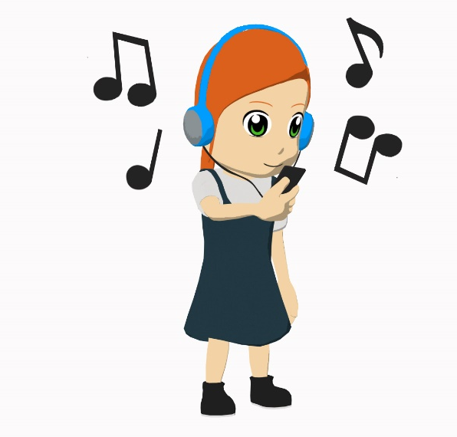
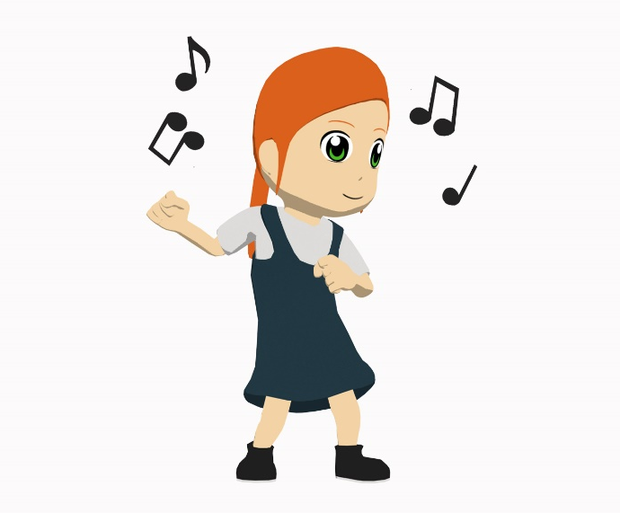
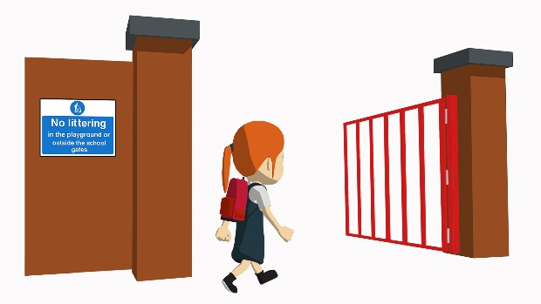
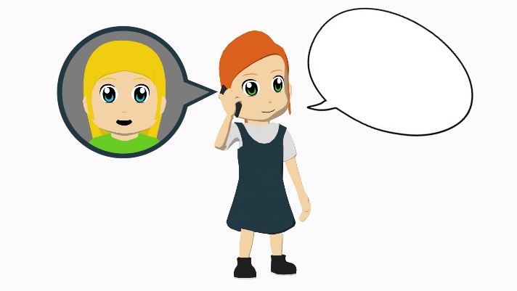
Vocabulario
escuchar
Listen to what Lucía does. Write 1 – 5.
Listen and match the action verb you hear to the picture.
C
B
A
1
A
2
C
3
D
E
D
E
4
[arrives]
¡Hola!
5
B
Notes:
Vocabulary practice activity (listening) [1/2]
Timing: 12 minutes
Aim: to focus students on the meanings of the lexical verbs, both in isolation (this slide) and then in sentence constructions (next slide)
Procedure:
1. On this slide, students listen to the individual verbs and match them to the action in the picture
2. On the next slide, students listen to the same verbs in sentence constructions. They have to transcribe & translate them.
Notes:
Students will hear the –a ending and need to translate it on the next slide, but this is not the main focus of the activity. Other activities in the sequence focus on the –a vs –ar endings together.
To make the second part of the activity more challenging, ask the students to translate directly into English (rather than transcribing first).
Transcript:
1. Escucha
2. Compra
3. Llega
4. Habla
5. Baila
Word frequency (1 is the most frequent word in Spanish): escuchar [281], comprar [361], llegar [75], hablar [90], bailar [1323]
Source: Davies, M. & Davies, K. (2018). A frequency dictionary of Spanish: Core vocabulary for learners (2nd ed.). Routledge: London

Slide 37
Now listen to the whole sentence about Lucía.
Write down what you hear. Afterwards, translate the sentences
escuchar
Baila en un barco.
Escucha en clase.
1
6
She dances in a boat.
She listens in class.
Compra una revista.
Llega temprano.
2
She buys a magazine.
7
She arrives early.
Escucha música.
Habla con una amiga.
3
8
She speaks with a (female) friend.
She listens to music.
Llega tarde.
Baila en una casa.
4
She arrives late.
9
She dances in a house.
Habla con un amigo.
Compra un libro.
5
She speaks with a (male) friend.
10
She buys a book.
Notes:
Vocabulary practice activity (listening) [2/2]

Slide 38
You tell a friend about Daniel.
escuchar / hablar
Student A: tell your friend what Daniel does & what is important for him to do.
Student B: listen and write in English:
what Daniel does.
what it’s important for him to do.
Then swap roles. Your cards are different.
Notes:
Timing: 10-12 minutes
Aim: to practise using the infinitive and 3rd person singular
Procedure:
1. Student A, referring to prompt cards, tells student B what Daniel already does (i.e. using 3rd person singular) and then what it’s important for him to do (using infinitive). Students may need to be reminded of the verb forms needed before starting.
2. Student B listens and takes notes (we suggest that this is done in a blank two-column grid with these two headers – see slides 43/44)
3. Then they swap roles.
4. Check answers and give feedback afterwards.
Note: Since correct use the infinitive and 3rd person singular isn’t essential to task completion, the listener should be encouraged to correct the speaker if s/he notices mistakes in use of –ar vs –a ending.

Slide 39
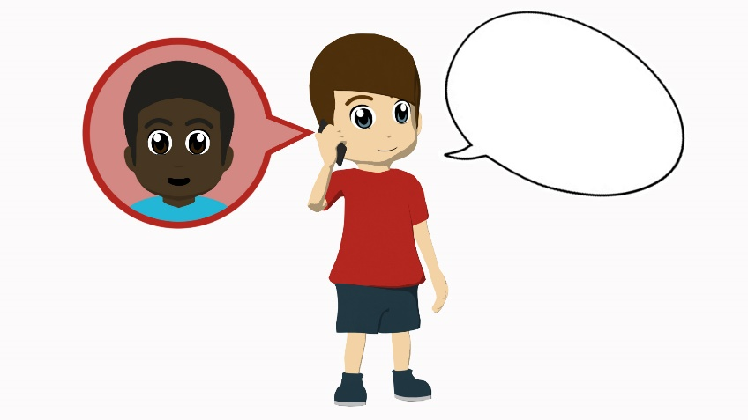
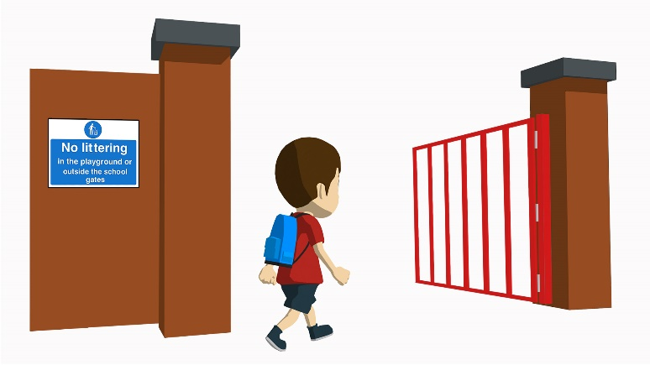
Student A
Daniel already does it
It’s important to…
¡Hola!
¡Hola!
[with a female friend]
[a magazine]
[salsa]
[with a male friend]
[arrives early]
[in class]
[arrives late]
[music]
Notes:
Student A speaking cards (these are also available in Word format)

Slide 40
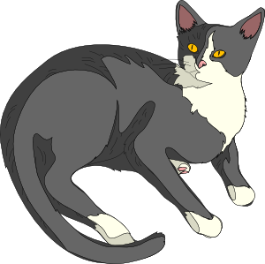
Student B
Daniel already does it
It’s important to…
¡Hola!
¡Hola!
[a newspaper]
[with a female friend]
[with a male friend]
[a house]
[in a boat]
[arrives early]
[music]
[a cat]
Notes:
Student B speaking cards (these are also available in Word format)

Slide 41
Student B answers
Daniel does it | it’s important to… (talking in general)
dances salsa
speak with a (female) friend
listens to music
dance in class
speaks with a (male) friend
buy a magazine
arrives late
arrive early
Notes:
Student B answer slide

Slide 42
Student A answers
Daniel does it | it’s important (talking in general)
buys a newspaper
speak with a (male) friend
dances in a boat
buy a cat
speaks with a (female) friend
buy a house
arrives early
listen to music
Notes:
Student A answer slide

Slide 43
Saying what people do (cont.)
-ar verbs; infinitive & 3rd singular (-a)(cont.)
SSC [cu] + vowel (cont.)
Y7 Spanish
Term 1.1 - Week 6 - Lesson 12
Nick Avery / Rachel Hawkes Artwork: Mark Davies
Date updated: 11/01/21
Notes:
Learning outcomes (lesson 12):
Consolidation of SSC [cu] + vowel (cue/cua/cui) Consolidation of -ar verbs; infinitive & 3rd singular (-a)
Word frequency (1 is the most frequent word in Spanish):
7.1.1.6 (introduce) ¿quién? [289]; hablar [90]; comprar [361]; bailar [1323]; llegar [75]; escuchar [281]; amiga [1172]; música [340]; tarde¹ [392]; temprano [1578]; importante [171]; bien [78]; con [14]; otra vez [59-vez]; pareja¹ [892]
7.1.1.3 (revisit) ser [7]; soy; eres; es; alegre [2081]; simpático [3349]; guapo [4192]; alto¹ [231]; bajo¹ [236]; y [4]; marca [marcar-993]; correcto [1467]; opción [1175]
Source: Davies, M. & Davies, K. (2018). A frequency dictionary of Spanish: Core vocabulary for learners (2nd ed.). Routledge: London

Slide 44
Fonética
escuchar / escribir
cui
Make a word.
Translate it!
cui
¡Hola! Soy CUI.
Soy CUE.
Soy CUA.
tro
dar
rpo
dro
es ____ la
cue
dado
cua
cue
cua
Notes:
Phonics starter task to recap this [cu] + vowel
Timing: 3 minutes
Aim: to practise saying and spelling words with [cu] + vowel
Procedure:
1. Students will work in pairs to put the words back together.
2. Student A chooses an SSC and says it aloud to their partner CUE, CUA or CUI.
3. Student B has to listen and write that SSC, completing it with a fragment in the middle.
4. They then swap roles.
5. They translate the words that they wrote (together each pair will produce the six words in English)
Note:
1. to make ‘cuerpo’ two word fragments are needed.
2. Exclamation marks were not included with ‘cui’ and ‘dado’ to avoid giving away the answer.
Word frequency (1 is the most frequent word in Spanish): cuerpo [232], escuela [424], cuatro [241], cuadro [1017], cuidar [751], cuidado [1822]
Source: Davies, M. & Davies, K. (2018). A frequency dictionary of Spanish: Core vocabulary for learners (2nd ed.). Routledge: London

Slide 45
← palabras en español
tarde
hablar
C
A
B
amiga
D
F
¿quién?
E
comprar
con
buy
with
H
who?
G
I
female friend
J
late
K
to speak
L
palabras en inglés →
Notes:
Vocabulary recap activity – snap [1/2]
Timing: 6 minutes
Aim: to consolidate meaning recognition
Procedure:
1. Each letter disappears then is obscured again on second click
Note:
This is also a way to practise the alphabet – encourage students to say a letter aloud to reveal the word behind it.
Words behind each letter (in alphabetical order)
A-F: tarde, hablar, amiga, ¿quien?, comprar, con
G-L: buy, with, who?, female friend, late, to speak

Slide 46
← palabras en español
llegar
Ñ
M
bailar
bien
N
O
música
escuchar
P
temprano
Q
music
well
early
R
S
T
U
to arrive
to dance
V
to listen
W
palabras en inglés →
Notes:
Snap (cont.) [2/2]
Words behind each letter
M-Q: llegar, bailar, bien, música, escuchar, temprano
R-W: music, well, early, to arrive, to dance, to listen
Note: this activity elicits almost all of the alphabet. Ask students which letters are missing (X, Y and Z).

Slide 47
escuchar
…salsa es fantástico.
…salsa.
…música es importante.
…música.
…con Elena.
…con Elena es maravilloso.
…tarde con Pepe es normal.
…tarde con Pepe.
…una casa.
…una casa es importante.
1
Monica is recording her Spanish homework, but her device has problems!
2
You hear her first word. Which ending must be missing?
3
4
Hint: listen for the –a or –ar verb endings.
5
Notes:
Grammar activity (listening) [1/2]
Timing: 8 minutes
Aim: to practise attending to the meanings of infinitives and 3rd person singular forms of verbs
Procedure:
1. Click on the orange action button to hear the first word of the sentence. This will either be an infinitive or 3rd person singular.
2. Decide which sentence ending must be correct (write it)
3. Check answers 1-5 before continuing with 6-10. While checking answers, ask for the English translation to ensure comprehension of lexical items.
Transcript:
Bailar
Escucha
Hablar
Llega
Comprar
Word frequency (1 is the most frequent word in Spanish): escuchar [281], comprar [361], llegar [75], hablar [90], bailar [1323]
Source: Davies, M. & Davies, K. (2018). A frequency dictionary of Spanish: Core vocabulary for learners (2nd ed.). Routledge: London

Slide 48
escuchar
…un periódico es normal.
…un periódico.
…temprano es difícil.
…temprano.
…con un amigo.
…con un amigo es maravilloso.
…en clase.
…en clase es importante.
…en una escuela.
…en una escuela es normal.
6
7
8
9
10
Notes:
Grammar activity (listening) [2/2]
Transcript:
6. Compra
7. Llegar
8. Habla
9. Escuchar
10. Baila.
Word frequency (1 is the most frequent word in Spanish): escuchar [281], comprar [361], llegar [75], hablar [90], bailar [1323]
Source: Davies, M. & Davies, K. (2018). A frequency dictionary of Spanish: Core vocabulary for learners (2nd ed.). Routledge: London

Slide 49
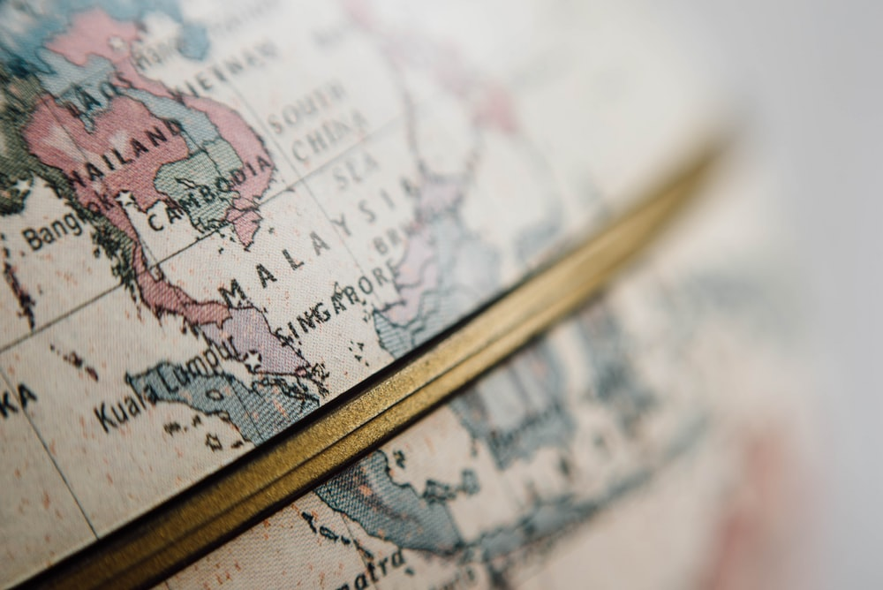
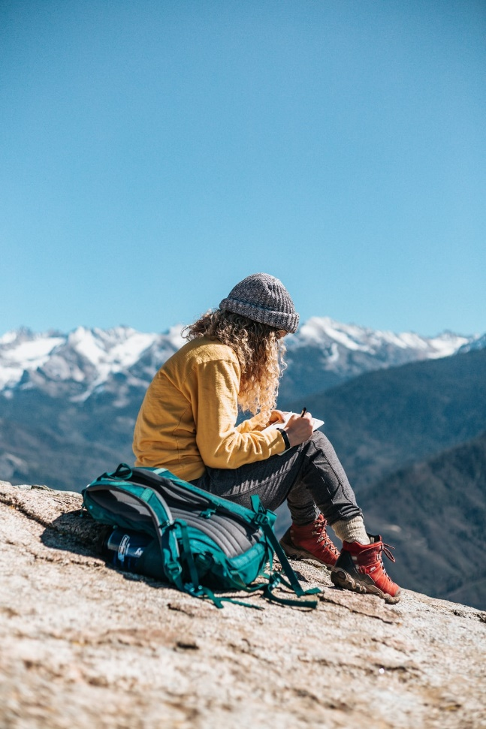
La gran aventura de Paula
Notes:
Pictures from https://unsplash.com/ (freely usable images)

Slide 50
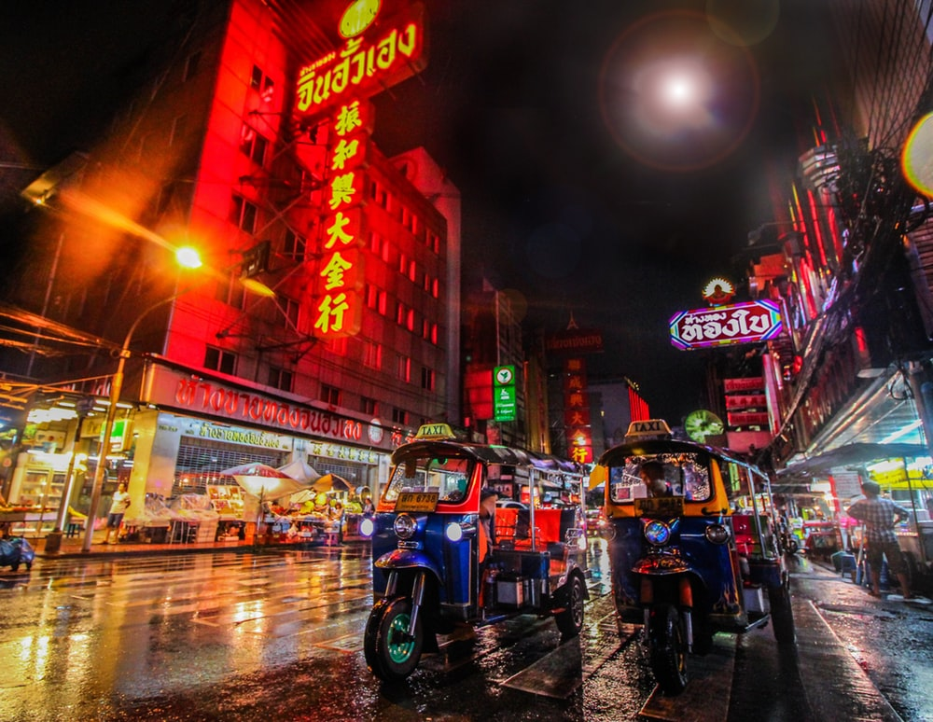
Bangkok
¿Dónde está…?
Tailandia
Malasia
China
Notes:
This mini-quiz activates world knowledge before the main narration activity.
Encourage students to answer in full sentences here – ‘Bangkok está en Tailandía’
Note: these three destinations have either previously-taught SSC OR SSC which are similar to English, therefore we can simply ask the question here and students apply their SSC knowledge when reading their answer aloud.

Slide 51
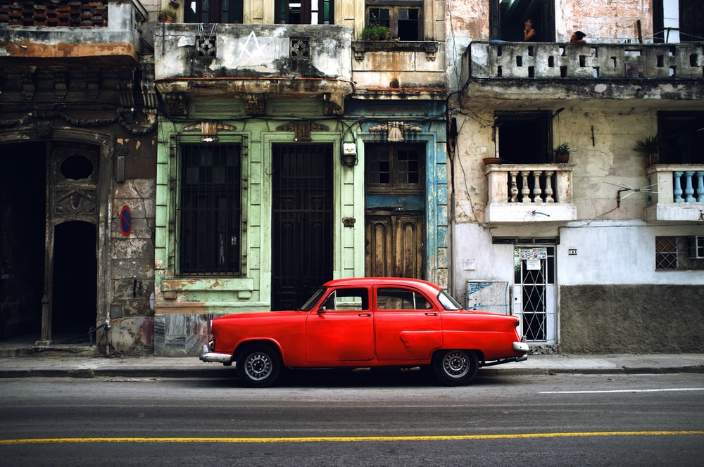
La Habana
La Habana es la capital de Cuba
¿Dónde está…?
El Salvador
Cuba
Guatemala
Notes:
Note: these three destinations have either previously-taught SSC OR SSC which are similar to English, therefore we can simply ask the question here and students apply their SSC knowledge when reading their answer aloud.
There is a callout on this slide giving further information about La Habana.

Slide 52
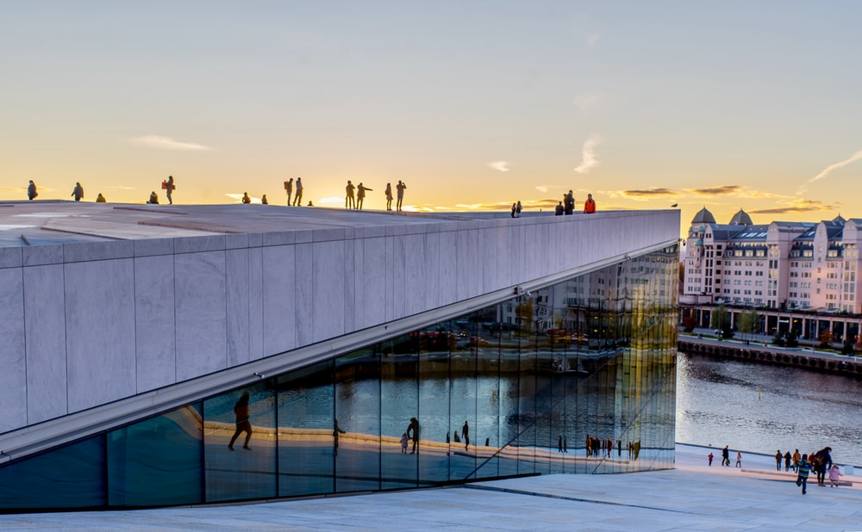
Oslo
¿Dónde está…?
Noruega
Polonia
Finlandia
Notes:
Note: these three destinations have either previously-taught SSC OR SSC which are similar to English, therefore we can simply ask the question here and students apply their SSC knowledge when reading their answer aloud.

Slide 53
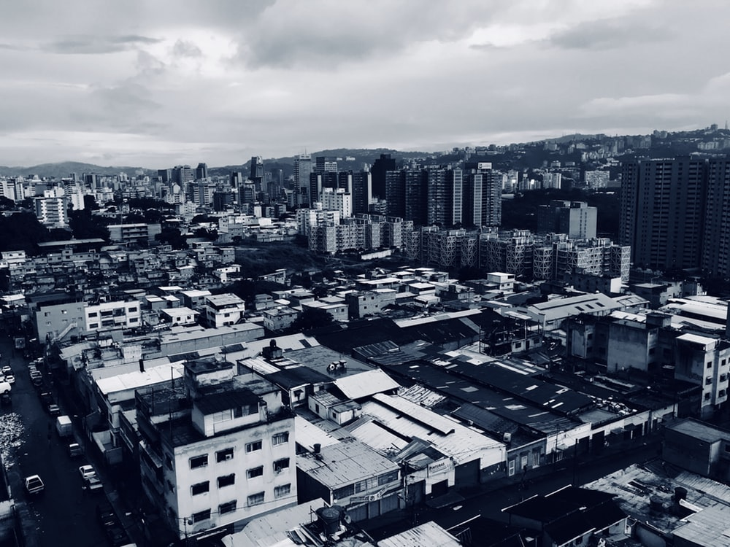
Caracas
Caracas es la capital de Venezuela.
¿Dónde está…?
Brasil
Venezuela
Chile
Notes:
Note: There are some new SSC included in the destinations, so we will want to give options to students, so that they can hear a strong model in the input, before selecting and repeating the word in their answer.
E.g. ¿Dónde está Caracas…? Brasil, Venezuela o Chile?
There is a callout on this slide giving further information about Caracas.

Slide 54
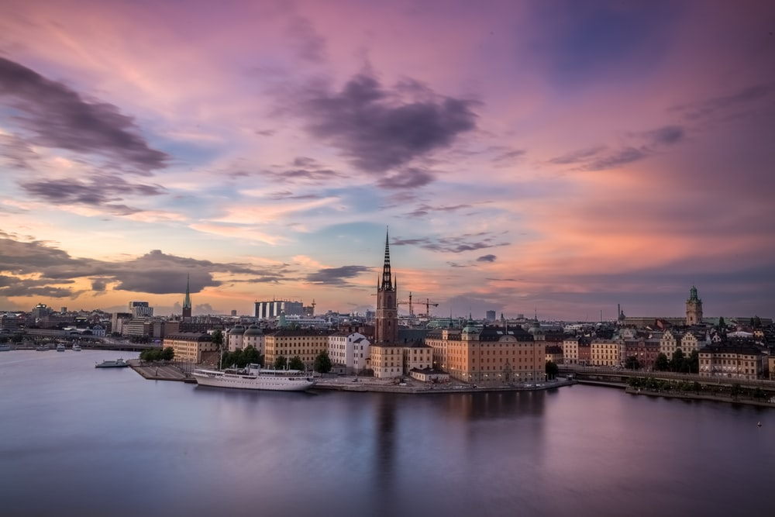
Estocolmo
¿Dónde está…?
Finlandia
Suecia
Francia
Notes:
Note: There are some new SSC included in the destinations, so we will want to give options to students, so that they can hear a strong model in the input, before selecting and repeating the word in their answer.
E.g. ¿Dónde está Estocolmo…? Finlandia, Suecia or Francia?

Slide 55
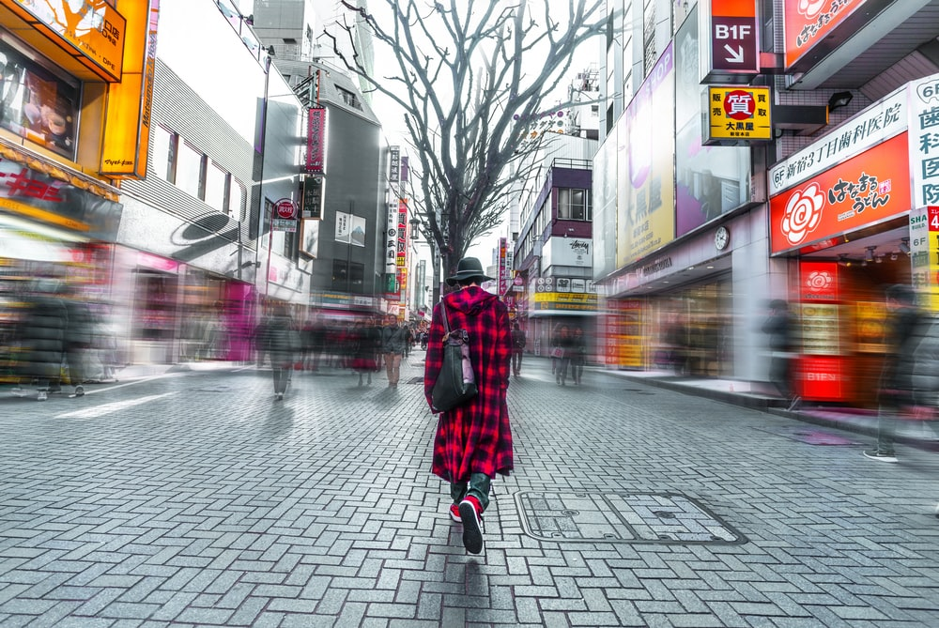
Tokio
¿Dónde está…?
Inglaterra
Francia
Japón
Notes:
Note: There are some new SSC included in the destinations, so we will want to give options to students, so that they can hear a strong model in the input, before selecting and repeating the word in their answer.
E.g. ¿Dónde está Tokio…? Inglaterra, Francia o Japón?

Slide 56
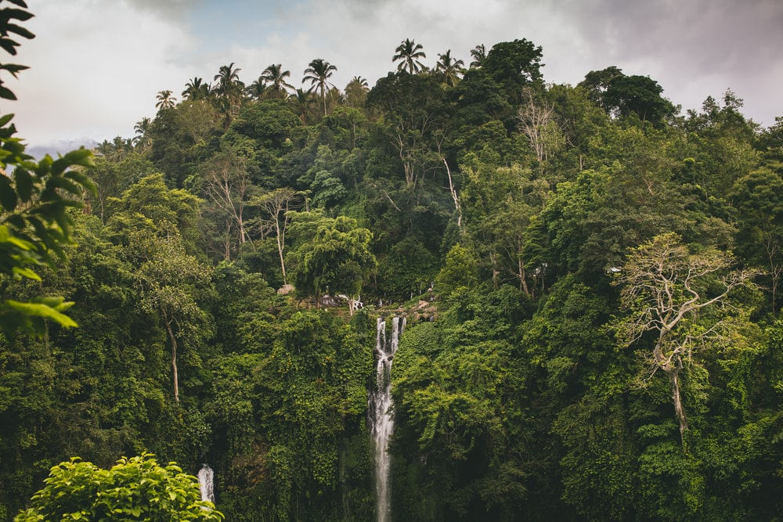
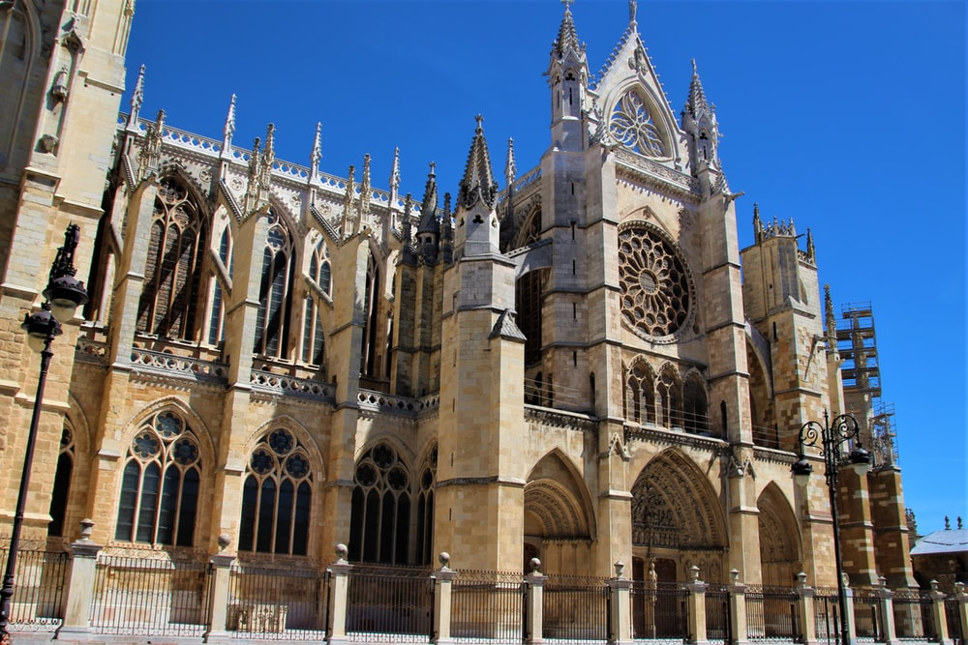
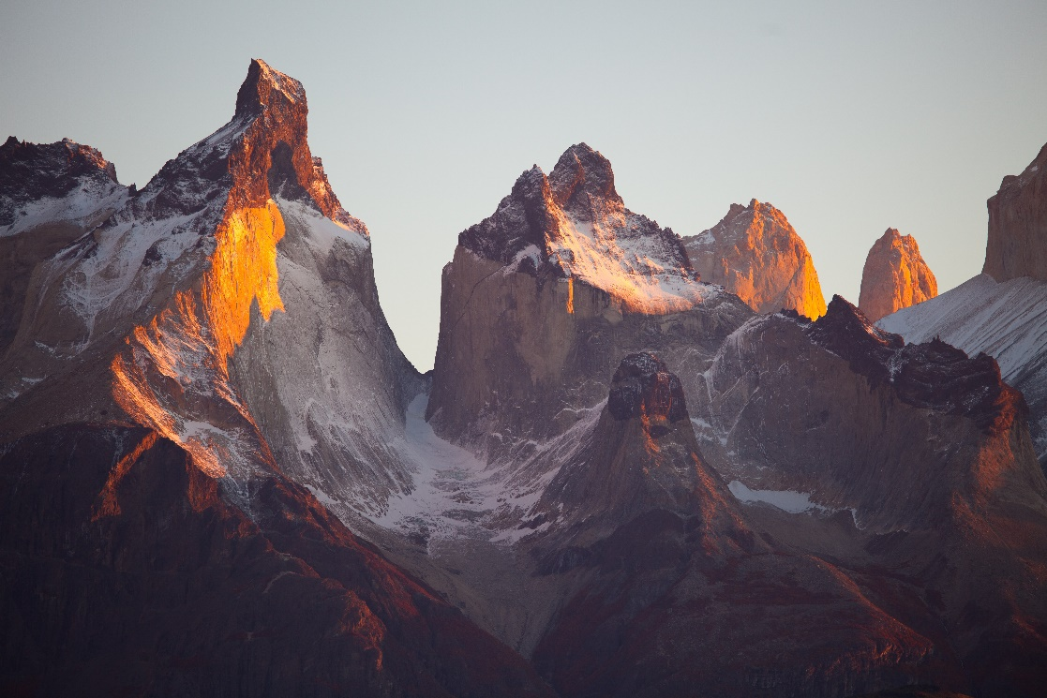
¿León?
B
A
Brasil
C
España
Chile
Notes:
Ask students to guess if it’s picture A, B, or C. Pictures from https://unsplash.com/ (freely usable images)

Slide 57
escuchar
What does she do?
In La Habana she
1
speaks with a (female) friend.
In Bangkok she
2
dances with a (male) friend.
buys a house.
3
In Caracas she
In Stockholm she
4
listens to music.
In Los Llanos she
5
arrives late.
In Tokio she
6
has a party.
In Oslo she
7
forgets a book
In California she
8
buys a boat
Notes:
Listening activity (pre-narration)
Timing: 6 minutes
Aim: to recognise the meanings of previously taught vocabulary items
Procedure:
1. Click on each orange button to play audio
2. Complete the sentence in English
3. Multiple repetitions may be needed
Note:
1. Make sure that students are aware that, when referring to a destination, Spanish uses ‘llegar A’ (‘en’ would refer to the means of arriving).
Transcript:
Habla con una amiga en La Habana.
Baila con un amigo en Bangkok.
Compra una casa en Caracas.
Escucha música en Estocolmo.
Llega tarde a Los Llanos.
Tiene una fiesta en Toledo.
Olvida un libro en Oslo.
Compra un barco en California.
Word frequency (1 is the most frequent word in Spanish): escuchar [281], comprar [361], llegar [75], hablar [90], bailar [1323], tener [19], olvidar [415]
Source: Davies, M. & Davies, K. (2018). A frequency dictionary of Spanish: Core vocabulary for learners (2nd ed.). Routledge: London

Slide 58
Paula’s trip was so good that she does it again! This time she goes to the places in a different order.
escuchar / hablar
Student A: Tell the story on your prompt cards!
Student B: Listen and take notes
What happens and in what order?
Then swap roles. Student B has a different set of cards.
Notes:
Paired speaking/listening activity (narration)
Timing: 10-12 mins
Aim: to practise using –ar verbs in 3rd person singular to recount a narrative
Procedure:
1. Student A recounts the 8 actions, in order, on the prompt cards (see slide 61)
2. Student B listens and takes notes of what happens in English
3. Swap roles.
4. Student B speaks (see slide 62 – different set of prompt cards) and Student A takes notes.
5. They then compare answers. Students could focus in particular on 1) where her journey starts; 2) Where it ends; 3) Which order of places to visit would be better.
Notes:
1. To challenge higher attaining students, you could change the nouns on the speaking cards to others seen in previous weeks (e.g. compra una cámara, un caballo etc.)

Slide 59
Persona A
A
B
C
D
Forgets a book
Listens to music
Buys a house
Arrives late
Oslo
Estocolmo
Caracas
Los Llanos
E
F
G
H
Dances with a (male) friend
Speaks with a (female) friend
Has a party
Buys a boat
Bangkok
Tokio
California
La Habana
Notes:
Student A speaking cards Note: Cards are labelled with letters for additional alphabet practice.

Slide 60
Persona B
A
B
C
D
Dances with a (male) friend
Speaks with a (female) friend
Buys a boat
Has a party
Bangkok
California
Tokio
La Habana
E
F
G
H
Forgets a book
Buys a house
Listens to music
Arrives late
Oslo
Caracas
Estocolmo
Los Llanos
Notes:
Student B speaking cards Note: Cards are labelled with letters for additional alphabet practice.

Slide 61
Deberes: una tarea escrita
Write the story of someone’s world trip. Use the present tense.
Use the verbs hablar, bailar, comprar, escuchar, olvidar, llegar.
Remember to use the –a verb ending for s/he.
City and country names are sometimes different in Spanish! Check this in a dictionary.
Notes:
OPTIONAL HOMEWORK TASK

Slide 62
Una gran aventura
Habla con una amiga en La Habana.
Baila con un amigo en Bangkok.
Compra una casa en Caracas.
Escucha música en Estocolmo.
Llega tarde a Los Llanos.
Tiene una fiesta en Tokio.
Olvida un libro en Oslo.
Compra un barco en California.
Notes:
Full text of Paula’s adventure – for reference only

Slide 63
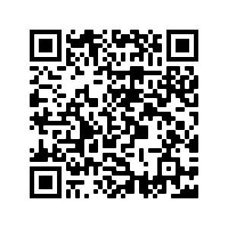
Deberes
Vocabulary Learning Homework (Term 1.1, Week 7)
Audio file
Audio file QR code:
Student worksheet
Quizlet link
In addition, revisit: Term 1.1 Week 4

